Slide 1
NHDPlus Support of the Open Water Data Initiative
NHDPlus News Session
ESRI International User Conference
July 22, 2015
Al Rea, USGS National Geospatial Program
Subcommittee on Spatial Water Data

Slide 2
OWDI as a Challenge
Access to water data is difficult
  Collected by hundreds of organizations
  No common infrastructure
  WaterML2 new exchange standard (O&M)
Understanding connections requires a geospatial framework
  Landscape to stream
  Stream to stream
Notes:
No common infrastructure except the internet
Lots of ways to share data on internet. Our task is to create good examples for people to follow.
Datasets like NHDPlus are proving to be very useful for the geospatial framework.

Slide 3

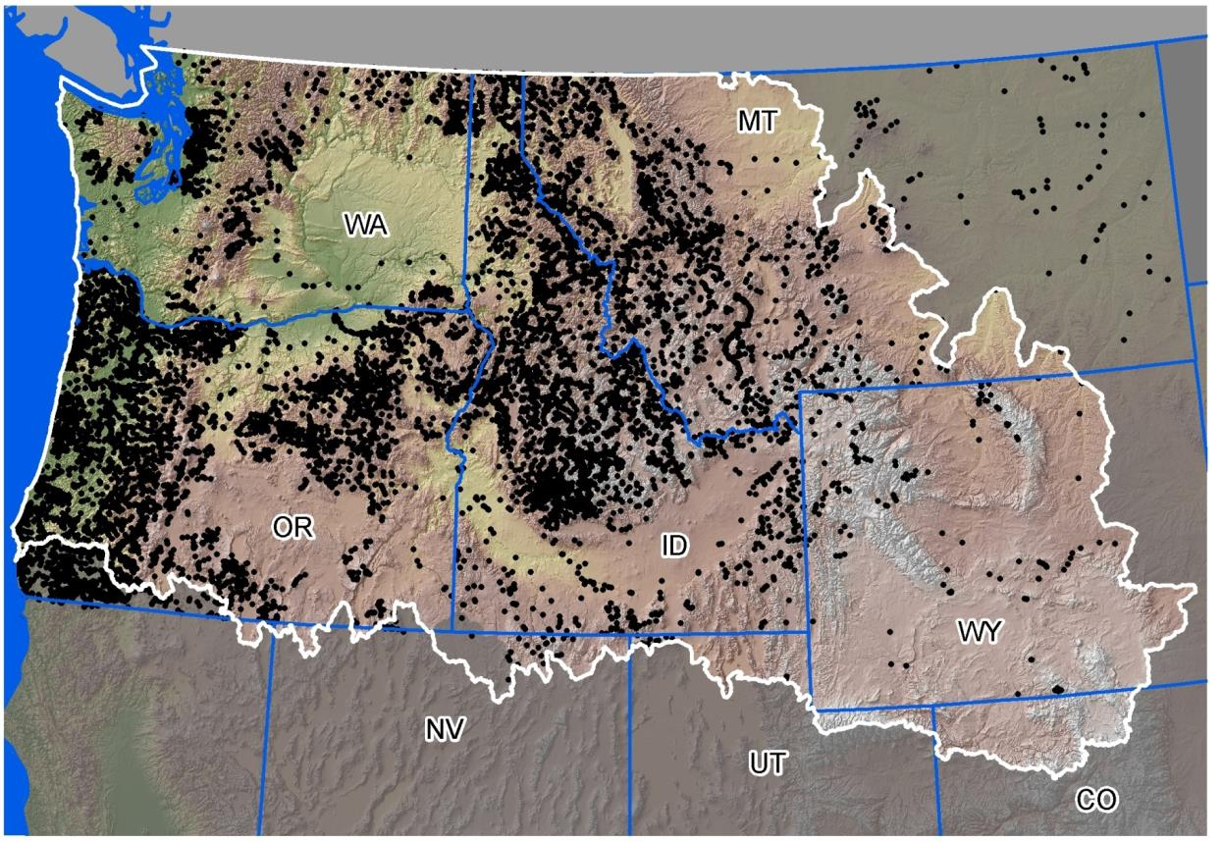















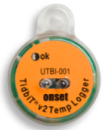
>45,000,000 hourly records
>15,000 unique stream sites
>60 agencies
$10,000,000
3
Notes:
Example dataset compiled for Great Northern LCC.
Compiling all these data was a lot of work (>12 person-years for 1993-2011, with more data collected since).
To collect from scratch would cost ~$10M.
They’ve been able to do some very good modeling with these data and using the NHDPlus stream network and catchments.
This example illustrates how valuable data can be, but also how much we could improve data access and delivery.

Slide 4
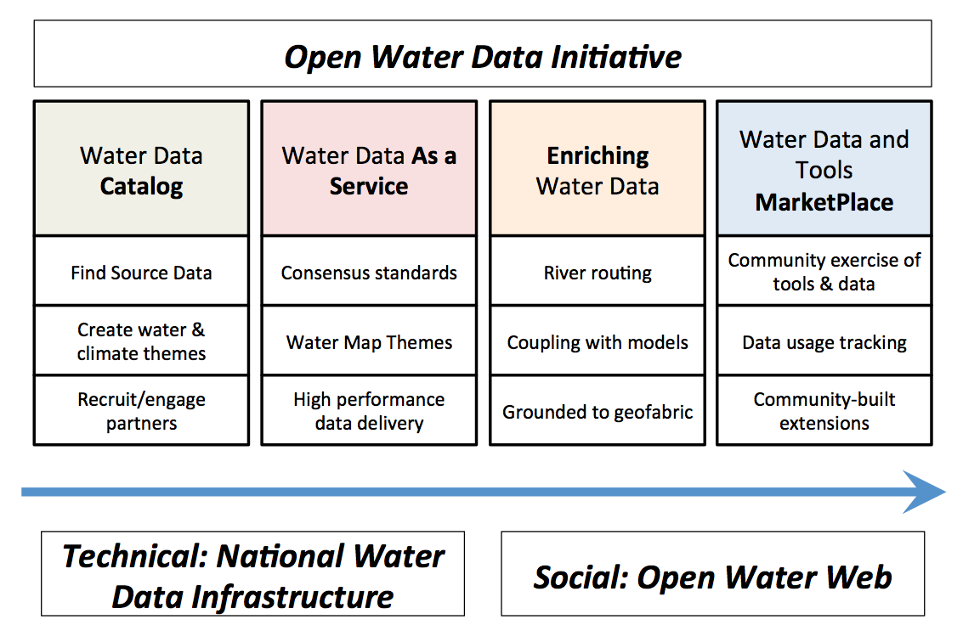
Notes:
Joining forces with Climate Data Initiative Water theme on catalog.
WaterML2 useful for services. Need to fill in geospatial services.
Lots of examples of routing and modeling, need to make interoperable on web.
Marketplace – a place to share data, tools, open source, usage tracking.

Slide 5
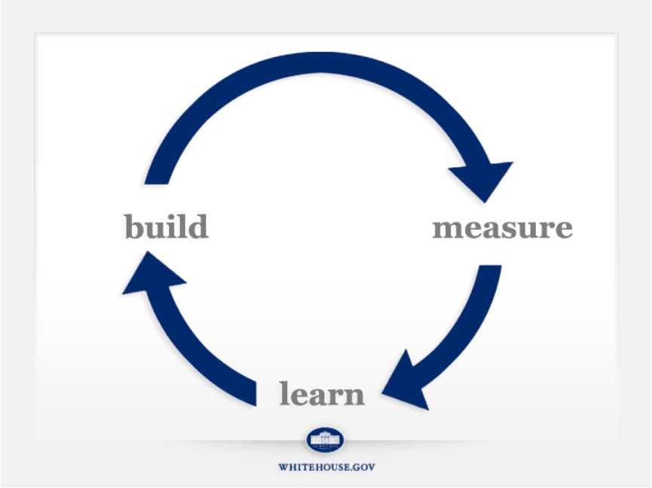
Lean Startup Methodology
product
ideas
data
Notes:
Don’t spend months/years gathering requirements.
Build MVP to help learn.
Goal is to get through the cycle as fast as possible

Slide 6
Use Case Concepts
Define use cases that respond to societal needs and cover broad range of water resources issues
Identify critical data inputs — focus on these first
Our emphasis is on the data, not the full solution
Measure and learn — like steering a car

Slide 7
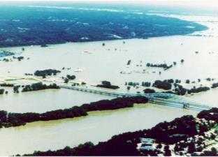
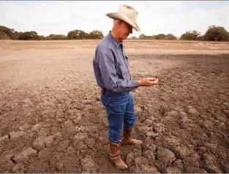
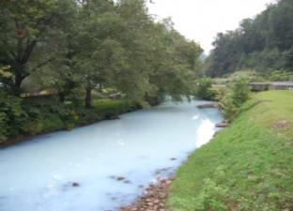
OWDI Working Groups
Work Group 1:
National Flood Interoperability Experiment
Identify flood data including stream-flow observations, forecasts and impacts
Developing Hydrofabric* v 0.1 and exploring data conflation
*Supported by 3 sub-teams
Work Group 2:
Drought
Decision Support System
Identify water resources data including natural flow, reservoir storage and drought impacts
Explore visualization of drought in Lower Colorado
Work Group 3:
Spill Response Tool
Identify water quality data including potential points sources and impacts
Exploring requirements for new/additional data (e.g. velocity forecasts and reservoir residence times)
Notes:
NFIE – IWRSS, CUAHSI. National hydrology model, flood inundation mapping and warning.
Elk R. WV spill, Jan 2014

Slide 8
Common Data Needs
NHDPlus V2.1
  National in single file geodatabase
  Denormalized (flattened) data model
  Available for download and as services
Sites indexed to NHDPlus V2.1 network
  Gages, NWS river forecast points
  Dams
  Large diversions and return flows
  …and many others

Slide 9
Status: Water Data as a Service
NWS forecasts and NWIS data as WML2
Robust serving capacity is necessary
Slow services aren’t used
Measurement of service usage is key
Repackaged seamless NHDPlus data for download—useful variation
Metadata, sensor calibration info
Machine readable ontologies

Slide 10
Status: Enriching Water Data
Linking data to a standardized geospatial framework (e.g. NHDPlus)
  Sites with observations and measurements
  Better integration of geospatial layers (e.g. WBD linked to NHDPlus network)
  Modeling parameters for catchments
Network trace (upstream/downstream) capability is key

Slide 11
Status: Water Data and Tools Marketplace (Community)
Community dialogue (SSWD, AWRA, etc.)
Web-based forum needed (wiki or similar)
Code/tool/procedure open source repositories (e.g. GitHub)
  Many agencies/teams already have
  Open forum or curated?
  Challenges:
    Keeping current
    Discoverability, accessibility

Slide 12
OWDI Examples:
ArcGIS Online web map showcasing some OWDI data services:
http://arcg.is/1CvFY6W
National denormalized NHDPlus V2.1 download:
ftp://ec2-54-227-241-43.compute-1.amazonaws.com/NHDplus/OWDI/

Slide 13
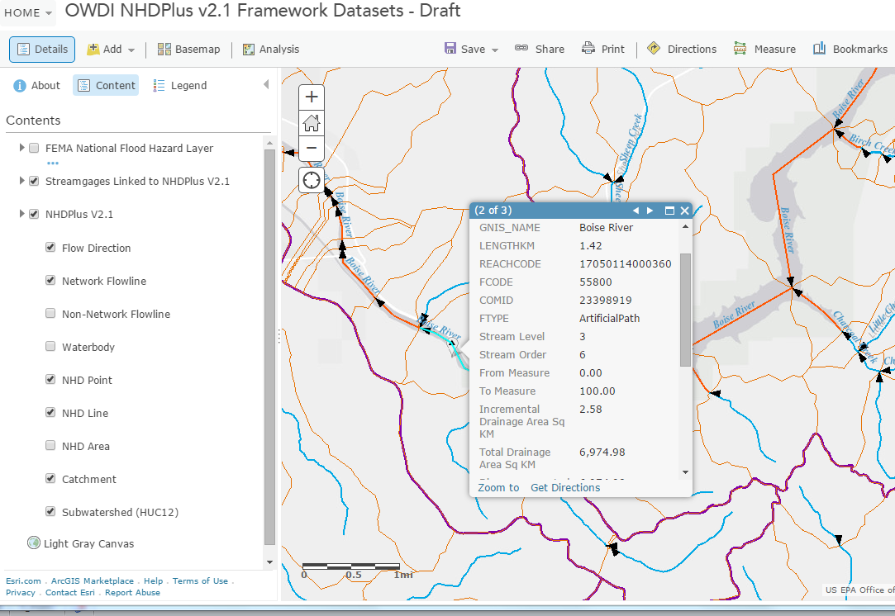

Slide 14
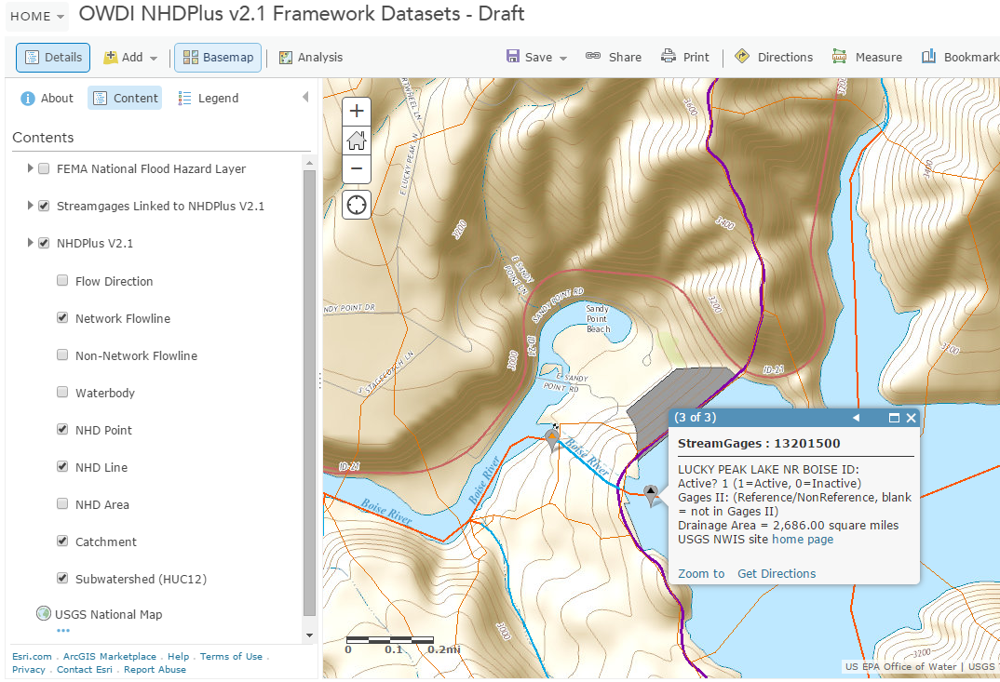

Slide 15
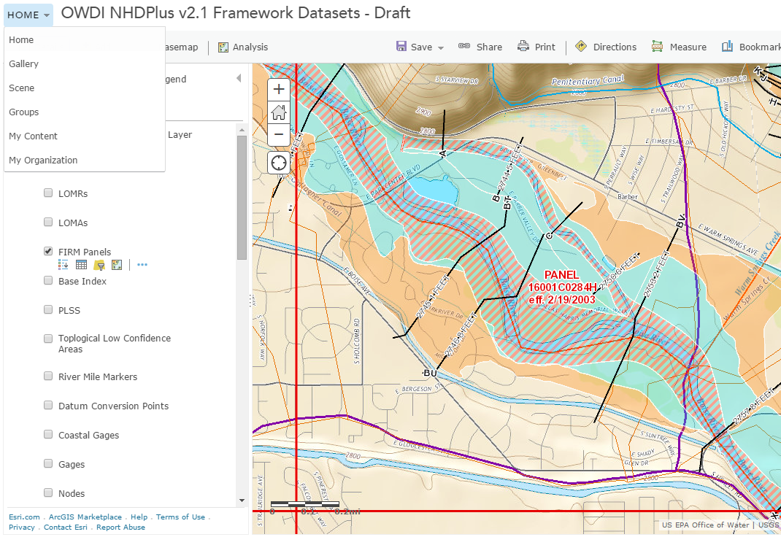

Slide 16
For more information:
Contacts:
Al Rea (ahrea@usgs.gov)
Tommy Dewald (Dewald.Tommy@epa.gov)
Cindy McKay (ldm@horizon-systems.com)

