Slide 1
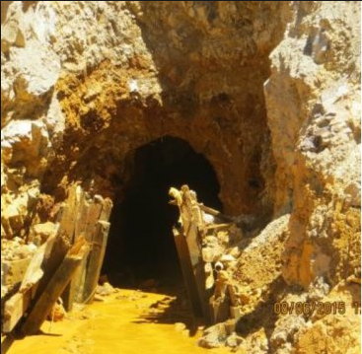
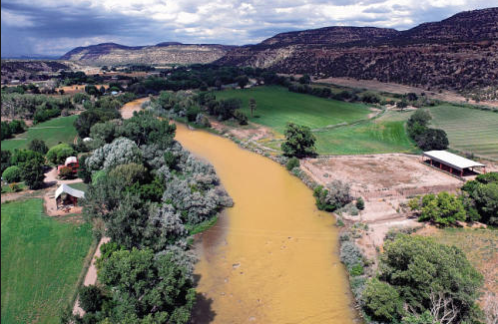
Applications of the Incident Command Tool for Drinking Water Protection
William B. Samuels, Ph.D, Rakesh Bahadur, Ph.D and Christopher Ziemniak
Leidos – Center for Water Science and Engineering
Alexandria, Virginia
AWRA GIS and Water Resources Conference
Sacramento, CA
July 11, 2016

Slide 2
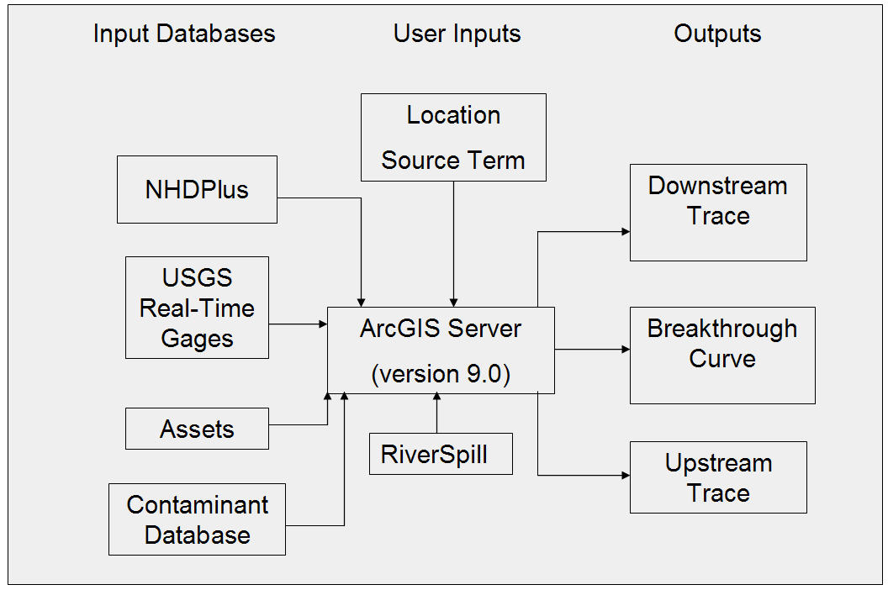
ICWater
simulate fate and transport of the
contaminants from point and non-point
sources
use minimum input data and user interface interaction for rapid emergency response modelling of toxic spills
perform hydraulic transport for the entire US river system
select water quality state variables that can represent the major processes that control water quality impacts and parameters available from national databases
ArcGIS

Slide 3
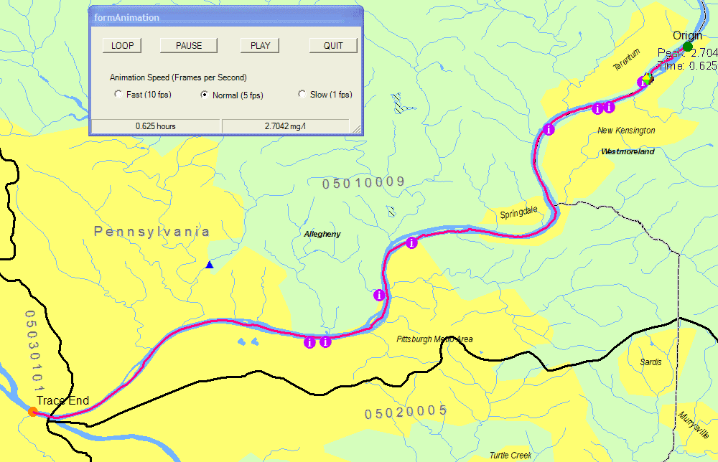
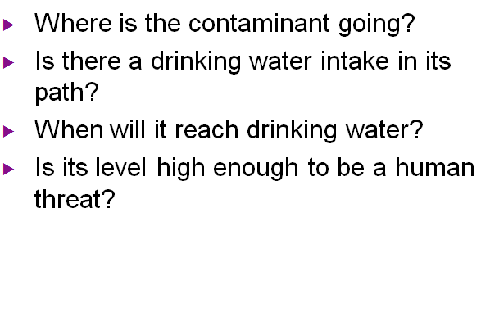
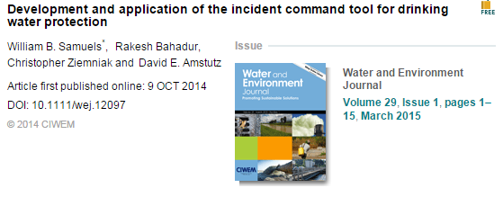
ICWater
Simulate fate and transport of the contaminants from point and non-point sources,
Use minimum input data and user interface interaction for rapid emergency response modeling of toxic spills
Perform hydraulic transport for the entire US river system
Select water quality state variables that can represent the major processes that control water quality impacts and parameters available from national databases.
ArcGIS

Slide 4
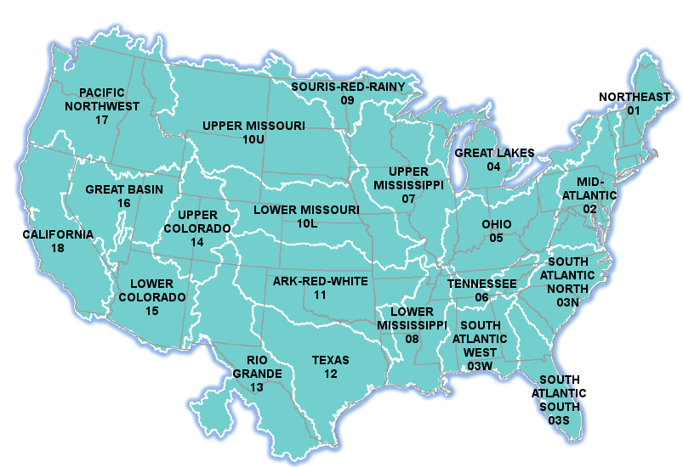
River Network (CONUS)
The NHDPlusV2 is organized by hydrologic regions. The data is further sub-divided into 4-digit hydrologic sub-regions. It is packaged as Geographic Information System databases to facilitate loading into ICWater

Slide 5
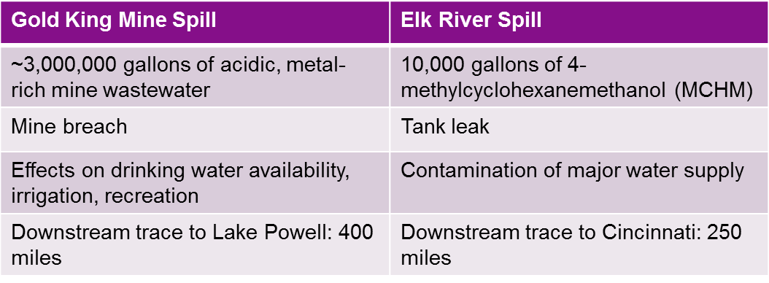
Recent Spill Events

Slide 6
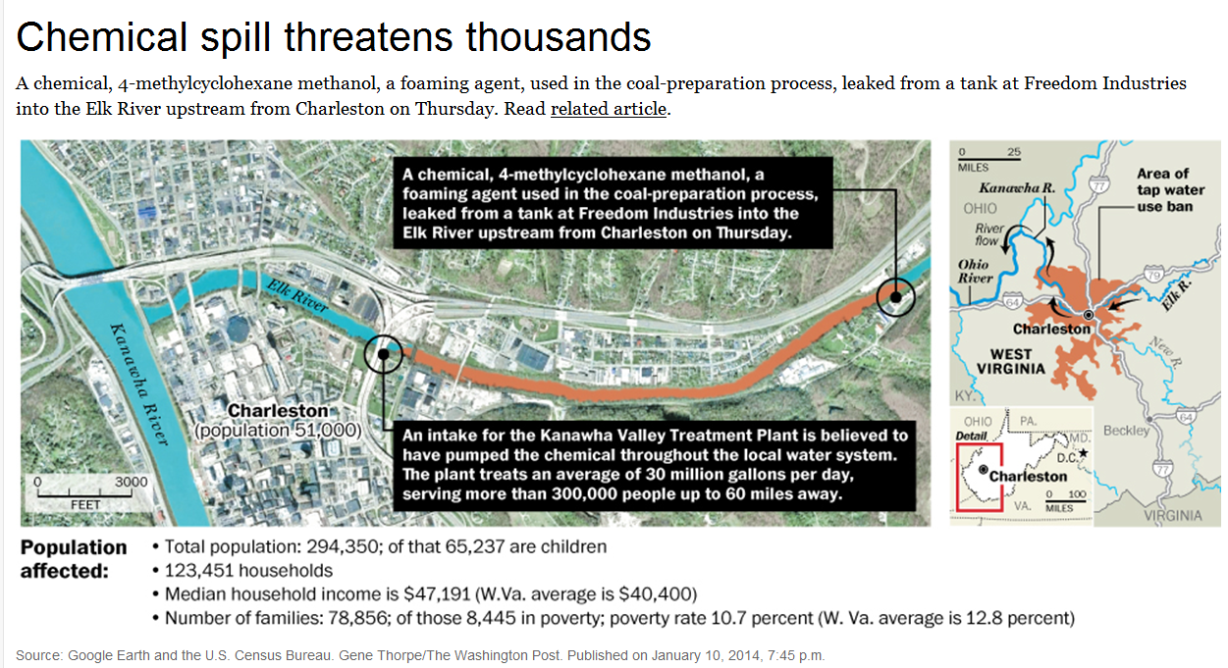
Freedom Industries facility into the Elk River
Tributary of the Kanawha River, in Charleston, West Virginia

Slide 7
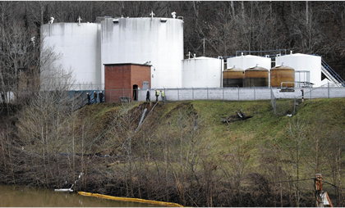
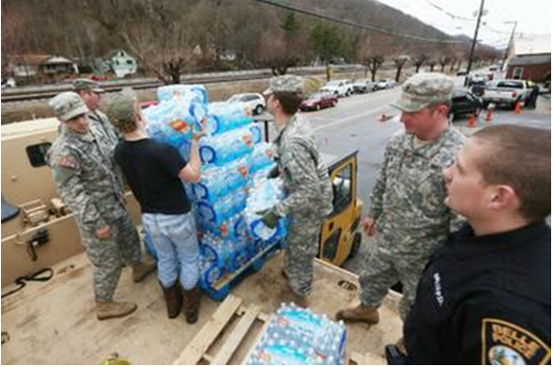
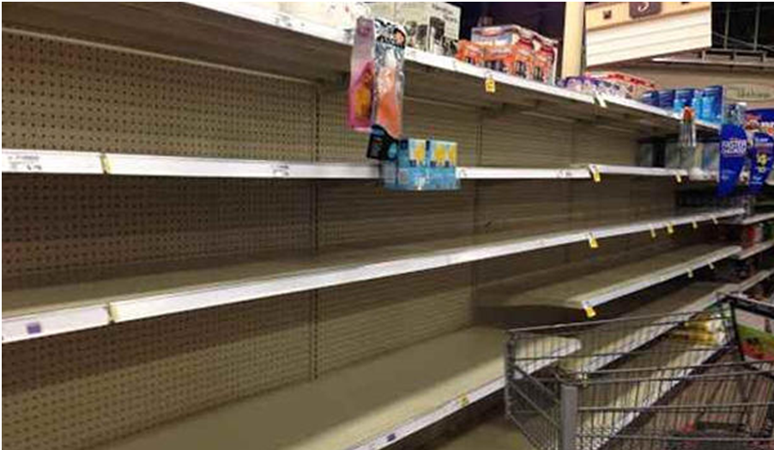
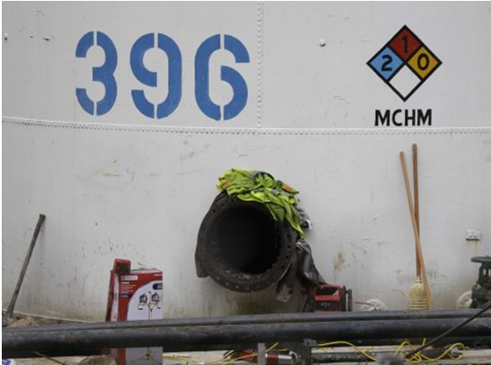

Slide 8
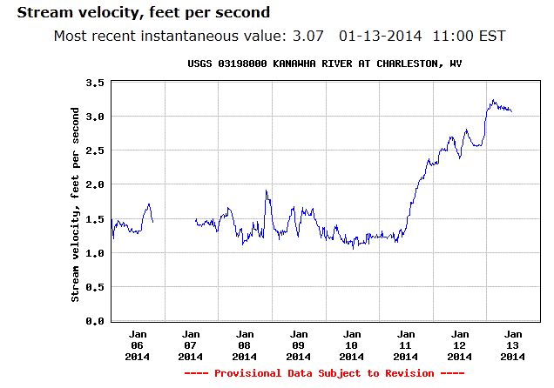
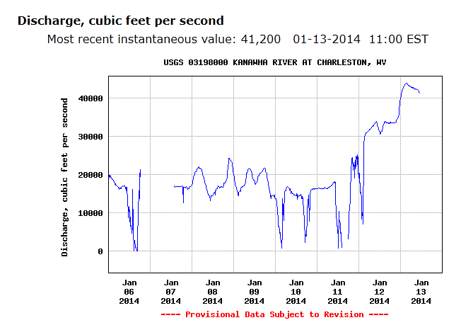
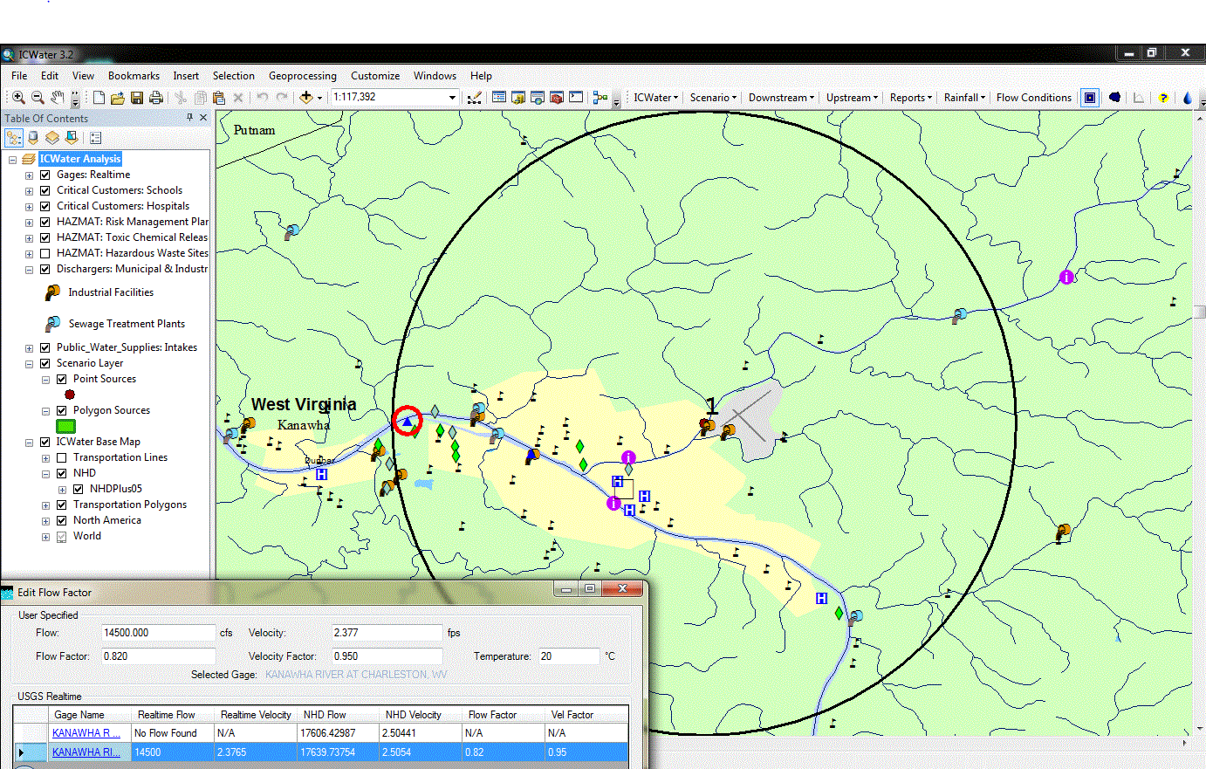
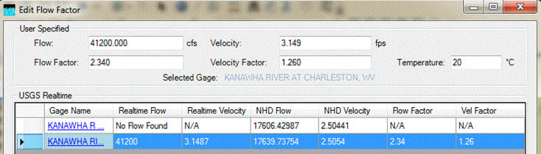
Measured
velocity
Intake
Spill site
Model velocity

Slide 9
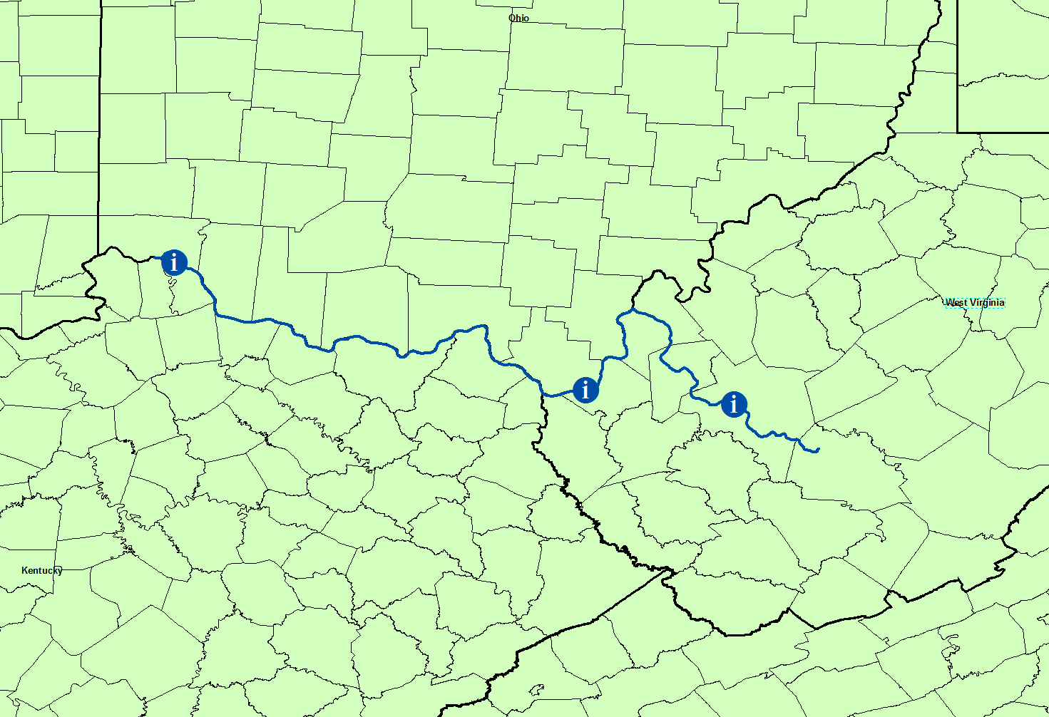
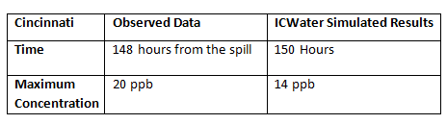
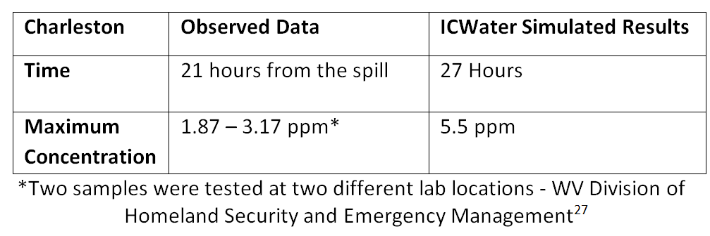
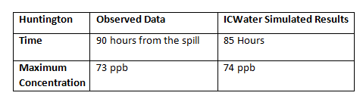
West Virginia Chemical Spill
Spill Site

Slide 10
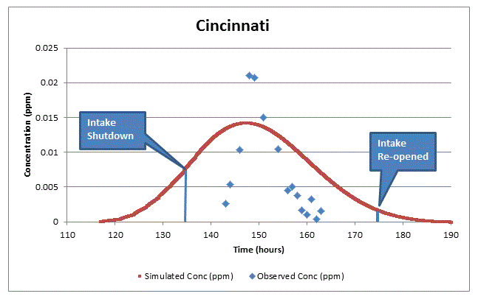
Decision-Making

Slide 11
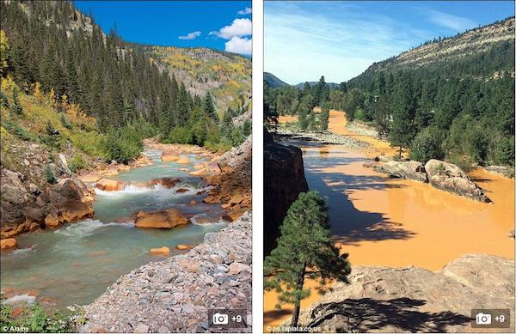
A Tale of Two Rivers
“Charles Dickens, PE”
It was the best of streams
It was the worst of streams
“….it was the age of wisdom, it was the age of foolishness…..”

Slide 12
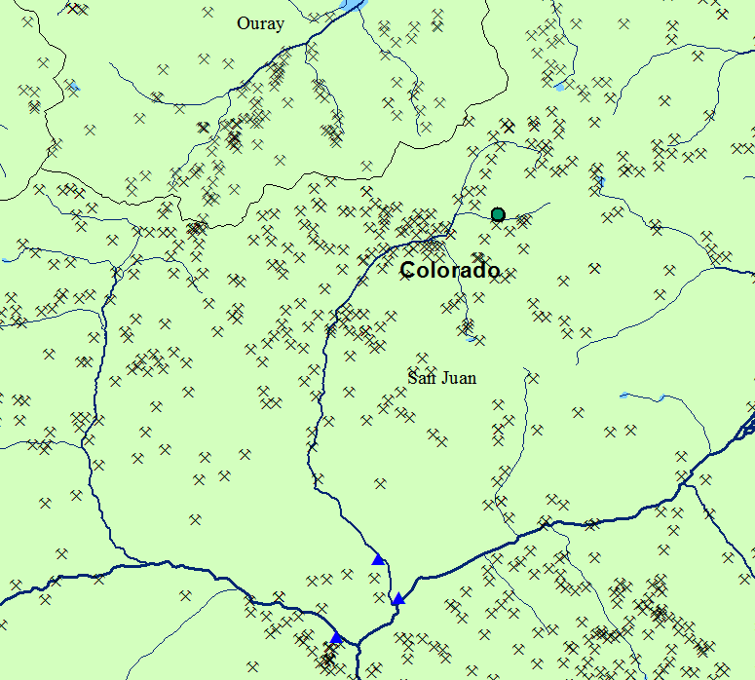
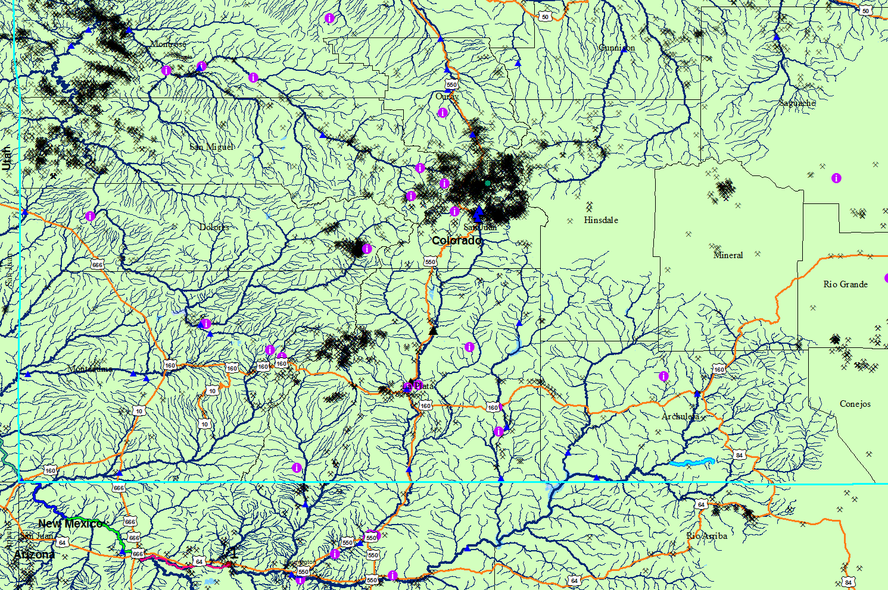
Spill Event
On August 5, 2015, EPA was conducting an investigation of the Gold King Mine. The intent of the investigation was to create access to the mine, assess on-going water releases from the mine to treat mine water, and assess the feasibility of further mine remediation.
The plan was to excavate the loose material that had collapsed into the cave entry back to the timbering. During the excavation, the loose material gave way, opening the adit (mine tunnel) and spilling the water stored behind the collapsed material.
Approximately, three million gallons of acidic, metal-rich mine wastewater from the Gold King Mine spilled into Cement Creek, a tributary of the Animas River.
The large pulse of water dissipated in about an hour.
Gold King Mine
NF Cement Creek
Gold King Mine
Cement Creek
Animas River

Slide 13
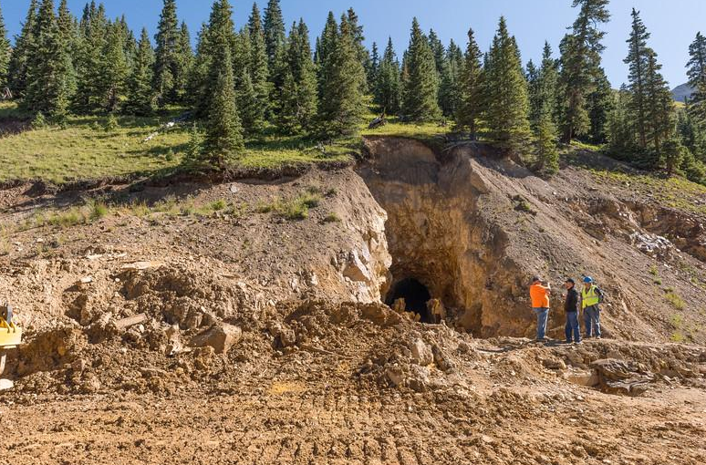
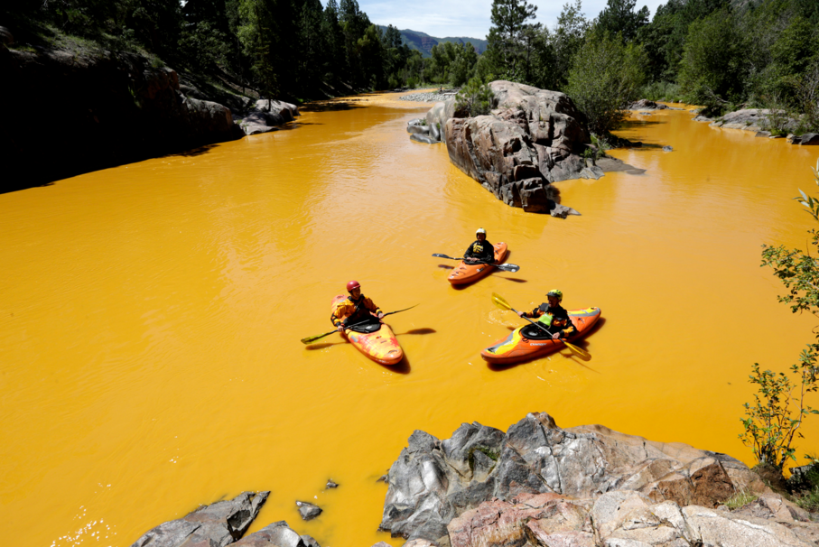
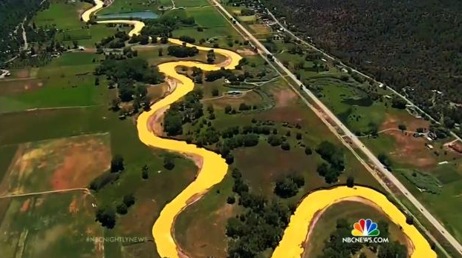
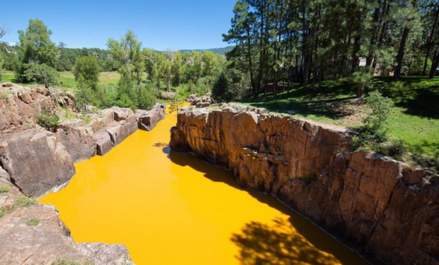

Slide 14
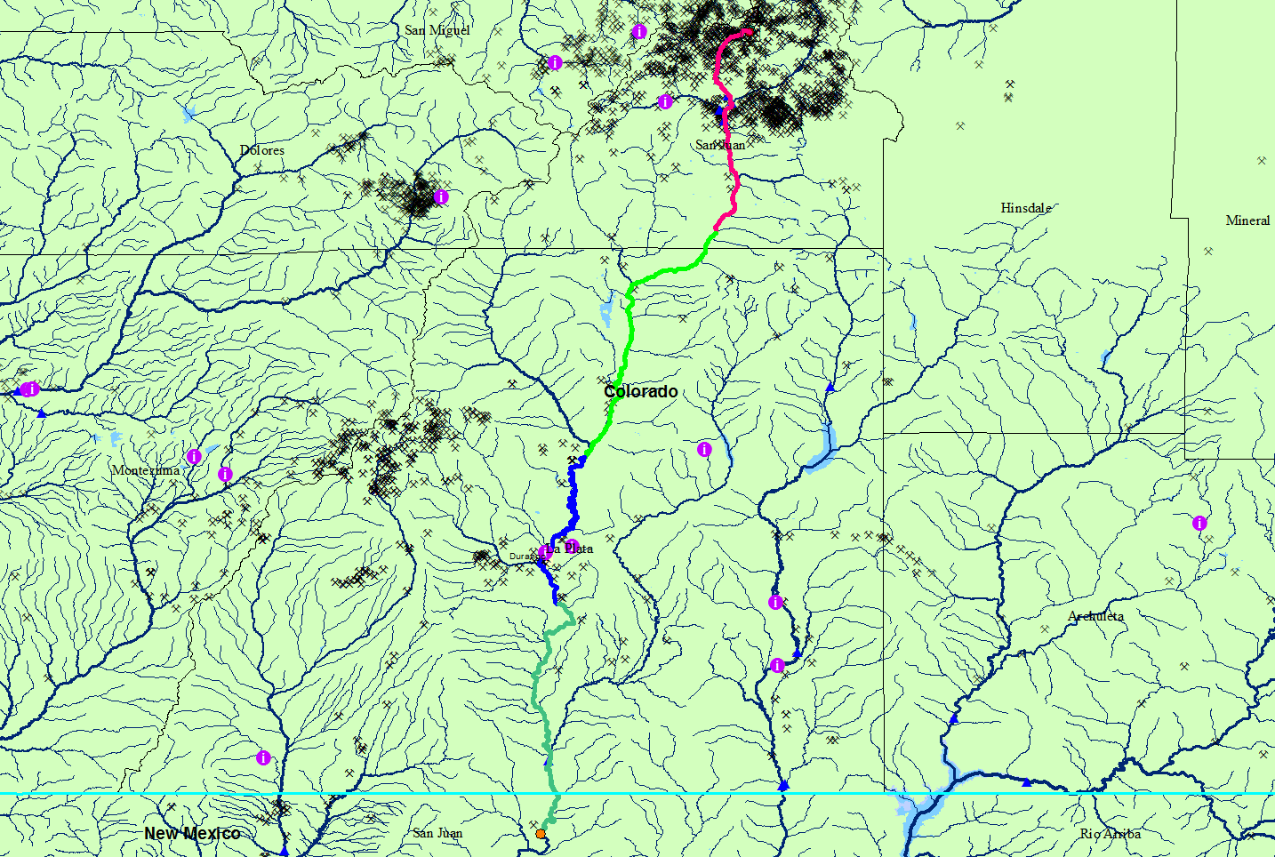
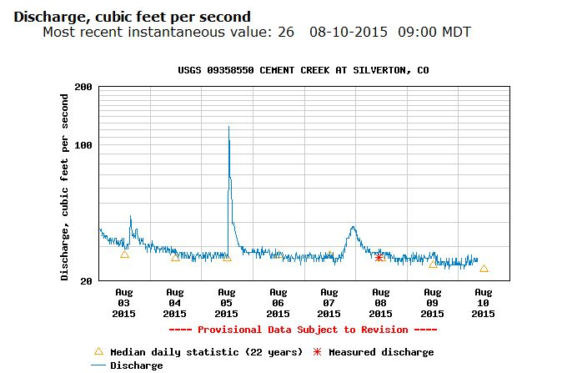
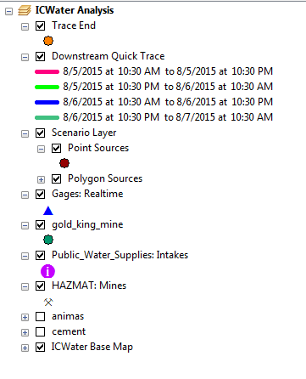
ICWater Quick Trace – 48 hours, based on flow at Cement Creek at Silverton, CO
Gold King Mine
48 hours travel time

Slide 15
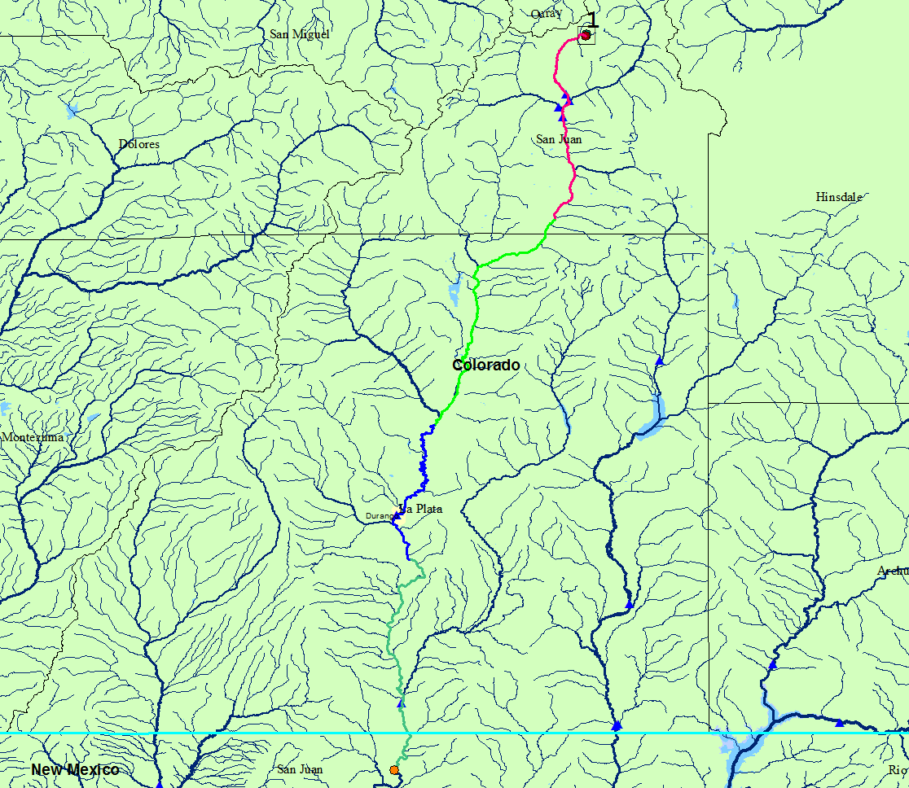
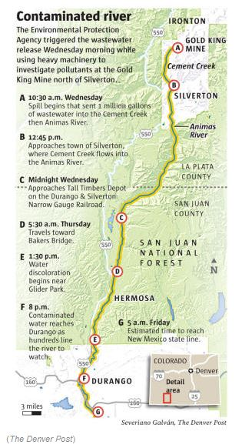
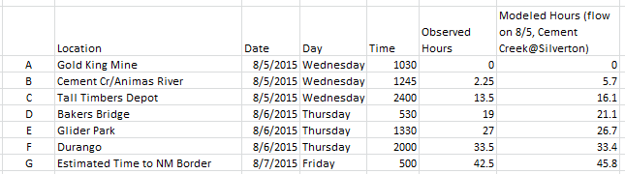

Initial Results
ICWater QuickTrace
A
Time of Travel Comparisons
B
C
D
E
F
G

Slide 16
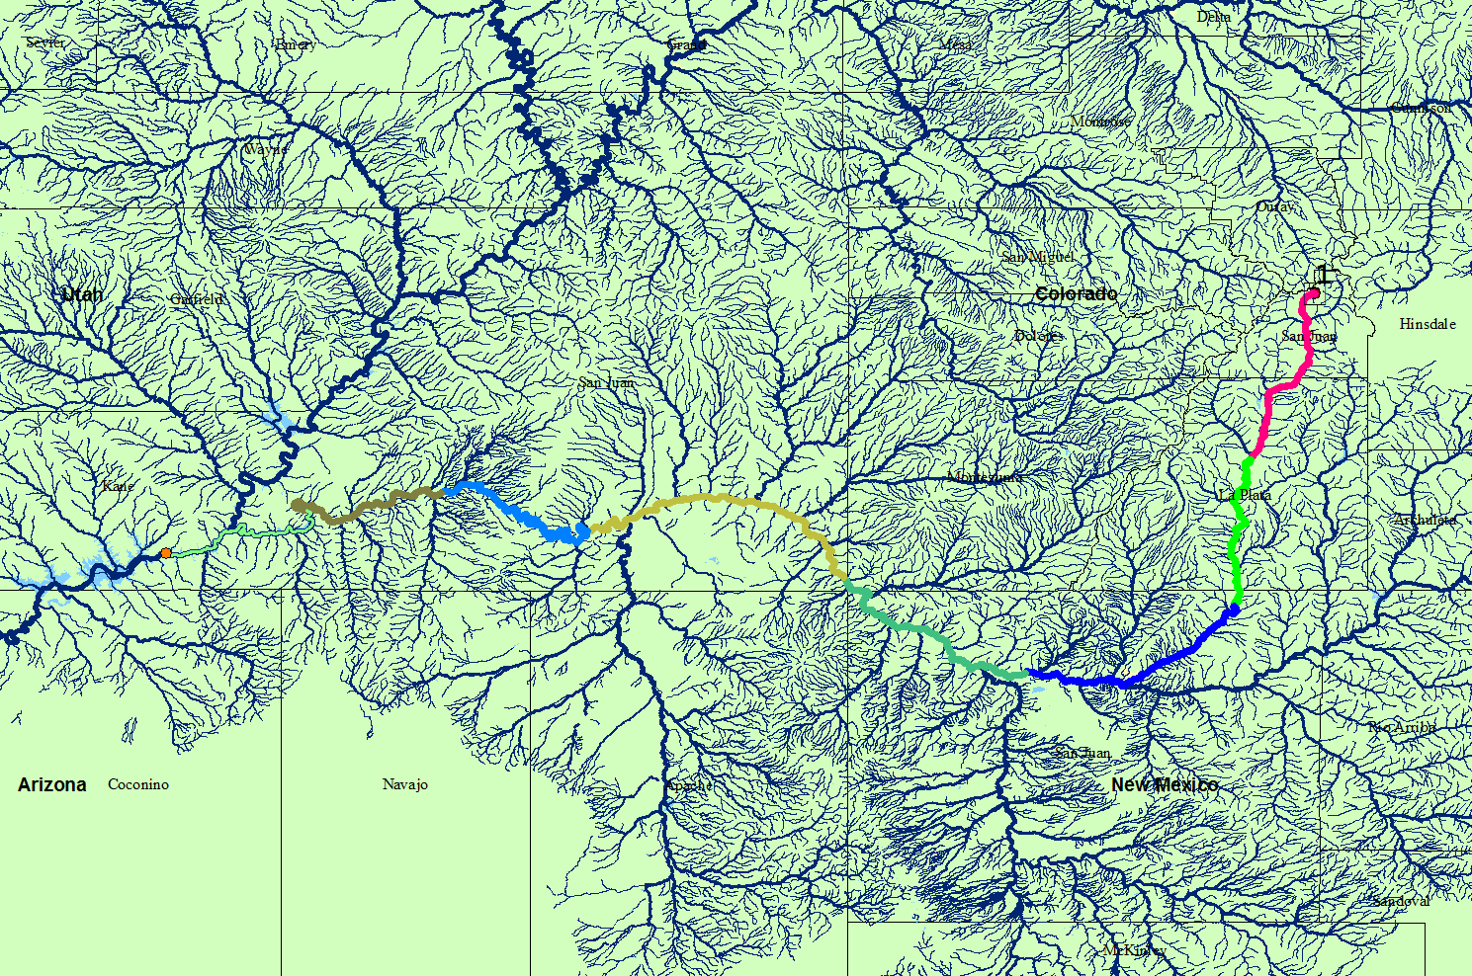
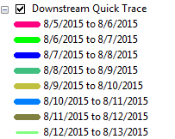
ICWater QuickTrace – 8 day travel time
Gold King Mine
Lake Powell
ICWater Preliminary Results

Slide 17
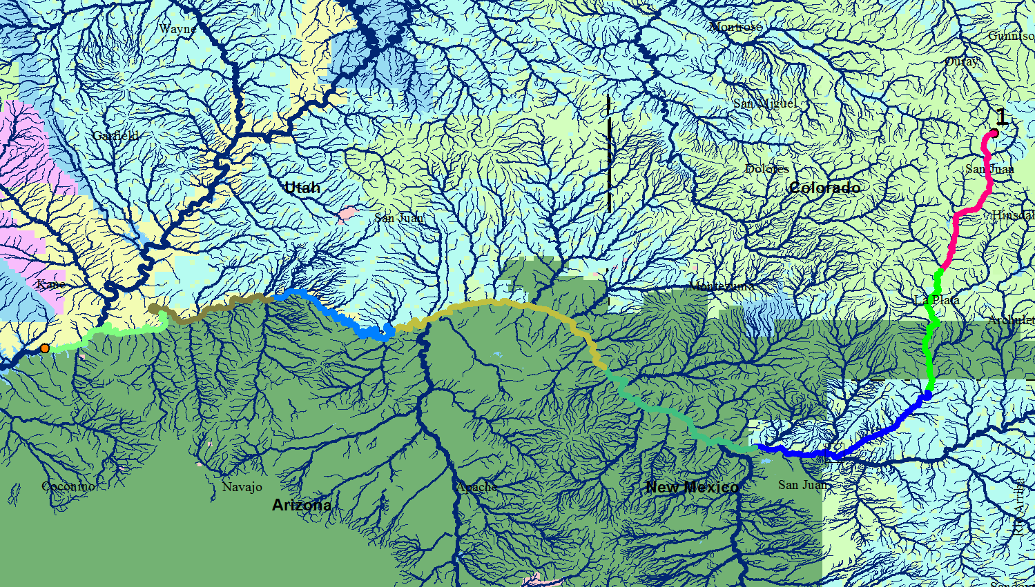
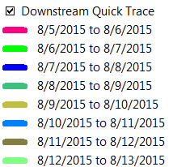
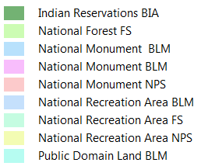
Gold King Mine Spill – Federal Lands
Gold King Mine
Lake Powell

Slide 18
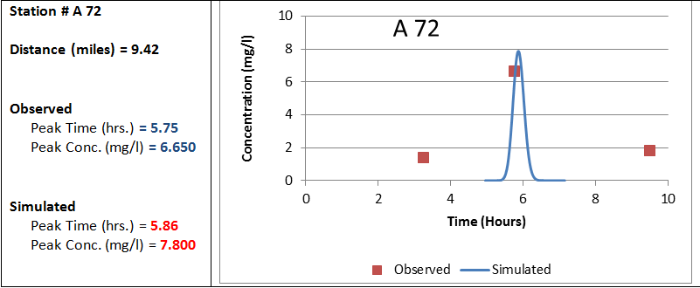
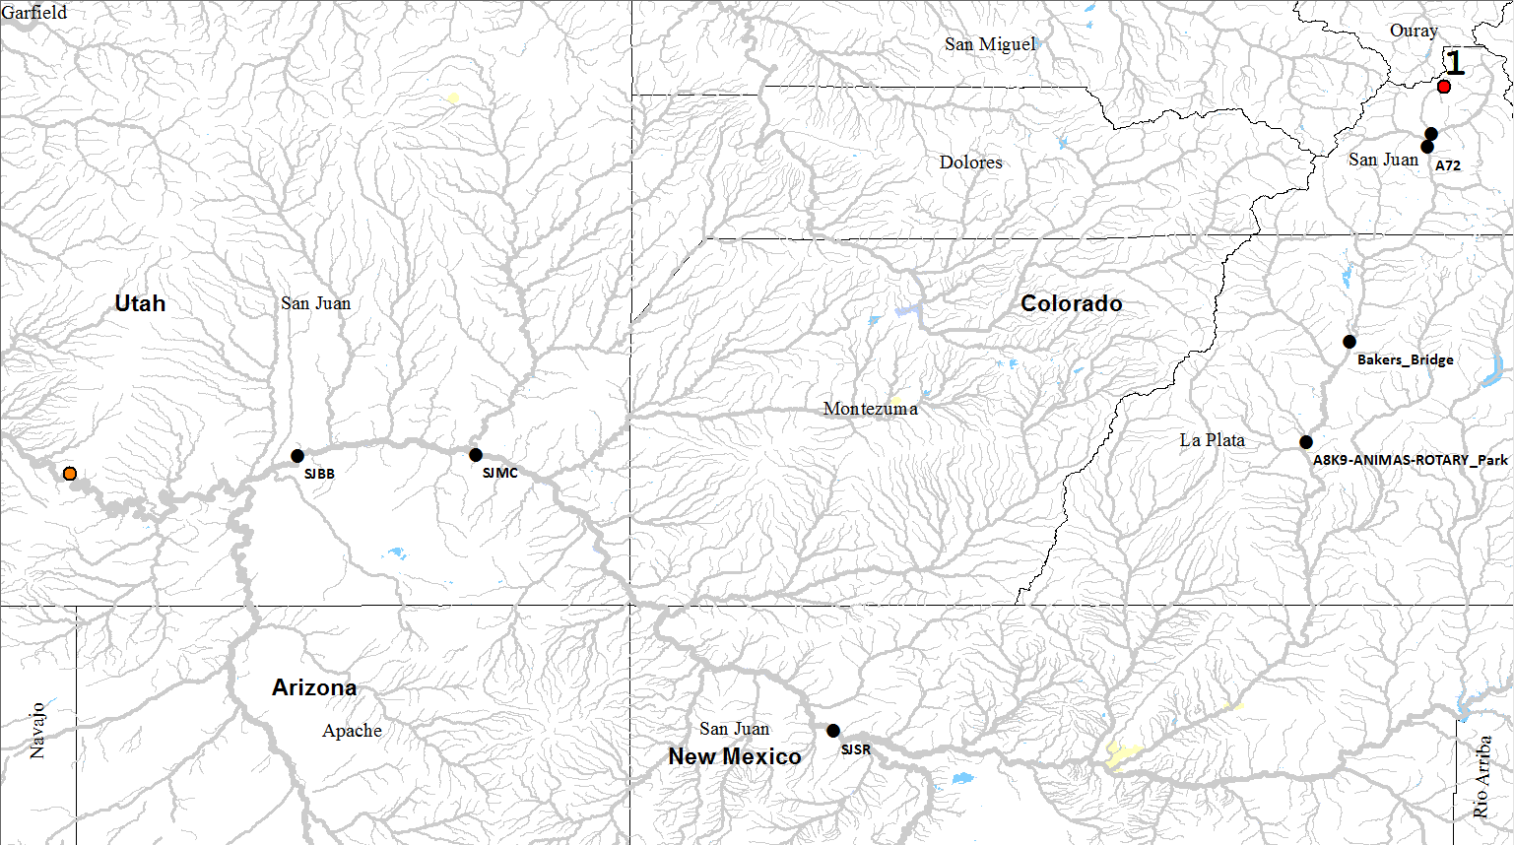
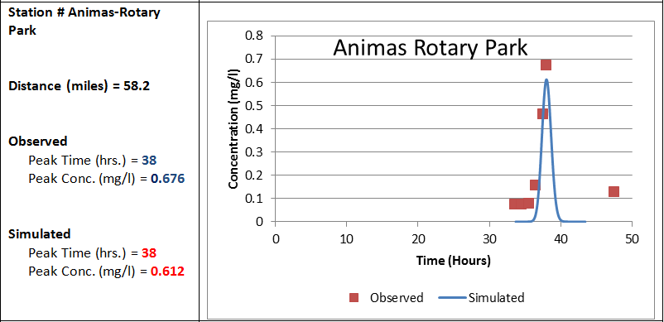
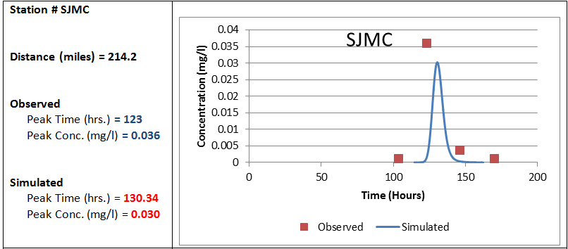
Model Comparisons with EPA
Monitoring Stations (manganese)

Slide 19
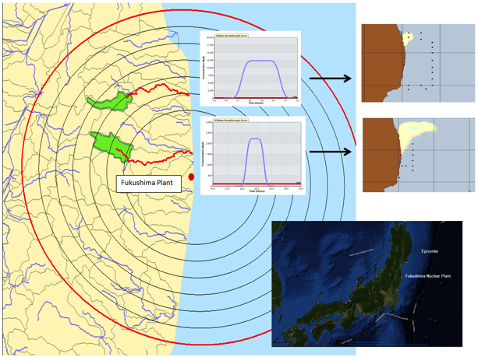
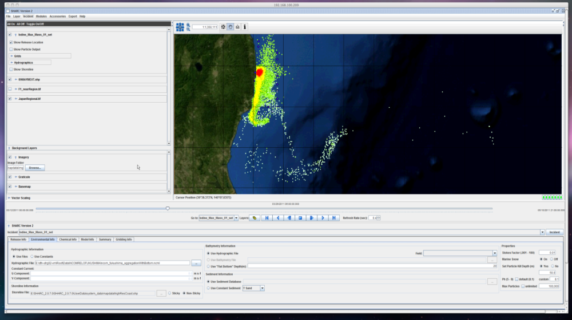
Fukushima

Slide 20

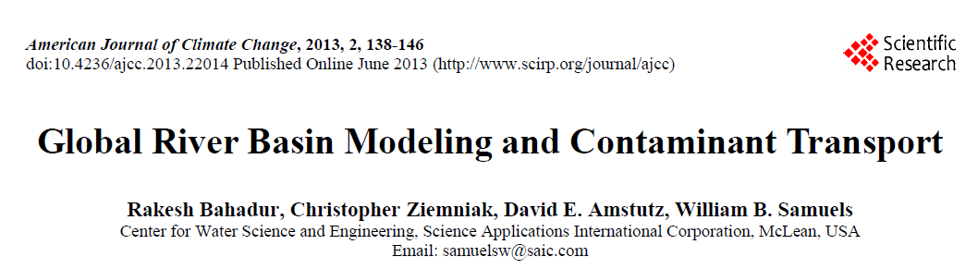
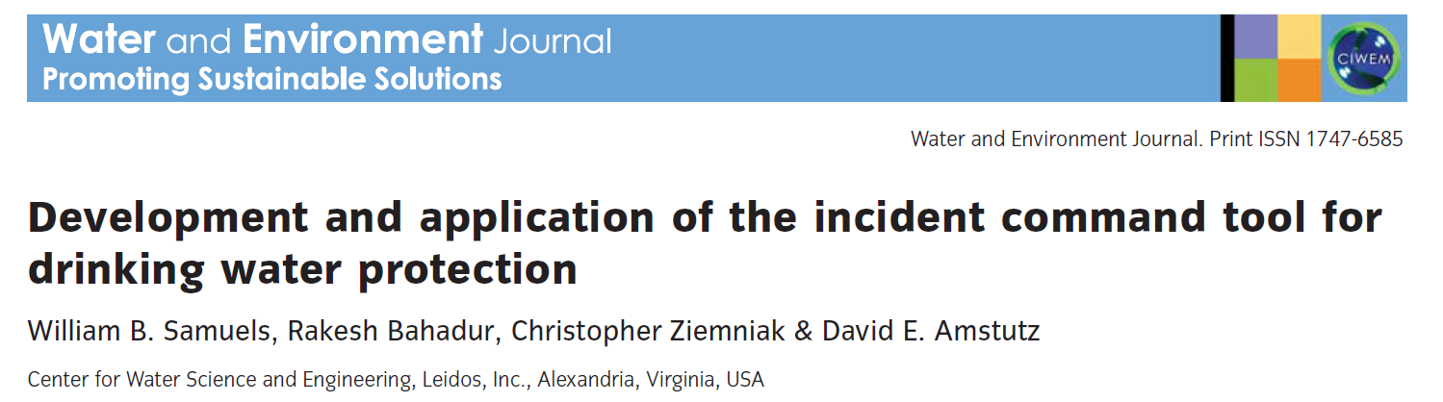
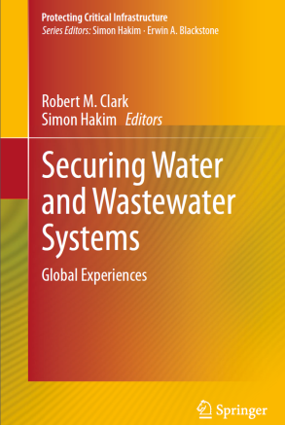
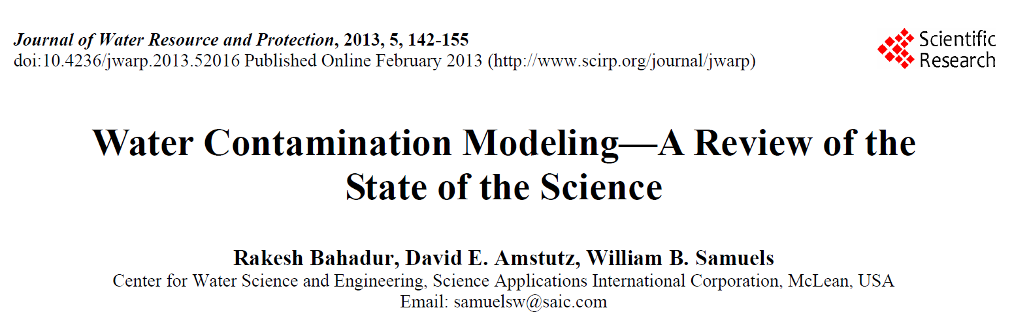

Publications

