Slide 1

EPA WATERS
Network Linked Data and Applications
American Water Resources Association
Specialty Conference on GIS and Water Resources
Sacramento, CA - July 12, 2016

Slide 2
Clean Water Act Implementation
Standards
  Designated uses (fishing, swimming, drinking, etc.)
  Criteria for meeting designated uses
Monitoring
Assessments
Waters not meeting designated uses (impaired waters)
Technical support and financial assistance to restore impaired waters to meet designated uses
Notes:
Safe Drinking Water Act focuses on drinking water protection

Slide 3
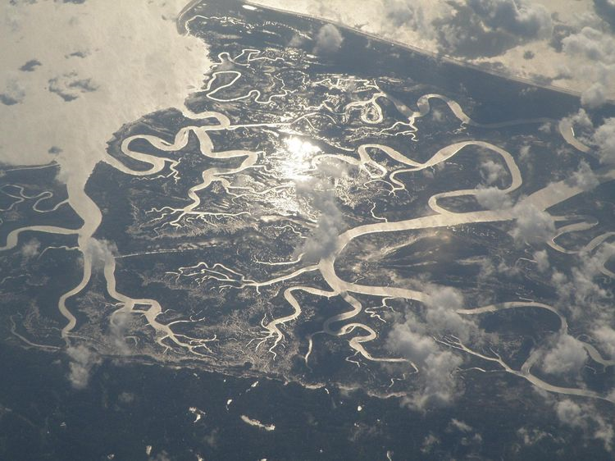
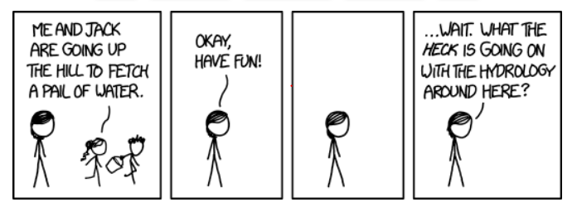
Why do we need a hydrologic framework anyway?

Slide 4

WATERS Data Architecture
(Watershed Assessment, Tracking & Environmental ResultS)
(www.epa.gov/waterdata/integrated-water-analysis-tools)
GRTS
ICIS
Nonpoint Source Grants
Reach Address Database
(RAD)
Permitted Dischargers
National
Hydrography
Dataset Plus
STORET
ATTAINS
Water Quality Monitoring
Water Quality Assessments,
Impaired Waters &
Total Maximum Daily Loads
Notes:
These water program systems existed before the nhd existed … they just didn’t linked together very well
WATERS links these water program systems hydrology – it doesn’t contain their complete data … only their primary identifiers
Initial mr (2000)
Flow validated mr (2002)
Nhdplus v1 (2006)
Nhdplus v2 (2013)

Slide 5
Network Linked Data Accessible Through WATERS
Public Access
Assessed Waters
Listed Impaired Waters
Impaired Waters with TMDLs
Beaches
Permitted Dischargers
Fish Consumption Advisories
Water Quality Monitoring Sites
Nonpoint Source Projects
Internal Access Only
Drinking Water Intakes
Source Water Areas
Available through the EPA Environmental Dataset Gateway
at https://edg.epa.gov/metadata/catalog/main/home.page
Notes:
EDG metadata feeds into data.gov

Slide 6
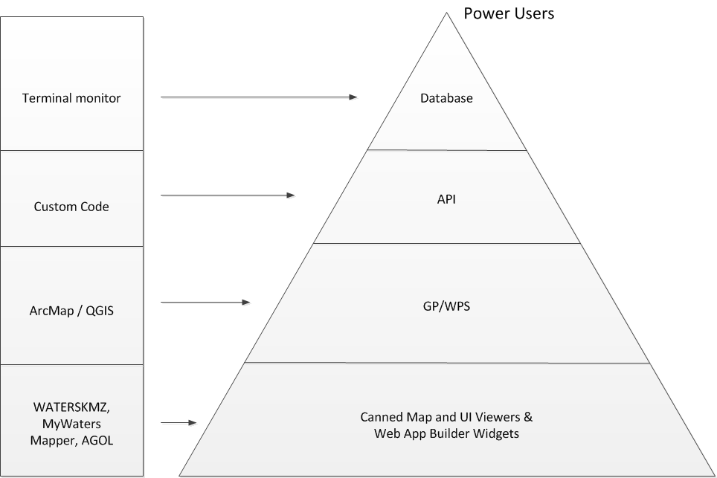
NHDPlus Technologies and Users
Some
Experts
Many
Knowledgeable Users
Huge Number
of Casual Users

Slide 7
NHDPlus Core Tools
  Desktop tools (ESRI ArcGIS)
  Network navigation
  Watershed delineation
  Catchment attribute allocation and accumulation (CA3T)
Web services
  Mapping and analytical services including -
    Network navigation with linked data search
    Watershed delineation
    Watershed report
    And others …
  Accessible by desktop clients (ESRI ArcGIS, Google Earth …) and Web viewers (ESRI ArcGIS Online …)

Slide 8
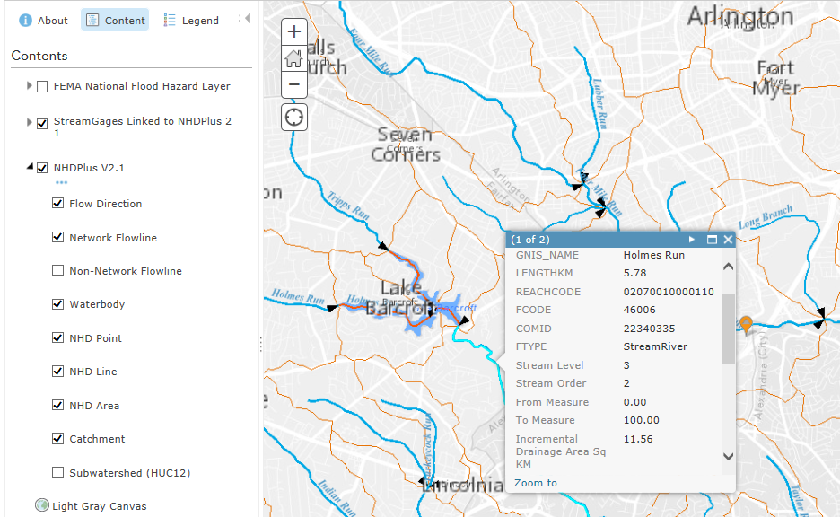
NHDPlus Core Capabilities –
Stream Network and Catchment Visualization
Introduction: Tools
(ArcGIS Online using draft NHDPlus Web services)
Notes:
Stream gage lined to nhdplus network partilly hidden behind stream identify box

Slide 9
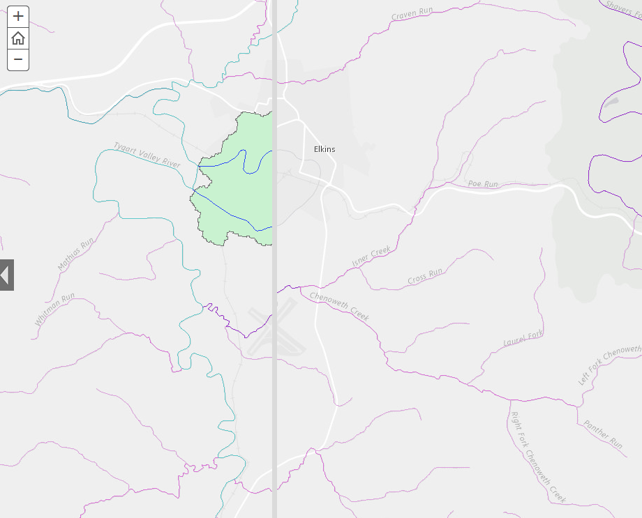
Another Stream Network Visualization
NHDPlus ESRI Story Map (draft)
Comparison Map with (L) and without (R) divergences
Swipe Bar
8
Notes:
non-dentritic (l) and dentritic (r) based upon nhdplus streamcalc vaa
Credit barb Rosenbaum (epa central gis support)

Slide 10
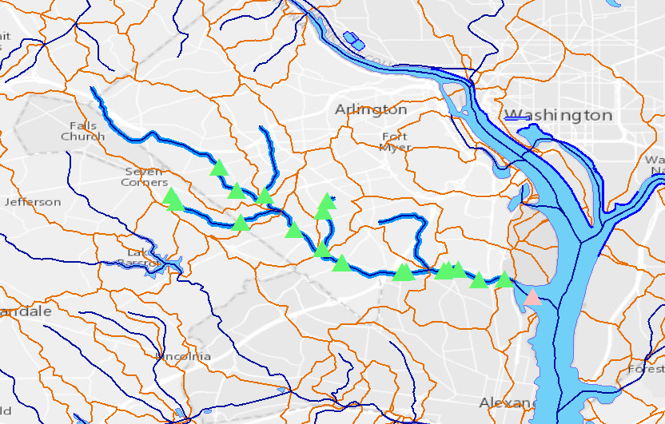
NHDPlus Core Capabilities –
Upstream Search for Linked Data
Water data that has been linked to the NHDPlus stream network can be queried using a network search (thick blue lines). In this case, water quality monitoring locations (green triangles) upstream from the starting point (yellow dot) were selected.
(ArcGIS Desktop using EPA NHDPlus Web services)

Slide 11
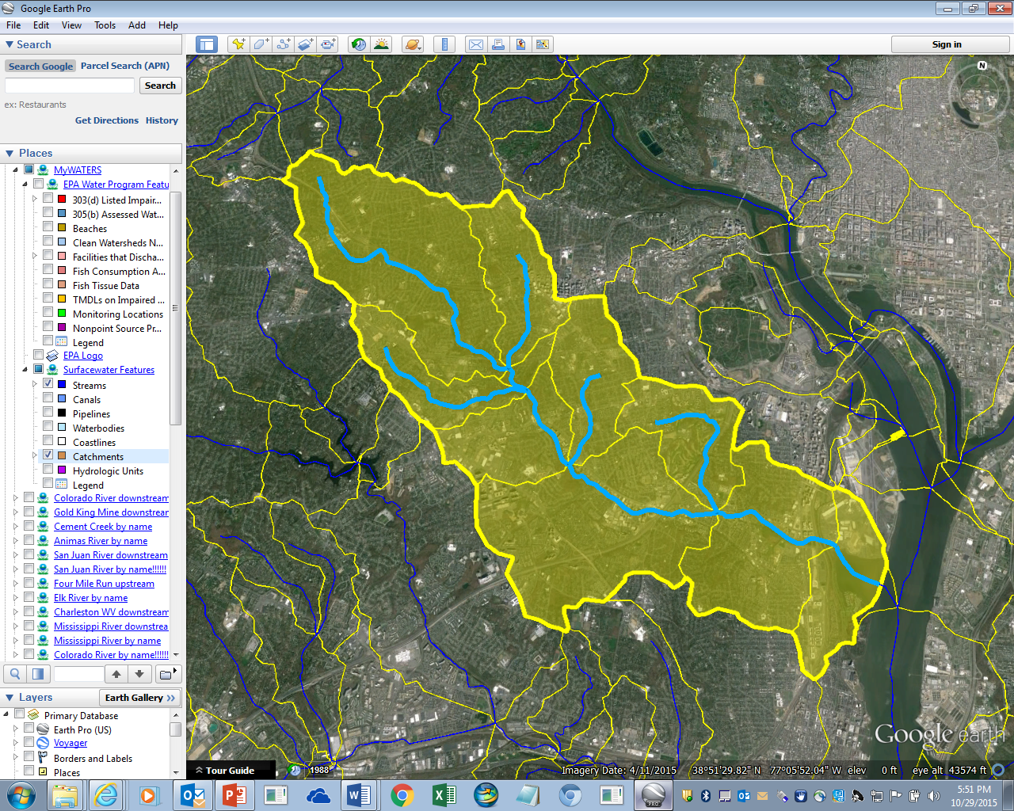
NHDPlus Core Capabilities –
Watershed Delineation and Report
A watershed (yellow area) can be delineated upstream from any location on the landscape (yellow dot) by first navigating the stream network (thick blue lines) above the point then combining the associated catchments (yellow boundaries). A report providing the NHDPlus attributes for the watershed can also be produced.
(Google Earth using EPA NHDPlus Web services)
Notes:
Can use catchments as tool to link data to the network …. At the catchment outlet
Analtyical service
Reference Alaska
Review jawra article comments for talking points

Slide 12
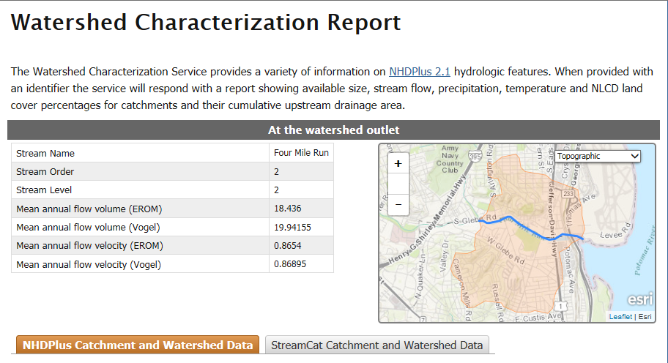
Enhanced Watershed Characterization Report
DRAFT

Slide 13
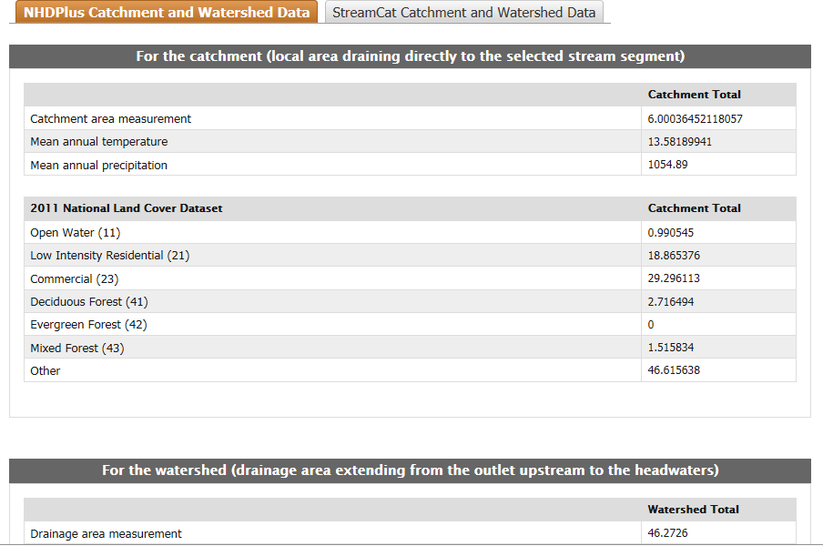
DRAFT

Slide 14
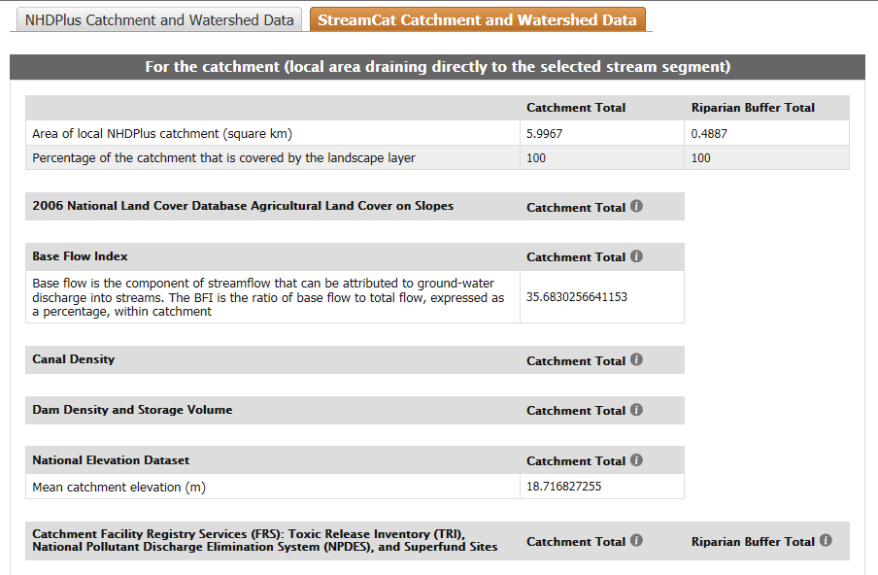
DRAFT

Slide 15
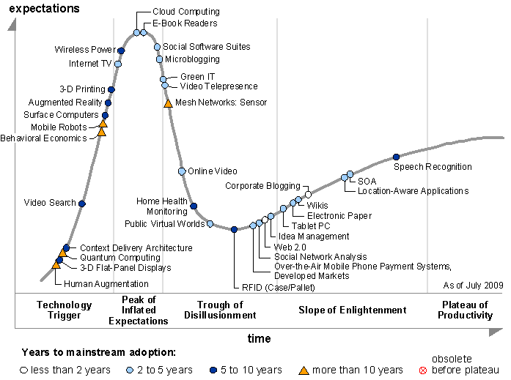
2009 Technology Hype Curve
(Gartner Group)
Progress
Notes:
robust analytical web services track with cloud computing

Slide 16
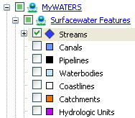
Gotchas!
Service performance for analytical services
  up/downstream search
  watershed delineation
Time and cost to compute/re-compute and store cached results (potential performance issue here, too)
Spinning Pinwheel
(formerly, the Dreaded Dancing Dot)
Notes:
2.6m networked flowlines and catchments
Database tuning
Pre-computing (caching) navigation results and/or result geometries
Different caching strategies – dynamic cache

Slide 17
Lots of Progress!
Cloud technology for scalable compute capacity
  FGDC GeoCloud pilot lessons learned
  Dept of Interior cloud contract now in place
Cheaper storage for caching large volumes of data
Web GIS – ArcGIS Online
Denormalized national NHDPlus FGDB
EPA Catchment-based Indexing Process
EPA StreamCat catchment attributes
Open Water Data Initiative collaboration with USGS and others
  Network Linked Data Index – remote access to linked data stores through central index
  Open source technologies (GitHub, etc)
NHDPlus Value-Added Attribute applications Challenge Grant?
16

Slide 18
Challenges
Service performance and resource issues
Incentives for organizations to stand up linked data stores
Effective data stewardship of framework datasets is key!
17
17

Slide 19

Thanks!
Tommy Dewald
dewald.tommy@epa.gov

