Slide 1


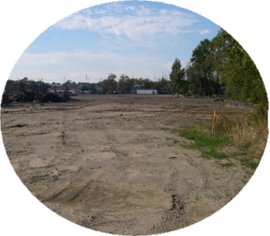


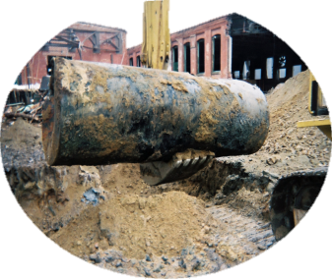
ACRES 5.0:
Brownfields Area-Wide Planning
Recipient Training
March 8, 2017
Notes:
INSTRUCTOR NOTES
- Introduce course – for ARC grantees that have experience entering data in ACRES
- Hand out ACRES business cards
- Presenter introductions (establish your credibility as a trainer giving them information about Brownfields/ACRES)
Name & organization
Role & number of years with Brownfields Program
Role & number of years with ACRES
- Distribute sign-in sheet
- Ask where the attendees come from, what their roles are within ACRES. This is a good way to see if PO’s are in the audience, familiar names, etc.

Slide 2
Objectives
Adding an Area-Wide Planning (AWP) cooperative agreement (CA) to your ACRES account
Accessing your AWP CA
Completing your AWP CA form
Associating existing ACRES properties to your AWP CA
Submitting your AWP data to your EPA Project Officer
Demonstrating ACRES tools and functions
Learn what resources are available for your questions
Notes:
INSTRUCTOR NOTES
- Delineate the roadmap/agenda for the next 1 hour– be specific about what they are going to get out of the training
- Set the tone for the training – interactive; encourage questions
- Hand out the course evaluation

Slide 3
New Reporting Form & ACRES Module for BF AWP Grantees
In Fall 2016, EPA received approval for a reporting form specific to BF AWP grant projects
  Aligns with the activities that BF AWP grantees do
  Enables grantees to share grant project details, associate other ACRES records, and report accomplishments on an ongoing basis
  Encourage grantees to continue to report as different revitalization goals in the project area are achieved, even post-BF AWP grant
ACRES contractors worked with EPA to create a new module in ACRES that matches the BF AWP reporting form. New module became available in Jan 2017
Notes:
INSTRUCTOR NOTES
- Delineate the roadmap/agenda for the next 1 hour– be specific about what they are going to get out of the training
- Set the tone for the training – interactive; encourage questions
- Hand out the course evaluation

Slide 4
Why is my role important to ACRES?
Whose job is it anyway?
Cooperative Agreement Recipients (CARs): Responsible for entering and updating ACRES information for AWP grants.
EPA Project Officers (POs): Responsible and accountable for data quality in their regions. POs ensure that the data meets our data quality standards.
  For AWP grants, it is especially important that POs work closely with their grantee and provide assistance/oversight to the ACRES data, so that property records are properly associated, with no double counting of leveraged funds/resources
EPA Headquarters: Responsible for overall data quality and system maintenance, enhancements, and improvements.
For CARS whose grants have closed (FY10 AWP pilots and FY13 AWP grantees) – EPA still wants your updates, please share with us your project area accomplishments by continuing to report in ACRES

Slide 5
Why is my role so important for ACRES?
It is important to have accurate & complete data because:
EPA needs a clear understanding of how communities are using their AWP grants to
  1) build upon other brownfield site assessments or cleanups, and
  2) quantify the range of other investments in the AWP project area that communities are able to leverage
EPA needs to rely on data reported in ACRES to help establish and measure success of the AWP program
Results are frequently reported to Congress
Data entered into ACRES are available to any requesting party through FOIA
Incomplete or inaccurate data negatively skews the data set
Audit trail

Slide 6
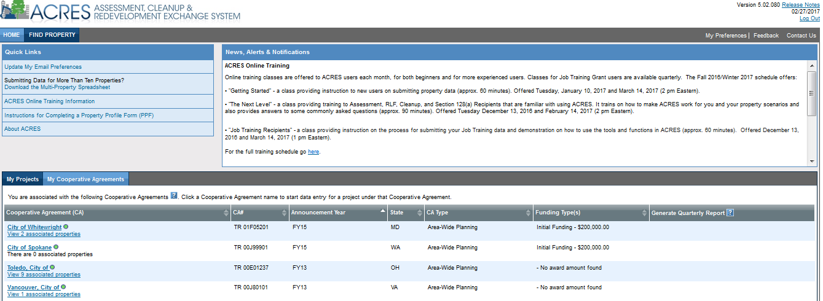
Adding an AWP Cooperative Agreement to your ACRES account
ACRES allows users to add multiple CAs to their account for easy access and data management.
To add a CA to your ACRES account, click the My Cooperative Agreements tab on your ACRES home page and click the green ‘Add Cooperative Agreement to My List’ button.
You will prompted to enter the 8-digit CA number (do not enter the 2 digit prefix) and state of your CA. Once you have you have confirmed your CA information, the CA will be listed under your My Cooperative Agreements tab.

Slide 7
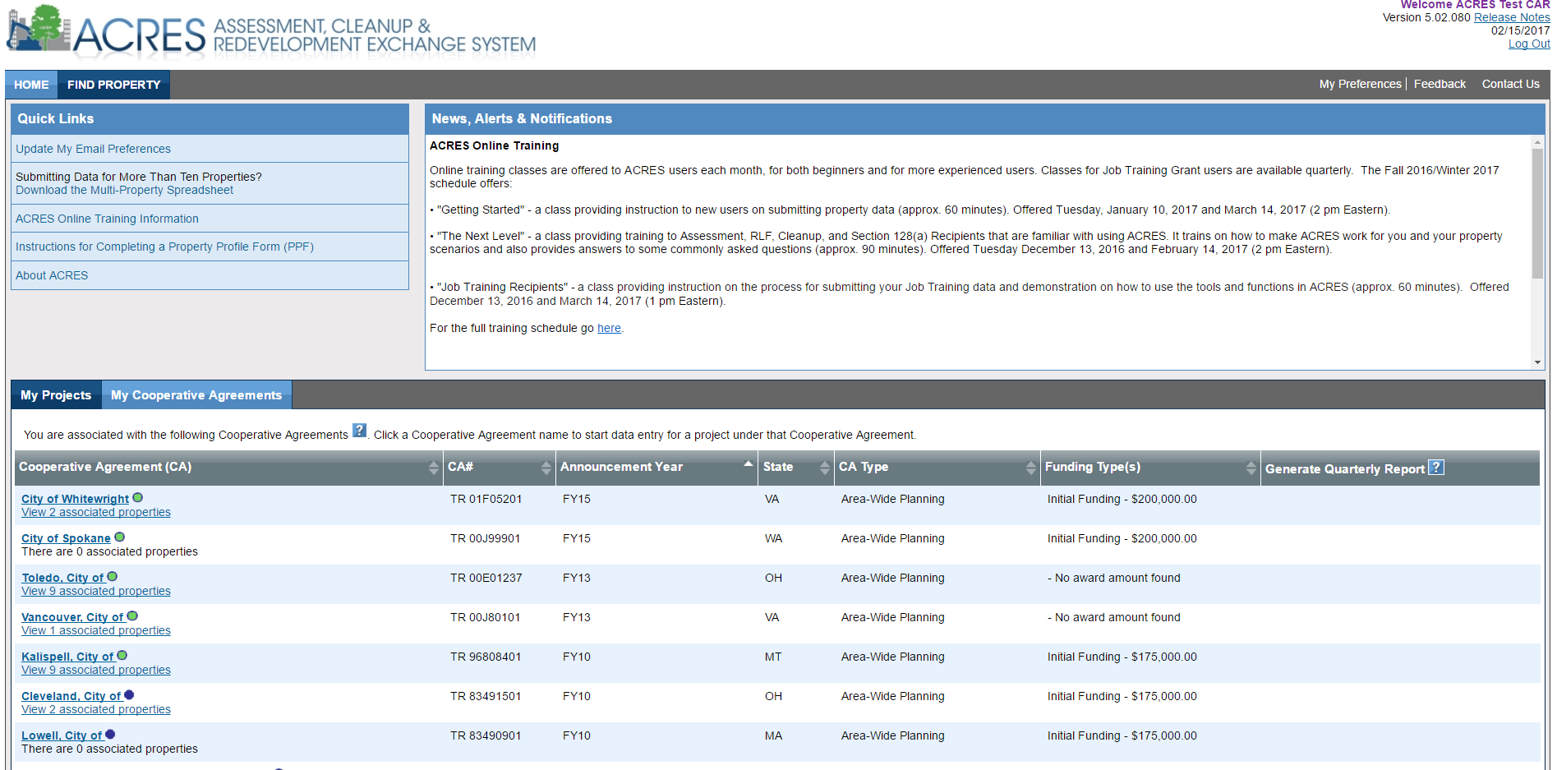
Accessing your AWP CA
All of your AWP grant associations will be listed under your My Cooperative Agreements tab.
The AWP form can be accessed by clicking the recipient name of your AWP grant.
The ‘View xx associated properties’ link directs users to a list of all properties associated to the AWP grant. The properties will also be visible on a map.

Slide 8
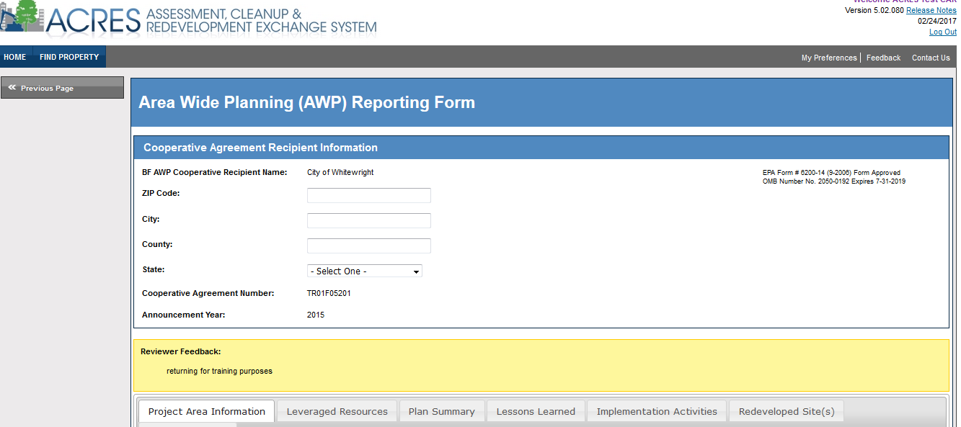
Completing your AWP form
When opening the AWP form, please enter your Cooperative Agreement Recipient Information.
Once you’ve entered the ZIP Code, the city, county and state fields will be auto-populated.
The AWP form is broken down into 6 parts- Project Area Information, Leveraged Resources, Plan Summary, Lessons Learned, Implementation Activities, and Redeveloped Sites(s).
**At the bottom of every section, there will be a ‘Save Changes’ button. Always save your changes before going to the next tab.

Slide 9
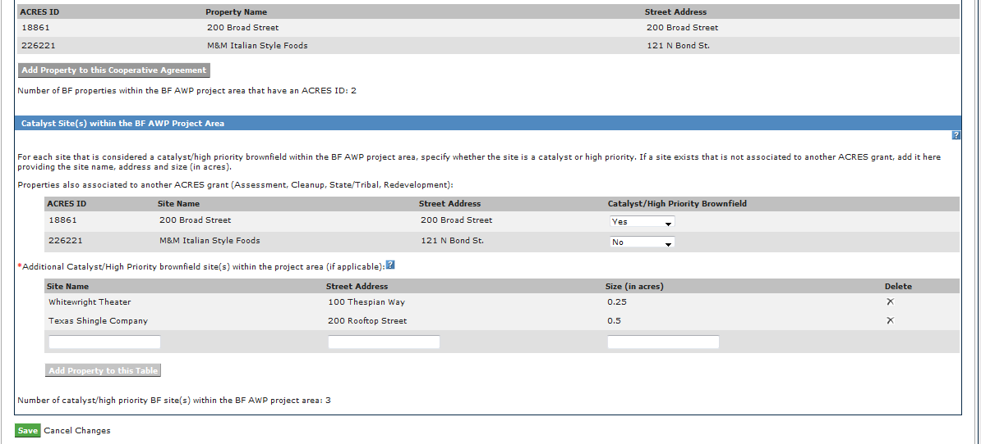
Part 1: Project Area Information
When completing Part 1 of the AWP form:
  Enter your Cooperative Agreement Recipient and BF AWP Project Information.
  Associate brownfields properties within the AWP project area that already have an ACRES ID to your AWP CA.
    These are properties where EPA resources for assessment/cleanup have been provided.
    When associating properties with ACRES ID to your AWP project, indicate whether they are considered catalyst/high priority sites in your project area.
Next, enter catalyst/high priority brownfield site(s) in your project area that do not have an ACRES ID in the section below. You will not create an ACRES ID for these properties.

Slide 10
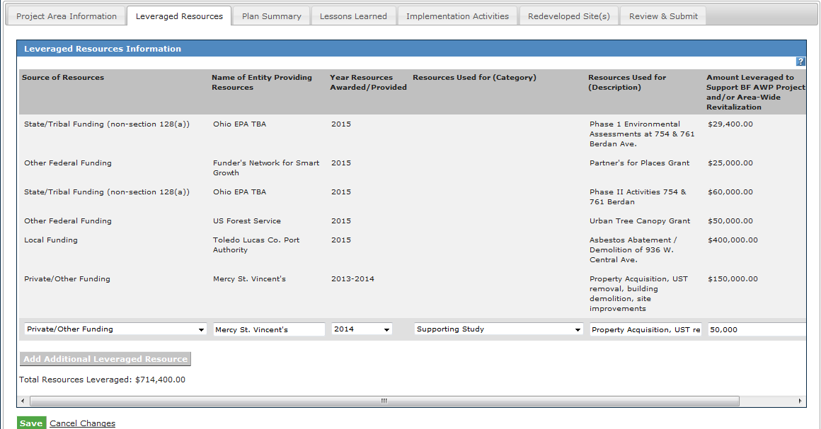
Part 2: Leveraged Resources
In Part 2 of the AWP form, enter your AWP leveraged resources information.
  Include leveraging that helps improve the overall project area (sidewalk improvements, street lighting, etc) and any site-specific leveraging that is not already included on another ACRES ID property record
  Enter all leveraging information including source of resources, name of entity, year resources were provided, what the resources were used for, and leveraged amount.
Reminders:
When entering leveraged funding, please be sure not to double count previously entered funding.
Unlike other grant types, funding leveraged prior to the AWP award can be entered.

Slide 11
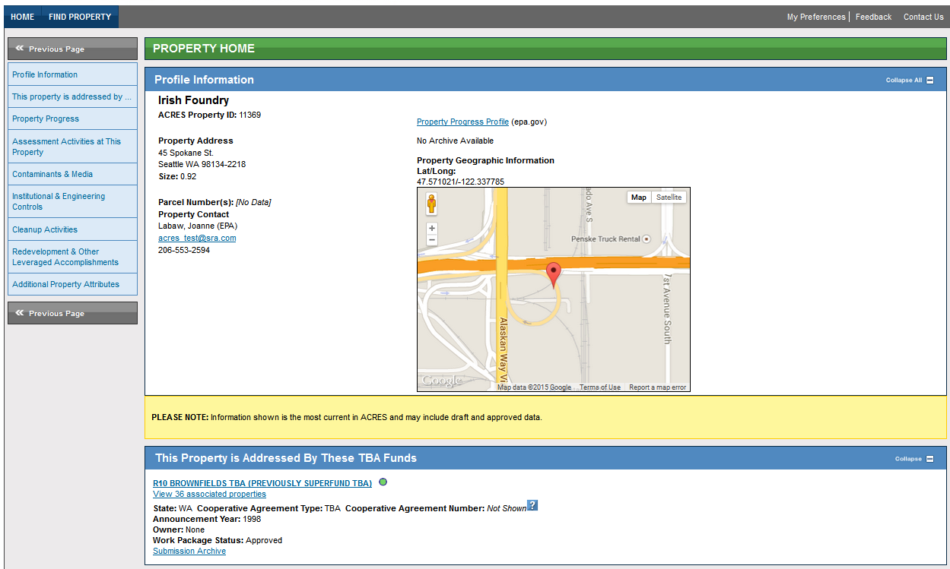
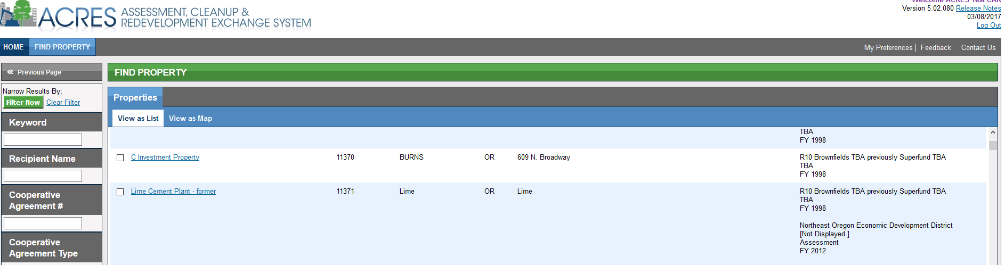
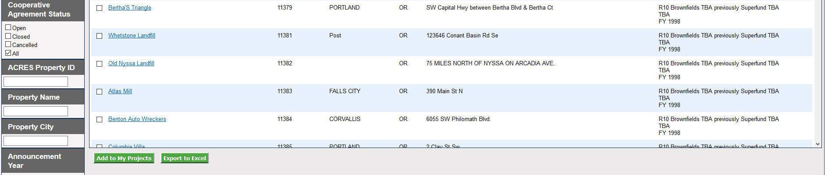
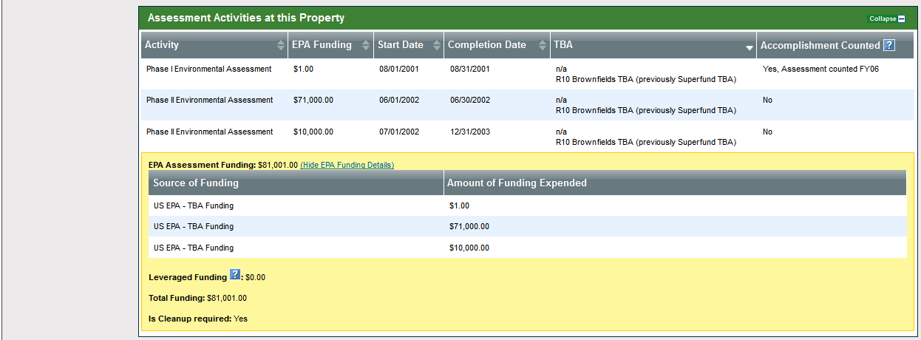
How to view previously entered leveraged funding
Search for your AWP property by entering the ACRES Property ID on the Find Property tab.
Click the Property name link to view the Property Home page.
The Property Home page allows you to view what data, including leveraged funding, has already been entered under associated brownfields properties (sites with an ACRES ID).
This is a great way to make sure you are not double-counting leveraged funding under your AWP grant.

Slide 12
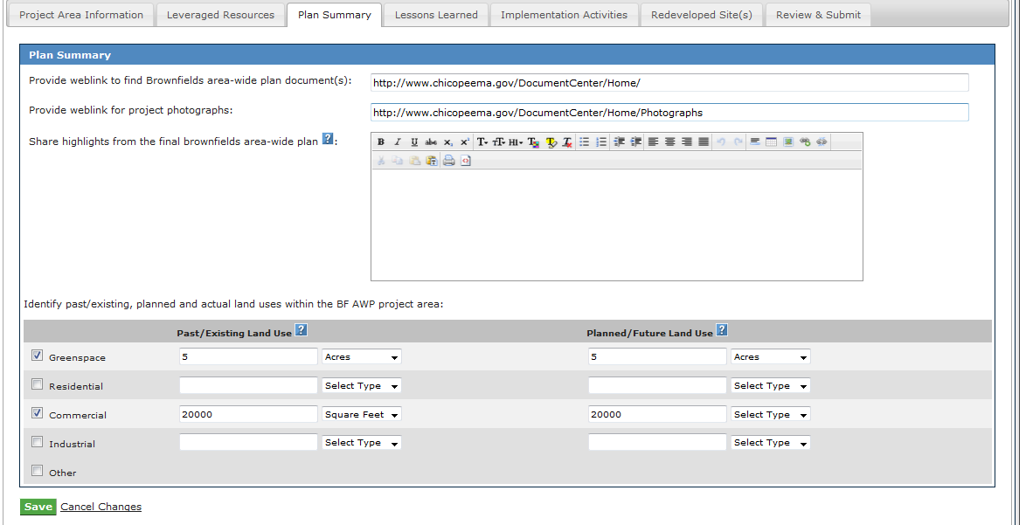
Part 3: Plan Summary
The Plan Summary Section allows users to:
  provide weblinks for brownfields area-wide plan documents and project photographs.
  share highlights from your area-wide plan (e.g., your community revitalization goals, exec summary, etc)
  identify past/existing land uses v. planned/future land uses, as identified in your area-wide plan.
**Please be sure to specify acres or square footage when entering amounts for the different types of land use.

Slide 13
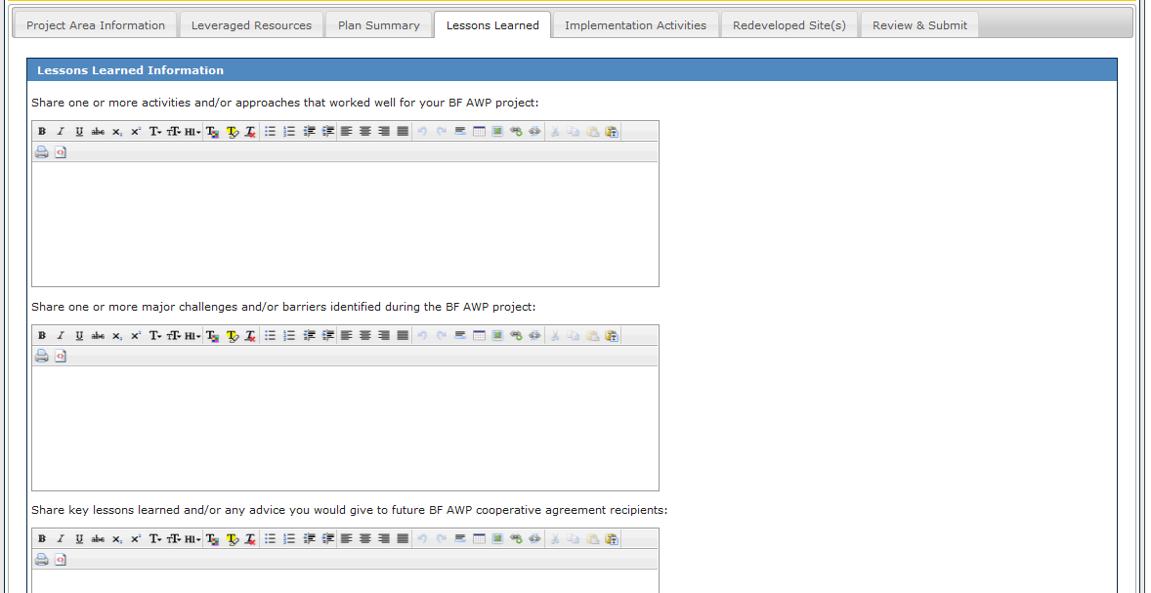
Part 4: Lessons Learned
Lessons Learned gives you the ability to provide narrative on what worked and did not work for your AWP grant, including
  activities and/or approaches that worked well for your project,
  major challenges or barriers identified during your project,
  advice you would give to future BF AWP recipients , and
  how you met the grant term & condition for considering changing climate conditions.
** When cutting and pasting your information, only enter text (exclude formatting) to avoid potential system errors

Slide 14
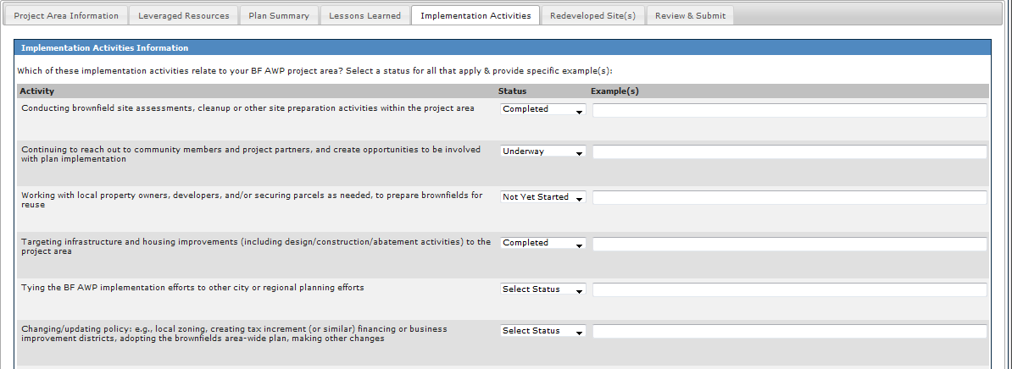
Part 5: Implementation Activities
In this section, provide the status of different implementation activities happening in your AWP project area.
For each related applicable activity:
  select a status of completed, underway or not yet started and
  provide a specific example of the activity.

Slide 15
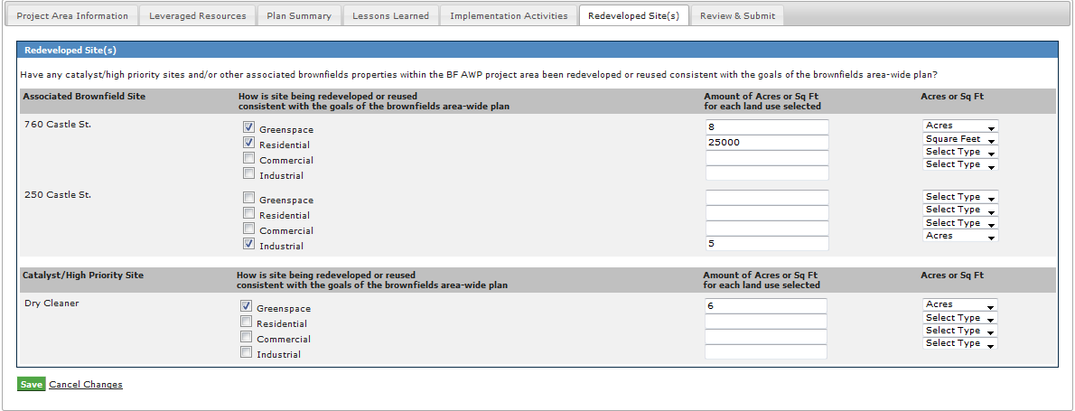
Part 6: Redeveloped Site(s)
All associated brownfield properties (again – these are sites with ACRES IDs) and any additional catalyst/high priority brownfield sites that don’t have an ACRES ID will be listed in the Redeveloped Site(s) section. These are the same sites that are listed under Part 1: Project Area Information.
As sites become redeveloped/reused consistent with the goals of the area-wide plan, identify the type of land use for each site (select from greenspace, residential, commercial or industrial) and the amount of acres or square footage.

Slide 16
Reviewing and Submitting your AWP data
Once your data has been entered, click the Review and Submit tab to send your work package to your EPA Project Officer.
The Review and Submit page will show all of your entered AWP data.
To submit your data, scroll to the bottom of the Review and Submit data page and click the ‘Submit Data Now’ button.
Once the data has been submitted, your AWP data will be locked for review and the ‘Submit Data Now’ button will no longer appear at the bottom of the page.
***Grant terms & conditions require quarterly submissions of your AWP information or updates.

Slide 17
ACRES Demonstration
Notes:
INSTRUCTOR NOTES
- cover specific fields/questions from attendees
- show calculated totals in CA, and mock duplicate record
- jobs leveraged / leveraged activities
- follow up and go back with activities leveraged
- may receive letter for follow up on some information gaps
NEW PPF
New explanation field if cleanup status is unknown
Expanded list of contaminants
Expanded list of media affected
More space to describe activities funded
Included Cost Share as a funding type for Cleanups and RLFs
Updated explanation of Jobs Leveraged
Combined the estimated and actual tables in the Redevelopment section
Included a sub grant issuance date (as well as the grant issue date) for RLF grants only
Ability to capture the cleanup completion documentation type (No Further Action Letter or Environmental Professional Certified)

Slide 18

What if I Have Questions?
Registration
  Go to https://cfext.epa.gov/acres
  Click “One Time Registration”
ACRES Help Desk
  Email: Acres_Help@usepa.onmicrosoft.com
  Telephone: 703-284-8212
  Monday-Friday 9-5pm, excluding Federal holidays
ACRES Information Web page: https://www.epa.gov/brownfields
  Quick Reference Guides
  Frequently Asked Questions
  Training Materials
  Release Notes
Notes:
INSTRUCTOR NOTES
Help with questions or issues is almost as close as the press of a button.
ACRES Help Desk hours – M-F/9-5 – encourage people to ask any and all questions; we are here to help. Also encourage people to contact us with suggestions for improvement or enhancement. We want to hear from our users and do not consider ACRES a “final product.” We are always looking for ways to improve the application and make it as streamlined and useful as possible.
CDX Help Desk – for help with register or username/password issues.
ACRES Information page – all QRGs have been updated, and a few new ones added! As training gears up again, we will post the schedule. We are also going to be posting short 10 minute recorded training clips to help with certain activities in ACRES.
WE WANT PICTURES! Historical, before and during Brownfields activities, after reuse – all of it! The form is in the back of the room and posted on ACRES Information.

Slide 19

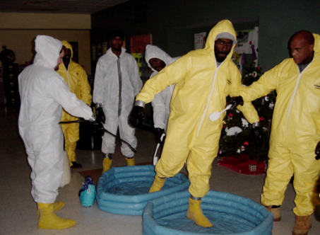

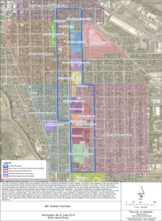

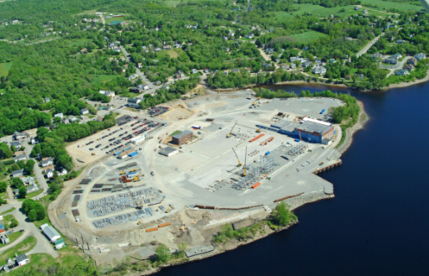
Questions?
Columbia, MO - Cleanup
Providence, RI – Job Training
Anaheim, CA – RLF
South Bend, IN – RLF
Brewer, ME - Assessment
Goshen, IN - AWP
Notes:
INSTRUCTOR NOTES
- Ask if anyone has any questions
- Remind everyone to turn in the course evaluation

