Slide 1
The NEI/EIS Nonpoint Data Category Development Process and QA
Live Webinar
September 27, 2018
Rich Mason & Jennifer Snyder
U.S. EPA

Slide 2
Outline
NEI and EIS Overview & Communication to Submitters
Nonpoint Augmentation: Why and Types
PM2.5 Speciation
Other non-SLT Datasets
2017 NEI: Schedule, Plan, & Selection Process
Nonpoint Details: QA, Data Tagging, Procedures
The Emissions Inventory System: Nonpoint Focus
Notes:
Overview 3-6, Augmentation 7-20, PM speciation 21-22, Other non-SLT datasets 23, 2017 NEI Plan 24-31, NP QA 32-37, Tagging 38, NP survey 39-40, NP procedures 41-43, OS/OG 44-51, EIS demo 52-87

Slide 3
High-level EIS and NEI Overview
Emission Inventory System (EIS)
  Data repository for air emissions data used to create the NEI
  Contains State, Local, Tribal (SLT) and EPA-submitted data
  Can be multiple emissions values for the same unit/process or SCC/county
  Annual, monthly, daily data
  Data available via a password-protected web site
    EIS Gateway https://eis.epa.gov/eis-system-web/welcome.html
National Emission Inventory (NEI)
  Snapshot in time from EIS
  Inventory version shared with the public every 3 years, 2014 most-recent
  One emissions value per process or SCC/county selected
  Annual emissions, county-level values for most of Nonpoint
Notes:
The Emission Inventory System is the database system which receives and stores the State/Local/Tribal and EPA-submitted emission data used to create the National Emission Inventory.
The EIS is capable of holding multiple alternative emission estimate from different submitters for a single process. Both Annual emissions (at a minimum) and sub-annual emissions can be stored.
The National Emission Inventory is a snapshot in time of the selected emissions values for a specified inventory year. The NEI is shared with the public and contains one selected annual emissions value per process per pollutant. During the Point course, we will discuss how that single value is determined.

Slide 4
Communication with data submitters (1)
1) General NEI/EIS Email Listserv
  Updates roughly every 2-4 weeks
  Imminent NEI-related (overall and detailed) milestones and planning
  Recent EIS updates or near-term EIS needs
  Points to the NEI/NOMAD SharePoint sites, public NEI websites
  Other useful information such as conferences, guidance, ongoing analysis
  Summary of Nonpoint Method Advisory (NOMAD) committee developments

Slide 5
Communication with data submitters (2)
2) NOMAD Committees
  By-definition, covers only EPA estimates developed for the nonpoint data category
  Hosted by EPA with some committees led via joint EPA/SLT
  Overall NOMAD team calls are monthly
  More-specific teams meet as-needed for “priority” sector(s) such as: Dust, Agricultural NH3, Residential Wood Combustion (RWC), Industrial and Commercial/Institutional (ICI) fuel combustion, Solvents, others
  Calls open to all SLT data submitters, RO and RPO staff, and others involved in EPA Tool development or use in NEI
3) Oil and Gas Committee
  National, monthly calls to discuss latest oil and gas tool developments
  Led by EPA, SLTs and Regional Office staff

Slide 6
Communication with data submitters (3)
4) EIS Gateway Announcements
5) SharePoint sites
  Main NEI SharePoint site open to all “data submitters and collaborators”
    Calendar, list of tasks, schedule, announcements, newsfeed
    Much of this is a work in progress -yet to be fully updated for the 2017 NEI
  “Shared with SLTs” folder for all other NEI work
  NOMAD Sub-site for Nonpoint data category work:
    Latest and archived EPA Tools
    NOMAD meeting minutes
  Contact Aimee StClair for access

Slide 7
Nonpoint Augmentation: Why?
In addition to SLT-submitted data, EPA uses augmentation and additional EPA datasets in order to have the most complete inventory for our end users.
Augmenting, or the addition of EPA datasets, is to include additional data not already received from SLTs
  Augmentation does not change a submitted SLT value in EIS
  PM, HAP and Chrome augmentation is calculated on SLT-submitted data (PM, VOC, Total Chromium)
  If VOC/PM is not submitted, then HAP Aug is not performed
  Filling gaps via independent sources like in-flight aircraft and offshore CMV
Notes:
Augmentation is adding data, not replacing data. The augmentation we’re focusing on here is the 2nd bullet. Our starting point are the SLT submitted data, so that is a key “ingredient” - our emission factors/speciation data is the other key ingredient and we’ll get into those shortly.
The third bullet is also augmentation through use of other datasets we feed into the hierarchy when doing the selection and that will be covered in the “selection process” part of the training

Slide 8
HAP Aug and Cr Speciation: Overview
HAP Augmentation: works on SLT-reported CAPs: VOC, PM & SO2
Chromium Speciation: Allocates SLT-submitted total Chromium to hexavalent and trivalent components
Underlying factors, profiles, and assignments for both HAP Augmentation and Chromium Speciation are stored in the same EIS tables (Augmentation Profile Information)
HAP-aug factors are generally based on measured emission factor, the SPECIATE database, and/or peer-reviewed literature
The resulting augmented data is created in EIS as an EPA dataset
Notes:
I cover them together because the equation is the same and the underlying data used are stored in the same EIS tables.
HAP aug factors are primarily from WebFire for point, and the EPA nonpoint tools for nonpoint.

Slide 9
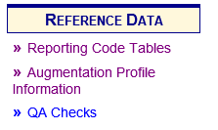

HAP Aug & Cr Speciation: General Approach
$Augmented Emissions Output pollutant=SLT_Reported Emissions Input Pollutant×Factor$
Factor is a value from a speciation profile or emissions factor ratio and is based on the emissions source (i.e., SCC, NAICS, specific facility or process)
$Input Pollutant$ is an SLT value, chromium for chromium augmentation, or a criteria air pollutant (CAP) for HAP augmentation
EIS performs this computation & creates separate augmented datasets in EIS
Factors and their mapping to sources are provided in EIS: “REFERENCE DATA” Section
Notes:
Here is the equation used to compute the augmented emissions – it is done at the process level. Same equation for HAP and chromium augmentation.
The FACTOR is a value from a speciation profile or emissions factor ratio (HAP to CAP) and is based on the type of source.
We used to do this calculation on our PCs and then submit the dataset. But since the 2011 NEI, the function was put into EIS. EIS creates the dataset.

Slide 10
About HAP and Chromium Factors
The Factors are grouped into “profiles” that reflect a type of source
  Profile assignments depend on source attributes -primarily SCC, but could be facility or process-specific
  If multiple SCCs share the same set of factors, then could be a named group
  HAP Aug factors for point sources primarily from WebFire
    Factor is a HAP to CAP ratio, computed outside of EIS
Notes:
The factors are grouped into profiles that describe a single SCC or a group of SCCs that share the same set of emission factors–A profile contains a set of factors for all the output pollutants for a given input pollutant.

Slide 11
Example profile– computed based on WebFIRE EFs: “combust-natgas”
HAP | HAP EF Lbs/million cubic feet gas (WebFIRE) | VOC EF Lbs/million cubic feet gas (WebFIRE) | HAP Aug Factor (this is the value in EIS)
toluene | 0.0034 | 5.5 | 0.0006182
hexane | 1.8 | 5.5 | 0.3272727
formaldehyde | 0.075 | 5.5 | 0.0136364
benzene | 0.0021 | 5.5 | 0.0003818
naphthalene | 0.0061 | 5.5 | 0.001109
Notes:
Ideally, use similar sources for VOC and VOC-HAPs

Slide 12
HAP Augmentation vs Cr Speciation
Key differences from chromium speciation:
  Input pollutant is an S/L/T-submitted CAP – we are using VOC, PM10-FIL, PM10-PRI, PM25-PRI, SO2
  Could result in a single output pollutant or a full suite of output pollutants
  Not every source that has a CAP is augmented (i.e., there is no overall default)
  Sum of the factors for a particular profile/input pollutant does not need to equal 1 (or 100%)
  If output pollutants are all HAP VOC and input pollutant is VOC, then the sum of the factors should be less than 1 (or 100%)

Slide 13
HAP Augmentation: Important Caveats!
Scenario where SLT submits Point VOC but no VOC HAPs (e.g., NG fuel combustion):
  HAP Augmentation creates VOC HAPs for Point
  SLT reports all VOC HAPs to NP, but does PT subtraction for VOC
  Results in NP VOC HAPs > NP VOC
  SLT reconciling (NP-PT) CAPs but not HAPs: EPA will tag-out SLT HAPs and use HAP augmentation consistently
HAP Augmentation is performed on ALL SLT-submitted data, and used where:
  SLT HAPs are determined to be problematic via QA (e.g., sum of HAP-VOC > VOC where HAP-VOC can be SLT-only or blend of SLT/HAP-Aug), or
  SLT HAPs are not submitted but are expected –this is a caveat to the Nonpoint Survey (discussed later)
SLTs can compute HAPs from VOC and PM using EIS HAP augmentation data, and it would be a duplication of effort; but it would ensure SLT data comprise most of the NEI

Slide 14
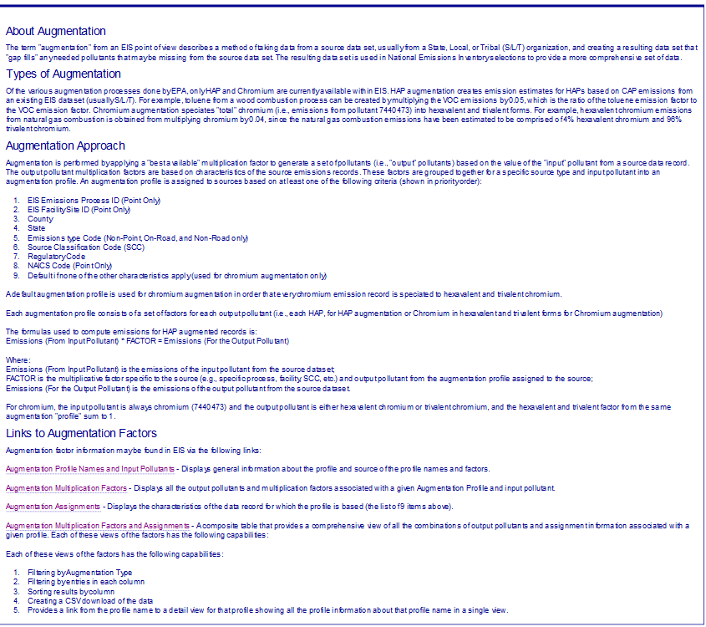
Augmentation Profile Information in EIS
General Information
Assignment hierarchy
Augmentation Data
Profiles
Factors
Profile Assignments
Composite Table (all of it expanded)

Slide 15
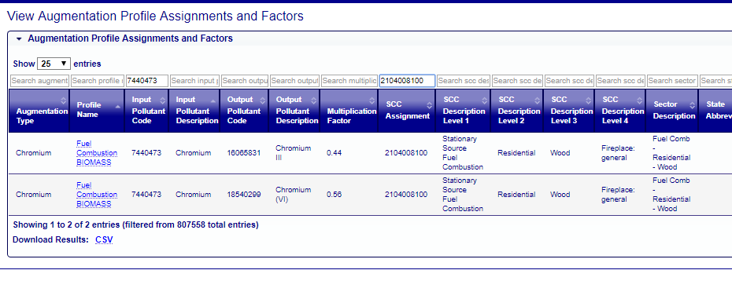
Chromium Speciation Screenshots:
SCC-level assignment

Slide 16
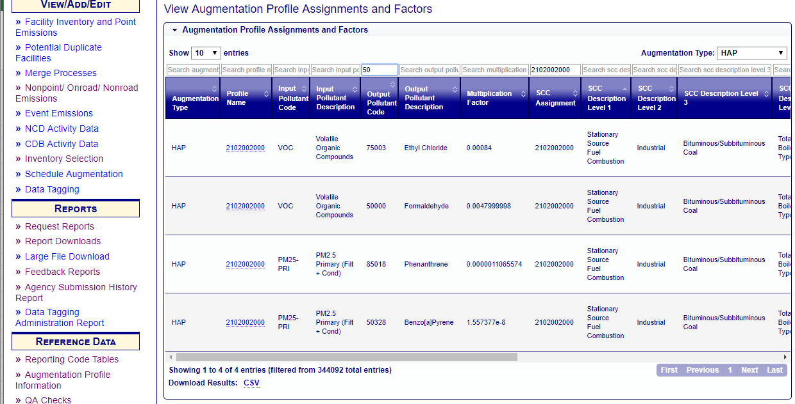
HAP Augmentation Screenshot: SCC-level

Slide 17
PM Augmentation: What PM Pollutants are needed in the NEI?
Air quality models use primary PM10 and PM2.5 (PM10-PRI and PM25-PRI)
  Derive PM-coarse by subtraction of PM25-PRI from PM10-PRI
  PM filterable and condensable components are required but not enforced in EIS
  Black Carbon (EC), Organic Carbon (OC), PM-nitrate (NO3), PM-sulfate (SO4) and “Other PM” (PMFINE) are derived from PM25-PRI and not open to SLT-submittal
HAP Augmentation currently uses primarily* PM25-PRI for nonpoint sources as an input (SLT-reported) pollutant to derive HAPs by ratio
    * exception is PM10-PRI for some oil and gas, commercial marine vessel and rail sources

Slide 18
What PM Pollutants are Allowed in EIS?
AERR: Any combination of PM10-PRI, PM25-PRI, PM-CON, PM10-FIL, PM25-FIL
Filterable PM components* (PM10-FIL, PM25-FIL) refer to particulate matter that may be physically captured on a filter during sampling
Condensable PM (PM-CON) is gas-phase at stack conditions but condenses to sub-micron liquids or particles after exiting the stack and cooling to ambient conditions
A few consistency QA checks in the EIS will reject all emissions:
  PM10-PRI must be >= each of these individual components: PM10-FIL, PM25-PRI and PM-CON
  PM25-PRI must be >= each of these individual components: PM25-FIL and PM-CON
  PM10-FIL must be >= PM25-FIL
Notes:
* We use “components” rather than “species” to avoid confusion with PM2.5 species used for AQ Modeling (e.g., EC/BC, OC, nitrate, sulfate, PMFINE)
Section 51.15 in the AERR for PM can be summarized as:
For each NEI cycle (3 years), annual emissions for all sources required for primary PM10 and PM2.5 AND FIL & CON components “as applicable”.
Now, we allow “Any combination of PM10-PRI…” continue bullet 2.1
What data does my state need to report to EPA?
(a) Pollutants. Report actual emissions of the following (see §51.50 for precise definitions as required):
(1) Required pollutants for triennial reports of annual (12-month) emissions for all sources and every-year reports of annual emissions from Type A sources:
(i) Sulfur dioxide (SO₂).
(ii) Volatile organic compounds (VOC).
(iii) Nitrogen oxides (NO_{X}).
(iv) Carbon monoxide (CO).
(v) Lead and lead compounds.
(vi) Primary PM_{2.5}. As applicable, also report filterable and condensable components.
(vii) Primary PM₁₀. As applicable, also report filterable and condensable components.
(viii) Ammonia (NH₃).
EPA defines “as applicable” to mean where emitted.

Slide 19
The PM Augmentation Tool
Current PM Augmentation process goal is to create all five PM pollutants, consistent with each other
Another goal is to also preserve SLT PM-PRI estimates, and add missing PM-CON and PM-FIL components only
  For 2014v2 NEI: Cleaned up (v1.2) and posted at: https://www.epa.gov/air-emissions-inventories/pm-augmentation
  Longer-term (possibly for 2017 NEI): Simplify tool, update ratios (emission factors),
  Even longer term: Incorporate into the EIS that also generates specific “Emissions Method Code”

Slide 20
What does the PM Augmentation Tool do?
Uses SLT-reported PM values and control devices for SCCs
Uses large set of look-up tables of ratios of PM species by SCC and up to 2 control devices
Ratios are largely based on AP-42 EFs and size distribution graphs, with some mapping to similar SCCs and controls
Sequence of math steps and ratios to be used depends upon which PM species have been reported by SLT
  31 possible permutations. Common ones are both PM-PRIs reported; both PM-FILs reported; All 5 reported; Only PM10-PRI reported
  See link to 2013 CMAS paper within PM Aug “Tool Description” for all conditional logic steps
Notes:
First off, all PM augmentation in this presentation, and in the 2014 NEI, will be restricted to stationary data categories: the PT and NP inventories.
These logic steps have hierarchal “trivial” and “non-trivial” conditions.

Slide 21
PM2.5 Speciation
Starting with the 2014 NEI, EPA provides 5 PM species based on PM2.5 from a “penultimate” NEI selection:
  Elemental/black carbon (EC), organic carbon (OC), nitrate (NO3), sulfate (SO4), and the remainder of PM25-PRI called PMFINE (a.k.a. “crustal” or “other PM”)
  Much of this information comes from the EPA SPECIATE database
Also provide a copy of PM25-PRI and PM10-PRI from diesel engines, labeled as DIESEL-PM25 and DIESEL-PM10
For 2014 NEI, all 7 “pollutants” reside in stand-alone EPA dataset “2014EPA_PMspecies”
None of these pollutants are reportable to NEI by SLT submitters

Slide 22
PM Speciation: References
Section 2.2.5 in the 2014v2 NEI TSD:
https://www.epa.gov/sites/production/files/2018-07/documents/nei2014v2_tsd_05jul2018.pdf
Section 3.2.2 in the 2014v7.1 Emissions Modeling Platform TSD: https://www.epa.gov/sites/production/files/2018-08/documents/2014v7.1_2014_emismod_tsd.pdf

Slide 23
Other non-SLT Nonpoint Datasets
Nonpoint dataset(s) from the Wagon Wheel –centralized EPA Access tool used to generate most EPA nonpoint estimates
Rail, Commercial Marine Vessels
Potential “Carry Forward”: Sources carried forward from previous NEIs
  Sources EPA had previously-estimated but will not for 2017 NEI due to resource limitations and lower priority
  Sources TBD: potentially include turkeys

Slide 24
2017 NEI Plan: Resources
Available on 2017 NEI Documentation site: https://www.epa.gov/air-emissions-inventories/2017-national-emissions-inventory-nei-documentation
PDF Plan document and 6 appendices
Last Plan posted July 2018

Slide 25

2017 NEI Plan: Nonpoint Overview
New staggered 3-category schedule for EPA tools
  No PT subtraction, low-resources
    First tools released/reviewed
    Minimal changes to existing methodology
  No PT subtraction, more resources needed
    Second batch of tools released/reviewed
    Broken up into “2a” and “2b” based on ability to update earlier (2a) or need to wait for additional work (2b)
  PT reconciliation required, varying-level of resources needed
    Last batch of tools released/reviewed
    Leverage 2017 SLT Point data in final version
Full list of all tools/EPA estimates in plan
Early engagement on Cat 1 and 2 tools

Slide 26
2017 Nonpoint NEI Schedule: Key Dates
June 15, 2018: EIS submittal window opened (all data categories)
November 15 – December 15, 2018: SLT comments on “Category 2b” EPA draft estimates/tools
March 31, 2019: Nonpoint survey and nonpoint emissions due for all nonpoint sources. All non-”Category 3” SLT inputs to EPA tools are due.
March 1 – April 30, 2019: SLT comments on “Category 3” EPA draft estimates/tools
May 31, 2019: All ”Category 3” SLT inputs are due
May 1 – September 1, 2019: EPA solicits corrections to draft NEI
December 31, 2019: NEI release in EIS for nonpoint data
February 28, 2020: 2017v1 NEI release in EIS; no plans for a 2017v2 NEI
See Appendix 1 for Suggested SLT Timeline and QA Checks

Slide 27

2017 NEI Plan:
What Will Define Nonpoint Success?
Early and engaged review of NEMOs (Nonpoint Emissions Methodology and Operator instructions) and draft tools –NOMAD meetings
Focus limited resources on tools/sectors requiring PT reconciliation
Accurate and on-time NP survey
Submit accurate and correctly-formatted inputs for EPA tools where desired
Understand how Option Group/Option Set will be used in NEI Selection –see Appendices 4 and 6

Slide 28
Nonpoint Selection Process: Blending Data
Necessary as not every agency submits a complete inventory: sources, spatial, and pollutants
EPA assists SLTs by developing its own estimates/tools and new input templates
A merge of data needs to happen, selecting the preferred/best pieces of data to go in the final NEI –a documented hierarchy

Slide 29
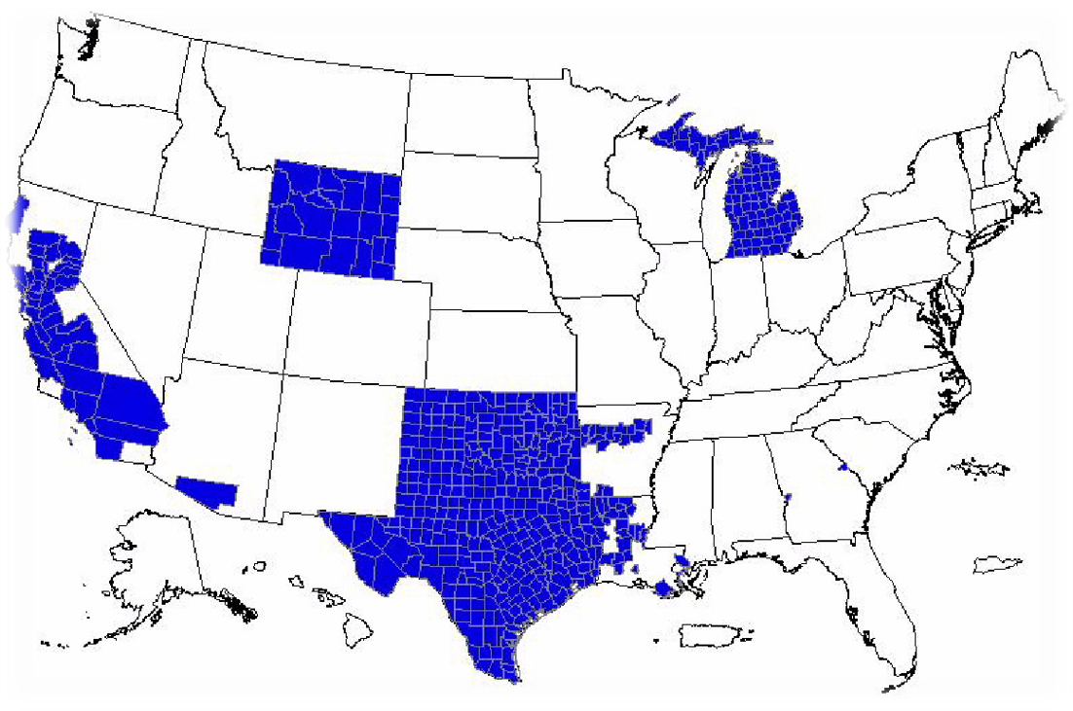
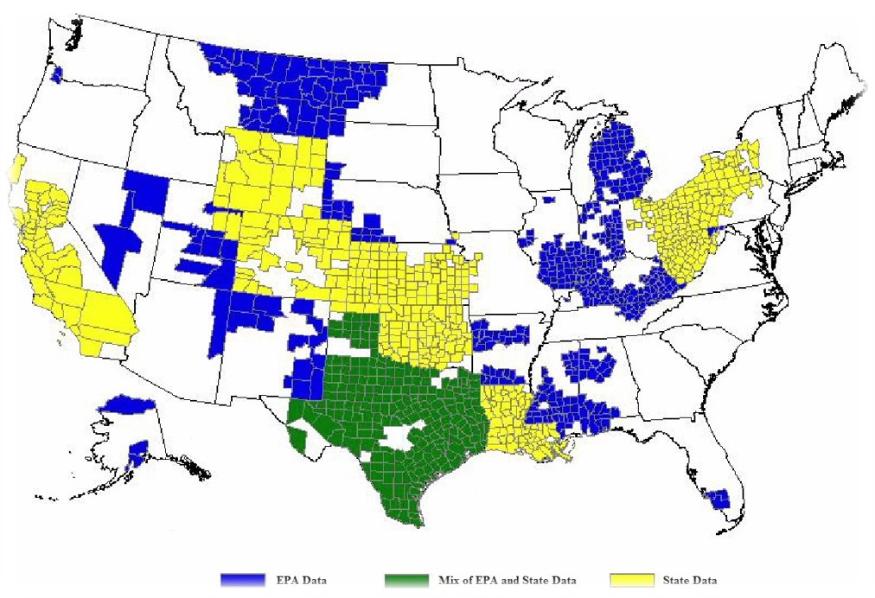
Role of SLTs vs. EPA
States are responsible for the emissions estimates
SLTs can choose to accept EPA estimates; however, states choose method to apply
  EPA methods are assumptions about activity and emissions rates that can be improved with local understanding
In the absence of SLT data, EPA still has to create a complete inventory.
2008 NEI NP oil and gas
2011 NEI NP oil and gas
Notes:
While EPA can create and promote emissions factors & methods, states choose the methods to apply
We allow states to meet their obligations by accepting EPA estimates where we have them
While we ask for some “method” information from states, we do not always get it (e.g., activity and emission factors)

Slide 30

Selection Hierarchy
Much like natural selection, only the best data will prevail
SLT data gets a leg up, since EPA’s historical policy is to give it precedence
PM Augmentation actually takes first priority, because it corrects minor errors

Slide 31
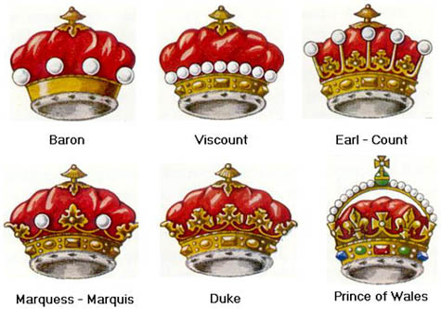
The Selection Hierarchy: 2014 NEI Example
Dataset Name | Description and Rationale | Rank
PM Speciation | Calculated by offline method splitting into 5 PM species: elemental carbon, organic carbon, nitrate, sulfate, and PM fine | 1
PM Augmentation | Fills in missing or inconsistent SLT PM | 2
SLT Data | Also called Responsible Agency Selection, merged into one dataset | 3
Chromium Augmentation | Hexavalent and Trivalent Chromium speciated from SLT reported chromium | 4
HAP Augmentation | Hazardous Air Pollutants speciated from SLT reported VOC and PM | 5
EPA CMV & Rail | Commercial Marine Vehicle and Locomotive data generated by EPA | 6
EPA Nonpoint | EPA’s nonpoint datasets, generated with vetting by SLTs in NOMAD Committee | 7
Other miscellaneous | ICI PM, 2011 data (when we’re really desperate or did not estimate 2014 emissions), MOVES | 8

Slide 32
Nonpoint Details: QA, Tagging, Business Rules
Notes:
Transition slide from components of nonpoint to HOW NP is built and QA

Slide 33

What happens after SLTs submit their data?
EPA does quality analysis on the SLT data (e.g., EIS reports)
EPA contacts the SLT to start a conversation about any findings
If SLT provides adequate timely response, then SLT data remains
If not, SLT data is “tagged,” which means it won’t be used in the final selection (which ultimately becomes the NEI)

Slide 34

QA: Outlier Check for 2017 Nonpoint
Create EIS comparison report—2014v2 NEI, 2014 SLT (RAS), 2014 EPA, 2017 SLT, & 2017 EPA datasets. Compare by ratio and difference.
Graph/map total (main criteria pollutant?) nationally and by state comparing 2014 to 2017 datasets. Look for trends, anomalies and missing/unexpected pollutants.
Mark records with emissions values more than 10 times higher than EPA estimates (if greater than 10 tons CAPs?), over double previous dataset value for larger sources.
Mark HAPs that are 10 times higher than EPA estimates (if greater than 100 lb?)
Sort high to low on pollutants and extra attention on Hg & NATA risk drivers (e.g., benzene, ethylene oxide, HAP metals)

Slide 35

QA: Missing Data
Look for missing states, missing pollutants, missing counties. Maps are helpful for this for geographical issues: new online “Qlik” tool should help
Look for retired counties -e.g., Bedford City VA & Shannon County SD
Check for Puerto Rico and Virgin Islands, Hawaii & Alaska
Make sure that the state did what they reported they’d do on the NP survey: with a few notable exceptions, for most of Nonpoint, there must be an estimate accepted
Look for zeroes that probably shouldn’t be zeroes
Submittal = 0 and a null submittal are treated entirely different. If an SLT wants to ensure no emissions for a given record (location/county/tribe, process (SCC/shape), pollutant) in the NEI, they should submit a zero for that record to prevent:
  HAP aug-based HAP emissions “gap-filling” missing (null SLT) values
  EPA estimates “gap-filling” missing (null SLT values) –CAPs and HAPs
  Particular focus on “expected” pollutants
Notes:
Mention that discussion of “expected” pollutants will come later in the presentation

Slide 36


QA: Nonsensical Data
Look for odd HAPs in certain sectors (commercial cooking lead, for example)
Look for criteria pollutants in odd places (VOC in dust)
Check that HAP VOC sum less than VOC

Slide 37

QA: EIS Sector Level
Look at point and nonpoint contributions, if point is small, then expect more nonpoint, or vice versa
Look for spatial gaps in data by pollutant, also down to SCC-level
Sum up all VOC or NOx or key pollutant for sector, see if it’s what we expect
Group by pollutant/sector for all SLTs. See if there are pollutants where there shouldn’t be.

Slide 38

Tagging Data
Used to prevent data from being part of a selection (the NEI)
  Mistake submissions from SLTs (bad data) –used to modify the selection hierarchy
  Historically: used to prevent EPA data from backfilling, inappropriately
    SLT covers the category all in point
    SLT doesn’t have that SCC/pollutant combination in their state or specific counties
    SLT uses a different SCC for that source (either a more general or several more specific)

Slide 39

Nonpoint Survey
Covered in the EIS Non-Point Survey webinar
Tagging for 2014 relied heavily on the nonpoint survey
  2017 NP survey was greatly simplified, only asking a couple simple questions to help EPA know whether or not to backfill with EPA data when SLT data not provided:
    Choose 1 of 4 answers for “No” (e.g., this emission source covered solely in your point source inventory)
    Allow EPA data to fill in missing expected pollutants at locations provided by SLT; this will prevent EPA data from appearing where no SLT data is submitted at that location
For 2017, new NP Survey, combined with implementing Option Group/Option Set (by SCC groups) should greatly reduce need for tagging
  No tagging is the goal, but QA of SLT/EPA data sometimes necessitate tagging

Slide 40
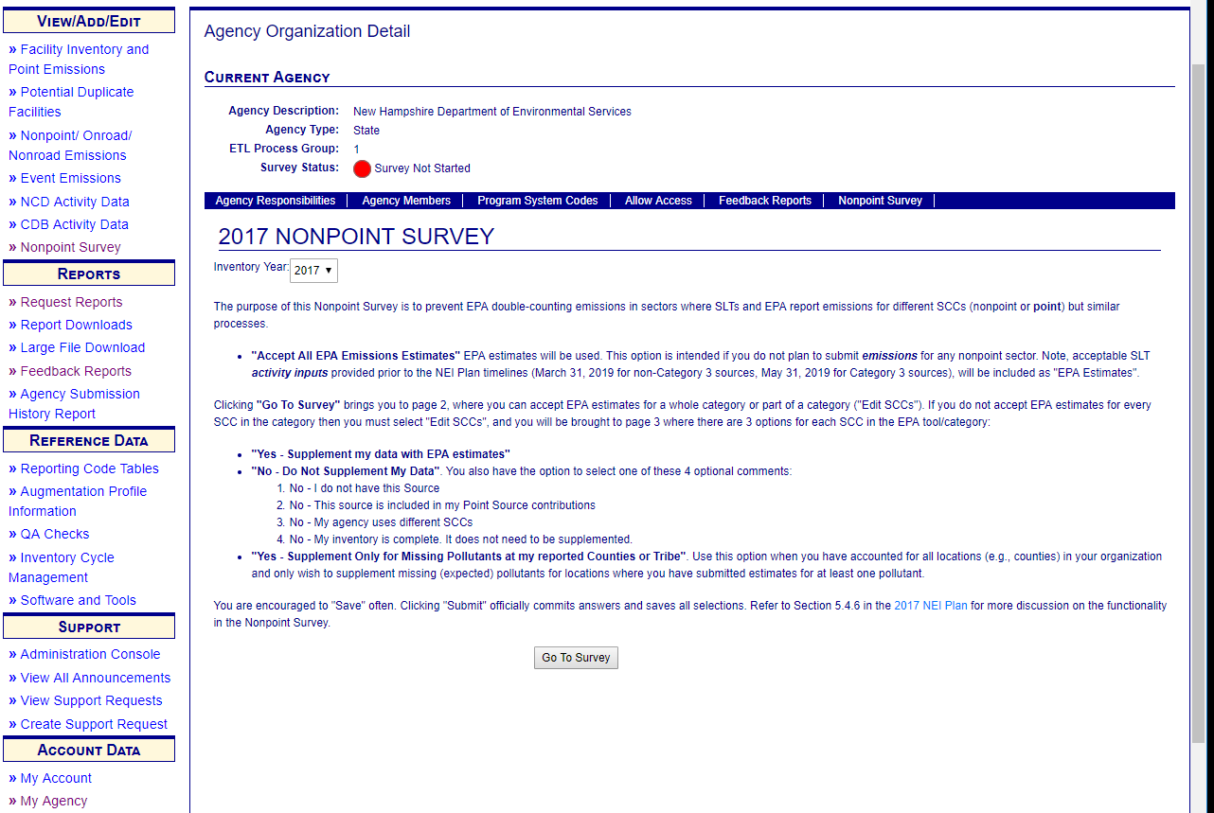
New Nonpoint Survey: Refer to 9/19 Webinar

Slide 41

Nonpoint Procedures
Expected Pollutants
  Provided by EPA, at SLT request
    By SCC
    Impacts how pollutants added to, or removed from, NEI selection
  First provided for 2014 NEI, refer to 2014v2 TSD and 2017 NEI Plan
New EIS QA Check for 2017: Ag fires (nonpoint) activity values required if submitting data

Slide 42
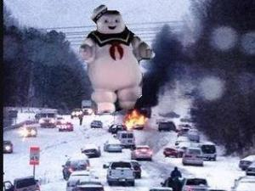
Expected Pollutants List: Nonpoint
List plays a more active role in NEI selection, compared to the Point list, to satisfy these goals:
  A consistent representation of pollutants
  Less state-to-state variability in pollutant coverage and magnitudes
Only provided for source types EPA estimates
  (e.g., motor vehicle fires, structure fires, wild animal waste)

Slide 43
Nonpoint Expected Pollutants Business Rules
Item | If an agency submits… | EPA will… | Unless…
1 | Emissions > EPA-expected checks | Use EPA in lieu | Agency provides “supporting info” –TBD
2 | Pollutants not in list | Remove pollutants | Agency provides “supporting info” -TBD
3 | VOC but no HAPs | Run HAP Aug, not use EPA tool data | VOC > EPA-expected
4 | Total VOC-HAPs > VOC | Replace all agency VOC-HAPs with HAP aug
5 | VOC + different VOC-HAPs | Use HAP aug to gap-fill | Total VOC-HAPs > VOC
6 | Incomplete expected CAPs | Supplement w/ EPA tool data | Agency directs EPA not to
7 | VOC but missing VOC-HAPs for non-EPA-estimated SCC | Use HAP aug | Agency also submits HAPs

Slide 44
Option Group/Option Set (OGOS):
Purpose & Definitions
To prevent potential overlap/overestimate of NEI emissions intra-dataset and between EPA and SLT submittals
  OGOS assignments are in the SCC Reference table
Option Group
  Defines the general categories where an SCC hierarchy exists; e.g., “Cattle”, “Waste Water Treatment”
Option Set
  A group of 1 or more SCCs that exist within and Option Group
  Highest rank alphabetically
Ranking Dataset
  Defined by Selection Definition in EIS
  Dataset with highest priority found for a given Option Group defines the level of Option Set to use

Slide 45
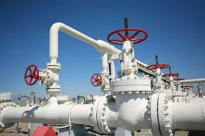
Option Group/Option Set: Introductory Example
EPA (lower ranking dataset) calculates
  Onshore gas production; fugitives: connectors
  Onshore gas production; fugitives: flanges
  Onshore gas production; fugitives, open ended lines
  Onshore gas production; fugitives: valves
  Onshore gas production; fugitives: other
State (higher ranking dataset) submits
  Onshore gas production; fugitives: all processes
Process implemented in EIS for 2017
Refer to Appendices 4 & 6 in the 2017 NEI Plan

Slide 46
Option Group/Option Set:
Business Rules
If OGOS assigned, EIS selection process determines Option Sets within the Option Group via:
  Location
  Pollutant
  Option Group
  Lowest option set assignment: length and group letter
  Dataset ranking
  Highest ranking Option Set with the Option Group
Ranking: <XnY>
  Lowest alphabetical first position “X” as Level 1
  Lowest numbers Level-2 “n” identifier
  Level 2 ranking “Y” if Level-2 identifier “n” is assigned
  Options Sets with 1-character (no Level-2) rank higher than those with 3 (a Level-2 identifier)
  Example: “A” > “A1A” > “B” > “B2A” > “B2B”

Slide 47
OGOS Example: RWC Hydronic Heaters
SCCs in Option Set | SCC Description | Option Set Code | SLT Data | EPA Data
2104008600 | Hydronic heater: general, all types | A |  | ✓
2104008610 | Hydronic heater: outdoor | B
2104008620 | Hydronic heater: indoor | B | ✓
2104008630 | Hydronic heater: pellet-fired | B |  | ✓
2104008640 | Hydronic heater: meets NESCAUM phase II standards | B | ✓
SCCs in Option Set | SCC Description | Option Set Code | SLT Data | EPA Data
2104008600 | Hydronic heater: general, all types | A | ✓
2104008610 | Hydronic heater: outdoor | B |  | ✓
2104008620 | Hydronic heater: indoor | B | ✓
2104008630 | Hydronic heater: pellet-fired | B |  | ✓
2104008640 | Hydronic heater: meets NESCAUM phase II standards | B | ✓
✓
= Data submitted
✓
= Data will be selected
First: What is the highest-ranking dataset in the selection for a given Option Group/location/pollutant showing for option set assignments? A: “B”
Next: apply that ranking for any lower datasets; in this case keep only B or less

Slide 48
OGOS Example: Detailed Scenarios
SCCs in Option Set | SCC Description: Storage & Transport, Petroleum & PP Transport | Option Set Code | SLT Data | EPA Dataset 1 | EPA Dataset 2
2505000000 | All Transport Types, Total: All Products | A |  | ✓
2505000030 | All Transport Types, Crude Oil | B |  |  | ✓
2505000060 | All Transport Types, Residual Oil | B |  |  | ✓
2505000090 | All Transport Types, Distillate Oil | B |  |  | ✓
2505000120 | All Transport Types, Gasoline | B |  | ✓
2505010000 | Rail Tank Car; Total: All Products | B1A | ✓
2505010030 | Rail Tank Car, Crude Oil | B1B |  | ✓
2505010060 | Rail Tank Car, Residual Oil | B1B |  | ✓
2505020000 | Marine Vessel; Total: All Products | B2A |  | ✓ | ✓
2505020030 | Marine Vessel, Crude Oil | B2B | ✓
2505020041 | Marine Vessel, Lube Oil-Barge | B2B |  | ✓

Slide 49
OGOS Example: Very Detailed Alternative
SCCs in Option Set | SCC Description: Storage & Transport, Petroleum & PP Transport | Option Set Code | SLT Data | EPA Dataset 1 | EPA Dataset 2
2505000000 | All Transport Types, Total: All Products | A |  | ✓
2505000030 | All Transport Types, Crude Oil | B |  |  | ✓
2505000060 | All Transport Types, Residual Oil | B |  |  | ✓
2505000090 | All Transport Types, Distillate Oil | B |  |  | ✓
2505000120 | All Transport Types, Gasoline | B |  | ✓
2505010000 | Rail Tank Car; Total: All Products | B1A |  | ✓
2505010030 | Rail Tank Car, Crude Oil | B1B |  | ✓
2505010060 | Rail Tank Car, Residual Oil | B1B |  | ✓
2505020000 | Marine Vessel; Total: All Products | B2A |  | ✓ | ✓
2505020030 | Marine Vessel, Crude Oil | B2B | ✓
2505020041 | Marine Vessel, Lube Oil-Barge | B2B |  | ✓
Notes:
B1A > B1B for same dataset and makes it into the selection because SLT data does not contain B1Y’s (or any 1-level “A”, or “B”s).

Slide 50
OGOS Example: Switching “B1A” to “B1B”
SCCs in Option Set | SCC Description: Storage & Transport, Petroleum & PP Transport | Option Set Code | SLT Data | EPA Dataset 1 | EPA Dataset 2
2505000000 | All Transport Types, Total: All Products | A |  | ✓
2505000030 | All Transport Types, Crude Oil | B |  |  | ✓
2505000060 | All Transport Types, Residual Oil | B |  |  | ✓
2505000090 | All Transport Types, Distillate Oil | B |  | ✓
2505000120 | All Transport Types, Gasoline | B |  | ✓ | ✓
2505010000 | Rail Tank Car; Total: All Products | B1B |  | ✓
2505010030 | Rail Tank Car, Crude Oil | B1A |  | ✓ | ✓
2505010060 | Rail Tank Car, Residual Oil | B1A |  | ✓ | ✓
2505020000 | Marine Vessel; Total: All Products | B2A |  | ✓ | ✓
2505020030 | Marine Vessel, Crude Oil | B2B | ✓
2505020041 | Marine Vessel, Lube Oil-Barge | B2B |  | ✓
Notes:
Identical to previous example except switched specific SCCs to be B1A rather than B1B

Slide 51
OGOS Example: “B” Trumps “BnY”
SCCs in Option Set | SCC Description: Storage & Transport, Petroleum & PP Transport | Option Set Code | SLT Data | EPA Dataset 1 | EPA Dataset 2
2505000000 | All Transport Types, Total: All Products | A |  | ✓
2505000030 | All Transport Types, Crude Oil | B | ✓ |  | ✓
2505000060 | All Transport Types, Residual Oil | B |  |  | ✓
2505000090 | All Transport Types, Distillate Oil | B | ✓ | ✓
2505000120 | All Transport Types, Gasoline | B |  | ✓ | ✓
2505010000 | Rail Tank Car; Total: All Products | B1A | ✓
2505010030 | Rail Tank Car, Crude Oil | B1B |  | ✓
2505010060 | Rail Tank Car, Residual Oil | B1B |  | ✓
2505020000 | Marine Vessel; Total: All Products | B2A |  | ✓ | ✓
2505020030 | Marine Vessel, Crude Oil | B2B | ✓
2505020041 | Marine Vessel, Lube Oil-Barge | B2B |  | ✓
Notes:
SLT reporting of B means this level is allowed for non-duplicated data in lower-hierarchy datasets.

Slide 52
The Emission Inventory System (EIS)
Nonpoint Focus
Notes:
Jump to live EIS demo for remaining slides

Slide 53
Viewing Nonpoint Emissions

Slide 54
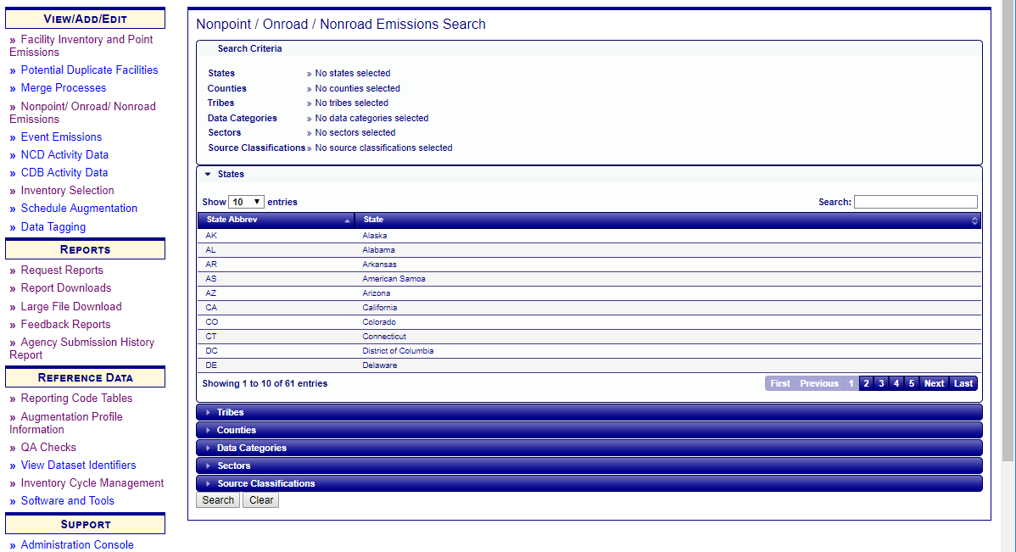
Nonpoint/Onroad/Nonroad Emissions
Notes:
The Nonpoint/Onroad/Nonroad Emissions allows you to view emissions by SCC/Pollutant. First search on the agency of interest. For this example, we will use NC.

Slide 55
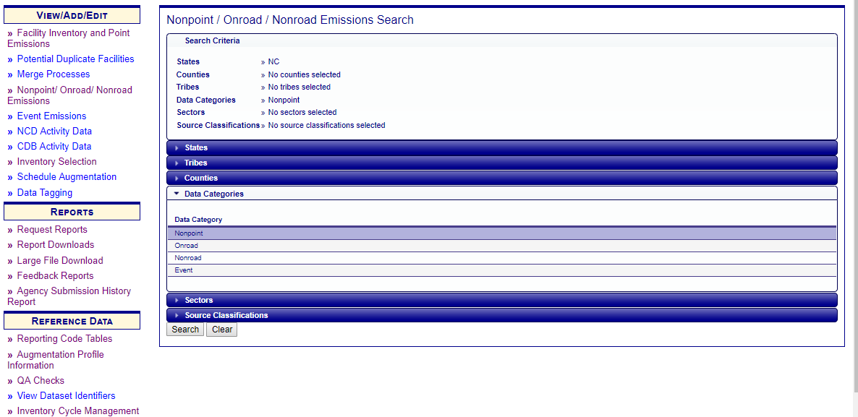
Nonpoint/Onroad/Nonroad Emissions – Cont’d
Notes:
Other filters such as:
State – Which you might want to use if you were using a large EPA dataset or NEI
Counties – To narrow your search even more
Data category – Nonpoint, Onroad, Nonroad or Events (we will use Nonpoint)
Sector
SCC

Slide 56
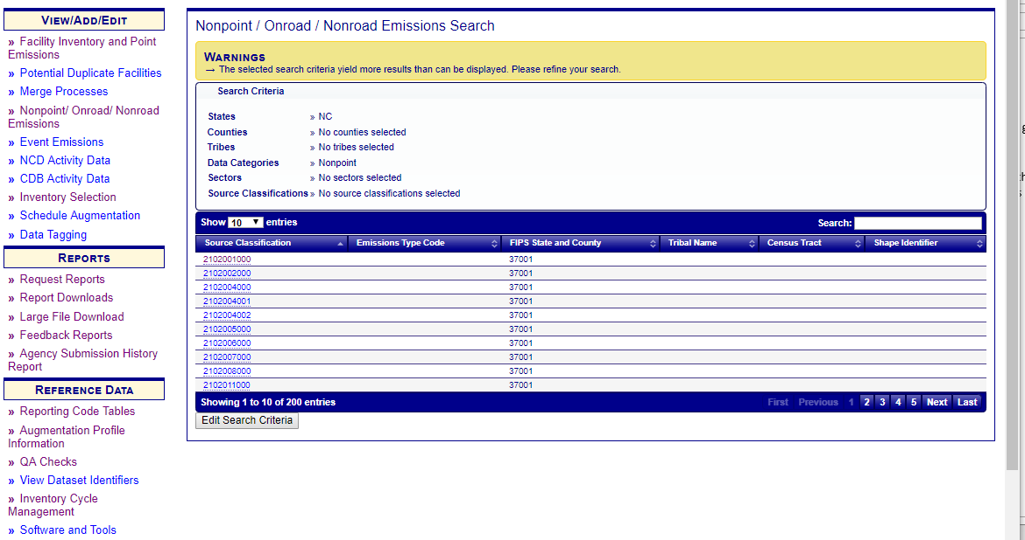
Nonpoint/Onroad/Nonroad Emissions - Warning
Notes:
Notice that because we did not narrow our search criteria, we have received a warning message which lets us know that not all the records could be displayed. You can download all of the results by selecting Download Results: CSV at the bottom on the page. This is true for almost every page in EIS.
Next select the SCC for the county of interest.

Slide 57
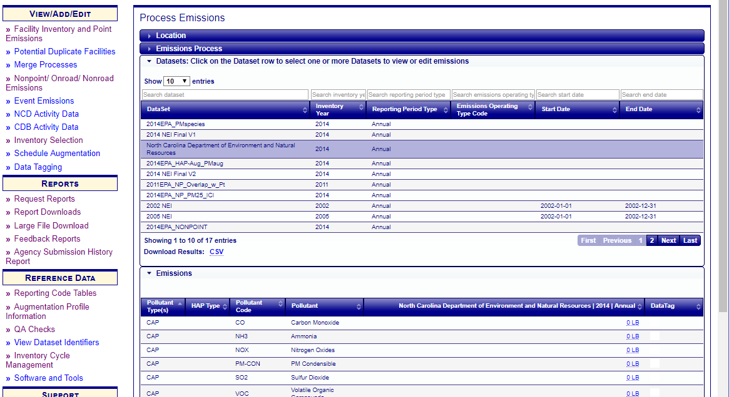
Process Emissions – Data Set
Notes:
Next select the dataset.

Slide 58
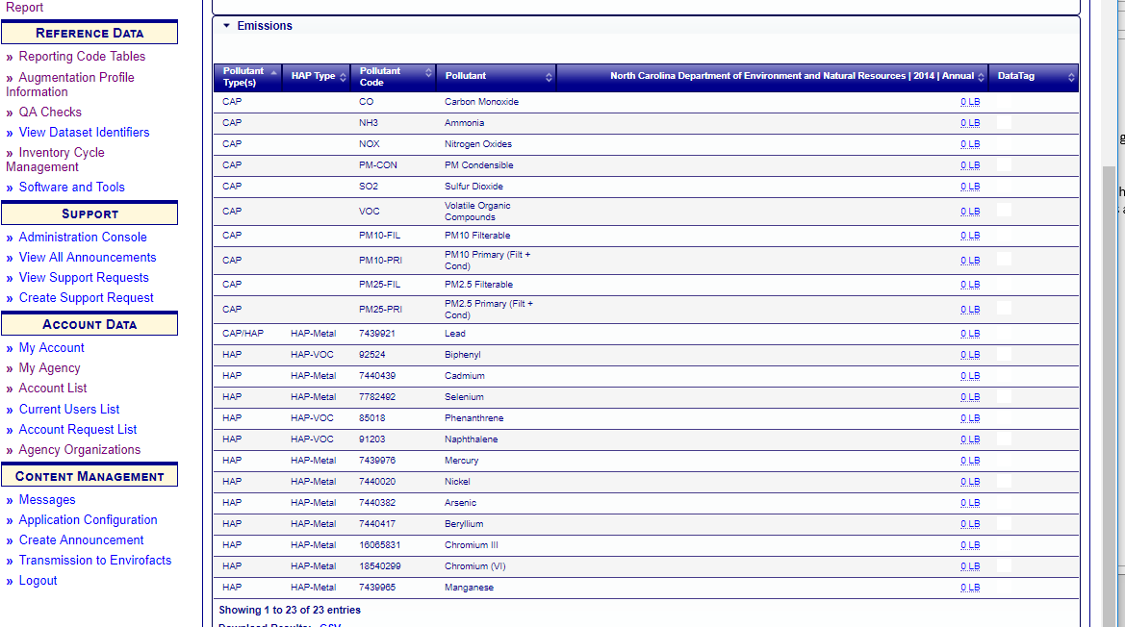
Process Emissions – Emissions
Notes:
The results are the pollutants and emissions for the SCC/county combination selected.
Notice that the emissions total is a link.
Notice the new “HAP Type” field.
You can also Add Emissions to a reporting period by selecting the dataset and then the Add Emissions button from the Process Emissions page.

Slide 59
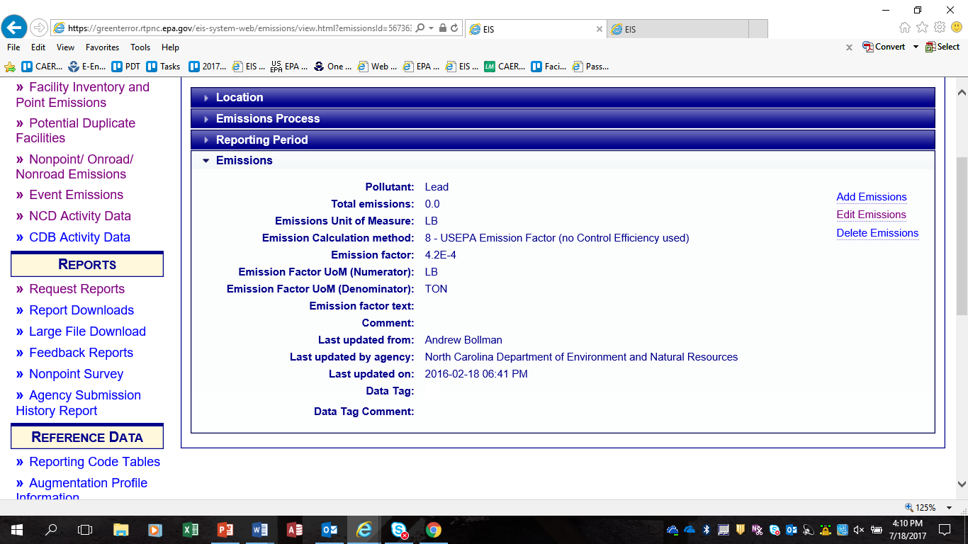
Process Emissions – Emissions Detail
Notes:
There are three action items if you are the data submitter.
Add Emissions
Edit Emissions, and
Delete Emissions
This is a great place to correct emissions if you only have a few.

Slide 60
Nonpoint EIS Reports

Slide 61
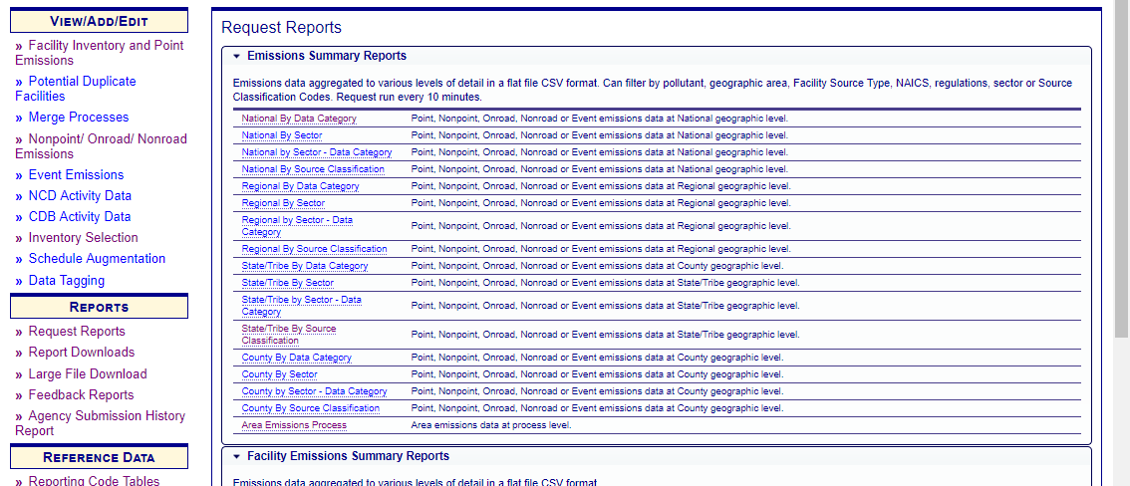
Request Reports
Notes:
The first report is the Emission Summary Report at National, Regional, State and County levels. Each of these geographic regions can be run on specific Data Category, Sector and/or SCC.
Area Emission Process report will give you a summary report by Shape IDs.

Slide 62
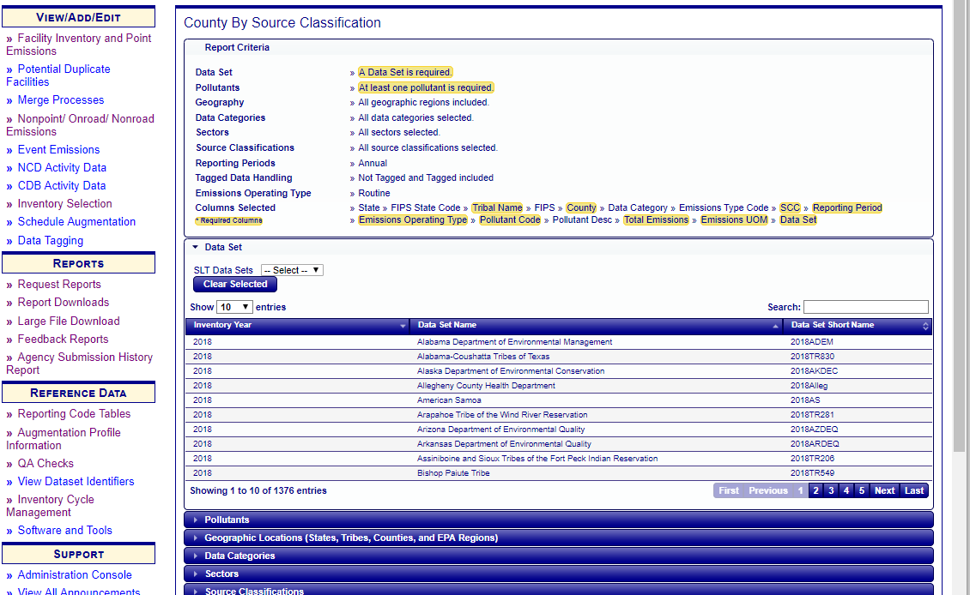
County by SCC Report
Notes:
The County by SCC will give you the must granular data and provide you with the source of the data.
The highlighted data fields at the top of the page are required filters.

Slide 63
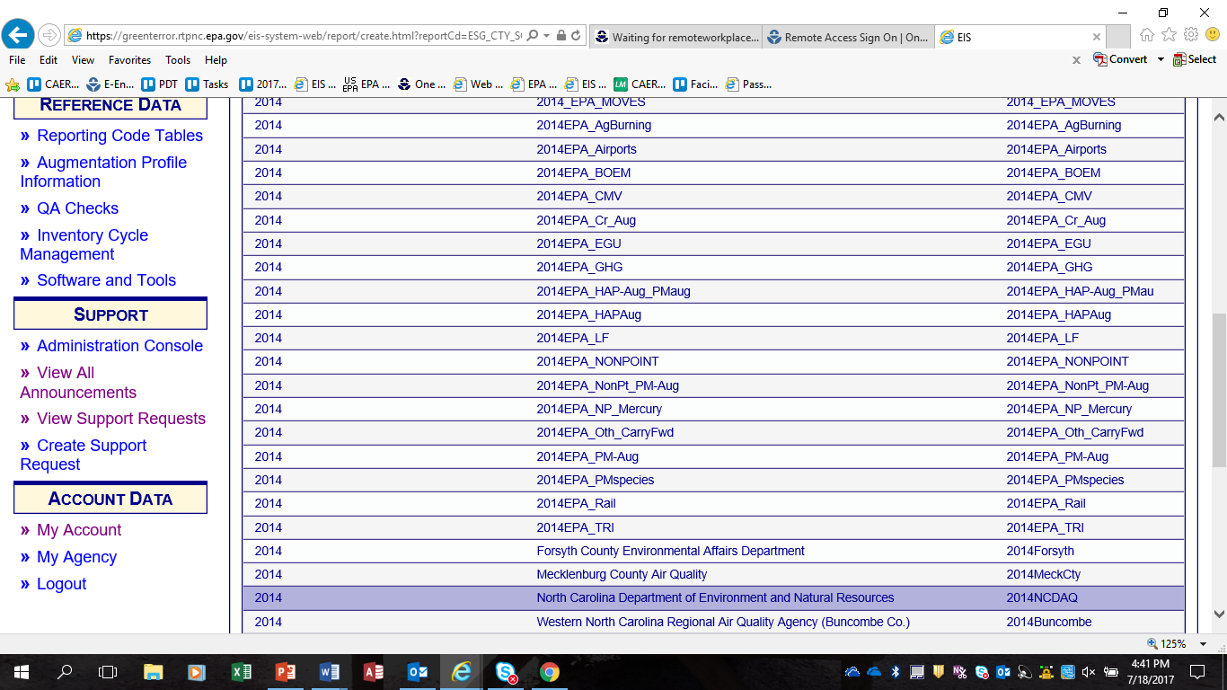
County by SCC – Data Set
Notes:
Your first required filter is the dataset. As you can see, along with your agency datasets are the EPA dataset.
We are going to select NC’s 2014.

Slide 64
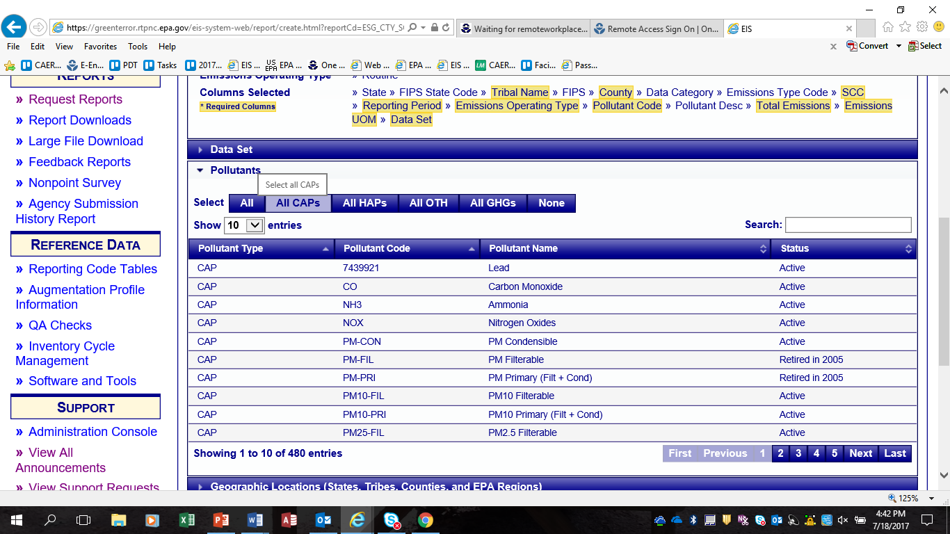
County by SCC - Pollutant
Notes:
Next are the pollutants. You can either use the pre-selected groupings at the top or you can search for individual pollutants using the Search box on the right. For this example we will select “All CAPS”.

Slide 65
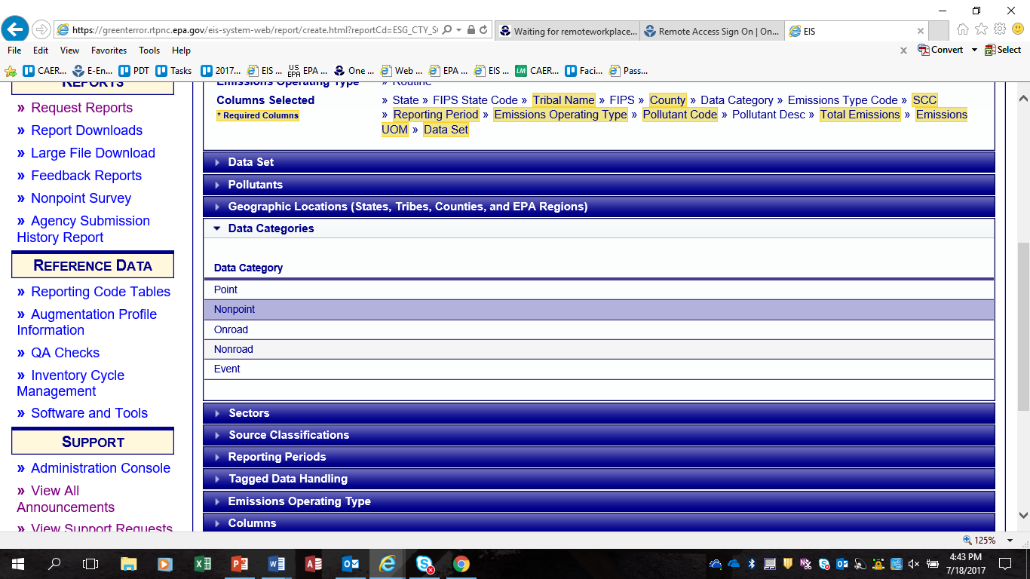
County by SCC – Data Category
Notes:
Next select a data category. I’ll select Nonpoint.

Slide 66
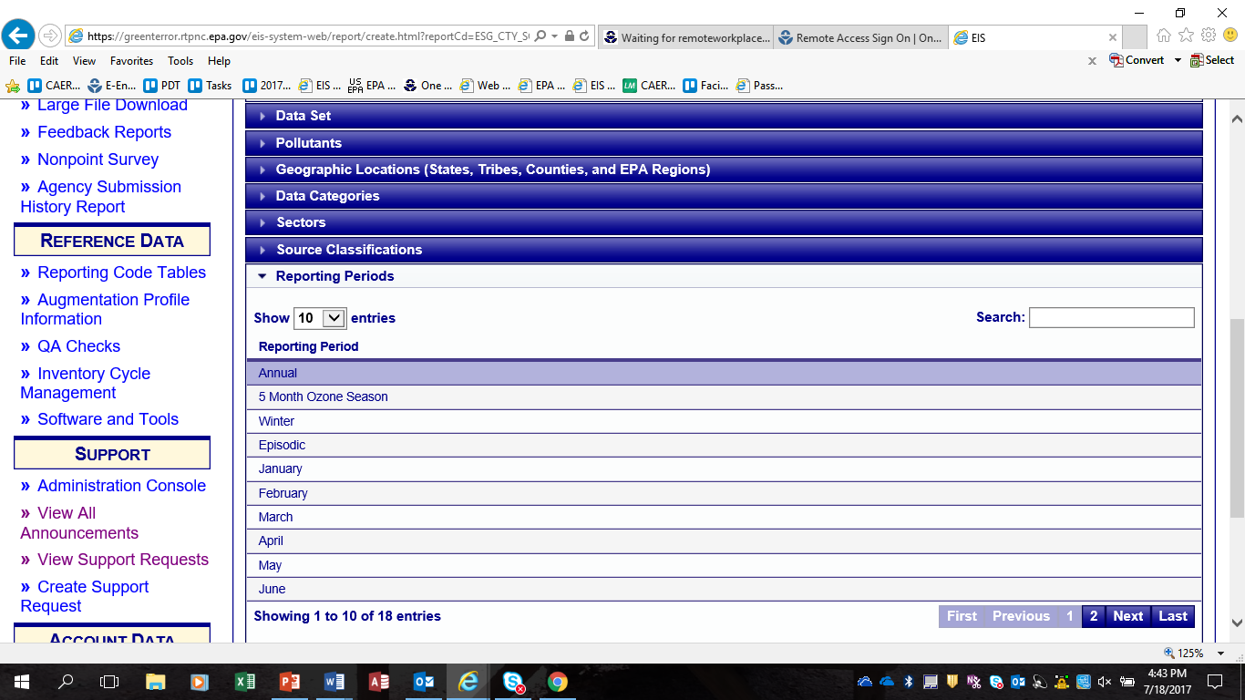
County by SCC – Reporting Period
New Filter
Notes:
You can also select a specific Sector or SCC. Reporting Period is a new filter. In the past EIS would accept reporting periods other than annual, but there was no way to get this data back out of EIS. This filter solves that issue. The default is already set at “Annual”. If you wish to pull something other than annual, you will need to deselect the default.

Slide 67
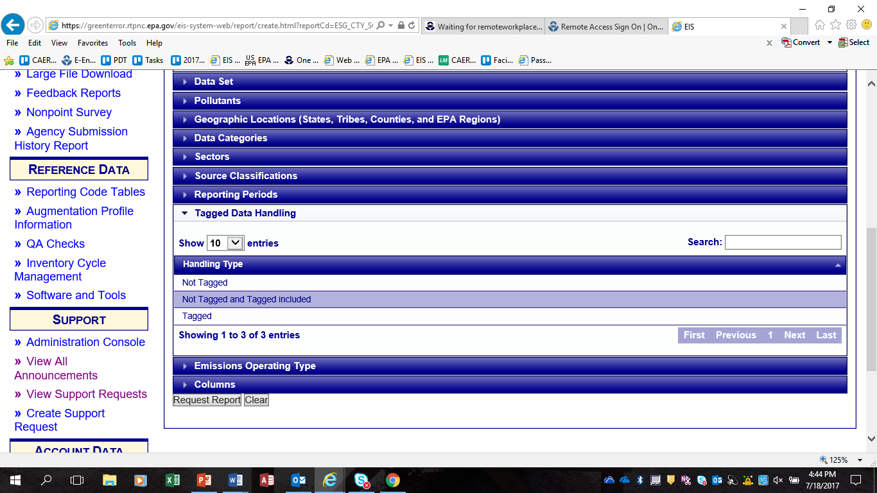
County by SCC - Tagging
NEW FILTER
Tagged Data – Will not be used in the NEI selection process
Not Tagged Data- Will be used in the NEI
Notes:
Tagging Type. This is another new filter.
Not Tagged – All data available for selection in the NEI
Tagged Data – Only data which will not be considered for the NEI. Can also use the Data Tagging Report which we will discuss later.
Not Tagged and Tagged Included – All data, both tagged and untagged
The default selection is “Not Tagged and Tagged Included”.
You will not be able to identify which records are tagged or untagged unless you run a report at the lowest granularity such as a Facility/Process report for Point or a County/SCC for nonpoint or mobile

Slide 68
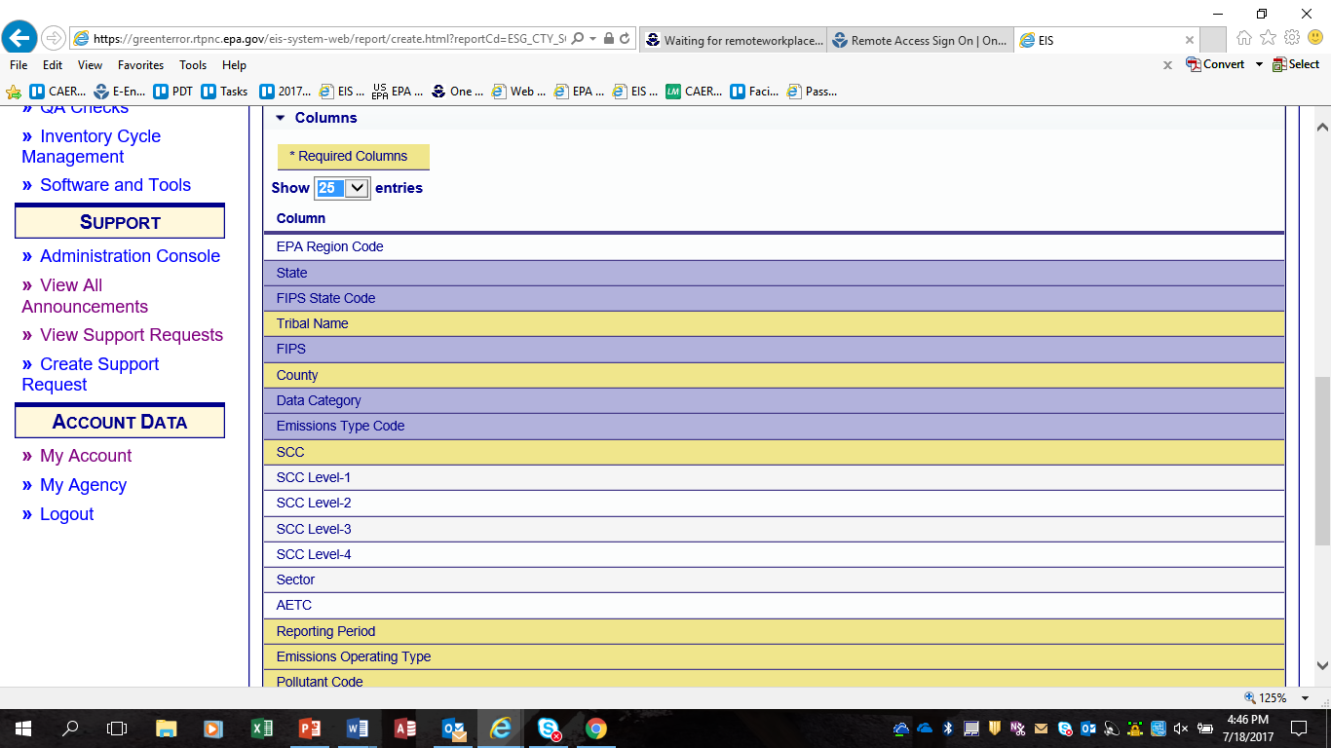
County by SCC – Custom Columns
Customize you reports!
Notes:
The largest change is that you can now customize your reports. Columns in the yellow are data fields which will be in all reports. Blue highlighted are suggested columns that will automatically be included unless they are deselected or turned off. All other columns are optional. The optional fields also include activity data and operational details. At total of 75 different columns.
Once you have chosen your columns then select “Request Report” at the bottom of the page.

Slide 69
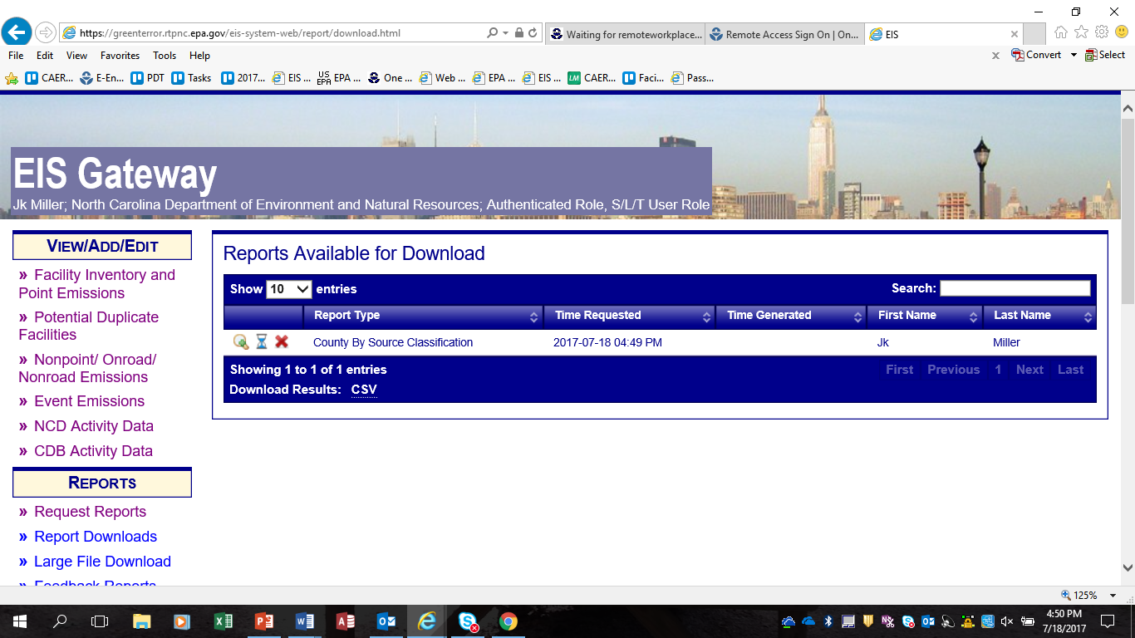
County by SCC – Report Download
Processing
“X” Cancel Report
Report Type: County By Source Classification
Data Set: 2014NCDAQ
Pollutant: 7439921, CO, NH3, NOX, PM-CON, PM-FIL, PM-PRI, PM10-FIL, PM10-PRI, PM25-FIL, PM25-PRI, SO2, VOC
Data Category: Nonpoint
Reporting Period Type: Annual
Tagged Data Handling: Both Tagged and Resolved Values
Emissions Operating Type: Routine
Notes:
Once you have selected “Request Report”, your report will be placed in a queue. To view this queue, select “Report Downloads”. When the magnifying glass is clicked, a pop-up will display the report criteria. The hour glass indicates that the report is in the processing queue. The red “X” can be used to cancel a report.
Reports kick off every 10 minutes. If there are quite a few requests in the queue, it could take a while to process your request. You should be able to view the entire queue. While EPA develops the NEI we can sometimes back this queue up for quite a while with large data requests.

Slide 70
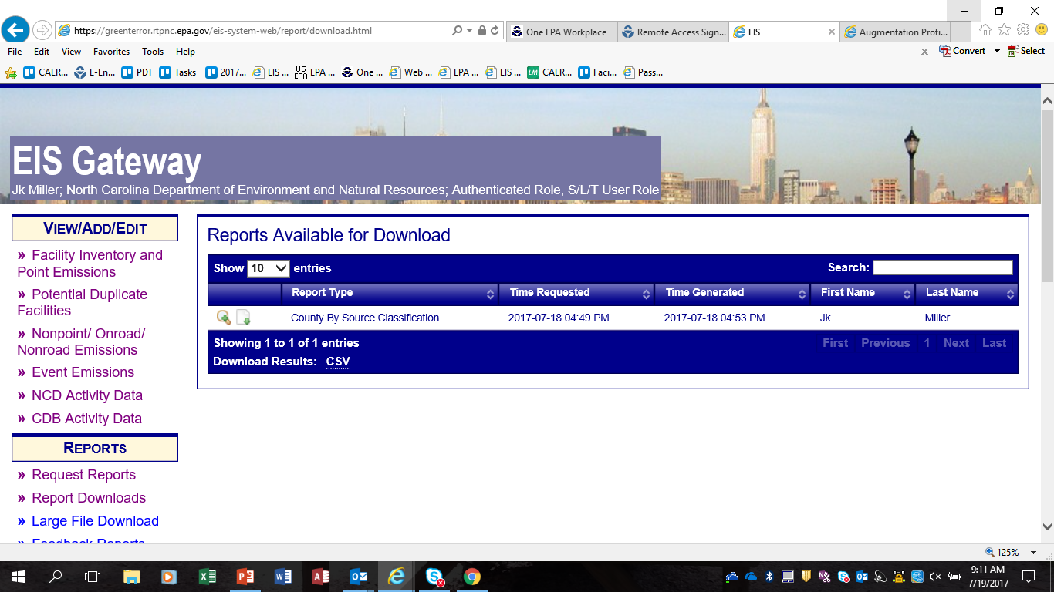
County by SCC – Report Download Cont’d
Download
Notes:
Once the report is available for download, a paper icon will replace the hourglass icon and you will no longer be able to delete the report and the report .
Reports remain available for about 3 weeks. If the report is important to you, download it.

Slide 71
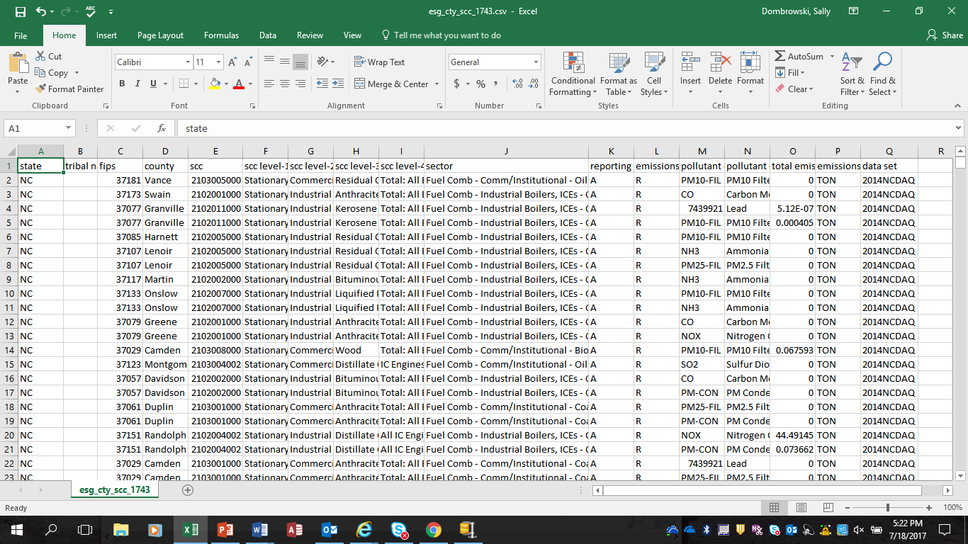
County by SCC - Report
Notes:
This is a sample of a report with the columns that I selected. The most important item to point out here is the data source. This is available only on the most granular reports. Facility/Process level or County by SCC.

Slide 72
Data Tagging, SMOKE Flat File Reports

Slide 73
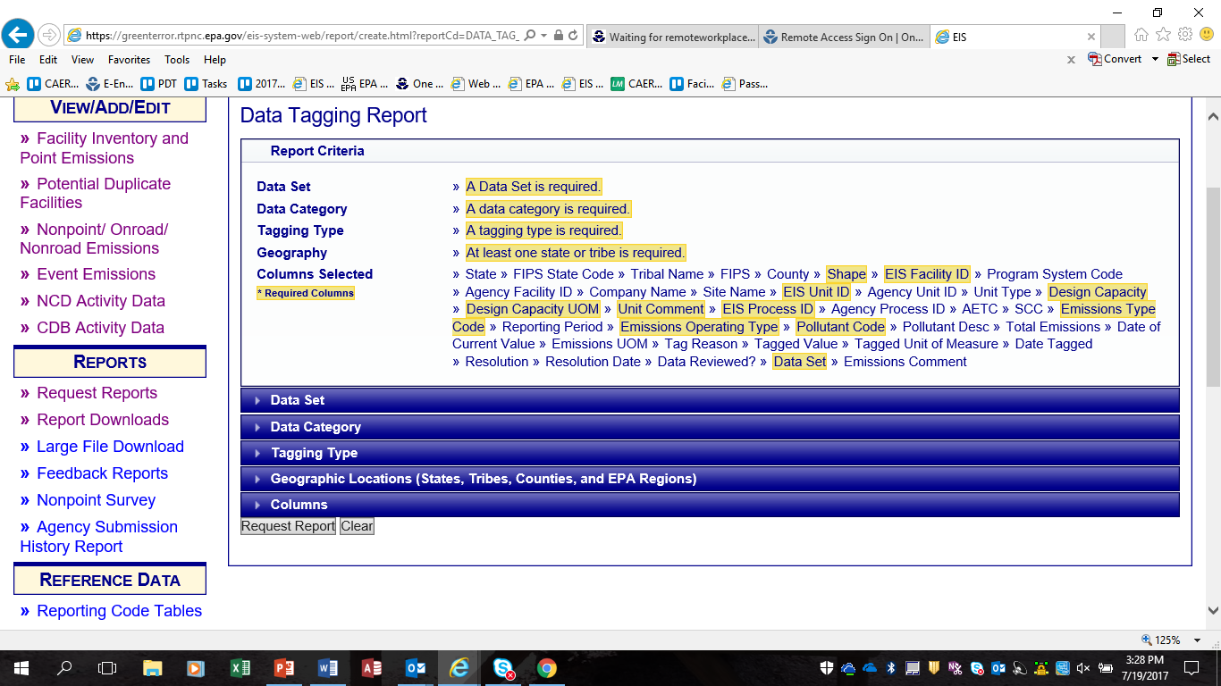
Data Tagging
Notes:
This is the Data Tagging Report. As previously mentioned “tagged” data is data which will not be used in an NEI selection. This report will give you a full list of all data that has been tagged and the reason for that tagging. This is an important report to run during the comment period on a given NEI selection.

Slide 74
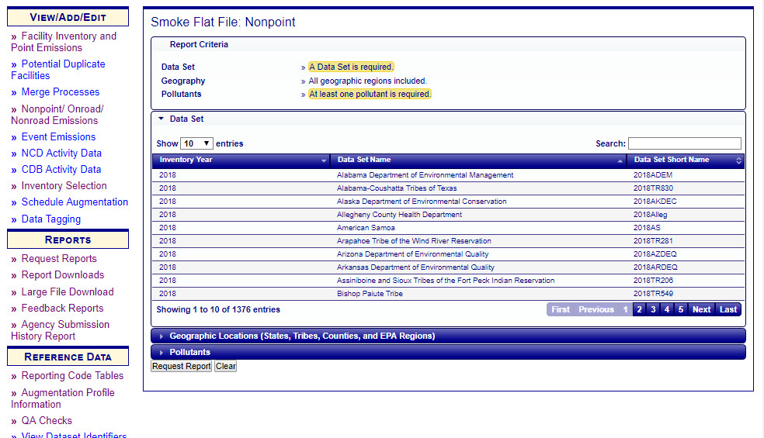
SMOKE Flat Files
Notes:
The Smoke Flat File for Point are the modeling files for a given NEI selection.
The National Smoke Flat Files are published by the EPA and made available within the Large File Download section of EIS. These are very large files and this report gives you an opportunity to filter down to your specific agency or region within Excel.

Slide 75
Comparison Reports

Slide 76
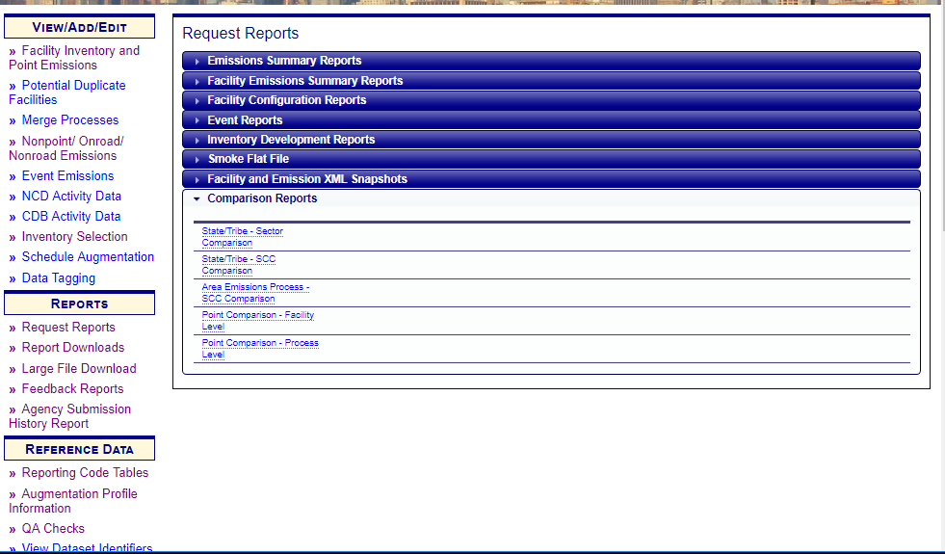
Comparison Report
NEW REPORT!
Notes:
We have promised for many years to develop a comparison report. It is finally here.
There are three levels at which you can request a comparison.
Area (Shape IDs), County/SCC Comparison
Point Facility Level
Point Process Level

Slide 77
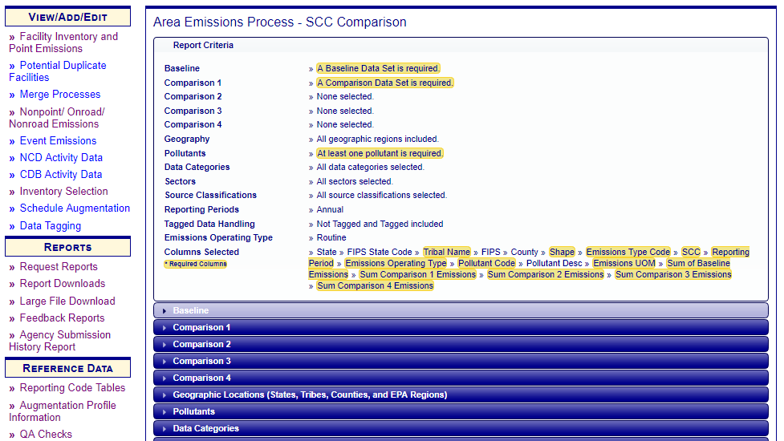
Comparison Report - Filters
Compare up to FOUR data sets to your base file.
Notes:
Looking at all the filters which are available, notice that you can compare up to four data sets to your base file.

Slide 78
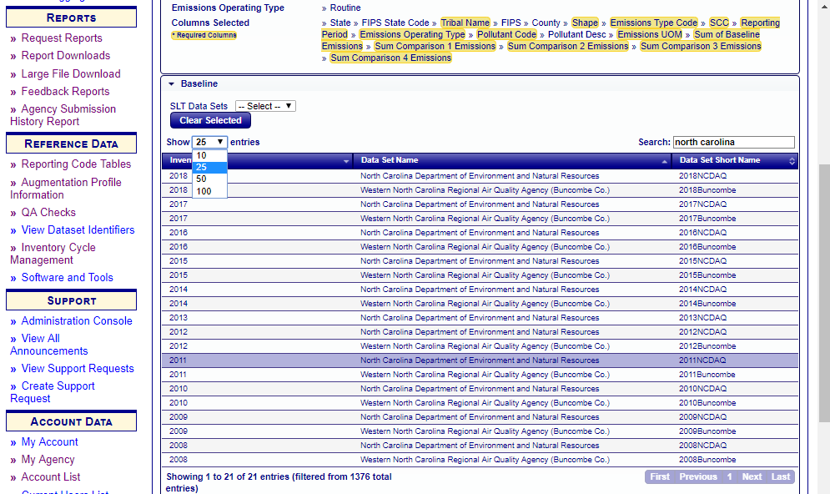
Comparison Report – Data Set
Select
2011 North Carolina as
Base Dataset
Notes:
For our example we will select 2011 North Carolina submission as our base data set.

Slide 79
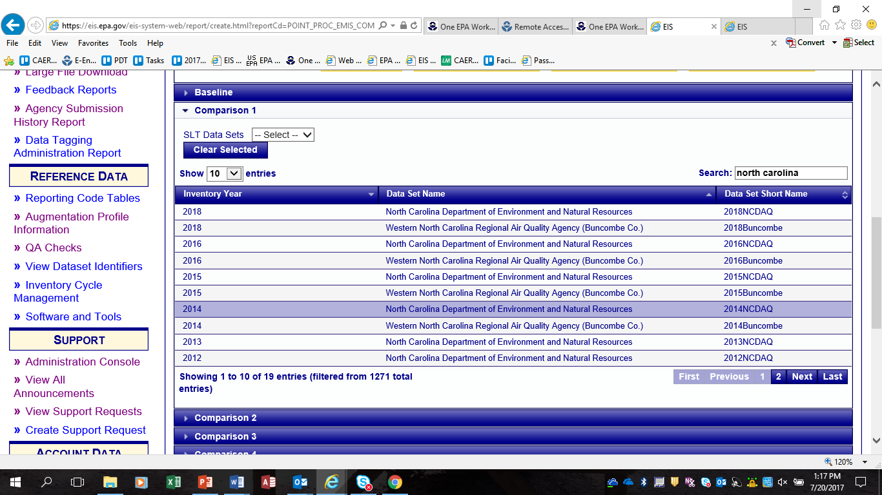
Comparison Report – Comparison Data Set
Select a comparison data set – 2014 North Carolina
Notes:
We want to compare what was submitted in 2011 to what has been submitted in 2014. We will select the 2014 North Carolina data set as our Comparison dataset 1.

Slide 80
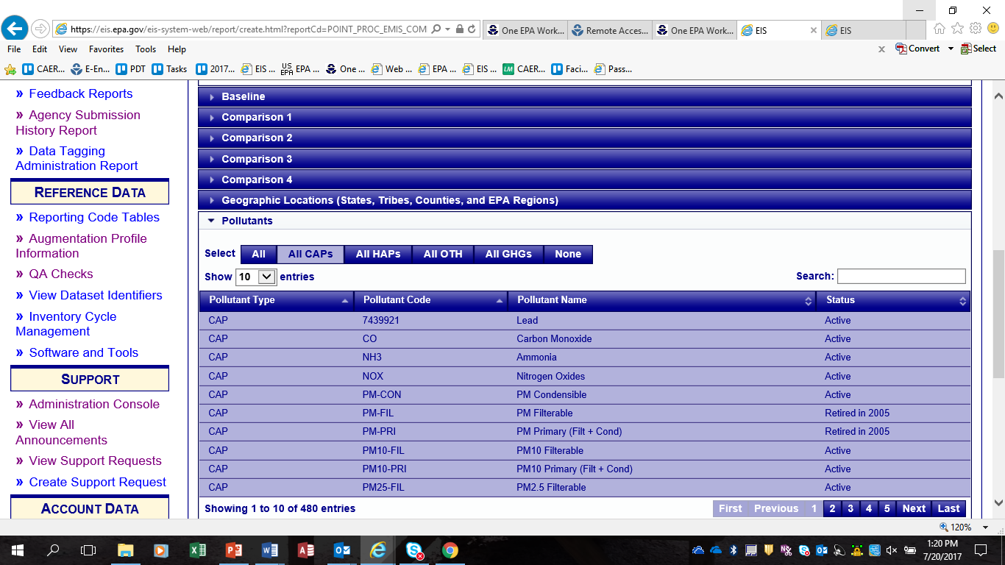
Comparison Report - Pollutants
Select pollutants
Notes:
You are required to select pollutants either individually or in the pre-selected groups.

Slide 81
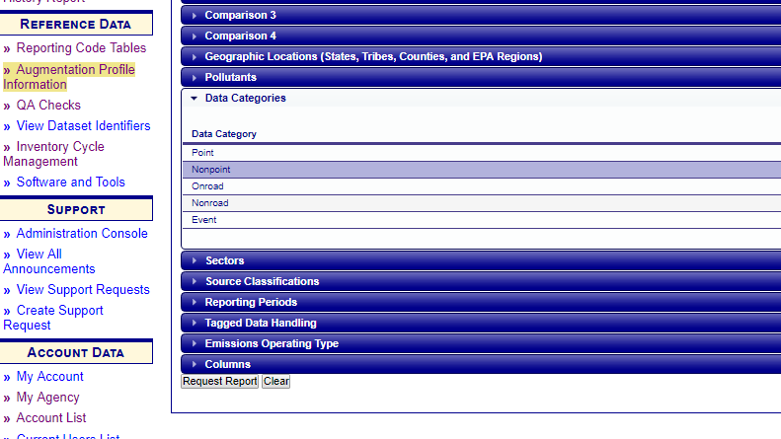
Comparison Report – Data Category
Select any other filters. We will use the Data Categories filter and select “Nonpoint”.
Notes:
Now you can select any other filters which may refine your report search. We will select the Point data category.

Slide 82
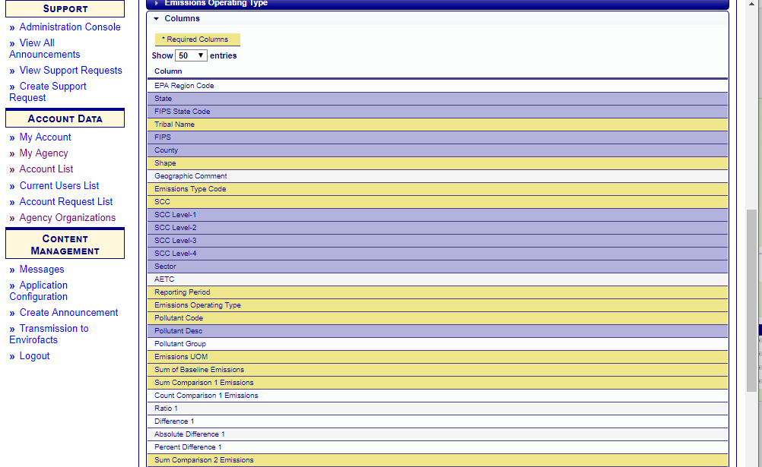
Comparison Report - Columns
Select columns that will appear in report. Up to 47 columns to choose from for area SCC comparison report.
Notes:
Remember that the yellow highlighted columns are required columns in this report. Blue are suggested or optional and may be turned off.
This a sample of the comparison report with minimal columns. The report shows the values in the base year selected and the comparison year. With this report you can now calculate differences, percent differences, ratios.

Slide 83
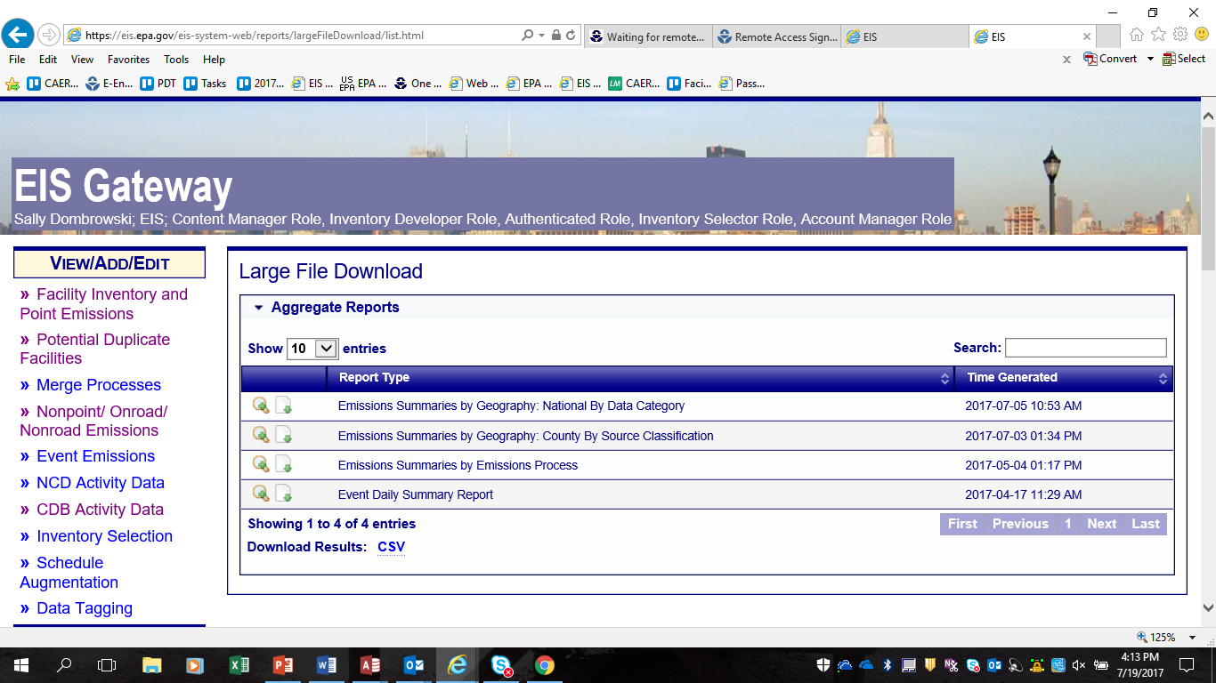
Large File Downloads
Notes:
The next item under reports is the Large File Download. These are detailed national files that are extremely large and could be very challenging to work with. We advise you to use the reports that we have discussed earlier and filter down to smaller data sets.

Slide 84
EIS Reference Data

Slide 85
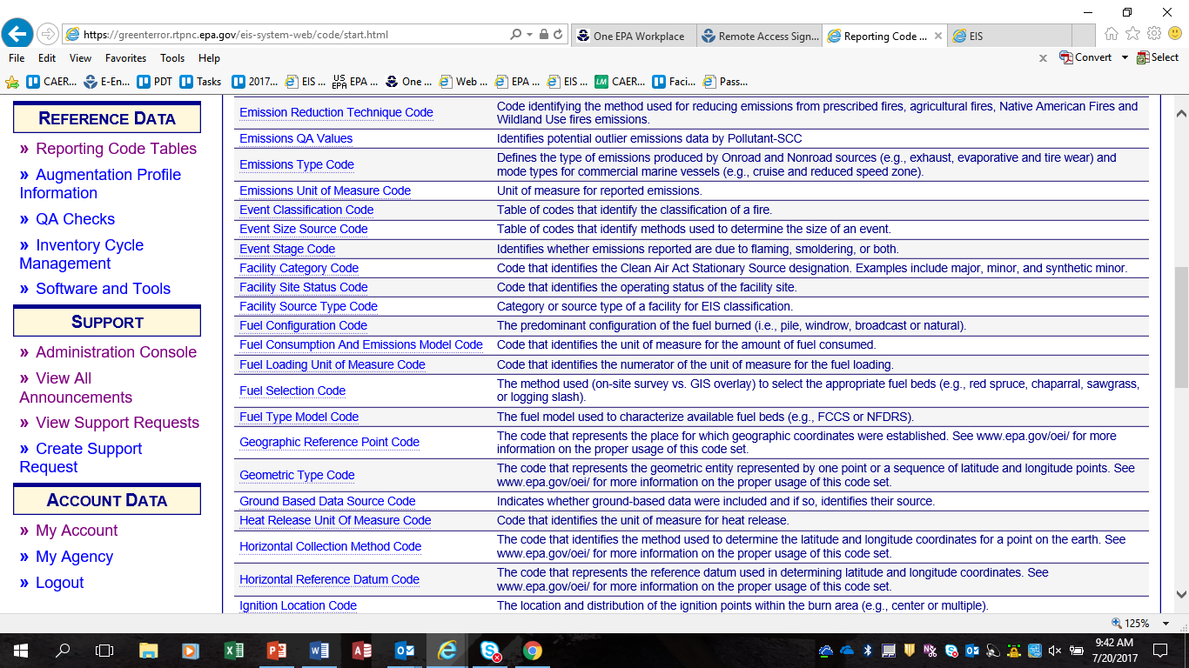
Reporting Code Tables
Notes:
Let’s move on to reference data. The first reference is the Reporting code Tables. This is the only place that you should ever look for codes for use in EIS.
Each table may be downloaded by using the Download to CSV function on the bottom of each table.

Slide 86
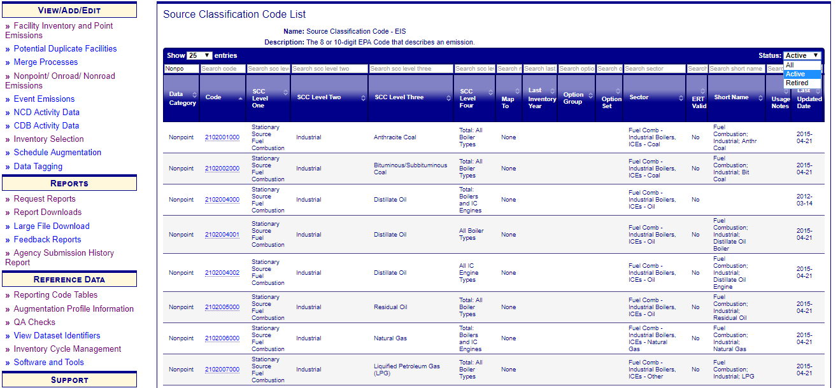
Reporting Code Tables - SCC
Also available on new SCC search tool
Notes:
This is the SCC table. While there have not been any changes to the format of the table, I did want to note a couple of items. For one, make sure that you always check the status of the codes in the top right hand corner. Most code tables are defaulted to Active, but a few such as the SCC list, is defaulted to ALL. This will include active as well as retired SCCs. Retired SCCs can be identified by a year in the Last Inventory Year column. The SCC table is also where you will find the Option Set/Option Group categories which will be covered later in this course.
Also there is a new (Synaptica) web service for SCCs. This service will allow your inventory systems to always have the must up to data SCCs.

Slide 87
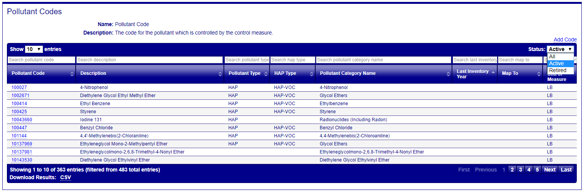
EIS Reference Data: Pollutant Table
New HAP Type field: allows for quicker QA of VOC vs HAP-VOC

Slide 88

NOMAD SharePoint Site
Notes:
Screenshot of the NOMAD Workgroup SharePoint Site

