Slide 1



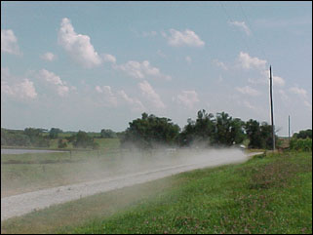
NOMAD Nonpoint Training:
The Wagon Wheel Tool
NOMAD Nonpoint Training:
The Wagon Wheel Tool
September 26, 2018

Slide 2
Agenda
Options for Submitting Data to EPA
Templates for Submitting Wagon Wheel Inputs to EPA
Overview and Structure of the Wagon Wheel Tool
Interactive Demo of the Input Templates and Wagon Wheel Tool

Slide 3
Nonpoint Source Categories Staggered Development Plan
Bin 1
Agricultural Pesticides
Agricultural Tilling
Bin 2A
Bin 3
ICI Fuel Combustion
Oil and Gas Production & Exploration
Asphalt Paving
Aviation Gasoline, Stage 1 & 2
Composting
Residential Construction Dust
Non-residential Construction Dust
Road Construction Dust
Mining & Quarrying
Open Burning Residential Household Waste
Open Burning Yard Waste
Residential Charcoal Grilling
Residential Heating (non-wood)
Commercial Cooking
Human & Animal Cremation (including Hg)
Other Nonpoint Mercury
Solvents
Stage 1 Gasoline Distribution
POTWs
Bin 2B
Agricultural Dust (from hooves)
Open Burning Land Clearing Debris
Road Dust: Paved & Unpaved
Mercury from Landfills
Residential Wood Combustion
Biogenics
Agricultural Livestock Waste
Agricultural Fertilizer Application
Portable Fuel Containers
Bold font = categories in the Wagon Wheel

Slide 4

Options for SLT Submittals
Submit Input Templates for Nonpoint Categories in Wagon Wheel via SharePoint
(March 31, 2019 except Bin 3, which is May 31)
Use Wagon Wheel to Calculate Emissions for Available Categories
(March 31, 2019; not an option for Bin 3)
Accept EPA Defaults via Nonpoint Survey
(March 31, 2019 for all categories)
Other emissions estimation methods
(March 31, 2019 for all categories)
Nonpoint emissions
Choose one option for each source category

Slide 5
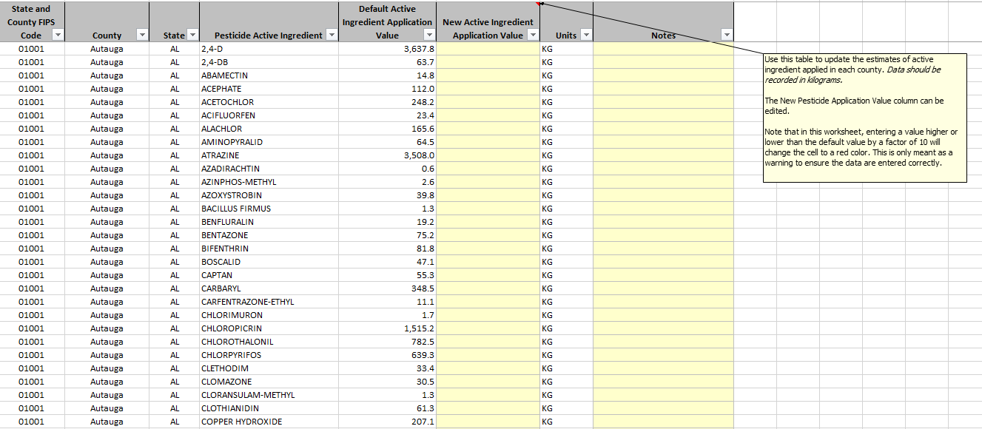
Option 1: Input Templates
Notes:
Note: The user does not interface with each individual “tool”, but rather, the input template(s) and centralized Wagon Wheel Access tool.

Slide 6
Option 2: The Wagon Wheel Tool
Developed in Microsoft Access
Tools are created so updated activity data can easily be input and used without needing to modify the tool
Macros can be created that allow us to quickly run tools
Ability to link tables between databases, so data only needs to be input once
W.W. will increase efficiency and decrease human error

Slide 7
Motivation for the Wagon Wheel
Many NEI excel tools are large & run slowly
Multiple places in which human error can occur when updating data
Many tools use the same data, but it needs to be input separately for each tool
Overall, not an efficient process

Slide 8
Wagon Wheel Tool Development
Develop Nonpoint Emissions Methodology and Operator instructions (NEMOs)
  Ask for state/local input
  Revise methods based on input
Constructed Tools in Access
  One central database
  Link to “modules”
  Assumptions in modules link to central database to edit
Notes:
David: Go over computer requirements here or in demo.

Slide 9
Wagon Wheel/ Master Database
Composting
Construction Dust and Open Burning
Aviation Gasoline Distribution
Mining and Quarrying
Wagon Wheel/
Master Database
Interface
Activity data (e.g. SEDS, County Business Patterns, Population)
Emission factors
General tables (FIPS codes, pollutant codes, SCCs)
Point source data
Crosswalks (PT to NP SCCs, ICI sector assignments)
Ag Tilling
Residential Grilling
Ag Pesticides
Residential Heating
Bridge Tool
Note: this is not a comprehensive list of all categories in the Wagon Wheel –see Slide 3
Notes:
Interface is part of the Wagon Wheel. Not all of these components are used for every WW category; for example, point source data is not used Ag Pesticides, Ag Tilling, Residential Heating and several others.

Slide 10
Demonstration
Please take out your computers and feel free to follow along with this demonstration

Slide 11

Step 1: Download the Tool
Category Tools
Output Database/ Bridge Tool
Central Database/ Tool Interface

Slide 12
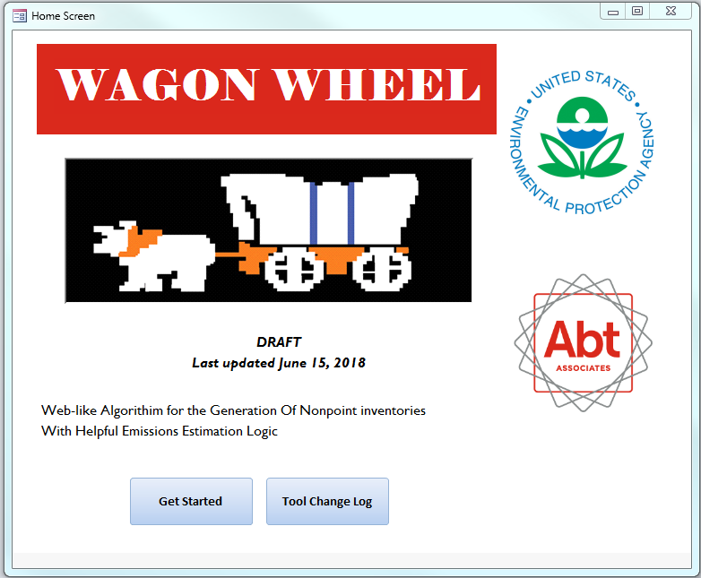
Step 2: Getting Started

Slide 13
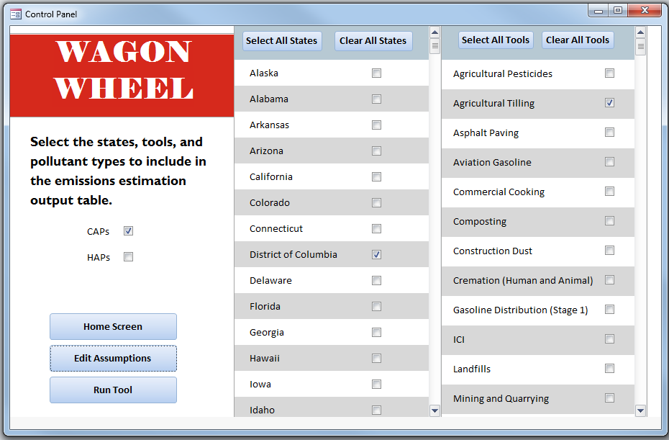
Step 3: Select Scenario
Notes:
Note: The WW is not equipped to process emissions for local counties or tribes.

Slide 14
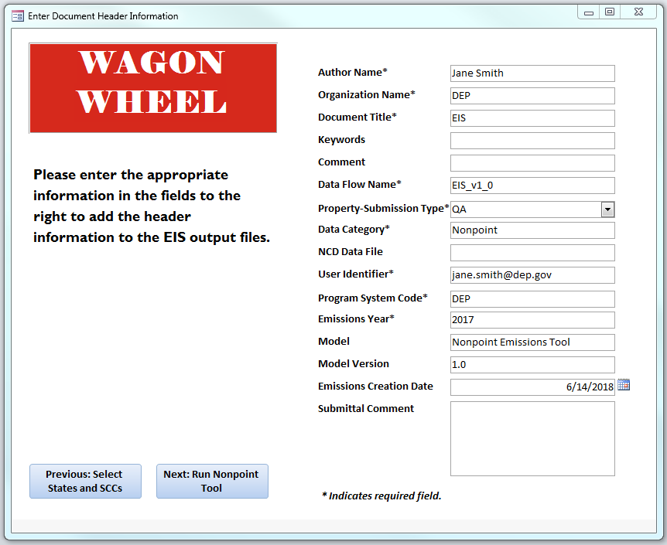
Step 4: Insert User Information

Slide 15
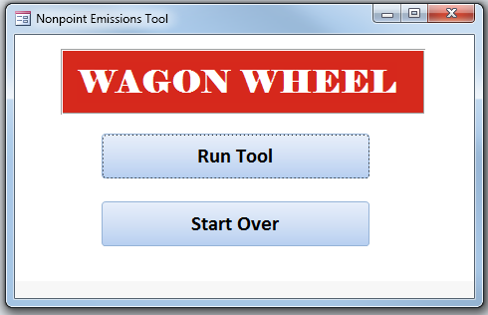
Step 5: Run Tool

Slide 16
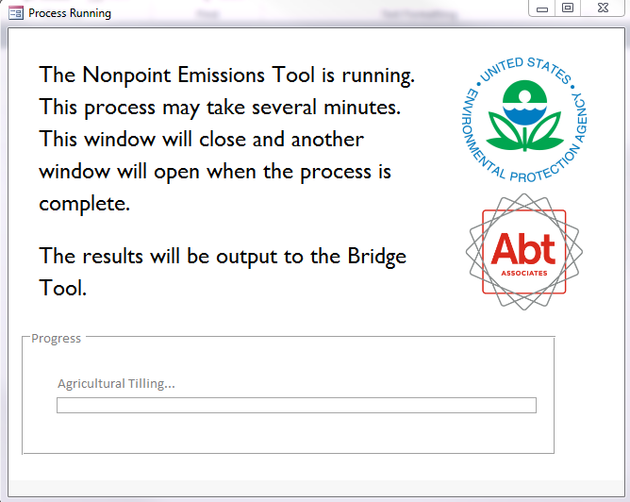
Step 6: Wait for Results

