Slide 1

SPECIATE and Preparing VOC and PM chemical speciation profiles for air quality modeling
Madeleine Strum and Casey Bray, EPA/OAQPS
Notes:
Welcome to the SPECIATE training in which we will teach you what is in EPA’s SPECIATE database, how we develop it, and explain the use of speciation profiles in EPA’s SPECIATE database to generate chemical speciation profiles for air quality modelling.
We have just released a major update to the database and we will tell you about that too.

Slide 2
TRAINERS
Madeleine Strum, PhD, EPA OAQPS, Air Quality Assessment Division (AQAD), Emissions Inventory and Analysis Group
Casey Bray, PhD, EPA OAQPS, Sector Policies and Programs Division (SPPD), Measurement Policy Group
LOGISTICS
Notes:
Madeleine Strum is in the emission inventory group in the Office of Air Quality Planning and Standards and is a very active member on EPA’s SPECIATE work group and is co-work assignment manager along with Marc Menetrez who is the lead for the SPECIATE database and work assignment manager. Marc is with National Risk Management Research Laboratory in EPA’s Office of Research and Development, located here at Research Triangle Park NC.
Casey Bray has been working on various aspects of SPECIATE as a student intern with ORD and is now with EPA’s, Sector Policies and Programs Division (SPPD), Measurement Policy Group. We are the group that is in charge of AP 42, we actually stole it from Madeleines group.

Slide 3
COURSE OUTLINE
8:00 SPECIATE, SPECIATE 101 (15 SLIDES PLUS DEMO)
8:30 SPECIATE Browser (2 SLIDES PLUS DEMO)
8:50 SPECIATE What’s New in SPECIATE5.0 (6 SLIDES)
9:10 Speciation Concepts (11 SLIDES)
9:30 Break
9:45 Speciation Concepts (20 SLIDES)
10:20 SPECIATE Data Gaps and Future Plan (9 SLIDES)
10:30 Break
10:45 Guide for Data Developers (10 SLIDES)
11:00 Preparing Profiles for SMOKE (16 SLIDES)
11:30 End of Class
Notes:
8:00 SPECIATE, SPECIATE 101 (Madeleine)
8:15 SPECIATE Browser (Casey)
8:30 SPECIATE What’s New in SPECIATE5.0 (Casey)
8:40 Speciation Concepts (Madeleine)
9:15 Break
9:45 SPECIATE Data Gaps and Future Plan (Casey)
10:15 Guide for Data Developers (Casey)
10:25 Preparing Profiles for SMOKE (Madeleine)
11:00 End of Class

Slide 4
CLASS OBJECTIVES
To introduce you to SPECIATE, its content and use
To introduce you to the SPECIATE Web Browser and its use
To discuss the recent release of additional data and data base changes --- SPECIATE5.0
To provide an opportunity to ask questions about SPECIATE
To inform data developers what is needed to get data into SPECIATE
To present the how the SPECIATE weight percent information gets converted to the speciation inputs used in SMOKE (GSPRO)
HEADS UP ON SPECIATION at the CONFERENCE

Slide 5
Speciation at the conference
Lightning Talks SPECIATE5.0 & Carbon Tuesday, 1:20pm
Poster session – Needs assessment of profiles in EPA modeling platform & NC State Poster exploring variability in Paved Road profiles, Tuesday 4:00-5:30pm
Modeling Session-Preparation of Volatility Basis Set Speciation profiles Wednesday 8:00am
Q&A with EPA on Thursday Afternoon 2:45pm
Toxics/Speciation Session SPECIATE5.0 & Speciation of fire emissions Friday 8:00am to 12:00pm
Notes:
There are a number of Speciation-related talks and posters so mark your calendars.
tomorrow, I’ll be giving a 5 minute overwiew of what is new in SPECIATE5.0
At the poster session there will be 2 posters, Casey will be giving her poster of the assessment she did to determine the highest priority needs for the database with regards to its use in Air quality modeling
Tesh and I will be showing a poster developed by a student in the statistics department at NC state, explorting the paved road profiles and their variability
At the modeling session on Wednesday, George Pouliot of EPA’s ORD will be presenting the addition of the new volatility basis set profiles that were added with SPECIATE5.0 and
There will be speciation covered with Q&A Thursday afternoon
Finally there are a few of speciation talks on Friday at the toxics/speciation session

Slide 6
SPECIATE 101
What is Speciation?
What is SPECIATE?
The SPECIATE Data Browser

Slide 7

WHAT IS SPECIATION?
Speciation disaggregates inventory species (e.g. VOC, PM_{2.5}) into more detailed species
propane
ethylene
VOC
formaldehyde
acetaldehyde
ethanol
etc.
elemental carbon/black carbon
organic carbon
nitrate
PM_{2.5}
sulfate
aluminum
silicon
iron
etc.
Notes:
Speciation is the process of disaggregating an inventory species representing a group of pollutants, and disaggregating it into the detailed species in that group. The detailed species depend on the type of source emitting the inventory species. For example, for a combustion source, once would expect that formaldehyde be a component of the VOC, but if the source is evaporation resulting from the application of a solvent-borne coating, then formaldehyde might not be a component of the VOC

Slide 8
SPECIATION IN GENERAL (STEPS)
Emissions source for inventory pollutant e.g. VOC, PM_{2.5}
Multiply inventory emissions by profile fraction to get emissions of specific chemical compounds
Assign Speciation Profile to source
100 tons of VOC
Solvent Utilization; Surface Coating; Architectural Coatings; Total: All Solvent Types in Autauga County, AL (SCC = 2401001000)
Profile Code: 8744
Composite Profile - Architectural Coatings: Solvent Borne and Waterborne
50 tons mineral spirits
9 tons texanol
9 tons propylene glycol
5 tons ethylene glycol
etc.
Notes:
This is an example of how you would use a speciation profile to determine what is in a particular VOC source that is in your emissions inventory. I’ve not listed all of the species in the speciation profile selected for this source, just the largest components (mineral spirits, texanol, etc.)

Slide 9
SPECIATION IN GENERAL (SPECIATE)
Assign Speciation Profile to source based on process (SCC)
SPECIATE is EPA’s repository of speciation profiles.
SPECIATE 5.0 is the current version.
Several hundred literature citations to SPECIATE have been found.
Notes:
So where do you get the profiles? From EPA’s SPECIATE database. Yes we maintain a repository of speciation profiles which are used for preparing inputs for photochemical air quality modeling – PM and organic gas, and other applications as explained in the next slide.
We update SPECIATE every few years, adding new profiles with each update. The current version is 5.0. The first posted version was SPECIATE3.2.
There are many users of SPECIATE throughout air quality management agencies, academia and other research institutions.

Slide 10
WHAT IS SPECIATE?
DATA SOURCES SPECIATE DATA USERS
Feedback on Data Gaps
Input to Air Quality Models
-- NEI Modeling Platform
NEI PM species (EC, OC, etc)
Source Apportionment/
Source Receptor Models
Black Carbon Report to Congress
Air Toxics Inventories
Peer-reviewed literature
Source testing of speciated emissions
Other
Notes:
We prefer to get sources of data for profiles from the peer-reviewed literature that reports results from source testing. We will also used source test programs that may not have been published. Finally, there are profiles in SPECIATE that may have been developed through other means. SPECIATE includes the reference/source of the information as well as lots of other meta data that we will take a look at.
Who are our users?
In addition to AQ modeling, speciation profiles area an important input for source-receptor modeling, allowing researchers to determine key sources of particular pollutants in specific locations. They may also be used to estimate emissions of air toxics –since the components of VOC can be HAPs (e.g., formaldehyde); also, some metal components of PM (e.g., manganese) can be HAPs.
Our users give us feedback on data gaps and we focus on these for updating SPECIATE.

Slide 11
WHAT IS SPECIATE?
A repository for speciated emissions profiles
  Profiles added to SPECIATE, but never removed
A searchable Microsoft® Access® database
Profiles for three air pollution emission types:
  Particulate Matter (PM) – (note there are several PM profile types)
  Total Organic Gases (TOG)
  Other [Mercury (Hg), Nitrogen oxides (NO/NO₂/HONO), semivolatile organic compounds (SVOC)]
Available on EPA Website: https://www.epa.gov/air-emissions-modeling/speciate
Notes:
We store the speciation profiles in SPECIATE in a Microsoft ACCESS database (MDB is the extension of the file once you unzip it). If you are not an ACCESS user, you can always copy the profiles you are interested in (you first have to know how to filter) out of the “view gas profiles” or “view PM profiles” queries that are built into the database and paste them into excel. Or, you can used the BROWSER on our website that Casey will demo.
Key to SPECIATE is the documentation which is available at the link. You only need the latest version of SPECIATE (4.5 is currently the latest version) because we retain all profiles from previous versions. If there is an error and we correct it, then we have both the corrected profile and original profile but we add a note to the original profile that points to the corrected profile. We keep all the documentation because they give you more information on the profiles added during each version.
Besides VOC and PM profiles, SPECIATE has profiles for NOX, mercury and semi-volatile VOC. We will not go over these at this training

Slide 12
WHAT IS SPECIATE?
Species include metals, ions, elements, organic and inorganic compounds
PM profiles are size-segregated (PM₁₀, PM_{2.5})
Lots of metadata (references, test methods, notes, geographic region…)
Profiles are rated for quality
  Pre-5.0: Judgement (J), vintage (V), number of data points (D)
  Post 5.0: QSCORE (more detailed evaluation to be covered later)
Notes:
There are about 2800 species in SPECIATE. They are stored in the SPECIES properties table – both VOC and PM species are in this table.
There are different profiles for different PM sizes – so be sure to look at the upper and lower size fields to make sure you are getting a PM2.5 profile and not a PM10 or TSP or particles of other size.
There are a lot of fields in SPECIATE that describe the profiles or species – this “meta data” is helpful to users who are selecting profiles to use for their applications.
You can read more about the ratings in the documentation. There are specific criteria that form the basis of the vintage rating (“V”) which concerns how old the profile is, and number of samples (data points or “D”) rating. The V and the D ratings are multiplied together and the result is used to establish the QUALITY score (A to E) based on the range of the V*D value (again see documentation for details). For the next version of SPECIATE (SPECIATE5.0) we are replacing this with a QUALITY SCORE that also accounts for the quality of the reference with respect to their use of quality assurance/quality control in their sampling, measurement and data analyses and their transparency.

Slide 13
Types of Profiles in SPECIATE
GAS – Organic gas, based on VOC or TOG
GAS-VBS – Used for volatility basis set (VBS) treatment in air quality models (contains intermediate volatility explicit and lumped species based on saturation vapor pressure)
PM-Simplified – Model-ready for AE5 aerosol mechanism
PM-AE6 – Model-ready for AE6/AE7 aerosol mechanism
PM-VBS – Model-ready for VBS treatment in chemical transport models (contains organic carbon and non-carbon organic matter lumped species broken out by saturation vapor pressure; includes SVOCs)
PM – Any other PM (i.e., not model-ready)
OTHER – Mercury, NOX, semi-volatile VOC (SVOC)
Notes:
For the latest version of SPECIATE we added a field called profile type to distinguish between the different types of proifiles.
Gas profiles are gaseous organic compound profiles that provide the composition of total organic gas (TOG) or volatile organic compound (VOC) emissions from sources.
There are 3 types of PM profiles PM which is any PM profile that is not AE6 or VBS.

Slide 14
KEY TABLES IN SPECIATE
List of profiles with meta data
PROFILES
SPECIES
SPECIES_PROPERTIES
KEYWORD-REFERENCE
Weight percents by profile and species ID
Species ID, name, molecular weight, other IDs, formula, whether it is a HAP, non-VOC
Keywords, References, Reference Properties (multiple references separated by carriage returns)
Derived from MasterReferenceList table

Slide 15
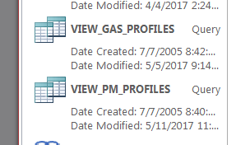
KEY SPECIATE QUERIES
Notes:
These queries give you the speciation profile weight percents with lots of meta-data about the profile (reference, test method, test data, profile date, notes, etc) and also about the compound (profiles species) such as the name of the compound in SPECIATE, chemical abstract numbers, and various properties of the compound . These 2 queries listed in the slide are the most useful and you can pull out what you need and put it into excel if you are not comfortable in ACCESS.

Slide 16
KEY METADATA COLUMNS
PROFILE_NAME
PROFILE_TYPE
Categorization fields
  CATEGORY_LEVEL_1_Generation_Mechanism
  CATEGORY_LEVEL_2_Sector_Equipment
  CATEGORY_LEVEL_3_ Fuel_Product
PROFILE_NOTES
CONTROLS
REGION
TEST_METHOD (formerly T_METHOD)
REF_DOCUMENTS (formerly DOCUMENT)
TEST_YEAR
VERSION
PROFILE_DATE (formerly P_DATE)
MASTER_POLLUTANT
QUALITY
QSCORE
new
SPECIATE5.0
new SPECIATE5.0
Notes:
One of the strengths in SPECIATE is the abundant metadata.
Here’s a list of data fields that in my opinion are most helpful in learning about a profile.
Profile name, of course, gives the name of the source tested. Profile type, which we went over, is tells you whether it is a gas, PM and if model ready PM or other profile.
The 3 categorization fields are new and indicate information about the source that was tested – the generation mechanism, , e.g., combustion, volatilization, the sector and/or equipment such as biomass burning, prescribed or boiler
The Notes provide any manipulation we did to the data or if it is a composite, which profiles are being composited together.
REGION tells you if the profile is specific to a particular region of the country such as specific oil and gas basin
TEST_METHOD is associated with the whole profile – not each species in the profile. So it is like how the data were sampled.
REF_DOCUMENTS gives you the reference or references for the profile. You will see for some profile we have multiple references
TEST_YEAR gives the year that the test was done
PROFILE_DATE gives the date that the profile was added to SPECIATE
QUALITY is an A to E rating based on number of samples and vintage
QCORE is a new numeric
Mention that some PM10 are not categorized yet – but they will be

Slide 17
EXAMPLES – USING MS ACCESS
1. How do I find a VOC profile related to “Oil and Gas” ? (CATEGORY_LEVEL_2_Sector_Equipment)
A. How do I find the profiles we added most recently? (VERSION, PROFILE_DATE)
B. How would I know if a profile is for a specific geographic
region? (REGION)
C. How do I get out the weight percentages for any one
profile? (View gas profiles or view PM profiles, filter on PROFILE_CODE)
2. How do I find a PM profile related to "Combustion"? (Use PROFILE_TYPE – search for ALL PM types, not just PM, and then look at CATEGORY_LEVEL_1_Generation_Mechanism)
Notes:
Lets look at the ACCESS database and examples. I will filter on Category_Level_2_Sector_Equipment for . ( “oil and gas”.)
For the latest profile look at the Version field to pull out the most recent ones added. You can also sort by the profile_date field.
There is a REGION field that tells you what REGION your profile is applicable to. Many oil and gas profiles are applicable to a specific area like oil and gas region or county or state. This is important for assigning profiles to inventory sources.
To get weight percentages use the VIEW gas profiles query or VIEW PM profiles query.

Slide 18
QUESTIONS?
Are there any questions on what we've covered so far?

Slide 19
THE SPECIATE DATA BROWSER
Provides database access for the non-Access® user
Ability to search, view and download profiles and/or metadata, species, and export them into Excel®
Filter by any metadata field; sort any field
Construct your own table with fields of interest
Links:
    SPECIATE Homepage
    SPECIATE Data Browser
Use Google Chrome (does not work in Internet Explorer)
Notes:
In addition to the access database, there is also a SPECIATE data browser. One of the key strengths of the browser is that it lets you easily search for profile and compare them against one another. The SPECIATE data browser can be accessed from the SPECIATE home page or directly from this link. So now we are going to look at a few examples using the data browser:
LINKS:
https://www.epa.gov/air-emissions-modeling/speciate
https://edap.epa.gov/public/single/?appid=fc3f186a-f39c-46d9-afa6-d4c3556b99c1&sheet=62a951b9-2689-46fb-b08b-1a6fa5814edb&opt=currsel&select=clearall
https://edap.epa.gov/public/single/?appid=fc3f186a-f39c-46d9-afa6-d4c3556b99c1&sheet=62a951b9-2689-46fb-b08b-1a6fa5814edb&opt=currsel&select=clearall

Slide 20
SPECIATE DATA BROWSER QUERY
How do I find any profile related to “Oil and Gas” [use the category level 2 field]
How would I know if a profile is for a specific geographic region? [Region field]
How do I compare weight percent for two profiles? [Select profiles, click Weight % (bar)]
How do I create my own table? [Custom Table]
How do I download profiles to MS Excel? [Right click, export data]
References – Note that some profiles have multiple reference [Search for 4049 – Motor Vehicle Exhaust ]
Notes:
Compare: 95476 and 95477
Profiles with more than one reference example 4049

Slide 21
What’s New in SPECIATE5.0
Released Summer 2019
Contains all prior version profiles plus new ones added (~450)
Simplified structure and new PROFILE_TYPE field (discussed)
Other additional metadata fields (categorization fields, VBS fields, emission rate fields for all profiles)
New browser based on Qlik Software (discussed)
QSCORE
New supplemental data information (show how links to QSCORES and references)
New ‘MasterReferenceList’ table with one row per profile per reference – useful if you are interested in a list of all the references used in SPECIATE
Notes:
A new version of SPECIATE was released at the end of June. As profile are never removed from the database, this version contains all previous profiles in version 4.5 with ~ 450 new profiles added. This update also included an update to the structure of the database. The structure has been simplified and we have added a profile type which was discussed previously in this training. We also added new meta data fields such as categorization, VBS fields, and a field for emission rates. We also introduced the new data browser, which we just discussed. A major improvement was the addition of the QSCORE and a new supplemental data file that links profiles with references and the profile workbooks.

Slide 22
Improved Documentation
Now providing Excel® workbooks showing calculations from the raw data (e.g., journal article) to SPECIATE profiles
Improved access to references
  Digital Object Identifiers (DOIs) for literature references
  Web links to reports where available on internet
  Documents that are not readily available via web link are posted on our ftp site
URL

Slide 23
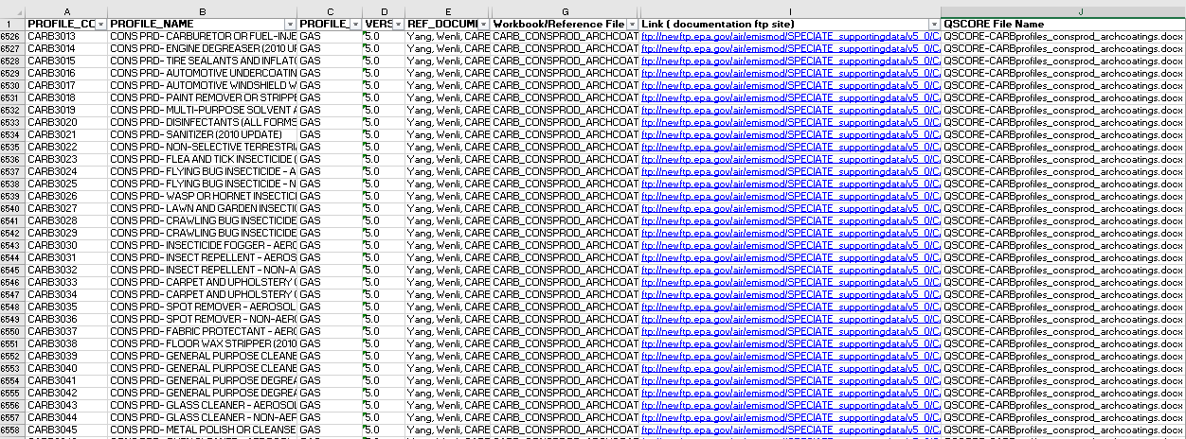
Supporting Data File
Notes:
Here is a screenshot of the file.

Slide 24
QSCORE
Evaluation criteria focused on
  Reference
  Relevance of data (emission source reflects current technology)
  Quality test program
  Documentation on sampling/analytical method
  Profile Completeness
  Data reduction/statistics
Our Cross-Office SPECIATE Workgroup develops the QSCORE for every profile via team discussions
Notes:
The QSCORE provides an evaluation framework that makes it easy to recognize and assign a point value to a study that is used to create an emission source profile.
-Based on a series of questions with points assigned to each one. For a study based on data from measurements, the maximum score is 30 while the maximum score for a study based on data from other methods is 29.
-The point rankings are as follows 20-30 – excellent, 12-19 – good, 5-11 – fair, <4 is poor.
-Data source: peer reviewed publication or not? Is it a US source and from a well known organization? Is this data source relatively new/representative of current emission source? Is it a priority source based on the results of the needs assessment by Bray et al?
-Sampling design: was the sampling design discussed logically are the limitations and assumptions clear? Did the samples capture the natural variability of the source
-Is the methodology sound?
-Data work up: Are standard deviations presented and acceptable? Are the data complete and ready for listing?

Slide 25
SPECIATE 5.0 Profile HIGHLIGHTS
Added profiles
  375 new GAS profiles for a total of 2,550
  80 new PM, PM-AE6 profile for a total of 3,854 (PM, PM-AE6, PM-SIMPLIFIED)
  6 PM-VBS and 4 GAS-VBS profiles
  No new Other profiles for a total of 249
  2814 species
Considering at least the following SPECIATE5.0 profiles for our air quality modeling platform:
Gas (TOG):
  Sugar cane burning
  Consumer products (multiple)
  Corrected heavy duty diesel
  Wyoming oil and gas (multiple)
PM (PM2.5):
  Marine Vessel AE6
  Corrected wildfire/prescribed fire
  Natural gas combustion
  Aircraft
Notes:
Hundreds of new profiles were added to SPECIATE, including 375 new gas profiles and 80 new PM profiles. We also added 6 new PM VBS profiles. Some of the new gas profiles added include profiles for sugar cane burning, consumer product, oil and gas and heavy duty diesel vehicle and some of the new PM profiles include an AE6 ready marine vessel profile, a correct emission source profile for wildfire/prescribed fires, natural gas combustion and aircraft.

Slide 26
QUESTIONS?
Are there any questions on what we've covered so far?

Slide 27
SPECIATION CONCEPTS
TOG (VOC) - Gas Profiles Terminology
Composite Profiles
“Gap-Filling” Profiles
PM Profiles and AE6
Assigning Inventory Sources to Profiles
VOC Integration
On-Road Speciation
Nonroad Speciation
Combination Profiles

Slide 28
VOC/TOG TERMINOLOGY
Gas Profiles in SPECIATE can be based on VOC or TOG (MASTER_POLLUTANT field)
Inventories have VOC (regulatory definition)
TOG is “Total Organic Gases”
TOG =VOC + exempt compounds (e.g., methane, ethane, various chlorinated fluorocarbons, acetone, perchloroethylene, volatile methyl siloxanes, etc.)
TOG profiles have a factor that allow you to convert VOC to TOG.
Methane, ethane, acetone
Numerous CFCs and HCFCs
Many other “exempt” compounds
VOC
TOG
Googled and got this from CARB fact sheet
Notes:
It is important to know the difference between total organic gases (TOG) and volatile organic compounds (VOC). TOG is total organic gases and it is basically everything – Volatile organic compounds or VOC are a subset and is based on an EPA regulatory definition. You should know that methane, ethane, acetone and many many others are NOT VOCs because they are exempt. Also several other commonly used compounds, some of which are HAPs are exempt and therefore not VOCs. Profiles can be based on TOG or VOC. The profile has a data field called MASTER_POLLUTANT that tells you what it is. The species properties table has a field that tells you whether each compound is a VOC (yes/no)

Slide 29
Carbonates, Metal carbides, Carbon Monoxide
Carbon dioxide, Carbonic acid
Carbonates, Metal carbides, Carbon Monoxide
Carbon dioxide, Carbonic acid
Methane
Methane
Ethane
Ethane
TOG/TOC
ROG/VOC
Benzene
Toluene
Xylenes
Propane
Other hydrocarbons
Acetone
Perchloroethylene
Methylene Chloride
CFCs
HCFs
PFCs
And more…
Acetone
Perchloroethylene
Methylene Chloride
CFCs
HCFs
PFCs
Benzene
Toluene
Xylenes
Propane
Other hydrocarbons
Aldehydes
Aldehydes
Carbonates, Metal carbides, Carbon Monoxide
Carbon dioxide, Carbonic acid
Carbonates, Metal carbides, Carbon Monoxide
Carbon dioxide, Carbonic acid
Carbonates, Metal carbides, Carbon Monoxide
Carbon dioxide, Carbonic acid
Methane
Methane
Methane
Methane
Ethane
Ethane
Ethane
Ethane
Acetone
Perchloroethylene
Methylene Chloride
CFCs
HCFs
PFCs
Benzene
Toluene
Xylenes
Propane
Other hydrocarbons
Acetone
Perchloroethylene
Methylene Chloride
CFCs
HCFs
PFCs
NMOG/NMOC
Benzene
Toluene
Xylenes
Propane
Other hydrocarbons
THC/HC
Benzene
Toluene
Xylenes
Propane
Other hydrocarbons
NMHC
Acetone
Perchloroethylene
Methylene Chloride
CFCs
HCFs
PFCs
Aldehydes
Aldehydes
Aldehydes
Notes:
Besides TOG and VOC, There are numerous other MASTER_POLLUTANTS you may come across in SPECIATE and these venn diagrams show what is included and what is excluded for each.
TOG is also called TOC (total organic compounds) and it is the most inclusive. VOC and ROC (ROC is reactive organic compounds) is the next most common MASTER _POLLUTANT you will see in SPECIATE. Examples or TOGs that are not VOCs (because they are exempt) include – methane, ethane, acetone, and may fluorinated and chlorinated hydrocarbons.
Non methane organic compounds or non-methane organic gases (NMOC/NMOG) are just like TOG/TOC but exclude methane.
Non methane hydrocarbons (NMHC) only include carbons and hydrogens so exclude aldehydes and other organic compounds with oxygen and nitrogen.
Total hydrocarbons (THC) or hydrocarbons (HC) include methane but exclude anything except for hydrogen and carbon.

Slide 30
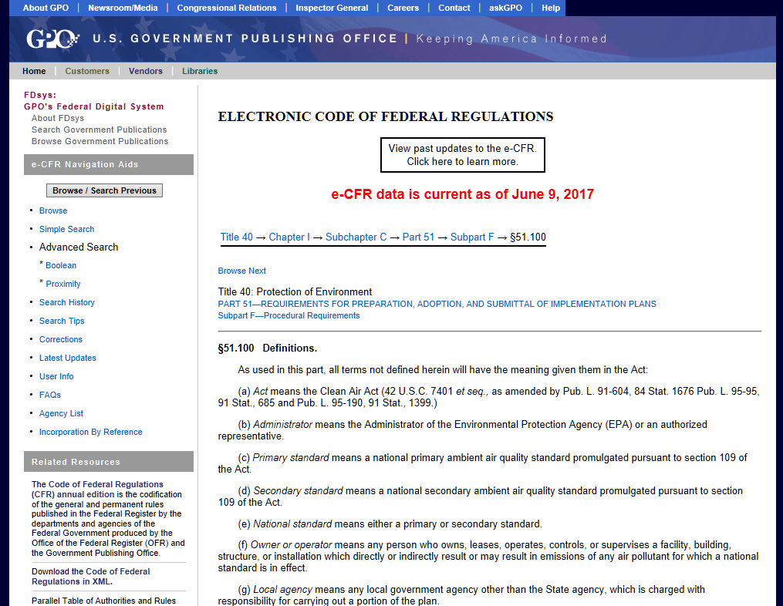
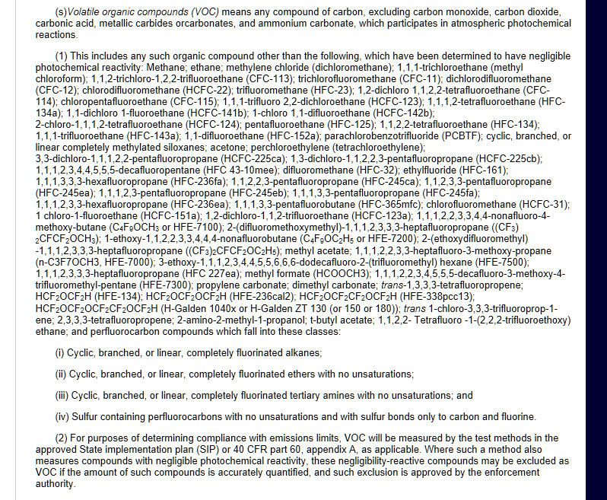
VOC EXEMPTION INFORMATION
EPA’s Regulatory Definition of VOC
VOC means any compound of carbon, excluding carbon monoxide, carbon dioxide, carbonic acid, metallic carbides or carbonates, and ammonium carbonate, which participates in atmospheric photochemical reactions.
This includes any such organic compound other than the following, which have been determined to have negligible photochemical reactivity: ……..
Electronic Code of Federal Register where the VOC information is available under Title 40 → Chapter I → Subchapter C → Part 51 → Subpart F → §51.100
http://www.ecfr.gov/cgi-bin/text-idx?SID=b77fd17146a534c225c8557b5ed4a469&node=40:2.0.1.1.2.3.8.1&rgn=div8
Notes:
The definition of VOC can be found in the Code of Federal Regulations (follow links in the slide)- note that it is really based on a list of what ISN’T a VOC. Show the definition by clicking on the link – you have to scroll down to get to the VOC definition!
See the code of federal register regulations for the list of exemptions (i.e., list of what ISNT a VOC)
The definition of VOC can change as new compounds get added to the list of exemptions. Our office, OAQPS, manages the rules that add compounds to the list of exemptions.
The person who manages this list is on the SPECIATE Work Group.

Slide 31
CURRENT STATUS OF VOC EXEMPTION
The EPA’s official link of Ground-level Ozone Pollution for more information on recent exemption and the history of VOC exemptions at:
https://www.epa.gov/ground-level-ozone-pollution/volatile-organic-compound-exemptions
Currently, we have about 70 exempt chemical/groups including methane and ethane.
More chemicals could be added to the list in future assessments.
Notes:
Again – same link as previous slide to the list

Slide 32
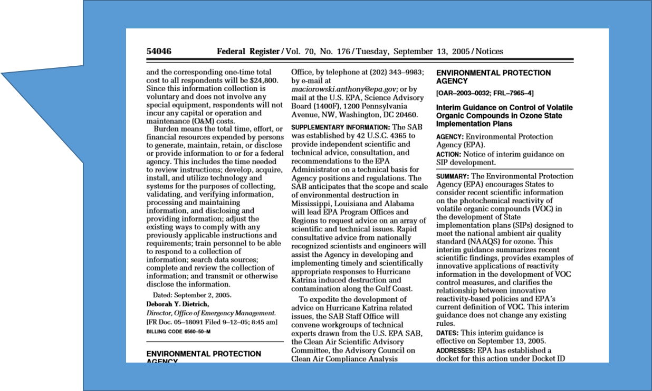
PROCESS OF VOC EXEMPTION
Interim Guidance of 2005 (70 FR 54046-54051) is the guiding process to assess the viability of a VOC exemption based on:
K_{OH}: Reactivity with OH
MIR: Maximum Incremental Reactivity to form O₃
Toxicity and environmental fate
GWP: Global Warming Potential
ODP: Ozone Depletion Potential
Viability as a better substitute for the same end-uses of other chemicals
Notes:
There are a number of factors that go into the decision to add a compound to the list of exemptions. These are listed on this slide and explained in the Federal Register notice reference here.
EPA does not exclude VOC unless a request is made. This is a voluntary program as an incentive to encourage use of better chemicals.

Slide 33
CONVERTING VOC TO TOG
(or TOG wt % to VOC wt %)
Ideally, when modeling you want TOG so you get all the species.
  TOG profiles have a factor that allow you to convert VOC to TOG.
  TOG = TOG-to-VOC ratio * VOC
  The TOG-to-VOC ratio is a metadata field in SPECIATE and is also in the GSCNV SMOKE ancillary file. It is computed as:
  TOG-to-VOC ratio = 100/(sum of VOC percent)
If you want to calculate a VOC weight percent from a TOG weight percent
  wt percent of VOC= wt percent of TOG *TOG-to-VOC ratio
Notes:
Models want TOG because that is the most complete “MASTER_POLLUTANT”. For example, even though a compound like ethane is exempt, the model still will use emissions of it. So inventories have VOC but most profiles are TOG so the emission modelling process needs to convert VOC to TOG. It uses aTOG-to-VOC ratio which is profile-specific. It is in SPECIATE (it is one of the data fields). It can be computed – all you have to know is which compound in your profile is a VOC and which is not. Then you can use that formula I present in the slide. The VOC-to-TOG factor is also in the GSCNV file which is a SMOKE ancillary file which we provide as part of an emissions modelling platform.
You can also compute the weight percent based on VOC from the weight percent based on TOG using the TOG-to-VOC ratio by multiplying the weight percent based on TOG times the TOG-to-VOC ratio

Slide 34
EXAMPLE TOG SPECIATION PROFILE
(selected fields from the Query “View Gas Profiles”)
P_NUMBER | GAS_PROFILE.NAME | CONTROLS | P_DATE | TOTAL | VERSION | TOG-to-VOC ratio | SPECIES_ID | SPECIES_PROPERTIES.NAME | WEIGHT_PER | VOC | MASTER_POLLUTANT
0051 | Flares - Natural Gas | Uncontrolled | 05-Jan-89 | 100 | 3.2 | 2 | 438 | Ethane | 30 |  | TOG
0051 | Flares - Natural Gas | Uncontrolled | 05-Jan-89 | 100 | 3.2 | 2 | 465 | Formaldehyde | 20 | YES | TOG
0051 | Flares - Natural Gas | Uncontrolled | 05-Jan-89 | 100 | 3.2 | 2 | 529 | Methane | 20 |  | TOG
0051 | Flares - Natural Gas | Uncontrolled | 05-Jan-89 | 100 | 3.2 | 2 | 671 | Propane | 30 | YES | TOG
Assume you have 100 lb VOC from Flare – How much propane?
Mass of Propane = 100 lb VOC x (30/100) [lb propane/lb TOG] x [2 lb TOG /1 lb VOC]
= 60 lb
Notes:
The example is a TOG speciation profile that has a TOG-to-VOC ratio of 2. Note that we don’t use this profile anymore (it is the old flare profile) but it is a good example because it has so few compounds in it and it is a TOG profile for which half of the compounds are exempt (i.e. not VOCS). If you were to download this profile from the VIEW gas profiles query you would also see that the MASTER_POLLUTANT is TOG. It is important that you use the TOG-to-VOC ratio if you want to estimate the amount of propane from 100 lbs of VOC based on this profile.

Slide 35
COMPOSITE PROFILES
Often, a single study may be too specific to apply to an inventory category or that study has multiple test scenarios or different operators.
A composite profile combines these data into something usable.
When creating a composite of different profiles, one can take the mean or median of each species from the various profiles being composited.
When compositing individual SPECIATE profiles, see PROFILE_NOTES for the profiles used in the composite.
Notes:
SPECIATE contains composite profiles. Either the paper presents the data as already composited (study composite) or we can take 2 or more profiles in SPECIATE and composite them to create a new composite profile. This can be done by taking either the mean or median. We include the “new” composite profile in SPECIATE and we provide information in the notes as to which profile codes were composited and whether we used the mean or median. There is also a field in SPECIATE that tells you whether the profile is a composite (ORIGINAL_COMPOSITE metadata field).

Slide 36
“GAP-FILLING” PROFILES
This is DIFFERENT from “Compositing” – It is adding missing species to a profile.
Why? ̶ Some profiles may be missing species that are expected. (Be aware of this when assigning profiles.)
We can create new profiles by filling in these species (gap-filling) from another profile.
Use “G” to indicate which profiles are gap-filled and the NOTES field to give details.
profile | pollutant | missing
95242 | Poultry Farm - Hen and Animal Waste | Methane Ethane
95241 | Swine Farm and Animal Waste
95240 | Beef Cattle Farm and Animal Waste
70% methane,
20% ethane
From profile 0203
(solid waste - animal waste decomposition)
+
Three new profiles for SPECIATE
Notes:
Recently we gap filled profiles missing methane and ethane to create a TOG profile from a VOC profile.
-not changing the mass

Slide 37
QUESTIONS?
Are there any questions on what we've covered so far?

Slide 38
BREAK
15 min.

Slide 39
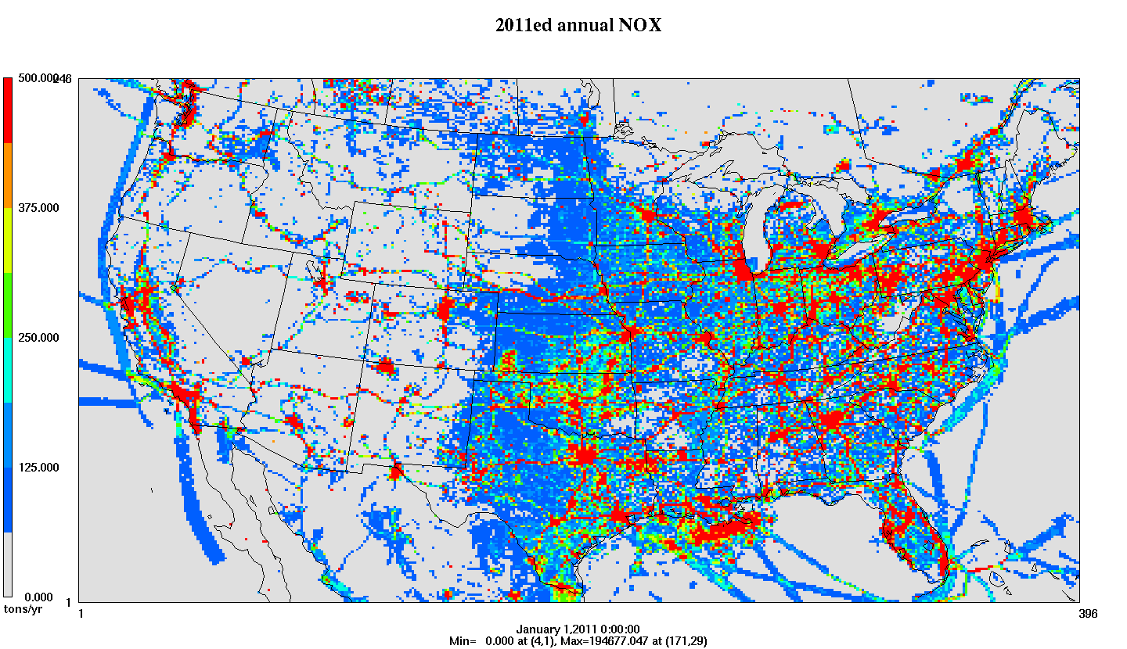

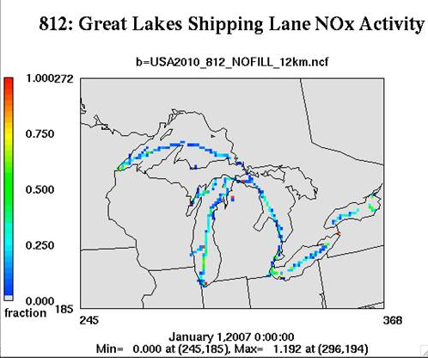
SPECIATE As Part of Emissions Preparation for Photochemical Air Quality Modeling
SMOKE software system performs
temporal allocation, speciation and spatial allocation
VOC and PM_{2.5} need to be speciated into chemical components for photochemical modeling
Each speciation profile is cross-referenced to an inventory source by source classification code (SCC), pollutant, and potentially by region
Thousands of SCCs in the NEI are mapped to a few hundred profiles
Onroad mobile source emissions species come directly from the EPA MOVES model
Temporal Profiles
Emission
Inventory
Speciation Profiles
Final product: hourly, speciated, gridded emissions in a format for an air quality model
Spatial Surrogates
Notes:
NEI emissions need to be processed before they can be applied in air quality models and this processing is done through the SMOKE software system.
-In the figure above, we are focused on the step in the center (speciation) not on the spatial or temporal allocation. (top and bottom panels fade with click)
-The NEI generally provides annual county level emissions totals for total PM2.5 and VOC while models need hourly gridded and speciated emissions.
An emissions modeling platform is the full set of emissions inventories, other data files, software tools, and scripts that process the emissions into the form needed for air quality modeling. Each emissions modeling platforms supports air quality modeling of an historic year and one or more later years. Each platform relies on a version of the National Emissions Inventory (NEI) for most of its data, although some adjustments are made to support air quality modeling. All data and scripts needed to prepare emissions for air quality modeling are provided with each emissions modeling platform.

Slide 40
SPECIATE Doesn’t Feed Directly Into SMOKE
  Develop chemical-mechanism specific profiles from profiles in SPECIATE
  Assign sources to profiles
Speciation profiles, species properties
Chemical mechanism mappings
Speciation Tool
Emission Inventories
Criteria Air Pollutants, Hazardous Air Pollutants
GSPRO: mechanism-specific profiles, GSCNV
SMOKE - Emissions Model
GSREF: SCC/FIPs-to-profile mapping
Model Species Emissions
Notes:
For air quality modeling SPECIATE is not the only thing you need for speciation. You need a chemical mechanism specific speciation profile which the Speciation Tool can provide. You would need to feed the tool the SPECIATE profiles and the chemical mechanism mappings.
The tool will produce the GSPRO file which is a file containing chemical mechanism-specific speciation profiles that have the same profile codes (PROFILE_CODE) as the SPECIATE non-chemical mechanism specific profiles. It will also produce the GSCNV (which contains the VOC-to-TOG conversion factors). Both of these files are fed into the SMOKE Emissions model (which does the speciation – i.e.,uses the profiles to create model species emissions as well as many other emission processing steps like temporal allocation and spatial allocation).
SMOKE computes model of gaseous model species and mass of particulate model species.

Slide 41
PM_{2.5} SPECIATION- MODELING PROFILE EXAMPLE
Example modeling speciation profile – AE6
Model species definitions
species name | species description | AE5 | AE6
POC | organic carbon | Y | Y
PEC | elemental carbon | Y | Y
PSO4 | sulfate | Y | Y
PNO3 | nitrate | Y | Y
PMFINE | unspeciated PM2.5 | Y | N
PNH4 | ammonium | N | Y
PNCOM | non-carbon organic matter | N | Y
PFE | iron | N | Y
PAL | aluminum | N | Y
PSI | silica | N | Y
PTI | titanium | N | Y
PCA | calcium | N | Y
PMG | magnesium | N | Y
PK | potassium | N | Y
PMN | manganese | N | Y
PNA | sodium | N | Y
PCL | chloride | N | Y
PH2O | water | N | Y
PMOTHR | unspeciated PM2.5 | N | Y
Prescribed Burning – Composite (91109)
pollutant | species | massfrac
PM2_5 | POC | 0.5019
PM2_5 | PEC | 0.1093
PM2_5 | PSO4 | 0.0033
PM2_5 | PNO3 | 0.0107
PM2_5 | PNH4 | 0.0034
PM2_5 | PAL | 0.0005
PM2_5 | PCA | 0.0007
PM2_5 | PCL | 0.0024
PM2_5 | PFE | 0.0004
PM2_5 | PK | 0.0014
PM2_5 | PMN | 0.0001
PM2_5 | PMOTHR | 0.0125
PM2_5 | PNA | 0.0014
PM2_5 | PNCOM | 0.3513
PM2_5 | PSI | 0.0001
PM2_5 | PTI | 0.0007
Notes:
You’ll notice the difference between a SMOKE profile and SPECIATE profile based on the species names.
PM profiles in SMOKE are aerosol module specific. The 2 modules we have used are AE5 and AE6. EPA’s modeling platform currently prepares emissions for AE6 which has a lot more model species than AE5. (It is easy to go form AE6 to AE5 but not the other way).
The AE6 species in red (non carbon organic matter which is “PNCOM”) and water (PH20) are not measured and need to be added to a profile because the Speciation Tool does not compute PNCOM. We used the procedure in the paper (Adam Reff, of EPA/OAQPS is the main author) “Emissions Inventory of PM2.5 Trace Elements across the United States, Environ. Sci. Technol., 43 (15), pp 5790–5796, 2009”
Not all profiles in SPECIATE have PNCOM so they are not used in our modeling since we produce emissions for AE6. In fact, the Speciation Tool drops profiles that don’t have either PNCOM or PH20. I call SPECIATE profiles that do have PNCOM or PH20 “AE6-ready”
The Speciation tool computes the remainder mass after all AE6-ready SPECIATE profile species are mapped to the appropriate AE6 species. This remainder is “PMOTHR” (unspeciated PM). So PM profiles in SPECIATE can sum to less than 100% and then the remainder is “PMOTHR”

Slide 42
HOW DO YOU KNOW THE PM_{2.5} PROFILE HAS WHAT YOU NEED?
Example1 – 95126 Gas-fired process heater exhaust
  This one does NOT have what you need for AE6.
Example 2 – 95462 Composite - Brake Wear
  This one does.
Many of the AE6-ready profiles come from
  Composite profiles from “Emissions Inventory of PM2.5 Trace Elements across the United States, Environ. Sci. Technol., 43 (15), pp 5790–5796, 2009” will have what you need.
  But, we did add more recent profiles as well (search for PNCOM or PH20).
Notes:
If you are using AE6 you can simply look at the PROFILE_TYPE to see all profiles that have been made AE6-ready in SPECIATE.
Dozens of AE6-ready Profiles were developed and presented in “Emissions Inventory of PM2.5 Trace Elements across the United States, Environ. Sci. Technol., 43 (15), pp 5790–5796, 2009” – these are the “911” profiles and most of the ones in our platform are these. However, we have added /updated some (such as the brake and tirewear profile and commercial marine vessel tanker profiles) since then and we continue to make sure profiles we want to use for modeling have PNCOM in them (or PH20 if there is no organic carbon)
You can convert a non-AE6 profile to AE6 by following the calculations in the Protocol in the SPECIATE5.0 documentation (Appendix G Protocol for Developing AE6-ready PM_{2.5} Speciation Profiles for Inclusion in SPECIATE)

Slide 43
SIMPLIFIED PROFILES – PM_{2.5} ONLY
These are legacy profiles.
They were used from AE5.
Their function was superseded by the Speciation Tool.
Notes:
You don’t need to use profiles that are labeled as “simplified” (one of the meta data field used only for PM profiles ) since the Speciation Tools can compute AE6 or AE5 profiles and the “simplified” profiles are AE5.
We put them into SPECIATE before the Speciation Tool existed

Slide 44
ASSIGNING SOURCES TO PROFILES – GSREF
Nonpoint (area) & Mobile (county level)
  You can assign profiles based on SCC and/or country/state/county.
  Provides no sub-county variation - If you want this, you need your source to be inventoried as a point source.
Point
  You can assign based on SCC and/or country/state/county and/or facility, unit, process, release point.
You can assign a combination of multiple profiles to the same source (10% profile A, 35% profile B, 55% profile C).
NEW-SMOKE4.5
Notes:
SPECIATE does not supply a cross reference file that maps profiles to inventory sources. This cross referencing is done in the modeling platform and the file that contains the mapping is called “GSREF” and it is used by SMOKE. Here’s a link to the website that documents EPA’s modeling platforms: https://www.epa.gov/air-emissions-modeling
Profiles are most often assigned based on the source classification code (SCC) or the SCC and county code (FIPS code) since some profiles apply to a specific geographic region.
For sources in the inventory such as nonpoint (formerly referred to as “area” sources) and mobile that are inventoried at the county level, you can use SCC and FIPS only. That means you can assign different profiles to 2 different parts of the county.
For point sources you could assign at the most detailed source –level : facility/process/ release point .
SMOKE has the ability to assign multiple profiles by SCC and FIPS. (previously you could only assign by multiple profiles by FIPS but they could not also vary by SCC)

Slide 45
Examples of Profile Assignments
SCC 3999999 “Industrial Process, NEC”
  Assigned to profile 0000 - Overall Average (the King of Defaults)
SCC 2811015001
Prescribed Forest Burning; Smoldering
County=Autauga, AL
  Assigned to profile 95421 – Composite Profile - Prescribed fire southeast conifer forest
SCC 2811015001
Prescribed Forest Burning; Smoldering
County=Gila, AZ
  Assigned to profile 95422 – Composite Profile - Prescribed fire southwest conifer forest
Notes:
If you don’t have an SCC code that enables you to know what kind of source it is, OR if you have source type for which there is no speciation information whatsoever in SPECIATE, then you have to assign it to the overall default profile. We have worked hard over the years to analyze sources assigned to 0000 and reduce the amount of mass assigned .
For the 2 fires examples note that the FIPS is used for the assignment – it is the same source but in 2 different parts of the country. They are assigned profiles that are region specific.

Slide 46
QUESTIONS?
Are there any questions on what we've covered so far?

Slide 47
VOC INTEGRATION - CONCEPT
Integration
  Process of taking select VOC HAPs from the HAP inventory and speciating the remaining VOC because it is generally believed that the HAP inventory is a better source of HAP emissions than the speciated VOC
  Want to avoid double counting of HAPs
  Want to speciate the remaining VOC taking into account HAPs that were removed
NBAFM chosen as “integration HAPs” in 2014 Modeling Platform
  Naphthalene, Benzene, Acetaldehyde, Formaldehyde, Methanol
  These are explicit VOC HAPs in the CB6-CMAQ chemical mechanism.
NONHAPVOC
  Remaining VOC after removing explicit VOC HAPs
  NONHAPVOC = VOC - NBAFM
Notes:
The key is that we want to use the HAPs that are in the inventory in the speciation process, and in order to not double count them we need to remove them from the speciation profile.
For HAPs that are mapped to themselves – explicit species we can’t use both the speciation profile and the inventory HAP because that would be double counting.
Naphthalene, Benzene, Acetaldehyde, Formaldehyde, Methanol or “NBAFM” is what are explicit in the chemical mechanism we are using to these are the HAPs we are integrating (but not in all sectors).
The key is that source by source, SMOKE will compute NONHAPVOC by subtracting the integrate HAPs and then use a renormalized speciation profile for NONHAPVOC which does not nave the integrate HAPs in it.

Slide 48
Integration Steps
VOC+ NBAFM emissions
SMOKE
Compute NONHAPVOC
INVTABLE
SMOKE Ancillary
FiIes
Convert to NONHAPTOG
GSCNV
SPECIATE NONHAPTOG and map NBAFM to model species
GSREF, GSPRO
Model species for CB6 (e.g., ACET, ALD2, ALDX, BENZ, CH4, ETH, ETHA, ETHY, ETOH, KET, IOLE, ISOP, OLE, PAR, PRPA, TOL, XYLMN, SOAALK, NAPH, BENZ, ALD2, FORM, MEOH, SESQ, TERP)
Notes:
This shows the steps. We input both HAPs and VOC into SMOKE.
SMOKE will use both the HAPs and the VOC as shown.
It will output all model species associated with the chemical mechanism – in this depiction of the “integrate” case, the highlighted model species are those coming from the HAPs in the inventory. ALD2 = acetaldehyde, NAPH = naphthalene, BENZ = benzene, MEOH = methanol, FORM = formaldehyde.

Slide 49
EXAMPLE OF INTEGRATED PROFILE
No integrate/No use of HAP inventory
Integrate
pollutant | species | massfrac
TOG | ACET | 0.0393
TOG | ALD2 | 0.0895
TOG | ALDX | 0.12
TOG | BENZ | 0.0201
TOG | CH4 | 0.2163
TOG | ETH | 0.0588
TOG | ETHA | 0.0225
TOG | ETHY | 0.0369
TOG | FORM | 0.0612
TOG | IOLE | 0.014
TOG | ISOP | 0.002153
TOG | KET | 0.006088
TOG | NAPH | 0.0119
TOG | NVOL | 0.0115
TOG | OLE | 0.0331
TOG | PAR | 0.1041
TOG | PRPA | 0.008873
TOG | TOL | 0.0798
TOG | UNR | 0.0437
TOG | XYLMN | 0.0203
pollutant | species | massfrac
NONHAPTOG | ACET | 0.0481
NONHAPTOG | ALDX | 0.1468
NONHAPTOG | CH4 | 0.2647
NONHAPTOG | ETH | 0.0719
NONHAPTOG | ETHA | 0.0275
NONHAPTOG | ETHY | 0.0451
NONHAPTOG | IOLE | 0.0172
NONHAPTOG | ISOP | 0.002634
NONHAPTOG | KET | 0.007449
NONHAPTOG | NVOL | 0.0141
NONHAPTOG | OLE | 0.0405
NONHAPTOG | PAR | 0.1273
NONHAPTOG | PRPA | 0.0109
NONHAPTOG | TOL | 0.0977
NONHAPTOG | UNR | 0.0534
NONHAPTOG | XYLMN | 0.0248
Fireplace wood combustion - pine wood– 4642
Notes:
Total massfrac = 1 for both profiles. On the left is a no integrate profile in which HAPs are not at all being used. On the right is an Integrate profile. Whenever you see NONHAPTOG as the pollutant you know it is an Integrate profile.
Note that the Integrate profile may Still have FORM and ALD2 and maybe also BENZ b/c of it might come from a mixture “species” that may have a small portion of these integrate HAPs. In one of the early CB05 mechanism mappings there were also compounds other than FORM or ALD2 that were mapped to FORM or ALD2 because they were thought to transform quickly to FORM and ALD2 (2ndary formation that is basically so fast that we map directly to FORM and ALD2) but an update to the mapping in the 2015-2016 timeframe changed the mapping of these so now very few NONHAPTOG profiles have any integrate species in them.
Note NONHAPTOG, i.e. need to go from NONHAPVOC -> NONHAPTOG (via GSCNV)
When we run the Speciation tool we generally create the 2 sets of profiles: integrate and no integrate and may also create no integrate where the explicit compounds are removed (so this results in TOG profiles that don’t sum to 1)

Slide 50
WHY NOT INTEGRATE A SOURCE
Point sources –
  The state reports HAPs at a different process level than where they reported VOCs. So HAP is at the facility but there is no VOC at that process level to do the subtraction.
  There is misalignment of VOC and HAP even though both are reported.
Nonpoint sources –
  There are no inventory NBAFM emissions at the source.
    If there really shouldn’t be, then remove NBAFM from the profile.
  NBAFM mass > VOC
Notes:
Need to have HAPs and CAPS at the same source (process) to integrate them. This doesn’t always happen with point sources where HAP may be reported ad a separate unit/process than CAPs. So generally we don’t integrate point sources.
Listed are 2 bullets of why sometimes nonpoint sources aren’t integrated.

Slide 51
TWO APPROACHES TO NO-INTEGRATE
1) Don’t use any HAPs from the HAP inventory.
  Use the profile to generate all model species - HAPs and nonHAPs.
2) Assume HAP inventory is better than speciation:
  Use the HAP inventory (NBAFM) for model species
  Create TOG profiles that drop the mass of NBAFM.
  TOG profiles will have less than 100% of mass if the profile has NBAFM.
Notes:
No integrate means you don’t subtract the HAPs from the VOC to create NONHAPVOC.
2 situations:
You ignore (remove) all HAPs in the inventory and use only speciation of VOC. So benzene is created by speciation of VOC. In this case your TOG profile weight percents do sum to 1.
You remove the explicit HAPs created by speciation of VOC by and only take them from the inventory. So if the speciation profile has benzene, you take it out of the profile and you only use benzene form the inventory. You don’t need to do this for HAPS that are part of lumped species, only HAPs that are explicit species. In this case your TOG profile weight percents can be less than 1 (because you removed the explicit HAPs).
We only use situation 2 when we do air toxics modeling with CMAQ since we don’t want to model benzene based on speciated VOC emissions but rather we want to use the benzene in the inventory.

Slide 52
VOC INTEGRATION BY SECTOR
Platform Sector * | Approach for Integrating
ptegu | No integration
ptnonipm | No integration
ptfire | No integration
othafdust | No integration
othar | No integration
othon | No integration
ag | N/A – sector contains no VOC
afdust | N/A – sector contains no VOC
biog | N/A – contains specific VOC model species
nonpt | Partial integration (NBAFM)
np_oilgas | Partial integration (NBAFM)
pt_oilgas | No integration
rwc | Partial integration (NBAFM)
nonroad | Full integration (calculated in MOVES)
c1c2rail | Partial integration (NBAFM)
othpt | Partial integration (NBAFM)
c3marine | Partial integration (NBAFM)
onroad | Full integration (calculated in the MOVES model)*
*See Modeling Platform technical support document for sector descriptions (https://www.epa.gov/air-emissions-modeling).
Notes:
Partial integration: means some sources are integrated and others aren’t
Biog – beis creates model species explicitly
Onroad: MOVES2014 doing integration within model (next slide) – more than just NBAFM is integrated – in fact all MOVES VOC HAPs ( plus ethanol, which Is not a HAP) are integrated.
The modeling platform technical support document provides a table like this to show which sectors are integrated, which are partially integrated and which are not integrated

Slide 53
ONROAD SPECIATION
MOVES2014 does speciation within MOVES for onroad sources
  Uses outputs from the Speciation Tool
  Different profiles for different vehicle model years, regulatory classes, fuel types, and emission processes
  Previously used COMBO files or weighted profiles to approximate, but was a coarse approach
PM_{2.5}
  AE6 species come directly from MOVES (in mass).
VOC
  16 pollutants are explicit, i.e. integrated.
  Model species (moles) and inventory pollutants (mass) come directly from MOVES.
  Need to specify chemical mechanism in the MOVES run
Notes:
Onroad speciation is very different form other sectors. SMOKE does not do the mapping or the speciation. That is done in MOVES. For both PM and TOG. This allows more detailed profiles to be applied than as described by the SCC and it allows them to be applied when generating the MOVES emission factors to account for MET variation.
MOVES integrates more HAPs (plus ethanol) than the other sectors (i.e., more than just NBAFM). A list is provided in the modeling platform TSD.

Slide 54
ONROAD SPECIATION IN MOVES
Speciation Tool
Notes:
Note that OAQPS provides mechanism-specific, integrated profiles to MOVES. For these profiles NONHAPTOG is not TOG – NBAMF but it is TOG – (all HAPs+ ethanol)
Speciation is done in MOVES.

Slide 55
NONROAD SPECIATION
MOVES2014a provides nonroad emissions that are semi-speciated.
Also provides individual HAPs - benzene, toluene, etc.
And provides the remainder along with the profile code
  e.g. NONHAPTOG95327 is the pollutant name
    NONHAPTOG is the difference between TOG and the sum of the HAPs.
    95327 is the profile code to use for NONHAPTOG.
  Unlike onroad, the speciation is done in SMOKE.
  Approach allows application of new chemical mechanisms in SMOKE without re-running MOVES.
Notes:
Nonroad is also different form other sectors and is different from onroad. Like onroad, more than just NBAFM are integrated and there is an ability to use profiles that are more detailed than the nonroad SCC.
But unlike onroad, the actual speciation step is done in SMOKE so we don’t have to provide the chemical mechanism-specific profile weight percents to nonroad.
If you see GSPRO records with strange looking pollutant (NHTOG95237) you can be sure it is for speciating a nonroad source.

Slide 56
Profiles used in MOVES2014b
ONROAD
Speciation of Total Organic Gas and Particulate Matter Emissions from On-road Vehicles in MOVES2014b
TOG – Table 4-1 (25 profiles)
PM2.5 – Table 5-4 (7 profiles)
NONROAD
Speciation Profiles and Toxic Emission Factors for Nonroad Engines in MOVES2014b
TOG – Appendix B, Table A4-13 (18 profiles)
PM2.5- Appendix C Table A4-14 (4 profiles)
Notes:
The profiles used in the MOVES model are documented – there is separate documentation for onroad vs nonroad. For onroad, TOG profiles are listed in Table 4-1 of the EPA document listed here. There are 25 TOG profiles which are used for different processes, fuels (including gasoline ethanol levels), vehicle types and technologies (tier 2 vs pre tier 2 for gasoline vehicles, and pre-2007 vs 2007 and later for diesel vehicles).
There are 7 PM2.5 profiles which distinguish between gas, diesel and compressed natural gas and technology for diesel vehicles and transit buses running on compressed natural gas.
For nonroad TOG there are 18 profiles based on technology (tier 1 tier2 tier 3), fuel, including gasoline (with different ethanol contents), and process (evap and exhaust). For PM there are 2 diesel profiles, 1 gas profile and 1 CNG profile. Some are based on onroad test data.

Slide 57
COMBINATION PROFILES
SMOKE now has a method of combining two or more speciation profiles for a specific SCC/FIPS.
Examples:
  Combine E0 and E10 fuel profiles
  Combine flare profile with oil & gas process profile

Slide 58
COMBINATION PROFILES (cont.)
Combine flare profile with oil & gas process profile
  Based on output from the Oil and Gas Tool (software & data that is used to develop EPA Oil and Gas estimates for the NEI)
SCC | PROFILE CODE | POLLUTANT | FIPS | FACTOR
2310021010 (Oil & Gas:On-Shore Gas Prod;Cond. Storage Tank) | SWFLA_R (Oil and Gas -SW Wyoming Basin Flash Gas Composition for Condensate Tanks) | NONHAPVOC | 56045 | 0.0456
2310021010 | FLR99 (Natural Gas Flare Profile with DRE >98%) | NONHAPVOC | 56045 | 0.9544
Notes:
We assigned 2 profiles to this source to account for the fact that most of the VOC coming from this SCC is actually coming from a flare. Note that FLR99 is a recently added profile for flares.
These assignments are in the GSREF.

Slide 59
QUESTIONS?
Are there any questions on what we've covered so far?

Slide 60
SPECIATE DATA GAPS AND FUTURE PLANS

Slide 61
DATA GAP ANALYSIS – AN ONGOING PROCESS
Goal: Every inventory source is assigned to a good profile that best fits its source category.
  Are assignments appropriate?
  How good are the available profiles?
  What research is needed to meet the goal?
Past Efforts: Analyses leading toward 2011 NEI Modeling Platform improvements
Current Efforts: Gaps and needs analysis

Slide 62
PAST EFFORTS
2008 NEI – 2013 volunteer identified over 200 source operations linked to generic profiles and > 500 kTpy of TOG speciated with the default profile (0000)
  Identified opportunities for pulp and paper operations
2011 NEI – EPA developed and applied appropriate composite source profiles for the Pulp & Paper and Chemical Manufacturing sectors from SPECIATE emissions profiles.
  Created composite profiles added to SPECIATE 4.5
Notes:
2011 NEI –
Pulp and Paper: 97 of 121 kTpy (80%) reassigned from profiles 0000 and 1185
Chemical Manufacturing: 20 of 90 kTpy (22%) reassigned from profile 0000
Composite profiles were added to SPECIATE 4.5.

Slide 63
Assessment of Important SPECIATE Profiles in EPA’s Emissions Modeling Platform and Current Data Gaps
Casey Bray, NC State & EPA/ORD Intern
Goals
  Elucidate profiles/categories of most importance for air quality modeling purposes
  Evaluate current profiles
  Identify and articulate research needs
Published in Atmospheric Environment, Spring 2019:
  Bray, Casey D., Madeleine Strum, Heather Simon, Lee Riddick, Mike Kosusko, Marc Menetrez, Michael D. Hays, and Venkatesh Rao. "An assessment of important SPECIATE profiles in the EPA emissions modeling platform and current data gaps." Atmospheric Environment (2019).
Poster at this conference: Tuesday 4:00-5:30pm

Slide 64
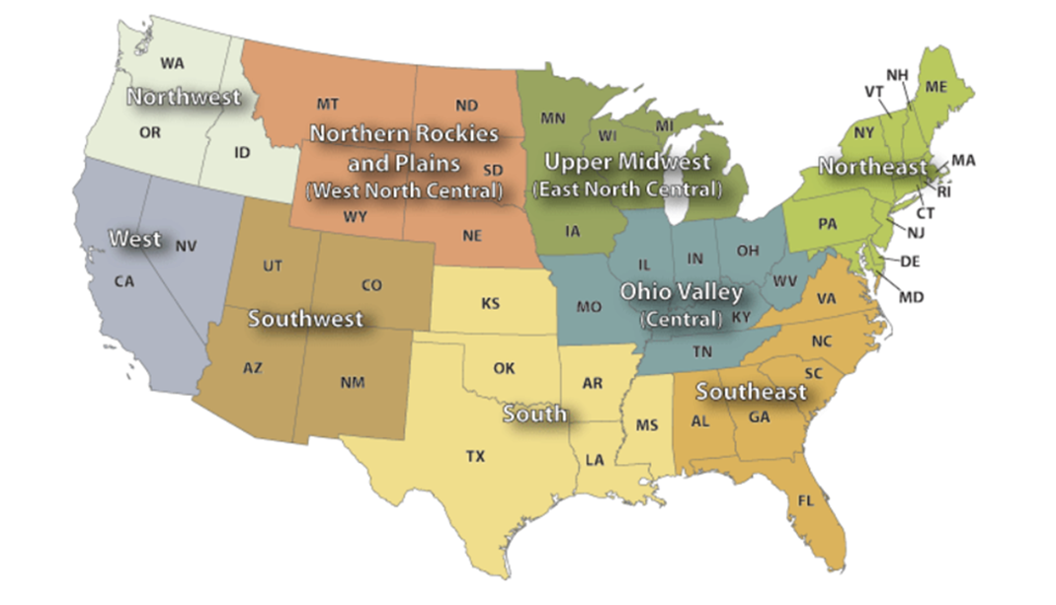
NOAA CLIMATE REGIONS

Slide 65
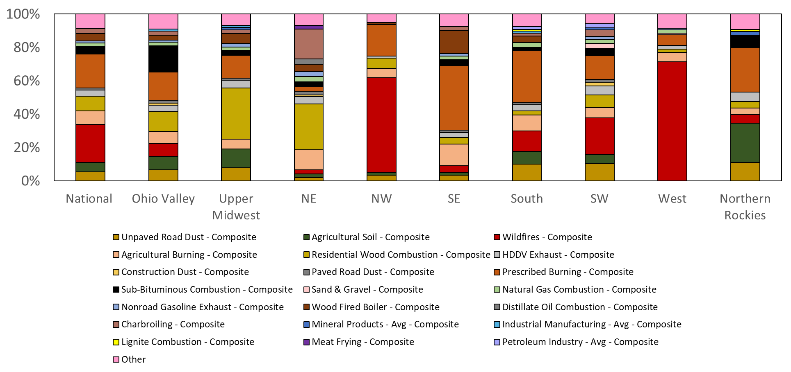
PM_{2.5} PROFILES* – REGIONAL DIFFERENCES
(% of mass assigned in 2014 EPA modeling platform) from Bray et al. (2019)
*excludes emissions from the onroad mobile sector
Notes:
-Wildfires prominent at the national level, in the northwest, the southwest and the west
-Residential wood combustion (gold) is prominent in the ohio valley, the upper Midwest and in the north east
-prescribed burning (orange) is prominent in the southwest, the south and the northern rockies

Slide 66
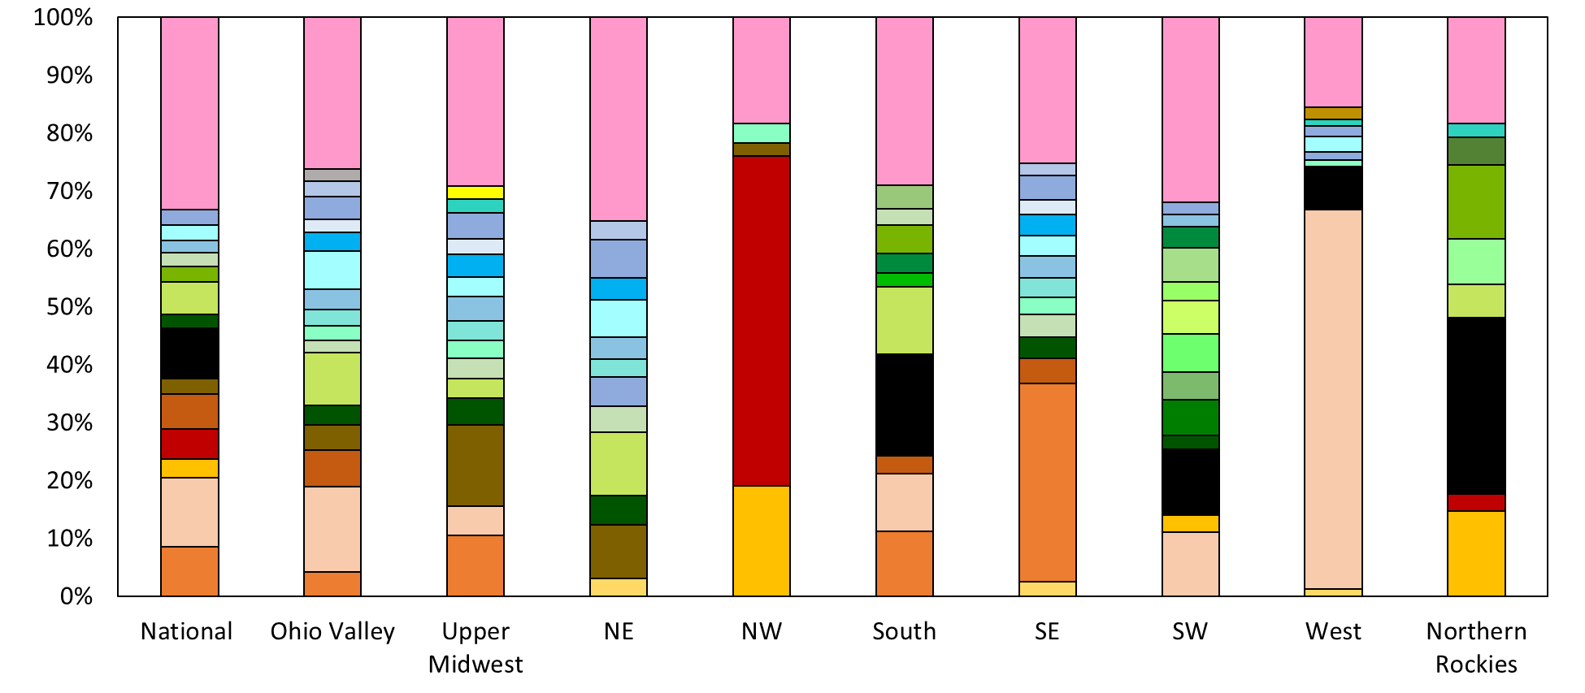
VOC PROFILES – REGIONAL DIFFERENCES*
(Bray et al., 2019)
*excludes emissions from the onroad and nonroad mobile sectors
Notes:
Pink is “other”
Blues and purples – consumer products and solvents (e.g. graphic arts, architectural coatings, consumer care products
Greens – oil and gas (the black bar represents the emission source profile for emissions from crude oil storage tanks, the light green represents the emission source profile for natural gas production)
Browns/orange/yellows = biomass burning emissions (peach = prescribed fire in the southwest conifer forest, red – wildfire northwest conifer forest, orange – prescribed fire in the southeast conifer forest and then the brown = fireplace wood combustion of pine wood

Slide 67
PRIORITY RANKINGS
Criteria |  | Points Assigned
(1) Tested emissions source representative of current technology | Technology (source) still in use | 0
 | Mix of outdated technologies and technologies still in use | 1
 | Teste source no longer represents current sources | 2
(2) Level of Documentation | Peer reviewed | 0
 | Documented in report or other accessible record | 1
 | No/missing documentation or engineering judgement | 2
(3) Inventory source matches tested source | All SCCs match tested source | 0
 | Less than 10% of SCC emission mass do not match tested source | 1
 | More than 10% do not match tested source | 2
(4) Percent of emitted mass/reactivity assigned to this profile in EPA’s 2014 emissions modeling platform | <4% (mass-based); <3% (reactivity-based) | 0
 | 4-8% (mass-based); 3-7% (reactivity-based) | 1
 | 8-12% (mass-based); 7-14% (reactivity-based) | 2
 | >12% (mass-based); > 14% (reactivity-based) | 3
(5) Error/Discrepancy in data? | None | 0
 | Discrepancy | 1
 | Error | 2
(6) Geographic region of source applicable? | Yes | 0
 | No | 1
Notes:
In notes add something about how this relates to QSCORE

Slide 68
Needs Assessment – Prioritization of Profiles
Ranked profiles based on quality, appropriateness and prevalence
PM_{2.5} emission source profiles most in need of update include those for fire (wildfires, prescribed fires, agricultural burning) and for sub-bituminous coal combustion
VOC emission source profiles most in need of update: crude oil storage tanks, oil and gas production – fugitives and prescribed fire in the southwest conifer forest
Notes:
See my poster for more info

Slide 69
QUESTIONS?
Are there any questions on what we've covered so far?

Slide 70
BREAK
15 min

Slide 71
Guidelines for Data Developers–
How to add data to SPECIATE
Link: Guidelines for Data Developers
Profile description and completeness
Quality
Format for compiling data
Data normalization
Notes:
The Guidelines for Data Developers document gives detailed overview of how data are added to SPECIATE. To
The first section describes the speciation profile (e.g. what a profile is, what it needs to be considered complete). The next section describes the caliber of quality that is necessary for an emission source profile as the EPA requires good or excellent quality data for the database. The third and fourth sections describes the formatting of the data for SPECIATE while the fifth section describes how the data should be normalized. Finally, the last section of the document describes the quality criteria factors (e.g. the QSCORE, which was discussed earlier). In this part of the presentation, we will focus on the first three sections: the profile completeness, the profile quality and then the format of the data for SPECIATE.

Slide 72
Guidelines for Data Developers – Completeness
Profiles presented as weight percent of chemical species (emission factors optional)
Emission source data should fully characterize the source emissions (an entire suite of species)
  It is possible that you will need more than one test and analysis method
For particulate matter emission source profiles, the size fraction of the PM should always be included
Notes:
In the SPECIATE database, profiles are presented as weight percent of chemical species measured in a source specific emission stream. The inclusion of emission factors is optional, however, it is recommended that they are included. It is important that emission source data fully characterizes the emission source in order to avoid mischaracterization of a source. For example, TOG profiles should include methane and all organic functional groups such as alkanes, alkanes, aromatics, etc. associated with the source. It is important to note that it very possible that to characterize the full suite of pollutants from and emission source, more than one test and analysis method will be necessary. For PM emissions source profiles, the size fraction of the PM should always be included to avoid confusion

Slide 73
Guidelines for Data Developers – Quality
Inherent value of profile is demonstrated by the QSCORE criteria
The QSCORE questions are provided in the Guidelines
Notes:
The quality of the data used to create the profile is important as it defines the quality of the emission source profile. The inherent value of a profile is demonstrated by the QSCORE criteria, which are provided in the Guidelines for Data Developers. As aforementioned in this presentation, the Q score rates profiles based on the data source, the methodology used in the study and the uncertainties and assumptions made. For more information on how to develop a high quality profile, please refer to the guidelines document.

Slide 74
Guidelines for Data Developers – Format for Compiling Data
SPECIATE is an Access database
To add your own data – Microsoft Excel Template
Data tabs in SPECIATE Data Template:
  RAWDATA
    Example
    Instructions
  PROFILES
  SPECIES
  MasterReferenceList
Notes:
The SPECIATE database is a Microsoft Access database. To add your own data to the database, a Microsoft excel template has been created to help facilitate proper formatting. This template has the fields needed for the current version of SPECIATE.
Pull up template
There are several tabs within this template. The RAWDATA tab is where you put the data from your study and compute the weight percents for the SPECIES tables. It is important to provide documentation of any steps to manipulate the data.
The PROFILES tab includes all the metadata about the profile (e.g. emission source, sampling conditions/methods, ect.)
The SPECIES tab includes species identification number, the profile code associated with the species, the percentage of the species in the profile, the uncertainty and method used to determine uncertainty and a description of the analysis method used to determine species percentages in the profile
Finally, the MasterReferenceList tab includes keywords for the profile and information that characterizes the reference documents associated with the profiles

Slide 75
THE SPECIATE WORKGROUP AND FUTURE PLANS
EPA’s SPECIATE Workgroup
Modelers tell us what is important
Ongoing literature searches
Peer-reviewed journal articles preferred
The “Master List” of references
Needs Analysis Project - data gaps
If you’re interested in having your data in SPECIATE you can voluntarily consult the Guidelines for Data Developers and send questions to: SPECIATE_WG@epa.gov
Notes:
The EPA has a SPECIATE workgroup that is composted of modelers, emission testers, inventory developers, and VOC policy analysts (?), with the modelers telling us what is important. We have an ongoing literature search with our library to keep us up to date on relevant literature as peer reviewed articles are preferred for emission source profile development. We will continue to sift through the Master List of potential references. In addition to this, the results of the needs analysis project highlighted data gaps in the database which we are trying to fill. If anyone is interested in having data in the SPECIATE database, please consult the Guidelines for Data Developers document and send any questions to SPECIATE_WG@epa.gov

Slide 76
FUTURE SPECIATE PLANS
Interim SPECIATE releases
Develop Standard Operating Procedure (SOP) for SPECIATE Profile Selection, Collection, and Entry
  Improve Documentation of Metrics and Processes
ACCESS database structure improvements (e.g. an improved reference structure)
Add new/improved profiles
Notes:
Instead of waiting for another full SPECIATE release, we are planning interim releases of the database. We strive to improve the documentation of speciate profiles and improve the structure of the access database (for example, we are planning on improving the reference structure) and we are also planning on adding new and or improved profiles to the database, for example, we are working on new emission source profiles for fires based on recent testing done in ORD.

Slide 77
QUESTIONS?
Are there any questions on what we've covered so far?

Slide 78
Speciation provides inputs to
Air Quality Models (AQMs)
Atmospheric chemistry consists of millions of reactions among many thousands of chemical compounds
AQMs use a condensed chemical mechanism with a manageable number of reactions and model species
  CB05, CB6
  SAPRC99, SAPRC07, SAPRC11
  RACM2
  CRIv2r5, and more
A chemical mechanism provides a basis for computer modeling studies of ozone, particulate matter (PM), visibility, acid deposition and air toxics issues
Chemical mechanisms require assignments of real compounds to model species of the condensed mechanism
Inventories with speciation get you the real compounds, but you need the model species
Notes:
Photochemical Air Quality models such as CMAQ simulate fate and transport of the various pollutants emitted from sources and produced via atmospheric chemistry.
Atmospheric chemistry consists of millions of reactions among many thousands of chemical compounds
Air aiql
2nd bullet provides examples of chemical mechanisms. For our NATA modelling, we are using a CMAQ version of for carbon bond 6 (CB6) that treats naphthalene as explicit. The platform documentation always provides which chemical mechanism we use.

Slide 79
SPECIATION FOR AQ MODELING
SPECIATE profiles
Speciation Tool
Mechanism-Specific chemical mapping
ethane
ethene
propene
butane
pentane
….
ETHA
ETH
OLE
PAR
….
Source-to-Profile cross reference (GSREF)
Mechanism-Specific Speciation Profiles (GSPRO and GSCNV)
Emissions Source for Inventory Pollutant-e.g. VOC, PM2.5
Assign Chemical Mechanism-specific Speciation Profile(s) to source based on process (SCC), location (GSREF)
Multiply Inventory emissions by profile factor to get emissions of AQM species:
moles for gases, mass for particulates
SMOKE
Notes:
Many tools and databases are used for AQ modeling speciation.
The AQ model uses a chemical mechanism which is a condensed form of the chemical reactions that occur in the atmosphere. This is one reason SPECIATE by itself is insufficient for the creating AQ- model profiles.
Also the profiles have to be assigned to sources (GSREF) and applied in SMOKE. Note that SMOKE generates moles for gaseous species and mass for particulates.

Slide 80
SPECIATION STEPS IN MODELING TOOLS
Speciation Tool: creates SMOKE ancillary files GSPRO and GSCNV
  Uses SPECIATE profiles
  Uses mechanism-specific chemical mapping, e.g., CB6 different from CB05
SMOKE: Uses GSREF to assign profiles to sources and uses ancillary files GSPRO and GSCNV to compute AQM emission files
Emissions Modeling Framework: can be used as an interface for managing inventories and related data (profiles), and interface for running the Speciation Tool and SMOKE

Slide 81
Where to find the GSREF
Platform data are provided at https://www.epa.gov/air-emissions-modeling/emissions-modeling-platforms
All platforms list the inputs to SMOKE – ftp site since files are so large
Most recent platform is 2016beta ftp://newftp.epa.gov/air/emismod/2016/beta/
Ancillary file contents listed at ftp://newftp.epa.gov/air/emismod/2016/beta/ancillary_data/ge_dat_for_2016beta_speciation_02jan2019_contents.txt
Look for all files with “gsref” in the name.
Key file is: -rw-rw-r-- 3.0 unx 9839789 tx defN 18-Dec-13 14:21 ge_dat/speciation/gsref_cmaq_cb6_2016ff_16j_10dec2018.txt

Slide 82
SPECIATION TOOL - SPTOOL
SPTOOL is a stand-alone tool that was developed to generate the GSPRO and GSCNV ancillary data SMOKE uses for speciation
SPTOOL implemented using open source PostgreSQL database and Perl interface
The latest SPTOOL install and User Guide can be downloaded from the EPA/CMAS website https://www.cmascenter.org/help/documentation.cfm?MODEL=speciation_tool&VERSION=4.0

Slide 83
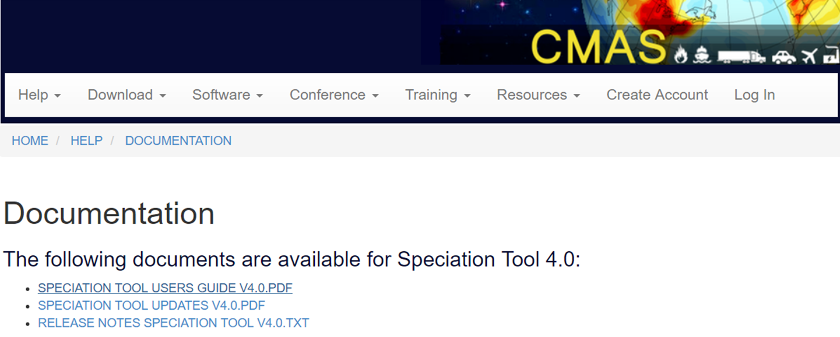
How to run “Quick Start” instructions – provided in extra slides of this training
Working on revising Speciation Tool (v5.0) to create AE6-ready profiles
  Will include updated user’s guide and documentation manual
Notes:
You need an account (it is free) to get the Speciation Tool from the Community Modeling and Analysis System (CMAS)
Web address is https://www.cmascenter.org/
But you don’t need it for the documentation (user’s guide and notes)

Slide 84
PREPARING EMISSIONS FOR MODELING
GSPRO contains factors to speciate
  Split Factor: numerator for mole-based speciation
  Divisor: denominator for the mole-based speciation
  Split Factor/Divisor = moles of model species per mass of TOG
  For PM, divisor = 1
GSCNV contains VOC-to-TOG conversion factors to convert inventory VOC (or ROG) to TOG to apply TOG-based speciation profiles
Notes:
The model ready profile in SMOKE is in the GSPRO file.
It has a split factor numerator which equals the mass fraction.
It has the divisor which is the model species molecular weight (for gases)

Slide 85
SMOKE GSPRO and GSCNV files
GSPRO sample profile
Speciation profile number | Pollutant ID (name) | Species ID (name) | Split factor | Divisor | Mass Fraction
0051 | TOG | CH4 | 0.2 | 16.042 | 0.2
0051 | TOG | ETHA | 0.3 | 30.069 | 0.3
0051 | TOG | FORM | 0.2 | 30.026 | 0.2
0051 | TOG | PRPA | 0.3 | 44.096 | 0.3
GSCNV sample profile
Name of pollutant converting from | Name of pollutant converting to | Speciation profile code | Conversion factor
VOC | TOG | 0051 | 2

Slide 86
Example GSPRO records
Pollutant is TOG
Pollutant is NONHAPTOG (remove formaldehyde)
GSPRO sample profile
Speciation profile number | Pollutant ID (name) | Species ID (name) | Split factor | Divisor | Mass Fraction
0051 | TOG | CH4 | 0.2 | 16.042 | 0.2
0051 | TOG | ETHA | 0.3 | 30.069 | 0.3
0051 | TOG | FORM | 0.2 | 30.026 | 0.2
0051 | TOG | PRPA | 0.3 | 44.096 | 0.3
Speciation profile number | Pollutant ID (name) | Species ID (name) | Split factor | Divisor | Mass Fraction
0051 | NONHAPTOG | CH4 | 0.25 | 16.042 | 0.25
0051 | NONHAPTOG | ETHA | 0.375 | 30.069 | 0.375
0051 | NONHAPTOG | PRPA | 0.375 | 44.096 | 0.375
Notes:
GSPRO maps TOG or NONHAPTOG to the model species. Note that in the above example model species names go into the GSPRO (3rd column)
GSCMV contains the VOC to TOG conversion factor (a single value per profile)

Slide 87
Example GSPRO records using Inventory HAPs
Inventory HAP Maps to Explicit CB6 HAP
SMOKE converts from pollutant code to NAME
GSPRO sample records
Speciation profile number | Pollutant ID (SMOKE name) | Species ID (name) | Split factor | Divisor | Mass Fraction
0000 | ACETALD | ALD2 | 1 | 16.042 | 1
0000 | FORMALD | FORM | 1 | 30.026 | 1
0000 | BENZENE | BENZ | 1 | 78.1118 | 1
0000 | METHANOL | MEOH | 1 | 32.0419 | 1
0000 | NAPHTH | NAPH | 1 | 128.1705 | 1
Notes:
GSPRO also has records for inventory pollutants that get mapped to explicit model species. Note that they are not split so the factor is 1.

Slide 88
Example GSPRO records using Inventory HAPs
Inventory HAP Maps to Lumped CB6
SMOKE converts from pollutant code to NAME
GSPRO sample records
Speciation profile number | Pollutant ID (SMOKE name) | Species ID (name) | Split factor | Divisor | Mass Fraction
0000 | STYRENE | OLE | 0.125 | 26.0373 | 1
0000 | STYRENE | TOL | 0.875 | 91.1305 | 1
0000 | PROPIONAL | ALDX | 0.6667 | 38.7194 | 1
0000 | PROPIONAL | PAR | 0.3333 | 19.3597 | 1
Notes:
If you want to integrate HAPs that are NOT explicit you can do that, and these are example of GSPRO records that accomplish that.. The Speciation tool will provide GSPRO records. You just have to tell the Speciation Tool what you are integrating. These types of records would be used in MOVES since MOVES integrates these 2 HAPs in addition to many others.

Slide 89
Example GSPRO records using Inventory HAPs
Inventory HAP maps to non CB6 HAP that is in CMAQ (version5.2)
GSPRO sample records
Speciation profile number | Pollutant ID (SMOKE name) | Species ID (name) | Split factor | Divisor | Mass Fraction
0000 | ACETALD | ALD2_PRIMARY | 1 | 30.069 | 1
0000 | FORMALD | FORM_PRIMARY | 1 | 30.026 | 1
0000 | ACROLEI | ACROLEIN | 1 | 56.0633 | 1
0000 | BUTADIE | BUTADIENE13 | 1 | 54.0904 | 1
Notes:
These model species are used in the air toxics version of CMAQ.

Slide 90
GSPRO PM_{2.5} example
GSPRO sample records
Speciation profile number | Pollutant ID (SMOKE name) | Species ID (name) | Split factor | Divisor | Mass Fraction
95475 | PM2_5 | PAL | 0.0078 | 1 | 0.0078
95475 | PM2_5 | PCA | 0.0105 | 1 | 0.0105
95475 | PM2_5 | PCL | 0.0275 | 1 | 0.0275
95475 | PM2_5 | PEC | 0.0666 | 1 | 0.0666
95475 | PM2_5 | PFE | 0.0156 | 1 | 0.0156
95475 | PM2_5 | PK | 0.0037 | 1 | 0.0037
95475 | PM2_5 | PMOTHR | 0.0565 | 1 | 0.0565
95475 | PM2_5 | PNCOM | 0.1786 | 1 | 0.1786
95475 | PM2_5 | PNH4 | 0.0444 | 1 | 0.0444
95475 | PM2_5 | PNO3 | 0.0238 | 1 | 0.0238
95475 | PM2_5 | POC | 0.4465 | 1 | 0.4465
95475 | PM2_5 | PSI | 0.0243 | 1 | 0.0243
95475 | PM2_5 | PSO4 | 0.0943 | 1 | 0.0943
Notes:
One PM2.5 GSPRO example. It has PNCOM so it can be used for the AE6 aerosol module.

Slide 91
Calcs done by SPTOOL to go from SPECIATE profile to GSPRO profile
Spreadsheet Tool: Sample_VOC_profile_calcs_speciate_training.xlsx
Notes:
The spreadsheet we are providing with this training allows you to follow the calculations done in the SPTOOL to create mechanism specific TOG profiles (GSPRO) from 1 SPECIATE profile for 2 different mechanisms and also to create a NONHAPTOG (INTEGRATE case) profile by zeroing out NBAFM.
The readme walks you through the steps. They are also provided in the other TABS. Two of the TABS contain chemical mechanisms (CB6 and CB05).
If you have a profile that has more species than this example you will have to modify the formulas. If you do not, then you just have to replace the profile species ids, species names and weight percents.
The most computationally intensive part is compound the molecular weights of the model species since they are profile-specific.

Slide 92
extras

Slide 93
How Profiles are Added
Notes:
Madeleine Strum is in the emission inventory group in the Office of Air Quality Planning and Standards and is a very active member on EPA’s SPECIATE work group and is co-work assignment manager along with Marc Menetrez who is the lead for the SPECIATE database and work assignment manager. Marc is with National Risk Management Research Laboratory in EPA’s Office of Research and Development, located here at Research Triangle Park NC.
Casey Bray has been working on various aspects of SPECIATE as a student intern with ORD and is now with EPA’s, Sector Policies and Programs Division (SPPD), Measurement Policy Group. We are the group that is in charge of AP 42, we actually stole it from Madeleines group.

Slide 94
SPTOOL SOFTWARE REQUIREMENTS
PostgreSQL can be downloaded from http://www.postgresql.org
Perl and the database drivers can be downloaded from http://www.perl.com
User must have database create privileges in PostgreSQL to run the Speciation Tool

Slide 95
SPTOOL QUICK START
Create a Speciation Tool directory
Extract the Speciation Tool installation files
    Change to the Speciation Tool directory
    Copy the Speciation Tool package to this directory
    Extract the zipped file
Verify required software packages are available.
    Run ./spool_reqd_checks.sh
Set environment variables
    Edit Assigns.sptool; Set SPTOOL_HOME
    Source Assigns.sptool

Slide 96
SPTOOL QUICK START
Initialize the Speciation Tool database
      Execute ./init_sptooldb_v4.0.csh
Execute the provided test case
      Change to the run directory; cd /run
      Run ./test_all.job
Review results
      Change to output directory; cd ../output

Slide 97
SPTOOL INSTALLATION
Create SPTOOL home directory with any valid directory name
Copy the installation file to home directory and extract
  tar -xvzf tar_Speciation_Tool_v4.0_11jan2017.tgz
Run script to check for required software and verify user PostgreSQL authorizations
  Run sptool_reqd_checks.sh

Slide 98
SPTOOL DATABASE INITIALIZATION
Speciation Tool must be initialized prior to making any runs. Initialization steps include:
    Update and source the assigns file Assigns.sptool
      Set the home directory
    Run the initialization script
      ./init_sptooldb_v4.0.csh
What happens during the SPTOOL initialization?
    Create database, set permissions, create the shared schema and table definitions for the tool data, and import data to the shared schema.

Slide 99
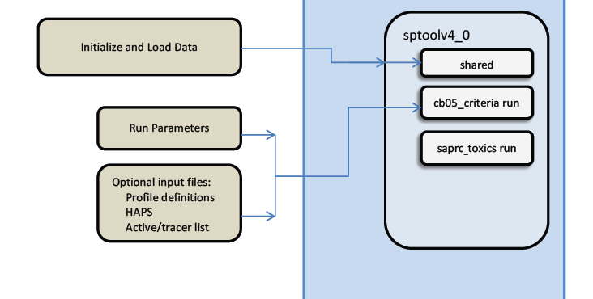
SPECIATION TOOL INITIALIZATION
Initialization creates the sptoolv4_0 PostgreSQL database with schema shared. Each run will create an additional named schema based on the user specs.
International Emissions Inventory Conference Baltimore, MD, August 15, 2017

Slide 100
SPTOOL ASSIGNS FILE
  Assigns.sptool file can be found in the top level SPTOOL home directory
    Update and source the Assigns.sptool file
  Assigns file sets environment variables that are required for the database initialization
    SPTOOL home directory
    Database name
    File names of input speciation data

Slide 101
SPTOOL INPUT FILES
  PROFILES_GAS – gas profile description and documentation
  WEIGHTS_GAS - organic gas mass fraction profiles (in weight percent)
  PROFILES_PM – PM profile description and historical information
  WEIGHTS_PM - PM mass fraction profiles (in weight percent)

Slide 102
SPTOOL INPUT FILES
  SPECIES_PROPERTIES – properties of individual organic compound, including molecular weight
  MECHANISM – mechanism mappings
    moles model species / mole organic compound
  MECHANISMPM - PM2.5 mechanism mappings
    mass model species / mass PM2.5
  CARBONS – number of carbon atoms in each model species

Slide 103
SPTOOL OUTPUT FILES
SPLITS_OUT (GSPRO) - SMOKE speciation profiles
    Split Factor: numerator for mole-based speciation
    Divisor: denominator for the mole-based speciation
    Split Factor/Divisor = moles of model species per ton of TOG
    For PM, divisor = 1
    CNV_OUT (GSCNV) - SMOKE VOC-to-TOG conversion factor file

Slide 104
RUNNING SPTOOL
  First source the Assigns.sptool file to set the required environment variables SPTOOL_HOME and SPTOOL_DB
  SPTOOL must be initialized prior to making any runs
  Run script - The perl program run_sptool.pl creates output SMOKE profile files - GSPRO and GSCNV
  The run script requires the SPTOOL database name, a name to uniquely label the database schema, and a run control file name as input
  perl $SPTOOL_SRC_HOME/run_sptool.pl $SPTOOL_DB cmaq_cb6_criteria RUNCTL

Slide 105
SPTOOL RUN CONTROL FILE
The run control file indicates run parameters and run-specific data files required for the Speciation Tool run.
The format of the run control file is
<keyword>, <option>
Examples,
MECH_BASIS, CB05
OUTPUT, VOC
RUN_TYPE, CRITERIA
AQM, CAMX
International Emissions Inventory Conference Baltimore, MD, August 15, 2017

Slide 106
RUN PARAMETERS
MECH_BASIS – select chemical mechanism to use
OUTPUT – select which output profiles to generate. Options are “VOC” for gas species and “PM” for particulates
RUN_TYPE - The RUN_TYPE options are: CRITERIA, INTEGRATE, NOINTEGRATE, HAPLIST, and VBS
AQM – this parameter selects model-correct species names for output files
TOLERANCE – specifies acceptable deviation from 100% for the sum of weight percentages (default is 5%)

Slide 107
SPTOOL FAQ
What happens when an organic compound used by a profile lacks a defined molecular weight?
  Any detailed organic compound with an undefined molecular weight is dropped from the profile because a molecular weight is required to compute splits factors. Dropped mass fraction due to missing molecular weights may takes the profile sum outside the selected tolerance, causing the profile to be dropped. This problem should be resolved by specifying missing molecular weights in the species properties.

Slide 108
SPTOOL FAQ
What happens when an organic compound used by a profile lacks an assignment in the mechanism mapping?
  SPTOOL issues a warning and the compound is assigned to UNK
When does SPTOOL renormalize a profile?
  If the sum of mass fractions for a profile is not 100%, and nothing is done to correct the profile, subsequent SMOKE processing will not conserve mass. SPTOOL renormalizes all gas profiles whose sum is within the tolerance thereby preserving VOC mass. Profiles outside the tolerance are dropped and a warning is issued.
  For the AE6 PM profiles, when sum of AE6 PM species is less than 100%, the remaining mass gets assigned to PMOTHR (=100% - sum of AE6). When the sum is greater than 100%, the profiles are dropped with a warning.

Slide 109
OLD SLIDES

Slide 110
PAST EFFORT: 2008 NEI (2013 VOLUNTEER)
Found low-hanging fruit in the 2008 NEI Platform
Reviewed VOC emission profiles applied to SCCs that are the largest sources of VOCs
Identified opportunities for Pulp & Paper
  Over 200 source operations linked to generic profiles
  Profile 1185: Coal Fired Boiler – Industrial linked to eight largest operations (43 of 144 kTpy)
The 2008 NEI had > 500 kTpy of TOG speciated with the default profile (0000).
Notes:
[Same idea as Reff, et.al. 2009 for PM profiles, but done superficially]
Reff et al., 2009: Reff, A., Bhave, P.V., Simon, H., Pace, T.G., Pouliot, G.A., Mobley, J.D., and Houyoux, M., Emissions Inventory of PM_{2.5} Trace Elements across the United States, Environmental Science and Technology, 43: 5790–5796, 2009.

Slide 111
IMPACT OF MISMATCHED PROFILES
Notes:
Comparing the two profiles – shows the species are very different for each profile – impact of mismatching profile

Slide 112
PAST EFFORTS: 2011 NEI MODELING PLATFORM IMPROVEMENTS
EPA developed and applied appropriate composite source profiles for the Pulp & Paper and Chemical Manufacturing sectors from SPECIATE emissions profiles.
Pulp and Paper: 97 of 121 kTpy (80%) reassigned from profiles 0000 and 1185
Chemical Manufacturing: 20 of 90 kTpy (22%) reassigned from profile 0000
Composite profiles were added to SPECIATE 4.5.
Notes:
[Same idea as Reff, et.al. 2009 for PM profiles, but done superficially]
Reff et al., 2009: Reff, A., Bhave, P.V., Simon, H., Pace, T.G., Pouliot, G.A., Mobley, J.D., and Houyoux, M., Emissions Inventory of PM_{2.5} Trace Elements across the United States, Environmental Science and Technology, 43: 5790–5796, 2009.

Slide 113
Overview for Using Data Development Guidelines
Notes:
Here is a quick step guide of the practices in this guideline for speciation data that could be incorporated into the speciate database. Review sections 1-4 and 6 of the guidelines – which describe how profiles should be created and documented. Then conduct source testing and analysis for chemical compositions. To assist in profile creation, there is a template available from the EPA SPECIATE homepage.

