Slide 1
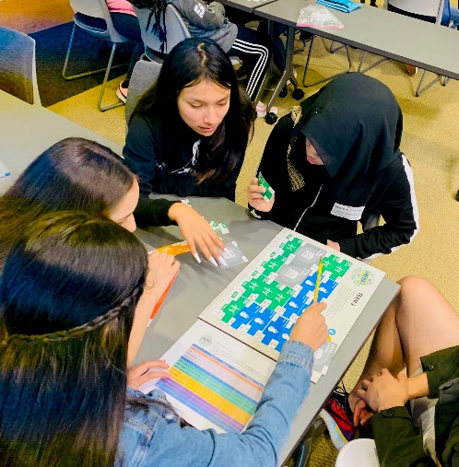
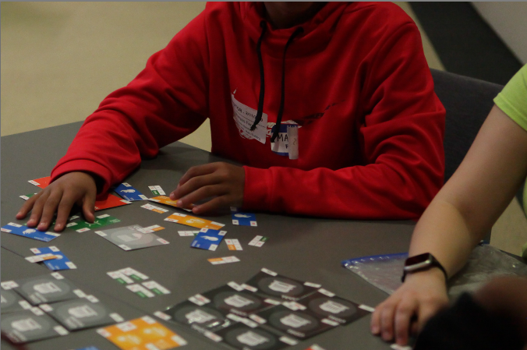
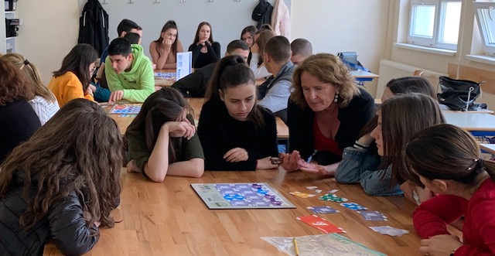
Welcome to GENERATE: The Game of Energy Choices
Disclaimer: The game and associated materials were developed in support of education and outreach, and do not represent official U.S. EPA opinion or policies. This document has been reviewed in accordance with U.S. Environmental Protection Agency policy and approved for publication.

Slide 2
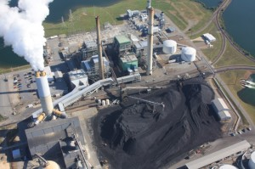
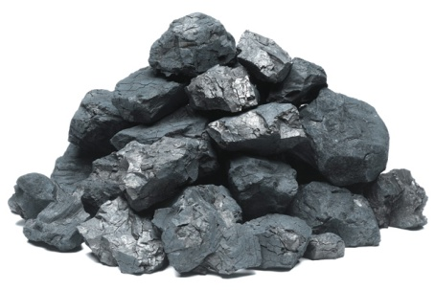
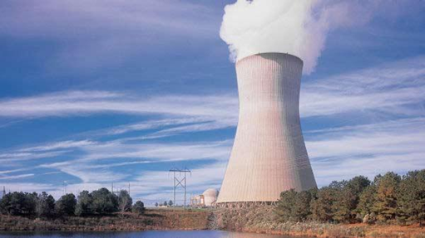
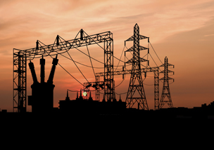
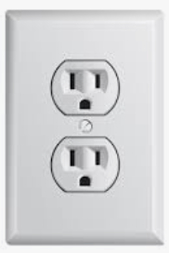
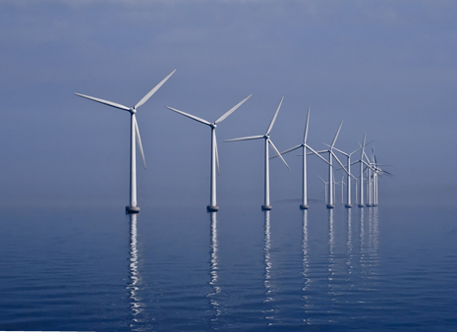
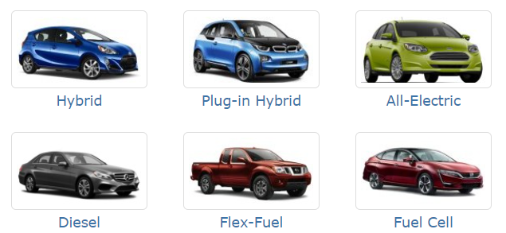
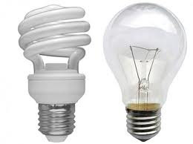
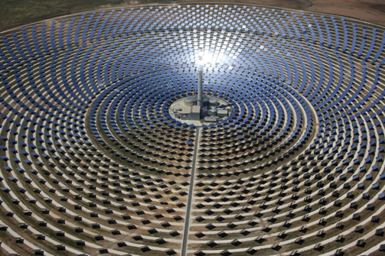
Energy 101: The big picture
Primary energy resources
Fossil: coal, natural gas, petroleum
Non-fossil, non-renewable: uranium
Renewable: wind, solar, hydro, geothermal, biomass
Technologies to convert primary resources to useable energy like electricity, gasoline, …
Petroleum Refineries
Electric Power Generation
End-use sectors
Residential
Commercial
Industrial
Transportation
Energy services – What do people actually need and want? Mobility (vehicle miles of travel) or accessibility (accessing education, work, shopping), lighting (lumens of light), comfort (space heating and cooling). Energy is a “derived demand”
Notes:
Energy can take many forms.
Primary energy resources include fossil fuels as well as renewables, like wind, solar, and hydropower. We also use uranium for nuclear power production.
We use energy in different “end-use sectors” like residential and commercial buildings (homes, offices, stores, etc), industrial facilities and manufacturing and in the cars and trucks we drive and the heavy-duty trucks that move the things we buy.
In between, we need to convert those primary resources to useable forms, like electricity, gasoline, and diesel.
Energy services are the things that we really need. Instead of thinking about a direct demand for a gallon of gasoline, what we really need is mobility (the vehicle miles traveled) to get us from point A to point B – like from home to school. But, sometimes mobility isn’t the final goal, but what people need is accessibility → being able to access education, work, and goods and services.

Slide 3
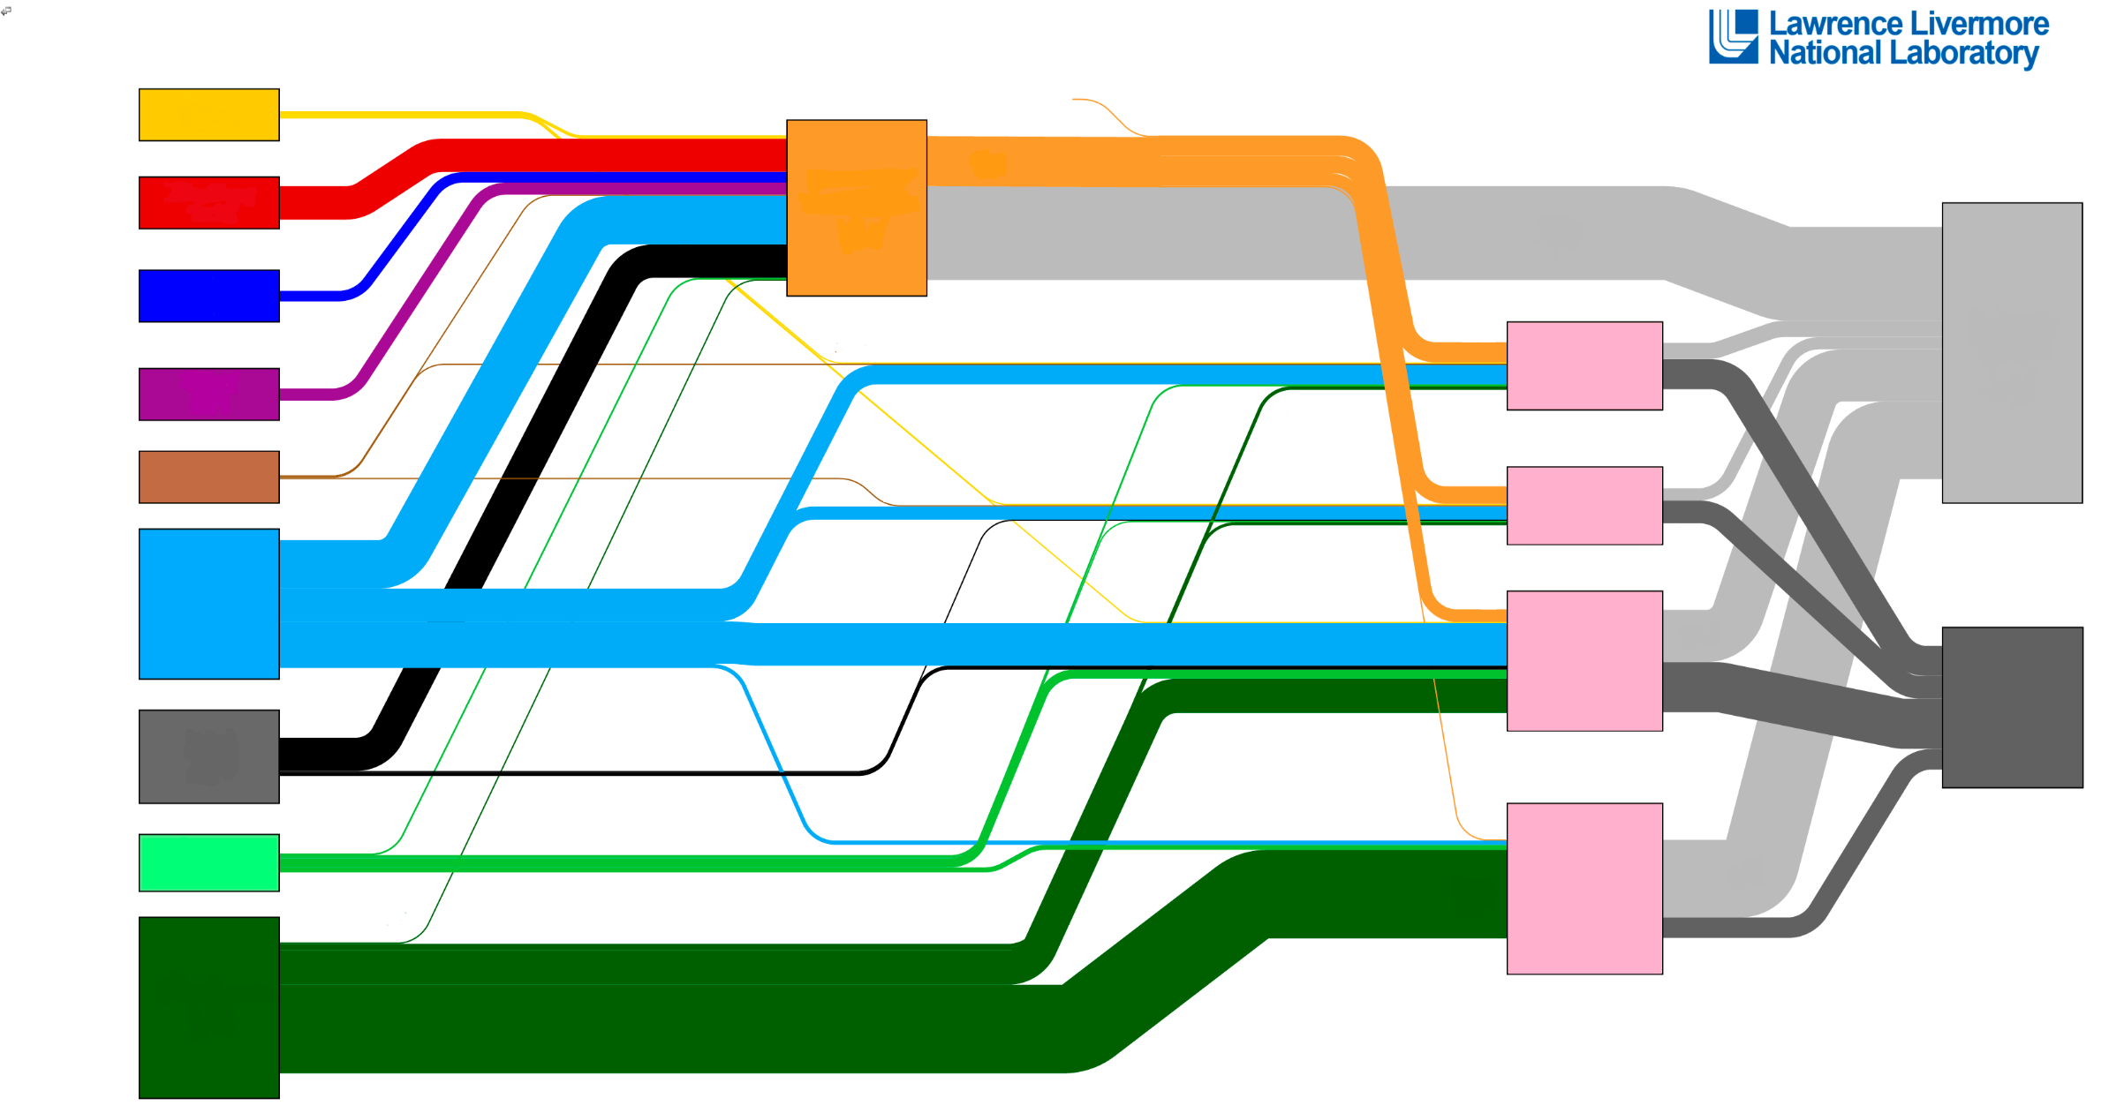
Connecting the dots
Coal
Natural Gas
Petroleum / Oil
Solar
Wind
Hydropower
Biomass
Geothermal
Nuclear
U.S Energy Flows from Resource to End Uses
1
Electricity
2
3
Rejected Energy
Residential
4
5
Commercial
6
Industrial
Energy Services
7
Transportation
8
9
Refineries
Adapted from https://flowcharts.llnl.gov/
Notes:
How do we connect the dots?
TELL STUDENTS:
This diagram is called a Sankey diagram, or flow diagram, and it connects all of our resources from primary resources to end use.
The width of the connecting flows represents the relative amounts of energy.
All flows of energy are represented here.
ASK STUDENTS:
What resources do we start with on the left? [The actual primary energy resource].
What where does all of the energy go to the right? [End-use demand sectors, or how and where we use that energy].
What do we need in between the energy resource and end use, to enable us to flip a switch and have the light turn on? [Technologies to convert the energy into useable resources, i.e., electric power plants to make electricity from coal, wind, solar, natural gas, uranium, etc.].
Each line on this infographic represents one of the energy sources listed on the left. Some of the resources are color coded (yellow for solar, black for coal, blue for natural gas, etc).
ASK STUDENTS:
Can you guess which energy sources match the numbers?
Which energy resource does the dark green represent? How might you know that? The answer is petroleum, because we know that cars and trucks are the main users of gasoline and diesel from petroleum. Crude oil is processed in refineries to make petroleum products like gasoline, diesel, jet fuel, and many other products.
Which energy resource is light blue? This energy resource goes to electricity production, but also directly to industry, homes and buildings. The answer is natural gas. We can see the blue flame on our gas stoves, for example.
If there is time, students can try to match the remaining energy forms with the colors on the graphic.
Let’s check and see if you’re correct. [Answers on next slide].

Slide 4
Connecting the dots
Solar = 1
Nuclear = 2
Hydropower = 3
Wind = 4
Geothermal = 5
Natural Gas = 6
Coal = 7
Biomass = 8
Petroleum / Oil = 9
U.S Energy Flows from Resource to End Uses
1
Electricity
2
3
Rejected Energy
Residential
4
5
Commercial
6
Industrial
Energy Services
7
Transportation
8
9
Refineries
Adapted from https://flowcharts.llnl.gov/
Notes:
Here are the answers. Any surprises?
ASK STUDENTS: Did you expect any of the energy sources to be larger, or smaller?
Many students will be surprised that renewables are not a larger share of electricity production, because they may hear about wind and solar on the news or in their readings. These are smaller, but are the fastest growing sources of electricity generation in the U.S.
ASK STUDENTS: What do you notice is happening with the thick gray lines, particularly on the upper right area of the slide?
This is rejected or wasted energy, or energy that doesn’t get turned into useful things.
ASK STUDENTS: How much is actually used versus wasted? Where is energy “lost” to rejected energy?
There is more rejected energy than the “useful energy” that goes to energy services. As an example, only about 1/3 of the primary energy that goes into power plants gets converted into electricity. This introduces the concept of efficiency. Some of the later rounds of the game include energy efficiency pieces.

Slide 5
Energy and our environment: why it matters
Energy-system related impacts
Air pollutants
Nitrogen Oxides (NO_{X})
Carbon monoxide (CO)
Sulfur Dioxide (SO₂)
Particulate Matter (PM)
…more
Greenhouse gases
Carbon dioxide (CO₂)
Methane (CH₄)
Nitrous oxide (N₂O)
Black carbon and short-lived climate forcers
Water use
~40% of total water withdrawals
Notes:
Now let’s think about environmental impact.
ASK STUDENTS: In what ways do energy extraction, conversion, and use impact the environment?
When we burn fossil fuels, it releases both greenhouse gases, like CO₂, as well as air pollutants that have impacts on health and ecosystems.
There are also methane emissions from processes involved in extracting and distributing natural gas.
Energy production and use can also use significant freshwater resources.
For example, total water withdrawals for all uses in the US in 2015 were estimated to be 322 billion gallons per day. Of that, 133 billion gallons per day (41%) are for thermoelectric power plants (natural gas, coal, and nuclear) https://doi.org/10.3133/cir1441

Slide 6
Generate: The Game of Energy Choices
Simulates an energy system
Helps us to see some of the challenges and tradeoffs involved in making energy choices
CO₂
Notes:
INTRODUCE THE GAME:
Generate is a simple simulation of our energy system
It uses numbers derived from engineering costs of building and operating electricity generating units.
It is important to understand individual types of energy resources, but also how they fit together as a grid.
The purpose of the game is to not to tell us the “right answer” but to help us understand the challenges and tradeoffs involved in making energy and policy decisions.

Slide 7
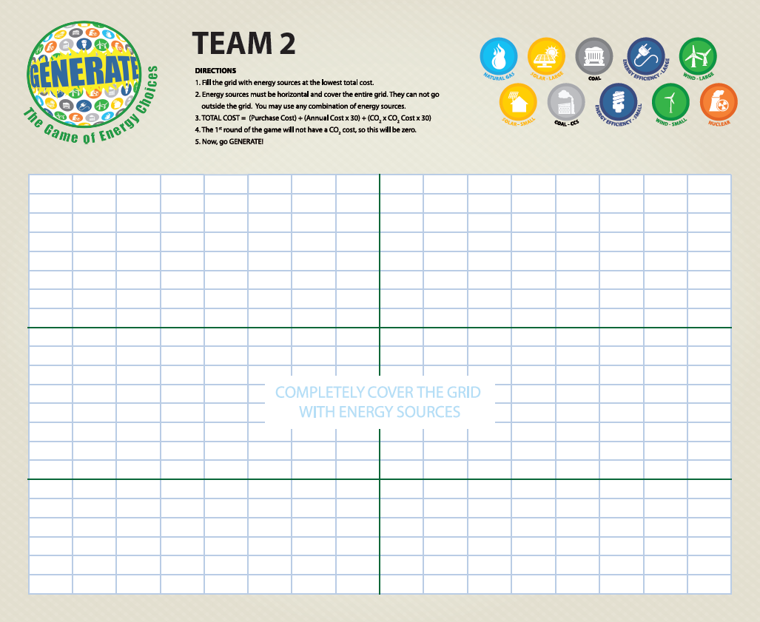
The game board = the “grid”
Student teams are the decision makers for how they want to produce energy
This board will be used for multiple rounds of game play
Each team can be thought of as a region, state, or country
Notes:
DESCRIBE THE GRID:
This is the grid. The name of the game is Generate because we are looking at how to produce, create or “generate” electricity for the electric grid.
The real-world electricity grid is made up of the power plants and other technologies that generate electricity. Electricity is transported through a complex system and over power lines to deliver electricity to the consumer.
For the game, our grid is the white area divided into rectangular units.
Each team has the same “grid” size
Each set will also have a mix of pieces which are the technologies that produce electricity.
The teams will NOT start the game with the same mix of energy pieces. This is like the real world, where different states, regions, and countries can have very different energy mixes.
The goal, in each round, is to completely fill the grid with energy pieces in order to achieve the lowest total score, or cost.
Pieces may not overlap, extend past the grid,or be placed sideways.

Slide 8
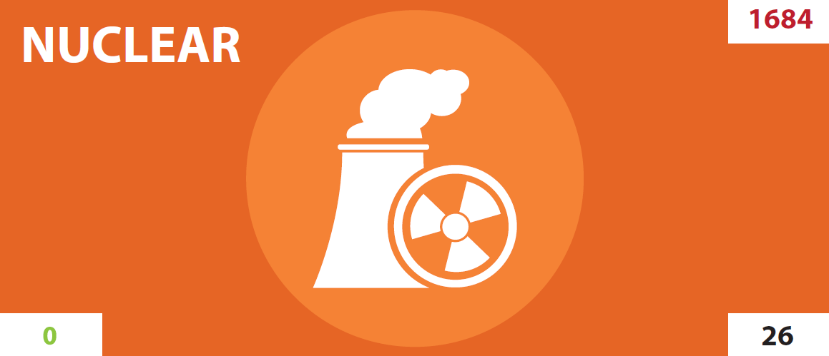
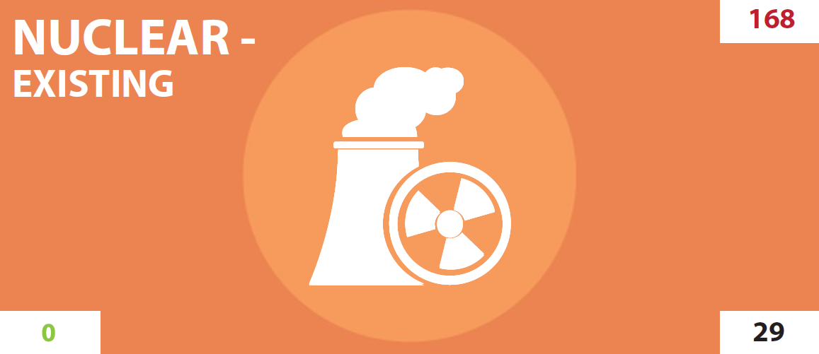
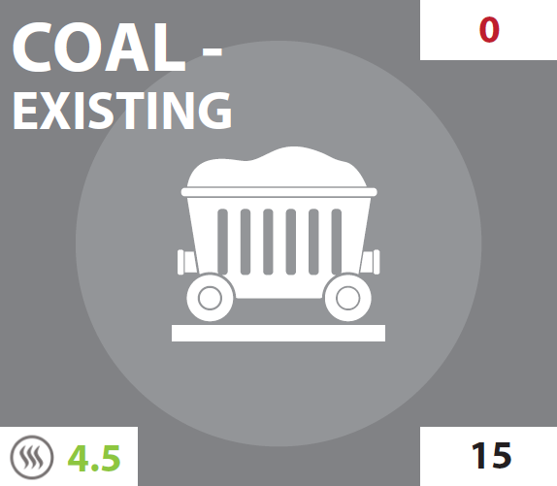
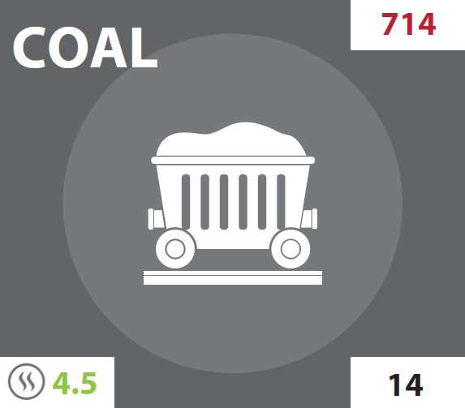
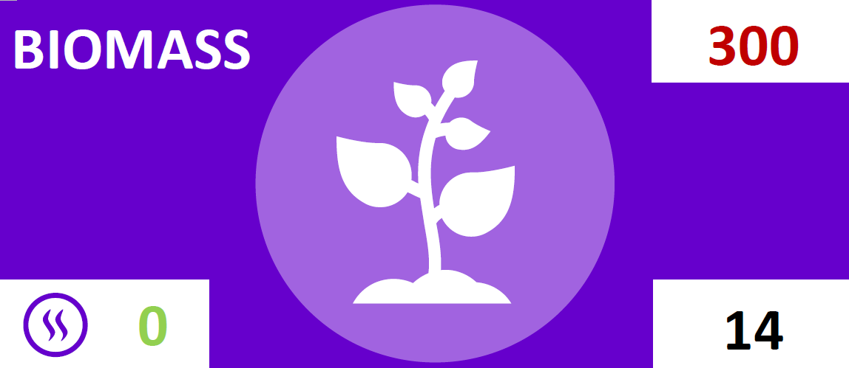
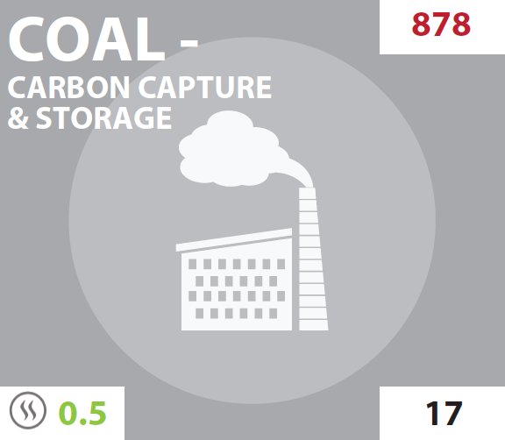
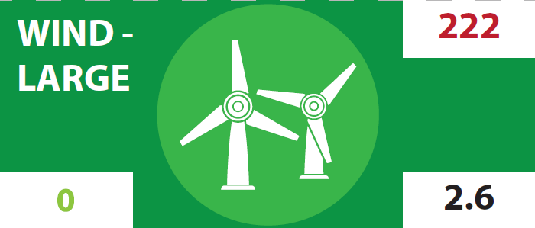
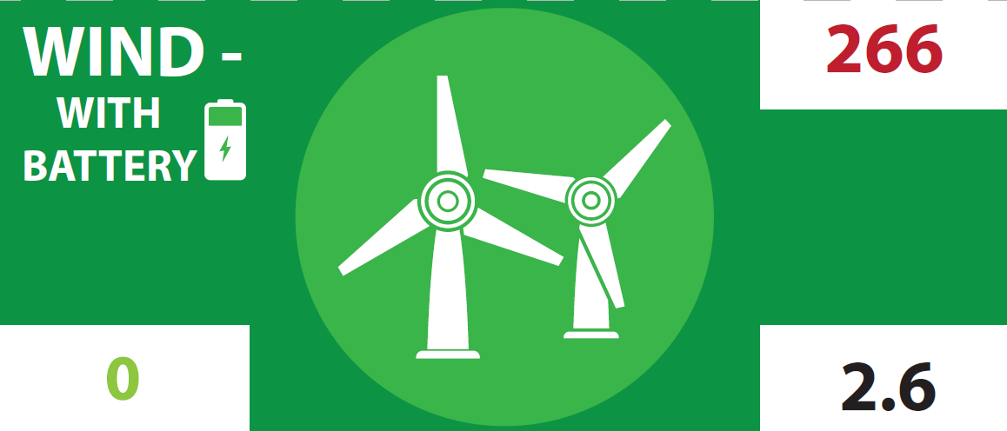
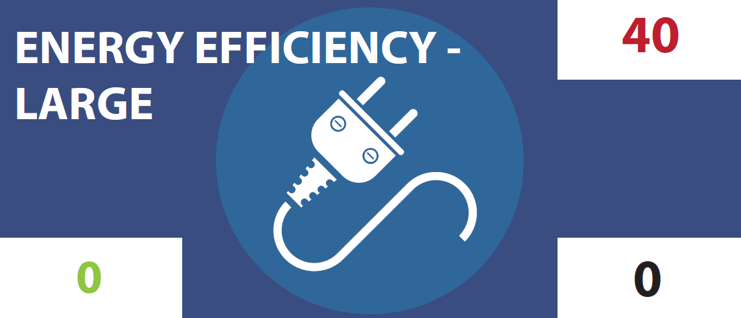
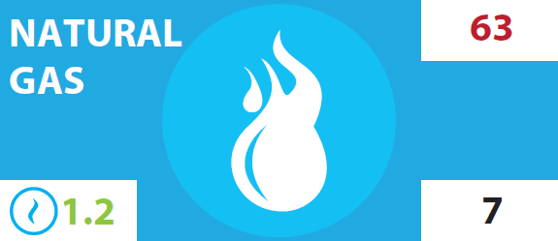
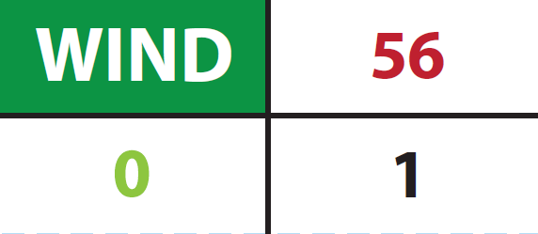
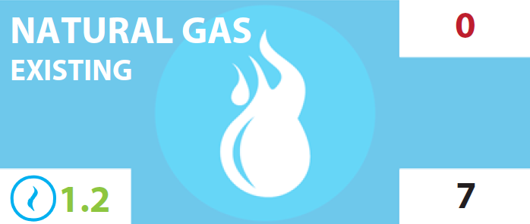
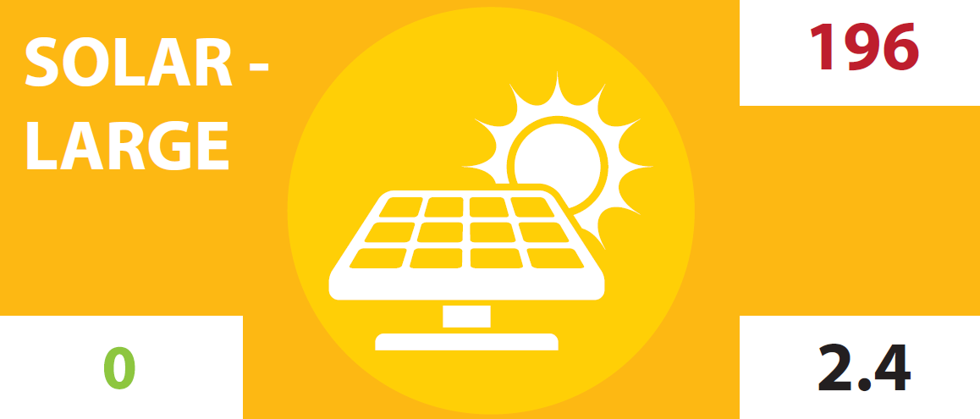
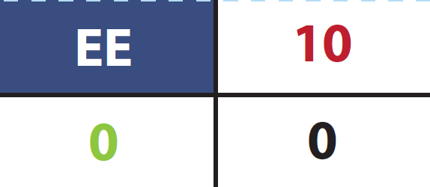
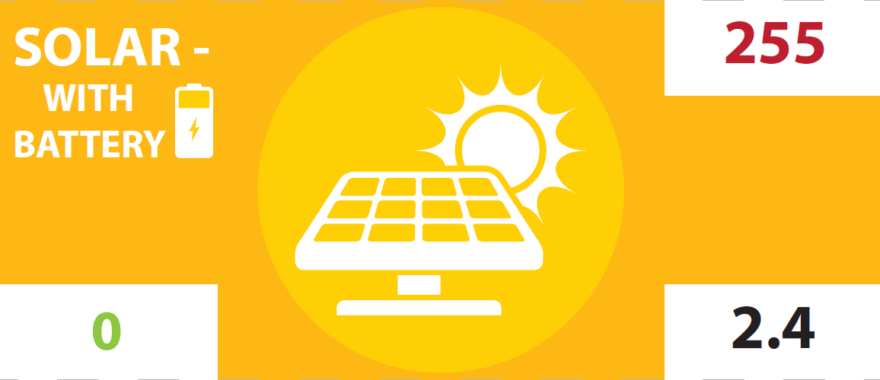
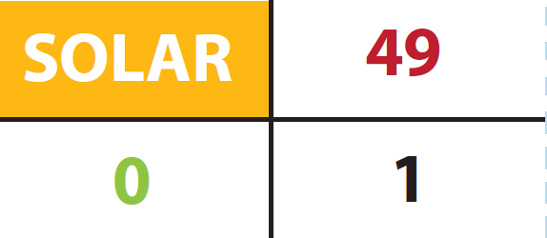
Types of energy pieces
NUCLEAR ENERGY
FOSSIL ENERGY
BIO-BASED ENERGY
RENEWABLE ENERGY
ENERGY EFFICIENCY
Notes:
DESCRIBE THE ENERGY PIECES:
These are the types of energy pieces available.
Compare the relative sizes of different pieces.
We will learn more about the costs in the new slides, but a couple of things to note.
Nuclear:
The nuclear pieces are the largest, which means they produce a lot of power and cover more of the grid for each piece.
Existing nuclear has a smaller cost to purchase, because these power plants need to be “relicensed” to continue operating for longer periods of time.
Fossil fuels:
Natural gas and coal have “existing” pieces – these are the power plants that are already built and operating, so they will have different costs. The teams won’t have to pay the purchase cost, which we will see on the next slide.
Coal with Carbon Capture & Storage (CCS) is coal with a technology to capture CO2 emissions so that they can be stored instead of emitted to the atmosphere.
There are also different types of renewables: wind and solar.
Renewables:
Some wind and solar have battery technologies with a higher cost. Why do renewables need batteries to store power? Renewables are sometimes called intermittent. Their electricity generation is not continuous – it depends on when the sun is shining, and the wind is blowing. They need batteries to store electricity for when it’s needed at different times of day. Also, some renewable energy installations may be large, and some may be small (think of a solar farm with acres of solar panels compared to smaller solar panels on rooftops of individual homes).
Biomass is another renewable resource. Biomass may be renewable and, depending on how and where it is grown and harvested, can be considered zero net carbon dioxide emissions. However, biomass differs from wind and solar because burning biomass still produces air pollutants.
Energy efficiency
Discuss these pieces in later rounds. These pieces reduce total demand for electricity.

Slide 9
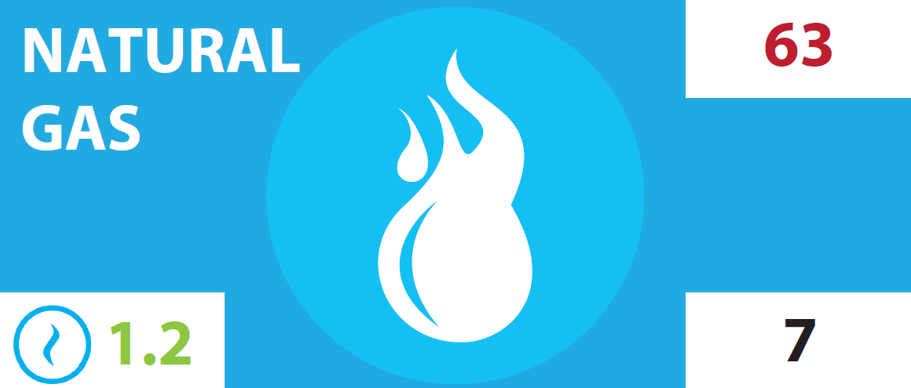
Round 1: Parts of the energy pieces
Size: How much energy does it produce?
Type:
What primary energy resource does it use?
Purchase Cost:
How much does it cost up front to build/purchase?
AQ Impacts: How much air pollution is produced? Scale of 0-3
Cost per piece = 63 + (7 x 30)
= 273
Annual Cost:
How much does it cost each year to run/operate?
CO₂ emissions:
How much CO₂ does it produce each year?
Lifetime: All energy pieces will last 30 years
Round 1: Cost per piece = Purchase cost + (Annual Cost x 30)
Notes:
How to play Round 3.
TELL STUDENTS:
Here we discuss the parts of the pieces and how to calculate the score.
The size is the amount of energy it produces or generates. Nuclear pieces are the largest. It takes four natural gas pieces or two coal pieces to cover the same board area as a nuclear piece. It takes two natural gas or large wind or solar to cover the same area as coal. Small pieces are 1/4th the size of the natural gas pieces.
The one-time purchase cost is in red, located on the upper right-hand corner. A good analogy is that the purchase cost is similar to the up-front cost of purchasing a car. What else does it take to run a car? [Answer: gasoline or diesel, maintenance, insurance, registration and taxes, inspection].
These are similar to the annual costs to operate and maintain a power plant. Power plants require fuels (except wind and solar) and maintenance. Point out that the annual cost is noted in black, located on the bottom right-hand corner.
In this game, we assume that our power plants or pieces are going to run for 30 years.
CO₂ emissions are located on the bottom left-hand corner in green.
AQ impact is how much air pollution is produced. This can be 0, 1, 2 or 3 wavy lines.
We will discuss how to use CO₂ emissions and AQ impacts in calculations for later rounds.
The example shows how to calculate a natural gas piece. Remember, these all last for 30 years so annual costs and emissions are multiplied by 30.

Slide 10
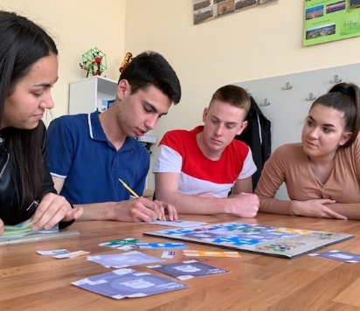
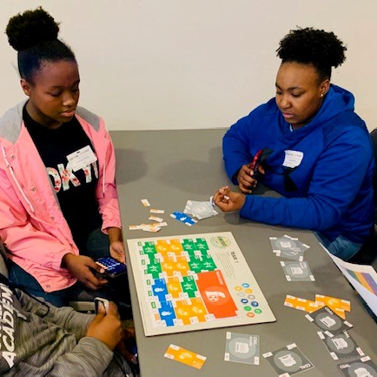
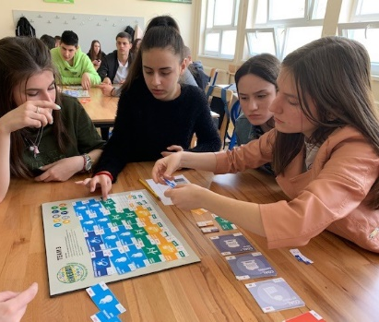
Let’s play!
Each team has a different energy mix to from which to choose
Goal is to fill the energy grid at the lowest cost
Team Jobs: Cost Control, Timekeeper, Recorder (of type and number of each piece used)
If playing virtually, facilitators will share your team Jamboard link in your room and move pieces
Students – Be sure to unmute your mics and participate actively
Notes:
BEFORE PLAYING, TELL STUDENTS:
Their goal is to achieve the lowest possible score.
They will have 10-15 minutes for Round 1.
Each team will write down how many pieces of each type they used on the score sheet.
Each team will show the type and number of each piece used. Some will be zero is they do not use some types of pieces.
TEACHERS:
Minimize the slides and project the spreadsheet. Be sure that the CO₂ price (highlighted in yellow) is set at 0.
Instruct teams to send up a representative with the score sheet, as they finish, so that you can begin plugging in their chosen energy mixes into the spreadsheet.
Once all teams have finished and been ranked, ask them to compare. The spreadsheet will show TOTAL COST of their electricity mix. They will be ranked according to the lowest cost for the full board.

Slide 11
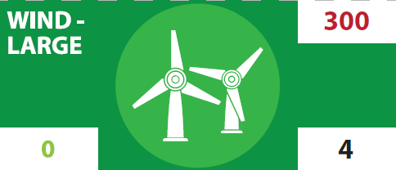
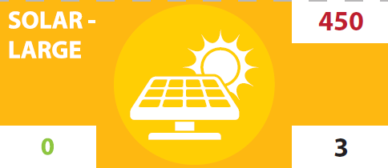
Round 2: CO₂ price + more renewables
Cost per piece = 63 + (7 x 30)
+ (1.2 x 1 x 30)
= 309
AQ Impacts: How much air pollution is produced? Scale of 0-3
CO₂ emissions:
How much CO₂ does it produce each year?
Lifetime: All energy pieces will last 30 years
CO₂ price = 1
Round 2: Cost per piece = Purchase cost + (Annual Cost x 30) + (CO₂ emissions x CO₂ price x 30)
Notes:
How to play Round 2.
TELL STUDENTS:
In Round 2, there will be a CO₂ price, which is described below.
But, each team will also be provided with additional pieces for renewables (both wind and solar).
CO₂ emissions are located on the bottom left-hand corner in green.
These annual CO₂ emissions will also be multiplied by 30 years.
Why is that?
CO₂ emission are long-lived, meaning they stay in the atmosphere for many years.
Cumulative emissions of CO₂ will be what determine long-term global average temperature changes, or global warming, that lead to changes in the climate.
In Round 2, we are putting a price on the emissions.
This price reflects the damages to society that come from each additional amount of CO₂ emitted.
What are the environmental, economic, and health costs due to damages from CO₂ and climate change? [Give students time to give some examples.]
These damages can include damage to coastal property from stronger storms or lives lost due to extreme heat. Other impacts can range from worse air quality, damages to roads, loss of coral reefs, and other impacts on people, infrastructure and ecosystems.
For this game, we use as a CO₂ price or multiplier (using a simplified number for quick calculations)
TEACHERS:
For each round with a CO₂ price, show it on the spreadsheet.
Student will need to recalculate the cost of the pieces, but only if they have CO₂ emissions (coal, natural gas).
TELL STUDENTS:
AQ impacts are represented as a simple scale from 0-3, and can reflect the impact on human health and the environment from air pollutants such as sulfur dioxide (SO2), nitrogen oxides (NOx), and particulate matter (PM), among others.
In this round, we can also discuss the AQ impacts of energy production. High levels of air pollution from burning fossil fuels can affect human health in different ways, such as impacts on our lungs and hearts. Certain groups can be at higher risk of having more serious health effects, such as children, older adults, and people with lung disease, such as asthma.
TEACHERS:
Teachers may also set a target for AQ Impacts on the spreadsheet. This can be done at the same time or after the students have completed their boards using a CO₂ price of 1. Setting an AQ Impact level of 10 will mean that some teams will have to change their mix to reduce AQ impacts.

Slide 12
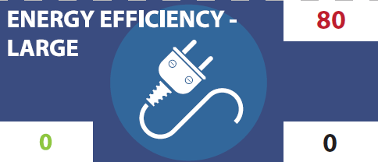
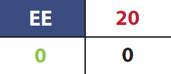
Round 3+: Higher CO₂ price + efficiency
Cost per piece = 63 + (7 x 30)
+ (1.2 x 30 x 4)
= 417
Lifetime: All energy pieces will last 30 years
If CO2 price = 4
Notes:
How to play Round 3.
TELL STUDENTS:
In Round 2, the CO₂ price will be increased again. We will set a higher price, but then each team will also get new energy efficiency pieces.
TEACHERS:
The CO₂ price can be set to 2, 3, 4 or more. A CO₂ price of 4 is recommended to see a major shift in the energy mix toward low to zero carbon.
AFTER TEAMS SOLVE for a CO₂ price of 4, give each team additional pieces for energy efficiency.
TELL STUDENTS:
These are cheaper than any other pieces and represent energy efficiency in homes and buildings. This reduces total electricity demand and represents the power plants that we don’t need to build.
Examples can include both energy efficiency (using more efficient light bulbs or air conditioning units) or energy conversation (using less energy by turning off lights and not running the A/C so much).
Quick version of Round 3 – efficiency only
TEACHER:
If there is not enough time for a full Round 3 with a higher CO₂ price, students can “freeze” their boards from Round 2. Tell students they should NOT change any pieces. Then, they will be given 3 large and 3 small efficiency pieces per team. The teams can only “swap” energy efficiency for other pieces, they cannot make any additional changes, such as removing a natural gas and adding a solar.
The goal is to see what happens when energy efficiency is introduced.
Show the results on the spreadsheet.
ASK STUDENTS:
How did the energy efficiency pieces affect the total cost? How did they affect the cost to build and operate? How did they affect the costs from CO₂?

