Slide 1
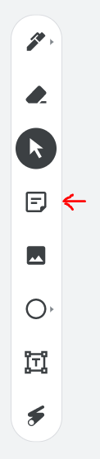
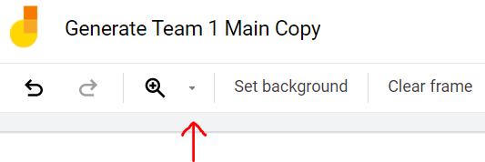
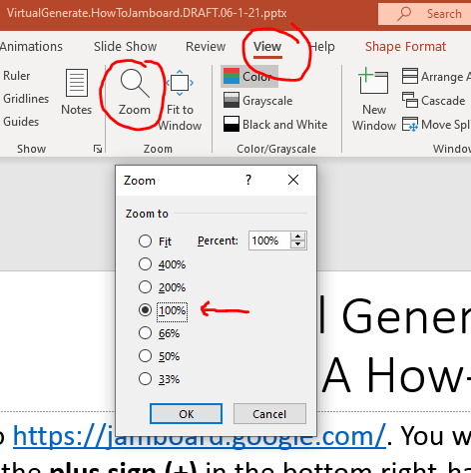
Virtual Generate Jamboards:
A How-to Guide
Go to https://jamboard.google.com/. You will need to be signed into a Google/Gmail account.
Click the plus sign (+) in the bottom right-hand corner of the screen to make a new Jamboard.
Click on “Untitled Jam” to rename your Jamboard to “Generate Team 1 Main Copy”
In the upper left corner, place a sticky note and type “Team 1.” (Sticky notes shown here →
are in the left-hand navigation on Jamboard)
Go to Slide 4 of these PowerPoint slides. Copy and paste the gameboard to your Jamboard.
Move gameboard to the bottom left corner. The gameboard will not be the correct
size when copied over. It will be resized during Step 9.
Click the Jamboard drop-down menu button next to the
magnifying glass and set zoom to 100%
Come back to these PowerPoint slides
and go to Slide 5. Set zoom to
100% on PowerPoint as well
→
→

Slide 2
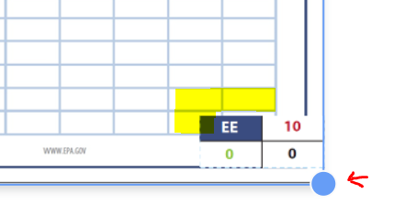
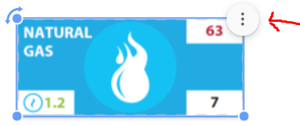
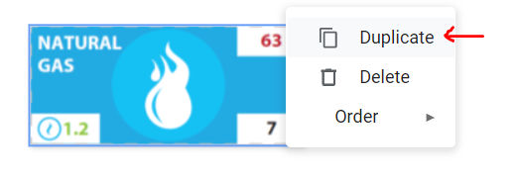
Keeping both Jamboard and PowerPoint zoomed to 100%, copy and paste each game piece individually from Slide 5 to your Jamboard. This will ensure correct sizing of pieces.
*If you select multiple game pieces on the PowerPoint and copy they will not size correctly when pasted to the Jamboard.
Grab one small piece (small wind, solar, or EE) and paste to Frame 1
of the Jamboard. Click and drag the corners of the gameboard (your
pointer will become a double headed arrow) to resize the gameboard
until one of the small pieces covers four grid squares on the board.
Go to Slide 6 on the PowerPoint to find the numbers of each piece
that will be available to Team 1.
Duplicate pieces from Slide 5 onto your Jamboard until you have the correct number of pieces for each energy type. To do this, click on a piece, click on the three vertical dots that appear on the upper right corner of that piece and click “duplicate.”

Slide 3
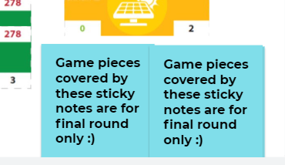
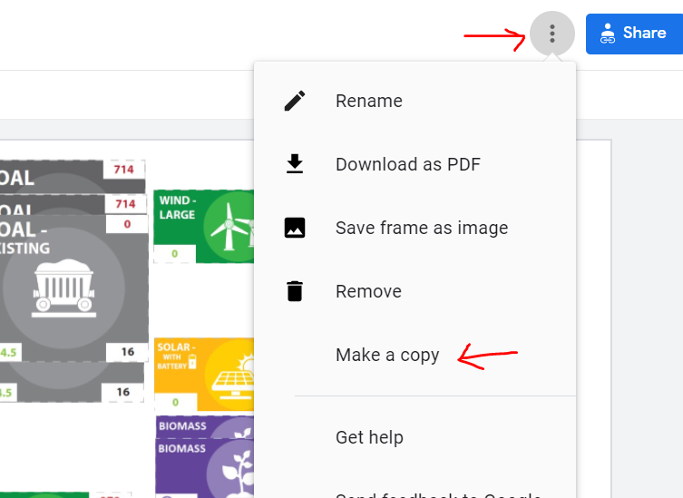
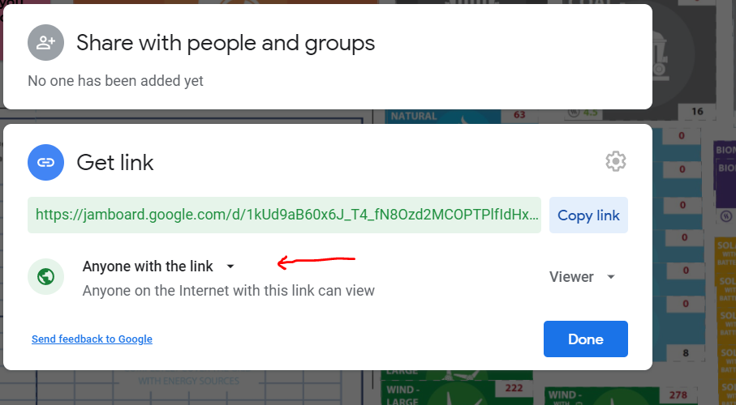
Once you have the correct number of pieces, use the Team 1 image on Slide 7 as a reference for organizing your pieces on your Jamboard.
Each team will also have the additional wind, solar, and energy efficiency pieces that are only available in later rounds (see Slide 12).
Place two sticky notes that say “Game pieces covered by these sticky notes are for Round 2 only” over the additional solar and wind pieces.
Place two sticky notes that say “Game pieces covered by these sticky notes are for final round only” over the Energy Efficiency pieces.
Each team has their own Jamboard. To make Teams 2-5, click on the “more actions” menu next to the blue “share” button in the upper right-hand corner of the Jamboard screen.
Click “Make a copy” and rename with the appropriate Team number. Use PowerPoint slides 6 to adjust the number of pieces per team. Use Slides 7-11 as a guide for how to arrange each Team board.
To share the Jamboards with players, be sure to set the “share” settings to “anyone with the link can edit.”
If you are planning on playing multiple games with different groups, it is recommended to have a set of “original” copies set to private. Each time you play a game, you can make shareable copies from the originals.

Slide 4
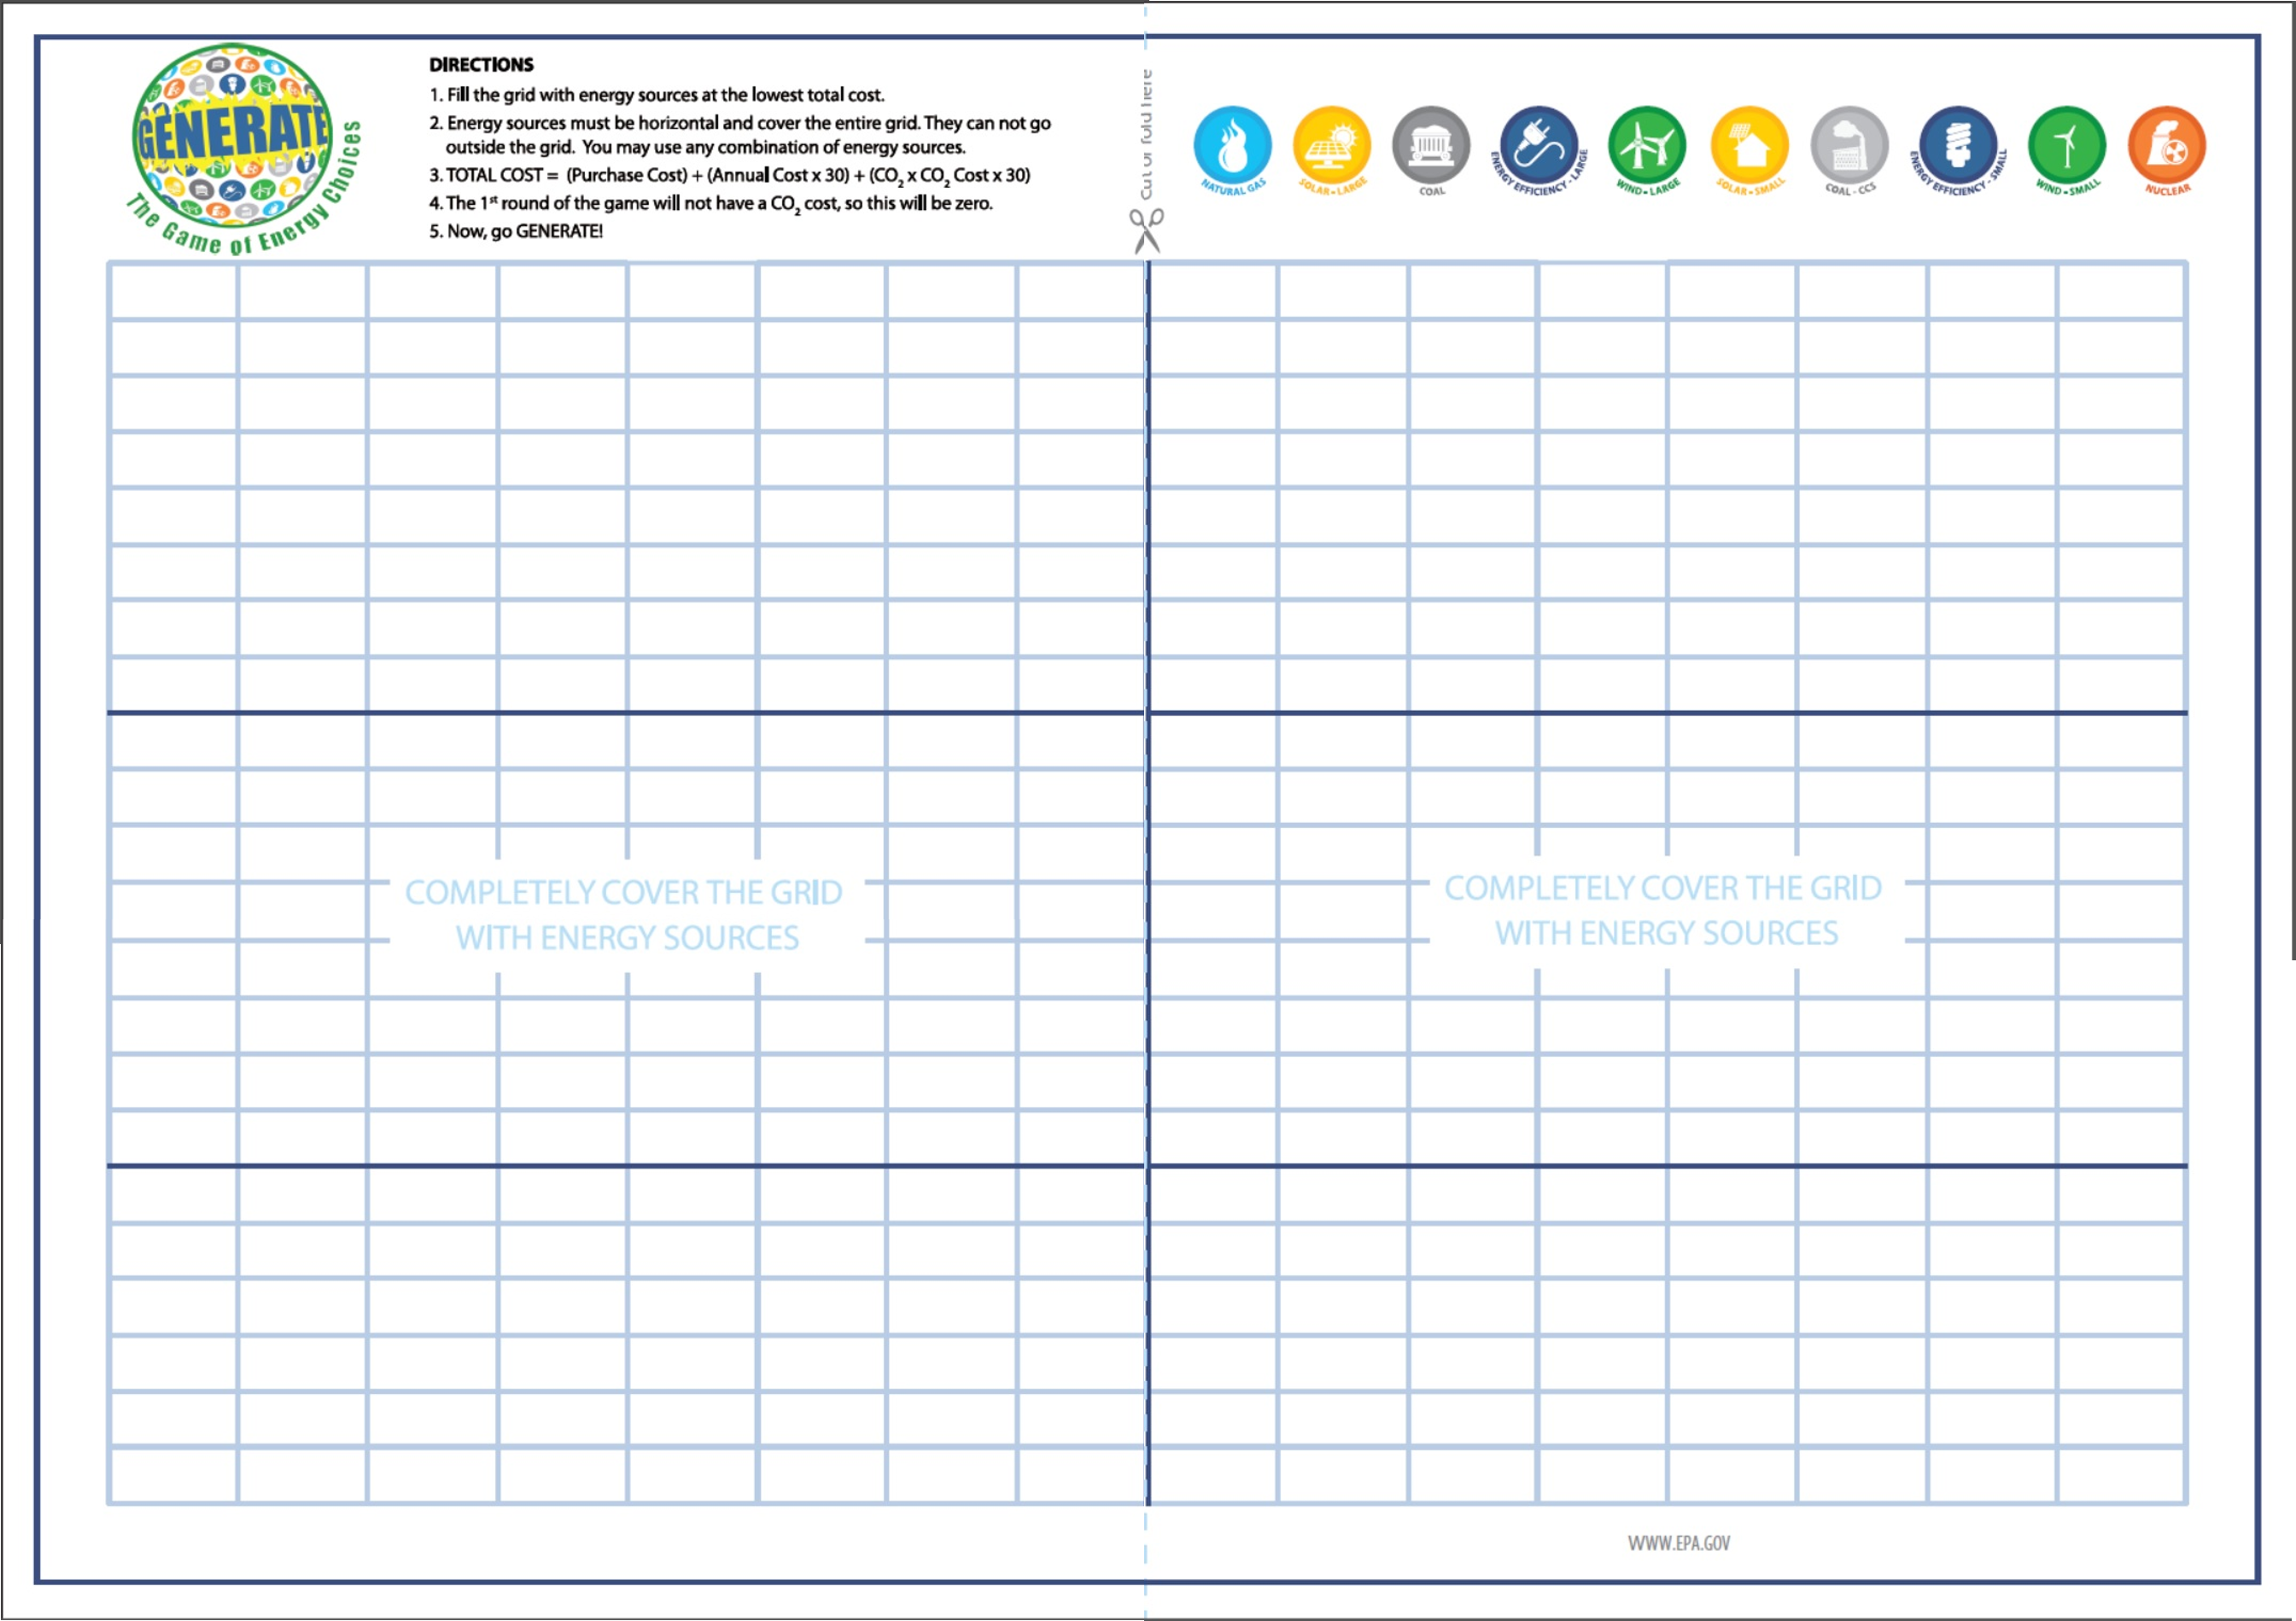

Slide 5
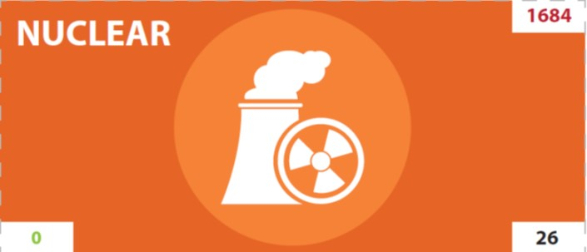
Pieces to copy to Jamboard

Slide 6
Distribution of pieces for each team
Team 1 |  |  | Team 2 |  |  | Team 3 |  |  | Team 4 |  |  | Team 5
Nuclear - New | 1 |  | Nuclear - New | 1 |  | Nuclear - New | 1 |  | Nuclear - New | 1 |  | Nuclear - New | 1
Nuclear - Existing | 2 |  | Nuclear - Existing | 1 |  | Nuclear - Existing | 1 |  | Nuclear - Existing | 1 |  | Nuclear - Existing | 1
Coal - New | 2 |  | Coal - New | 2 |  | Coal - New | 2 |  | Coal - New | 2 |  | Coal - New | 2
Coal - Existing | 3 |  | Coal - Existing | 3 |  | Coal - Existing | 1 |  | Coal - Existing | 6 |  | Coal - Existing | 2
Coal - CCS | 2 |  | Coal - CCS | 2 |  | Coal - CCS | 2 |  | Coal - CCS | 2 |  | Coal - CCS | 2
Natural Gas - New | 2 |  | Natural Gas - New | 1 |  | Natural Gas - New | 5 |  | Natural Gas - New | 1 |  | Natural Gas - New | 6
Natural Gas - Existing | 3 |  | Natural Gas - Existing | 6 |  | Natural Gas - Existing | 6 |  | Natural Gas - Existing | 1 |  | Natural Gas - Existing | 6
Wind - Small | 4 |  | Wind - Small | 8 |  | Wind - Small | 2 |  | Wind - Small | 8 |  | Wind - Small | 7
Wind - Large | 2 |  | Wind - Large | 3 |  | Wind - Large | 2 |  | Wind - Large | 3 |  | Wind - Large | 2
Wind with Battery | 1 |  | Wind with Battery | 1 |  | Wind with Battery | 1 |  | Wind with Battery | 1 |  | Wind with Battery | 1
Solar - Small | 4 |  | Solar - Small | 0 |  | Solar - Small | 6 |  | Solar - Small | 0 |  | Solar - Small | 1
Solar - Large | 1 |  | Solar - Large | 2 |  | Solar - Large | 3 |  | Solar - Large | 1 |  | Solar - Large | 0
Solar with Battery | 1 |  | Solar with Battery | 1 |  | Solar with Battery | 1 |  | Solar with Battery | 1 |  | Solar with Battery | 1
Biomass | 2 |  | Biomass | 2 |  | Biomass | 2 |  | Biomass | 2 |  | Biomass | 2
Additional pieces for Round 2
Wind - Large | 3
Wind with Battery | 3
Solar - Large | 4
Solar with Battery | 2

Slide 7
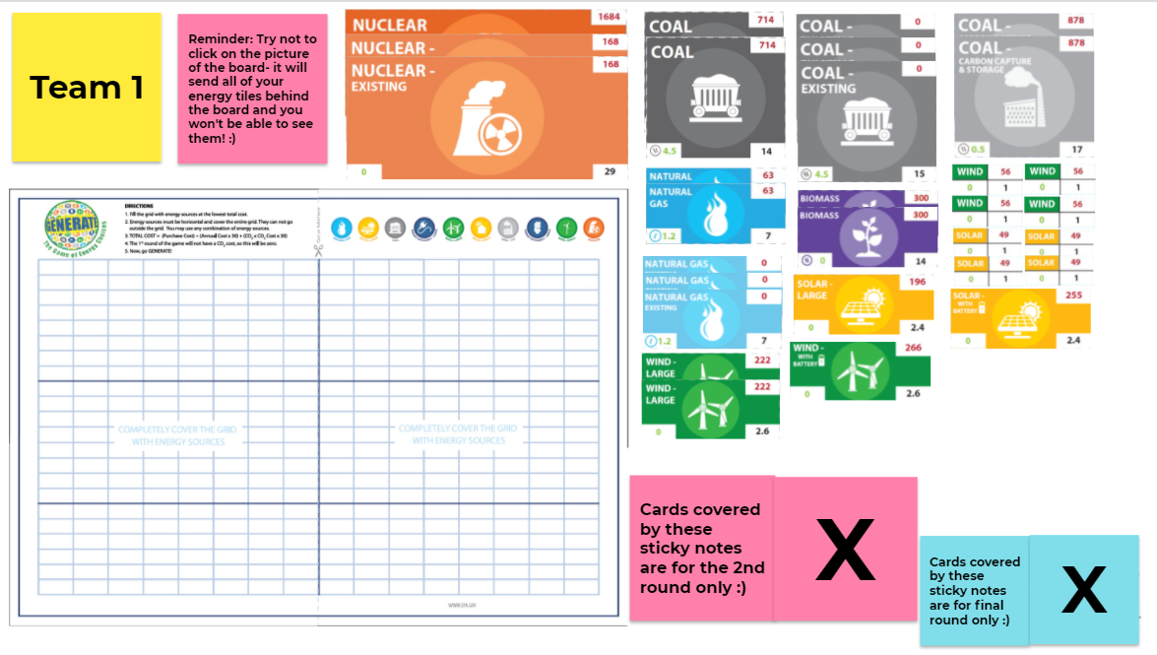
Team 1

Slide 8
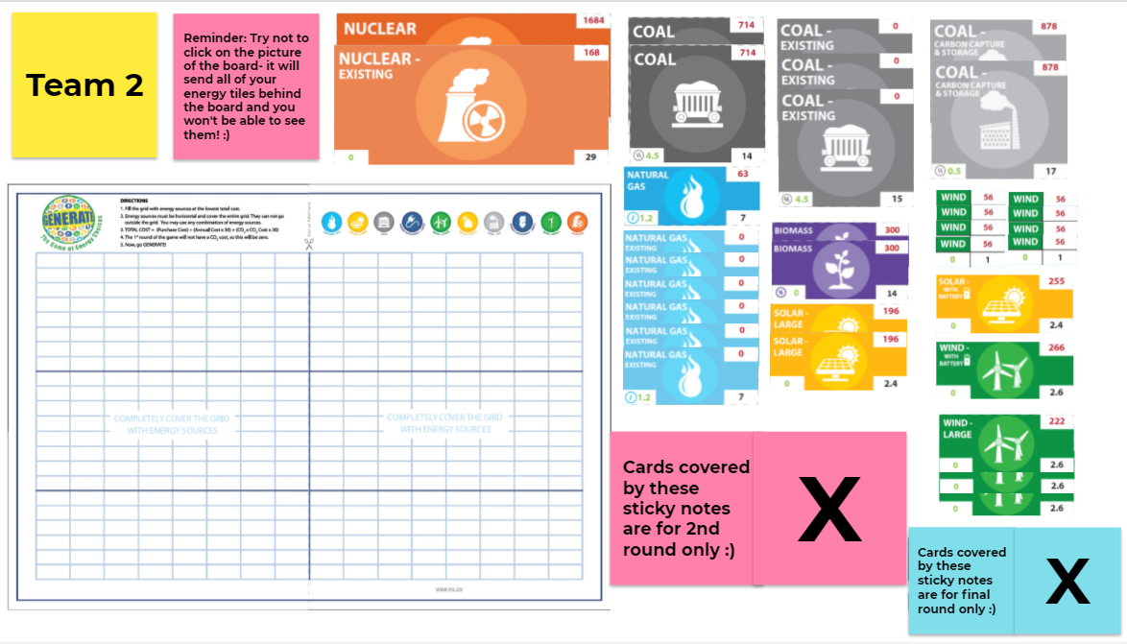
Team 2

Slide 9
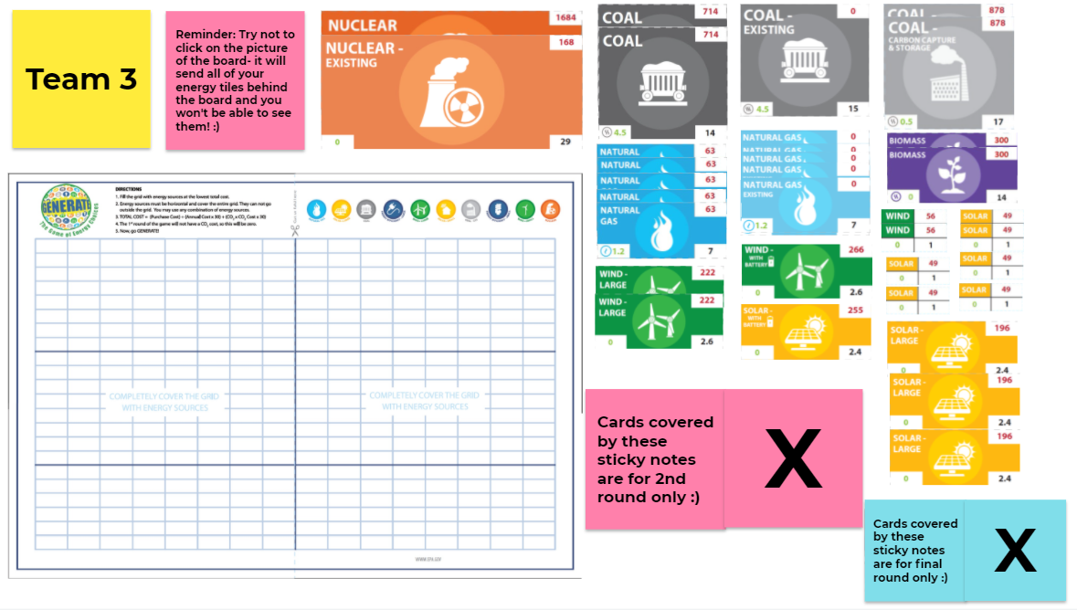
Team 3

Slide 10
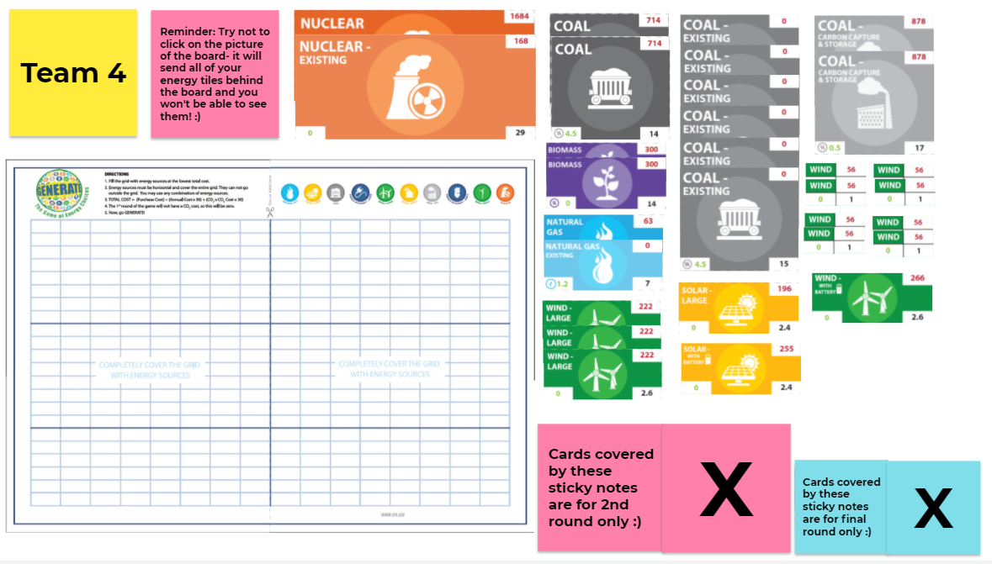
Team 4

Slide 11
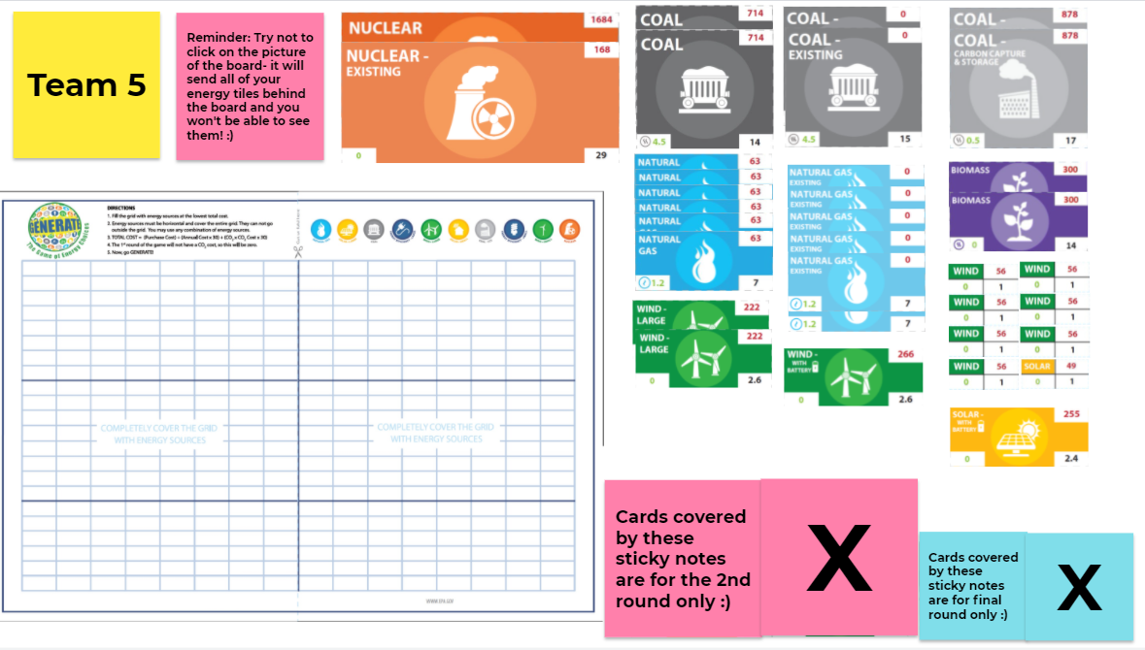
Team 5

Slide 12
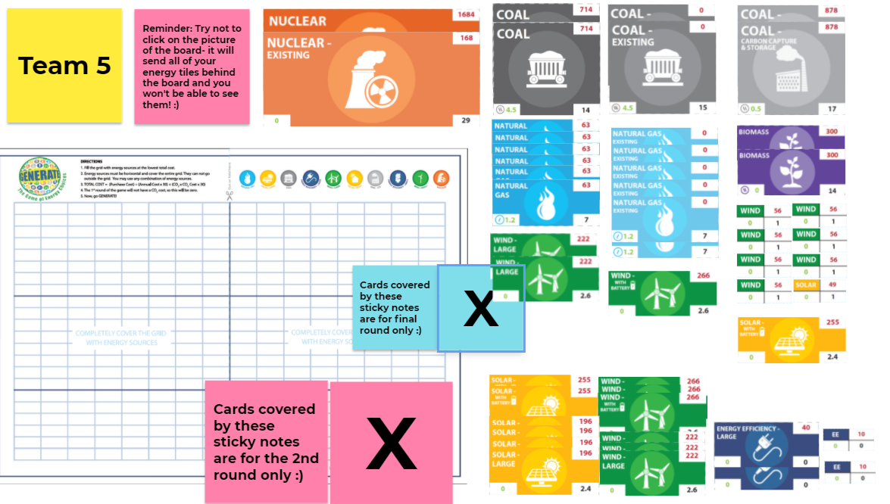
Additional wind, solar and efficiency pieces
Each team will have the same number of additional wind, solar and efficiency pieces.

