Slide 1
High Temperature Thermal Treatment of PFAS
Jonathan Krug
CEMM/AMCD
Office of Research and Development
Meet the Scientist| Board of Scientific Counselors
October 12th , 2021
The views expressed in this presentation are those of the author(s) and do not necessarily represent
the views or policies of the U.S. Environmental Protection Agency.

Slide 2
Goals
Highly electronegative F makes C-F bonds particularly strong, requiring high temperatures for destruction
  CF4 requires 1,440 °C for >1 sec to achieve 99.99% destruction (Tsang et al., 1998)
  Information regarding potential products of incomplete combustion (PICs) is lacking
  Desire to achieve full defluorination and fluorine mineralization (HF)
This research is exploring minimum conditions (temperature, residence time, combustion parameters) necessary for adequate PFAS destruction
  Different thermal destruction technologies exhibit a large range of temperatures
    hazardous waste incinerators, municipal waste combustors, sewage sludge incinerators, etc.
  Halogens inhibit flame propagation
  PICs from F radicals more likely than for other halogens
    Stability of CF2 and CF3 radicals suggest the possible reformation of PFAS species
  Can FTIR detectable surrogate PFAS gases be used to determine destruction behavior of larger PFAS molecules
Inform program offices about the adequacy of different thermal processes to adequately destroy PFAS wastes
  EPA tasked with developing PFAS thermal treatment guidance under the National Defense Authorization Act (NDAA)
  Develop a mechanistic understanding of PFAS behavior and help interpret results from full-scale field studies

Slide 3
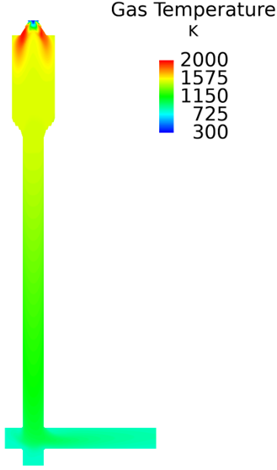
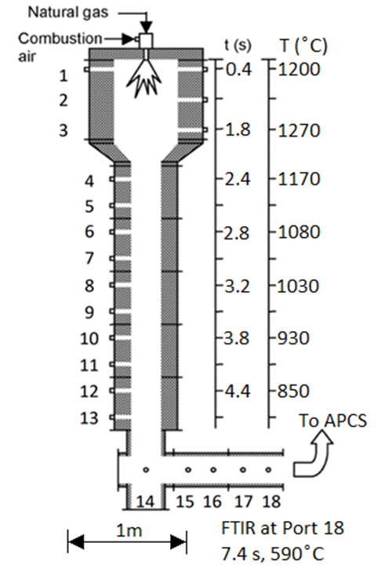
Approach
Inhouse experiments supported by fundamental modeling
  Moderate temperature bench-scale experiments with Ca sorbents and Al catalysts
  High temperature pilot-scale thermal destruction of C1 and C2 PFAS (gases)
  High temperature thermal destruction of AFFF (liquids)
Computational fluid dynamic (CFD) model
  Developed for DoD for thermal destruction of chemical warfare agents
  Modified by EPA to include three commercial incinerator designs
  Further modified to include NIST compiled C1-C3 fluorinated kinetics
  Large molecule fluorine kinetics being developed by DoD (SERDP & DoD Labs) and EPA (NCSU)
EPA inhouse pilot-scale combustors include a refractory lined furnace (right) and a rotary kiln with afterburner.
  Well characterized research combustors able to capture salient features of full-scale units
  Serve as EPA accessible platforms to address research questions
  Serve as sources to develop and test PFAS sampling and analytical techniques
Support full-scale field efforts in a variety of thermal destruction systems

Slide 4
Current Status
First moderate temperature thermal reaction (FTOHs w/ CaO) paper published - https://doi.org/10.1016/j.chemosphere.2021.129859
  Fluorine reaction with CaO (forming CaF2) effectively destroyed FTOHs at moderate temperatures (400-900 °C) with non-detectable PICs
  Encouraging results as a control technology or co-firing PFAS wastes in cement kilns
  Al catalyst experiments initiated (w/ Guild Associates)
First high temperature thermal destruction (C1 and C2 PFAS gases) paper submitted to JAWMA
  CF4, CHF3, and C2F6 destruction efficiencies and PICs measured w/ FTIR
  PFAS destruction and PIC formation characterized (w/ variable temperatures and residence times) and compared to kinetic model predictions
  Different PFAS structures (C-H and C-C) examined
  Surrogate gases amenable to real-time FTIR measurement (useful for field testing)
High temperature experiments initiated with AFFF
  Legacy formulation of 3% PFAS in water including C8 PFOS
  FTIR measurements to be augmented by OTM-45, evacuated canisters, and sorbent methods to characterize destruction and targeted and non-targeted fluorinated PICs
C1-C3 fluorinated kinetics are being augmented with C4-C8 kinetics (DoD laboratories and NCSU)
  Existing CFD combustion model includes three commercial incinerator designs and two pilot-scale units
  Existing C1-C3 fluorinated kinetics (~1000 reactions) included
  Expanding the kinetics to include larger PFAS compounds
  Goal to independently predict PFAS destruction (and PIC formation) in practical full-scale incineration systems

Slide 5
Contributors
William Linak, CEMM/AMCD/CSB
C.W. Lee, CEMM/AMCD/CSB
Paul Lemieux, CESER/HSMMD/STMMB
Jeff Ryan, CEMM/AMCD/CSB
Peter Kariher, CEMM/AMCD/CSB
Erin Shields, CEMM/AMCD/CSB
Lindsay Wickersham, CEMM/AMCD/CSB
William Roberson, CEMM/AMCD/CSB
Stephen Jackson, CEMM/AMCD/CSB
Ariel Wallace, CEMM/AMCD/CSB
Ken Krebs, CEMM/AMCD/CSB
Hannah Liberatore, CEMM/AMCD/CSB
Supported by SHC 5.4.4 “Thermal Treatment of PFAS”

