Slide 1

Water Quality Assessment Training for Tribes
Module 2
Overarching Considerations in Assessing Water Quality Data
Notes:
Note: This presentation was produced for EPA with contractor support. It has been reviewed by EPA HQ staff, but has not been reviewed by senior EPA management or the Office of General Counsel. The exercises associated with this module are incorporated into the slides – i.e., there are no handouts or other items existing as external files that need to be printed or circulated.

Slide 2
Module 2: Learning Objectives
To understand the potential data sources and formats that may be available from both the Tribe and other data partners for use in producing a water quality assessment
To identify the factors that can affect the quality of data used for a water quality assessment
To understand the limitations of data that do not meet a Tribe’s data quality objectives, and how to document known data quality issues
Notes:
The learning objectives for Module 2 are to:
To understand the potential data sources and formats that may be available from both the Tribe and other data partners for use in producing a water quality assessment
To identify the factors that can affect the quality of data used for a water quality assessment
To understand the limitations of data that do not meet a Tribe’s data quality objectives, and how to document known data quality issues

Slide 3
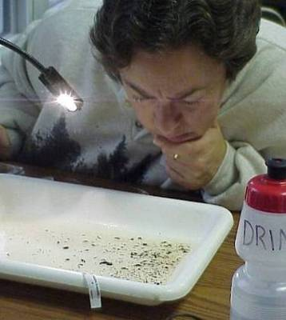
Opening Discussion: What is Water Quality Data, and Who Has It?
  When we talk about water quality data for assessments, what are we talking about?
  Who collects these data, and why do they collect it?
  What do we need to know if we plan to use the data?
Notes:
This module focuses on water quality data to support tribal water quality assessments. Before we get into the presentation slides, let’s open with a discussion about water quality data and what’s needed to support an assessment.
For starters, what kind of data do we need to assess water quality?
[Chemical, physical, biological . . . other data can add to the picture, such as land use/cover, riparian conditions, etc. Write their responses on a flip chart, and group them.]
Who collects water quality data, and why?
[Continue with the questions, supplementing their responses with these notes: Data collectors may include tribes, state water agencies, health departments (bacteria), watershed groups, college students, etc. Reasons for collecting may include assessing current conditions, studying trends, surveillance of beaches for bacteria, or to fulfill class requirements, in the case of students.]
What do we need to know about the data, if we plan to use it?
[If we plan to use the data, we might be interested in who-what-where-why-when it was collected, whether the parameters are among those we’re interested in, and whether or not documented protocols (e.g., via a quality assurance project plan) were used.]

Slide 4
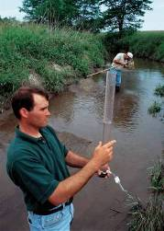
What Do We Want From Our Data?
  Inclusive: covering key parameters of concern
  Credible: to accurately reflect water quality conditions
  Robust: to reflect conditions under a variety of rainfall/flow regimes
  Useful: helping us identify appropriate solutions
  Efficient: the least cost for the most benefit!
Notes:
When considering the data we’re collecting, it’s important not to lose sight of why we’re collecting it. Sometimes we get so much into the routine of collecting samples, taking them to the lab, and entering the results in a spreadsheet that we forget about why we’re doing it.
Before we get into the details of how to assess and evaluate your data, here’s a shout-out for always remembering why you’re doing what you’re doing: we want to find and fix problems where they exist, and prevent them when and where things are good.

Slide 5
Types of Water Quality Data – Commonly Assessed Parameters
Physical (Water Column)
  Suspended Solids
  Clarity/Turbidity
  Temperature
  Conductivity
  Flow
Chemical
  pH
  Dissolved oxygen
  Nitrogen
  Phosphorus
  Metals
Biological
  Macroinvertebrates
  Pathogens (E. Coli)
Habitat (Physical)
  Substrate
  Bank Conditions
  Pool/Riffle Mix
What Types of Water Quality Data Does Your Tribe Collect? How Does Your Tribe Use These Data?
Notes:
Let’s explore how these parameters are linked to water quality a bit more. As discussed in Module 1, water quality – and the criteria we use to assess water quality – is linked to physical, chemical, and biological attributes. Since each water body has a distinct suite of designated uses, you should monitor each water body for the parameters that will help you to determine if that water body is meeting the standards for those specific designated uses. For example, if your water body has primary contact recreation listed as a designated use, you should monitor E. coli levels over time and then assess the data to see if it meets the water quality standard. Each separate assessment for a water body is then integrated with all individual assessments for that water body to form the overall water body assessment. The water body may meet standards for some water quality standards and not meet for others.
Physical data are useful screening indicators of potential problems, often because they can have an impact on aquatic organisms and the effects of some chemicals.
Chemical data include measurements of key chemical constituents in water, sediments, and fish tissue. Monitoring for specific chemicals provides a snapshot of water quality at a point in time, helping to identify the causes for impairment and helps trace the source of the impairment.
Biological data include measurements of aquatic biological communities. We’re most familiar with bacteria, because they have such a significant impact on recreational waters, but we also can assess macroinvertebrates, fish, algae, and other organisms to evaluate the condition of an aquatic ecosystem. The biological communities of a waterbody reflect the impact of multiple physical, chemical, and habitat parameters on water quality over time. Biological data are excellent indicators of aquatic life use support over the long-term.
Habitat data include physical descriptions of sites and surrounding land uses, and the condition of streamside and riparian zone vegetation. Habitat data can be used to supplement and help interpret other kinds of data in the assessment.
.Ask participants about the types of water quality data they collect, and how they use the data.
Let’s take a brief look at each of the common parameters that you are likely monitoring through your water quality programs. For each parameter, I’ll briefly review what it is, some of the potential sources, and the associated impacts. For some training participants, this may be relatively new information and for others, this may be a refresher. Either way, it is important to understand each of these parameters before moving into Module 3 where we will explore data assessment for each parameter.

Slide 6
Physical Data: Turbidity
Measure of water clarity from suspended matter in nephelometric turbidity units (NTUs)
  Inorganic matter (e.g., sediment, minerals, metals)
  Organic matter (e.g., algae, colloidal material, etc.)
Sources
  Erosion/runoff
  Wastewater and other industrial discharges
  Decomposing woody debris
  Excessive nutrient levels
Potential impacts
  Inhibits primary contact recreation and aesthetics
  Linked to algae blooms
  Aquatic life function (feeding, respiration, etc.)
  Poor water quality for drinking water sources
Notes:
[For this slide, the instructor can choose to use this as an interactive activity with the group by asking questions before revealing slide bullets:
What does this parameter measure?
What are some of the sources?
What are some of the impacts?
The goal is to get participants thinking about how turbidity relates to indicators of water quality in the context of an assessment. What does turbidity help tribes understand about overall tribal water quality?]
Turbidity is a parameter that describes the cloudiness or murkiness of a waterbody. To measure turbidity, an optical tool measures the amount of light that scatters through a water sample, expressed as a Nephelometric Turbidity Unit or NTU. More scattered light, which translates to higher NTUs, means higher turbidity. Lower NTUs means less turbidity and clearer water.
The cloudiness or murkiness results from different types of suspended particles from a variety of sources. Sediment from streambank erosion, as well as agricultural and urban nonpoint source runoff can increase turbidity levels. Organic matter from sewage discharges may also increase turbidity.
High turbidity levels can inhibit primary contact recreation and aesthetics of a waterbody. High turbidity levels can be an indicator of high nutrient levels because phosphorus is often attached to sediment and soils entering a waterbody through erosion, which can lead to algal growth. Turbidity impacts aquatic life in a number of ways. The cloudy water can absorb heat, which can in turn deplete dissolved oxygen levels. Particles can clog fish gills and affect respiration as well as smother eggs and macroinvertebrates. High turbidity levels in waterbodies that supply drinking water require additional treatment. It’s important to establish a baseline turbidity level for the water bodies you monitor, and to determine if its turbidity levels arise from natural or human-caused sources.

Slide 7
Physical Data: Temperature
Measure of heat in degrees (Fahrenheit or Centigrade)
Sources/factors influencing water temperature
  Weather
  Absence/presence of riparian shade
  Dams and other barriers that stagnate water bodies
  Industrial discharges
  Stormwater runoff
  Dissolved organic carbon, suspended particles and color
  Groundwater inputs
  Lake stratification and mixing
Potential impacts of increased temperature
  Reduced dissolved oxygen
  Increased metabolic rate of aquatic life
  Negative impacts on aquatic species’ life cycle
  Increased biota sensitivity to toxics, parasites, diseases
Notes:
[For this slide, instructor can choose to use this as an interactive activity with the group by asking questions before revealing slide bullets:
What does this parameter measure?
What are some of the sources?
What are some of the impacts?
The goal is to get participants thinking about how temperature relates to indicators of water quality in the context of an assessment. What does temperature help tribes understand about overall tribal water quality?]
Temperature is how warm or cold a waterbody is at a point in time, measured in degrees Fahrenheit or Centigrade.
A variety of factors can affect a waterbody’s temperature, including weather, the extent of riparian shade along a stream corridor, dams or other obstructions that block flow and stagnate water so it absorbs more heat, industrial discharges may contribute effluent at a higher temperature, and urban runoff from hot pavement. Temperature can also increase due to dissolved organic carbon that absorbs light. Groundwater inputs may also affect temperature, as can lake stratification and mixing.
High temperatures can result in lower dissolved oxygen levels, affecting fish and macroinvertebrate health. Temperatures outside of optimal ranges for different species can result in organism stress and death. Certain organisms are sensitive to temperature changes during the reproductive stage. Increasing water temperatures can increase the metabolic rate of some fish species, meaning that fish would need to increase the amount of energy intake to survive. Stressed fish and macroinvertebrates are in turn more sensitive to other stressors, including toxicity from exposure to chemical pollutants and disease.

Slide 8
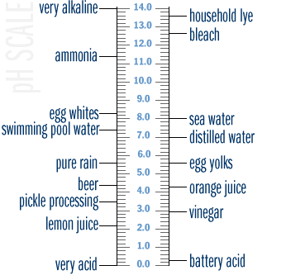
Chemical Data: pH
  Measure of hydrogen ion concentration affecting water acidity/alkalinity in pH standard units
    0 (acidic) to 14 (basic)
    7 is neutral
  Sources
    Acid rain
    Mining activities
    Wastewater discharges
  Potential impacts
    pH outside of 6.5 - 8.0 range stresses aquatic life and reduces diversity
    Low pH mobilizes metals and compounds that can harm aquatic life
Notes:
[For this slide, instructor can choose to use this as an interactive activity with the group by asking questions before revealing slide bullets:
What does pH measure?
What are some of the sources affecting pH?
What are some of the impacts of changes in pH outside an optimal range?
The goal is to get participants thinking about how pH relates to indicators of water quality in the context of an assessment. What does understanding pH help tribes understand about overall tribal water quality?]
pH is a measure of water acidity using pH standard units 0 to 14. Measurements ranging from 0 to 6 are considered acidic, a measurement of 7 is considered neutral, and measurements from 8 to 14 are considered basic.
pH levels can indicate water quality that is changing chemically. Sources of acidic water include acid rain, wastewater discharges from mining activities and other industries can also affect pH levels of a waterbody. However, some waterbodies are naturally acidic, like bog lakes.
Optimal pH levels for aquatic life are range from 6.5 – 8.0. Outside of this range, aquatic life can become stressed and more susceptible to toxicity. Low pH levels can mobilize metals and other toxic compounds that can harm aquatic life.

Slide 9
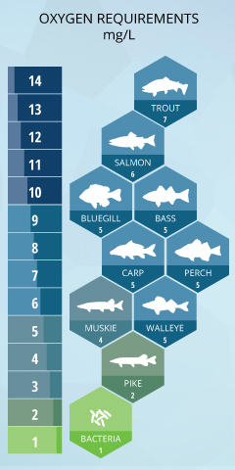
Chemical Data: Dissolved Oxygen
    Level of gaseous oxygen available to aquatic life for respiration
      Indicator of water body biological health
      High levels of DO are better for aquatic life (e.g. usually cooler waters since cold water contains more DO)
      Natural daily fluctuations in DO levels
        Day : DO levels rise due to photosynthesis
        Night: DO levels fall due to respiration and oxygen consumption
    Measured in milligrams per liter (mg/L) or parts per million (ppm)
    DO saturation measured as a percent of 100
Fondriest Environmental Learning Center
Notes:
[For this slide, instructor can choose to use this as an interactive activity with the group by asking questions before revealing slide bullets:
What does dissolved oxygen measure? Is it better to have high or low dissolved oxygen?
What are some of the sources/factors that lead to low dissolved oxygen levels?
What are some of the impacts of low dissolved oxygen that could affect uses of tribal waterbodies?
The goal is to get participants thinking about how dissolved oxygen relates to indicators of water quality in the context of an assessment. What does understanding the impact of low dissolved oxygen help tribes understand about impact on waterbody uses and overall tribal water quality?]
Dissolved oxygen, often referred to as DO, is the level of gaseous oxygen in the water available to aquatic life for respiration. DO levels are an indicator of biological health of a waterbody. Sensitive organisms often require high dissolved oxygen concentrations. DO levels naturally fluctuate on a daily basis. During the day, DO levels rise due to photosynthesis. During the night, DO levels fall due to respiration and oxygen consumption. This is why it is important to take DO measurements at a consistent time of the day for revisiting sites. DO is measured as milligrams per liter (mg/L) or parts per million (ppm). DO can also be measured as percent saturation. However, the water quality standards for DO are expressed in mg/L.

Slide 10
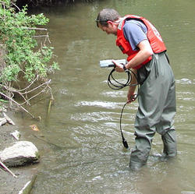
Chemical Data: Dissolved Oxygen
Sources
  Changes in water temperature
    Thermal discharges from manufacturing or power plants
    Reduction of riparian shade
    Dams and other barriers
  Decomposing organic matter that increases the biological oxygen demand
    Excessive algae
    Industrial and municipal wastes (raw sewage)
Potential impacts
  Cause aquatic life to move from a waterbody
  Fish kills
US Geological Survey
Notes:
Factors that contribute to low DO levels include changes in water temperature. Warm water holds less dissolved oxygen than cold or well-mixed water.
So the factors that increase water temperature, including thermal discharges, reductions in riparian shade, and dams, also contribute to decreased DO levels.
Decomposing organic matter can also increase the biological oxygen demand and reduce dissolved oxygen levels. Organic matter could be from excessive algae or industrial or municipal wastes. Commonly, sewage bypasses are very common on and tribal personnel may encounter a spill of this nature.
Insufficient DO levels can cause aquatic life to move from a waterbody or die. Fish kills are often a result of low dissolved oxygen levels.

Slide 11
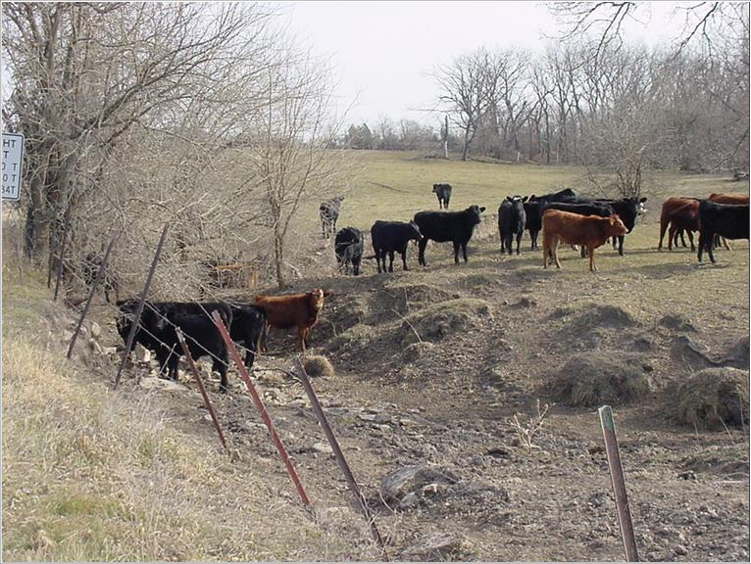
Chemical Data: Phosphorus
  Essential nutrient for plants and animals
  Measured in milligrams (or micrograms) per liter or parts per million (billion)
  Sources
    Runoff from fertilized lawns, cropland, construction sites and animal manure
    Wastewater treatment plants and other industrial sources
    Eroded soil and natural geology
    Drained or degraded wetlands
    Decomposing organic matter
    Internal loading from legacy phosphorus
  Potential Impacts
    Algal blooms
    Turbidity/loss of clarity due to increased organic matter
    Low dissolved oxygen that can harm aquatic life
Notes:
[For this slide, instructor can choose to use this as an interactive activity with the group by asking questions before revealing slide bullets:
What does phosphorus measure?
What are some of the sources of phosphorus?
What are some of the impacts of excess phosphorus?
The goal is to get participants thinking about how phosphorus relates to indicators of water quality in the context of an assessment. What does understanding phosphorus help tribes understand about overall tribal water quality?]
Phosphorus is an essential nutrient for plants and animals. We measure phosphorus in milligrams (or micrograms) per liter or parts per million (billion).
Sources contributing phosphorus to waterbodies include soils because phosphorus adheres to soils and, in some areas, natural geology, and decomposing organic matter. Human sources can include discharges from wastewater treatment plants, runoff from lawns, agricultural areas, and construction activities, drained or degraded wetlands.
Past sources of phosphorus can remain in a waterbody’s sediments. This is a legacy source of phosphorus from previous sources. Legacy phosphorus is a source of internal phosphorus loads to a waterbody.
Phosphorus is the limiting nutrient in freshwater ecosystems, so adding excess phosphorus to a lake, river or wetland will cause profound changes in plant growth. Phosphorus is the main cause for algae blooms. The decomposition of excessive plants and algae can deplete dissolved oxygen levels. Turbidity from increased phosphorus can also lead to increased temperatures and deplete dissolved oxygen.

Slide 12

Chemical Data: Nitrogen
  Important nutrient for plants and animals, measured in milligrams per liter or parts per million
  Sources
    Runoff from fertilized lawns, cropland, & manure
    Wastewater treatment plants
    Failing septic systems
    Industrial discharges
  Potential impacts
    Altered diversity in waterbodies
    Algal blooms in marine, other nitrogen-limited waters
    Increased nitrate levels harmful in drinking water supplies
Notes:
[For this slide, instructor can choose to use this as an interactive activity with the group by asking questions before revealing slide bullets:
What does nitrogen measure?
What are some of the sources of nitrogen?
What are some of the impacts of excess nitrogen?
The goal is to get participants thinking about how nitrogen relates to indicators of water quality in the context of an assessment. What does understanding the role of nitrogen help tribes understand about overall tribal water quality?]
Nitrogen is another nutrient essential to plants and animals. The sources and impacts are relatively the same as phosphorus, though nitrogen is not often the limiting nutrient. It can trigger excessive plant growth and contribute to decreased dissolved oxygen levels. Nitrate, a form of nitrogen, in drinking water supplies can pose a health risk because nitrate can restrict oxygen flow in the bloodstream. You may have heard the term “blue baby syndrome” referring to this impact.

Slide 13
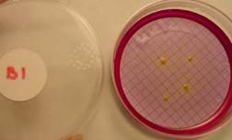
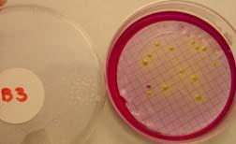
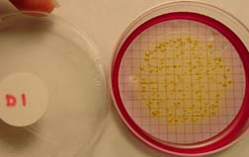
Biological Data: E. coli
Indicator of the potential presence of pathogens in drinking and recreational waters
Measured as colony-forming units (CFUs) per 100 milliliters of water
Sources
  Wastewater treatment plants
  Septic systems
  Stormwater runoff carrying pet and wildlife waste
  Combined sewer overflows
  Runoff from livestock and manure storage areas
Potential impacts
  Health risks from disease-causing bacteria, viruses, and protozoans affecting uses like swimming, drinking, and fishing
  May also be an indicator for elevated nutrients, leading to low dissolved oxygen from increased oxygen demand affecting aquatic life
Notes:
[For this slide, instructor can choose to use this as an interactive activity with the group by asking questions before revealing slide bullets:
What does E.coli measure?
What are some of the sources of E.coli?
What are some of the impacts of high levels of E.coli that could affect uses of tribal waterbodies?
The goal is to get participants thinking about how E.coli relates to indicators of water quality in the context of an assessment. What does understanding the impact of E.coli help tribes understand about impact on waterbody uses and overall tribal water quality?]
E. coli are bacteria found in the gastrointestinal tract and feces of warm-blooded animals. The presence of E. coli in water indicates fecal contamination and the likely presences of other pathogens. E. coli are measured as colony-forming units (CFUs) per 100 milliliter of water. Many tests measure total coliforms to indicate whether fecal coliform bacteria are present, including E. coli.
Sources of E. coli and other pathogens include wastewater treatment plant discharges, improper functioning septic systems, untreated combined sewer overflows from combined sewer systems that carry both sanitary and stormwater, stormwater runoff from urban environments that may contain pet waste, as well as runoff from agricultural areas with livestock and manure storage facilities.
E.coli in waterbodies from these sources can pose health risks for recreation and drinking water. In addition, E.coli can indicate that nutrients from sources may be present and could deplete dissolved oxygen levels.

Slide 14
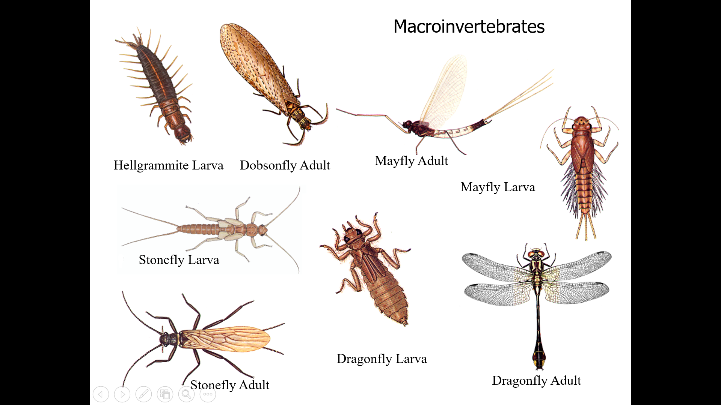
Notes:
Do any of you use these types of water quality indicators?

Slide 15
Biological Data: Macroinvertebrates
  Animals without a backbone that can be seen with the naked eye, usually bottom-dwellers
  Indicators of biological responses to stressors in a waterbody
  Species present represent historical water quality
  Measured through Index of Biotic Integrity (IBI)
  Sources of primary stressors
Notes:
[For this slide, instructor can choose to use this as an interactive activity with the group by asking questions before revealing slide bullets:
What do macroinvertebrates measure?
What are some of the primary stressors that have the potential to affect macroinvertebrate abundance and diversity?
The goal is to get participants thinking about how macroinvertebrate abundance and diversity serves as a response indicator to cumulative waterbody stressors. What does understanding macroinvertebrate abundance and diversity/richness as measured through an index like IBI help tribes to understand about tribal water quality?]
Macroinvertebrates is a term that encompasses a variety of animals that live on the bottom of waterbodies and can be seen with the naked eye, including insect larvae, snails, mussels, crayfish, worms, and beetles.
When collected and analyzed as part of a monitoring program, the Index of Biotic Integrity is used to examine the presence, diversity, and abundance of macroinvertebrate species. This type of index is often adjusted to account for regional differences. Different macroinvertebrates have different tolerance levels to pollutants. Some species are stressor tolerant, meaning they can survive in polluted waters. Other species are stressor intolerant, meaning that they cannot survive in polluted waters. A greater number and a wider diversity of stressor intolerant species indicate better water quality.
Macroinvertebrates respond to an aggregate of stressors in a waterbody over time, including changes in physical habitat and waterbody conditions, chemical pollutants, and aquatic biology.

Slide 16
Habitat Data
  Condition of existing aquatic habitat
  Measured via parameter-specific indices
  Based on regional reference conditions
  In-stream characteristics
  Stream bank and channel characteristics
  Indicator of habitat degradation by human activities
Notes:
[For this slide, instructor can choose to use this as an interactive activity with the group by asking questions before revealing slide bullets:
What does habitat data measure?
What are some of the primary stressors that have the potential to affect habitat conditions?
The goal is to get participants thinking about how habitat data relates to indicators of water quality in the context of an assessment. What does understanding habitat conditions help tribes understand about waterbody uses and overall tribal water quality?]
Habitat data evaluates the condition of existing aquatic habitat occupied by aquatic organisms using parameter-specific indices. In-stream characteristics include the type of sediment depositional areas, such as pools with slower moving water, and riffles and runs with faster moving water. These areas create variations in bottom substrates, including sediment and moving or embedded rocks, that provide in-stream habitat for macroinvertebrates and fish. Stream bank and channel characteristics include the plants in and around the stream, leaf litter and other decomposing organic material that falls into the stream, and submerged logs, sticks, and woody debris. Other habitat characteristics include stream channel width and shape, stream bank slope and modifications, and stream bank cover – all factors that can affect erosion rates. Stream channel shading affects temperature. All of these habitat factors affect the shelter, food, and dissolved oxygen levels that fish and macroinvertebrates need to survive. A habitat survey examines these aspects and rates the stream according to their quality. Changes to habitat conditions occur due to development and riparian landowner activities that alter natural stream channel and streambank conditions. The presence and abundance of invasive species is also an indicator of habitat degradation.

Slide 17
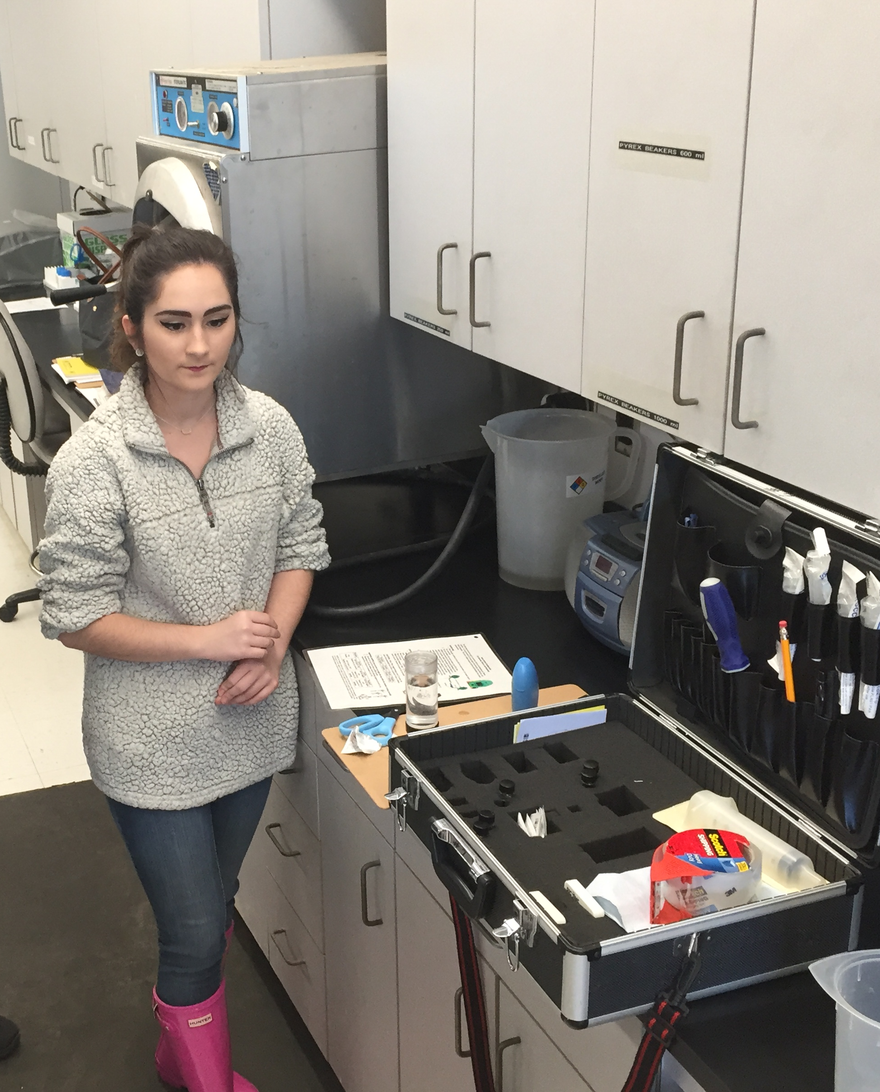
So . . . can we use any and all data we find?
There are LOTS of data out there
  Tribal data, university data, watershed group data, state data, federal data, etc.
Before using the data:
  How is your tribe generating quality data? Such as:
    Do you calibrate your field sensors?
    Do you have documented field and lab protocols?
    QAPP in place?
      Established Data Quality Objects?
      Do you perform QA of results?
  How can you assess the quality of outside data? Such as:
    Who collected it?
    Where was it collected?
    How was it collected/analyzed?
    How old is it?
    How was it managed?
Notes:
We’ve talked about some of the many water quality parameters out there – physical, chemical, and biological. We also talked about how each type of data can tell us something about water quality, and help inform our assessments. We’re going to spend the rest of this session talking about how to determine whether or not the data we collect – from our programs, and from external sources – is useful. That is, will an analysis of the data help us to construct an accurate and timely assessment of the quality of our waters.

Slide 18
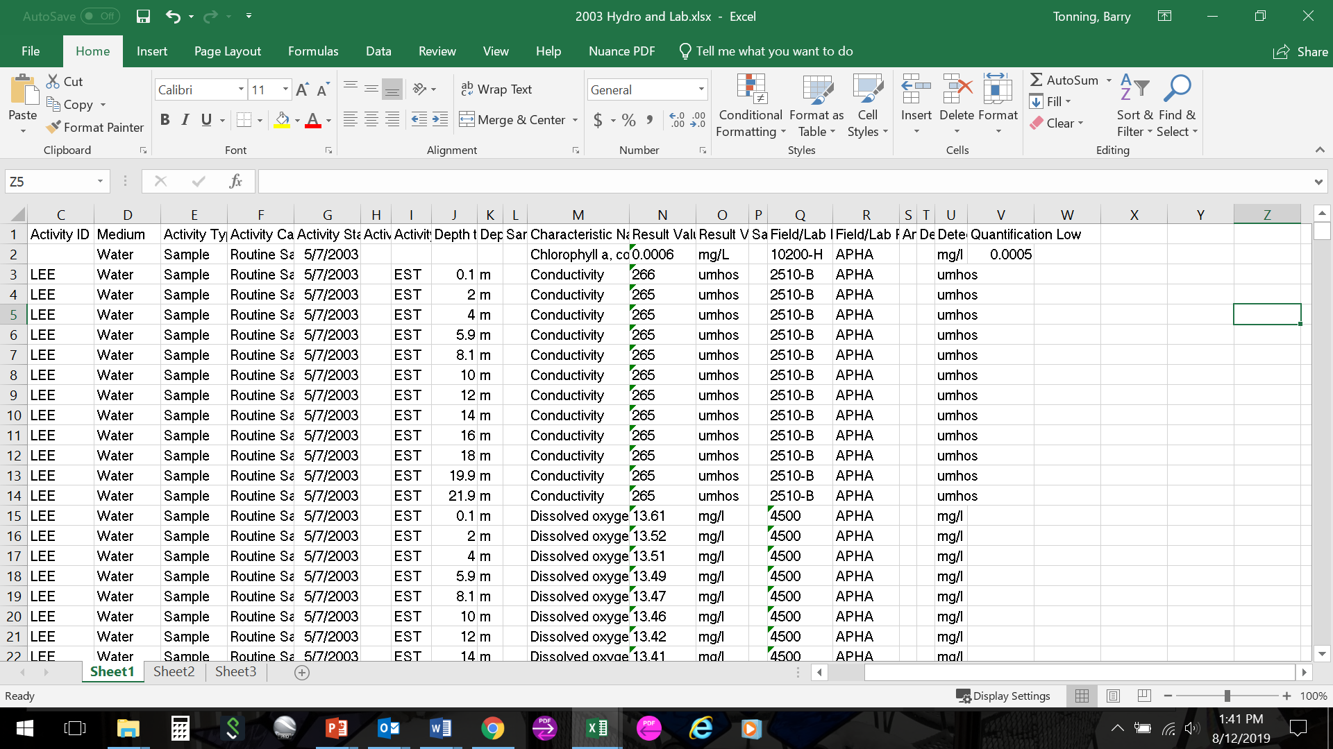
Considerations for Assessing Data
  How are water quality data managed?
    Hard copy v. electronic management
    Consistency among parameters over time for analysis
  Does each data set have supporting metadata?
    Documents when, where, why, how of sampling
    Allows comparability of data over time
    Enhances validity
    Explains irregularities
    Ability to combine data/comparable
Notes:
Let’s start off with discussing how you collect and manage your own tribal data. We want to assess your data sets to determine how they are useful and useable for the tribal water quality assessment.
There are some basic considerations to assess whether data are usable. Some of the questions you’ll need to consider as part of this data assessment:
How are the tribal data managed?
A basic step in assessing data is ensuring they are managed in a way that allows you to summarize and analyze them easily. Are your data maintained on paper monitoring forms or have data been entered into an electronic format like a spreadsheet or a database. Some parameters may have different data management approaches, depending on who is responsible for collecting the data. No two tribes will have exactly the same approach, but each tribe should strive to establish a consistent approach to data management based on available staff expertise and resources. In gearing up to develop a water quality assessment, tribal staff may need to invest time and resources to get all existing water quality data into a uniform format, ideally electronic to allow for easier analysis and storage over time. Let’s discuss the different approaches you’re currently using to manage tribal water quality data. What are the challenges and benefits to these data management approaches?
[Ask participants to share the different approaches they use for managing tribal water quality monitoring data.]
Does each tribal data set collecting have supporting metadata that will give the data set context? This is another consideration for assessing tribal water quality monitoring data to ensure the data are usable for the assessment. Data about data are referred to as metadata. Metadata is documentation about the when, where, why, and how related to each water quality sample that a tribe collects. Good metadata will allow tribal staff to determine if data sets from year to year are comparable by providing information on whether sampling occurred during the same season, using the same procedures, at the same locations. Knowing this information increases the validity of the data set and helps to explain any irregularities in the data. All of this information will help tribal staff determine if the water quality data sets are usable for the assessment. How are the metadata for your water quality monitoring data documented?
[Ask participants to share the different approaches they use for documenting and managing metadata.]

Slide 19
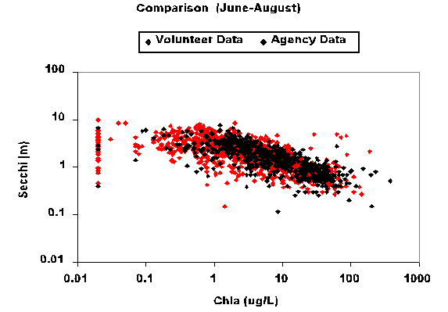
Considerations for Assessing Tribal Data
  Are there procedures for validating data?
    Decision points to accept, reject, or qualify data
    Procedures could include:
      Examining results for high/low results
      Checking calculations
      Calculating precision & accuracy
      of instruments
  Are data adequate for a water quality assessment?
Notes:
The previous slide mentioned data validation. This is a really important piece of data assessment that links directly to a tribe’s water quality monitoring program.
Data validation is another important consideration for assessing tribal data before conducting a water quality assessment.
Are there procedures in place for validating the data? These procedures will help tribal staff decide whether to accept, reject, or qualify data for use in the water quality assessment. The procedures could include activities such as examining data for high/low results, checking calculations, calculating precision and accuracy of instruments. The tribe’s Quality Assurance Plan, often referred to as a QAPP, should document these data validation procedures and decision points.
Upon assessing the data based on these considerations, a tribe can then ask: Are the data adequate for a water quality assessment? Note, there will ALWAYS be data gaps. No data set is perfect but is it sufficient?
If tribal staff can confirm tribal water quality data are adequate for the water quality assessment, the next step would be to compile these data sets to analyze against applicable water quality standards. This is the focus of Module 3. If the assessment of existing tribal water quality data reveal there are data gaps, tribal staff will have to determine the appropriate next steps. In some cases, this may be additional water quality monitoring. In other cases, it could be using existing data and documenting any associated data issues. There could also be a decision to look for non-tribal data that could be used to supplement existing tribal water quality data.
[Ask participants if they know what decision criteria they have in place for accepting, rejecting, or qualifying data for use in decision-making.]
Let’s discuss possible non-tribal data sources. Then we’ll take a deeper dive into assessing all data, tribal and non-tribal, for use in the tribe’s water quality assessment.

Slide 20
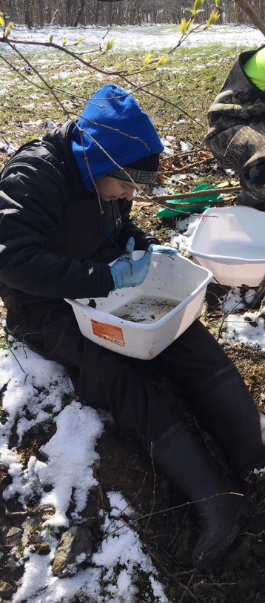
A note about tribal data
Tribes need established procedures for:
  Providing data stewardship – who will oversee the collection, management and storage of data, and how will it be done?
  Protecting their data – storage of paper files, transferring results to electronic databases, maintaining backup databases
  Encompasses data collection, analysis, evaluation, assessment and data management
Also:
  Tribal data collected with 106 funding must be shared with EPA at the end of each grant cycle.
  Tribal data collected using other resources does not have to be shared
Notes:
We often have questions about data privacy, data protection, and so on. Just a few comments:
Tribes, like any organization, need established procedures for:
Providing data stewardship – who will oversee the collection, management and storage of data, and how will it be done?
Protecting their data – storage of paper files, transferring results to electronic databases, maintaining backup databases
Also:
Tribal data collected with 106 funding must be shared
Tribal data collected using other resources does not have to be shared
Note if state programs are in the audience that all data collected by state agencies, regardless of funding source, are to be shared in order for states to be eligible to receive 106 grants.

Slide 21
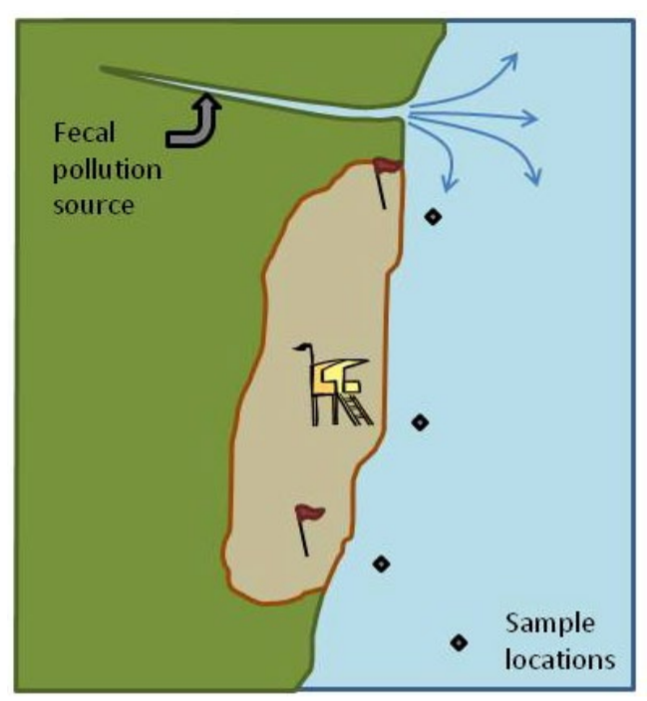
Why Consider Other Data?
Might help to create a more comprehensive water quality assessment
To fill data gaps
To obtain other relevant information that supplements tribal data
Important for tribes interested in TAS for Section 303(d)
Supplement organizational monitoring for efficiency and cost savings
USGS Gage
Tribe Site
Tribe Site
Notes:
Identifying, collecting, analyzing, and using other available data can help to improve your understanding of conditions in tribal waters – even if the data is useful only for general screening purposes. If the data meets your quality objectives in the tribal QAPP, it can also help to create a more comprehensive water quality assessment.
Doing so is actually a Clean Water Act requirement under Section 303(d). This is something to consider for tribes with interest in Treatment as a State (TAS) for Section 303(d). It requires that States and Tribes assemble and evaluate all existing and readily available water quality-related data and information to develop the required list of impaired waterbodies (§§ 130.7(b)(1) and 130.7(b)(2)). EPA’s Consolidated Assessment and Listing Methodology (CALM) guidance says “States, territories, and authorized tribes must consider all existing and readily available data when making water quality standard attainment and impairment decisions.”
So the question becomes, what are other readily available data that tribes could consider to use for a water quality assessment?

Slide 22
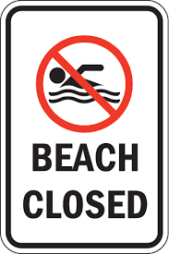
What Other Types of Data Can Tribes Consider?
Volunteer monitoring data
Beach closure notices
Fish consumption advisories
Fish kills
Source water assessments
Waste site inventories
Land use/cover data
Hydrology, climate, geological studies/reports
And more!
Notes:
Other types of existing data beyond tribal water quality monitoring data could include geological characteristics found in watershed plans or Total Maximum Daily Load (TMDL) documents, beach closure information, fish consumption advisories, fish kill information, Tribal or state source water assessment under the Safe Drinking Water Act, and other studies and reports. The goal is to have as comprehensive a data set as possible when conducting the overall water quality assessment.
[Ask participants to name other non-tribal data that could inform a water quality assessment.]
Now that we’ve brainstormed all the possible types of data that could supplement existing tribal monitoring data, let’s think about the agencies and organizations that may have these data.

Slide 23
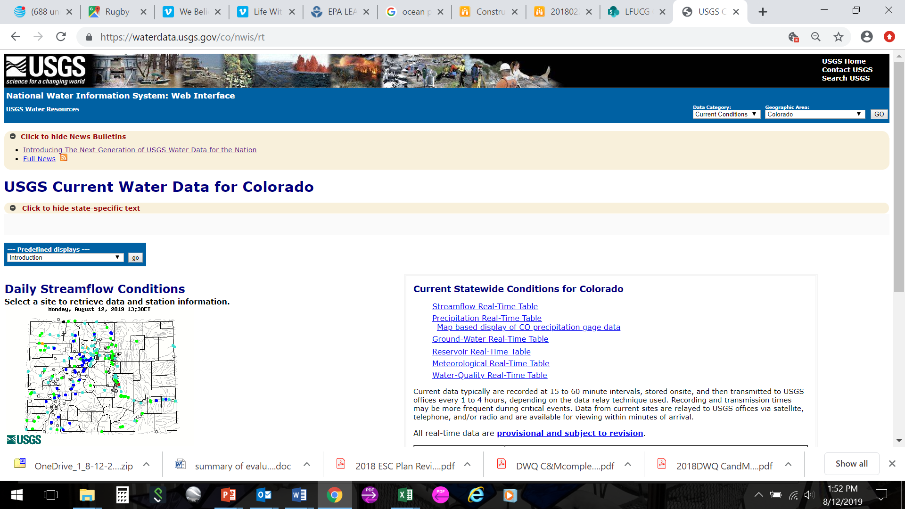
Possible Sources for Additional Water Quality Data: Federal Agencies
U.S. Environmental Protection Agency (ATTAINS, NARS)
EPA & USGS Water Quality Portal (WQX/WQP)
U.S. Geological Survey
Notes:
A variety of federal, state, and local partners may have water quality data for tribal waters if a partnership exists. In other cases, data from waterbodies upstream of tribal waters could be useful.
Federal agencies that may have data include U.S. EPA, U.S. Geological Survey, as well as…

Slide 24
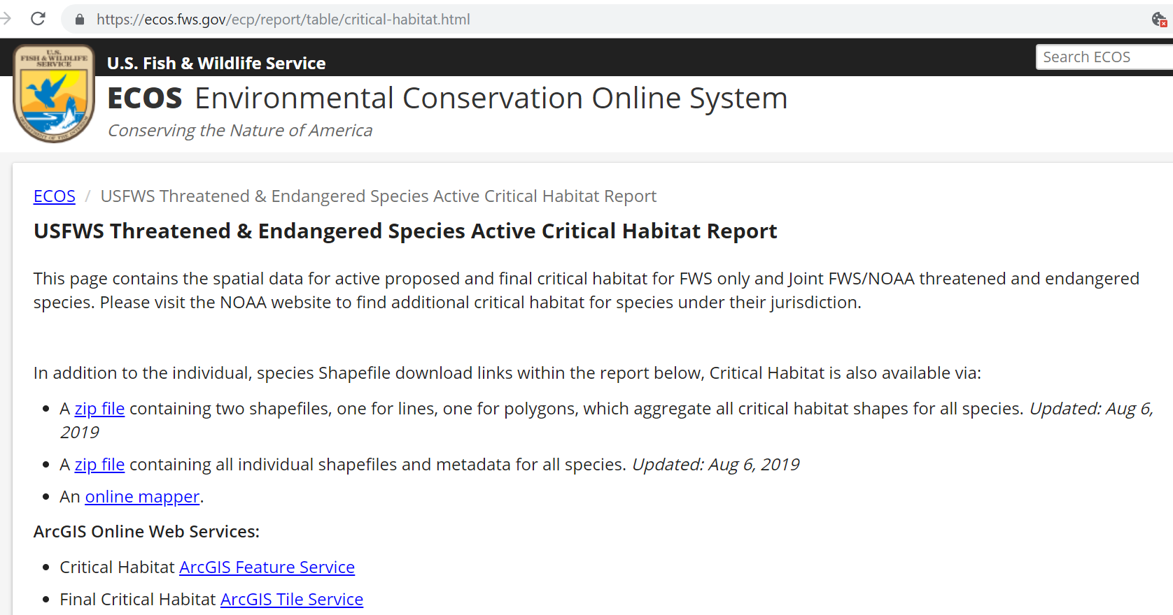
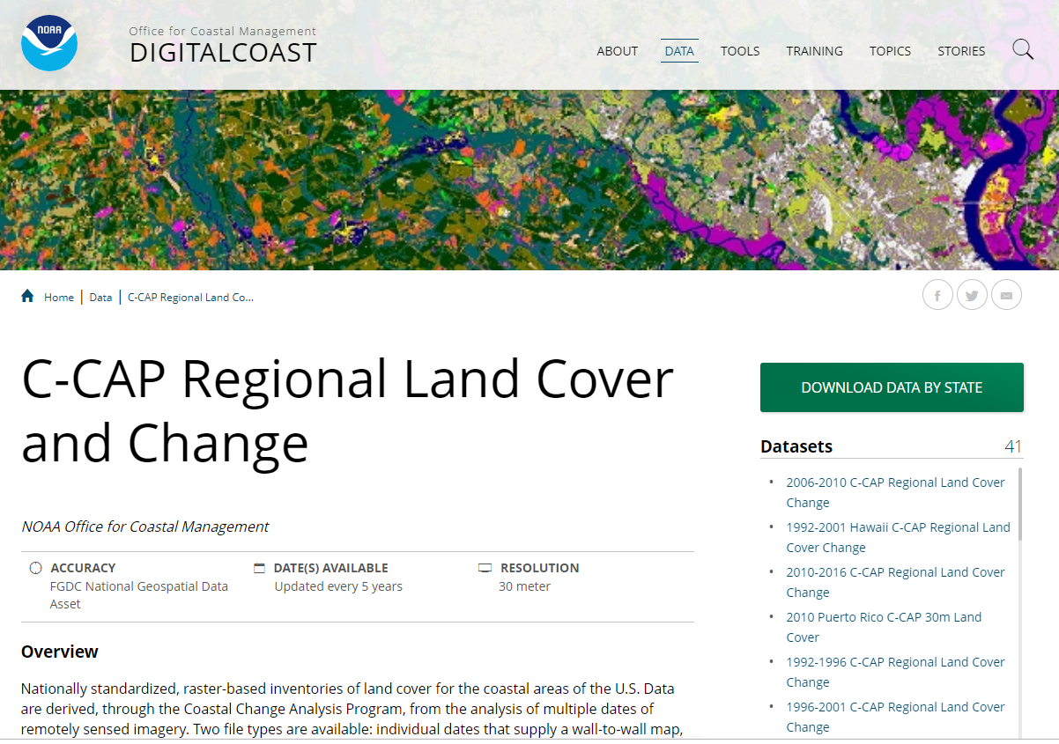
Possible Sources for Additional Water Quality Data: Federal Agencies, Other Groups
U.S. Fish and Wildlife Service
  Fish, habitat
U.S. Department of Agriculture Forest Service
  Forest management plans
National Oceanic Atmospheric Administration (coastal and estuarine data for both oceans and Great Lakes)
Notes:
U.S. Fish and Wildlife Service, and the U.S. Department of Agriculture’s Forest Service.
One online resource to consider visiting to help build this list of potential data partners is the River Network’s Who Protects Water? website. This interactive mapping tool allows users to enter a location and see organizations at all levels working to protect and restore rivers and drinking water. Information from this mapping tool may identify other groups that could have data for use in your tribal water quality assessment. It is important to keep in mind that not all data will be monitoring data. Some information may be more qualitative in nature. But this supplemental data and information can help support a broader understanding of tribal water quality when integrated into the overall assessment.
This list of potential data partners is in no way exhaustive. It’s possible that tribes have worked with other federal agencies.
[Ask participants to name other data partners that may have provided them with water quality data or that they are working with to generate supplemental data. Have them mention what type of water quality data they’ve obtained from this partner and the process that they used to get the data.]

Slide 25
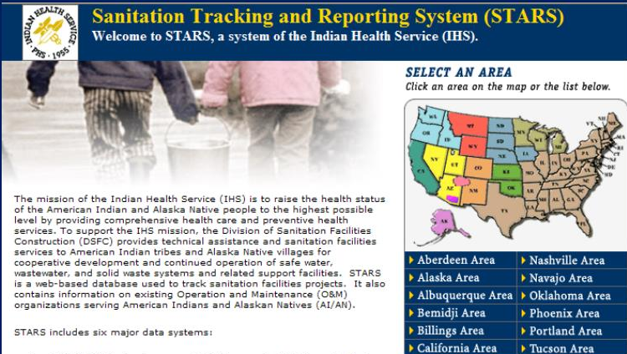
Possible Sources for Additional Tribal Water Quality Data
Bureau of Indian Affairs
Indian Health Services
Tribal commissions and ceded territory agencies
Range of possible data
  Water quality
    Monitoring data
    Fisheries (census and contaminant data)
    Natural resources
    Drinking water intake results
  Source information
    Septic systems
    Landfills/waste sites
Notes:
Tribal agencies that may have data on septic system location/age/type data, water quality data (from drinking water and wastewater treatment plants they operate), fisheries data, landfills / waste sites, and other natural resources info (landslides, eroded areas, etc.).
[Ask participants if they’ve requested water quality data from these agencies and what type of water quality data they’ve obtained.]

Slide 26
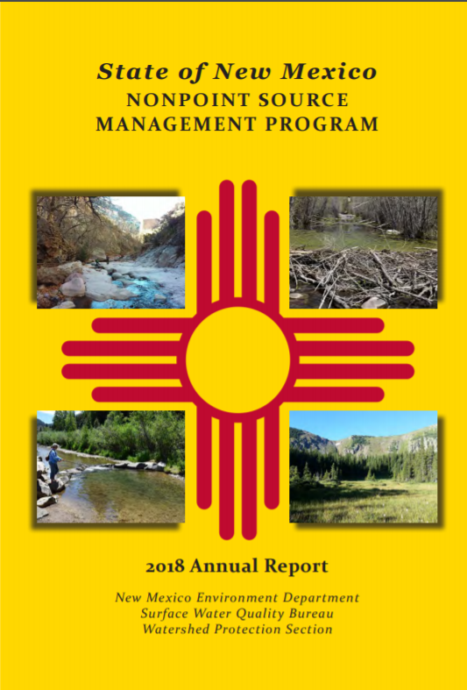
Possible Sources for Additional Water Quality Data: State Agencies
State Departments of environmental protection (305(b)/303(d) water quality assessment data, modeling, NPS assessments, source water protection assessments, watershed plans)
Departments of natural resources (scenic rivers monitoring)
Departments of health (recreational waters bacteria sampling, septic systems)
Notes:
State agencies that may have data include state departments of natural resources that may have scenic rivers monitoring data. State environmental protection agencies can provide assessment data, modeling, nonpoint source and source water protection assessments, and watershed plans that may have information for waterbodies upstream from or shared boundary waters with tribes. Departments of health can usually provide recreational waters bacteria sampling and possibly septic system data.
Again, this list isn’t exhaustive, but provides a good starting point for state data.
[Ask participants to name other state data partners that may have provided them with water quality data or that they are working with to generate supplemental data. Have them mention what type of water quality data they’ve obtained from this state-level partner and the process that they used to get the data.]

Slide 27
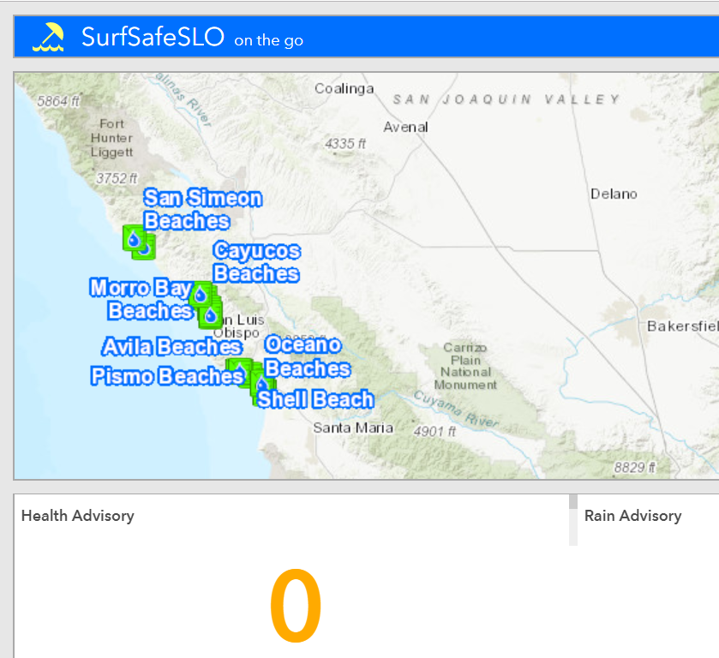
Possible Sources for Additional Water Quality Data: Local Agencies
Departments of Health
  Septic system data
  Beach monitoring data
Water Utilities
  Wastewater data
  Drinking water monitoring data
Soil and Water Conservation Districts
  Water quality
  Septic
  Beach data
Notes:
Local agencies that may have data include departments of health and water utilities. Departments of health at the local level may also have septic system data and beach monitoring data. Water utilities have wastewater data and drinking water monitoring data. Soil and water conservation districts may also have water quality data, septic system data, and beach-related data.
Are there other local agencies that could provide useful data for a tribal water quality assessment?
[Ask participants to name other local agency partners that may have provided them with water quality data or that they are working with to generate supplemental data. Have them mention what type of water quality data they’ve obtained from local agency partner and the process that they used to get the data.]

Slide 28
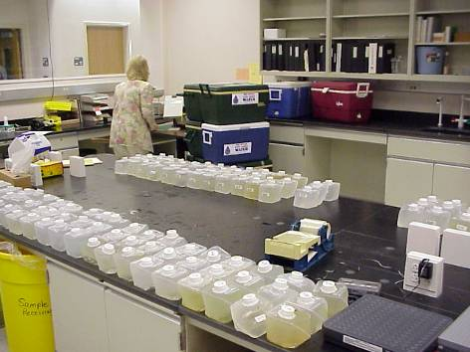
Possible Sources for Additional Water Quality Data: Other Local Partners
Universities
  Research studies
  Lab reports
Watershed groups
  Volunteer monitoring
  Modeling
  Nonpoint source assessments
  River Network’s “Who Protects Water” website: https://www.rivernetwork.org/membership/map-who-is-protecting-your-water/
Notes:
Don’t forget about local universities and watershed groups doing work in the area near tribal waters. The information generated by academia or watershed organizations might be useful and relevant to the tribal water quality assessment.
[Ask participants to name other local partners that may have provided them with water quality data or that they are working with to generate supplemental data. Have them mention what type of water quality data they’ve obtained from these local partners and the process that they used to get the data.]

Slide 29

When Asking for Data From Potential Partners
Be specific about data needs and intended use of the requested data
Ask for the timeframe to fill data request
Request a point of contact for follow-up
Ask for the information needed to evaluate data quality
  Metadata
  QAPP
Ask about the data format; be prepared to reformat
Notes:
When non-tribal data aren’t readily available online, tribal staff may have to reach out to potential data partners and ask for data. If you find you need to do this, here are some things to keep in mind.
When asking for non-tribal data and information, be sure to be specific about the type of data needed, ask how long it might take for the data to be made available, and ask for a point of contact for purposes of following up.
If you choose to ask for data, try to be as specific as possible about what you’d like so that the partner organization can limit the data they provide to only what you really need and want, with the associated supporting documentation. If tribal staff preparing the water quality assessment want only specific years or parameters, then specify those needs. If known, include information on the research lead or study to help narrow down the request. Some repositories of secondary data have many, many datasets. With more specificity, the entity providing the secondary data will have an easier time finding the data and you may receive the data more quickly.
Ask how long it may take to obtain the data. Some repositories of secondary data receive many, many data requests per day. Requesting the timeframe will also provide an appropriate time to follow-up with the data provider if the data are not provided at the appropriate time.
Don’t forget to ask who to follow-up with, for both dataset and technical issues. Follow-up may be necessary if the requested data are not provided within an appropriate timeframe. Additionally, after tribal staff obtain the requested data, it is possible they may encounter issues when evaluating the data (e.g., missing data, quality assurance). Depending on the nature of the issues, tribal staff will need to know the most appropriate person to contact. For example, if macroinvertebrate community health data are requested and later provided, tribal staff may discover a possible error during the analysis and may need to contact the data provider. It may turn out that the data provider is a database manager, when a biologist is needed to actually answer the questions.
It will be important to obtain not only the raw water quality data, but also the information related to the data – the metadata. As we discussed previously, metadata are critical for understanding the quality of the data. The metadata should document information on who collected the data, the equipment used, procedures followed, the lab involved, dates, location, etc..
The data you receive from data partners may come in a variety of formats, including hardcopy print-outs, scans of typed or hand-written data, PDFs, Excel®, Access®, or other formats. Be prepared to transform data into a format that is compatible with the tribe’s preferred data format. Data reformatting has the potential to introduce errors into the dataset. For example, when hardcopy data are transcribed into Excel®, typographical errors can occur. Copy/paste errors are also common. Reformatting secondary data results in the need for an added layer of data review and QA checks.
[Ask participants what formats they use to manage their own tribal data. Ask participants what formats they’ve encountered when using partners’ data for purposes of water quality assessments.]
Now we’re going to discuss an EPA online data tool called the Water Quality Portal that can help you access non-tribal data.

Slide 30
Water Quality Portal Exercise
https://www.waterqualitydata.us/
Notes:
The Water Quality Portal or WQP is a cooperative service sponsored by the United States Geological Survey (USGS),the Environmental Protection Agency (EPA), and the National Water Quality Monitoring Council (NWQMC). It serves data collected by over 400 state, federal, tribal, and local agencies. You can find it at www.waterqualitydata.us backslash.

Slide 31
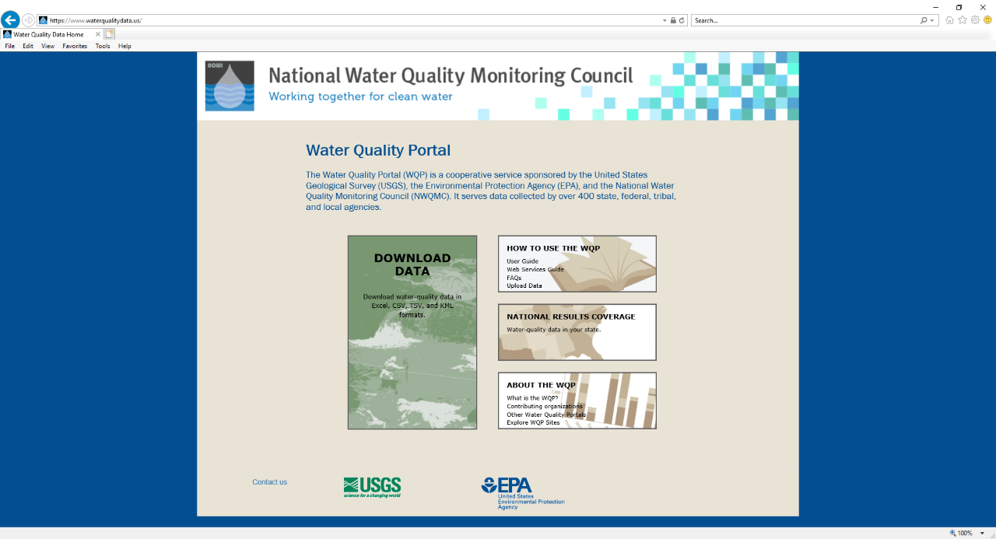
Notes:
When you go to the Water Quality Portal website’s homepage, this is what you’ll see. To download water quality data, click the “Download Data” box. The boxes to the right are hyperlinked to webpages about the Water Quality Portal and how to use it.
(NOTE: The WQP interface is undergoing a revision after the release of this module. Please update screenshots as necessary or perform a live demo of the water quality portal application instead)

Slide 32
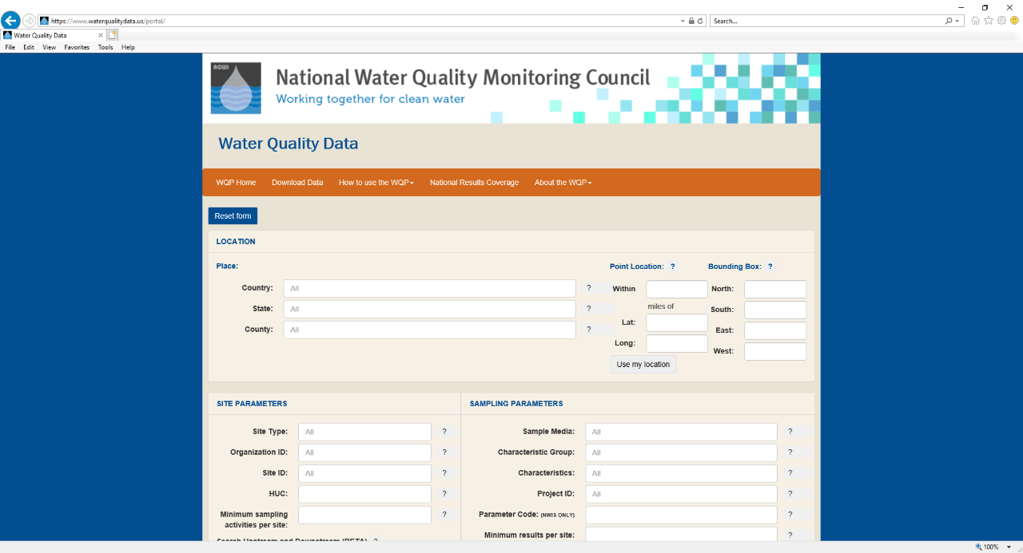
Notes:
This is the water quality data download page. To begin, you must determine a location to download data for. You can search for all data within a county. If you’re looking for a specific site, you can input the geographic coordinates of the site. The bounding box option allows you to search for locations within the box defined by coordinates.
If you are looking for data within a specific hydrologic unit, you can input the hydrologic unit code in the “HUC” field within the “Site Parameters” section. Users often input 8-, 10-, or 12-digit HUCs.

Slide 33
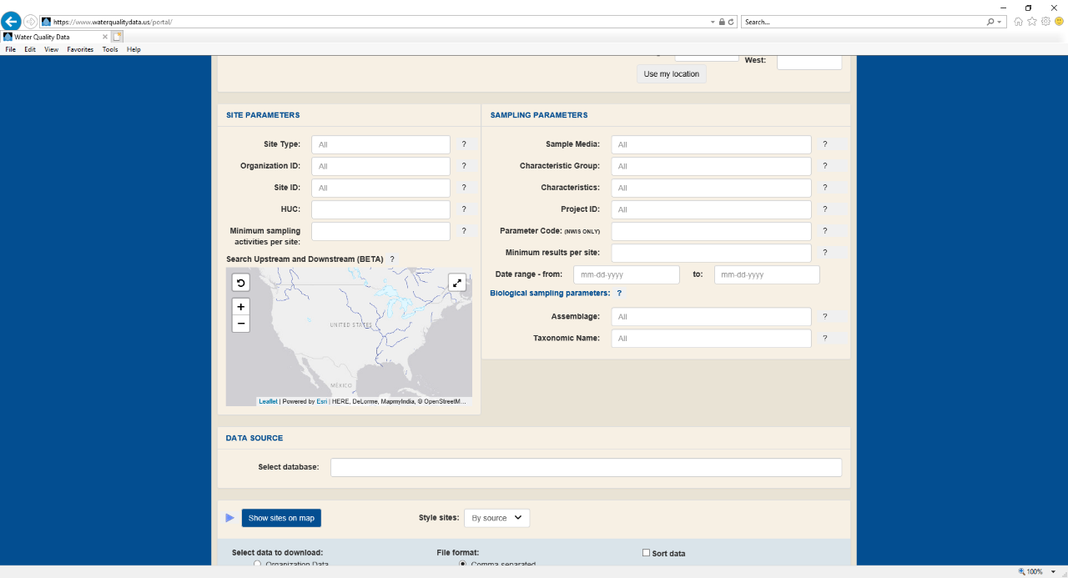
Notes:
Once you define the location for which you want to find water quality data, you can specify the types of sites and data that you want to search for. For example, you could search for only stream sites by specifying the “Site Type” or could search for only U.S. Geological Survey data by specifying the “Organization ID”. If you’re looking for data at a specific site and know its site identifier, you can input it into the “Site ID” field.
The “Sampling Parameters” section allows you to specify the type of data you want to search for. For example, if you’re looking for sediment data, select “Sediment (NWIS/STORET)” from the “Sample Media” field. You can also specify specific chemical constituents or groups of constituents. If you’re only looking for data from a specific time period, specify that period in the “Date range” field.
Finally, the database field allows you to select the BIODATA, NWIS, STORET, or STEWARD databases.

Slide 34
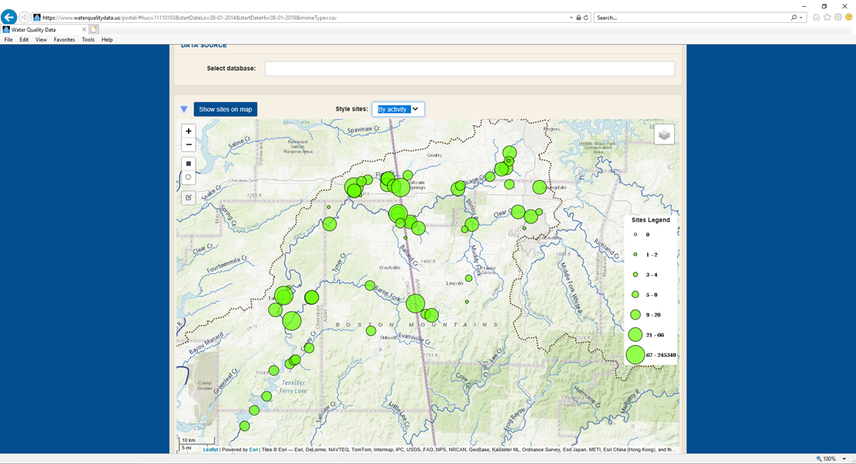
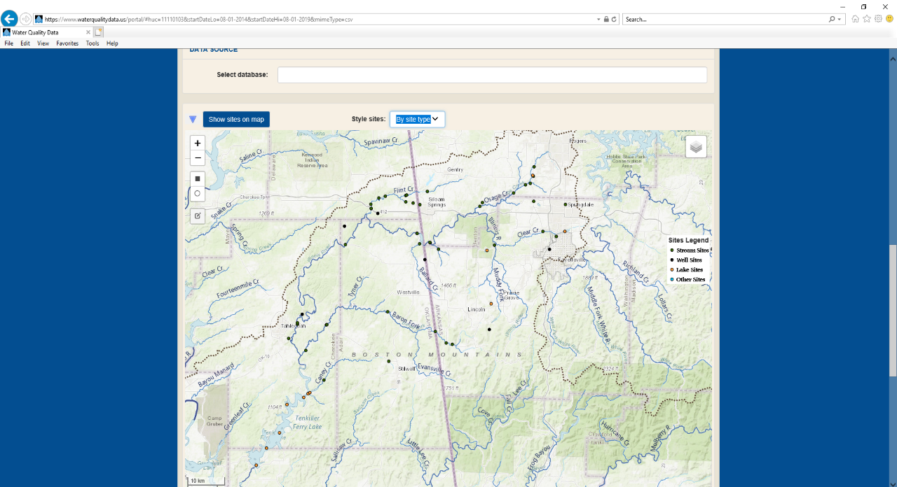
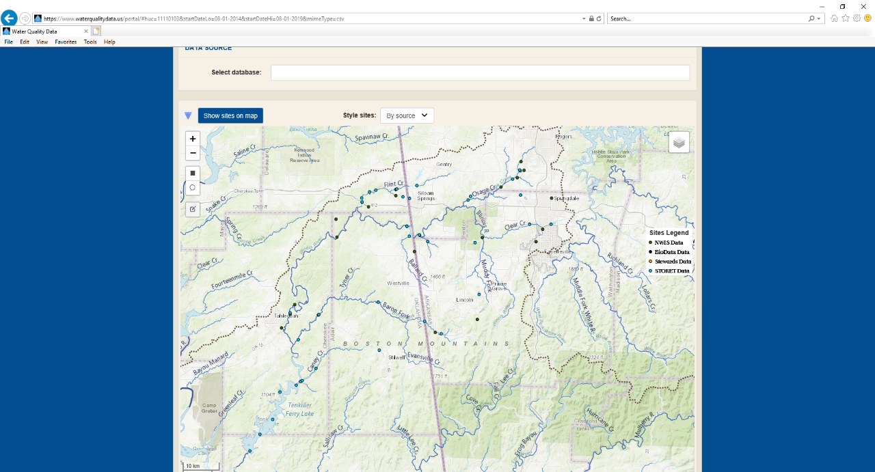
Notes:
The Water Quality Portal has a mapping feature.
The sites were plotted on a new map that appeared. However, the map was zoomed out to the conterminous United States. The screenshot on this slide was zoomed to the identified sites. This maps shows the sites by database.
Let’s look at the other mapping options. Click the drop-down menu for the “Style sites:” and choose “By site type”. Click the drop-down menu for the “Style sites:” and choose “By activity”.
After you’re done looking at the maps, click the blue arrow by the “Show sites on map” button to minimize the map.

Slide 35
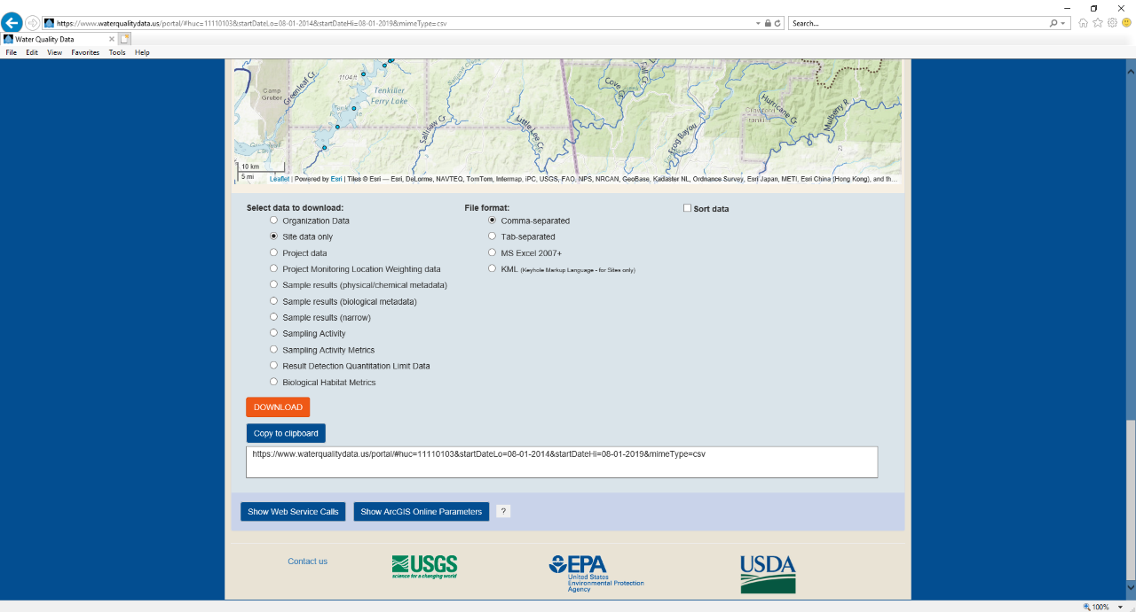
Notes:
Below the map, the final section of the web page allows you to specify what type of data that you want to download and the format of the download.
In our Illinois River example, lets look at the site information. Click the “Site data only” bullet and then click the orange “Download” button.
Small windows will pop-up to tell you how many sites there are and where you want to save the zip file to. After the file is saved and unzipped/extracted, open it.

Slide 36
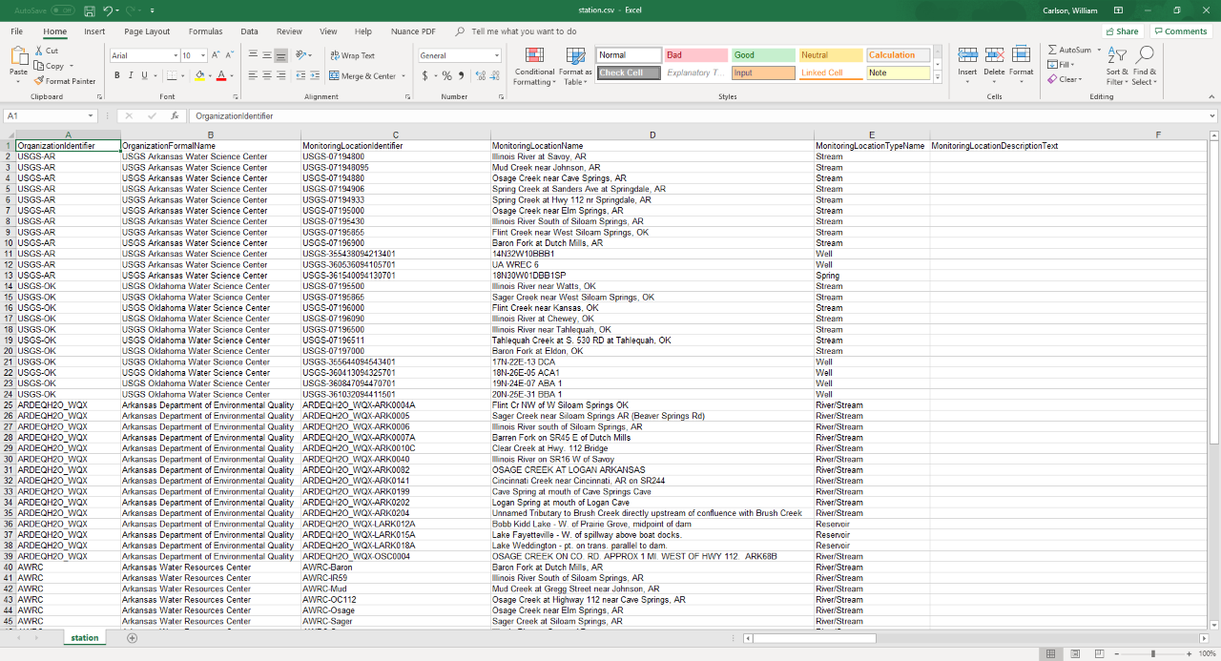
Notes:
When the file was first opened, all the columns were shrunk down. In this slide, we’ve expanded all the columns. Just looking at this slide, we can see that some streams and wells were sampled by the U.S. Geological Survey, while Arkansas DEQ sampled some river/stream and reservoir stations.
If you want to only look at a certain station, you can use this file and specify the station of interest in your Water Quality Portal Search.
We’re going to download all the data for this HUC. So, let’s go back to the Water Quality Portal and download that data.

Slide 37
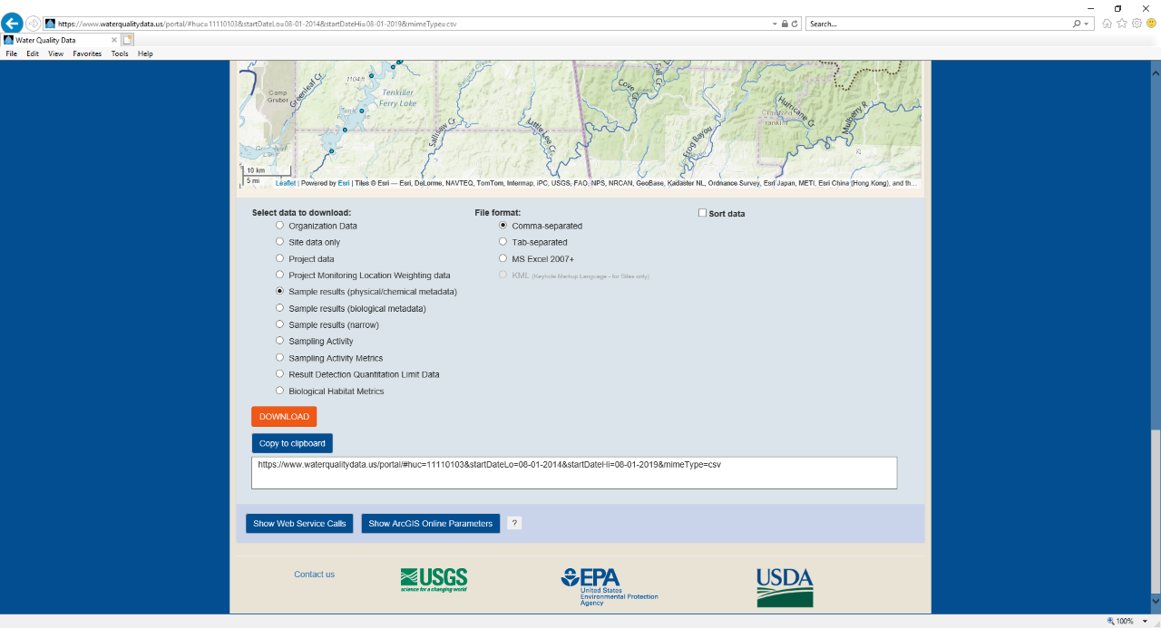
Notes:
We’re now back at the bottom of the Water Quality Portal’s water quality data search page. Before, we selected the “Site data only” bullet to download data about the sample stations. Let’s download the water chemistry data at these sites.
Now, click the “Sample results (physical/chemical metadata)” bullet.
Again, several windows will pop-up to tell you how many records are retrieved and where to save the file to.

Slide 38
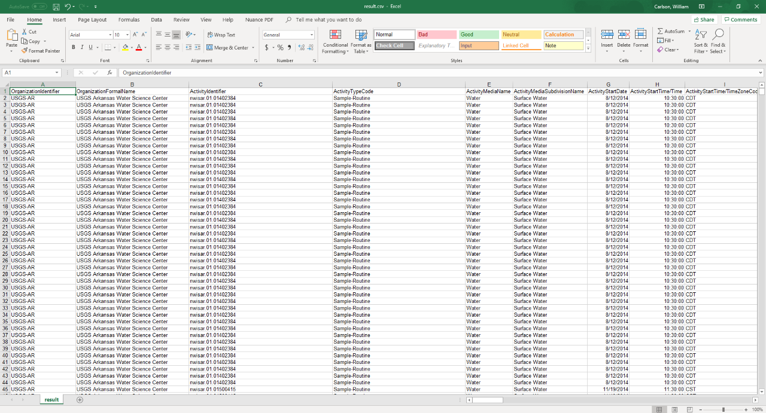
Notes:
We’re in Excel, and we’ve expanded the width of all the columns again.
When you do this, you can scroll through the data and determine if it is what you need.
Our example yielded over 50,000 records. Let’s do another example where we specify more search criteria.

Slide 39
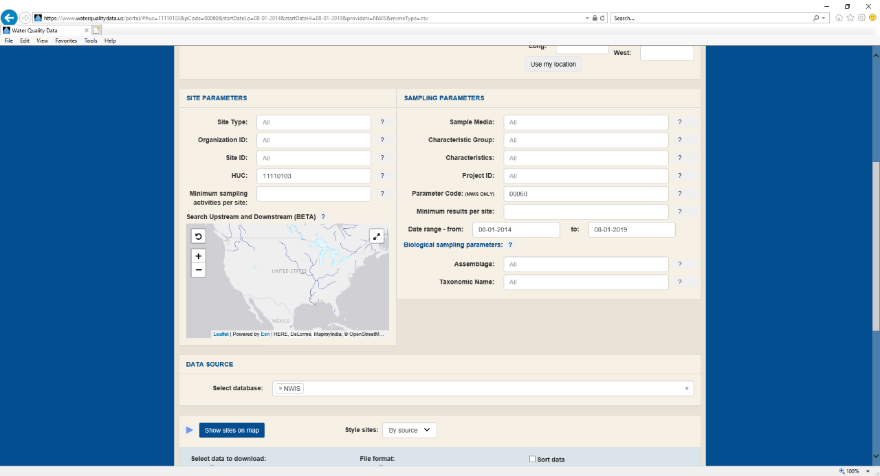
Notes:
We’re back in the Water Quality Portal. Before we only specified the HUC and the date range. Let’s set up some more queries. This slide and the next several slides present different queries.
Now let’s specify only data in the National Water Information System (NWIS) maintained by the U.S. Geological Survey. In the “Select database” drop-down menu, select “NWIS”.
Let’s just look for some flow data. In the “Parameter Code” field, which only works for NWIS data”, we’ll specify code “00060”. If you don’t know what parameter code you’re looking for, click the little question mark icon to the right of the field. A window will pop-up with information about the field. In this specific case, the pop-up window includes a link to a webpage will all of the parameter codes used in NWIS.
You can follow the same procedures to view the three maps, download the sites data, and download the results data.

Slide 40
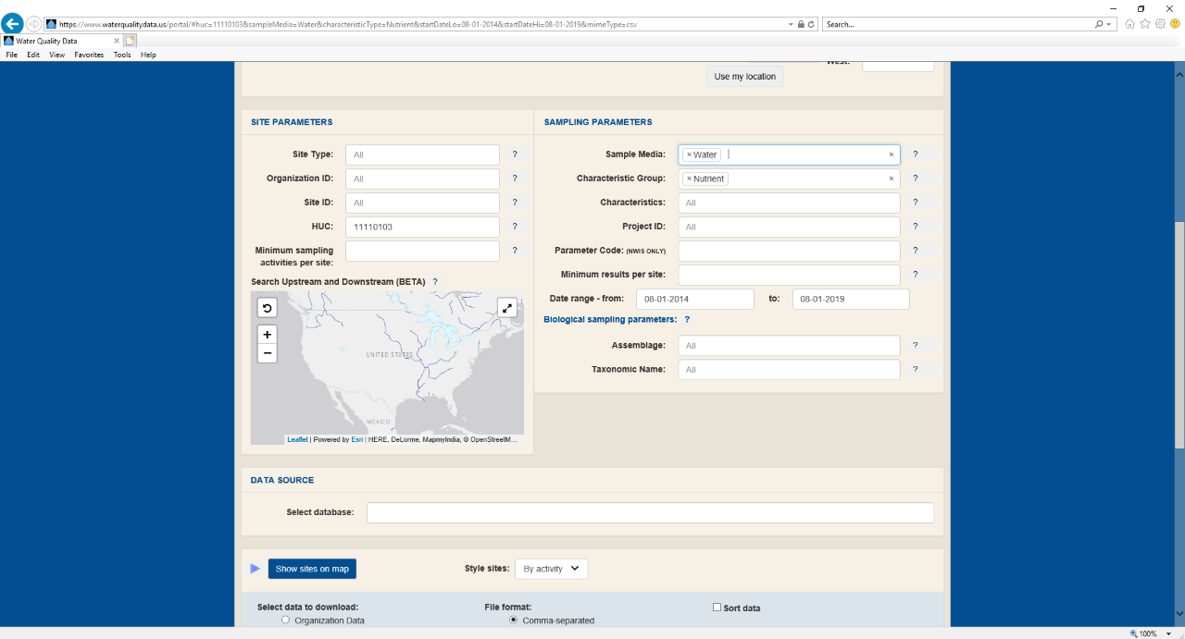
Notes:
Here is another example where we input more specifications.
In this query, in addition to the HUC and date range, let’s specify nutrient data from water samples. Select “Water” from the “Sample Media” field and “Nutrients” from the “Characteristic Group” field. This will return nutrient water chemistry data collected over the past 5 years from this HUC.
Again, you can follow the same procedures to view the three maps, download the sites data, and download the results data.

Slide 41
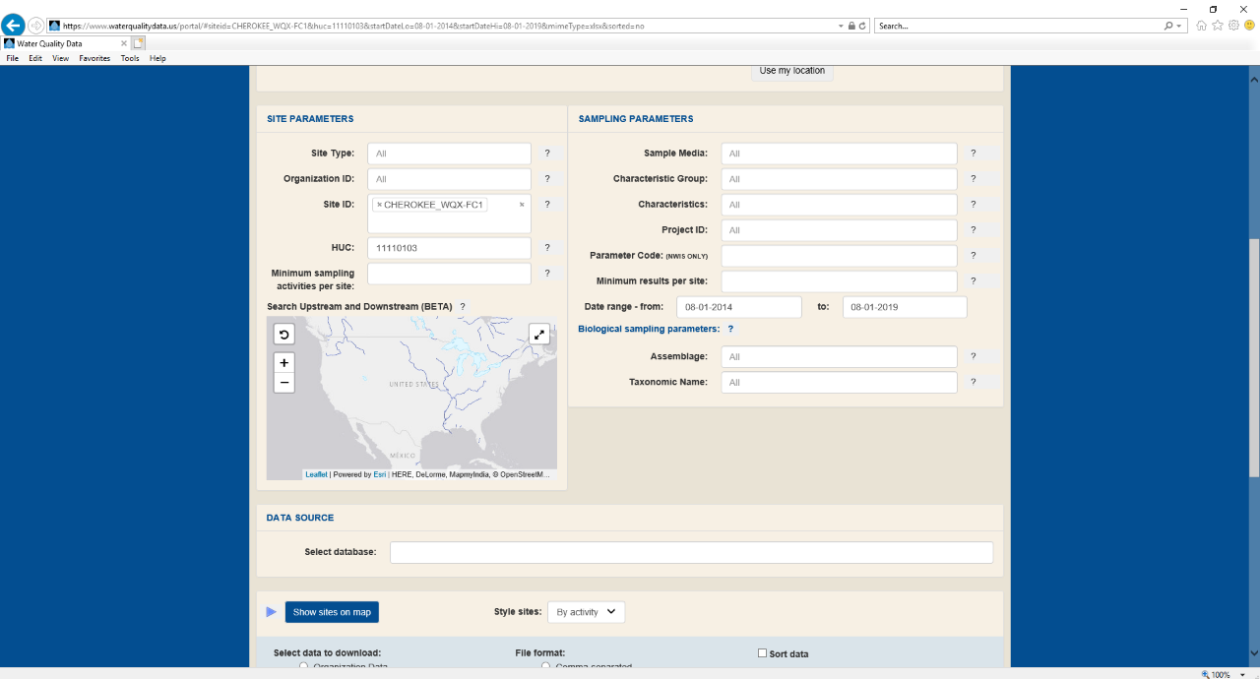
Notes:
For this example, we want to determine what data that the Cherokee Nation has collected from Flint Creek. In this case, we already know about the site, so we don’t have to query sites in a specific area and look at the maps.
We’ll leave the HUC and date range. Let’s input “Cherokee_WQX-FC1”.
Again, you can follow the same procedures to view the three maps, download the sites data, and download the results data.
When you go home and try this for yourself, you can use the user’s guide available at the Water Quality Portal website.

Slide 42
Online Data Sources
Watershed Index Online: https://www.epa.gov/wsio
Recovery Potential Screening: https://www.epa.gov/rps
Healthy Watersheds Protection: https://www.epa.gov/hwp
WATERS GeoViewer: https://www.epa.gov/waterdata/waters-geoviewer
NOAA National Estuarine Reserve System-Wide Monitoring Program Data: https://coast.noaa.gov/digitalcoast/data/nerr.html
How’s My Waterway: https://mywaterway.epa.gov/
National Aquatic Resource Surveys: https://www.epa.gov/national-aquatic-resource-surveys
Notes:
Let’s take a look at some other online sources of data you can consider.
The Watershed Index Online provides online tools and data for viewing watershed characteristics within user-selected geographic areas anywhere in the conterminous United States.
The Recovery Potential Screening Tool provides comparative watershed indicators, assessment methods and example projects as well as a full national set of state-specific watershed comparison tools that use the Watershed Index Online datasets.
The Healthy Watersheds Protection website covers protection projects and analysis methods for protecting aquatic systems via landscape approaches. Included in this site is a preliminary assessment of watershed health in each of the 48 conterminous states.
How’s My Waterway is a mapping application that shows monitoring, assessment, drinking water, NPDES facilities, 319 projects and more to allow users to more easily interact with EPA water data.
The National Aquatic Resource Surveys are a statistically unbiased assessment of condition of the nations waters. Results and protocols can be used to inform assessments and sampling methods.
The WATERS GeoViewer provides simple access to stream network search for water information as well as watershed delineation and associated landscape attributes.
The NOAA National Estuarine Reserve System-Wide Monitoring Program Data provides site-based monitoring data provide standardized, quantitative measures to determine how conditions are changing in the short and long term. Three major components are focused on (1) abiotic indicators of water quality and weather, (2) biological monitoring, and (3) watershed, habitat, and land use mapping.

Slide 43
Break!
Notes:
Provide the group with a 20 minute break.

Slide 44
Data Quality Considerations
Notes:
In the first half of the presentation, we focused mostly on who has water quality data. During that discussion, we briefly touched on some data quality considerations.
It should be clear by now that no matter the source of data – collected by a tribe or outside data partners – evaluating the quality of data for a water quality assessment is imperative. Let’s talk more in-depth about data quality considerations for water quality assessments.

Slide 45
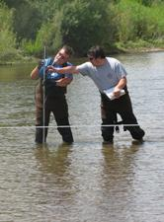
Discussion: Characteristics of High-Quality Data
What characteristics will you consider for tribal and non-tribal data to ensure data are high quality?
Which characteristics are highest priority for your tribe?
Source: Lian and Wu, 2017.
Notes:
We’ve talked about identifying and compiling comprehensive water quality data for assessments. Assuming you’ve collected a large suite of data, the next step is to evaluate the quality of the data. If you’re looking to include the highest quality data possible in your assessment, what characteristics will you consider – both for your own data, and data from outside sources?
[You are likely to hear answers that touch on age of a data set, number of data points, statistical relevance, etc. Gather these answers on a flip chart for reference.]
Since these data are being considered for use in an assessment, which characteristics are of highest priority to your tribe when thinking about data quality?
[You are likely to hear a variety of answers/rationale for which characteristics should take priority for an assessment.]

Slide 46
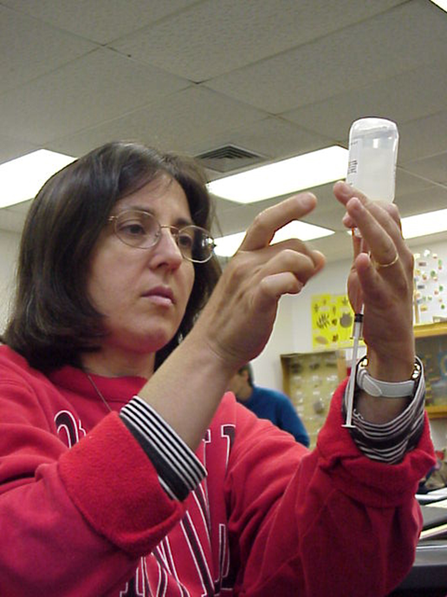
Let’s Break Down Data Quality
Quality assurance elements
Quality control data
Quality assessment procedures
Notes:
Three facets of evaluating data quality are (1) quality assurance elements, (2) QC data, and (3) quality assessment.
The quality assurance elements refer to procedures that are used to manage those unmeasurable components of a project, such as sampling at the right place and time with the proper equipment and using the correct techniques.
The quality control data are those generated from the collection and analysis of QC samples and are used to estimate the magnitude of errors related to obtaining the data.
Quality assessment is the overall process of determining the quality of the data by reviewing the application of the QA elements and the analysis of the QC data.
Every measurement is subject to potential errors that can cause the result to differ from the true value and can also cause results of repeated measurements to differ from each other. Types of errors include measurement errors, random errors, and systematic errors. Measurement errors are the difference between a measured quantity and the true value. Random errors are naturally occurring errors that aren’t able to be corrected. Systematic errors occur when an instrument hasn’t been properly calibrated.
Measurement errors are a part of any measurement process and should not be considered mistakes. Generally, the goal of QC data analysis is to quantify the random and systematic errors in the measurement process and to reduce the overall error where possible.

Slide 47
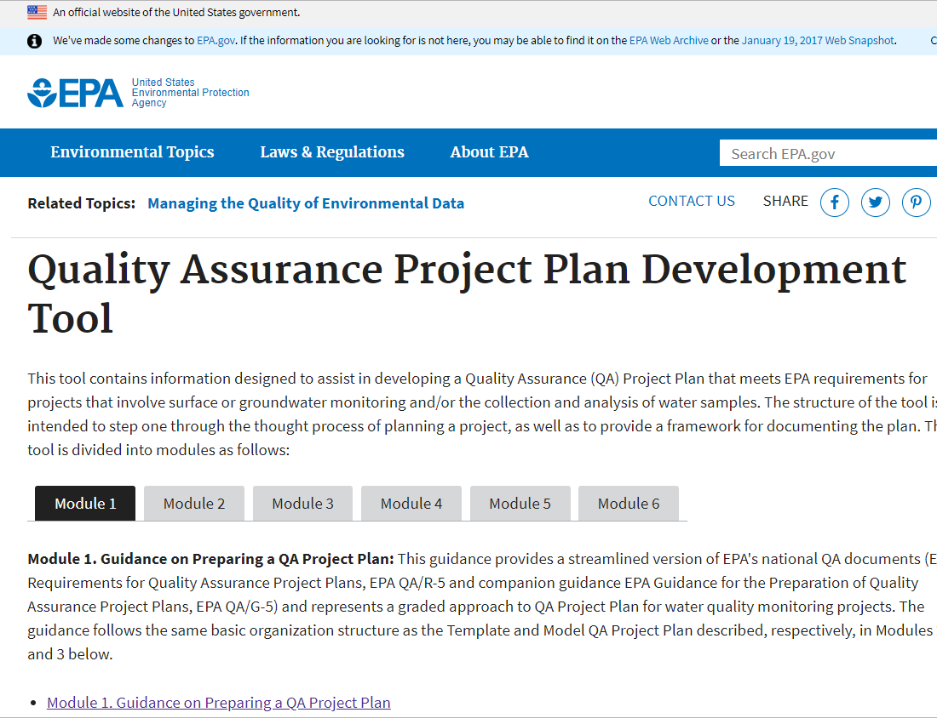
Quality Assurance Project Plan (QAPP): Quick Review
  Documents the procedures to ensure the data collected for a particular purpose meet data quality objectives
  Can address data that:
    Include direct measurements (data collected by the tribe writing the QAPP)
    Non-direct measurements (secondary data collected from other sources)
Notes:
Let’s do a quick review of Quality Assurance Project Plan, or QAPP.
Any tribe that conducts Section 106 monitoring has a QAPP in place. The QAPP describes data collection activities and the procedures in place to ensure the data are of high quality to support data quality objectives or DQOs.
QAPPs apply to tribal water quality monitoring data, which is primary data for your assessment, and secondary sources of data that could also be incorporated into an assessment. According to EPA’s 106 Guidance, if a tribe chooses to use data from secondary sources in decision making, then the tribe’s QAPP must also include a discussion of how the tribe will review and evaluate data from the secondary source to determine that it meets the DQOs set for the purposes of supporting a water quality assessment (EPA Final 106 Guidance).

Slide 48
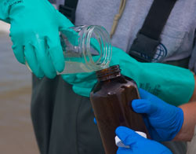
Data Quality Objectives (DQOs) and Water Quality Assessments
  Establishes the quality and quantity of data needed to support decisions
    Clarify study objectives
    Define the appropriate type of data
    Specify tolerable levels of potential decision errors
  Specifies data performance and acceptance criteria
    Quantitative
    Qualitative
  EPAs DQO Guidance: https://www.epa.gov/sites/default/files/2015-06/documents/g4-final.pdf
Notes:
The objective of a water quality assessment is to determine if water quality meets the is supporting water quality standards to support a for specific a designated use, as discussed in Module 1. Let’s talk a little more about Data Quality Objectives, or DQOs, and how they relate to water quality assessments.
These are the quantitative and qualitative criteria used to describe how good the data need to be to meet a project's objectives. In this case, the project we’re discussing is a water quality assessment. The data are intended for important decision-making purposes that affect aquatic life and public health, as well as cultural uses. As a result, the associated DQOs are going to be more rigorous than if the project was intended to be more educational in nature, such as raising key stakeholders’ basic water quality awareness, or establishing water quality trends.
EPA DQO guidance available at https://www.epa.gov/sites/default/files/2015-06/documents/g4-final.pdf

Slide 49
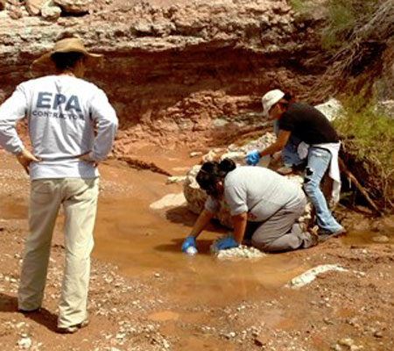
Data Quality Indicators (DQIs) for Water Quality Assessments
  Data quality indicators (DQIs) are quantitative and qualitative measures of the quality of the data
  DQIs to meet DQOs will vary, but often include:
    Precision
    Bias
    Accuracy
    Representativeness
    Comparability
    Completeness
Notes:
Data quality indicators, or DQIs, are quantitative and qualitative measures of the quality of the data collected for a project, based on the DQOs.
Datasets are typically evaluated for six indicators to assess the sufficiency of a particular dataset to be used for a particular purpose, such as an assessment. The indicators are: Precision, bias, accuracy, representativeness, comparability, and completeness. The QAPP should address the process or method for evaluating data against the selected data quality indicators.
Let’s take a close look at each indicator that could be selected to determine data quality for tribal and non-tribal data.

Slide 50
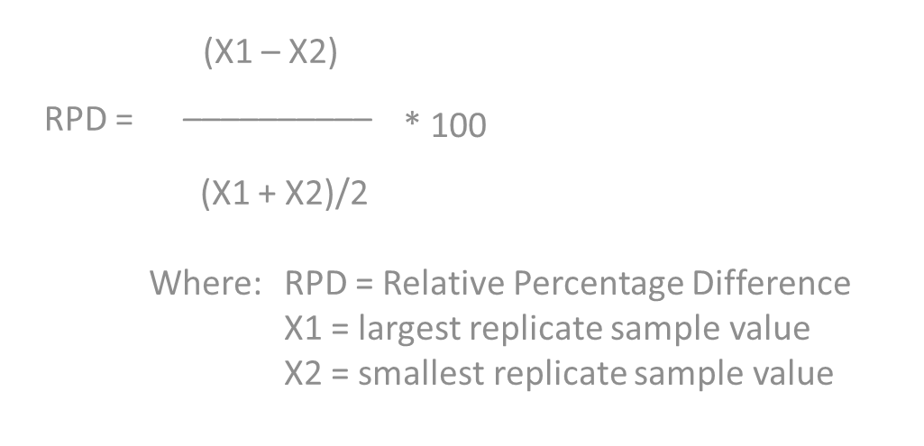
What Is Precision?
  Assessment of the degree to which two or more measurements are in agreement
  Amount of random error in a data set
  Measure of the “scatter” of the results
    Data with high precision = less scatter (results are clumped together)
    Data with less precision = more scatter (results are dispersed over a wider area)
  Coupled with bias to determine accuracy
  Can be measured as Relative Percent Difference (RPD)
Notes:
Precision is an assessment of the degree two or more measurements are in agreement. Duplicate samples are used to check the precision of field collection or laboratory analyses and verifies repeatability of the sample data. Duplicates are collected the same time as the water quality sample. It shows the amount of random error exists in a data set.
Precision is a measure of the scatter of results. Results that are clumped together have less scatter. They have high precision. Results that are dispersed over a wider area have more scatter and would have less precision.
Precision coupled with bias helps determine the overall accuracy of the data.
One way to calculate precision is by using Relative Percent Difference. This is the difference between duplicate results for the analyses of a sample, relative to the mean or average value of those results. RPD is expressed as a percent. This is the calculation for Relative Percent Difference. You may see this type of calculation in your tribal QAPP. In this equation, X1 is the largest replicate sample value and X2 is the smallest replicate sample value. The desired RPD may vary between field duplicate precision and lab sample precision.

Slide 51
What is Bias?
  Systematic error or persistent distortion in data
  Causes constant errors in a particular direction
  Coupled with precision to determine accuracy
  Site selection can introduce bias
Notes:
Bias is a systematic error in a method or measurement system, and can affect all results. It is coupled with precision to determine data accuracy. Bias can result from mishandling sampling containers, using uncalibrated equipment, sensor drift, sampling only certain types of sites (e.g., only near-bank areas), or other issues. Positive bias, typically from contamination introduced in the sample collection and analysis process, causes the results in the samples to be consistently higher than what is actually present in the environment. Negative bias causes the results to be consistently lower than what is actually occurring in the environment. Approaches for selecting sites to sample can introduce bias because you may only be sampling near a discharge rather than a pristine area of the tribal lands.. Using a randomized design for selecting sample locations avoids bias.

Slide 52
What is Accuracy?
  Degree of agreement of an analytical result with the true value (probe calibrations)
    Results closer to the true value = higher data accuracy
    Results farther from the true value = less accurate data
  Affected by both systematic errors (bias) and random errors (imprecision)
  Can be measured with spiked samples and calculated as Percent Recovery (%R)
%R = (R1/R2)100
Where: %R = percent recovery of a parameter
R1 = the observed value for a
parameter, obtained via
testing/analysis
R2 = the actual value of the
parameter in the sample
Notes:
Accuracy is a measure of confidence that describes how close a measurement is to its true value. Results closer to the true value have higher accuracy. Results that are farther from the true value have less accuracy. You may understand this in respect to calibrating probes. You use calibration solutions to ensure the meter is reading accurately before sampling.
Accuracy is a combination of systemic errors associated with bias and random errors associated with precision, or imprecision.
Accuracy can be measured with spiked samples and calculated as Percent Recovery (%R), defined as 100 times the observed concentration, divided by the true concentration. Tribes don't often do accuracy checks for water samples unless they have a certified lab. It’s important for a tribe’s contract lab to conduct accuracy checks.

Slide 53
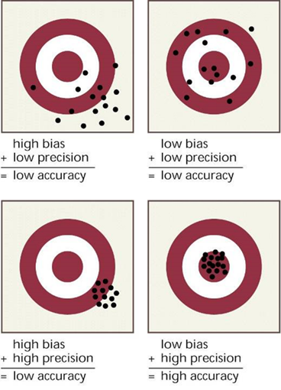
How Bias and Precision Affect Accuracy
Notes:
This “target” graphic illustrates how bias and precision in sampling results can affect the accuracy of your data, and the likelihood that your assessment will reflect actual waterbody conditions. You can see how bias in your results tends to skew things off to one side or another relative to the bulls’ eye, which represents the “true” value for a parameter in the waterbody at that particular time and place. You can also see the effects of high precision, and low precision. Our pursuit of quality data is in large part an effort to reduce bias and improve precision, so we have an accurate picture of water quality conditions.

Slide 54
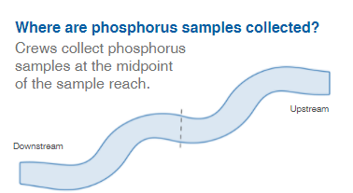
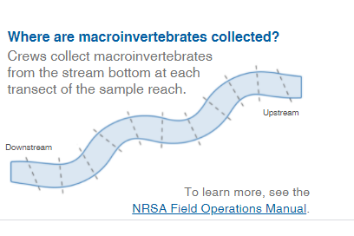
What is Representativeness?
The extent to which measurements characterize the true environmental condition or population at the time a sample was collected.
Two Types of Representativeness should be considered:
  Spatial Representativeness
    Field Method Considerations
    Site Selection Considerations
  Temporal Representativeness
National Rivers and Streams Assessment Field Methods Application -- https://riverstreamassessment.epa.gov/fieldmethods/.
Notes:
Field method considerations are important to ensure that how the sample is collected is representative of what you are trying to measure. For example, do you need to collect one grab sample, collect several samples at different locations or create a composite sample? Do you need to sample at several transects or from different habitats to effectively represent the condition of interest? Some knowledge of the indicator and likely variability is necessary to decide on the method that will be used. For an interactive example of how different indicators may require different approaches for collecting representative data AT A SITE, see the National Rivers and Streams Assessment Field Methods Application -- https://riverstreamassessment.epa.gov/fieldmethods/. Examples from the tool are shown on the slide. Here you will see that for the NRSA objectives, some indicators are collected throughout the entire reach while others are collected at just one location.
Site Selection Considerations are also necessary to ensure your representative requirements are met. Selecting sites through judgmental or targeted designs is appropriate if the project objectives require representation of the site (or specific sites). Selecting sites through a probability or randomized design is appropriate when the project requires representativeness for a broader population of waters that cannot all be sampled for resource or other reasons (i.e. all lakes in a watershed or reservation; all streams within a specific region).
Temporal Representativeness: To ensure appropriate temporal representative, it is necessary to consider the sample frequency required to reflect the range of conditions across relevant time intervals (e.g., seasonal, diurnal, high/low flow conditions) pertinent to the project objectives.

Slide 55
What is Comparability?
Degree to which data can be compared directly to similar studies
Repeated use of standardized sampling protocols and analytical methods = more comparable
Different sampling protocols and analytical methods = less comparable
  E.g. : Arsenic – one method Detection level is 1 mg/l and another is 0.25 mg/l (ca yield very different results)
Important to document data procedures to verify/evaluate comparability
Notes:
Comparability is the degree to which data can be compared directly to similar studies. Using standardized sampling protocols, the same or comparable analytical methods and units of reporting with comparable sensitivity helps ensure comparability. Tribes selecting testing methods that are EPA-approved and/or currently being employed by other water quality monitoring programs tend toward increased comparability of primary and secondary data. Selecting sites where previous water quality monitoring has taken place can also help increase data comparability – in trend analyses, for example.

Slide 56
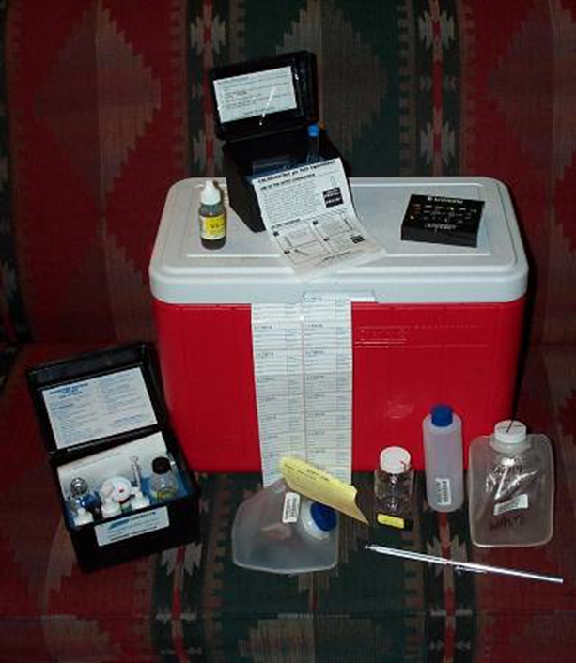
What is Completeness?
  Amount of usable data collected versus the amount of data called for in the sampling plan
  Measured as target percentage of valid results obtained compared to the total number of samples taken for a parameter
  Target percentage will vary from program to program
Notes:
Comparison between the amounts of usable data collected versus the amount of data called for in the sampling plan. This is measured as target percentage of valid results obtained compared to the total number of samples taken for a parameter. A tribe can set a target completeness goal. For example, the Karuk Tribe in California expected completeness on their water quality monitoring program to be over 90%, given the efficiency of past sampling activities conducted by this tribal program.

Slide 57
Reviewing Data Quality Indicators (DQIs) and Data Sets
  Review DQOs/DQIs for all tribal data over time
    Purpose and objectives may vary as monitoring program matures
    Determine if all tribal data sets meet DQOs for assessment
  Follow secondary/external data quality evaluation procedures in the tribe’s QAPP
    Consider DQIs in the QAPP covering the secondary dataset
    Compare secondary data QAPP to the tribal QAPP
    Determine which DQIs align and which do not
    Determine tribe’s acceptable level of quality based on this review
Notes:
Using the DQIs in the tribal QAPP established to support a water quality assessment, tribes should review existing data sets and secondary non-tribal data against the DQIs.
For tribal data, older data sets may have had QAPPs with DQOs and associated DQIs not intended to support decision-making like a water quality assessment. The QAPP for these older data sets should document the DQOs and DQIs used to ensure the quality of the data collected at that time. By reviewing the DQOs and DQIs under those previous QAPPs, you should be able to assess whether the older data sets will meet the current DQOs and DQIs.
This type of DQO/DQI review should also happen with non-tribal data. As we previously discussed, each tribe will need to determine and document in the QAPP the procedures for quality review of secondary data. Here’s an example from the Karuk Tribe in California. The Data Acquisition section of this tribe’s QAPP states:
“If it appears that the “external” data might facilitate water body evaluation, the data will first be reviewed to verify that they are of sufficient quality to meet the needs of the project by examining:
(1) the sample collection and location information;
(2) the data, to see whether they are consistent with known tribally-collected data from the same general vicinity; and
(3) the QA/QC information associated with the data.
If the data are of insufficient or unknown quality, limitations will be placed on its use in supporting project decisions.”
This will require a comparison of the tribe’s QAPP to the QAPP associated with the secondary data. The goal is to determine where the DQIs align between tribal data requirements and secondary data.
Let’s consider a couple of data scenarios involving reviewing secondary data. As we review the scenarios, think about your tribe’s QAPP, or the example provided from the Karuk Tribe.

Slide 58
Data Quality Scenario 1:
Watershed group collects biweekly chemistry samples
  June through September
  Purpose: evaluation of effects on macroinvertebrate health during summer low-flow critical conditions
An upper Midwest Tribe wants to use data set to estimate annual pollutant loading
Discussion: Is this watershed data representative of the conditions the tribe wants to evaluate for their water quality assessment? Why or why not?
(HINT: When might pollutant loading be highest and when is it lowest and what data did you capture?)
Notes:
Scenario 1
A watershed group collects data composed of biweekly chemistry samples from June through September to evaluate effects on benthic macroinvertebrate community health during summer, low-flow critical conditions. If a tribe wants to use this dataset to help estimate annual pollutant loading, the tribe must evaluate the watershed group’s data quality objectives.
Discussion on Scenario 1:
Would this data suit the tribe’s needs? If your tribe has secondary data evaluation requirements in your QAPP, would your tribe use this data? Do you think the tribe, given their secondary data evaluation considerations, would use this data?
Answer for Scenario 1:
The watershed group sampled during summer, low-flow conditions; however, pollutant loading may be highest following spring snowmelt and spring rains. In this case, the watershed data may not be representative of the conditions that the tribe wants to evaluate for purposes of the water quality assessment.

Slide 59
Data Quality Scenario 2
Watershed group worked with trained volunteers to collect water quality data
  Used field test kits
  Purpose: To determine the concentration of a specific pollutant to the nearest milligram per liter
Tribe’s data is analyzed in a lab to the nearest microgram/liter
Discussion: How might the tribe use both datasets for the water quality assessment? What additional information might be needed?
Notes:
Scenario 2:
The watershed group used trained volunteers with field test kits to determine the concentration of specific pollutant, to the nearest milligram per liter. However, the tribe wants to evaluate the watershed group’s data with another dataset where the specific pollutant was analyzed in a laboratory to the nearest microgram per liter.
Discussion question on Scenario 2:
If your tribe has secondary data evaluation requirements in your QAPP, would your tribe use this data? Do you think the tribe, given their secondary data evaluation considerations, would use this data? Do you think the data would be useful for screening purposes?
Answer for Scenario 2:
In this case, there might be incompatibility issues regarding comparisons of the tribe’s primary data and the watershed group’s secondary data. The tribe will have to further investigate the comparability of the two methods before making a determination on usability for purposes of the water quality assessment.
These examples highlight the importance of obtaining QAPPs and other metadata related to secondary data for purposes of evaluation. Now let’s discuss considerations for screening the actual data, both primary and secondary, before use.

Slide 60
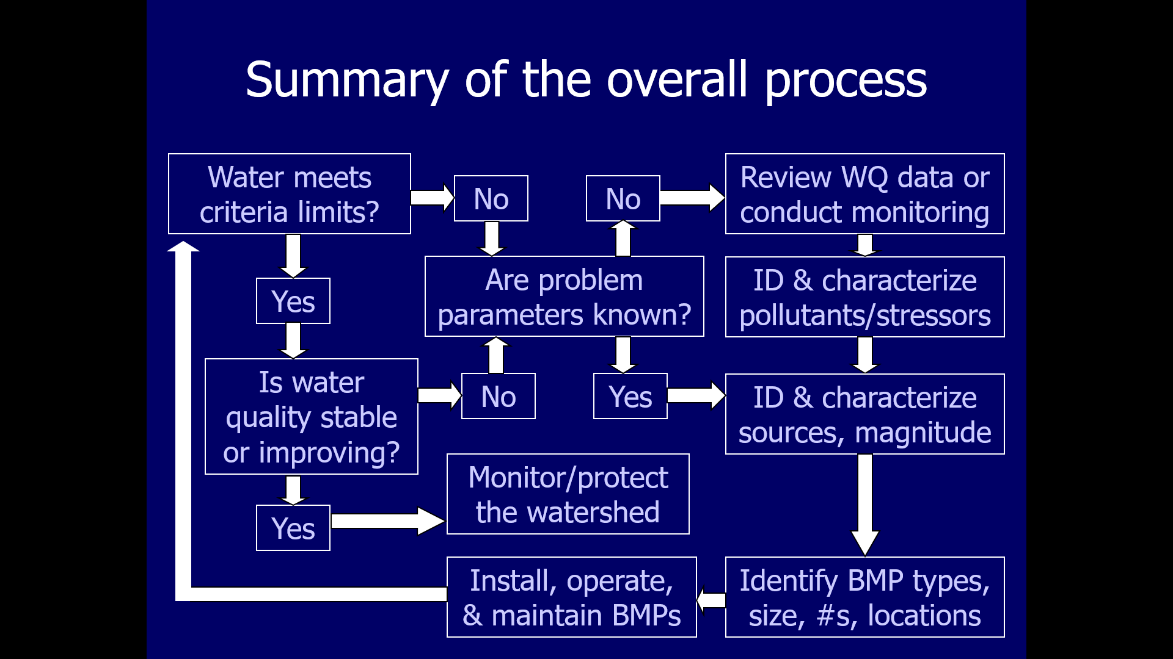
Screening Data
Determine data credibility
Ensure appropriate data quality
Potential screening criteria
  Parameters and methods used
  Range checks
Notes:
Before primary or secondary data are evaluated and used to answer study questions, tribes should screen each dataset to determine whether the data are of sufficient quality for use in the water quality assessment. Datasets may have errors, some of which might be significant. Here’s a question: what kind of errors would be really significant? (Failure to follow sampling procedures, contaminating sample collection bottles, decimal point errors, using old reagents, etc.). If tribes identify these errors through screening, it is possible to evaluate the data and possibly mitigate the errors before use in the assessment.
The next few slides present some typical screening analyses that are used to identify and mitigate errors in a dataset.

Slide 61
Data Screening Considerations:
Parameter v. Methods
Parameters can have many forms (total nitrogen, total Kjeldahl nitrogen, nitrate, nitrite )
Essential to specify the chemical form of the parameter
An analytical method is the procedure for determining the amount/concentration of the parameter
  Several analytical methods can apply to a parameter
  Essential to specify which analytical method is used
  Limits of detection are also important to consider. Specifically, when the water quality standard is near the detection limit.
Notes:
A parameter is a chemical, physical, or biological component of water quality. An analytical method is the procedure that is implemented to determine the presence, amount, or – most often – the concentration of the constituent within the sample. The concentrations of many constituents can be determined by multiple analytical methods. It is important to make sure that the results of two analytical methods for the same constituent are comparable. For example, one analytical method may have a higher method detection level, and be incapable of measuring small concentrations of a particular constituent. EPA’s CALM guidance states “data collected using methods different from those the state prefers should be considered if the detection limits for the method are appropriate for both the criteria threshold and the concentration detected.”

Slide 62
Data Screening Considerations: Range Checks
Identify the range of possible concentrations for each parameter based on:
  Site
  Historical data
  Recent watershed changes
Values outside of that range may be in error
  Investigate upstream/upland conditions before discarding data
  Check to see if the collection method requires field blanks and make sure they are all below the limit of detection (indicates whether sample is contaminated or not)
Notes:
Range checks are a quality assurance procedure to determine if sampling results are within the range of expected values, given past sampling results, waterbody conditions, and point source / nonpoint source inputs – including those associated with recent changes in the watershed, such as new land clearing and/or construction, increases in livestock, row crop changes, intense rain events, illicit dumping, and other causes.
Each parameter has a broad range of possible concentrations. For example, water temperatures may vary from 0 to 100 degrees Celsius and pH of water samples can vary from 1 to 14 standard units. When a tribe performs QA on a dataset, if any temperature or pH results are not within those ranges, the data are likely in error and should be further reviewed. For example, with pH, if a pH of 74 standard units is reported in a dataset, the tribal staff should investigate this suspicious value. It’s possible that the pH is actually 7.4 (seven and four-tenths) standard units; however, it’s also possible that the pH is a completely different value and the 74 is a typographical error. The result value must be investigated. If no explanation can be found, the result should be considered invalid and excluded from the assessment. Sometimes data will have comments or other metadata that helps explain unexpected results.
Sampling results that skew significantly higher or lower than expected ranges require investigation. They may indicate important changes in water quality, or they may be related to errors related to sample collection, analysis, or reporting. For example, a pH result of 3.5 in a stream that normally has a pH range of 6.8 to 7.5 could be error-related, or could indicate an upstream discharge, illicit dumping, or other changes in watershed conditions.

Slide 63
Exercise 2: Data Screening
Notes:
Now we’re going to work on a data screening exercise to apply what we’ve learned so far on data quality.

Slide 64
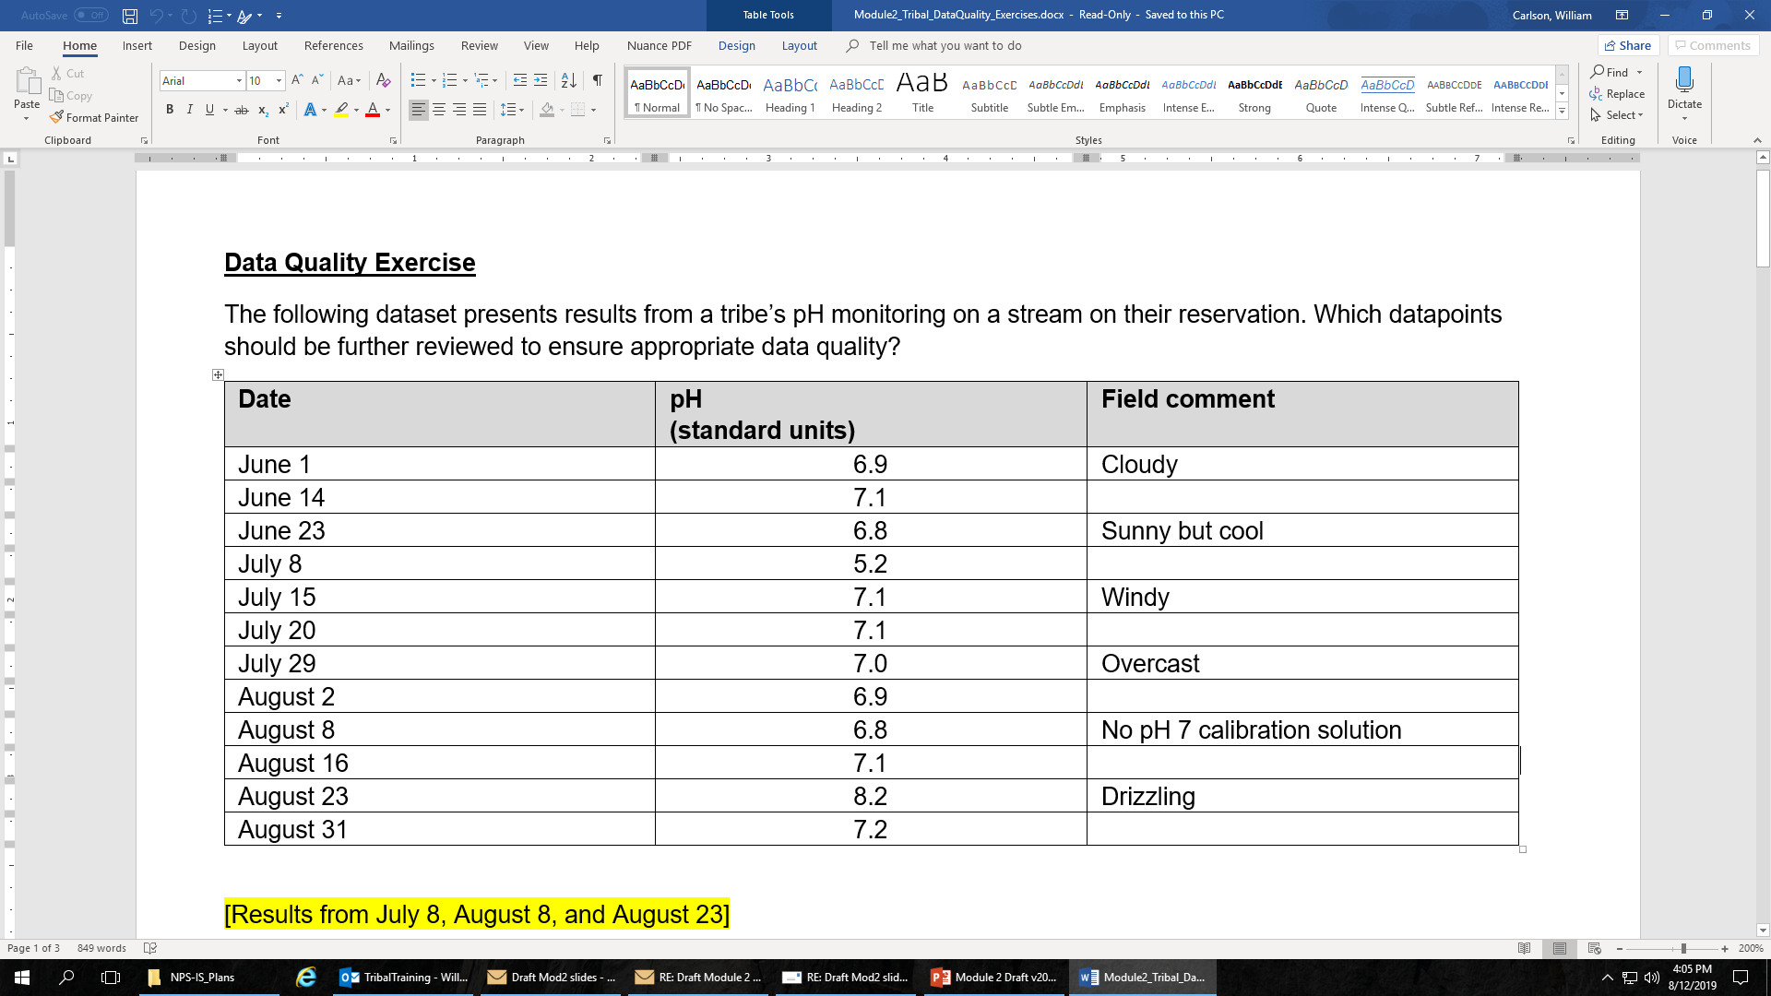
Which datapoints need further review?
Notes:
The following dataset presents results from a tribe’s pH monitoring at a stream on their reservation.
Question:
Which datapoints should be further reviewed to ensure appropriate data quality?
Answer:
Results from July 8th (pH is significantly lower than all other dates), August 8th (instrument was not fully calibrated), and August 23rd (precipitation may affect pH).

Slide 65
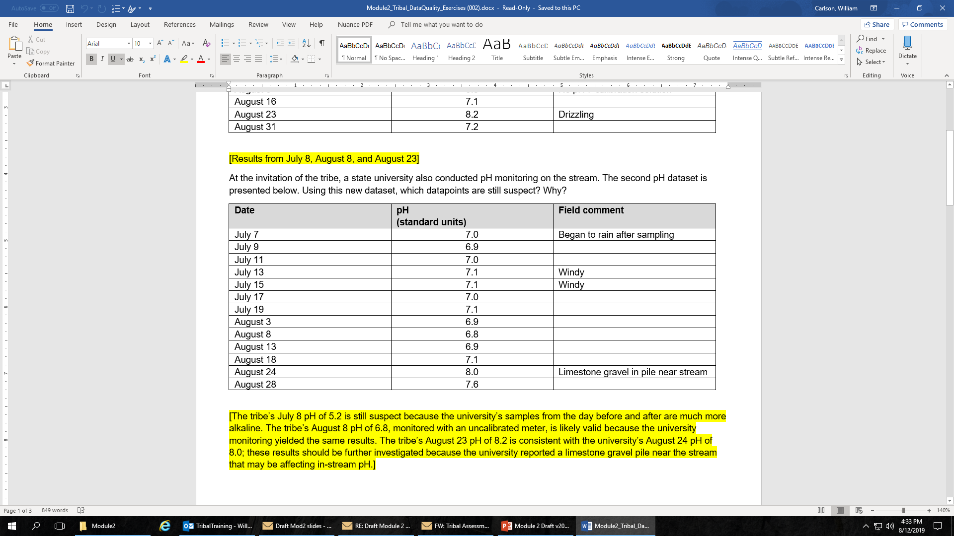
Which datapoints still need further review?
Notes:
At the invitation of the tribe, a state university also conducted pH monitoring on the stream. The second pH dataset from the university is shown in the bottom table; the tribal data appears in the top table.
Question:
Using this new dataset, which datapoints are still suspect? Why?
Answer:
The tribe’s July 8 pH of 5.2 is still suspect because the university’s sample results from the day before and after are much more alkaline / higher.
The tribe’s August 8 pH of 6.8, monitored with an uncalibrated meter, is likely valid because the university monitoring yielded the same results.
The tribe’s August 23 pH of 8.2 is somewhat consistent with the university’s August 24 pH of 8.0. If the university samplers reported a new limestone gravel pile near the stream, do you think this should be investigated – that is, would this impact the instream pH levels?

Slide 66
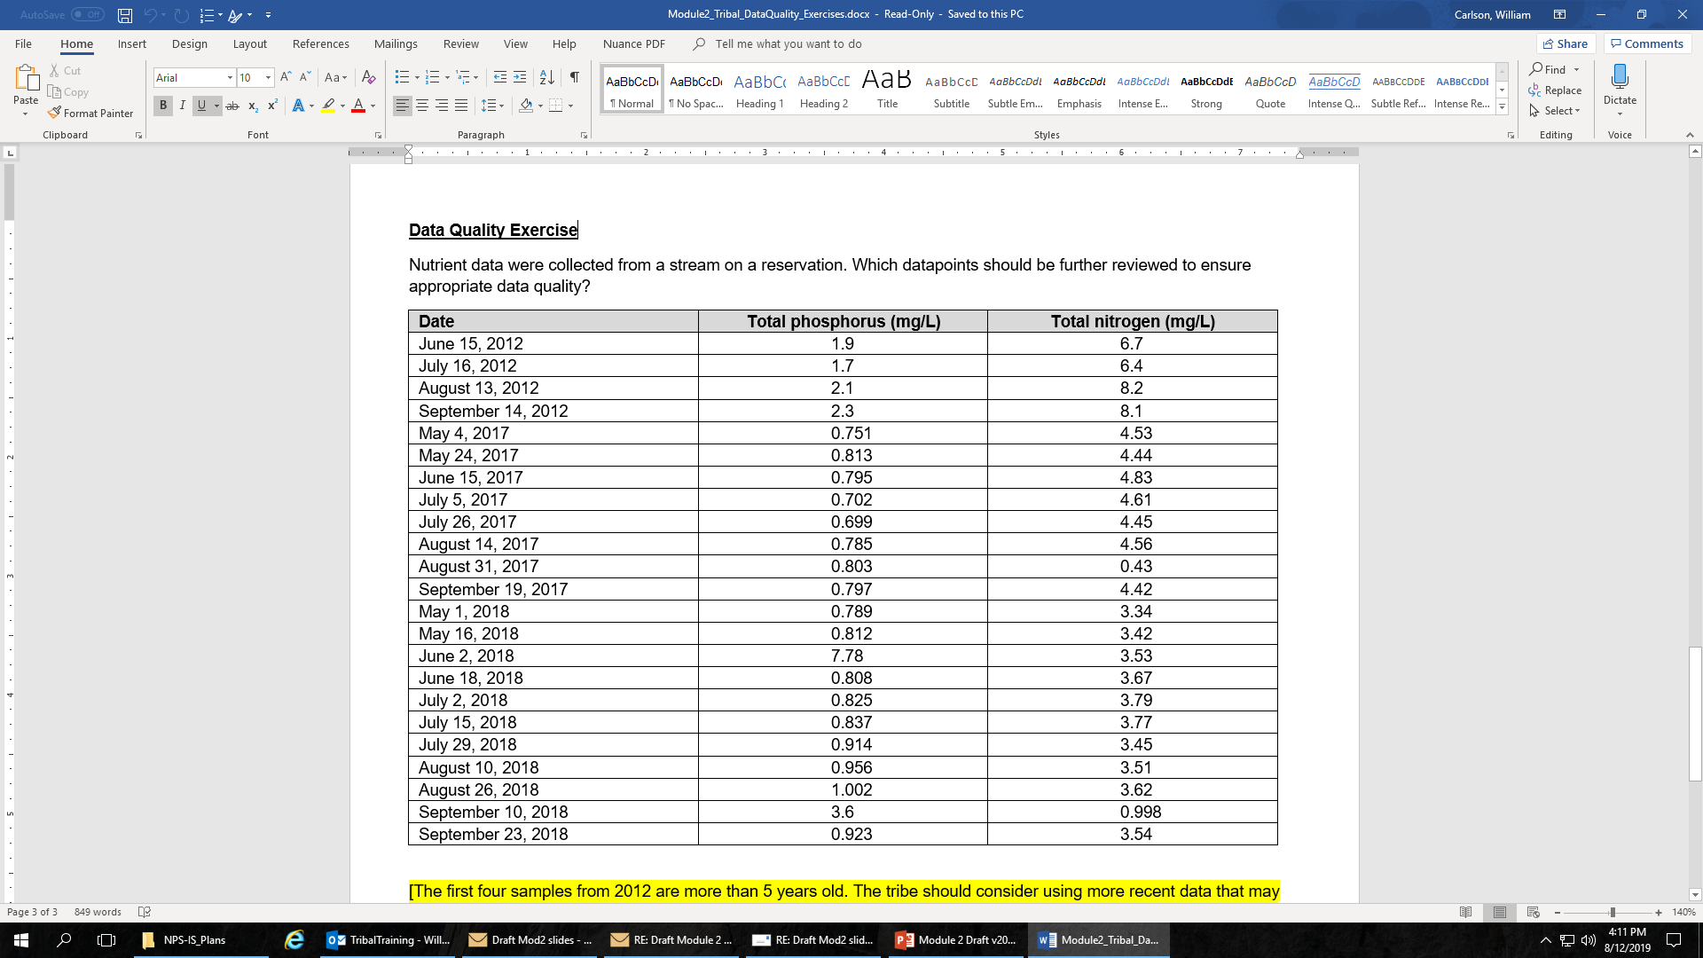
Which datapoints need further review?
Notes:
Nutrient data were collected from a stream on a reservation.
Question:
Which datapoints should be further reviewed to ensure appropriate data quality?
Answer:
The first four samples from 2012 are more than 5 years old but appear to have values that are much higher than the 2017 and 2018 concentrations. The tribe should consider using more recent data that may be more representative of current water quality (notice how much larger the 2012 concentrations are than the 2017 and 2018 concentrations). Consider that there may have been changes in the watershed that have led to an improvement in water quality.
The August 31, 2017 total nitrogen and June 2, 2018 total phosphorus results may have been input incorrectly. They are both an order of magnitude different that the other datapoints.
The September 10, 2018 total phosphorus and total nitrogen results may have been input incorrectly. They appear to have input the results in the wrong columns.

Slide 67

Which datapoints need further review?
Notes:
How about this turbidity data?
Which sample results might need further review?
Answers:
The August 21st results are unusually high – but there appears to be a reason: rain and high flows, which have apparently increased turbidity. So this result may accurately reflect conditions at that particular time, but it should be recognized that this result reflects high flow conditions, rather than an anomaly resulting from equipment malfunction, entry error, etc.
Also, the readings appear to be increasing from October 4th through December 4th, due to the previously unknown presence of cattle near the stream. Again, this finding represents a very real impact to water quality, rather than a sample collection or other error. These types of findings are what we base our BMP targeting efforts on. That’s why it’s important to differentiate between data problems or errors and real deviations that point to actual water quality problems that we want to address.

Slide 68

Which datapoints need further review?
Notes:
OK, last one!
Which datapoints in this table might need to be reviewed?
Answers:
The results for the sample with no signature on the chain of custody form should be noted. However, the result seems to generally fall within the range of the other findings. Nevertheless, this datapoint should be flagged so users note the discrepancies. The comments on no field notes, new sample bottles, new staff, and duplicates do not indicate any problems, unless some other item is noted – e.g., the staff person was not trained, the bottles were not of the type approved by the QAPP, etc.
Now, look at the two very high readings. Both of these are accompanied by lab comments that indicate a violation of the protocols for collecting and analyzing bacteria samples: the holding time was exceeded on September 19th, and the sample was not kept on ice on November 15th. Both of these conditions can affect bacteria levels – i.e., bacteria can reproduce in warm water over time, making the time and temperature conditions very important.
Do you notice any other issues with this data set? YES! There is a result reported for November 31st! There is no such thing as November 31st – November only has 31 days. So this result needs to be discarded if the actual date cannot be verified.
The findings

Slide 69
Organizing Your Data for Analyses
Entering your data on a spreadsheet GREATLY simplifies the analysis
  It also helps to protect and preserve your data
Clean up your data by:
  Making sure everything is consistent, such as dates, parameter names, site designations, etc.
  Checking for commas vs. decimal points
  Looking for letters within numbers
Keep data organized via:
  Filename protocols with dates, controls on data entry, periodic reviews

Slide 70
Bottom Line in Assessing Data Quality
Identify the data being considered for use
  Tribal (primary)
  Non-tribal (secondary)
Collect information on how the data was produced (sample collection, analysis, reporting procedures)
Review data quality guidance used in producing the data (QAPP, DQOs/DQIs)
Screen the data for obvious problems
  Poor documentation of procedures
  Values below detection limits, significant outliers, etc.
Evaluate the usefulness of the data
Document justifications for data use / non-use
Notes:
Reducing errors so water quality data accurately reflects actual conditions is one of the important goals of a data assessment. Documentation helps to identify potential errors and reduces the chances that mistakes will occur. Results of analyses of chemical data or any other type of data may be of limited value unless they are accompanied by documentation about sample collection, analytical methods, and quality control (QC) protocols. Poorly documented sample collection, analysis, and reporting may lead to potential problems.
Once it is determined that the data set meets basic documentation requirements, you might decide to do additional screening of the actual data sets. At a minimum, it is helpful to look for values below the detection limit of the analytical method, because these may influence how the data set is analyzed or incorporated with other data. If, upon analyzing the data, evaluators suspect errors in the collection or analysis, they may want to conduct more in-depth analysis of QA/QC procedures. This screening could include reviews of QA/QC reports to determine if the data set meets the tribe’s QA/QC requirements regarding documenting measurement system performance (e.g., adequate use of QC samples), the approach to handling missing data and nondetects, and deviations from standard operating procedures.

Slide 71
Key Module Take-Aways
Identify all existing and readily available data for the assessment
  Parameters collected by the tribe through its monitoring program
  Other relevant data and information about tribal waters or watershed
Use online data tools and work with other local data partners
QAPPs and DQOs are foundational to assessing data quality
Evaluate all existing and readily available data for the water quality assessment
  Review for quality through QAPP review and data screening
  Use only data of adequate quality after review and screening
Notes:
That’s it for this module on Overarching Considerations in Assessing Water Quality Data.
You should have identified some key take-aways through the information presented in this module.
First, identify all existing and readily available data for your water quality assessment. This includes tribal monitoring data and other relevant data about tribal waters and upstream waterbodies that could affect tribal water quality conditions.
Other relevant data may come from non-tribal partners at many levels. You can use online data tools, like the Water Quality Portal, or you may have to directly ask for these other data from partners.
Your tribal QAPP and the associated Data Quality Objectives, or DQOs, are foundational to assessing data quality for use in your tribal water quality assessment.
Use your QAPP and DQOs to screen all data, tribal and non-tribal, that you might use for the water quality assessment. Use only data of adequate quality, defined by your QAPP and DQOs, to include in your water quality assessment. Document what you’ve chosen to use and document why you’ve decided not to use other data sets.
Module 3 will now integrate information from Modules 1 and 2 to focus on data analysis by parameter for a water quality assessment.

Slide 72
Thank You
Questions?

Slide 73
References
Mueller, D.K., Schertz, T.L., Martin, J.D., and Sandstrom, M.W., 2015, Design, analysis, and interpretation of field quality-control data for water-sampling projects: U.S. Geological Survey Techniques and Methods, book 4, chap. C4, 54 p.
US EPA. 1997. Volunteer Stream Monitoring: A Methods Manual. EPA 841-B-97-003 https://www.epa.gov/sites/production/files/2015-06/documents/stream.pdf
US EPA. 2002. Consolidated Assessment and Listing Methodology: Toward a Compendium of Best Practices. First Edition, July 2002. Office of Water, Office of Wetlands, Oceans, and Watersheds. Washington DC.
US EPA. 2006. Guidance on Systematic Planning Using the Data Quality Objectives Process/EPA QA-G4. Office of Environmental Information. Washington DC. EPA/240/B-06/001 https://www.epa.gov/sites/production/files/2015-06/documents/g4-final.pdf
US EPA. 2007. Final Guidance on Awards of Grants to Indian Tribes Under Section 106 of the Clean Water Act for Fiscal Year 2007 and Beyond. Office of Water, Office of Wastewater Management. EPA 832-R-06-003. https://www.epa.gov/sites/production/files/2014-09/documents/final-tribal-guidance.pdf.
US EPA 2006. Guidance for Quality Assurance Project Plans, EPA QA/G5. Office of Mission Support. EPA/240/R-02/009. https://www.epa.gov/sites/default/files/2015-06/documents/g5-final.pdf
Notes:
References
Mueller, D.K., Schertz, T.L., Martin, J.D., and Sandstrom, M.W., 2015, Design, analysis, and interpretation of field quality-control data for water-sampling projects: U.S. Geological Survey Techniques and Methods, book 4, chap. C4, 54 p.
US EPA. 1997. Volunteer Stream Monitoring: A Methods Manual. EPA 841-B-97-003 https://www.epa.gov/sites/production/files/2015-06/documents/stream.pdf
US EPA. 2002. Consolidated Assessment and Listing Methodology: Toward a Compendium of Best Practices. First Edition, July 2002. Office of Water, Office of Wetlands, Oceans, and Watersheds. Washington DC.
US EPA. 2006. Guidance on Systematic Planning Using the Data Quality Objectives Process/EPA QA-G4. Office of Environmental Information. Washington DC. EPA/240/B-06/001
https://www.epa.gov/sites/production/files/2015-06/documents/g4-final.pdf
US EPA. 2007. Final Guidance on Awards of Grants to Indian Tribes Under Section 106 of the Clean Water Act for Fiscal Year 2007 and Beyond. Office of Water, Office of Wastewater Management. EPA 832-R-06-003. https://www.epa.gov/sites/production/files/2014-09/documents/final-tribal-guidance.pdf.
US EPA 2006. Guidance for Quality Assurance Project Plans, EPA QA/G5. Office of Mission Support. EPA/240/R-02/009. https://www.epa.gov/sites/default/files/2015-06/documents/g5-final.pdf

