Slide 1
Water Quality Assessment Training for Tribes
Module 4 – Classroom Version
Analyzing Data to Determine Use Support for
Water Quality Assessment Reports
Notes:
Note: This presentation was produced for EPA with contractor support. It has been reviewed by EPA HQ staff, but has not been reviewed by senior EPA management or the Office of General Counsel.

Slide 2
Module 4: Learning Objectives
Further explore how water quality data are used to evaluate designated uses
Process and evaluate basic datasets to determine designated use support
Use the results of data analysis to determine next steps
Identify resources useful for analyzing data and addressing water quality impairments
Notes:
The learning objectives for Module 4 are to:
Further explore how water quality data is used to evaluate designated uses
Process and evaluate basic datasets to determine designated use support
Use the results of data analysis to determine next steps
Identify resources useful for analyzing data and addressing water quality impairments

Slide 3
Water Quality Standards: A Quick Refresher
Designated Uses
Criteria
Antidegradation
Notes:
Module 1 of this training presented an in-depth discussion of water quality standards. Module 3 covered specific water quality standards for different parameters. In this module, we’ll merge the concepts of Modules 1 and 3 together to examine how we analyze data to determine whether waterbodies are supporting designated uses.
Let’s start with a brief refresher of water quality standards.
Water quality standards are composed of designated uses, criteria, and antidegradation. Designated uses are the beneficial uses of a waterbody that a state or tribe has formerly adopted. For example, a stream may be designated for human recreation or fish habitat. Water quality criteria are developed to protect individual designated uses; for example, a dissolved oxygen criterion to protect fish living in a waterbody or a manganese criterion to protect humans that drink water from that waterbody. Antidegradation prevents waters that support their uses and meet the criteria from being degraded to the point of no longer supporting their uses and meeting the criteria, and prevents degradation of high quality waters unless it is necessary for important social or economic development.

Slide 4
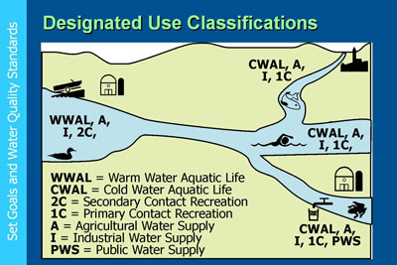
Designated Uses Refresher Multiple uses are typical; most sensitive criteria define targets
Explicit Value = actual number/magnitude
Notes:
Waterbodies are used by all life, and different organisms use waterbodies for different purposes. For example, humans use water for potable consumption and recreation. Terrestrial wildlife also use water for potable consumption, while aquatic wildlife live in the water.
States and tribes designate beneficial uses for waters in their territories based upon how humans and wildlife use or could use the waters. Designated uses are broad goals for how specific waterbody segments can and should be used.
Each designated beneficial use protects one or more specified activities for one or more specific populations. The water quality criteria associated with each use also target those specific activities and populations. Criteria for the same pollutant may include different numeric values for different uses because the different uses protect different activities for different populations. For example, the drinking water nitrate criterion of 10 milligrams per liter protects human health to prevent blue baby syndrome (methemoglobinemia), whereas a warmwater habitat waterbody use nitrate criterion of 0.5 milligrams per liter protects aquatic life from eutrophication (and the resultant reduction in dissolved oxygen).

Slide 5
Use Support Determination Exercises
Explicit Value = actual number/magnitude
Aquatic Life Other Than Fish
Coldwater Habitat
Warmwater Habitat
Primary Contact
Irrigation Water Supply
Livestock Water Supply
Public Drinking Water Supply
Notes:
Now lets run through some exercises that illustrate how to determine designated use support. In each example, we will identify a variety of designated uses – the uses we’ll look at are listed on the slide. Then we’ll review the appropriate water quality criteria for those uses, analyze some monitoring data, and determine whether or not the uses are met. Finally, we’ll discuss some possible next steps the tribe might consider, given the analytical results.

Slide 6
Making Designated Use Impairment Decisions: Hypothetical Example and Exercise
Assess water quality at three hypothetical sites
Salamander Creek, Red Brook, and Green Run
Identify the designated uses
Identify the water quality criteria parameters needed to evaluate each designated use
Apply the criteria to the water quality data to make a use impairment decision
Integrate the impairment information into an assessment
Discuss next steps based on assessment findings
Notes:
We’ve been stressing in this course that applying your knowledge of waterbody uses, use-based water criteria, and results from the monitoring data is a key part of the water quality assessment process. These activities lead to a determination on whether or not a waterbody meets its designated uses, based on the available data.
For this exercise, we’re going to assess three hypothetical tribal waterbodies: Salamander Creek, Red Brook, and Green Run.
We’ll identify the designated uses for each of these hypothetical waterbodies and then identify the water quality criteria parameters needed to evaluate each designated use.
To determine if a designated use is met or impaired, we’ll compare the water quality data for each parameter to the water quality criteria.
We’ll make a designated use impairment decision for each waterbody and compile that information into a mini-assessment.
With the assessment findings for this example, we’ll discuss what next steps this hypothetical tribe should consider to restore tribal water quality.

Slide 7
How the Tribe Uses Tribal Waters
Reservation Boundary
Green Run
Salamander Creek
Red Brook
Notes:
Each creek on the reservation – Salamander Creek, Red Brook, and Green Run – is very important to the tribe. To protect each creek, the tribe commissioned a study to determine how the tribe and wildlife use each creek.
Salamander Creek, Red Brook, and Green Run are used by many tribal residents that live on the reservation. The tribe allows several water withdrawals from the creeks. Some withdrawals are for groups of tribal residents to use for potable water in their homes. Other withdrawals are for tribal residents who own livestock in the Red Brook watershed. Historically, the livestock were allowed to enter and drink from the stream. But the streambanks were damaged by hoof-shear, the stream substrates were trampled and compacted, and bacteria from manure began to increase. Overall, habitat conditions for fish, aquatic insects, amphibians, and reptiles were badly damaged. Now the tribe allows the livestock owners to withdraw water for their animals at off-channel locations. Several tribal residents also farm and are authorized to divert water from Salamander Creek to irrigate their crops.
Tribal water program staff studied the ecology of each creek. They instituted a fish monitoring program to help evaluate fish community health. The staff also catalogued the benthic macroinvertebrates in Salamander Creek, which are an important part of the food web. Red Brook and Green Run are much smaller and benthic macroinvertebrates were not studied on these creeks. However, even though they are small, tribal residents regularly recreate in and along the streams.
Finally, the staff studied the various water chemistry parameters for the three waterbodies, to determine whether or not the waters were supporting the uses assigned to them by the tribe’s water quality standards.

Slide 8
Beneficial Uses Designated for the Three Tribal Creeks
Type | Designated Use | Salamander Creek | Red Brook | Green Run
Aquatic Life Support | Aquatic Life Other Than Fish | X
 | Coldwater Habitat |  | X | X
 | Warmwater Habitat | X
Recreation | Primary Contact |  | X | X
Water Supply | Irrigation Water Supply | X
 | Livestock Water Supply |  | X
 | Public Drinking Water Supply | X
Notes:
After studying the streams on the reservation, the tribe decided to designate four beneficial uses for Salamander Creek, three beneficial uses for Red Brook, and two beneficial uses for Green Run. To protect these uses, tribal water quality staff developed numeric criteria for certain parameters, including pollutants and water quality conditions. The table on the next slide shows the measurable parameters that are important for determining the ability of the waterbodies to support each of their designated uses.

Slide 9
Water Quality Parameters for Designated Uses
Designated Use | Bacteria | Conductivity | Dissolved Oxygen | Metals | Nitrate | pH | Temp | Total Phosphorus
Aquatic Life Other Than Fish | -- | X | X | -- | X | X | -- | X
Coldwater Habitat | -- | -- | X | -- | -- | X | X | X
Warmwater Habitat | -- | X | X | -- | X | X | -- | X
Recreation | X | -- | -- | -- | -- | -- | -- | --
Irrigation Water Supply | -- | X | -- | -- | X | -- | -- | --
Livestock Water Supply | -- | -- | -- | X | -- | -- | -- | --
Public Drinking Water Supply | -- | X | -- | -- | X | -- | -- | --
Notes:
To determine if a designated use is supported or impaired, it’s necessary to look at multiple water quality parameters that affect each specific designated use. Looking at this table, you can see that:
For aquatic life other than fish, the parameters are conductivity, dissolved oxygen, nitrate, pH, and total phosphorus.
For coldwater habitat, the parameters are dissolved oxygen, pH, temperature, and total phosphorus.
Warmwater habitat looks at conductivity, dissolved oxygen, nitrate, pH, and total phosphorus.
Recreation only looks at bacteria.
The two agricultural water supply uses (irrigation and livestock) takes into account conductivity and nitrate, and public water supply adds metals to the suite of parameters.
As we noted, tribal staff developed numeric criteria for each designated use. The tribe used published research and ecoregional recommendations to determine which pollutants to evaluate for each designated use and to determine the numeric thresholds, averaging period, allowable exceedances, and so on for each criterion.
Let’s look at the designated uses and associated parameters for each of the tribe’s three waterbodies.

Slide 10
Salamander Creek: Introduction
Designated Use | Conductivity | Dissolved Oxygen | Nitrate | pH | Total Phosphorus
Aquatic Life Other Than Fish | X | X | X | X | X
Irrigation Water Supply | X |  | X
Public Drinking Water Supply | X |  | X
Warmwater Habitat | X | X | X | X | X
Notes:
We’ll start with Salamander Creek.
This is a large creek with many uses.
The tribe decided to designate four beneficial uses for Salamander Creek: Aquatic Life Other Than Fish, Irrigation Water Supply, Public Drinking Water Supply, and Warmwater Habitat. To protect these four uses, the tribe developed numeric criteria for certain parameters.

Slide 11
Salamander Creek: Numeric Criteria
Explicit Value = actual number/magnitude
Salamander Creek is designated for four uses that have the following numeric criteria:
Parameter | Unit | Type | Statistic | Exceedance | Aquatic Life Other Than Fish | Irrigation Water Supply | Public Drinking Water Source | Warmwater Habitat
Conductivity | uS/cm | Maximum | Instantaneous | 10% | 750 | 2,500 | 1,000 | 1,500
Dissolved oxygen | mg/L | Minimum | Instantaneous | None | 5.0 | -- | -- | 5.0
Nitrate | mg/L | Maximum | Average* | None | 1.5 | 100 | 10* | 1.0
pH | SU | Range | Instantaneous | None | 6.5<pH<9 | -- | -- | 6.5<pH<9
Total phosphorus | mg/L | Maximum | Average | None | 0.1 | -- | -- | 0.3
Duration = period of time
* The nitrate criterion is instantaneous for the public drinking water source.
Notes:
Here are the numeric criteria for the four designated uses applicable to Salamander Creek.
To fully support, both of the criteria listed in the table must be met for the Irrigation Water Supply and Public Drinking Water Supply uses; if either or both criteria are not met, the use is not supported. To fully support Aquatic Life Other Than Fish and Warmwater Habitat uses, all five criteria must be met; if three or four criteria are met, then the use is not supported; and if less than three criteria are met, the use is not supported. Here are the specific numeric criteria descriptions:
Conductance: No more than 10% of samples per season may exceed the numeric thresholds.
Dissolved oxygen: No samples per season may exceed the numeric thresholds.
Nitrate: The average of all samples per season may not exceed the numeric threshold, except for the drinking water designated use, where no individual sample per season may exceed the numeric threshold.
pH: No sample per season may exceed the numeric threshold range.
Total phosphorus: The average of samples per season may not exceed the numeric threshold.

Slide 12
Salamander Creek: Aquatic Life Other Than Fish
Ten samples were collected and evaluated
Explicit Value = actual number/magnitude
Date | Cond. (uS/cm) | DO (mg/L) | Nitrate (mg/L) | pH (SU) | TP (mg/L)
May 23 | 600 | 10 | 0.8 | 7.1 | 0.08
Jun 9 | 800 | 9 | 0.9 | 7.0 | 0.09
Jun 24 | 1,000 | 10 | 1.2 | 7.0 | 0.14
Jul 1 | 600 | 10 | 1.6 | 6.9 | 0.15
Jul 15 | 575 | 9 | 1.8 | 6.8 | 0.19
Jul 29 | 550 | 7 | 1.3 | 6.7 | 0.23
Aug 6 | 450 | 6 | 1.7 | 6.8 | 0.29
Aug 15 | 750 | 6 | 1.9 | 6.7 | 0.32
Aug 23 | 1,600 | 7 | 1.3 | 6.8 | 0.35
Sep 3 | 950 | 6 | 0.9 | 6.9 | 0.30
Average | 788 | 8 | 1.3 | 6.9 | 0.21
Aquatic life other than fish has five numeric criteria
Parameter | Unit | Type | Stat. | Exceed. | Criterion
Cond. | uS/cm | Max | Inst. | 10% | 750
DO | mg/L | Min | Inst. | None | 5.0
Nitrate | mg/L | Max | Avg | None | 1.5
pH | SU | Range | Inst. | None | 6.5 – 9.0
TP | mg/L | Max | Avg. | None | 0.1
Duration = period of time
Notes:
Let’s evaluate the Aquatic Life Other Than Fish Use. Recall from the previous slide that five numeric criteria apply to the Aquatic Life Other Than Fish Use; they are shown in the table on the left. The table on the right shows the 10 samples that the hypothetical tribe collected and evaluated for pertinent parameters.
Conductivity: Sample results range from 450 to 1,600 uS/cm. Note that four sample results exceed the conductivity maximum criterion of 750 uS/cm; an exceedance rate of 40% violates the allowable exceedance rate of 10%. The criterion is not met.
Dissolved Oxygen: Sample results range from 6 to 10 mg/L. No sample result is less than the minimum criterion of 5.0 mg/L. The criterion is met.
Nitrate: Sample results range from 0.8 to 1.9 mg/L, and the average is 1.3 mg/L. The samples’ average does not exceed the criterion of 1.5 mg/L. The criterion is met.
pH: Sample results range from 6.7 to 7.1 SU. All ten sample results are within the pH criterion range of 6.5 to 9.0 SU. The criterion is met.
Total Phosphorus: Sample results range from 0.08 to 0.35 mg/L, and the average is 0.21 mg/L. The samples’ average exceeds the criterion of 0.1 mg/L. The criterion is not met.
Use Support for Aquatic Life Other Than Fish in Salamander Creek: The use is not supported because only 3 of 5 criteria are met. Conductivity and total phosphorus are probable causes of impairment.

Slide 13
Salamander Creek: Irrigation Water Supply
Ten samples were collected and evaluated
Explicit Value = actual number/magnitude
Date | Cond. (uS/cm) | DO (mg/L) | Nitrate (mg/L) | pH (SU) | TP (mg/L)
May 23 | 600 | 10 | 0.8 | 7.1 | 0.08
Jun 9 | 800 | 9 | 0.9 | 7.0 | 0.09
Jun 24 | 1,000 | 10 | 1.2 | 7.0 | 0.14
Jul 1 | 600 | 10 | 1.6 | 6.9 | 0.15
Jul 15 | 575 | 9 | 1.8 | 6.8 | 0.19
Jul 29 | 550 | 7 | 1.3 | 6.7 | 0.23
Aug 6 | 450 | 6 | 1.7 | 6.8 | 0.29
Aug 15 | 750 | 6 | 1.9 | 6.7 | 0.32
Aug 23 | 1,600 | 7 | 1.3 | 6.8 | 0.35
Sep 3 | 950 | 6 | 0.9 | 6.9 | 0.30
Average | 788 | 8 | 1.3 | 6.9 | 0.21
Irrigation water supply has two numeric criteria
Duration = period of time
Parameter | Unit | Type | Stat. | Exceed. | Criterion
Cond. | uS/cm | Max | Inst. | 10% | 2,500
Nitrate | mg/L | Max | Avg | None | 100
Notes:
Let’s evaluate the Irrigation Water Supply Use. Two criteria apply to the Irrigation Water Supply Use; they are shown in the table on the left. The table on the right shows the 10 samples that the hypothetical tribe collected and evaluated for pertinent parameters.
Conductivity: Sample results range from 450 to 1,600 uS/cm. No sample result exceeds the conductivity maximum criterion of 2,500 uS/cm. The criterion is met.
Nitrate: Sample results range from 0.8 to 1.9 mg/L, and the average is 1.3 mg/L. The average does not exceed the criterion of 100 mg/L. The criterion is met.
Use Support for the Irrigation Water Supply Use on Salamander Creek: The use is fully supported because both criteria are met.

Slide 14
Salamander Creek: Public Drinking Water Supply
Ten samples were collected and evaluated
Explicit Value = actual number/magnitude
Date | Cond. (uS/cm) | DO (mg/L) | Nitrate (mg/L) | pH (SU) | TP (mg/L)
May 23 | 600 | 10 | 0.8 | 7.1 | 0.08
Jun 9 | 800 | 9 | 0.9 | 7.0 | 0.09
Jun 24 | 1,000 | 10 | 1.2 | 7.0 | 0.14
Jul 1 | 600 | 10 | 1.6 | 6.9 | 0.15
Jul 15 | 575 | 9 | 1.8 | 6.8 | 0.19
Jul 29 | 550 | 7 | 1.3 | 6.7 | 0.23
Aug 6 | 450 | 6 | 1.7 | 6.8 | 0.29
Aug 15 | 750 | 6 | 1.9 | 6.7 | 0.32
Aug 23 | 1,600 | 7 | 1.3 | 6.8 | 0.35
Sep 3 | 950 | 6 | 0.9 | 6.9 | 0.30
Average | 788 | 8 | 1.3 | 6.9 | 0.21
Public drinking water supply has two numeric criteria
Duration = period of time
Parameter | Unit | Type | Stat. | Exceed. | Criterion
Cond. | uS/cm | Max | Inst. | 10% | 1,000
Nitrate | mg/L | Max | Inst. | None | 10
Notes:
Only two numeric criteria apply to the Public Drinking Water Supply Use; they are shown in the table on the left.
The table on the right shows the 10 samples that the hypothetical tribe collected and evaluated for pertinent parameters.
Conductivity: Sample results range from 450 to 1,600 uS/cm. One sample result (August 23rd: 1,600 uS/cm) exceeds the conductivity maximum criterion of 1,000 uS/cm; an exceedance rate of 10% equals the allowable exceedance rate of 10% . The criterion is met.
Nitrate: Sample results range from 0.8 to 1.9 mg/L. No sample result exceeds the maximum criterion of 10 mg/L. The criterion is met.
Use Support for the Public Drinking Water Supply Use on Salamander Creek: The use is fully supported because both criteria are met.

Slide 15
Salamander Creek: Warmwater Habitat
Ten samples were collected and evaluated
Explicit Value = actual number/magnitude
Date | Cond. (uS/cm) | DO (mg/L) | Nitrate (mg/L) | pH (SU) | TP (mg/L)
May 23 | 600 | 10 | 0.8 | 7.1 | 0.08
Jun 9 | 800 | 9 | 0.9 | 7.0 | 0.09
Jun 24 | 1,000 | 10 | 1.2 | 7.0 | 0.14
Jul 1 | 600 | 10 | 1.6 | 6.9 | 0.15
Jul 15 | 575 | 9 | 1.8 | 6.8 | 0.19
Jul 29 | 550 | 7 | 1.3 | 6.7 | 0.23
Aug 6 | 450 | 6 | 1.7 | 6.8 | 0.29
Aug 15 | 750 | 6 | 1.9 | 6.7 | 0.32
Aug 23 | 1,600 | 7 | 1.3 | 6.8 | 0.35
Sep 3 | 950 | 6 | 0.9 | 6.9 | 0.30
Average | 788 | 8 | 1.3 | 6.9 | 0.21
Warmwater Habitat has five numeric criteria
Parameter | Unit | Type | Stat. | Exceed. | Criterion
Cond. | uS/cm | Max | Inst. | 10% | 1,500
DO | mg/L | Min | Inst. | None | 5.0
Nitrate | mg/L | Max | Avg | None | 1.0
pH | SU | Range | Inst. | None | 6.5 – 9.0
TP | mg/L | Max | Avg. | None | 0.3
Duration = period of time
Notes:
Similar to the Aquatic Life Other Than Fish Use, all five numeric criteria apply to Warmwater Habitat Use. These criteria are shown in the table to the left. The table on the right shows the 10 samples that the hypothetical tribe collected and evaluated for pertinent parameters.
Conductivity: Sample results range from 450 to 1,600 uS/cm. One sample result (August 23rd: 1,600 uS/cm) exceeds the conductivity maximum criterion of 1,500 uS/cm; an exceedance rate of 10% equals the allowable exceedance rate of 10%. The criterion is met.
Dissolved Oxygen: Sample results range from 6 to 10 mg/L. No sample result is less than the minimum criterion of 5.0 mg/L. The criterion is met.
Nitrate: Sample results range from 0.8 to 1.9 mg/L, and the average is 1.3 mg/L. The samples’ average exceeds the criterion of 1.0 mg/L. The criterion is not met.
pH: Sample results range from 6.7 to 7.1 SU. All ten sample results are within the pH criterion range of 6.5 to 9.0 SU. The criterion is met.
Total Phosphorus: Sample results range from 0.08 to 0.35 mg/L, and the average is 0.21 mg/L. The samples’ average is less than the criterion of 0.3 mg/L. The criterion is met.
Use Support for the Warmwater Habitat Use on Salamander Creek: The use is not supported because 4 of 5 criteria are met. Nitrate is the probable causes of impairment.

Slide 16
Salamander Creek: Use Support Summary
Designated Use | Use Support | Probable Cause of Impairment
Aquatic Life Other Than Fish | Not Supporting | Conductivity and Total Phosphorus
Irrigation Water Supply | Full | --
Public Drinking Water Supply | Full | --
Warmwater Habitat | Not Supporting | Nitrate
Notes:
Now, let’s bring it all together. Salamander Creek is designated for four uses. Each of the uses was evaluated using (1) results from 10 samples that the hypothetical tribe collected and (2) the numeric criteria applicable to each use.
The Irrigation Water Supply and Public Drinking Water Supply uses were each evaluated using conductivity and nitrate criteria, and both sample results met both criteria for both uses. These uses are fully supported.
The Aquatic Life Other Than Fish and Warmwater Habitat uses were each evaluated using conductivity, dissolved oxygen, nitrate, pH, and total phosphorus criteria. The conductivity and total phosphorus criteria were not met for the Aquatic Life Other Than Fish Use; thus, this use is not supported and conductivity and total phosphorus are the probable causes of impairment. The nitrate criterion was not met for the Warmwater Habitat Use; thus this use is only not supported and nitrate is the probable cause of impairment.

Slide 17
What might be the next steps?
Two waterbody uses were not met:
Aquatic Life Other Than Fish – Conductivity and total phosphorus criteria were not met
Warmwater Habitat – Nitrate criterion was not met
What should the tribe consider as next steps for:
Monitoring strategy – Any changes/refinements needed?
Assessing impairment parameters – What should they look for?
Notes:
Now, let’s discuss next steps the tribe might consider, given the impairments. You can see the two waterbody uses that are listed as impaired.
Do you think the tribe should adjust its monitoring strategy, given the results? [Answer: Additional sampling could be done for conductivity, nitrate, and total phosphorus, to better characterize the impairments to both uses, and to zero in on where exactly the inputs for these parameters might be coming from.]
What about other types of assessments that might help to determine the impairment cause or causes? [The tribe could conduct a land use / pollutant source inventory and assessment, to determine what potential sources of these pollutants may be affecting aquatic life populations. This could include aerial photo reviews of concentrated livestock locations, fertilized row crop fields, and other sites; analyses of septic system locations and concentrations; and visual surveys of other sources of conductivity, phosphorus, and nitrate.

Slide 18
Red Brook: Introduction
Designated Use | Bacteria | Dissolved Oxygen | Metals | pH | Temperature | Total Phosphorus
Coldwater Habitat |  | X |  | X | X | X
Livestock Water Supply |  |  | X
Recreation | X
Notes:
Now let’s look at another example. Red Brook also flows through the reservation. The tribe has designated three beneficial uses for Red Brook: Coldwater Habitat, Livestock Water Supply, and Recreation.

Slide 19
Red Brook: Numeric Criteria
Red Brook is designated for three uses that have the following numeric criteria:
Parameter | Unit | Type | Statistic | Exceedance | Coldwater Habitat | Livestock Water Supply | Recreation
Dissolved oxygen | mg/L | Minimum | Instantaneous | None | 5.0 | -- | --
E. coli | counts/ 100 mL | Maximum | Geometric mean | None | -- | -- | PCR/SCR 126 / 430
Metals (Cr, Fe, Ni, and Zn) | ug/L | Maximum | Instantaneous | None | -- | (varies) | --
pH | SU | Range | Instantaneous | None | 6 < pH < 9 | -- | --
Temperature | F | Maximum | Instantaneous | None | 50 | -- | --
Total phosphorus | mg/L | Maximum | Average | None | 0.3 | -- | --
Duration = period of time
Notes:
The tribe has developed several numeric criteria that apply to one or more of these designated uses. The numeric criteria are presented in the table on this slide. The criteria for four metals (chromium, iron, nickel, and zinc) are hardness-dependent; the specific criteria are presented in a later slide.
To fully support the Coldwater Habitat use, all four criteria must be met. If two or three criteria are met, then the use is not supported. If one or no criteria are met, the Coldwater Habitat use is not supported. To fully support the Livestock Water Supply Use, all four metals criteria must be met. If three or less criteria are met, the use is not supporting. To fully support the Primary and Secondary Contact Recreation use, the E. coli geometric mean criterion must be met – note that there are numeric criteria for each of the two recreation uses, primary and secondary contact recreation. If that criteria is not met, then the Recreation use is not supported.
Dissolved oxygen: No samples per season may exceed the numeric threshold.
E. coli: The geometric mean of samples per season may not exceed the numeric thresholds. The criterion for primary contact is 126 counts per 100 mL; the criterion for secondary contact is 430 counts per 100 mL.
Metals: Metals criteria vary by hardness. Only 10 percent of samples per season may exceed the numeric threshold for the appropriate hardness.
pH: No sample per season may exceed the numeric threshold range.
Temperature: No sample per season may exceed the numeric threshold.
Total phosphorus: The average of samples per season may not exceed the numeric thresholds.

Slide 20
Red Brook: Coldwater Habitat
Coldwater Habitat has four numeric criteria
Four samples were collected and evaluated
Parameter | Unit | Type | Stat. | Exceed. | Criterion
DO | mg/L | Min | Inst. | None | 5.0
pH | SU | Range | Inst. | None | 6.0 – 9.0
Temp. | F | Max | Inst. | None | 50
TP | mg/L | Max | Avg. | 10% | 0.3
Date | Dissolved oxygen (mg/L) | pH (SU) | Temperature (Fahrenheit) | Total phosphorus (mg/L)
June 1 | 5.2 | 7.0 | 48 | 0.29
July 3 | 4.9 | 7.2 | 51 | 0.35
July 27 | 4.7 | 7.4 | 53 | 0.41
August 4 | 4.6 | 7.3 | 55 | 0.34
Duration = period of time
Notes:
Now let’s evaluate the Coldwater Habitat use. Four numeric criteria apply to this use and are shown in the table to the left.
The table on the right shows the 4 samples that the tribe collected and evaluated for dissolved oxygen, pH, temperature and total phosphorus.
Let’s go through each parameter and determine if the water quality criteria are met.
Question #1: Do the dissolved oxygen samples meet the criterion?
Answer #1: No, three of four samples are less than 5.0 mg/L.
Question #2: Do the pH samples meet the criteria?
Answer #2: Yes, all four samples are between 6.0 and 9.0 SU.
Question #3: Do the temperature samples meet the criterion?
Answer #3: No, three of the four temperatures are greater than 50 degrees Fahrenheit.
Question #4: Does the total phosphorus samples average meet the criterion?
Answer #4: No, the average of 0.35 mg/L is greater than 0.30 mg/L. You don’t need a calculation though. Three of four samples are quite a bit greater than 0.30 mg/L and one sample is just below 0.3 mg/L; thus, the average will be greater than 0.30 mg/L.
Question #5: Does Red Brook support the Coldwater Habitat use?
Answer #5: No. Criteria for three of four pollutants are not met; the use is not supported.
Let’s move on to the metals criteria.

Slide 21
Red Brook: Livestock Water Supply
Livestock Water Supply has four numeric criteria that vary by hardness
Constituent | Jun 1 | Jul 3 | Jul 27 | Aug 4 | Sep 9
Hardness | 300 | 400 | 300 | 50 | 200
Chromium | 180 | 260 | 150 | 25 | 120
Iron | 240 | 300 | 230 | 200 | 230
Nickel | 100 | 150 | 140 | 10 | 95
Zinc | 270 | 300 | 200 | 100 | 260
Duration = period of time
If hardness is less than 100 mg/L or greater than 400 mg/L, use the criteria at 100 mg/L or 400 mg/L, respectively.
Notes:
The Livestock Water Supply use has four numeric criteria for metals. The criteria for each metal are hardness-dependent (i.e., different numeric thresholds apply at different hardness concentrations). Samples with less than 100 mg/L hardness are evaluated with the 100 mg/L criteria, while samples with more than 400 mg/L hardness are evaluated with the 400 mg/L criteria.
Let’s go through each metal and determine if the water quality criteria are met.
Question #6: Which samples meet water quality standards and which do not?
Answer #6: June 1st, July 3rd, and August 4th meet standards. July 27th does not meet due to nickel (140 ug/L sample is greater than criterion of 130 ug/L). September 9th does not meet due to nickel (95 mg/L sample is greater than the criterion of 94 mg/L) and zinc (260 mg/L sample is greater than the criterion of 220 mg/L).
Question #7: Is the Livestock Water Supply use supported?
Answer #7: No, the criteria are not met for two metals (nickel and zinc). The use is not supported.
Now, let’s assume the metals numeric criteria allowed for up to 20% of samples to exceed the criteria. If more than 20% of samples exceed a metal’s criteria, then that metal’s criteria is not met.
Question #8: Now, which metals meet water quality criteria and which do not?
Answer #8: Chromium (0% exceedance), iron (0% exceedance), and zinc (20% exceedance) meet. Nickel (40% exceedance) does not meet.
Question #9: Is the Livestock Water Supply use supported?
Answer #9: No, the criteria is not met for one metal (nickel). The use is still not supported.
Let’s move on to the Recreation use.

Slide 22
Red Brook: Recreation
Date | E. coli density (counts/100mL) | Geometric mean (counts/100 mL)
May 1 | 100 | 115
May 9 | 250
May 17 | 95
May 22 | 70
May 30 | 120
July 3 | 300 | 157
July 10 | 150
July 16 | 85
July 23 | 200
July 31 | 125
September 4 | 65 | 106
September 10 | 80
September 17 | 430
September 24 | 130
September 30 | 45
Explicit Value = actual number/magnitude
Recreation has two E. coli numeric criteria depending on the type of contact recreation. Each criterion is a 30-day geometric mean of at least five samples.
Primary contact criterion: 126 colony counts/100 mL
Secondary contact criterion: 423 counts/100mL
Notes:
Two numeric criteria apply to the Recreation use: Primary Contact and Secondary Contact. In either case, a 30-day geometric mean of at least 5 E. coli samples is calculated to compare with the numeric criterion. The table on the right presents 15 samples collected during the recreation season. A 5-sample geometric mean is presented for each 30-day period. Let’s evaluate this designated use.
Question #10: If Red Brook is designated for primary contact recreation, which 30-day periods meet the water quality criteria and which do not?
Answer #10: The May and September geometric means meet the criteria. The July geometric mean does not meet it.
Question #11: Does Red Brook support its Primary Contact Recreation use?
Answer #11: Only 2 of 3 30-day geometric means meet the criteria.
Question #12: If Red Brook is designated secondary contact recreation, which 30-day periods meet water quality standards and which do not?
Answer #12: May, July, and September geometric means all meet the criteria.
Question #13: Does Red Brook support its Secondary Contact Recreation use?
Answer #13: Yes. All three geometric means meet the criteria.
Question #14: Now let’s consider another wrinkle on the criteria. Let’s say that Red Brook is designated for secondary contact recreation, and the secondary contact recreation use has an additional criteria, which says there is a not-to-exceed individual maximum criterion of 400 counts per 100 milliliters for the same 30-day period. Which 30-day periods meet the criteria and which do not?
Answer #14: May not-to-exceed values and the geometric mean meet the criteria. July not-to-exceed values and the geometric mean meets the criteria. A September not-to-exceed sampling result does not meet the criteria, but the geometric mean does meet criteria.
Question #15: Does Red Brook support its Secondary Contact Recreation use?
Answer #15: Not supported. While all three geometric means meet criteria, only 2 of three 30-day periods meet the not-to-exceed individual maximum criteria.

Slide 23
Red Brook: Use Support Summary
Designated Use | Use Support | Probable Cause of Impairment
Coldwater Habitat | Not | Dissolved oxygen, temperature, total phosphorus
Livestock Water Supply | Not | Nickel, zinc
Recreation (Primary Contact) | Not Supporting PCR; Supporting for SCR | --
Notes:
Now, let’s bring it all together. Red Brook is designated for three uses. Each of the uses was evaluated using (1) results from 10 samples that the hypothetical tribe collected and (2) the numeric criteria applicable to each use.
The Coldwater Habitat use is not supported because dissolved oxygen, temperature, and total phosphorus do not meet criteria. The Livestock Water Supply use is not supported because nickel and zinc do not meet criteria. Finally, the Primary Contact Recreation use is fully supported.

Slide 24
What might be the next steps?
The Primary Contact Recreation use is Not supported
An exceedance was noted during one month of sampling
The Coldwater Habitat use is not supported
Dissolved oxygen, temperature, and total phosphorus do not meet criteria
The Livestock Water Supply use is not supported
Nickel and zinc do not meet criteria. Finally, the Primary Contact Recreation use is fully supported.
What should be the next steps for monitoring?
How about next steps for assessing the sources of impairment?
Notes:
Now, let’s talk about next steps. You can see that the Primary Contact Recreation criteria are all met, but that the Coldwater Habitat and Livestock Water Supply uses are not met. The problem parameters are DO, temperature, and total phosphorus for Coldwater Habitat, and nickel and zinc for Livestock Water Supply.
Question #16: What sort of adjustments or changes in the monitoring strategy might help the tribe to better understand these impairments?
Answer #16: Discussion should focus on sampling more often and targeted sampling to narrow down the sources of these parameter exceedances. For Coldwater Habitat, the tribe might consider biomonitoring – looking at macroinvertebrates, fish assemblages, and physical habitat parameters.
Question #17: How about next steps for other means that could be used to assess the sources of the impairment?
Answer #17: Answers may include aerial photo analyses, septic system surveys, tree canopy studies, fertilizer and livestock waste source assessments, visual surveys, etc.
Question #18: Given that the Primary Contact Recreation criterion was not met in July, should the tribe take any special precautions to protect the public?
Answer #18: Yes – the tribe should notify the public when it finds that the bacteria criterion has been exceeded, and recommend that no contact occur with the waters until the criterion is met.

Slide 25
Green Run: Introduction
Designated Use | Bacteria | Dissolved Oxygen | pH | Temperature | Total Phosphorus
Coldwater Habitat |  | X | X | X | X
Recreation | X
Notes:
Now let’s look at another example. Green Run is a small stream on the reservation. Along Green Run is a small park with a public bathing beach. The tribe has designated two beneficial uses for Green Run: Coldwater Habitat and Recreation. You can see the water quality criteria parameters that apply to each of the uses in the table.

Slide 26
Green Run: Numeric Criteria
Green Run is designated for two uses that have the following numeric criteria:
Parameter | Unit | Type | Statistic | Exceedance | Coldwater Habitat | Public Drinking Water Supply | Recreation
Dissolved oxygen | mg/L | Minimum | Instantaneous | None | 5.0 | -- | --
E. coli | counts/ 100 mL | Maximum | Geometric mean | None | -- | -- | 126 / 430
pH | SU | Range | Instantaneous | None | 6 < pH < 9 | -- | --
Temperature | F | Maximum | Instantaneous | None | 50 | -- | --
Total phosphorus | mg/L | Maximum | Average | None | 0.3 | -- | --
Duration = period of time
Notes:
The tribe has developed several numeric criteria that apply to one or more of these designated uses. The numeric criteria are presented in the table on this slide. To fully support the Coldwater Habitat use, all four criteria must be met. If two or three criteria are met, then the use is not supported. If one or no criteria are met, the Coldwater Habitat use is not supported. To fully support the Recreation use, the E. coli geometric mean criteria must be met. If the criterion is not met, then the Recreation use is not supported.
Dissolved oxygen: No samples per season may exceed the numeric threshold.
E. coli: The geometric mean of samples per season may not exceed the numeric thresholds. The criterion for primary contact is 126 counts per 100 mL; the criterion for secondary contact is 430 counts per 100 mL.
pH: No sample per season may exceed the numeric threshold range.
Temperature: No sample per season may exceed the numeric threshold.
Total phosphorus: The average of samples per season may not exceed the numeric threshold.

Slide 27
Green Run: Coldwater Habitat
Coldwater Habitat has four numeric criteria
Four samples were collected and evaluated
Parameter | Unit | Type | Stat. | Exceed. | Criterion
DO | mg/L | Min | Inst. | None | 5.0
pH | SU | Range | Inst. | None | 6.0 – 9.0
Temp. | F | Max | Inst. | None | 50
TP | mg/L | Max | Avg. | 10% | 0.3
Date | Dissolved oxygen (mg/L) | pH (SU) | Temperature (Fahrenheit) | Total phosphorus (mg/L)
June 1 | 8.2 | 7.1 | 49 | 0.08
July 3 | 9.0 | 7.0 | 50 | 0.12
July 27 | 8.8 | 7.1 | 50 | 0.15
August 4 | 8.7 | 7.2 | 49 | 0.19
Duration = period of time
Notes:
Now let’s evaluate the Coldwater Habitat use. Four numeric criteria apply to this use and are shown in the table to the left. The table on the right shows the 5 samples that the hypothetical tribe collected and evaluated for dissolved oxygen, pH, temperature and total phosphorus.
Let’s go through each parameter and determine if the water quality criteria are correct.
Question #19: Do the dissolved oxygen samples meet the criterion?
Answer #19: Yes. All four samples are greater than 5.0 mg/L.
Question #20: Do the pH samples meet the criteria?
Answer #20: Yes. All four samples are between 6.0 and 9.0 SU.
Question #21: Do the temperature samples meet the criterion?
Answer #21: Yes. All four samples are less than 50 mg/L.
Question #22: Does the average of total phosphorus samples meet the criterion?
Answer #22: Yes. The average of 0.14 mg/L is less than 0.30 mg/L. Again, you don’t need a calculator: All four samples are less than 0.3 mg/L; therefore the average will be less than 0.3 mg/L.
Question #23: Does Green Run support the Coldwater Habitat use?
Answer #23: Yes. Criteria for all four parameters are met; the use is not supported.
Let’s move on to the Recreation use.

Slide 28
Green Run: Recreation
Date | E. coli density (counts/100mL) | Geometric mean (counts/100 mL)
May 1 | 84 | 68
May 9 | 23
May 17 | 61
May 22 | 98
May 30 | 129
July 3 | 221 | 75
July 10 | 128
July 16 | 85
July 23 | 46
July 31 | 21
September 4 | 48 | 77
September 10 | 82
September 17 | 140
September 24 | 117
September 30 | 41
Explicit Value = actual number/magnitude
Recreation has two numeric criteria depending on the type of contact recreation. Each criterion is a 30-day geometric mean of at least five samples.
Primary contact criterion: 126 colony counts/100 mL
Secondary contact criterion: 423 counts/100mL
Notes:
Two numeric criteria apply to the Recreation use: Primary contact and Secondary contact. In either case, a 30-day geometric mean of at least 5 samples is calculated to compare with the numeric criterion. The table on the right presents 15 samples collected during the recreation season. A 5-sample geometric mean is presented for each 30-day period. Let’s evaluate this designated use. Green Run is designated for primary contact recreation.
Question #21: Which 30-day periods meet water quality standards and which do not?
Answer #21: May, July, and September geometric means meet.
Question #22: Does Green Run support its Primary Contact Recreation use?
Answer #22: Yes. All three geometric means meet the primary contract criterion..
Now let’s look at Green Run holistically.

Slide 29
Green Run: Use Support Summary
Designated Use | Use Support | Probable Cause of Impairment
Coldwater Habitat | Full | --
Recreation (Primary Contact) | Full | --
Notes:
Green Run is designated for two beneficial uses. Each of the uses was evaluated using (1) results from 10 samples that the hypothetical tribe collected and (2) the numeric criteria applicable to each use.
The Coldwater Habitat use is supported because dissolved oxygen, pH, temperature, and total phosphorus meet criteria. The Recreation use is fully supported because the primary contact recreation geometric mean criterion is met.
Let’s talk about next steps for Green Run.

Slide 30
What might be the next steps?
Green Run meets all the criteria for Coldwater Habitat and Primary Contact Recreation
There is no immediate need to identify any sources of waterbody stressors for this stream
Are there any monitoring adjustments needed?
What should be the goal for Green Run?
Notes:
So what might be the next steps for Green Run?
We don’t have any impairments, so there is no need to look for stressors that might cause exceedances in our water quality criteria.
Question #23: Do we need to adjust our monitoring program?
Answer # 23: Answers will include a discussion that the monitoring program should be continued as is, unless future problems emerge.
Question #24: What should be the goal for Green Run?
Answer #24: Answers should focus on waterbody protection and ongoing monitoring / surveillance, to ensure that existing high levels of water quality are maintained. This will include continuing the monitoring program, analyzing any future development or land use changes in the watershed, periodic visual surveys, and so on.

Slide 31
Designated Use Support: All Three Streams
Type | Designated Use | Salamander Creek | Red Brook | Green Run
Aquatic Life | Aquatic Life Other Than Fish | Not
 | Coldwater Habitat |  | Not | Full
 | Warmwater Habitat | Not
Recreation | Primary Contact Recreation |  | Not | Full
Supply | Irrigation Water Supply | Full
 | Livestock Water Supply |  | Not
 | Public Drinking Water Supply | Full
Notes:
OK, no let’s review our analyses for the three streams.
Salamander Creek is in full support of two designated uses and is not supporting two more designated uses. Red Brook is not supporting three designated uses. Green Run supports both of its designated uses.

Slide 32
Red Brook: Next Steps...
Designated Use | Use Support | Probable Cause of Impairment
Coldwater Habitat | Not | Dissolved oxygen, temperature, total phosphorus
Livestock Water Supply | Not | Nickel, zinc
Recreation (Primary Contact) | Not | E. Coli bacteria
Notes:
Let’s take our “Next Steps” discussion a little farther for Red Brook, so you can get a feel for how the monitoring results provide a framework for additional assessment tasks that help to tease out the sources of the stressors causing waterbody impairment. Remember that Red Brook is impaired for all of its three designated uses. Let’s get into some additional detail about where the tribe could go from here, to identify the impairment sources.

Slide 33
Red Brook: Stressor Source Inventory & Assessment
Designated Use | Use Support | Probable Cause of Impairment
Coldwater Habitat | Not | Dissolved oxygen, temperature, total phosphorus
Livestock Water Supply | Not | Nickel, zinc
Recreation (Primary Contact) | Not | E. coli bacteria
Point Source Inventory
Carpenter’s shop
Automotive plating company
Stone quarry
Industrial facility
Nonpoint Source Inventory
Single family homes
Junkyard
Park
Truck-stop
Pasture
Septic Systems
Notes:
Let’s say the tribe did a point source inventory and identified the following point sources that discharge directly to Red Brook:
A carpenter’s business with a 10 employees served by a small sanitary wastewater treatment package plant.
A small automotive company that does metal plating.
A stone quarry.
An industrial facility that uses non-contact cooling water to cool down industrial processing equipment.
Question #25: Which point sources might warrant further evaluation, given the impairments and implied stressors causing impacts to Red Brook?
Answer #25: The small automotive company might discharge nickel and zinc using for plating, which may contribute to the Livestock Water Supply impairment. The industrial facility may discharge warm water, which may contribute to the Coldwater Habitat impairment. The other two businesses are not as much of a concern based upon the current impairments. The carpenter’s business may discharge E. coli loads, which could be contributing to the impairment for Primary Contact Recreation. The stone quarry may discharge sediment, but no sediment water chemistry data are available.
Now let’s think about nonpoint sources. The tribe inventoried nonpoint sources in Red Brook’s floodplain:
20 single family homes served by onsite treatment systems with septic tanks.
A junkyard with many rusting old cars and farm equipment.
A park with several trails through the woods. The trails cross Red Brook at several riffles.
A truck stop with large parking lot that drains to a shallow pond that turns green every summer.
A pasture with 25 goats. Exclusion fencing prevents direct access to Red Brook.
Question #26: Which nonpoint sources might warrant further evaluation given the impairments to Red Brook?
Answer #26: The single family homes septic systems may be contributing bacteria and phosphorus to Red Brook, if the systems are malfunctioning, contributing to the Recreation and Coldwater Habitat impairments. The junkyard with rusting vehicles may contribute metals to the Livestock Water Supply impairment.; the tribe should investigate where the stormwater runoff drains to. The truck stop’s pond may contribute to the Coldwater Habitat impairment; the green water may indicate eutrophication that can lead to decreased dissolved oxygen concentrations. This shallow pond may be hydrologically connected to Red Brook. Additionally, if hydrologically connected, the shallow pond may contribute warm water to Red Brook. The pasture may also contribute to the Coldwater Habitat impairment. While the fencing prevents the goats from accessing the stream, their waste may migrate to Red Brook via overland flow following precipitation events. Since the Recreation use is met, the goats’ waste may not contribute significant bacteria loads. But the goats’ waste may contribute nutrients. The wooded park is not likely contributing to any impairment; however, any loss of tree cover could contribute to stream warming.

Slide 34
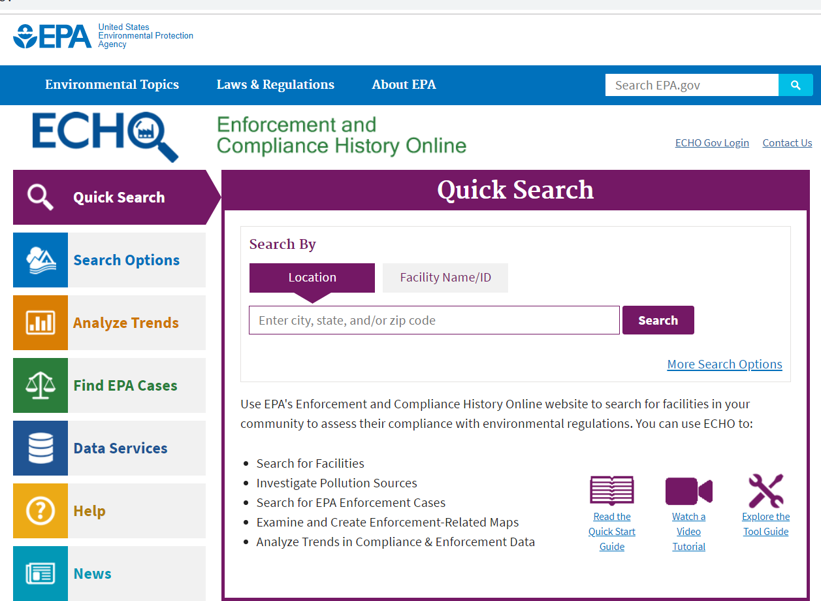
Resources for identifying stressor sources
Point Sources – Environmental Compliance History Online (ECHO) echo.epa.gov
Search for Facilities
Investigate Pollution Sources
Search for EPA Enforcement Cases
Examine and Create Enforcement-Related Maps
Analyze Trends in Compliance & Enforcement Data
Notes:
Before we adjourn, let’s note a few of the useful online sources of data for assessing water quality. For point sources, the US EPA Environmental Compliance History Online database provides information on NPDES permitted facilities, enforcement action, and other info.

Slide 35
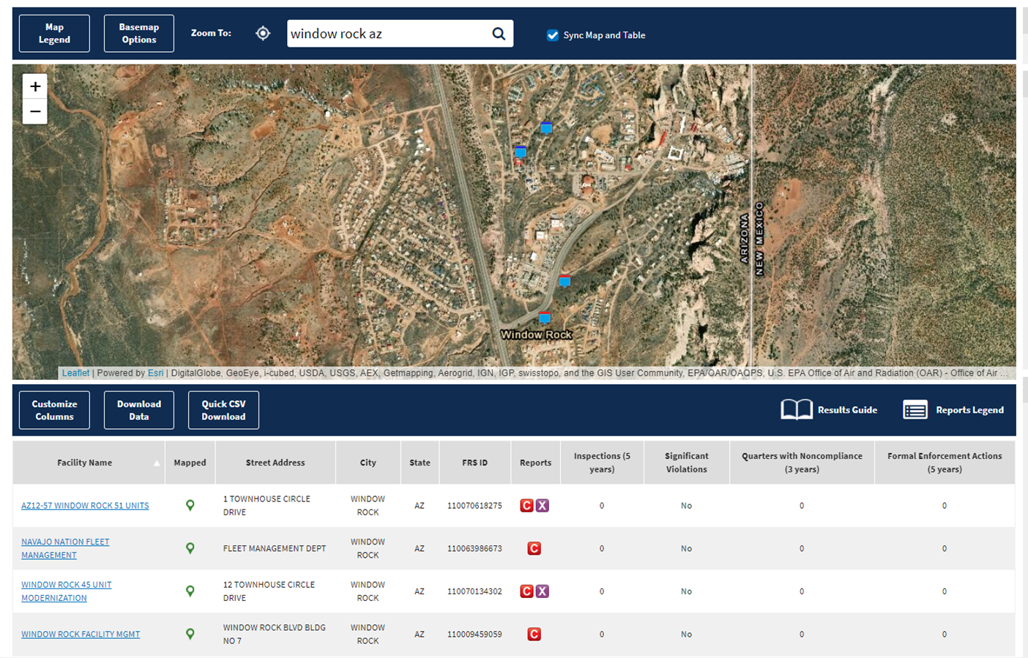
Notes:
ECHO produces maps of specific locations, with lists of NPDES permitted facilities and links to facility contacts, facility types, inspections, compliance reports, violations, and other information. It provides a wealth of info for watershed assessments.

Slide 36
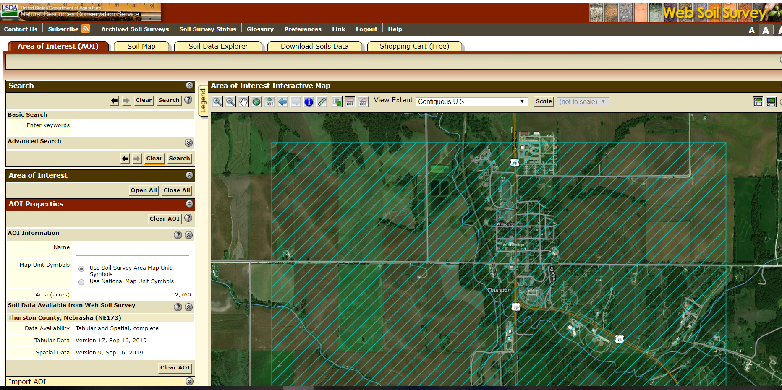
Resources for identifying stressor sources
Nonpoint sources
Aerial and topographical maps (GoogleEarth, AcmeTopo, etc.)
Web Soil Survey – https://websoilsurvey.sc.egov.usda.gov/App/HomePage.htm
Spreadsheet Tool for Estimating Pollutant Loads (STEPL) – https://www.epa.gov/nps/spreadsheet-tool-estimating-pollutant-loads-stepl
Notes:
There are many, many online assessment tools to help better characterize nonpoint sources of pollution. Aerial and topographic maps are a good place to start: they give you an idea of land use, the steepness of the terrain, basic stream layout and surface hydrology, and vegetation within riparian areas. The USDA online Web Soil Survey provides mapping data on specific soil types, which lets you assess soil erodibility, possible nutrient content, and other factors. The Spreadsheet Tool for Estimating Pollutant Loads (STEPL) can help you walk through a basic or in-depth analysis of sediment and nutrient loading from various watersheds and subwatersheds, which helps you to develop some perspectives on the proportionality and significance of various pollutant sources. There are other sources for evaluating nonpoint pollution data – what assessment information do you use?

Slide 37
Resources for identifying stressor sources
Nonpoint Sources
Stream Visual Assessment Protocol (Version 2)
https://www.nrcs.usda.gov/Internet/FSE_DOCUMENTS/nrcs144p2_042678.pdf
What NPS assessment methods do you use?
Notes:
Finally, please consider the USDA NRCS Stream Visual Assessment Protocol, which is an easy-to-use but comprehensive approach for assessing instream and riparian conditions for wadable of streams. The protocol uses ranking sheets for flow, substrate, bank conditions, riparian conditions, and stressor identification parameters that help to identify conditions that may be contributing to water quality problems. Online training modules are available to help train staff, landowners, and others in using the protocol.

Slide 38
Thank You!
Notes:
That concludes this final module of our course on using and evaluating data to produce water quality assessments.
Any questions?
Please fill out your evaluation forms, and thanks for attending!

