Slide 1

Water Quality Assessment Training for Tribes
Module 3
Assessing Data for Specific Water Quality Parameters
Notes:
Note: This presentation was produced for EPA with contractor support. It has been reviewed by EPA HQ and other staff but has not been reviewed by senior EPA management or the Office of General Counsel. NOTE: There are handouts for the exercises associated with this training module. The exercises exist as separate electronic files, formatted for printing on 8.5 x 11 paper. Please make sure you have these printed and ready for use.

Slide 2
Module 3: Learning Objectives
Introduce basic approaches of assessing data for specific water quality parameters
Understand the distinction between acute and chronic water quality criteria
Describe the importance of sample size when evaluating water quality data
Understand how conventional parameters are evaluated against water quality criteria
Learn how nutrients, biological parameters, pathogens, and metals are evaluated against water quality criteria
Notes:
The learning objectives for Module 3 are to:
Introduce basic approaches of assessing data for specific water quality parameters
Understand the distinction between acute and chronic water quality criteria
Understand the importance of sample size when evaluating water quality data
Understand how conventional parameters are evaluated against water quality criteria
Understand how nutrient parameters are evaluated against water quality criteria
Understand how biological parameters are evaluated against water quality criteria
Understand how pathogens are evaluated against water quality criteria
Understand how metals are evaluated against water quality criteria

Slide 3
Numeric Water Quality Criteria
  What is a numeric water quality criterion?
    EPA develops recommended human health and aquatic life water quality criteria as guidance to tribes/states for use in developing their own criteria. Levels adopted in Tribal or state water quality standard or otherwise applied to monitoring data to assess water quality
  Numeric criteria are expressed as
    Less than, such as nitrate is not to exceed 10 mg/L
    Greater than, such as the 7-day average of the daily mean dissolved oxygen should be at least 8.5 mg/L
    A range, such as pH: pH shall be within the range of 6.5 to 8.5
Notes:
A numeric water quality criterion sets a threshold or benchmark for a parameter to protect aquatic life or human health. Recall that a numeric water quality criterion is a part of a water quality standard, the other parts being designated uses and antidegradation provisions. The numeric criteria are the actual numbers that need to be met. For example, a certain pollutant concentration in streams. This module addresses assessing data to see if a water body is meeting a particular water quality criterion and therefore the designated use.
Let’s look at a couple of examples of water quality criteria to see what they look like. A numeric criterion can be a number that should not be exceeded, such as nitrate is not to exceed 10 mg/L. Or it can go in the other direction, such as dissolved oxygen criteria. Dissolved oxygen criteria are written as values that are minimums, such as dissolved oxygen needs to be at least 8.5 mg/L. Criteria can also specify a range of values, such as pH shall be within the range of 6.5 to 8.5. In that case, pH in the water body shouldn’t go below 6.5 and shouldn’t go above 8.5.
Looking at these examples again, see that the example nitrate criterion is pretty simple—nitrate is not to exceed 10 mg/L. It’s just a single number, an instantaneous “do not exceed” value. Now look at the example dissolved oxygen criterion. You can see that there are more parts to it—the 7-day average of the daily mean dissolved oxygen should be at least 8.5 mg/L. This involves what is known as an averaging period, in addition to the actual number. Let’s take a closer look at the different parts of a numeric water quality criterion. simplify

Slide 4
Parts of a Numeric Water Quality Criterion
Explicit Value = actual number/magnitude
Duration = period of time
Example: Should not exceed 10 mg/L as an annual average, and cannot be exceeded more than 10% of the time.
Frequency = recurrence interval
Notes:
Remember there are usually several parts of a numeric water quality criterion.
There is the actual number, which is referred to as the “explicit value” and is sometimes referred to as the “magnitude” of the criterion. In the example here, the explicit value is 10 mg/L.
The “duration” is the period of time over which the standard applies and is often derived from the studies used to develop the standard. It is the period of time over which aquatic life can be exposed to slightly elevated levels of pollutants without harm, as long as the average is not exceeded for the specified time period. The duration in this example is a year.
The recurrence interval is also known as the “frequency,” or the number of times an excursion can occur over time without impacting the use. The assumption is that the organisms can recover over time, as long as the stress is infrequent and the recovery period is sufficient. The recurrence interval in this case is “no more than 10% of the time.” This 10% recurrence interval is a common value used in criteria for conventional pollutants. Another recurrence interval provided in EPA guidance for toxic criteria is “no more than once every three years.” Expression of the magnitude, duration and frequency greatly aid application and interpretation of water quality criteria. Some states and tribes that do not specify the 10% recurrence interval in their water quality standards instead employ the 10% recurrence interval in their assessment and listing methodology to interpret variability associated with natural conditions or sampling uncertainty.

Slide 5
Considerations for Acute and Chronic Water Quality Criteria – Aquatic Life
  Acute: Toxicity at higher concentrations over short time periods
  Chronic: Lower concentrations, longer term exposures
  Example: chloride criteria for aquatic life
    Acute 860 mg/L
    Chronic 230 mg/L
Notes:
Acute and chronic criteria were addressed in Module 1 this morning. Recall that the averaging period is shorter for acute criteria and longer for chronic criteria. This is based on the concept that aquatic life can tolerate longer periods of exposure to a pollutant when the pollutant is at a lower concentration. It’s important to note that some aquatic species are more sensitive to pollutants than others – and some life stages of organisms are more sensitive. Criteria are development by testing pollutant concentrations on a wide range of organisms – fish, mollusks, insects, and plants.
Let’s review an example of a parameter that commonly has a different criterion for acute and chronic exposure—chloride.

Slide 6
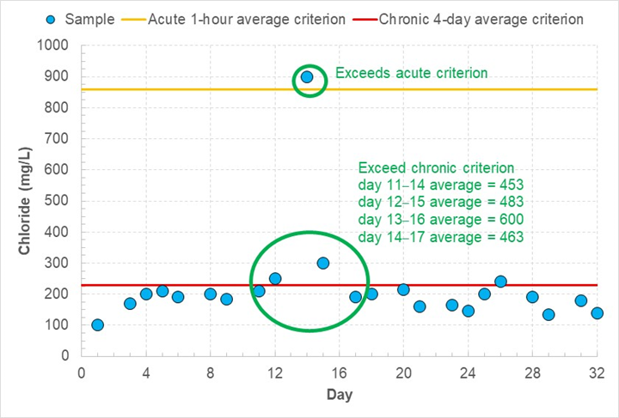
Acute and Chronic Water Quality Criteria: Lummi Nation Chloride Example
Notes:
The Lummi Nation has both acute and chronic chloride criteria, shown on this slide (Lummi Indian Business Council 2007).
Take a look at this graph. It shows the chloride concentration in milligrams per liter on the left vertical axis – the Y axis; and consecutive days from zero to 32 along the horizontal X axis. It also shows the acute and chronic chloride water quality criteria, with the acute level in gold and the chronic level in red. Now, note the blue circles, which show the chloride concentrations on each of the various sampling days. You can see right away that some of the sampling values for some days exceed the chronic criterion, and one result is above the acute criterion.
So, in this example data set, one of the samples exceeds the acute 1-hour average criterion of 860 mg/L. To evaluate if the stream violates the chronic 4-day average criterion, we first calculate consecutive 4-day averages of the chloride concentrations. Four of the 4-day averages exceed the chronic standard of 230 mg/L chloride. You can see those different four-day periods listed in green.

Slide 7
Considerations for Sample Size
  Sample size should target research questions:
    Types of waterbodies to be assessed
    High/low flow conditions to be considered
    Parameters of interest & seasonality
  Number of samples to be taken
    Balance cost and completeness of dataset (seasonality coverage, etc)
    Note: Not meeting minimum sample size does not always mean you can’t make a decision
Notes:
The number of samples that you have for each parameter, each type of waterbody, and each type of flow condition should be considered when you evaluate data. If you only have a few data points, or if they represent only one type of sampling site or flow condition, there is less confidence in the analysis than if you have a full season of data, collected from multiple sites over a range of conditions.
Let’s take a look at an example.

Slide 8
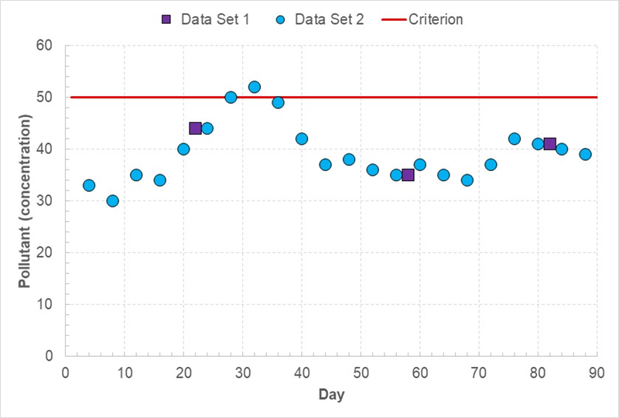
Sample Size Example
Notes:
Here is another graph, with concentrations of an unnamed pollutant listed vertically along the left axis and consecutive days listed horizontally across the bottom. Two data sets are shown, one as three purple squares, and another as many more blue circles.
In the example shown here, if you only sampled on the days indicated with a purple square, you would not have observed any exceedances of the criterion. But if you took samples every four days, indicated by the blue circles, you would see that the criterion was exceeded on day 32. The more frequently you collect samples, the more likely you are to find an exceedance if such a condition exists.

Slide 9
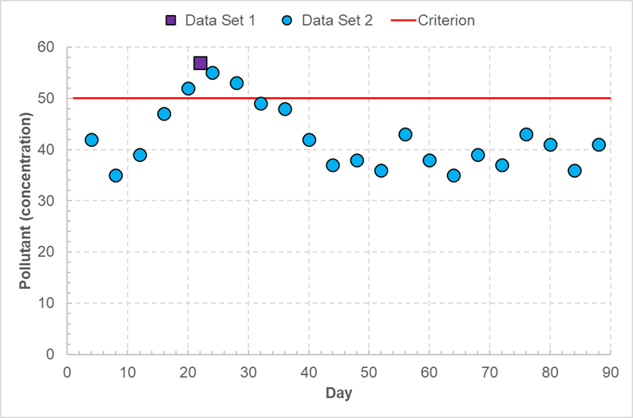
Considerations for Sample Size
Aim to collect enough data to interpret the numeric criterion
You may need to make decisions with a small dataset
Numerous factors are considered when developing a sampling frequency, but that is for another module
Notes:
If you are evaluating a criterion that is assessed on a seasonal basis, use caution drawing conclusions based on only a few samples. For example, in the data set shown here, if you only had the one sample shown by the purple square, you might think that the water body is impaired. However, with a full season of data, shown by the blue circles , you see that the seasonal average concentration – and most datapoints displayed – are below the criterion.
However: what if the data shown in the graph reflected the results for a toxic parameter that had a four-day averaging period? Would there be a violation of the criterion between Day #20 and Day #30? [YES]

Slide 10
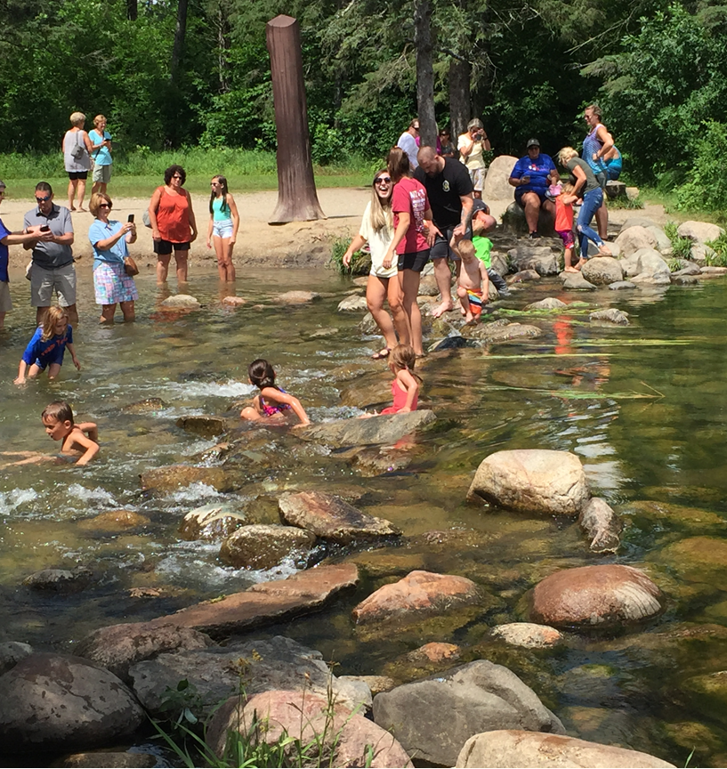
WQS: Designated Uses
  Examples of beneficial use designations:
    Drinking water source
    Swimming (primary contact)
    Boating (secondary contact)
    Aquatic life support (fish, etc.)
    Cultural and traditional uses
    Agricultural, industrial, other uses
Mississippi River Headwaters
Notes:
We talked a little about “designated uses” for shirts and tops, and how you can categorize these items based on how they’re used. The same approach is used for tribal surface waters. Tribes and states designate their lakes, rivers, streams, wetlands, and coastal water according to their beneficial uses. It’s clear that a single waterbody might be used for more than one thing – for example, most waters are at least designated for primary and secondary contact recreation, and aquatic life support. Tribes and states can designate all the use categories they think are appropriate. So, you have “recreation” split up into primary contact recreation – swimming, skiing, and so on – as well as secondary contact – boating, fishing, and so on. Aquatic life support usually is divided into cold water and warm water – salmon and trout for coldwater, and bass protection for warmwater, for example. (US EPA, 2018)

Slide 11
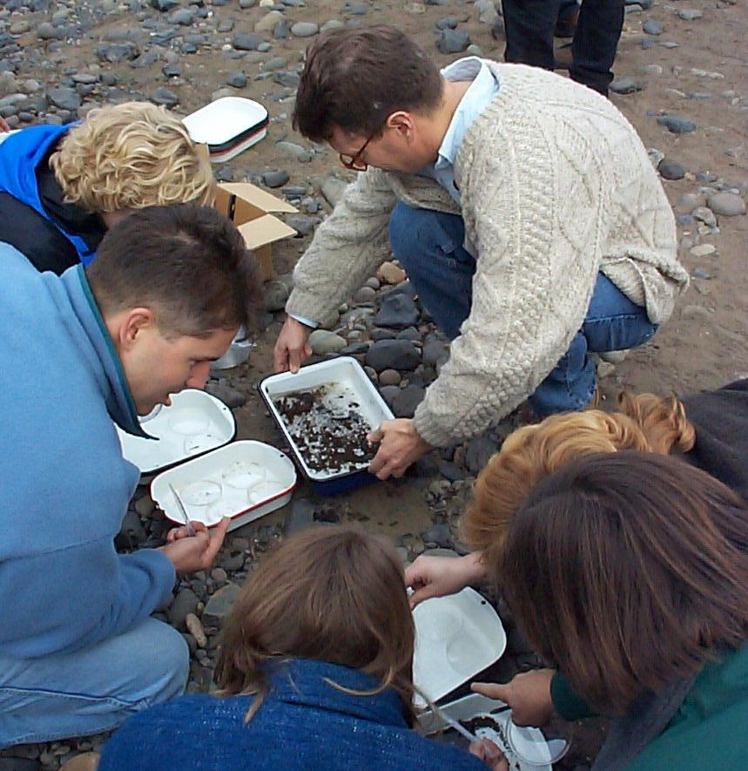
Overview of Water Quality Standards
Conventional: DO, pH, Temperature, Turbidity
Nutrients
Biological
Pathogens
Metals
Water Quality Criteria
Designated Uses
Anti-degradation
Notes:
Let’s move on and look at analysis of specific parameters.
We are going talk over each parameter listed here. We’ll show you some examples of how to evaluate data and also break out into groups to work on problem sets.

Slide 12
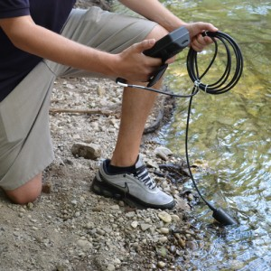
Analysis of Conventional Pollutants
  DO, pH, temperature, turbidity, conductivity
  Relatively easily to measure
https://www.fondriest.com/environmental-measurements/measurements/measuring-water-quality/dissolved-oxygen-sensors-and-methods/
Notes:
The Clean Water Act (CWA Section 304(a)(4)) designates dissolved oxygen, pH, water temperature, and turbidity as “conventional.” Conventional parameters can be measured fairly easily and cheaply, and they provide basic information about aquatic life support and other qualities of the water. I’ll walk you through each of these conventional parameters and explain why we monitor each of these and will provide examples of numeric water quality criteria. We talked about these parameters in Module 2; we’ll briefly review them here and provide more details about data assessment.

Slide 13
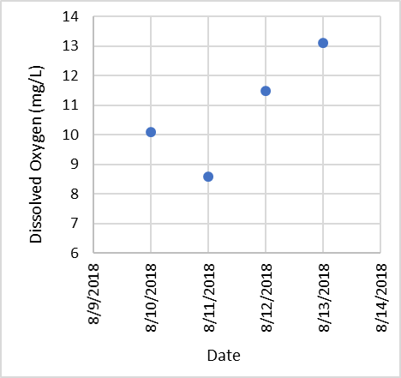
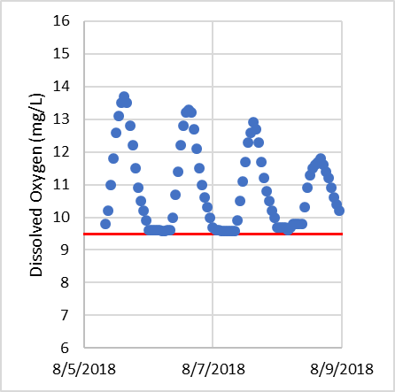
Dissolved Oxygen
  Critical for life!
  Causes of low dissolved oxygen
  Relationship with temperature
  Discrete and continuous measurements
  How can you be confident of your DO readings?
Notes:
Dissolved oxygen is a measure of how much oxygen is dissolved in the water. Dissolved oxygen is important because plants and animals need it to survive. Just like we humans need oxygen from the air to breathe, plants and animals need oxygen from the water for respiration.
Dissolved oxygen numeric criteria are usually in the form of a minimum concentration; that is, the concentration of dissolved oxygen can’t go below the numeric criteria.
These graphs show monitoring results for dissolved oxygen, with the concentrations listed vertically on the Y axis and the sampling dates listed horizontally along the X axis. You can see four monitoring results in the top graph, and almost hourly sampling results in the bottom graph.
What causes dissolved oxygen to drop too low? When bacteria and other microorganisms breakdown organic matter such as algae, manure, dead plants, or leaf litter, they use up oxygen, and often cause low dissolved oxygen. This can happen if there is too much dead and decaying organic matter in a waterbody. When there are many plants in a waterbody, dissolved oxygen tends to fluctuate greatly over the course of the day when photosynthetic processes are peaking – low in the early morning and high in the late afternoon.
Dissolved oxygen can be measured with readings at just one point in time (like the figure on the top), or can be monitored continuously, which is usually at an interval such as hourly or every 15 minutes (like the figure on the bottom).
How can you be confident of your DO readings? CALIBRATION! (reinforce)

Slide 14
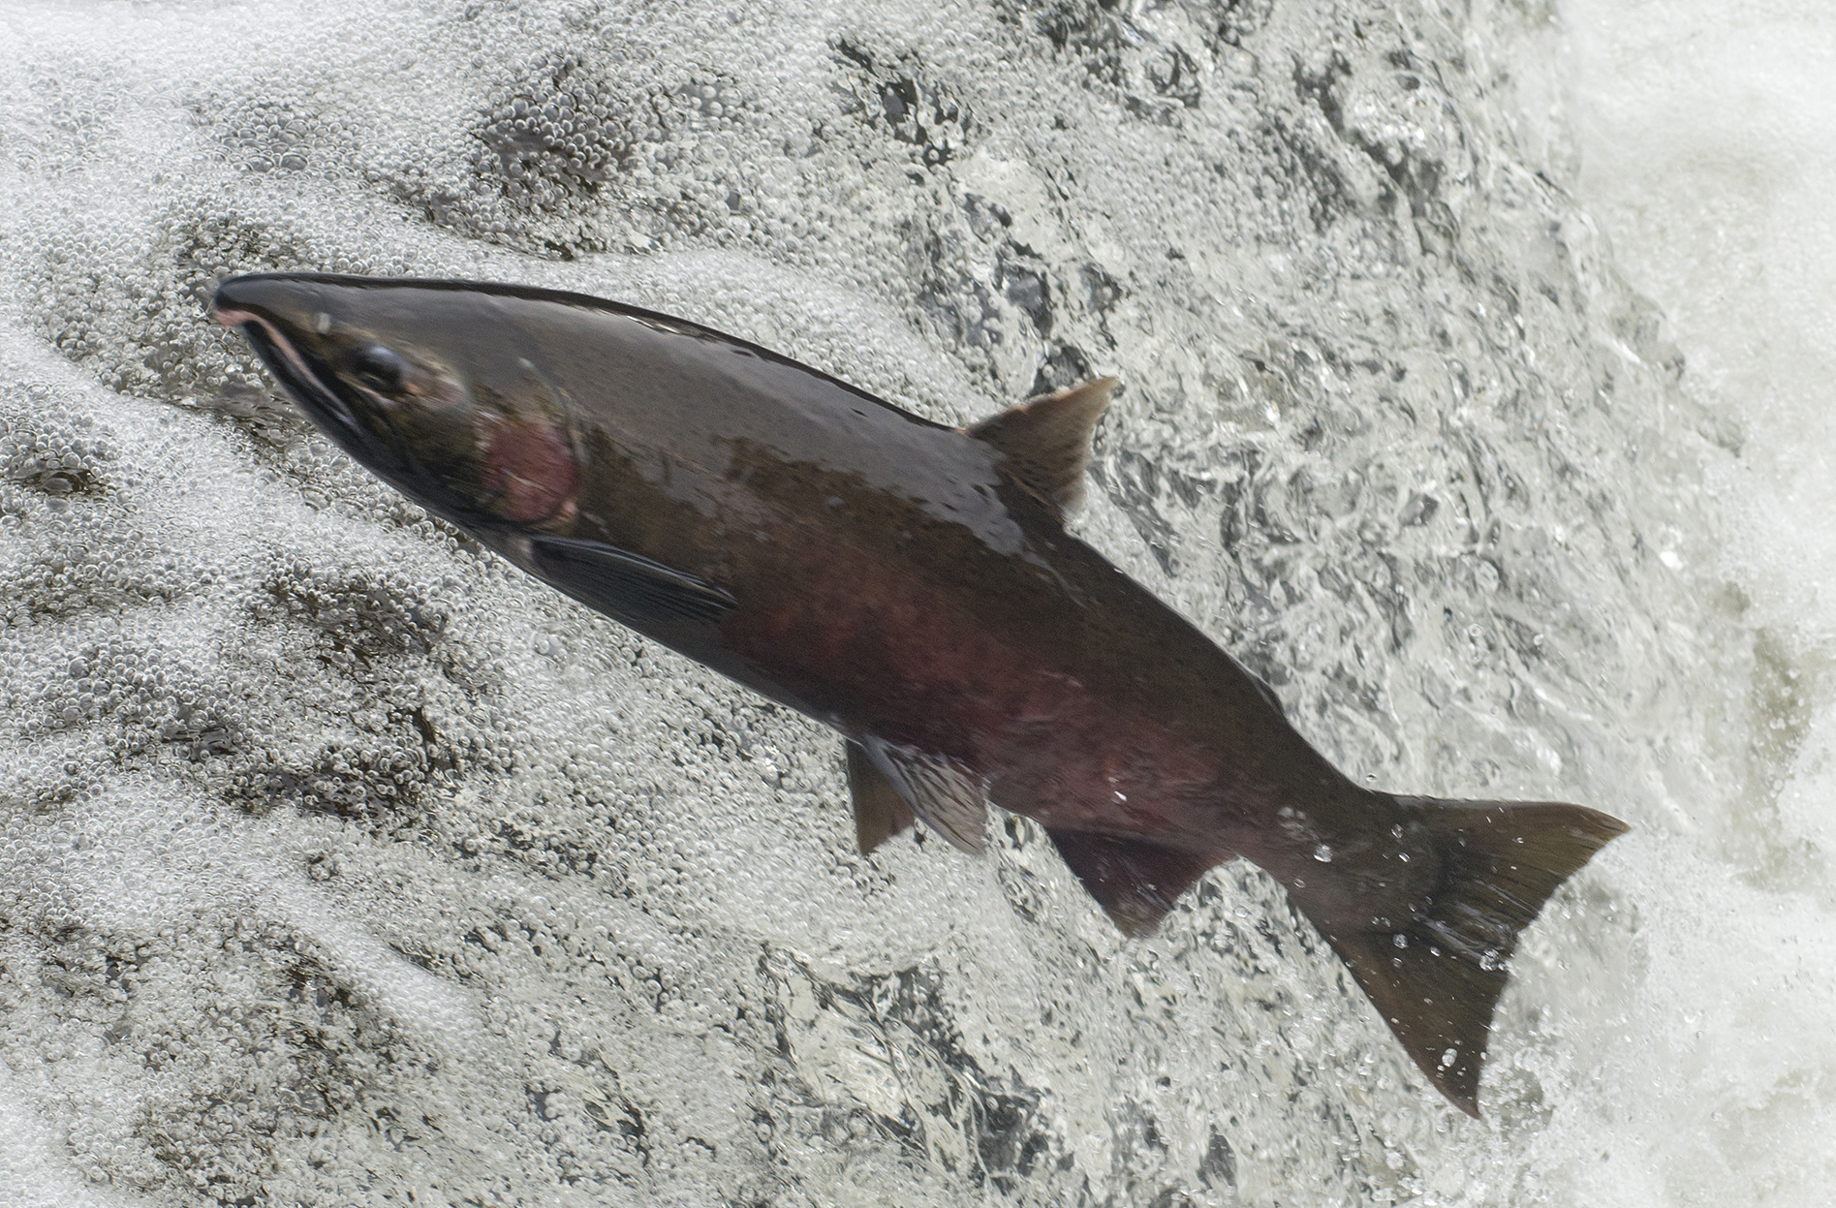
Examples of Dissolved Oxygen Criteria: Makah Tribe
Salmon and trout spawning
  7-day average of the daily mean dissolved oxygen: 11 mg/L
  Minimum: 9.5 mg/L
Salmon and trout rearing and migration
  7-day average of the daily mean dissolved oxygen: 8.5 mg/L
  Minimum: 6.5 mg/L
https://nwtreatytribes.org/loomis-great-day-salmon-tribal-treaty-rights-everyone-lives/
Notes:
Some dissolved oxygen criteria also have averaging periods. The Makah Tribe dissolved oxygen criteria has more than one value to consider—a 7-day average and a single sample minimum (Makah Tribe 2006). In order for a water body to support the designated use, the dissolved oxygen has to meet both criteria – that is if it fails either it is not meeting the designated use. To assess waters for the 7-day average criteria, the data need to be averaged over the 7 day period that the criterion uses. To assess waters for the single sample minimum, individual samples are compared with the minimum value.
Some criteria specify minimum sample sizes. If the criteria does not, Tribes can look to water quality criteria or assessment guidance documents of nearby tribes or states to help select an appropriate desired minimum sample size for averaging. When multipart criteria that have an averaging period specify minimum sample sizes, monitoring programs should strive to collect at least that many samples during the averaging period. If the minimum sample size is not met, the data can still be reviewed to determine whether the available data clearly indicate impairment or suggest likely impairment. Tribes may then decide whether assessing the water as not meeting designated uses or conducting follow-up investigations are warranted. For example, if a 7 day averaging period requires 5 samples and only 4 are available but even adding in very high DO value as the final value would still result in an average below the criterion it may be appropriate to assess the water as not meeting the designated use. Regardless of whether the desired number of sample are available, results that indicate problems should prompt an investigation into the potential sources of the problem, to see if they can be identified and addressed.

Slide 15
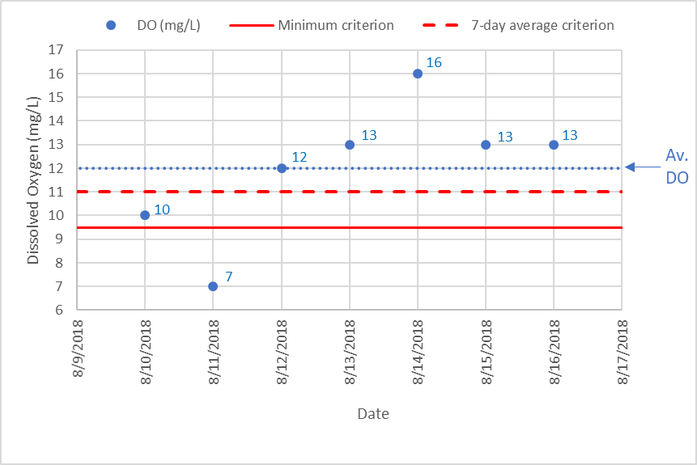
Dissolved Oxygen Assessment
  Salmon and trout spawning water
    7-day average of the daily mean dissolved oxygen: 11 mg/L
    Minimum: 9.5 mg/L
  7-day average: 12.3 mg/L
  Range: 8.6–13.9 mg/L
Notes:
OK, time for another graph of monitoring results! We have the same format here, with DO concentrations along the vertical axis, and sampling dates along the horizontal axis. The minimum criterion is shown by the continuous red line, and the 7-day average is shown by the dashed red line.
In this example data set, dissolved oxygen concentration was measured daily for a week. Dissolved oxygen started off a little low, and then increased partway through the week. Let’s see if this water body meets the dissolved oxygen criteria. The 7-day average needs to be at least 11 mg/L [point to the dashed red line]. Does this data set meet that value?
[Pause and wait for a response.]
If you average these 7 values, the average is 12 mg/L [point to the dashed blue line], so the water body does meet the criterion, because the 7-day average is greater than 11. The minimum value can’t be below 9.5
[Point to the solid red line].
Does this data set meet that criterion?
[Pause and wait for a response.]
The lowest dissolved oxygen concentration measured was 7.0 mg/L, which is less than the minimum criteria of 9.5 mg/L. So, even though the 7-day average meets the dissolved oxygen criterion, the minimum recorded value does not. Therefore, this water body does not meet the dissolved oxygen criteria based on this data set. Something else to consider, with just one value below the minimum, that might suggest you need to additional sampling -- including consideration of diurnal cycles -- to determine whether this is really a problem. If you keep it in perspective, you only caught one of a number of low values or whether you just happened across something of an outlier.
We need to mention he 10% rule here again. Bring it into the example. And how it applies here.

Slide 16
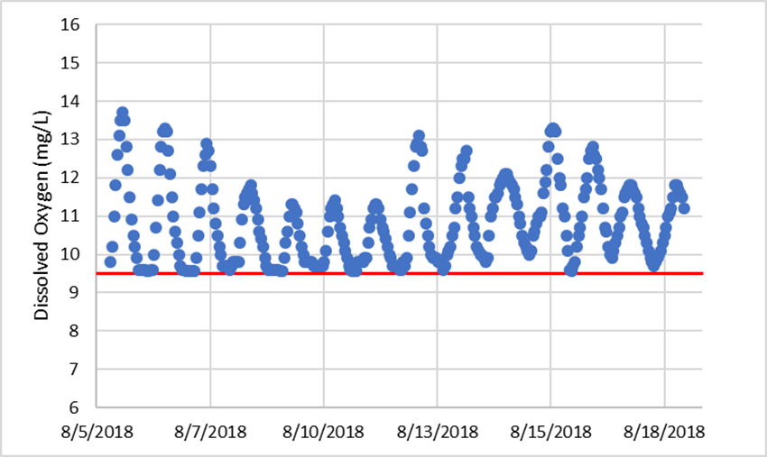
Dissolved Oxygen Assessment
  Salmon and trout spawning water criteria
    7-day average of the daily mean dissolved oxygen: 11 mg/L
    Minimum: 9.5 mg/L
Notes:
Here’s another graph, set up the same way, with hourly sampling results for dissolved oxygen.
In this second dissolved oxygen data set, dissolved oxygen was measured hourly over two weeks. See the daily cycle of dissolved oxygen, in that it is lowest in the early morning and highest in the late afternoon. This is why, if you’re just getting one measurement, it’s good to go in the early morning to see how low the dissolved oxygen concentration has dipped. See that the dissolved oxygen drops to close to the minimum criterion, but it never goes below the criterion. The dissolved oxygen therefore meets that component of the standard.

Slide 17
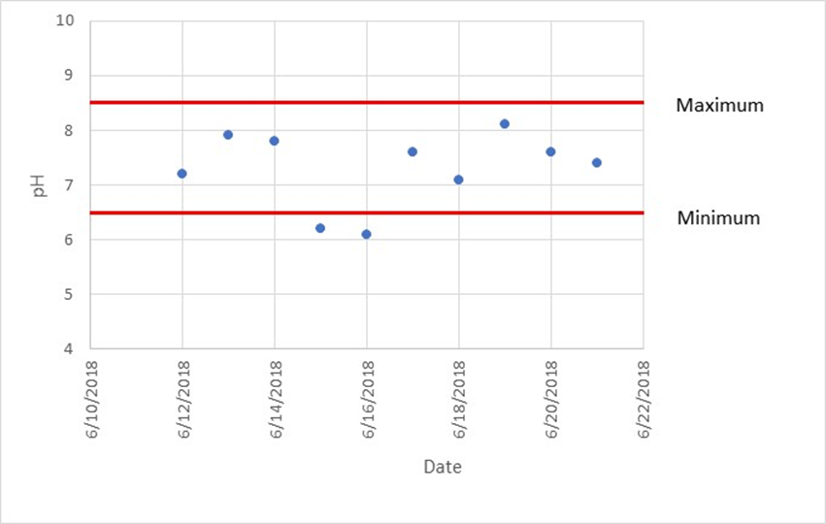
pH Criteria
  A measure of acidity and alkalinity of the water
  Criteria require keeping pH within a specific range
    To protect human health, the pH must be within the range of 5 to 9
    To protect aquatic life, the pH must be within the range of 6.5 to 9.0 for freshwater and 6.5 to 8.5 for saltwater
Notes:
Here’s a graph of pH monitoring data, with the pH values shown in the vertical axis and the sampling dates along the bottom. The acceptable range for pH is shown by the red lines.
As you may know, pH is a measure of the acidity and alkalinity of the water. Most aquatic life cannot survive if the water is either too acidic or too alkaline. Because of this, pH criteria typically have a minimum and a maximum value.
For the protection of human health for the consumption of water or organism, EPA Section 304(a) pH criterion is within the range of 5 to 9.
https://www.epa.gov/wqc/national-recommended-water-quality-criteria-human-health-criteria-table
For protection of aquatic life, EPA Section 304(a) pH criterion continuous concentration (i.e., chronic) is within the range of 6.5 to 9.0 for freshwater and 6.5 to 8.5 for saltwater. Saltwater also shouldn’t deviate more than 0.2 from natural.
https://www.epa.gov/wqc/national-recommended-water-quality-criteria-aquatic-life-criteria-table
For example, the Puyallup Tribe pH criteria say that pH needs to be within the range of 6.5 to 8.5 in freshwaters or 7.0 to 8.5 in marine waters (Puyallup Tribe n.d.).
In the example data set on this slide, two of the pH measurements are below the minimum value of 6.5. There are no measurements that exceed the Puyallup Tribe’s maximum value of 8.5. Because there are two values outside of the acceptable range, this water body does not meet the pH criteria. Some states and tribes allow a 10% exceedance for the pH criteria. In this example, if a 10% exceedance exception were allowable, the water body would still not meet the criteria because two of 10 samples exceed criteria.

Slide 18
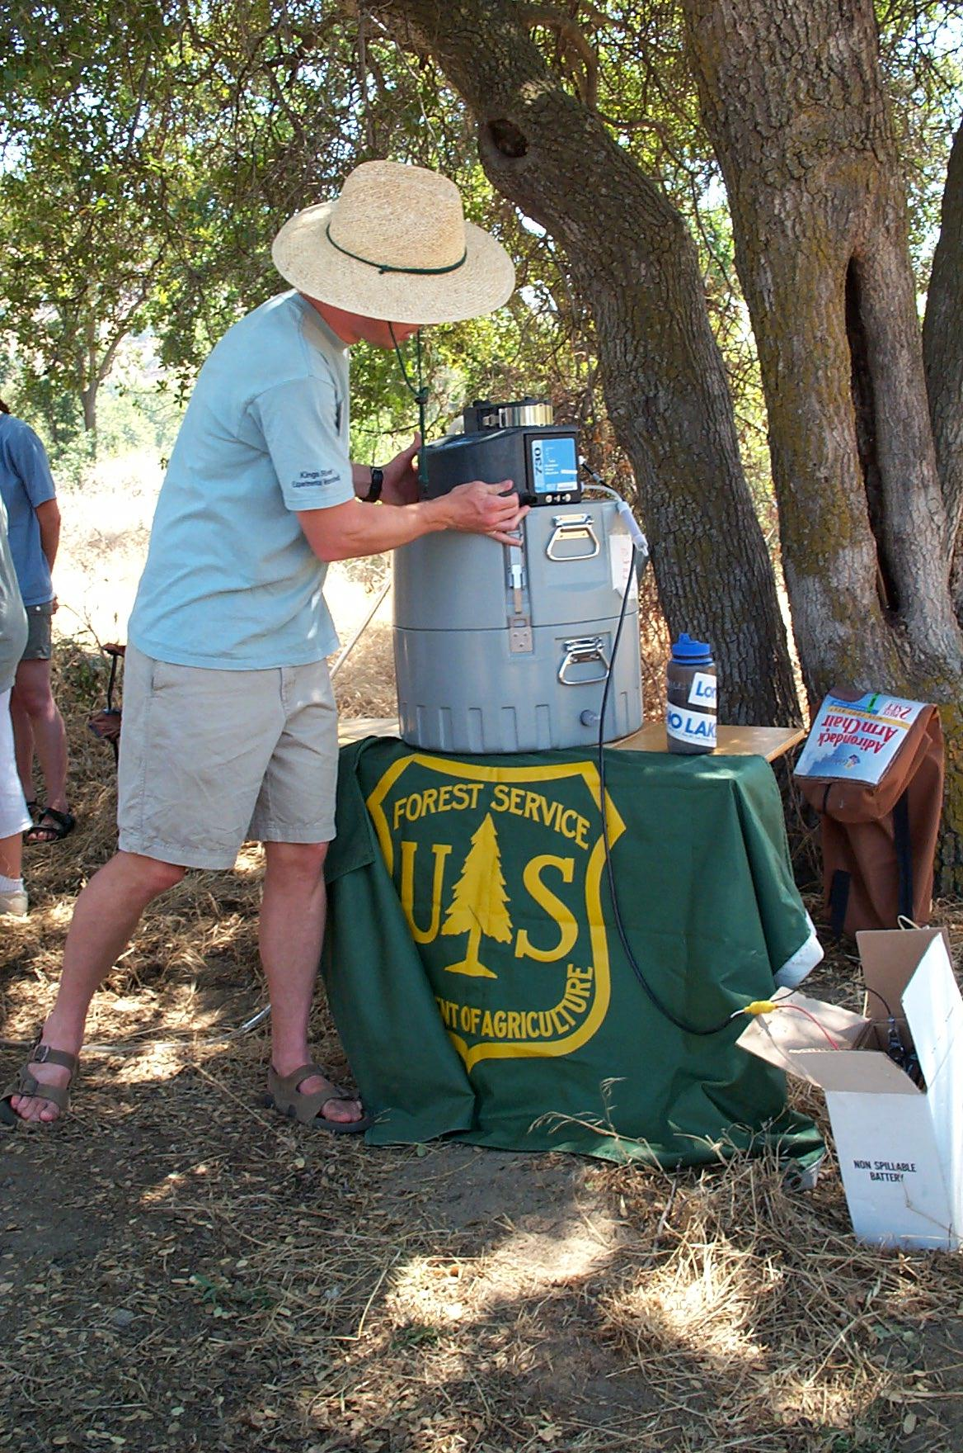
Temperature
  Criteria focused on aquatic life support—warmwater and coldwater
  “In a stream, the introduction of heat by other than natural causes shall not increase the temperature, as measured upstream from the point of introduction, by more than 2.7° C (5° F), based on the weekly average of the maximum daily temperatures measured at mid-depth or three feet, whichever is less.”
Notes:
Water temperature criteria are often expressed differently. Criteria are typically focused on ensuring that fish and other aquatic organisms can live and reproduce. Sometimes the approach will specify an acceptable range of water temperatures.

Slide 19
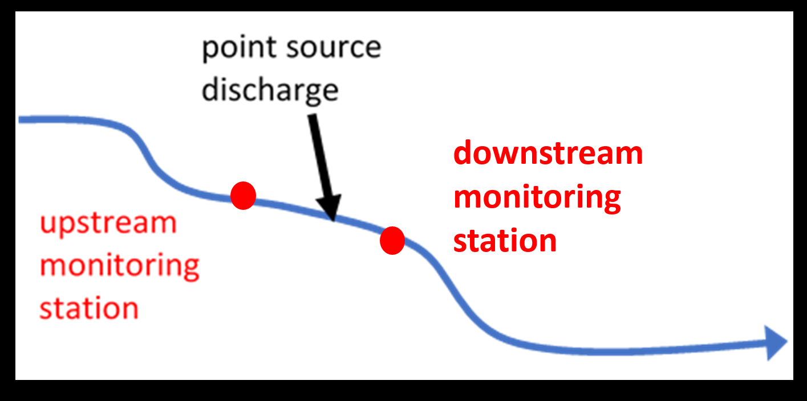
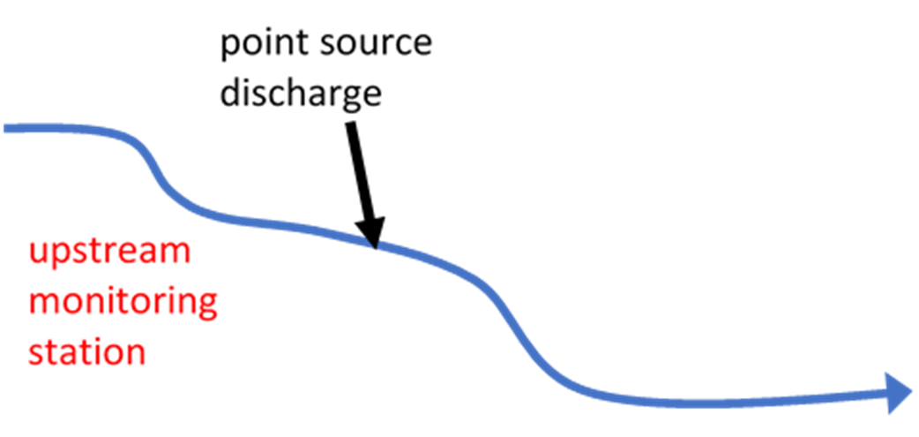
Temperature Criteria Example
downstream monitoring station
Notes:
Let’s use an example from the Pueblo of Laguna Tribe to illustrate this concept (Pueblo of Laguna 2014).
The diagram shows a stream with a point source that discharges into the stream. Monitoring stations are located on the stream at points both upstream and downstream of the point source. Daily temperatures would be collected to determine if the temperatures in the stream exceeded the water quality criterion.

Slide 20
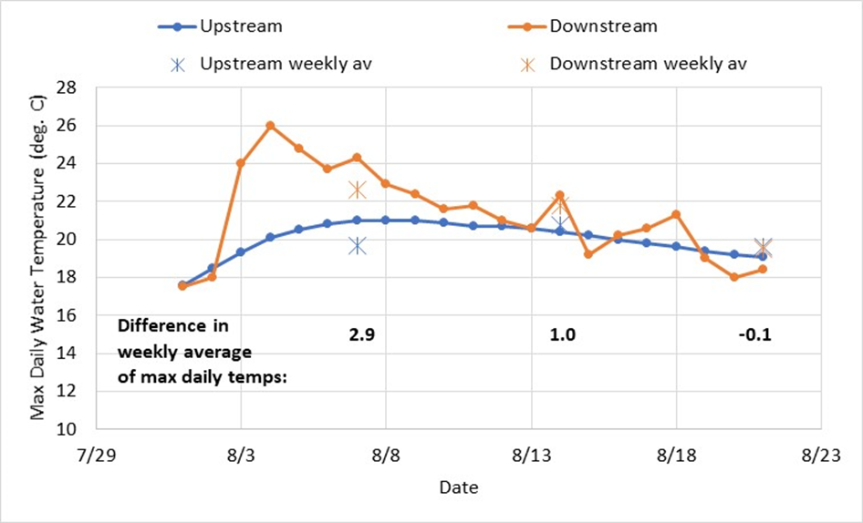
Temperature Example
  “No increase in the weekly average of the maximum daily temperature between upstream/ downstream locations that is greater than 2.7° C”
Notes:
There’s more going on in this graph for temperature, but the format is similar to the ones you’ve already seen. In this case, temperature is shown along the vertical axis, with sampling dates across the bottom. This time, we have two data sets: one for the upstream sampling sites, shown in blue, and another in gold, for the downstream sites.
The temperature water quality criterion is no increase in the weekly average of the maximum daily temperature between upstream and downstream locations that is greater than 2.7 degrees Celsius.
Using the example temperature criterion, here are some hypothetical stream water temperature data. Each dot shows the maximum daily water temperature. The blue circles are the temperatures upstream of the point source, and the orange circles are the temperatures downstream of the point source. The blue stars show the weekly averages at the upstream station, and the orange stars show the weekly averages at the downstream station. The difference in the weekly averages of the maximum daily temperatures have been calculated and are shown on the graph.
Does this stream meet the temperature criterion? [Pause and wait for a response.]
The stream does NOT meet the criterion. In the first week, the maximum temperature increased on average by 2.9 degrees Celsius, which is greater than 2.7 degrees Celsius. The temperature change was smaller in the second week, and the temperature actually went down slightly in the third week. But, because the difference in the first week was greater than the allowed increase in temperature, this stream does not meet the temperature criterion.
Note that these examples showing the effects of point source discharges can be complicated. For example, what if the upstream reach is already impaired for temperature, due to stormwater runoff from large parking lots or other causes? The point source discharge may not increase the stream temperature at all, but could still be greatly elevated over natural conditions. There are a lot of issues to sort out when we look at how point source discharges are considered. Can you think of other examples?

Slide 21
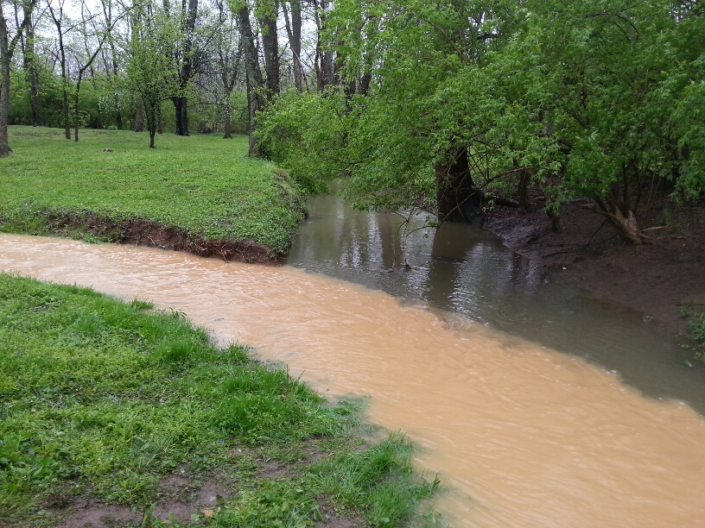
Turbidity
  Measure of cloudiness of water
  Turbidity shall not exceed 5 NTU over background when background turbidity is 50 NTU or less, with no more than a 10 percent increase when background turbidity is more than 50 NTU. Background turbidity shall be measured at a point immediately upstream of the turbidity-causing activity.” (Pueblo of Sandia Tribe 2010)
  “Turbidity shall not exceed 25 NTU.” (Pueblo of Tesuque 2015)
Notes:
Turbidity is a measure of the cloudiness of water, which can be caused by organic and inorganic matter such as sediment, soluble organic compounds, algae, and other microscopic organisms. Similar to temperature criteria, turbidity criteria are also often expressed as an acceptable increase over background turbidity. High turbidity can directly affect aquatic life by limiting visibility for swimming organisms or indirectly affect aquatic life by limiting light penetration for submerged aquatic vegetation that is habitat for fish and macroinvertebrates.
EPA does not have Section 304(a) criteria for turbidity. States and tribes often investigate natural background conditions or use a reference stream approach to develop their turbidity criteria. In some cases, the methods for determining background conditions are included in the listing criteria or assessment methodology.
In this example from the Pueblo of Sandia, the acceptable increase in turbidity from a turbidity-causing activity is based on the background turbidity. If the background turbidity is less than 50 nephelometric turbidity units (NTU), then the turbidity is not allowed to increase by more than 5 NTU. If the background turbidity is more than 50 NTU, the turbidity is not allowed to increase by more than 10 percent (Pueblo of Sandia Tribe 2010). Other turbidity criteria are a not-to-exceed value, such as the Pueblo of Tesuque’s turbidity shown here in the second example (Pueblo of Tesuque 2015).

Slide 22
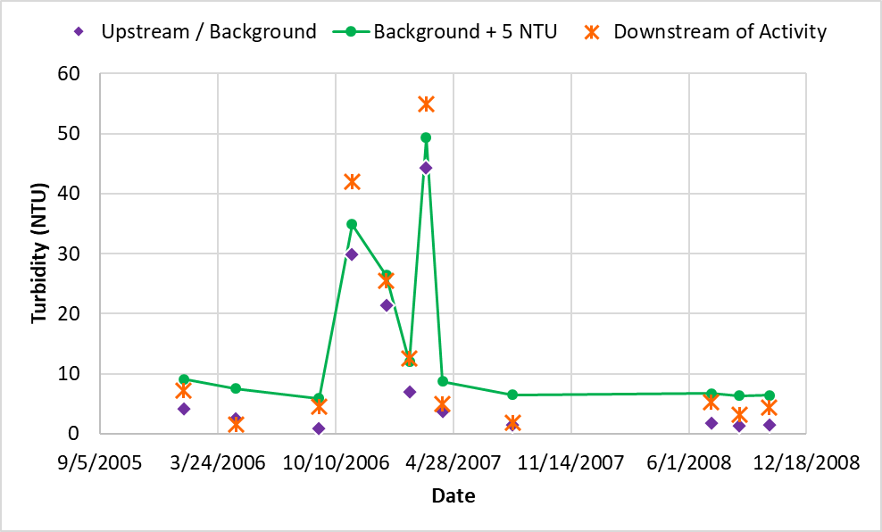
Turbidity: Increase over Background Turbidity Example
Pueblo of Sandia: “Turbidity shall not exceed 5 NTU over background when background turbidity is 50 NTU or less, with no more than a 10 percent increase when background turbidity is more than 50 NTU. Background turbidity shall be measured at a point immediately upstream of the turbidity-causing activity.”
Note conditions when criteria is exceeded
Notes:
Using the turbidity criteria from the Pueblo of Sandia, this slide shows a hypothetical turbidity data set collected to evaluate the effect that an activity has on a stream’s turbidity. As the standard states, background turbidity is measured at a point upstream of the turbidity-causing activity.
The purple diamonds in the figure are from the upstream background site. Note that all of the purple diamonds are less than 50 NTU. Because the standard states that “Turbidity shall not exceed 5 NTU over background when background turbidity is 50 NTU or less,” the criteria that we will compare the downstream turbidity data to are the background turbidity measurements plus 5 NTU, represented by the green line. The data downstream of the turbidity-causing activity are the orange markers. Note that sometimes the orange marker is below the criterion (or the green line), and sometimes it is above the criterion. The orange markers are above the criteria when turbidity is higher in general. The conclusion of this analysis would be that the activity leads to a violation of the water quality standard at times.
A follow-up investigation for the data analyst could be to identify the watershed and water body conditions when the turbidity criterion is exceeded. For example, is it under high flows? What months? Etc.
Other questions to consider: Is background an average? Is it an average of all years of data or just last year? Do the samples have to be in the same season? Month? What other data could you look at to get some insight on this spike? Flow data? Rainfall data? Knowledge about upstream activities such as construction?

Slide 23
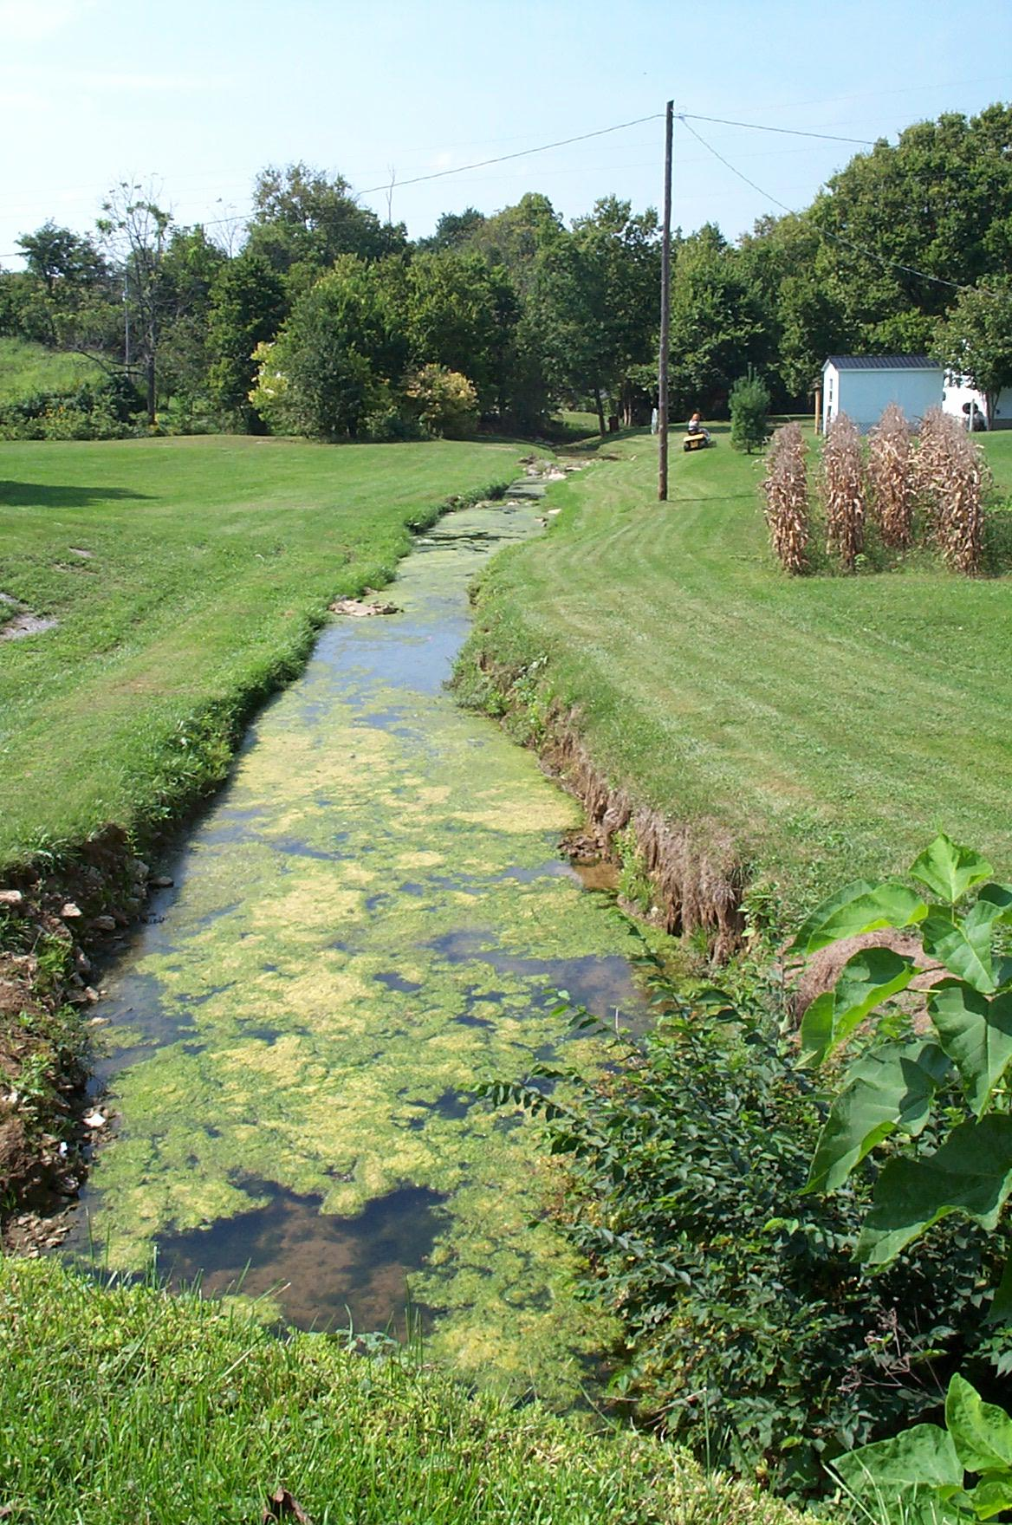
Analysis of Nutrient Parameters:
Nitrogen and Phosphorus
Essential for aquatic life—food for algae and plants
Too much can lead to excessive algae and/or plants: eutrophication, harmful algae blooms and fish kills
Other nutrients can be directly toxic: ammonia
Notes:
.
Nutrients are found naturally in the environment and are essential for aquatic life and other organisms to survive. Nutrients are also released into the environment by anthropogenic sources; for example, fertilizer-application, discharge of untreated sanitary waste, and deposition of animal waste.
While nutrients are essential for life, high levels of nutrients in a water body can lead to excessive growth of algae and plants and can be harmful to aquatic ecosystems. (As described in the DO portion of this training) This nutrient enrichment or “nutrient pollution” of a water body is known as eutrophication. With eutrophication, the excess algae grow, eventually die and are decomposed by bacteria that consume dissolved oxygen for their metabolic processes. As a result, oxygen levels in the water decrease. Nitrogen and phosphorus are two nutrients that, in excessive quantities, can lead to eutrophication. In addition, some nutrients can be directly toxic to organisms. For example, high concentrations of ammonia can lead to toxic buildup of ammonia in internal tissues and blood, and potentially death.

Slide 24
Example
Nitrogen and Phosphorus Aquatic Life Criteria
To support fishing, frogging, recreation, and the propagation and maintenance of a healthy, well-balanced population of fish and other aquatic life and wildlife, the total phosphorus level shall not exceed 10 parts per billion (Miccosukee Tribe 2010, R4).
Aquatic life: References EPA’s ecoregional criteria for TP, TN, and water clarity (Pueblo of Laguna 2014, R6 & https://www.epa.gov/nutrient-policy-data/ecoregional-nutrient-criteria-rivers-and-streams )
High quality coldwater fishery: total inorganic nitrogen shall not exceed 1.0 mg/L and total phosphorus shall not exceed 0.1 mg/L (Pueblo of Nambé 2017, R6).
EPA has issued final recommended ambient numeric nutrient water quality criteria recommendations for lakes and reservoirs. https://www.epa.gov/nutrient-policy-data/ambient-water-quality-criteria-address-nutrient-pollution-lakes-and-reservoirs
Notes:
Some tribes have developed numeric criteria for nitrogen and/or phosphorus. Most nutrient criteria address total nitrogen and total phosphorus, rather than inorganic nitrogen, phosphates, and other nutrient subfractions.
The slide shows 2 actual examples of nutrient criteria for aquatic life. Note that the uses are slightly different from one another, but all are for aquatic life. Note also that none of these criteria specify averaging periods or recurrence intervals. While not written into the standards language itself, sometimes this information on averaging periods and recurrence intervals can be found in assessment guidance documents. For example, when assessing nutrients for aquatic life, the Oneida Water Resources Program considers a stream to be fully supporting of aquatic life if 90% of the phosphorus samples in a calendar year meet the standard (Oneida Nation 2017).
Seasonal averages are often evaluated as well. For example, the State of Minnesota’s river eutrophication criteria are compared against June–September average data (MPCA 2017). Tribes will need to consider local factors specific to their watersheds when they develop nutrient criteria and assessment methodologies. When the nutrient criteria are only expressed as narrative standards – like “no nuisance algal growth” or so on, tribes and states usually develop some sort of surrogate measure to establish a benchmark for what that means in terms of a parameter that can be assessed. For example, for lakes, sometimes chlorophyll a concentrations are used as an indicator to measure algal growth, along with phosphorus concentrations.

Slide 25
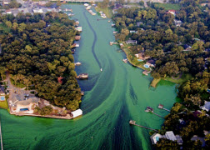
Nutrients: Freshwater v. Saltwater Ecosystems
Freshwater: typically more sensitive to phosphorus?
Saltwater: typically more sensitive to nitrogen?
Important to understand nutrient effects
Source: Lian and Wu, 2017.
Notes:
Nutrients have different effects on different types of ecosystems. In the past, it was thought that freshwater systems were more sensitive to phosphorus inputs than nitrogen inputs, and saltwater systems were more sensitive to nitrogen than phosphorus inputs. However, nutrients can affect ecosystems in different ways.
We now know that nitrogen inputs can affect freshwater systems, and phosphorus can affect saltwater environments – research is continuing on this complex subject. In lakes, it is also important to consider chlorophyll a concentrations and Secchi depth alongside nutrients, and to understand trophic state. Not every eutrophic lake should be considered impaired, since for some that is their natural state.

Slide 26
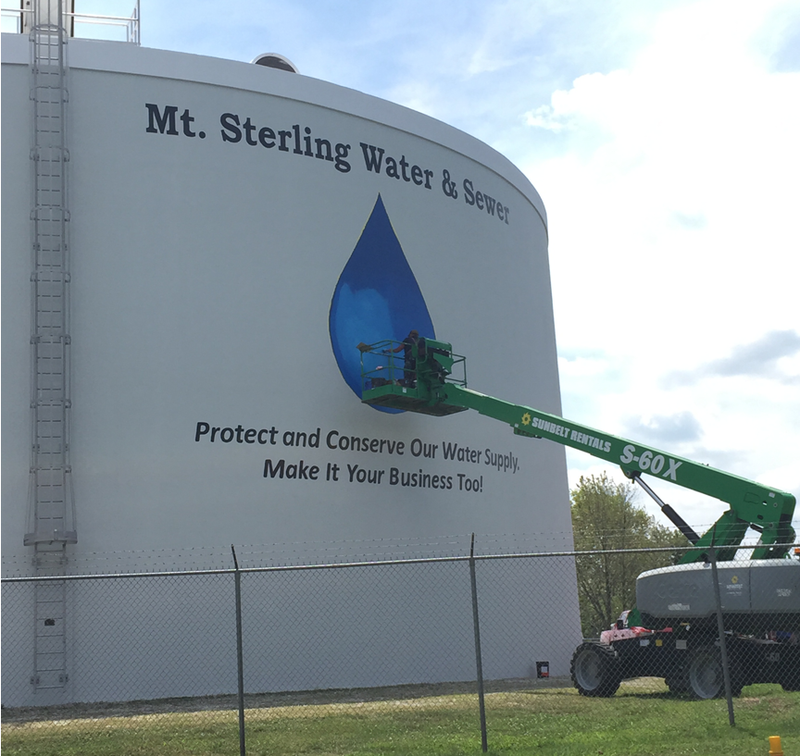
Nutrient Criteria for Other Uses
Primary contact ceremonial use: Total inorganic nitrogen not to exceed 10.0 mg/L (Isleta Tribe, R6)
Drinking water: Nitrate not to exceed 10 mg/L (Laguna Tribe, R6)
Notes:
Other tribes have nutrient criteria for uses such as ceremonial uses and drinking water. These are based on the Safe Drinking Water Act maximum contaminant level or MCL for nitrate, which is intended to prevent health impacts related to methemoglobinemia, also called “blue baby syndrome.”
Now we’re going to break into groups and work on 2 exercises. Each exercise has multiple questions—please discuss these with your group and be ready to present your answers to the class after the break.

Slide 27
Exercise #1: Turbidity and Nutrients
(See Handout)
Notes:
Break into small groups.
Pass around the handouts for the exercises.
Each group should follow the instructions on the handout.
The first two exercises deal with turbidity and nutrients.
Groups can work together on the two exercises for 15 minutes.
Report-outs can be completed in 5 to 10 minutes.

Slide 28
Break!
Notes:
Provide the group with a 20 minute break.

Slide 29
Exercise #1:
Group Review and Discussion
Notes:
Discuss answers to exercise 1.

Slide 30
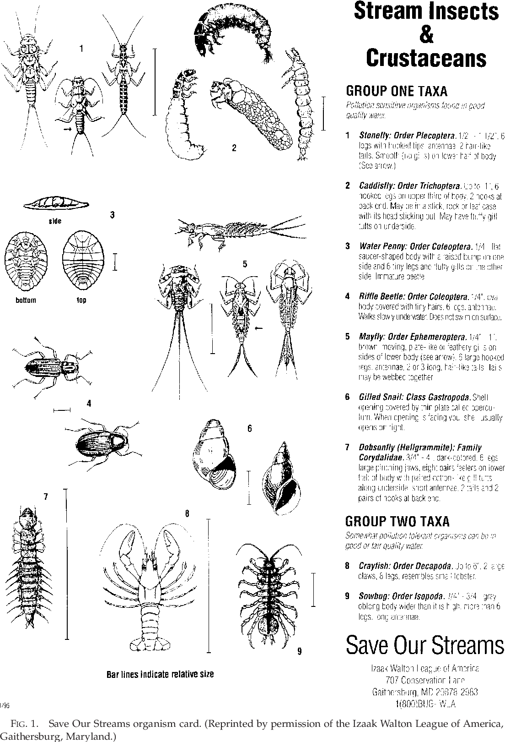
Analysis of Biological Parameters
Studies find links between:
  groups of organisms
  habitat conditions
  other parameters
and water quality conditions.
An index is created to organize and quantify the linkages, so water quality can be assessed by characterizing the organisms, habitat, etc.
Notes:
Biological parameters for assessing water quality can include collecting or observing groups of organisms, instream and riparian habitat, and other parameters and evaluating the results against an index created for that specific purpose. You might be familiar with some basic approaches, like collecting “bugs” – stream organisms – to assess whether the water can support various kinds of insect larva and other organisms. These indices provide an approach to make broad judgments on water quality by looking at these parameters. The better the scores, the higher the water quality. Let’s take a deeper dive into this topic.

Slide 31
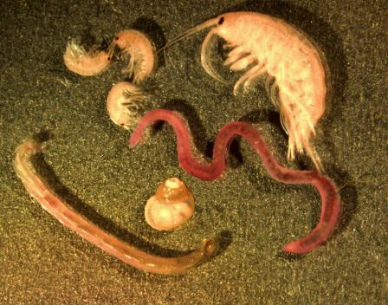
Analysis of Biological Parameters
  Macroinvertebrates
  Fish
  Algae
  Habitat
  Trophic state
  Culturally important species (wild rice, salmon, cattails)
Source: G. Carter via NOAA/GLERL
Notes:
As we noted, biological information provides a holistic assessment of water quality conditions. Instead of measuring the individual pollutants in a water body, biological data measure the biological response of the aquatic life that we are trying to protect. Biological parameter indices are based on fish assemblages, macroinvertebrate diversity, and other parameter values found at reference – or relatively undisturbed – sites. For example, if there is a lower fish species diversity or lower numbers than you would expect, given the type of waterbody, it indicates that there may be some factor that is stressing the fish, such as high sediment concentrations, low DO, poor quality habitat, or some other cause. Certain species of organisms are more sensitive to pollution than others. For example, a fish species might require higher dissolved oxygen concentrations or clear, non-turbid waters. If these pollution-sensitive organisms are absent from a water body where you would expect to find them, it indicates that the water body is not healthy.
Biological monitoring can be used to detect degraded waters and to evaluate how a water body responds to management efforts (USEPA 2017).
There are not a lot of examples of tribal numeric water quality criteria for biological parameters. However, tribes do use biological data to evaluate water bodies. Tribes can also use ecoregional fish and macroinvertebrate community health indices and biological condition gradients developed by the states or federal agencies. A biological condition gradient is a framework for evaluating biological response to increasing stressors. Metrics – or quantitative measurements – and some of the indices they’re incorporated into are described in the next couple of slides.

Slide 32
Biological Monitoring and Assessment Considerations
What methods to use? Examples can be found from national programs(for example the National Aquatic Resource Surveys, states and other organizations
What experts might be needed? Level of expertise and cost will differ based on level of taxonomy needed
How to ensure quality and consistency of the data? Consider having independent taxonomists re-identify a subset of the samples to make sure the data are accurate.
How will you assess condition? Use available metrics and indices or create your own?
Notes:
Some items to consider in developing and building a biological monitoring and assessment program include:
Given your objectives, what methods to use? If you want to be able to compare your data to other information from waters nearby or within your ecoregion, you might consider using existing national or state methods. Examples can be found in
manuals from the National Aquatic Resource Surveys at https://www.epa.gov/national-aquatic-resource-surveys/manuals-used-national-aquatic-resource-surveys. NARS is an EPA/State/Tribal partnership that assesses the nation’s coastal waters, lakes, rivers/streams and wetlands.
State program documents
National Environmental Methods Index - https://www.nemi.gov/methods/
You will also need to think about the expertise and related costs associated for taxonomy. While fish identification is typically done in the field by fish biologists, identification of macroinvertebrates usually needs to be done in a lab in order to reach identify the organisms beyond family. It is important to know that the level of expertise and cost will differ based on level of taxonomy needed to support your intended assessment.
Another important piece to factor in is how you will ensure the quality and consistency of the data. Incorporation of appropriate quality control measures such as having independent taxonomists re-identify a subset of the samples can catch unintended misidentifications or taxa counts that can impact your results.
Additionally, in establishing a biological component to your assessment, you need to think about how you will assess condition. Knowing whether you plan to use single metrics such as # of EPT taxa or an IBI that more comprehensively assess the biological assemblage is important in determining methods, level of expertise that is needed, etc. Example assessment approaches and indices can be found from NARS as well as state programs
IBIs can be used to evaluate different types of organisms in a water body such as fish, macroinvertebrates, plants, plankton and others. They have been found to be very effective tools for assessing biological condition across waterbody types. The next slides show examples of metrics as well as benthic macroinvertebrate and fish metrics/IBIs (or MMIs) using examples from the National Rivers and Streams Assessment

Slide 33
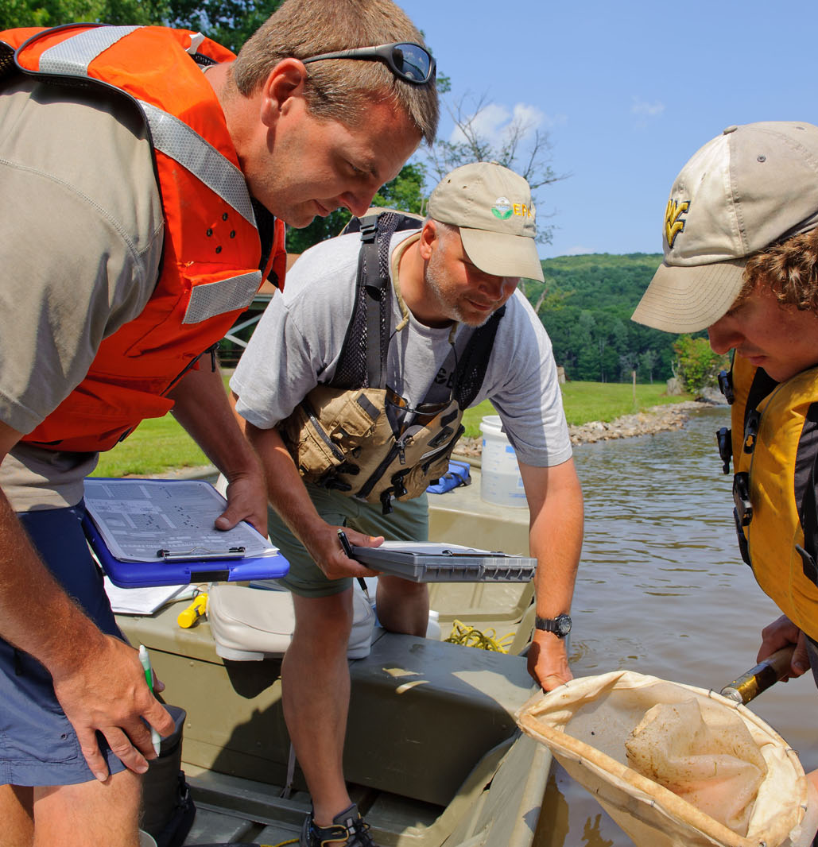
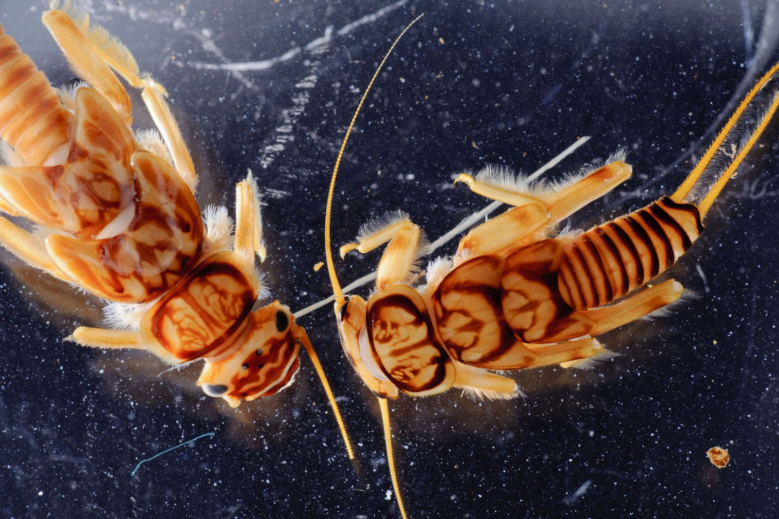
Macroinvertebrates
Macroinvertebrates are organisms that are large (macro) enough to be seen with the naked eye and lack a backbone (invertebrate).
Examples of aquatic macroinvertebrates include insects in their larval or nymph form, crayfish, clams, snails, and worms
They inhabit all types of waters including rivers, streams, lakes, wetlands and coastal waters.
Why monitor macroinvertebrates? Aquatic macroinvertebrates are good indicators of quality because:
  They can't escape pollution and show the effects of short- and long- term pollution events
  They may show the impacts from habitat loss not detected by traditional water quality assessments.
  Some are very intolerant of pollution.
  They are relatively easy to sample
Notes:
In this presentation we are focusing on two biological assemblages that are often used in monitoring programs: Macroinvertebrates and fish.
One common biological parameter that is measured is one we mentioned a few minutes ago: macroinvertebrates. Macroinvertebrates include the larval/nymphal life stages of insects and other types of invertebrate animals that are large enough to be seen with the naked eye.
Macroinvertebrates are used as measure of biological condition for a number of reasons including that they can’t avoid pollution or habitat conditions that impact them – as such they show the effects of short and longer term pollution events as well as habitat loss. There are a number of species that are also very intolerant of pollution, so the loss or decline of those species can be an indication of problems. Additionally, they are relatively easy to sample and there are a number of effective methods and assessment protocols available.

Slide 34
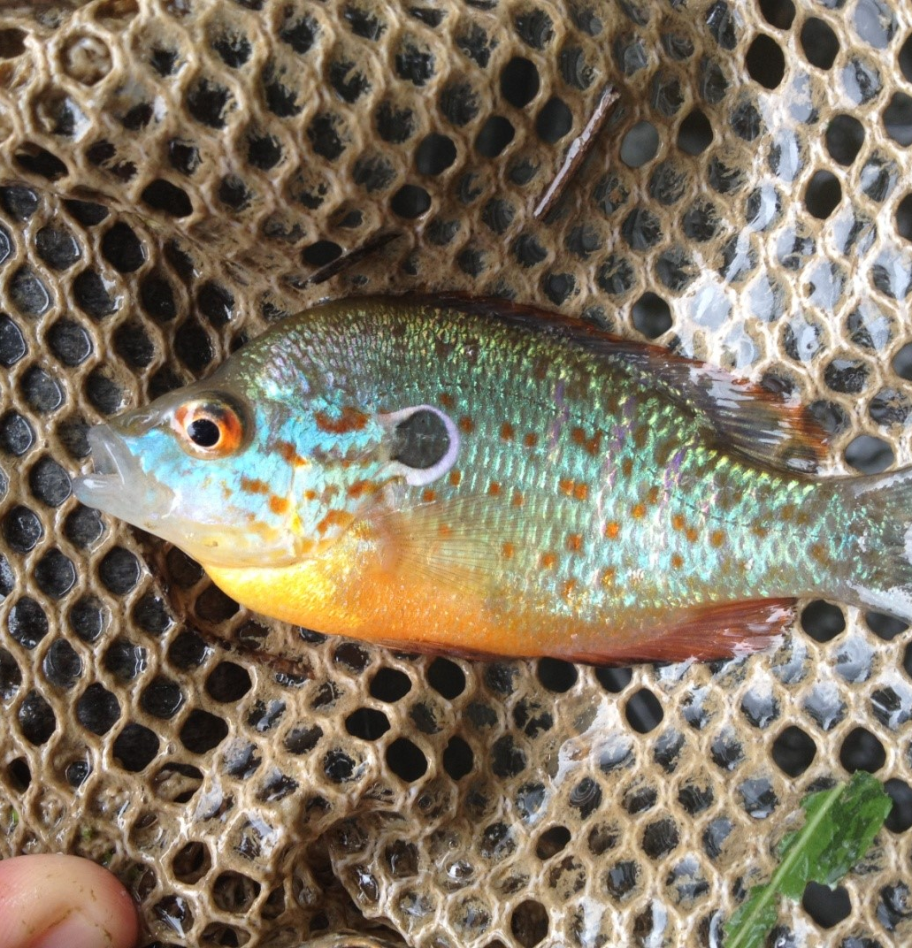
Fish Assemblage
Assessments of fish assemblages typically look to evaluate the variety and diversity of fish (whether small darters or large fish that are eaten by people) that exist at the location.
Why monitor fish?
  Fish are sensitive indicators of physical and chemical habitat degradation, environmental contamination, migration barriers and overall ecosystem productivity.
  They are affected by changes in temperature, dissolved oxygen, pH and myriad other physical and chemical constituents in water.
  They are also economically, culturally and recreationally valuable.
Notes:
Fish are another biological assemblage often used in stream monitoring programs. They require plants, insects and small aquatic creatures to feed on; in-stream and streambank cover to shelter in; appropriate sediment/substrate conditions for spawning; and overhanging vegetation to shade the water in which they live. When a stream is impacted by pollution or degraded habitat, fish are affected.
An important note about fish as an indicator of water quality: the assessment is different from assessments for sport fishing or stocking decisions in that the assessments typically look to evaluate the variety and diversity of fish (whether small darters or fish that are eaten by people) that exist at the location. While it does not require a census of all fish species present, the focus is not solely on those that are targeted by people when fishing.
Fish are used as an indicator of water quality because they are sensitive to pollution, barriers such as dams that can impact the natural system, changes in temperature, pH and other aspects of water quality. Additionally, they are economically, culturally and recreationally valuable so understanding their condition is important and can serve as an effective means of communicating to the public about the impacts of poor water quality.

Slide 35
Indicator Development: Aspects of Macroinvertebrate Assemblages to Consider (National Rivers and Streams Assessment Example)
  Taxonomic richness — number of families or genera within different taxonomic groups
  Taxonomic composition — proportional abundance of certain taxonomic groups
  Taxonomic diversity — distribution of the number of taxa and the number of organisms
  Feeding groups — distribution of filterers, scrapers, grazers, and predators
  Habits/habitats — distribution of macros by how they move and where they live
  Pollution tolerance — distribution of macros by the range of contamination they can tolerate
Notes:
Well constructed MMIs or IBIs will typically have metrics selected from a variety of pre-established categories that account for different attributes. The multi-metric index or MMI for macroinvertebrates developed by EPA for the National Rivers and Streams Assessment, referred to as the NRSA, uses a total index score that is the sum of scores from metrics selected to represent the six individual aspects of macroinvertebrate community structure listed on the screen. If tribes want adopt the same sampling approach as NRSA, they could use the NARS ecoregional index instead of creating their own. The NARS ecoregional indices can be found on EPA’s website at https://www.epa.gov/sites/production/files/2016-03/documents/nrsa_0809_march_2_final.pdf

Slide 36
Indicator Development: Aspects of Fish Assemblage to Consider (National Rivers and Streams Assessment Example)
Nonnative species based on presence in 8-digit USGS Hydrologic Units
Taxonomic composition
Species richness
Habitat guild
Life history/migratory strategy
Reproductive guild
Trophic guild
Tolerance to anthropogenic disturbance
Notes:
For the National Rivers and Streams Assessment, scientists developed a fish MMI to assess condition of the fish community. Separate indices were developed for each of the nine aggregated ecoregions used in NARS.. These indices are based on a variety of metrics representing 8 different aspects of fish community assemblage – shown on the slide – including taxonomic composition, habitat guilds, tolerance to anthropogenic disturbance, etc. Fish were collected using standard electrofishing methods, and tallied and identified in the field. Except for those used for tissue analysis and as voucher specimens, they were then released alive.

Slide 37

Biological Metrics Combined Into Indices
  Multiple metrics combined mathematically into an Index of Biological Integrity (IBI)
Metrics
  EPT % Taxa Richness Shannon Diversity
  % Individuals in Top 5 Taxa
  Scraper Taxa Richness
  Clinger % Taxa Richness
  EPT Taxa Richness
  Tolerant %Taxa Richness
Benthic MMI for Wester Mountains Ecoregion - NRSA
Index
Find the NARS ecoregional index for your ecoregion at
https://www.epa.gov/national-aquatic-resource-surveys/reports-and-data-national-rivers-and-streams-assessment-2013-2014.
Notes:
On this slide is an example of the index that is used to evaluate the water quality of rivers and streams in the Western Mountains ecoregion as part of the National Rivers and Streams Assessment. First, the metrics listed on the left are calculated from the benthic macroinvertebrates collected from the stream. As we discussed before, these specific metrics were selected to represent the 6 attributes of the macroinvertebrate community. Then, the scores of these metrics are combined into an overall multimetric index (MMI) (similar to an IBI), score. The MMI score is used to evaluate the water quality of the stream. Thresholds were developed using the reference condition approach to interpret the scores. More information on the reference approach can be found in NARS reports and technical support documents.
Next we will look at the output of some of the scoring that has been developed for NRSA indices using that reference approach to see how they are applied. While NRSA uses good, fair and poor categories could also be for meeting/not meeting WQS or other appropriate categorizations. We have examples for both macroinvertebrates and fish. More information on how these were developed can be found in the NRSA 2013-2014 report and Technical Support Document. For information on field and lab methods, see the NRSA Quality Assurance Project Plan, Field Operations manual and Laboratory Operations Manual. These documents for all four waterbody types included in NARS can be found at https://www.epa.gov/national-aquatic-resource-surveys/manuals-used-national-aquatic-resource-surveys

Slide 38
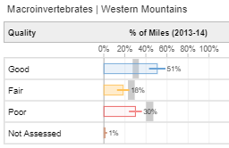
National Rivers and Streams Assessment Benthic MMI Scoring by Ecoregion
  Ecoregion Good Benchmark Poor Benchmark
  CPL ≥54.9 <40.7
        NAP ≥55.0 <40.9
        NPL ≥56.8 <42.6
        SAP ≥45.0 <30.8
        SPL ≥35.5 <21.3
        TPL ≥40.3 <26.2
        UMW ≥36.9 <22.7
        WMT ≥50.1 <35.9
        XER ≥57.0 <42.8
National Rivers and Streams Assessment 2013-2014 Technical Support Document. https://www.epa.gov/national-aquatic-resource-surveys/nrsa
Find the NRSA ecoregional results for your region at : https://riverstreamassessment.epa.gov/dashboard/
Notes:
As noted earlier, macroinvertebrates are sensitive indicators of physical and chemical habitat degradation, environmental contamination, etc. Macroinvertebrate IBIs assess the taxa present in a water body and provide an overall score of biotic integrity.
For example, the National Rivers and Streams uses fish and macroinvertebrate IBIs to assess support of aquatic life uses in wadeable warmwater streams. This table and the one on the next slide shows the biological criteria for macroinvertebrates and fish; see how there are different criteria for different ecoregions ? If you were assessing a stream with these criteria, you would need to know the ecoregion that the stream is in. In some cases indicators may also be developed separately for different stream types (headwater streams, large rivers).
The figure shows how the index was used to assess the condition of rivers and streams in the Western Mountain Ecoregion. The colors indicate condition as assessed against reference conditions. The benchmarks of 50.1 and 35.9 were used to separate rivers and streams into good, fair and poor categories. The grey bar shows the national confidence intervals and how they overlap or do not overlap the Western Mountains assessments.

Slide 39
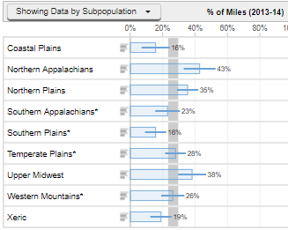
National Rivers and Streams Assessment Fish MultiMetric Index (MMI) Scoring by Ecoregion
Aggregated Ecoregion Good/Fair Fair/Poor
Northern Appalachians (60) ≥ 57.6 < 47.1
Southern Appalachian (94) ≥ 60.3 < 49.8
Coastal Plains (39) ≥ 57.3 < 46.8
Northern Plains (42) ≥ 46.3 < 35.8
Southern Plains (43) ≥ 50.2 < 39.7
Temperate Plains (28) ≥ 58.0 < 47.5
Upper Midwest (28) ≥ 39.8 < 29.3
Western Mountains (70) ≥ 75.9 < 65.4
Xeric West (25) ≥ 76.8 < 63.7
National Rivers and Streams Assessment 2013-2014 Technical Support Document. https://www.epa.gov/national-aquatic-resource-surveys/nrsa
Find the NRSA ecoregional results for your region at : https://riverstreamassessment.epa.gov/dashboard/
Notes:
As noted earlier, fish are sensitive indicators of physical and chemical habitat degradation, environmental contamination, migration barriers and overall ecosystem productivity. They are affected by changes in temperature, dissolved oxygen, pH and myriad other physical and chemical constituents in water. Fish IBIs are similar to macroinvertebrate IBIs in that they assess the species present in a water body and provide an overall score of biotic integrity.
This table provides similar benchmarks as the previous slide, except these are the ones used by NRSA for fish. Again, these differ by ecoregion because of differences in natural expectations as well as the quality of reference conditions. If you were assessing a stream with these criteria, you would need to know the ecoregion that the stream is in. In some cases indicators may also be developed separately for different stream types or habitat types (cold water vs. warmwater systems) because the number and type fish that naturally exist in these systems is different.
The figure shows the percent of river and stream miles in good condition based on the Fish MMI for each of the 9 ecoregions. The grey bar shows how the ecoregional results overlap (or do not as is the case for the Southern Plains) with the national results. For example, the NRSA found that 42% of river and stream miles in the Northern Appalachians were in good condition based on the fish indicator which is significantly better than the national condition (26% +-3%)

Slide 40
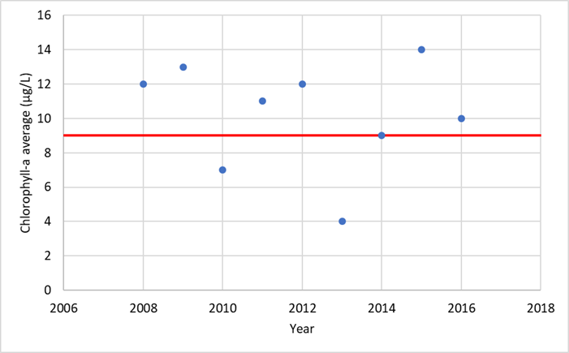
Chlorophyll in Lakes
  Chlorophyll-a criteria: ≤ 9 μg/L
  June–Sept observed chlorophyll-a average: 10 ug/L
Notes:
This example shows growing season averages of chlorophyll-a in a lake. The growing season averages bounce around a bit—some are less than and some are greater than the standard. Because the average of all of the seasonal averages is 10 µg/L, the lake does not meet the chlorophyll-a criterion.
Note that sometimes, nutrient and Secchi depth standards are used at the same time, and a lake won’t be listed as impaired until more than one of the standards is exceeded during the summer. Here again, it’s important to carefully read and fully understand how the water quality criteria are expressed in the standards!

Slide 41
Analysis of Pathogen Parameters: Escherichia coli (E. coli) and Enterococci
  Recreational uses—water contact activities
  Indicators of fecal contamination and potential exposure to pathogens
  Tribal water quality criteria
  USEPA recommendations
Indicator | Geometric Mean | Single Sample Maximum
Enterococci (marine and freshwater) | 35 | 130
E. coli (freshwater) | 126 | 410
USEPA recommended pathogen water quality criteria (colony forming units per 100 mL sample) for an estimated illness rate of 36 per 1,000 primary contact recreation users
Table from USEPA (n.d.(a))
Notes:
Recreational water quality criteria protect the public while they’re participating in water contact activities such as swimming and wading in waters that are designated for these recreational uses. Two types of organisms that are used as indicators of fecal contamination in surface waters are E. coli and Enterococci, measured as “colony forming units” or CFUs per 100 mL of sample water. Many tribes have numeric criteria for pathogen indicators that can be used to evaluate waters.
If your tribe does not have numeric criteria, you can use the USEPA’s recommended recreational water quality criteria, shown here (USEPA n.d.(a)). These types of pathogens are derived from the waste of warm-bloodied animals. Common sources pathways include discharges of untreated sanitary waste from wastewater treatment plants and on-site treatment systems, direct deposition of waste in waterbodies by wildlife and livestock, runoff from upland areas used by wildlife and livestock.

Slide 42
E. coli: Averaging Period and Recurrence Interval
  Geometric mean
  Navajo Tribe E. coli criterion: 126 cfu/100 mL as a geometric mean, *minimum of 4 samples in 30 days
Month | Monthly Geometric Mean | # of Samples
Apr | 71 | 6
May | 62 | 5
Jun | 174 | 6
Jul | 218 | 4
Aug | 199 | 3
Sep | 133 | 3
Oct | 98 | 4
*EPA’s current criteria recommendations for E. coli and enterococci do not include a sample size
Notes:
Many pathogen criteria use a 30-day geometric mean for the averaging period. The geometric mean is a way of averaging data that is appropriate for data sets that have a lot of small values and a few large ones, which is common with pathogen indicators. You can use programs like Microsoft Excel to calculate the geometric mean of a data set. The Navajo Tribe’s E. coli criterion is 126 cfu / 100 mL as geometric mean of a minimum of four samples in 30 days (Navajo Nation Environmental Protection Agency 2007). Let’s take a look at this example data set and assess it against the Navajo Nation’s criterion.
This table summarizes the E. coli monitoring data by month, providing the monthly geometric means and the number of samples that were taken per month. For simplification, we’re going to just look at the data summarized by month, instead of by all 30-day time periods. The monthly geometric means that are greater than 126 are shown in red.
But look at the corresponding number of samples. What do you notice?
[advance to the next slide]

Slide 43
E. coli: Averaging Period and Recurrence Interval
  Geometric mean
  Navajo Tribe E. coli criterion: 126 cfu/100 mL as a geometric mean, *minimum of 4 samples in 30 days
Month | Monthly Geometric Mean | # of Samples
Apr | 71 | 6
May | 62 | 5
Jun | 174 | 6
Jul | 218 | 4
Aug | 199 | 3
Sep | 133 | 3
Oct | 98 | 4
*EPA’s current criteria recommendations for E. coli and enterococci do not include a sample size
Notes:
Not all of the months have a minimum of 4 samples; some only have 3 samples. Therefore, only the geometric means shown in red here would be considered as not meeting the criterion.

Slide 44
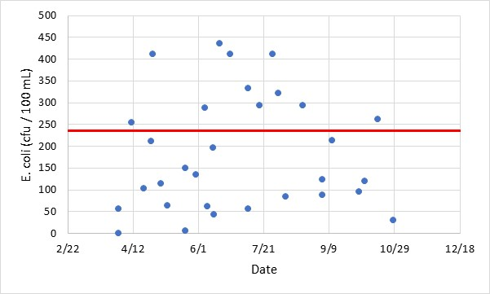
E. coli: Averaging Period and Recurrence Interval
Single sample maximum
Navajo Tribe E. coli criterion: 235 cfu/100 mL
11 out of 31 samples, or 35%, are greater than 235
Notes:
Now let’s look at the Navajo Nation’s single sample maximum criterion: 235 cfu / 100 mL. There is no specified recurrence interval. Some of the other state and tribal E. coli criteria don’t allow any exceedances of the single sample maximum, while some criteria specify that no more than 10 percent of the samples can exceed the single sample maximum. In the data set shown here, 11 out of the 35 samples taken that year, or 35 percent, exceed the criterion. Therefore, whether the Navajo Nation doesn’t allow any exceedances, or if they allow 10 percent to exceed, either way this water body does not meet the E. coli criterion.

Slide 45
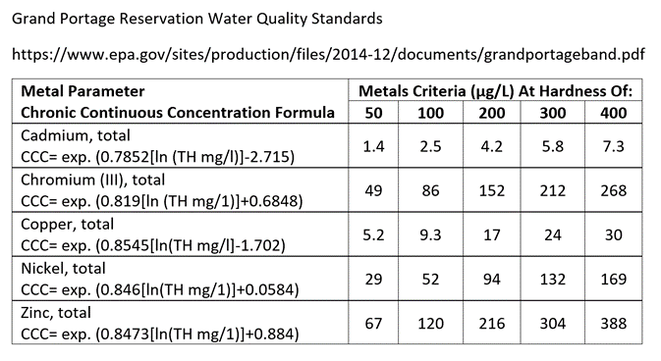
Analysis of Metals
Dissolved vs. total
Acute and chronic
Toxicity varies with water chemistry conditions which means you need to collect other parameters too.
Copper chronic criterion (µg/L) = exp. (0.8545[ln total hardness]-1.702)
Notes:
Many tribes have water quality criteria for metals that apply to water bodies that are designated for aquatic life and drinking water uses. Metals can be measured in the dissolved form or as total metals. The USEPA recommends that dissolved metals be used in water quality criteria, because dissolved metal concentrations better represent the metals that impact aquatic life (USEPA 1993). Metals standards often include acute criteria to protect against short-term, high concentration exposures and chronic criteria to protect against longer-term exposures at lower concentrations.
Because the toxicity of metals varies with chemical characteristics of the site, metals criteria are often written as models that take into account the parameters that contribute to toxicity (e.g., dissolved organic carbon or hardness). In this example, the Grand Portage Reservation’s criteria for copper is shown in the equation on the slide (Grand Portage Reservation 2005). The standards document also provides example criteria at different hardness values, so that you don’t need to use the equation. Either way, you need to know the levels of input parameters water to evaluate metals toxicity, so make sure that they are measured at the same time as the metals are measured!

Slide 46
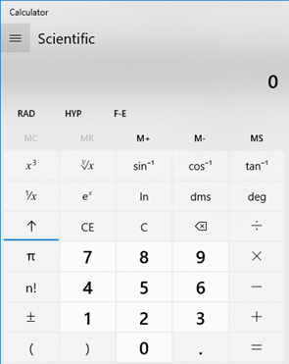
Metal Criterion Example
  • Nickel chronic criterion (µg/L) = exp. (0.846[ln total hardness]+0.0584)
  • If hardness = 137 mg/L, nickel chronic criterion = e^(0.846 x ln(137) + 0.0584)
Notes:
Using the example nickel criterion from the previous slide, let’s take a look at how to calculate the criterion in a particular water body. You first have to measure the hardness of the water; let’s suppose that the hardness is 137 mg/L. To use the formula to calculate the criterion, you first take the natural log of 137, to get approximately 4.92.
Natural log is abbreviated as “ln,” which you can see in the image of the Microsoft calculator that many of you have on your work computers [point to the “ln” on the slide].
You multiply the result (4.92) by 0.846, and then you add 0.0584. Then you take the result, which is 4.22, and use that value as the exponent of the mathematical constant “e,” which you can also see in the image of the calculator [point to the “ex” on the slide].
These functions are also typically found in smart phone calculators.
When you type in 2.50, then ex [this is read as “e to the x”], the result is 68.03, which would be the nickel chronic criterion in this water body.

Slide 47
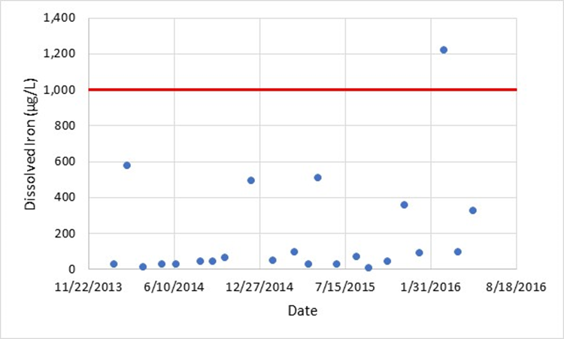
Analysis of Metals: Recurrence Interval
  Allows one exceedance every three years
Notes:
Numeric criteria for metals typically may be exceeded no more than once every three years for a water body to be meeting the criteria (USEPA n.d.(b)). Here’s a graph of monitoring data for iron concentrations, in micrograms per liter. In the example shown on the slide, the iron criteria is 1,000 ug/L. There is one exceedance of the criterion. Because only one exceedance was observed, the water body meets the iron criterion.

Slide 48
Exercise #2:
Biological Indices
Metals
Pathogens
(See Handout)
Notes:
Break into small groups.
Refer the groups to the handout.
Have them work on the three exercises cited.
Groups can work on the exercise for 15 minutes.
Report-outs can take 5 to 10 minutes.

Slide 49
Exercise #2:
Group Review and Discussion
Notes:
Discuss answers to exercise 2.

Slide 50
Thank You
Questions?

Slide 51
References
Carlson, R. E. 1977. “A Trophic State Index for Lakes.” Limnology and Oceanography 22(2): 361–69.
Carlson, R. E., and J. T. Simpson. 1996. A Coordinator’s Guide to Volunteer Lake Monitoring Methods. North American Lake Management Society. February 1996.
Coeur d’Alene Tribe. 2010. Water Quality Standards for Approved Surface Waters of the Coeur D’Alene Tribe. Effective June 12, 2014.
Fond du Lac Band of Lake Superior Chippewa. 2001. Fond due Lac Band of Lake Superior Chippewa Water Quality Standards of the Fond du Lac Reservation Ordinance #12/98 as amended. Adopted September 11, 2001.
Grand Portage Reservation. 2005. Grand Portage Reservation Water Quality Standards. Final version as of May 24, 2005, with revised criteria adopted August 8, 2006, and appended variance from mercury criteria.
Iowa DNR (Department of Natural Resources). 2004. Biological Assessment of Iowa’s Wadeable Streams. Prepared by Thomas F. Wilton, TMDL and Water Quality Assessment Section, Environmental Services Division, Des Moines, Iowa. October 2004.
Lummi Indian Business Council. 2007. Water Quality Standards for Surface Waters of the Lummi Indian Reservation. Adopted August 20, 2007.
J. Lyons, L. Wang, and T.D. Simonson. 1996. Development and Validation of an Index of Biotic Integrity for Coldwater Streams in Wisconsin. North American Journal of Fisheries Management 16(2): 241-256.
Makah Tribe. 2006. Water Quality Standards for Surface Waters. September 30, 2006.
Maxted, J.R., M.T. Barbour, J. Gerritsen, V. Poretti, N. Primrose, A. Silvia, D. Penrose, and R. Renfrow. 2000. Assessment framework for mid-Atlantic coastal plain streams using benthic macroinvertebrates. Journal of the North American Benthological Society 19(1):128–144.
Miccosukee Tribe. 2010. Water Quality Standards for Surface Waters of the Miccosukee Tribe of Indians of Florida. Miccosukee Environmental Protection Code Subtitle B. Adopted December 19, 1997; amended October 6, 2010.
MPCA (Minnesota Pollution Control Agency). 2014. Development of a fish-based Index of Biological Integrity for assessment of Minnesota’s rivers and streams. Document number wq-bsm2-03. Minnesota Pollution Control Agency, Environmental Analysis and Outcomes Division, St. Paul, MN.
MPCA (Minnesota Pollution Control Agency). 2017. Guidance Manual for Assessing the Quality of Minnesota Surface Waters for Determination of Impairment: 305(b) Report and 303(d) List;
2018 Assessment and Listing Cycle. Document number wq-iw1-04. October 2017.
Navajo Nation Environmental Protection Agency. 2007. Navajo Nation Surface Water Quality Standards 2007. Passed by Navajo Nation Resources Committee on May 13, 2008.
Ohio Environmental Protection Agency. 2006. Methods for Assessing Habitat in Flowing Waters: Using the Qualitative Habitat Evaluation Index (QHEI). OHIO EPA Technical Bulletin EAS/2006-06-1. Revised by the Midwest Biodiversity Institute for State of Ohio Environmental Protection Agency. June 2006.
Oneida Nation. 1996. Oneida Nation Water Quality Standards.
Oneida Nation. 2017. Final Water Quality Assessment Report: April 1, 2015–March 31, 2017. Prepared by Melis Arik, October 30, 2017.
Paul, M., B. Walsh, J. Oliver, and D. Thomas. 2017. Algal Indicators in Streams: A Review of their Application in Water Quality Management of Nutrient Pollution. Developed by Tetra Tech and United States Environmental Protection Agency, Office of Water, Office of Science and Technology. Washington, D.C. 44 pp.
Pueblo of Laguna. 2014. Pueblo of Laguna Water Quality Standards. Effective July 19, 2017.
Pueblo of Nambé. 2017. Water Quality Code.
Pueblo of Sandia. 2009. Pueblo of Sandia Water Quality Standards. Effective March 9, 2010.
Pueblo of Tesuque. 2015. Pueblo of Tesuque Water Quality Standards. Effective May 8, 2017.
Puyallup Tribe. n.d. Water Quality Standards for Surface Waters of the Puyallup Tribe. Effective October 31, 1994.
Spokane Tribe of Indians. 2003. Surface Water Quality Standards. March 7 2003, Resolution 2003-259.
USEPA (United States Environmental Protection Agency). 1993. Office of Water Policy and Technical Guidance on Interpretation and Implementation of Aquatic Life Metals Criteria. Memorandum to Water Management Division Directors from Martha Prothro, Acting Assistant Administrator of Water, EPA. October 1, 1993.
USEPA (United States Environmental Protection Agency). 2011. Biological Assessments: Key Terms and Concepts. EPA/820/F-11/006. March 2011.
USEPA (United States Environmental Protection Agency). 2015. 2015 Drinking Water Health Advisories for Two Cyanobacterial Toxins. Office of Water 820F15003. June 2015.
USEPA (United States Environmental Protection Agency). 2016a. National Rivers and Streams Assessment 2008–2009: Technical Report. Office of Wetlands, Oceans and Watersheds, Office of Research and Development. Washington, DC. https://www.epa.gov/sites/production/files/2016-03/documents/nrsa_08_09_technical_appendix_03082016.pdf.
USEPA (United States Environmental Protection Agency). 2016b. A Practitioner’s Guide to the Biological Condition Gradient: A Framework to Describe Incremental Change in Aquatic Ecosystems. EPA-842-R-16-001. Washington, DC. https://www.epa.gov/sites/production/files/2016-02/documents/bcg-practioners-guide-report.pdf.
USEPA (United States Environmental Protection Agency). 2016c. Rivers and Streams Assessment 2008-2009: A Collaborative Survey (EPA/841/R-16/007). Washington, DC. https://www.epa.gov/sites/production/files/2016-03/documents/nrsa_0809_march_2_final.pdf
USEPA (United States Environmental Protection Agency). 2017. Water Quality Standards Handbook Chapter 3: Water Quality Criteria. Office of Water, EPA 823 B 17 001.
USEPA (United States Environmental Protection Agency). 2019. Reference Library of Water Quality Standards Policy and Guidance Documents. https://www.epa.gov/wqs-tech/reference-library-water-quality-standards-policy-and-guidance-documents.
U.S. Environmental Protection Agency. 2020. National Rivers and Streams Assessment 2013–2014: A Collaborative Survey. EPA 841-R-19-001. Washington, DC. https://www.epa.gov/national-aquatic-resource-surveys/nrsa
U.S. Environmental Protection Agency. 2020. National Rivers and Streams Assessment 2013-2014 Technical Support Document. EPA 843-R-19-001. Office of Water and Office of Research and Development. Washington, D.C. https://www.epa.gov/national-aquatic-resource-surveys/nrsa
U.S. Environmental Protection Agency. n.d.(a). Manuals used in the National Aquatic Resource Surveys. https://www.epa.gov/national-aquatic-resource-surveys/manuals-used-national-aquatic-resource-surveys
USEPA (United States Environmental Protection Agency). n.d.(b). Recreational Water Quality Criteria. Office of Water 820-F-12-058.
USEPA (United States Environmental Protection Agency). n.d.(c). Guidelines for Deriving Numerical National Water Quality Criteria for the Protection of Aquatic Organisms and Their Uses. Office of Research and Development. PB85-227049.
WHO (World Health Organization). 1998. Guidelines for Drinking-Water Quality—Second Edition—Volume 2—Health Criteria and Other Supporting Information—Addendum. Geneva.
Notes:
References are pasted in a continuous text box on the slide, and below:
References
Carlson, R. E. 1977. “A Trophic State Index for Lakes.” Limnology and Oceanography 22(2): 361–69.
Carlson, R. E., and J. T. Simpson. 1996. A Coordinator’s Guide to Volunteer Lake Monitoring Methods. North American Lake Management Society. February 1996.
Coeur d’Alene Tribe. 2010. Water Quality Standards for Approved Surface Waters of the Coeur D’Alene Tribe. Effective June 12, 2014.
Fond du Lac Band of Lake Superior Chippewa. 2001. Fond due Lac Band of Lake Superior Cbippewa Water Quality Standards of the Fond du Lac Reservation Ordinance #12/98 as amended. Adopted September 11, 2001.
Grand Portage Reservation. 2005. Grand Portage Reservation Water Quality Standards. Final version as of May 24, 2005, with revised criteria adopted August 8, 2006, and appended variance from mercury criteria.
Iowa DNR (Department of Natural Resources). 2004. Biological Assessment of Iowa’s Wadeable Streams. Prepared by Thomas F. Wilton, TMDL and Water Quality Assessment Section, Environmental Services Division, Des Moines, Iowa. October 2004.
Lummi Indian Business Council. 2007. Water Quality Standards for Surface Waters of the Lummi Indian Reservation. Adopted August 20, 2007.
J. Lyons, L. Wang, and T.D. Simonson. 1996. Development and Validation of an Index of Biotic Integrity for Coldwater Streams in Wisconsin. North American Journal of Fisheries Management 16(2): 241-256.
Makah Tribe. 2006. Water Quality Standards for Surface Waters. September 30, 2006.
Maxted, J.R., M.T. Barbour, J. Gerritsen, V. Poretti, N. Primrose, A. Silvia, D. Penrose, and R. Renfrow. 2000. Assessment framework for mid-Atlantic coastal plain streams using benthic macroinvertebrates. Journal of the North American Benthological Society 19(1):128–144.
Miccosukee Tribe. 2010. Water Quality Standards for Surface Waters of the Miccosukee Tribe of Indians of Florida. Miccosukee Environmental Protection Code Subtitle B. Adopted December 19, 1997; amended October 6, 2010.
MPCA (Minnesota Pollution Control Agency). 2014. Development of a fish-based Index of Biological Integrity for assessment of Minnesota’s rivers and streams. Document number wq-bsm2-03. Minnesota Pollution Control Agency, Environmental Analysis and Outcomes Division, St. Paul, MN.
MPCA (Minnesota Pollution Control Agency). 2017. Guidance Manual for Assessing the Quality of Minnesota Surface Waters for Determination of Impairment: 305(b) Report and 303(d) List;
2018 Assessment and Listing Cycle. Document number wq-iw1-04. October 2017.
Navajo Nation Environmental Protection Agency. 2007. Navajo Nation Surface Water Quality Standards 2007. Passed by Navajo Nation Resources Committee on May 13, 2008.
Ohio Environmental Protection Agency. 2006. Methods for Assessing Habitat in Flowing Waters: Using the Qualitative Habitat Evaluation Index (QHEI). OHIO EPA Technical Bulletin EAS/2006-06-1. Revised by the Midwest Biodiversity Institute for State of Ohio Environmental Protection Agency. June 2006.
Oneida Nation. 1996. Oneida Nation Water Quality Standards.
Oneida Nation. 2017. Final Water Quality Assessment Report: April 1, 2015–March 31, 2017. Prepared by Melis Arik, October 30, 2017.
Paul, M., B. Walsh, J. Oliver, and D. Thomas. 2017. Algal Indicators in Streams: A Review of their Application in Water Quality Management of Nutrient Pollution. Developed by Tetra Tech and United States Environmental Protection Agency, Office of Water, Office of Science and Technology. Washington, D.C. 44 pp.
Pueblo of Laguna. 2014. Pueblo of Laguna Water Quality Standards. Effective July 19, 2017.
Pueblo of Nambé. 2017. Water Quality Code.
Pueblo of Sandia. 2009. Pueblo of Sandia Water Quality Standards. Effective March 9, 2010.
Pueblo of Tesuque. 2015. Pueblo of Tesuque Water Quality Standards. Effective May 8, 2017.
Puyallup Tribe. n.d. Water Quality Standards for Surface Waters of the Puyallup Tribe. Effective October 31, 1994.
Spokane Tribe of Indians. 2003. Surface Water Quality Standards. March 7 2003, Resolution 2003-259.
USEPA (United States Environmental Protection Agency). 1993. Office of Water Policy and Technical Guidance on Interpretation and Implementation of Aquatic Life Metals Criteria. Memorandum to Water Management Division Directors from Martha Prothro, Acting Assistant Administrator of Water, EPA. October 1, 1993.
USEPA (United States Environmental Protection Agency). 2011. Biological Assessments: Key Terms and Concepts. EPA/820/F-11/006. March 2011.
USEPA (United States Environmental Protection Agency). 2015. 2015 Drinking Water Health Advisories for Two Cyanobacterial Toxins. Office of Water 820F15003. June 2015.
USEPA (United States Environmental Protection Agency). 2016a. National Rivers and Streams Assessment 2008–2009: Technical Report. Office of Wetlands, Oceans and Watersheds, Office of Research and Development. Washington, DC. https://www.epa.gov/sites/production/files/2016-03/documents/nrsa_08_09_technical_appendix_03082016.pdf.
USEPA (United States Environmental Protection Agency). 2016b. A Practitioner’s Guide to the Biological Condition Gradient: A Framework to Describe Incremental Change in Aquatic Ecosystems. EPA-842-R-16-001. Washington, DC. https://www.epa.gov/sites/production/files/2016-02/documents/bcg-practioners-guide-report.pdf.
USEPA (United States Environmental Protection Agency). 2016c. Rivers and Streams Assessment 2008-2009: A Collaborative Survey (EPA/841/R-16/007). Washington, DC. https://www.epa.gov/sites/production/files/2016-03/documents/nrsa_0809_march_2_final.pdf
USEPA (United States Environmental Protection Agency). 2017. Water Quality Standards Handbook Chapter 3: Water Quality Criteria. Office of Water, EPA 823 B 17 001.
USEPA (United States Environmental Protection Agency). 2019. Reference Library of Water Quality Standards Policy and Guidance Documents. https://www.epa.gov/wqs-tech/reference-library-water-quality-standards-policy-and-guidance-documents.
U.S. Environmental Protection Agency. 2020. National Rivers and Streams Assessment 2013–2014: A Collaborative Survey. EPA 841-R-19-001. Washington, DC. https://www.epa.gov/national-aquatic-resource-surveys/nrsa
U.S. Environmental Protection Agency. 2020. National Rivers and Streams Assessment 2013-2014 Technical Support Document. EPA 843-R-19-001. Office of Water and Office of Research and Development. Washington, D.C. https://www.epa.gov/national-aquatic-resource-surveys/nrsa
U.S. Environmental Protection Agency. n.d.(a). Manuals used in the National Aquatic Resource Surveys. https://www.epa.gov/national-aquatic-resource-surveys/manuals-used-national-aquatic-resource-surveys
USEPA (United States Environmental Protection Agency). n.d.(b). Recreational Water Quality Criteria. Office of Water 820-F-12-058.
USEPA (United States Environmental Protection Agency). n.d.(c). Guidelines for Deriving Numerical National Water Quality Criteria for the Protection of Aquatic Organisms and Their Uses. Office of Research and Development. PB85-227049.
WHO (World Health Organization). 1998. Guidelines for Drinking-Water Quality—Second Edition—Volume 2—Health Criteria and Other Supporting Information—Addendum. Geneva.

Slide 52
Additional Slides for Possible Use
Notes:
This section provides additional slides that the instructor may choose to use if time allows or if the training participants are interested in additional information.

Slide 53
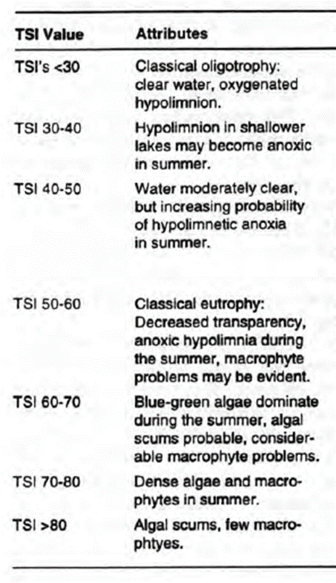
Trophic State Index
  Biological productivity: nutrients, algae and plant growth, transparency
  Carlson TSI for lakes: oligotrophic to hypereutrophic
[Table from Table 7.4 in Carlson and Simpson 1996]
Notes:
Another type of index that is used to assess water quality is a trophic state index, or TSI, which combines different measures of biological productivity in a water body. A common trophic state index is the Carlson TSI, which ranks water bodies based on their chlorophyll concentration, phosphorus concentration, and transparency (Carlson 1977). This table shows the Carlson TSI and lake attributes that are typically seen in lakes with certain TSI scores.

Slide 54
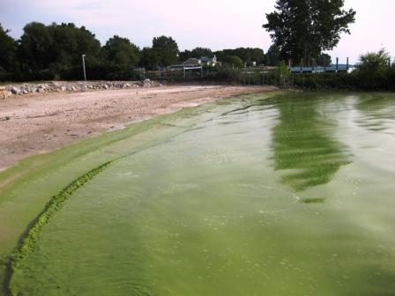
Algae metrics
  Chlorophyll-a concentration
  Periphyton biomass
  Diatom species assemblage
Notes:
Algae can be used in different ways to assess water quality. Because chlorophyll-a is a component of algae, chlorophyll-a concentration can be used as a measure of the amount of algae in a water body. Some states and tribes have standards for chlorophyll-a in lakes and/or streams. For example, in North Carolina, the chlorophyll-a concentration in lakes and reservoirs that are designated as trout waters and that are greater than 10 acres should not exceed 15 µg/L. Some entities look at the amount of periphyton in streams to evaluate a water body. Periphyton is a mix of algae, bacteria, and decaying matter that is found attached to underwater surfaces. Too much periphyton or chlorophyll-a in a water body could indicate that it is over-enriched with nutrients.
Species assemblages of algae are also used to evaluate the condition of a water body. Diatoms are a type of algae that are used as water quality indicators. For example, the state of New Jersey uses benthic diatom species assemblage data to assess water bodies (Paul et al. 2017).

Slide 55
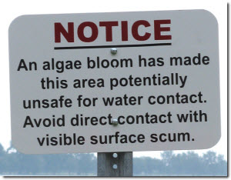
Toxic Algae
  Cyanobacteria
  Harmful algal blooms (HABs)
  Toxins monitoring: microcystin
Notes:
Certain types of algae have toxins in them that can harm humans, pets, and aquatic life. These toxins are typically from a group of organisms called cyanobacteria. Cyanobacteria act like algae because they photosynthesize, but they are technically bacteria. There is an increasing amount of interest in learning more about these harmful algal blooms, or HABs, in order to come up with strategies of how to minimize their occurrence. States and tribes monitor some of the more common toxins, such as microcystin. There are no numeric criteria for the actual toxins, but there are EPA drinking water health advisory levels (USEPA 2015). These health advisories are not legally enforceable standards, but can be used to evaluate water bodies.

Slide 56
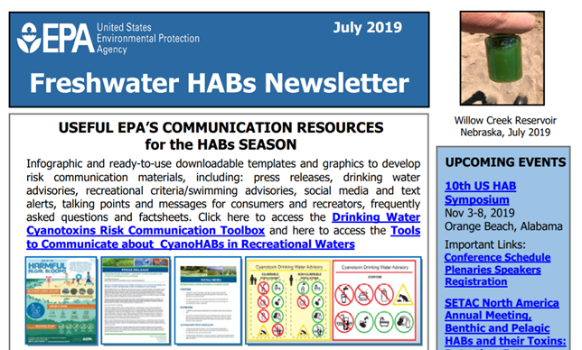
https://www.epa.gov/cyanohabs/cyanohabs-newsletters-2019
Notes:
In May 2019, EPA established recommended water concentrations for the cyanotoxins microcystins and cylindrospermopsin. For microcystin, the recommended concentration is at or below 8 micrograms per liter. For cylindrospermopsin, the recommended concentration is at or below (15 micrograms per liter. EPA’s recommendations are intended to protect public health for all age groups and are based on peer-reviewed and published science.

Slide 57
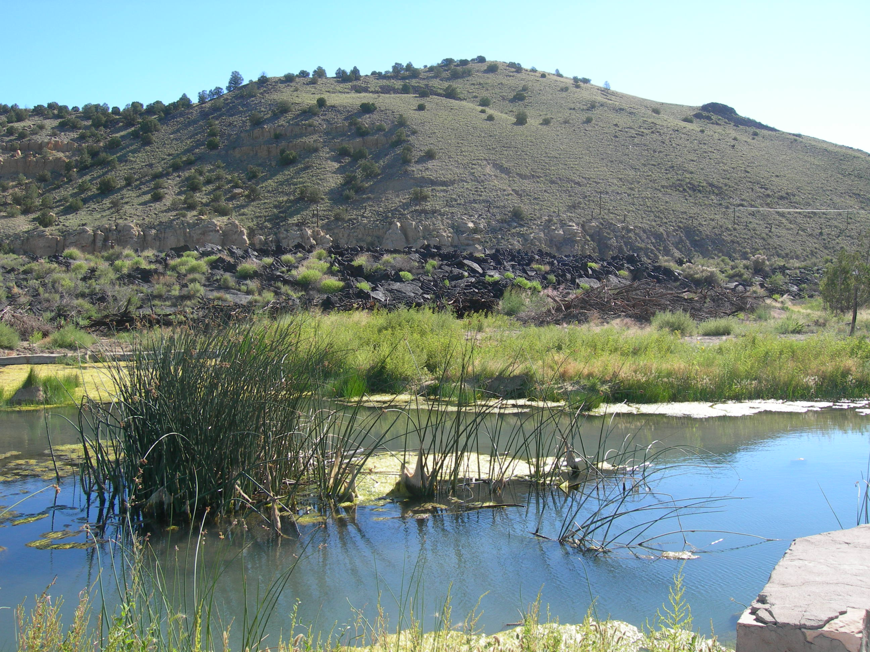
Habitat
  Aquatic habitat influences water quality and aquatic life
  Habitat metrics
    Substrate
    Instream cover
    Channel morphology
    Riparian and bank condition
    Pool and riffle quality
    Gradient
Notes:
Similar to metrics that are used to assess biological health, metrics can also assess habitat quality. Aquatic habitat is important because it influences water quality and aquatic life. For example, habitat can provide cover from predators, support species of prey, and provide optimal places for spawning. There are many types of habitat evaluations that are used to evaluate habitat quality. The example metrics listed here are from a habitat index that is used in Ohio. Each metric evaluates a component of habitat quality, and each characteristic is important in supporting aquatic life.

Slide 58
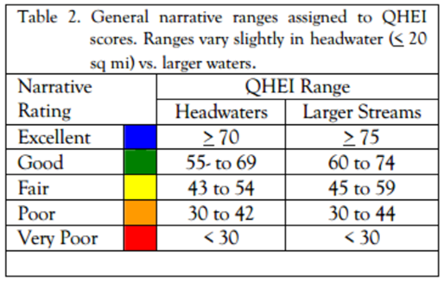
Habitat
  Some states use numeric habitat assessments
  Ohio Qualitative Habitat Evaluation Index to determine cause of impairment
[Table from Ohio Environmental Protection Agency 2006]
Notes:
Continuing with the Ohio example, Ohio uses the Qualitative Habitat Evaluation Index, or QHEI, to measure the physical factors that affect aquatic communities such as fish and macroinvertebrates (Ohio Environmental Protection Agency 2006). This habitat index has numeric thresholds that are used to help determine the cause of aquatic life impairment.

