Slide 1
Tribal Listening Session on EPA Climate Implementation Plans December 9, 2021
Hosted by EPA Office of Tribal and International Affairs Additional EPA Program Participants:
Office of Water, Office of Air and Radiation, Office of Land and Emergency Management, Office of Chemical Safety and Pollution Prevention
Notes:
Lisa – start recording – any objection?
Intro poll while we wait: Who is on today’s call? Options: Tribal leader, Tribal environmental staff, Tribal climate professional, EPA staff, Other
Go over logistics for the webinar

Slide 3
Today’s Discussion
Opening remarks
Jane Nishida, Assistant Administrator, Office of International and Tribal Affairs
Purpose of Today’s Discussion
Receive Tribal Input
EPA’s Climate Adaptation Planning and Implementation Process
Recap of October EPA Tribal Listening Session
Areas of Discussion
Next Steps
Notes:
Review agenda briefly
Before Jane remarks, ask if there are any tribal leaders on the call who would like to introduce themselves and/or provide any opening remarks
Then go to Jane

Slide 4
Purpose of Today’s Discussion
Hear from Tribes on the development of EPA Program Climate Implementation Plans
EPA’s Climate Adaptation Planning and Implementation Process
EPA Climate Adaptation Plan
Nine HQ Program Offices
10 Regional Offices
Climate Adaptation Implementation Plans
Notes:
Focus is on hearing from the tribes about how EPA can ensure our programs continue to be successful (protect public health and the environment) given a changing climate.
To set the stage for our discussion, let’s take a look at EPA’s climate adaptation planning and implementation process, which includes our agency wide plan and implementation plans for both national programs and regions.

Slide 5
EPA’s Climate Adaptation Planning and Implementation Process
Integrate climate adaptation into EPA programs, policies, rulemaking processes, and enforcement activities.
Consult and partner with Tribes, states, territories, local governments, environmental justice organizations, community groups, businesses, and other federal agencies to strengthen adaptive capacity and increase the resilience of the nation, with a particular focus on advancing environmental justice.
Implement measures to protect the Agency’s workforce, facilities, critical infrastructure, supply chains, and procurement processes from the risks posed by climate change.
Measure and evaluate performance.
Identify and address climate adaptation science needs.
EPA’s Climate Adaptation Plan October 2021
EPA Climate Adaptation Plan
Nine HQ Program Offices
10 Regional Office
Climate Adaptation Implementation Plans
Notes:
The EPA Climate Adaptation Plan identifies 5 priority areas the agency will focus on over the next four years as the climate changes and disruptive impacts increase
Recap what the priority actions are
In the chat, someone please add link to EPA Climate Adaptation Plan: https://www.epa.gov/system/files/documents/2021-09/epa-climate-adaptation-plan-pdf-version.pdf

Slide 6
EPA’s Climate Adaptation Planning and Implementation Process
EPA Program/Region Climate Adaptation Implementation Plans
19 Action Oriented Implementation Plans
Currently in development phase
Today’s focus
Tribal Climate Listening Session, October 2021
What we heard
EPA Climate Adaptation Plan
Nine HQ Program Offices
10 Regional Office
Climate Adaptation Implementation Plans
Notes:
The implementation plans are what each program office and region will do to implement the priority actions of the agency-wide plan. They are action oriented and focus on what EPA needs to do to ensure we continue to have success in our mission – protecting public health and the environment – as climate changes. Climate adaptation implementation plans are not designed to solve the climate crisis.
There are 19 implementation plans in total, 9 HQ program offices and 10 regional offices.
In addition to OITA, OLEM, OCSPP, OAR, and OW are on today and listening to your input.

Slide 7
Areas of Discussion
Training, Technical Assistance and Outreach
Applying Science in Adaptation
Opportunities for Partnership
Policy and Regulatory Framework
Other Areas of Tribal Interest
Notes:
These areas of discussion are based on draft priority discussions across the programs and reflect the initial input we have received from tribes.
Poll before moving forward: Where are you in your climate adaptation process? Options: Don’t know where to start, Have a plan, but don’t know how to implement it, Have a plan and ready to implement it, Have a plan and implementing it, Other

Slide 9
Training, Technical Assistance and Outreach
What are specific training and technical assistance needs?
How can EPA make climate adaptation training, technical assistance and outreach opportunities visible and easily accessible?
What training do you think is important for EPA staff in terms of climate adaptation and Tribal engagement?
Notes:
Bullet 1: Poll question, What are your specific training and technical assistance needs? (can pick more than 1). Options list: Writing a climate adaptation plan, How to implement a climate adaptation plan, Understanding vulnerabilities, Finding resources, Accessing climate data, Engaging with leadership and community, Other
Bullet 2: Poll question, What are barriers to accessing training, technical assistance and outreach information? (can pick more than 1) Options list: EPA is not providing the information needed, EPA is not reaching the right audience, Internet access, Hard to find information online, Funding
Bullet 3: Open ended
If time, have time for additional needs discussion (suggest referencing the OAR tribal climate adaptation tools for more ideas)
Tribal Adaptation Guide: https://www.adaptationclearinghouse.org/resources/tribal-climate-adaptation-guidebook.html (share as a link in chat)

Slide 10
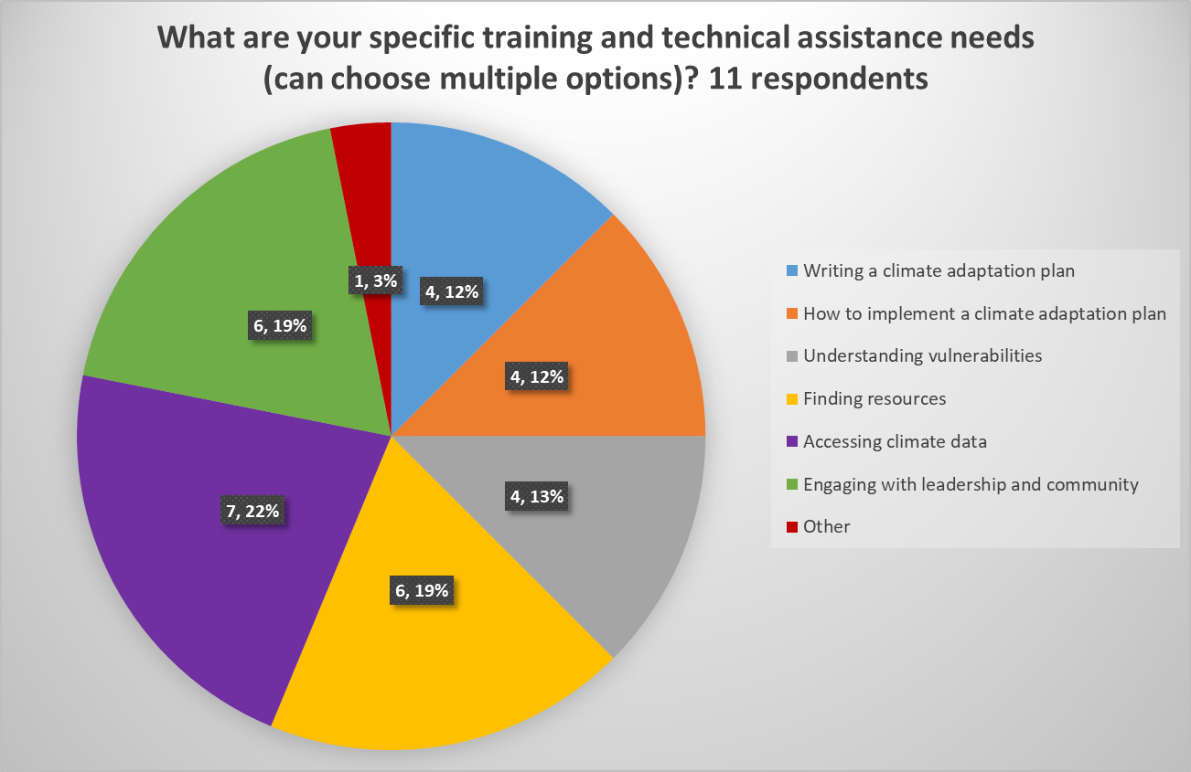

Slide 11
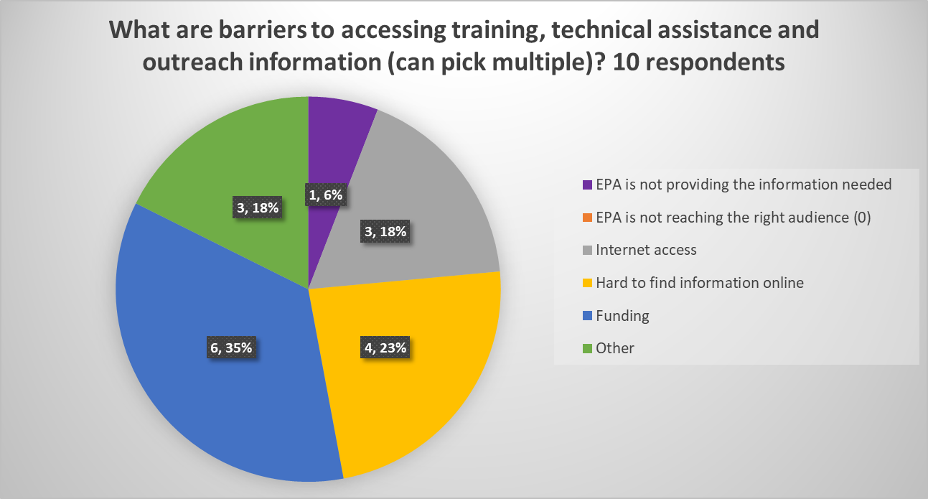

Slide 12
Applying Science in Adaptation
What are the tribal specific science needs when it comes to identifying climate risks/impacts to unique tribal practices or ways of life?
What is the role of TEK in climate adaptation decisions?
What are the barriers for advancing science in EPA’s adaptation work with tribes?
Notes:
Open discussion for bullets 1, and 2
Bullet 3 poll: What are the barriers for advancing science in EPA’s adaptation work with tribes? (can chose more than 1) Options: Access to climate adaptation data, Capacity to analyze climate data and perform site specific decisions (mapping, engineering, etc), Need for decision support tools, Staff with climate adaptation science expertise, other

Slide 14
Opportunities for Partnership
How do you see EPA’s role in development of your climate adaptation efforts?
What are your ideas on how EPA and tribes can leverage resources (financial, technical) to address climate impacts in tribal areas?
What are the barriers to EPA’s climate adaptation work with tribes and other federal agencies?
Notes:
Open ended; no polls

Slide 15
Policy and Regulatory Framework
What are specific EPA policies, guidance and regulations that should explicitly consider adaptation or identify climate adaptation requirements?
How can EPA provide meaningful guidance to our staff in addressing tribal treaty and reserved rights early in our climate-related consultations?
What are the barriers to addressing tribal climate adaptation impacts in EPA’s policy and regulatory framework?
Notes:
Open ended, no polls

Slide 16
What other information would you like for EPA to know?
Notes:
Open ended

Slide 17
Next Steps
EPA is currently drafting Program and Regional specific implementation plans
How do we continue the conversation?
Consultation is anticipated in Spring 2022
Notes:
How to continue the conversation, and specifically, how would tribes like us to engage with them, especially since there are 19 different plans

Slide 18
Thank you!
Office of Tribal and International Affairs
Lisa Berrios, berrios.lisa@epa.gov
Office of Water
Karen Gude, gude.karen@epa.gov
Office of Air and Radiation
Pat Childers, childers.pat@epa.gov
Office of Land and Emergency Management
Erika Wilson, wilson.erika@epa.gov
Office of Chemical Safety and Pollution Prevention
Amanda Hauff, hauff.amanda@epa.gov
These slides will be posted online at: https://www.epa.gov/tribal
Notes:
https://www.epa.gov/tribal post in chat

