Slide 1
Combined Air Emissions Reporting System (CAERS) Training for Preparers and Certifiers 3/23/2022
Notes:
On behalf of the US EPA, I’d like to welcome you to the Combined Air Emissions Reporting System or CAERS.

Slide 2
Goal of Training
Provide CAERS users with an understanding of:
What is CAERS?
User Roles
System Requirements
TRI-bound HAPS Data
Timing of Submissions
Registration Process
Highlights of CAERS Features – Live Demo
Help and Resources – Live Demo
A copy of this power point presentation will be available for distribution after the training.
Notes:
Provide CAERS users with an understanding of:
What is CAERS?
User roles
System requirements
TRI-bound HAPS data
Timing of Submissions
Registration process
Highlights of CAERS features
Help and resources
A copy of this power point presentation will be available for distribution after the training.

Slide 3
Disclaimer
This training is intended for instructional purposes only. Any data or facility information shown in the training, is illustrative only, and should not be confused with a facility’s live report for any given inventory year.
Notes:
A quick disclaimer. You may see facility names and some data in this training. This training is intended for instructional purposes only. So any data or facility information you see in the training, is illustrative only, and should not be confused with a facility’s live report for any given inventory year.

Slide 4
Combined Air Emissions Reporting System (CAERS) Welcome to CAERS for Preparers and Certifiers 03/23/2022
Notes:
On behalf of the US EPA, I’d like to welcome you to the Combined Air Emissions Reporting System or CAERS. This training will cover the registration process in the first part, then the user interface, bulk entry, and bulk upload reporting in CAERS.

Slide 5
What is CAERS?
Combined Air Emissions Reporting System (CAERS): an application that allows industry from subscribed State, Local, or Tribal authorities (or SLTs) to report their air emissions so you can:
Meet SLT-specific air emissions reporting requirements
Report annually or triennially to Air Emissions Reporting Rule (AERR per 40 Code of Federal Regulations or CFR, Part 51) via your SLT.
Optionally, get a head start on Toxics Release Inventory (TRI) air toxics emissions (per 40 CFR, Part 372), to be finished in TRI-MEweb
You should check with your SLT to determine if you meet the criteria. Facilities reporting to Georgia Department of Natural Resources (GADNR) will follow the additional opt-in process in CAERS.
Notes:
The Combined Air Emissions Reporting System (CAERS) is an application that allows industry from subscribed State, Local, or Tribal authorities (or SLTs) to report their air emissions, so that you can:
Meet specific SLT air emissions reporting requirements given individual SLT regulations.
Report annual or triennial emissions to meet the requirements of the U.S. EPA’s Air Emissions Reporting Rule (AERR), as per the Code of Federal Regulations (or CFR) 40, Part 51.
And, optionally, get a head start on reporting your facility’s toxics air emissions to the U.S. EPA’s Toxics Release Inventory (TRI), as per 40 CFR Part 372.
You should check with your SLT to determine if you meet the criteria.

Slide 6
CAER User Roles - Preparer
Is authorized to prepare an emissions report for that facility (e.g., consultant, staff person working for the facility).
There may be more than one preparer for a facility (each with an account associated with the facility). If submitting HAPs data for TRI within CAERS, this could include the TRI preparer.
There may be a single preparer for more than one facility (with an account associated with several facilities).
A preparer cannot fulfill the same role as the Certifier, not authorized to certify and submit the report on behalf of the facility.
Notes:
There are two types of roles in CAERS: preparers and certifiers. You are a Preparer if you are authorized to prepare an emissions report for a facility.
For example, you might be a consultant or staff person working for the facility.
There may be more than one preparer for a facility, although each preparer will have their own account associated with that facility.
There may be a single preparer for more than one facility. In this case the preparer’s account will be associated with more than one facility.
A preparer cannot fulfill the same role as the Certifier, as only the certifier is authorized to certify and submit the report on behalf of the facility.

Slide 7
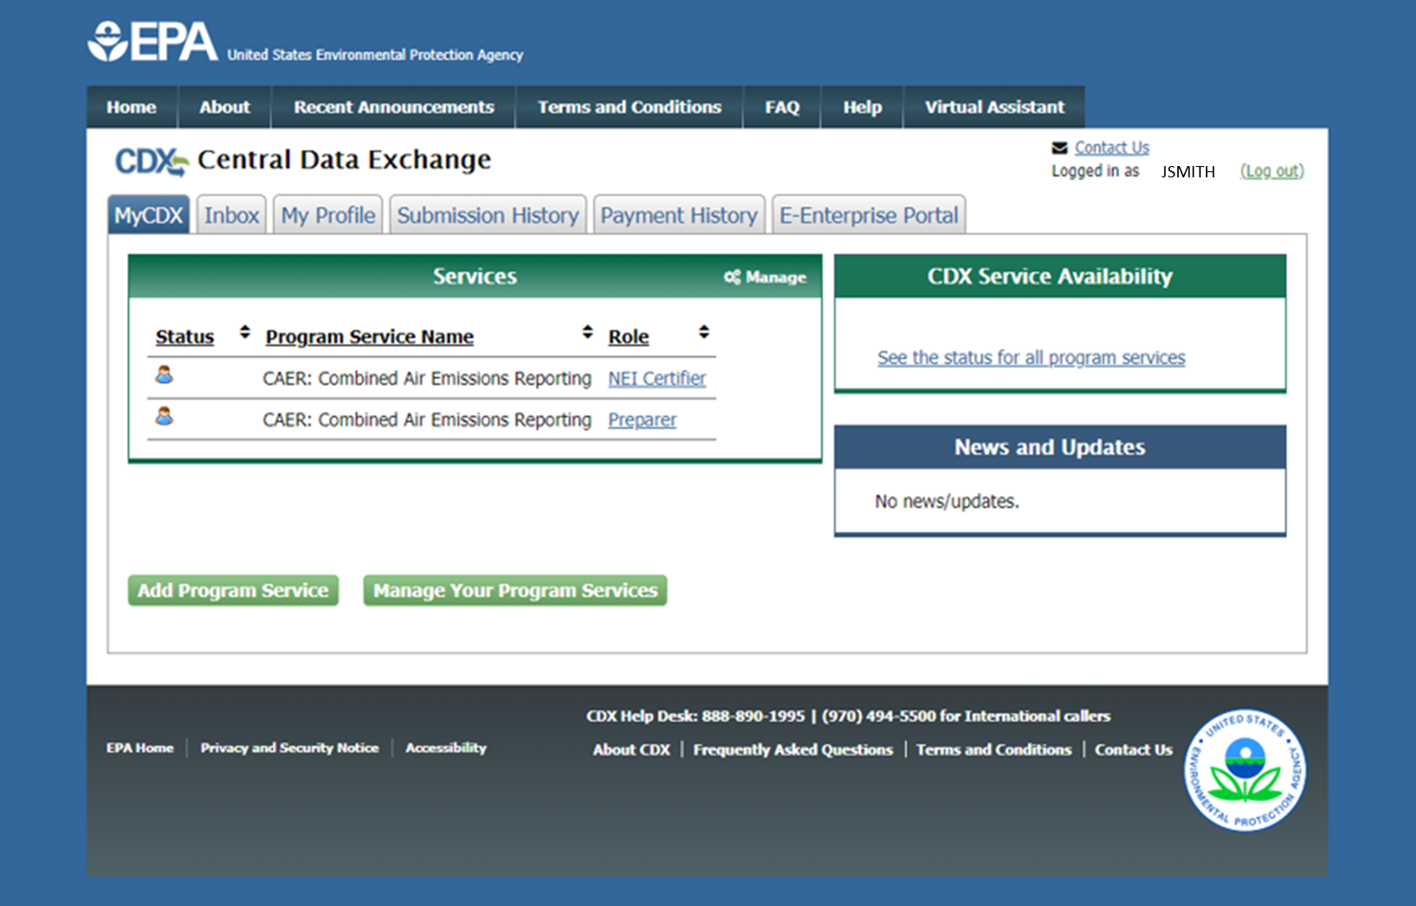
MyCDX Page in CDX
Notes:
When you go into your “My CDX” page, shown on this slide, you will see that role assigned to your account. We’ll get to that later in the training.

Slide 8
CAERS User Roles - Certifier
Can prepare the emissions report and is also authorized to certify the emissions report to meet your legal obligation for reporting to your SLT.
There may be only one Certifier for a facility.
There may be a single Certifier for more than one facility (multiple facilities associated with the certifier account).
The Certifier can also be the preparer (only one CAERS account needed).
Total toxics air emissions are made available for TRI-MEweb once the facility has certified the report in CAERS. Certification of the report signals to CAERS that the report is complete, but it is not a certification of the TRI submission. Toxics air data is certified in TRI-MEweb, not CAERS.
Notes:
You are a certifier if you are authorized to certify the emissions report to meet your legal reporting obligation to your State, Local, or Tribal authority (or SLT).
There may be only one Certifier for a facility, even though there could be multiple preparers.
There may be a single Certifier for more than one facility, so that multiple facilities can be associated with one certifier account.
The Certifier is able to do everything a Preparer does in the System, and only needs one account to both prepare and certify the emissions report.
If you are taking advantage of CAERS to help you calculate your toxics data, your certifying your report signals CAERS that your report is complete and any toxics air emissions data can be aggregated to facility totals and made available to TRI-MEweb. You will not, however, be certifying air toxics data in CAERS, rather, this will be done in TRI-MEweb.

Slide 9
Preparer and NEI Certifier in MyCDX Page
Notes:
When you go into your “My CDX” page, you will see “NEI Certifier” next to your CAER account.

Slide 10
Establishing Preparer/Certifier Roles
Each SLT has its own process with its reporting facilities to establish who is preparer/certifier. If you have not heard from your SLT about this already, of if you are new and missed the relevant communication from them, you should reach out to them directly to the POC information listed at the end of this presentation. Don’t try to register in CDX until you’ve communicated with your SLT, to avoid further delays.
What if I don’t know who will certify yet? You will be able to begin the report, but you won’t be able to send it to your SLT for review. As soon as you know who your certifier will be, let your SLT know, and then the new certifier should go to CDX to register.
What if our preparer or certifier leaves the company? Let your SLT know of the staff change. Then the new staff person should register in CDX per the above steps. The SLT will remove the old preparer/certifier in CAERS and your new staff should reach out to the SLT if the old preparer/certifier has not been removed within a reasonable amount of time.
Notes:
What if I don’t know who will certify yet? You will be able to begin the report, but you won’t be able to send it to your SLT for review. As soon as you know who your certifier will be, let your SLT know, and then the new certifier should go to CDX to register. Then the SLT will verify the new certifier is associated with the correct facility in CAERS.
What if our preparer or certifier leaves the company? Go to CDX to register the new person or add an existing preparer or certifier to that facility. Then the SLT will verify the new certifier is associated with the correct facility in CAERS.

Slide 11
Reporters to GADNR Only
For Georgia reporters only, every CAERS preparer/NEI certifier will be checked against info at GECO EI. If they are not matched, then a Georgia Reviewer will reach out to the facility to resolve the discrepancy. Otherwise, Georgia reviewer will remove the unmatched CAERS users from CAERS.

Slide 12
System Requirements
To use CAERS, you will need:
A recent version of any internet browser such as Chrome, Explorer, Edge, or Firefox. Your internet connectivity will determine how fast data can be uploaded.
Microsoft Excel: Bulk uploads will be in “XLSX”.
For JSON upload instructions send an email to caer@epa.gov with your facility name and ID. Our CAER IT staff will be able to provide guidance.
Notes:
To use the CAER system, you will need:
Internet browser and connectivity: This should be a recent version of any internet browser such as Chrome, Explorer, or Firefox. Your internet connectivity will determine how fast data can be uploaded.
Microsoft Excel: Bulk uploads will be in “XLS” or “XLSX”.
If you are interested in sending your report using JSON, please send an email to caer@epa.gov for more information and include the name and ID of your facility. Our CAER IT staff will be able to provide guidance.

Slide 13
TRI – bound HAPs Data
Optional HAPS/air toxics data entry in CAERS. CAERS adds data up to the facility totals, ready for pre-population in TRI-MEweb.
If not required by your SLT:
SLT review of reported HAPS/air toxics air emissions not required
Submission of HAPS/air toxics through CAERS.
How does this help facilities?
Enter data into CAERS directly vs. separate workbooks for calculations then entered to TRI-MEweb.
SLT review of your criteria pollutant data before your data gets to TRI-MEweb gives you the opportunity to correct any related toxics data before it is available in TRI-MEweb.
E.g., SLT finds throughput error for a unit/process affecting CO and NOX, that is also affecting your VOC calculations. As you correct that throughput, all affected emissions are corrected.
We are encouraging facilities to submit HAPS data at process level in CAERS.
If HAPS aren’t reported, EPA does HAP augmentation on your data which could be inaccurate.
By submitting their own HAPs emissions at process level in CAERS, facilities take ownership of their data.
Notes:
Let’s talk about the TRI option in CAERS. You can enter HAPS/air toxics data in CAERS. CAERS will add that data up to your facility total and that data will be available to prepopulate as part of your TRI-MEweb submission. Regulations do not require your report to be reviewed by your SLT for your toxics data to be made available for TRI reporting. You are also not required to report your HAPS/toxics through CAERS.
So how does this help facilities?
You’ll be able to enter this data and take advantage of the CAERS calculation features, where applicable, rather than have to do your calculations separately in a workbook.
Also, there may be corrections that your SLT is requiring you to make to criteria pollutants, that may affect your toxics emissions as well. So having your SLT review your criteria pollutant data before your data gets to TRI-MEweb gives you the opportunity to correct any related toxics data. For example, assume your SLT finds an error with throughput for a unit/process affecting your facility’s CO and NOX emissions, that is also affecting your VOC calculations. As you correct that throughput, all affected emissions are corrected as well.
We are encouraging facilities to submit HAPS data at the process level in CAERS. EPA performs calculations on your data by performing HAP augmentation estimates. These estimates may not be as accurate as your data. By submitting your own HAPs emissions at process level at CAERS, facilities are in charge of their data.

Slide 14
Timing of Submissions
TRI-MEweb is July 1st
NEI/TRI facilities should certify their NEI forms before you start a TRI-MEweb submission because data is pushed from CAERS to TRI-MEweb.
Early data submittal and SLT review allows us to keep data consistent across NEI and TRI programs.
SLT deadline for submissions of Annual or Triennial reports.
Per your SLT deadline.
Leave time for questions and resolution of issues and in case we need to address bugs.
Registrations: Include or delete registered Preparers and Certifiers no later than two weeks after opening CAERS.
Reporting: Start no later than one month before and submit no less than 2 weeks before the SLT deadline.
We want to avoid last minute submissions. Submit your data early!
Notes:
Here are some considerations to help you plan the timing of your submission in CAERS:
The deadline for submission to TRI-MEweb is July 1st. NEI/TRI facilities should certify their NEI forms before you start a TRI-MEweb submission because data is pushed from CAERS to TRI-MEweb.
By entering your data early, you can make sure to take advantage of the SLT review that might affect your HAPS/toxics data, and you help us keep data consistent across the NEI and TRI programs. Leave time for questions and resolution of issues and in case we need to address bugs. With all of this in mind, you should include or delete any preparers or certifiers no later than two weeks after CAERS has opened for reporting. We also encourage you to start your report no later than one month before and finish it no less than 2 weeks before your SLT deadline, or the TRI deadline, whichever comes first.

Slide 15
Registration Process
Three major steps:
Register in CDX, if you are new to CDX (get access email)
Set up CAERS in CDX (if you did not report previously through CAERS)
Your SLT recognizes you and grants you entry to your facility in CAERS
Notes:
The overall steps for preparers and certifiers to register so they are able to begin reporting are:
Go through opt-in/opt-out process in GECO. Use all the tools in GECO to enter all your information. This will include providing preparer and certifier information.
Register in CDX, if you are new to CDX. This will include waiting for an access email.
Set up CAERS in CDX (if you did not report previously through CAERS)
Receive approval email
Please don’t send separate emails to GADNR, as this will only delay your registration process.
Next, we’ll go over each one of these steps in more detail.

Slide 16
1. Register in CDX
If you already have a CDX account, you have already completed this part of the process and can move to “Step 2. Set up CAERS in CDX”. You may be able to use the same Electronic Signature Agreement (ESA) in CDX that you use for other programs/systems in CDX. You may need additional ESAs for additional organizations you are associated with. You should reach out to the CDX help desk if you have questions about this.
Reporters to GADNR, even if you have a CDX account, you must register in GECO per slide 10.
Notes:
If you already have a CDX account, then you have already completed this part of the process and can move to “Step 2. Set up CAERS in CDX”. Note that may be able to use the same Electronic Signature Agreement (ESA) in CDX that you use for other programs/systems in CDX. You may need additional ESAs for additional organizations you are associated with. You should reach out to the help desk if you have questions about this.

Slide 17
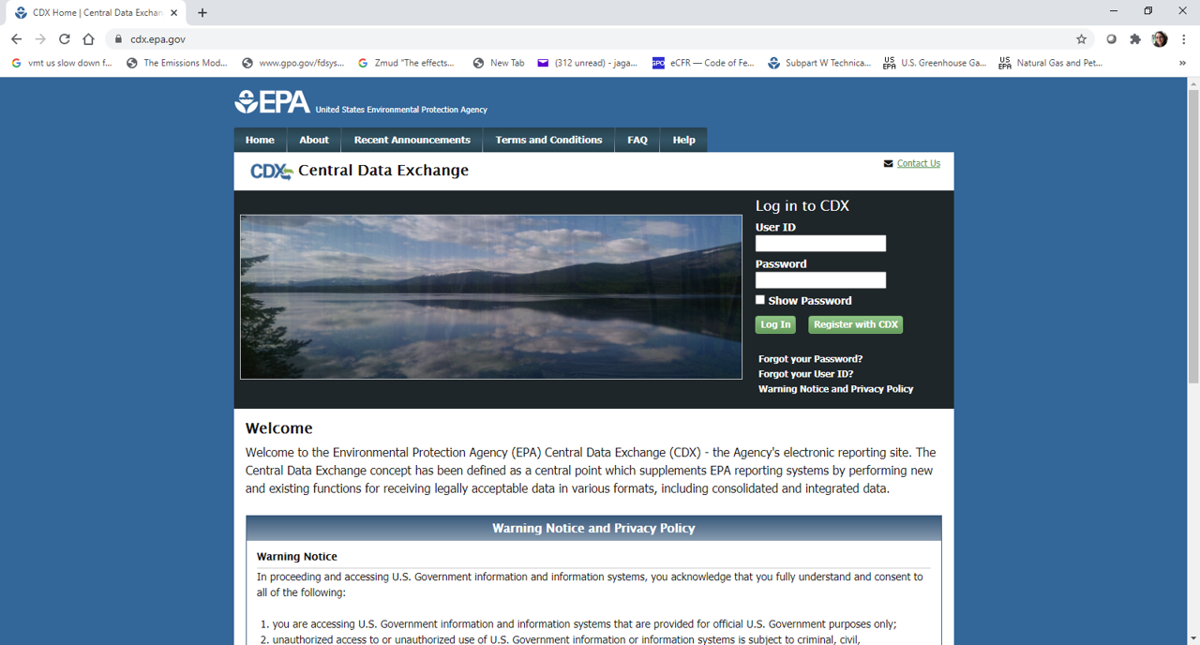
CDX Login Page
Go to: https://cdx.epa.gov/
Notes:
Enter the URL “https://cdx.epa.gov/” in your preferred web browser. This will bring you to the CDX login screen where you will click the “Register with CDX” button.

Slide 18
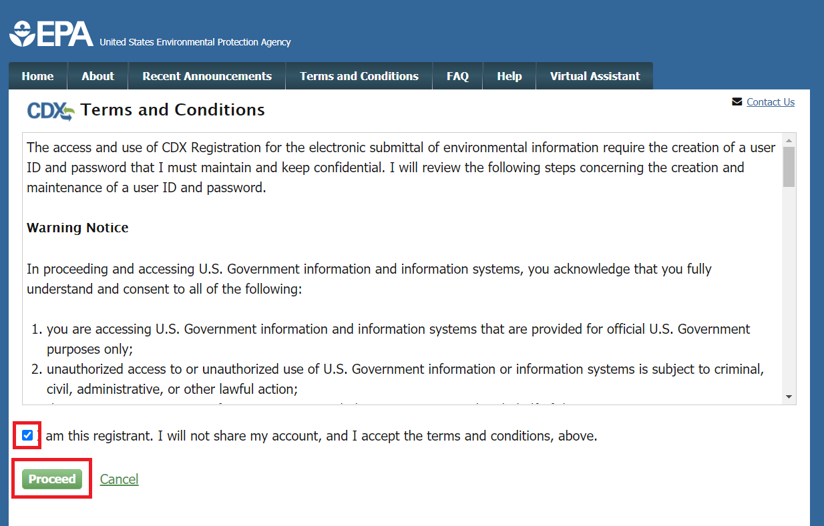
CDX Terms and Conditions
Notes:
You will be directed to the Terms and Conditions screen for CDX registration. After reading these, check the box confirming that you are the registrant and click “Proceed” at the bottom left of your screen.

Slide 19
2. Set up CAERS in CDX

Slide 20
CDX CAERS Program Service Selection
Notes:
You will be taken to a list of EPA Systems. Find “CAER: combined Air Emissions Reporting” in that list and click on it.

Slide 21
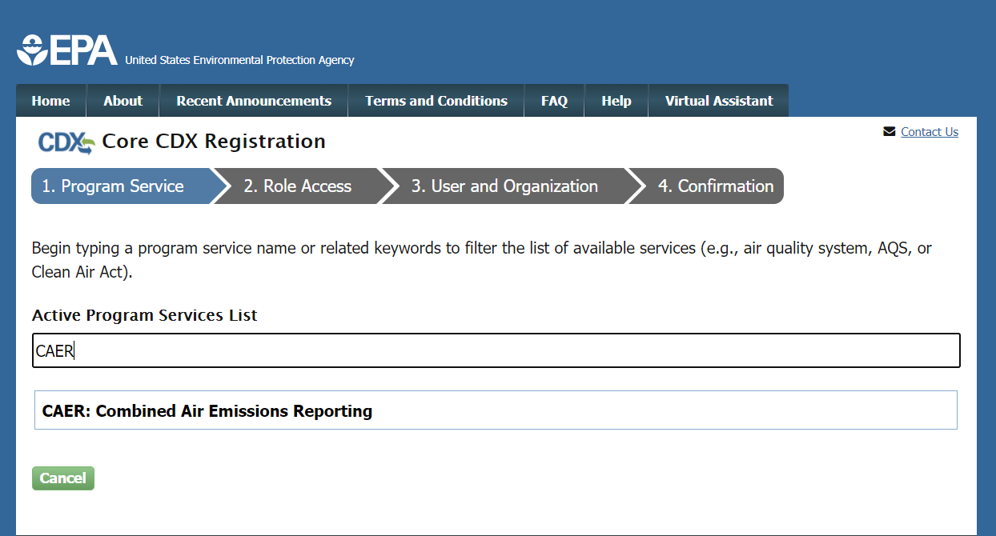
CDX Program Service Search
Notes:
Or you can search for “CAER” in the Active Program Services List field. This will filter the list to only include “CAER: Combined Air Emissions Reporting”. Select “CAER” from the list.

Slide 22
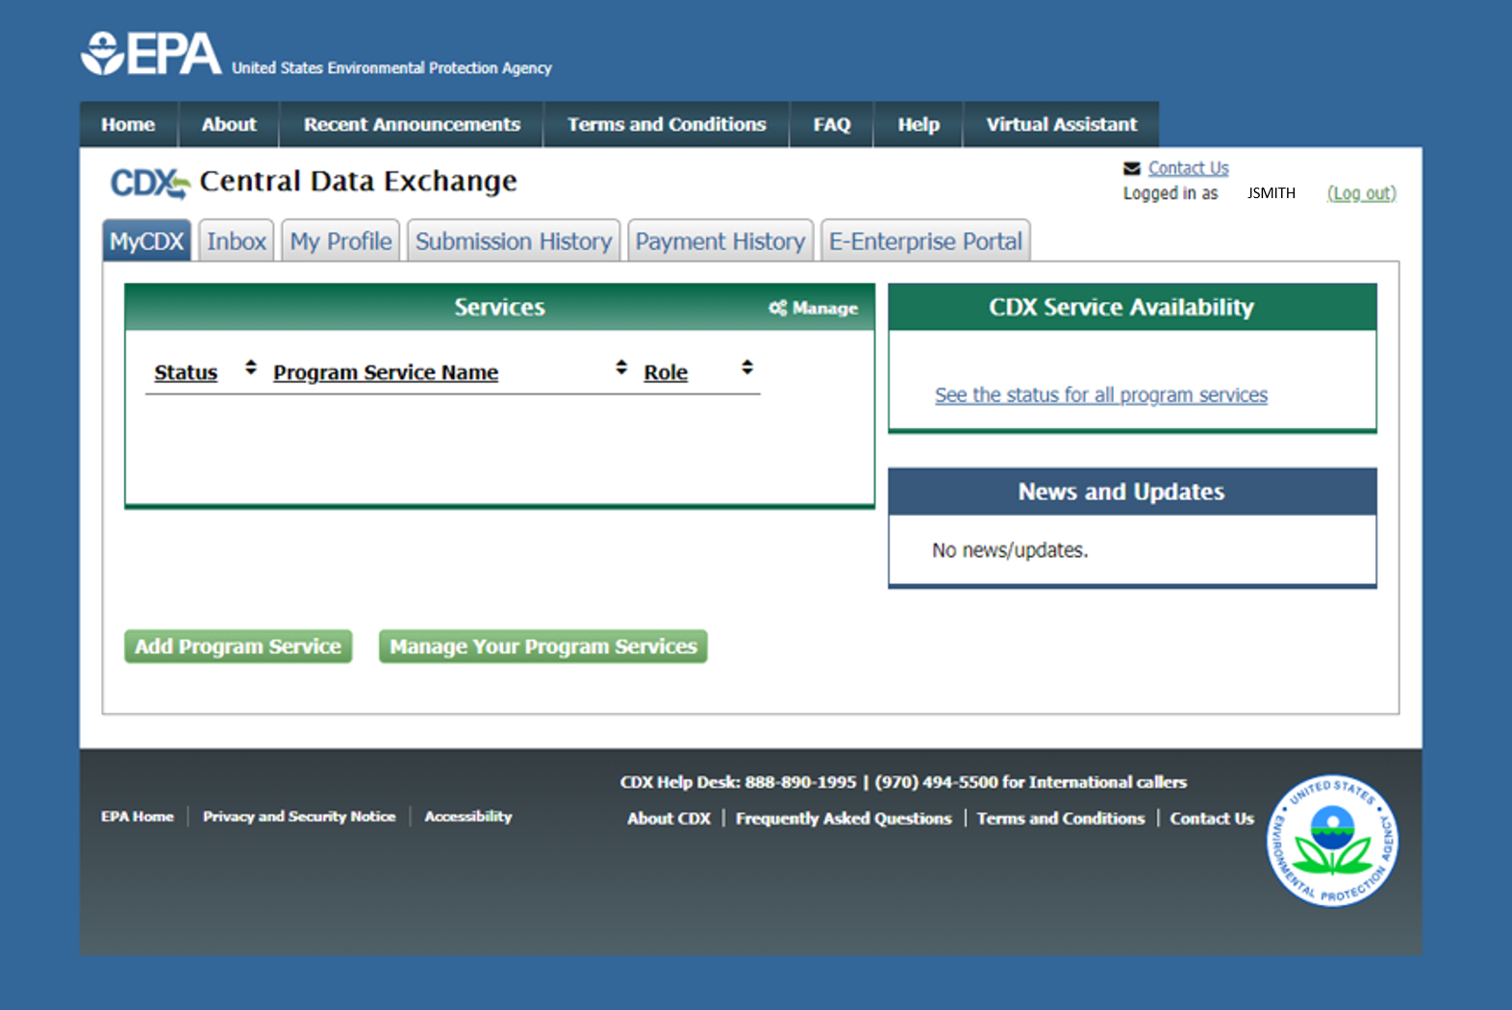
CDX Adding a Program Service
Already have a CDX account? Add CAERS by clicking here.
Notes:
If you already have access to CDX and need to add CAERS. You can add CAERS by clicking on “Add Program Service” from your MyCDX page.

Slide 23
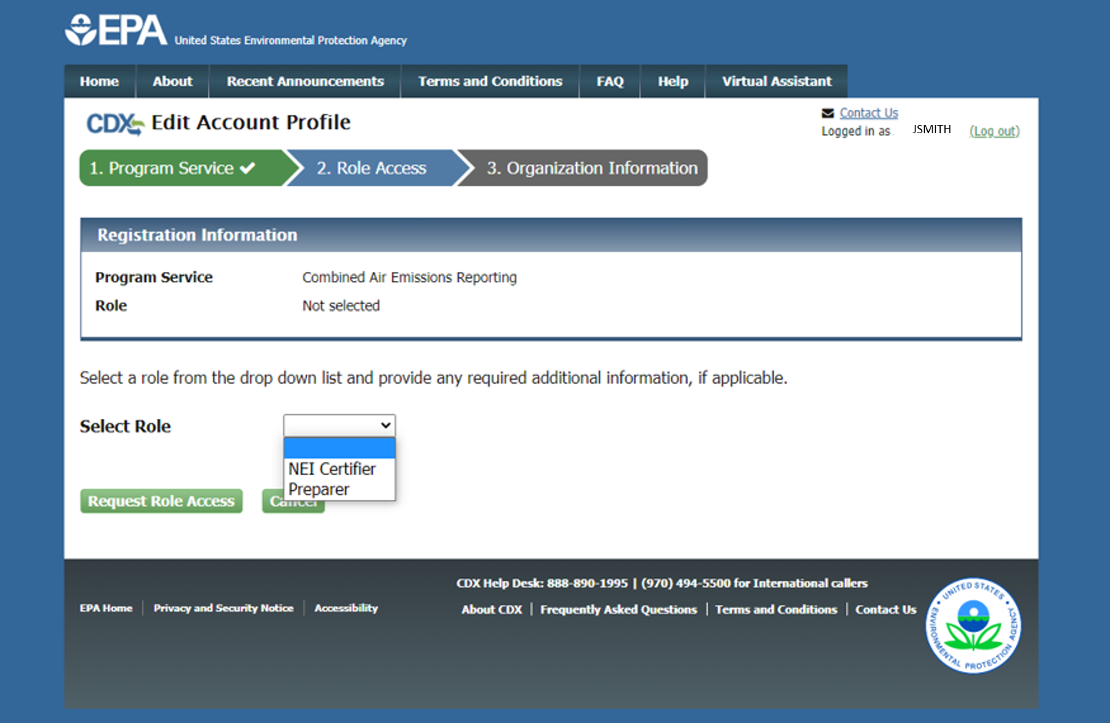
CDX Selecting a Role
If you are both preparer and certifier for a facility, you only need to select “Certifier”.
Notes:
On the Role Access screen you have the options of registering as either “NEI Certifier” or “Preparer”. After selecting one or the other click “Request Role Access”. You will be taken to a page where you will select a role: preparer or certifier. While both roles are shown here for demonstration purposes, remember that if you are both a preparer and certifier for a facility, you only need to register as certifier.

Slide 24
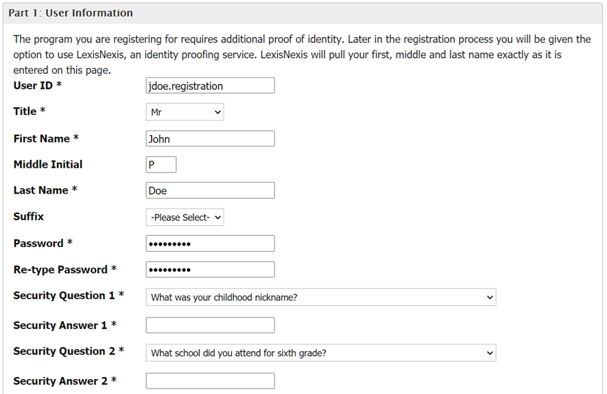
CDX Entry of User Information
Notes:
On the User and Organization screen complete the User Information section, including your preferred User ID, password, and CDX security questions and answers. Make sure to follow all instructions that are provided, including the identity authentication questions asked. Make sure you remember the answers to those. The authentication questions is an additional step that is needed to ensure that only you, the authorized staff, can work on and submit the report, and to be in CROMERR compliance.

Slide 25
CDX Entry of Organization Information
Notes:
After entering User Information you will need to scroll to the bottom of the screen and enter Organization Information in the field. If multiple individuals work for a company, then they should all register for the same company in CDX. After you search for an organization click on an Organization ID link to select the respective organization.

Slide 26
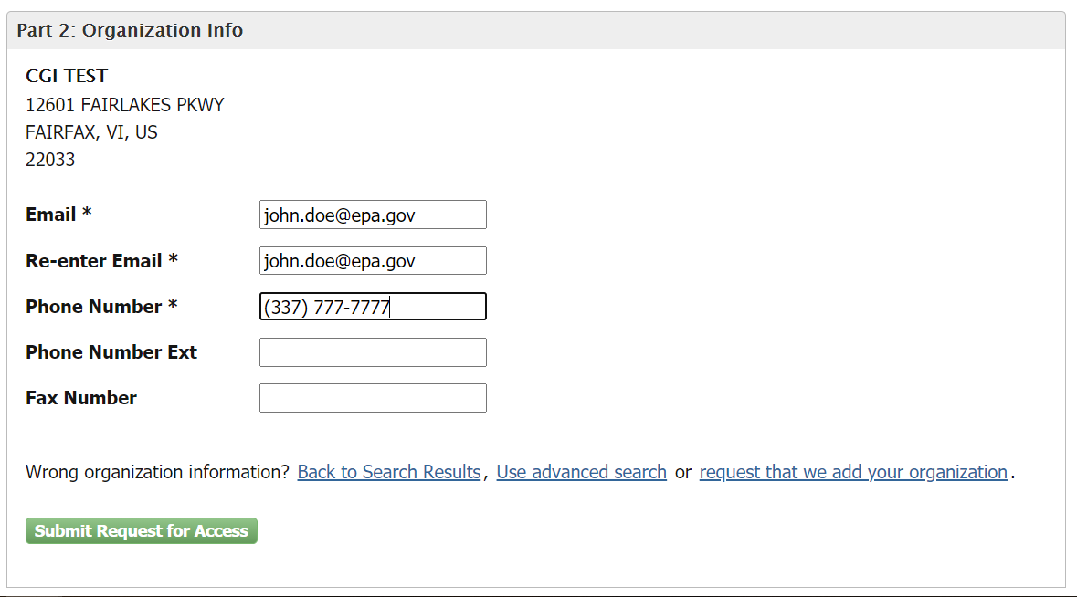
CDX Entry of Organization Contact
You will get an email. Check your email and spam folder. You need the code in that email for the next set of steps.
Notes:
After selecting an organization you will be required to enter an email address and phone number where you can be contacted. Then, click “Submit Request for Access”. This will generate an email sent to the email address you provided and forward you to the confirmation screen.

Slide 27
CDX Entry of User Code
Remember that email? Enter the code contained in that email here.
Notes:
Locate the email that was automatically sent to your address and enter the provided code. Once you have located the email and code, enter the code in the “Code” field here. If you have trouble finding the email please check you junk or spam folder. Then, click “Create Account”.

Slide 28
CDX LexisNexis Identity Verification
Notes:
You will then be brought to the ‘Identity Verification’ screen where you will need to provide your personal information to gain access to CDX.
Important: You MUST provide accurate personal information during CDX registration in order to pass LexisNexis Electronic Identity Verification. If you do not pass LexisNexis verification you will be prompted to view, print, and sign a paper ESA. If this happens simply view and sign the paper ESA by clicking the ‘Paper Verification’ link and then closing the resulting window. This will bring you to the ‘MyCDX Home’ screen. Reach out to the CDX help desk for further instructions.

Slide 29
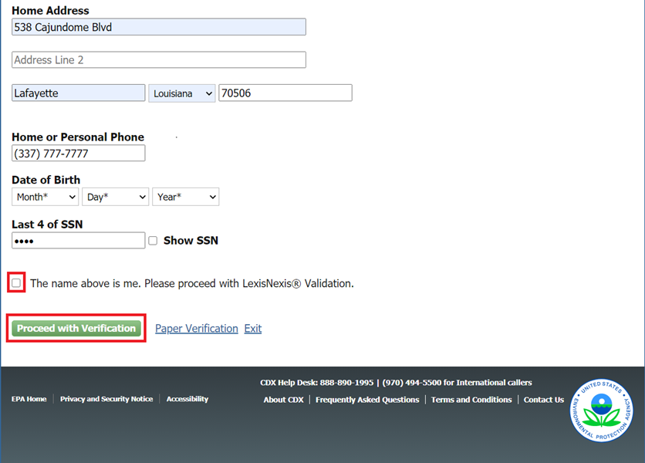
CDX LexisNexis Identity Verification Continued
Notes:
When you are done filling out your personal information, scroll to the bottom of the Identity Verification screen. Then, check the box as shown below and click the ‘Proceed to Verification’ button.

Slide 30
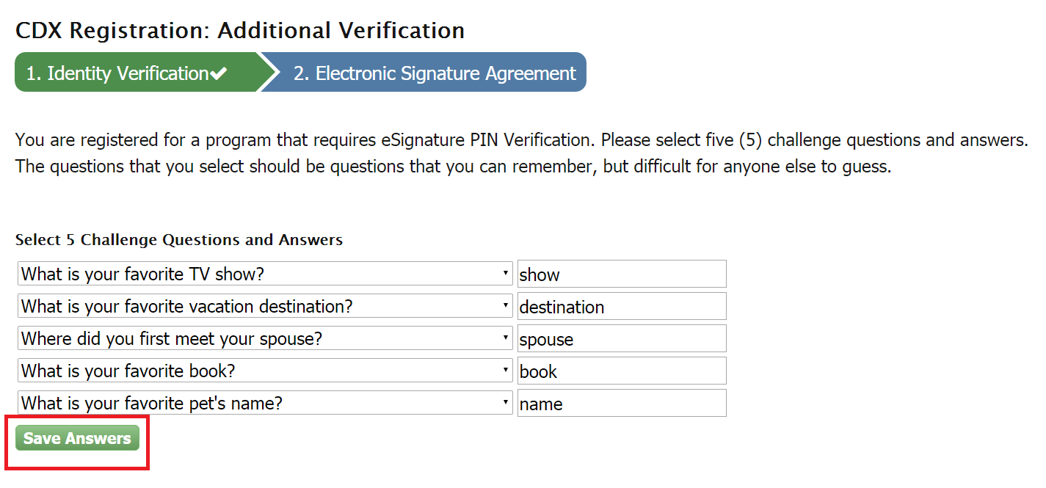
CDX Electronic Signature Agreement
Notes:
If you have passed identity verification, you will then be directed to choose and answer 5 challenge questions as part of the verification process. These will be used when signing/submitting reports in CAER. After entering your answers, click the ‘Save Answers’ button.

Slide 31
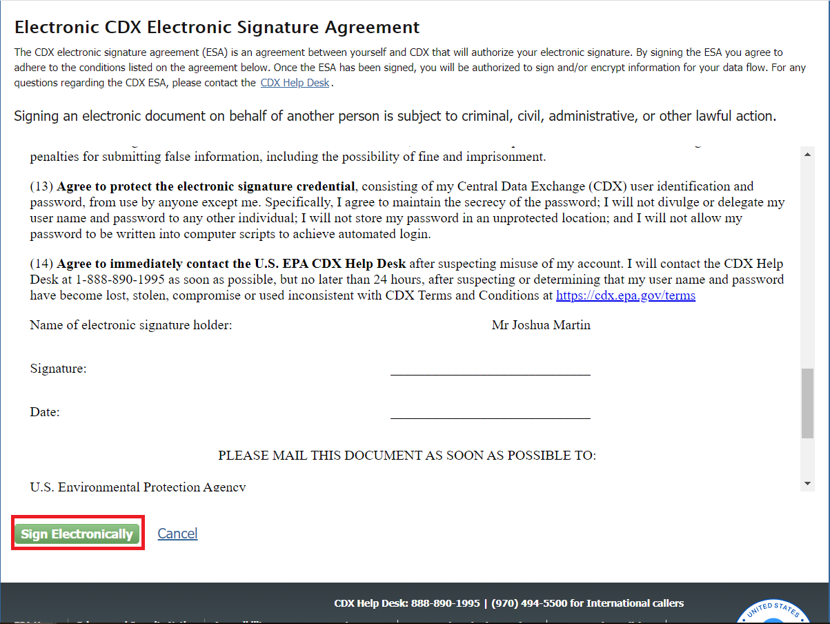
CDX Electronic Signature Agreement Continued
Notes:
You will then be prompted to electronically sign an ESA. Click the ‘Sign Electronically’ button as seen below. Click ‘Accept’ in the pop-up window that appears after clicking the button. Remember that you may be able to use the same Electronic Signature Agreement (ESA) in CDX that you use for other programs/systems in CDX. You may need additional ESAs for additional organizations you are associated with. You should reach out to the help desk if you have questions about this.

Slide 32
eSignature Widget Password Entry
Notes:
Enter all required information in the ‘eSignature Widget’ pop-up. At the end of the 3 steps, click the ‘Sign’ button to complete the process.

Slide 33
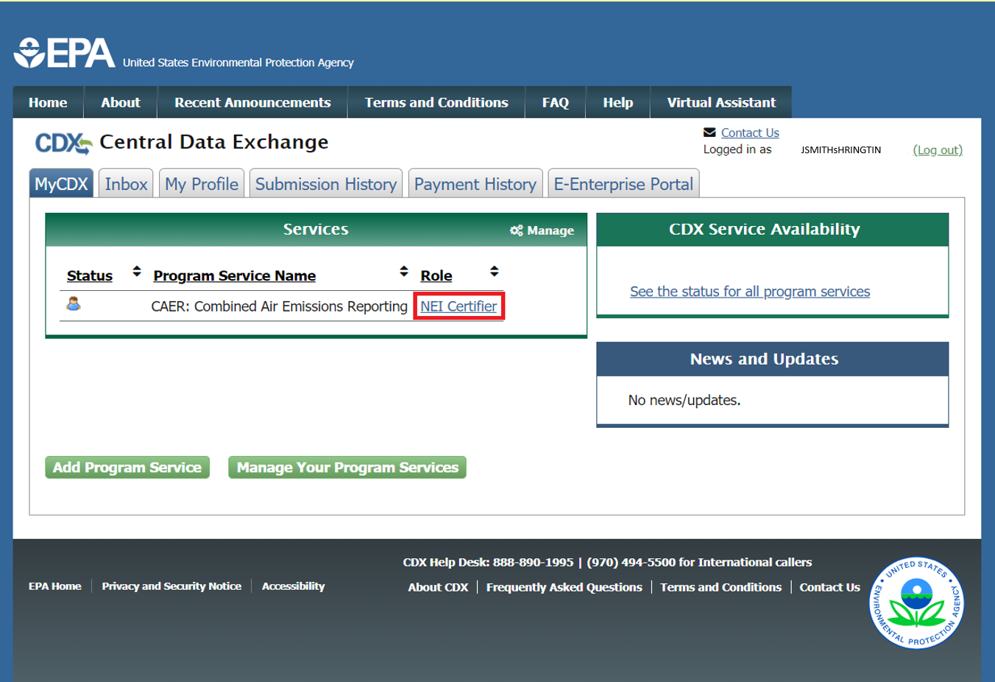
MyCDX Page After Registration
Notes:
Following clicking to sign the Electronic Signature Agreement you should receive an email that the process is complete. You will also be redirected to the ‘MyCDX Home’ screen inside your CDX account automatically. Once redirected your account should be automatically activated. The ‘NEI Certifier’ link in the ‘Role’ column on the ‘MyCDX Home’ screen will be active and clickable as shown.

Slide 34
Help in CDX
Notes:
If at any point, you need help, refer to the CDX help desk. To help facilitate getting you the answers you need quickly, you should ask all questions related to your registration in CDX, and questions about navigating the “MY CDX” page, to the CDX help desk, and not to SLT or EPA staff. You will be taken to the right contact information for help by clicking on the “Help” tab above.

Slide 35
3. Receive Approval Notification from CAERS
With the previous steps completed your SLT will:
Verify that your preparer and certifier contact information.
GADNR reporter information will be compared with user information in GECO.
Approve your association with the correct facility(ies) in CAERS.
Send you a confirmation email – then you will be ready to begin reporting.

Slide 36
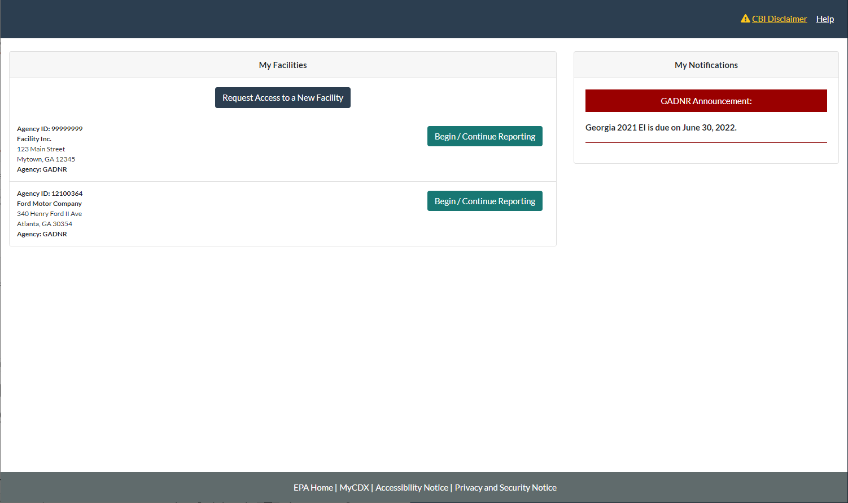
CAERS My Facilities Page
From this point, all facilities reporting to GADNR will go through the opt in process to be in the demo. Facilities not reporting to GADNR will start their reports. Aside from the live demo, please consult the User Guide for additional information.
Notes:
Once you have received your confirmation from your SLT, you should see all the facilities that your account is associated to listed in your “My Facilities” page. The My Facilities page in CAERS where the user can see a list of the facilities they are associated to.

Slide 37
Questions so Far?

Slide 38
Highlights of CAERS Features
Familiarize you with CAERS features but not exhaustive
Detailed trainings on specific aspects of CAERS are forthcoming
Go to the User Guide for more information (will be updated for March release)
Notes:
In this training we highlight features you should be aware of in CAERS. The time you spend understanding these basic features will help you navigate CAERS, and ensure that your reporting experience is as smooth as possible. More detailed trainings on specific features of CAERS will be available soon. So this training isn’t meant to cover any of the features exhaustively. While we are updating our User Guide, the current version of that guide contains helpful information that you can refer to if you’d like to become more familiar with CAERS.

Slide 39
Highlights of CAERS Features
Three options for data entry:
User interface
Notes:
To enter data you will have three options. First, the User interface – is for users with few changes to a previous year report, and with different kinds of changes. It can also be used to update a report if a few additional changes are needed after using the bulk upload.

Slide 40
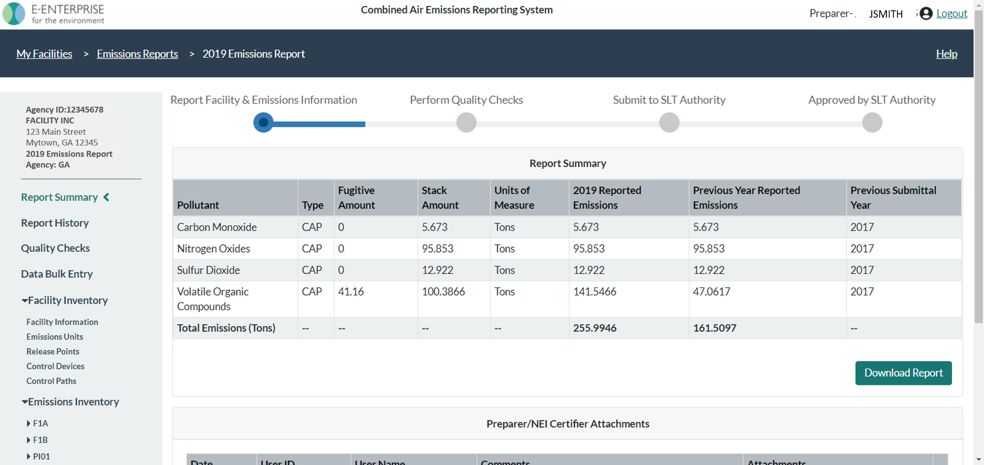
CAERS Main Report Page
Notes:
Whatever method you choose, you will eventually be in the user interface, so knowing the basics of this page will be very helpful. At the top of the screen, there is a trail of breadcrumbs at the top left of the screen so you can go back to previous screens. There is a step by step menu at the top-middle of your screen so you know which step of the process you are in. The left-hand side menu has a series of links for both your facility inventory and your emissions inventory, plus other features, so you can access all of them from there.

Slide 41
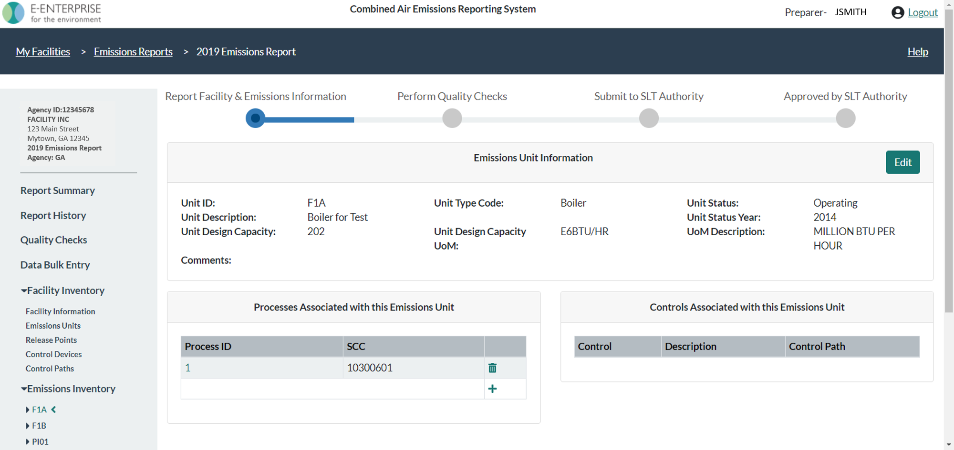
CAERS Emissions Unit Information Page
Notes:
Each screen will behave the same way. For example, you can edit any part of your submission by clicking on the “Edit” button which will then open that box of information.

Slide 42
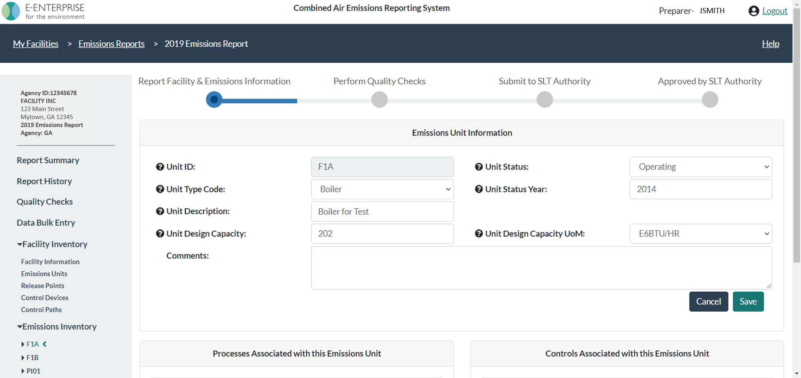
CAERS Emissions Unit Information Edit Page
Notes:
Data that shouldn’t be changed is greyed out. Once you’ve entered your new data or edits, then you can click on “Save” and this will take you back to the previous screen. If you click “Cancel” it will take you back to the previous screen without saving any changes you might have made.

Slide 43
CAERS Drop Down Menu Example
Notes:
Drop down menus allow you to select options to help you avoid typos or other entry errors.

Slide 44
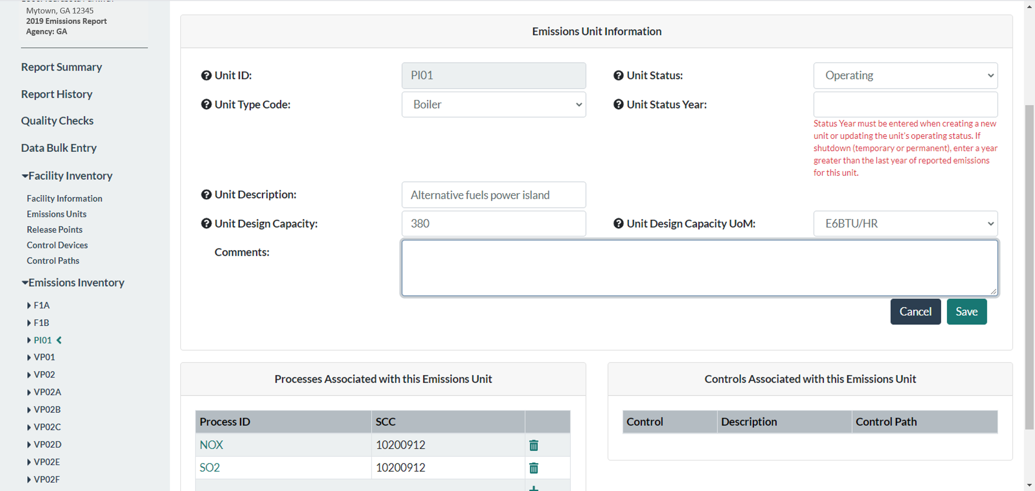
CAERS On-screen Quality Assurance Checks
Notes:
On screen QA checks help you avoid having issues later.

Slide 45
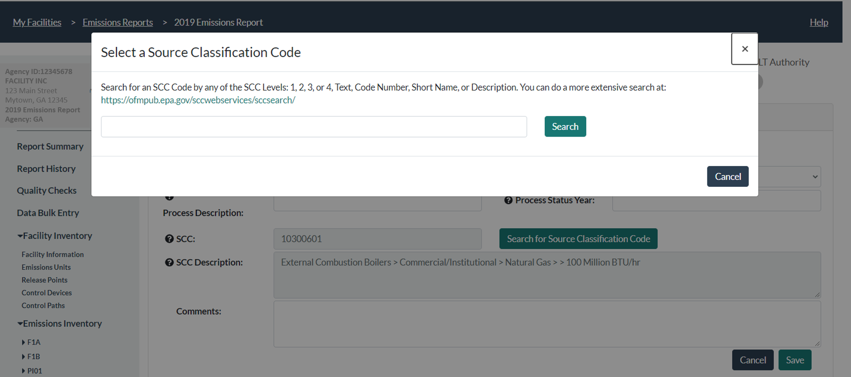
CAERS Search Pop-Up Window
Notes:
Modal windows help with searches such as for Source Classification Codes or SCCs and North American Industrial Classification System codes or NAICS.

Slide 46
Highlights of CAERS Features
Three options for data entry:
User interface
Bulk entry
Notes:
Bulk entry – is for users with a few changes to their annual throughput and emissions estimation method, but with few to no changes to their facility inventory. This method is also convenient if you do not have any control equipment information to include in your report. There are two tabs.

Slide 47
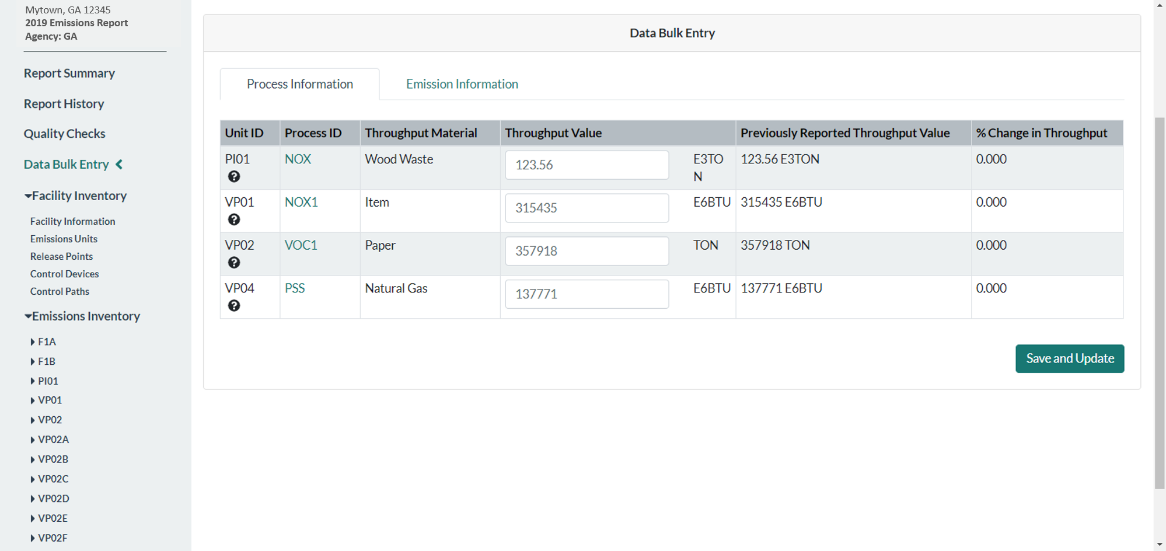
CAERS Throughput Bulk Entry
Notes:
To use bulk-entry you should already have your units and processes set up. Then all you have to do is enter the new throughput information in the “Process Information” tab.

Slide 48
CAERS Total Emissions Bulk Entry
Notes:
Enter emissions information in the “Emissions Information” tab.

Slide 49
Highlights of CAERS Features
Three options for data entry:
User interface
Bulk entry
Bulk upload
Via preformatted
Via JSON upload (email caer@epa.gov with questions)
Notes:
Bulk upload – is for users with a large number of changes, and/or with a variety of changes from a previous year report, this includes new and/or large facilities with no previous reporting history who will want to start a brand new report.
Via excel template – for users who would like to work with excel
Via JSON upload – for users who would like to send data directly from their custom systems.

Slide 50
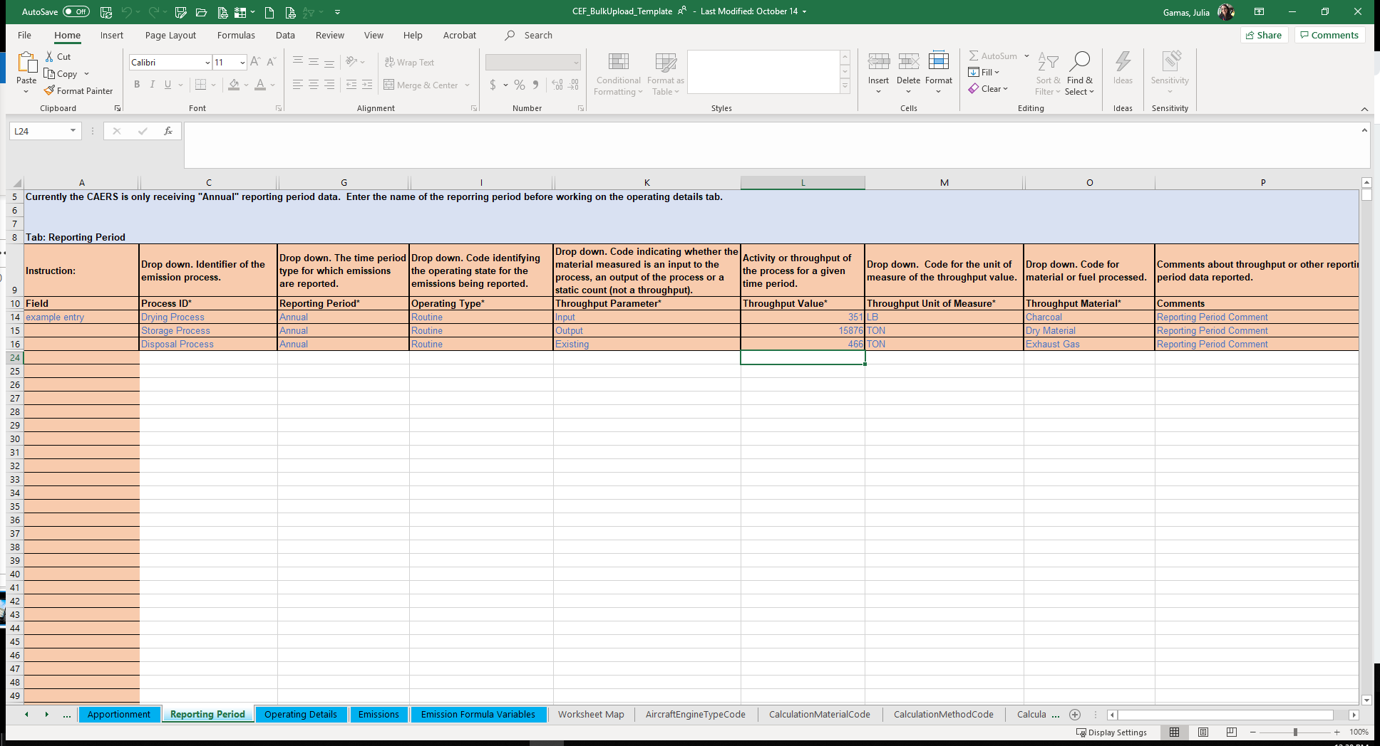
Bulk Upload Excel Template Example
Notes:
The template has blue and gray tabs. The gray tabs have reference data. The blue tabs are where you enter the data. While you may need to invest some time entering the data in the blue tabs, and getting used to the format, in subsequent years, updating the bulk upload spreadsheet should be easier as you’ll only have to update the data.

Slide 51
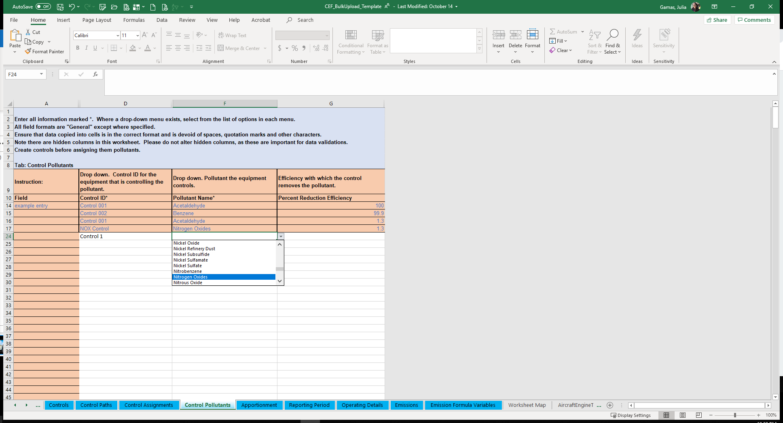
Bulk Upload Excel Template Example Continued
Notes:
The bulk upload template should be used carefully, as it also contains drop down menus and some formulas and references. If you have a lot of data to update every year, you may consider using the JSON upload. For more information about that send us an email to caer@epa.gov.

Slide 52
Highlights of CAERS Features
Three Options for Data Entry
Previous Year Data
Notes:
However you choose to enter your data, your data will be pre-populated from data from your previous year submission unless you are reporting for a brand new facility.

Slide 53
CAERS Emissions Reports Page
Notes:
Previous year data is available as a starting point for a current inventory year report. When you start a new report, data from your last report is automatically prepopulated in your current year report. For example, if you reported last in 2018, your starting point for your 2020 report would be 2018 data that you would then update.

Slide 54
Highlights of CAERS Features
Three Options for Data Entry
Previous Year Data
Bulk Download into Pre-formatted Excel Template
Notes:
In addition, you will be able to download your previous year report in the excel template you will need for bulk upload. This will allow you to make the relevant changes directly to the template.

Slide 55
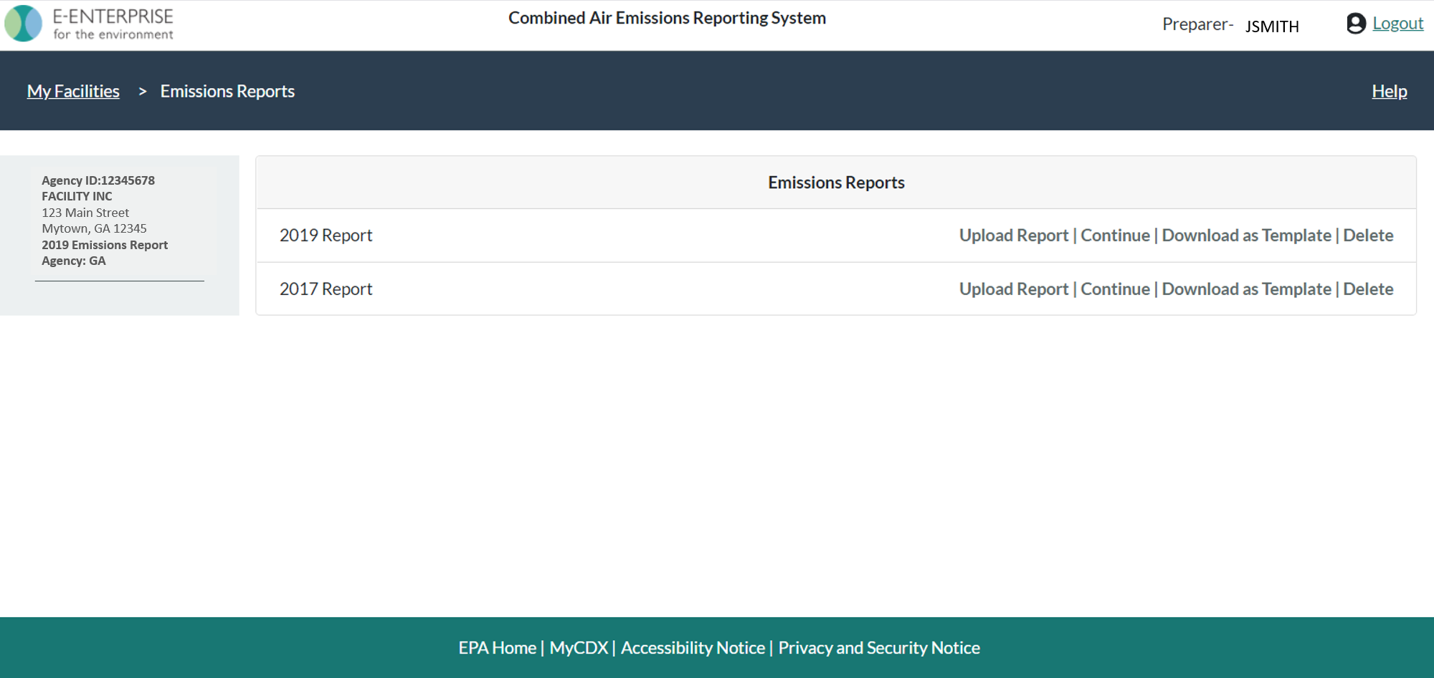
CAERS Emissions Reports Prepopulated Template Download
Notes:
By clicking on “Download as Template” from your Emissions Reports screen, you’ll be able to download your emissions report in the relevant excel template. You’ll then be able to edit it and re-load it. You’ll need to take care that any time you upload a template, you’ll be erasing everything that was there before.

Slide 56
Highlights of CAERS Features
Three Options for Data Entry
Previous Year Data
Bulk Download into Pre-formatted Excel Template
File Attachments
Notes:
Your SLT requires you to provide supplemental information to your estimates so they can replicate your estimates, such as data fields, formulas, and references to specific souces of emission factors.

Slide 57
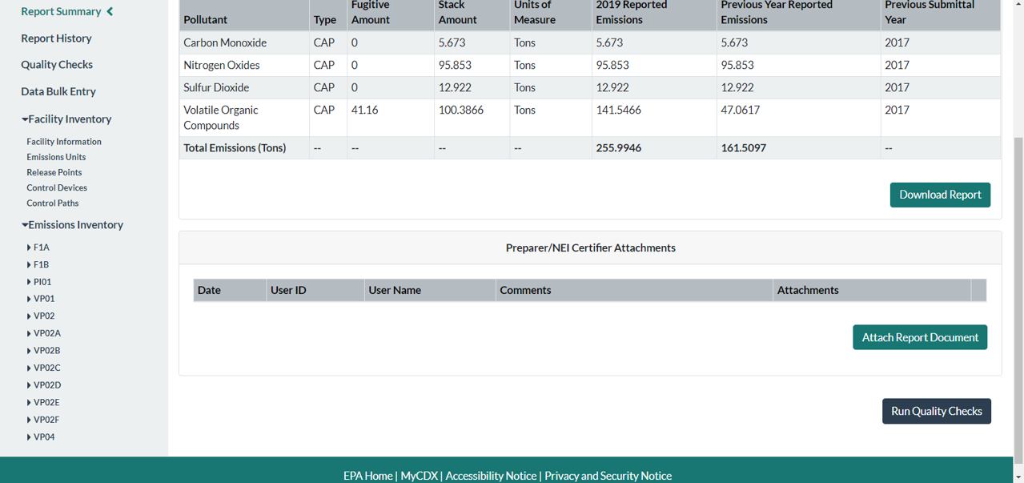
CAERS Document Attachment Page
Notes:
This can be done by attaching any excel files that contain your calculations to your report.

Slide 58
Highlights of CAERS Features
Three Options for Data Entry
Previous Year Data
Bulk Download into Pre-formatted Excel Template
File Attachments
Report History & Log
Notes:
A report summary contains a summary of your submission in an excel file, and is available for download in CAERS.

Slide 59
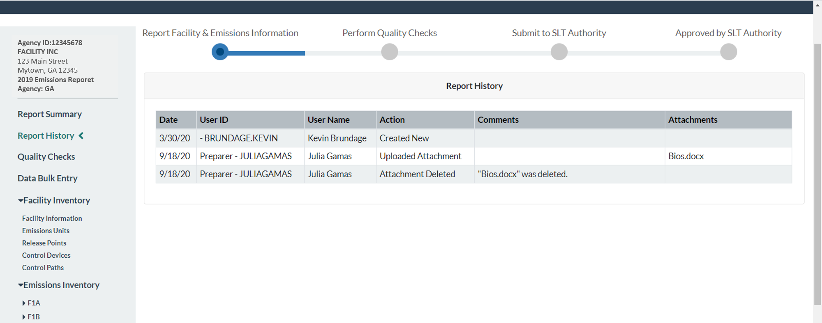
CAERS Report History Page
Notes:
A “Report History” page tracks major activities from reporters and certifiers such as attachments, certification, and submission of the report. You can always refer to the report history page to see if another reporter has worked on the report, for example.

Slide 60
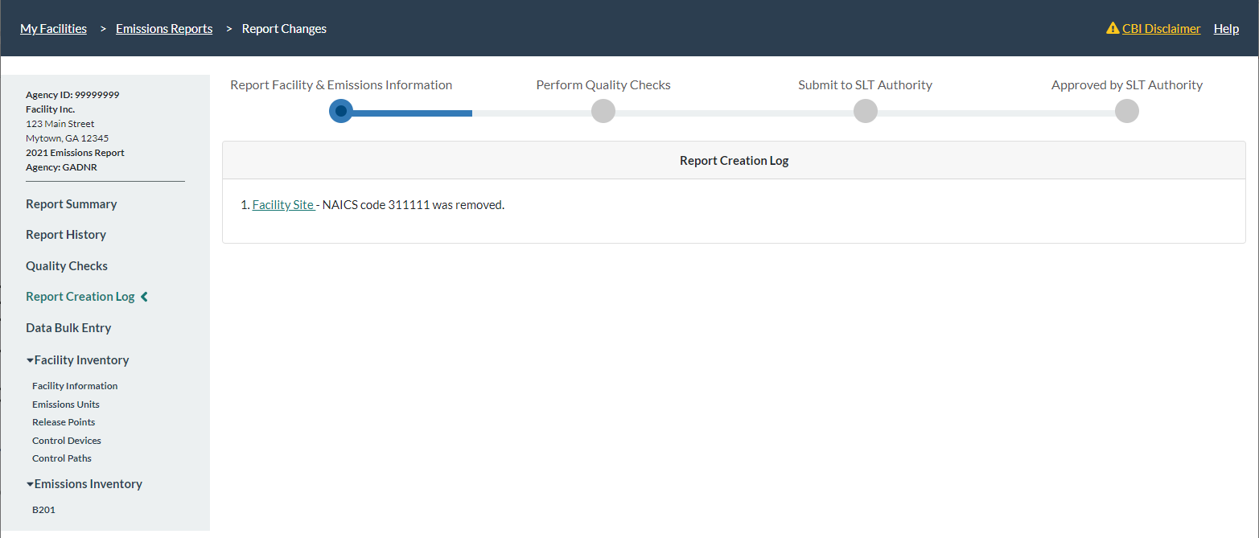
CAERS Report Log Page
Notes:
A log page tracks relevant actions done in the report.

Slide 61
Highlights of CAERS Features
Three Options for Data Entry
Previous Year Data
Bulk Download into Pre-formatted Excel Template
File Attachments
Report History & Log
Report Summary Download
Notes:
A report summary contains a summary of your submission in an excel file, and is available for download in CAERS.

Slide 62
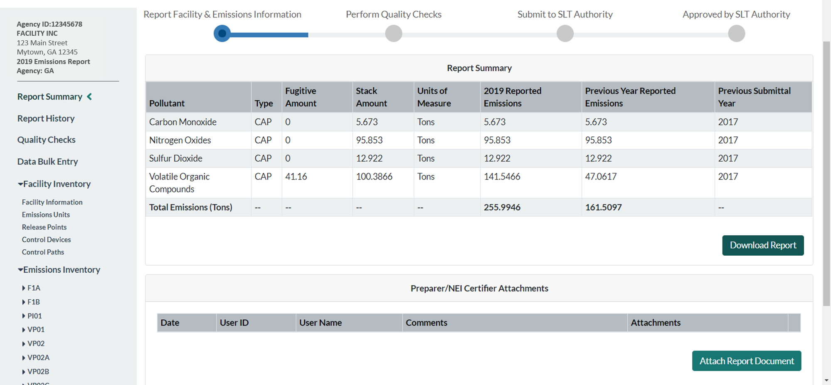
CAERS Summary Report Download
Notes:
It should not be confused with a bulk download, as the report will not provide a previous year submission in the correct excel template and is only a summary as opposed to the complete report with detailed data. If you submit HAPs emissions at process level, you will get facility-wide summary for TRI-ME HAPs reporting.

Slide 63
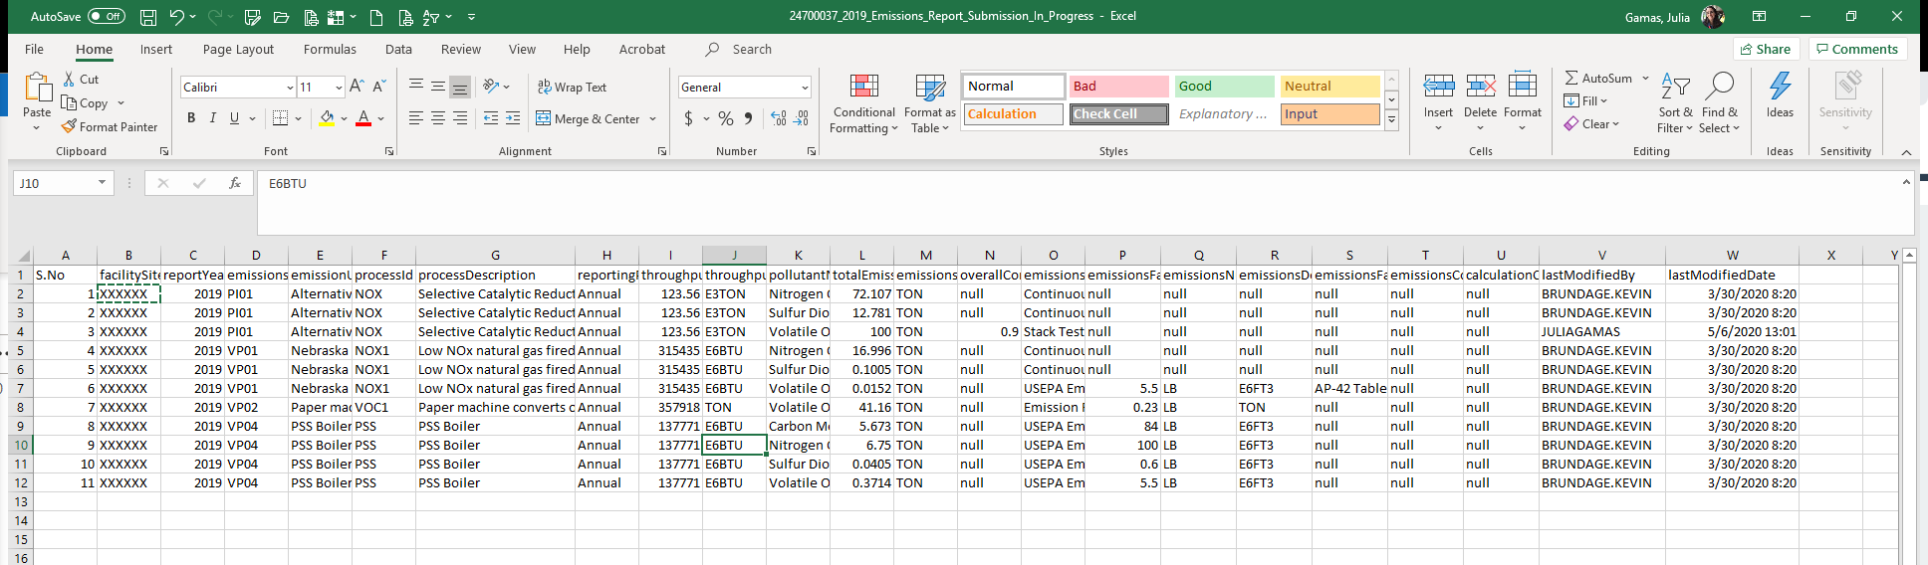
CAERS Example Summary Report
Notes:
You’ll be able to see the summary of your report in an excel file. The summary report will list your processes, estimation methods, throughputs, and other information.

Slide 64
Highlights of CAERS Features
Three Options for Data Entry
Previous Year Data
Bulk Download into Pre-formatted Excel Template
File Attachments
Report History & Log
Report Summary Download
Toxics Air Emissions Calculated and Added for TRI-MEweb
Notes:
Let’s talk a bit about your ability to use data you have entered into CAERS to TRI.

Slide 65
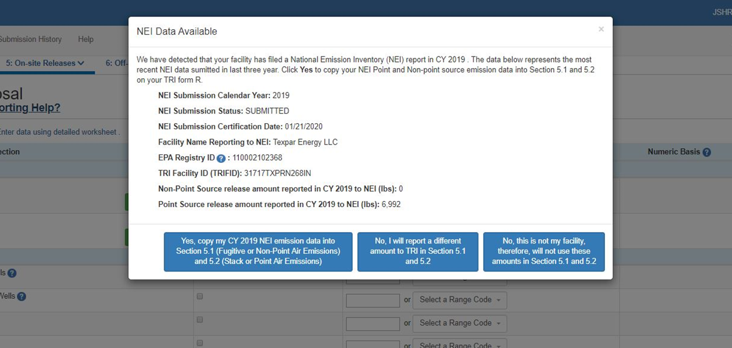
TRI-MEweb Page for Use of CAERS Data
Notes:
You’ll enter your data in CAERS, as shown, at the unit/process level. Toxics data will be added up to totals by facility. Once a reporter enters TRI-MEweb, they’ll be able to select the relevant report. This feature is optional, but we highly encourage you to take advantage of it. Furthermore, if you have HAPS, as explained earlier in the training you may want to enter your HAPS data rather than have EPA perform HAP augmentation on it. The raw data that you provide will always provide better information than the HAP augmentation estimate, which may not be as accurate. If your facility’s NEI reporter is a different person from your TRI-MEweb reporter, you may want to have them coordinate so that the TRI reporter is in TRI, once you have certified your submission.

Slide 66
Help and Resources
User Guide and Training Videos (Forthcoming): https://www.epa.gov/e-enterprise/e-enterprise-combined-air-emissions-reporting-caer
Help from within CAERS
Notes:
Finally, while our video tutorial is designed to illustrate the use of CAERS, you should supplement this video with the CAERS User Guide that contains additional information, as well as additional resources that can help you with your report. An updated version of our current User Guide will be available for download from the CAER website.

Slide 67
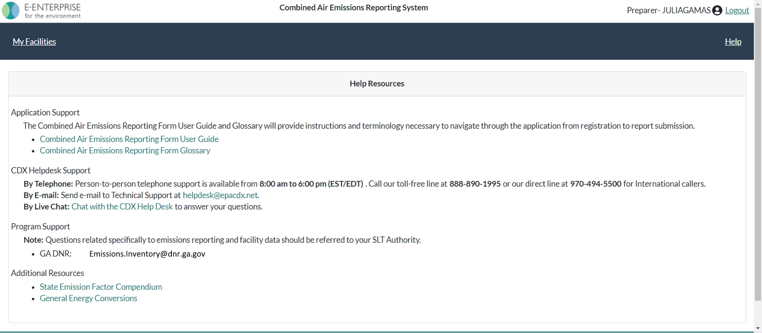
CAERS Help Resources Page
This help page will be updated soon, as the SLT compendium and emission factor updates are now provided to the user in CAERS.
Notes:
It is also available by clicking on the “Help” link in CAERS. Here you will find the user guide, a glossary, and also the information for the CDX help desk, program support with your SLT email or POC, and additional resources.

Slide 68
Help from CDX Help Desk
For CDX questions such as:
Can’t login/Password resets
Repudiation
For CAERS application questions such as:
Unexplained errors while using the CAERS application
How to enter a specific piece of data
How to navigate from one screen to another
CDX Help Desk:
Phone: Person-to-person telephone support from 8:00 am to 6:00 pm (EST/EDT). Call our toll-free line at 888-890-1995 or our direct line at (970) 494-5500 for International callers.
E-mail: Technical Support at helpdesk@epacdx.net
Notes:
If you have any questions about how to use the application itself, you should reach out to the help desk for questions about how to enter data into CAERS:
By Phone: Person-to-person telephone support is available from 8:00 am to 6:00 pm (EST/EDT). Call our toll-free line at 888-890-1995 or our direct line at (970) 494-5500 for International callers.
By E-mail: Send e-mail our Technical Support team at helpdesk@epacdx.net
Note that the help desk above is not the right resource for questions about the data itself. Those questions should be referred to your SLT Authority.

Slide 69
Program Questions
For program questions such as:
What data to use to fix critical errors that appear in red.
Selecting an appropriate SCC and/or emission factor.
Finding out the unit capacity measure of a unit.
The appropriateness of a calculation method for the emission being estimated.
POCS:
Georgia Department of Natural Resources (GADNR): Emissions.Inventory@dnr.ga.gov
Lincoln Lancaster, NE County Health Department (LLCHD): Gary Bergstrom, gbergstrom@lincoln.ne.gov
Pima, AZ Department of Environmental Quality (PDEQ): Janice Easley, Janice.easley@pima.gov
Rhode Island Department of Environmental Management (RIDEM): Alexi.Mangili@dem.ri.gov
Washington, D.C. Department of Energy & Environment (DOEE): air.quality@dc.gov

Slide 70
Want to make CAERS better?
Please help us make CAERS better by sending us feedback to caers@epa.gov. Help us prioritize upcoming features and functionality.
To make your reporting easier:
What else should CAERS be able to do?
What data elements should CAERS collect to send to other SLT and EPA air programs?
How should CAERS do this?
How should CAERS not do this?
Notes:
At any time during your use of CAERS you can send us feedback via our caer email, caers@epa.gov, letting us know what else you think CAERS should be able to do, and how CAERS can best do what you need it to do.

Slide 71
Questions

