Slide 1
Exchange Network Grants Program FY 22 Solicitation Notice Webinar
Office of Mission Support
Office of Information Management
Information Exchange Partnership Branch
April 2022
www.epa.gov/exchangenetwork

Slide 2
Notes for Participants
If you did not pre-register for this session by emailing Shela Poke-Williams, please enter the following into the TEAMS chat:
Your organization/division name
Your tribe, state, or territory
EPA will maintain these records internally; they will not be shared with any third parties

Slide 3
Notes for Participants
= Unmuted
= Muted
To maintain audio quality for all participants, please keep yourself muted during the presentation
Note: the webinar hosts may mute all or specific participants if background noise is present
If you have a question about a particular slide or topic during the presentation portion, please type it into the TEAMS chat
These questions will be addressed in the ‘Q & A’ session
During the ‘Q & A’ session, you may unmute yourself to ask a question or use the TEAMS chat feature
All questions/answers will be added to our FAQs on the EN Website

Slide 4
Agenda
EN Program Overview
Notable Changes from FY2021
SN Guidance and Other Applicant Resources
TOP 8: Common Applicant Mistakes to Avoid
Question and Answer (Q&A) Session

Slide 5
Overview of the EN Grants Program

Slide 6
Exchange Network (EN) Grant Purpose
Facilitate sharing of environmental data
Reduce burden and avoid costs
Streamline data collection and exchanges
Increase the quality and access to environmental data through discovery, publishing, outbound and analytical services
Increase data and IT management capabilities to allow for full participation in the EN

Slide 7
EN Grant Program Funding Summary
FY 2022 is the 21st year EPA will award competitive funding to eligible applicants
Since 2002, the EN Grant Program has awarded 942 grants to states, tribes, and territories (approximately $252 million)
All 50 states and the District of Columbia, 86 tribes, and 5 territories have received EN grants
In FY22, EPA expects to award approximately $8,000,000 in 25-35 assistance agreements

Slide 8
Who is Eligible to Apply for EN Grants?
Entities Eligible for Funding (see SN Section III-A):
States
U.S. Territories
Federally Recognized Tribes and Alaska Native Villages
Inter-tribal Consortia of Federally Recognized Tribes
Some other entities, if they are an instrumentality of a state or tribe
State and Territory Applicants: Provide a signed attorney general letter certifying this status
Tribal Applicants: Provide a certification and supporting documentation from the tribal council or other appropriate tribal government official certifying this status
Notes:
Emphasize the ‘instrumentality of the tribe’ language here, as this is a new emphasis in our SN

Slide 9
What are the Funding Thresholds for EN Grants?
Single Applicant Awards: – may request up to $200,000
Partnership Awards – may request up to $400,000
Partnership eligibility criteria (see SN Section III-D) must be met
Note: EPA will not consider partnerships formed from agencies within a single state, territorial, or tribal government as eligible
Single Applicants Applying Under ‘Individual Capacity Building with Mentorship’ – may request up to $215,000
Up to $200,000 in project costs & $15,000 in mentorship costs
Open to tribes and territories only
All opportunity requirements must be met (see SN Appendix C, Page C3)

Slide 10
What Can I Not Request Funding For in an EN Grant?
Applicants can not request EN grant funds for:
Construction Costs
Operations and Maintenance, including previous EN projects and flows
Workshops and Conferences not primarily benefitting the applicant/applicable partners or ones conducted primarily for EPA’s benefit
Pre-Award Costs
Management Fees
Development and deployment of physical nodes implementing the Exchange Network protocol and specification

Slide 11
What are the FY22 EN Funding Areas?
In FY22, there are three Exchange Network Funding Areas:
EN Funding Area 1: Increased Data Access and Innovative Business Processes
EN Funding Area 2: Eliminate paper submittals and expand e-reporting
Funding Area 3: Augment the information management capacity of EN partners

Slide 12
What are EN Project Opportunities?
EN Project Opportunities are specific project write-ups that provide potential applicants with the information needed to design a proposal for a particular data exchange, data service, or project type
These write-ups are available in Appendices A-C
Each includes a description, essential background information, suggested project activities, estimated costs, and helpful links/resources
Applicants can apply under one or multiple EN project opportunities or propose projects that do not have a specific EN project opportunity write-up
Notes:
If proposing your own project, you must identify which EN Funding Area will be supported

Slide 13
EN Project Opportunities under EN Funding Area 1
EN Project opportunities in Appendix A fall under EN Funding Area 1
Projects in this area help agencies adopt innovative business processes, data management practices and services to support applicant workflows
EN Project Opportunities include:
EN SERVICES | INNOVATIVE BUSINESS PROCESSES
Virtual Exchange Service (VES) | Continuous Water Quality Monitoring
Shared CROMERR Services (SCS) | Open Data Projects (including Geospatial Data)
Substance Registry Services (SRS)

Slide 14
EN Project Opportunities under Funding Area 2
EN Project Opportunities in Appendix B fall under EN Funding Area 2
Projects in this area are designed to eliminate paper submittals and expand e-reporting required as part of EPA programs
Opportunities within Appendix B are created by EPA National Program Offices to help stakeholders submit and share programmatic data for thirteen EPA programs

Slide 15
EN Project Opportunities under Funding Area 2
EN Project Opportunities include:
AIR | WATER
Air Quality System (AQS) | eBeaches
Emission Inventory System (EIS) | Safe Drinking Water Information System (SDWIS)
Combined Air Emissions Reporting (CAER) | Water Quality Exchange (WQX)
 | Assessment TMDL Tracking And ImplementatioN System (ATTAINS)
ENFORCEMENT AND COMPLIANCE | Drinking Water State Revolving Fund & Clean Water State Revolving Fund
ICIS (Integrated Compliance Information System) | Underground Injection Control (UIC)
(NPDES) National Pollutant Discharge Elimination System | OTHER DATA EXCHANGES
WASTE | Facility Registry Service (FRS)
Resource Conservation & Recovery Act (RCRA Info)

Slide 16
EN Project Opportunities Under Funding Area 3
EN Project Opportunities in Appendix C fall under EN Funding Area 3
Projects in this area are intended to support applicants in building the IT and data management capacity necessary to manage environmental programs and enable increased participation in the EN
Opportunities in this area are only open to tribes and territorial applicants
EN Project Opportunities include:
EN CAPACITY BUILDING | (EN CAPACITY BUILDING CONTINUED)
Individual Capacity Building | Individual Capacity Building with Mentorship**
Collaborative Capacity Building | **Funding threshold of $215,000

Slide 17
FY22 Grant Cycle*
September 30
April 6
April 11
April 13*
*Tribal Session
March 2
April - May
May 1,
11:59 PM ET
June - July
July/August
EPA Tentative Deadline for Issuing Awards
FY 2022 Solicitation Notice Published on Grants.Gov
Applicant Webinars
Application Scoring and Final Ranking
FY 2022 Grants Processed
Application Status Letters Mailed
Application Due Date
*Tentative timeline

Slide 18
Notable Changes from FY2021

Slide 19
Notable Changes to the FY22 Solicitation Notice
Renaming of 'EN Funding Opportunities' to 'EN Project Opportunities’
Language updates for improved user clarity/document readability
New, streamlined templates for the project opportunity write-ups in appendices A-C
Removal of the Radon and Open Dump as specific EN project opportunities
Projects must support the new EPA’s [Draft] FY 2022-2026 Strategic Plan
See Section I-C. Environmental Results Supported by Assistance Activities
Additional optional project narrative table formats
See Appendix E, Overview of the Project Narrative
Notes:
Note: Applicants can still propose Radon/Open Dump projects

Slide 20
Notable Changes to the FY22 Solicitation Notice
New stand-alone EEDS criteria
See Section V-A Evaluation Criteria
New EEDS project narrative section
See Appendix E, Overview of the Project Narrative
New EEDS applicant guidance
See Appendix D
New budget calculation guidance
See Appendix D
Updated optional templates for the cover letter, project narrative, and budget narrative attachment form
Available on the EN website or the grants.gov listing

Slide 21
SN Guidance and Other Applicant Resources

Slide 22
SN I-C. Environ. Results Supported by Assistance Activities
The activities to be funded under this announcement support multiple goals and objectives under EPA’s Draft FY 2022-2026 Strategic Plan
https://www.epa.gov/system/files/documents/2021-10/fy-2022-2026-epa-draft-strategic-plan.pdf
Applicants must:
Identify in the ‘project description’ section of their project narrative which goal(s) and objective(s) from the Draft Plan are supported by their proposed project.
Include both the number and title of each supported goal and objective (e.g., ‘Goal 1: Tackle the Climate Crisis, Objective 1.2 Accelerate Resilience and Adaption to Climate Change Impacts’)
Briefly describe for each how they will be supported by the proposed project.

Slide 23
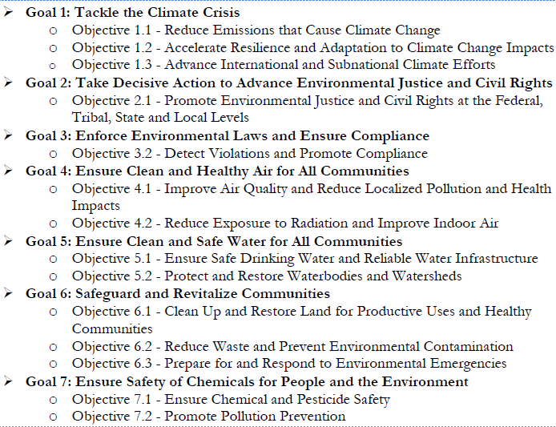
SN I-C. Environ. Results Supported by Assistance Activities
Note: Proposed projects may support more than one strategic goal and objective
Applicants should list and describe all that apply from the list included in the SN
See SN Page 7

Slide 24
SN I-C. Environ. Results Supported by Assistance Activities
Applicants should also:
Identify which EPA strategic goal and objective from the list is most supported by each project goal as identified in the ‘Project Goals, Outputs, and Outcomes’ section of the project narrative.
Applicants should only list one strategic goal and objective per project goal
If there are multiple options, applicants should choose the best fit.
Please note that the same strategic goal and objective may be listed for multiple project goals.

Slide 25
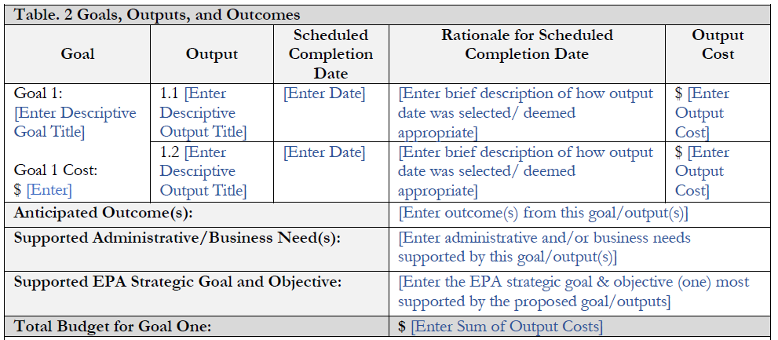
SN I-C. Environ. Results Supported by Assistance Activities
Example from the optional ‘Project Goals, Outputs, and Outcomes’ table as provided on SN Page E4

Slide 26
SN III-B. Threshold Eligibility Criteria for Applications
Proposed projects must:
Lead to a completion of activities (brought into production)
Have a project period of 3 years
Not exceed the stated funding thresholds
Not request funds for previously funded activities or deliverables
Applicants:
Must substantially comply with Section IV’s instructions and requirements
May not have more than four active Exchange Network assistance agreements with the Agency as of December 31, 2021

Slide 27
SN III-F. Performance Partnership Grants (PPG)
States, certain interstate agencies, and tribes can choose to combine two or more environmental program grants into a single PPG
Note: Local governments are not eligible for PPGs
Territories can consolidate various environmental program grants into a single Consolidated Grant (CG)
Applicants who wish to include awarded grant funds in a PPG/CG should:
Clearly state this in the cover letter and the ‘Project Description’ section of the project narrative
Include the PPG/CG number

Slide 28
SN V-A. Evaluation Criteria
All applications are evaluated and scored on the following criteria:
Project Outputs and Outcomes Leading to Environmental Results (10 Points)
Project Feasibility and Approach (12 Points)
Alignment with EN Funding Areas (48 Points)
Budget, Resources, and Key Personnel (18 Points)
Past Performance (12 Points)
Applicants who have never received an EN grant must explicitly state this in the ‘Past Performance’ section of the project narrative

Slide 29
Appendix D: Identifying Items for Reuse
Applicants must explicitly identify which EN data and technology management resources developed by EN partners will be reused or repurposed
Should be addressed within the ‘Commitment to Reuse’ section of their project narrative
Applicants must also commit to register any newly developed resources (required since 2011) and commit to register the reuse of existing resources (required since 2018)
Should be addressed through two distinct commitment statements within the ‘Commitment to Reuse’ section of their project narrative

Slide 30
E-Enterprise Community Inventory Platform (EECIP)
Accessible at https://www.eecip.net
EECIP is an online community and living project inventory for employees of federal, tribal, territorial and state environmental agencies to enter information about agency projects, technical environment and the professional interests of users
Users can learn from and collaborate with colleagues and experts and discover, reuse or repurpose the work of others
Site search includes projects, agencies, discussion topics and staff

Slide 31
Shared Services Resources Catalog (SSRC)
Accessible at https://sscatalog.epa.gov/sharedservicecatalog/search
The Shared Services Resource Catalog (SSRC) is:
Part of EPA’s System of Registries
A catalog of EPA, state, tribal and territory services
A registry of XML schema, widgets, plug-ins, web services and many other resources all of which can be reused by others
Users can search for existing data and IT assets, grouped by similar resource types, through the searchable interface
SSRC does not require registration or a password

Slide 32
Previous EN Projects – EN Website
Accessible at: https://www.epa.gov/exchangenetwork/previous-exchange-network-grant-projects
This link provides records of all prior EN grant awards, listed by fiscal year
Where available, these records also include links to reusable components registered in SSRC during grant close-outs
Registering the development and reuse of IT components in SSRC is a Term & Condition of all Exchange Network grants; see Section VI-B
Click the hyperlink in the ‘Registered Components’ column to directly access the associated SSRC record

Slide 33
Appendix D: E-Enterprise Digital Strategy (EEDS)
Evaluation criteria awards points to projects that align with the principles of the E-Enterprise Digital Strategy (EEDS)
See Criterion 3F in Section V-A ‘Evaluation Criteria’
The three principles of the EEDS are the:
The ‘Information Centric Approach’, including an emphasis on ‘API-First’
The ‘Shared Platform Approach’
The ‘Customer Centric Approach’
Applicants should explicitly address how their project aligns with the principles of EEDS in the ‘Project Alignment with the E-Enterprise Digital Strategy (EEDS)’ section of their project narrative

Slide 34
Appendix D: E-Enterprise Digital Strategy (EEDS)
Access the EEDS full text here:
https://e-enterprisefortheenvironment.net/wp-content/uploads/2019/08/Interim-E-Enterprise-Digital-Strategy-V-2.0.pdf
Page D2 of the SN now includes a one-page applicant guide to EEDS
Includes an overview of each of the three principles
Includes example activities

Slide 35
Appendix D: How to Compose a Budget
To help applicants avoid common budget errors, the FY22 Solicitation Notice now includes a detailed guide to composing a budget
Includes a description of the cost category
Includes a list of what details are needed when charging costs to this category
Includes a description of how to calculate the costs in this category
Includes an optional table format to help correctly calculate costs and provide all necessary information

Slide 36
Personnel
To calculate: multiply the annual salary and the percentage of time for each staff member. Add the personnel costs for all staff to get the total personnel cost. For example:
Staff Position (Project Role) | Staff Name | Annual Salary | % of Time Devoted to Project | Personnel Cost
Project Manager | Neal XXX | $125,000 | 10% | $12,500
IT Specialist | Diana XXX | $75,000 | 15% | $11,250
Env. Specialist | Karen XXX | $50,000 | 30% | $15,000
Total Personnel Costs |  |  |  | $38,750

Slide 37
Fringe Benefits
To calculate (expressed as a percentage): multiply the personnel cost by the organization’s fringe benefit rate to calculate the fringe benefit cost for each employee. Add up all fringe benefit costs for all employees to calculate the total fringe benefit cost. For example:
Staff Position | Staff Name | Personnel Cost | Fringe Benefit Rate | Total Fringe Benefits
Project Manager | Neal XXX | $12,500 | 22% | $2,750
IT Specialist | Diana XXX | $11,250 | 22% | $2,475
Env. Specialist | Karen XXX | $15,000 | 22% | $3,300
Total Fringe Costs |  |  |  | $8,525

Slide 38
Travel
To calculate: for each project trip, multiply the estimated cost of each applicable trip item by the duration and number of travelers. Add up the total costs from each trip to calculate the total travel cost. For example:
Trip | Trip Item | Estimated Cost | Duration | # of Travelers | Total Cost
 | Airfare | $550 | N/A | 2 | $1,100
1 | Per Diem | $22 meals (x3 daily) + $124 lodging = $190 | 3 Nights | 2 | $1,140
 | Rental Car | $60 | 4 Days | 2 | $480
 | Mileage | 80 miles x $0.50 per mile = $40 | 4 Days | 2 | $320
 | Trip Destination | San Francisco, California (EPA R9)
 | Purpose of Travel | Participation in Annual Regional EN Meeting
 | Trip One Cost | $3,040
 | Total Travel Costs | $3,040

Slide 39
Equipment
To calculate: identify equipment items, the estimated costs for each item (Price per unit) and the number of units you expect to purchase (quantity). Multiply each equipment item’s price per unit cost by the quantity; then add up the costs to calculate the total. For example:
Item | Quantity | Price Per Unit | Estimated Cost
Pix4Dmapper, Perpetual License | 1 | $4,000 | $4,000
SLEIS Software Upgrade and License/Support | 1 | $15,000 + $40,000 = $55,000 | $55,000
Total Equipment Costs |  |  | $59,000

Slide 40
Supplies
To calculate: identify supply items, quantity, and price per unit for your project. Multiply each supply item’s quantity by its price per unit to find the supply cost. Then add up all supply costs to calculate the total. For example:
Supply Category | Item | Quantity | Price Per Unit | Estimated Cost
Monitoring Supplies | Pressure Transducer | 2 | $500 | $1,000
Computing Device | Laptop Computer | 2 | $800 | $1,600
Testing Supplies | PVC Gloves, pack of 1,000 | 1 | $250 | $250
Light Refreshments at Conference | Coffee packets | 400 | $0.29 | $116
Total Supply Costs |  |  |  | $2,966

Slide 41
Contractual
To calculate contractual cost: identify all contracts that your project will require. Then, add up the contract costs you calculated to find the total. For example:
Item | Hours | Rate | Contract Purpose | Procurement Method | Estimated Cost
Gold Systems, Inc. | 450 | $185 | To provide multiple environ-mental media system trainings, access, outreach, and support to the consortium members | Competitive proposals | $83,250
Total Contractual Costs |  |  |  |  | $83,250

Slide 42
Other
To calculate other cost: create a table to show how the costs are categorized as other direct costs. Add them up to calculate the total other direct costs. For example:
Category | Item | Quantity | Price Per Item | Estimated Cost
Rental and Lease Cost | Suction Dredge Equipment Rental | 1 | $2,500 | $2,500
Participant Support Cost | Training fee for 3 community members | 3 | $250 | $750
Subaward | Subaward to ABC [EN Partner Org. Name] | 1 | $20,000 | $20,000
Total Other Costs |  |  |  | $23,250

Slide 43
Indirect Cost and Indirect Cost Agreements
Indirect cost are those costs incurred for a common or joint purpose benefitting more than one cost objective, and not readily assignable to the cost objectives specifically benefitted.
Examples may include overhead expenses (e.g., rent or utilities) or general and administrative expenses (e.g., personnel department costs)
If you wish to include indirect costs in your proposed budget when applying for an assistance agreement, you must provide a copy of your current approved indirect cost rate agreement
Your cognizant agency is responsible for negotiating your indirect cost rate and issuing the appropriate ICR Agreement.
An applicant’s ICR rate should be valid, at a minimum, through the award period

Slide 44
Indirect Cost - Example
An applicant’s rate, according to their Negotiated Indirect Cost Rate (IDC) agreement, is 19.6% and expires on 6/30/2023, making it valid through the period of performance start date of 10/1/2022.
Their IDC agreement states that the base amount is comprised of: total direct costs excluding capital expenditures (buildings, individual items of equipment, and alterations and renovations) and subawards.
Their budget reads as follows: Personnel: $15,072; Fringe: $6,782; Travel: $4,500; Contractual Services: $118,035; and Other (a subaward): $20,804.
Their total direct cost amount is $165,193; there are no capital expenditures, but there is a subaward which cannot be included in the base.
Therefore, the base amount is $144,389 ($165,193 - $20,804).

Slide 45
Indirect Cost – Example (Cont.)
To calculate their indirect costs, the applicant multiplies the rate by the base amount:
19.6% can be expressed as a decimal by dividing it by 100: 19.6/100 = 0.196
0.196 (rate) x 144389 (base amount) = $28,300.244
The applicant rounds this to the nearest whole dollar amount: $28,300.
Effective Period | IDC Rate | Description of Base | Base Amount | Total
07/01/2022 – 06/03/2023 | 19.6% | Total direct costs excluding capital expenditures | $144,389 | $28,300
Total Indirect Costs |  |  |  | $28,300

Slide 46
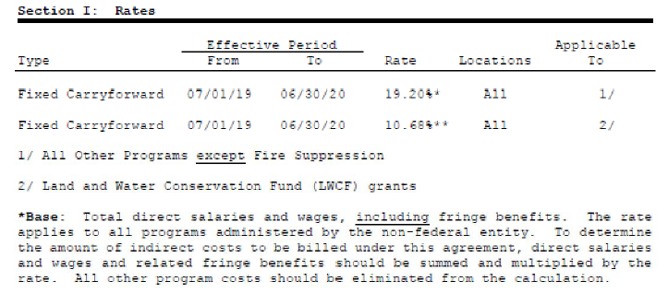
Indirect Cost Rate Agreement

Slide 47
Optional, Fillable Templates
In FY22, optional, fillable templates are available to applicants for:
the Cover Letter
the Project Narrative
the Budget Narrative Attachment Form
Available as Word documents for ease of applicant access and editing
The use of these templates is not required, nor do they guarantee a high application score and/or funding
These tools have been provided to applicants to help ensure all required information is appropriately captured in these required attachments

Slide 48
Optional, Fillable Templates (Continued)
Available at: https://www.epa.gov/exchangenetwork/exchange-network-grant-program#Resources
Applicants using the optional templates should feel free to expand and edit the suggested text as needed/desired
Blue text enclosed in brackets signifies text to expand/edit
Change all text to black and remove brackets before submitting
Remove any sections of blue bracketed text that are not applicable to you
Delete all template notes (1st page of each template doc) and all footnotes before submitting

Slide 49
Optional, Fillable Templates (Example)
The [State, Tribe or Territory Name] [Name of Department or Agency]’s [program] submits this application under [‘insert project opportunity name(s)’]. If successful, this application will allow the [Department/Agency name or abbreviation] to [brief description of work to be accomplished]. This supports EN Funding Area(s) [‘1’, ‘2’, and/or ‘3’] by [describe how the proposed work specifically supports one or more EN Funding Areas].
The Narnia Department of Unicorn’s Environmental Program (DUEP) submits this application under EN project opportunities Open Data Projects including Geospatial and Individual Capacity Building. If successful, this application will allow the DUEP to develop an innovative drone monitoring system for Narnia’s network of enchanted streams and to develop and implement a reporting system to submit this information to EPA. This supports EN Funding Areas 1 and 2 by building an innovative business process for stream monitoring and building the reporting capacity of DUEP.

Slide 50
Other Applicant Resources
Appendix E of the Solicitation Notice contains:
An overview of the project narrative (see pages E3 – E9)
An overview of mandatory and additional application attachments (see pages E10 – E12)
Detailed instructions for submitting applications through Grants.gov (see pages E13 – E15)
Appendix F of the Solicitation Notice contains an optional pre-submission checklist for applicants
The EN website contains detailed applicant FAQs (see https://www.epa.gov/exchangenetwork/exchange-network-grant-program#Resources)

Slide 51
TOP 8: Common Applicant Mistakes to Avoid

Slide 52
Please do not include any monetary amounts less than one dollar in your application budget amounts
E.g. $13,369.67 should be $13,370
Round these amounts up or down to the nearest whole dollar amount and recalculate your budget(s) (in the project narrative & on all budget forms) before submitting
Including Penny Amounts in your Budget (Amounts < $1)
#8

Slide 53
The Exchange Network grant period of performance is three years
List the project start date as October 1st, 2022
List the project end date as September 30, 2025
We encourage applicants to include realistic and generous scheduled completion dates (list for each output and goal) which stretches over the entire 3-year period of performance
Incorrect Period of Performance Dates
#7

Slide 54
Applicants who are requesting funds for travel must document in their Budget Narrative Attachment Form:
trip item (e.g., ‘airfare’, ‘mileage’, etc.)
estimated cost per trip item
duration
number of travelers
destination
purpose of travel
Project Narrative Section 7 ‘Overview of Project Budget’ should also a travel summary, including travel costs and each travel destination, traveler name, and cost per participant
#6
Budgeting for Travel, But Not Including Key Details
Notes:
Remember: travel costs to the National EE/EN Conference are not allowable by state and territory applicants, as these costs are covered by ECOS. However, tribal applicants can apply for funding for this.

Slide 55
With subawards, the subawardees(s) would get something for themselves by carrying out their portion of the proposed work.
- All cost associated with a subaward should be captured in the “Other” budget category
- Partnering organizations in EN partnership awards often receive subawards to carry out assistance agreement activities for, and in coordination with, the lead applicant.
By comparison, a contract entails the hiring of person(s) to complete a set tasks.
These cost should be captured in the “Contractual” category.
#5
Confusion on Contracts vs. Subawards
Notes:
Partnering organizations in EN partnership awards often receive subawards to carry out assistance agreement activities for, and in coordination with, the lead applicant.
Like grant recipients, subrecipients measure performance against program objectives, comply with award requirements, use funds to carry out program activities, and make programmatic decisions
A contractor operates in a competitive environment, with contractors providing goods and services to the assistance agreement recipient that are ancillary to program operations. Contractors are not subject to compliance requirements of the assistance agreement and must be selected in compliance with competition requirements specified in 2 CFR Part 200 as interpreted in EPA’s Best Practice Guide for Procuring Services, Supplies, and Equipment Under EPA Assistance Agreements.
Note: Contractor/vendor costs should be captured under the budget category ‘contractual’.

Slide 56
Notes on Subawards and Contracts
See Section II-A of the SN for more information on subawards and contracts
For applications that include a subaward, applicants should also review:
The EPA subaward policy: https://www.epa.gov/grants/grants-policy-issuance-gpi-16-01-epa-subaward-policy-epa-assistance-agreement-recipients
For applications that include a contract, applicants should also review:
The competition requirements specified in 2 CFR Part 200
EPA’s Best Practice Guide for Procuring Services, Supplies, and Equipment Under EPA Assistance Agreements
Applicants that intend to distribute all their EPA funding for subaward(s) and/or procurement contracts must explain how they will manage these transactions in compliance with applicable Federal requirements without EPA funding for personnel.
Applicants remain accountable to EPA for proper expenditures of EPA funding

Slide 57
Applicants should outline a detailed project plan, which includes:
• each project goal and its cost;
• all output(s) associated with that project goal;
• a scheduled completion date for each listed output;
• a brief rationale for how each output date was selected and deemed appropriate;
• output cost(s);
• anticipated outcome(s) affiliated with each project goal;
• the business and/or administrative need(s) which will be supported by each project goal; and
• the (one) EPA strategic goal and objective which is most supported by each project goal.
#4
Not Including Critical Information in a Detailed Project Plan

Slide 58
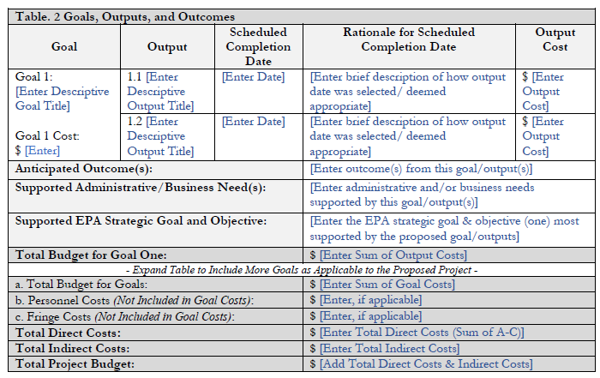
(Optional)
Workplan
Table
Template

Slide 59
Applicable to both the 424 form and the Key Contacts Attachment Form (mandatory)
Authorized Representative (AOR)
Payee
Administrative Contact (POC)
Project Manager
If any changes in key personnel occur, please reach out to Erin McGown ASAP with an updated Key Contact form
Please note the Authorized Representative and Payee can not be the same person.
#3
Wrong Contact Names and Addresses on

Slide 60
Your ICR rate should be valid, at a minimum, through the award period
Tribal applicants can submit a draft version of their current year ICR agreement, as submitted to DOI
Tribal applicants may also request a Regulatory Exception to continue to use an expiring/expired fixed rate with carry-forward
All applicants may also elect to use the De Minimis Rate of 10% of modified total direct cost
* Please reference your base rate to ensure you are only charging to appropriate categories
#2
Invalid or Incorrectly Calculated Indirect Cost Rates (ICRs)
Notes:
!EPA may allow recipients that previously had IDC rates to also use the 10% de minimus rate, provided they do not receive more than $35,000,000 in Federal funding per fiscal year and they have requested and received a regulatory exception.

Slide 61
Please ensure that the budgets captured on the following forms match exactly before submitting your application:
Project Narrative (sections 2 & 7)
Budget Narrative Attachment Form
424 and 424A Forms
Check the indirect cost rate and calculations across your budget objects
#1
Mismatching Budget Amounts across the Application

Slide 62
Stay Connected
Subscribe to EN Alerts
Participate in EN Stakeholder conference calls
Visit our exchange network website for the latest information!
http://www.epa.gov/exchangenetwork

Slide 63
Contact Us
Erin McGown
Acting Program Manager –
Exchange Network Grant Program
Office of Information Management
Information Exchange Partnership Branch
ENGrantProgram@epa.gov

Slide 64
Questions?
Please feel free to ask questions over the phone or through the TEAMs chat
Click the microphone icon to unmute yourself
Muted
Unmuted

