Slide 1
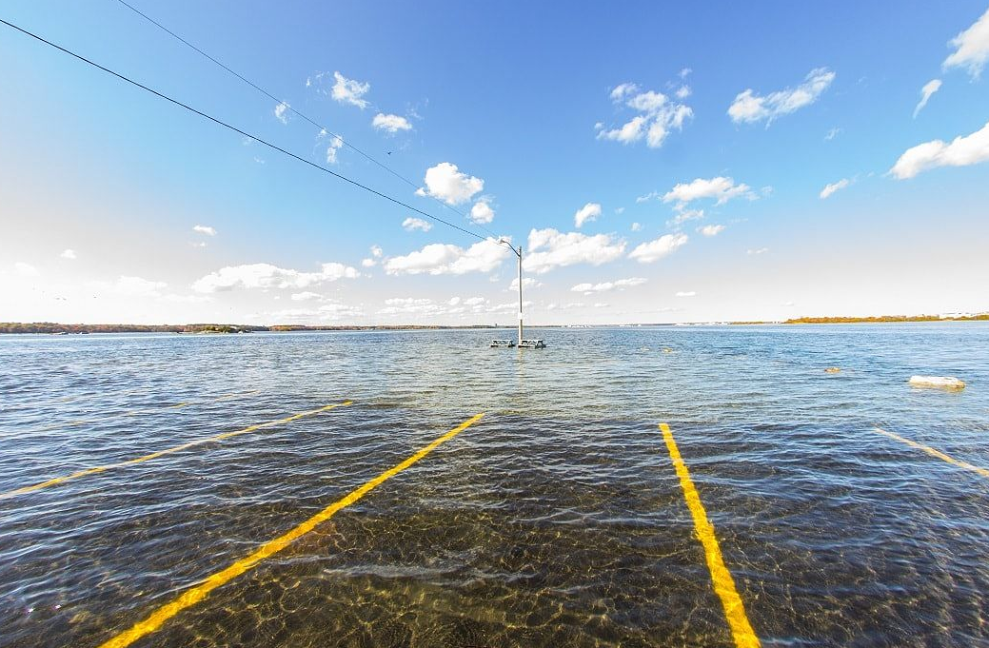
Nuisance flooding in New England and effects on groundwater salinity
James Heiss, PhD
Assistant Professor
Environmental, Earth, and Atmospheric Sciences
Kennedy College of Sciences
University of Massachusetts Lowell
james_heiss@uml.edu
Photo by Dan Gobbi

Slide 2
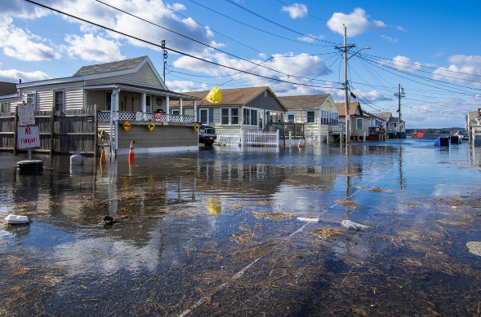
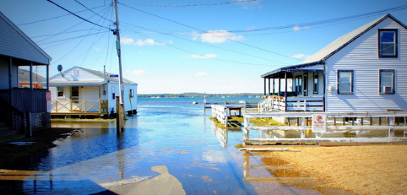
What is nuisance flooding?
Nuisance flooding
Tidal flooding/sunny day flooding/nuisance flooding is the inundation of coastal areas during exceptionally high tides, without the aid of winds or precipitation.
Photo by Mary Sapienza

Slide 3
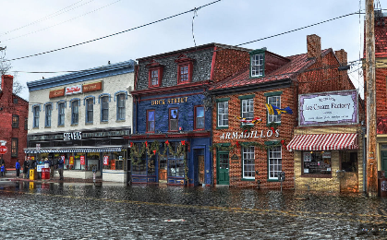
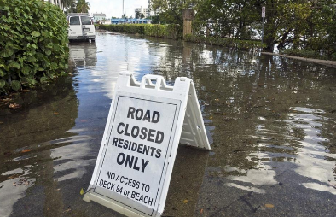
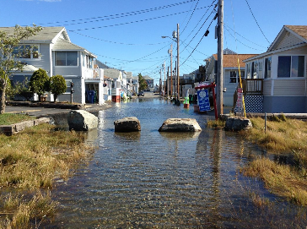
What is nuisance flooding?
Nuisance flooding: Known and unknown impacts
Economic losses
Frequent road closures
Photo by Amy McCovern
Lannis Waters, palmbeachpost.com
Impacts to groundwater and nutrient loading?
Overwhelmed storm drains
Photo by Maren Bhaget

Slide 4
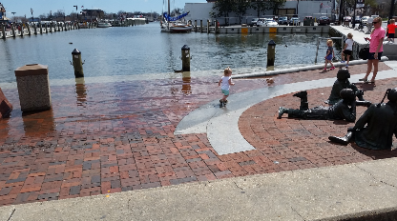
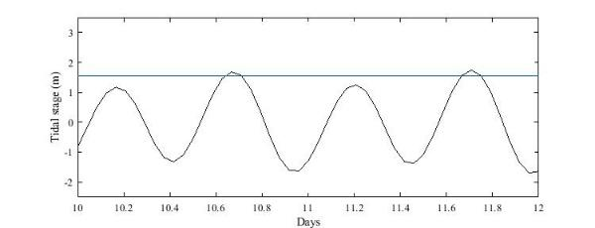
What causes nuisance flooding?
Background: The importance of tides
Tidal stage in Boston, MA
Tidal flood threshold
2 days

Slide 5
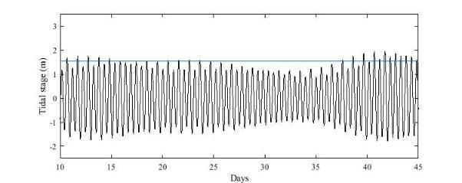
What causes nuisance flooding?
Background: The importance of tides
Tidal stage in Boston, MA
Tidal flood threshold
2 days
35 days

Slide 6
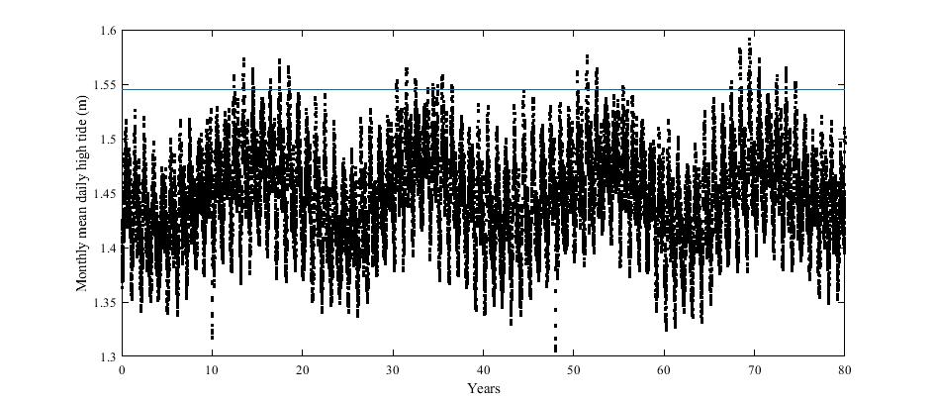
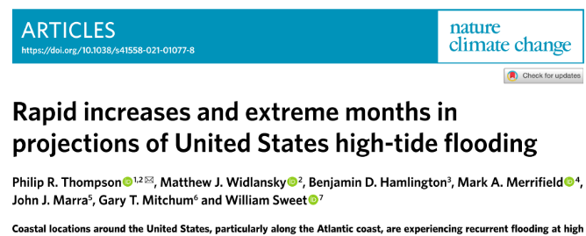
What causes nuisance flooding?
Background: The importance of tides
Monthly mean high tide level: Boston, MA
Tidal flood threshold

Slide 7
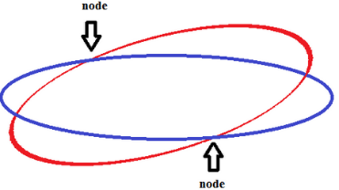
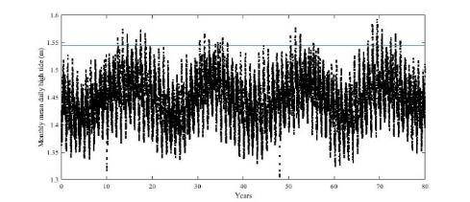


What causes nuisance flooding?
Background: Tidal Harmonics
In tidal predictions, the long and short period tides are represented by tidal constituents
The tidal constituents represent motion of the Earth, Moon, and Sun system
Example: Lunar Nodal Cycle – Moon’s orbit wobbles

Slide 8
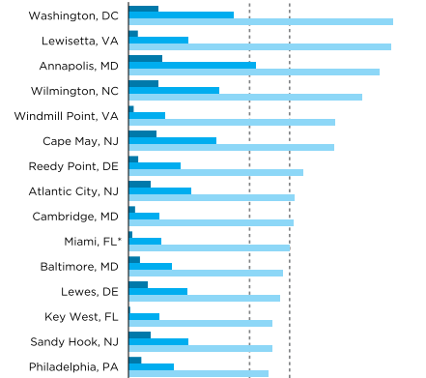
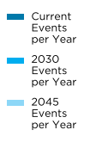

Background: Future nuisance flooding
Spanger-Siegfried et al. (2014)
City-by-city tidal flooding frequencies (events per year) from present day (dark blue) to 2045 (light blue)
Across board there is going to be a large increase in the frequency of these events.
We anticipate that groundwater salinity will be strongly affected by these future events

Slide 9
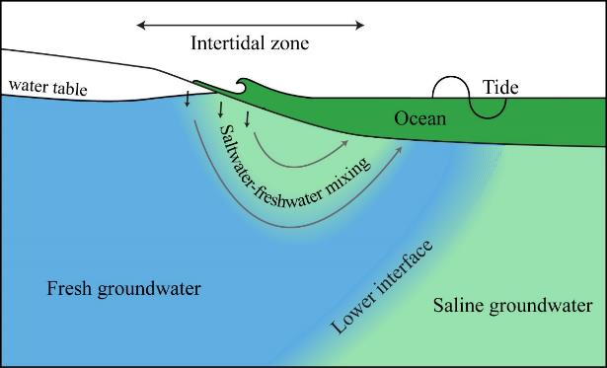
Coastal groundwater systems

Slide 10
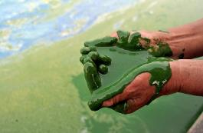
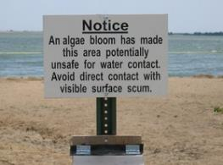
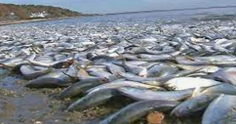
Coastal groundwater systems
DO, DOC, SO₄²⁻
Modeled
NO₃⁻
Fe²⁺
PO₄³⁻
Chemical reactions
Objective: Understand aquifer responses to increases in tidal flooding frequency

Slide 11
Driving research question
How will salinity in coastal aquifers respond to increases in tidal flooding due to rising sea level? How sensitive are intertidal salinities to sea level rise projections?

Slide 12

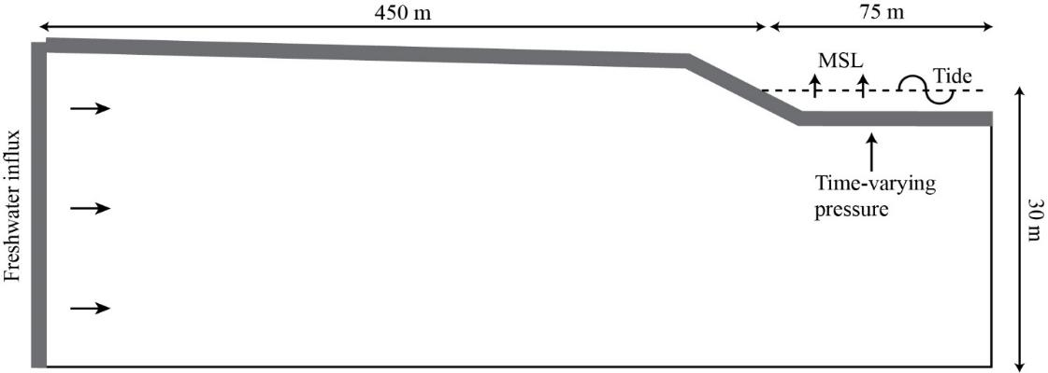
Model Domain and Boundary Conditions
Groundwater flow and transport model
USGS SUTRA code for variably-saturated variable-density groundwater flow and salt transport
Hydraulic conductivity = 10 m/d

Slide 13
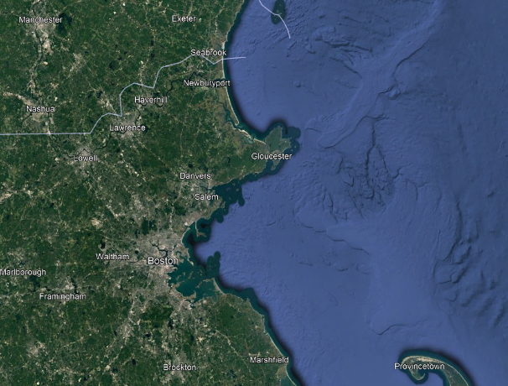
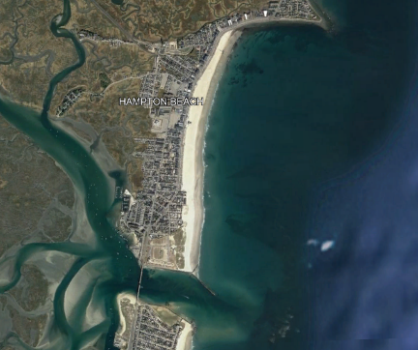
Model Domain and Boundary Conditions
Hampton Beach, NH topographic slope

Slide 14
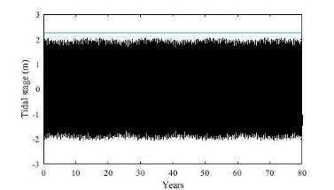
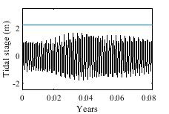
Model Domain and Boundary Conditions
Hampton Beach, NH; Tide+SLR
Tides only

Slide 15
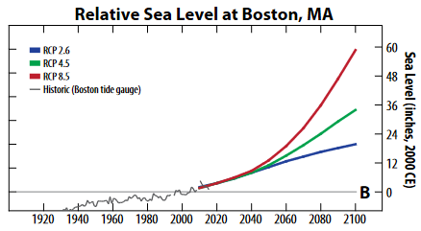
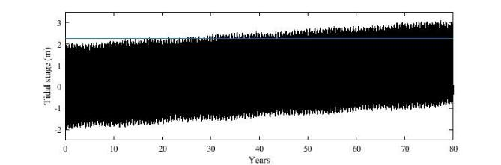
Model Domain and Boundary Conditions
Hampton Beach, NH; Tide+SLR
Tides only
+
=
Model scenarios:
No SLR
RCP 2.6 (0.85 m)
RCP 4.5 (1.10 m)
RCP 8.5 (1.49 m)

Slide 16
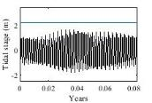
Model Domain and Boundary Conditions
Groundwater flow and transport model
4 Model scenarios: No SLR, RCP 2.6 (0.85 m), RCP 4.5 (1.10 m), RCP 8.5 (1.49 m)
Temporal discretization: 5 minute time steps to 2100
Hydraulic conductivity = 10 m/d

Slide 17
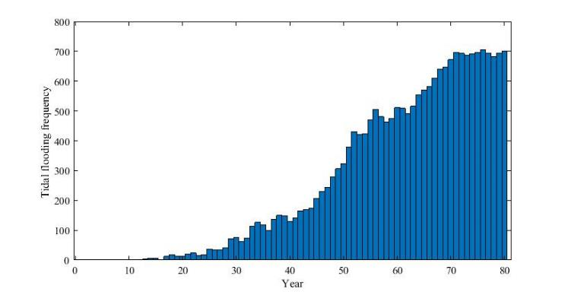
Model Domain and Boundary Conditions
Groundwater flow and transport model
4 Model scenarios: No SLR, RCP 2.6 (0.85 m), RCP 4.5 (1.10 m), RCP 8.5 (1.49 m)
Temporal discretization: 5 minute time steps to 2100
Hydraulic conductivity = 10 m/d

Slide 18
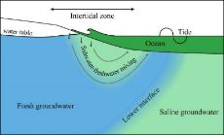

Pore water salinity dynamics
RCP 2.6
RCP 4.5
RCP 8.5
Freshwater flow path
15 years
30 years
45 years
60 years
75 years

Slide 19
Pore water salinity dynamics
RCP 2.6
RCP 4.5
RCP 8.5
Freshwater flow path
15 years
30 years
45 years
60 years
75 years

Slide 20
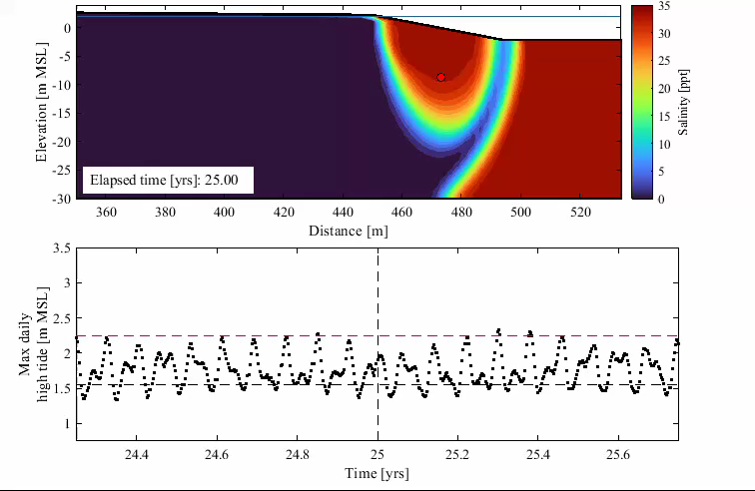
Pore water salinity dynamics
RCP 4.5
Start: 2045
End: 2070
Berm elevation
Mean high tide

Slide 21
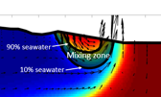
Intertidal mixing zone size
Mixing zone growth rates:
RCP 2.6: 58 m²/yr
RCP 4.5: 63 m²/yr
RCP 8.5: 87 m²/yr
8x
526 m²
Berm elevation

Slide 22

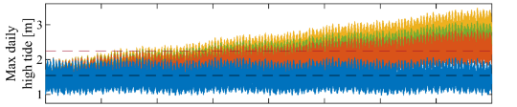

Water table salinity through time
Berm = 450 m
No SLR
RCP 2.6
RCP 4.5
RCP 8.5

Slide 23
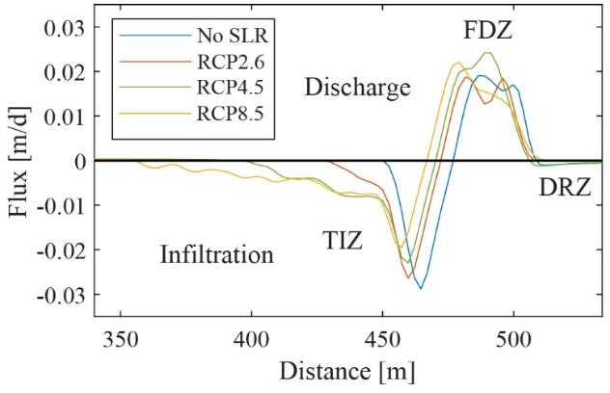

Vertical fluid exchange
Fresh discharge zone
Fresh discharge zone
Infiltration
Tidal infiltration zone
Tidal infiltration zone

Slide 24
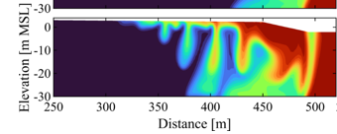


Summary
Model results show: Increased tidal flooding due to sea level rise disrupts intertidal mixing patterns over decadal time scales and leads to an 8 fold increase in the size of the saltwater-freshwater mixing zone.
Implications for biogeochemical processes and material fluxes to coastal ecosystems

Slide 25
Moving forward
These results are based on models that simplify the real-word
Observe aquifer responses in the field
Please be in touch if you have access to or are aware of a site that experiences tidal flooding that can be instrumented – james_heiss@uml.edu
Thank you!

Slide 27
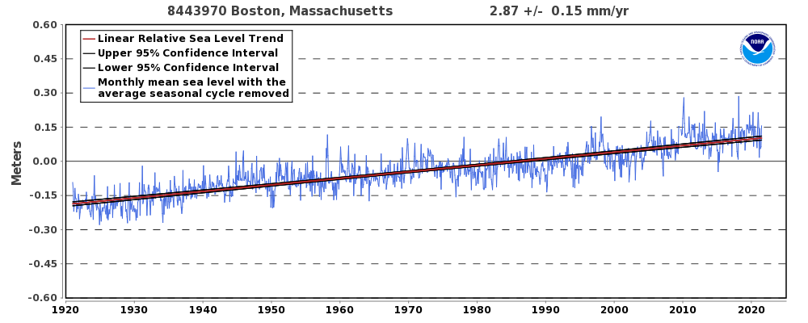
What causes tidal flooding?
Boston, MA Sea Level Rise
Boston Research Advisory Group Report, 2016

Slide 28

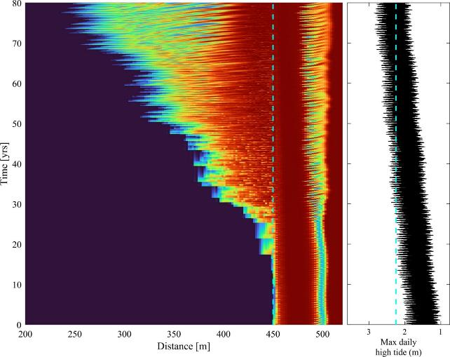
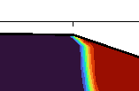

Water table salinity through time
RCP 4.5
x-shore berm location
berm elevation
berm
z = 2.25 m
x = 450 m

Slide 29
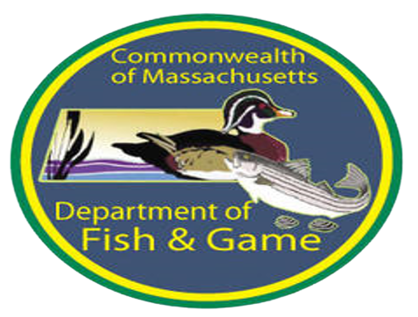
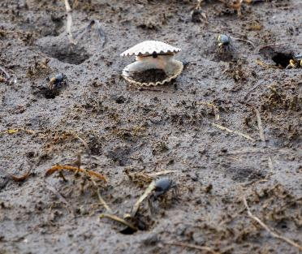
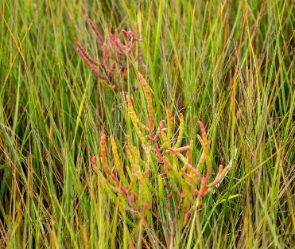
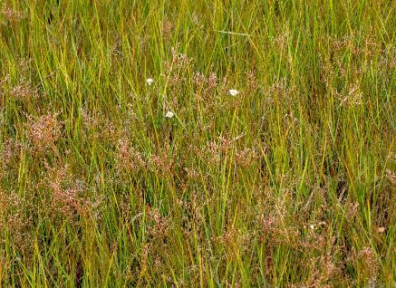
A Watershed Approach to Environmental Restoration and Preservation on a Changing Coast
SNEP 2022
Elisabeth Cianciola

Slide 30
What is an In-Lieu Fee Program (ILFP)?
Under Section 404 of the Clean Water Act, the Army Corps of Engineers requires compensatory mitigation for unavoidable impacts to aquatic resources
ILFP allows Corps permittees to make payment rather than mitigate onsite
  Payment only allowed for impacts remaining after avoidance and minimization
  Corps decides whether onsite or in-lieu fee mitigation is appropriate
  ILFP Sponsor uses payments to fund mitigation projects
    Can take the form of preservation, enhancement, rehabilitation and restoration projects

Slide 31
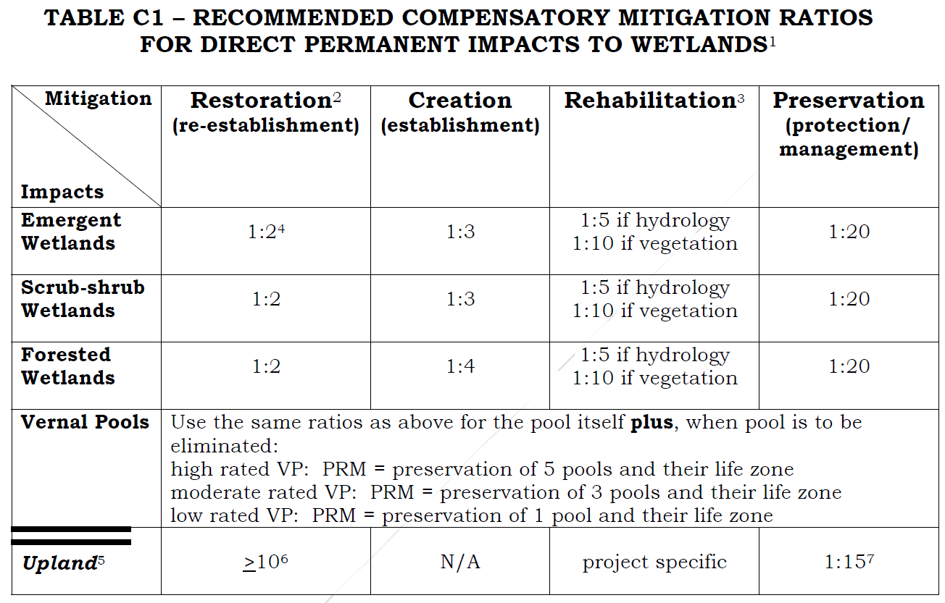
Notes:
As shown in this table, multipliers are used to ensure that projects funded by in lieu fee programs provide greater ecological benefit than improving an area the same size as the area that will be impacted. For example, the fee for impacting a tenth of an acre of wetland would be used to restore at least two tenths of an acre of wetland. Preservation projects have the highest multipliers because they don't replace functions that are lost because of permitted impacts.

Slide 32
About the MA ILFP
Established in 2014
Sponsor = Department
of Fish and Game (DFG)
Four service areas
  Berkshire/Taconic
  CT River
  Quabbin/Worcester
  Coastal
    North
    Central
    South
Notes:
Service areas are defined by watershed and ecoregion boundaries.

Slide 33
MA ILFP Revenue by Permittee Type
Notes:
Analysis done for the program's five-year report showed that the majority of ILF funds come from projects in the transportation and utility sectors. This is typical of ILF programs because linear right-of-ways often lack good opportunities for environmental mitigation.

Slide 34
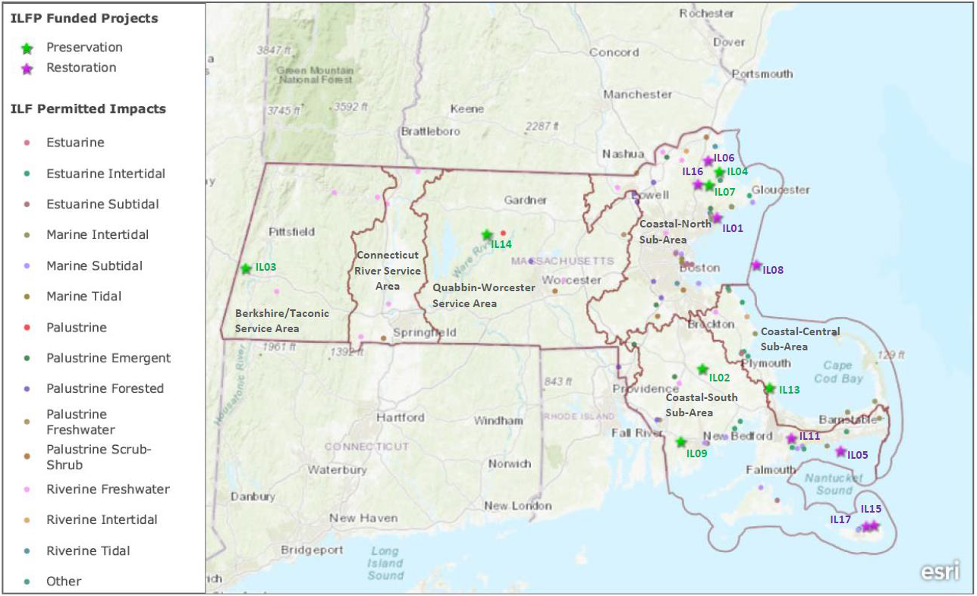
Locations of Impacts and Mitigation Projects
Notes:
As the density of points on the map shows, the program is most active in coastal watersheds.

Slide 35
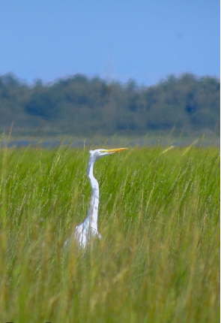
PROGRAM GOALS
  Protect high-quality aquatic resources under threat of loss or adverse change
  Restore degraded wetlands connected to high-quality wetlands
  Restore riparian buffers on agricultural lands
  Restore habitat continuity in coldwater streams and along the coast
  Facilitate coastal wetland migration to adapt to sea level rise
Google Images, 2019

Slide 36
ILF in the SNEP Region
Conservation projects
Nemasket River
Lyons Brook
Tidal restoration projects
Yarmouth reef
Nantucket reef
Restoration projects in planning
Nantucket eelgrass restoration
Chop Chaque Bogs restoration

Slide 37
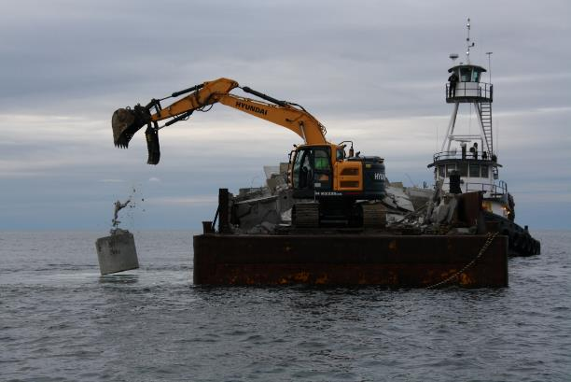
Yarmouth Reef
Deployed 2,000 CY of material over 2.1 acres
Cost of over-land transportation, weight of granite vs. concrete
Site marking & relationship to equipment size
Broad dispersal off barge effective
Deployment on January 6, 2020.
Notes:
For the Yarmouth reef project, DFG's Division of Marine Fisheries deployed 2,000 cubic yards of repurposed construction material over a 2.1-acre area to provide structured marine habitat. Some aspects of the project were different than expected. For example, transportation costs were higher because some of the material was granite that was moved over land where DMF had planned for concrete that would be transported by water. Inclement weather also delayed the deployment for a few weeks after the site was marked, giving the markers opportunity to move. But overall, the broad dispersal of material off of the barge was effective.

Slide 38
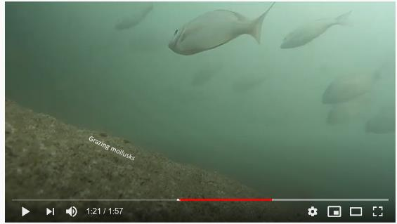
Project Results
Meets construction specifications open vs. structured
Pre and post side-scan sonar
5-yr monitoring 2021-2025
ecological diversity & production
https://www.youtube.com/watch?v=0Jt7sWsBqGA

Slide 39
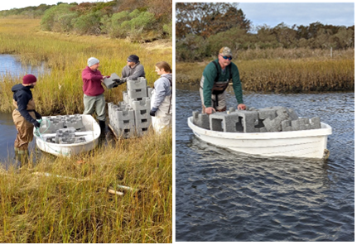
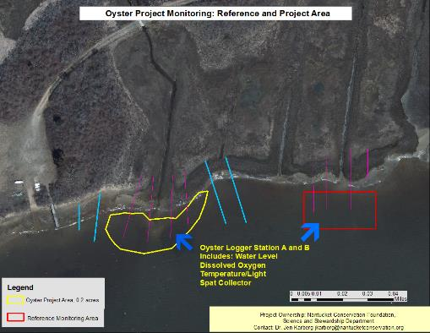
Nantucket Reef
NCF installed 0.17 acre reef November 2021
  500 oyster castles
  30 shell bags with 1,093,675 spat
Purple crab trapping and native cordgrass planting
in 1.1-acre salt marsh dieback area

Slide 40
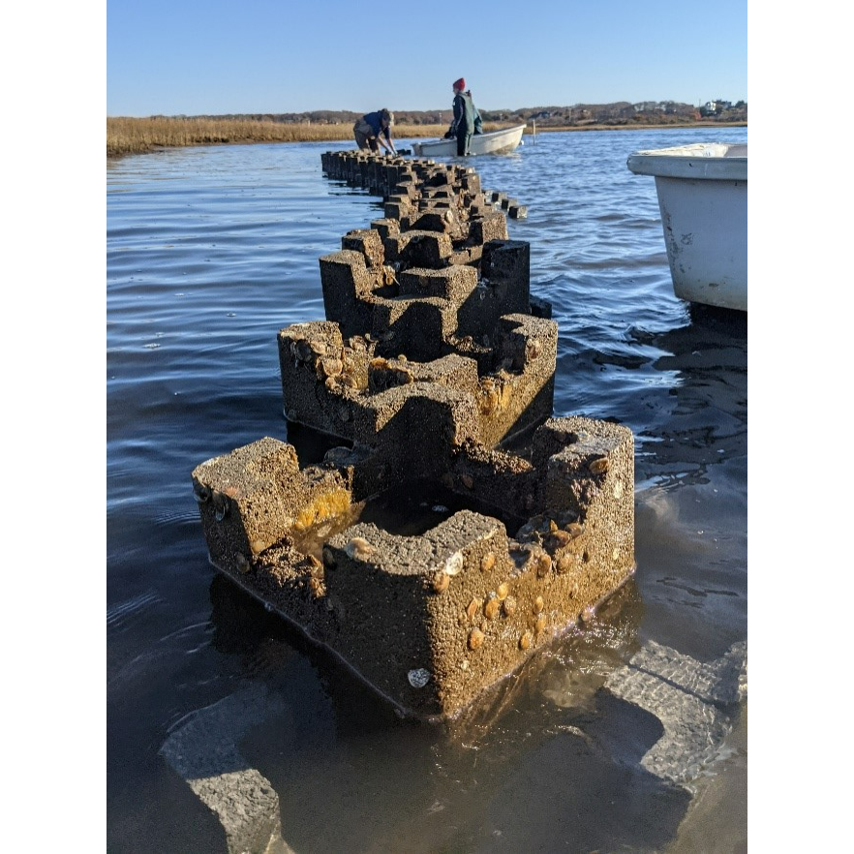
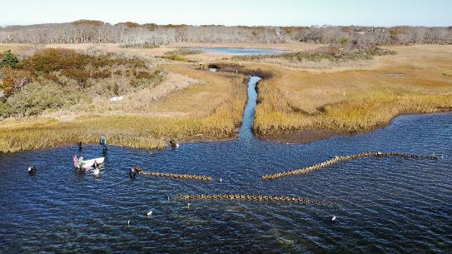
Project Results
Secure permits prior to purchasing supplies or setting oyster spat
Practice building on dry, flat land
Plan installation during lowest tides

Slide 41

Nemasket River
8.10 acres marsh
6.64 acres forested wetland
River
  One bank only, 5,070'
  Both banks and channel, 1,220'
70.0 acres Pine-hardwood upland
Notes:
Transitioning to preservation projects, MassWildlife used ILF funds to purchase land on the Nemasket River in Middleborough. It includes 8 acres of marsh and 6 acres of forested wetland. The property includes the left bank of about 5,000 feet of the river and both banks of another 1,000 feet. The majority of the property is forested upland.

Slide 42




Project Results
Notes:
Although there are some challenges with a utility easement and ATV use, the property provides valuable habitat for wildlife such as the red-bellied cooter. The property is managed as part of the Taunton River Wildlife Management Area.

Slide 43

Lyons Brook, Westport
3.6 acres forested wetland
46.1 acres oak/beech forested upland
3,600' river
  Both banks, stream channel, & 100’ buffer
Notes:
Buzzards Bay Coalition also used ILF funds to grant a conservation restriction to the Westport Land Trust. The property includes 3.6 acres of forested wetland, 3,600 feet of stream, and 46 acres of forested upland. It encompasses the majority of the Lyons Brook watershed, which drains into the East Branch of the Westport River.

Slide 44




Project Results
Notes:
The property has walking trails and has been posted with signs about the project.

Slide 45

Nantucket Eelgrass
Restoration site A near Monomoy (41 ̊ 17’9.06”, -70 ̊ 4’39.78”)
Restoration site B near Coatue (41°19'37.12", -70° 2'6.46")
Both sites previously supported eelgrass
Environmental data suggest sites are suitable for eelgrass
Reference site on Hussey Shoal (41° 17.205’, 70° 4.936”)
Plant 1/3 acre annually 2022-2024
Notes:
The last projects that I'll describe today haven't been implemented yet. Nantucket Land Council is planning to restore a half acre of eelgrass at two locations. Eelgrass was present at both sites historically, and monitoring data suggest that these sites could support eelgrass now. Nantucket Land Council plans to divide the planting equally over a three year period and use a reference site on Hussey Shoal as a benchmark to see if the restoration sites are on track to support self-sustaining eelgrass meadows.

Slide 46

Chop Chaque Bogs
Restore ~6 acres of
retired cranberry bogs
  Remove water
  control structures
  Move sand out of wetlands
  Plug ditches
  Roughen bog surface
Owned by Town of Mashpee
  Conservation restriction
  to be held by
  Native Land Conservancy
Notes:
The Chop Chaque bog project will restore 6 acres of retired cranberry bogs by removing water control structures, moving sand off of the bogs, plugging the drainage ditches, and roughening the bog surface. The site is owned by the Town of Mashpee and will have a conservation restriction held by the Native Land Conservancy.

Slide 47

Additional Resources
MA In-Lieu Fee Program
https://www.mass.gov/in-lieu-fee-program
Annual program reports & Instrument
Project reports & factsheets
Funding announcements
Notes:
For additional information about the in lieu fee program in Massachusetts including annual program reports, project reports and factsheets, and funding announcements, I encourage you to go to the program website. Thank you.

Slide 48

Greening the Woonasquatucket River Greenway
Alicia Lehrer, Woonasquatucket River Watershed Council (WRWC) Executive Director
Understanding Regional Climate Change Impacts

Slide 49


WRWC Mission: Create positive environmental, social and economic change by revitalizing the Woonasquatucket River, its Greenway and its communities.

Slide 50

283,757 total population
(27% of RI)

Slide 51

More Than 7,000
people live in Olneyville
In EPA Region 1 – Northeast
92% all EJ Indexes
96% wastewater discharge
For the state of RI, Olneyville
94% minority population
94% low-income population
86% linguistically isolated population
95% population < high school education
Highest density native Spanish speaking population in Providence.
Notes:
Olneyville is a densely settled target community for climate change issues like flooding and urban heat island.

Slide 52

100 Year Flood Zone
Notes:
This map shows that the Woonasquatucket, the lower part of which is tidal, has double impacts as we move downstream when severe storms mixed with storm surge coming upstream from Narragansett Bay can create huge flooding problems. I’m going to show you some pictures of what was a 1,000 year storm but is now expected more like every 30 years or more.

Slide 53



March 2010
Flood
Frontline Resident Cohort
NRCS Flood Resilience Project

Slide 54

The Woonasquatucket River Greenway

Slide 55


Using A Successful Public/Private Partnership
To Green the Greenway
WRWC
Build Partnerships
Leverage Funds – LIKE SNEP
Secure Loans
Landscape C&M
Project Agreement
C&M Charter
GI
Property
Owner
Project Agreement
Easement for C&M
RIDOT
Feasibility & Design
Funds for C&M
C&M
Easement
Notes:
Combine with new slide further in presentation

Slide 56

Greening the Greenway Pilot Project
  90% Impervious
  42 Parking Spaces
  Entrances & Exits
  - Westminster Street (x1)
  - San Souci Drive (x2)
  Catch Basin
WOONASQUATUCKET RIVER
N
SAN SOUCI DRIVE (ONE WAY)
0.71-acre
WESTMINSTER STREET

Slide 57

Greening the Greenway Pilot Project
  6,000 SF of impervious surface removed
  38 Parking Spaces
  Entrances & Exits
  - Westminster Street (x1)
  - San Souci Drive (x1)
  Bioretention Basin
  Volume: 1,450 CF
  Treats runoff from 17,400 SF of impervious surface

Slide 58


GTG Pilot Construction
Concurrent w/ New Greenway Spur
Notes:
$1million for design secured. $5 million for construction currently in TIP but potentially moving out of TIP or wrapping into viaduct project?

Slide 59

Citizens Bank – Post Construction

Slide 60


GTG Pilot – Post Construction

Slide 61



WRWC River Rangers Install GTG GI Job Training
Signage in English & Spanish
Engages Community

Slide 62


Building on the Pilot:
Prioritizing Projects - Highest Possible Score = 100
Points For:
Drainage System (drains from & to) – 3 to 25
Visibility, Connection to Greenway – 0 to 20
Matching Funding Opportunity – 0 to 5
Existing Partnership – 0 to 10
Educational Opportunity – 0 to 10
RIDOT Stormwater Credits – 0 to 25
Bonus Points (e.g. potential new section of Greenway)
Site Restrictions Negative Points

Slide 63
GTG Potential Projects

Slide 64
Project 1
Greening & Cleaning Manton Ave
Goals
Employ “Nature at Work” green infrastructure techniques along Manton Avenue to capture and treat stormwater runoff from the neighborhood, starting at Olneyville Square and moving northwest up Manton Avenue.
  Install Tree Filters – 4 Tree Filters w/ attached catch basins installed
  Install other green landscape elements – 8 sidewalk inset planting areas installed
Notes:
SARA: Students speaking to adults in a different way - bigger impact and reach
Overall goal: Making sure that the residents of all ages in the community are comfortable and confident to speak out on climate resilience issues that matter most to them. To give the community members the tools to work together and create the solutions for their community. Working with youth and adults to create the most impactful, meaningful connections and highlight the importance of intergenerational efforts.

Slide 65
After Pilot: Site 1 – Manton Avenue, Olneyville
Before

Slide 66

After Pilot: Site 1 – Manton Avenue, Olneyville
New sidewalk planting bed
New Tree Filter w/ attached catch basin
New sidewalk planting bed
Note: Street tree shown in “Before” pic was knocked down by a car during the course of this project. The WRWC will be replacing the tree with remaining partner funds.
After

Slide 67


Site 2 – Farm Fresh RI Food Hub

Slide 68



Site 2 – Farm Fresh RI Food Hub – Ranger Install
The Market Now! Photo Credit: Farm Fresh RI

Slide 69

Site 3a – Iglesia Puerta De Refugio - Before

Slide 70


Site 3a – Iglesia Puerta De Refugio - After

Slide 71


Site 3a – Iglesia Puerta De Refugio – Ranger Install

Slide 72

Site 3b – Iglesia Puerta De Refugio - Before

Slide 73


Site 3b – Iglesia Puerta De Refugio - After

Slide 74

In Design – GTG Phase II -Downtown Greenway

Slide 75

In Design – GTG Phase II -Downtown Greenway 2023

Slide 76

The Impact
GTG Stormwater Capture – 1” Design Storm
San Souci Pilot: 539 cubic feet, 4,032 gallons
Manton Tree Filters: 315 cubic feet, 2,356 gallons
Pleasant Valley Tree Filters: 1,250 cubic feet, 9,351 gallons
Greystone Social: 2,495 cubic feet, 18,664 gallons
Farm Fresh: 5,510 cubic feet, 41,150 gallons
TOTAL CAPTURE 1” Storm: 10,109 cubic feet, 75,553 total gallons
The Bad News: 5 sq mi capture needed to impact flooding = 600 Pilot Projects

Slide 77



The Good News: Education, New Stewards, Support
Young Stewards
Tours
Art Highlights Projects

Slide 78



Greening the Woonasquatucket River Greenway
Clean Water, Environmental Justice, Community Engagement and Resilience
Alicia Lehrer
Executive Director
alehrer@wrwc.org
(401) 861-9046
@WRWCRI on Facebook
@thewoony on Instagram
@wrwc on Twitter

Slide 79


Thank You
Notes:
None of us can do this alone. Together we can keep transforming Providence.
We are committed to filling the gap by attracting both public and private resources. This shared revenue model positions our organization for sustainable success to continue the revitalization work that we take so seriously. With a lean staff, our pursuit of philanthropy will be modest but no less important. We look forward to our continued work together and continuing to bring great economic return to the state though our transformation of Woonasquatucket River Watershed and it's adjoining property.

