Slide 1

Tier2 Submit TM
How To Fill Out Your Tier II Form
Using Tier2 Submit Software

Slide 2
Notice:
This presentation provides guidance to facilities with Emergency Planning and Community Right-to-Know Act (EPCRA) Tier II reporting requirements.
The statutory provisions and EPA regulations described in this guidance presentation contain legally binding requirements.
This guidance presentation does not substitute for the provisions or regulations, nor is this presentation a regulation.
In the event of a conflict between the discussion in this presentation and any statute or regulation, this presentation would not be controlling.
This guidance does not impose legally binding requirements on the EPA or the regulated community, and it might not apply to a particular situation based upon circumstances.
For specific requirements and details, refer to the implementing regulations of 40 CFR Part 370 (42 U.S. Code § 11022) and check with your state, tribe, or territory for your specific requirements.

Slide 3
What is Tier2 Submit?
Tier2 Submit is a free software tool that is provided by the EPA to assist states, tribes, and territories in their collection of hazardous chemical and extremely hazardous chemical (EHS) Information. It is intended to help facilities meet their annual
Tier II submission requirements of the Emergency Planning and Community Right-to-Know Act (EPCRA) [40 CFR Part 370]. EPCRA was authorized by Title III of the Superfund Amendments and Reauthorization Act (SARA Title III).
New versions of Tier2 Submit are released annually.
Tier2 Submit integrates with CAMEO Data Manager and the the CAMEO suite to assist in preparedness and response activities.
https://www.epa.gov/epcra/tier2-submit-software

Slide 4
What is a Tier II Report?
Section 312 of EPCRA [40 CFR Part 370] requires that facilities submit Tier II Information for hazardous chemicals, which include EHSs. A Tier II Report is a means of submitting the required information to state or tribal and local planning and response agencies, which includes fire departments. Reports must include information on the chemicals present at the facility, facility information, and facility contacts. More information on the requirements are provided later in this document.
https://www.epa.gov/epcra/tier-ii-forms-and-instructions

Slide 5
Submission Flow Using Tier2 Submit
Chemicals: Inventory and collect information on your chemicals.
Facility Information: Gather information on your facility and required contacts.
Review and understand your state, tribe, or territory and local requirements, including any additional reporting, fees, and submission methods.
Enter required and requested information into Tier2 Submit.
Export your submission file.
Submit the submission file to your state, tribe, or territory. Ensure to also submit to the local planning and response agencies, including your fire department, if required in your state, tribe, or territory.

Slide 6
EPA Terms and Acronyms
Hazardous Chemical
A chemical is a hazardous chemical if the Occupational Safety and Health Administration (OSHA) Hazard Communication Standard (HCS) [29 CFR 1910.1200(g)] requires a Safety Data Sheet (SDS). Note that things you may not think of as chemicals (e.g., copper, sand, zinc, lead acid batteries, etc.) are included in the term Hazardous Chemical.
Extremely Hazardous Substance (EHS)
A chemical is an Extremely Hazardous substance (EHS) if it is listed in
40 CFR Part 355 Appendix A or Appendix B.
Reporting Threshold
A quantity value used to determine if the specific hazardous chemical is required to be listed on your Tier II report. Note: the term hazardous chemical includes all substances that OSHA requires a SDS for.
Threshold Planning Quantity (TPQ)
TPQs are quantity values (in pounds) established by the EPA for each EHS. TPQ values are provided in 40 CFR Part 355 Appendix A or Appendix B.

Slide 7
EPA Terms and Acronyms
Safety Data Sheet (SDS)
Chemical information sheets that are required by the OSHA HCS
[29 CFR 1910.1200(g)]. These information sheets provide chemical information such as the properties of each chemical; physical, health, and environmental health hazards protective measures; and safety precautions for handling, sorting, and transporting the chemical. These are formally known as Material SDS (MSDS).
State or Tribal Emergency Response Commission
(SERC) or (TERC)
An organization designated by the Governor or Tribal leaders to implement the EPCRA provisions within the jurisdiction. Responsibilities include establishing procedures, responding to requests for information, designating local emergency planning districts, and appointing and supervising local or tribal emergency planning committees.
Local or Tribal Emergency Planning Committee
(LEPC or TEPC)
An organization appointed by the SERC or TERC to develop emergency response plans and to provide information about chemicals in the community to the citizens. Committees must include participation from State and local officials; police, fire, civil defense, and public health professionals; environment, transportation, and hospital officials; facility representatives, and representatives from community groups and the media.

Slide 8
What you need to know before getting started:
Your Chemicals
Your Facility
Your state, tribe, or territory Specific Requirements

Slide 9
Your Chemicals
Compile a list of all the chemicals present at your facility and the maximum quantity present (in pounds) at any time during the previous calendar year. Guidance to convert from gallons to pounds for liquids is provided on the next slide.
Hazardous Chemical Determination: Determine which of your chemicals are required to have an SDS under the OSHA HCS [29 CFR 1910.1200(g)]. Determine if any of these chemicals meet the exemptions provided in EPCRA Section 311(e) [40 CFR Part 370.13]. Exempt chemicals do not need to be reported, unless required by your state, tribe, or territory. All other hazardous chemicals must be reported.
Extremely Hazardous Substance (EHS) Determination: Determine whether each of the hazardous chemicals is also an EHS and note the threshold planning quantities (TPQ) for each of the EHS chemicals, by using 40 CFR Part 355 Appendix A and Appendix B
Document the Chemical Abstract Service (CAS) numbers for each of your chemicals. You may use the SDS or this website to determine CAS numbers: https://commonchemistry.cas.org/
Determine the reporting thresholds for each chemical. More information is provided on this later in this presentation on the page titled, “Do you need to submit a Tier II Report (Reporting Thresholds)”.

Slide 10
Your Chemicals –
Converting from gallons to pounds for liquids
Refer to 40 CFR 370.14 and the Tier II Inventory Form Instructions for more detailed instructions.
All amounts must be reported as weight in pounds. To convert gas or liquid volume to weight in pounds, multiply by an appropriate density factor.
  Pounds = density (lbs/gal) x gallons on site
  Density = specific gravity x 8.34 (lbs/gal)
  Example: You received one large shipment of a solvent mixture last year. The shipment filled five 5,000-gallon storage tanks. You know that the solvent contains 10% benzene, which is a hazardous chemical. You figure that 10% of 25,000 gallons is 2,500 gallons. You also know that the density of benzene is 7.29 pounds per gallon, so you multiply 2,500 gallons by 7.29 pounds per gallon to get a weight of 18,225 pounds.
You may also use the EPA Gallon to Pound Conversion Tool

Slide 11
Your Chemicals –
Mixture Calculations
Refer to the Help, Slide 69 of this presentation, 40 CFR 370.14, and the Tier II Inventory Form Instructions for more detailed instructions.
EHS Mixture Threshold Determination: For determining if your facility met or exceeded the threshold levels for EHSs, you must use the aggregated value of the total quantity of each EHS present throughout your facility at any one time in the previous calendar year. For each EHS, add together the quantity of that EHS present as a component in all mixtures and all other quantities of the EHS. Reporting of EHS mixtures is the same as for non-EHS mixtures, as described in the first bullet on this page.
Options for Mixture reporting: If a hazardous chemical is part of a mixture, you have the option of reporting the entire mixture or only the portion of the mixture that is a particular hazardous chemical [e.g., If a hazardous solution weighs 100-pounds but is composed of only 5% of a particular hazardous chemical (remainder of the solution is water), you can indicate either 100-pounds of the mixture or 5-pounds of the hazardous chemical].

Slide 12
Your Facility Information
Facility Name
Facility Location & Mailing Address
  Location of chemicals: official 911 address or legal description of location.
  Location of chemicals: Latitude and Longitude (Tier2 Submit can help provide this)
  Mailing Address for the facility
The Dun & Bradstreet number for your company
  https://www.dnb.com/duns-number.html
The NAICS Code for your industry
  https://www.naics.com/search/ or https://www.census.gov/naics/
Contact Information for:
  Two Emergency Phone Numbers. One must be a 24-hr/day 7-day/week number
  Owner or Operators
  Tier II Information Contact

Slide 13
Your state, tribe, or territory
Specific Requirements
EPCRA (40 CFR Part 370) provides flexibility to the states, tribes, and territories to enact more stringent requirements on facilities, within their jurisdictions, and to determine the method of submitting the information.
Determine if your state, territory, or tribe allows submission of Tier2 Submit Submission Files. If your jurisdiction requires submission via a different software, you may not want to proceed with using Tier2 Submit.
Determine if your state, territory, or tribe has reporting requirements in addition to the Federal mandates. Note that jurisdictions that use Tier2 Submit may request for additional data field be added to Tier2 Submit.
The EPA website has a list of state and territory Tier II reporting requirements and procedures, and contacts. You should verify with your jurisdiction that the information provided by the EPA is accurate prior to proceeding.

Slide 14
Reporting Thresholds:
Do you need to submit a Tier II Report?
Review your compiled list of all the chemicals present at your facility and the maximum quantity present (in pounds) at any time during the previous calendar year.
For the chemicals you determined to be EHSs
Reporting is required for each EHS chemical that was present at your facility in quantities over the TPQ or 500 pounds (whichever is less)
For the chemicals you determined to be hazardous chemicals, but not EHSs
Reporting is required for each non-EHS hazardous chemical which was present in quantities at or above 10,000 pounds
For Diesel and Gasoline, at retail gas stations, in underground storage tanks (UST)
Gasoline: Reporting is required if more than 75,000 gallons was present
Diesel: Reporting is required if over 100,000 gallons was present

Slide 15
Getting Started:
Download and Install the Tier2 Submit software for the previous calendar year’s reporting period. The versions are named for the reporting year; the March 2023 submissions will require you to use the Tier2 Submit 2022 software.
Open the newly installed software.

Slide 16
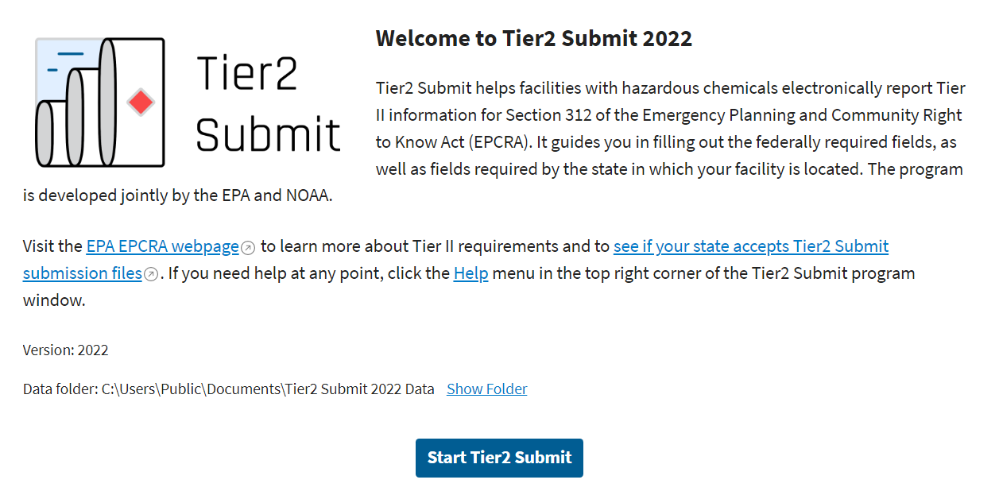
Getting Started:
Welcome Page:
This page contains information and links to understand Tier II reporting and your state, tribe, or territory specific requirements.
Click “Start Tier2 Submit” to start creating your Tier II report.

Slide 17
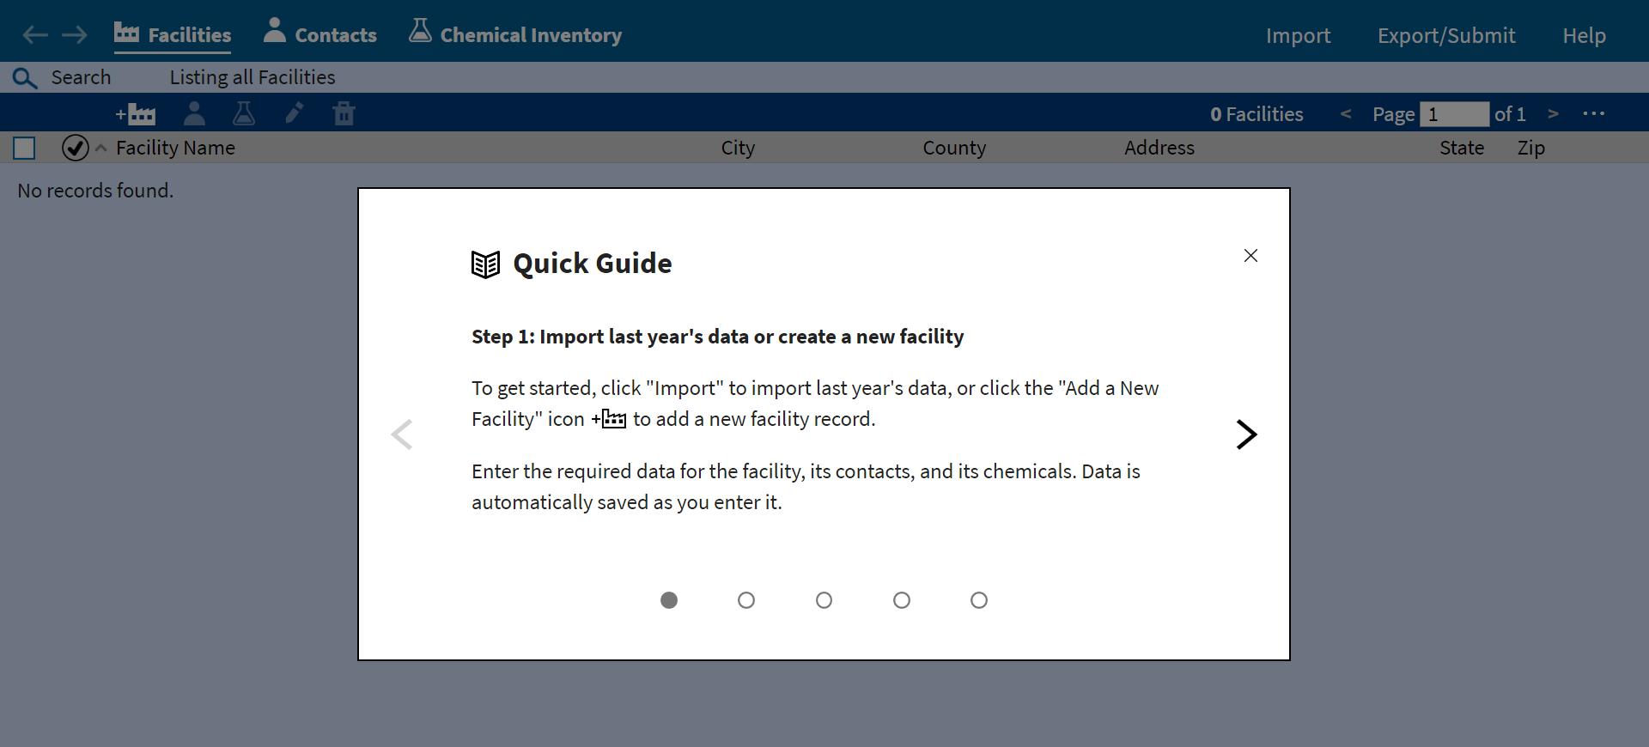
Getting Started:
Quick Guide:
The first time you open Tier2 Submit, you will see
this Quick Guide.
It walks you through the steps to generate your Tier II report.

Slide 18
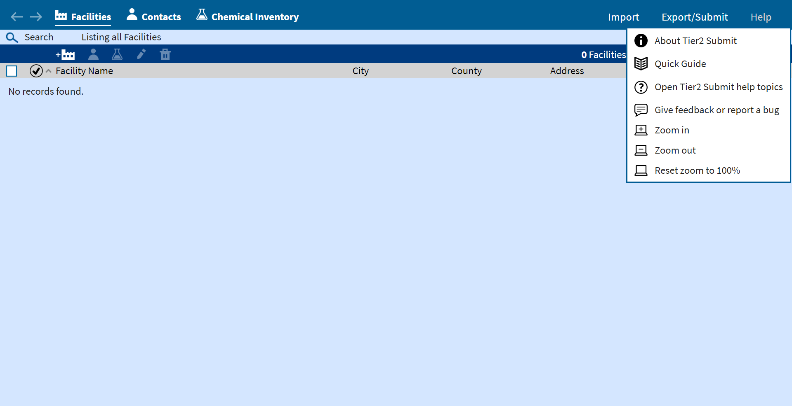
Getting Started:
Quick Guide:
After you close
the Quick Guide,
it will be available
at any time
in the Help Menu
Help Topics:
The help topics are extensive. Use them freely throughout the application.

Slide 19
Getting Started:
Page Layout:
The bar at the top
will always be
displayed to
Provide navigation.

Slide 20
Getting Started:
Where are you?
The left side of the tool bar
indicates which part of Tier2 Submit you are in
with the white underline.
Special Actions
The right side of the toolbar displays some special actions you may wish to take.
Import last year’s data
Export/Submit this year’s data so that you may
submit it
Help menu
Saving Your Data:
There is no “Save” command.
Your data is automatically saved as you type it.

Slide 21
Importing a File From Last Year
    If you used Tier2 Submit for the last reporting year, you may import that data to be used as the starting point for this year’s filing. The data will need to be updated for the current reporting year.
    Locate last year’s data file and use that path to import the data into Tier2 Submit. You may be able to get the file in electronic format from your state, tribe, or territory if you can’t find your submission file.
    If you did not use Tier2 Submit last year, proceed to Slide 31

Slide 22
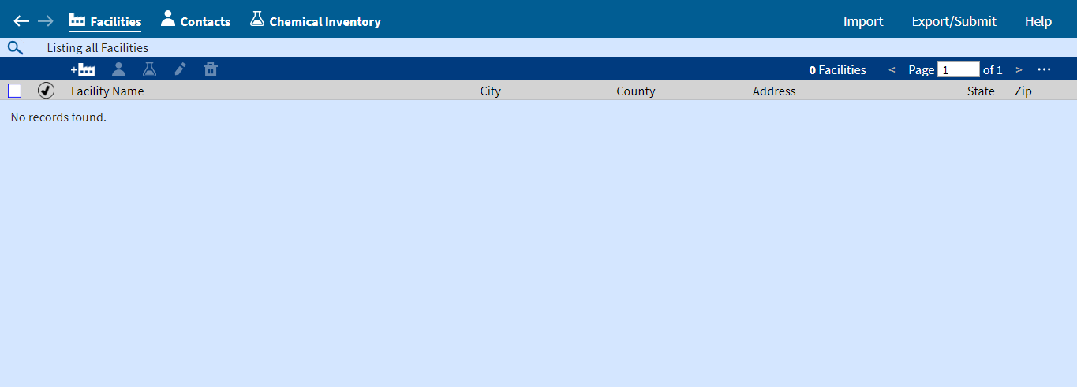
Importing a file from last year
Importing a File:
Start by clicking
on “Import”

Slide 23
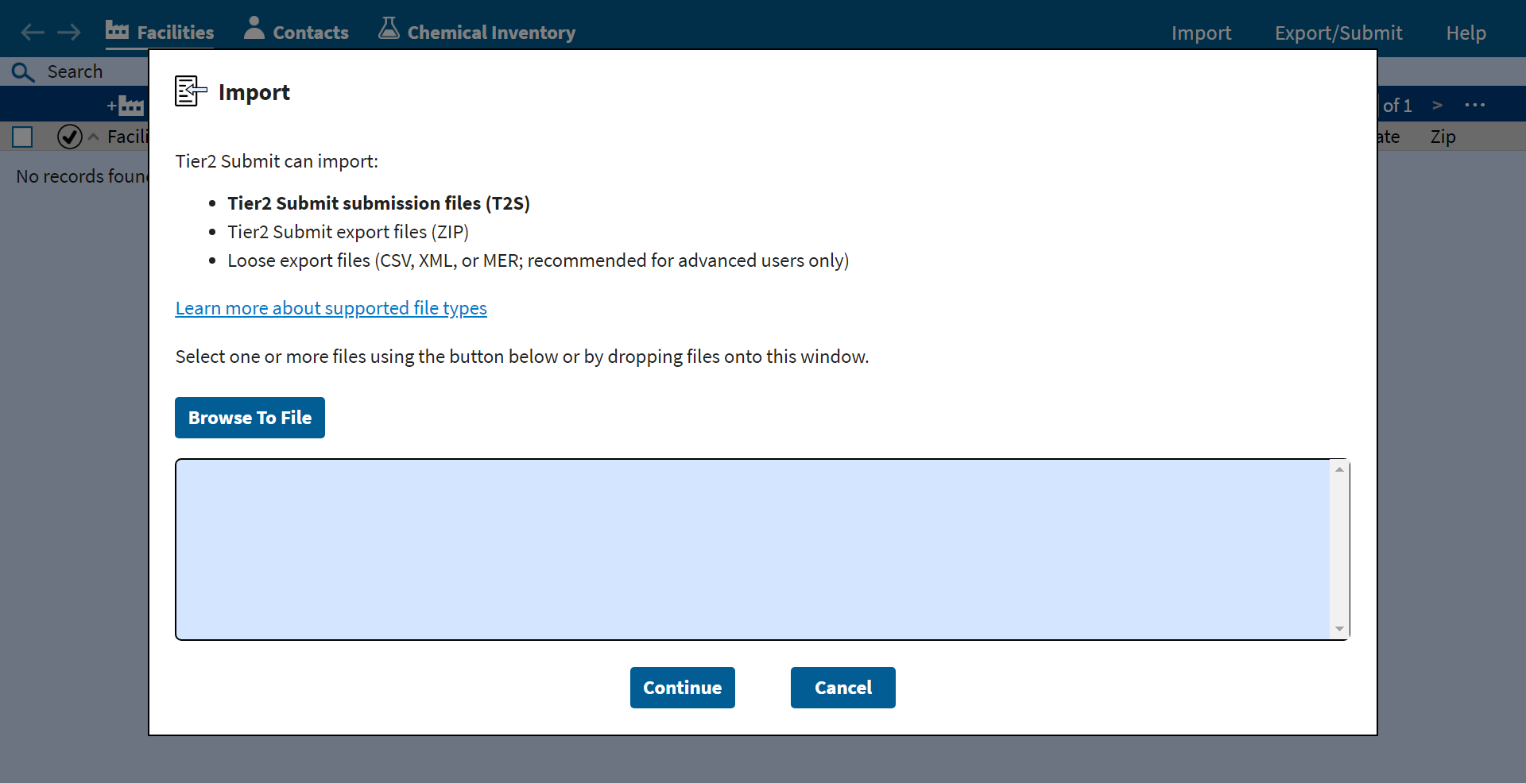
Importing a file from last year
Importing a File:
Then select,
“Browse to File”
to find where
the file is stored on your computer.

Slide 24
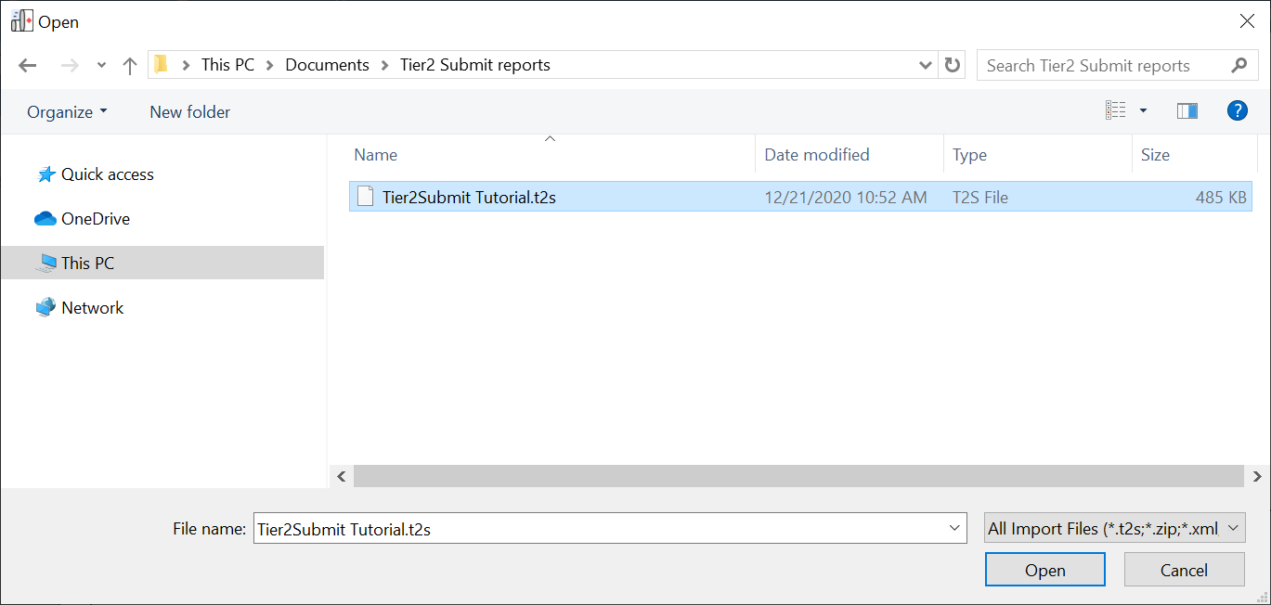
Importing a file from last year
Importing a File:
Find where
the file is stored on your computer.
The file should have a .t2s extension. It may have a .zip extension.
Once you found the file, select “Open”.

Slide 25
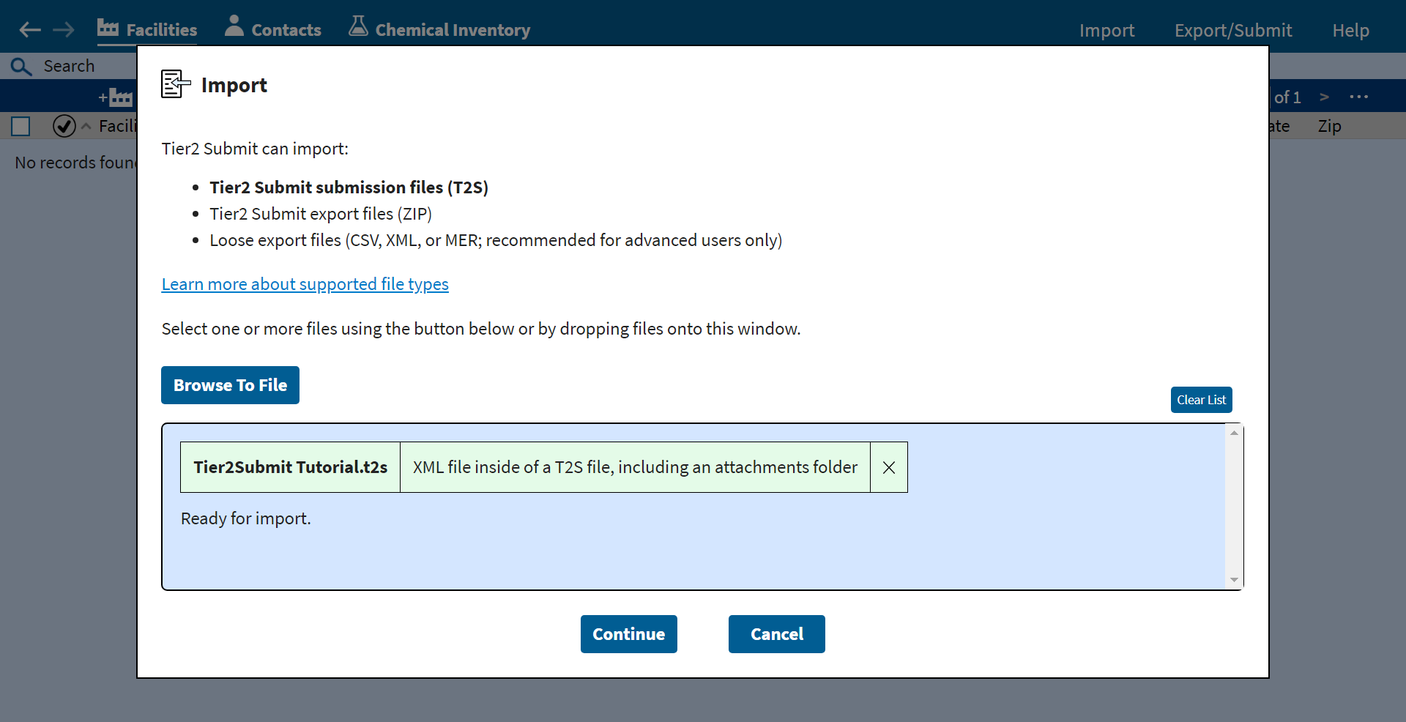
Importing a file from last year
Importing a File:
If you have the correct file.
Select “Continue”
to import the file.

Slide 26
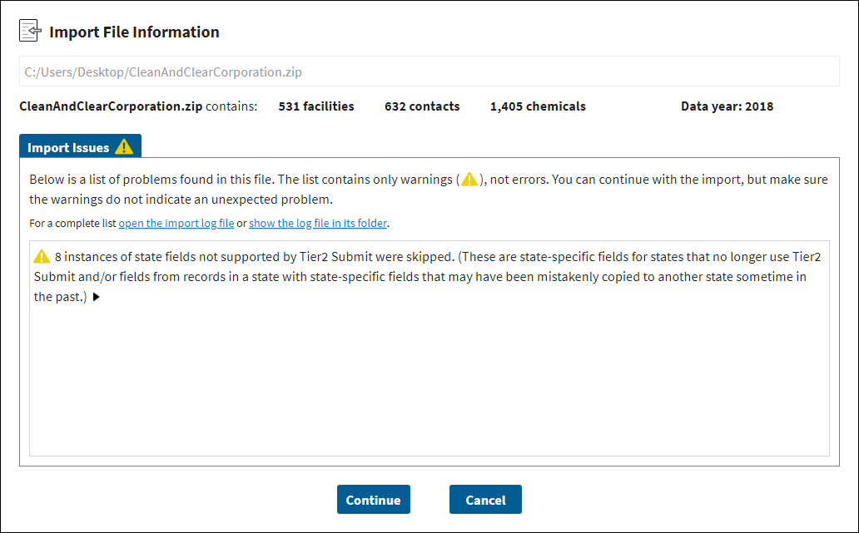
Importing a file from last year
Importing a File:
You may see
warning or errors.
Read the messages carefully and contact RMPRC@epacdx.net
if you have questions.

Slide 27
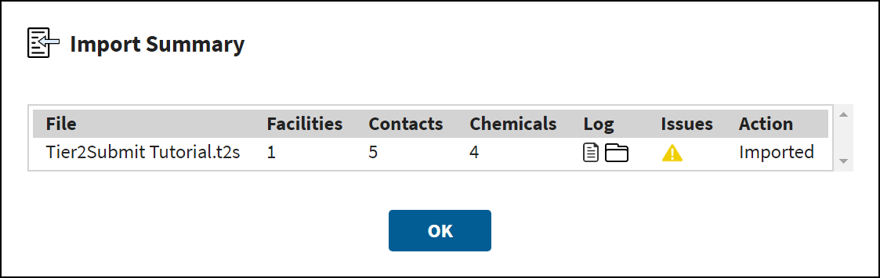
Importing a file from last year
Importing a File:
If the import is
successful the
screen will look
like this.
Select “OK”
to continue.

Slide 28
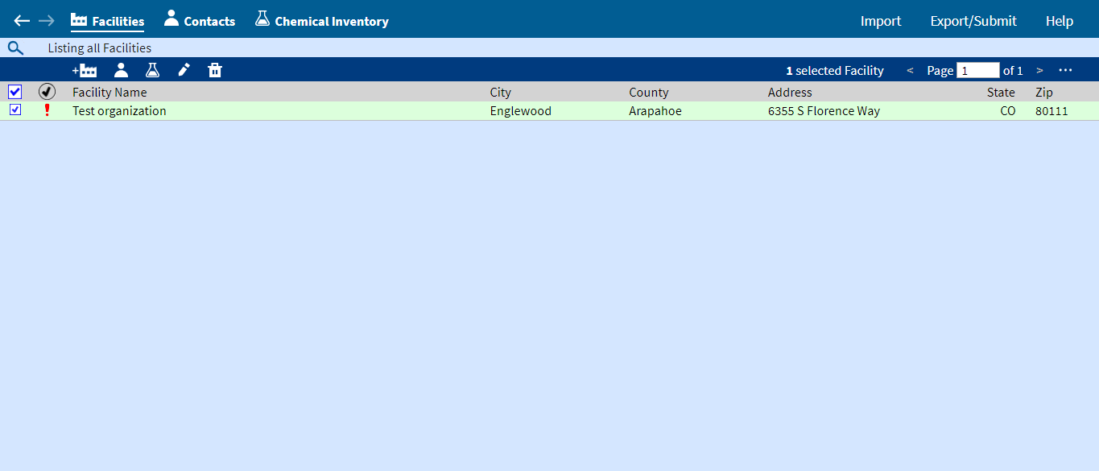
Importing a file from last year
Importing a File:
After import, your
facilities from last year will be listed under “Facilities”.
To open and view details for a facility, double-click on it.
The row will flash green and then you can proceed with updating for this year.

Slide 29
Importing a file from last year
Importing a File:
Tier2 Submit reviews the data and notes any errors or missing data.
To review the errors click the red exclamation mark (!).

Slide 30
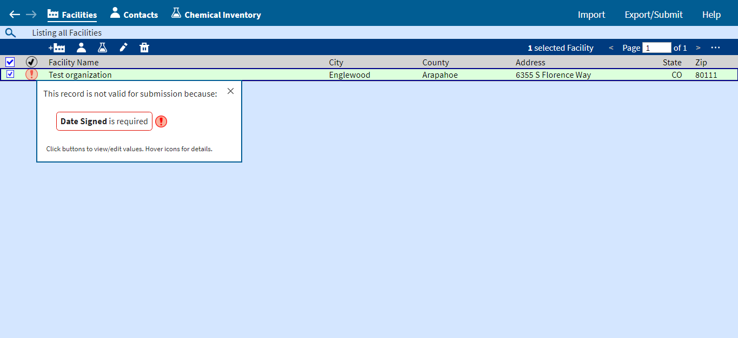
Importing a file from last year
Importing a File:
A list of errors will appear, don’t be alarmed. You will be prompted to update the data as you proceed through the application.

Slide 31
Creating a new facility
    If you did not use Tier2 Submit last year, you will need to create a new facility.
    If you imported your data file from last year and do not have any new facilities to add, proceed to Slide 34

Slide 32
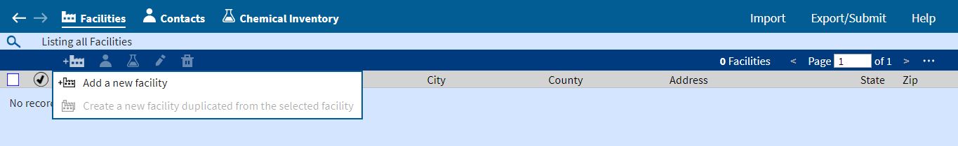
Creating a New Facility:
Creating A New Facility:
Click on the facility icon
Then select “Add a new facility”

Slide 33
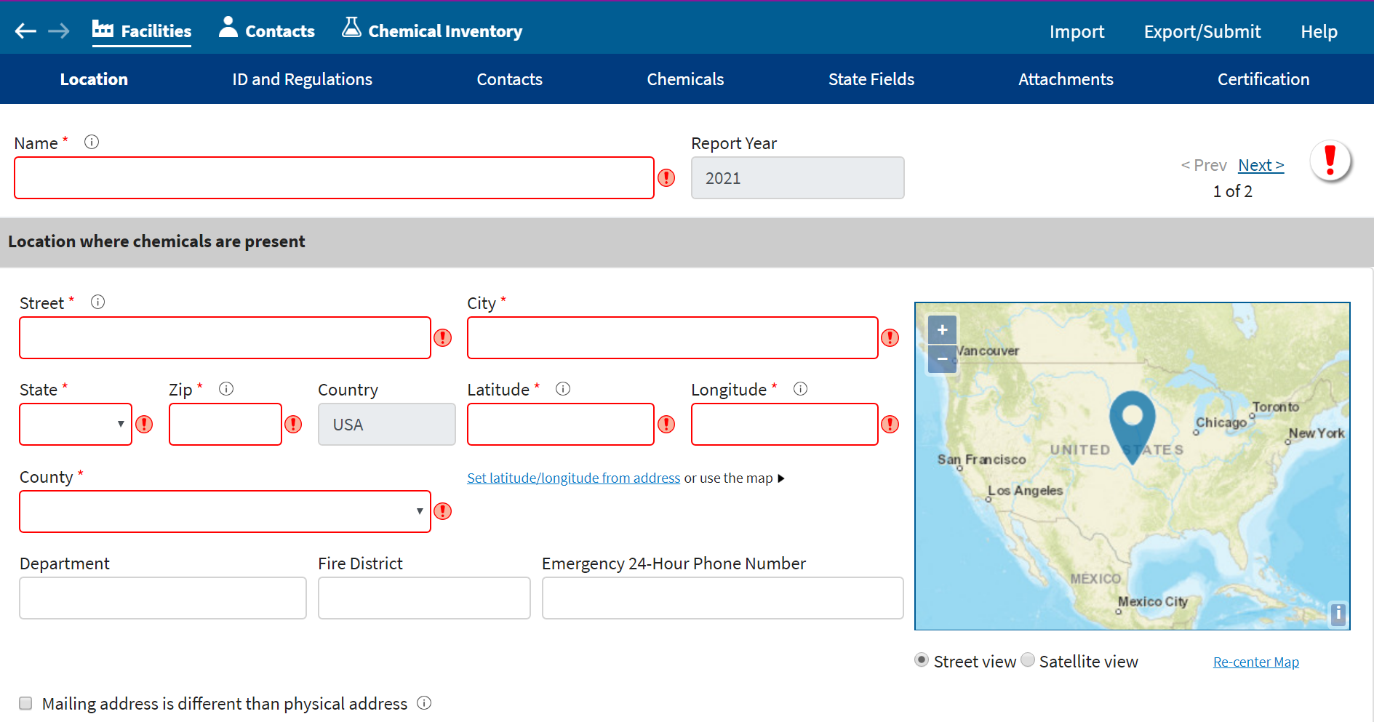
Creating a New Facility:
Creating A New Facility:
Answer the questions and enter the information that you prepared in the “What you need to know before getting started” section of this training.

Slide 34
Facility data
    If you created a new facility, you need to enter all the required information for your facility.
    If you imported a data file from last year, please verify that the information is correct for this year.

Slide 35
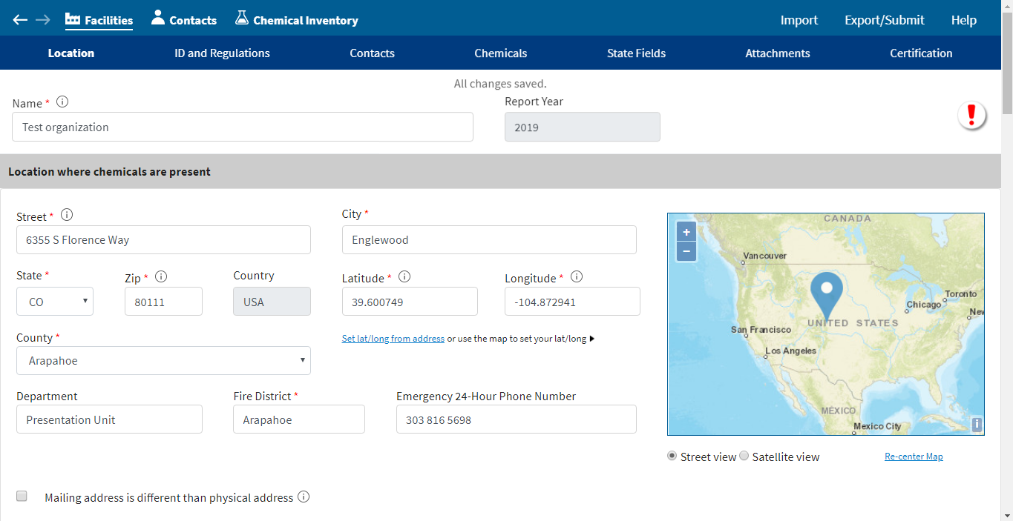
Facility data: Navigation
Navigation:
When you open a facility record, the dark blue tool bar at the top represents sections of the record
The gray bars correspond to those sections.

Slide 36
Facility data: Location
Location:
Start at the top of the record, in the “Location” section.
This is the location of the facility where chemicals were in inventory, not headquarters or
other locations.

Slide 37
Facility data: Location
Location:
Note that fields with red asterisks ( * )
Are required fields.

Slide 38
Facility data: Location
Location:
It is very important that the latitude and longitude are exact.
Tier2 Submit can help you determine the exact location.
Use Tier2 Submit to verify the location is correct, even if you imported last year’s data.

Slide 39
Facility data: Location
Location:
Note that states, tribes, and territories may have different requirements.

Slide 40
Facility data
ID and Regulations:
When finished with each section,
click on the
next section or
scroll down the page.

Slide 41
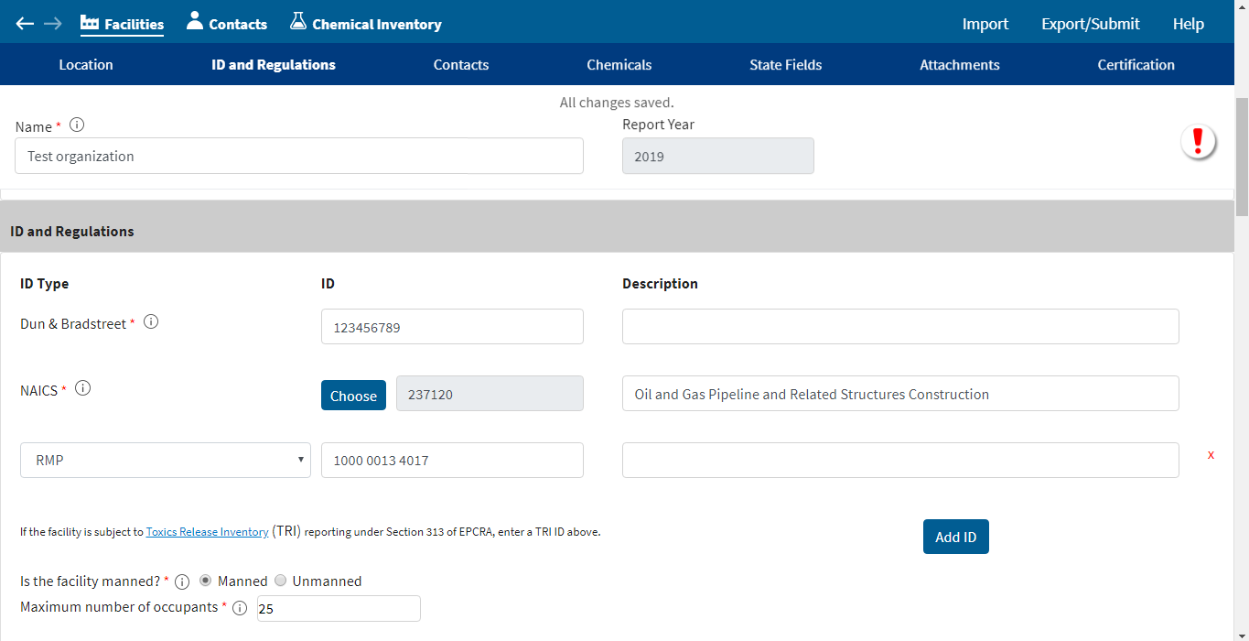
Facility data: ID and Regulations
ID and Regulations:
Enter the required and requested information.
The Dun & Bradstreet Website can provide this number. If your facility is a public utility or other non-business entity, you may enter “N/A”.

Slide 42
Facility data: ID and Regulations
ID and Regulations:
Enter the required and requested information.
You may get your NAICS number on the NAICS website or the US Census website.

Slide 43
Facility data: ID and Regulations
ID and Regulations:
Facilities are considered “Manned” if there is ever one person there. The “maximum” is the largest number of people you’d ever expect at the facility.

Slide 44
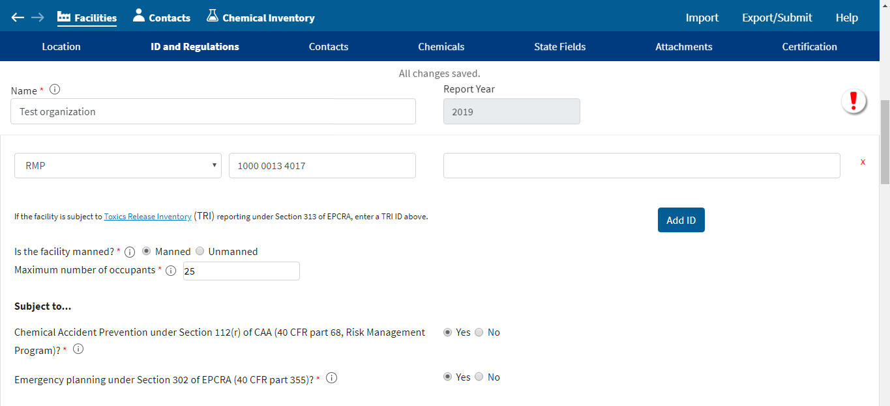
Facility data: ID and Regulations
ID and Regulations:
If your facility is required to have a Risk Management Program, you will
need to enter its ID.
For more information, visit the EPA
RMP website.

Slide 45
Facility data: ID and Regulations
ID and Regulations:
If your facility is subject to Section 302 of EPCRA, you need to provide a Facility Emergency Coordinator in the “Contacts” section.

Slide 46
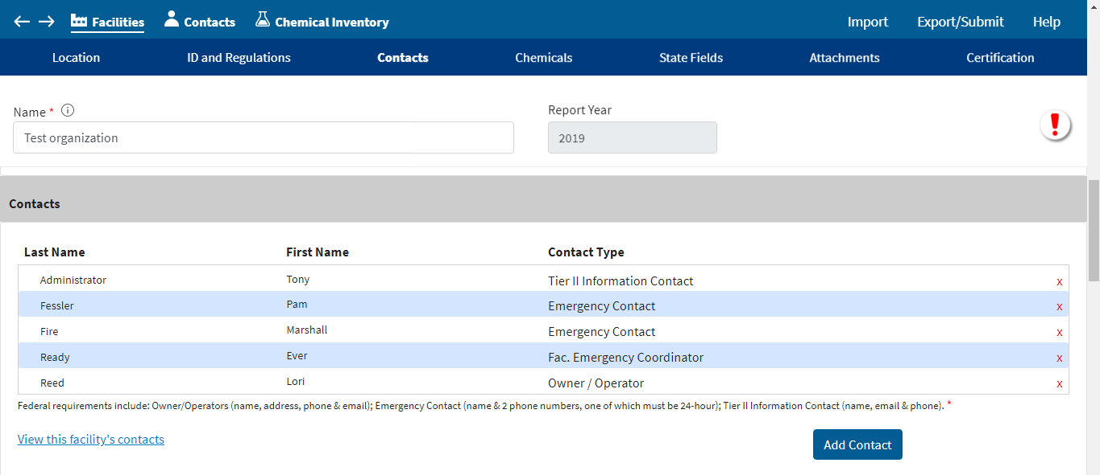
Facility data: Contacts
Contacts:
When finished with each section,
click on the
next section or
scroll down the page.

Slide 47
Facility data: Contacts
Contacts:
Three contact types
are required:
Emergency (2)
Owner / Operator (1)
Tier II Information (1)
You must provide 2 Emergency Contacts:
Must be 2 different phone numbers provided, and 1 must be a 24-hr number. There must also be an email address provided.

Slide 48
Facility data: Contacts
Contacts:
If you are subject to Section 302 of EPCRA, you will also need to provide a Facility Emergency Coordinator contact.

Slide 49
Facility data: Contacts
Contacts:
If you imported a file from last year, you will see your contacts here.
If you did not, you will need to enter them.

Slide 50
Facility data: Contacts
Contacts:
Click “Add Contact”
to add new contacts.
When there are contacts listed,
double-click on a contact to edit the information.

Slide 51
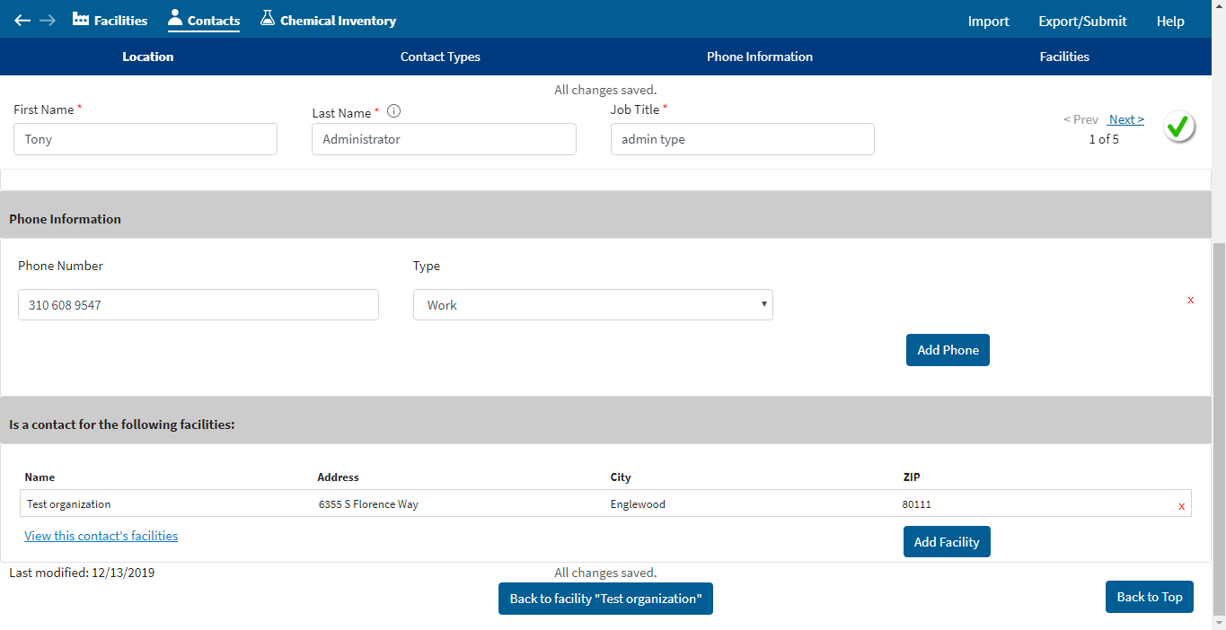
Facility: Contacts
Contacts:
This is the detailed contact information page.
Fill out one page for each contact you create.
Then return to the Facility Page by clicking “Back to facility record”.

Slide 52
Chemical Inventory
It is now time to add and verify your reportable chemical inventory. You may refer to Slides 6-14 of this presentation for more details.
QA Quick Recap of Reporting Thresholds:
Extremely Hazardous Substances (EHS): 500 pounds or the TPQ, whichever is lower
Hazardous Chemicals (non-EHS): 10,000 pounds
Retail Gas Stations: 75,000 gallons for gasoline or 100,000 gallons for diesel, if in complaint Underground Storage Tanks (UST)

Slide 53
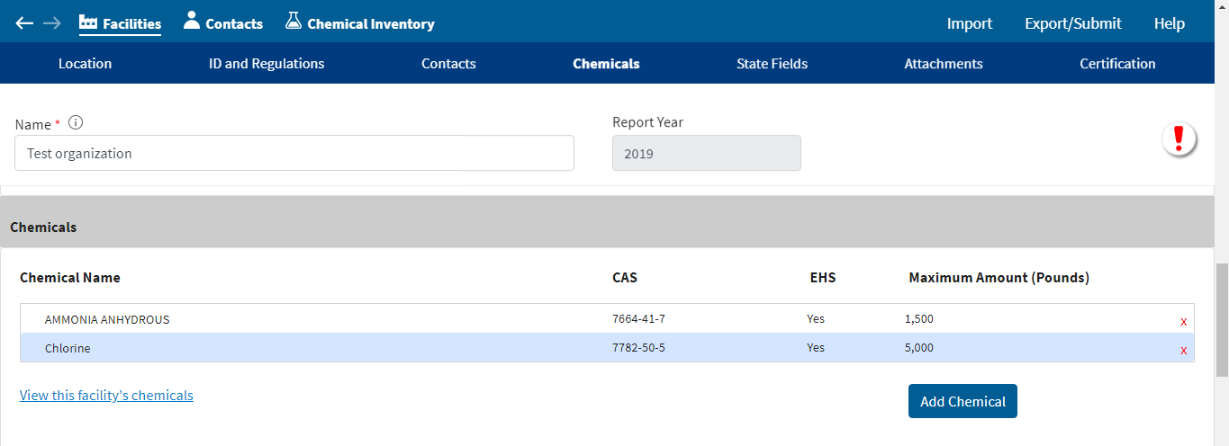
Chemical Inventory
Chemicals:
When finished with each section,
click on the
next section or
scroll down the page.

Slide 54
Chemical Inventory
Chemicals:
If you imported your file from last year, you will see your chemicals listed here.

Slide 55
Chemical Inventory
Chemicals:
To update details for a chemical, double-click on the chemical to be updated.

Slide 56
Chemical Inventory
Chemicals:
To add a new chemical, click
“Add Chemical”.

Slide 57
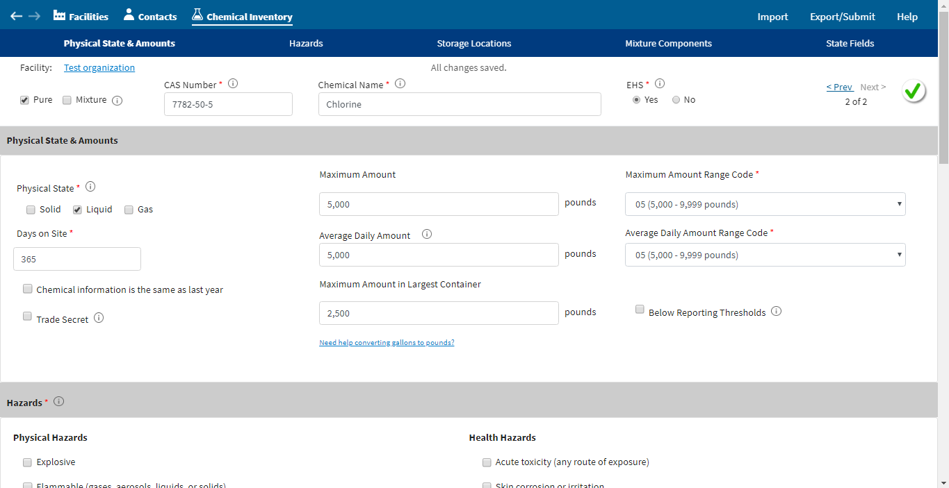
Chemical Inventory
Chemicals:
After you double-click on a chemical
or select
“Add Chemical”,
you will see a page for chemical details.
Update and complete the fields, ensuring to complete all required fields.
Note that fields with red asterisks ( * )
Are required fields.

Slide 58
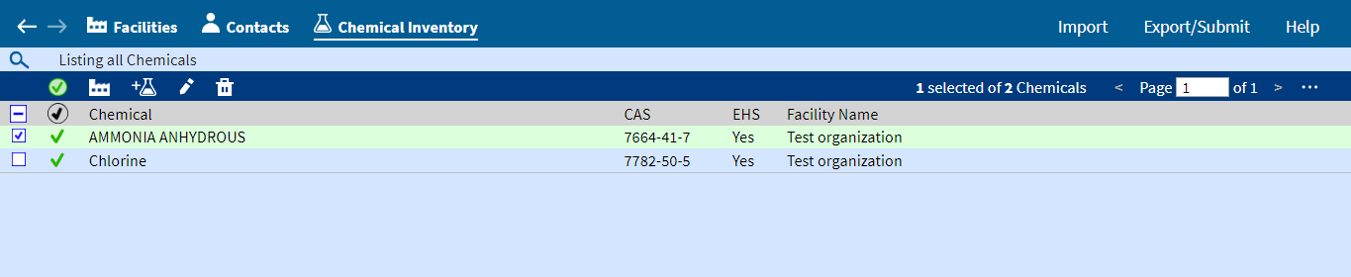
Chemical Inventory
Chemicals:
The Chemical Inventory can also be accessed via the top toolbar
by clicking on
“Chemical Inventory”.
In Chemical Inventory you can view the facility, add or edit chemicals, view or edit chemicals, and delete chemicals.
Chemical Inventory Command Buttons
View Facility Details for the chemical
Add new or edit existing chemical
View or edit details of existing chemical
Delete existing chemical

Slide 59
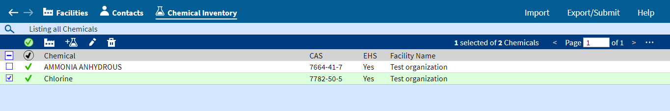
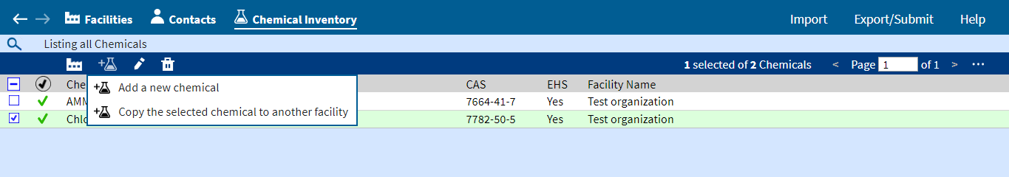
Chemical Inventory
Chemicals:
To add a new chemical, click on the chemical beaker icon, and then click “Add a new chemical”.

Slide 60
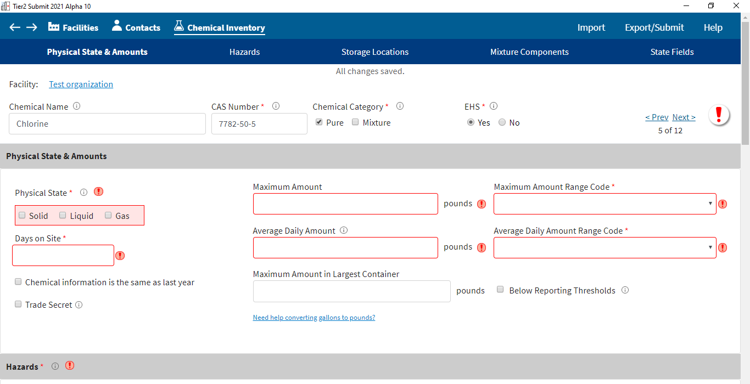
Chemical Inventory
Chemical Record:
In each chemical’s record, you will be asked to enter information about the chemical’s physical state, quantity, hazards, storage locations, and mixture components.

Slide 61
Chemical Inventory
Chemical Record:
In each chemical’s record, please ensure that you enter the correct chemical name and CAS number.
Also, select “Yes” or “No” to indicate if the chemical is an Extremely Hazardous Substance (EHS).

Slide 62
Chemical Inventory
Chemical Record:
If you imported last year’s data, and nothing has changed from the last year,
Check the box for “Chemical information is the same as last year” in the “Physical State & Amounts” section
and don’t edit any other information.

Slide 63
Chemical Inventory
Chemical Record:
Enter the Maximum and average quantities in pounds for each chemical.
After amounts are entered, Tier2 Submit should automatically populate the maximum and average range codes. Please verify this information is correct.

Slide 64
Chemical Inventory
Chemical Record:
Select Trade Secret ONLY if your facility has followed all the steps to file trade secret claims.
See link at bottom of page for more details.
https://www.epa.gov/epcra/epcra-trade-secret-forms-and-instructions

Slide 65
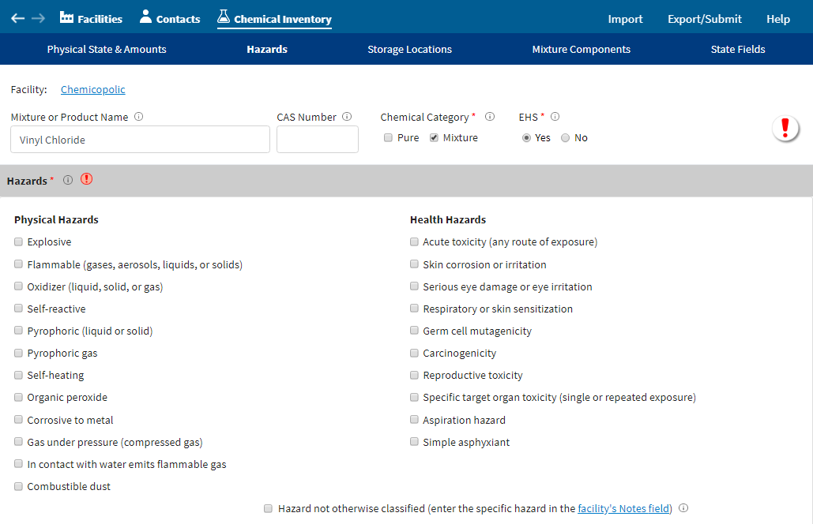
Chemical Inventory
Chemical Record:
Refer to the chemical’s SDS to complete the “Hazards” portion for each chemical’s record.
You must enter all physical and health hazards associated with each chemical.

Slide 66
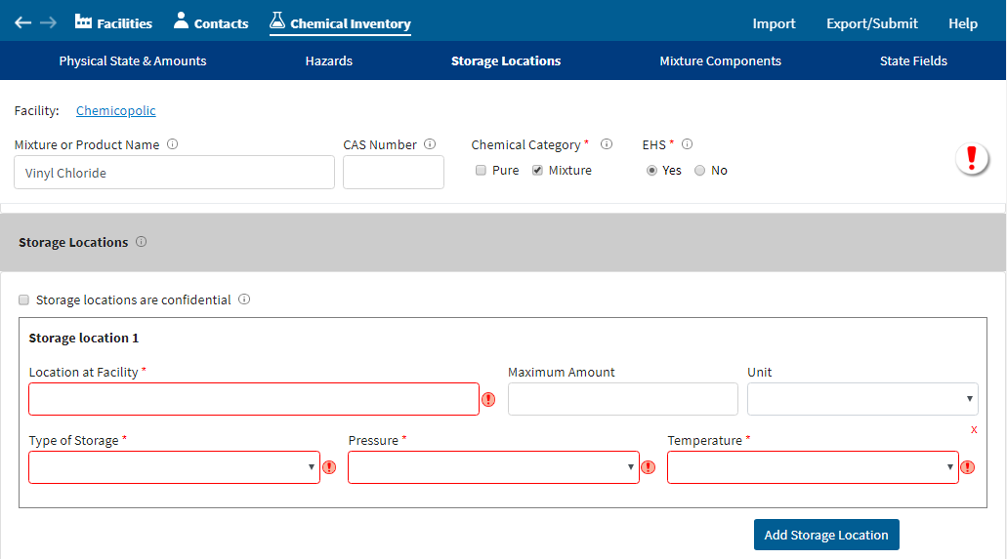
Chemical Inventory
Chemical Record:
Fill out the storage location information to provide emergency responders the location and storage details of your chemicals.
If the chemical is stored in more than one location, click the “Add Storage Location” button to add more locations.

Slide 67
Chemical Inventory
Chemical Record:
If you mark the “Storage locations are confidential” box, then you must complete and submit a Tier II Confidential Location Information Form.
You still need to fill in the type of storage, pressure, and temperature in this section.
https://www.ecfr.gov/current/title-40/chapter-I/subchapter-J/part-350

Slide 68
Chemical Inventory: Mixtures
The next 4 slides focus on chemicals that were stored as mixtures at your facility. For more detailed instructions refer to the Tier2 Submit Help, Slide 11 of this presentation, 40 CFR 370.14, and the Tier II Inventory Form Instructions.
If you have mixtures with hazardous chemical components, you have the option of reporting the entire mixture or only reporting the portions of the mixture that are hazardous chemicals. Note: Your mixture reporting method must be consistent with your Section 311 reporting.
Note for EHS Mixture Thresholds: If you stored a mixture containing a certain EHS, and you also stored that EHS in its pure form, you must combine the total quantities of all occurrences of that EHS to determine if the amount is over the reporting threshold.
Note for non-EHS Mixture Thresholds: If you stored a mixture containing a certain non-EHS hazardous chemical, and you also stored that chemical in its pure form, you are not required to combine the amount in mixture and the pure amount to determine if the amount is over the reporting threshold.
Refer to Slide 14 of this presentation for more guidance on reporting thresholds.

Slide 69
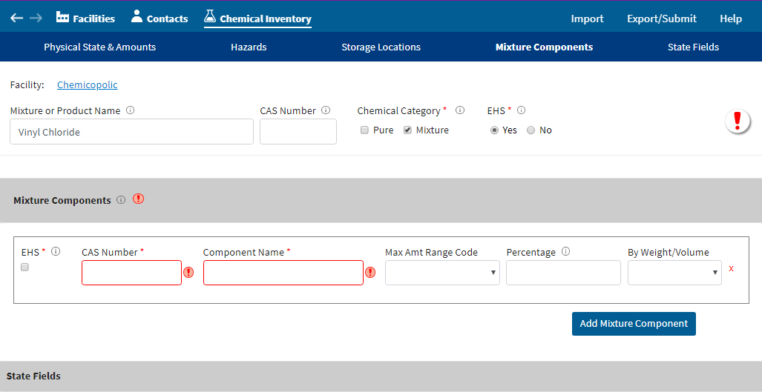
Chemical Inventory: Mixtures
Mixtures as Mixtures:
Provide the name, as provided on the SDS.
Enter the CAS number, if available.
Check the box next to “Mixture”.
If the mixture contains EHS(s), check “yes”.
Move down to Mixture Components section
Refer to the Help, Slides 11 and 68 of this presentation, 40 CFR 370.14, and the Tier II Inventory Form Instructions for more detailed instructions.

Slide 70
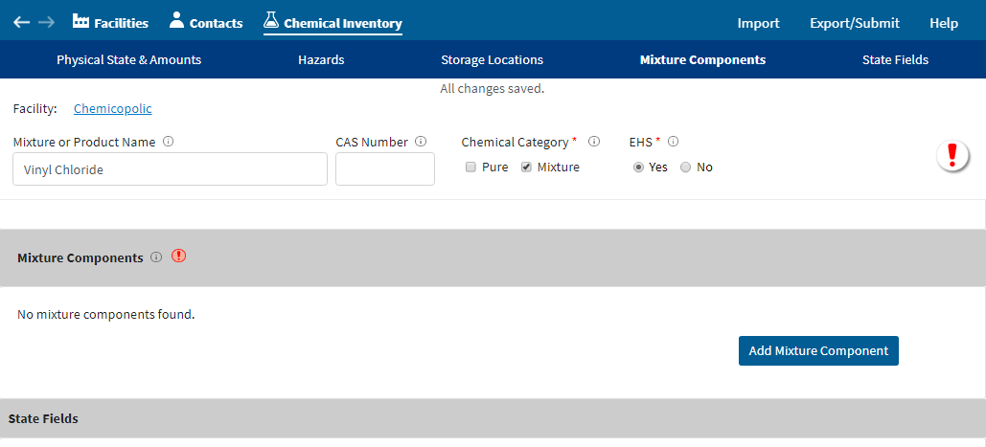
Chemical Inventory: Mixtures
Mixtures as Mixtures:
In the Mixture Components section,
click “Add Mixture Component”
Refer to the Help, Slides 11 and 68 of this presentation, 40 CFR 370.14, and the Tier II Inventory Form Instructions for more detailed instructions.

Slide 71
Chemical Inventory: Mixtures
Mixtures as Mixtures:
List all components of your mixture that are hazardous chemicals.
Check the EHS box, if appropriate.
Enter the CAS number of the component.
Enter the Component Name.
Enter Range Code, Percentage, and Weight/Volume.
Refer to the Help, Slides 11 and 68 of this presentation, 40 CFR 370.14, and the Tier II Inventory Form Instructions for more detailed instructions.

Slide 72
Chemical Inventory: Mixtures
Mixtures as Pure:
Create a chemical record for each hazardous chemical in the mixture.
Check the box next to “Pure”.
Complete all required fields.
Refer to the Help, Slides 11 and 68 of this presentation, 40 CFR 370.14, and the Tier II Inventory Form Instructions for more detailed instructions.

Slide 73
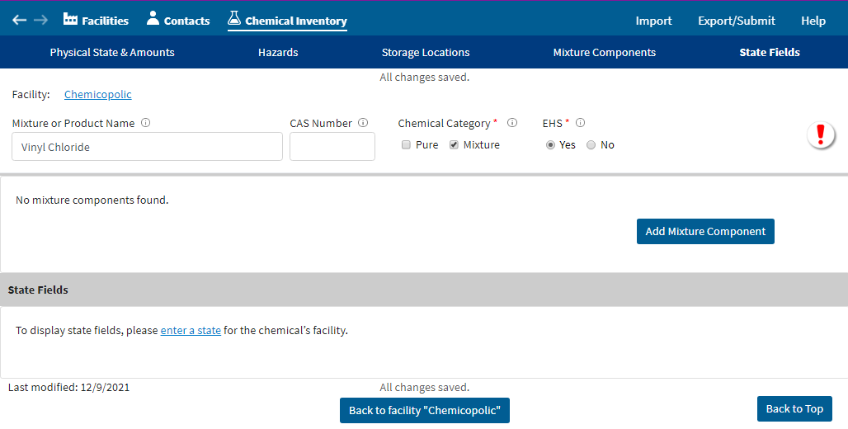
Chemical Inventory
State Fields for Chemicals:
Some states, tribes, and territories have “State Fields” for chemicals. Provide any information requested under the Chemical Inventory “State Fields” section.

Slide 74
Chemical Inventory
Chemical Record:
The “Back to facility record” button, at the bottom of each chemical record, will take you back to the chemical’s
facility page.

Slide 75
State Fields
Some states, tribes, and territories require additional information in the “State Fields” section, and others do not. Depending on the state, tribe, or territory that you chose in the “Location” section of the facility page, there may or may not be specific State Fields to complete in this section.
Always check this section to verify if there are required or requested fields because the requirements may change from year to year.

Slide 76
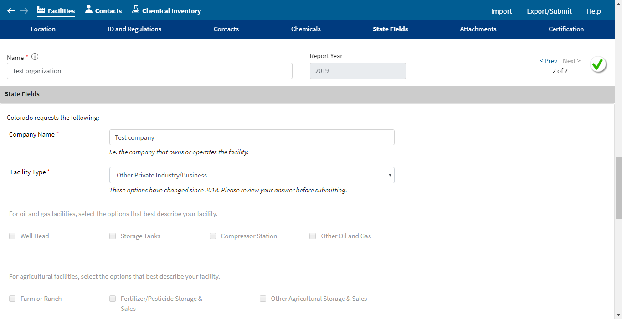
State Fields
State Fields:
When finished with each section,
click on the
next section or
scroll down the page.

Slide 77
State Fields
State Fields:
Complete all the fields for your state, tribe, or territory.
Note: some answers may trigger more questions that you will need to answer.

Slide 78
Attachments
Federal regulations do not require facilities to attach site plans or descriptions of dikes or other safeguard measures.
Check with your state, tribe, or territory for any specific requirements that they may have.

Slide 79
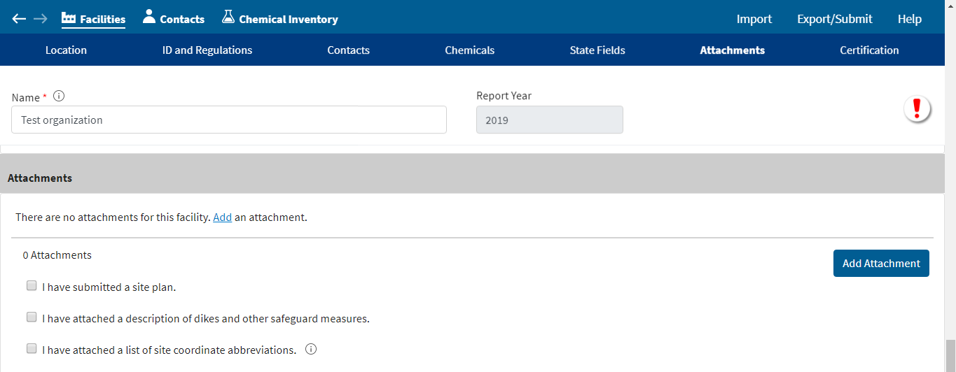
Attachments
Attachments:
When finished with each section,
click on the
next section or
scroll down the page.

Slide 80
Attachments
Attachments:
All attachments must be submitted in electronic format and submitted using the attachment process.
Attachments may be submitted in a wide variety of formats including: AVI, DOCX, GIF, JPG, MOV, PDF, PNG, TIF, and XLSX.

Slide 81
Certification
If you’ve entered all the information for each of the hazardous chemicals that were stored at your facility during the previous calendar year, at or above reporting thresholds, then you are close to completing your Tier II Form!!!
The next step is to certify the Tier II Form.

Slide 82
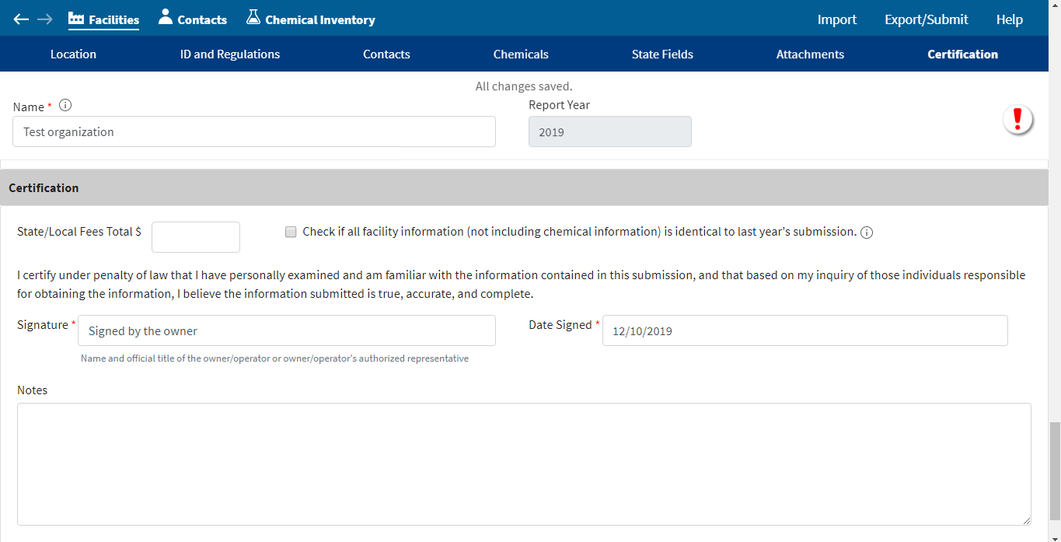
Certification
Certification:
When finished with each section,
click on the
next section or
scroll down the page.

Slide 83
Certification
Certification:
You should check with your state, tribe, or territory to determine what fees you may owe.
Enter the total fees for your state, tribe, or territory (if any).

Slide 84
Certification
Certification:
Enter the correct name, title, and date.

Slide 85
Checking for Errors
You have been through the Tier2 Submit application and think that you have completely entered your Tier II Information. But before your data file can be exported to be submitted, it must be checked for errors.
Tier2 Submit does extensive error checking for you.

Slide 86
Checking for Errors
Checking for Errors:
When finished with each section,
click on the
next section or
scroll down the page.

Slide 87
Checking for Errors
Checking for Errors:
In your Facility Screen, click on the red exclamation mark (!) to see your errors.

Slide 88
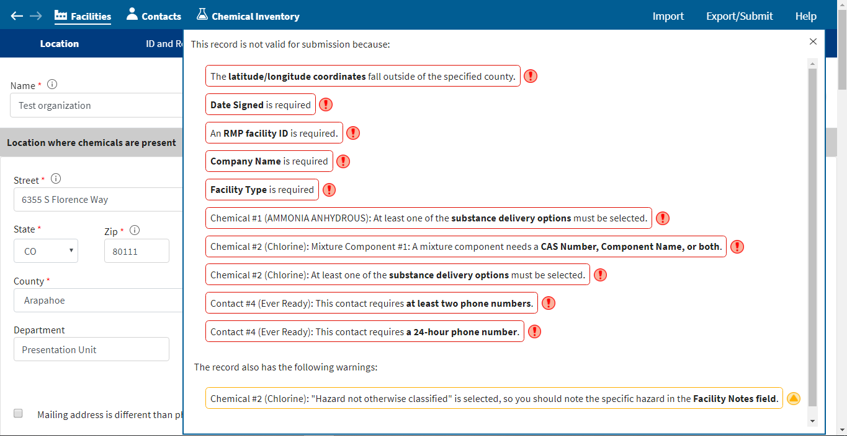
Checking for Errors
Checking for Errors:
In the list of errors,
you will need to correct all the errors with a red exclamation mark (!).
Click on each error and Tier2 Submit will take you to where you can fix the data.

Slide 89
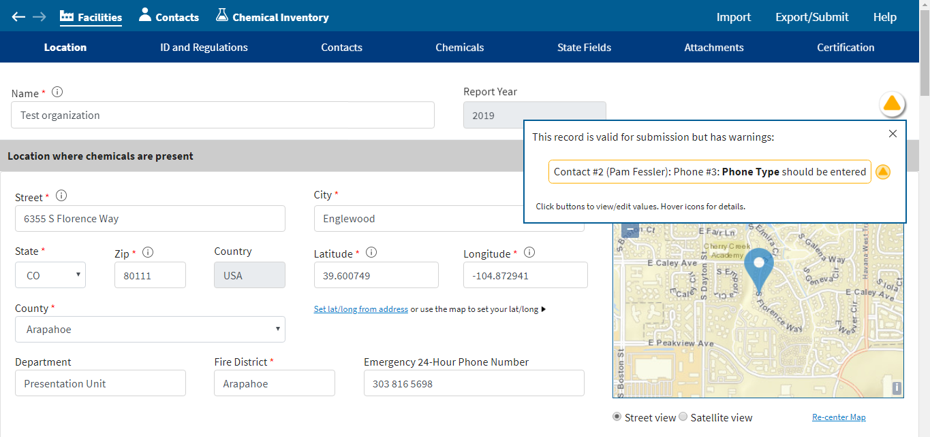
Checking for Errors
Checking for Errors:
After correcting the red exclamation
mark (!) errors, there may be a yellow “warning”. You are not required to fix these warnings, but it please fix them.
Click the yellow “warning” icon to correct these.

Slide 90
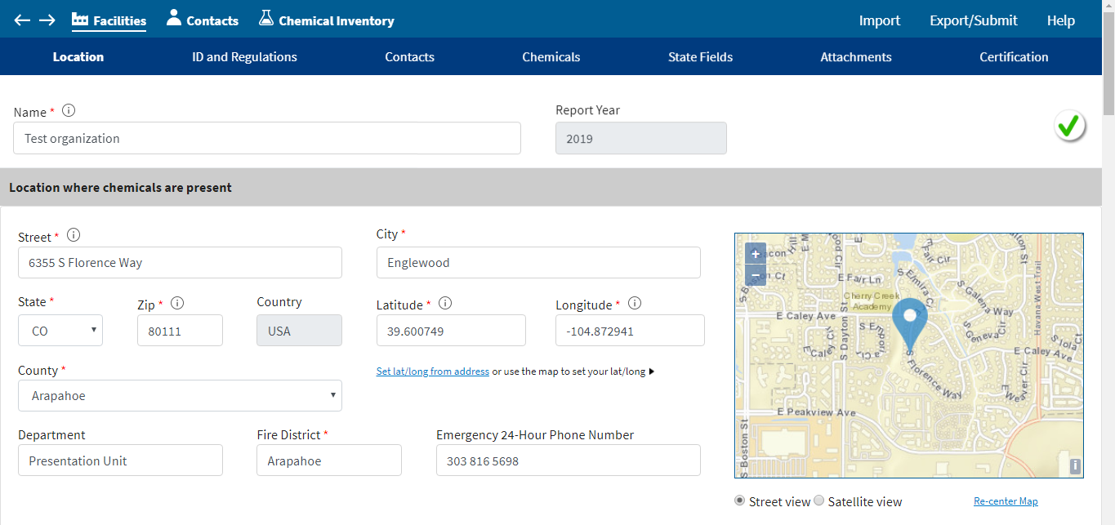
Checking for Errors
Checking for Errors:
Once you have fixed all the errors
and warnings,
you will see a green checkmark ().
This means the Tier II form is ready to export and submit.

Slide 91
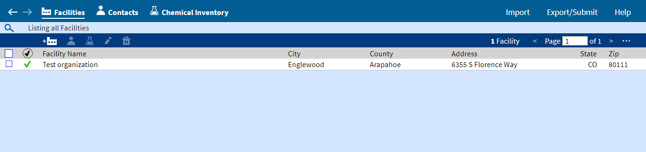
Checking for Errors
Checking for Errors:
You can also check for the green checkmark () in the Facilities list.

Slide 92
Exporting Your Submission File
After entering all the Tier II Information and correcting the errors and warnings, it is time to export a Submission File and to then submit that file to your state, tribe, or territory.
You are not finished after you click “Create Submission File”. Tier2 Submit does not send your file anywhere. It stores it on your computer for you to send.
You must submit the Tier2 Submit file directly to your state, tribe, or territory. Check with your state, tribe, or territory for submission requirements each year because submission requirements change frequently.
Save a copy of your T2S file in a safe place so that you can begin next year’s report with this year’s data, rather than starting from scratch.

Slide 93
Exporting Your Submission File
Export/Submit:
When you’re ready to export your submission file, click on “Export/Submit”.

Slide 94
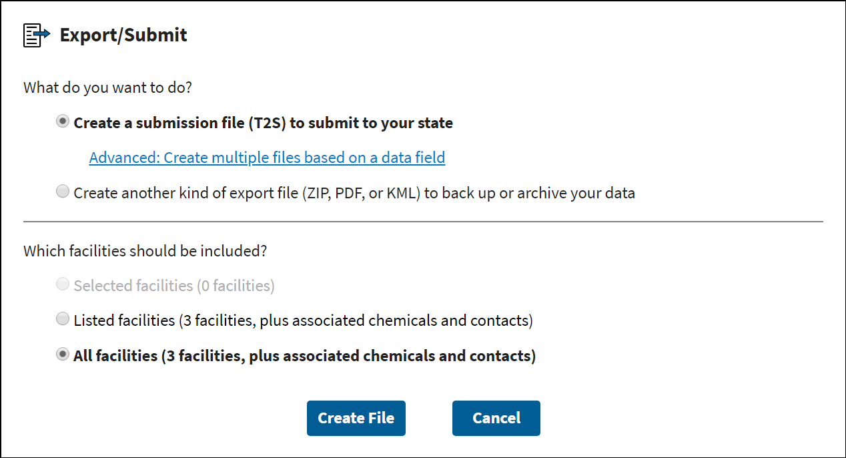
Exporting Your Submission File
Export/Submit:
Choose what type of file you want to create and what facilities should be included.
Click “Create File”
Explore the Help if you need advanced export features.

Slide 95
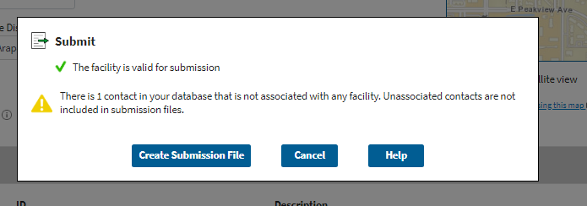
Exporting Your Submission File
Export/Submit:
Click “Create Submission File”

Slide 96
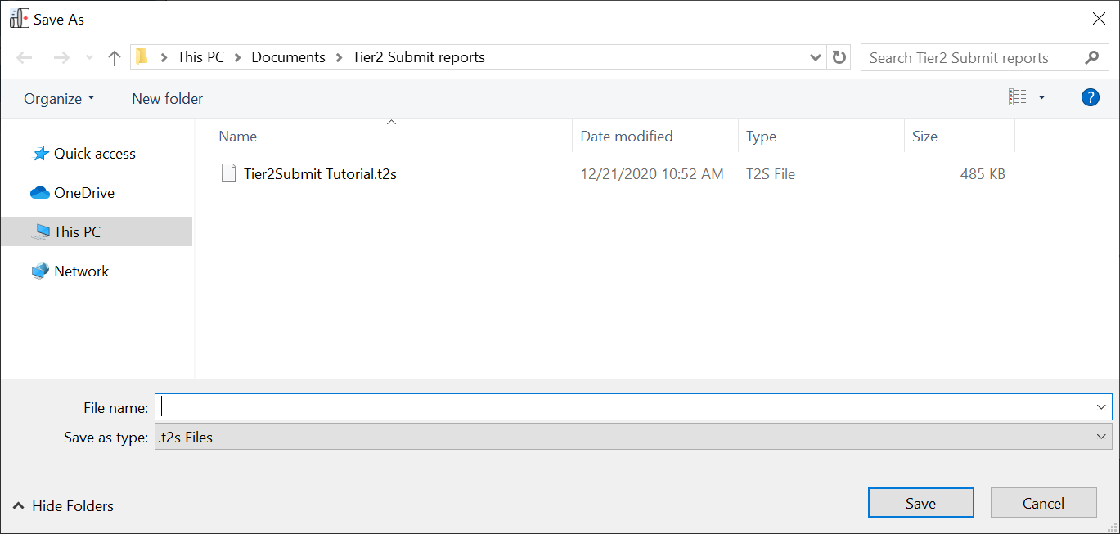
Exporting Your Submission File
Export/Submit:
Enter the name you want to give to your file (usually the name of the facility and year) and the location you want to save it to on your computer.

Slide 97
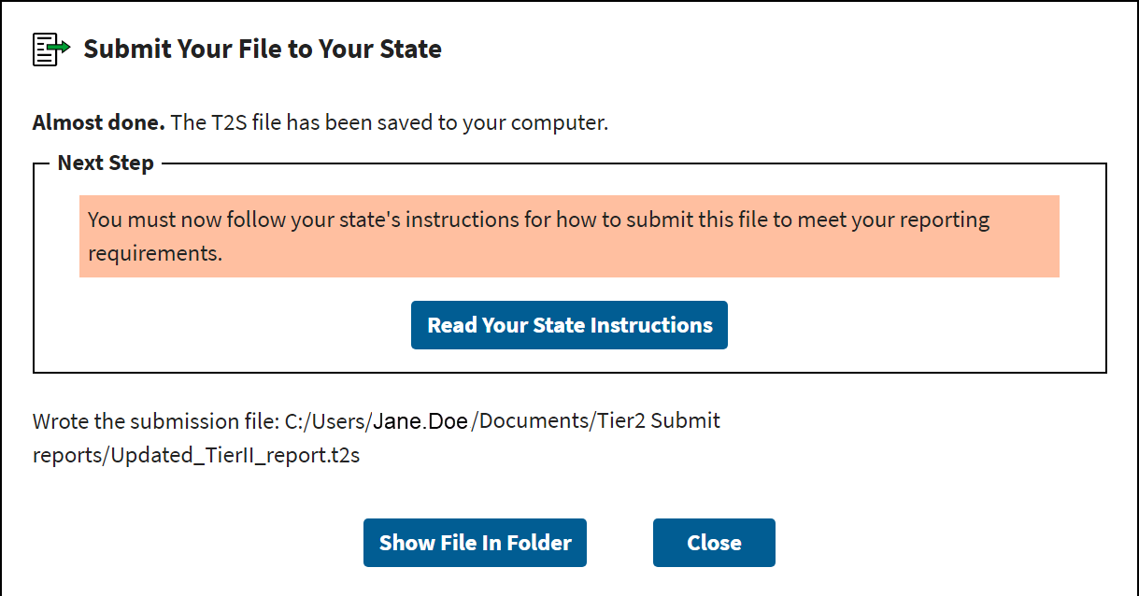
Exporting Your Submission File
Export/Submit:
Your file is now saved, but you still need to submit the file to your state, tribe, or territory.
Click “Read Your State Instructions” to learn about how to submit your file.
Click “Show File in Folder” to open the folder on your computer where your file is saved.

Slide 98
Creating a PDF
You may need to create a PDF if your state, tribe, territory, Local Emergency Planning Committee, or Fire Department require a hard copy of your Tier II Form.
You may want to create a PDF to save on your computer and/or to print so that you have a paper copy of your Tier II Form.

Slide 99
Creating a PDF
Export/Submit:
If you’d like a PDF copy of your report
click “Export/Submit”
This may be printed so that you have a hard copy.

Slide 100
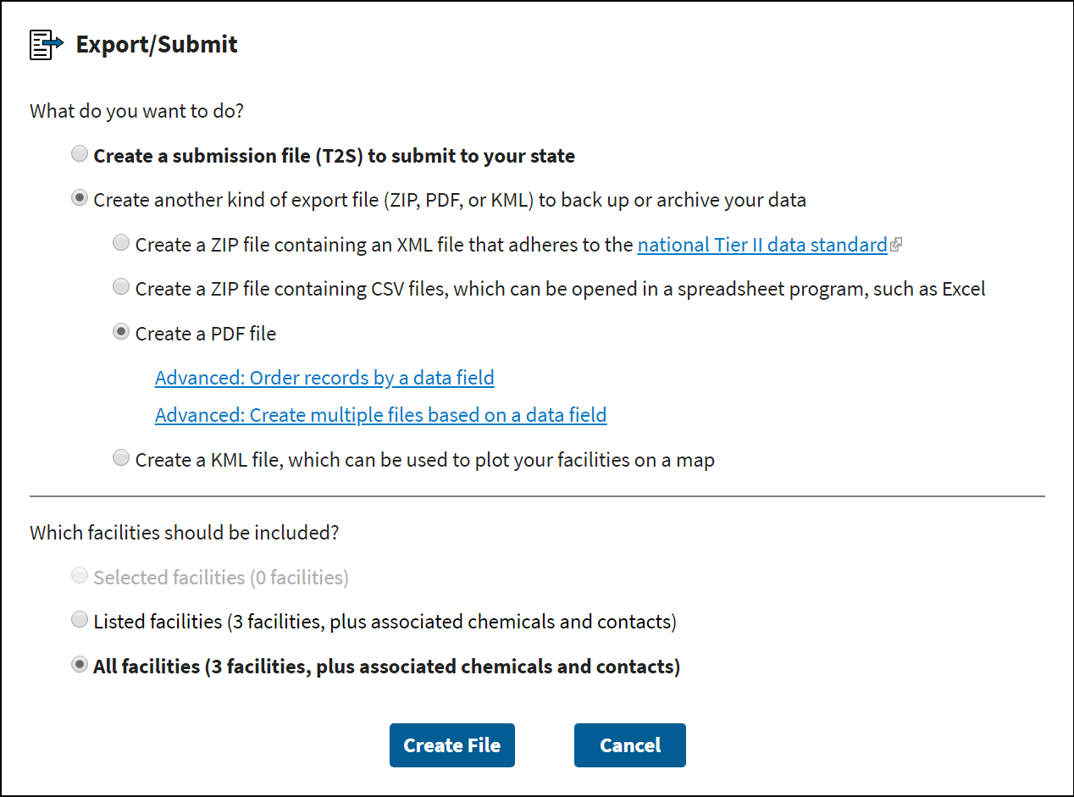
Creating a PDF
Export/Submit:
Select “Create another kind of export file”
Then select “Create a PDF file”
Then select “Create File”

Slide 101
Resources
As you work through entering your Tier II Information, you can use the “Help” in Tier2 Submit to locate guidance and resources. There are also information circles ( ) throughout the program to help you enter the information correctly.
The remaining slides also offer helpful links.

Slide 102
Resources: Regulations and Rules
PART 350 – Trade Secret Claims For Emergency Planning And Community Right-To-Know …
https://www.ecfr.gov/current/title-40/chapter-I/subchapter-J/part-350
PART 355 - Emergency Planning and Notification
https://www.ecfr.gov/current/title-40/chapter-I/subchapter-J/part-355
Appendix A to Part 355 - The List of Extremely Hazardous Substances and Their TPQs (Alphabetical)
https://www.ecfr.gov/current/title-40/chapter-I/subchapter-J/part-355#Appendix-A-to-Part-355
Appendix A to Part 355 - The List of Extremely Hazardous Substances and Their TPQs (CAS Number Order)
https://www.ecfr.gov/current/title-40/chapter-I/subchapter-J/part-355#Appendix-B-to-Part-355
PART 370 - Hazardous Chemical Reporting: Community Right-To-Know
https://www.ecfr.gov/current/title-40/chapter-I/subchapter-J/part-370
42 U.S. Code § 11022
https://www.govinfo.gov/content/pkg/USCODE-2019-title42/pdf/USCODE-2019-title42-chap116.pdf
Occupational Safety and Health Administration (OSHA) Hazard Communication Standard (HCS)
https://www.osha.gov/laws-regs/regulations/standardnumber/1910/1910.1200

Slide 103
Resources: EPA Guidance
Emergency Planning and Community Right-to-Know Act (EPCRA)
https://www.epa.gov/epcra
EPCRA Tier II Confidential Location Information Form
https://www.epa.gov/epcra/tier-ii-forms-and-instructions
EPCRA Facts Sheets
https://www.epa.gov/epcra/epcra-fact-sheets
Guide to the Emergency Planning and Community Right-to-Know Act
https://www.epa.gov/sites/default/files/2020-10/documents/guide_to_epcra.pdf
State Tier II Reporting Requirements and Procedures
https://www.epa.gov/epcra/state-tier-ii-reporting-requirements-and-procedures
Tier II Chemical Inventory Form Instructions
https://www.epa.gov/sites/default/files/2017-06/documents/tier_ii_inventory_form_instructions_2017.pdf
Trade Secrets
https://www.epa.gov/epcra/epcra-trade-secret-forms-and-instructions

Slide 104
Resources: Other Resources
CAS Numbers
https://commonchemistry.cas.org/
Dun & Bradstreet numbers
https://www.dnb.com/duns-number.html
NAICS Codes
https://www.naics.com/search/ or https://www.census.gov/naics/
RMP Reporting Center: For questions about using Tier2 Submit, contact the RMP Reporting Center via email (RMPRC@epacdx.net) or phone (703-227-7650) on weekdays 8:00am to 4:30pm Eastern Time.
EPA Gallons to Pounds conversion Tool
https://www.epa.gov/sites/default/files/2014-01/gallonspoundsconversion.xls

