Slide 1
Benefits of Integrated Planning – Permittees Version
Space for Local Logo, Presenter details, etc.
Generic content obtained on US EPA website
https://www.epa.gov/npdes/integrated-planning-municipal-stormwater-and-wastewater
Photo courtesy of J. Cory Rayburn.

Slide 2
What Is Integrated Planning?
Integrated planning is...
A voluntary opportunity for municipalities to meet Clean Water Act (CWA) obligations by sequencing wastewater and stormwater projects that also allows the use of innovative approaches like green infrastructure.
Integrated planning is NOT…
A way to change regulatory standards.
A way to change permit requirements.

Slide 3
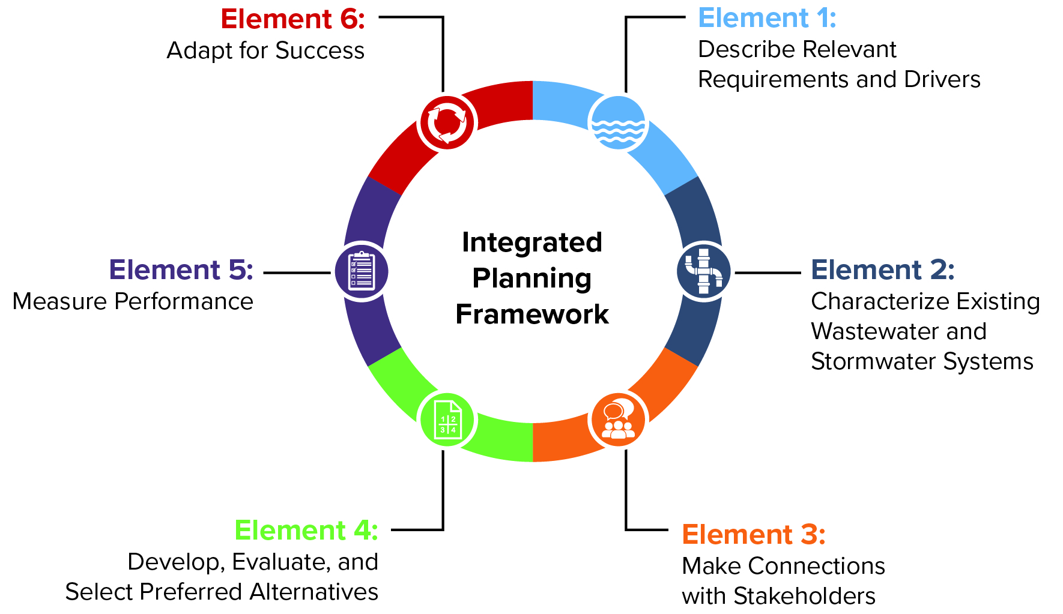
Elements of an Integrated Plan

Slide 4
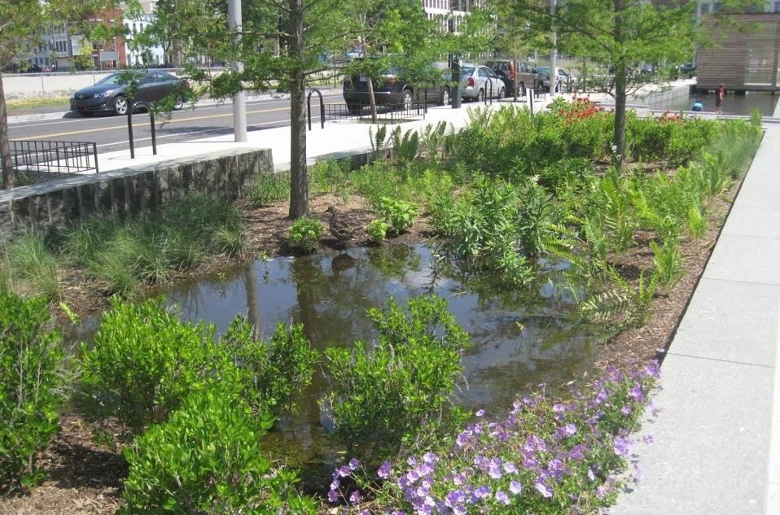
What Regulated Sources of Water Pollution Can an Integrated Plan Address?
Combined sewer overflows (CSOs)
Sanitary sewer overflows (SSOs)
Wastewater treatment facility (WWTF) discharges
Municipal separate storm sewer system (MS4) discharges
Photo courtesy of Alisha Goldstein EPA.

Slide 5
What Other Types of Environmental Priorities Can an Integrated Plan Account for?
Integrated planning may also help you consider other environmental and community priorities, as long as reprioritization provides equal or greater water quality benefits, including:
Green infrastructure, including land conservation
Water conservation and reuse
Biosolids waste management
Resiliency and flooding
Environmental justice
Other public health priorities such as safe drinking water and air quality

Slide 6
Benefits of Integrated Planning
Many municipalities and wastewater utilities that developed integrated plans have gained:
 | Faster water quality improvements and health protections in priority areas.
 | More cost-effective and affordable infrastructure investments.
 | Long-term certainty of investments that considers the community’s needs and objectives.
 | Innovative solutions that comprehensively cut across multiple pollutant sources and city departments

Slide 7
Consider How Integrated Planning Can Benefit You
Consider how your community can support community objectives.
Integrated planning can help in:
Proactively ensuring compliance with new permit limits.
Achieving designated uses of state waterbodies faster.
Reducing enforcement actions and their resource costs.

Slide 8
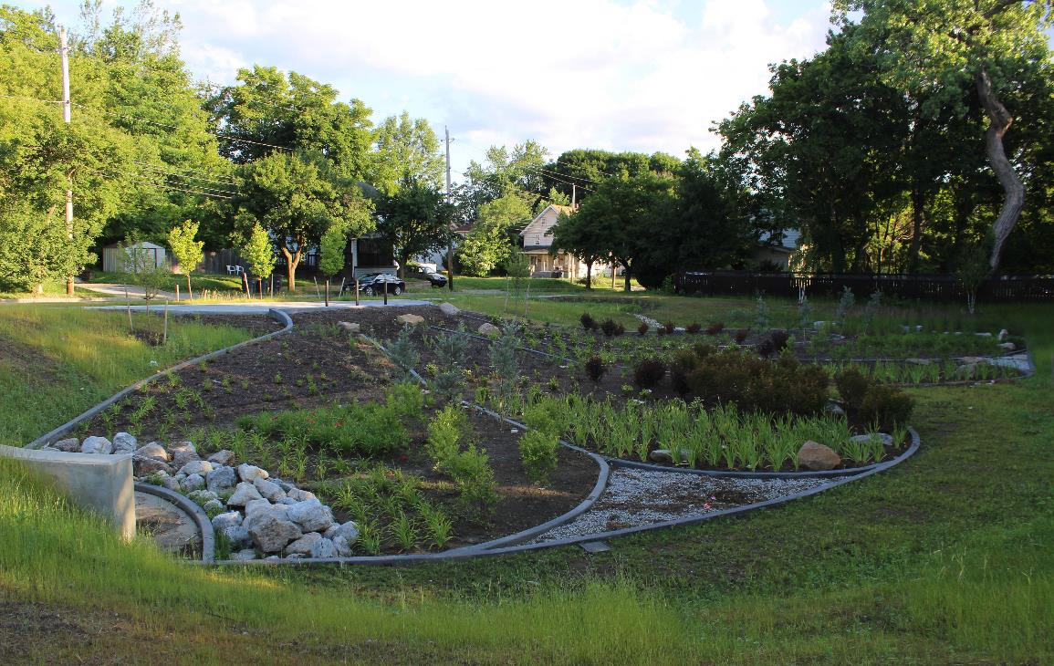
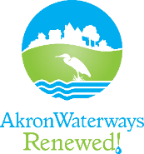
Permittee Savings
Akron, Ohio saved $158 million in project costs between 2015 and 2019 by reprioritizing projects
Photo courtesy of City of Akron.
Photo courtesy of City of Akron.

Slide 9
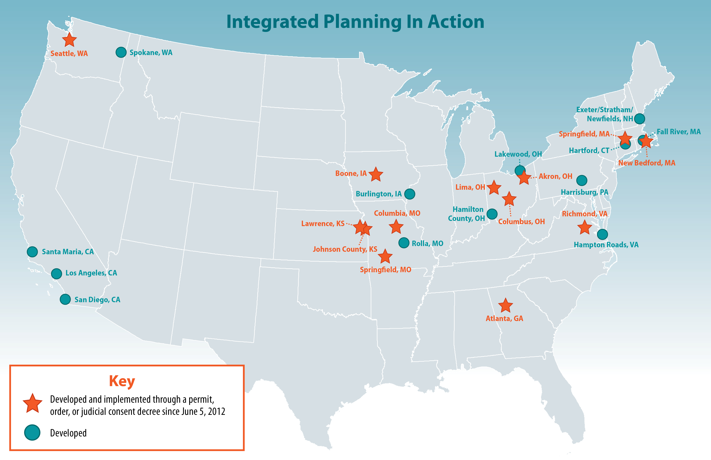
Getting Started
Talk to your permitting authority about your goals with integrated planning
Explore integrated plans from other permittees
Access fact sheet series and resources to help municipalities through planning process
For more information: EPA's Integrated Planning website

Slide 10
Possible Integrated Planning Goals
Holistically reduce multiple discharges
Reduce CSOs
Prevent SSOs
Reduce bypasses at the treatment plant
Reduce stormwater pollution
Meet anticipated permit limits or pollution reductions in order to protect local waterbodies
Comply with TMDLs
Reduce costs of compliance
Re-prioritize projects for compliance
Meet climate resiliency needs in sensitive or vulnerable environments
Prioritize capital infrastructure costs, particularly for overburdened communities
Conserve water or energy

Slide 11
Explore Integrated Plans from other Permittees
https://storymaps.arcgis.com/stories/20e0e046df084e1ba1ecfac3414edc07

Slide 12
Permittee Testimonial
“[We’re] doing the integrated planning approach, but we’re also solving five or six other issues, and we’re getting the secondary benefits, like with green infrastructure, we’re getting green space. We’re getting new roads out of it. We’re getting infrastructure for economic development. So in the back end, the city, although not calculated, ultimately, will end up with a better implemented program than just doing the siloed approach.”
Kevin Buckley, Seattle, Washington
https://www.epa.gov/system/files/documents/2021-07/rtc-profile-seattle.pdf
Photo courtesy of City of Seattle - Seattle Parks & Recreation.

Slide 13
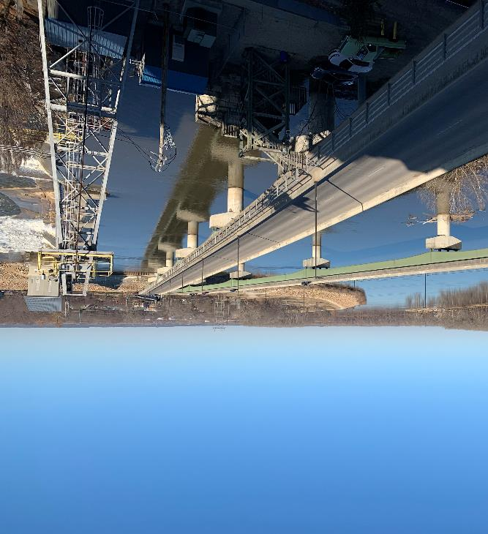
Permittee Testimonial (cont.)
“I think the thing that it helps us overcome, as well as the regulator, is the fixed permit cycle.…We need to not look just five years out we need to look at 20 years out. And so it kind of helped bring that into focus that everybody was on the same page between KDHE, EPA, and us on where we’re headed and when we’re gonna get there. And it didn’t have those confines of the strict NPDES permit schedule or compliance.”
Dave Wagner, Lawrence, Kansas
Photo courtesy of Josh Carson, City of Lawrence Staff.
https://www.epa.gov/system/files/documents/2021-07/rtc-profile-lawrence.pdf

Slide 14
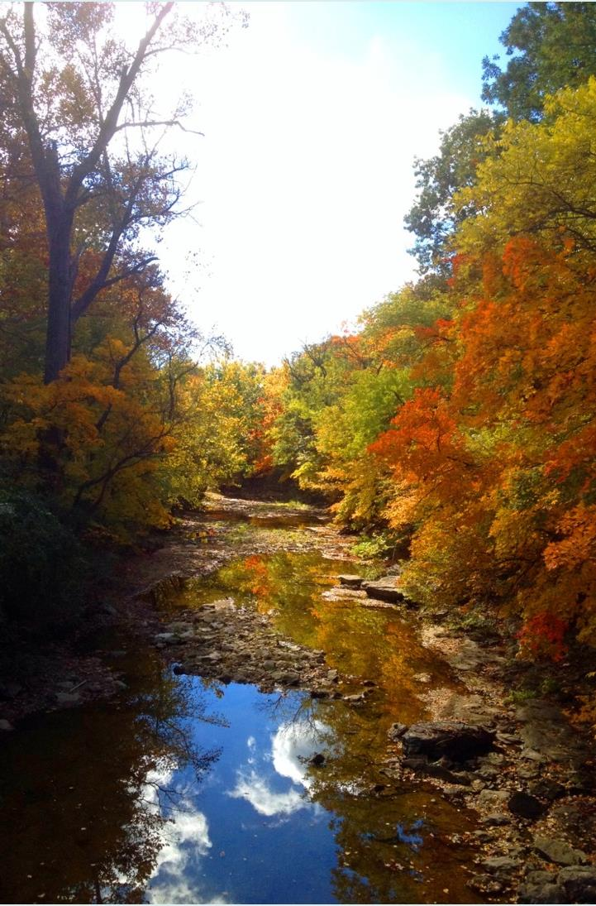
Potential Plan Development Funding Sources
Clean Water State Revolving Fund
Water Infrastructure Finance and Innovation Act
Sewer Overflow and Stormwater Reuse Municipal Grants Program
Building Resilient Infrastructure Communities Program
For more information: Funding the Development of an Integrated Plan
Photo courtesy of City of Columbia.

Slide 15
EPA’s Technical Resources
Information Resources
2012 Integrated Planning Framework
Sustainability planning guidance
Financial capability assessment guidance
Fact Sheet Series to develop an integrated plan
2021 Report to Congress
Recorded Webinars
The Straight Scoop on Integrated Planning
Introducing EPA’s Integrated Planning Element Four
Integrated Planning Peer-to-Peer Exchange for Municipalities

Slide 16
EPA’s Municipal Ombudsman
EPA’s Municipal Ombudsman is available to help your community navigate EPA resources while coordinating with EPA offices and advocating for fair processes and uniform application of CWA policies.
More information:
Municipal Ombudsman, EPA webpage
Water Environment Federation podcast, June 2020

Slide 17
EPA Integrated Planning Technical Assistance
EPA is providing technical assistance to municipalities collaborating with their permitting authority to develop an integrated plan.
Contact Heather Huddle at huddle.heather@epa.gov by August 31, 2023 to request technical assistance.
For more information: Integrated Planning Technical Assistance

