Slide 1
Benefits of Integrated Planning – Elected Officials Version
Space for Local Logo, Presenter details, etc.
Generic content obtained on US EPA website
https://www.epa.gov/npdes/integrated-planning-municipal-stormwater-and-wastewater
Photo courtesy of J. Cory Rayburn.

Slide 2

What Is Integrated Planning?
Integrated planning is...
A voluntary opportunity for municipalities to meet Clean Water Act (CWA) obligations by sequencing wastewater and stormwater projects that also allows the use of innovative approaches like green infrastructure.
Integrated planning is NOT…
A way to change regulatory standards.
A way to change permit requirements.

Slide 3
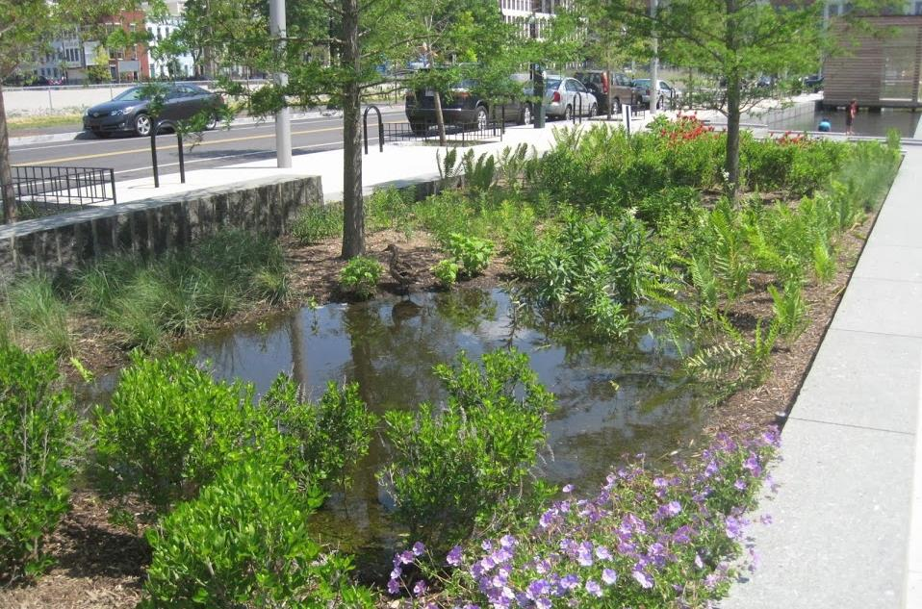
What Regulated Sources of Water Pollution Can an Integrated Plan Address?
Combined sewer overflows
Sanitary sewer overflows
Municipal wastewater treatment facility discharges
Municipal separate storm sewer system discharges
Photo courtesy of Alisha Goldstein EPA.

Slide 4
What Other Types of Environmental Priorities Can We incorporate into an Integrated Plan?
Integrated planning may also help us consider other environmental and community priorities:
  Water conservation and reuse
  Biosolids waste management
  Resiliency and flooding
  Environmental justice
  Safe drinking water
  Green infrastructure, including land conservation
  Other public health priorities such as air quality

Slide 5
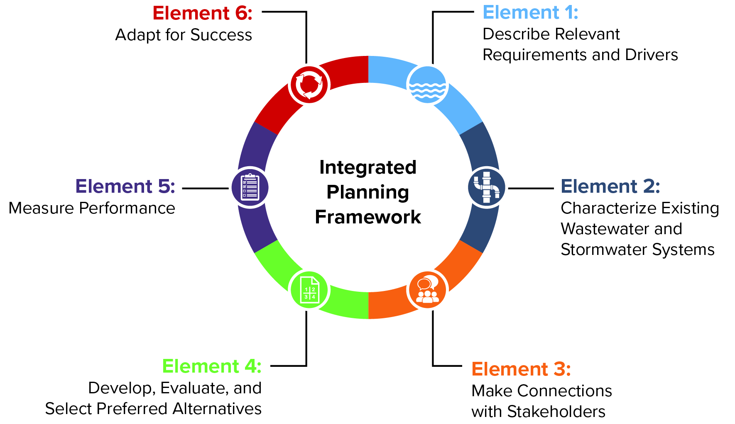
Elements of an Integrated Plan

Slide 6

Benefits
Flexibility to make water quality improvements
Schedule projects more affordably
Foster enhanced collaboration across our departments
Proactively ensure compliance with new permit limits
Potentially reduce enforcement actions and associated costs
Address other community priorities
Photo courtesy of CDM Smith.

Slide 7
Who Can Help Us with the Integrated Planning Process?
Permitting Authority Representative
Supporting State Staff [municipality should list staff]
Wastewater and Stormwater Technical Staff [municipality should list staff]
Wastewater and Stormwater Management [municipality should list staff]
City Planning Staff [municipality should list staff]
Parks Department Staff [municipality should list staff]
Transportation Department Staff [municipality should list staff]
Community Outreach Staff [municipality should list staff]

Slide 8
Is it Expensive to Develop an Integrated Plan?
The cost to develop a plan is typically less than 1 percent of the cost to implement the projects included in the plan.
Funding for planning activities is available from a variety of different sources including EPA and state loan programs, EPA grants, other federal agencies grants and loans, state grant funds, or philanthropic organizations.
EPA has published the Funding the Development of an Integrated Plan fact sheet to help permittees understand the costs of developing an integrated plan which includes some potential resources for funding support.
For more information: Funding the Development of an Integrated Plan

Slide 9

Potential Plan Development Funding Sources
Clean Water State Revolving Fund (CWSRF)
Water Infrastructure Finance and Innovation Act (WIFIA)
Sewer Overflow and Stormwater Reuse Municipal Grants Program
Building Resilient Infrastructure Communities Program (BRIC)
Funding the Development of an Integrated Plan (IP)
Photo courtesy of City of Columbia.

Slide 10
EPA Resources
EPA is developing resources to help permitting authorities and permittees learn about integrated planning, benefits, how to get started, and funding resources. All current and new resources can be found on the integrated planning website.
EPA’s Municipal Ombudsman is also available as a resource to communities.
For more information: Integrated Planning Implementation Documents

