Slide 1
DELETE THIS SLIDE PRIOR TO PRESENTATION
This PowerPoint serves as a template presentation which introduces topics related to air quality and is part of a suite of presentations provided by the EPA for the Megacities program.
See speaker notes for an additional description of slide content. Slides should be edited or added to as necessary for your particular needs. Slides with highlighted yellow text require the addition of specific context and information for your city.

Slide 2
Introduction to Air Quality

Slide 3
Overview
1. Overview
2. Conventional Air Pollutants
3. Health Effects
4. Climate pollutants
5. Additional References

Slide 4
Section 1: Overview
1. Overview
2. Conventional Air Pollutants
3. Health Effects
4. Climate pollutants
5. Additional References

Slide 5
Ambient Air Pollution
Air pollution is a leading cause of disease and death
4.1M deaths globally were attributed to outdoor/ambient PM_{2.5} exposure in 2016
90% of global deaths from air pollution occur in low- and middle-income countries (LMIC)
Caused by:
  Rapid urbanization
  Increased energy use and motorization
  Burning of waste and solid fuels
The World Bank: The Global Health Cost of Ambient PM_{2.5} Air Pollution (2020)

Slide 6
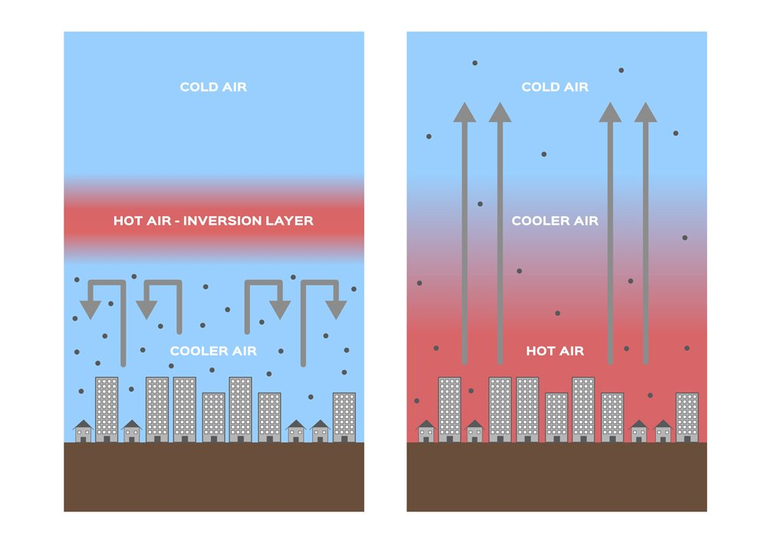
Historical Air Pollution Events
1930, Muese River Valley, Belgium - 63 deaths
1948, Donora, Pennsylvania - 23 deaths, 7,000 people affected
1950, Poza Rica, Mexico - 22 deaths, 320 hospitalized
1952, London - 4,000 deaths
1953, New York City - 200 deaths
1962, London – 700 deaths
1984, Bhopal, India - 4,000 immediate deaths, 15,000 deaths later
Normal Conditions
Inversion Layer
https://www.shutterstock.com/image-vector/inversion-layer-pm-25-vector-dust-1296240271
Notes:
1930, Muese River Valley, Belgium - 63 deaths
Heavy industrial air pollution, domestic coal burning, and climatic conditions including a temperature inversion caused heavy smog to blanket the Muese River valley area over the course of a few days, serving as one of the first instances post-industrial revolution linking morbidity, mortality, and air pollution.
1948, Donora, Pennsylvania - 23 deaths, 7,000 people affected
Emissions from US Steel and American Steel, in addition to a temperature inversion, caused smog that blanketed Donora for five days until it finally rained, causing 23 deaths and affecting many others into the future.
1950, Poza Rica, Mexico - 22 deaths, 320 hospitalized
Hydrogen sulfide at an oil field was vented into the air during a temperature inversion; although the acute phase lasted only about 20 minutes, that short exposure caused the death of 22 people.
1952, London - 4,000 deaths
A temperature inversion was created when a high-pressure air mass stalled over the Thames River Valley, and cold air came in from the west. Londoners were burning additional coal due to low temperatures, and industry in the area as well as cars were emitting smoke, soot, and sulfur dioxide.
1953, New York City - 200 deaths
1962, London – 700 deaths
1984, Bhopal, India - 4,000 immediate deaths, 15,000 deaths later
Chemical accident at Union Carbide pesticide plant; over 500k people were exposed to methyl isocyanate gas, which is highly toxic. Thousands were killed, many thousands more were injured, and thousands more deaths occurred as time passed.
Figure explanation:
The figure on the left depicts typical conditions, in which the temperature of the air decreases with elevation, which allows for upward air flow.
The figure on the right depicts the formation of an inversion layer, which occurs when there is a layer of air where the temperature instead increases with height. When this occurs, all the air under the layer is unable to escape, which causes pollution to be trapped.

Slide 7
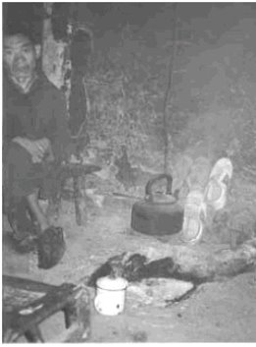
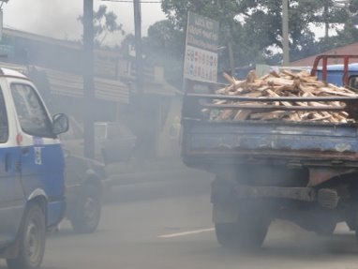
Indoor Air Impacts Outdoors and Outdoor Air Impacts Indoors
OUTDOOR
Infiltration/penetration leads to indoor exposures
Largest exposures to outdoor pollution may occur indoors
INDOOR
Ventilation exposures
May result in neighborhood effects

Slide 8
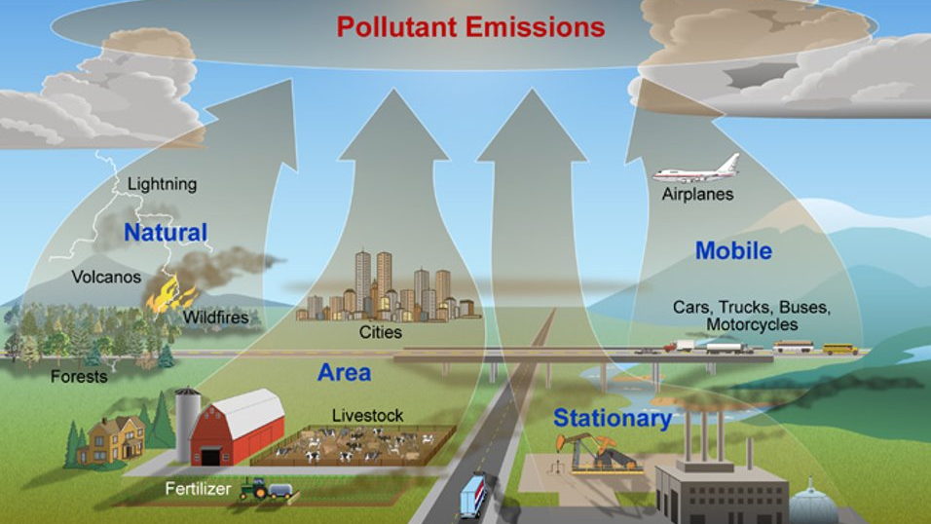
Pollutant Emissions
http://www.nature.nps.gov/air/aqbasics/sources.cfm​
Notes:
There are many different sources of pollution, from natural sources like volcanoes and wildfires, to mobile sources such as cars and airplanes.

Slide 9
Section 2: Conventional Air Pollutants
1. Overview
2. Conventional Air Pollutants
3. Health Effects
4. Climate pollutants
5. Additional References

Slide 10
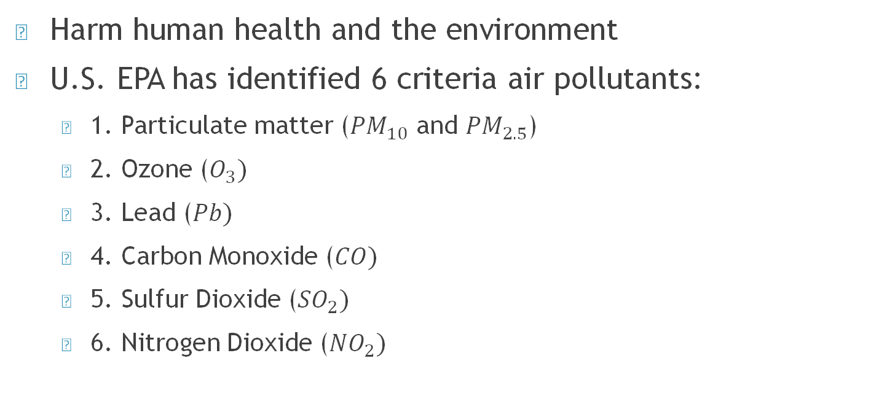
Conventional Air Pollutants
Harm human health and the environment
U.S. EPA has identified 6 criteria air pollutants:
  1. Particulate matter (${PM}_{10}$ and ${PM}_{2.5}$)
  2. Ozone ($O_{3})$
  3. Lead ($Pb)$
  4. Carbon Monoxide ($CO)$
  5. Sulfur Dioxide (${SO}_{2})$
  6. Nitrogen Dioxide (${NO}_{2})$
PM and Ozone are the focus of presentation
Notes:
These are called "criteria" air pollutants because the EPA sets National Ambient Air Quality Standards for these pollutants based on criteria from the latest scientific information. These six pollutants are common and widespread across the United States, and are known to harm health, the environment, and cause property damage. These pollutants leave the population exposed and can travel long distances.

Slide 11
Air Pollutant Sources and Effects
 | Major Sources | Health Effects | Environmental Effects
SO2 | Industry | Respiratory and cardiovascular illness | Precursor to acid rain, which damages lakes, rivers, and trees; damage to cultural relics
NOx | Vehicles; industry | Respiratory and cardiovascular illness | Nitrogen deposition leading to over-fertilization and eutrophication
PM | Vehicles; industry | Particles penetrate deep into lungs and can enter bloodstream | Visibility
CO | Vehicles | Headaches and fatigue, especially in people with weak cardiovascular health
Lead | Vehicles (burning leaded gasoline) | Accumulates in bloodstream over time; damages nervous system | Fish/animal kills
Ozone | Formed from reaction of NOx and VOCs | Respiratory illness | Reduced crop production and forest growth; smog precursor
VOCs | Vehicles; industrial processes | Eye and skin irritation; nausea; headaches; carcinogenic | Smog precursor
Notes:
These represent examples of sources, health, and environmental effects, and are not an exhaustive list.

Slide 12
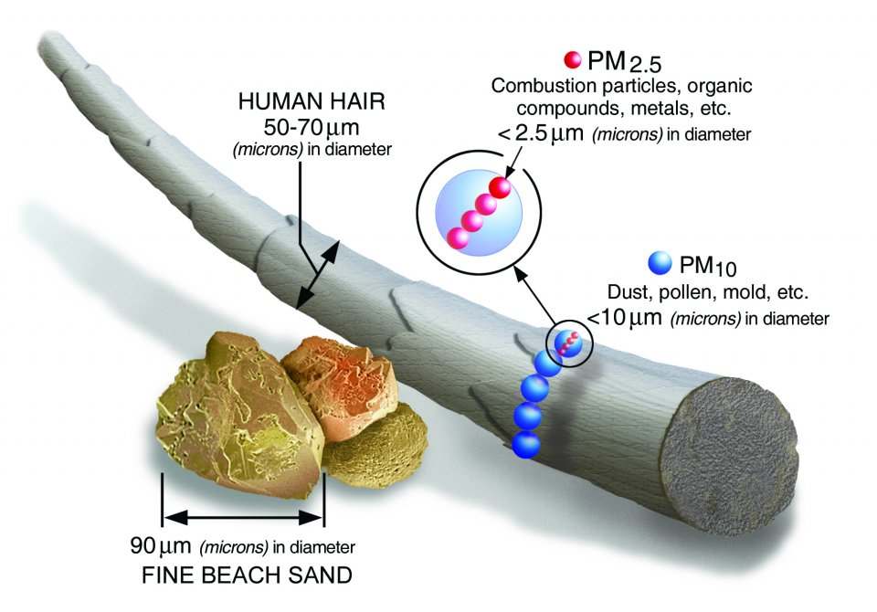
Particulate Matter
Particulate Matter (PM) Basics | US EPA

Slide 13
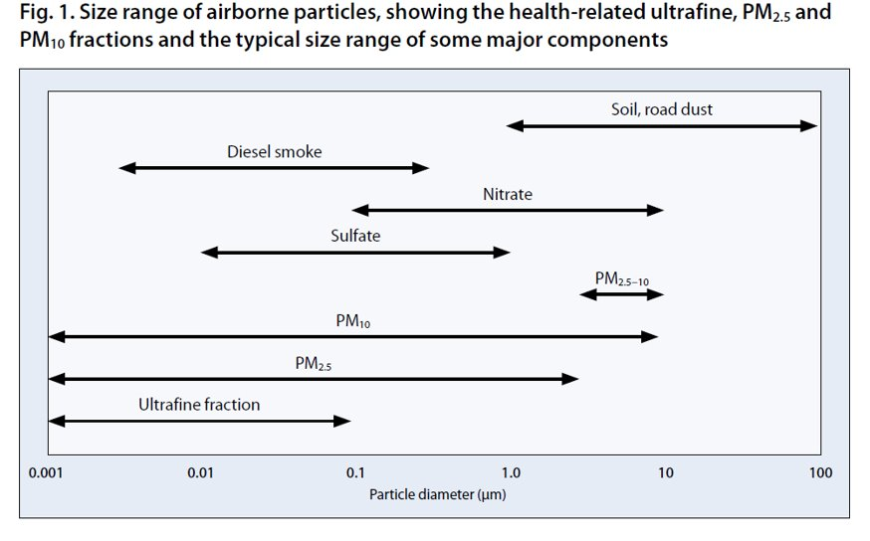
Particulate Matter Sizes
WHO 2005

Slide 14
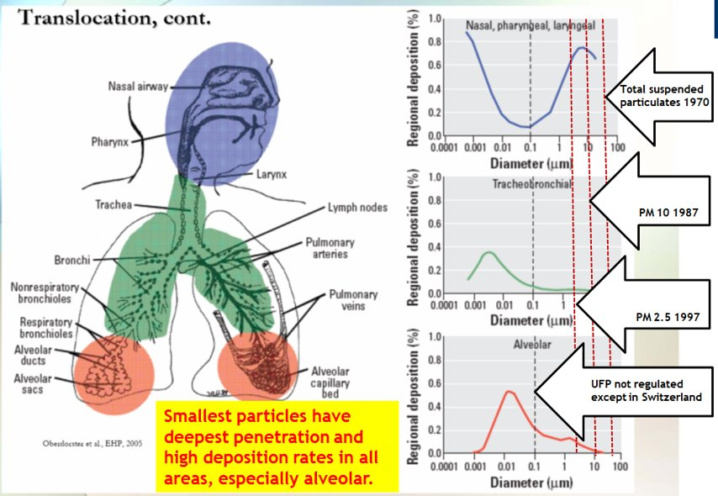
Particulate Matter Penetration
Airborne Nanoparticles: Control and Detection, Rezaei and Johnson
Notes:
Looking at the graphs, we see that the nasal, pharyngeal, and laryngeal regions have the highest deposition of larger particulates and ultra fine particulates.
The tracheobronchial region has the highest deposition of ultrafine particles, and the alveolar regions have high deposition rates for ultrafine particles and PM2.5 particles.
Research indicates that smaller particles are a larger threat to health, due to their ability to penetrate deep into lungs or even enter blood.
U.S. Legislation first began in 1970 to regulate total suspended particulates in the US, then continued to regulate PM 10 particles in 1987 and finally PM2.5 regulations were put in place in 1997. Ultra fine particles are still widely unregulated, partially due to difficulties in monitoring.

Slide 15
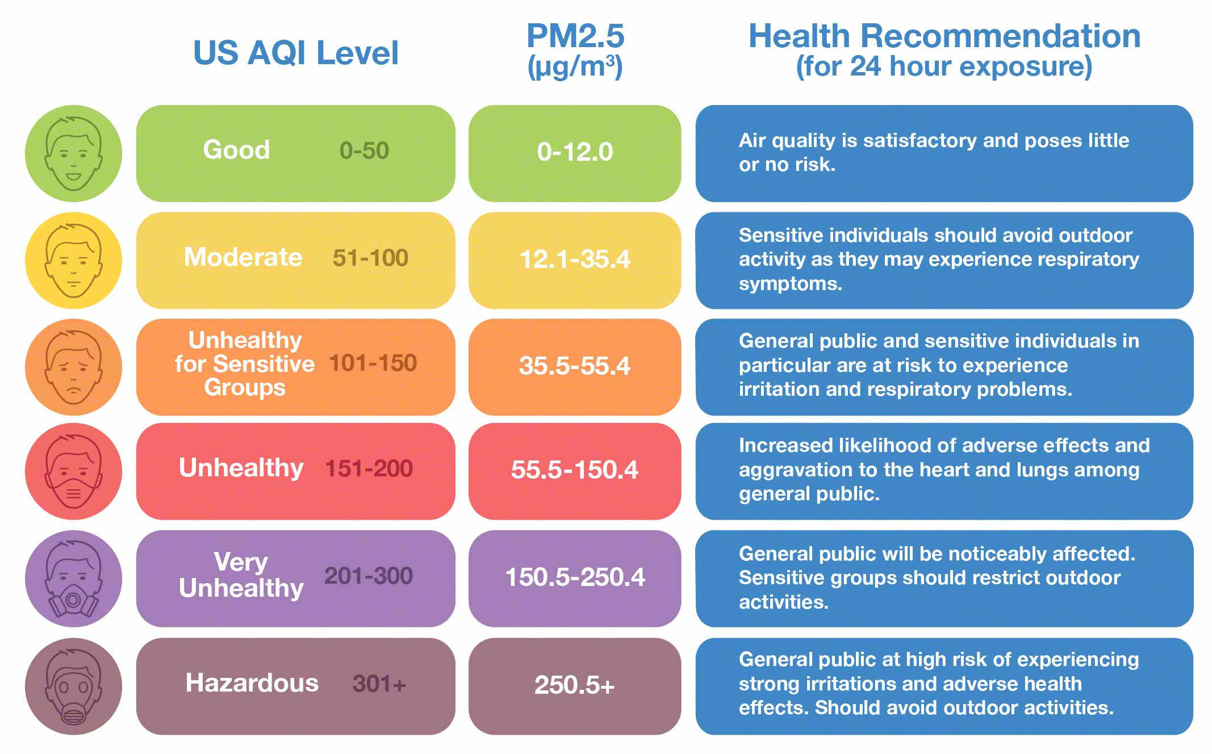
US Air Quality Index and PM_{2.5}
https://www.iqair.com/us/blog/air-quality/Kabul-air-quality-november-2020
Notes:
The US AQI was created to have an interpretable measure of air pollution and its health impact on different groups of people, focusing on acute effects. Raw measurements for different air pollutants are converted into a different AQI value based on a standard formula, and the highest value is reported for the day.
The AQI level corresponds to a different status such as “good,” “moderate,” or “unhealthy for sensitive groups” to provide guidance for the general public and those at higher risk of experiencing respiratory problems. At risk groups can include children, older adults, active people and those working outdoors and people with lung diseases.
Source: EPA, 2014 “Air Quality Index: A Guide to Air Quality and Your Health”

Slide 16
Coarse Particulate Matter: PM₁₀
Solid or liquid particles in air
Can be large or dark enough to be seen as soot or smoke
  Diesel trucks, woodstoves, power plants
Chemical and physical composition vary widely
Effects include:
  Lung tissue damage
  Cancer
  Reduced visibility

Slide 17
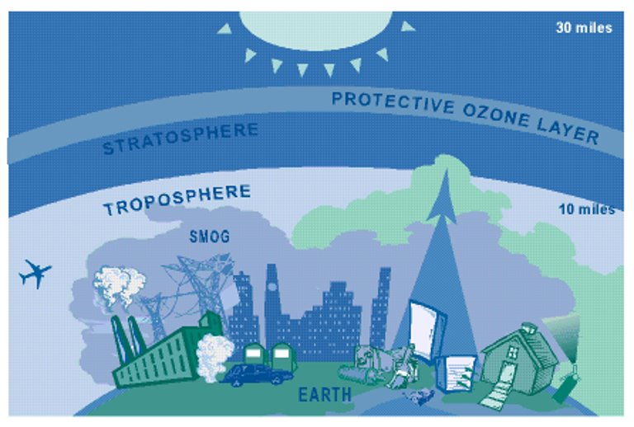
Ozone
http://www.policyalmanac.org/environment/archive/ozone.shtml ​
Notes:
As can be seen in this diagram, stratospheric ozone is located in the upper atmosphere. It forms naturally and protects the population from harmful ultraviolet rays
On the other hand, tropospheric ozone is created by the interaction between man-made emissions (including VOCs and nitrogen oxides) with heat and sunlight, in addition to the oxidation of methane. Major sources of VOCs include cars and gasoline burning engines, as well as chemical manufacturing. Tropospheric ozone is harmful to human health, primarily causing respiratory irritation and aggravating chronic disease.

Slide 18
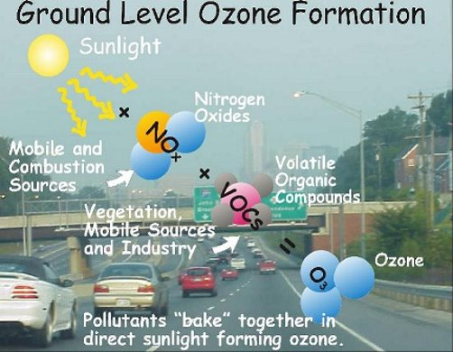
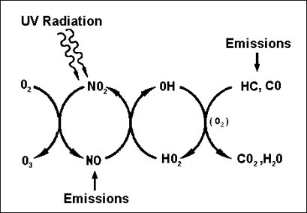
Ozone Formation
http://www.stadtentwicklung.berlin.de/umwelt/umweltatlas/ed306_06.htm​
http://www.geo.sunysb.edu/ess-workshops/lesson-plans.html​
Notes:
These diagrams depict the chemical processes that form ozone. With inputs of Nitrogen oxides and VOCs in addition to UV radiation, ozone is created.
Ozone cannot form without the presence of UV radiation, which usually occurs in the form of sunlight.

Slide 19
PM and Ozone in [YOUR CITY]
What are some major sources of PM and O₃?
What policies are currently in place to reduce PM and O₃?
What are the biggest local conventional air pollutant concerns in [YOUR CITY]?
What are the local challenges to reducing these pollutants?

Slide 20
Other Pollutants
CO
Vehicles, kerosene/gas space heaters, stoves, chimneys
Reduces the amount of oxygen that can be transported in the blood stream
NOx
On and non-road vehicles, power plants, industrial sources
Oxidizing agent that reacts with VOCs to form O₃
Forms nitrates that contribute to PM_{2.5}
Pb
SO₂
Lead can be released directly into the air, historically came mainly from lead in motor vehicle gasoline; still used in gasoline for some aircraft and other processes
Largest source is the burning of fossil fuels by power plants and other industrial facilities
Short-term exposures harm the respiratory system
Accumulates in the bones and can cause a multitude of effects, including neurological effects in children

Slide 21
Section 3: Health Effects
1. Overview
2. Conventional Air Pollutants
3. Health Effects
4. Climate pollutants
5. Additional References

Slide 22
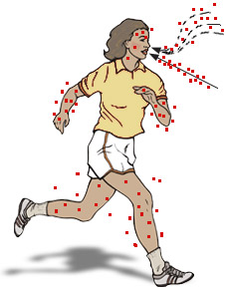
Air Pollutants Enter the Body through:
Inhalation: Breathing exposes the nose, throat, and lungs
Ingestion: Air pollutants can deposit on food or vegetation that will be eaten by humans
or livestock, or
Absorption through the skin.
Notes:
Entry:
Air pollutants get into the body mainly through breathing. People breath nearly 13,000 liters of air each day.
They can also be ingested or absorbed through the skin.
Once a pollutant enters the body, it can remain in the lungs (e.g., asbestos), be exhaled, or move into the blood from the lungs (like the oxygen we breathe) or from the digestive system or skin.
If pollutants enter the bloodstream, they can be transported to all parts of the body.
As it moves through and around the body, a pollutant can undergo many chemical changes, especially as it passes through the liver, becoming less, or more, toxic.
The pollutant can be exhaled, it can leave the body in urine, bowel movements, sweat, or breast milk, or it can be stored in hair, bone, or fat.
Susceptible Groups:
Although effects of air pollution can vary greatly from one person to another, those most directly affected include the elderly, infants, pregnant women, and those who suffer from long-term chronic lung or heart disease.
In addition, those who engage in vigorous physical activity outdoors are also vulnerable due to the higher levels of air exchange taking place in deep lung tissue.

Slide 23
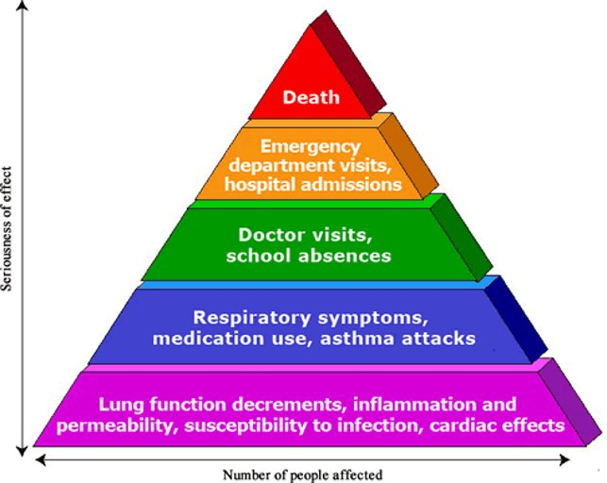
PM and Ozone Health Effects
Health Effects of Ozone in the General Population, US EPA
Notes:
It is key to note that pollutants such as PM and Ozone have very serious health effects that impact a smaller number of people, and less severe health effects that are still important and affect large portions of the population.

Slide 24
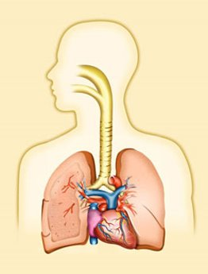
Acute Health Effects from Air Pollution
Wheezing, coughing, respiratory infections, phlegm production
Aggravated asthma and emphysema
Airway inflammation
Decreased lung function capacity
Heart rate variability
Altered blood coagulability
Altered cardiac electrical activity
Increased daily morbidity and mortality
Notes:
Air pollution causes many acute health affects, impacting different parts of the respiratory system.

Slide 25
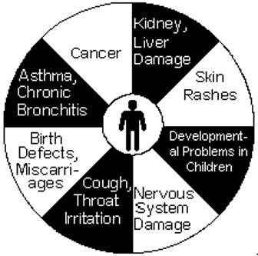
Chronic Health Effects
Chronic respiratory disease
Lung cancer
Heart disease
Brain, nerve, liver, kidney damage
Aggravation of medical conditions in elderly
Developmental effects in children
Mortality
Notes:
There are a variety of chronic health effects that can occur from air pollution as well, from cough and throat irritation, to chronic respiratory disease to cancer and mortality.

Slide 26

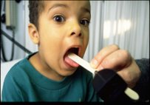



Health Effects on Children
Windows of vulnerability during development
Environmental exposures
Physiological differences
Different health effects in children and adults
Notes:
Children are not little adults – the health effects they experience differ due to environmental exposures, physiological differences, and windows of vulnerability during development.

Slide 27
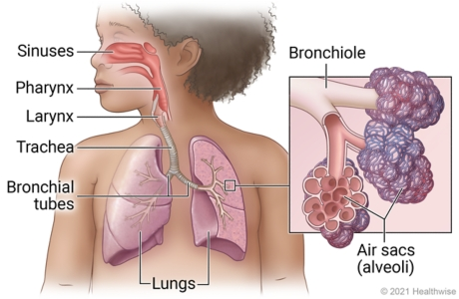
Children’s Lungs are Still Developing
80% of alveoli develop after birth through adolescence; pollution may cause permanent damage
Children’s airways are narrower, so the effects of irritation or inflammation can be more severe
https://myhealth.alberta.ca/Health/Pages/conditions.aspx?hwid=tp12432

Slide 28
Section 4: climate pollutants
1. Overview
2. Conventional Air Pollutants
3. Health Effects
4. Climate pollutants
5. Additional References

Slide 29
Climate Pollutants
Greenhouse Gases (GHGs)
Short-Lived Climate Pollutants (SLCPs)
Exist in the atmosphere for days to decades
Trap heat in atmosphere
Primarily includes CO₂, methane, nitrous oxide, and fluorinated gases
Subset of GHGs
Includes black carbon, methane, and hydrofluorocarbons (HFCs)
Pollutants that have a warming impact on climate

Slide 30
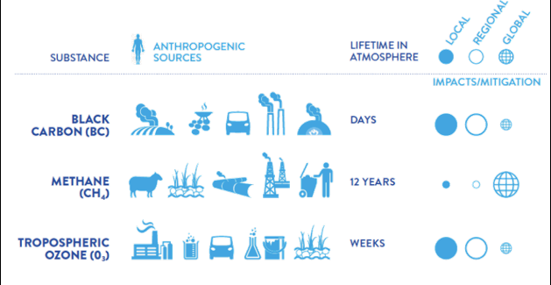
Short-lived Climate Pollutants
http://ccacoalition.org/en/science-resources​

Slide 31
Short-Lived Climate Pollutant (SLCPs) Sources
Brick production
Inefficient cookstoves and biomass burning
Diesel exhaust
Methane leakage from oil and natural gas production
Methane emissions from waste decomposition and agriculture

Slide 32
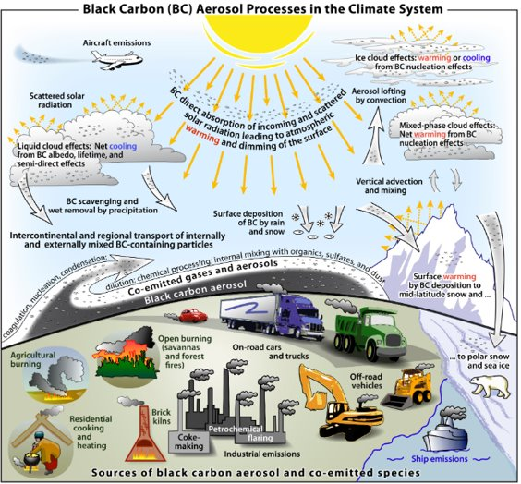
Black Carbon
Bond et al., J Geophys. Res., 2013. Figure by D. Fahey
Notes:
Black carbon can be emitted from many sources, including agricultural burning, residential cooking and heating, vehicle emissions, industrial processes, and more.
Black carbon in the atmosphere can directly absorb incoming solar radiation, which leads to atmospheric warming. At the same time, black carbon can lead to some cooling effects as it can help form clouds which increase the reflection of radiation.

Slide 33
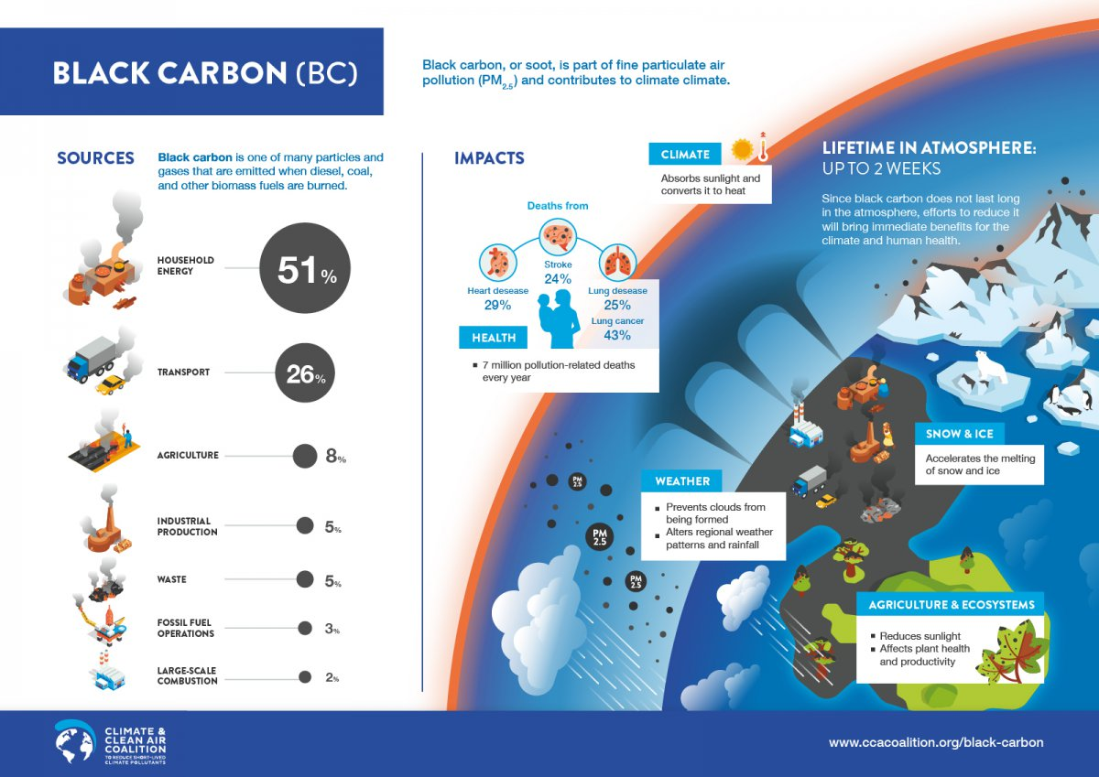
Climate Impacts of Black Carbon
CCAC, 2011
Notes:
Black carbon particles are formed from the incomplete combustion of biomass and fossil fuels
Sources include resident cooking and heating, diesel engines, industrial coal and brick kilns, and open burning
Black carbon is harmful to human health and can accelerate warming

Slide 34
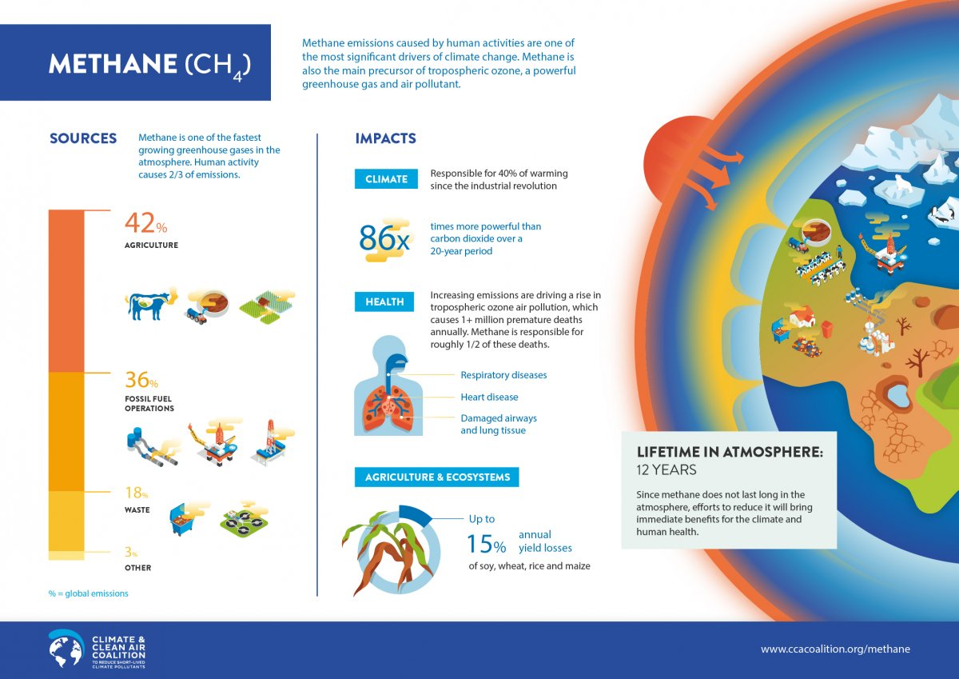
Climate Impacts of Methane
CCAC, 2011
Notes:
Key points:
Methane is a significant driver of climate change, and is a precursor of tropospheric ozone, which is a powerful GHG and air pollutant
Main sources include agriculture, fossil fuel operations, and waste. Human activity causes 2/3rds of emissions
Methane is 86x more powerful than CO2 over a 20-year period

Slide 35
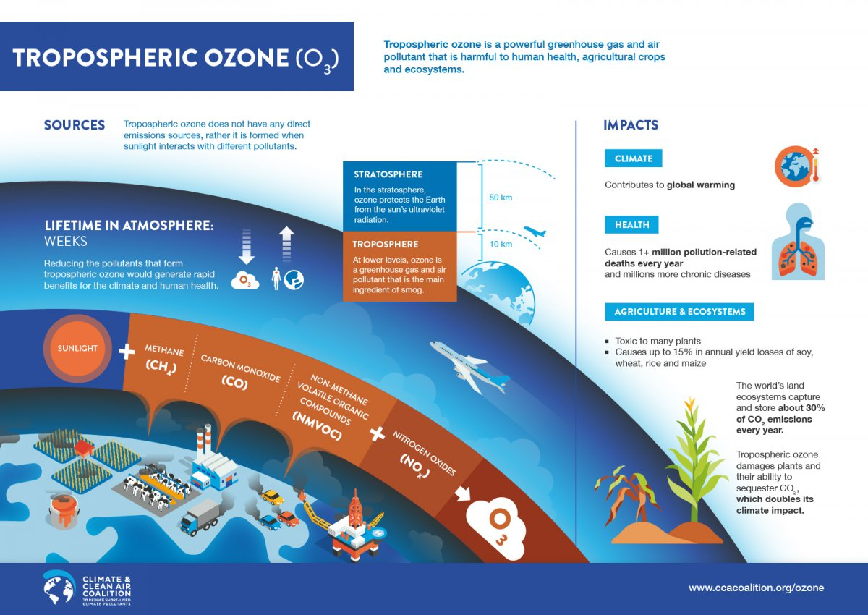
Climate Impacts of Ozone
CCAC, 2011
Notes:
Key points:
Tropospheric ozone is an air and climate pollutant. It is harmful to human health, the climate, and agriculture/ecosystems
Is a secondary pollutant that forms from methane, carbon monoxide, VOCs, Nox, and sunlight
Initial sources of precursor pollutants include vehicles, industry, and agriculture

Slide 36
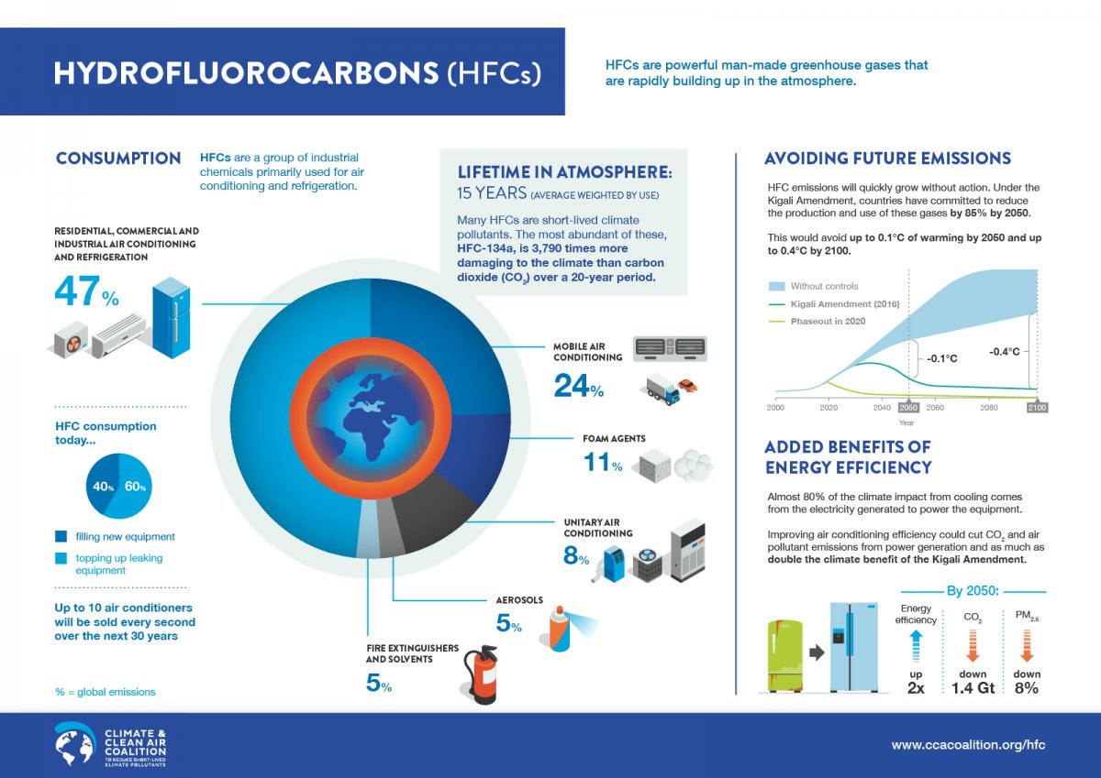
Climate Impacts of Hydrofluorocarbons
CCAC, 2011
Notes:
Key points:
HFCs are man-made GHGs
Typically used for air conditioning, refrigeration, fire retardants, aerosols, and more
Extremely powerful greenhouse gases which accelerate global warming

Slide 37
Section 5: Additional references
1. Overview
2. Conventional Air Pollutants
3. Health Effects
4. Climate pollutants
5. Additional References

Slide 38
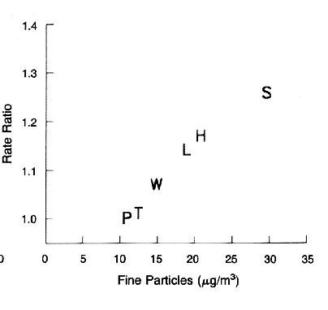
Harvard Six Cities and American Cancer Society Studies
1993 & 2006– 14 to 16% increase in mortality for each 10 µg/m³ of PM_{2.5}.
Dockery DW, Pope CA III, Xu X, et al, An association between air pollution and mortality in six US cities. New England Journal of Medicine. 1993. Vol 329. 1753-1759.
9% increase in cardiopulmonary and a 14% increase in lung cancer mortality for each 10 ug/m³ of PM_{2.5} when looking at over 50 metropolitan regions of US
Pope CA III, Thun MJ, Namboodiri MM, Dockery DW, Evans JS, Speizer FE, Hath CW Jr. 1995. Particulate air pollution as a predictor of mortality in a prospective study of US adults. American Journal of Respiratory and Critical Care Medicine. 151:669-674.
Notes:
First studies to demonstrate this relationship.
There are strengths and weaknesses to each PM_{2.5} mortality study that argue for using risk estimates drawn from both analyses. While the ACS‐based study includes a much larger population over a broader geographic area than the H6C study, the ACS population is less racially diverse, better educated, and more affluent than the national average. By contrast, the H6C cohort population is more representative of the United States, but estimates PM mortality risk in eastern U.S. cities where PM_{2.5} is generally comprised of a larger fraction of sulfate than it is in western cities. There are other differences in population demographics and exposure‐related factors that may also contribute to differences in the eastern and western United States. To the extent that PM_{2.5}‐related mortality is strongly influenced by particle composition, applying a H6C‐based risk coefficient nationwide may result in biased estimates of PM_{2.5} mortality in the west. Conversely, applying an ACS‐based risk estimate nationwide may not characterize well the PM_{2.5} mortality impacts in the eastern United States.⁽31⁾

Slide 39
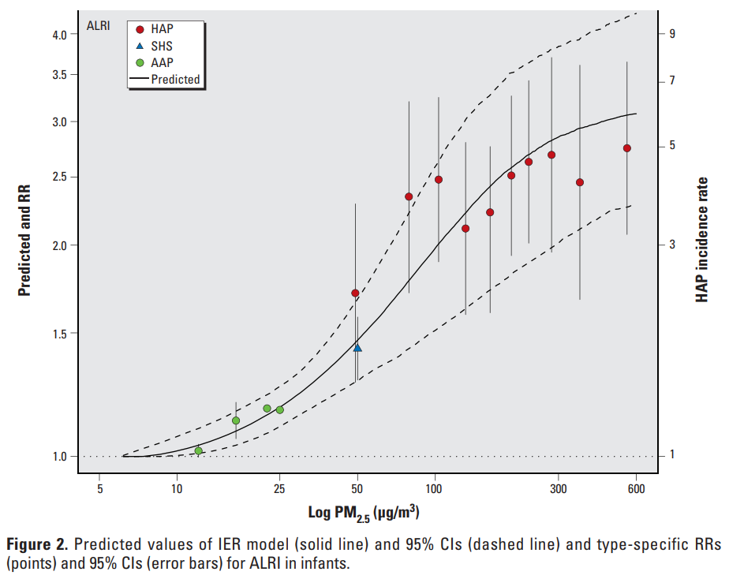
Integrated Exposure Response Functions
Burnett et al., 2014.
Notes:
The integrated exposure response function incorporates PM2.5 concentrations from various sources to be able to estimate health impacts associated with PM2.5 concentrations that range from 5 to 600 ug/m3.

Slide 40
Thank you!

