Slide 1
DELETE THIS SLIDE PRIOR TO PRESENTATION
This PowerPoint serves as a template presentation which introduces topics related to air quality and is part of a suite of presentations provided by the EPA for the Megacities program.
See speaker notes for an additional description of slide content. Slides should be edited or added to as necessary for your particular needs. Slides with highlighted yellow text require the addition of specific context and information for your city.

Slide 2
Ambient Air Quality Monitoring

Slide 3
Overview
1. Objectives
2. Air Monitoring Basics
3. Monitoring Options
4. Low-Cost Sensors and Remote Satellites
5. Integrated Strategy
6. Infrastructure and Best Practices

Slide 4
Section 1: Objectives
1. Objectives
2. Air Monitoring Basics
3. Monitoring Options
4. Low-Cost Sensors and Remote Satellites
5. Integrated Strategy
6. Infrastructure and Best Practices

Slide 5
Air Quality Monitoring System Guidance
Measurement strategies should fit a purpose
A successful, sustainable monitoring strategy requires more than equipment
  Equipment costs are not the full costs
Quality assurance planning is a critical component to air monitoring strategies
Satellite-based remote sensing is promising but does not replace ground-based monitors
Measurement systems are necessary but not sufficient to reduce pollution
Filling the Gaps: Improving measurement of ambient air quality in low and middle income countries. The World Bank, U.S. Environmental Protection Agency, U.S. Department of State. 2017 ​
Notes:
Securing and sustaining high quality air quality data globally is a challenge. This challenge can be met if governments, academics, the private sector and civil society work together to find creative solutions. There is a clear business case to be made for improving public health by reducing air pollution. ​
​
1. Measurement strategies must be selected to fit a purpose. Air quality monitoring strategies should be informed by countries’ air quality management goals and monitoring needs. ​
​
2. A successful, sustainable monitoring strategy requires more than equipment. ​
Human and institutional systems needed to ensure high data quality and data can be analyzed and communicated​
​
3. Quality assurance plans are one of the most critical components of an air measurement strategy. Decision makers must have confidence that the monitoring data underpinning their decisions is of an adequate quality to withstand scrutiny, especially when there are significant financial and programmatic investments​
​
4. Satellite-based remote sensing is promising, but does not replace ground based monitors. ​
​
5. Measurement systems are necessary but not sufficient to reduce air pollution. Air quality measurement strategies must be placed in the context of a broader air quality management program, with a focus on achieving emission reductions and improvements to public health, rather than being an end itself. ​
​
Air quality data can be a powerful tool to inform the public about the dangers of air pollution. Publicly available data can support communication efforts so people can take action to protect themselves. An informed public can help advocate for the investments needed to reduce pollution and also be a part of people powered emission reduction strategies, e.g., vehicle emission testing or cookstove change-out programs. ​
​

Slide 6
Air Quality Monitoring Goals
Support compliance with ambient air quality standards
  Assess highly polluted areas or large emission contributors
  Maintain regulations of pollution levels
Evaluate background concentrations and health risks in population centers
  Provide justification for health targets through epidemiological modeling
Report air quality to the public
  Alerts public to protect themselves against poor AQ days
  Provides public pressure for legislation
Support air pollution research
  Collaboration with local or external research efforts

Slide 7
A successful, sustainable monitoring strategy requires more than equipment.

Slide 8
Setting Monitoring Objectives
Example Monitoring Objectives
 | Objective
Continuing Objectives
1 | Provide monitored air quality data to the public via an air quality index (AQI)
2 | Provide regulatory grade data to influence policy
3 | Support compliance and enforcement efforts to achieve NAAQS by 2025
4 | Contribute to an emissions control strategy
5 | Promote research with the national university regarding air quality and health
One-Time Objectives
6 | Support update of the national AQMP (including identification of key sources and institutions that can make a difference to air quality)
7 | Calibrate low-cost sensor network against regulatory grade monitors
Objectives should be set in support of air quality monitoring goals
Limited resources require targeted and tactful monitor placement and implementation

Slide 9
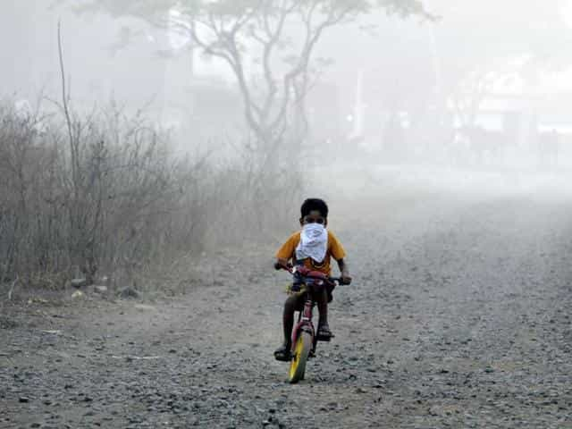
Measuring the Air in Low- and Middle-Income countries (LMICs)
Air quality management systems should include a measurement component to address policy objectives and document trends over time
Measurement systems have a broad range of capabilities characterized by:
  Prevalence
  Measurement fidelity/accuracy
  Data availability
  Available support
https://www.hindustantimes.com/indore/pollution-in-indore-gets-an-intervention/story-Wde8DBSMtJYfGn1ThPVLIO.html

Slide 10
What are [YOUR CITY]’s monitoring objectives?

Slide 11
Section 2: Air Monitoring Basics
1. Objectives
2. Air Monitoring Basics
3. Monitoring Options
4. Low-Cost Sensors and Remote Satellites
5. Integrated Strategy
6. Infrastructure and Best Practices

Slide 12
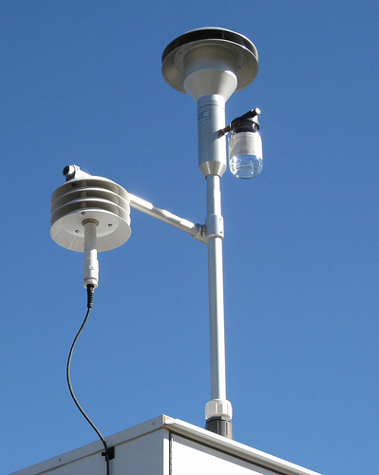
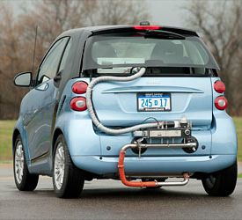
Air Monitoring Basics
Ambient Monitoring
  Systematic, long-term assessment of air pollutant levels
  Measures quantity and type of pollutants in outdoor air
Emissions Measurement
  Monitoring particulate and gaseous emissions from a specific source
https://www.flickr.com/photos/brewbooks/3122790831/
Image Source

Slide 13
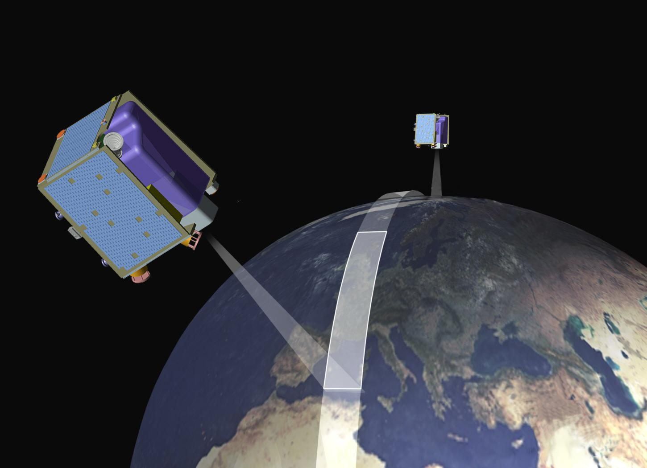
Air Quality Monitoring
Air quality monitoring is performed to:
  Assess the extent of air pollution
  Ensure compliance with national legislation
  Evaluate air quality control options
  Provide data for air quality modeling
  Understand human exposures
Monitoring types
  Active
  Passive
  Remote sensing
https://commons.wikimedia.org/wiki/File:RapidEye_Satellites_Artist_Impression.jpg

Slide 14
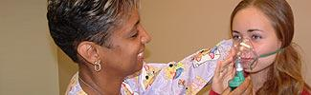
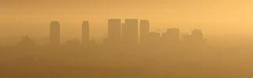




There are many pollutants to monitor:
Ground-Level Ozone
Particulate Matter
Carbon Monoxide
Lead
Sulfur Dioxide
Nitrogen Dioxide
https://www.epa.gov/criteria-air-pollutants

Slide 15
Pollutant Basics
Air Pollutant | Type | Source Example | Useful Detection Limits
PM_{2.5} | Primary and secondary | Fuel combustion | 5 µg/m³ (24 hour)
PM₁₀ | Primary and secondary | Dust, fuel combustion | 10µg/m³ (24-hour)
NO₂ | Primary and secondary | Fuel combustion (often marker of traffic) | 10 ppb
SO₂ | Primary | Fuel combustion | 10 ppb
CO | Primary | Fuel combustion | 0.1 ppm
O₃ | Secondary | Formed via UV (sunlight) and presence of other key pollutants | 10 ppb
Pb | Primary | Smelting, aviation gasoline, waste incinerators, more | 0.05 µg/m³ (24-hour)
Air Sensor Guidebook 2021

Slide 16
Monitoring Network Strategies
Human health objective
  Stations in population centers, near busy roads, in city centers, near schools or hospitals, background sites
Monitoring strategies should consider:
  Investment costs, operating and maintenance costs, reliability of system, staff capacity, operation requirements
Data management systems and databases
  Data storage
  Data retrieval
  Data analysis
  Used in conjunction with meteorological and source activity data

Slide 17
Section 3: Monitoring Options
1. Objectives
2. Air Monitoring Basics
3. Monitoring Options
4. Low-Cost Sensors and Remote Satellites
5. Integrated Strategy
6. Infrastructure and Best Practices

Slide 18
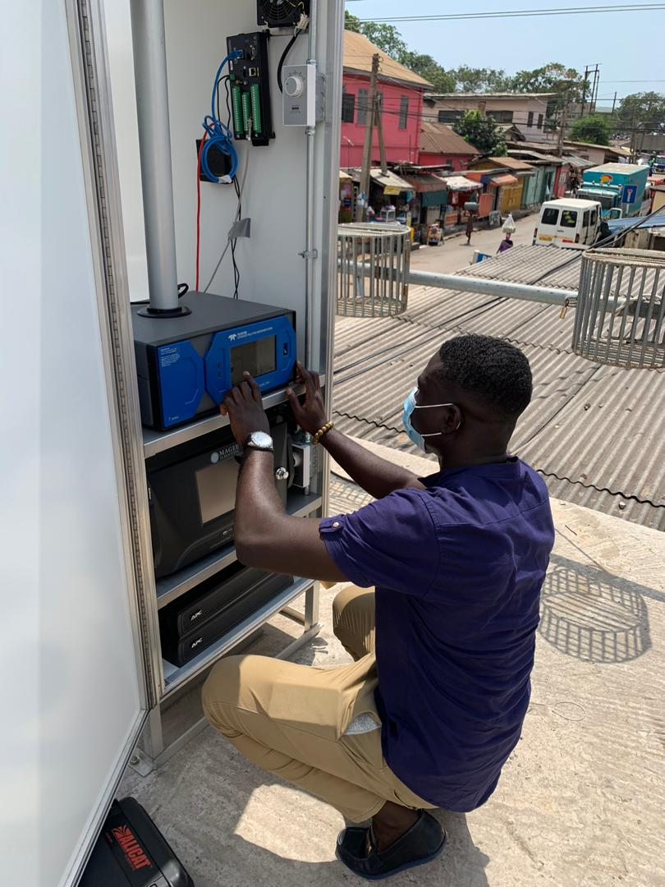
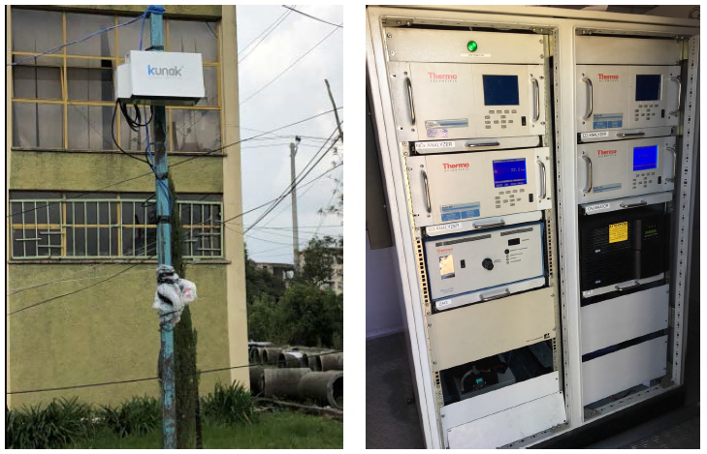
Monitoring Options
Kunak sensor in Addis Ababa, 2019
National Meteorological Agency Shelter in Addis Ababa, 2018
Teledyne T640, AE33 aethalometer, and datalogger installation in Accra, 2020
Notes:
There are many different types of monitors and sensors to choose from.
EPA has a formal process for the evaluation of technologies proposed for use as Federal Reference Method (FRM) or Federal Equivalent Method (FEM) monitors that are used for monitoring compliance with the National Ambient Air Quality Standards. These are considered the gold standard for air quality monitoring.

Slide 19
Monitor Types
U.S. EPA formally evaluates technologies proposed to monitor compliance with the National Ambient Air Quality Standards (NAAQS)
Federal Reference Method (FRM)
  Provides fundamentally sound and scientifically defensible concentration measurements
  Serve as the basis of comparison to judge other methods
Federal Equivalence Method (FEM)
  Provide comparable level of compliance decision making quality as FRMs
Testing and Performance Criteria
Accuracy | Precision
Range | Detection Limit
Pollutant specificity | Noise
Drift | Multi-site measurement
US EPA Office of Research and Development, 2019
Notes:
Both FRMs and FEMs have very strict measurement performance criteria to ensure that data supports accurate and effective air quality management decisions.
• EPA ORD (RTP, NC) is Congressionally mandated to review new instrument designs and formally designate approved monitors as either FRMs or FEMs.
Both have strict testing requirements and performance criteria
Also include QA/QC steps of:
Manufacturing specifications, siting to meet regulatory requirements, internal and external instrument and laboratory audits, inspection and validation of data

Slide 20
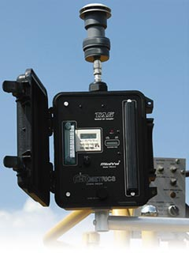
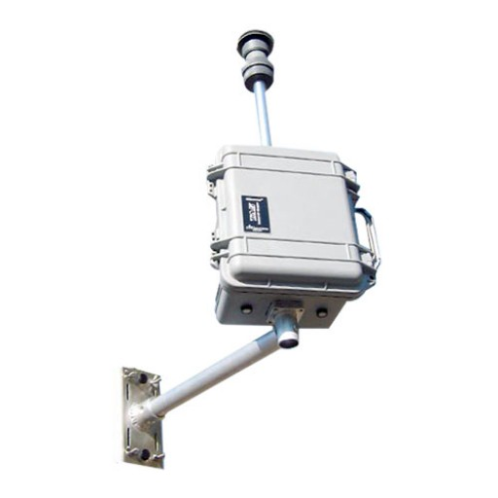
Federal Reference Method Monitors
AirMetrics Sampler
MiniVol Sampler
http://www.airmetrics.com/images/headers/applications.jpg
https://geneq.com/environment/image/cache/catalog/old/products-3/Airmetrics-pm2-512x512.jpg
Notes:
Federal reference method monitors use active sampling of air to collect particles on filter, which is then handled, stored, and weighed in a laboratory setting. The materials can then be further analyzed for their species via lab analysis.
Prospective users of the methods listed should note (1) that each method must be used in strict accordance with its associated operation or instruction manual and with applicable quality assurance procedures, and (2) that modification of a method by its vendor or user may cause the pertinent designation to be inapplicable to the method as modified.

Slide 21
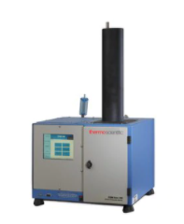
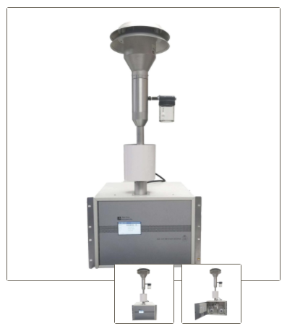
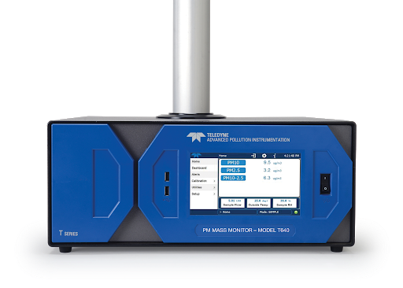
Federal Equivalency Method Monitors
TEOM Continuous Ambient Particulate Monitor
BAM 1020 Continuous Particulate Monitor
Teledyne T640 Particulate Monitor
https://assets.thermofisher.com/TFS-Assets/CAD/product-images/teom-1405.jpg-650.jpg
https://metone.com/products/bam-1020/
https://www.teledyne-api.com/prod/particulatematter/PublishingImages/T640-monitor.png
Notes:
FEM monitors use beta attenuation (BAM), mass concentration measurement (TEOM), and scattered light spectrometry (T640) to measure PM concentrations. There are other monitors, these are just some examples.

Slide 22
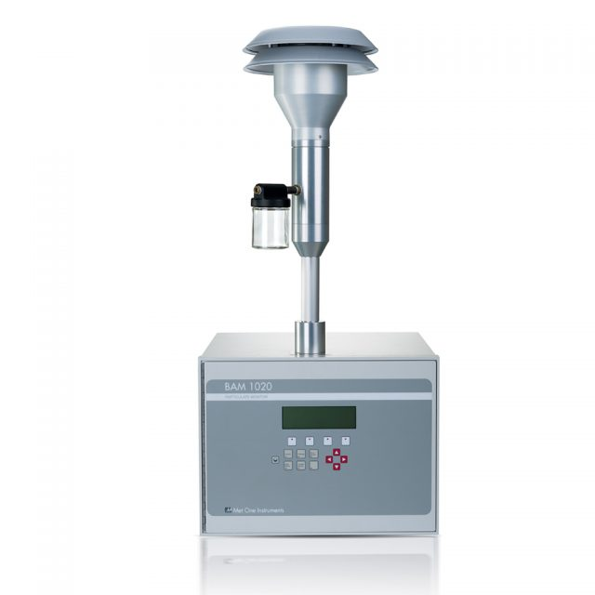
Continuous Air Quality Monitors - PM
Beta Attenuation Monitor (BAM)
  At U.S. Embassies
  Continuous particulate monitor (PM₁₀, PM_{2.5})
  U.S. EPA FEM
  Long term unattended remote operation
  Low operating costs
  Automatic calibration checks
  Controls humidity
  Hourly filter
  Integrated datalogger for data output
https://www.et.co.uk/products/air-quality-monitoring/particulate-monitoring/bam1020-2/
Notes:
Also TEOM, tapered element oscillating monitor via direct mass measurement.
Teledyne T640 uses scattered light spectrometry for measurement.

Slide 23
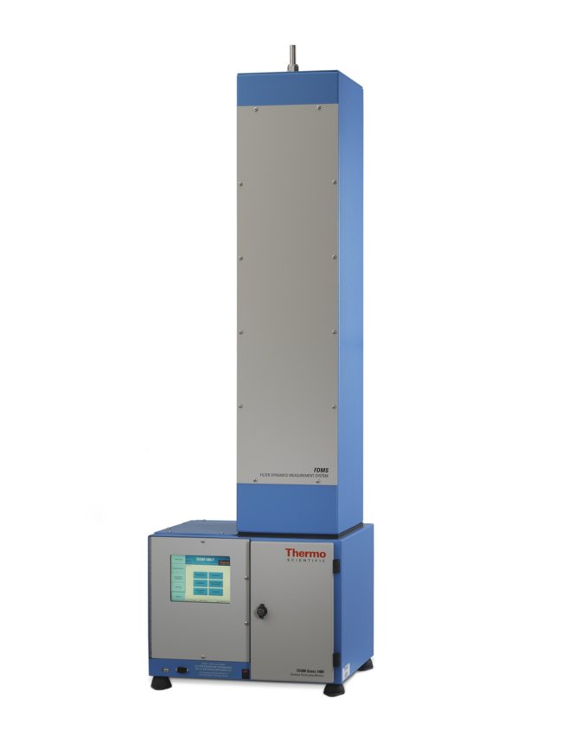
Continuous Air Quality Monitors
Tapered Element Oscillating Microbalance Monitor (TEOM)
  Continuous particulate monitor (PM₁₀, PM_{2.5}, PM₁)
  US EPA FEM
  Draws ambient air through filter at constant flow rate, weighing the filter and calculating real time mass concentrations of PM
  Controls ambient temperature and pressure
https://assets.thermofisher.com/TFS-Assets/CAD/product-images/teom-1405f.jpg-650.jpg
Notes:
The TEOM monitor technique relies upon an exchangeable filter cartridge seated on the end of a hollow tapered tube. The wider end of the tube is fixed. As the air passes through the filter, particulate is deposited. The filtered air then passes through the tapered tube to a flow controller. The tapered tube with the filter on its end is maintained in oscillation in a clamped-free mode. The frequency of oscillation is dependent upon the physical characteristics of the tapered tube and the mass on its free end.
As particulate deposits land on the filter, the filter mass change is detected as a frequency change in the oscillation of the tube. The mass of the particulate matter is thus determined inertially, i.e. directly. When this mass change is combined with the flow rate through the system, the monitor yields an accurate measurement of the particulate concentration in real time.

Slide 24
Gravimetric Air Quality Monitors - PM
Gravimetric monitors
  U.S. EPA FRM
  Rely on weighing airborne particles to determine concentrations
  Labor intensive
  Not real-time
  Can be highly accurate, used to detect violations of air quality standards

Slide 25
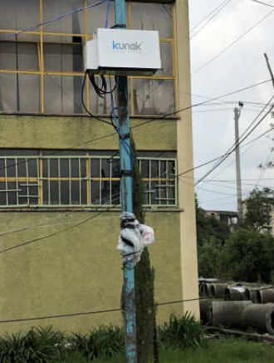
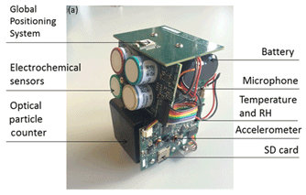
Low-Cost Sensors
Optical, metal oxide, or electrochemical sensors integrated together
Passive or active monitoring
High temporal resolution
https://amt.copernicus.org/articles/12/4643/2019/
Notes:
In addition to federal monitors, low-cost sensors have recently come on the market to provide data like that that is provided through FEMs, but use simpler and more low-cost methods for measurement.
These sensors tend to use optical, metal oxide, or electrochemical sensors integrated together. They can take advantage of passive monitoring, where air passes through a sensor without the use of a pump or a need for electricity, or active monitoring, which pulls air through the system.
Sensors can have high temporal resolution meaning they provide data that are resolved in time, including hourly or minute measurements.
PM sensors currently use optical OEM sensors
Particles scatter light from a laser or LED as they move through the measurement cell
Scattered light is then measured by a detector and the signal is used to estimate either the volume of an ensemble of particles and/or the number of particles in the air
Count estimate is then converted to mass concentration based on mass calibration or a density estimate
(The old adage is that you can have something fast, cheap, and good, but you can only pick two of the 3 – this is the fast and cheap version, while the FEM versions are fast and good.)
It is important to note, however, that sensors have some drawbacks. Increased humidity causes particles to grow, which increases the volume of the particle (but not the actual mass of the PM)
Can cause the mass to be over-estimated

Slide 26
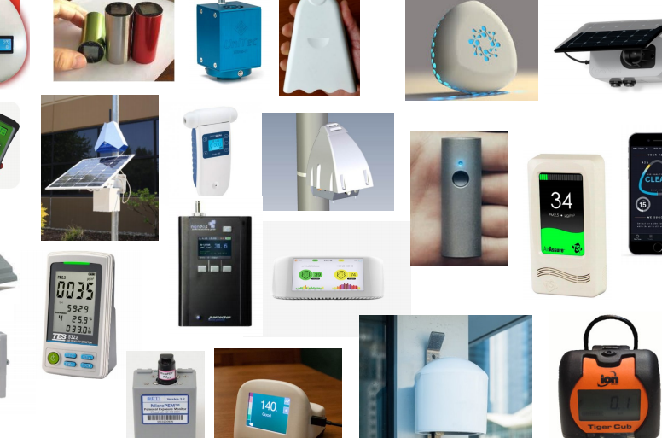
Low-Cost Sensors
https://www.epa.gov/sites/production/files/2019-12/documents/frm-fem_and_air_sensors_dec_2019_webinar_slides_508_compliant.pdf
Notes:
Here, we can see that there are MANY sensors that exist on the marketplace. Some use similar technology. Some stream to a cloud, some stream to a proprietary platform. Some are transparent, some use unknown algorithms to output data.

Slide 27
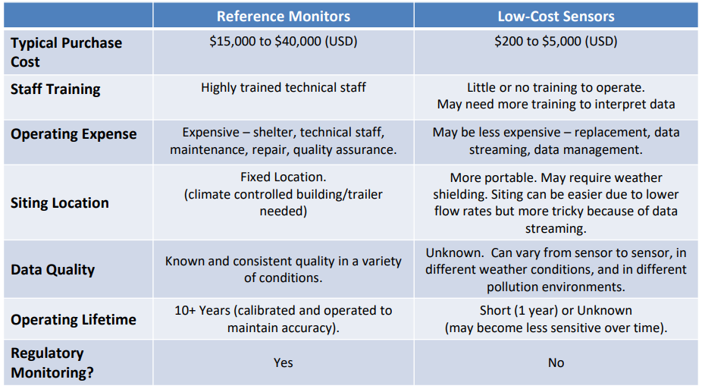
Reference Monitors v. Low-Cost Sensors
US EPA Office of Research and Development, 2019

Slide 28
When should I use monitors v. low-cost sensors?
FRM/FEM Monitor
Low-Cost Sensor
Regulatory
Compliance
High data quality
Establishing new system
Sufficient funding
Sufficient space
Non-regulatory
Informational
High time resolution needed
Limited by cost or infrastructure needs
Need smaller or portable options
Notes:
Validate sensors with monitors. Benchmarking.

Slide 29
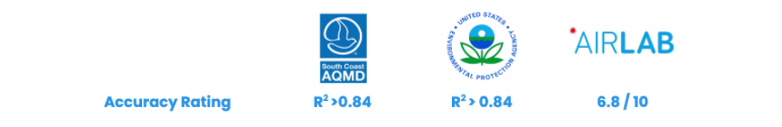
Calibration Challenges
Geographically relevant calibration
  Consider aerosol size distribution, composition, meteorological conditions
Deployment relevant calibration
  Need to imitate actual deployment conditions during calibration for relevance
Temporally relevant calibration
Sensor performance has been calibrated against FEM monitors.

Slide 30
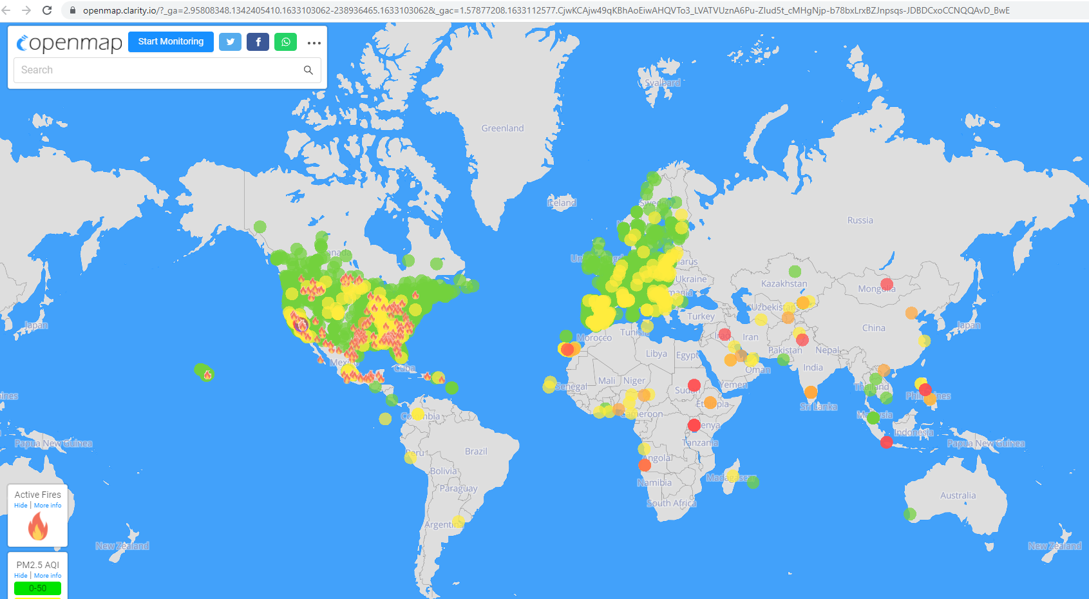
Example Sensor Network – Low-Cost PM_{2.5} Sensors
https://openmap.clarity.io/
Notes:
Real time map as of 12:25am, October 2, 2021

Slide 31
AirNow
Partnership of US EPA, NOAA, NPS, CDC, and more
Advance AQM worldwide through data and knowledge sharing
Helps decision makers communicate connections between air pollution, health, and sustainability goals
Helps inform and involve public in efforts to improve AQ
Collaborate on development of air quality tools
Advance air quality forecasting to support public health, raise public awareness, and advise sensitive populations
Build a community of people to share knowledge and expertise
Airnow.gov

Slide 32
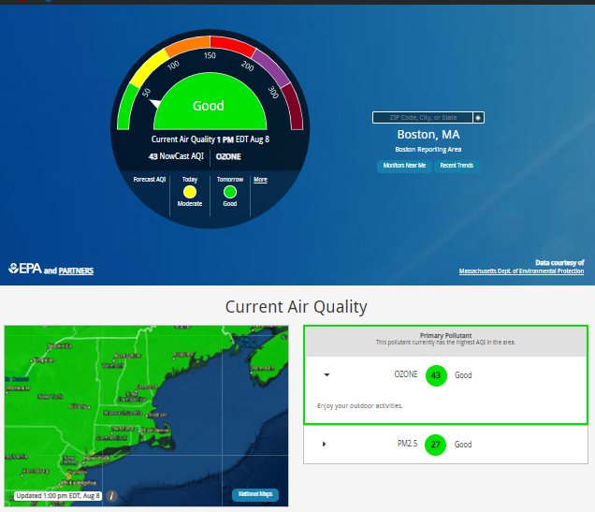
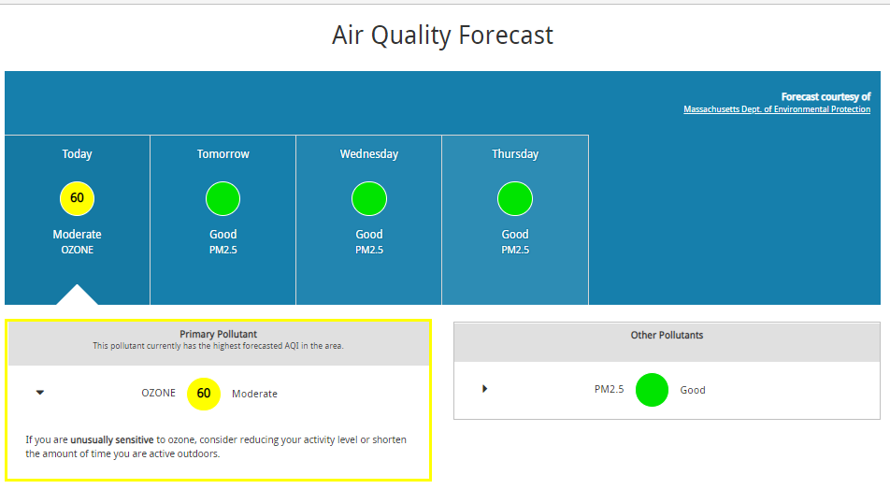
AirNow: City-level AQI
Airnow.gov
Notes:
This is an example of a site-specific air quality dashboard on AirNow. Here, visitors can see current air quality in the context of the index, the primary pollutant, and any relevant announcements.
Metropolitan Statistical Areas with populations of 350,000 are required to report the AQI daily to the general population.
Forecasts are also generally available, but not required
Weather reporting often includes forecasts of AQI

Slide 33
AirNow-International
Helping countries and regions around the world inform the public about the quality of the air they breathe by providing real time air quality information
Provide tools and information to advance AQM worldwide
Collaborate on development of air quality tools
Advance air quality forecasting
Build a community of people to share knowledge and expertise
https://www.airnow.gov/international/us-embassies-and-consulates/
Notes:
Platform for data sharing.
Helps decision makers communicate the connection between air pollution, health, and sustainability goals
Helps involve public in efforts to improve AQ
Promotes sustainable development
Supports better public health through data sharing and knowledge exchange
Raises public awareness, warns of pollution episodes, advises sensitive populations

Slide 34
Global Environment Monitoring System for Air (GEMS/Air)
Enables national governments to improve air quality by leveraging new innovations and technology
Allows governments and stakeholders to make evidenced-based decisions through increased use of air quality data
Based on three key strategic actions:
  1. Innovation Labs (via pilot projects)
  2. The Solutions Space
  3. Upscaling
https://www.unep.org/explore-topics/air/what-we-do/monitoring-air-quality
Notes:
From UNEP:
“Innovation labs are not research projects, they are experiments with beneficiaries, that are meant to seed innovative approaches to problem solving at local and national level.” Future applications might include satellite surface estimates for pollution hotspots
The Solutions space “provides insight towards solutions that can be upscaled, replicated and adapted in similar context.” An example is the launch of a real-time interactive map
Upscaling: The creation of the global consortium for better air quality data (CBAQd) will help facilitate implementing scalable solutions by convening communities of academia, practice, policy makers, non-state actors, private sector, and financing entities

Slide 35
What monitors does [YOUR CITY] maintain? What pollutants do you measure?

Slide 36
Section 4: Low-Cost Sensors and Remote Satellites
1. Objectives
2. Air Monitoring Basics
3. Monitoring Options
4. Low-Cost Sensors and Remote Satellites
5. Integrated Strategy
6. Infrastructure and Best Practices

Slide 37
How to Collect Useful Data Using Sensors
Ask a question
  Are PM_{2.5} concentrations higher during rush hour than during other times of the day?
Develop an approach
  Logistics, resources, data requirements
Determine sensor locations
  Proximity to pollutant of interest, exposed population
Collect measurements
  QC, maintenance
  Data review, validation
Analyze, interpret, and communicate results

Slide 38
Using Sensors for Analysis
What questions are you asking of your sensor data?
How did you determine the sensor locations?
What do your maintenance procedures include?
How have you analyzed and reviewed data?
How have you communicated or reported on air quality data?

Slide 39
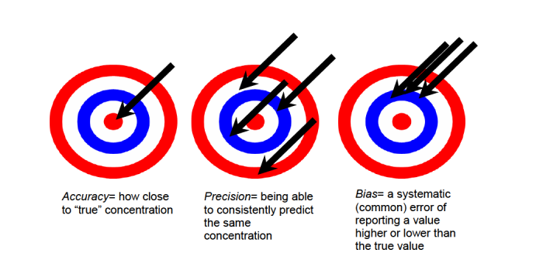
Accuracy, Precision, and Bias of a Sensor
https://cfpub.epa.gov/si/si_public_record_report.cfm?Lab=NERL&dirEntryId=277996&simpleSearch=1&searchAll=air+sensor+guidebook

Slide 40
Sensor Performance Guidance
Application | Pollutants | Precision and Bias Error | Data Completeness | Rationale
Education and information | All | < 50% | >50% | Measurement error is not as important as demonstrating that the pollutant exists.
Hotspot Identification and Characterization | All | < 30% | > 75% | Higher quality data are needed to ensure that the pollutant exists but also at a concentration close to its true value.
Supplemental Monitoring | All | < 20% | > 80% | Supplemental monitoring may have value in providing additional air quality data to complement existing monitors but must be of sufficient quality to fill gaps.
Personal Exposure | All | < 30% | > 80% | Precision and bias errors suggested are representative of those reported in the scientific literature.
Regulatory Monitoring | NO₂ PM_{2.5} PM₁₀ | < 15% <10% | > 75% | Precise measurements are needed to ensure high quality data can meet regulatory requirements.
Air Sensor Guidebook 2021

Slide 41
Which of the sensor applications from the previous slide are most important to [YOUR CITY]? Least important?

Slide 42
Resources: Performance of Low-Cost Sensors
Low-cost sensors tend to be inaccurate compared to more expensive monitors, and require more labor to maintain
Air Quality Sensor Performance Evaluation Center, from South Coast Management District
  Evaluates performance of commercially available “low-cost” sensors in the field and in the laboratory
EPA: Performance Testing Protocols, Metrics, and Target Values for Fine Particulate Matter Air Sensors
Relevant articles
  Kang et al., “Performance evaluation of low-cost air quality sensors: A review” Link.
  Zamora et al., “Evaluating the Performance of Using Low-Cost Sensors to Calibrate for Cross-Sensitivities in a Multipollutant Network” Link.
  Tagle et al., “Field performance of a low-cost sensor in the monitoring of particulate matter in Santiago, Chile” Link.
  Khreis et al., “Evaluating the Performance of Low-Cost Air Quality Monitors in Dallas, Texas” Link.

Slide 43
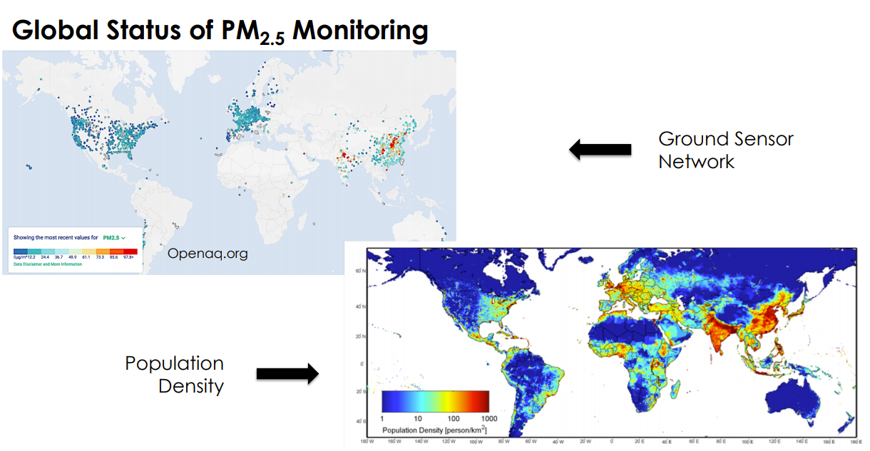
Why Remote Sensing?
NASA’s Applied Remote Sensing Training Program, 2018

Slide 44
Satellite-Based Air Quality Data
Satellites measure radiance at solar wavelengths and infer presence of aerosols from how they impact radiance
  Dependent on haze level height and planetary boundary layer height, which vary with geography, time of day, season, meteorological conditions
Complement sparse networks of ground-based monitors
Ground-based monitors needed to validate satellite data, which often underestimates concentrations
Alvarado et al., 2019
Notes:
Satellite is useful in expanding range, but it is biased downward compared to monitors.
Operationalize AOD (aerosol optical depth), which is the degree to which light has been absorbed or scattered by particles
Relationship between AOD and surface PM concentrations
Humidity
Effects of clouds, dust, snow, topography
Morning to afternoon observations only
Satellite-based remote sensing can be effective when combined with ground-level data
Ground-truthed to local monitors

Slide 45
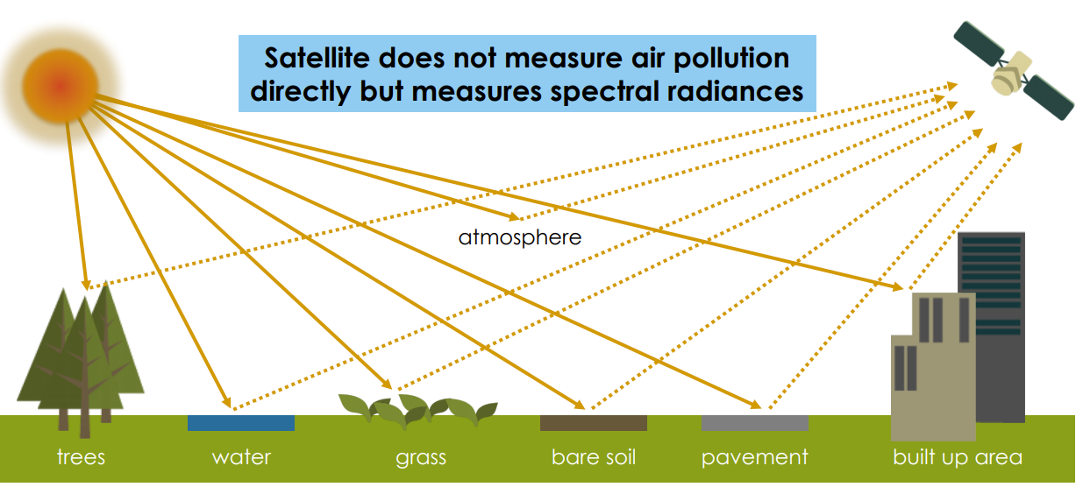
Satellite Measurements
NASA’s Applied Remote Sensing Training Program, 2018
Notes:
Satellite measured spectral radiance, used with a priori informative and radiative transfer theory, retrieval algorithms, geophiscal parameters like AOD, then applications like pm estimates

Slide 46
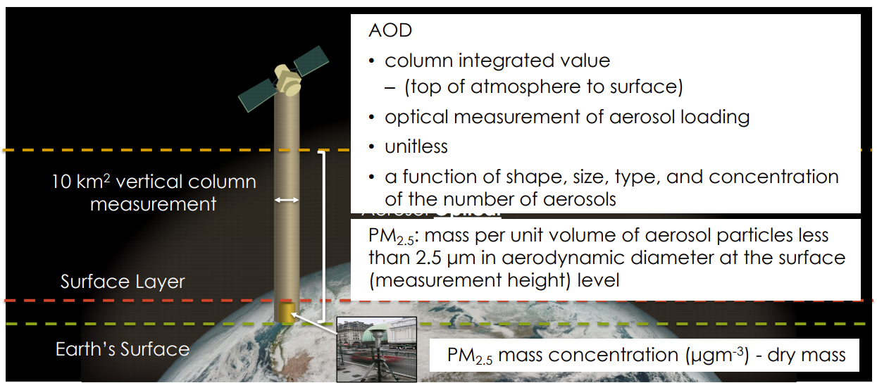
Satellite Aerosol Optical Depth (AOD) to PM_{2.5} Estimates
NASA’s Applied Remote Sensing Training Program, 2018
Notes:
Aerosol optical depth data from satellites allows for the monitoring of aerosols in the troposphere and PM2.5 estimates.

Slide 47
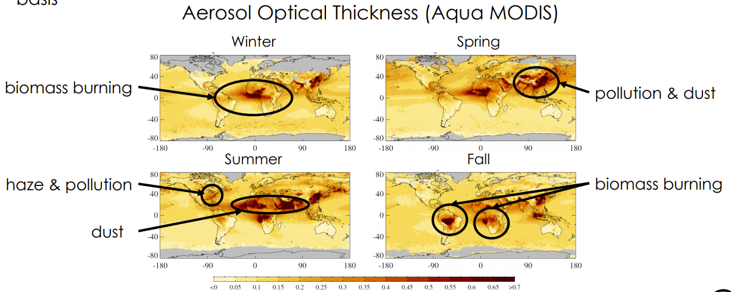
Satellite AOD Daily Measures
NASA’s Applied Remote Sensing Training Program, 2018
Notes:
Note AOD is unitless
Note it differs between seasons

Slide 48
Satellite-based remote sensing is promising but does not replace ground-based monitors.

Slide 49

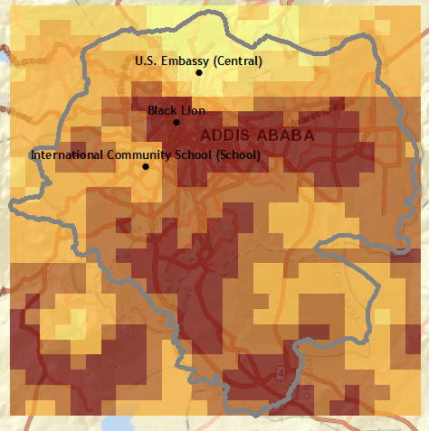
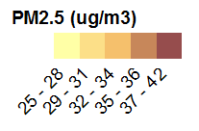
Original and Ground-Truthed Comparison
Original van Donkelaar et al. (2019) satellite
Locally ground-truthed satellite surface

Slide 50
Section 5: Integrated Strategy
1. Objectives
2. Air Monitoring Basics
3. Monitoring Options
4. Low-Cost Sensors and Remote Satellites
5. Integrated Strategy
6. Infrastructure and Best Practices

Slide 51
How to use sensor and reference-grade data together
Sensors have varying performance. Collocation of sensors with FRM/FEM monitors for calibration is critical.
  Compare and adjust sensor data to FRM/FEM monitor data
  Collocate before, mid, and after deployment of sensors
Sensors may be sensitive to:
  Temperature
  Presence of other pollutants
  Humidity
  Aging
Equipment provide complementary information.
US EPA Office of Research and Development, 2019
Notes:
How can we use sensor and monitor data together? We need to be realistic. If given a certain amount of funding, it makes sense to incorporate some low cost sensors into the network to take advantage of their ease of use and their lower cost. Often, as we saw, sensors can cost a fraction of the cost of a reference grade monitor.
To be able to believe the data streaming from a sensor, we need to collocate sensors with FRM/FEM monitors. What does this mean?
Collocation is the process by which a reference monitor (FRM/FEM) and non-reference monitor (sensor) are operated at the same time and place under real world conditions for a defined evaluation period.
It is important to note that sensors may be sensitive to a number of factors, which can be corrected for or better understood through a collocation study. These things include
Relative humidity – High humidity may cause PM sensors to overestimate the mass concentration. Gas sensors often show sensitivity.
Temperature – Sensors may show sensitivity.
Co-Pollutants – Sensors may react to other pollutants which can “interfere” with how the sensor responds to the target pollutant.
Time – Drift may be apparent over time. Sensors may become less responsive as they age. • Noisy Data – Spurious data points may or may not be evident. May be related to data logging errors, electronic noise, etc.

Slide 52
Examples of Monitors and Sensors Working Together

Slide 53


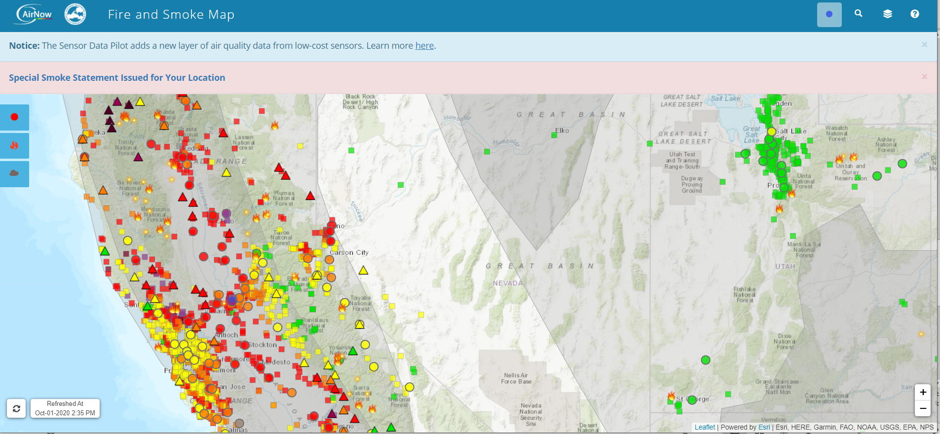
AirNow Sensor Data Pilot Example
Notes:
This map is a snapshot of the new sensor pilot with uncorrected PurpleAir data during the October 2019 Kincaide fire.
The take-away is that at this time due to the fire itself, there were power outages that impacted data delivery and monitoring by the air districts and AirNow has limited information at the time.
But you can see how much sensor data can fill in those gaps.

Slide 54
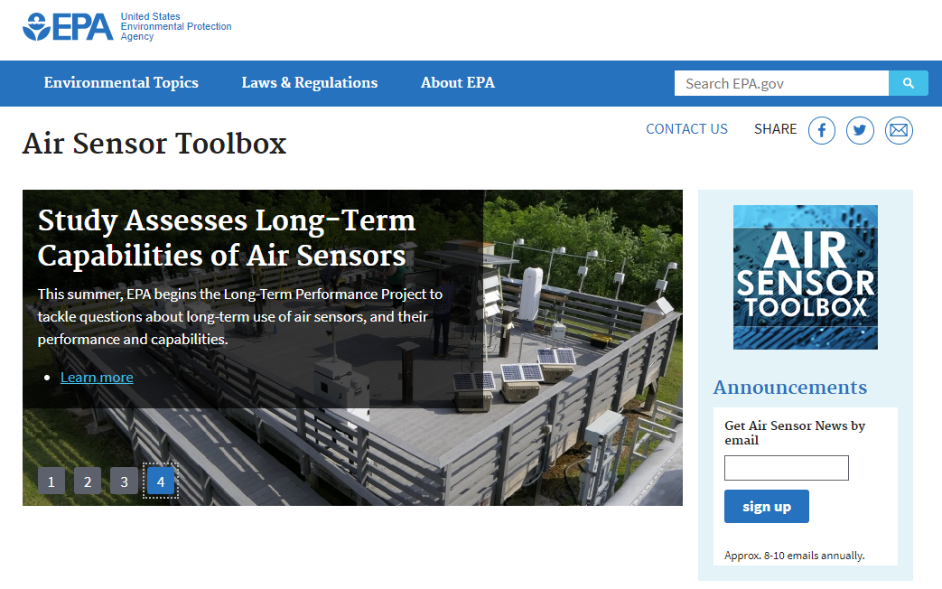
https://www.epa.gov/air-sensor-toolbox

Slide 55

http://www.aqmd.gov/aq-spec

Slide 56
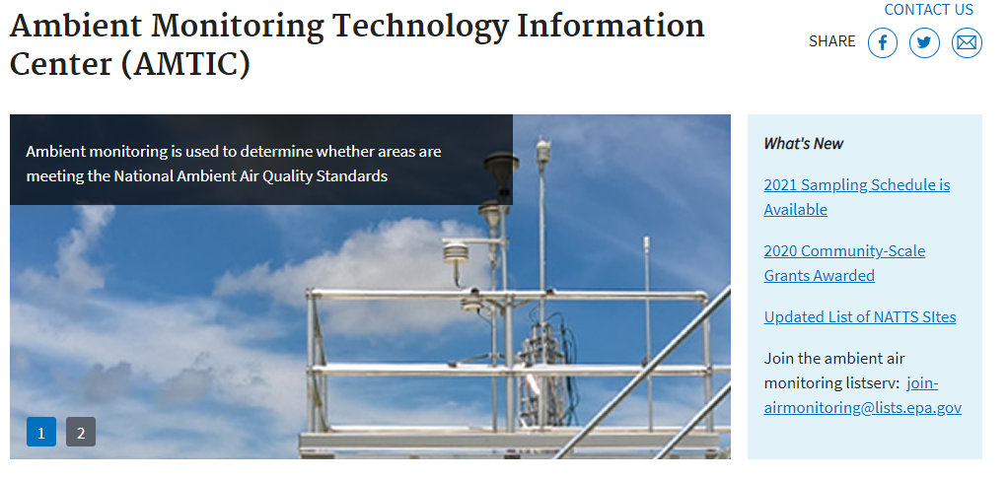
https://www.epa.gov/amtic

Slide 57
Section 6: Infrastructure and Best Practices
1. Objectives
2. Air Monitoring Basics
3. Monitoring Options
4. Low-Cost Sensors and Remote Satellites
5. Integrated Strategy
6. Infrastructure and Best Practices

Slide 58
Infrastructure Requirements
Continuous and gravimetric monitors require power source
  Continuous monitors need grid access
    Can be supplemented with uninterrupted power supply (UPS) devices
  Gravimetric samplers can use batteries; solar power
Monitors require internet access to transmit data to data management system
  Internet access
  Cellular access
Gravimetric filter monitors require field teams able to deploy and collect filters from monitoring sites

Slide 59
Institutional Capacity
Institutional coordination
  Cross-governmental and cross-sectoral coordination
Staff capacity
  Background and experience
Staff availability
  Competing tasks
Funding resources
  Internal funding
  Donor funding

Slide 60
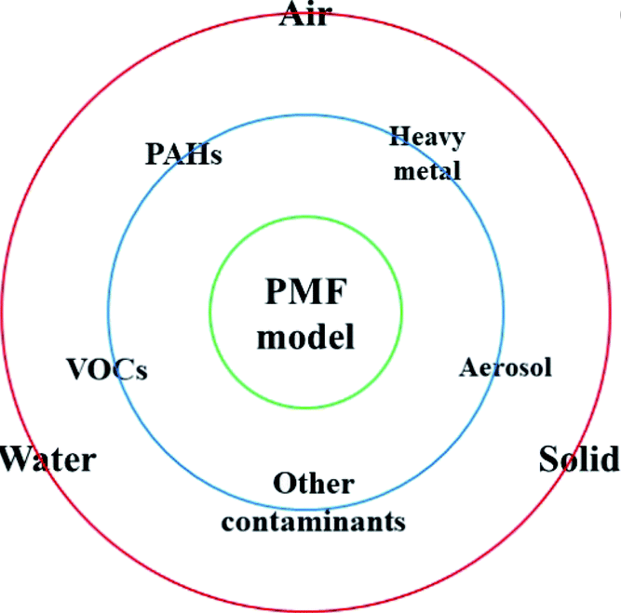
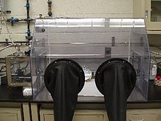
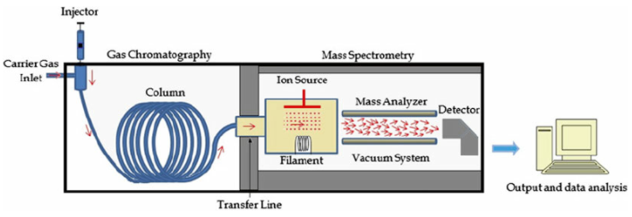
Laboratory and Analytical Capacity
https://pubs.rsc.org/ja/content/articlelanding/2020/em/c9em00529c#!divAbstract
https://en.wikipedia.org/wiki/Glovebox
https://www.researchgate.net/figure/Schematic-plot-of-the-main-components-of-GC-MS-instruments_fig1_273955959
Notes:
For monitoring air quality, a laboratory setting and certain instruments such as a glove box or gas chromatograph mass spectrometers are helpful tools.

Slide 61
Data Management Best Practices
Archival
  Reliable, redundant storage of data
  Also contains quality assurance information
Accessibility
Analysis to inform decision-making
  What analysis is needed to achieve AQ management goals?
  Large community building open-source tools
Public communication
  Consider how to reach sensitive subgroups
  Data should be paired with messages that inform action

Slide 62
Quality assurance planning is a critical component to air monitoring strategies.

Slide 63
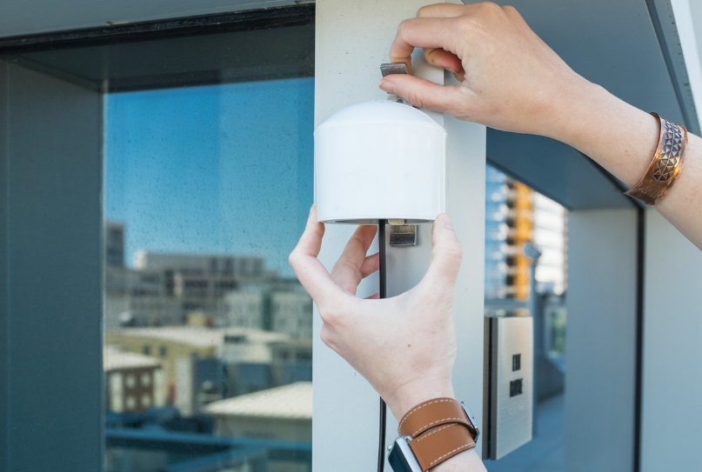
Quality Assurance and Quality Control
Establish data quality objectives
Standard operating procedures
  Maintain consistency
Staff training
  Filter handling and analysis
  Equipment calibration and maintenance
  Troubleshooting techniques
https://www2.purpleair.com/

Slide 64
Additional Resources
EPA: Performance Testing Protocols, Metrics, and Target Values for Fine Particulate Matter Air Sensors
EPA: Air Sensor Guidebook

Slide 65
Thank you!

