Slide 1
DELETE THIS SLIDE PRIOR TO PRESENTATION
This PowerPoint serves as a template presentation which introduces topics related to air quality and is part of a suite of presentations provided by the EPA for the Megacities program.
See speaker notes for an additional description of slide content. Slides should be edited or added to as necessary for your particular needs. Slides with highlighted yellow text require the addition of specific context and information for your city.

Slide 2
Emissions Inventory Development

Slide 3
Air Quality Management Planning
Public Participation
Air Quality Goal Setting
Air Pollution Control Strategies
Air Quality Monitoring
Impacts of Air Quality
Legislation, Regulation, and Implementation
Air Quality Modeling
Emissions Inventory
Compliance and Enforcement
Human and Environmental Assessment
Air Quality Data
Notes:
This conceptual model shows the format of air quality management planning. If we begin in the center, we see that air quality data is the crucial middle point that all other activities are tied to. Air quality data can be collected by monitoring, modeling, and capturing details within emissions inventories. Then, we take those data to understand the impacts of air quality via human and environmental assessment. These details can be used to set air quality goals, and then determine air pollution control strategies, which may be based on legislation, regulation, and implementation, and then eventually compliance and enforcement. These details provide additional data to be considered in assessing air quality. This work all occurs under the overarching umbrella of public participation, as the public is arguably the most significant stakeholder in this work.

Slide 4
Overview
1. Introduction
2. Pollutant Sources
3. Tools and Data Sources

Slide 5
Section 1: Introduction
1. Introduction
2. Pollutant Sources
3. Tools and Data Sources

Slide 6
What is an emissions inventory?
An emissions inventory is a database which lists sources of air pollutants and their corresponding level of emissions discharged during a year or other time period
Can be used by governments to determine significant sources of air pollutants to develop regulations
Used in “bottom-up” approaches to air quality management to support air quality modeling and fate and transport estimation
https://www.epa.gov/air-quality-management-process/managing-air-quality-emissions-inventories

Slide 7
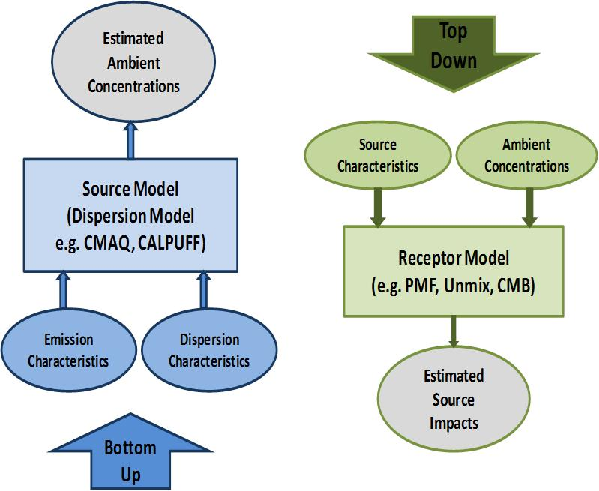
Bottom-Up and Top-Down Approaches to Air Quality
Adapted from Johnson et al. 2011 by Sonoma Technologies, Inc., used with permission.

Slide 8
Obtaining Emission Data
Continuous Collection
Stack Sampling
Material Balance Calculations
Emission Factors
Use of equipment which measures the emissions of pollutants on a continuous basis​
Extraction of an emission sample from a stack and analysis of discharge rate​
The difference between amount of material entering an energy producing process and amount of material consumed by that process​
Estimate of average emission rate for a specific process​

Slide 9
Using Emission Factors to Calculate Emissions
An emissions factor is a representative value that relates the quantity of a pollutant released to the atmosphere with an activity associated with the release of that pollutant
Factors are usually expressed as the weight of pollutant divided by a unit weight, volume, distance, or duration of the activity emitting the pollutant (e.g., kilograms of particulate emitted per megagram of coal burned)
​
E = A x EF x (1-ER/100)​
Where: ​
E = emissions;​
A = activity rate;​
EF = emission factor, and​
ER = overall emission reduction efficiency, %
Caution when applying EF – most emission factors are derived for specific countries, where factors that influence emissions, such as control technologies, fuel types and specifications, and operational factors may differ

Slide 10
Section 2: Pollutant Sources
1. Introduction
2. Pollutant Sources
3. Tools and Data Sources

Slide 11
Where Do Pollutants Come From?
Agriculture
Energy production
Natural sources
Waste (landfills)
Road transport
Fuel combustion (industry, households, others)

Slide 12
Pollutant Types
Primary Pollutants
PM_{2.5}:
Secondary Pollutants
PM_{2.5}:
Air toxics
Benzene
PM₁₀: dust, ash, soot​
Ozone (O₃):
Black Carbon (BC)
Organic Carbon (OC)
Elemental Carbon (EC)
Sulfate (SO₄) ​
Toluene
Pesticides
Plasticizers
Sulfur dioxide (SO₂)
Volatile Organic Compounds (VOCs)
VOCs
Methane (CH₄)
NOx​
Nitrogen oxides (NOx)

Slide 13
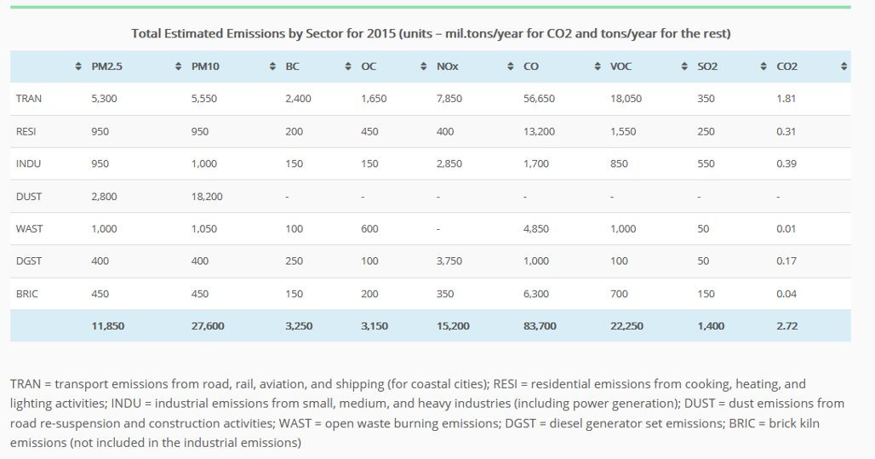
[YOUR CITY] Emissions Profile
If the information is available, include a profile of emissions in your city
Example: Indore, India
Urbanemissions.info

Slide 14
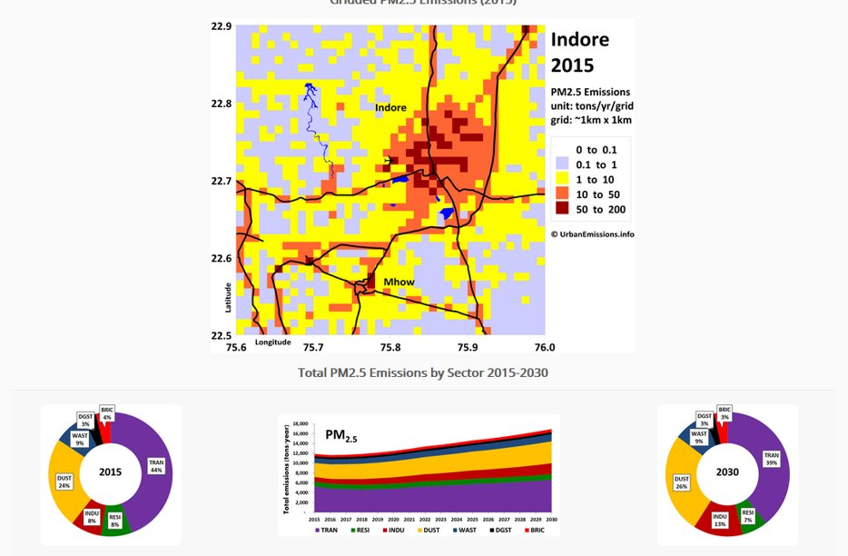
[YOUR CITY] Emissions Profile
Indore example continued; replace with your city’s data
Urbanemissions.info

Slide 15
Section 3: Tools and Data Sources
1. Introduction
2. Pollutant Sources
3. Tools and Data Sources

Slide 16
Global Tools for Emissions Estimation
A small number of globally available tools provide “evidence-based” emissions datasets, sometimes using remote sensing data
These datasets have been supported by efforts to generate global GHG inventories, and expanded to conventional air pollutants​
Can be particularly comprehensive and consistent for biogenic emissions categories (e.g., wildfire, VOCs from vegetation) which are otherwise difficult to measure
Typically combines emission factor databases and emissions activity data to calculate emission inventories
Notes:
Global scale emissions datasets are a place to start if you have limited data about emissions from various sectors in your city or region. Best and most precise if you can start to collect your own data to refine these estimates over time.

Slide 17
Global Scale Emissions Datasets
Emissions of Atmospheric Compounds and Compilation of Ancillary Data (ECCAD)
Copernicus Atmosphere Monitoring Service (CAMS) global and region-specific emissions (April 2019 version, CAMS-Glob) – available at 0.1 x 0.1˚ for years 2000-2020, many sectors​
Community Emissions Data System (CEDS, CMIP6 version) – available at 0.5 x 0.5˚from 1950-2017, many sectors​
Regional Emission Inventory in Asia (REAS)
Notes:
ECCAD provides
Large number of datasets at global and regional scales, at various spatial and temporal resolutions and time periods.
Tools allow visualization, and on-line data analysis and comparison. Statistical information over geographical regions are available for each dataset.
Data download as interoperable NetCDF CF-compliant files.
Detailed metadata for each dataset.
an aggregator of many emissions datasets​
Copernicus Atmosphere Monitoring Service global and regional emissions :
As part of the European Copernicus Atmosphere Service (CAMS), diverse emission datasets have been developed. Global and regional European anthropogenic emissions for several sectors for a large number of atmospheric compounds have been developed. In addition, detailed emissions from ships based on ship identification systems have been developed. Different datasets providing natural emissions are being processed, such as the emissions of biogenic volatile organic compounds from vegetation, nitrogen compounds emissions from soils, emissions from the oceans and emissions from volcanoes. Methodologies for evaluating the emissions and their consistency at different scales are being generated. Temporal profiles at different scales are also being developed. All the emissions developed in CAMS are available from the ECCAD (Emissions of atmospheric Compounds and Compilation of Ancillary Data (eccad.aeris-data.fr) database
Community Emissions Data System:
data system produces emission estimates by country, sector, and fuel with the following characteristics:
Annual estimates of anthropogenic emissions (not including open burning) to latest full calendar year over the entire industrial era. Readily updated every year.
Emission species: aerosol (BC, OC) and aerosol precursor and reactive compounds (SO₂, NO_{x}, NH₃, CH₄, CO, NMVOC) and CO₂ (as reference)
Seasonal cycle (monthly) and aggregate NMVOCs by sector/sub-sector
Gridded emissions
State/province spatial detail for large countries – in progress
Regional Emission inventory in Asia (REAS):
Species: SO2, NOx, CO, NMVOC, PM10, PM2.5, BC, OC, NH3, and CO2
Years: 1950-2015
Area: East, Southeast, and South Asia.
Emission sources: Fuel combustions in power plants, industry, transport, and domestic sectors; Industrial process; Agricultural activities (fertilizer application and livestock); and Others (fugitive emissions, solvent use, human, etc.) * Emissions from international and domestic aviation and navigation, including fishing ships as well as NOx emissions from soil are not included.
Spatial resolution: 0.25 degree by 0.25 degree
Temporal resolution: Monthly

Slide 18
Data Inputs for Creating Emissions Inventories
Tools can be used to estimate emission inventories, usually for specific sources
Tools differ in their data input needs as well as their output
Some tools contain activity data
E.g., COPERT, Motor Vehicle Emission Simulator (MOVES), Long-range Energy Alternatives Planning System – Short Lived Climate Pollutants (LEAP-SLCP)
Alternatively, emission factor databases can be used
Require activity data (e.g., cubic feet of natural gas burned)
E.g., European Monitoring and Evaluation Programme (EMEP)/European Environment Agency (EEA) Air Pollutant Emission Inventory Guidebook, AP-42 Emission Factors

Slide 19
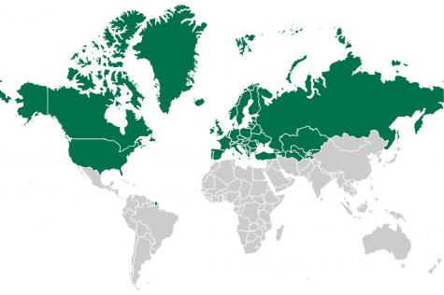
EMEP/EEA Air Pollutant Emission Inventory Guidebook
Developed by the European Environment Agency (EEA) for use in Europe and the wider United Nations Economic Commission for Europe (UNECE) area
Provides guidance on how to compile an emissions inventory, including emission factors
Includes emission factors for mobile, point, area, and biogenic sources
Covers a wide range of pollutants – particulate matter; organic compounds; SOx; NOx; lead; toxic, hazardous, and other non-criteria pollutants
Map of UNECE
https://unece.org/map-region
http://www.eea.europa.eu/themes/air/emep-eea-air-pollutant-emission-inventory-guidebook ​

Slide 20
AP-42 Emissions Factors
U.S. EPA’s AP-42, Compilation of Air Pollutant Emissions Factors
Contains emission factors for more than 200 air pollution source categories
EPA’s online tool WebFIRE can be used for emissions factor retrieval and development
Contains EPA’s recommended emissions factors for criteria and hazardous air pollutants
https://www.epa.gov/air-emissions-factors-and-quantification/ap-42-compilation-air-emissions-factors

Slide 21
Other Emission Factor Databases
Wide ranges of sources and pollutants covered
UK National Atmospheric Emissions Inventory
Syke Air Pollutant Emission Factor Library
Australia Emission Estimation Technique Manuals
Co-ordinated European Programme on Particulate Matter Emission Inventories, Projections and Guidance (CEPMEIP)
Focus on developing PM emission inventories
Collection of information from various sources including the EMEP/EEA Guidebook and national reports
IPCC Emission Factor Database (EFDB)
Collection of information on greenhouse gas emission factors from various sources including the 2006 IPCC Guidelines for National Greenhouse Gas Inventories

Slide 22
COPERT (EEA Model)
Used to develop emission inventories from mobile on-road sources including emissions factors and activity data for EEA member countries
For non-EEA countries, need additional data:
Fleet
Usage
Evaporation
Country
Vehicle fleet and mileage
Speeds and mileage percentage driven by each vehicle technology
Distribution of evaporative emissions to different driving modes and fuel RVP
Monthly temperature and relative humidity, average daily trip distance
https://www.eea.Europa.eu/themes/air
Notes:
Developed by the European Environment Agency (EEA)
Designed for analyses at a minimum spatial level of city
COPERT Street Level is available for sub-city analyses

Slide 23
Motor Vehicle Emission Simulator (MOVES, US Model)
Similar tool to COPERT
Used to develop emission inventories from mobile sources (both on-road and non-road) in the US
Designed for use within the US, but custom domains can be set up
User will need to add fleet, usage, and domain data
Contains emissions factors for mobile sources that can be applied elsewhere
https://www3.epa.gov/otaq/models/moves/index.htm ​
Notes:
includes emission factors, nation-wide activity data for the US, and default state and local allocation factors
Capable of conducting analysis at a project scale (only for on-road emissions)

Slide 24
Long-range Energy Alternatives Planning – Short-Lived Climate Pollutants tool (LEAP-SLCP)
Calculates historical emission inventories based on default emission factors (from IPCC) and activity data (which can be changed by the user)
Covers a wide range of pollutants
BC, CH₄, OC, non-methane volatile organic compounds (NMVOCs), CO, NOx, SOx, CO₂, NH_{X}, and other PM_{2.5}
Emission factors for GHGs or local air pollutants used to calculate emissions loadings
http://www.energycommunity.org/
Notes:
Part of the Climate and Clean Air Coalition (CCAC) National Action Plans “toolkit” (along with the Rapid Benefits Calculator and BenMAP-CE), developed by Stockholm Environmental Institute (SEI)
LEAP itself only calculates emissions (not impacts), but can be linked to other tools, such as LEAP-IBC.

Slide 25
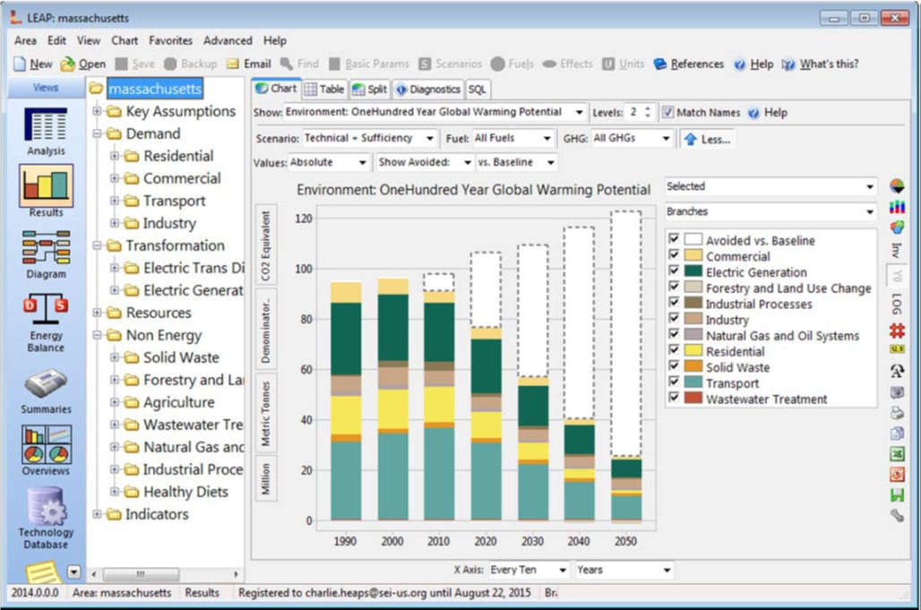
LEAP-SLCP Example
Notes:
This screenshot shows an example analysis for the state of Massachusetts, looking at projected changes in emissions from different sectors, and the anticipated avoided emissions. LEAP can assist with many other types of analysis and visualizations as well.

Slide 26
Resources
EMEP/EEA Guidebook – http://www.eea.europa.eu/themes/air/emep-eea-air-pollutant-emission-inventory-guidebook ​
AP-42 Emission Factors – http://www3.epa.gov/ttn/chief/ap42/index.html ​
COPERT – http://emisia.com/products/copert-4 ​
MOVES – https://www3.epa.gov/otaq/models/moves/index.htm ​
LEAP-SLCP – http://www.energycommunity.org/
UK National Atmospheric Emission Inventory – http://naei.defra.gov.uk/data/ef-all ​
Australia Emission Estimation Technique Manuals – http://www.npi.gov.au/reporting/industry-reporting-materials/emission-estimation-technique-manuals ​
CEPMEIP – http://www.air.sk/tno/cepmeip/ ​
Syke Air Pollutant Emission Factor Library – http://www.apef-library.fi/ ​
IPCC EFDB – http://www.ipcc-nggip.iges.or.jp/EFDB/main.php
Africa Open Data https://africaopendata.org/

Slide 27
Thank you!

