Slide 1
DELETE THIS SLIDE PRIOR TO PRESENTATION
This PowerPoint serves as a template presentation which introduces topics related to air quality and is part of a suite of presentations provided by the EPA for the Megacities program.
See speaker notes for an additional description of slide content. Slides should be edited or added to as necessary for your particular needs. Slides with highlighted yellow text require the addition of specific context and information for your city.

Slide 2
Air Quality Benefits and Valuation

Slide 3
Overview
1. Health Impacts of AQM
2. Introduction to Benefits Analysis
3. Benefits Estimation Tools
4. Inputs
5. Economic Valuation
6. Example Analysis Results

Slide 4
Section 1: Health Impacts of AQM
1. Health Impacts of AQM
2. Introduction to Benefits Analysis
3. Benefits Estimation Tools
4. Inputs
5. Economic Valuation
6. Example Analysis Results

Slide 5
How does air pollution affect health?
https://www.lalpathlabs.com/blog/health-effects-of-air-pollution/
Notes:
A range of effects ranging from the mild to moderate discomfort to critical long term degeneration and disease

Slide 6
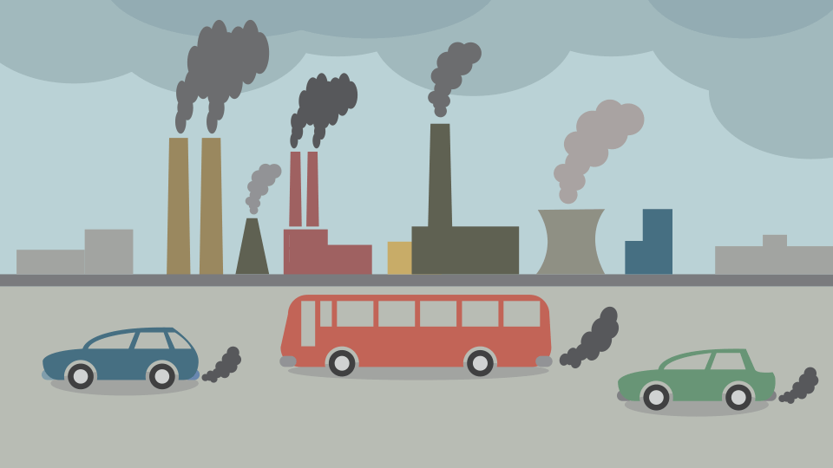
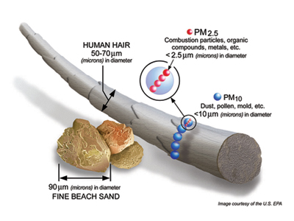
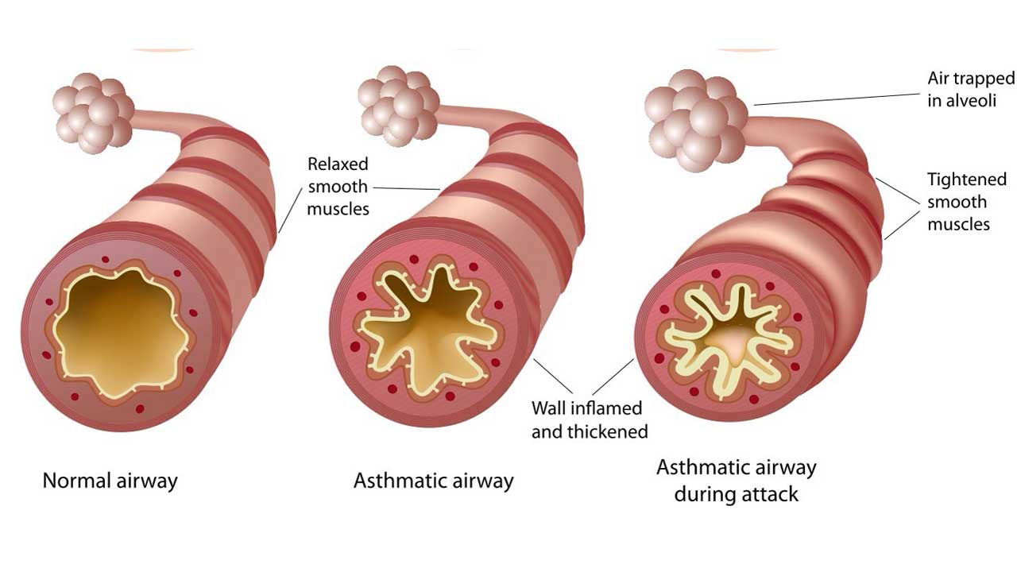
How does fine particulate matter (PM_{2.5}) impact human health?
Emissions
https://climatekids.nasa.gov/air-pollution/
Fine particles
https://www.epa.gov/pm-pollution/particulate-matter-pm-basics
Human health impacts
https://guardian.ng/features/asthma-avoid-dust-smoking/

Slide 7
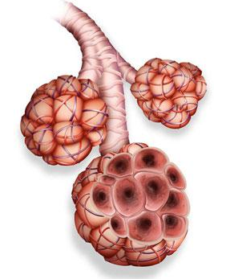
How does ozone (O₃) impact human health?
Causes muscles in the airways to constrict, trapping air in alveoli, leading to shortness of breath, causing:
Difficulty breathing deeply
Airway damage and inflammation
Frequent asthma attacks
Aggravation of pre-existing lung diseases
Healthy airway on left; Inflamed airway on right
PENTAX Medical Company, via link
https://www.epa.gov/ground-level-ozone-pollution/health-effects-ozone-pollution
Notes:
Ozone, an oxidant, can cause airways to constrict, trapping air deep in the lungs – aggravation of asthma, worsening of other lung diseases like COPD

Slide 8
Health Burden of Air Pollution Worldwide
World Health Organization (WHO) estimates:
In 2016, 4.2M deaths were linked to air pollution globally
Of those deaths:
58% resulted from ischemic heart disease stroke
18% resulted from lower respiratory infection
18% resulted from chronic obstructive pulmonary disease (COPD)
6% resulted from lung cancer
https://www.who.int/en/news-room/fact-sheets/detail/ambient-(outdoor)-air-quality-and-health
Notes:
Some deaths may be attributed to more than one risk factor at the same time, such as smoking and ambient air pollution affecting lung cancer

Slide 9
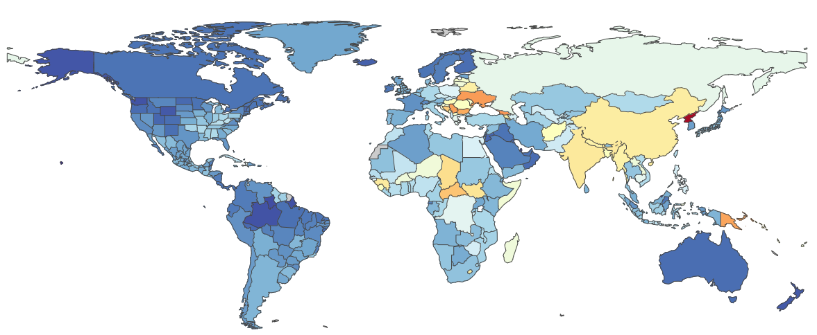
Global Burden of Disease (GBD) Study
The GBD was first published in 2010 and has been updated six times through 2019
Observational epidemiological study began data collection in 1990
Describes mortality and morbidity from major disease, injuries, and risk factors globally, regionally, and nationally
Describes trends over time
Global death rates attributable to air pollution, 2017
(Cool colors show lower death rates; warm colors show higher death rates)
https://www.healthdata.org/gbd/about/history
Notes:
Note: Can look for newer data at https://vizhub.healthdata.org/gbd-compare/

Slide 10
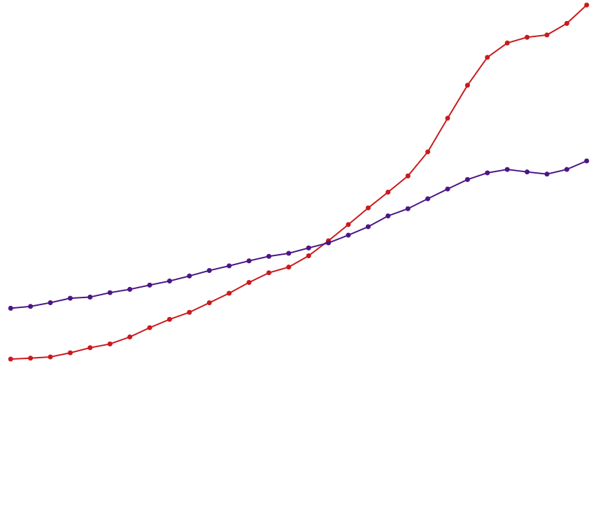
Global Burden of Disease Tools
All Causes Attributable to Ambient Particle Matter Pollution
10%
India
Global
GBD Results Tool: http://ghdx.healthdata.org/gbd-results-tool
GBD Data Visualization: https://vizhub.healthdata.org/gbd-compare/
Percent of total deaths
5%
0%
2018
1990
2005
Year
Notes:
This graph shows the percent of total deaths that were attributable to ambient particle matter pollution from 1990 to 2019, for India (shown in red) and the entire globe (shown in purple). As you can see, this percentage has been rising, especially dramatically for India in recent years.
- Users can make their own accounts on vizhub to explore and visualize the GBD data

Slide 11
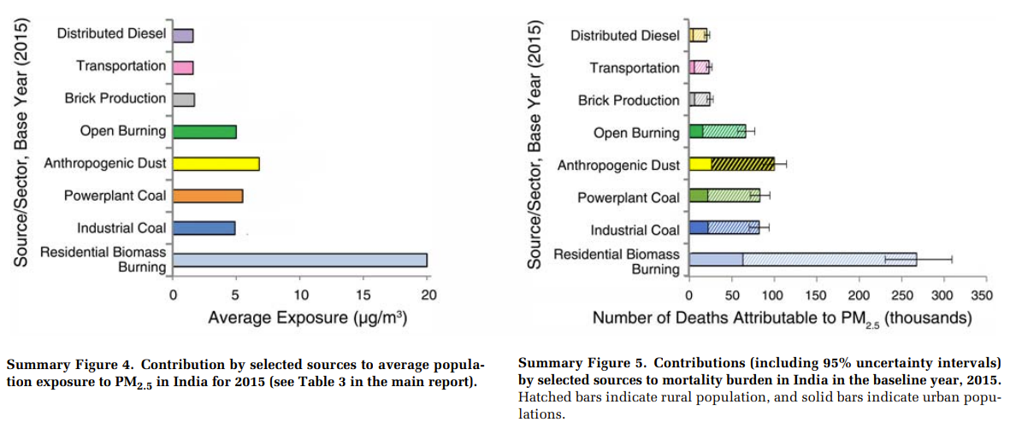
Health Burden of Air Quality Example: India
GBD MAPS Working Group, 2018
Notes:
Global Burden of Disease (GBD) from Major Air Pollution Sources (MAPS) is a multiyear collaboration between the HEI, IHME, India Institute of Technology, Bombay, Tsinghua University, University of BC, Sri Ramachandra Medical College, and others.
If no action is taken, population exposures to PM2.5 are likely to increase substantially by 2050.

Slide 12
Section 2: Introduction to Benefits Analysis
1. Health Impacts of AQM
2. Introduction to Benefits Analysis
3. Benefits Estimation Tools
4. Inputs
5. Economic Valuation
6. Example Analysis Results

Slide 13
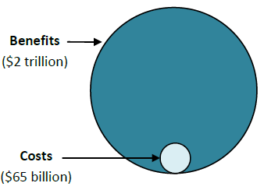
What is benefits analysis?
Answers the basic question:
What are the health and economic benefits of emissions controls and the associated improvements in air quality?
Can be used to:
Compare against the costs of a policy
Decide between different policies
Improve efficiency and effectiveness of policies
Determine if a particular policy is “worth it” to society
Benefits and Costs of the U.S. Clean Air Act
https://www.epa.gov/clean-air-act-overview/benefits-and-costs-clean-air-act-1990-2020-second-prospective-study​

Slide 14
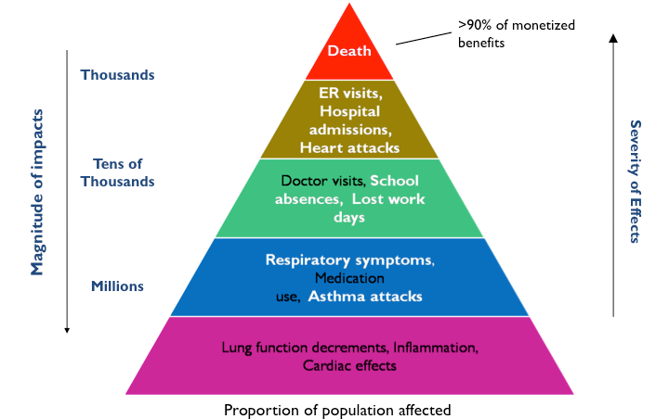
What are the benefits of improved air quality?
How can air pollution affect health?
https://www.epa.gov/benmap/how-benmap-ce-estimates-health-and-economic-effects-air-pollution

Slide 15
What are the benefits of improved air quality?
Environmental Benefits:
Improved visibility
Improved forest and crop yields
Improved water quality
Improved habitat quality
Reduced acid deposition
Reduced Health Risk of:
Early death
Chronic disease
Heart attacks
Asthma attacks
Hospital admissions
Bronchitis
School absences
Missed work
Good Visibility Day
Bad Visibility Day

Slide 16
Baseline Health Burden Assessment
Estimate of premature mortality and morbidity attributable to air pollution in a region
Can be conducted based on current or recent estimates of pollutant concentrations (such as ozone or PM_{₂.₅})
Provides useful information to support air quality management planning, educate decision-makers and the public

Slide 17
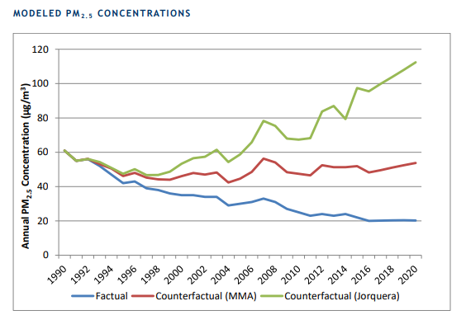
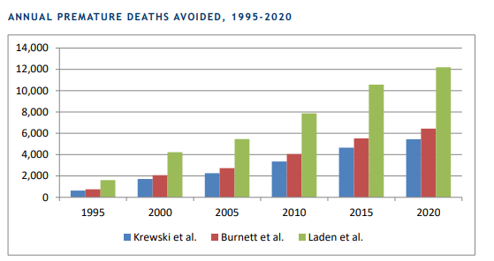
Retrospective benefits analysis
How have changes in pollution over time contributed to changes in health outcomes?
Requires historical monitor or model data, population, and incidence
Example: Santiago retrospective benefit-cost analysis
https://www.epa.gov/sites/default/files/2019-02/documents/santiago_megacities_partnership_final_report.pdf

Slide 18
What is a distributional analysis?
The quantitative evaluation of how the effects of a policy or regulation are distributed across social groups
Alternatively, quantification of the disparity of exposure or health burden across groups
Often useful for analyses involving Environmental Justice concerns

Slide 19
Section 3: Benefits Estimation Tools
1. Health Impacts of AQM
2. Introduction to Benefits Analysis
3. Benefits Estimation Tools
4. Inputs
5. Economic Valuation
6. Example Analysis Results

Slide 20
What is an air quality benefits analysis tool?
Benefits analysis tools can be used to quantify impacts of improvements in air quality
Impacts
Pollutants
Inputs
Health or economic
Conventional or climate
Ambient or household
Emissions or ambient air quality concentrations
User inputs or preloaded information
Notes:
May be able to use emissions as inputs, or may require ambient air quality concentrations
Can be flexible and rely on user inputs, or can be pre-loaded with information

Slide 21
Basic Components of Air Quality Benefits Tools
1. Emissions or Air Quality Inputs
What types of pollutants can the software model?
Can the program conduct basic air quality modeling from emissions inputs, or does it require air quality monitor or model data inputs?
2. Health Impact Evaluation
Can the software analyze mortality endpoints? Morbidity endpoints?
Can the software analyze non-human health impacts?
3. Valuation
4. Geographic scale

Slide 22
Major Software Types
Advantages | Software Type
 | BenMAP-CE | LEAP-IBC | AIR Q+ | GAINS | HAPIT
Refined health and economic benefit evaluation | X
Costs and benefits of alternative emissions control strategies | X |  | X | X
Can be used for household air pollution |  |  | X |  | X
Easy integration of new knowledge |  | X |  |  | X
Capable of worldwide analyses | X | X |  | X
Includes valuation of health benefits | X | X

Slide 23
LEAP-IBC vs. BenMAP-CE
LEAP-IBC: Long-Range Energy Alternatives Planning System with Integrated Benefits Calculator (SEI)
BenMAP-CE: Environmental Benefits Mapping and Analysis Program, Community Edition (US EPA)
LEAP-IBC | BenMAP-CE
Minimal data input required | Data input intensive: air quality, population, baseline incidence, concentration response functions
Coarse resolution results: country-level changes in premature death, crop yield, and regional radiative forcing | Fine resolution results: health outcomes and economic benefits
Focus on climate change | Focus on air quality and health

Slide 24
LEAP-IBC Tool
Designed for use in developing countries/emerging economies
Estimates responses of PM_{2.5} and ozone to grid-scale emissions using a global air quality model
Includes calculations to determine the impact on health, crops, and climate
Requires limited user inputs
Default data is available for all parameters

Slide 25
BenMAP-CE Tool
BenMAP-Community Edition
Uses health impact functions to relate changes in PM_{2.5} and ozone concentrations with health outcomes
Works with population and baseline incidence data at various levels of aggregation
Estimates economic value of health outcomes
Can report local scale or national scale results
BenMAP-CE: Global Burden of Disease Module
Allows users to select a country or region and calculate health impacts of reducing PM_{2.5} emissions using data from the 2010 GBD study
Notes:
Accepts air quality inputs at a range of scales from 1km

Slide 26
This presentation will use BenMAP-CE to demonstrate health benefits and valuation calculations.

Slide 27
Section 4: Inputs
1. Health Impacts of AQM
2. Introduction to Benefits Analysis
3. Benefits Estimation Tools
4. Inputs
5. Economic Valuation
6. Example Analysis Results

Slide 28
What inputs do we need to estimate benefits?

Slide 29
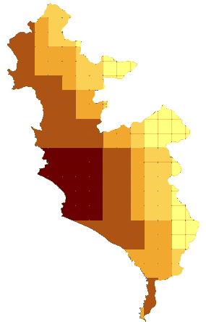
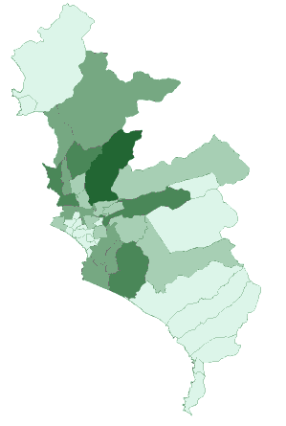
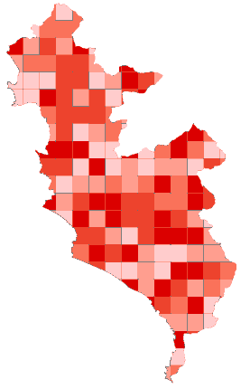
Health Impact Functions
Health impact functions quantify how changes in pollutant concentrations impact outcomes of interest
∆ Y = Yo (1-e ^{-ß∆ PM}) * Pop
ΔPM – Air Quality Change
Pop – Population
(number of people
per district)
Y_{O} – Baseline Incidence
(mortality at the country level)
ΔY – Change in Incidence
(mortality by grid cell)
Notes:
Health impact functions quantify how changes in pollutant concentrations impact outcomes of interest, such as a chance in incidence of a health effect. This requires several different inputs, such as the air quality change, the population, and the baseline incidence.

Slide 30
Health Impact Functions
Incidence
(log scale)
Ln(y) = Ln(B) + ß(PM)
Ln(B)
PM concentration
Health impact function
∆ Y = Yo (1-e ^{-ß∆ PM}) * Pop
Yo – Baseline Incidence
Pop –
Exposed population
ß - Effect estimate
∆PM – Air quality change
Notes:
The top equation illustrates one of the most common risk models used in epidemiology, a log-linear equation relating concentration (of pollutant) with the log of incidence of a health effect. The effect estimate (Beta) is derived from this equation and used to construct the health impact function on the bottom, along with other inputs.

Slide 31
Effect Estimate “ß”

Slide 32
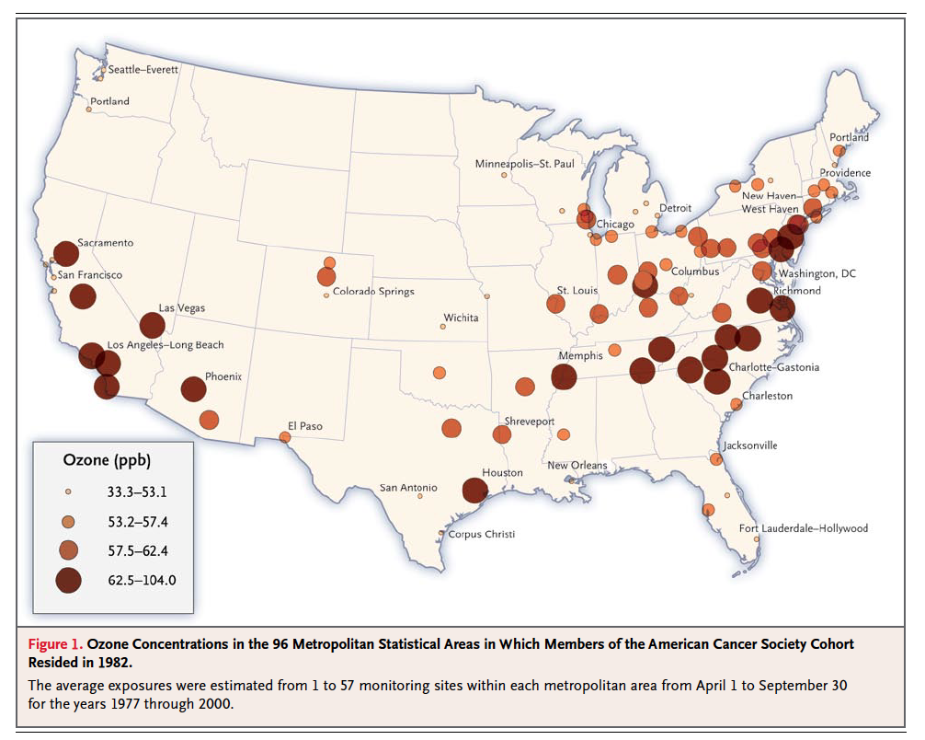
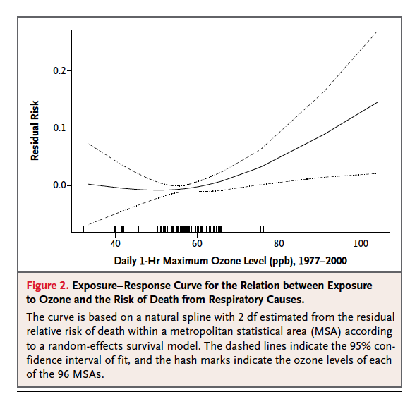
Epidemiological Studies Link Pollution With Effects
Changes in air pollution exposure
Concentration-response relationship
Jerrett et al., 2009
Notes:
This is an example of an epidemiological study of the kind used to develop health impact functions for application in a health burden or health benefits analysis. This one links ozone in cities in the U.S. with mortality risks.
The graph on the left shows the exposure part of the study and the right shows the concentration response relationship relating the two along with the associated uncertainty.

Slide 33
How do you decide what studies to use?
Minimum requirements:
Non-overlapping health endpoints
Time-series, case-cross-over or cohort studies.
Prefer:
Study populations matching the policy site
Population attributes similar to those affected by air pollution
Sufficient study population size
Multi-city studies
Multi-pollutant models
∆ Y = Yo (1-e ^{-ß∆ PM}) * Pop

Slide 34
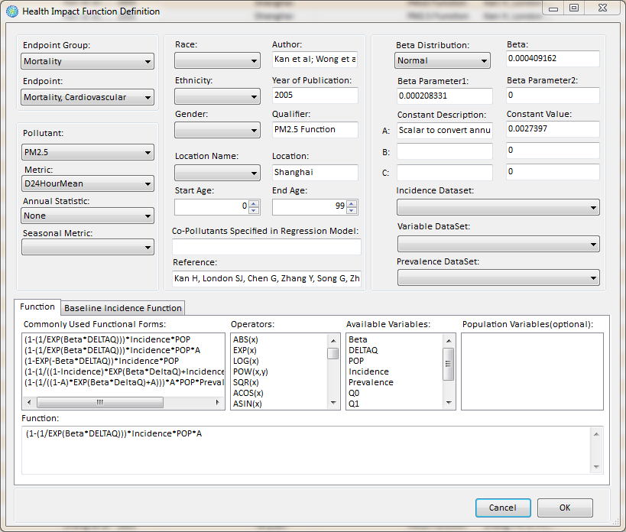
How do you decide what studies to use?
BenMAP-CE contains over a hundred health impact functions for China and the US
∆ Y = Yo (1-e ^{-ß∆ PM}) * Pop

Slide 35
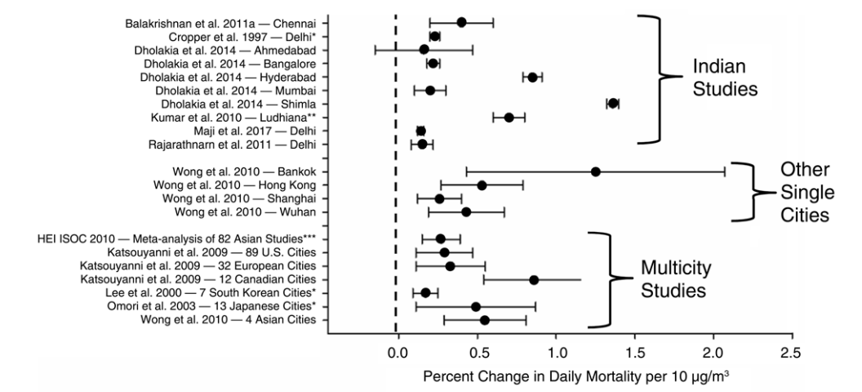
Mortality can differ by location and context
Conduct a local epidemiological study for most accurate results
GBD MAPS Working Group, 2018
Notes:
- Time-series studies of mortality associated with daily exposures to PM
- Mortality associated with daily exposure to PM can vary by location
- Conduct a local epidemiological study for most accurate results

Slide 36
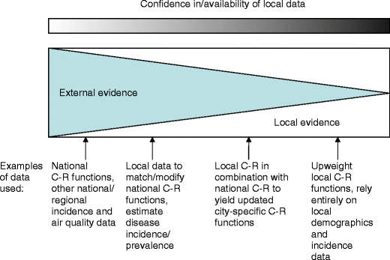
Local vs. General Data
Hubbell et al., 2009
Notes:
Initial health benefits analyses or health burden analyses often must rely heavily on external evidence or studies not conducted in the area where the health analysis is being conducted. Over time the goal is to improve these health analyses with more locally collected data and health studies, as the pool of local studies grows and you have greater confidence in local info. Often you are using a mix, particularly early on.​

Slide 37
Harvard Six Cities and American Cancer Society Studies
1993 & 2006– 14 to 16% increase in mortality for each 10 µg/m³ of PM_{2.5}.
Dockery DW, Pope CA III, Xu X, et al, An association between air pollution and mortality in six US cities. New England Journal of Medicine. 1993. Vol 329. 1753-1759.
9% increase in cardiopulmonary and a 14% increase in lung cancer mortality for each 10 ug/m³ of PM_{2.5} when looking at over 50 metropolitan regions of US.
Pope CA III, Thun MJ, Namboodiri MM, Dockery DW, Evans JS, Speizer FE, Hath CW Jr. 1995. Particulate air pollution as a predictor of mortality in a prospective study of US adults. American Journal of Respiratory and Critical Care Medicine. 151:669-674.
Notes:
First studies to demonstrate this relationship.
There are strengths and weaknesses to each PM_{2.5} mortality study that argue for using risk estimates drawn from both analyses. While the ACS‐based study includes a much larger population over a broader geographic area than the H6C study, the ACS population is less racially diverse, better educated, and more affluent than the national average. By contrast, the H6C cohort population is more representative of the United States, but estimates PM mortality risk in eastern U.S. cities where PM_{2.5} is generally comprised of a larger fraction of sulfate than it is in western cities. There are other differences in population demographics and exposure‐related factors that may also contribute to differences in the eastern and western United States. To the extent that PM_{2.5}‐related mortality is strongly influenced by particle composition, applying a H6C‐based risk coefficient nationwide may result in biased estimates of PM_{2.5} mortality in the west. Conversely, applying an ACS‐based risk estimate nationwide may not characterize well the PM_{2.5} mortality impacts in the eastern United States.⁽31⁾

Slide 38
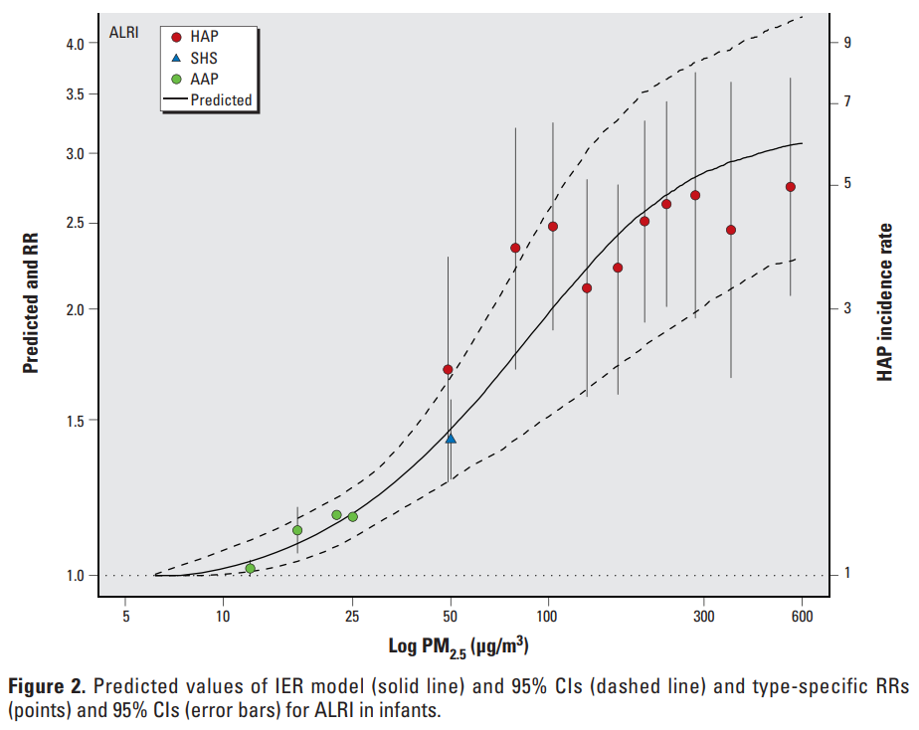
Integrated Exposure Response Functions
Burnett et al., 2014
Notes:
The literature includes many studies that link exposure to pollutant (e.g. PM 2.5) with predicted health outcomes.

Slide 39
Air Quality Data “ΔPM”

Slide 40
Air Quality Data
∆ Y = Yo (1-e ^{-ß∆ PM}) * Pop
Air quality can be determined through:
Monitoring of air quality at specific locations over time
Modeling of air quality based on emissions inventories
Globally available data sets, e.g., Global Burden of Disease data

Slide 41
Options for Exposure Data
∆ Y = Yo (1-e ^{-ß∆ PM}) * Pop
Government monitoring systems
Monitor data from academic studies
Exposure surfaces based on modeling
Satellite-based measurement
Calibrated sensor-based estimates

Slide 42
Air Quality Data
∆ Y = Yo (1-e ^{-ß∆ PM}) * Pop
Changes in air quality can be determined using:
Air quality monitoring over time
Retrospective only
Air quality modeling of changes in emissions over time
Prospective or retrospective
Provides the basis for being able to determine changes in health outcomes based on changes in air quality
ΔPM – Air Quality Change

Slide 43
Selecting Air Quality Data
∆ Y = Yo (1-e ^{-ß∆ PM}) * Pop
For BenMAP Analysis
The “right” air quality data depends on the policy question
Analysis for the future?
Analysis for the past?
Local or regional impacts?
BenMAP-CE will accept:
Photochemical grid model data
User-provided or built-in monitoring data, which it interpolates to create a surface
“Rolled-back” monitoring data that simulates a concentration change
Air quality data must be at same time scale as the epidemiological data (e.g., annual mean, 8hr max, etc.)
Fine Particle Levels in China

Slide 44
Population and Baseline Incidence, “Pop” and “Y₀”

Slide 45
Population and Baseline Incidence
Can be broken down by age, gender, and ethnicity
∆ Y = Yo (1-e ^{-ß∆ PM}) * Pop
Population data allows determination of who is being exposed to air pollutants
Pop – Population
Baseline incidence data allows us to determine how healthy the population is before analysis
Y_{O} – Baseline Incidence

Slide 46
Selecting Population Data
∆ Y = Yo (1-e ^{-ß∆ PM}) * Pop
For BenMAP Analysis
Goal is to match the population characteristics of the epidemiological studies
Consider whether to use historical or projected population levels
BenMAP-CE includes:
U.S. population by age/sex/race
China population for all ages
Global Burden of Disease tool includes population for all ages worldwide
Population density in Several Asian Nations

Slide 47
Selecting Incidence Rates
∆ Y = Yo (1-e ^{-ß∆ PM}) * Pop
For BenMAP Analysis
Baseline rates of death and disease must match the characteristics of the health endpoint to be calculated:
Location
Demographic characteristics
Year (historical/projected)
BenMAP-CE contains baseline incidence rates matched to each health impact function for U.S., China and GBD tool
Baseline mortality rates in East China

Slide 48
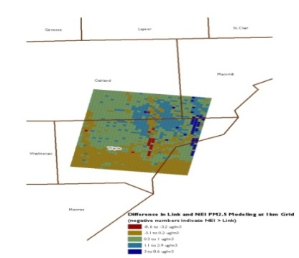
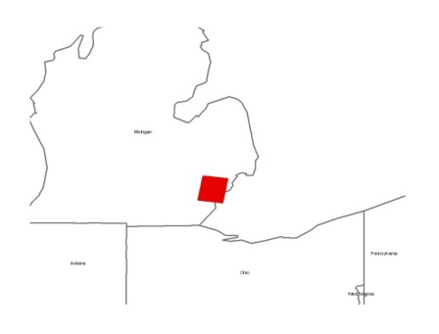
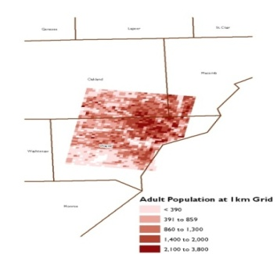
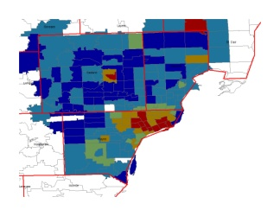
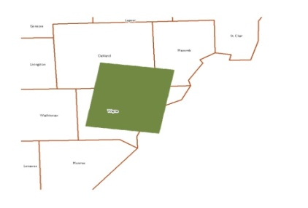
Local-Scale Modeling Requires Location-Specific Health Inputs
Fine-scale air quality modeling
Fine-scale population exposure
City-specific baseline incidence
Local Incidence count
Notes:
When conducting a local analysis, it is important to use location-specific inputs such as air quality modeling, population exposure, and baseline incidence.

Slide 49
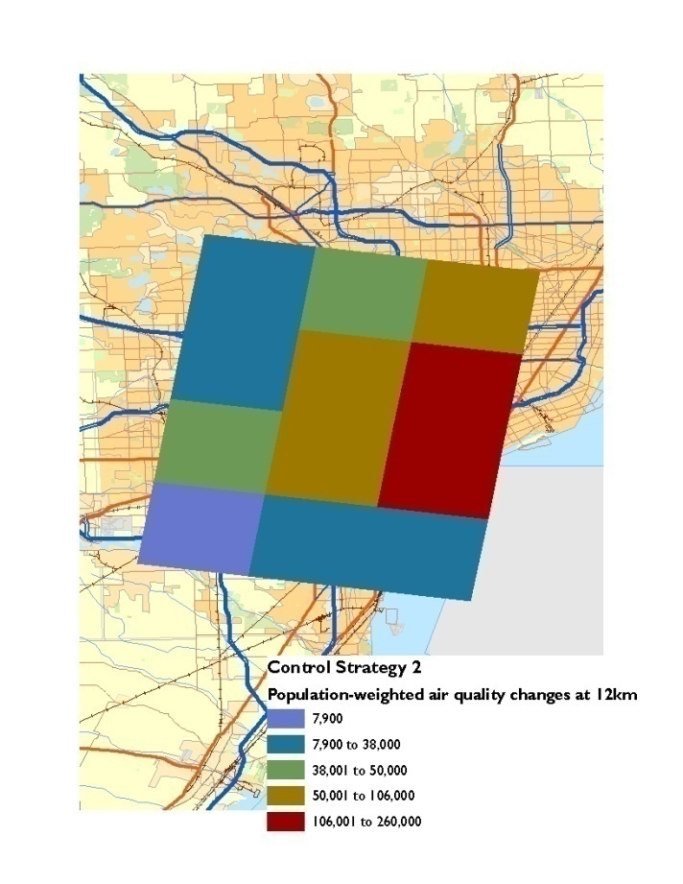
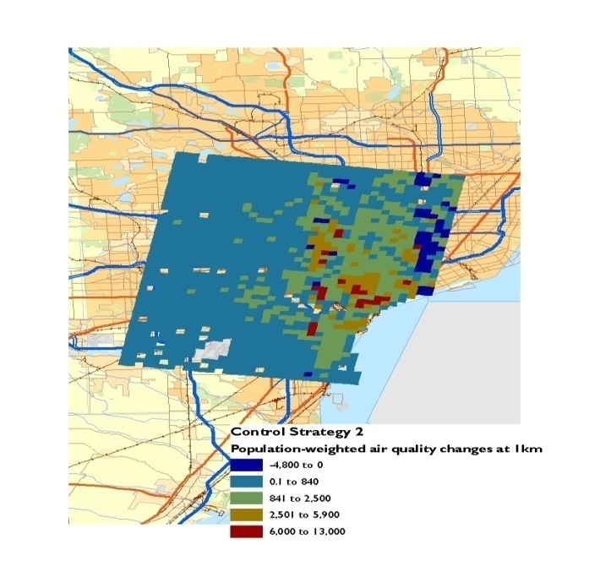
Level of Model Resolution
Comparing estimates of population exposure to annual mean PM₂.₅ at different model resolutions
Population-weighted
exposure at 12km
(Population * Air Quality Δ)
Population-weighted
exposure at 1km
(Population * Air Quality Δ)
Notes:
Notice the additional resolution and spatial variability that refined air quality surface and population data can provide.

Slide 50
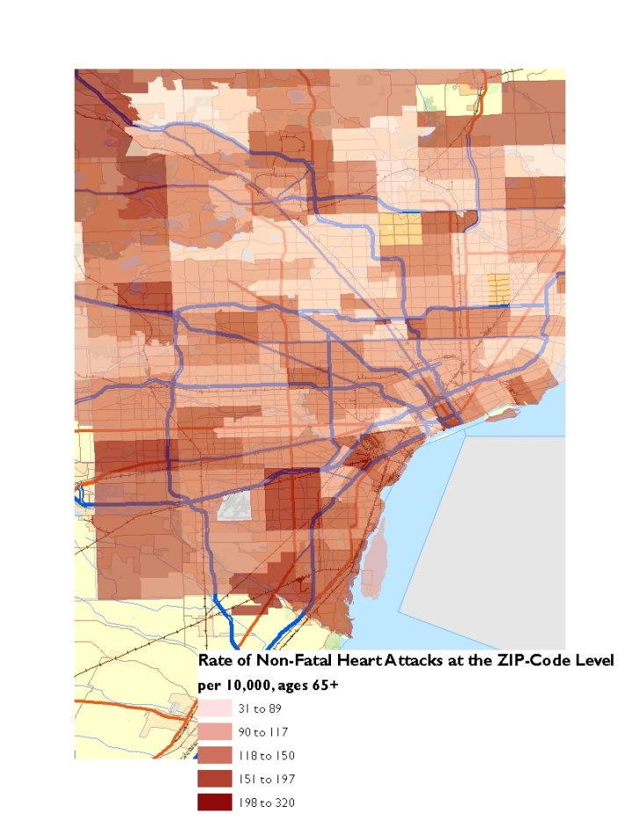
Variability in Local vs. National Data
Variability in rate of non-fatal heart attacks between Detroit and US
Area | Age Range | Value (per 10,000)
Nationwide | 0-17 | 0.03
 | 18-64 | 17.8
 | 65+ | 149
Detroit | 0-17 | No reported cases
 | 18-64 | 0 to 36
 | 65+ | 31 to 320
Notes:
Illustrates the value of fine scale baseline incidence data versus using national level data.

Slide 51
Describing Uncertainty
Qualitative measures of uncertainty—consider each input variable:
How confident are you in the estimated air quality values?
How well does the epidemiological study match the policy site?
Are your baseline incidence rates reported for the right location and time period?
Quantitative measures of uncertainty
Most epidemiological studies report a standard error
BenMAP-CE performs a Monte-Carlo analysis using the standard error
Users can report 95% confidence intervals around point estimates
200
Incidence
100
0
Mean
400
300
Incidence
200
100
0
Mean

Slide 52
Section 5: Economic Valuation
1. Health Impacts of AQM
2. Introduction to Benefits Analysis
3. Benefits Estimation Tools
4. Inputs
5. Economic Valuation
6. Example Analysis Results

Slide 53
What is economic valuation?
Economic valuation is the practice of applying monetary units (e.g., U.S. dollars or Indian rupees) to physical outcomes measured in non-monetary units (e.g., hospitalizations, improvements in air quality)
Value broadly represents the extent to which individuals are willing to trade money for goods and services

Slide 54
Comparing Health Benefits and Cost of Program Implementation
Should policy-makers enact an air quality management regulation that costs 250 million dollars annually?
Need to know what the benefits of the policy are
What if the annual benefits are:
2,000 avoided hospitalizations due to respiratory illness
3,000 avoided emergency room visits due to cardiovascular illness
50 avoided premature deaths
Improved visibility
How do we compare these benefits and costs?

Slide 55
Why pursue economic valuation?
Allow policy-makers to see a comparison of regulatory costs and benefits
Allow policy-makers to direct funds to the policies that provide the greatest (net) benefits to society
Understand the major benefit categories stemming from a regulation
Enable communication of the impacts of air quality management → the “business case” for policy

Slide 56
What data do we need to value benefits?
Cost of Illness (COI)
Captures the direct dollar savings to society of reducing a health effect
Ignores the value to individuals of reduced pain and suffering
Generally a lower bound when no WTP estimates are available
Willingness to Pay (WTP)
Measures the complete value of avoiding a health outcome
Relies on either revealed or stated preferences for risk reductions
Generally more uncertain than COI
Controversial due to differing global economic conditions
Notes:
Cost of Illness (COI)
How much does it cost to go to the hospital?
Do parents have to stay home and miss work because a child is sick?
How much pay do you lose because you are sick and can’t go to work?
Willingness to Pay (WTP)
How much is it worth to you to reduce your risk of death?
How much is it worth to you to not get a chronic disease?
How much is it worth to you to not be sick?
Revealed or stated preferences:
Revealed preferences from labor market studies provide values for fatal risk reductions
Stated preferences from “contingent valuation” studies provide values for chronic illnesses and acute respiratory effects

Slide 57
Valuation in International Contexts
As willingness to pay measures can differ based on income, different countries may choose to determine benefits based on improved health outcomes themselves
Value of a Statistical Life
Common metric used in benefit-cost analysis to determine total benefits of a policy
Based on willingness to pay measures
Controversial due to unequal economic conditions across the globe

Slide 58
Valuing Non-Fatal Health Effects
Leveraging available literature:
WTP estimates less likely to exist for non-fatal outcomes compared to fatalities
COI estimates cannot be easily transferred between countries due to differences across health care systems
Medical databases may provide costs or charges for medical treatment (e.g., hospitalizations, emergency department visits) for specific health endpoints
Productivity losses generally wage rates multiplied by missed work time
Notes:
In the U.S., medical databases include AHRQ’s MEPS and HCUP databases

Slide 59
Value of a Statistical Life (VSL)
An estimate of how much people are willing to pay for small reductions in their risks of dying from adverse health conditions that may be caused by environmental pollution
This value is extrapolated to find the value of one fewer death in an entire population
https://www.epa.gov/environmental-economics/mortality-risk-valuation

Slide 60
Calculating the VSL
$500 * 10,000 = $5m
In a population of 10,000, reducing pollution would avoid one premature death
(i.e., reduce risk by 1 chance in 10,000)
Each of 10,000 are willing to pay $500 to reduce risk of death by 1 chance in 10,000
VSL is then WTP multiplied by the inverse of the risk reduction

Slide 61
Do you agree with VSL approach?
Is the VSL approach appropriate for [YOUR COUNTRY]?
Why or why not?
VSL in [YOUR COUNTRY]: [insert VSL measure in your country]
U.S. EPA recommends a central estimate of $8.7 million ($2005) updated to the year of the analysis for U.S. based analyses
https://www.epa.gov/environmental-economics/mortality-risk-valuation

Slide 62
Valuing Health Benefits
Robinson, Hammitt, and O’Keefe (2018):
Use context‐specific values as the central estimates if available.
Transfer international default values…
… if context-specific values are not available
… in sensitivity analyses (even if context-specific values are available)
https://cdn2.sph.harvard.edu/wp-content/uploads/sites/94/2017/01/Robinson-Hammitt-OKeeffe-VSL.2018.03.23.pdf
Notes:
Paper focuses primarily on low- and middle-income countries.

Slide 63
Section 6: Example Analysis Results
1. Health Impacts of AQM
2. Introduction to Benefits Analysis
3. Benefits Estimation Tools
4. Inputs
5. Economic Valuation
6. Example Analysis Results

Slide 64
Avoided Health Impacts and Valuation: US
2011 Policy reducing emissions from power plants in U.S.
Summary of Health Impacts Avoided
Monetized Health and Welfare Benefits^{A}
Health endpoint | Value
PM_{2.5}-related mortality (Pope et al. 2002) | 14,000 (4,000—25,000)
PM_{2.5}-related mortality (Laden et al. 2006) | 36,000 (17,000—56,000)
O₃-related mortality (Bell et al. 2004) | 50 (17—84)
O₃-related mortality (Levy et al. 2005) | 230 (160—300)
PM_{2.5}-related chronic bronchitis | 9,200 (320—18,000)
PM_{2.5}-related non-fatal heart attacks | 22,000 (5,800—39,000)
PM_{2.5} and O₃-related respiratory hospitalizations | 4,200 (1,500—6,700)
PM_{2.5} and O₃-related emergency department visits | 14,000 (7,200—21,000)
Endpoint | Value (billions of 2006$)
Human health^{B}
Pope et al. 2002 PM_{2.5} and Bell et al. 2004 O₃ mortality estimates | $120 ($10—$360)
Laden et al. 2006 PM_{2.5} and Levy et al. 2005 O₃ mortality estimates | $290 ($26—$840)
Visibility | $3.6
Total
Pope et al. 2002 PM_{2.5} and Bell et al. 2004 O₃ mortality estimates | $120 ($10—$360)
Laden et al. 2006 PM_{2.5} and Levy et al. 2005 O₃ mortality estimates | $290 ($26—$850)
^{A} All values rounded to two significant figures
^{B} Discounted at 3%
Notes:
Example summary from a US regulatory analysis showing both the quantification and valuation of health benefits of this power plant emissions control policy… covers PM and ozone, mortality and morbidity.​

Slide 65
Thank you!

