Slide 1
DELETE THIS SLIDE PRIOR TO PRESENTATION
This PowerPoint serves as a template presentation which introduces topics related to air quality and is part of a suite of presentations provided by the EPA for the Megacities program.
See speaker notes for an additional description of slide content. Slides should be edited or added to as necessary for your particular needs. Slides with highlighted yellow text require the addition of specific context and information for your city.

Slide 2
Source Apportionment

Slide 3
Overview
1. Pollutant Sources
2. Positive Matrix Factorization
3. Using Source Apportionment in BenMAP Analyses

Slide 4
Section 1: Pollutant Sources
1. Pollutant Sources
2. Positive Matrix Factorization
3. Using Source Apportionment in BenMAP Analyses

Slide 5
Where Do Pollutants Come From?
Agriculture
Energy production
Natural sources
Waste (landfills)
Road transport
Fuel combustion (industry, households, others)

Slide 6
Pollutant Types
Primary Pollutants
PM_{2.5}:
Secondary Pollutants
PM_{2.5}:
Air toxics
Benzene
PM₁₀: dust, ash, soot​
Ozone (O₃):
Black Carbon (BC)
Organic Carbon (OC)
Elemental Carbon (EC)
Sulfate (SO₄) ​
Toluene
Pesticides
Plasticizers
Sulfur dioxide (SO₂)
Volatile Organic Compounds (VOCs)
VOCs
Methane (CH₄)
NOx​
Nitrogen oxides (NOx)

Slide 7


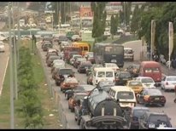
[YOUR CITY]: Pollution Sources
In this slide, include major sources of pollution in your city. If possible, please elaborate on the trends in pollution sources in following slides, i.e., changes in vehicle composition, decreases in solid waste burning, new industries or industry regulation
Example: Accra
  Crustal dust
  Biomass burning​
  Vehicle emissions​
  Tire and brake wear​
  Road dust​
  Sea salt​
  Solid waste burning
Harmattan winds
Sea spray at Labadi beach
Traffic in Accra

Slide 8
[YOUR CITY]: Emissions Characteristics
Include elemental breakdown of pollution sources in your city if there is an existing study documenting source types and elemental composition of emissions.
Example: Accra
Source​ | Elemental species​
Crustal dust​ | Si, K, Ca, V, Cr, Ni, Cu, Fe, Ti, Al, Mg, Mn​
Biomass burning​ | K, Cl, SO₄, Ca, P​
Aged biomass burning​ | K, SO₄​
Sea salt​ | Na, Cl, S​
Vehicle exhaust/Road dust​ | Cu, Zn, Sb, Pb, Ni, Al, Si, Ca, Fe​
Solid waste burning​ | Br​
Gugamsetty et al. 2012, Zhou et al. 2013, Vossler et al. 2015, Zhou et al. 2014​
Notes:
This information will need to come from a source apportionment study already completed in your city. Karagulian et al., 2015 may mention relevant studies. Conducting a literature search on articles related to your city and the terms “Source Apportionment,” “PMF,” or “chemical mass balance” may be helpful as well.

Slide 9
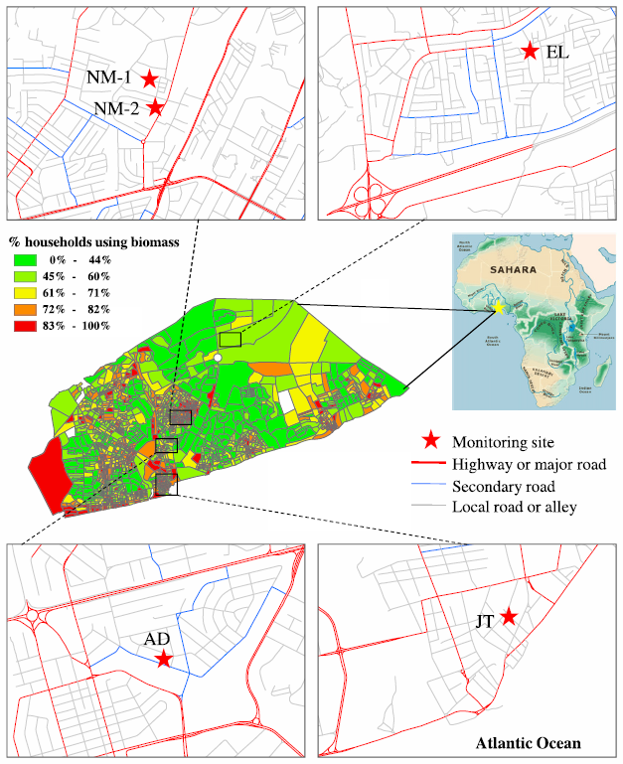
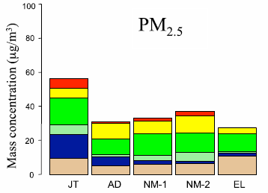
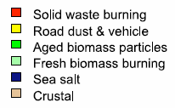
[YOUR CITY]: Source Apportionment
If data is available, include overview of source apportionment in your city
Example: Accra
Zhou et al. 2013

Slide 10
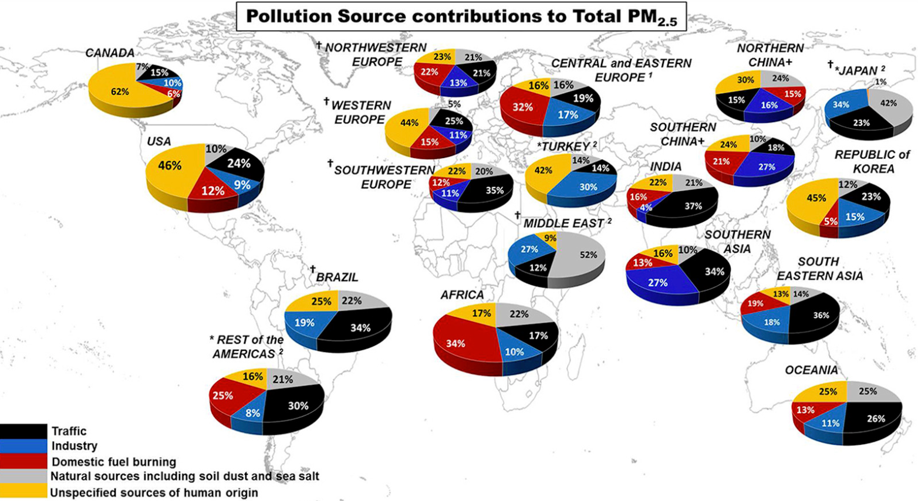
Source Apportionment Global Review
Karagulian et al., 2015

Slide 11
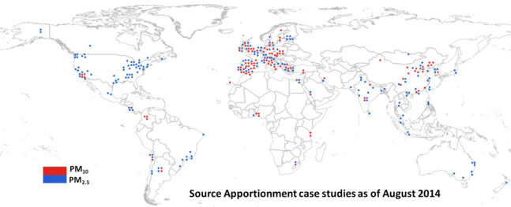
Source Apportionment Global Review
Karagulian et al., 2015

Slide 12
Source Apportionment Global Review
419 source apportionment studies in 51 countries analyzed ambient urban PM_{2.5} for its source
Add values of your city if applicable
Emissions Source | [YOUR CITY] | Globally
Traffic |  | 25%
Industrial activity |  | 15%
Domestic fuel burning |  | 20%
Sources of human origin (unspecified) |  | 22%
Natural sources (dust and sea salt) |  | 18%
Karagulian et al., 2015

Slide 13
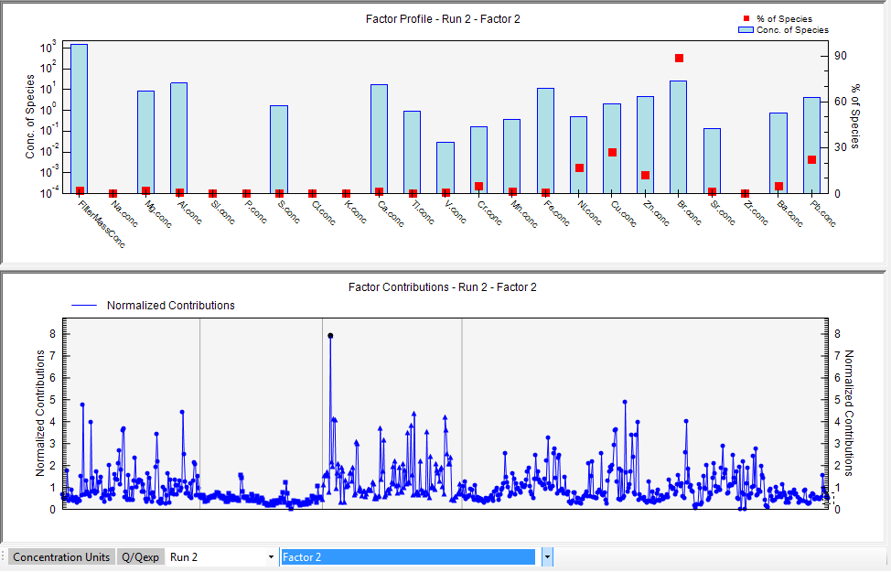
Source Apportionment
Best supported by gravimetric / filter samples that can be chemically analyzed to identify
  Organic constituents
  Metals
Use tools such as positive matrix factorization (PMF), chemical mass balance models (CMB), or the Unmix model to analyze speciated data, match sources and estimate contributions of each

Slide 14
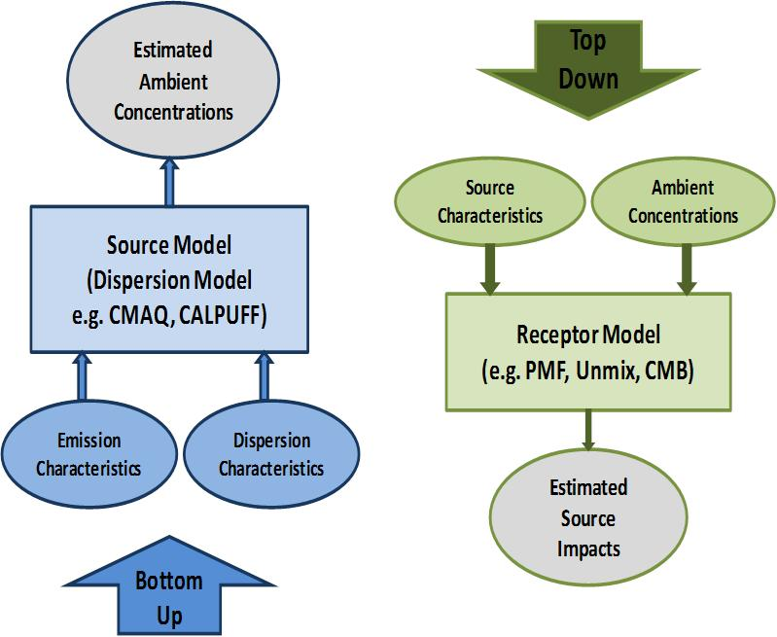
Bottom-Up and Top-Down Approaches to Air Quality
Adapted from Johnson et al. 2011 by Sonoma Technologies, Inc., used with permission.

Slide 15
Receptor Models
f = species profile​
g = amount of mass contributed by each factor
e = error

Slide 16
Receptor Models
knowledge about sources
none
complete
PMF
UNMIX
CMB
Chemical
Mass
Balance
Model
Multivariate
Receptor
Model
Explanatory Factor
Analysis Models
Confirmatory Factor
Analysis Models
Regression Models
p is unknown
F is unknown
m > 1
p is known
F is known
m = 1
p is hypothesized
F is partially known
m > 1
Notes:
CMB can be applied to one sample, requires source profiles, effective near-source with well characterized source emissions. ​
UNMIX does not use uncertainty, so if no edge resolution, no solution is possible. Determines source contribution. ​
PMF does not need source profile, but needs a lot of ambient measurements, and sources must vary temporally to be resolved.
​
Chemical Mass Balance (CMB) Model​
Receptor model using effective-variance least squares method​
Requires speciated profiles of potentially contributing sources and corresponding ambient data from analyzed samples at a single receptor site​
Ideal for localized nonattainment problems ​
​
UNMIX Model​
Unmixes concentrations of chemical species measured in ambient air to identify contributing sources​
Chemical profiles of sources not required, instead are generated internally from ambient data using factor analysis​
Estimates number of sources, compositions, and contributions to each sample​
​
Positive Matrix Factorization (PMF)​
Mathematical receptor model ​
Analyzes environmental sample data​
Reduces large number of variables in complex analytical datasets to source types and contributions​
Can be used for many samples at many sites​
Provides robust uncertainty estimates and diagnostics

Slide 17
Section 2: Example Tool: Positive Matrix Factorization
1. Pollutant Sources
2. Example Tool: Positive Matrix Factorization
3. Using Source Apportionment in BenMAP Analyses

Slide 18
Positive Matrix Factorization (PMF)
Multivariate factor analysis tool
Decomposes matrix of speciated sample into factor contributions and factor profile matrices
Values must be positive (non-negative)
Inputs:
  Mass of each species in each sample
  Uncertainty of each species mass in each sample
Outputs:
  Source factor profiles
  Source contributions
Notes:
The goal of receptor models such as PMF is to solve the chemical mass balance between measured species concentrations and source profiles, with the number of factors, the species profile of each source, and the amount of mass contributed by each factor to each individual sample.
Inputs to PMF include the mass of each species in a sample, which comes from a filter measurement that is then speciated in a lab setting into its component parts, and the uncertainty of each species in each sample.
Outputs include the source factor profiles, or fingerprints of each source type, and the relative contribution of each source to the total mass. Note that SPECIES (e.g., Pb, Si) are not the same as the sources (e.g., road dust, sea salt).

Slide 19
PMF Basics
Goal is to solve the chemical mass balance between measured species concentrations and source profiles
f = species profile​
g = amount of mass contributed by each factor​
PMF decomposes a matrix of speciated sample data into factor contributions (G) and factor profiles (F)
Factor profiles must be interpreted by the user to identify the source types contributing to that factor

Slide 20
PMF Calculations
X_{ij} = Matrix of observations on i days for j species
G_{ik} = Factor contributions on day i for factor k
  Units of ng/m3 / m3
F_{kj} = Factor compositions to factor k for species j
    Units of ng/ng
p = Number of factors (user selected)
Date EC_ng/m3 OC_ng/m3…. Species_J
Day_1 120.0 1040.0 ……..
Day_2 197.0 1320.0 ..…..
. . .
. . .
. . .
i days
j species
Date Factor1 Factor2…. FactorP
Day_1 120.0 1040.0 ……..
Day_2 197.0 1320.0 ..…..
. . .
. . .
Day_i . .
i days
p factors
Factor EC OC …… Species_J
Factor1 234.1 1410.0……..
Factor2 237.0 5334.0..…..
Factor3 . .
. . .
Factor_P . .

Slide 21
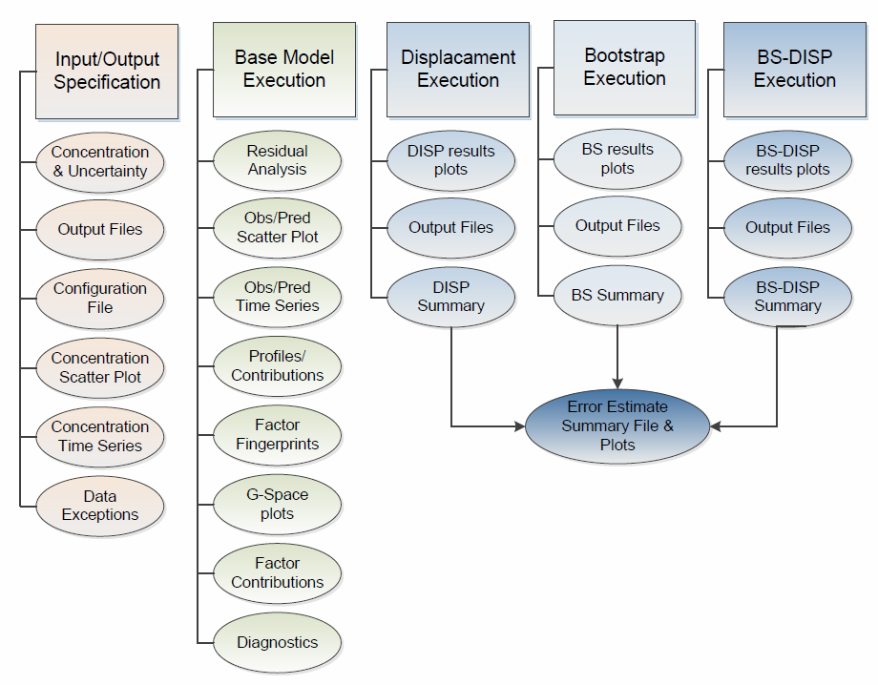
PMF Fundamentals
Displacement
PMF 5.0 Fundamentals and User Guide

Slide 22
EPA’s PMF Tool Process
Input Data
Data diagnostics
Base model run 1
Base model run diagnostics
Base model run 2
Source factor profile analysis

Slide 23
Step 1. Input Data

Slide 24
Monitoring Sites

Slide 25
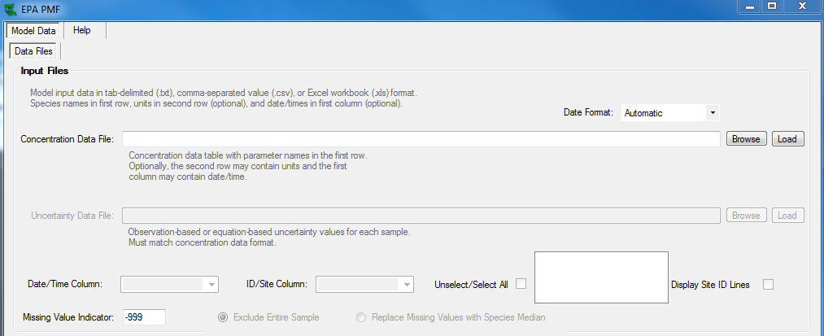
Getting Started with PMF
Sample species concentrations
Sample species uncertainty values
https://www.epa.gov/air-research/positive-matrix-factorization-model-environmental-data-analyses

Slide 26
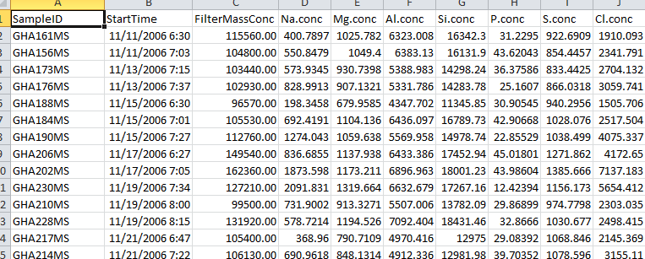
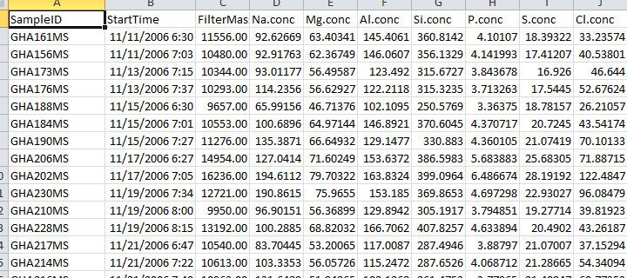
Concentration Files
Headers for both sheets must be identical; can’t have spaces
Missing data must be listed as -999
During file preparation, remove species with more than 50% of samples missing or below detection limit
Uncertainty files can be observation-based or equation-based
Concentration file
Uncertainty file

Slide 27
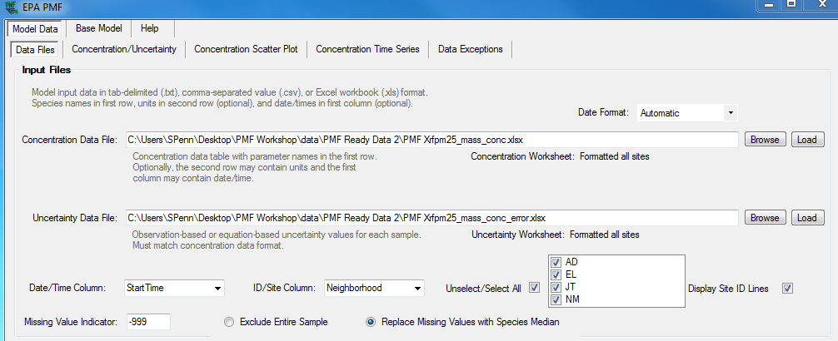
Input Data

Slide 28
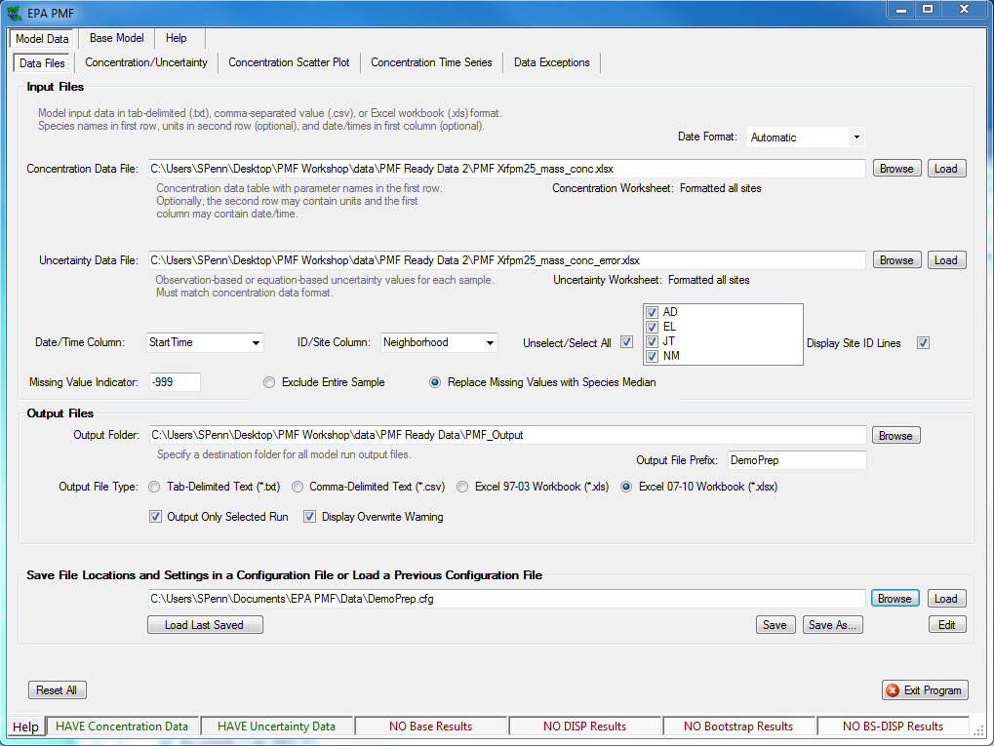
Input Data

Slide 29
Step 2. Data Diagnostics

Slide 30
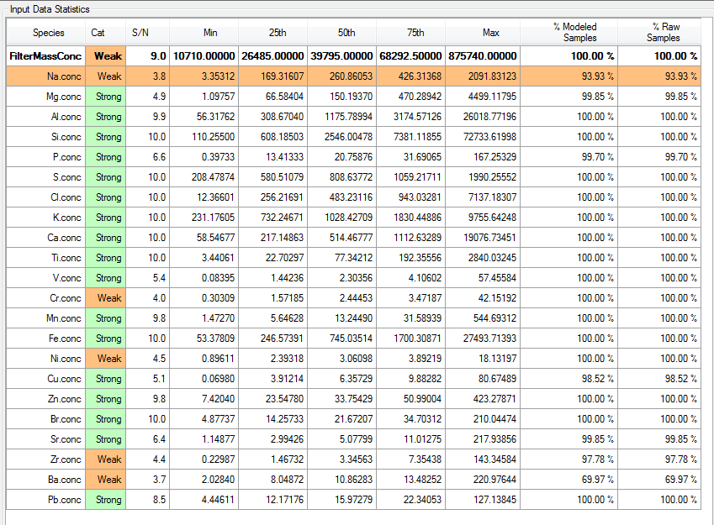
Weighting Species

Slide 31
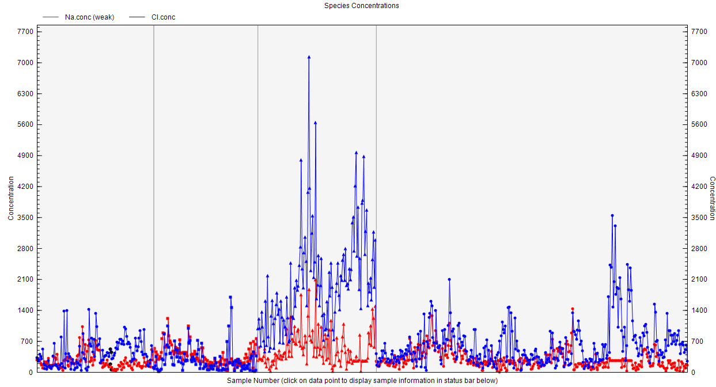
Descriptive Data
Concentration Scatter Plot
Concentration Time Series
Data exceptions

Slide 32
Step 3. Base Model 1

Slide 33
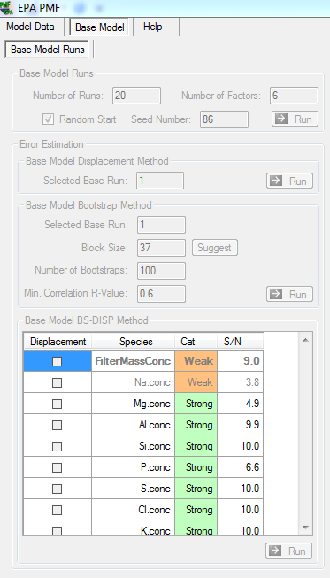
Base Model Run
Choose Random Start
Select number of factors
Select number of runs

Slide 34
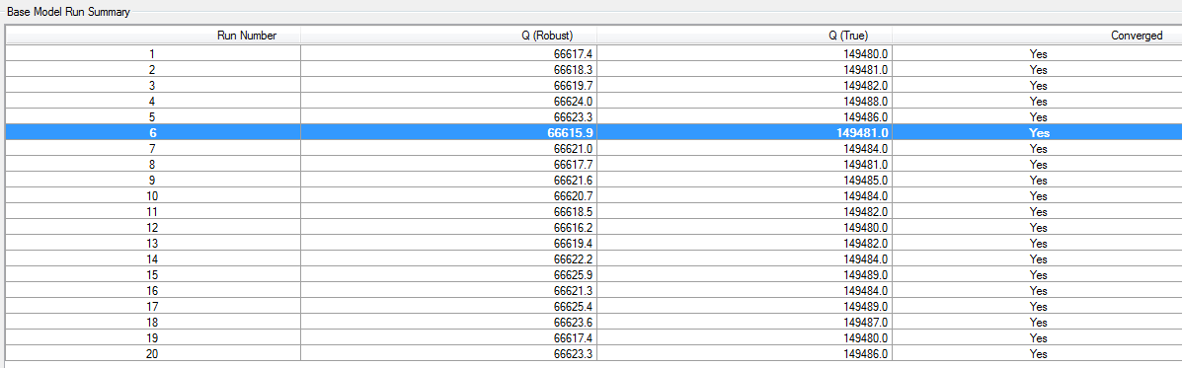
Base Model Run
Q (Robust) and Q (True) are goodness-of-fit parameters that assess how well the model fits the input data.
Lowest Q (Robust) is model run that is depicted.

Slide 35
Step 4. Base Model Diagnostics

Slide 36
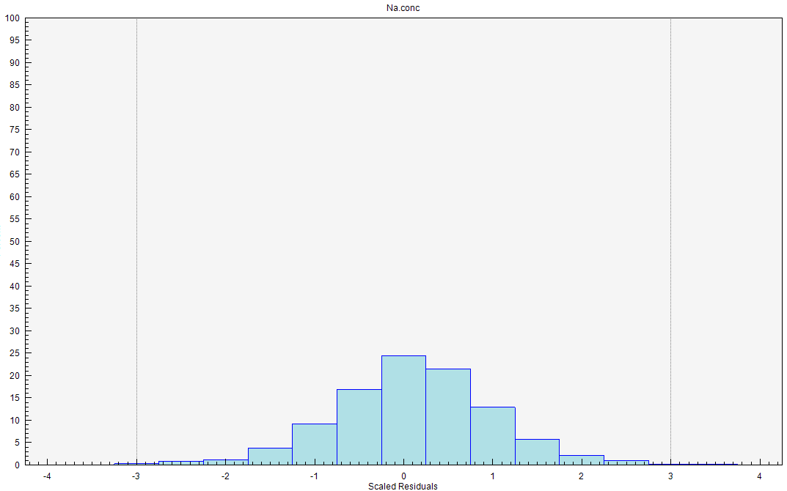
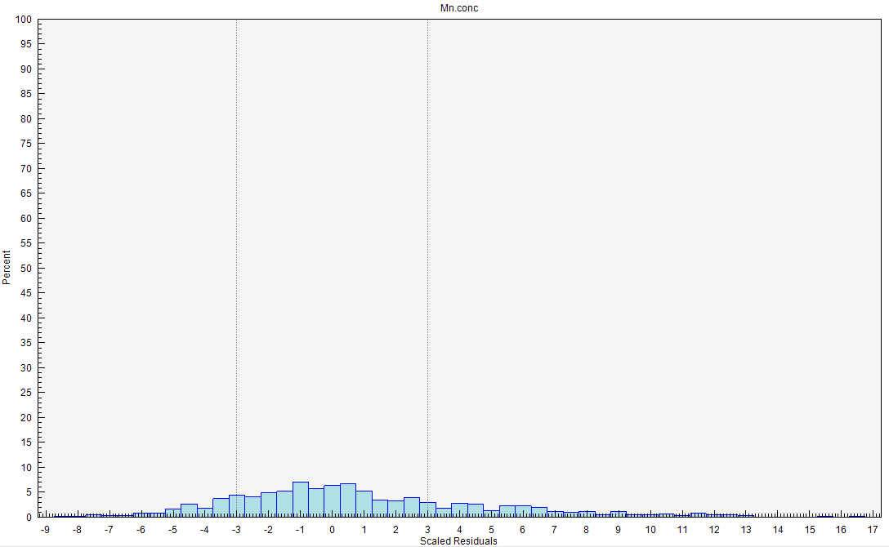
Residual Analysis
Uncertainty-scaled residuals
Shows how well the model fits each species
If a species has many large scaled residuals, this indicates poor model fit
Residuals should be within +3 and -3

Slide 37
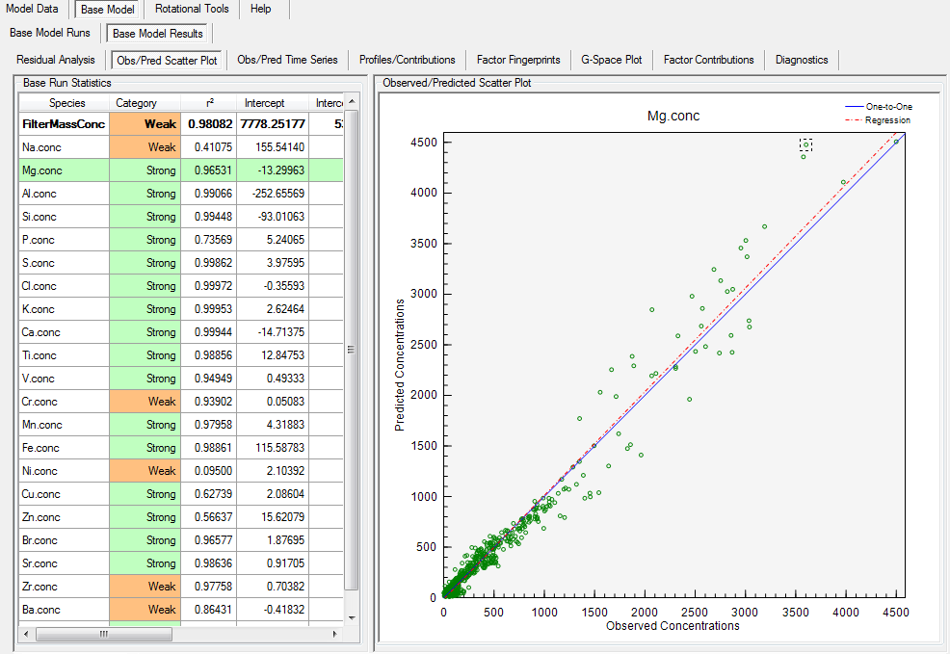
Observed/Predicted Scatter Plot
Comparison between observed (input data) and predicted (modeled) values used to determine if the model fits the individual species well
Species that do not have a strong correlation between observed and predicted should be downweighted

Slide 38
Step 5. Base Model Run 2

Slide 39
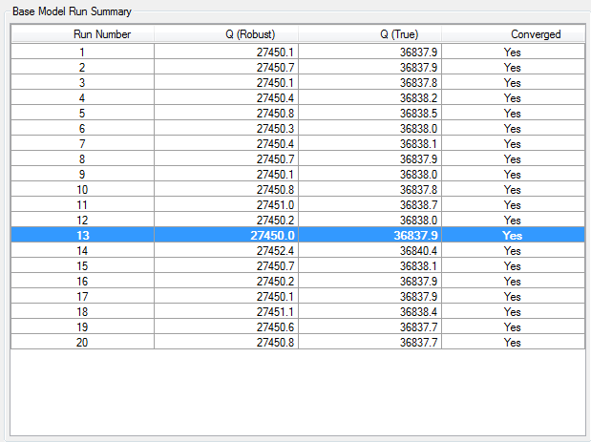
Re-Running the Base Model
Re-run base model based on decisions made from residual analysis and predicted v. observed scatter plots
Use the same base model run starting point:
  20 runs
  6 factors
  Random start
Next, re-check the residual analysis and predicted v. observed figures

Slide 40
Step 6. Source Factor Profile Analysis

Slide 41
Profile/Contributions: Solid Waste Burning

Slide 42
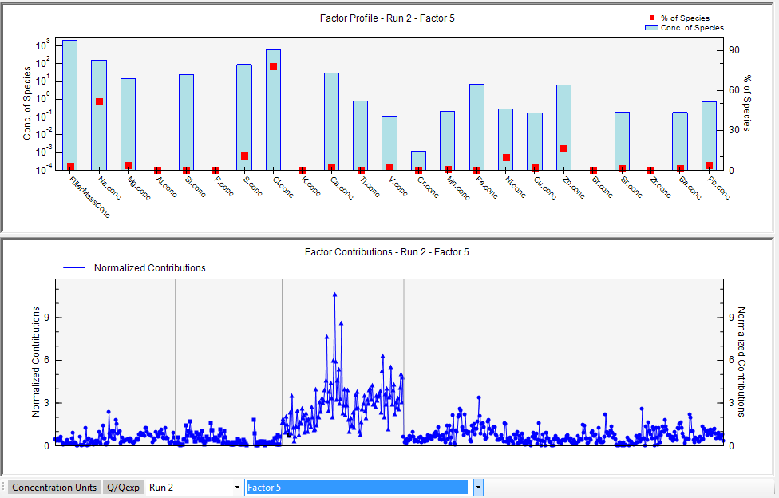
Profile/Contributions: Sea Salt

Slide 43
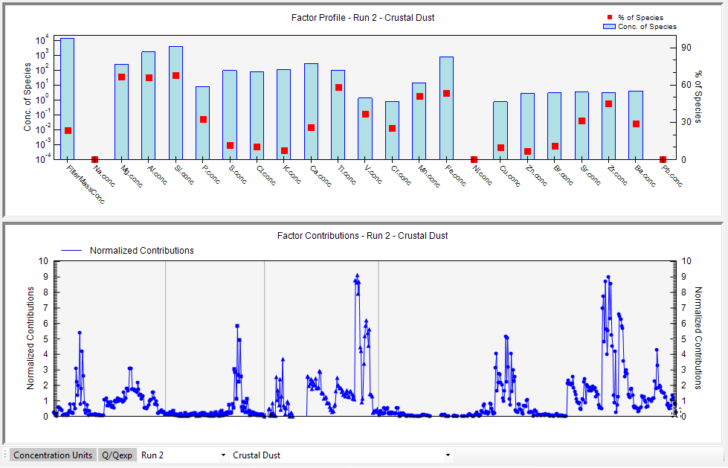
Profile/Contributions: Crustal Dust

Slide 44
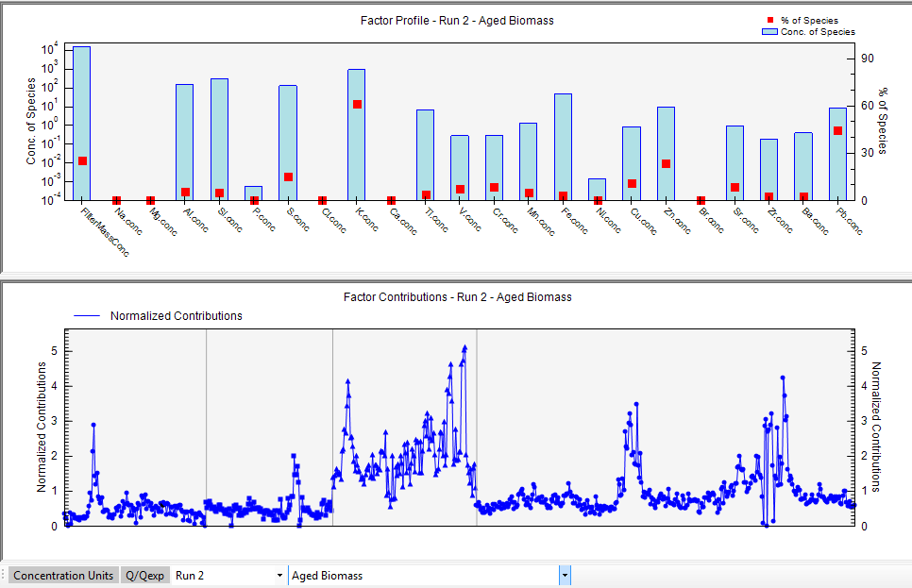
Profile/Contributions: Aged Biomass

Slide 45
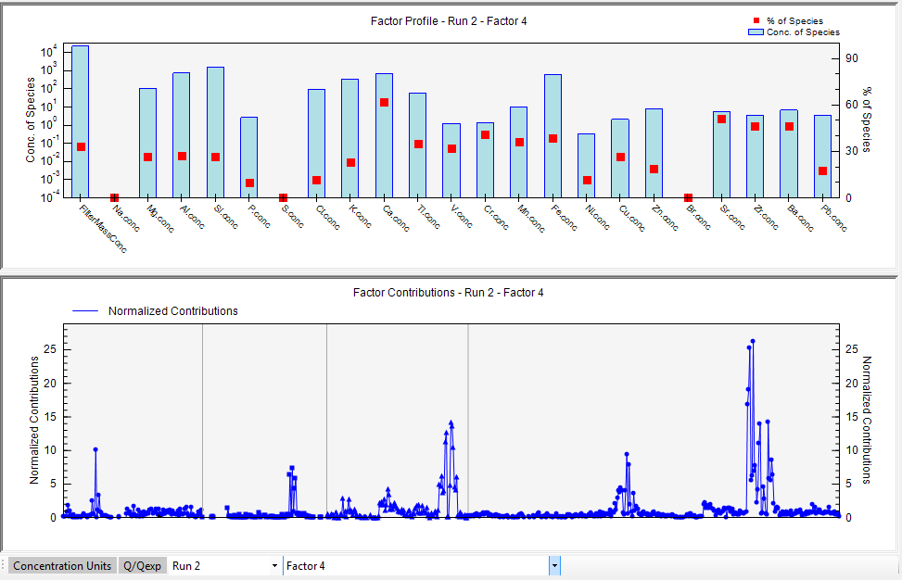
Profile/Contributions: Road Dust

Slide 46
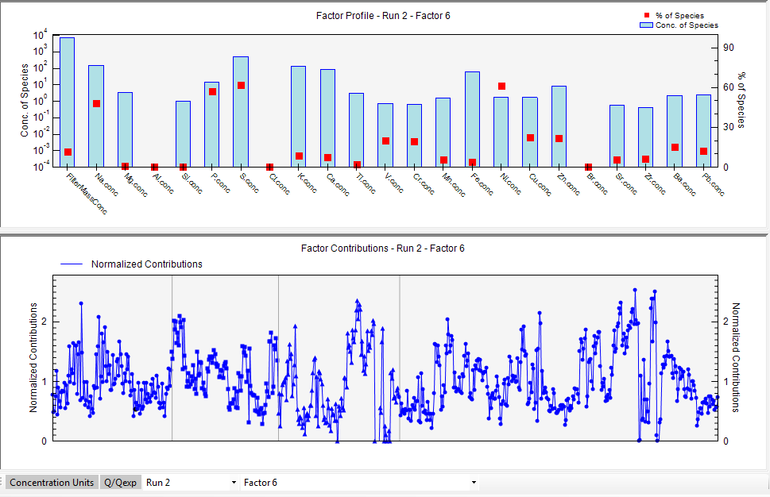
Profile/Contributions: Biomass Burning

Slide 47
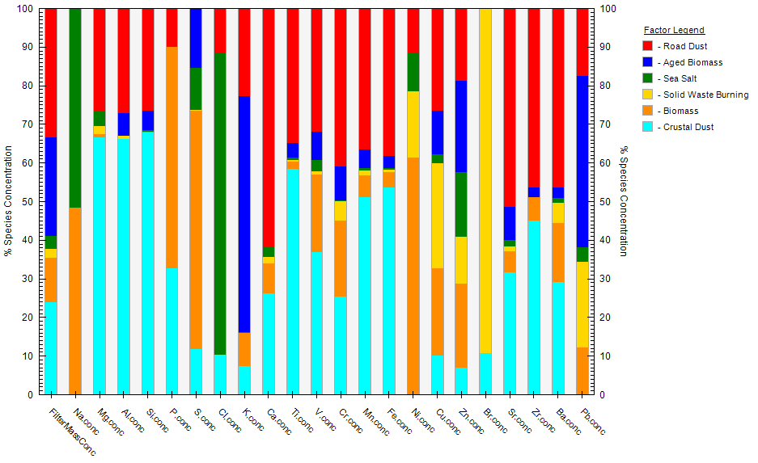
Factor Fingerprints

Slide 48
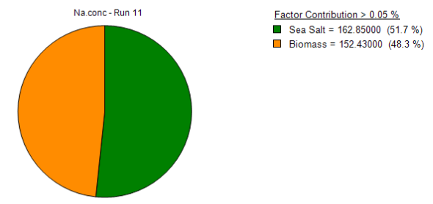
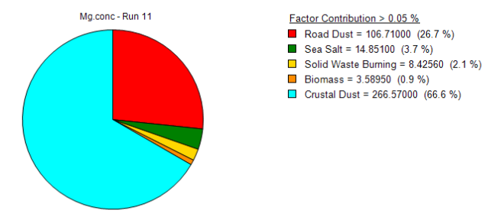
Factor Contributions

Slide 49
Output Files
File Name | Contents
*_diag | record of the user inputs and model diagnostic information (identical to the Diagnostics screen)
*_contrib | Contributions for each base run used to generate the contribution graphs on the Profiles/Contributions tab. Sorted by run number
*_profile | Profiles for each base run used to generate the profile graphs on the Profiles/Contributions tab.
*_resid | Residuals (regular and scaled by uncertainty) for each base run, used to generate the graphs and tables on Residual Analysis screen
*_run_comparison | Summary of the species distribution for each factor over all PMF runs and compared to lowest Q(robust) run
*_base | Contrib, Profile, Resid, and Run Comparison on separate worksheets in the same excel workbook.

Slide 50
Next Steps in PMF
After running the base model, you can:
  Re-run the base model for a different number of factors to see if another value has a better fit to input data
  Estimate displacement error
  Estimate base model error
EPA PMF has a number of training exercises associated with it that can be used for practicing the technique and understanding source profiles
Many studies can be used to understand source profiles, as well

Slide 51
How to Use PMF Results
Once you have run PMF and are confident in the source contributions and their profiles, you can use this information in a number of ways:
  Understanding individual source contributions overall and by neighborhood
  Air quality control strategy creation
  Policy assessment
  Creating a baseline for future analyses

Slide 52
After Using PMF
Trend analyses by contributions
  Day of week vs. weekday box plots or non-parametric tests
  Spectral analysis to find periodicity
  Seasonal analysis
  Contribution by wind speed and direction
    Nonparametric regression (NPR)
Mass apportionment
    Can include total mass directly as a species to get mass apportionment (Reff et al., 2007)
    Multiply out the factor profiles and contributions to get mass from each factor

Slide 53
Section 3: Using Source Apportionment in BenMAP Analyses
1. Pollutant Sources
2. Positive Matrix Factorization
3. Using Source Apportionment in BenMAP Analyses

Slide 54
Environmental Benefits Mapping and Analysis Program (BenMAP) Analysis Outline
Example is for Accra:
  Air pollution sources in Accra
  Source apportionment study in Accra
Using source apportionment data to create targeted monitor rollback scenario in BenMAP
Health incidence results from targeted monitor rollback
Comparing source apportionment monitor rollback results with baseline assessment results
Note that the analysis done during this exercise is simplified for illustrative purposes and does not reflect an actual policy proposed by Ghana.

Slide 55
Using Source Apportionment Details in BenMAP
Monitor Site (24-hour average) | Total PM_{2.5} (µg/m³) | Road dust & vehicle (µg/m³) | Fresh & Aged Biomass (µg/m³)
Jamestown | 57 | 5 (8.8%) | 21 (36.8%)
Asylum Down | 31 | 10 (32.3%) | 10 (32.3%)
Nima – 1 | 33 | 8 (24.2%) | 12 (36.4%)
Nima – 2 | 37 | 11 (29.7%) | 13 (35.1%)
East Legon | 28 | 3 (10.7%) | 11 (39.3%)
Note these are 24-hour average measurements taken during non-Harmattan season,
whereas other monitoring may include all months of the year.
Zhou et al., 2013

Slide 56
Analytical Assumptions
We assume 1:1 correspondence between the percent reduction in PM_{2.5} emissions in a source category and percent reduction in ambient PM_{2.5} concentrations from that category
We assume full compliance with the hypothetical regulation (e.g., full 50% decrease in source-specific PM_{2.5} concentration)
We assume full implementation of the hypothetical regulation by 2020

Slide 57
Source Apportionment in Accra
Monitor Site (24-hour average) | Total PM_{2.5} (µg/m³) | Road dust & vehicle (µg/m³) | Fresh & Aged Biomass (µg/m³) | Total Road and Biomass (µg/m³) | Decrease Road and Biomass Emissions by 50% - Decrease total PM_{2.5} by:
Jamestown | 57 | 5 (8.8% of total) | 21 (36.8% of total) | 26 (45.6% of total) | 22.8%
Asylum Down | 31 | 10 (32.3% of total) | 10 (32.3% of total) | 20 (64.5% of total) | 32.3%
Nima – 1 | 33 | 8 (24.2% of total) | 12 (36.4% of total) | 20 (60.6% of total) | 30.3%
Nima – 2 | 37 | 11 (29.7% of total) | 13 (35.1% of total) | 24 (64.9% of total) | 32.4%
East Legon | 28 | 3 (10.7% of total) | 11 (39.3% of total) | 14 (50.0% of total) | 25.0%
Zhou et al. 2013
Notes:
At each monitoring site, we show the PM2.5 attributable to each source according to the PMF analysis in Zhou et al., 2013. In the final column, we see that if we decrease road and biomass emissions by 50%, this decreases total PM2.5 by different percentages, as shown in the red box.

Slide 58
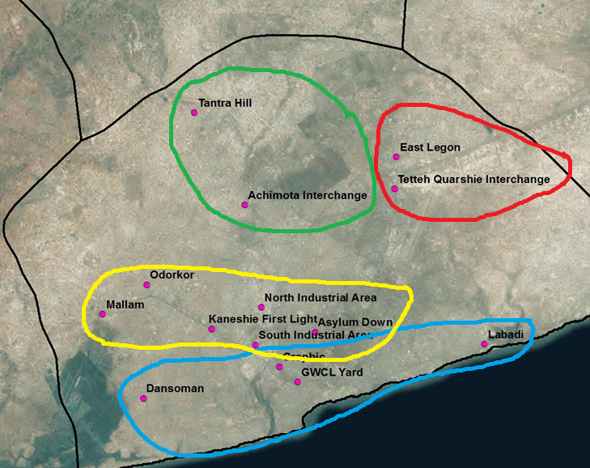

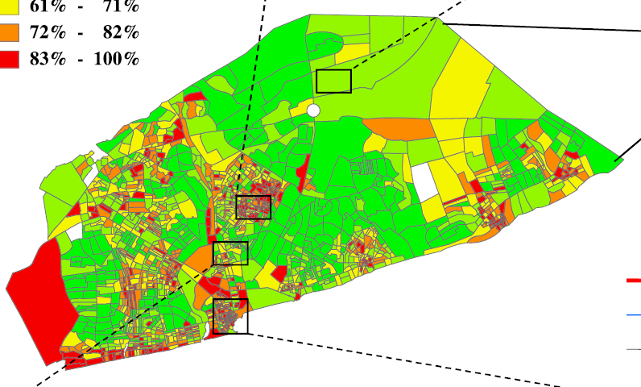
Applying Reductions by Monitor
Nima
East Legon
Asylum Down
Jamestown
Zhou et al., 2013
Notes:
We apply reductions in PM concentrations to the monitors in each neighborhood, as shown in the figure on the left. The figure on the right shows the percent of households in Accra using biomass fuels, with the brightest green referring to lower percentages, and darker reds referring to higher percentages.

Slide 59
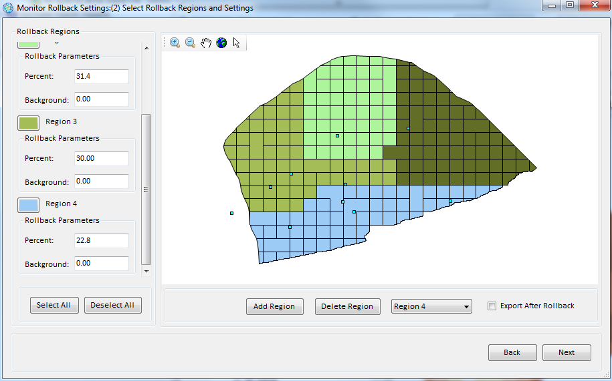
Monitor Rollback Scenario
Region | Percent
1, East Legon | 25.0
2, Nima | 31.4
3, Asylum Down | 30.0
4, Jamestown | 22.8
BenMAP-CE monitor rollback scenario screenshot
Notes:
We use BenMAP-CE to analyze the policy scenario laid out two slides prior. We apply the percent reduction in PM2.5, shown in the table on the right, to the spatial areas aligned with the regions in the BenMAP screenshot on the left.

Slide 60

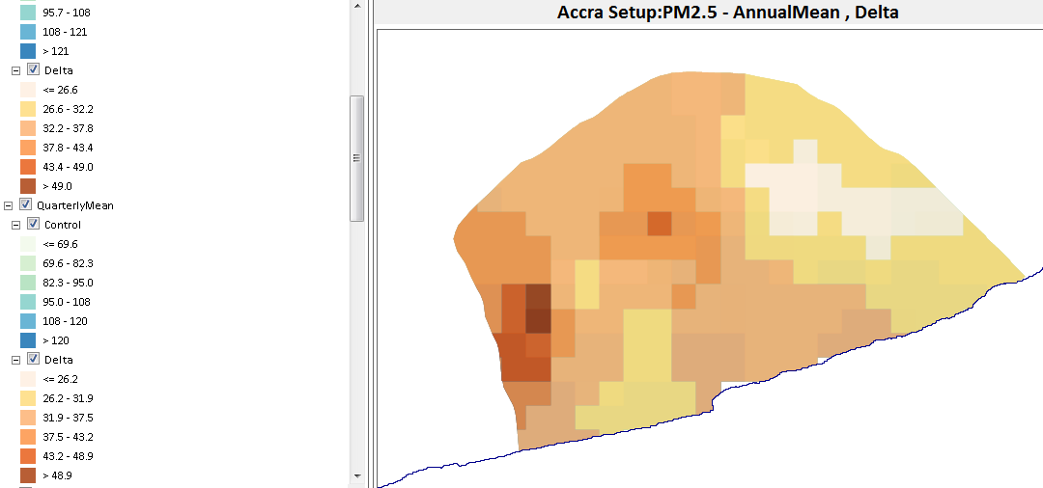

Monitor Rollback Scenario
Change in PM_{2.5} concentrations across Accra associated with emissions reduction policy scenario, in µg/m³
Notes:
Change in PM2.5 concentrations across Accra due to emissions reduction policy scenario

Slide 61
Health Impact Results: US-Based Studies
Health Endpoint | Epidemiological Study | Age Range | Change in Incidence due to 2020 Targeted Mitigation Rollback
Mortality, All Cause | Krewski et al. 2009 | 30-99 | 3,607
Mortality, All Cause | Laden et al. 2006 | 25-99 | 8,428
Mortality, All Cause | Pope et al. 2002 | 30-99 | 3,607
Health Endpoint | Epidemiological Study | Age Range | Change in Incidence due to 2020 Targeted Mitigation Rollback
Mortality, All Cause | Woodruff et al. 1997 | Infants | 143
Mortality, All Cause | Woodruff et al. 2006 | Infants | 235
Notes:
Note: Update results with appropriate significant figures based on data inputs.

Slide 62
Health Impact Results: Integrated Exposure Response Function (IER)
Health Endpoint | Epidemiological Study | Age Range | Change in Incidence due to 2020 Targeted Mitigation Rollback
Mortality, Ischemic Heart Disease | Burnett et al. 2014 | 30-99 | 542
Mortality, Cerebrovascular Disease | Burnett et al. 2014 | 30-99 | 1,049
Mortality, COPD | Burnett et al. 2014 | 30-99 | 51
Mortality, Lung Cancer | Burnett et al. 2014 | 30-99 | 21

Slide 63
Health Impact Results: Asthma Hospital Admissions
Health Endpoint | Epidemiological Study | Age Range | Change in Incidence due to 2020 Targeted Mitigation Rollback
Hospital Admissions, Asthma | Sheppard et al. 2003 | 0-64 | 168,937

Slide 64
Comparison with Baseline Assessment
What do these results mean?
  How do these results compare with the baseline assessment results?
  Why did you use 2020 projected air quality data instead of 2014 monitored air quality data?

Slide 65
2020 Health Impact Results: US-Based Studies
Health Endpoint | Epidemiological Study | Age Range | 2020 PM_{2.5} Attributable Incidence | Change in Incidence due to 2020 Targeted Mitigation Rollback | Incidence Post-Rollback
Mortality, All Cause | Krewski et al. 2009 | 30-99 | 10,430 | 3,607 | 6,823
Mortality, All Cause | Laden et al. 2006 | 25-99 | 17,711 | 8,428 | 9,283
Mortality, All Cause | Pope et al. 2002 | 30-99 | 10,430 | 3,607 | 6,823
Health Endpoint | Epidemiological Study | Age Range | 2020 PM_{2.5} Attributable Incidence | Change in Incidence due to 2020 Targeted Mitigation Rollback | Incidence Post-Rollback
Mortality, All Cause | Woodruff et al. 1997 | Infants | 452 | 143 | 309
Mortality, All Cause | Woodruff et al. 2006 | Infants | 663 | 235 | 428

Slide 66
2020 Health Impact Results: IER
Health Endpoint | Epidemiological Study | Age Range | 2020 Air Pollution Attributable Incidence | Change in Incidence due to 2020 Targeted Mitigation Rollback | Incidence Post-Rollback
Mortality, Ischemic Heart Disease | Burnett et al. 2014 | 30-99 | 1,487 | 542 | 945
Mortality, Cerebrovascular Disease | Burnett et al. 2014 | 30-99 | 2,140 | 1,049 | 1,091
Mortality, COPD | Burnett et al. 2014 | 30-99 | 155 | 51 | 104
Mortality, Lung Cancer | Burnett et al. 2014 | 30-99 | 60 | 21 | 39

Slide 67
2020 Health Impact Results: Asthma Hospital Admissions
Health Endpoint | Epidemiological Study | Age Range | 2020 Air Pollution Attributable Incidence | Change in Incidence due to 2020 Targeted Mitigation Rollback | Incidence Post-Rollback
Hospital Admissions, Asthma | Sheppard et al. 2003 | 0-64 | 537,805 | 168,937 | 368,868

Slide 68
Thank you!

