Slide 1
DELETE THIS SLIDE PRIOR TO PRESENTATION
This PowerPoint serves as a template presentation which introduces topics related to air quality and is part of a suite of presentations provided by the EPA for the Megacities program.
See speaker notes for an additional description of slide content. Slides should be edited or added to as necessary for your particular needs. Slides with highlighted yellow text require the addition of specific context and information for your city.

Slide 2
Setting Ambient Air Quality and Emission Standards

Slide 3
What are Air Quality Standards?
"Primary standards set limits to protect public health, including the health of ‘sensitive’ populations such as asthmatics, children, and the elderly.” - U.S. EPA
“An air quality standard defines the maximum amount of a pollutant averaged over a specified period of time that can be present in outdoor air without harming public health, and thus, it defines clean air.” - California Air Resources Board
Definition can vary by country or agency, but generally air quality standards are established limits of air pollution concentrations to protect public health.
Notes:
US EPA sets National Ambient Air Quality Standards (NAAQS) to protect public health, based on extensive review of scientific literature
States are required by federal law to attain NAAQS or develop attainment plans

Slide 4
What is the purpose of an air quality standard?
Potential goals of establishing a standard include:
  Improve air quality for people near a specific emissions source (e.g., power plant)
  Reduce the prevalence of chronic health effects (e.g., chronic bronchitis) within a city or neighborhood
  Reduce acute health effects (e.g., asthma attacks) within a city or neighborhood
  Increase crop production
  Improve visibility at a park or recreational area
Notes:
Standards can be set for different purposes.
Generally speaking, primary purpose for setting standard would be to improve public health. Even within that category, there can be different types of standards.
Other standards, sometimes called secondary standards, may protect against other impacts related to visibility, materials damage, crops, ecological impacts
Improving visibility/general air quality will likely be less restrictive than reducing the impact on specific health outcomes

Slide 5
Standards vs. Guidelines
Standards
Generally set by a governing or regulatory agency
Guidelines
Recommended air quality limits
Often legislation requires that jurisdictions must stay under the air pollution standard limits
Typically set by a public health or environmental organization such as the World Health Organization
Can assist countries in setting their own standards
Can be enforceable with fines, penalties, etc.
Not enforceable

Slide 6
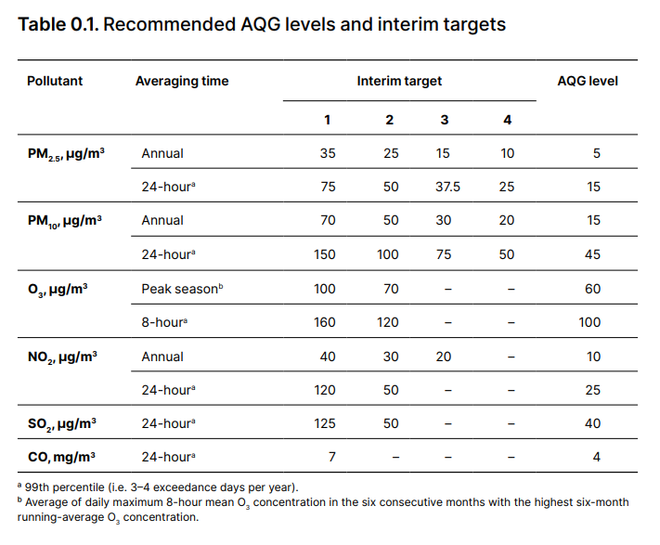
World Health Organization (WHO) Air Quality Guidelines
Air Quality Guidelines (AQG)
are evidence-informed recommendations for protecting public health from adverse effects of air pollutants
Interim targets serve as incremental steps in progressive reduction of pollution in areas where pollution is currently high
WHO, 2021 Global Air Quality Guidelines
Notes:
Guidelines are not enforceable but can serve as the basis for a given city or country’s AQ standard, and for the long-term goals of local and national AQ management planning.

Slide 7
U.S. EPA National Ambient Air Quality Standards (NAAQS)
The Clean Air Act (CAA) gives the U.S. EPA the authority to establish NAAQS to protect public health and the environment​
NAAQS have been established for six pollutants:​
  Ozone(O₃), particulate matter (PM_{2.5} and PM₁₀), carbon monoxide (CO), lead (Pb), nitrogen dioxide (NO₂), sulfur dioxide (SO₂)​
​EPA reviews the standards every five years​
Independent Clean Air Scientific Advisory Committee (CASAC) advises EPA in the standard development process

Slide 8
U.S. EPA NAAQS Review Process
Planning
Integrated Science Assessment (ISA)
Risk/Exposure Assessment (REA)
Policy Assessment (PA)
Rulemaking
Begins with a science policy workshop to gather input from scientific community and public
Comprehensive review, synthesis, and evaluation of the most policy-relevant science
Assessment draws on previous information to characterize exposures and associated risks to health and the environment
Staff analysis of scientific bases for alternative policy options for consideration
EPA develops and publishes a notice of proposed rulemaking for updating NAAQS based on information from prior steps
Integrated Science Assessment (ISA)
Planning
Risk/Exposure Assessment (REA)
Rulemaking
Policy Assessment (PA)
https://www.epa.gov/criteria-air-pollutants/process-reviewing-national-ambient-air-quality-standards

Slide 9
Summary of Current U.S. NAAQS
Pollutant [links to historical tables of NAAQS reviews] |  | Primary/ Secondary | Averaging Time | Level | Form
Carbon Monoxide (CO) (last updated 2011) |  | primary | 8 hours | 9 ppm | Not to be exceeded more than once per year
 |  |  | 1 hour | 35 ppm
Lead (Pb) (last updated 2016) |  | primary and secondary | Rolling 3 month average | 0.15 μg/m³ ⁽¹⁾ | Not to be exceeded
Nitrogen Dioxide (NO₂) (last updated 2018) |  | primary | 1 hour | 100 ppb | 98th percentile of 1-hour daily maximum concentrations, averaged over 3 years
 |  | primary and secondary | 1 year | 53 ppb ⁽²⁾ | Annual Mean
Ozone (O₃) (last updated 2020) |  | primary and secondary | 8 hours | 0.070 ppm ⁽³⁾ | Annual fourth-highest daily maximum 8-hour concentration, averaged over 3 years
Particle Pollution (PM) (last updated 2020) | PM_{2.5} | primary | 1 year | 12.0 μg/m³ | annual mean, averaged over 3 years
 |  | secondary | 1 year | 15.0 μg/m³ | annual mean, averaged over 3 years
 |  | primary and secondary | 24 hours | 35 μg/m³ | 98th percentile, averaged over 3 years
 | PM₁₀ | primary and secondary | 24 hours | 150 μg/m³ | Not to be exceeded more than once per year on average over 3 years
Sulfur Dioxide (SO₂) (last updated 2019) |  | primary | 1 hour | 75 ppb ⁽⁴⁾ | 99th percentile of 1-hour daily maximum concentrations, averaged over 3 years
 |  | secondary | 3 hours | 0.5 ppm | Not to be exceeded more than once per year
https://www.epa.gov/criteria-air-pollutants/naaqs-table
Notes:
EPA sets two types of standards: primary standards, to protect public health; and secondary standards, to protect the public welfare from effects including visibility impairment, damage to building and national monuments, and damage to ecosystems.​
When EPA sets air quality standards, it also must specify the air quality statistics that the Agency will use to determine whether an area is meeting the standards. These statistics are known as the “form of the standard” and are derived separately for each standard.

Slide 10
U.S. EPA NAAQS Compliance Assessment
The U.S. EPA uses “design values” to describe a given location’s air quality levels relative to the NAAQS
  Designates ‘nonattainment’ areas
  Assesses progress towards meeting the NAAQS, classified as ‘Maintenance’
Design values are calculated as 3-year averages of the pollutant’s ‘form’ (see previous table)
  Ex: Ozone design value is the annual fourth-highest daily maximum 8-hour concentration, averaged over 3 years
Design values exclude erroneous measures, measures captured during ‘exceptional events’, and measures captured by monitors with network/site issues
EPA Map of Design Values:
https://epa.maps.arcgis.com/apps/MapSeries/index.html?appid=bc6f3a961ea14013afb2e0d0e450b0d1
EPA design values assessment tables: https://www3.epa.gov/airquality/greenbook/kdtc.html
Notes:
While a “design value” may not be relevant to your own country or city, it is helpful to think about how to determine if your city has met standards
Compliance is often based on multi-year averages to account for year-to-year variation
Often excludes certain data points as well (such as erroneous measures) which requires analysis

Slide 11
Considerations

Slide 12
Key Considerations
Setting pollutant standards should consider:
  Purpose and goal(s) of the standard
  Health or other physical effects of interest
  Population of interest
  Relevant pollutant metrics (e.g., mean vs. max, averaging time)
The key factor in determining standards is the supporting literature
Determining and setting standards may be limited by data availability
  Level at which pollutants are monitored temporally and geographically
  Quality of the data supporting the standards (i.e., Federal Equivalent Method vs. Federal Reference Method vs. Sensors)
Notes:
See https://www.epa.gov/air-sensor-toolbox/frequent-questions-about-air-sensors for more information about the performance of air sensors.

Slide 13
Effects of Interest
What health effects are you most interested in reducing?​
  What health effects are most prevalent within your population of interest?​
  What available evidence exists within the local or international literature to support the link between exposure and the health outcome? ​
  Are pollutant concentrations likely impacting short-term or long-term health?​
  Do you see a lot of variability in concentrations from day to day? Are there frequent extreme concentration events that last several days?​
  Does pollution vary spatially via hot spots, or is it generally evenly distributed?​
Are there other physical or environmental effects?
  Visibility, haze, crop damage, property damage, etc.
Notes:
PM mixtures can vary place to place – some areas have more sulfate for example – due to burning of high sulfur coal. We are still learning about relative toxicity of PM components but these differences mean it is best to use studies conducted in areas with similar sources and concentration levels. ​
​
Ex: There are high rates of hospitalizations due to bronchitis in persons living near the power plant due to the high PM emissions​

Slide 14
Population of Interest
Who will the AQ standard impact?
Dependent upon the standard’s purpose and health effects of interest:
  Are we looking at specific neighborhoods, regions, cities, etc.?
  Are we interested in specific age groups (e.g., neonatal)?
  Ex: standards may be stricter in high population areas

Slide 15
Temporal Scale
What is the temporal scale for the air quality standard?
Depends on the purpose of the standard
Are we looking at short-term or long-term benefits?
How does the pollutant vary during the day? Are spikes in concentration common?
What metrics have been linked to health impacts?
What resolution of data is available?
  Federal Equivalent Methods (FEMs) provide 1-hour or 24-hour measures while Federal Reference Methods (FRMs) provide 24-hour measures
  Clarity sensors typically provide hourly or daily averages

Slide 16
Temporal Scale
What is the temporal scale for the air quality standard?
Pollutant | Metric Options | Units
Ozone | 1-hour daily maximum | ppb
 | 8-hour daily maximum
 | 8-hour mean
 | 24-hour mean
PM (PM_{2.5} & PM₁₀) | Annual mean | µg/m³
 | 24-hour mean
Nitrogen Dioxide | 1-hour daily maximum | ppb or µg/m³
 | 24-hour mean
 | Annual mean
Sulfur Dioxide | 1-hour daily maximum | ppb or µg/m³
 | 24-hour mean
Notes:
Most common metrics for standards set by WHO and U.S. EPA​

Slide 17
Thank you!

