Slide 1
DELETE THIS SLIDE PRIOR TO PRESENTATION
This PowerPoint serves as a template presentation which introduces topics related to air quality and is part of a suite of presentations provided by the EPA for the Megacities program.
See speaker notes for an additional description of slide content. Slides should be edited or added to as necessary for your particular needs. Slides with highlighted yellow text require the addition of specific context and information for your city.

Slide 2
Air Quality Management Plan Development

Slide 3
Overview
1. Introduction
2. Framework
3. Challenges
4. Mitigation Options
5. Additional Considerations
6. New Air Quality and Climate Management Plan

Slide 4
Section 1: Introduction
1. Introduction
2. Framework
3. Challenges
4. Mitigation Options
5. Additional Considerations
6. New Air Quality and Climate Management Plan

Slide 5
Why Prepare an Air Quality Management Plan (AQMP)?
Brings together legal, technical, and practical considerations in one place
Memorializes government commitments
Outlines gaps and needs to fully implement, measure, and evaluate the plan
Serves as a visible sign of commitment that is attractive to international donors
Notes:
Brings together legal, technical, and practical considerations in one place
Legal authority to pursue clean air goals
Technical analyses that show the emission reduction measures being pursued will be effective to
Memorializes government commitments made for implementation, measurement, and enforcement
Outlines gaps and needs to fully implement, measure, and evaluate the plan
Serves as a visible sign of commitment and a blueprint for further investment that is attractive to international donors looking to invest in cleaner air (e.g., World Bank PMEH, WHO)

Slide 6
Successful Air Quality Management
Good quality science on nature, sources, and impacts of air pollution
Shared understanding among major stakeholders
Leadership at national level
Defined roles for each level of government
Clear accountability and enforcement
Notes:
- Good quality science and analytical information on the nature, sources, and impacts of air pollution
Shared understanding of the problem among major stakeholders (pollution sources, political leaders, environmental officials, public interest groups, community-based organizations, citizens)
- Active involvement of stakeholders and shared commitment to improve air quality
- Shared burden of control across contributing sources and regions
- Leadership at national level to enable participation, set fair levels of control, and resolve conflicts between stakeholders
- Defined roles for each level of government involved
- Strong penalties, clear accountability, and meaningful enforcement at the national, state, and local levels

Slide 7
Megacities Framework: Integrated Air Quality Model
1. Gather Available Air Quality Data and Information
6. Implement Enhanced Data
Collection Capacity
2. Assess Current Situation: Identify Key Sources and Hotspots of Exposure
5. Enhance Data Collection Capacity to Evaluate Progress on Emission Mitigation Actions
3. Conduct Analysis of New Emissions Control Measures to Prioritize Actions
4. Take Action:
Legal
Policy
Technologies
Hierarchy of Actions
Legal – What are the gaps?
Policy – What actions can be taken?
Technologies – What control and monitoring technologies are needed?
Source Categories for Best Practices
Point sources (including energy)
Mobile sources
Area sources
Notes:
This slide demonstrates the integrated air quality model that is the backbone of the Megacities Partnership work. The general premise is that with any amount of air quality information and will to make change, local and national government agencies can begin to make policy updates to improve air quality and therefore improve quality of human life while decreasing air pollution related health impacts.
First, the aim is to gather available air quality data and information.
Next, assess the current air quality situation, identifying key air pollution sources and hotspots of exposure. This can be done by collecting relevant emissions source, population, and health impact data. Typically, we have done these analyses using US EPA’s environmental benefits mapping and analysis program, called BenMAP-CE, or BenMAP Community Edition.
From there, we can conduct analyses of new emissions control measures to prioritize actions, and for example, target sources like large industries or mobile source emissions.
Then, the aim is to help the local agencies take action, which can be legal, policy-specific, or change to technology.
Once action has been taken, the goal is to enhance data collection capacity to further evaluate progress on the emission mitigation actions. This is important because often the action includes improving air quality monitors, expanding the network, improving data collection or publication methods, etc.
Then implement enhanced data collection capacity, and begin the process again. The US has gone through this process more than once, beginning in 1970 with the advent of the Clean Air Act. Other developing countries have just begun the process and have made it through a few of the steps over four or five years.

Slide 8
Air Quality Management Planning
Public Participation
Air Quality Goal Setting
Air Pollution Control Strategies
Air Quality Monitoring
Legislation, Regulation, and Implementation
Impacts of Air Quality
Air Quality Modeling
Emissions Inventory
Compliance and Enforcement
Human and Environmental Assessment
Air Quality Data
Notes:
To accompany the previous slide, this conceptual model shows the format of air quality management planning. If we begin in the center, we see that air quality data is the crucial middle point that all other activities are tied to. Air quality data can be collected by monitoring, modeling, and capturing details within emissions inventories. Then, we take those data to understand the impacts of air quality via human and environmental assessment. These details can be used to set air quality goals, and then determine air pollution control strategies, which may be based on legislation, regulation, and implementation, and then eventually compliance and enforcement. These details provide additional data to be considered in assessing air quality. This work all occurs under the overarching umbrella of public participation, as the public is arguably the most significant stakeholder in this work.

Slide 9
Section 2: Framework
1. Introduction
2. Framework
3. Challenges
4. Mitigation Options
5. Additional Considerations
6. New Air Quality and Climate Management Plan

Slide 10
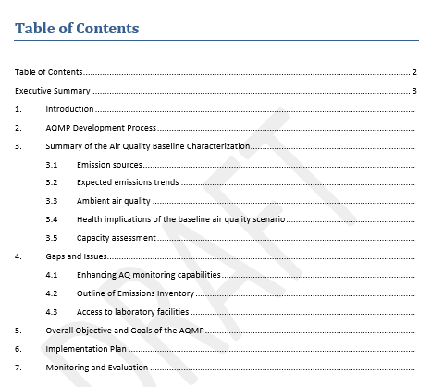
Air Quality Management Plan (AQMP) Framework

Slide 11
Chapter 1: Introduction
Reviews the authority that organizations have to set air quality standards and implement air quality plans
Should provide a brief statement on why action is needed, such as:
  “Current conditions present an unacceptable health burden for [YOUR CITY]’s population and are not in line with international (WHO) standards for air quality.”
  “The health burden has clear economic implications for [YOUR CITY], limiting healthy time that could be available for working or schooling, and presenting a direct cost for respiratory health treatments.”
  “Without action, economic growth will lead to emissions growth in the vehicle, industrial, and household waste burning sectors, which will worsen air quality.”

Slide 12
Chapter 2: AQMP Development Process
Outlines the major steps taken to complete the plan:
  Section on development of the focus for source-specific emissions standards and ambient concentration standards
  Should reference any stakeholder engagement (even within the government) that has occurred already
  Summarize the status of the monitor or model information on which analytic work is based
  List the analytic steps in prospectively assessing the effectiveness of future emissions reduction measures

Slide 13
Chapter 3: AQ Baseline
Summarize analytic work on emissions sources and ambient air quality
Good place to summarize the work completed to date on:
  AQ monitoring
  Estimated health impacts
  Source attribution, to be updated with new results when available
Review anticipated future growth in emissions from key sources, accounting for any known or anticipated changes in key emission sectors

Slide 14
Forecasting Future AQ Baseline
EPA Second Prospective Study Figure 1-1
Notes:
Retrospective analysis:
Can look at the reduction in emissions from a certain policy being implemented such as the Clean Air Act (CAA), and compare it to how emissions would have been expected to be in a business-as-usual scenario​
Area A is the total emissions avoided ​
Prospective analysis: ​
By projecting how emissions would change in a business-as-usual scenario and comparing it to the projected emissions with a policy implemented, we can see the benefits of a potential policy ​
Area B+C is total emissions to be avoided with CAA​
​

Slide 15
Chapter 4: Gaps and Issues
Good place to identify needs for evaluating and improving emissions and AQ standards in the near future:
  Enhancing AQ monitoring (type and location of new monitors)
  Data management system
  Access to laboratory for speciation, capacity building for source attribution
  Gaps in implementing a “bottom-up” capability (for example, an emissions inventory)

Slide 16
Chapter 4: Gaps and Issues
Bottom-up approach shown at left, allows for simulation of effect of source controls
Look to identify data collection and enhancements needed to implement a bottom-up approach in the long term, as the plan is reviewed and refined

Slide 17
Chapter 5: Overall Objective of AQMP
If not covered in first chapters, can state objective here
Needs to be agreed to by all partners/stakeholders
Example from Waterberg AQMP:
“Ambient air quality in the Waterberg Bojanala Priority Area is brought into full compliance with national ambient air quality standards by 2020 and the state is maintained as the region develops.”

Slide 18
Chapter 6: Specific Goals of AQMP
Very important to state goals as prerequisite for implementation plan/roles and responsibilities
Also needs to be agreed to by all partners/stakeholders
Examples from Waterberg AQMP:
  “Cooperative governance in the WBPA promotes the implementation of the AQMP.”
  “Air quality management in the WBPA is supported by effective systems and tools.”
  “Ambient concentrations of air pollutants comply with the NAAQS in the WBPA as a result of emission reductions.”
  Air quality decision making in the WBPA is informed by sound research.
  Knowledge and the understanding of air quality amongst stakeholders in the WBPA is enhanced.

Slide 19
Chapter 7: Implementation Plan
Should reflect an investment in the process of standard setting, implementation, and enforcement across multiple institutions
At minimum, need representatives from:
  Federal Ministries (Environment, Energy, Health, and Transport)
  Mayor’s office and agencies
  Also requires outreach to regulated entities
Advisory Committee provides a forum for gaining commitment of governmental stakeholders

Slide 20
Chapter 7: Implementation Plan
1. Begin with stated goals
2. Outline individual objectives necessary to reach goals
3. Identify main and participatory partners
4. Proposed timeframe for completion
5. Identify indicators of success

Slide 21
Chapter 7: Implementation Plan Example, Waterberg
Goal 3: Ambient concentrations of air pollutants comply with the NAAQS in the WBPA as a result of emission reductions
Objectives | Activities | Mandatory Responsibility | Participatory Responsibility | Time-frames | Indicators
Emission from Listed Activities are reduced in the WBPA | Assess the cumulative impact and develop emission reduction plans for new Listed Activities that ensure the NAAQS are not exceeded as a result of the new development using standard emission inventory data | Industry representative, Licensing Authorities | LEDET AQO, NWDACE AQO, WDM AQO, BDM AQO | On-going | AQIAs include cumulative assessments and emission reduction plans using standard emission inventory data
Particulate emissions from mining in WBPA are reduced | In areas of the WBPA where there is non-compliance with NAAQS as a result of emissions from mining, implement and regulate more effective dust control measures | Mine representatives | LEDET AQO, NWDACE AQO, WDM AQO, BDM AQO | 1 to 12 month then on-going | Amended dust emission reduction plans

Slide 22
Chapter 8: Monitoring, Evaluation, and Review
“Monitoring” refers not just to AQ monitors, but monitoring progress in implementing the plan
Provides accountability and transparency
Should assure stakeholders that the plan can be responsive to changing conditions, such as:
  faster or slower growth in emissions rates
  air pollutant exposures
  the economy
  analyses that shed new light on priority emission sources
  changes in availability of financing

Slide 23
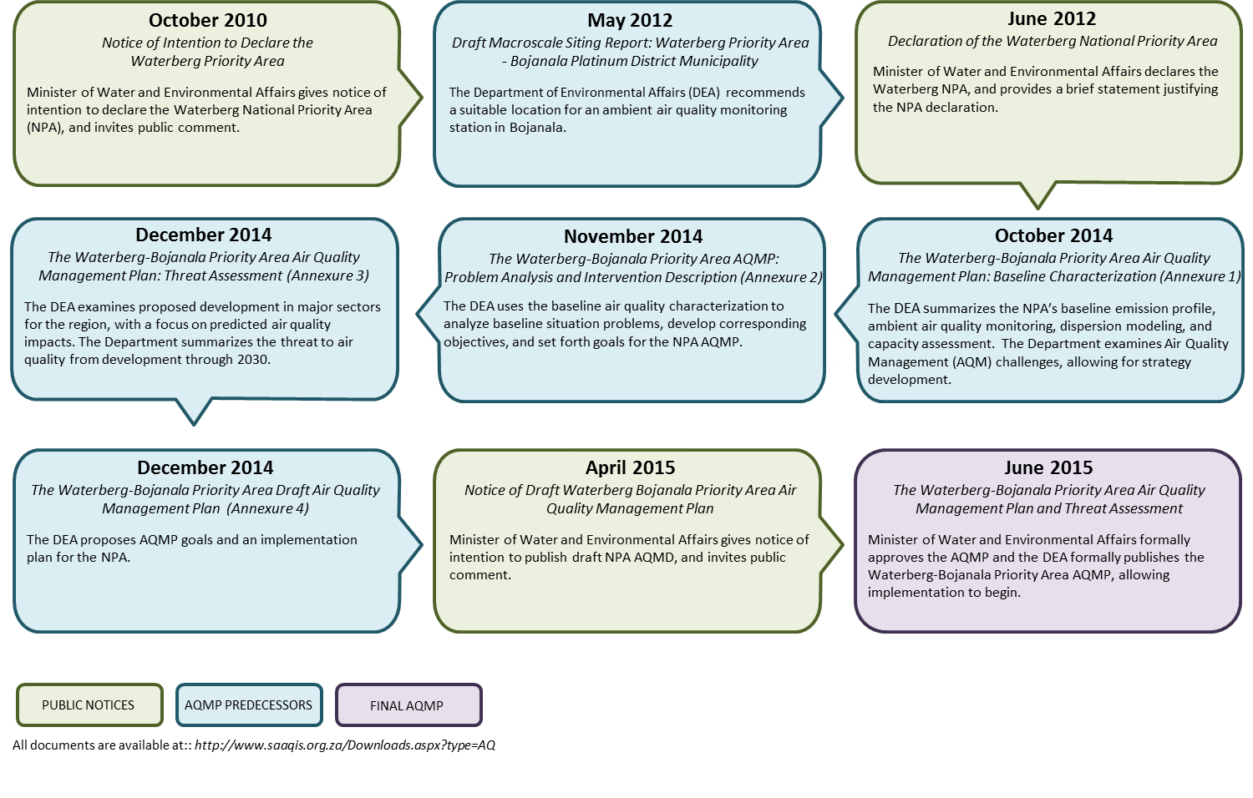
AQMP Process Example: South Africa
http://www.saaqis.org/za/Downloads.aspx?type=AQ
Notes:
The AQMP process can take many years to make it around just one time (in this case, 2010-2015)
This specific process includes time for public comment, examination of proposed development and air quality impacts, analysis of the baseline air quality characteristics, strategy development and AQMP goals, and then the publishing of the final AQMP, allowing implementation to begin

Slide 24
Section 3: Challenges
1. Introduction
2. Framework
3. Challenges
4. Mitigation Options
5. Additional Considerations
6. New Air Quality and Climate Management Plan

Slide 25
Challenges in Building an AQMP
Assessing the impact of both current air quality health burden, and changes to air pollutant concentrations and health under proposed air quality standards
Developing a process for identifying roles and responsibilities for all AQMP steps
Reaching agreement on the most urgent needs for capacity building, equipment, and technology
Notes:
Developing a Baseline Health Risk Assessment (a technical challenge) to be used in the AQMP
Internal and external communications strategy for the AQMP

Slide 26
Regulatory Challenges
Standards may need to be updated:
  Are ambient standards health-based?
  Do they address the pollutants of concern?
  Are they consistent with WHO guidelines?
Enforcement and compliance may be weak:
  Is it clear which agencies are responsible for enforcement?
  Do institutions have the right equipment to measure compliance?
Legal authority may be inadequate:
  Are goals and objectives for clean air established in law?
  Does the law provide a process to resolve conflicts between economic development and clean air?

Slide 27
Technical Challenges
Understanding of health and economic implications of air pollution may be incomplete:
  Do air pollution control institutions have capacity to assess health risks?
  Can these institutions make a business case for clean air?
Required data may be unavailable:
  Is there an emission inventory?
  Is monitor data accessible?
  Is there a data management plan and system?
Equipment may be lacking:
  Can emissions levels for mobile and stationary sources be tested with modern equipment?
  Is emissions control technology available?

Slide 28
Financial Challenges
Is there adequate funding for AQM staff?
Is there a capital and maintenance plan for AQ monitoring equipment and/or sensors?
Do institutions have the capacity to access a data management system (including AQ measurements, emissions inventory, permitting data)?
Is there funding for continuous training and capacity building?
Can donors identify capacity and technology gaps to assist in financing AQM goals?

Slide 29
Section 4: Mitigation Options
1. Introduction
2. Framework
3. Challenges
4. Mitigation Options
5. Additional Considerations
6. New Air Quality and Climate Management Plan

Slide 30
Example Mitigation Options
Vehicles
Vehicle emission standards and inspection program
Vehicle import limits or taxes, especially used vehicles
Fuels
Clean diesel standards
Low-sulphur fuel
Fuel import standards
Transport systems
Safe walking and cycling
Public transport systems enhancements
Parking policies
Small Industrial Sources
Improved compliance for existing industrial standards

Slide 31
Example Mitigation Options (cont’d)
Energy Sector
Renewable electricity generation
Genset standards and regulations
Construction Industry
Dust control measures, e.g., water sprinkling
Building materials and debris recycling and disposal
Open waste burning
Ban curb burning, with improved waste collection
Composting and waste sorting strategies
Household fuel burning
Stove replacement
Incentivize cleaner fuels

Slide 32
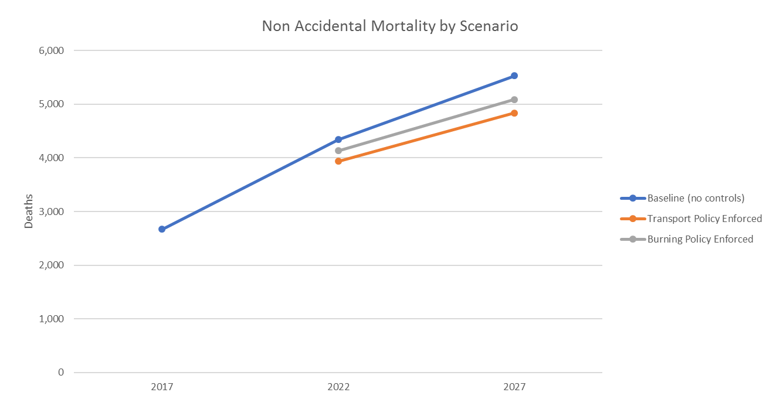
Health Impacts from Mitigation Policy
Example from Addis Ababa:
Notes:
This figure shows the non-accidental mortality in Addis Ababa, comparing the baseline (no controls), with an enforced transport policy, and with an enforced burning policy. We can see that the transport policy decreases mortality the most.

Slide 33
Section 5: Additional Considerations
1. Introduction
2. Framework
3. Challenges
4. Mitigation Options
5. Additional Considerations
6. New Air Quality and Climate Management Plan

Slide 34
Building a “Business Case” for the AQMP
What does it mean to create a “business case”?
  From South Coast Air Quality Management District:
  “A business case could exist where a technology, fuel, or other strategy reduces emissions and also improves energy efficiency, reduces fuel or maintenance costs, creates new job opportunities, or has other cost savings and economic benefits.”
Examples:
  In transport sector, fuel efficiency savings can be enough to justify moving to newer vehicles
  In stationary source sector, industry can be motivated by funding incentives and/or permitting flexibility for low emitting technologies

Slide 35
Compliance and Enforcement Responsibilities
Will a regulatory program be necessary for AQMP implementation?
Which government ministry, department or agency will be responsible for developing and implementing the regulatory program?
    Legal mandate: Federal/State/City?
    Formulation of policy/legislation/standards/guidelines?
    Coordination and supervision?
    Compliance monitoring and enforcement?
Notes:
Will there be a legal mandate? On what level will it be enforced?
Will there be the formulation of legislation, standards, or will there only be guidelines?
How will there be coordination and supervision of the standards?
How will it be known that compliance is required?

Slide 36
Instrument Choice/Regulatory Responses
Voluntary
Economic/Market-Based
Mandatory
Public education
Emissions fees
Establish technology /performance standards
Issue permits/licenses to operate
Require monitoring of environmental releases or impacts on the ambient environment
Require reporting of accidents
Establish responsibility for clean up of contamination and compensation of victims
Technical assistance awards
Tax incentives/subsidies
Tax incentives
Subsidies
Tradable permits
Emission offsets

Slide 37
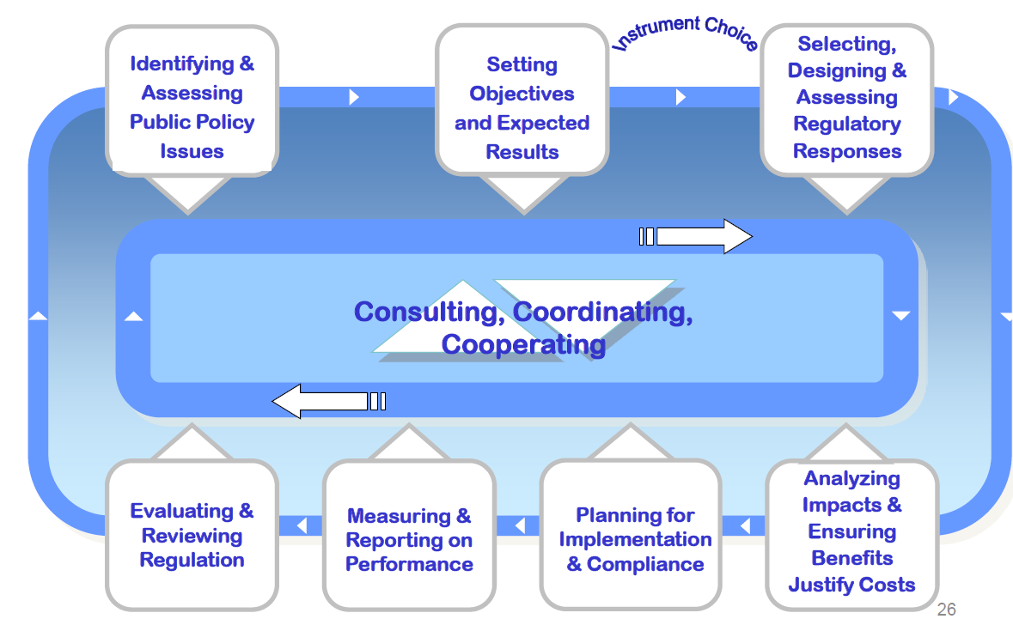
Developing Regulatory Program for AQMP Implementation
Notes:
Developing a regulatory program for AQMP implementation is a continuous cycle. It can start with identifying issues, setting objectives, and then choosing an instrument for regulatory response. Analysis of the policy choice can include benefit-cost analysis to justify the decision. Next comes planning for implementation and compliance, then measuring and reporting on performance. Finally, the regulation requires evaluation and review, which moves into the identification of policy issues once again.

Slide 38
Instrument Choice/Regulatory Responses
Some considerations for choice of instrument/management approach:
  What is the solution to the issue?
  What instrument/management approach will be used to apply the solution?
  Analysis of costs, benefits and impacts:
    What resources will be required to apply the chosen instrument/management approach?
    Is the chosen instrument/management approach financially viable, socially acceptable and technically feasible?
    Will the chosen instrument/management approach yield long term impacts?

Slide 39
Regional Cooperation in AQM
Build flexibility and capacity-building to create a level playing field
Use compliance monitoring and oversight
Use standardized methodologies across regions and countries
The science-policy exchange is a two-way street
Build a strong expert network
Develop methods to exchange and share regional/national data

Slide 40
Section 6: New Air Quality and Climate Management Plan
1. Introduction
2. Framework
3. Challenges
4. Mitigation Options
5. Additional Considerations
6. New Air Quality and Climate Management Plan

Slide 41
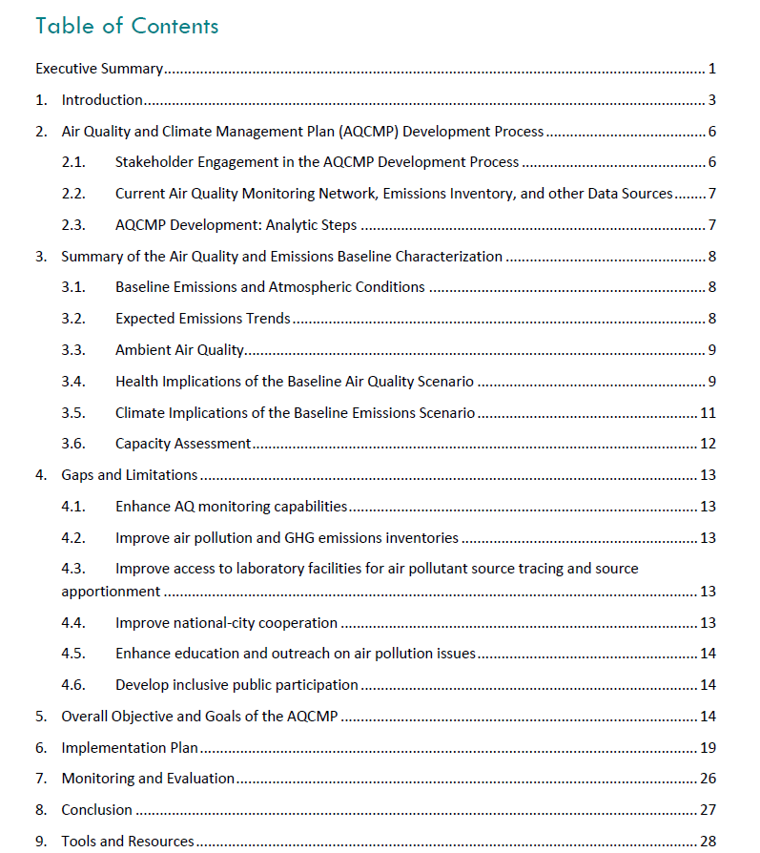
Integrated Air Quality and Climate Management Plan (AQCMP) Framework
Notes:
The Megacities program has developed a new integrated air quality and climate management framework, which incorporates considerations of climate change mitigation throughout the original AQMP structure. In particular, this includes references to additional tools and resources for considering climate impacts in the plan.

Slide 42
Integrated Air Quality and Climate Management Plan (AQCMP)
Incorporates both air quality and climate change mitigation planning
  focus on short-lived climate pollutants (SLCPs)
Centerpiece objective in the new plan suggests incorporating a climate lens, such as:
“The city halves carbon emissions by 2035, as ambient particulate air quality is brought into full compliance with national standards and the state of compliance is maintained with economic development in the region”
Notes:
The new template incorporates both air quality and climate change mitigation planning, with a focus on major overlapping pollutants such as short-lived climate pollutants (SLCPs).

Slide 43
Resources Included in AQCMP
Call-out boxes with supporting information throughout template
  Introductory climate change concepts
  Intersections between air quality and climate
  Mitigation actions to target major air and climate pollutants
List and description of tools and resources
  Health benefits estimators, emissions estimators, and measure decision support tools
  Additional integrated planning frameworks
  Examples of integrated plans from other cities or countries

Slide 44
Thank you!

