Slide 1
DELETE THIS SLIDE PRIOR TO PRESENTATION
This PowerPoint serves as a template presentation which introduces topics related to air quality and is part of a suite of presentations provided by the EPA for the Megacities program.
See speaker notes for an additional description of slide content. Slides should be edited or added to as necessary for your particular needs. Slides with highlighted yellow text require the addition of specific context and information for your city.

Slide 2
Estimating Costs of Emissions Controls and Mitigation Strategies

Slide 3
Overview
1. Introduction
2. Cost Estimates
3. Sources and Tools
4. Advanced Topics

Slide 4
Section 1: Introduction
1. Introduction
2. Cost Estimates
3. Sources and Tools
4. Advanced Topics

Slide 5
Why conduct cost analysis?
  To make informed air quality policy decisions, information on control strategies and their associated costs are necessary
  Many sector- and technology-specific costs exist
    Unit costs
    Costs based on optimization models
  Note that technology adoption may interact with cost in the longer-term
    Learning effect
    Technological change

Slide 6
Costs are connected to emissions sources
Emissions sources can include:
  Mobile sources, e.g., trucks, cars, trains
  Point sources, e.g., industry and factories
  Indoor air pollution from fuel burning
  Unpaved road dust
The Megacities Partnership focuses on ambient air pollution

Slide 7
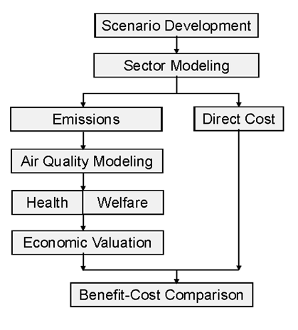
Benefit-Cost Assessment for Air Pollution
Direct costs are estimated in parallel with emissions estimates
Cost can then be compared with “monetized” benefits of air pollution control

Slide 8
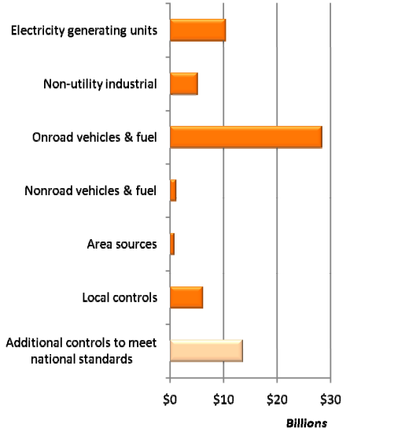
Example Results: Direct Costs of U.S. Clean Air Act
EPA, The Benefits and Costs of the Clean Air Act from 1990 to 2020: Summary Report. (2011)
Notes:
Electric utility emissions reductions were large, but costs were lower because of emissions trading plan.
Vehicles regulation is more decentralized – hence more expensive – but that is not a general result.
NAAQS controls are those implemented after all the national level rules are fully implemented – so they are almost by definition the most costly per ton of emissions controlled.

Slide 9
Example: Santiago Megacity Retrospective Benefit-Cost Analysis
Sector-specific implementation costs, 1990-2020

Slide 10
Section 2: Cost Estimates
1. Introduction
2. Cost Estimates
3. Sources and Tools
4. Advanced Topics

Slide 11
Cost Estimates for Point and Area Sources
  Generally reported as:
    Costs per unit associated with a specific control measure
    Cost per ton of pollutant emission reduced
  Estimates based on:
    Purchased equipment costs
    Direct installation costs
    Costs for site preparation and buildings
    Indirect installation costs (e.g., engineering costs, contractor fees)

Slide 12
Pollutant Reduction Measures and Costs in LEAP Model: Bangladesh
Source Sector | Measure | Target: Policy Scenario 1 | Target: Policy Scenario 2
Residential | Replacing traditional biomass cookstoves with improved biomass cookstoves | 100% replacement of traditional stoves with improved stoves by 2030 | -
Waste | Reduce open burning of waste | - | Eliminate open burning of MSW by 2050 by either constructing landfills to accommodate solid waste or treating solid waste through composting/recycling/anaerobic digestion
Industry | Replace traditional brick kilns with improved brick kilns | 100% conversion of traditional kilns to improved kilns by 2030 | -
Industry | Replace traditional rice parboiling units with improved units | 100% replacement by 2050 | -
Agriculture | Reduce crop residue burning in fields | - | 100% reduction of open crop burning by 2050
Agriculture | Intermittent wetting and drying for rice cultivation | 20% more land area used for rice cultivation adopts AWD technology | 100% conversion of continuously flooded rice to AWD technology by 2050
Transport | Eliminate high emitting vehicles | 100% conversion of gasoline vehicles to CNG by 2050 Phase out Pre-Euro diesel vehicles | -
Kuylenstierna et al., 2020

Slide 13
Cost Estimates for Mobile Sources
  Generally reported as:
    Costs per unit associated with a specific control measure
    Cost per ton of pollutant emission reduced
    Cost per gallon for fuel standards
  Unit costs associated with tailpipe controls, operating refinements, evaporative emissions controls, or engine modifications that usually apply only to new vehicles
  Costs associated with fuel requirements take effect across entire fleet

Slide 14
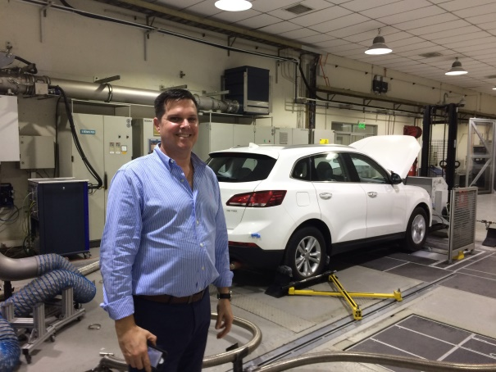

Example: Cost Estimates for Santiago Megacity Analysis
Emissions Standard | LIGHT DUTY gasoline vEHICLES (icct 2012) | LIGHT DUTY Diesel Vehicles (ICCT 2012) | Heavy Duty vEHICLES (ICct 2016) | motorcycleS (lat 2005)
No Standard → EURO I | $156 | $62 | $469* | $31**
EURO I → EURO II | $69 | $92 | $469* | $100**
EURO II → EURO III | $134 | $371 | $469 | $141**
EURO III → EURO IV | $28 | $160 | $4,151 | -
EURO IV → EURO V | $11 | $337 | $506 | -
EURO V → EURO VI | - | $518 | $2,510 | -
Notes: All costs are summarized in 2016 USD. Values converted using 2016 Purchasing Power Parity values and country-specific inflation. LD = Light Duty. HD = Heavy Duty. * Incremental costs to comply with EURO I and EURO II standards for heavy duty vehicles are assumed to be equal to the incremental cost of reaching EURO III. ** Incremental costs from LAT (2005) are assumed to be equal to the midpoint of the ranges provided by the authors.
EPA staff participating in emissions testing

Slide 15
Section 3: Sources and Tools
1. Introduction
2. Cost Estimates
3. Sources and Tools
4. Advanced Topics

Slide 16
Unit Cost Sources and Tools
  USEPA’s Control Strategy Tool (CoST)
      Models emissions reductions and costs associated with control strategies applied to point, area, and mobile sources
      Contains the Control Measure Database (CMDB), which has information on control efficiencies and costs for criteria pollutants
  USEPA’s Control Cost Manual
  Provides guidance for development of costs for air pollution control devices
  Focuses on point and stationary area source pollution controls for VOCs, PM, NO_{X}, and some acid gases (primarily SO₂ and HCl)

Slide 17
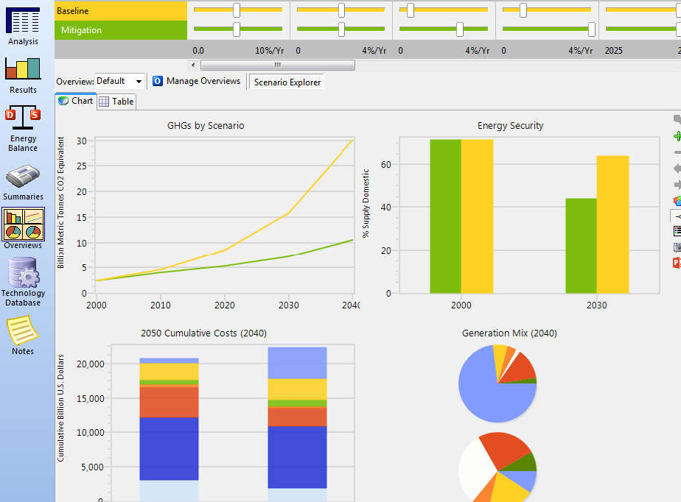
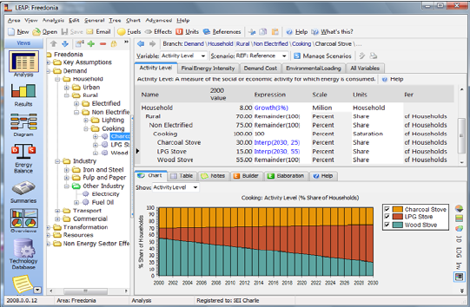
Long-Range Energy Alternatives Planning Tool (LEAP)
https://leap.sei.org/
Notes:
The LEAP tool is used for energy policy analysis and climate change mitigation assessment. It was developed by the Stockholm Environment Institute. LEAP is a scenario-based modeling tool that can account from greenhouse gas emission sources and sinks, as well as local and regional air pollutants.

Slide 18

Black Carbon Mitigation Measures Considered in LEAP
Measure to reduce radiative forcing from short-lived substances
Diesel particle filters as part of a Euro 6/VI package for road and off-road diesel vehicles
Replacing coal by coal briquettes in cooking and heating stoves
Introduction of clean-burning biomass stoves for cooking and heating
Replacing traditional brick kilns with vertical shaft kilns and Hoffman kilns
Substitution of clean-burning cook stoves using modern fuels for traditional biomass cook stoves
https://wedocs.unep.org/20.500.11822/8028

Slide 19
Section 4: Advanced Topics
1. Introduction
2. Cost Estimates
3. Sources and Tools
4. Advanced Topics

Slide 20
Costs (and benefits) can extend beyond direct impacts of the policy.

Slide 21
Economy-Wide Effects
Direct costs: costs first incurred by the industry, resident, or entity required to control air pollutant emissions
Direct costs can change behavior as well, such as changes in employment, GDP, prices, and other economic metrics
A complex macro-model can be used to estimate these “secondary” effects of direct costs
Notes:
Like taxes, direct costs can change behavior – so the ultimate cost to the economy might be different than the sum of the direct costs
So direct costs can lead to changes in employment, GDP, prices, and other economic metrics
Example: A tax placed on gasoline can have economic ramifications beyond the increased costs to individuals; individuals may then decide to stay at home more often to save money, reducing GDP

Slide 22
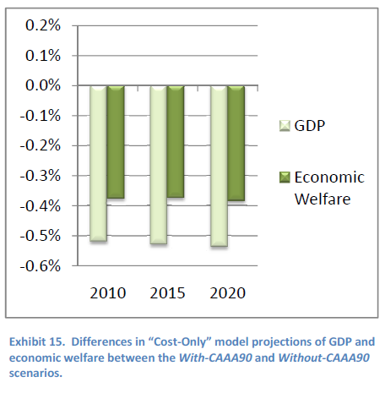
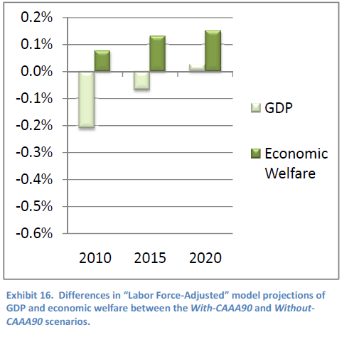
Considering Costs and Benefits in Economy-Wide Modeling
Costs alone: GDP and welfare decline
Costs and benefits together: GDP and welfare increase
EPA, The Benefits and Costs of the Clean Air Act from 1990 to 2020: Summary Report (2011)

Slide 23
Resources
  CoST – https://www.epa.gov/economic-and-cost-analysis-air-pollution-regulations
  USEPA’s Control Cost Manual – https://www.epa.gov/economic-and-cost-analysis-air-pollution-regulations/cost-reports-and-guidance-air-pollution#cost manual
  LEAP - https://leap.sei.org/
  Learning Effect Papers
    Edward S. Rubin, Sonia Yeh, David A. Hounshell, and Margaret Taylor. "Experience curves for power plan emission control technologies," International Journal of Energy Technology and Policy, Vol. 2, Nos. 1/2, 2004.
    EPA, Science Advisory Board, Advisory Council for Clean Air Compliance Analysis, "Benefits and Costs of Clean Air Act – Direct Costs and Uncertainty Analysis", EPA-SAB-COUNCIL-ADV-07-002, Advisory Letter, June 8, 2007. Available at http://www.epa.gov/sab/pdf/council-07-002.pdf.

Slide 24
Thank you!

