Slide 1
DELETE THIS SLIDE PRIOR TO PRESENTATION
This PowerPoint serves as a template presentation which introduces topics related to air quality and is part of a suite of presentations provided by the EPA for the Megacities program.
See speaker notes for an additional description of slide content. Slides should be edited or added to as necessary for your particular needs. Slides with highlighted yellow text require the addition of specific context and information for your city.

Slide 2
Communication Planning

Slide 3
Air Quality Management Planning
Public Participation
Public Participation
Air Quality Goal Setting
Air Pollution Control Strategies
Air Quality Monitoring
Impacts of Air Quality
Legislation, Regulation, and Implementation
Air Quality Modeling
Emissions Inventory
Compliance and Enforcement
Human and Environmental Assessment
Air Quality Data
Notes:
Focus on communication with the public to convey technical information, goals, and future plans

Slide 4
Overview
1. Communication Goals
2. Use of Media
3. Technical Results
4. Key Audiences
5. Public Involvement and Engagement
6. Roles and Responsibilities
7. Communication Materials
8. Evaluation

Slide 5
Section 1: Communication Goals
1. Communication Goals
2. Use of Media
3. Technical Results
4. Key Audiences
5. Public Involvement and Engagement
6. Roles and Responsibilities
7. Communication Materials
8. Evaluation

Slide 6
What do you want to achieve?
  Attitude change (e.g., public support)
  Generate support for program development (e.g., adoption of mitigation strategy)
  Behavior change (e.g., adopt cleaner cookstoves and cease operation of old, dirtier cookstoves)
Choose
SMART Goals
Specific
Measurable
Attainable
Realistic
Time-based

Slide 7
Communication Goals
Learn about your audience(s)
Work to build trust and credibility
Implement effective dialogue
Create and deliver effective messages
Evaluate the effectiveness of your communication

Slide 8
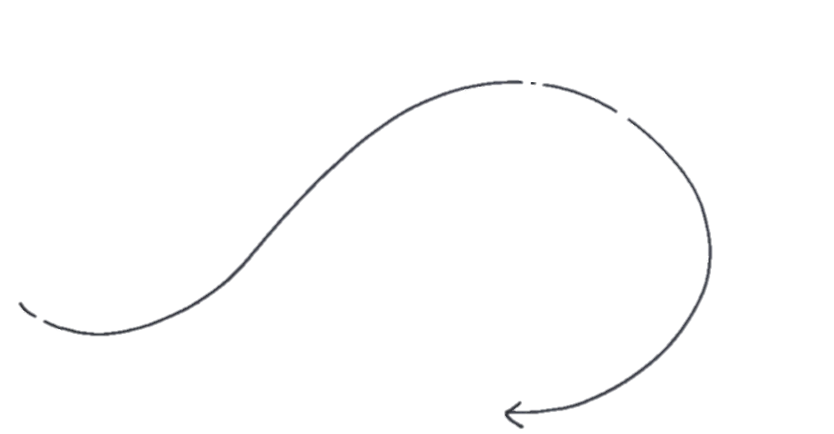








Steps in Communication Planning
Consider the Audience
Solicit Feedback
Incorporate Lessons Learned
Set Goals
Provide Context
Establish Trust
Leverage Existing Knowledge
Provide Toolkits, Case Studies and Templates
https://reefresilience.org/communication/communication-planning-process/
Notes:
Communication planning starts with leveraging existing knowledge and considering set goals. When seeking to communicate plans, especially with technical information, it is important to consider the audience (to potentially pare down jargon and technical details), provide relevant context, and establish trust.
It is important to include public engagement throughout the process, soliciting feedback and incorporating it into plans (or acknowledging why certain input was not incorporated).

Slide 9




Understand What You Will Communicate
What are you planning to do?
Why are you proposing this?
What effect will it have?
Who will it affect?
How much will it cost/save?
How long will it take?

Slide 10
Establishing Trust and Credibility
Third party validation
Demonstrating supporting characteristics
Caring
Honesty
Organizational credibility
Consistency
Accessibility
Competence
Dedication
Strong track record
From credible sources
Notes:
It is important to establish trust with the broader public when implementing new policies and measures. A few strategies here include seeking third-party validation, embodying key characteristics in your work, and upholding organizational credibility.

Slide 11
Section 2: Use of Media
1. Communication Goals
2. Use of Media
3. Technical Results
4. Key Audiences
5. Public Involvement and Engagement
6. Roles and Responsibilities
7. Communication Materials
8. Evaluation

Slide 12
Use of Media
What are trusted sources of information used by your key audiences?
What media tools are available?
Notes:
What are trusted sources of information used by your key audiences?
What media tools are available?
Traditional print and broadcast
Web based and social media
Mobile technology
Different media tools can be used for different audiences

Slide 13
Section 3: Technical Results
1. Communication Goals
2. Use of Media
3. Technical Results
4. Key Audiences
5. Public Involvement and Engagement
6. Roles and Responsibilities
7. Communication Materials
8. Evaluation

Slide 14
Communicating Technical Results
Factual
Short
Simple
Relevant
Respectful
Limit acronyms; use ordinary words
Similar to “results” section of analytical report; avoid “spin”
Actions relevant to stakeholder

Slide 15
Data Visualization
Goal: Present accurate information so users may understand and use for decision making
Facilitate the communication of multi-dimensional risk information
Must be part of broader risk communication strategy
  Consider uncertainty in information being represented

Slide 16
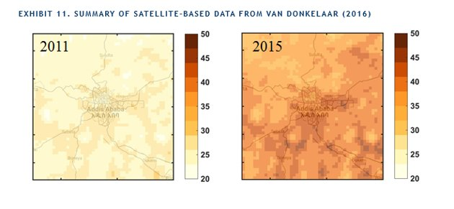
Example: Explaining Complex Concepts
Van Donkelaar, 2016
Notes:
This is an example of a bad title for these images.
The images show annual 24-hour PM2.5 concentrations (ranging from 20-50 ug/m3) across Addis Ababa, as determined based on satellite estimates from van Donkelaar 2016. The figures show the change over time between 2011 and 2015.
What is a better title that could be used, other than what is included in Exhibit 11?

Slide 17
Section 4: Key Audiences
1. Communication Goals
2. Use of Media
3. Technical Results
4. Key Audiences
5. Public Involvement and Engagement
6. Roles and Responsibilities
7. Communication Materials
8. Evaluation

Slide 18
Identify Your Audiences
Who will benefit from knowing this information?
Who can benefit from actions your agency may take?
Who can help advocate for the programs you want to implement?
Who may bear costs for the program?
Who else may be affected?
Who could stop the project from being successful?
Who are internal and external target groups?
Notes:
The audience may be everyone or be composed of subgroups
Questions to ask in identifying audiences

Slide 19
Developing Messages for Different Audiences
Simple
Translate complex concepts
Easy to explain, easy to understand
Limited
Combine ideas into themes
Too many concepts can be confusing
Consistent
Target information but avoid conflicting information
Via different venues or media
Repeated often
By different people, to different audiences

Slide 20
Key Messaging Considerations
Timeline
Goals
Program design
Public involvement
Impact
Notes:
What the program is and what it is not
Why the program is necessary
How it will affect the public
What will happen in the short term and long term
How the program will bring changes to current status quo
What the government’s responsibility will be in the new program
What the timeline of the project will be and when changes will take effect
What will happen if outlined goals are not achieved
How the public will know if the program has been successful
What actions the public is being asked to take

Slide 21
Section 5: Public Involvement and Engagement
1. Communication Goals
2. Use of Media
3. Technical Results
4. Key Audiences
5. Public Involvement and Engagement
6. Roles and Responsibilities
7. Communication Materials
8. Evaluation

Slide 22
Public Involvement and Engagement
Advisory committees and task forces
Public and informal meetings
Build consensus and trust
Open Houses
Build trust and share information
Moderate emotions
Workshops
Share technical details

Slide 23
International Standards for Public Participation
Rio Declaration, 1992
Bali Guidelines
Multi-lateral agreements
  AARHUS Convention (1998)
  Malmo Declaration (2000)
  Inter-American Strategy for the Promotion of Public Participation in Sustainable Development in Decision-Making (2001)

Slide 24
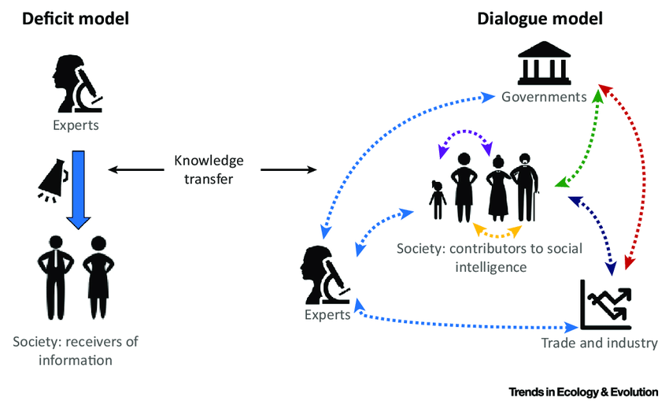
Deficit Model to Dialogue Model
Adapted from Courchamp et al., 2017
Notes:
This figure depicts a shift needed in science communication. The standard deficit model of communication is a one-way flow between experts telling information, and members of society receiving information, which assumes that the public simply needs more information to be convinced of a certain idea or concept.
A dialogue model is based on an interchange with the public and different stakeholders on benefits, drawbacks, and costs, using public engagement as a basis. It acknowledges differences in values, perspectives, and knowledge, and that more communication between different groups is needed to come to a consensus, rather than a one-way flow of information from “experts”.

Slide 25
Reasons for Public Involvement
Increases community ownership and compliance
Perceived as a fairer process
Reduces litigation
Addresses misunderstandings
Addresses social and economic needs of affected parties – allows them to “vent”
Fosters better relationships and builds partnerships
Expands your skill base and produces more creative solutions
Reality and practicality check
Technically superior options
Better environmental outcomes!

Slide 26
Principles of Public Involvement
Respond to needs and priorities of the public
Increase public understanding
Increase legitimacy and accountability
Communicate how public input affects the decision
Notes:
People should have a say in decisions that affect their lives
Includes the promise that the public’s contribution will influence decisions
Communicate the interests of the participants and meet their process needs
Seek out and involve those potentially affected
Participants help define how they participate
Provide participants with the information needed to participate in a meaningful way
Communicate to participants how their input affected the decision

Slide 27
Steps for Effective Public Involvement
Assess
Plan and budget
Design
Engage
Evaluate
Identify interested parties and key issues
Provide technical/financial assistance
Meeting design, desired outputs, logistics and materials
Ground rules
Build trust through experienced, reliable, and authentic messengers
Conduct public consultation
Review, use input, and provide feedback
Evaluate public involvement activities

Slide 28
Section 6: Roles and Responsibilities
1. Communication Goals
2. Use of Media
3. Technical Results
4. Key Audiences
5. Public Involvement and Engagement
6. Roles and Responsibilities
7. Communication Materials
8. Evaluation

Slide 29
Roles and Responsibilities
Messaging starts at the top
Press and communication staff
Technical staff
Leaders work with staff to develop key goals and objectives
Develop plan, messages, materials
Keep schedule
Provide robust technical and policy decisions
Review messages for accuracy
Available to answer detailed questions
Budget
Plan for material printing, airtime, web development
Integral to all action development budgets
Includes resources for public participation

Slide 30
Section 7: Communication Materials
1. Communication Goals
2. Use of Media
3. Technical Results
4. Key Audiences
5. Public Involvement and Engagement
6. Roles and Responsibilities
7. Communication Materials
8. Evaluation

Slide 31
Communications Materials
Basic Materials | Additional Materials
Communications plan Fact Sheet Web Posting Training | Advance Outreach Press Announcement Call List Questions and Answers Talking Points Additional Fact Sheets Stakeholder Calls Public Hearings
Notes:
Most projects will only require basic materials
Depending on the project, additional materials may be needed

Slide 32
Written Communication Plan
Summary of Action
Statement with key messages
Stakeholders
Schedule
Materials
Roles
Notes:
Summary of Action: What is being done?
Summary background information as needed
Potential questions and answers
Statement with key messages: 3-4 messages
Stakeholders – Who needs to know what is happening?
Schedule: What are the short-term and long-term deadlines?
What events are available or need to be planned to help get the message out?
Materials: What materials need to be developed?
Varies on the extent of the action
Roles: Who is responsible for which communications?
Key Contacts for content and communications

Slide 33
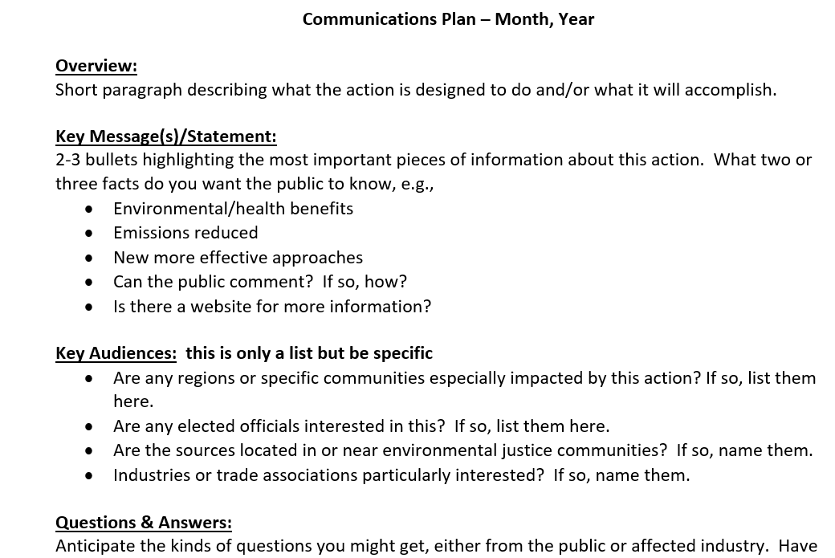
Communications Plan
Notes:
v

Slide 34
Section 8: Evaluation
1. Communication goals
2. Use of Media
3. Technical Results
4. Key Audiences
5. Public Involvement and Engagement
6. Roles and Responsibilities
7. Communication Materials
8. Evaluation

Slide 35
Evaluation
Evaluate your communication
  How was the message received?
  Did you reach your intended audiences?
  Did the message create your desired goal (e.g., behavior change)?
  Were there any unintended consequences of the communication?

Slide 36
Additional Resources
EPA resources
  Particulate Matter web course for healthcare professionals (https://www.epa.gov/pmcourse)
  Wildfire smoke course for healthcare professionals (https://www.epa.gove/wildfire-smoke-course)
  AirNow.gov: EPA’s flagship source for AQ data and more
    AirNow International
  Video tools to help the public understand low-cost air sensors
    Air Sensor PSA
    Air Sensors: Regulatory Data and Sensor Data Quality
    Air Sensors: Measurements and Your Health
    Air Sensors: Sources of Air Quality Information
  Public participation guide (https://www.epa.gov/internation-cooperation/public-participation-guide)

Slide 37
Additional Resources
Resources for public involvement
  International Association for Public Involvement
  The Access Initiative
  Implementing Principle 10 and the Bali Guidelines
  Southern African Institute for Environmental Assessment Handbook One Stop Participation Guide
  Aarhus Clearinghouse for Environmental Democracy

Slide 38
Thank you!

