Slide 1
DELETE THIS SLIDE PRIOR TO PRESENTATION
This PowerPoint serves as a template presentation which introduces topics related to air quality and is part of a suite of presentations provided by the EPA for the Megacities program.
See speaker notes for an additional description of slide content. Slides should be edited or added to as necessary for your particular needs. Slides with highlighted yellow text require the addition of specific context and information for your city.

Slide 2
Air Quality Index

Slide 3
Overview
1. Intro to AQI
2. AQI Communication
3. Calculating AQI
4. Source Data
5. Example

Slide 4
Section 1: Intro to AQI
1. Intro to AQI
2. AQI Communication
3. Calculating AQI
4. Source Data
5. Example

Slide 5
What is an Air Quality Index?
An Air Quality Index (AQI) is a communication device to convey to the general public air quality conditions in a standard framework
In the U.S., the EPA bases the AQI on five pollutants:
  ground-level ozone
  particulate matter (PM_{2.5} and PM₁₀)
  carbon monoxide
  nitrogen dioxide
  sulfur dioxide
Notes:
AQI is a communication device to convey to the general public air quality conditions in a standard framework: Transforms weighted values of individual air pollutants into a single, digestible number for the general public​
Typically, the reported AQI will be based on either PM_{2.5} or ozone, due to elevated air concentrations

Slide 6
Pollutants in the U.S. AQI
The U.S. EPA has set National Ambient Air Quality Standards (NAAQS) for six principal “criteria” pollutants
  Lead is not considered in the Air Quality Index because sampling occurs over weeks to months, rather than hours
  Criteria pollutants impact human health, and are emitted from numerous or diverse sources
  Regulated at the state or tribal government level
  Standards set without concern for economic cost
Hazardous air pollutants are not included in the AQI, but are regulated
  This list includes pollutants such as benzene, arsenic, cadmium, and nickel
  These pollutants are regulated through emissions standards for relevant industries

Slide 7
U.S. AQI Levels
Daily AQI Color | Levels of Concern | Values of Index | Description of Air Quality
Green | Good | 0 to 50 | Air quality is satisfactory, and air pollution poses little or no risk.
Yellow | Moderate | 51 to 100 | Air quality is acceptable. However, there may be a risk for some people, particularly those who are unusually sensitive to air pollution.
Orange | Unhealthy for Sensitive Groups | 101 to 150 | Members of sensitive groups may experience health effects. The general public is less likely to be affected.
Red | Unhealthy | 151 to 200 | Some members of the general public may experience health effects; members of sensitive groups may experience more serious health effects.
Purple | Very Unhealthy | 201 to 300 | Health alert: The risk of health effects is increased for everyone.
Maroon | Hazardous | 301 and higher | Health warning of emergency conditions: everyone is more likely to be affected.
AQI Basics | AirNow.gov

Slide 8
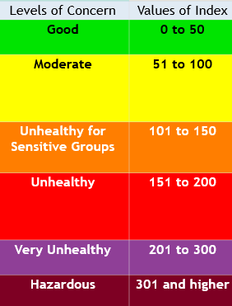
PM_{2.5} AQI Breakpoints
50: Annual Standard
(12 µg/m³)
100: Short-term Standard
(35 µg/m³)
Roughly consistent with Emergency Action Plans
500: Significant Harm Level
Notes:
AQI is a useful communication device, but what are the breakpoints based on? For each pollutant, breakpoints between values in the index are based on pollution standards. ​
Pollutant Standards Index (PSI); created in 1976

Slide 9
Section 2: AQI Communication
1. Intro to AQI
2. AQI Communication
3. Calculating AQI
4. Source Data
5. Example

Slide 10
Communication of AQI
In the U.S., Metropolitan Statistical Areas with populations of 350,000 are required to report the AQI daily to the general population
Forecasts are also generally available, but not required
Weather reporting often includes forecasts of AQI
https://www.airnow.gov/sites/default/files/2020-05/aqi-technical-assistance-document-sept2018.pdf

Slide 11
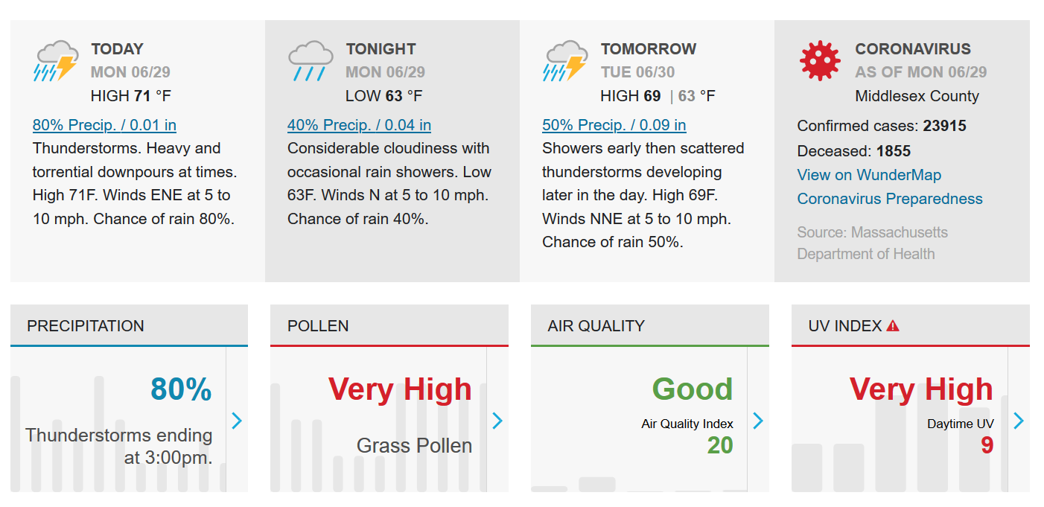
AQI in Weather Reporting
www.wunderground.com
Notes:
Example of a weather report with AQI included​

Slide 12
AQI in the U.S.
Calculated by pollutant
Based on pollutant-specific breakpoints
  Breakpoints are the highest and lowest pollutant concentrations for a given AQI category
The final value reported is the highest AQI value, with the associated responsible pollutant
Example:
8-hour ozone value of 0.07843 ppm
PM_{2.5} value of 35.927 µg/m³
CO value of 8.452 ppm

Slide 13
Section 3: Calculating AQI
1. Intro to AQI
2. AQI Communication
3. Calculating AQI
4. Source Data
5. Example

Slide 14
Calculating the AQI
Identify the highest concentration among all monitors within each reporting area and truncate as follows:
  Ozone (ppm) – truncate to 3 decimal places
  PM_{2.5} (µg/m³) – truncate to 1 decimal place
  PM₁₀ (µg/m³) – truncate to integer
  CO (ppm) – truncate to 1 decimal place
  SO₂ (ppb) – truncate to integer
  NO₂ (ppb) – truncate to integer
Example:
8-hour ozone value of 0.07843 ppm
= 0.078 ppm
PM_{2.5} value of 35.927 µg/m³
= 35.9 µg/m³
CO value of 8.452 ppm
= 8.4 ppm
Adapted from Technical Assistance Document for the Reporting of Daily Air Quality, EPA

Slide 15
Calculating the AQI
Example:
8-hour ozone value of 0.078 ppm
PM_{2.5} value of 35.9 µg/m³
CO value of 8.4 ppm
2. Find the two breakpoints that contain the pollutant concentration
 | Ozone (8-hour) | Ozone (1-hour) | PM_{2.5} (24-hr) | PM₁₀ (24-hr) | CO (8-hr) | SO₂ (1-hr) | NO₂ (1-hr)
Good (0 – 50) | 0 - 0.054 |  | 0 - 12.0 | 0 - 54 | 0 - 4.4 | 0 - 35 | 0.53
Moderate (51 – 100) | 0.055 - 0.070 |  | 12.1 - 35.4 | 55 - 154 | 4.5 - 9.4 | 36 - 75 | 54 - 100
Unhealthy for Sensitive Groups (101 – 150) | 0.071 - 0.085 | 0.125 - 0.164 | 35.5 - 55.4 | 155 - 254 | 9.5 - 12.4 | 76 - 185 | 101 - 380
Unhealthy (151 – 200) | 0.086 - 0.105 | 0.165 - 0.204 | 55.5 - 150.4 | 255 - 354 | 12.5 - 15.4 | 186 - 304 | 361 - 649
Very Unhealthy (201 – 300) | 0.106 - 0.200 | 0.205 - 0.404 | 150.5 - 250.4 | 355 - 424 | 15.5 – 30.4 | 305 - 604 (24-hr) | 650 - 1249
Hazardous (301 – 500) |  | 0.405 - 0.604 | 250.5 - 500.4 | 425 - 604 | 30.5 - 50.4 | 605 - 1004 (24-hr) | 1250 - 2049

Slide 16
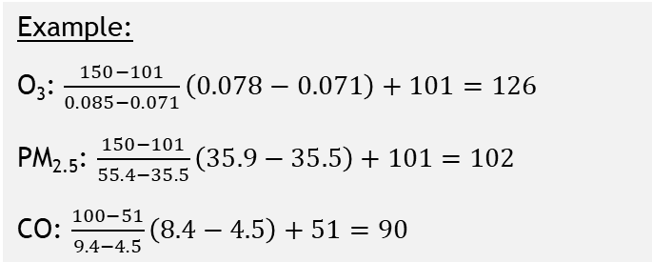
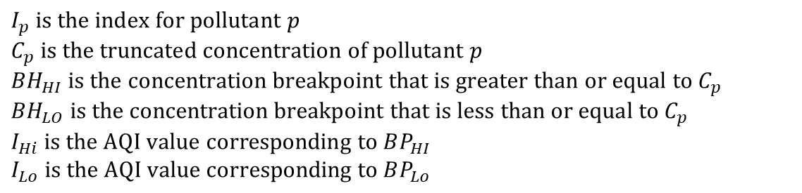
Calculating the AQI
3. Calculate the index using the standardizing index
$$I_{p}=\frac{I_{Hi}−I_{Lo}}{BP_{HI}−BP_{Lo}}\left(C_{p}−BP_{Lo}\right)+I_{Lo}$$
Where:
$$I_{p} is the index for pollutant p$$
$$C_{p} is the truncated concentration of pollutant p$$
$${BH}_{HI} is the concentration breakpoint that is greater than or equal to C_{p}$$
$${BH}_{LO} is the concentration breakpoint that is less than or equal to C_{p}$$
$$I_{Hi} is the AQI value corresponding to BP_{HI}$$
$$I_{Lo} is the AQI value corresponding to BP_{Lo}$$
Example:
O₃: $\frac{150−101}{0.085−0.071}\left(0.078−0.071\right)+101=126$
PM_{2.5}: $\frac{150−101}{55.4−35.5}\left(35.9−35.5\right)+101=102$
CO: $\frac{100−51}{9.4−4.5}\left(8.4−4.5\right)+51=90$
Notes:
So the AQI itself is just the interpolated value within the identified “breakpoints bin”​

Slide 17
Calculating the AQI
4. The AQI is the highest index value calculated and the associated responsible pollutant
Example:
O₃: 126
PM_{2.5}: 102
CO: 90
The AQI is 126, with ozone as the responsible pollutant

Slide 18
Section 4: Source Data
1. Intro to AQI
2. AQI Communication
3. Calculating AQI
4. Source Data
5. Example

Slide 19
Source Data for AQIs
AirNow: Federal Equivalency Monitors (FEMs)
  Embassies monitor PM_{2.5}
IQAir: www.iqair.com
  Sources and calculation methods unclear
air-quality.com
  Sources and calculation methods unclear
The World Air Quality Project: aqicn.org
  Data from environmental protection agencies
  Based on PM_{2.5} monitoring

Slide 20
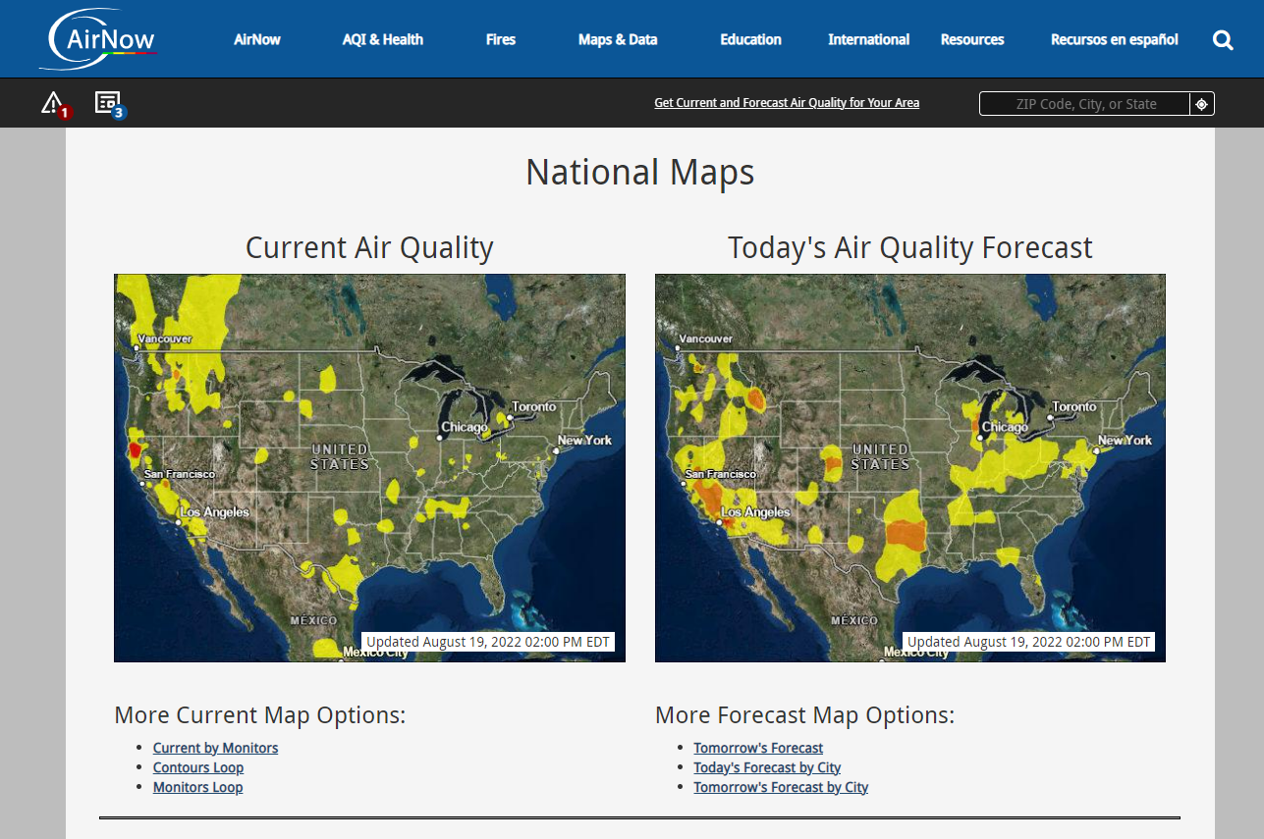
Airnow: U.S.
National Maps | AirNow.gov
Notes:
AirNow is a US gov’t website that provides an easy way to look at current and forecasted air quality in the U.S. National maps show where air quality will be worse on a given day, and visitors to the site can also look at site-specific air quality information by selecting a location on the map.​

Slide 21
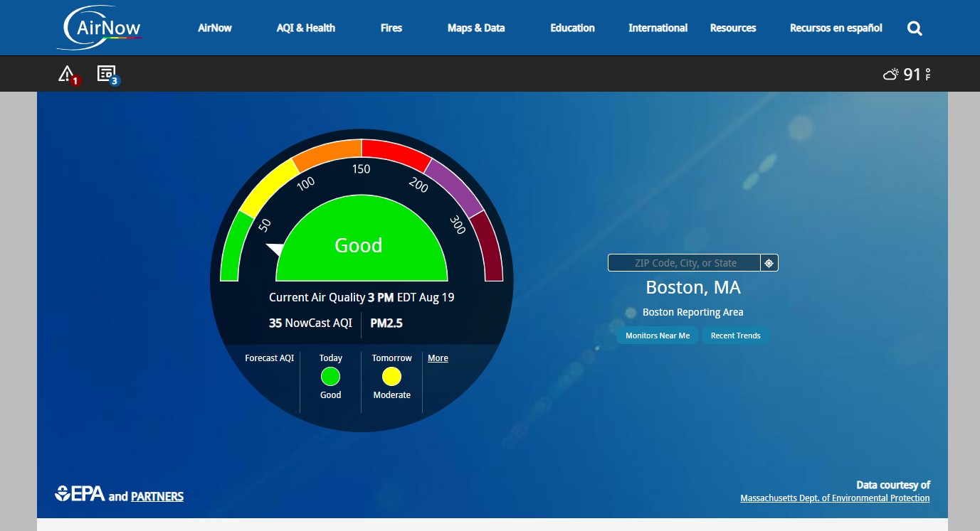
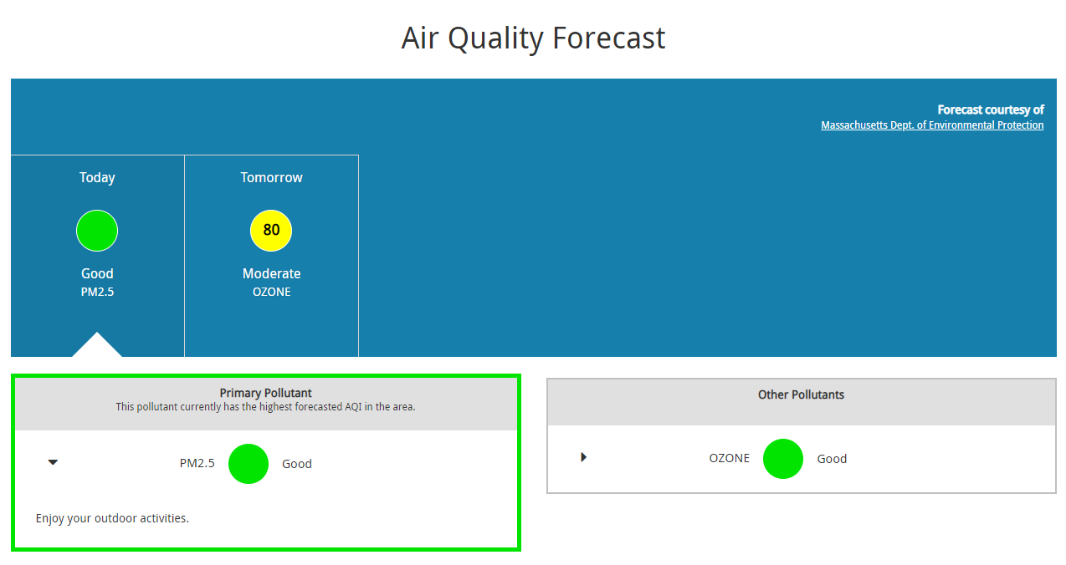
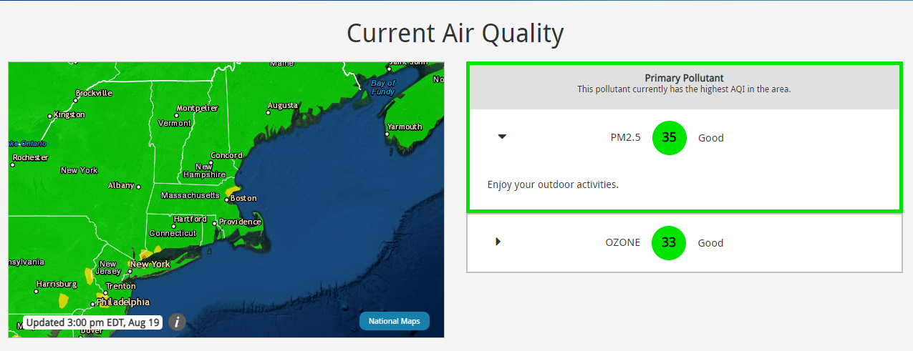
AirNow: City-Level AQI
AirNow.gov
Notes:
This is an example of a site-specific air quality dashboard on AirNow. Here, visitors can see current air quality in the context of the index, the primary pollutant, and any relevant announcements.

Slide 22
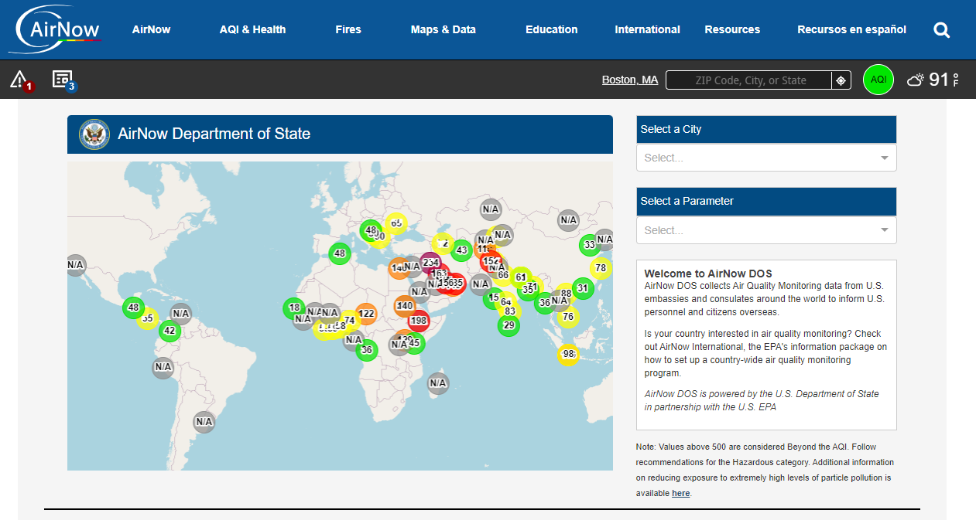
AirNow: International
US Embassies and Consulates | AirNow.gov
Notes:
AirNow also provides international air quality metrics based on monitoring data from U.S. embassies and consulates.​

Slide 23
Section 5: Example
1. Intro to AQI
2. AQI Communication
3. Calculating AQI
4. Source Data
5. Example

Slide 24
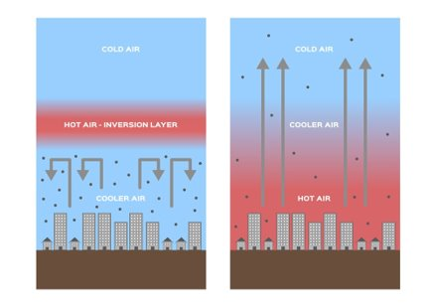
Example: Santiago, Chile
Santiago experiences extreme, multi-day thermal air inversions resulting in sustained high pollutant levels
Ministry of Environment developed a method for informing the public of a “critical episode” on days when air quality is predicted to be poor
On “critical episode” days, restrictions are placed on industry and transportation depending on the episode status
  Episode status determined from AQI as Good, Alert, Pre-emergency, and Emergency
  Restrictions include: parking restrictions, restricting road type access, prohibiting agricultural burning and use of non-certified heaters, etc.
https://www.shutterstock.com/image-vector/inversion-layer-pm-25-vector-dust-1296240271​

Slide 25
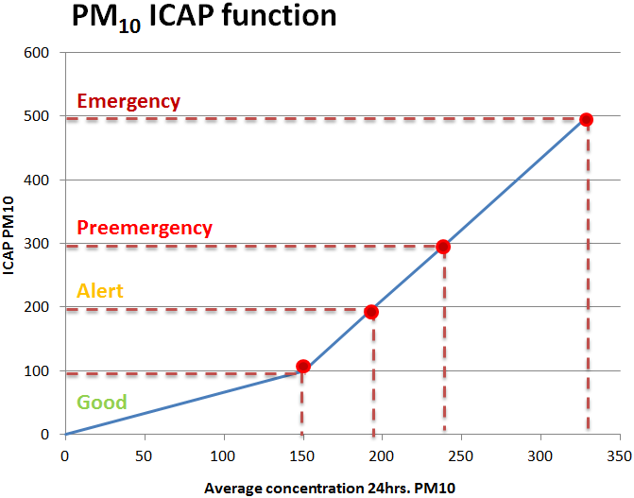
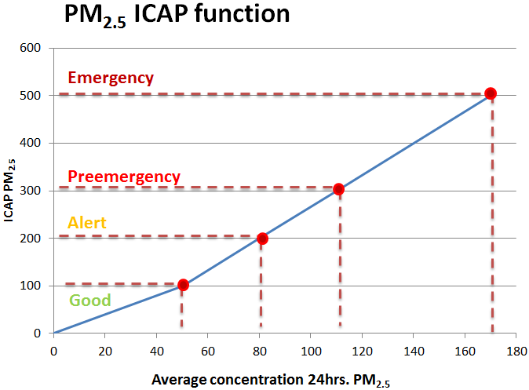
Example: Santiago’s Converted Air Quality Index (AQI) to PM levels
*ICAP is a Spanish acronym for AQI

Slide 26
Thank you!

