Slide 1
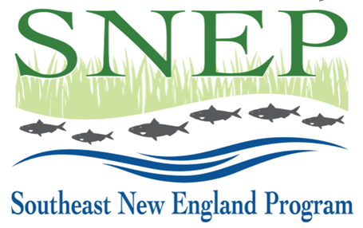
SNEP Forum June 13, 2023 Room 1: Increasing Public-Private Partnerships To date, SNEP has had limited engagement and partnership with private organizations. In this session, we will discuss how SNEP, the SNEP Network, and the SNEP Watershed Implementation Grants program currently engage with private organizations; and identify opportunities for our Program and partners to strengthen these regional partnerships. --

Slide 2
SNEP Forum
June 13, 2023
For each discussion, please consider and provide input on the following questions as it relates to the discussion topic:
What is SNEP doing well?
How can SNEP better work with you or your organization? Benefit you or your organization, or integrate your work?
What could SNEP improve upon or do differently?
Where do you see regional gaps in information, funding, etc. that SNEP could fill?
What do you think SNEP should do?

Slide 3
For purposes of conversation:
Consider Public-Private relationships broadly
Public – Private definition:
A public–private partnership is a long-term arrangement between a government and private sector institutions. Typically, it involves private capital financing government projects and services up-front, and then drawing revenues from taxpayers and/or users over the course of the PPP contract. From Wikipedia
Public = SNEP and its affiliates
Private = non-governmental including private sector or non-private

Slide 4
A few examples from SNEP Watershed Implementation Grant (SWIG) program
private landowners like the Brown family in Harwich who've provided land and cash match toward a cranberry bog restoration project there;
private companies like Horsley Witten or Tetra Tech that have provided in-kind match toward specific projects;
projects where public or non-profit entities are incentivizing private investment toward SNEP goals on private property. Examples would include:
Chepachet wastewater management district;
Groundwork RI's work with private property owners;
Newport's WQ management overlay; etc.

Slide 5
A few examples from SNEP Network
Clark/SNEP Network support for Blackstone Watershed Collaborative
Partnership with ACCO (Association for Climate Change Officers) in FY2 to offer training SNEP Network partners and municipal officials for ACCO certification.

Slide 6
Where are there opportunities to create and/or strengthen public – private relationships to advance SNEP mission?
SNEP's mission:
Our mission is to foster collaboration among regional partners across southeast New England's coastal watersheds to protect and restore water quality, ecological health, and diverse habitats by sharing knowledge and resources, promoting innovative approaches and leveraging economic and environmental investments to meet the needs of current and future generations.
SNEP Network's mission:
Our mission is to empower communities to achieve healthy watersheds, sustainable financing
and long-term climate resilience through management of stormwater and restoration projects. We focus on strengthening and building community capacity at the local level to move towards implementation, financing and the creation of sustainable revenue streams.

