Slide 1
Understanding the SNEP Region through Existing Data
Tim Pasakarnis
Water Resources Analyst
Cape Cod Commission
SNEP Monitoring Subcommittee Chair
June 13, 2023 SNEP Forum | Bristol Community College

Slide 2
The SNEP Region
2 states
3 major estuary basins
6 distinct ecoregions
134 municipalities
143+ stewardship groups
~300 subwatersheds

Slide 3
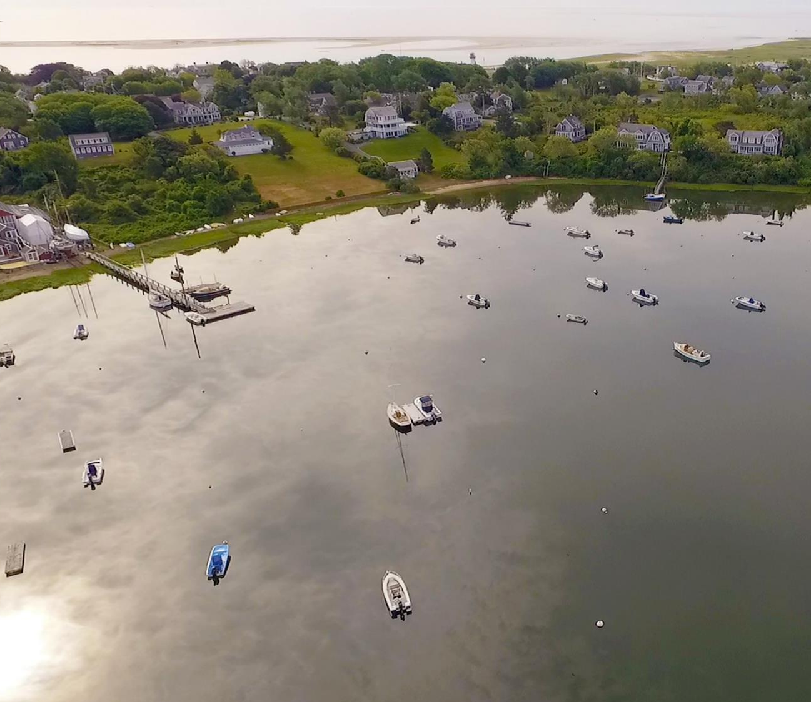
SNEP Region Existing Data
Where we started
Initial Questions
What is regional monitoring?
Who is collecting data?
What types data are they collecting?
Once data is collected, where is it stored?
How / how much of this data is accessible?

Slide 4
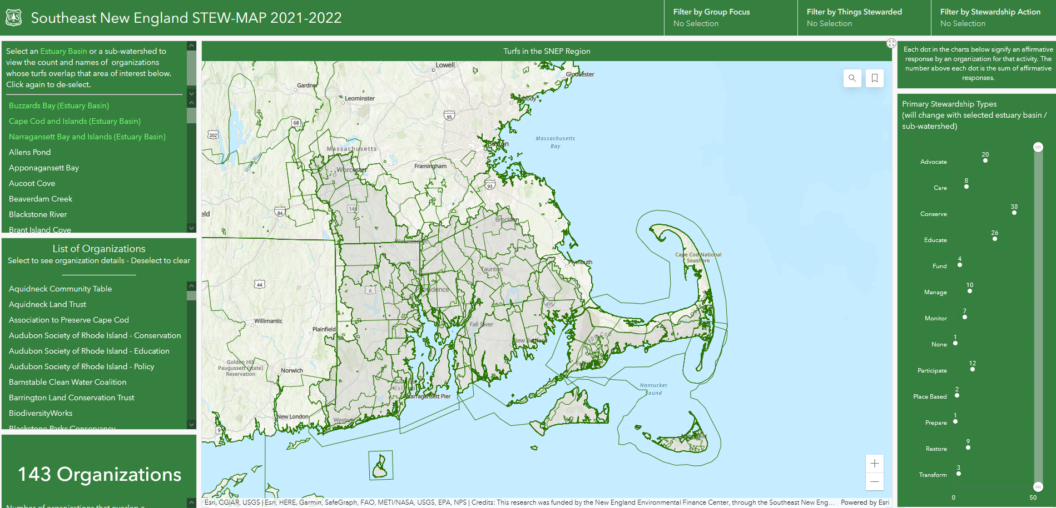
SNEP Region – Existing Data
Current Efforts
Inventory, categorize, and map
SNEP STEW-MAP
Stewardship Organizations
Stewardship Turfs
Organization and funding relationships
Monitoring Subcommittee
Lessons from Regional Databases
State of the Region Report

Slide 5
SNEP Region – Existing Data
Understanding Barriers to Uniform Data
Current Efforts
SNEP STEW-MAP
Lack of standard format / notation
Data formats reflect organization needs / uses
Organizational momentum hard to overcome
Monitoring Subcommittee
Adding Value to Data Sharing
Lessons from Regional Databases
Standardized data can make for easier regulatory reporting
Adding visualization / analysis on shared data can make it more useful
Reduced effort for long-term data exploration / analysis
State of the Region Report

Slide 6
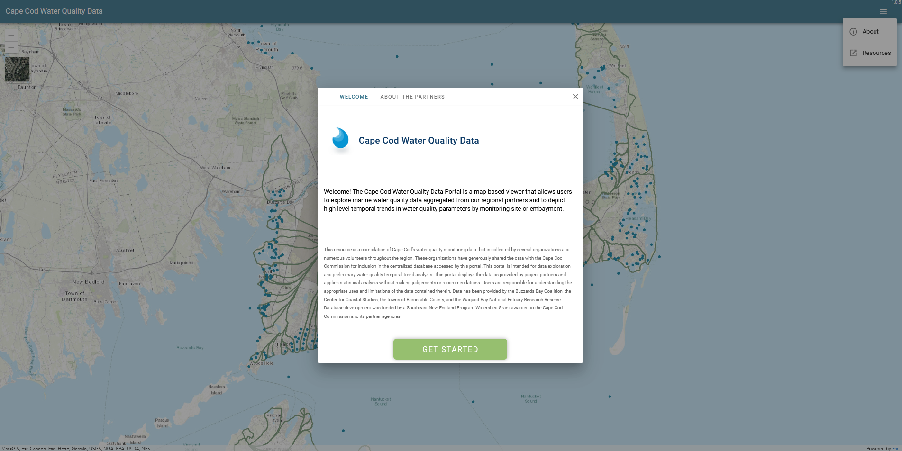
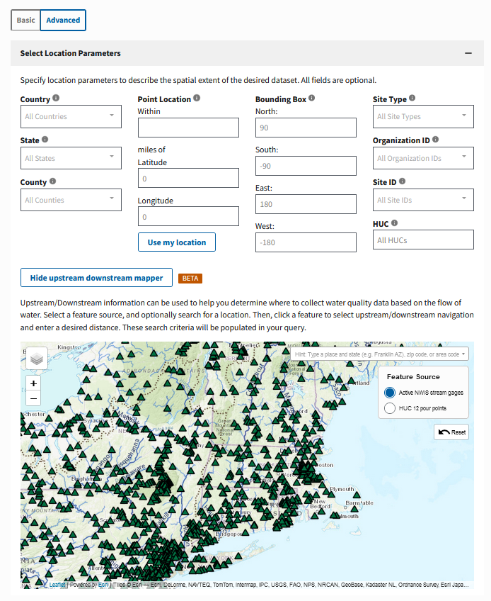
SNEP Region – Existing Data
Cape Cod Commission – Regional Water Quality Database
Current Efforts
SNEP STEW-MAP
Monitoring Subcommittee
Water Quality Portal
Lessons from Regional Databases
How much SNEP data is there already?
Partner impressions and experiences with WQX / WQP
Existing WQX support resources
State of the Region Report

Slide 7
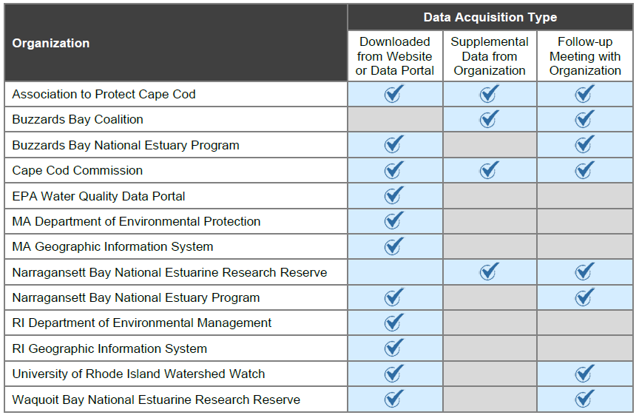
SNEP Region – Existing Data
Current Efforts
Looks at key metrics / parameters
SNEP STEW-MAP
Water Quality
Habitat
Watershed / Land Use
Monitoring Subcommittee
Direct engagement with data providers
Lessons from Regional Databases
13 Data Sources Federal, State, County Gov’t
Non-profits & Academic Institutions
State of the Region Report

Slide 8
How are we doing?
What is SNEP currently doing well to improve regional data?
Where do you see gaps in information or data that SNEP could fill?

Slide 9
Live Notes

Slide 10
How can we improve?
What is SNEP currently doing well to improve regional data?
Where do you see gaps in information or data that SNEP could fill?
How can SNEP better work with you / your organization?
What can SNEP improve upon?

Slide 11
Live Notes

Slide 12
SUMMARY / WRAP UP

