Slide 1
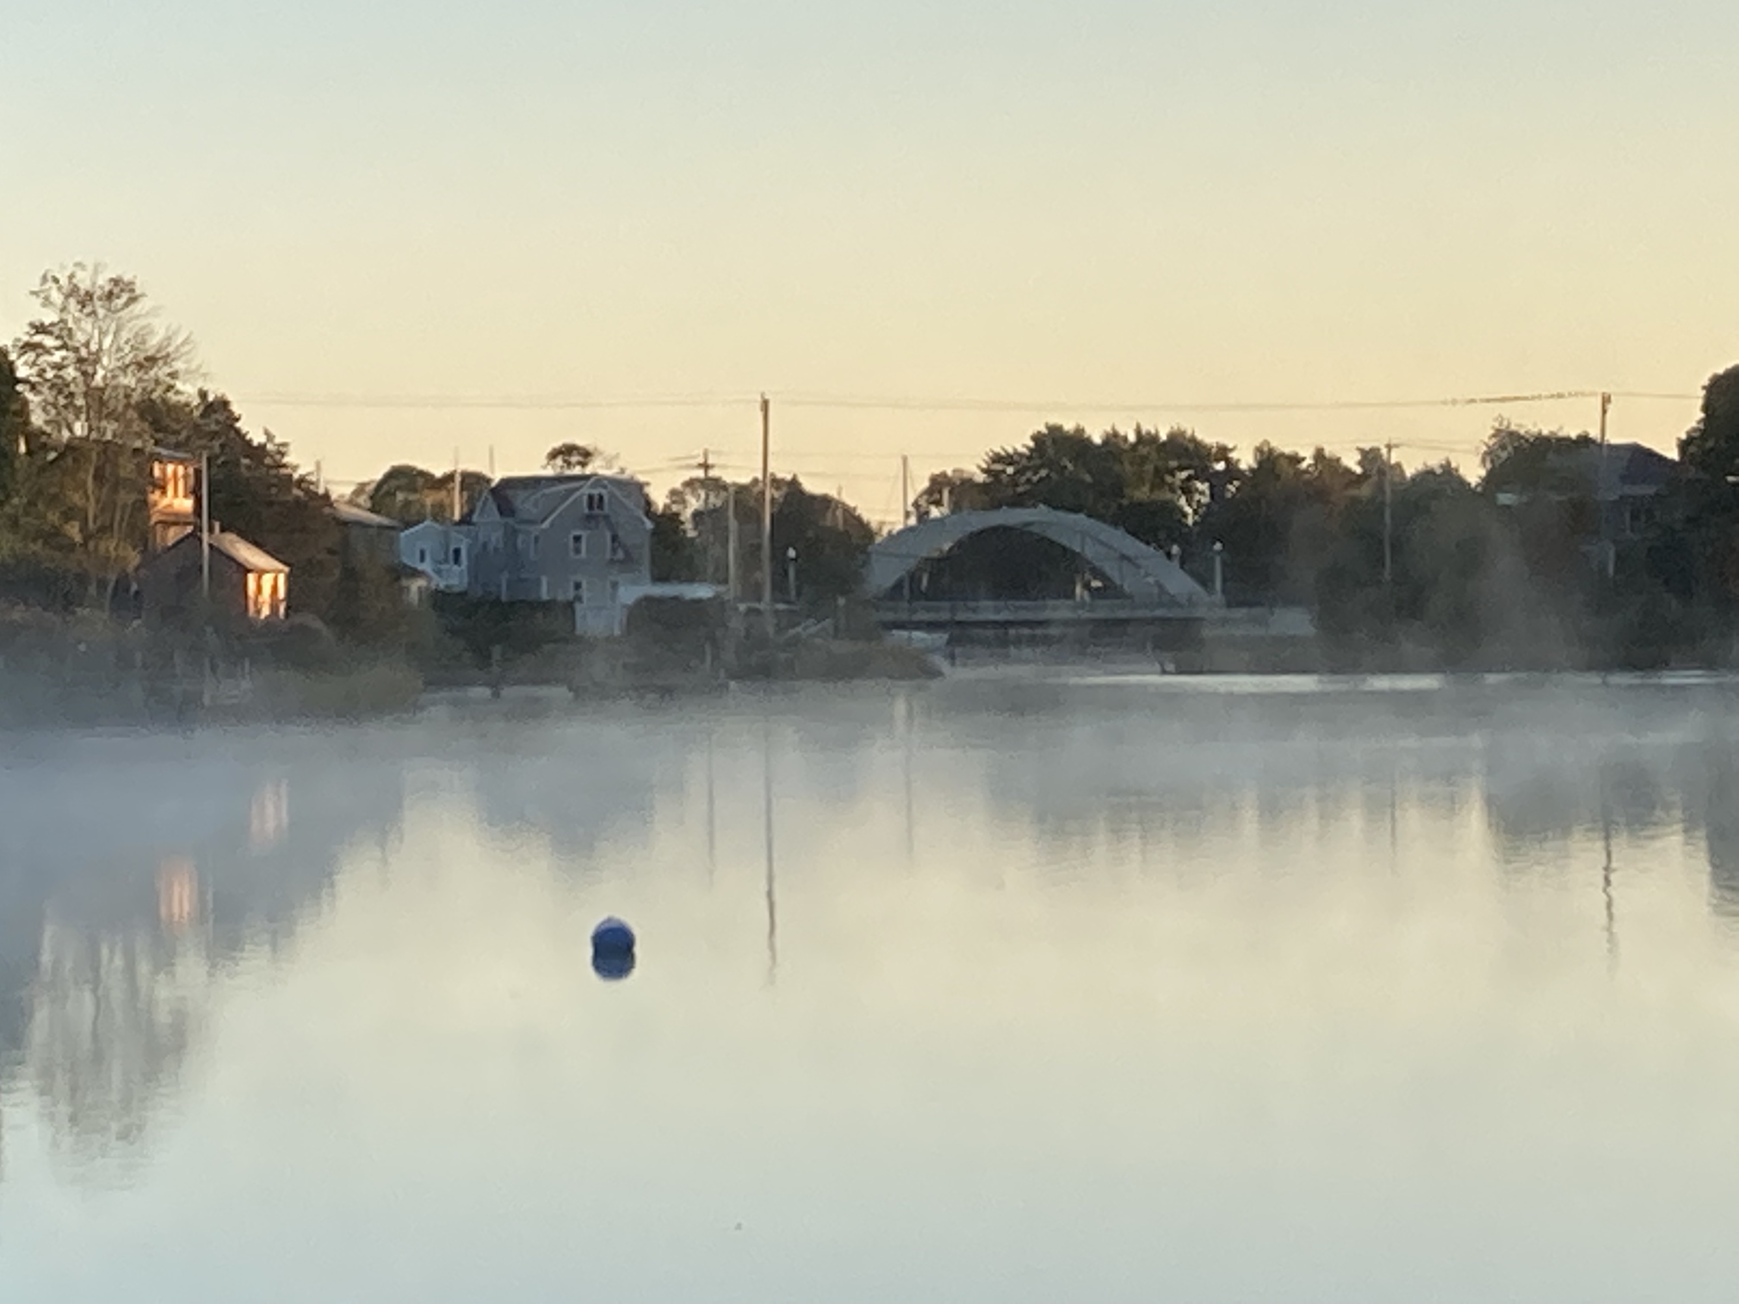
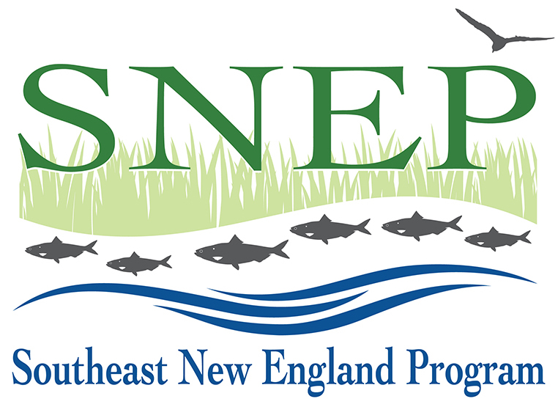
Keeping Track of
Funding Opportunities
Forum Session 1, Room 3
TOM ARDITO
RESTORE AMERICA’S ESTUARIES
SWIG Program Director
tardito@estuaries.org

Slide 2
Today’s Session
Brief Overview of Key Funding Opportunities (non-comprehensive!)
Discussion
Focus
Aligning SNEP & Community Priorities
Green Infrastructure, Ecological Restoration, Clean Water, Habitat Restoration, Green Streets, Environmental Justice, etc.

Slide 3
SNEP Sources (RI & MA)
SNEP Watershed Implementation Grants (SWIG)
$2M - $4M per year; grants up to $500k; 33% match
Ecological Restoration, WQ, Multi-Benefit Projects & Partnerships
Next RFP early 2024
SNEP 2023 Stormwater & Natural Infrastructure Grants
$2.3M available; $400k - $600k per – no match requirement
RFP currently open
SNEP 2023 Priority Research Grants
Priorities in RFP
$100k - $300k per
RFP currently open
SNEP Environmental Justice Grants
Broad Eligibility for all SNEP Funds
www.epa.gov/snep

Slide 4
National Coastal Resilience Fund
Federal Funds Administered by National Fish & Wildlife Foundation (NFWF)
Nature-based Projects that enhance coastal resilience and habitat for fish & wildlife
Nationwide Program: $140M in 2023
Next RFP March 2024 -- Emphasizing RI & CT
Planning or Implementation
Broad Eligibility
www.nfwf.org or info@throwe-environmental.com

Slide 5
RAE/NEP Watersheds Grant
EPA Funding through Restore America’s Estuaries
Narragansett Bay & Buzzards Bay Watersheds
Next RFP out late 2023
$2M total; $200k - $500k per
30% NF Match
Broad Eligibility
www.estuaries.org

Slide 6
RI Infrastructure Bank Programs
Municipal Resilience Program (MRP) & Action Grants
Stormwater Project Accelerator (Bridge Loans)
Municipal Infrastructure Grant Program
Water Quality Protection Charge (Drinking Water)
Clean Water State Revolving Fund (Loans & loan forgiveness for hard & soft water quality projects, stormwater, habitat, etc.)
www.riib.org

Slide 7
MA Municipal Vulnerability Preparedness Program
Climate Resilience Planning and Implementation
Specific to municipalities
MVP 2.0: Resilience planning grants; plans establish action grant eligibility
MVP Action Grants:
Up to $3M per community
$5M for regional projects
Average grant $300k+
Next RFP Spring 2024
resilientma.org/mvp

Slide 8
MA Coastal Zone Management Grant Programs
Coastal Resilience Grant Program
Municipalities: Coastal Flooding, Erosion & Sea Level Rise
Up to $2M / project
RFR open through July 11
CZM Coastal Habitat & Water Quality Grants
WQ, Habitat, Stormwater
Broad Eligibility: Comprehensive Habitat Restoration
Up to $100k Planning / $800k Implementation
Due June 16

Slide 9
Other Government Sources
Federal: EPA, NOAA, USFWS, NRCS, NPS, etc.
See grants.gov
RI: Bond Issues, DOT Stormwater Credits, Coastal Habitat Grants
See RI DEM and RI CRMC
MA: Mass. Div. of Ecological Restoration, Mass. Environmental Trust, etc.
NEPs: NBEP, BBNEP

Slide 10
Private & Community Foundations

Slide 11
Discussion Points
What is SNEP doing well?
How can SNEP better work with you or your organization? Benefit you or your organization, or integrate your work?
What could SNEP improve upon or do differently?
Where do you see regional gaps in information, funding, etc. that SNEP could fill?
What do you think SNEP should do?

