Slide 1
Improving/Tweaking the Existing Structure of SNEP
Session 2, Room 1
1:00-2:00PM
U.S. EPA, Southeast New England Program

Slide 2
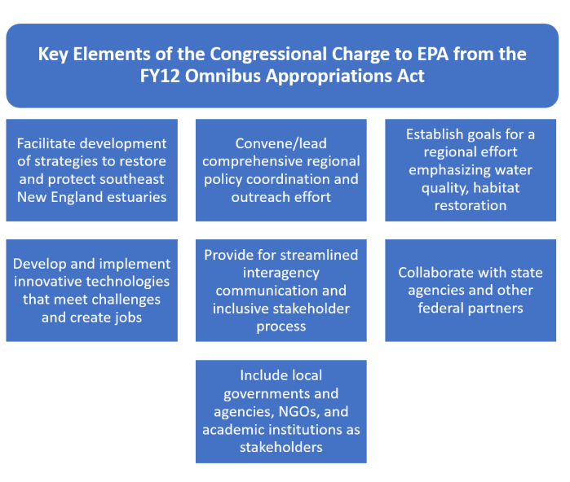
FY12 Congressional Charge

Slide 3
Goals and Key Actions
Increase Local Capacity to Complete Projects and Adopt New Policies
Increase Available Solutions
Ensure Diverse Representation in Program Decision-Making
Demonstrate Ways to Address Common Challenges
Increase Community Leaders’ Understanding of the Benefits of Restoration Projects

Slide 4
SNEP Committee Structure
EPA
Federal Partners
Steering Committee
Monitoring Subcommittee
Ecosystem Services Subcommittee
Public Input

Slide 5
SNEP Public Events
Biennial Public Forum
Trainings and Workshops via SNEP Network
Biennial Research Symposium
Grant Announcements
Topic Based Workshops
Webinars

Slide 6
Current Structure
EPA
Direct Grants, Estuary Program Grants, Contracts, Interagency Agreements
SNEP Watershed Implementation Grants Program
SNEP Network
SNEP Watershed Implementation Grants
Technical Assistance
Workshops/Trainings
Pilot Projects
Community Assistance Projects

Slide 7
Discussion
Strengths and Weaknesses of Current Approach?
Additional Programmatic Areas to Focus On (next 3-5 years)?
Areas to De-Emphasize or Re-Emphasize?
Geographic Focus?
Your experience with SNEP?

