Slide 1
Room 2: Communicating Project Successes in The SNEP Region
SNEP Forum
June 13, 2023

Slide 2
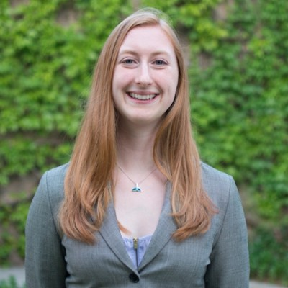
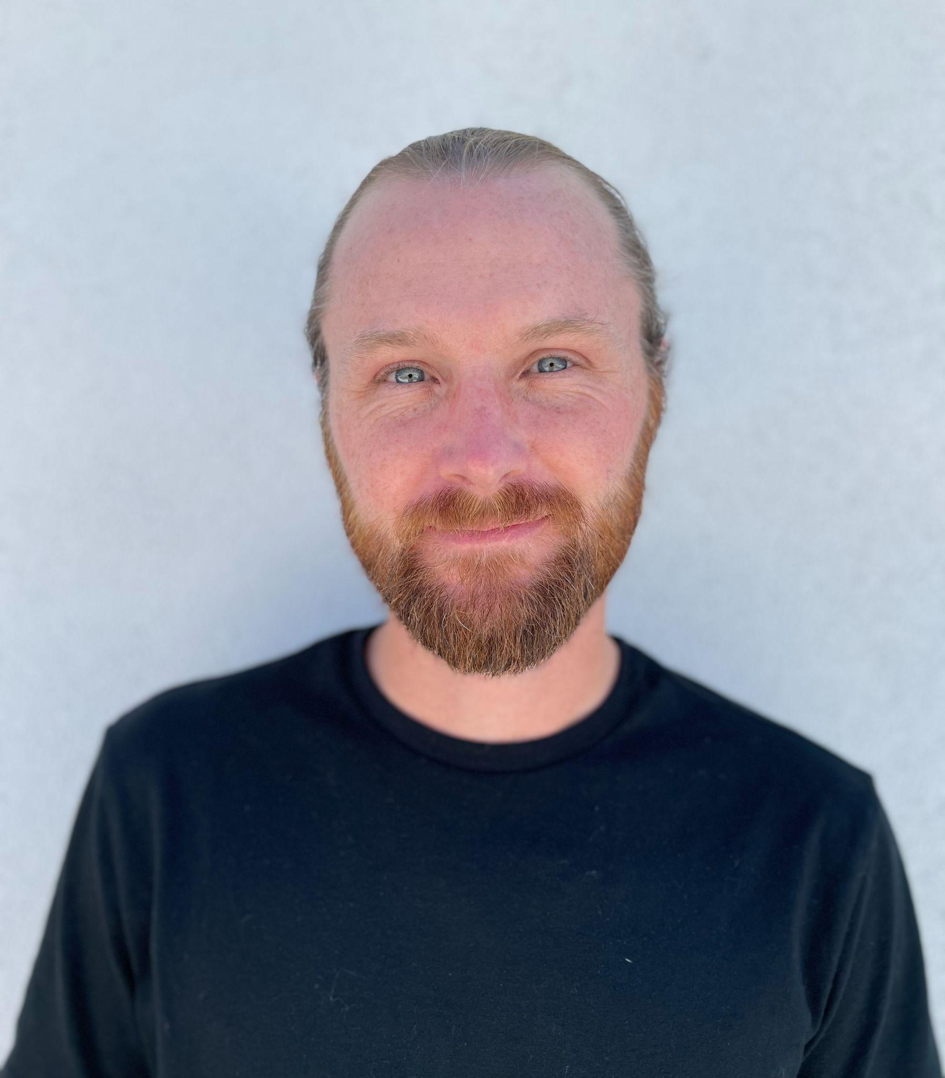
Your Moderators​
Haley Miller is a life scientist at USEPA Region 1, and the new SNEP Habitat Coordinator. She holds an M.S. in Forest Resources and B.S. in Environmental Science and Policy, with a background in wetland ecology.
Bryce DuBois is a Visiting Assistant Professor of Environmental Studies at the College of the Holy Cross. He holds a Ph.D. in Environmental Psychology and an MA in Clinical Psychology. ​

Slide 3
Agenda
Welcome 5 mins
Count off into three groups 5 mins
Introductions
Group agreements
Designate roles (note-taker)
Rotate 10 mins each (x3)
Gallery walk and uplift (vote) 5 mins
Share Out and Conclude 15 mins

Slide 4
In this session we will focus on compelling stories in the SNEP region and ask specific questions:
who is telling good stories about environmental challenges and restoration?
what data is used to support those narratives?
how can SNEP do a better job of capturing, emulating, and amplifying those narratives?
whose stories should we be telling?
Outcomes of this particular discussion will be used to inform the SNEP monitoring and ecosystem services subcommittees, along with other SNEP efforts.
Notes:
The goal of this session is to discuss what stories we tell about the work in and across the SNEP region, and what stories we tell about the challenges ahead. This approach mirrors the one used by the Narragansett Bay Estuary Program in their recent participatory planning event for the CCMP. The outcomes of this particular discussion will be used to inform the monitoring and ES subcommittees, along with other SNEP efforts.

Slide 5
Topic | Success stories (how do you know?) | Challenge stories (how do you know?) | Other stories (how do you know?)
Safe and Healthy Watersheds
Thriving Watersheds and Natural Lands
Sustainable Communities
Notes:
OPEN OPPORTUNITY FOR FEEDBACK

Slide 6
Group agreements (AKA ‘ground rules’)
We agree to:
Listen from zero. Keep an open mind. Be fully present and patient, actively listening to each other without distraction and without interrupting others.
Call in and call out. Share our perspectives, ideas, and narratives while allowing space for others to share theirs. Be curious and ask questions before making judgments.
Assume the best and take responsibility for impact. When our intent and impact do not align, we agree to acknowledge harm, make a commitment to improve, and ask what’s needed to move forward. We also agree to be compassionate with ourselves, understanding we are all lifelong learners.
(adapted from Jen West / NOAA OCM)

Slide 7
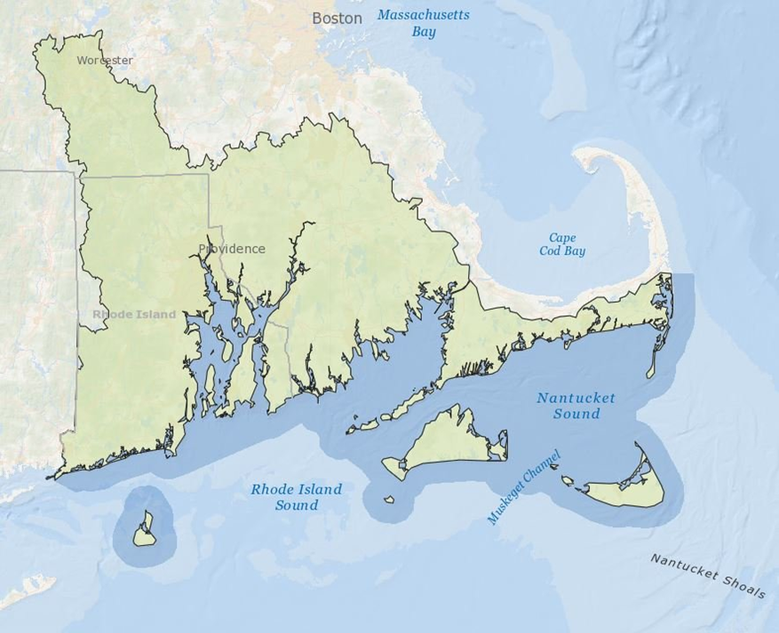

Slide 8
General Guidance and Discussion Questions​
What is SNEP doing well?
How can SNEP better work with you or your organization? Benefit you or your organization, or integrate your work?
What could SNEP improve upon or do differently?
Where do you see regional gaps in information, funding, etc. that SNEP could fill?
What do you think SNEP should do?

