Slide 1
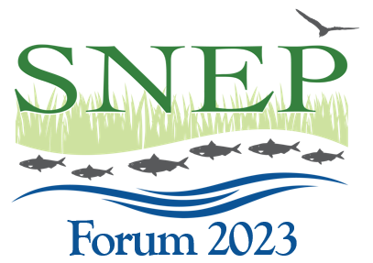
Increased Engagement with Academic Institutions
SNEP Forum 2023
Session 3, Room 1
Tim Pasakarnis, Cape Cod Commission
Bryce DuBois, College of Holy Cross
Adam Reilly, U.S. EPA Region 1

Slide 2
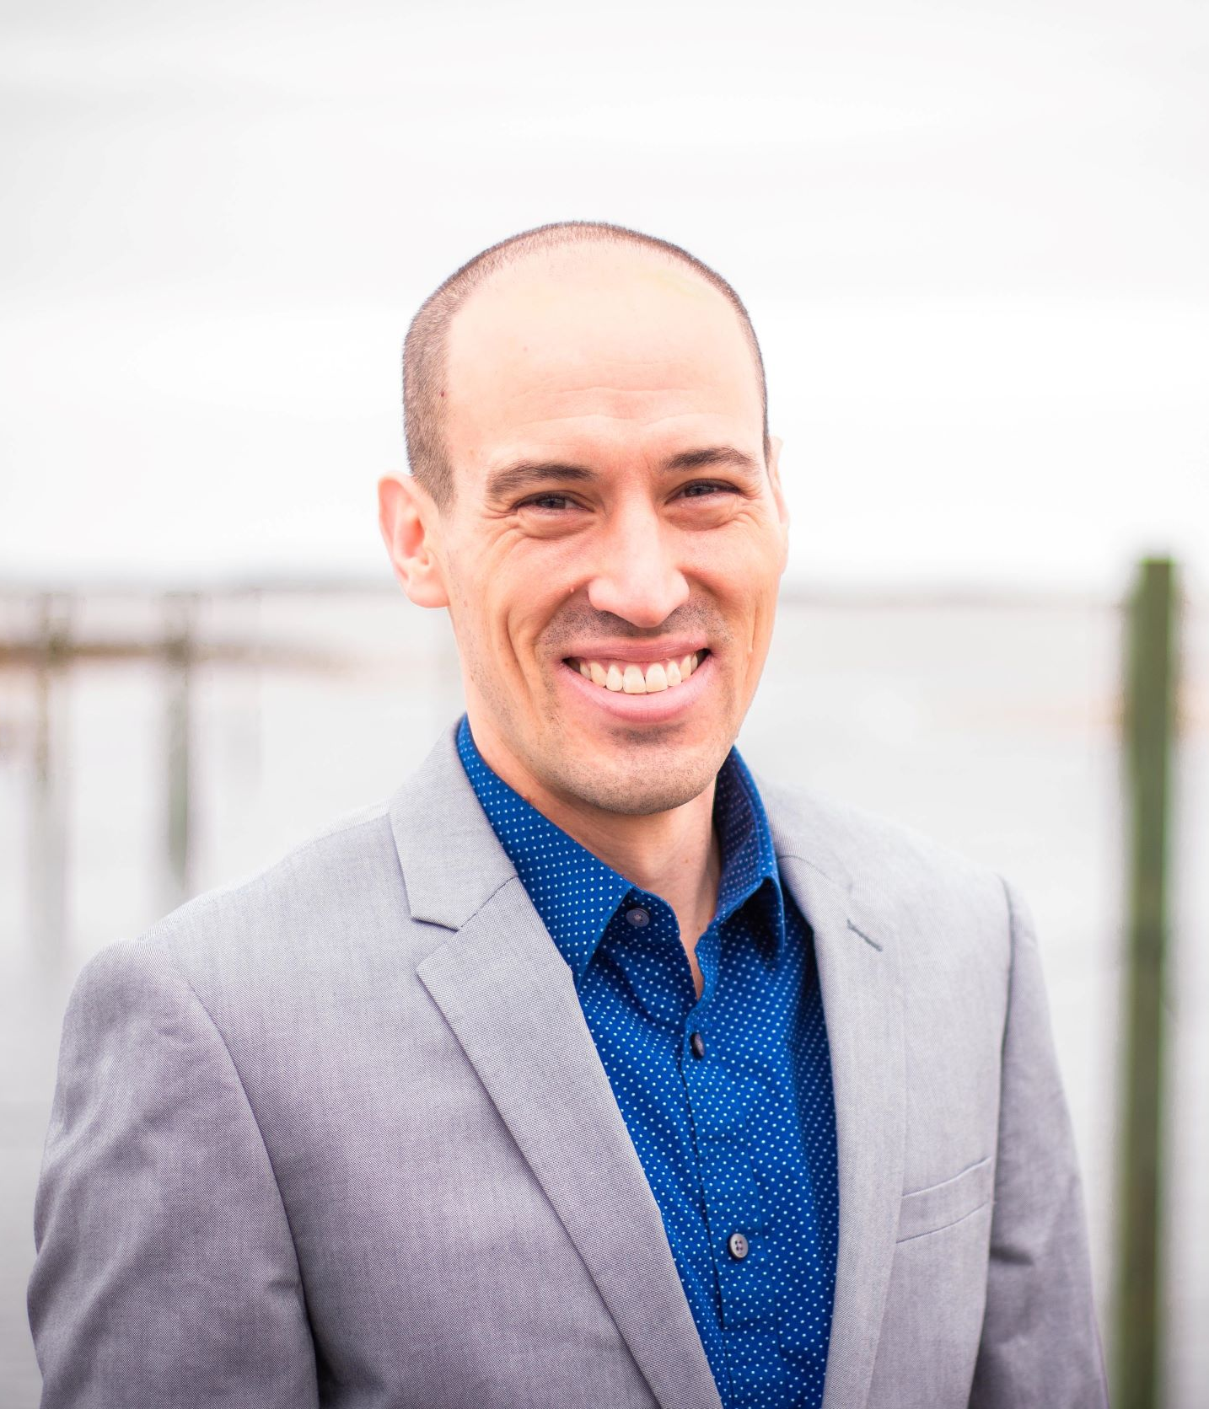
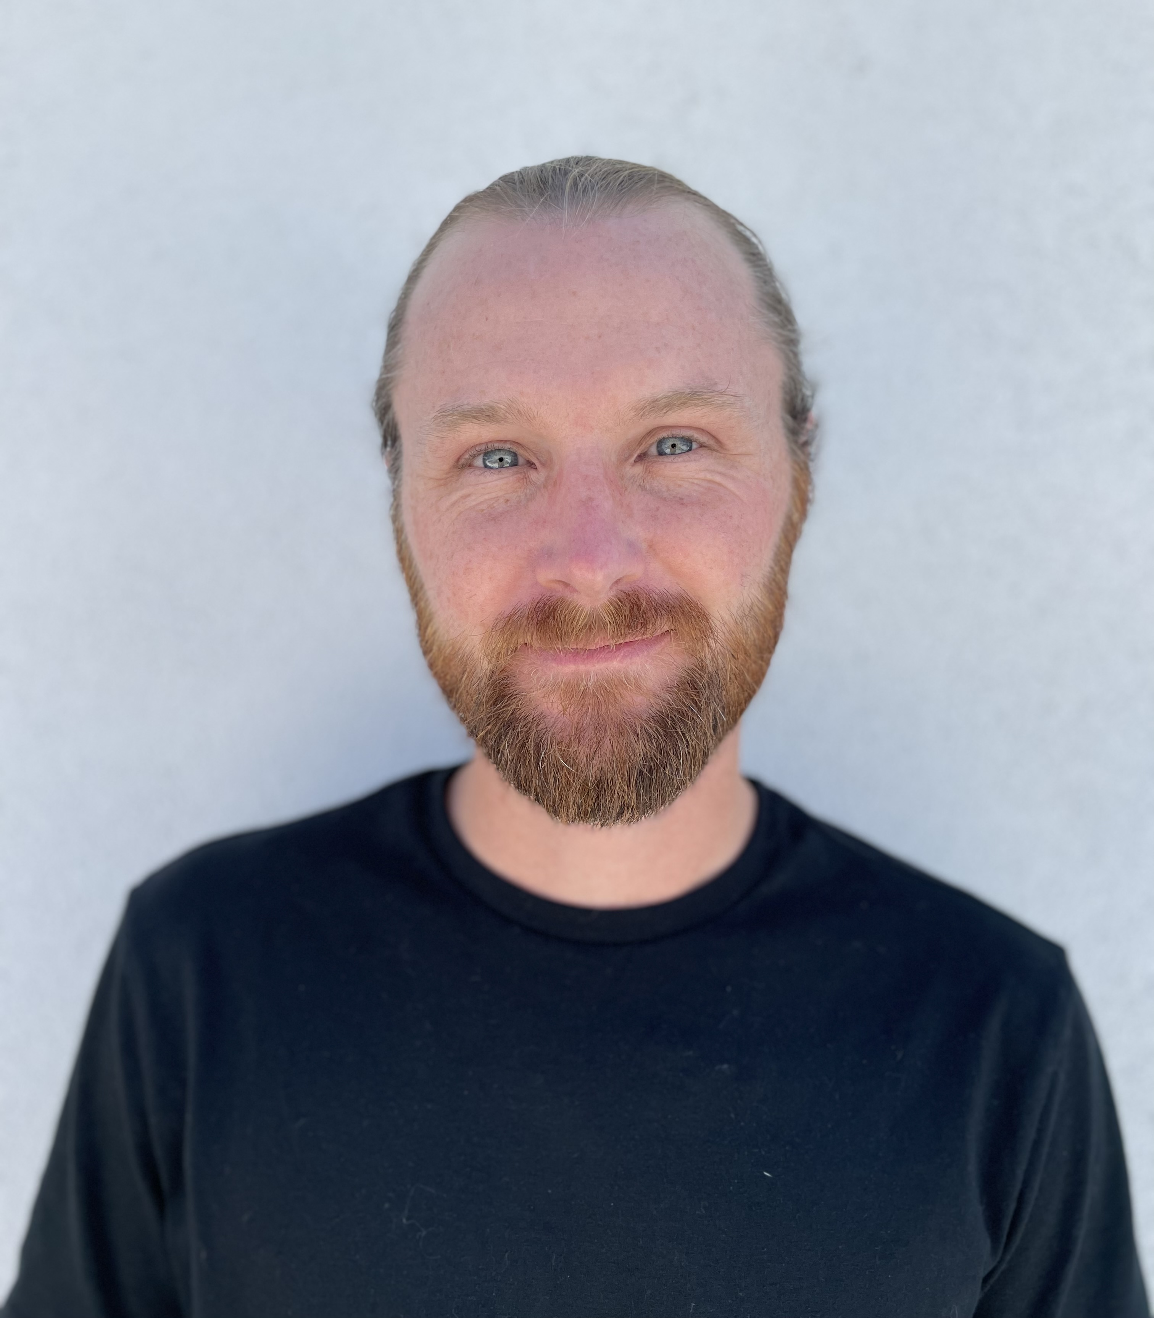
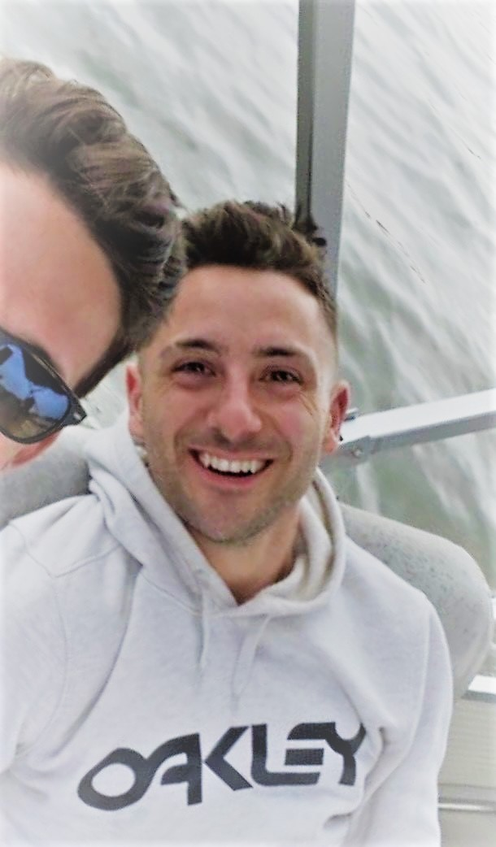
Your Moderators
Tim Pasakarnis is a Water Resources Analyst with the Cape Cod Commission. Tim holds a Ph.D. in Environmental Engineering, a B.A. in Biology, and has been with the Commission for 5 years.
Bryce DuBois is a Visiting Assistant Professor of Environmental Studies at the College of the Holy Cross. He holds a Ph.D. in Environmental Psychology and an MA in Clinical Psychology.
Adam Reilly is the Communications Coordinator for the Southeast New England Program and has been at EPA Region 1 for nearly 4 years. He holds an M.S. in Environmental Science and a B.S. in Professional and Technical Writing.

Slide 3
In This Session, We Will:
Review SNEP’s existing relationships with regional academic institutions
Discuss SNEP’s research goals and approaches; and
Ask how SNEP might better support a sustained level of partnership with academic institutions in support of those regional goals.

Slide 4
Research Goals and Objectives
Innovative Technologies and Approaches
Evaluation of Ecosystem Service Benefits
Monitoring
Tracking Program Effectiveness
Harmful Algal Blooms
Effective Communication and Outreach

Slide 5
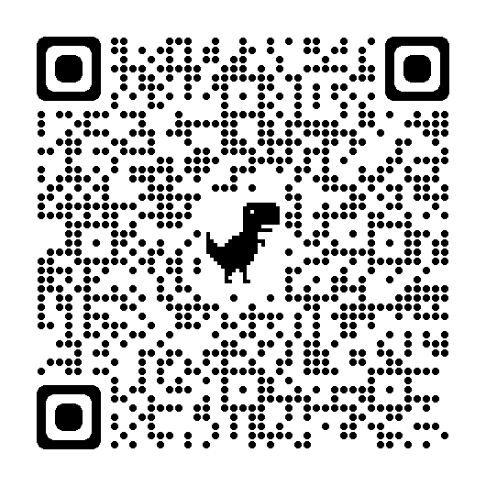
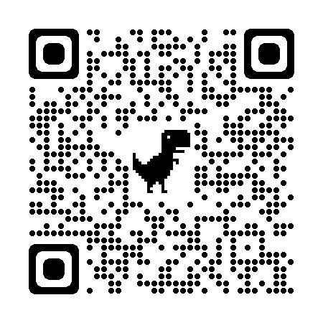
2023 SNEP Research Grants:
Informational Webinar/Q&A: June 22, 2023, 12:30 - 2:00p EST
Modeling and Assessing Coastal Lake and Pond Health
Lessons Learned from Implementing Permeable Reactive Barriers
Eelgrass Viability: Flowering and Seeding, Impacts of Climate Change, Long-term Prognosis
Grant Opportunity via Grants.gov
Open until July 28, 2023

Slide 6
Tie Your Response to the Following Questions
What is SNEP doing well?
How can SNEP better work with you or your organization, benefit you or your organization, or integrate your work?
What could SNEP improve upon or do differently?
Where do you see regional gaps in information, funding, etc. that SNEP could fill?
What do you think SNEP should do?

Slide 7
Discussion Question 1
Who has SNEP engaged with?
b. What additional institutions are out there? Who should SNEP be engaging with?

Slide 8
Our Partners*
Association to Preserve Cape Cod
Buzzards Bay National Estuary Program
Cape Cod Commission
*Clark University
*College of the Holy Cross
Conservation Law Foundation
EPA (ORD-AED)
MA Department of Environmental Protection
MA Division of Ecological Restoration
MA Coastal Zone Management
MA Natural Resources Conservation Service
Martha’s Vineyard Commission
Mashpee Wampanoag Natural Resources Department
Mass Audubon
*Mass Maritime Academy
Narraganset Bay Estuary Program
Narragansett Bay Estuarine Research Reserve
Narragansett Tribal Nation
National Oceanic and Atmospheric Administration
New England Interstate Water Pollution Control Commission
RI Dept. of Environmental Management
RI Natural Resources Conservation Service
Save the Bay
Southeastern Regional Planning and Economic Development District
The Nature Conservancy
*UMass Boston School for the Environment
*UMass Dartmouth SMAST
*University of New Hampshire Stormwater Center
*University of Rhode Island
*University of Southern Maine
U.S. Army Corps of Engineers
U.S. Fish and Wildlife
U.S. Geological Survey
Wampanoag Tribe of Gay Head (Aquinnah)
Waquoit Bay Estuarine Research Reserve
*Truncated List
Notes:
Who else would you add;

Slide 9
Discussion Question 2
Of the academic institutions listed, where are there opportunities for us to create a mutually beneficial and sustainable partnership?

Slide 10
Discussion Question 3
Now that we’ve identified areas of mutual interest, how can SNEP improve engagement? What should we do next?

