Slide 1
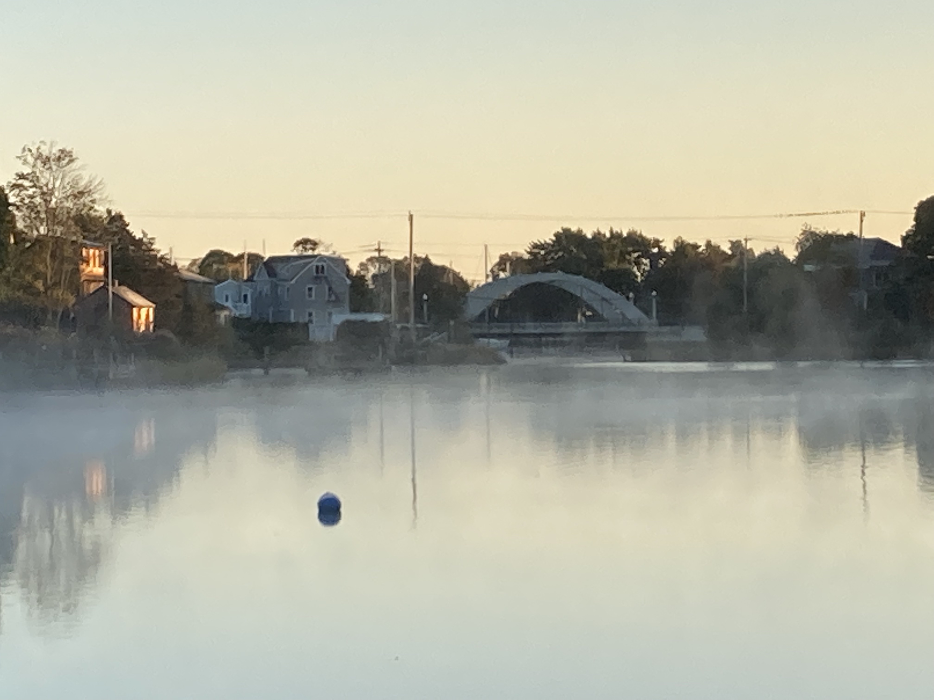

Community-Led Project Design, Learning & Engagement
Forum Session 3, Room 2
TOM ARDITO
RESTORE AMERICA’S ESTUARIES
SWIG Program Director
tardito@estuaries.org

Slide 2
Today’s Session
Introduce SWIG Grantees & Projects
Introductions, Definitions & Comments
Discussion

Slide 3
SWIG Examples
Hinkley’s Pond/Herring River Headwaters Eco-restoration
Cuttyhunk Ghost Gear Removal
Chepachet Village Wastewater Improvements
Silver Creek Restoration / Bristol Municipal Golf Course
Woonasquatucket River Greenway

Slide 4
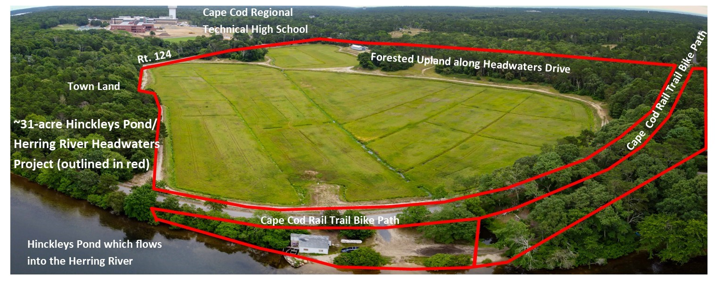
Hinkley’s Pond/Herring River
Headwaters Eco-restoration
Mike Lach, Harwich Conservation Trust
31-acre Cranberry Bog Restoration, Design Phase

Slide 5
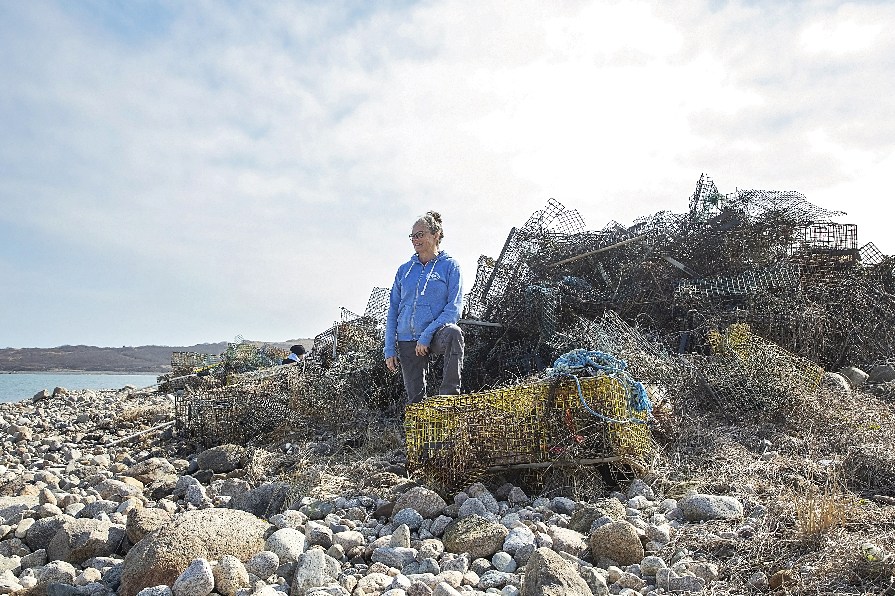
Cuttyhunk Ghost Gear Removal
Laura Ludwig, Center for Coastal Studies
Remove derelict fishing gear on Cuttyhunk Island
Planning & Implementation

Slide 6
Chepachet Village Wastewater Improvements
Karen Scott, Town of Glocester, RI
Establish management district to incentivize wastewater improvements
Planning & Implementation

Slide 7
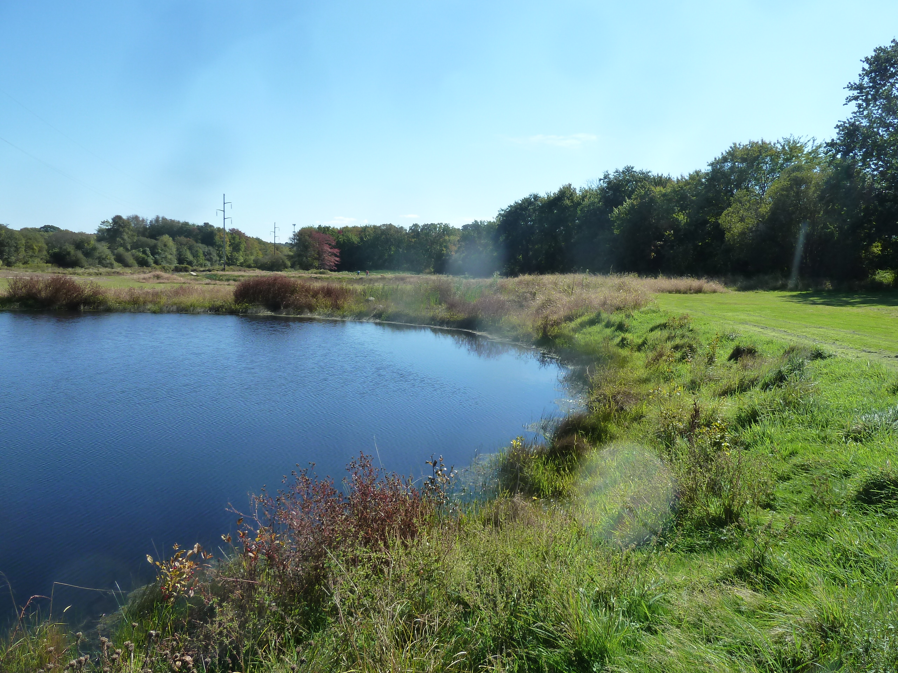
Silver Creek Restoration
Ed Tanner, Town of Bristol, RI
Wetland Restoration / Golf Course Redevelopment
Planning and Implementation

Slide 8
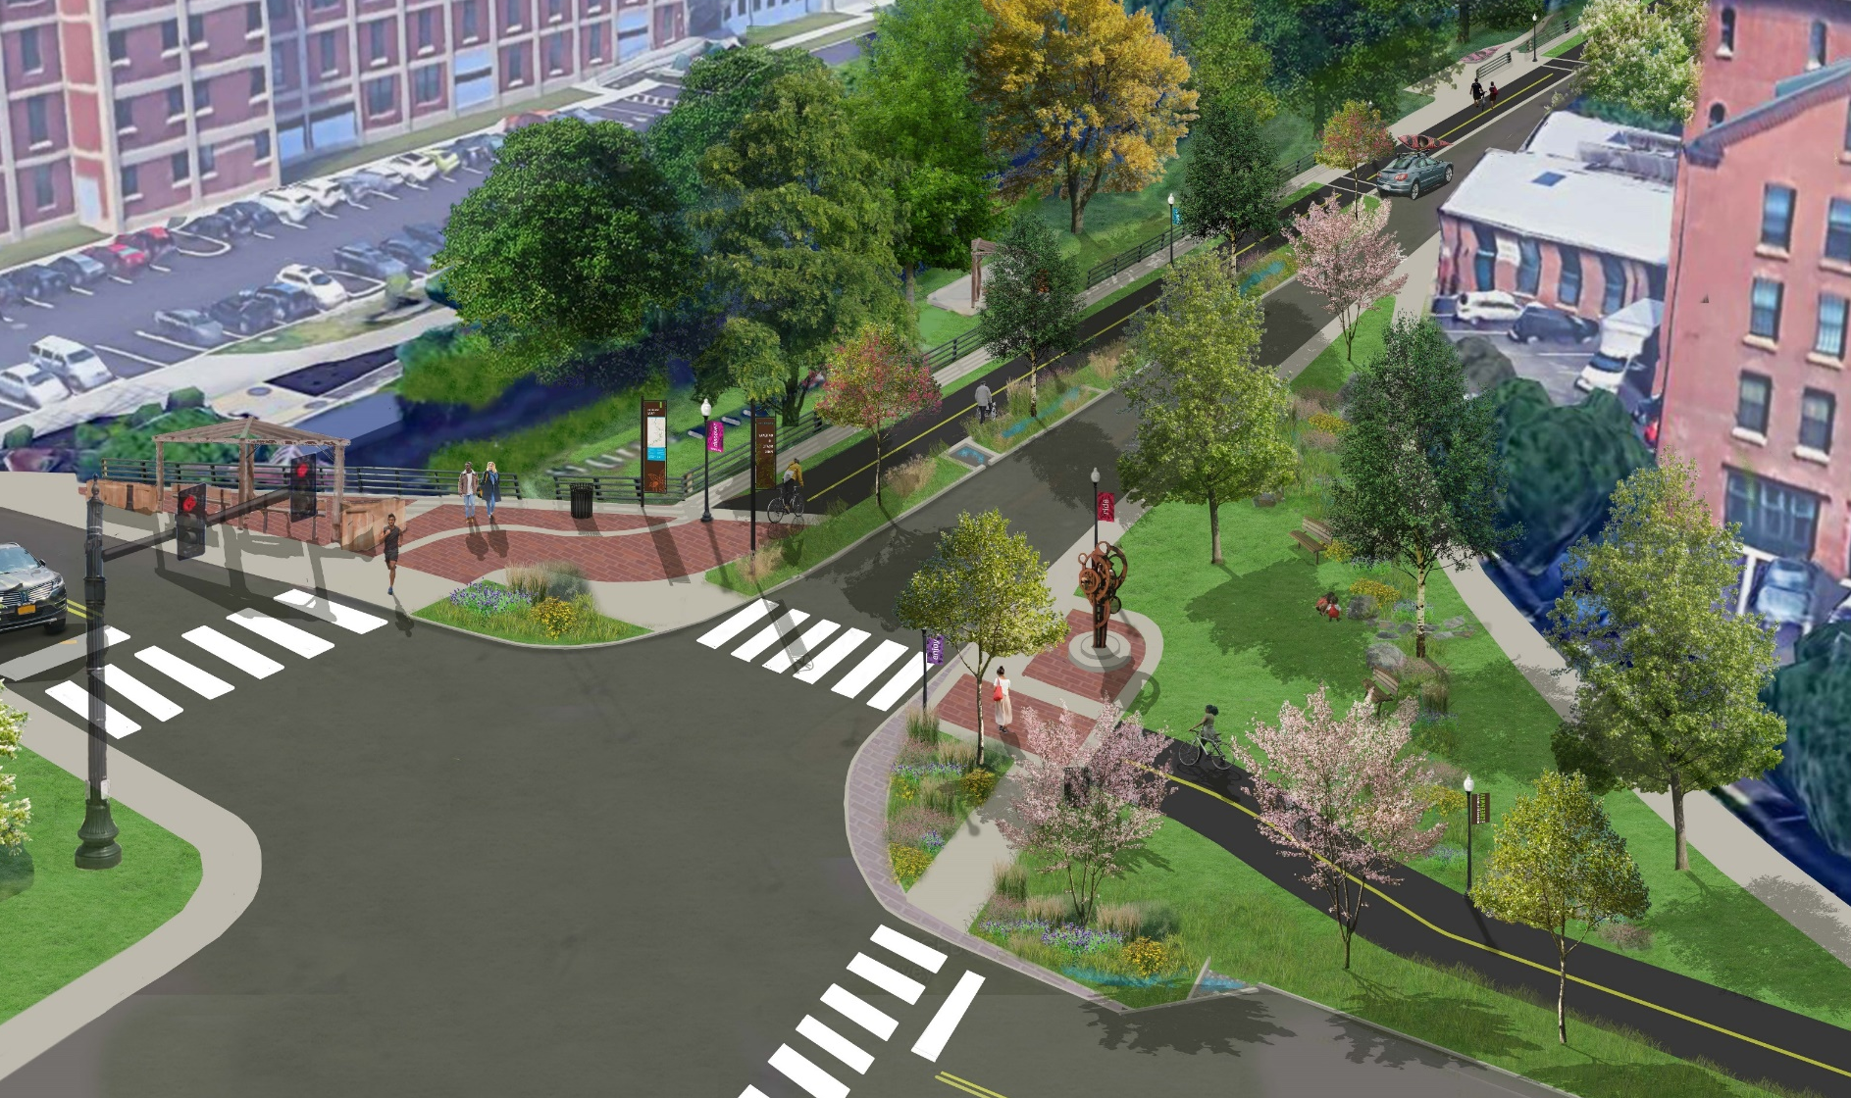
Woonasquatucket River Greenway
Alicia Lehrer, WRWC
Urban Greenway & Stormwater Management
Planning & Implementation

Slide 9
Discussion Points
What is SNEP doing well?
How can SNEP better work with you or your organization? Benefit you or your organization, or integrate your work?
What could SNEP improve upon or do differently?
Where do you see regional gaps in information, funding, etc. that SNEP could fill?
What do you think SNEP should do?

