Slide 1
Proposed Revisions to Air Emissions Reporting Requirements (AERR) Webinar For Communities
August 29, 2023

Slide 2
AERR Proposal – Webinar Logistics
Please join by phone or computer, not both
All participants are on mute
Attending via computer and have a question?
Type your question in the Q&A
EPA staff will review and read your question at the end of the presentation during the Q&A portion of the webinar
Attending only via phone and have a question:
Raise your hand via *9 and again to lower your hand. Once called upon, please press *6 to unmute yourself.
This webinar is not intended as a forum to submit comments. Instructions for submitting comments are included at the end of this presentation and in the preamble of the proposal rule.
The webinar is being recorded, the recording and the power point slides will be published after the webinar.
Type questions in Q&A
Closed captioning is available
Leave meeting at any time

Slide 3
EPA Conduct Reminder
The US Environmental Protection Agency (US EPA) is committed to facilitating productive dialogue and an environment of mutual respect and safety. The Agency will not tolerate harassment, discrimination, intimidation, inappropriate language and images, or sustained disruption of this public event.
EPA expects all participants, including panelists, speakers, and presenters, to conduct themselves in a respectful, professional, and civil manner. US EPA will monitor and moderate this virtual event to ensure that common standards of decency are upheld.

Slide 4
Proposed AERR Updates
EPA published proposed updates to the AERR on August 9, 2023
Primary objectives of the proposal:
Ensure that EPA has sufficient information to identify and solve air quality and exposure problems to support and implement parts of the Clean Air Act
Ensure that communities have data they can use to understand significant environmental risks that may affect them

Slide 5
What is the AERR?
The AERR is a regulation that requires states, local agencies¹, and some Tribes² to report some annual air emissions data to EPA
The current regulation allows for voluntary reporting of air toxics. Air toxics also are called hazardous air pollutants, or “HAP.”
It also allows voluntary reporting of emissions from prescribed burning and wildfires
EPA uses the data collected and other resources to create the National Emissions Inventory (NEI)
¹ States may delegate reporting authority to local agencies
² For Tribes with Treatment as a State (TAS) for emissions inventory reporting
Notes:
By emissions, this means the air pollution that comes out of factories, cars, trucks and buses - and even wildfires.

Slide 6
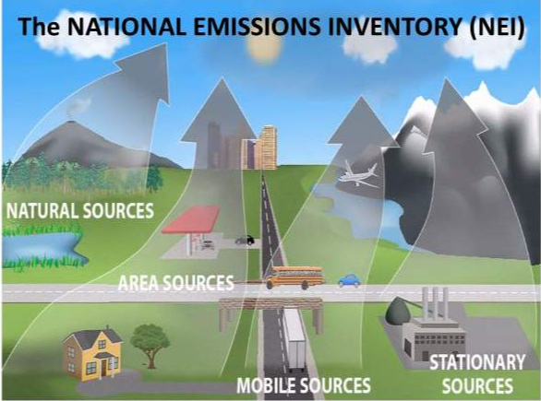
What is the National Emissions Inventory?
Detailed estimate of from sources that emit air pollution
SMALL
STATIONARY
LARGE

Slide 7
Uses of the National Emissions Inventory
The NEI supports many programs and activities:
Air Quality Standards Risk Analysis
Congress Press
Report on the Environment
Other Agencies Global Analysis
AirToxScreen
Individuals and Communities

Slide 8
What is EPA Proposing to Do That Would Help Communities Get More Information?
Require owners/operators of point sources to report annual air toxics emissions, with option for states to report on industry’s behalf
Require certain facilities located in Tribal nations and in federal waters to report emissions directly to EPA
Require reporting of prescribed burning activity information
Activity information is the date, location, acres burned, and other details about the fire
We will provide this data on the National Emissions Inventory website

Slide 9
What Does the AERR Currently Require?
The current rule requires states to report criteria pollutants and precursors
Criteria pollutants that must be reported include: Carbon monoxide (CO), sulfur dioxide (SO₂), particulate matter (PM) ≥ 10 and 2.5 microns in diameter (PM₁₀ and PM_{2.5}), and Lead (Pb)
Precursors are pollutants that contribute to the formation of the criteria pollutants
For example, volatile organic compounds (VOC) and nitrogen oxides (NO_{X}) are precursors to ozone formation
Ammonia (NH₃) is a precursor to PM formation

Slide 10
What Does the AERR Currently Require? (continued)
Certain facilities are reported as “point sources”
At these facilities, emissions are required to be reported separately for each activity that creates emissions within the facility
For each stack
For each non-stack release, called “fugitive” sources
States report other emissions sources such as residential wood combustion and mobile sources as county-wide emissions totals or input data to emissions models

Slide 11
What is a “Point Source” Under the Current Rule?
Under the current AERR, point sources are facilities with the potential to emit criteria pollutants and precursors above certain thresholds
“Potential to emit” is how much a facility could emit if it is operating at the upper limit of its state-issued permit
The threshold is usually 100 tons/year potential to emit
For lead, the current threshold is for actual emissions instead of potential emissions. That threshold is 0.5 tons/year
The proposal does not include changes these thresholds

Slide 12
How Would the Proposed Updates to AERR Improve Air Toxics Data?
We are proposing to add more point sources for collection of air toxics
This will provide more complete air toxics information, which will help EPA better understand risks to communities and take steps to reduce those risks
The current rule requires states to report about 13,400 point sources
Under the current rule, states voluntarily report about 62,000 point sources (59,000 with air toxics)
EPA estimates about 129,500 point sources would be reported under the proposal
Under the proposal,
All “major” sources would be point sources, using the definition of “major source” from the Clean Air Act
Smaller sources would also be point sources when:
Their industry is on our proposed list of industry codes
Their emissions of air toxics are greater than or equal to proposed emissions reporting thresholds
Facilities would not need to be within states to be a point source – could be within Tribal nations and federal waters
Notes:
When I say “major” sources, this means those facilities that exceed similar potential emissions thresholds as I described on the previous slide for criteria pollutants and precursors. Additionally, major sources include sources with 25 tons or more of any combination of hazardous air pollutants or with 10 tons or more of any individual hazardous air pollutant.

Slide 13
How is EPA Proposing to Collect Air Toxics Data about Facilities?
Owners/operators would report each emissions release within the facility individually with each location
Except for small businesses that can report facility totals
Proposal would allow states to report on industry’s behalf, with EPA approval
The “major” sources would report emissions of all air toxics (hazardous air pollutants)
Smaller “non-major” sources would report emissions when (a) they are part of certain industries specified in the proposal and (b) their emissions exceed proposed emissions reporting thresholds

Slide 14
AERR Proposed Point Source Collection Overview
Source test data
Air toxics emissions reporting, proposed default approach
EPA
NEI Data Provided to Communities
Owners/ Operators
Criteria Pollutant Emissions Reporting (no change)
SLT optionally accepts air toxics reporting responsibility
State, local, and some Tribal agencies (SLT)

Slide 15
Why is EPA Asking for Detailed Data for Each Release and Location in a Facility?
Currently EPA requires owners/operators to report facility total air emissions data for the Toxics Release Inventory program and states voluntarily report more detailed data voluntarily for the National Emissions Inventory
When EPA does not get detailed data from states, it uses facility total data from the Toxics Release Inventory in models to estimate risk
The models do a better job estimating risk with the more detailed emissions data
The data we are proposing to collect would be more detailed so that EPA can do a better job estimating risk for surrounding communities

Slide 16
Why EPA Needs Detailed Emissions Data
Legend
Area Source
Point source
Facility Center
The facility center (yellow) is further away from the homes and school than the more detailed emissions releases (red)
Using the facility center for estimating risk could miss the impacts of the closer releases on risk
Homes
School

Slide 17
What is the Timing of the Proposed New Air Toxics Data Collection?
For facilities operating outside of states (such as Indian country and federal waters), 2025 is the proposed first reporting year
Would be collected in 2026 and available publicly in 2028
For most facilities operating in states, 2026 is generally first reporting year under the proposal
In the proposal, this is referred to as facilities operating within states’ Clean Air Act implementation planning authority
This later date allows states time to prepare for reporting on behalf of owners/operators
Would be collected in 2027 and 2028 and available publicly in 2029

Slide 18
Why is Does It Take Time to Release the Emissions Data?
Owners/operators need to time to collect and report the data correctly
States/locals/Tribes need time to review the point source data and make sure it has high quality, and then report it to EPA
EPA also reviews the data and combines it with additional information to make it more complete

Slide 19
Why is EPA Proposing to Collect More Information About Prescribed Burning?
EPA uses databases, satellite observations, and models to estimate emissions from wildfires and prescribed burning
This gives us emissions for each fire on each day that it burned
These emissions are used in air quality models that predict pollution in the atmosphere
The emissions models need information about the when the burning occurred, the number of acres burned, types of biomass burned, whether the burning used piles or not
We call this information “Activity data”
For wildfires, we have a lot of good activity data in national databases
For prescribed burns, we do not have as much good activity data, so we are proposing to require it

Slide 20
How Would the Prescribed Burning Information Help Communities?
Communities can be affected by wildfires and prescribed burning when smoke from the burning blows into the communities
Prescribed burning is more controlled than wildfires and is used to reduce the possibility of catastrophic wildfires
The US Forest Service has indicated they plan to do more prescribed burning in the coming years
By having better information about prescribed burns and their emissions, EPA can assess how the burns impact air quality in communities

Slide 21
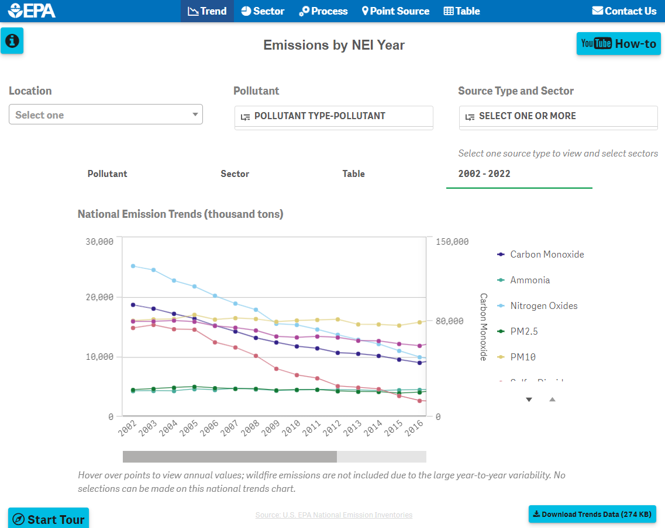
How to get the NEI Data?
2020 NEI Story Map: https://storymaps.arcgis.com/stories/d7d730f974c6474190b142a49ae8d3bd
See also main 2020 NEI page: https://www.epa.gov/air-emissions-inventories
Includes NEI Exploration Tool (at right)
Includes links to other ways to access

Slide 22
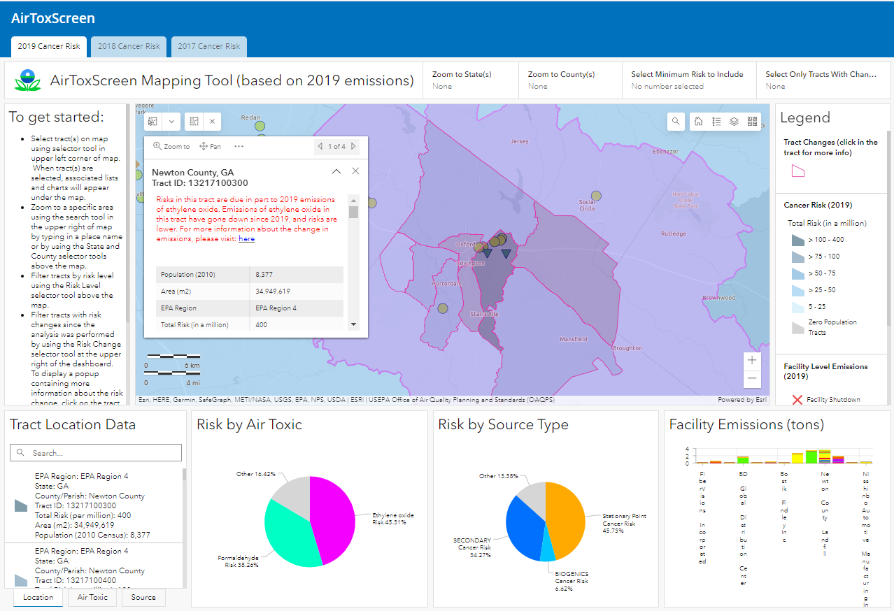
How to get the Risk Data?
2019 AirToxScreen: https://www.epa.gov/AirToxScreen/2019-airtoxscreen
Includes AirToxScreen mapping tool (shown at right)

Slide 23
AERR Proposal Comments and Questions
AERR website: https://www.epa.gov/air-emissions-inventories/air-emissions-reporting-requirements-aerr
You may submit written comments through October 18, 2023
Comments can be sent via www.regulations.gov, docket ID EPA-HQ-OAR-2004-0489
You may also send comments by email to a-and-r-docket@epa.gov or by Fax to (202) 566–9744. Be sure to include the docket ID number in the subject line.
Public hearing August 30, 1-3pm
Please see AERR website for link to hearing
Advanced registration has closed, but can join hearing via link on website. We may have time for others who want to speak
Clarifying questions can be sent to NEI_Help@epa.gov (Please include AERR in the subject line)

