Slide 1
EPA Tools and Resources Webinar:
Environmental Quality Index (EQI)
Alison K. Krajewski
US EPA Office of Research and Development
August 16, 2023
Office of Research and Development

Slide 2
Presentation Outline
Problem
Approach
Environmental Quality Index
  Data sources
  Methodology
  Examples
Impact
Take home messages

Slide 3
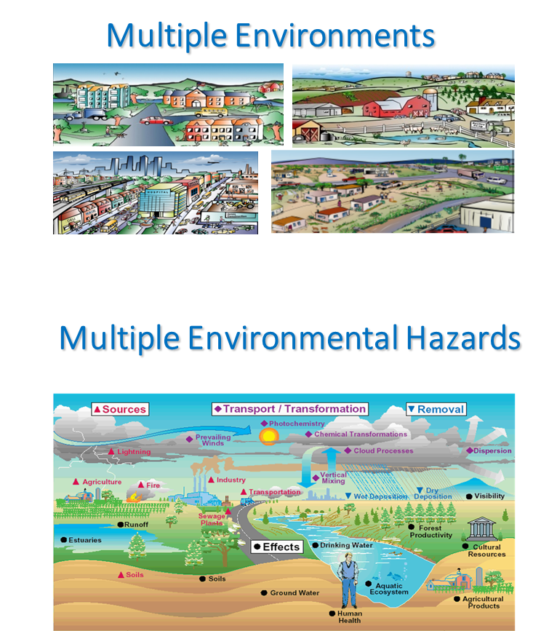
Problem
Human health and disease - a complex process
Exposures to harmful and benign substances occurring simultaneously
  Environmental exposures tend to cluster
No single exposure can be held responsible for good or poor health
Notes:
Clearly state the environmental and/or public health challenge, answering the question, “Why should I care?”
Present how the problem affects state environmental/public decision makers
It is encouraged to state the environmental statute and/or regulation that the project addresses

Slide 4
Approach
Construct an environmental quality index (EQI) for all counties in the U.S.

Slide 5
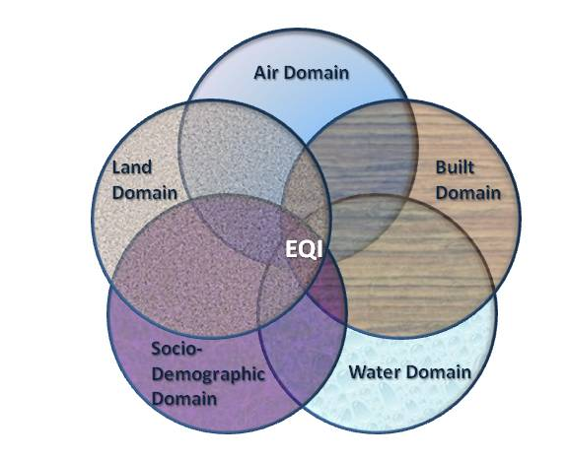
Environmental Quality Index
Multiple domains that influence exposure and health
  Five domains: air, water, land, built environment, and sociodemographic
Incorporates data representing chemical, natural, and built environment
Separate overall and domain indices by rural-urban status
Two county-level time periods available: 2000-2005 and 2006-2010
1

Slide 6
Data Sources

Slide 7
Air Domain
2000-2005 county EQI: 87 variables
2006-2010 county EQI: 43 variables
Representing criteria and hazardous air pollutants
Data sources
  EPA Air Quality System (AQS)
  National Air Toxics Assessments (NATA)
1
Lobdell DT, Jagai JS, Rappazzo K, Messer LC. Data sources for an environmental quality index: availability, quality, and utility. Am J Public Health. 2011 Dec;101 Suppl 1(Suppl 1):S277-85. doi: 10.2105/AJPH.2011.300184.

Slide 8
Water Domain
2000-2005 county EQI: 80 variables
2006-2010 county EQI: 51 variables
Representing overall water quality, general water contamination, recreational water use (2000-2005 only), domestic water use, drinking water quality, atmospheric deposition, drought, and chemical contamination
Data sources
  Watershed Assessment, Tracking & Environmental Results Database (WATERS)
  National Contaminant Occurrence Database (NCOD)
  National Atmospheric Deposition Program (NADP)
  USGS Water Use Estimates
  Drought Monitor Data
  Safe Drinking Water Information System (SDWIS new to 2006-2010)
Lobdell DT, Jagai JS, Rappazzo K, Messer LC. Data sources for an environmental quality index: availability, quality, and utility. Am J Public Health. 2011 Dec;101 Suppl 1(Suppl 1):S277-85. doi: 10.2105/AJPH.2011.300184.
1

Slide 9
Land Domain
2000-2005 county EQI: 26 variables
2006-2010 county EQI: 18 variables
Representing agriculture, pesticides, contaminants (2000-2005 only), facilities, radon, mining activity (new 2006-2010)
Data sources
  Census of Agriculture Full Report (Ag Census)
  EPA Geospatial Data Download Service (facilities data like National Priority List (NPL)
  National Geochemical Survey (2000-2005 only)
  National Pesticide Use Database
  Maps of Radon Zone
  Mine Safety and Health Administrations Mines Data Set (new 2006-2010)
1
Lobdell DT, Jagai JS, Rappazzo K, Messer LC. Data sources for an environmental quality index: availability, quality, and utility. Am J Public Health. 2011 Dec;101 Suppl 1(Suppl 1):S277-85. doi: 10.2105/AJPH.2011.300184.

Slide 10
Sociodemographic Domain
  2000-2005 county EQI: 12 variables
  2006-2010 county EQI: 11 variables
  Representing socioeconomic, crime, political character new 2006-2010), creative class representation (new 2006-2010)
  Data sources
    US Census
    Uniform crime reports
    Leip’s Atlas of US Presidential Elections (new 2006-2010)
    USDA Economic Research Service Creative Class County Codes (new 2006-2010)
Lobdell DT, Jagai JS, Rappazzo K, Messer LC. Data sources for an environmental quality index: availability, quality, and utility. Am J Public Health. 2011 Dec;101 Suppl 1(Suppl 1):S277-85. doi: 10.2105/AJPH.2011.300184.
1

Slide 11
Built Environment Domain
  2000-2005 county EQI: 14 variables
  2006-2010 county EQI: 5 variables
  Representing roads, highway/road safety, commuting behavior, business environment, subsidized housing environment, walkability (new 2006-2010), green space (new 2006-2010)
  Data sources
    Duns and Bradstreet North American Industry Classification System (NAICS) Codes
    Topologically Integrated Geographic Encoding and Referencing (TIGER) Data and NAVTEQ streets
    Fatality Annual Reporting System
    Housing and Urban Development
    US Census
    EnviroAtlas Green Space dataset (new 2006-2010)
    EPA’s National Walkability Index (new 2006-2010
Lobdell DT, Jagai JS, Rappazzo K, Messer LC. Data sources for an environmental quality index: availability, quality, and utility. Am J Public Health. 2011 Dec;101 Suppl 1(Suppl 1):S277-85. doi: 10.2105/AJPH.2011.300184.
1

Slide 12
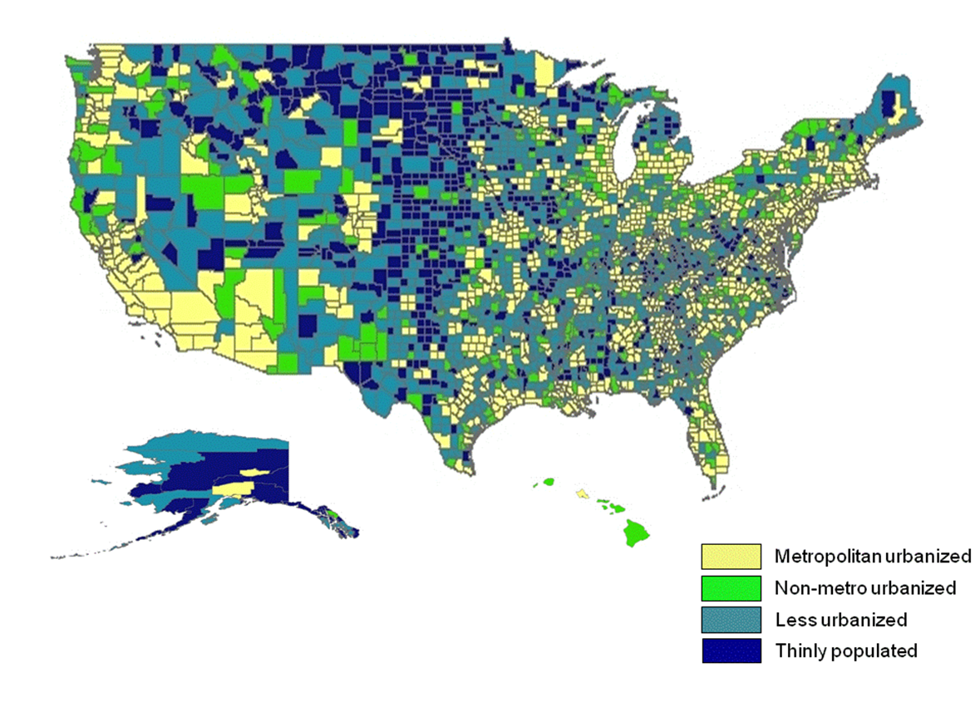
Rural-urban continuum code (RUCC) stratification for all counties in the US
1
Source: USDA, Measuring rurality: Rural-urban continuum codes.
Notes:
There are 9 RUCC categories defined by the USDA.
For the EQI, those 9 were collapsed to 4:
Codes 1-3 = RUCC1 = metropolitan urbanized
Codes 4-5 = RUCC2 = non-metropolitan urbanized
Codes 6-7 = RUCC3 = less urbanized
Codes 8-9 = RUCC4 = rural
For the RUCC-stratified EQI, the process described in the previous slide was re-done within each of the strata. Each RUCC has its own 5domain-specific EQIs and its own overall EQI.

Slide 13
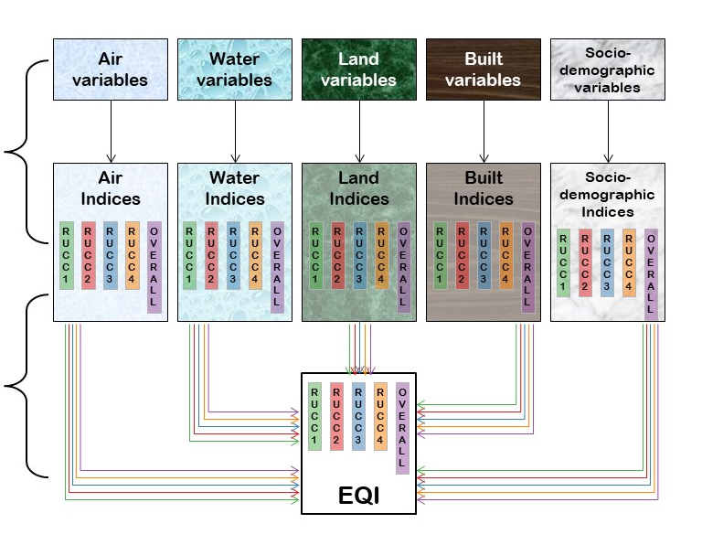
Conceptual Framework for Domain-Specific and Overall EQI Construction
Principal components analysis (PCA) reduced multiple variables into domain specific indices, for each rural-urban continuum code (RUCC) strata and overall
Domain specific indices combined using PCA to create EQI, for each RUCC strata and overall
1
Messer LC, Jagai JS, Rappazzo KM, Lobdell DT. Construction of an environmental quality index for public health research. Environ Health. 2014 May 22;13(1):39. doi: 10.1186/1476-069X-13-39.

Slide 14
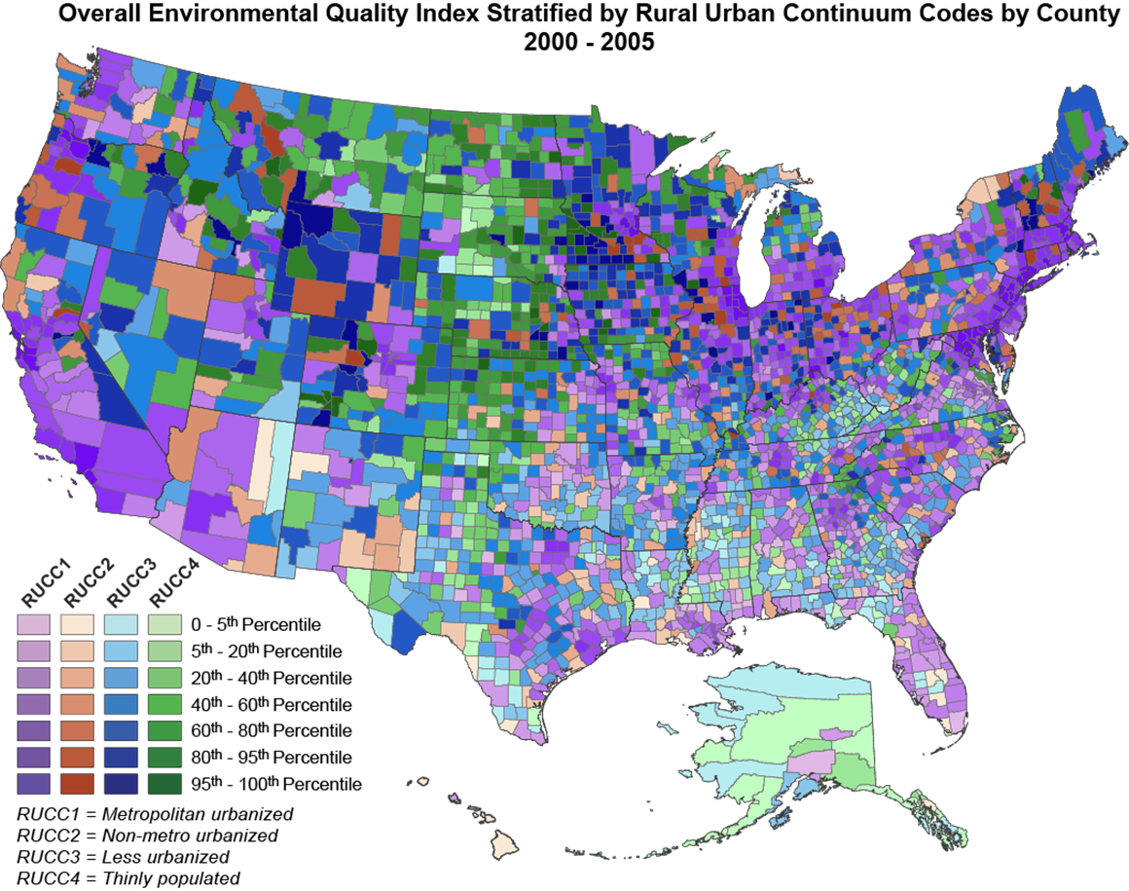
Overall EQI Stratified by RUCC by county, 2000-2005
1

Slide 15
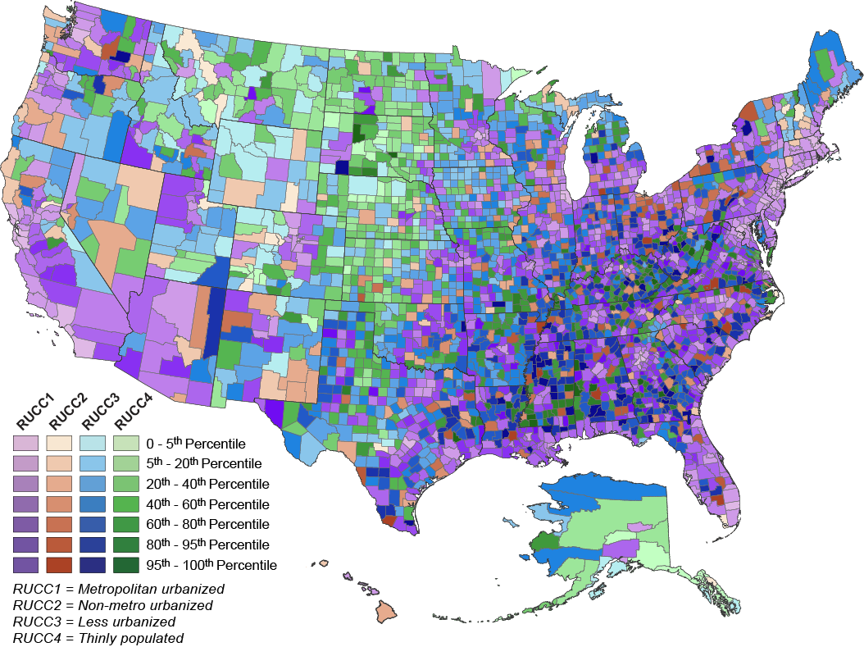
Overall EQI Stratified by RUCC by county, 2006-2010
1

Slide 16
EQI and Health Outcome Studies
Preterm birth (birth certificate records)
Mortality (death certificate records)
Control variable: birth outcomes related to hurricane exposure (birth certificate records)
Cancer (SEER)
Adult asthma (Truven MarketScan)
Infant mortality (linked infant mortality/birth certificate records)
Obesity and physical inactivity (NHIS)
End Stage Renal Disease (US Renal Data System)
Birth defects (NBDPS and Texas Department of State Health Services)
1

Slide 17
Public Access to the EQI
https://www.epa.gov/healthresearch/environmental-quality-index-eqi
1

Slide 18
2000-2005 County EQI and Health Outcome Studies

Slide 19
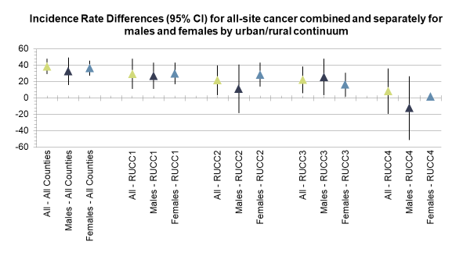
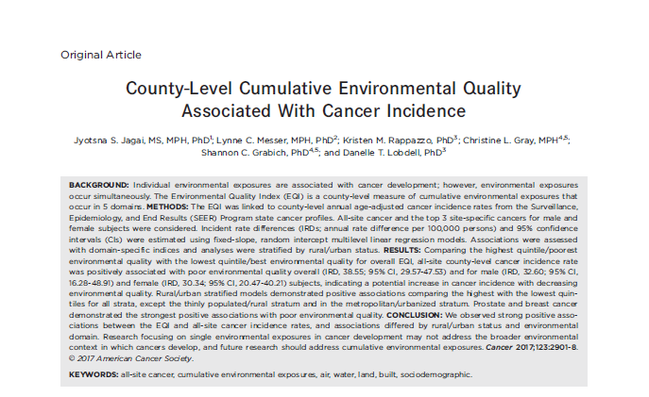
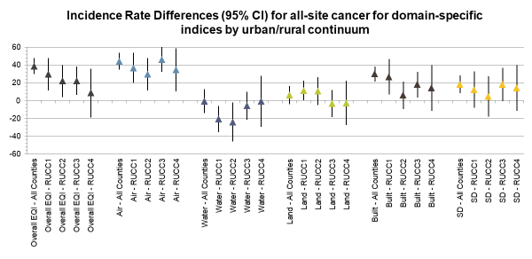
EQI and Cancer Incidence
1
Notes:
Jyotsna Jagai (at the time University of Illinois at Chicago and she is now at University of Chicago) led this study. Population-based cancer incidence rates were abstracted from National Cancer Institute state cancer profiles. We assessed the relationships between county-level exposures representing the period 2000-2005 and age adjusted cancer incidence rates representing the period 2006-2010 to account for the lag in cancer development. We also stratified by male/female. We used quintiles for the EQI. I am showing here only the results for the incidence rate difference for the highest quintile/worst environmental quality with best environmental quality quintile used as reference.
Counties with poor environmental quality demonstrated a higher incidence of cancer cases—on average 39 more cases per 100,000 people—than counties with good environmental quality over the study period.
Counties with poor environmental quality demonstrated a higher incidence of cancer cases in males—on average 30 more cases per 100,000 people—than counties with good environmental quality over the study period.
Counties with poor environmental quality demonstrated a higher incidence of cancer cases in females—on average 33 more cases per 100,000 people—than counties with good environmental quality over the study period.
RUCC stratified models demonstrated positive associations for males and females in most strata except in thinly populated (RUCC4)
In domain-specific analyses, the strongest positive associations were seen in the air domain across all strata of the urban/rural continuum.
The built and sociodemographic domains also demonstrated positive associations across RUCC.
In general, effect estimates for site-specific cancers for both male and female subjects were negative or near null (Supporting Fig. 1). However, both prostate cancer and breast cancer demonstrated positive
associations when comparing the highest quintile/poorest environmental quality to the lowest quintile/best environmental quality for the overall EQI (IRD, 10.17; 95% CI, 0.84-19.50; and IRD, 7.29; 95% CI, 3.05-11.54, respectively).

Slide 20
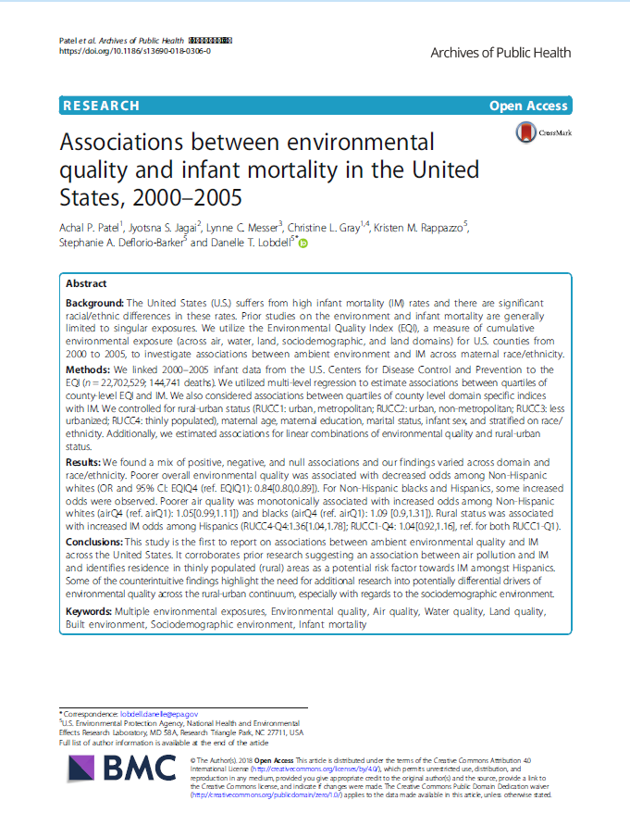
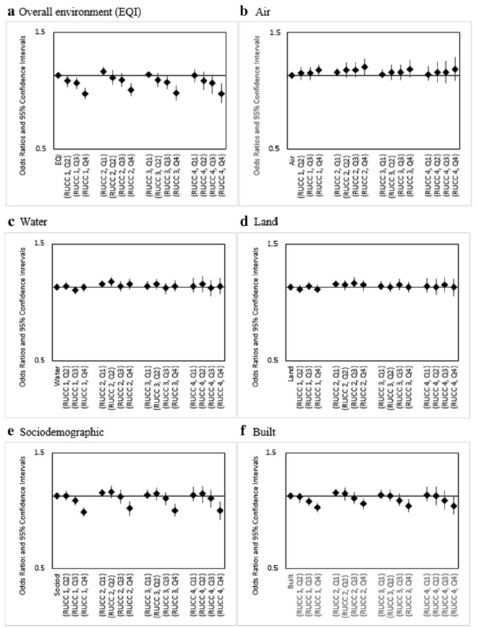
EQI and Infant Mortality
Adjusted ORs (95% CI) for linear combinations of overall EQI/domain-specific indices and rural-urban status for infants of Non-Hispanic
White mothers, United States (2000–2005). RUCC 1: metropolitan urbanized areas, RUCC 2: non-metropolitan urbanized areas, RUCC 3: less
urbanized, RCC 4: thinly populated areas. Both the overall EQI (a) and the five domain-specific indices (b-f) were modeled as quartiles, with the
first quartile indicating best quality and the fourth indicating worst
1

Slide 21

Obesity and Physical Activity Modified by EQI
Air Water Land Built SD
1
Notes:
This study was led by Chris Gray who was an ORISE fellow at the time who is now at Duke. She linked county-level Behavioral Risk Factor Surveillance System data for obesity and leisure time physical inactivity with the EQI. She estimated the association between age-adjusted LTPIA and age-adjusted obesity across tertiles of the EQI
In worst cumulative quality environments, the obesity prevalence associated with Leisure time physical inactivity (TPIA) in the overall population is much higher in the worst quality environments (PD: 0.645 (95% CI: 0.599, 0.690) compared to best quality environments (PD = 0.341 (95% CI: 0.287, 0.396)), and this finding holds among both males and females. When looking at domains, air, water, built and sociodemographic domains showed effect measure modification with worst quality environments.

Slide 22
2006-2010 County EQI and Health Outcome Studies

Slide 23
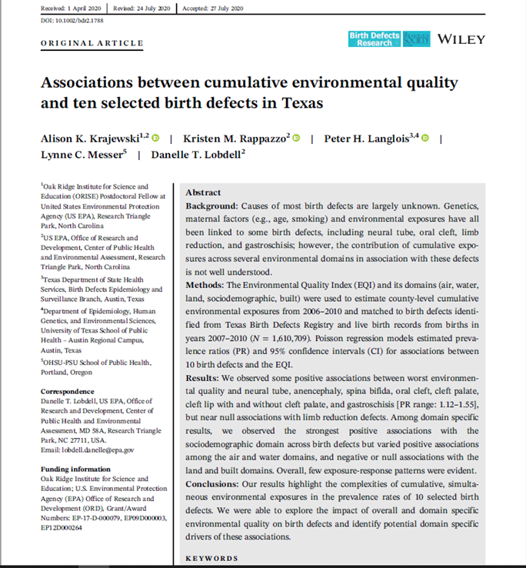
EQI and Birth Defects
Adjusted prevalence ratios and 95% CIs for associations between overall EQI (2006–2010), using lowest category (<25%, better environmental quality) as the reference, and 10 selected birth defects (2007–2010) with worsening environmental quality increasing from top to bottom.
1
Notes:
This work was led by Alison Krajewski. We collaborated with the Texas Department of Health using the Texas Birth Defect Registry data. We examined 10 selected birth defects listed here. This study was focused only on the state of Texas.
When assessing the associations between cumulative environmental quality and 10 selected birth defects, we observed positive associations with the worst overall environmental quality and most of the selected birth defects. Specifically, neural tube, anencephaly, spina bifida, oral cleft, cleft palate, cleft lip with and without cleft palate, and gastroschisis.

Slide 24
EQI and Birth Defects, continued
1
Air Domain
Notes:
We observed varied associations between the domain specific indices and birth defects. Here I show Air Domain and Sociodemographic Domain.
The strongest associations with the air domain were observed in the third quartile of the air domain for neural tube, anencephaly, oral cleft and cleft lip with and without cleft palate, but in the second quartile for limb reduction and longitudinal limb reduction defects.
The associations with the sociodemographic domain were mostly positive; however, the patterns of association across the selected birth defects varied. In general, upper quartiles showed PRs elevated from the null compared to the lowest quartile of sociodemographic domain exposure for anencephaly, oral cleft defects, and limb reduction defects; however, the highest magnitude effect was observed with the second quartile, with decreasing magnitude with each higher category

Slide 25
EQI and Birth Defects, continued
1
Sociodemographic Domain
Notes:
We observed varied associations between the domain specific indices and birth defects. Here I show Air Domain and Sociodemographic Domain.
The strongest associations with the air domain were observed in the third quartile of the air domain for neural tube, anencephaly, oral cleft and cleft lip with and without cleft palate, but in the second quartile for limb reduction and longitudinal limb reduction defects.
The associations with the sociodemographic domain were mostly positive; however, the patterns of association across the selected birth defects varied. In general, upper quartiles showed PRs elevated from the null compared to the lowest quartile of sociodemographic domain exposure for anencephaly, oral cleft defects, and limb reduction defects; however, the highest magnitude effect was observed with the second quartile, with decreasing magnitude with each higher category

Slide 26
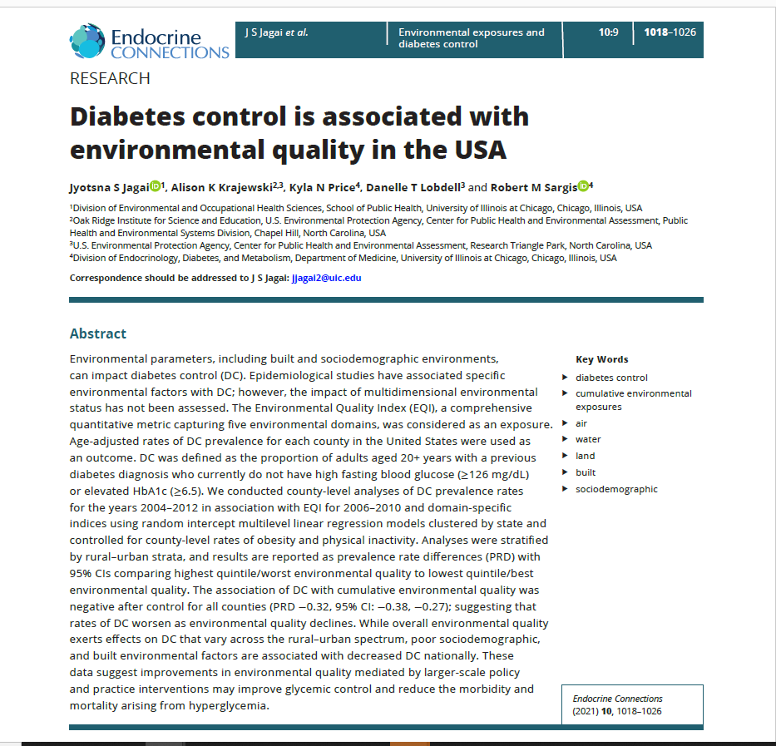
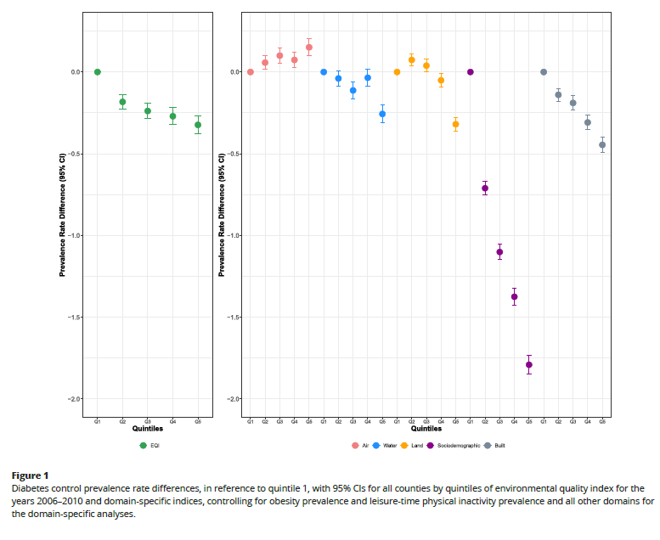

EQI and Diabetes Control
1
Notes:
This work was led by Jyotsna Jagai who is at the University of Chicago. Using the 2006–2010 EQI, we found that the prevalence of diabetes control, a positive outcome, decreased as environmental quality decreased with a prevalence rate difference of −0.32; suggesting that if a county were to improve from the quintile with the poorest environmental quality to that with the best environmental quality, the prevalence of diabetes control will improve by 0.32 per 100,000 population.
Associations varied across environment-specific domains. The air domain was associated with an increased prevalence of DC. The strongest associations were seen with the sociodemographic domain.
When examining results across RUCC, this table summarizes what was observed. For Overall EQI, saw a decrease in DC for all of the RUCC’s. For the Water, Land and Sociodemographic domains we saw decrease in diabetes control with decrease in environmental quality for all RUCC’s.
The association of diabetes control, a positive outcome, with cumulative environmental quality is negative after controlling for obesity and leisure-time physical inactivity for all counties (PRD −0.32, 95% CI: −0.38, −0.27) (Fig. 1), suggesting rates of DC decrease with worse environmental quality.
We used a random intercept mixed-effect linear model, clustered by state, to estimate the fixed effects of EQI quintiles and environmental domain-specific quintiles on DC prevalence annually. We clustered by the state in order to account for policies in funding for and care of diabetes which may vary at the state level. We conducted analyses using quintiles, which allow for more meaningful interpretation
between areas of good (1st quintile), moderate (3rd quintile), and poor (5th quintile) environmental quality.
FYI… If I need to go into this…..When we examined Diabetes and EQI found mixed results: Comparing counties in the highest quintile/poorest environmental quality to those in the lowest quintile/best environmental quality, counties with poor environmental quality demonstrated lower total diabetes prevalence rates. Associations varied by rural– urban strata; overall better environmental quality was associated with lower total diabetes
prevalence rates in the less urbanized and thinly populated strata. When considering all counties, good sociodemographic environments were associated with lower total diabetes prevalence rates (prevalence difference 2.77, 95% confidence interval 2.71–2.83), suggesting that counties with poor sociodemographic environments have an annual prevalence rate 2.77 per 100,000 persons higher than counties with good sociodemographic environments.

Slide 27
Ongoing Activities
Census tract version
Examining EQI and redlining
Create community-level EQI in partnership with community
1

Slide 28
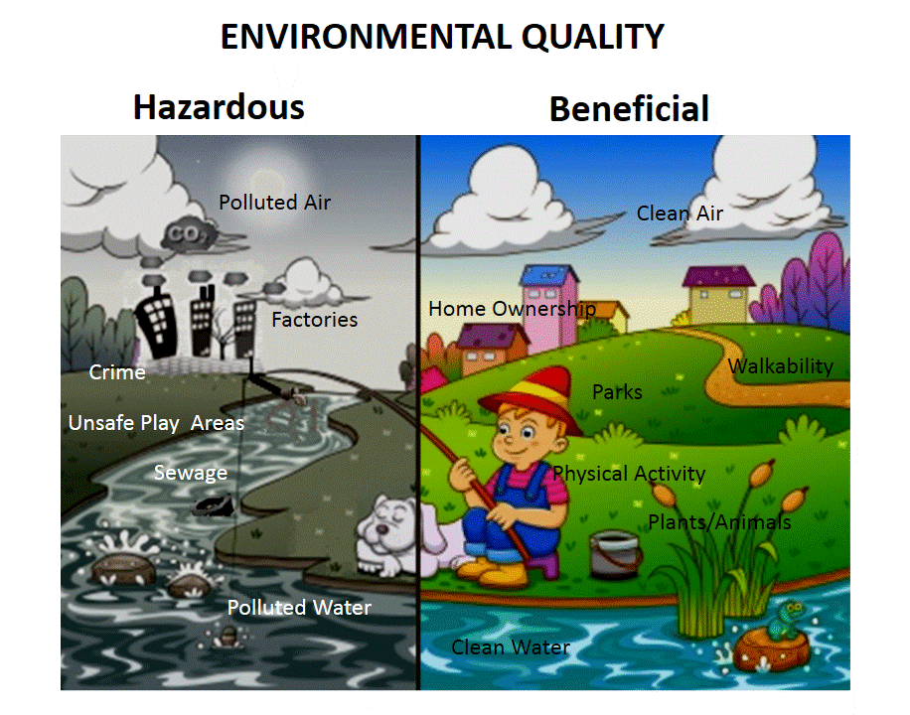
Impact
Developed to explore:
  Associations with adverse health effects
  How various environmental factors contribute in concert to health disparities in low-income, underrepresented minority and vulnerable populations
Results from studies can be used for hypothesis generating studies to explore cumulative exposures in communities
  Help communities prioritize interventions
Characterizing environmental quality across the US
1

Slide 29
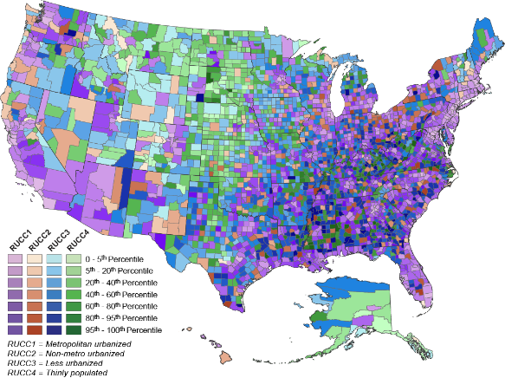
Take Home Messages
EQI:
Characterize environmental quality across US
Indicator of ambient conditions/exposure in environmental health modeling
Multiple domains that influence exposure and health
Public access: https://www.epa.gov/healthresearch/environmental-quality-index-eqi
1

Slide 30
Contact
Danelle Lobdell (PI)
Chief, Epidemiology Branch
Center for Public Health and Environmental Assessment
US EPA Office of Research and Development
lobdell.danelle@epa.gov
919-843-4434
Alison Krajewski (Presenter)
Epidemiologist
Center for Public Health and Environmental Assessment
US EPA Office of Research and Development
krajewski.alison@epa.gov
28
The views expressed in this presentation are those of the authors and do not necessarily reflect the views or policies of the US EPA. Any mention of trade names, products, or services does not imply an endorsement by the US Government or EPA. EPA does not endorse any commercial products, services, or enterprises.

Slide 31
Acknowledgements
GIS contractors
  Mark K Murphy
  Suzanne Pierson
  Barbara Rosenbaum
  Steven Jett
Former EPA
  Rachel Winegardner (EPA/CPHEA)
Former ORISE and Student Contractors
  Achal Patel
  Kyle Messier
  Genee Smith
  Yun Jian
  Shannon Grabich
  Ryan Siebens
  Grace DiCecco
Study team
  Danelle Lobdell (EPA/CPHEA)
  Kristen Rappazzo (EPA/CPHEA)
  Alison Krajewski (EPA/CPHEA)
  Stephanie DeFlorio-Barker (EPA/CPHEA)
  Tom Luben (EPA/CPHEA)
  Kathleen Torso (EPA/CPHEA)
  Anne Weaver (EPA/CPHEA)
  Lynne Messer (OHSU-PSU School of Public Health)
  Jyotsna Jagai (MacArthur Foundation)
  Christine Gray (Duke University)
  Monica Jimenez (ORISE Post-doctoral fellow)
  Dashel Nance (ORAU Student Contractor)
  Eric Brown(ORAU Student Contractor)
1

Slide 32
Publications
Lobdell DT, Jagai JS, Rappazzo K, Messer LC. (2011) Data sources for environmental assessment: determining availability, quality and utility, American Journal of Public Health Suppl 1:S277-85
Messer LC, Jagai JS, Rappazzo KM, Lobdell DT. (2014) Construction of an environmental quality index for public health research. Environmental Health 13:39 DOI: 10.1186/1476-069X-13-39.
Rappazzo KM, Messer LC, Jagai JS, Gray CL, Grabich SC, Lobdell DT. (2015) The association between environmental quality and preterm birth in the United States, 2000-2005: a cross-sectional analysis. Environmental Health 14:50 doi:10.1186/s12940-015-0038-3
Grabich, S. C., Horney, J., Konrad, C., & Lobdell, D. T. (2015). Measuring the Storm: Methods of Quantifying Hurricane Exposure with Pregnancy Outcomes. Natural Hazards Review, doi: 10.1061/(ASCE)NH.1527-6996.0000204
Grabich, Rappazzo, Gray, Jagai, Jian, Messer, Lobdell. (2016) Additive interaction between heterogeneous environmental quality domains (air, water, land, sociodemographic and built environment) on preterm birth. Frontiers in Public Health http://dx.doi.org/10.3389/fpubh.2016.00232
Jian Y, Messer LC, Jagai JS, Rappazzo KM, Gray CL, Grabich SC, Lobdell DT. (2017) The associations between environmental quality and mortality in the contiguous United States 2000-2005. Environmental Health Perspectives 125:355-362 http://dx.doi.org/10.1289/EHP119
Jagai JS, Messer LC, Rappazzo KM, Gray CL, Grabich SC, Lobdell DT. (2017) County-level cumulative environmental quality associated with cancer incidence. Cancer http://dx.doi.org/10.1002/cncr.30709
Jian Y, Wu CYH, Gohike JM (2017) Effect modification by environmental quality on the association between heatwaves and mortality in Alabama, United States. International Journal of Environmental Research and Public Health 14:1143 https://doi.org/10.3390/ijerph14101143
Gray CL, Lobdell DT, Rappazzo KM, Jian Y, Jagai JS, Messer LC, Patel AP, DeFlorio-Barker SA, Lyttle C, Solway J, Rzhetsky A. (2018) Associations between environmental quality and adult asthma prevalence in medical claims data. Environmental Research 166: 529-536 https://doi.org/10.1016/j.envres.2018.06.020
Gray CL, Messer LC, Rappazzo KM, Jagai JS, Grabich SC, Lobdell DT. (2018) The association between physical inactivity and obesity is modified by five domains of environmental quality in U.S. adults: A cross-sectional study. PLoS One. https://doi.org/10.1371/journal.pone.0203301
Patel AP, Jagai JS, Messer LC, Gray CL, Rappazzo KM, Deflorio-Barker SA, Lobdell DT. (2018) Associations between environmental quality and infant mortality in the United States, 2000-2005. Archives of Public Health 76:60. https://doi.org/10.1186/s13690-018-0306-0
Kosnik MB, Reif DM, Lobdell DT, Astell-Burt T, Feng X, Hader JD, Hoppin JA. (2019) Associations between access to healthcare, environmental quality, and end-stage renal disease survival time: proportional-hazards models of over 1,000,000 people over 14 years PLoS One. https://doi.org/10.1371/journal.pone.0214094
Jagai JS, Krajewski AK, Shaikh S, Lobdell DT, Sargis RM. (2020) Association between environmental quality and diabetes in the USA. Journal of Diabetes Investigation 11(2):315-324. https://doi.org/10.1111/jdi.13152
Krajewski AK, Rappazzo KM, Langlois PH, Messer LC, Lobdell DT. (2021) Associations between cumulative environmental quality and ten selected birth defects in Texas. Birth Defects Res. 113:161-172. doi: 10.1002/bdr2.1788. Epub 2020 Aug 31 PMID: 32864854.
Jagai JS, Krajewski AK, Price KN, Lobdell DT, Sargis RM. (2021) Diabetes control is associated with environmental quality in the USA. Endocrine Connections. doi: https://doi.org/10.1530/ec-21-0132
Nance D, Rappazzo KM, Jensen ET, Hoffman K, Cotton CC, Krajewski AK, Turner KO, Genta RM, Lobdell DT, & Dellon ES. (2021) Increased risk of eosinophilic esophagitis with poor environmental quality as measured by the Environmental Quality Index. Diseases of the Esophagus doi: https://doi.org/10.1093/dote/doab041
1

Slide 33
Thank you!
Questions

