Slide 1
Welcome! The live event will start shortly.
Audio is available online with your device or by telephone.
  Optional dial in: +1 646 828 7666
  Meeting ID: 161 455 0436
  Q&A: Please submit questions via the “Q&A” box.
A recording of today’s webinar will be posted.

Slide 2
FY24 Guidelines for Technical Assistance to Tribal Nations and Entities Addressing Brownfields Grant
EPA Office of Brownfields and Land Revitalization
September 11, 2023

Slide 3
Welcome
Webinar Purpose: Assist applicants with understanding the FY2024 Guidelines for Technical Assistance to Tribal Nations and Entities Addressing Brownfields Grant
Disclaimer: NOFO (Notice of Funding Opportunity) guidelines supersede any information provided in this presentation or by the presenters

Slide 4
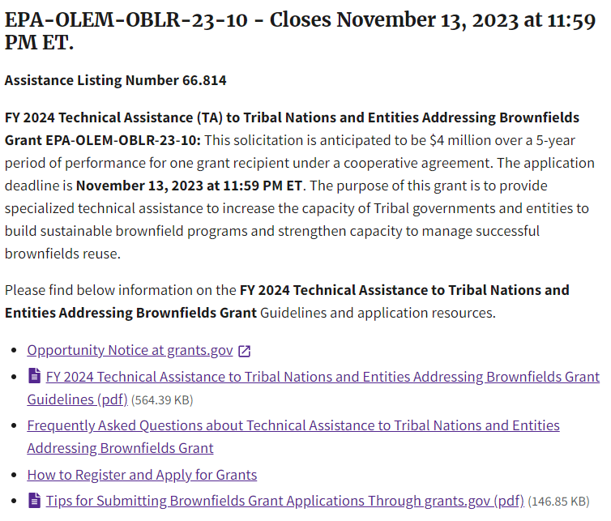
Useful Links
Technical Assistance to Tribal Nations and Entities Addressing Brownfields Grant Opportunity Page:
www.epa.gov/brownfields/fy-2024-grant-guidelines-technical-assistance-tribal-nations-and-entities-addressing
Apply on Grants.gov:
www.grants.gov/web/grants/view-opportunity.html?oppId=350042
FY24 Frequently Asked Questions:
  www.epa.gov/brownfields/fy-2024-frequently-asked-questions-about-technical-assistance-tribal-nations-and
Grants.gov Tip Sheet:
www.epa.gov/system/files/documents/202308/Grants.gov%20Tip%20Sheet_Aug%202023_0.pdf

Slide 5
Webinar Agenda
General Information
Overview of Grant and Background
Application Process
  Submitting Your Application in Grants.gov
  Application Content
    Narrative Information Sheet
    Threshold Criteria
    Ranking Criteria/Narrative and Milestones
Next Steps
Questions

Slide 6
Grant Overview – Timeline
Anticipated Timeline:
  November 13, 2023: Application submission deadline
  February 2024: Selection announced
  Spring 2024: Workplan and grant paperwork finalized
  Spring 2024: Cooperative Agreement awarded/funds become available
The submission due date will not change, however,
other dates listed above are subject to change.

Slide 7
Background
Goals
Provide nationwide technical assistance to:
Federally recognized Indian Tribes,
Alaska Native Villages,
Alaska Native Regional Corporations,
Alaska Native Village Corporations,
the Metlakatla Indian community, and
Intertribal Consortia.
Note: There are currently 574 Federally Recognized Tribes, and there are many names that these sovereign nations use to describe their culture, history, and geography, including Tribe, Village, Nation, Band, and Pueblo. For the purpose of this webinar, the EPA Brownfields Program uses “Tribe” and “Tribal Nation” as all-encompassing terms.

Slide 8
Background
Goals Continued
To increase the capacity of Tribal Nations and Entities to build sustainable brownfield programs and manage successful brownfields reuse in the following areas:
Build partnerships to support reuse of Tribal lands (e.g., housing, recreation, finance, etc.);
Build Tribal expertise for safely reusing brownfield sites through outreach, training and coaching;
Connect Tribal members with experienced Tribal environmental response professionals who have experience in brownfields assessment, cleanup and reuse;
Facilitate meetings between Tribal members, developers, lenders, and others involved in the cleanup and reuse of brownfield properties; and
Facilitate brownfield reuse efforts by supporting Tribal community and other stakeholder involvement activities including development of fact sheets and other outreach materials.

Slide 9
Overview of the Grant
Grant Details
Funding: up to $4,000,000
Period of Performance: 5-year period of performance
Awards: 1
Type of Award: Cooperative Agreement

Slide 10
Who is Eligible to Apply?
Intertribal Consortia
Nonprofit organization exempt from taxation under Section 501(c)(3)
Limited liability corporation in which all managing members are 501(c)(3) nonprofit organizations or limited liability corporations whose sole members are 501(c)(3) nonprofit organizations
Limited liability partnership in which all general partners are 501(c)(3) nonprofit organizations or limited liability corporations whose sole members are 501(c)(3) nonprofit organizations
Other Nonprofit organizations

Slide 11
Overview of the Grant
Applications must include how the applicant will provide technical assistance in each of the five general subject areas described below:
Facilitate Storytelling and Promote Collaboration About Brownfields Reuse
Assist Tribal Nations and Entities in Understanding and Building Tribal Response Programs
Science and Technology Relating to Brownfields Assessment, Remediation, and Site Preparation for Safe and Resilient Reuse
Integrated Approaches to Brownfields Cleanup and Reuse
Brownfields Finance and Planning Strategies for Tribal Nations and Entities
See Section I.A. for further information on subject areas.

Slide 12
Overview of the Grant
5 Subject Areas
Facilitate Storytelling and Promote Collaboration About Brownfields Reuse
Demonstrate and highlight new approaches for storytelling, meaningful involvement, including youth engagement in brownfield site program activities
Activities should help build case studies and help Tribal Nations and entities share success stories through a variety of formats

Slide 13
Overview of the Grant
5 Subject Areas
Assist Tribal Nations and Entities in Understanding and Building Tribal Response Programs
    Address how to support Tribal Nations and entities in meeting the four statutory criteria outlined in CERCLA § 128(a). The four elements are:
    1) timely survey and inventory of brownfield sites in state or Tribal land,
    2) oversight and enforcement authorities, or other mechanisms and resources,
    3) mechanisms and resources to provide meaningful opportunities for public participation, and
    4) mechanisms for approval of a cleanup plan and verification and certification that cleanup is complete
    Demonstrate the benefits of having a Tribal Response Program, and how demonstrating benefits can build support for the program

Slide 14
Overview of the Grant
5 Subject Areas
Science and Technology Relating to Brownfields Assessment, Remediation, and Site Preparation for Safe and Resilient Reuse
    Focus on assessment and inventory methods, site mapping, site prioritization, development of a site prioritization scheme/methodology, sampling and cleanup methods, institutional controls and long-term stewardship to ensure long-term protection of human health and the environment, and risk assessment methods and policies
    Review and explain technical reports; provide information about basic science, environmental policy, and other technical matters; and help in understanding health risks associated with a brownfield site
    Help in drafting and reviewing requests for proposals and bids when competing contracts

Slide 15
Overview of the Grant
5 Subject Areas
Integrated Approaches to Brownfields Cleanup and Reuse
    Address linkages between environmental, economic, cultural, and social issues at brownfield sites
    Empower Tribal Nations and entities to pursue brownfield site planning, cleanup, and reuse and increase coordination among such efforts including prevention of future brownfield sites
    Provide information to assist to better understand environmental issues and how these issues affect brownfield cleanup and redevelopment

Slide 16
Overview of the Grant
5 Subject Areas
Brownfields Finance and Planning Strategies for Tribal Nations and Entities
Address finance and quality of life associated with brownfields cleanup and reuse (facilitating visioning and reuse sessions and assisting Tribes in finding other funding sources that facilitate cleanup and reuse of brownfield sites)
Note: Recipients will need to coordinate with other Federal technical assistance providers, such as Technical Assistance to Brownfields Communities, EJ Thriving Communities Technical Assistance Centers (TCTACs), and Environmental Finance Centers.

Slide 17
Questions & Progress Check
General Information
Overview of the Grant
Application Process
  Submitting Your Application in Grants.gov
  Application Content
    Narrative Information Sheet
    Threshold Criteria
    Ranking Criteria/Narrative and Milestones
Next Steps
Questions

Slide 18
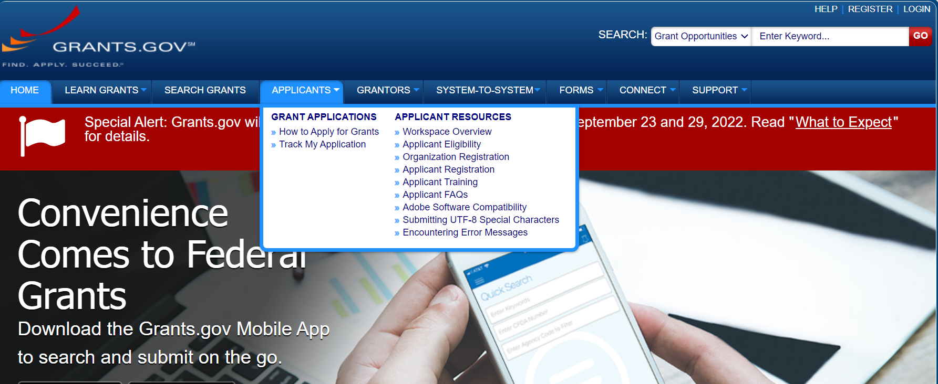

Submitting Your Application Package
Applications are due November 13, 2023 at 11:59 PM ET
via Grants.gov
Grants.gov Tip Sheet
Grants.gov Resources for Applicants

Slide 19



Requirements to Submit an Application
Requirement | Accept | Reject
Active www.sam.gov account through November 13, 2023 | The account is active and matches the applying entity’s info | Inactive/expired account Account is being updated, but is in “processing” status
Obtain a Unique Entity Identifier (UEI) generated in http://www.sam.gov/ | The same UEI must be used on future applications | Another organization’s/ department’s UEI is listed on the Standard Form 424
Active www.grants.gov account | Associated with same, correct UEI number | Application is not submitted through Grants.gov solely due to an incomplete registration/inactive account
Submission by the Authorized Organization Representative (AOR) | Designated in Grants.gov by the E-business POC (listed in sam.gov) Has a Grants.gov account Submits the application in Grants.gov | Someone other than the designated AOR submits the application
UEI replaced the DUNS requirement.
See more information at https://sam.gov/content/duns-uei

Slide 20
Your www.grants.gov Application Package
REQUIRED FORMS
1. Application for Federal Assistance (SF-424)
2. Budget Information for Non-Construction Programs (SF-424 A)
3. Preaward Compliance Review Report (EPA Form 4700-4)
[Guidance on how to complete this form is available at www.epa.gov/grants/tips-completing-epa-form-4700-4.]
4. EPA Key Contacts (Form 5700-54)
5. Project Narrative Attachment Forms, as one file, and include:
  Narrative Information Sheet
  Responses to Threshold Criteria
    Required Attachments (as applicable)
  Narrative (responses to ranking criteria)
    Milestones Schedule
OPTIONAL FORMS
1. Grants.gov Lobbying Form – To be submitted by applicants requesting more than $100,000 of EPA grant funding.
2. Negotiated/Proposed Indirect Cost Rate Agreement – submit using the Project Narrative Attachment Form.
EPA Forms can be found at: www.epa.gov/grants/epa-grantee-forms
A workplan is not required at time of submission. The applicant that is selected for funding will negotiate a workplan with EPA before the cooperative agreement is awarded.

Slide 21
Exceptions to Applying through Grants.gov
Limited or No Access to Internet
Must request a waiver at least 15 calendar days before the deadline
EPA must approve the request
  See procedures in Appendix 1 of NOFO Guidelines
There is no guarantee EPA will approve the request.
Every effort must be made to complete all prerequisites in order to apply through www.grants.gov.

Slide 22

The Application Has Been Submitted – Now What?
After signing and successfully submitting the application package, within 24 to 48 hours the AOR should receive a series of notification emails from www.grants.gov.
If the AOR did not receive notification emails or the application package did not transmit successfully, immediately contact the www.grants.gov Help Desk (open 24/7; except federal holidays) at 1-800-518-4726. Make sure to get a case number.
Applications that are not successfully submitted and ‘validated’ by the deadline will be considered late and will be rejected.

Slide 23
Questions & Progress Check
General Information
Overview of the Grant
Application Process
  Submitting Your Application in Grants.gov
  Application Content
    Narrative Information Sheet
    Threshold Criteria
    Ranking Criteria/Narrative and Milestones
Next Steps
Questions

Slide 24
Application Content
Applications must conform to the following outline:
  Narrative Information Sheet (3-page limit) Section IV.D.
  Threshold criteria responses Section III.C.
    Eligibility and/or contractor documentation, if applicable
  Narrative (15-page limit) Section IV.E.
  Milestones schedule (does not count towards 15-page limit)
These are the documents you will add to the Project Narrative Attachment Form in grants.gov
Applications exceeding the page limit will not be reviewed
  8 ½ x 11 inches paper size
  Use standard Times New Roman, Arial, or Calibri fonts with a 12-point font size
Application materials must be submitted in English
Photos and graphics will not be considered

Slide 25
Application Content
Narrative Information Sheet
Applicant Identification
Funding Requested
Project Contacts
Cooperative Partners
EPA’s Plan to Release Copies of Applications
  Place on official letterhead
  3-page limit
  Do not include a project summary/overview

Slide 26
Application Content
Narrative Information Sheet
Applicant Identification
  Name and address of entity applying for funds
  Applicant’s Unique Entity Identifier (UEI) Number
Funding Requested
  Grant Type Indicate “Technical Assistance to Tribal Nations and Entities Addressing Brownfields Grant”
  Include the amount being requested
  Must not exceed $4,000,000

Slide 27
Application Content
Narrative Information Sheet
Project Contacts
  Project Director → Name, phone number, email, mailing address
  Chief Executive → Name, phone number, email, mailing address
Cooperative Partners
  Name, phone numbers, email, and mailing address

Slide 28

Application Content
Narrative Information Sheet:
Certifying Confidential Information
EPA’s Plan to Release Copies of Applications
EPA may post submitted applications on our website after the award is announced in February of 2024.
EPA recommends that applications not include trade secrets or commercial or financial information that is confidential or privileged, or sensitive information, if disclosed, that would invade another individual’s personal privacy (e.g., an individual’s salary, personal email addresses, etc.).
On the Narrative Information Sheet…Clearly indicate which portion(s) of the application you are claiming as confidential, privileged, or sensitive information, or state ‘n/a’ or ‘not applicable’ if application does not have confidential, privileged, or sensitive information.
Information that is claimed as confidential, privileged, or sensitive will be redacted before release.
Review Section IV.D. for more information on the Narrative Information Sheet

Slide 29
Questions & Progress Check
General Information
Overview of the Grant
Application Process
  Submitting Your Application in Grants.gov
  Application Content
    Narrative Information Sheet
    Threshold Criteria
    Ranking Criteria/Narrative and Milestones
Next Steps
Questions

Slide 30
Application Content
Threshold Criteria
Threshold criteria are evaluated on a pass/fail basis
Applicant Eligibility
Project Eligibility/Five Subject Areas
Procurement and Documents (if applicable)
Substantial Conformity
Submission of Applications via Grants.gov
Reminder: The threshold criteria will not count against the 15-page narrative limit of the Narrative nor the 3-page limit of the Narrative Information Sheet, and does not have an individual page limitation.

Slide 31
Application Content
Threshold Criteria
Threshold criteria are evaluated on a pass/fail basis
Applicant Eligibility (Section III.A.)
Eligible entities include:
  Intertribal Consortia (comprised of eligible Indian Tribes)
  Nonprofit organization exempt from taxation under Section 501(c)(3)
  Limited liability corporation (all managing members or sole members are 501(c)(3) nonprofit organizations)
  Limited liability partnership (all general partners or sole members are 501(c)(3) nonprofit organizations)
  Other Nonprofit organizations
Eligible nonprofit entities must attach documentation/evidence of nonprofit status under Federal, state or Tribal law, as applicable.
Intertribal consortia must attach documentation that they meet the requirements in 40 CFR 35.504(a) and (c). All members of the Intertribal consortium must authorize submission of an application to provide nationwide technical assistance.

Slide 32
Application Content
Threshold Criteria
Project Eligibility/Five Subject Areas
Applicants must clearly describe approaches/activities to address all five of the proposed subject areas as described in Section I.A.
Procurement and Documents (if applicable)
  Applicants must disclose whether they have already selected a contractor that will be compensated with EPA funds
  Provide a copy (or link to) to the solicitation documents and the signed executed contract, or state 'n/a' or 'not applicable' if a contractor has not been procured.
  Substantial Conformity
  Ensure that you have conformed with the formatting requirements set forth in Section IV.C.
  Submission of Applications
  Applications must be submitted through www.grants.gov by 11:59 p.m. ET on November 13, 2023.
Review Section III.C. for more information on Threshold Criteria
32

Slide 33

Application Content
Threshold Criteria
Failing Threshold Criteria means your application will not move forward

Slide 34
Questions & Progress Check
General Information
Overview of Grant
Application Process
  Submitting Your Application in Grants.gov
  Application Content
    Narrative Information Sheet
    Threshold Criteria
    Ranking Criteria/Narrative and Milestones
Next Steps
Questions

Slide 35
Application Content
Narrative/Ranking Criteria
Application must have passed all threshold criteria to be ranked
The Narrative includes responses to all 7 ranking criteria (125 points total)
    Project Description (45 Points)
    Organizational Knowledge/Experience/Expertise (30 Points)
    Past Performance (10 Points)
    Community Need (10 Points)
    Budget/Resources (15 Points)
    Performance Measurement: Anticipated Outcomes and Outputs (5 Points)
    Leveraging (10 Points)
Applications that do not provide any response for a criterion may receive a score of 0.
Be clear, concise, and address all ranking criteria
  It helps to include the criteria number and title
Narrative must not exceed 15 pages
Review Section IV.E. for more information on the Narrative and Ranking Criteria

Slide 36
Application Content
Narrative/Ranking Criteria
Project Description (45 Points)
Describe current problem(s), and proposed solution(s). Include a summary of the overall project approach, benefits, and milestones to accomplish the project goals.
Describe how you will deliver nationwide technical assistance (TA) across all five subject areas, including how the project will:
  Employ the most effective and efficient methods of delivering TA for the Tribal Nations and entities;
  Ensure appropriate assistance and fair distribution across the country;
  Ensure communities and organizations are aware of the availability of the project’s technical support;
  Provide access to a variety of Tribal members with direct expertise and experience in Tribal projects; and
  Promote community engagement and active involvement.

Slide 37
Application Content
Narrative/Ranking Criteria
Project Description Continued
Describe how the project will result in materials and TA that will promote capacity and build knowledge.
Describe how the TA will facilitate linkages between environmental, economic, cultural, and social issues.
Provide information on how your project will help identify and stimulate the availability of funds/ stimulate economic development.
Provide information on how the project will facilitate the identification and reduction of threats to human health and the environment, particularly threats to the health or welfare of sensitive populations.

Slide 38
Application Content
Narrative/Ranking Criteria
Project Description Continued
Discuss how the project will facilitate the use or reuse of existing infrastructure, energy efficiency or siting a facility that generates renewable energy, create or preserve greenspace, or assist in other nonprofit reuses of brownfields.
Discuss your plan/approach and methods to effectively and efficiently provide technical assistance.
  If applicable, identify the need for participant support costs to carry out the EPA funded project and outline a sound process for determining the amounts of allowable stipends, procedures for accounting for payments, and documenting that the costs are allowable and do not duplicate other support.
  If applicable, identify the need and function for an advisory council to carry out the EPA funded project and outlines a sound process for determining amounts of allowable stipends, procedures for accounting for payments, and documenting that the costs are allowable and do not duplicate other support.

Slide 39
Application Content
Narrative/Ranking Criteria
Organizational Knowledge/Experience/Expertise (30 Points Total)
Summarize your organization’s knowledge, experience, and expertise relevant to the five subject areas.
Discuss your organization’s knowledge, experience, expertise, and availability in helping Tribal Nations and entities address brownfield challenges.
Discuss the network you have in place to identify and mobilize resources, such as key contacts, proposed partnerships, stakeholder groups, or other resources that have additional knowledge or experience in providing technical assistance to Tribal Nations and Entities.
Discuss your organization’s organizational capacity to support a high volume of Tribal Nations or entities requesting support.

Slide 40
Application Content
Narrative/Ranking Criteria
Past Performance (10 Points Total)
Identify and describe each of your current and/or most recent federally and/or non-federally funded assistance agreements that are most similar in scope and relevance in terms of structure and/or deliverables to the proposed project.
Describe:
    Whether and how you were able to successfully manage and complete those agreements and achieve the objectives of the project.
    Your history of meeting the reporting requirements under those agreements, including whether you adequately and timely reported on your progress towards achieving the expected outputs and outcomes of those agreements and whether you submitted acceptable final performance reports under the agreements.

Slide 41
Application Content
Narrative/Ranking Criteria
Community Need (10 Points Total)
Describe how your proposed project will meet the needs of Tribal Nations and Entities who are unable to draw on other sources of funding for environmental remediation and subsequent reuse of brownfield sites located in low-income or sparsely populated communities.
Discuss how the proposed project will benefit Tribal Nations and Entities with demographic and environmental indicators of need and the extent to which these needs relate to current brownfield and other environmental challenges.

Slide 42
Application Content
Narrative/Ranking Criteria
V. Budget/Resources (15 Points Total)
Specify the costs by budget category, associated with each task. Provide a budget description for each task in narrative format, including the basis for each cost estimate, as well as the projected outputs where possible.
Describe your approach, procedures, and controls for ensuring that grant funds will be expended in a timely and cost-effective manner.
  See www.epa.gov/grants/rain-2019-g02 for EPA guidance on preparing budgets

Slide 43
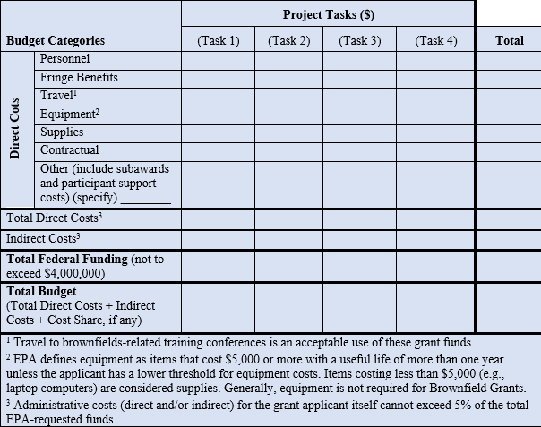
Application Content
Narrative/Ranking Criteria
V. Budget/Resources Continued
Ensure budget table adds up to the total requested amount of funding!
Sample Budget Table Format

Slide 44
Application Content
Narrative/Ranking Criteria
Performance Measurement: Anticipated Outcomes and Outputs (5 Points)
Specify the anticipated environmental outcomes and outputs.
Discuss how you propose to track, measure, and evaluate your progress (and identify when the project is not on schedule) in achieving the project outcomes, outputs, and project results, including both quantitative and qualitative performance measurements.

Slide 45
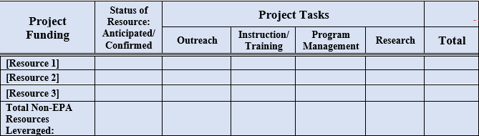
Application Content
Narrative/Ranking Criteria
Leveraging (10 Points)
Demonstrate how you will leverage additional funds/resources beyond the EPA cooperative agreement funds awarded to support your proposed project activities, and how these leveraged funds/resources will be used to contribute to the performance and success of the proposed project.
Describe the extent to which in-kind and/or partner commitments to providing services/ resources (including amount and type) to the proposed project are available, and whether these commitments have already been made. If leveraged resources are not yet committed to the project, describe the likelihood that these commitments will materialize during the project.
Sample Leveraged Resources Table (Optional)

Slide 46
Application Content
Milestones Schedule
Attach Milestones Schedule
  Include start and completion dates of significant tasks under your program
  Reminder: The milestones schedule will not count against the 15-page narrative limit of the Narrative, and does not have an individual page limitation.

Slide 47
Reminder: Application Package
REQUIRED FORMS
1. Application for Federal Assistance (SF-424)
2. Budget Information for Non-Construction Programs (SF-424 A)
3. Preaward Compliance Review Report (EPA Form 4700-4)
[Guidance on how to complete this form is available at www.epa.gov/grants/tips-completing-epa-form-4700-4.]
4. EPA Key Contacts (Form 5700-54)
5. Project Narrative Attachment Forms, as one file, and include:
  Narrative Information Sheet
  Responses to Threshold Criteria
    Required Attachments (as applicable)
  Narrative (responses to ranking criteria)
    Milestones Schedule
OPTIONAL FORMS
1. Grants.gov Lobbying Form – To be submitted by applicants requesting more than $100,000 of EPA grant funding.
2. Negotiated/Proposed Indirect Cost Rate Agreement – submit using the Project Narrative Attachment Form.
Limit attachments to required/relevant documents
A workplan is not required at time of submission. The applicant that is selected for funding will negotiate a workplan with EPA before the cooperative agreement is awarded.

Slide 48
Questions & Progress Check
General Information
Overview of Grant
Application Process
  Submitting Your Application in Grants.gov
  Application Content
    Narrative Information Sheet
    Threshold Criteria
    Ranking Criteria/Narrative and Milestones
Next Steps
Questions

Slide 49
Next Steps
Familiarize yourself with the FY2024 Guidelines
  Begin compiling and organizing the required documentation
Address all criteria
  If a criterion does not apply, briefly explain why
Quality over quantity
  Too much information is not necessarily a good thing
Do not include photos or graphics
Contact EPA early with any questions: brownfields@epa.gov

Slide 50
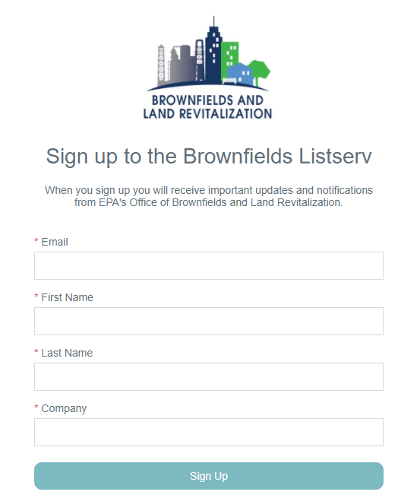
A copy of today’s presentation is available at www.epa.gov/brownfields/fy-2024-grant-guidelines-technical-assistance-tribal-nations-and-entities-addressing.
The recording of the presentation will be available in the coming weeks.
Thanks for Joining Us!!
Click Here to Join the Brownfields Program Listserv

Slide 51

Questions?

