Slide 1

Combined Air Emissions Reporting System (CAERS)
Reporting Control Devices in CAERS
January 10, 2024
Notes:
On behalf of the US EPA, I’d like to welcome you to the Combined Air Emissions Reporting System or CAERS.

Slide 2
Before we begin…
Keep yourselves muted. Type your questions in the chat box as we go through the training.
A copy of this ppt and the video will be uploaded to our CAERS website.
Disclaimer: This training is intended for instructional purposes only. Data shown in the training are illustrative, and do not represent a real report for any facility or inventory year. None of the examples represent a complete report. This training does not cover examples of all possible control device configurations. You should always consult your State, Local, Tribal Authority (SLT) if you have questions when entering control device information into CAERS.

Slide 3
Outline of Training
Control-related Concepts and Data Fields
Steps to Enter Data (where/how to enter your data)
Examples (what data to enter) for Different Control Configurations
  No Control Devices
  Single Control Device
  Controls in Series
  Controls in Parallel
  Complex Control Device Configurations
Questions

Slide 4
Control-related Concepts and Data Fields

Slide 5
Release Point Apportionment
Percent release point apportionment: The average annual percent of an emissions process that is vented through a release point. The percent of emissions that are sent to a stack release point through controls is also referred to as “capture efficiency”. Percent captured = Percent pollutant stream routed to the device going to “stack” type release points (X%). Percent not captured = Percent going to “fugitive” release point (100-X)%
Stack
X%
Control (s)
Uncontrolled Emissions
…
Process
Fugitive
(100-X)%
Note that 100% of the original emissions must be assigned to one or more release points

Slide 6
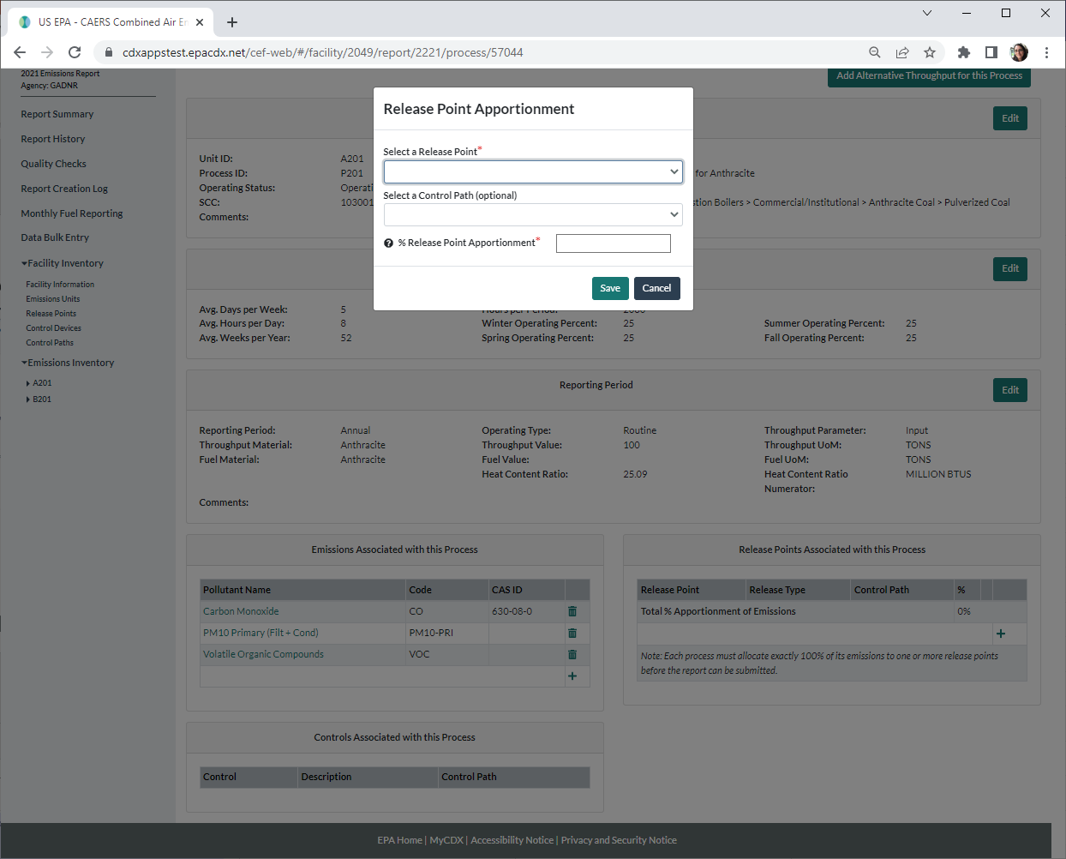
Release Point Apportionment in the User Interface
Found in the screen for each existing process under the “Release Points Associated with this Process” heading.
The process and release point(s) must exist in CAERs before emissions can be apportioned.

Slide 7
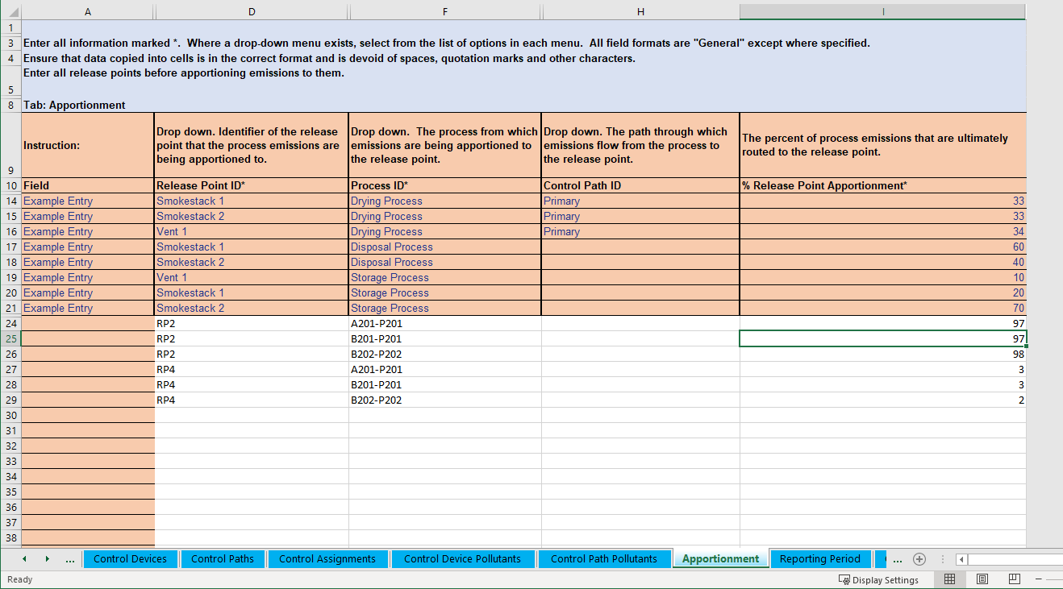
Release Point Apportionment in the Bulk Upload Template
Found in the “Apportionment” tab and can be entered for existing release points.

Slide 8
Percent Control Effectiveness
Percent control effectiveness: The percentage of time or activity throughput that a control approach is operating as designed, including the capture and reduction devices. This percentage accounts for the fact that controls typically are not 100% effective because of equipment downtime, upsets and decreases in control efficiencies. This could be estimated from the amount of time the control is operational, versus down for maintenance or repairs. When the control is not effective, the pollutant is not removed from the emissions stream.
Removed Emissions
        Example:
        Control Effectiveness =
        (2000-200)/(2000) *100 = 90%, where:
        the emissions Process or Unit ran for 2000 hours.
        the Control Scenario was operationally down for 200 hours.
% when control is effective
Stack
Control (s)
% when control is not effective

Slide 9
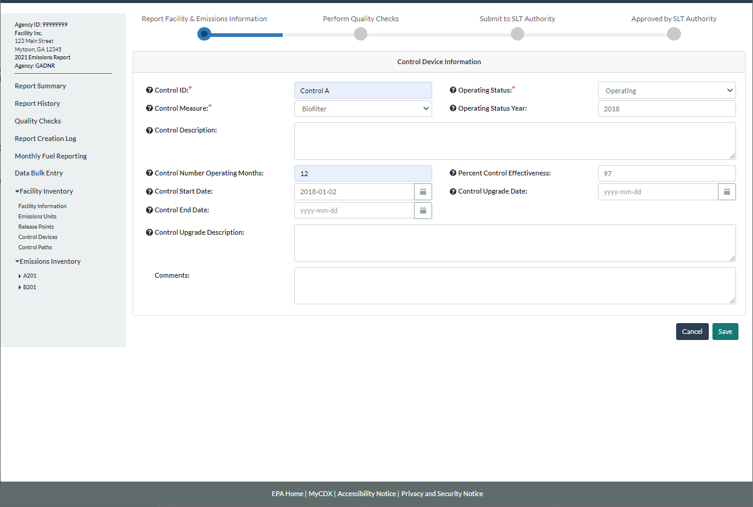
Control Effectiveness in the User Interface
Found in the screen for each new or existing control device.

Slide 10
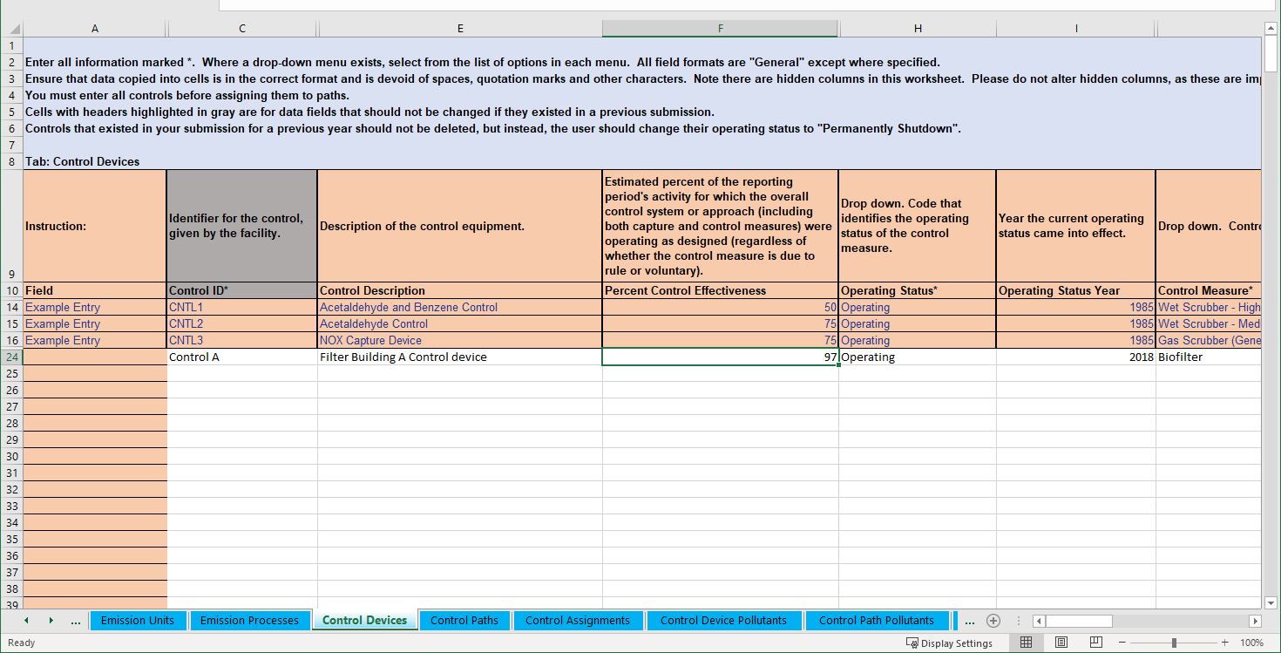
Control Effectiveness in the Bulk Upload Template
Found in the “Control Device” tab.

Slide 11
Control Percent Pollutant Reduction Efficiency
Percent Pollutant Reduction Efficiency: The percent reduction achieved for the pollutant when all control measures are operating as designed. This information could be obtained from the vendor or test data, for example.
Removed Emissions
Example:
The control device removes 95% of the pollutant.
% pollutant reduction efficiency
Stack
% when control is effective
Control (s)

Slide 12
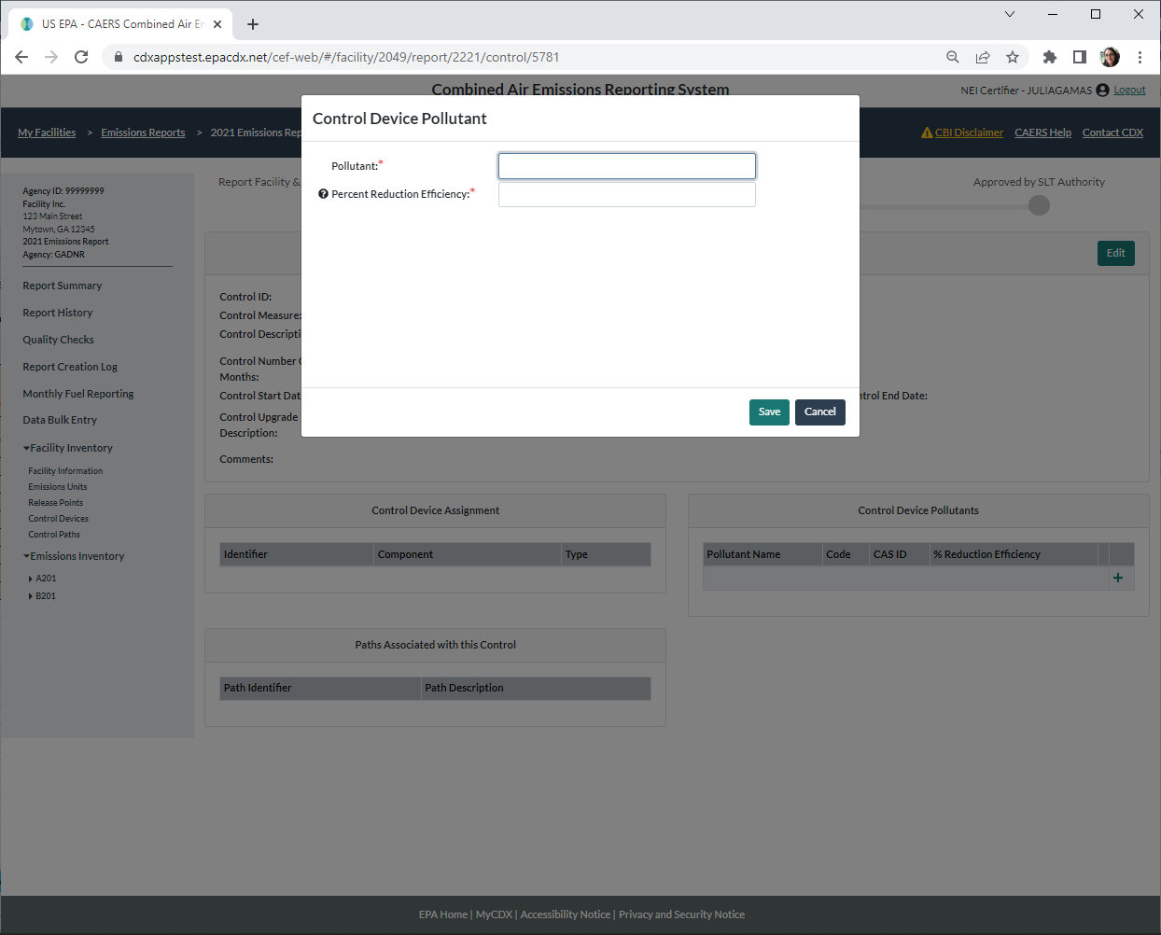
Control Percent Pollutant Reduction Efficiency in the User Interface
Found in the screen for each existing control device, under “Control Device Pollutants”.

Slide 13
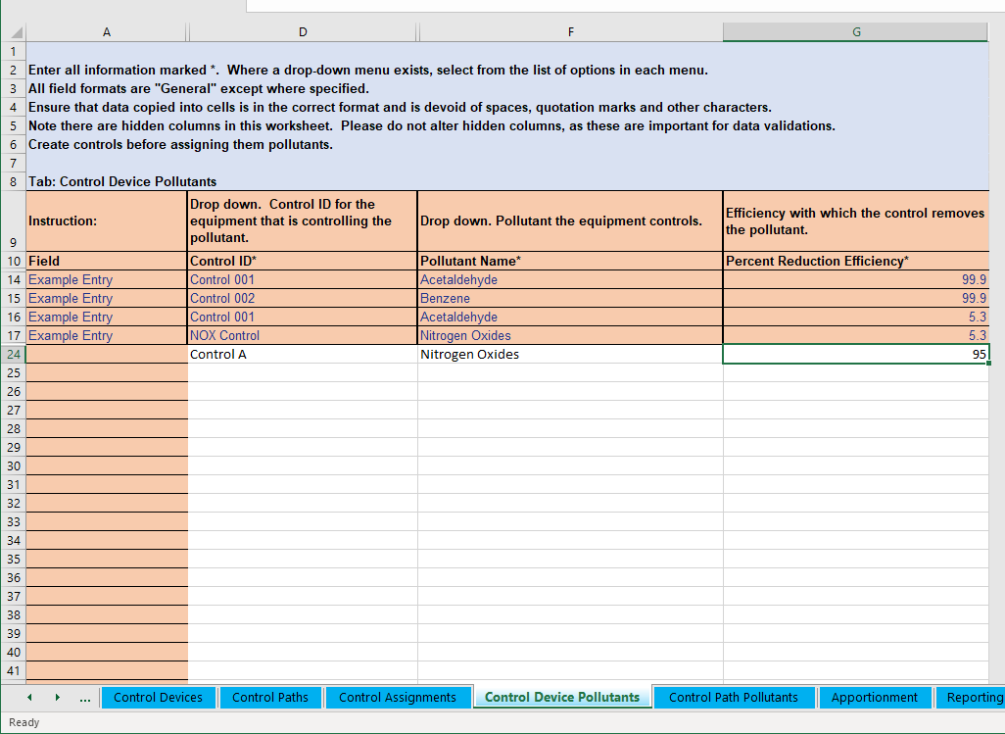
Control Percent Pollutant Reduction Efficiency in the Bulk Upload Template
Found in the “Control Device Pollutants” tab and can be entered for existing controls.

Slide 14
Flow of Uncontrolled Emissions
Removed Emissions
% Efficient
Stack Emissions
% Effective
% Not efficient
Release point apportionment (% Captured)
Stack Emissions
Uncontrolled Emissions
Control
Process
Release point apportionment (% Not captured)
% Not effective
Fugitive Emissions
% Not captured = 100 - % Captured
% Not effective = 100 - % Effective
% Not efficient = 100 - % Efficient

Slide 15
Controlled (Post-Control) Emissions
Fugitive Emissions
Controlled Emissions
=
+
Stack Emissions
Removed Emissions
Controlled (Post-control) emissions = Uncontrolled emissions * [ 100 – (% Capture Efficiency * % Control Effectiveness * % Control Pollutant Reduction Efficiency)]
% Efficient
Stack Emissions
% Effective
% Not efficient
Release point apportionment (% Captured)
Stack Emissions
Uncontrolled Emissions
Control
Process
Release point apportionment (% Not captured)
% Not effective
Fugitive Emissions

Slide 16
Accounting for the Entire Emissions Stream
Uncontrolled emissions apportioned to release points => fugitives, captured emissions
Captured emissions => emissions when control is effective, emissions when control is not effective
Emissions from effective control => removed, not removed if control is not 100% efficient
Removed emissions = uncontrolled emissions * capture * control effectiveness * control pollutant reduction efficiency
Stack emissions= uncontrolled emissions * captured * (1- control effectiveness * control pollutant reduction efficiency)
Controlled (Post-control) Emissions = uncontrolled emissions * (1 – captured * control effectiveness * control pollutant reduction efficiency) = stack emissions + fugitive emissions

Slide 17
Reporting Control Devices
Individual control devices are listed for the facility.
  Pollutants removed by each control device are listed with it.
  % pollutant reduction efficiency refers to the amount of the specific pollutant removed by each device.
  Control device configuration is defined:
    Single
    In series
    In parallel
    Combinations / Complex Configurations
Control devices are placed in “paths” so that the device:
  is associated to the right unit/process and release point
  can be associated to multiple unit/processes and release points where applicable

Slide 18
What is a Path?
Path: A “container” of one or more control devices that are connected, and through which an emissions stream flows.
Child Path: is a path contained within another path
Parent Path: contains one or more children paths and can also contain additional control devices. A parent path can be a child path to a larger parent path
Primary or Main Path:
  contains one or more control devices and/or children paths
  The path that ultimately associates the control devices/paths it contains from a unit/process to a release point

Slide 19
Simplest Example of a Path
Path A
Unit 1
Process 1
Control A
Release Point 1
Release Point 2

Slide 20
Path Concepts
Control Path Assignment: the position that a control devices has within a path with respect to other control devices that are present (for example, the first control device in a path is assigned 1).
Control Apportionment: the percentage of the emissions that are being directed to the next control or path.
Path Effectiveness: The combined effectiveness of the controls in that path. Must be present on a main or primary path.
Path Pollutant Percent Reduction Efficiency: The combined percent reduction efficiency of the pollutant for the entire path. Must be present on a main or primary path.

Slide 21
Single Control Device
For a single control device one path is needed. The control is placed in that path. That path will be the primary path, and it will associate the process to the release point. Because there’s only one control, path assignment is just equal to 1.
Path A (primary)
Unit 1
Process 1
Control A
Release Point 1
Release Point 2
Information You Need: release point apportionment (% to Release Point 1 and 2), control effectiveness, pollutant reduction efficiency, path assignment = 1, control apportionment = 100%.

Slide 22
Single Control Device on Multiple Units/Processes
Note that once this path is created for a single control device, any process sending emissions to the same release point can also use that path. So, you only have to create that path once, then reuse it as needed for each process.
Process 1
Path A (primary)
Unit 1
Process 2
Control A
Release Point 1
Process 3
Release Point 2
Information You Need: release point apportionment, control effectiveness, pollutant reduction efficiency, path assignment = 1, control apportionment = 100%.

Slide 23
Multiple “Single Control Devices”
Path A (primary)
Process 1
Unit 1
Process 2
Control A
Release Point 1
The case of multiple control devices that are “single” controls between a unit/processes and release point is the same as for a single control. One path is created for each control and each path associates the unit/process with the respective release point.
Path assignment = 1 and control apportionment = 100% for each control device in each of its paths.
Process 3
Release Point 4
Path B (primary)
Process 1
Unit 2
Process 2
Control B
Release Point 2
Process 3
Release Point 5
Path C (primary)
Process 1
Unit 3
Process 2
Control C
Release Point 3
Process 3
Release Point 5

Slide 24
Single Control Device on Multiple Units/Processes/Release Points
Process 1
Unit 1
Process 2
A path can be shared by units/processes if they all direct their emission through the control(s) in that path and also “share” release points
Release Point 1
Path A (primary)
Process 3
Control A
Process A
Unit A
Process B
Release Point 2
Process C
Release Point 3
Information You Need: release point apportionment (% to Release Points 1,2, and 3), control effectiveness, pollutant reduction efficiency, path assignment = 1, control apportionment = 100%.

Slide 25
Control Path Assignment
A Control Path Assignment defines the order in which control devices are configured, each control or child path is given a sequence number:
  Increasing “sequence number” if in sequence
  The same “sequence number” if in parallel

Slide 26
Multiple Control Devices – In Series
Multiple controls in series can be placed in a path and that path can be reused by many processes going to the same release point(s), if it is the primary path between each process and release point(s), as in the previous slide.
In Series Path (primary)
Release Point 1
1
2
Unit 1
Process 1
Control A
Control B
…
Release Point 2
Release Point n
Information You Need: release point apportionment, control effectiveness, pollutant reduction efficiency, path assignment (position of control in the sequence; control A=1, Control B=2,…), control apportionment = 100%.

Slide 27
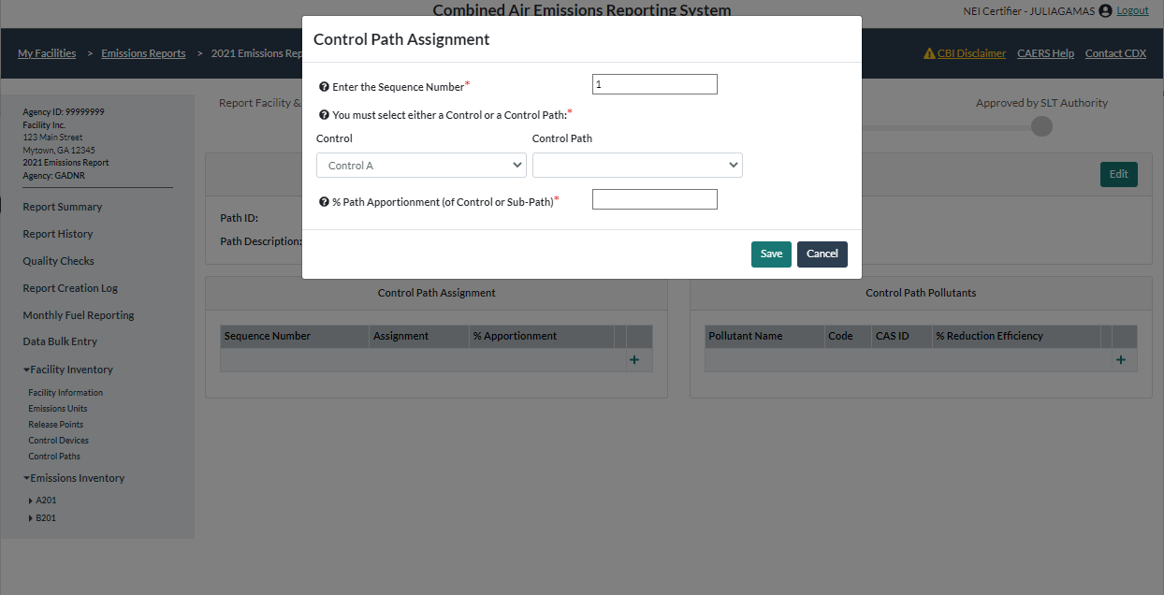
Control Path Assignment in the User Interface
Found in the screen for each existing path.

Slide 28
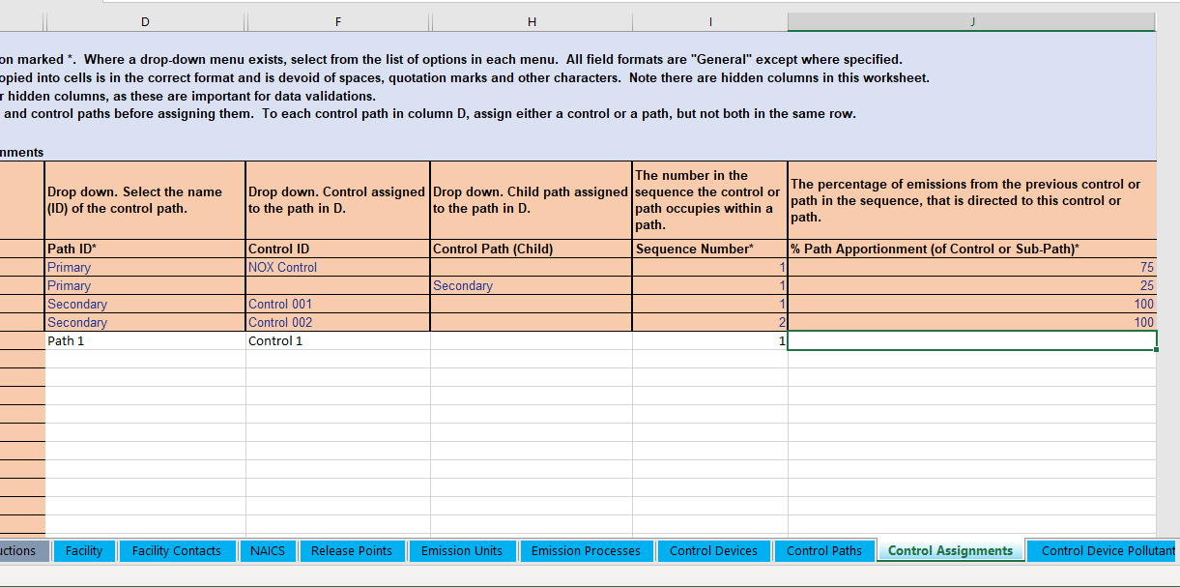
Control Path Assignment in the Bulk Upload Template
Found in the “Control Assignments” tab using existing controls and paths.

Slide 29
Multiple Control Devices – In Parallel
Multiple control devices in parallel can be placed in on path and that path can be reused if it is the primary path, so long as it associates units/processes with the same release point(s).
In Parallel Path (primary)
Control A
Unit 1
Process 1
Control B
Release Point 1
…
Release Point n
Information You Need: release point apportionment, control effectiveness, pollutant reduction efficiency, path assignment (position of control in the sequence, if parallel, all controls have the same sequence number), control apportionment (e.g. 33% per control).

Slide 30
Control Apportionment
Flow of emissions from one control device to the next will be tracked via the Control Apportionment
  % of the emissions are routed to the next control or path.
  100% of the emissions are tracked, a control apportionment percentage < 100% for a control device means that some emission are also being routed to another control device or path.
  Are entered when entering control path assignment data.
Release Point Apportionment (revisited):
  Different than control apportionment
  Total uncontrolled emissions generated at the unit/process must be accounted for in terms of where they were ultimately released:
    Different types of release points
      Stack
      Fugitive
    100% of the original emissions must be assigned to one or more release points

Slide 31
Control Apportionment in the User Interface
Found in the screen for each existing path.

Slide 32
Control Apportionment in the Bulk Upload Template
Found in the “Control Assignments” tab using existing controls and paths.

Slide 33
Percent Path Effectiveness
Required on main paths (those associated with a release point apportionment)
If only one control device exists, it is equal to the percent control effectiveness for that control.
May depend on how those control devices are laid out (in sequence, parallel, a combination). For example, if in sequence: the multiplication of % control effectiveness, if in parallel: the average or weighted average of control device effectiveness.
Consult your SLT on the best way to represent path effectiveness, especially if you have a complex control set up.
Entered in the screen for each path.

Slide 34
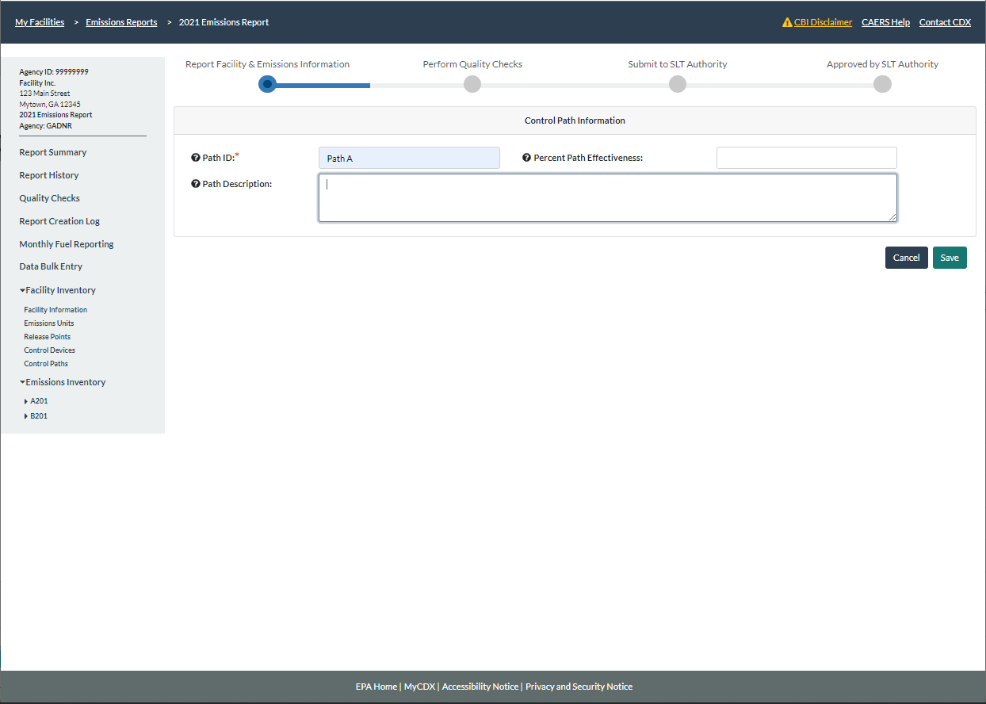
Path Effectiveness in the User Interface
Found in the screen for each path.

Slide 35
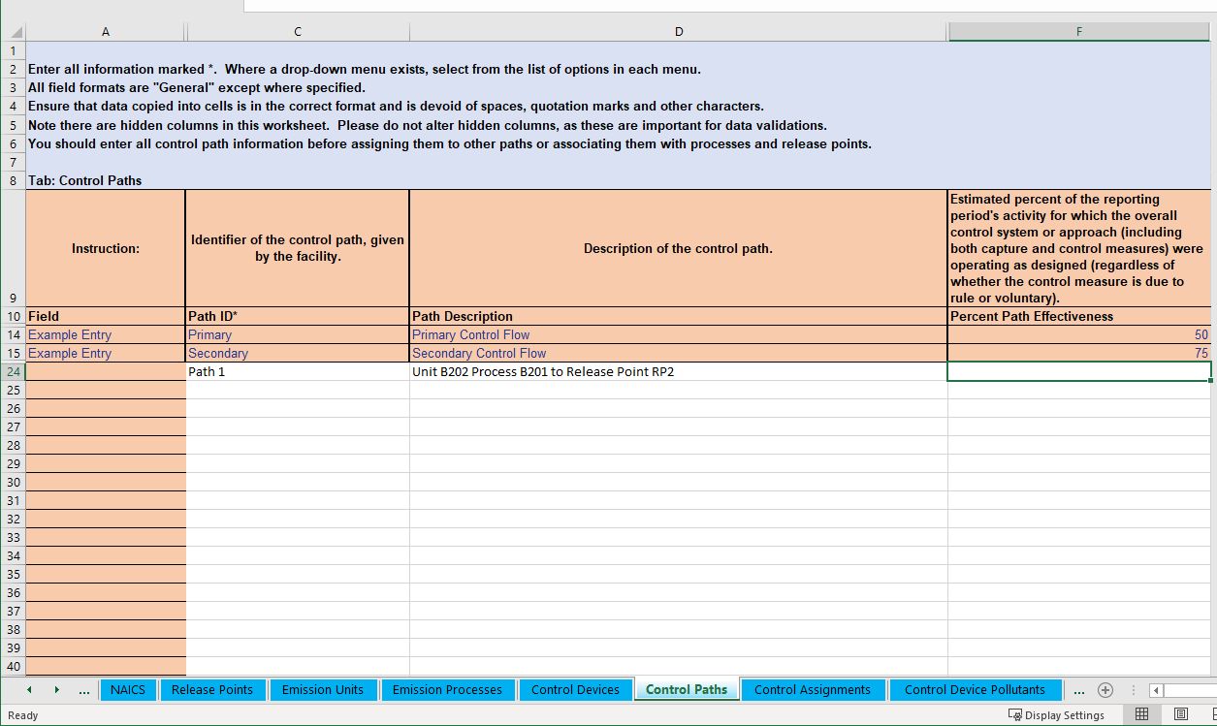
Path Effectiveness in the Bulk Upload Template
Found in the “Control Paths” tab.

Slide 36
Path Pollutant Percent Reduction Efficiency
Required on main paths (those associated with a release point apportionment)
If there is only one control device, then it is the same as the control percent reduction efficiency.
If there are more than one control device reducing the same pollutant, it is a combination of the reduction efficiency of all those devices.
May depend on how those control devices are laid out (in sequence, parallel, a combination).
Consult your SLT to determine the best way to represent path pollutant percent reduction efficiency if you have a complex controls set up.

Slide 37
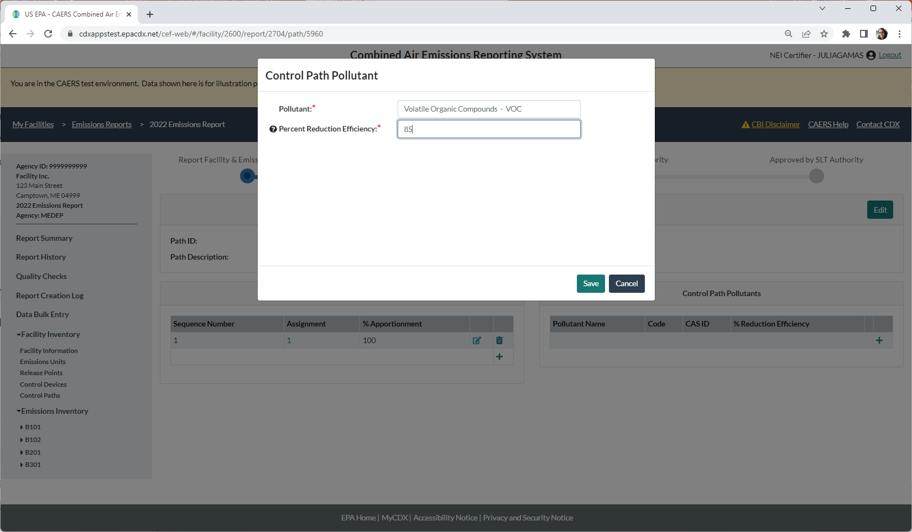
Path Pollutants in User Interface
Can be added in the screen for an existing path.

Slide 38
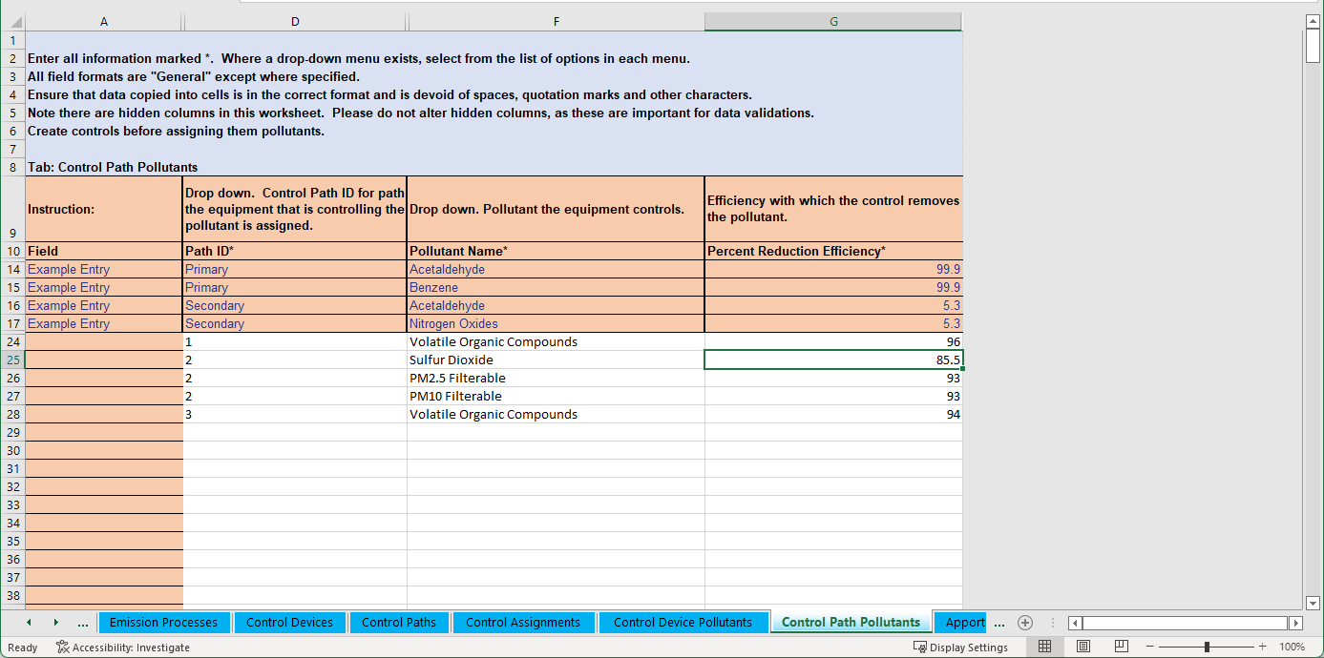
Path Pollutants in Bulk Upload
Can be entered, for an existing path, in the “Control Path Pollutants” tab of the bulk upload template.

Slide 39
Overall Percent Control in CAERS
Not required. Can be entered to help you calculate your facility emissions.
If entering this amount, you should select a method of calculation that does not include controls. CAERS will factor in the overall percent control in your emissions calculation if you have entered it:
  Single Control Overall Percent Control = percent captured * efficiency * effectiveness.
  Parallel Controls that control the same pollutant: add individual overall %
  In Series Controls that control the same pollutant: multiply individual overall % controls
  Complex Controls that control the same pollutant: may need average, weighted average. Consult your SLT on the best approach.
  You may also need to factor in control apportionments.

Slide 40
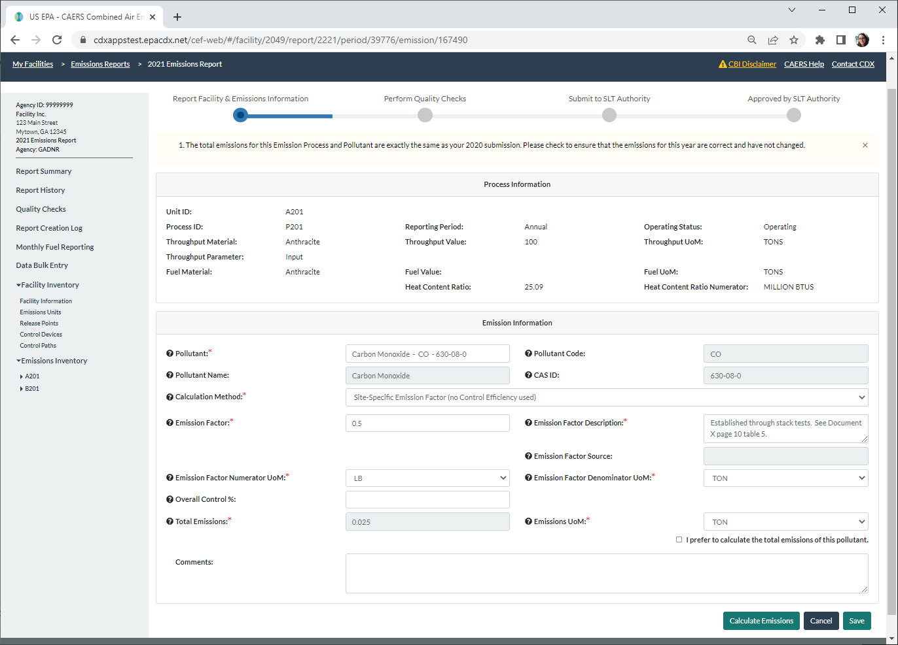
Overall Percent Control in User Interface
Found in the emissions estimation screen.

Slide 41
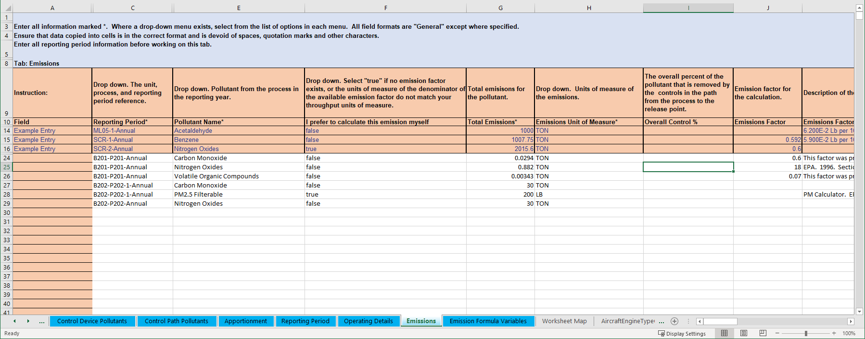
Overall Percent Control in the Bulk Upload Template
Found in the “Emissions” tab and can be entered for an existing unit/process and pollutant.

Slide 42
Steps to Enter Data

Slide 43
General Data Entry Steps for Control Devices and Paths in CAERS
Ensure unit/process and release point data are available first.
Enter control device data: effectiveness, pollutant and % pollutant reduction efficiency
Place the control into a path: assignment (sequence #), control apportionment
  Control into path
  Child path into parent path
  Controls and/or children paths into a primary path
  Associated efficiency and effectiveness
Apportion emissions from the process to the release point (release point apportionment)
If using overall % control, calculate and enter that information.

Slide 44
Control Data in User Interface

Slide 45
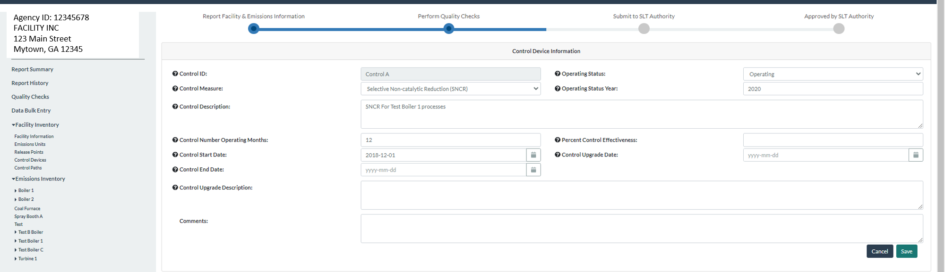
Select Control Devices and Add New Control Device
Notes:
In the user interface, click on the “Control Devices” link on the left hand side menu. Add data about new control device suc has control ID, control measure, operating status and status year, operating months, and percent control effectiveness.

Slide 46
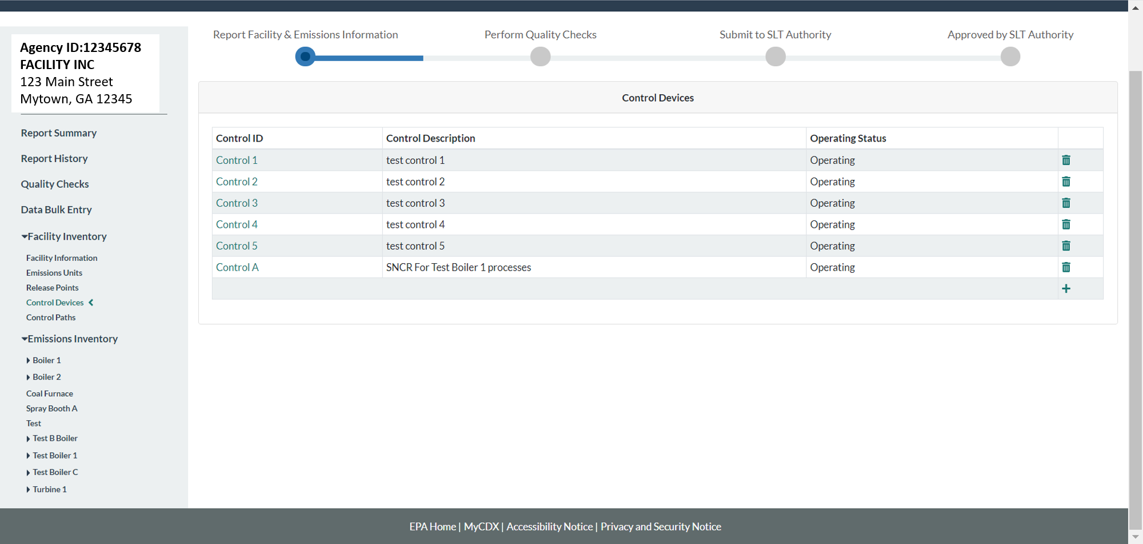
See New Control in List of Control Devices
Notes:
After adding the control it can be seen in the list of existing control devices for the facility.

Slide 47
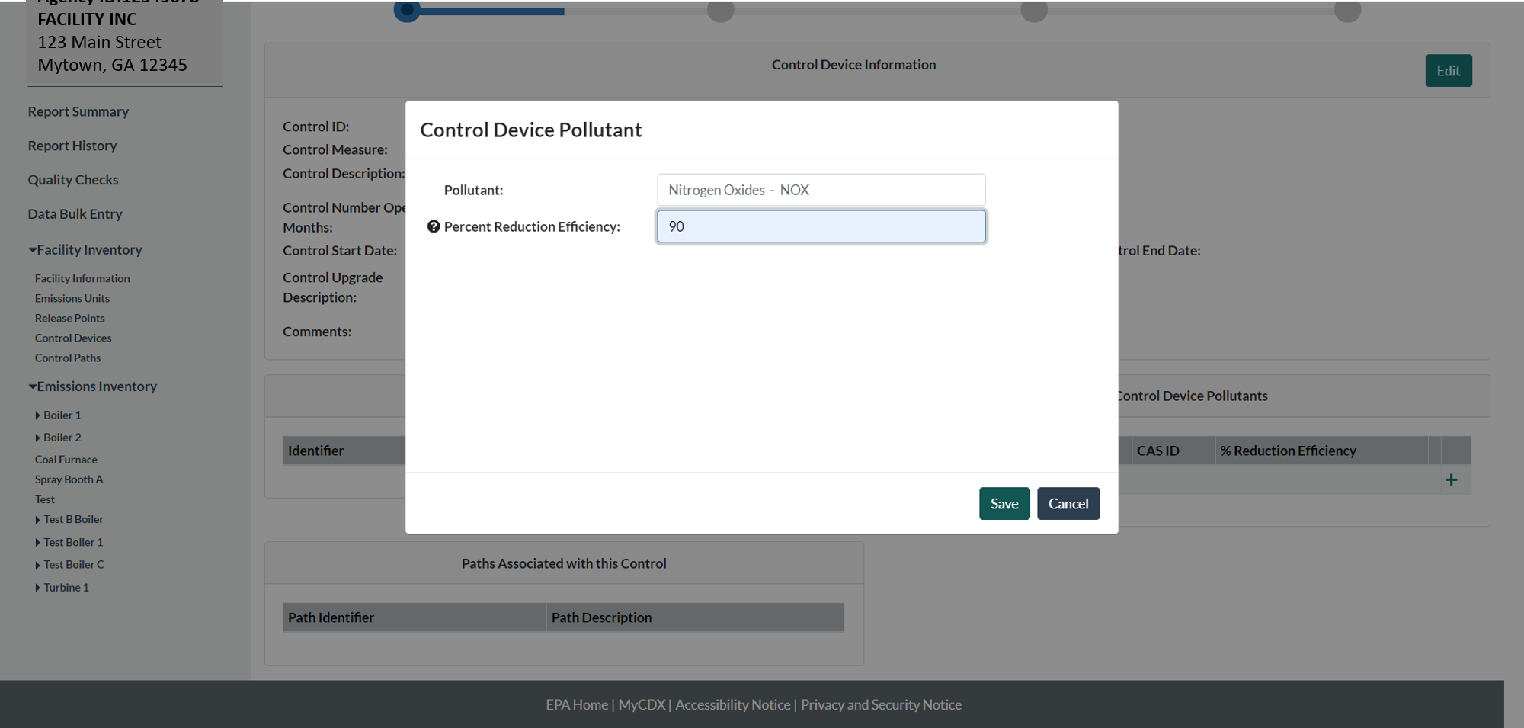
Select Control Device and Add Pollutant Data
Notes:
Click on the control device from the list, and it will open it again, now allowing you to add more data. Add pollutant and pollutant control efficiency.

Slide 48
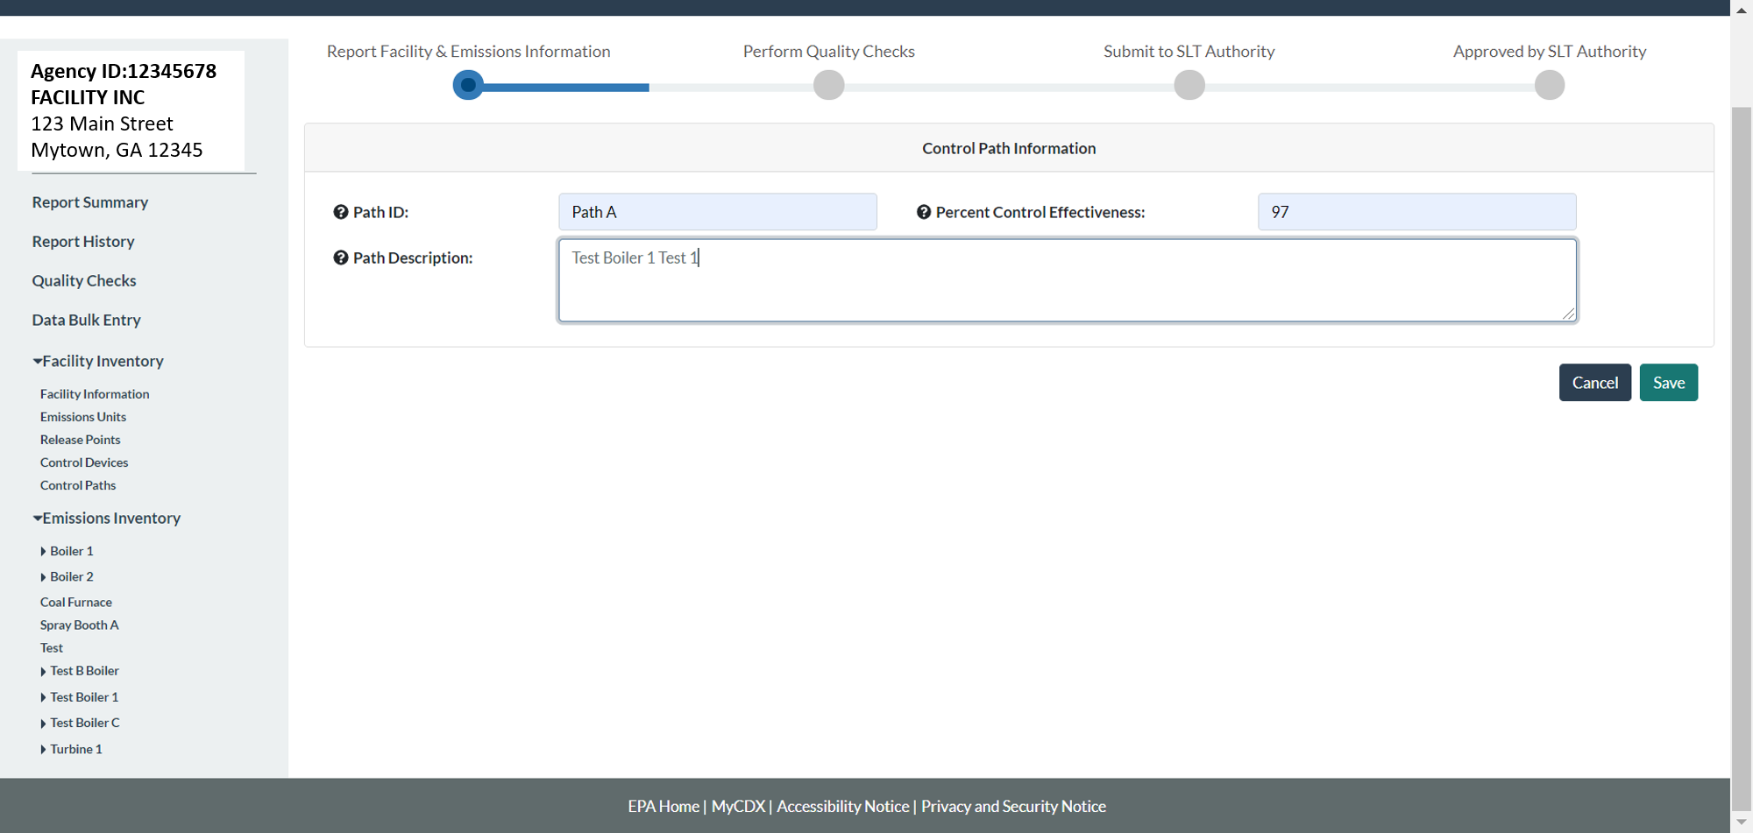
Select Control Paths and Add New Path
Notes:
Click on “Control Paths” on the left hand side menu and this will take you to a list of existing paths. Click on the plus sign to add path data. Add path data. Control device effectiveness is the same as that for the control device for the case of a single control.

Slide 49
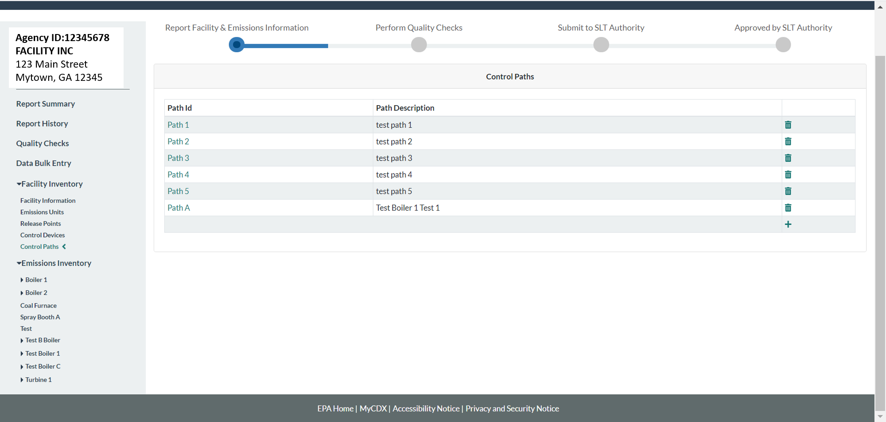
See New Path in List of Paths
Notes:
Click save and you’ll be able to see the path in the list of control paths.

Slide 50
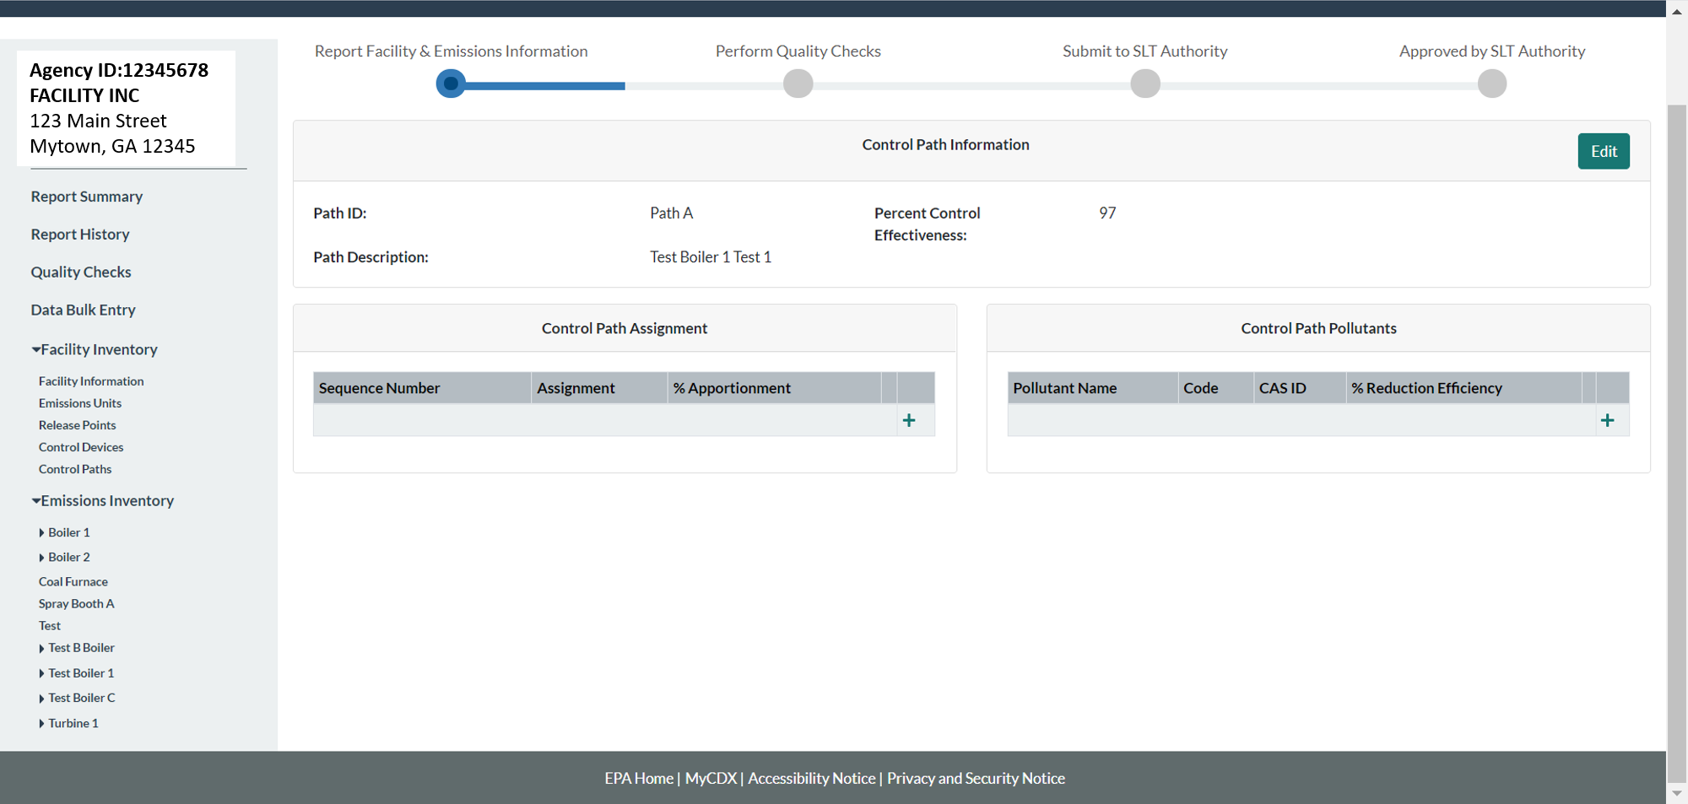
Select Path and Add Data
Notes:
Click on the newly created path from the list of paths. Add Control Path assignment and pollutants

Slide 51
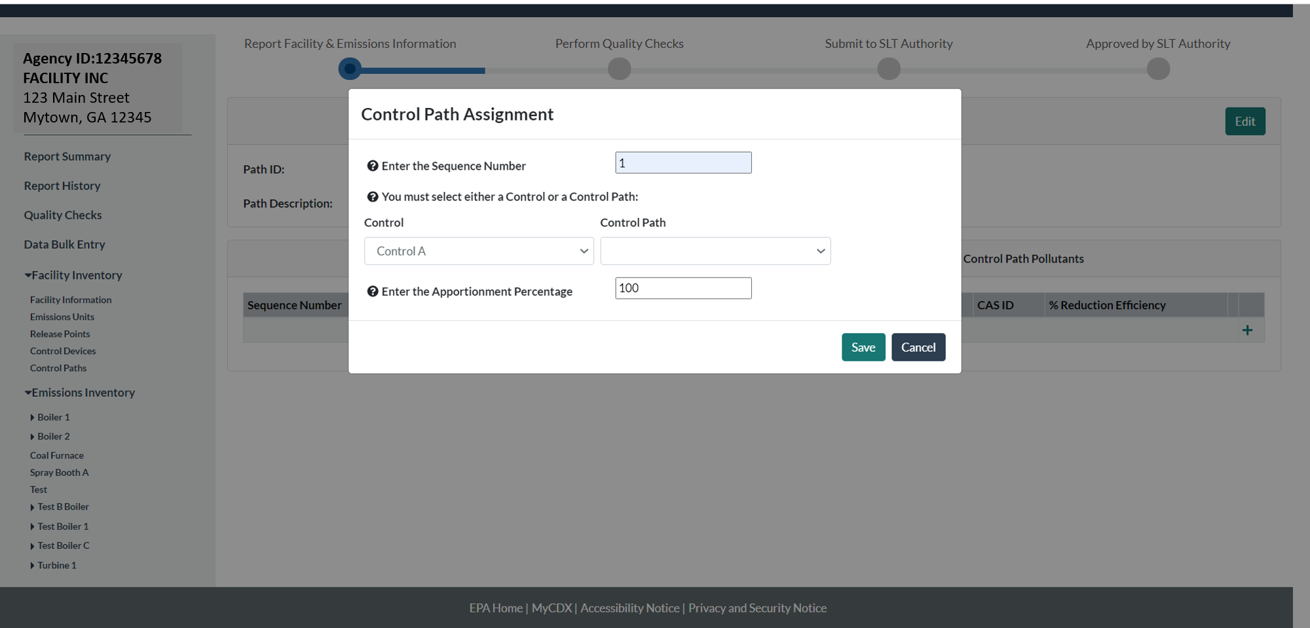
Control Path Assignment Data
Notes:
Add control sequence number and the percentage of the pollutant stream coming from the process.

Slide 52
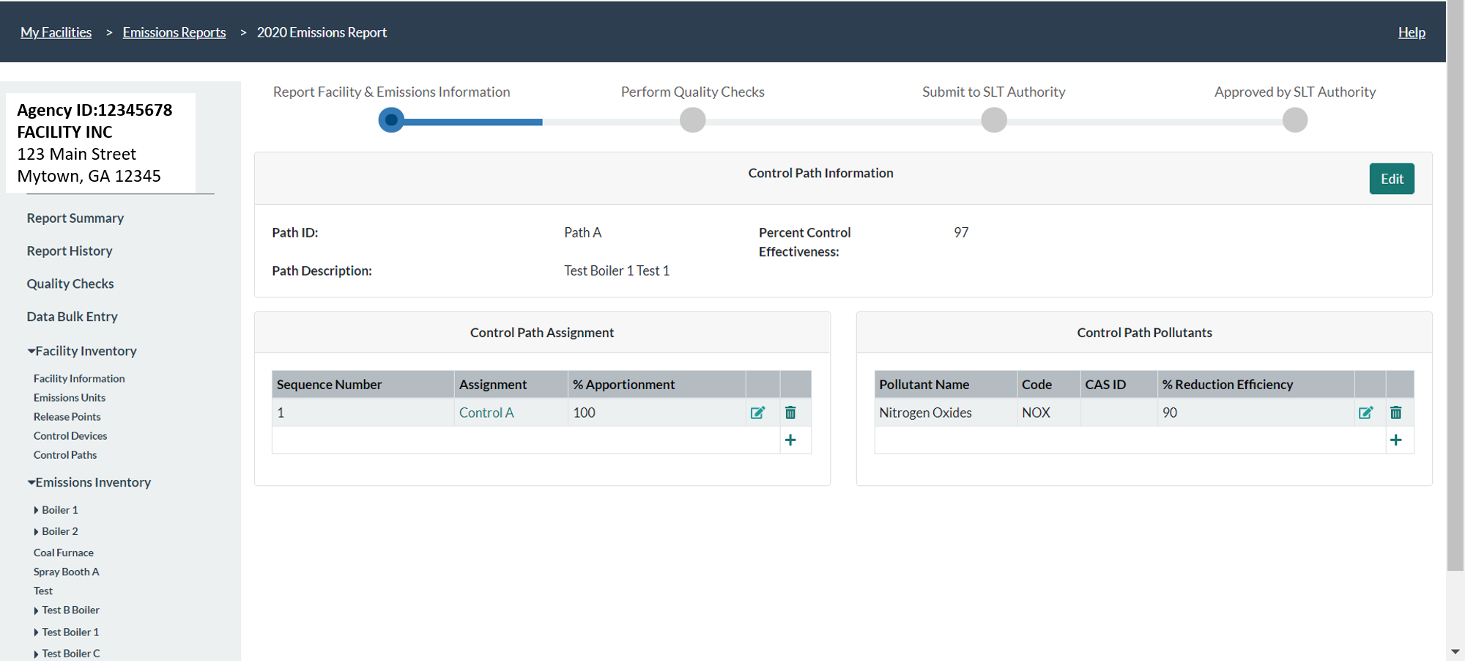
Add Control Path Pollutants
Notes:
Add control path pollutant information (pollutant and percent pollutant control reduction efficiency). Now your path information is complete.

Slide 53
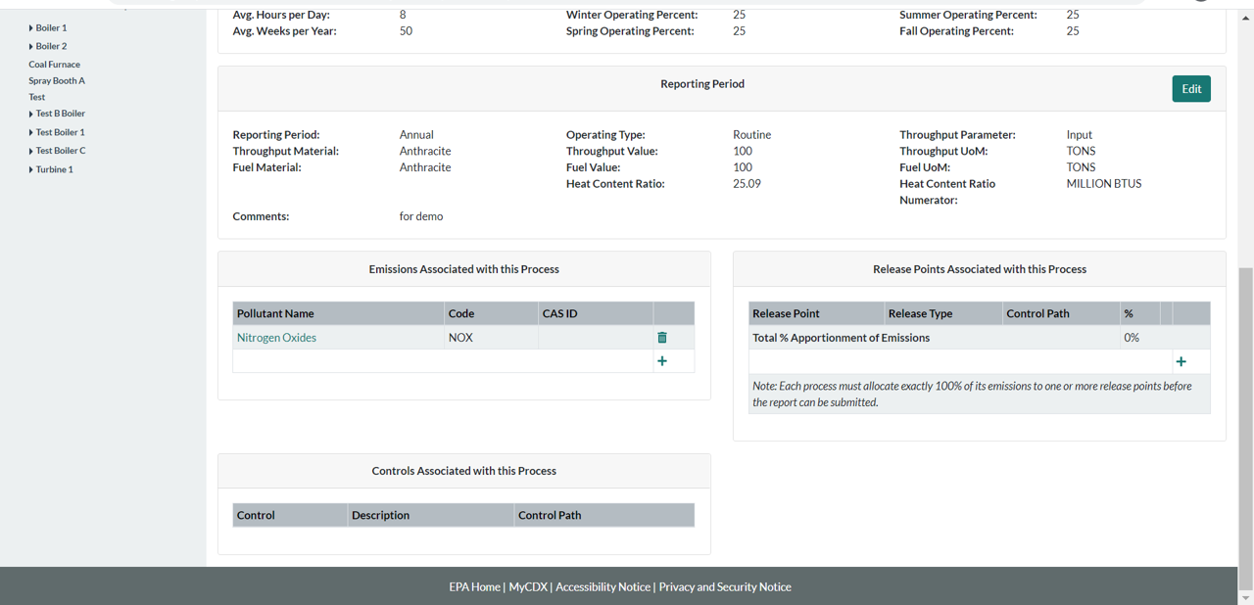
Select the Process for the Control Device
Notes:
Now you need to tell the system which release points these emissions go to. Go to the process page by clicking on the unit and process you are looking for from the left hand side menu. Once in the page for that process, add a release point.

Slide 54
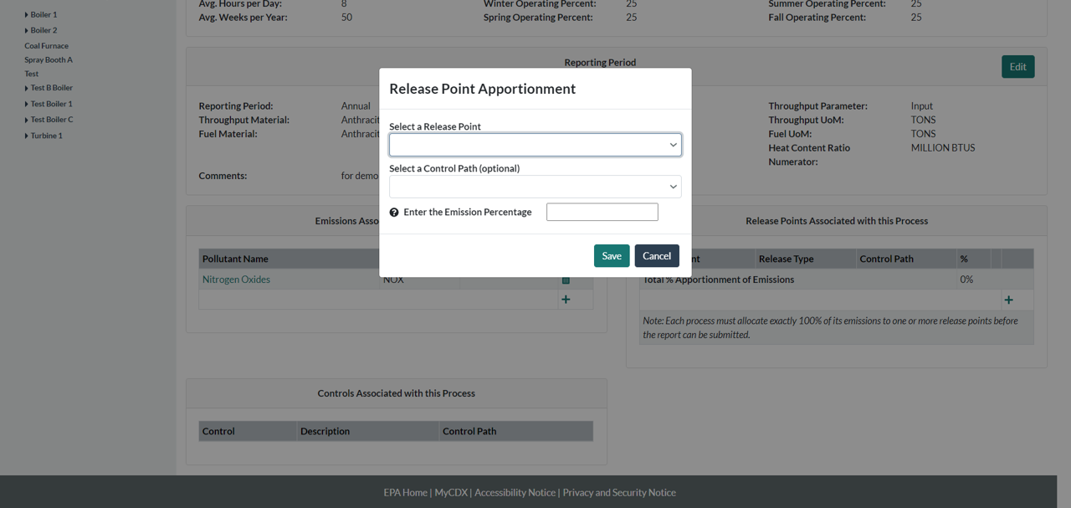
Select Release Point for that Process
Notes:
Add a release point apportionment. Or if a release point already exists there that you want to associate with the pollutant just click on it to edit it.

Slide 55
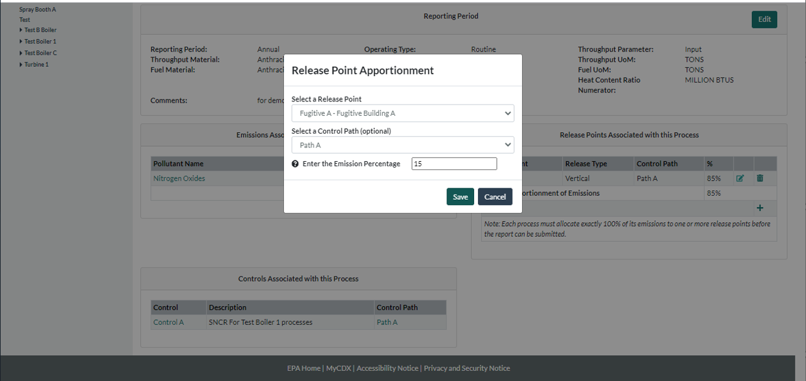
Associate Process and Release Point
Notes:
If your device capture isn’t 100% then you have fugitives and you would enter those as well.

Slide 56
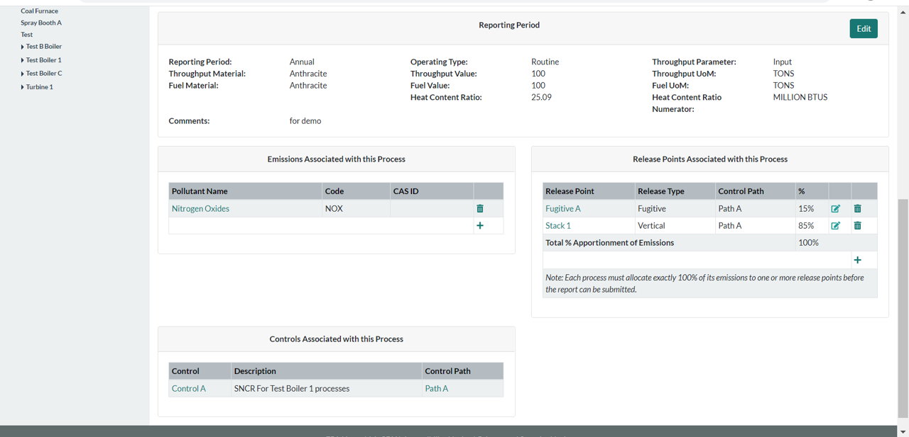
See Release Point(s) Linked to Process and Associated Paths
Notes:
Note that release point apportionment of emissions from that process to its release point(s) should add up to 100% (i.e. all emissions from the process have to go somewhere).

Slide 57
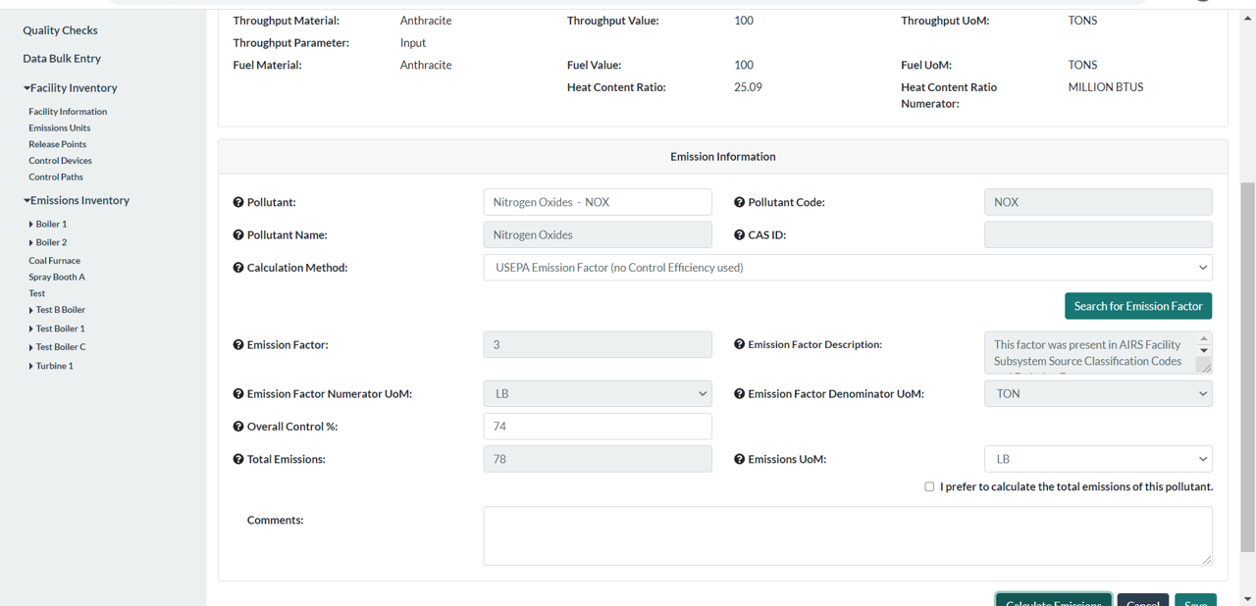
Can Use Pre-Control Emission Factor
You must add control equipment to use the overall control %
Notes:
Conversely you can select a “pre-control” emission factor and include an overall control %. If you chose that overall control % then your emissions will be calculated using that %.

Slide 58
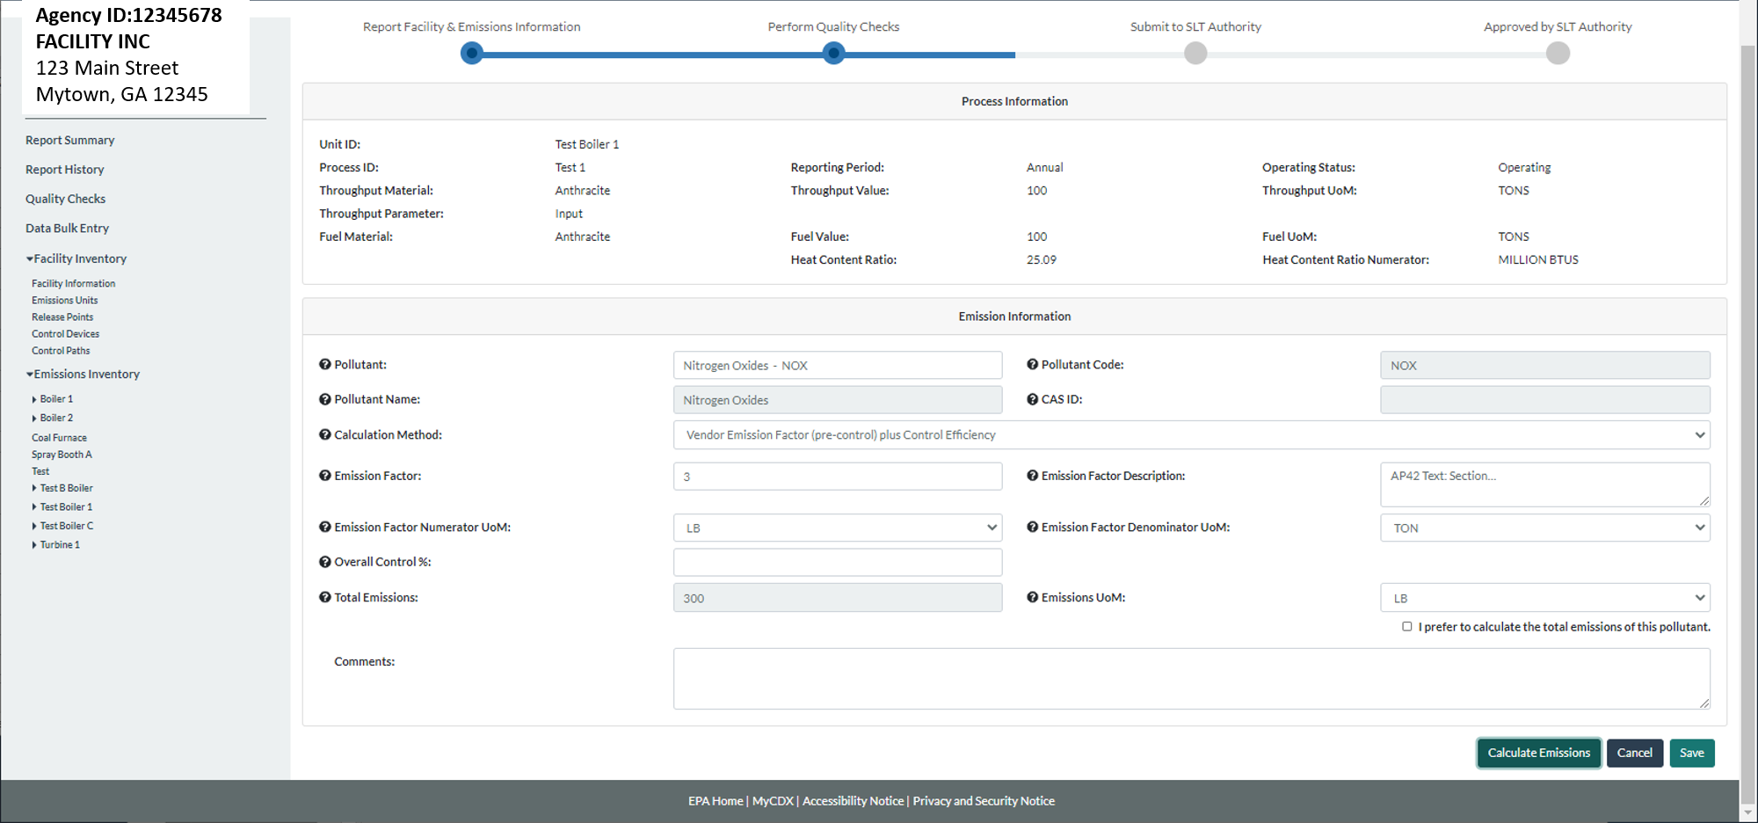
Or, Can Use Post-Control Emission Factor
If using post control factor, do not enter Overall Control %
Notes:
If the “plus control efficiency” emission factor is available for the control, you can select it.

Slide 59
Control Device in Bulk Upload

Slide 60
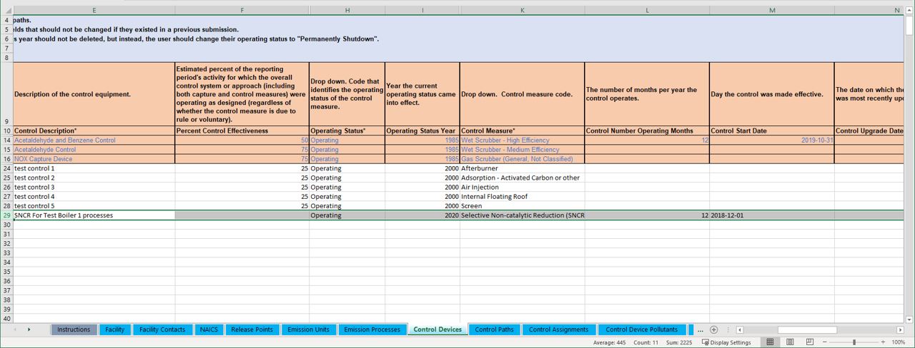
Enter Data in Control Devices Tab
Notes:
Click on the Control Devices tab. Data to enter includes the control description, percent control effectiveness, operating status and operating status year, and the control measure. Other data include control start, end date, and modification date if it has been modified.

Slide 61
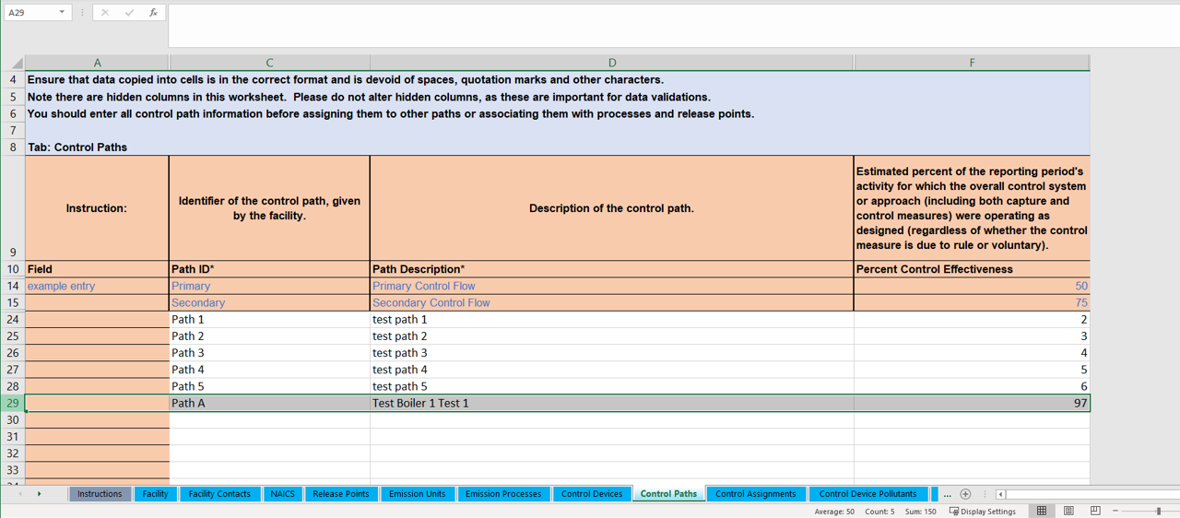
Enter Data in the Control Paths Tab
Notes:
In the Control Paths tab enter the Path ID, description and percent control effectiveness. The effectiveness is the same as for the control device when there is only one control.

Slide 62
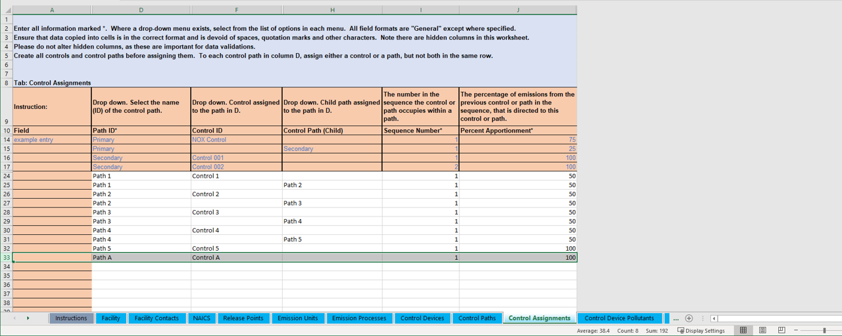
Enter Data in the Control Assignments Tab
Notes:
In the case of one control you only enter the control into the primary path.

Slide 63
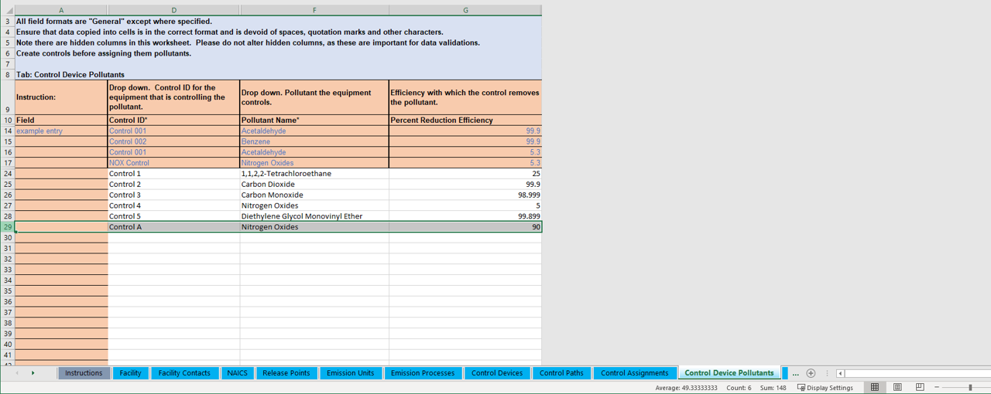
Enter Data in the Control Device Pollutant Tab
Notes:
In the Control Device Pollutant Tab enter the control ID and the pollutant and percent reduction efficiency.

Slide 64
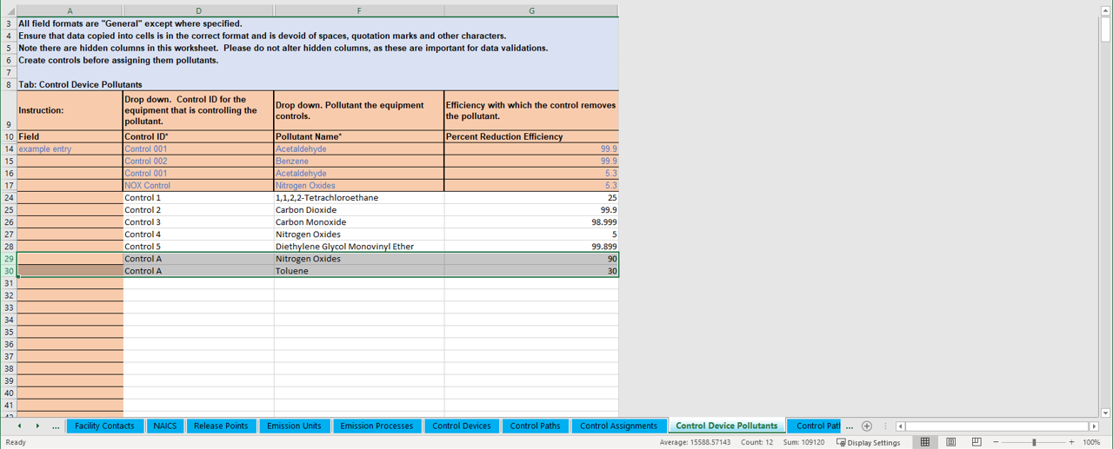
Enter All Pollutants if More than One
Notes:
Note that if your control device controls more than one pollutant, you should enter all of those pollutants here. In this case we show as an example, Toluene, which is a hazardous air pollutant.

Slide 65
Enter Data in the Apportionment Tab
Notes:
In the apportionment tab, enter data for the release point such as the type, description and the apportionment from its path. In this example, Path A captures 85% of emissions and those are routed to Stack 1. 15% of emissions aren’t captured so they are apportioned to a fugitive release point.

Slide 66
List Pollutants in Emissions Tab
Notes:
Make sure that the same pollutants listed in the control, are listed in the process associated with it in the Emissions tab.

Slide 67
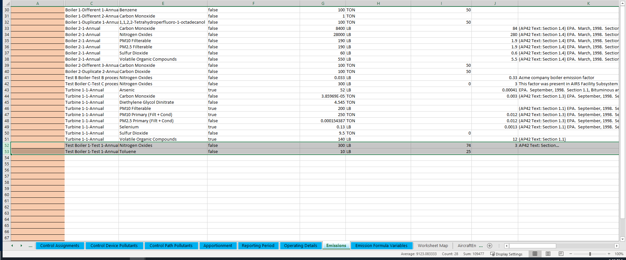
List Overall % if Applicable in the Emissions Tab
Notes:
Note that in the Emissions tab you can enter a pre-control emission factor and include the overall percentage control. When you upload the workbook CAERS will give you a QA check to recalculate your emissions.

Slide 68
Considerations to Keep in Mind
Please don’t re-label or delete controls that existed in a previous year report, instead, mark them as “Permanently Shut Down” or your inventory in EPA will be out of sync. Seeking input on when/how/why facilities relabel components, send to caer@epa.gov.
You could enter your control data in UI to help guide you, then download in BU template to continue the rest of your report and vice-versa.

Slide 69
Examples for Different Configurations

Slide 70
Example Facility with Many Configurations
RP 3
RP 1
Control 2
Control 3
RP 4
Control 5
Control 4
P101
RP 2
B101
Control 1
B301
P301
P201
P102
B201
B102

Slide 71
Example of Paths for a Facility with Many Configurations
RP 3
RP 1
Path 2
Control 2
Control 3
RP 4
Control 5
Control 4
P101
RP 2
B101
Control 1
B301
P301
P201
P102
Path 3
B201
B102
Path 1

Slide 72
No Control Device Example
RP 3
Release Point RP3 Apportionment 95%
RP 4
Release Point RP4 Apportionment 5%
P102
B102

Slide 73
Single Control Device Example
RP 1
Overall Control % for VOC =
90% * 98% * 96% = 84.67%
Release Point RP1 Apportionment 90%
Path 1 Reduction efficiency VOC = 96%
Path 1 Reduction effectiveness VOC = 98%
RP 2
Effectiveness = 98%
Efficiency VOC = 96%
Release Point RP2 Apportionment 10%
Control 1
Sequence # = 1
B301
P301
Path 1
Control/Path Apportionment = 100%

Slide 74
Example of Two Processes Sharing a Path
Planer
In this example we have two processes sending emissions into the Planer Mill Cyclofilter. Path 1 can be the primary path for the single control and can be used for both processes. Path 1 goes from the processes to the release point.
Planer Mill Cyclofilter
Release Point
Planer Trim Block Hog
Path 1
Paths
Path ID | Sequence Number | Control or Child Path Assignment | Assigned Control or Child Path Apportionment
Path 1 | 1 | Planer Mill Cyclofilter | 100%
Release Points
Unit ID | Process ID | Path ID | Release Point ID | Release Point Apportionment
Planer | Process 1 | Path 1 | Stack 1 | 100%
Planer Trim Block Hog | Process 2 | Path 1 | Stack 1 | 100%

Slide 75
Pause for Single Control Device Q&A
If you only have one control device or single control device configurations in your facility, this concludes your training. You are welcome to stay, and you may also refer to the remaining slides for further details.
The rest of the training is for reporters whose facilities have multiple controls.

Slide 76
Example Controls in Series
Path 2 Reduction efficiency
PM10 = 93%
PM2.5 = 93%
SO2 = 99.5% or (1-(1-0.95)*(1-0.9))*100
Path 2 effectiveness = 97% (average)
Release Point RP1 Apportionment = 90%
RP 1
PM 10 Fil & PM2.5 Fil: Assume calculation method was manufacturer specification (pre control) emission factor
Sequence # = 1
Sequence # = 2
Control/Path Apportionment = 100%
Control 2
Control 3
Overall PM 10 Control % =
90% * 99% * 93% = 82.86%
Path 2
Effectiveness = 95%
Efficiency SO2 = 95%
Effectiveness = 99%
Efficiency PM10 Fil = 93%
Efficiency PM2.5 Fil = 93%
Efficiency SO2 = 90%
Overall PM 2.5 Control % =
90% * 99% * 93% = 82.86%
Path Apportionment = 100%
P101
B101
RP 2
Release Point RP2 Apportionment = 10%
SO2: Assume calculation method was pre-control plus control efficiency, then must assuming presence of both controls.

Slide 77
Example Controls in Parallel
RP 3
Path 3 Reduction efficiency
VOC = 95% (average of both controls)
Path 2 effectiveness = 97.5 (average of both controls)
Release Point RP3 Apportionment 90%
Path 3
RP 4
Overall VOC Control % =
90% * {[50% * (97% * 95%)]+ [50% * (98% * 95% )]} = 90% * (46.07% + 46.55%) = 83.35%.
Release Point RP4 Apportionment 10%
Sequence # = 1
Control 5
Control 4
Sequence # = 1
Effectiveness 98%
Efficiency VOC 95%
Effectiveness 97%
Efficiency VOC 95%
Path Apportionment = 50%
P201
Path Apportionment = 50%
B201

Slide 78
Additional Considerations about Overall Pollutant Control %
When calculating emissions, if you have more than one control for the same pollutant, then your overall control % may be:
In series for same pollutant: capture % * average effectiveness * [1- ((1-control1 pollutant reduction efficiency)*(1-control2 pollutant reduction efficiency) *…)]
In parallel for same pollutant: (overall controlled emissions 1 + overall controlled emissions 2+…)
Really complex controls configuration for same pollutant, estimate (discuss with your SLT):
  For example, (controlled emissions in series + controlled emissions in parallel)/uncontrolled emissions,
  For example, average, weighted average, depending on the control device configuration
You’ll have to factor in the control apportionment as well when estimating overall control %. See example from previous slide 78.
If using an emission factor:
  CAERS will calculate your post-control emissions if you enter Overall Control %. If you plan to do that, only use a pre-control emission factor if using a factor for your calculations.
  If you enter a post-control emission factor CAERS will not allow the use of overall % control.
If you do not enter an emission factor, and you enter total emissions and an overall control %, CAERS will assume the total emissions you have entered are post control and will not use the overall control % value you entered.

Slide 79
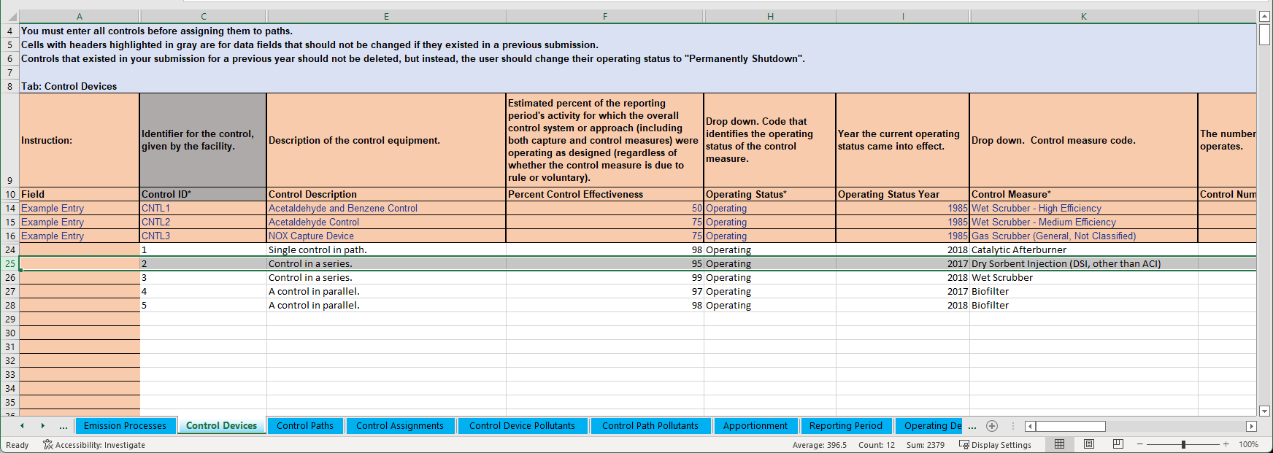
Control Device Tab for this Example

Slide 80
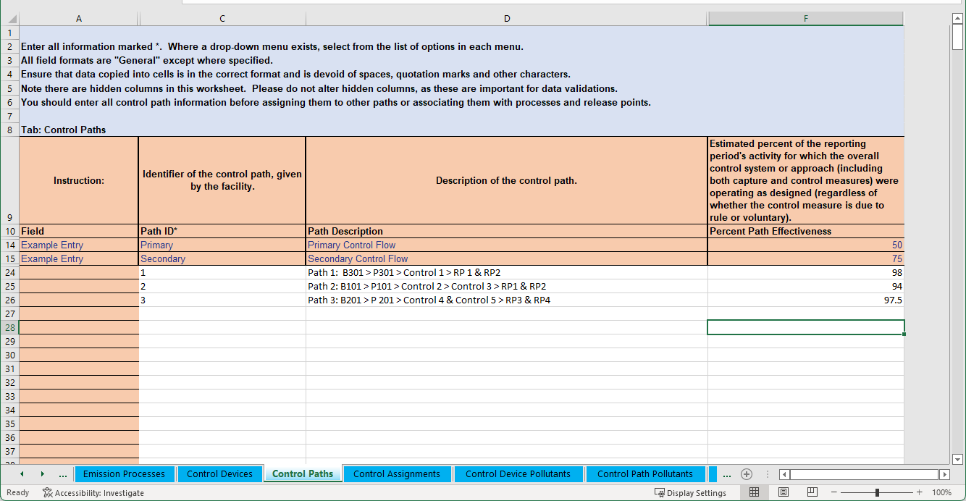
Control Paths Tab for this Example

Slide 81
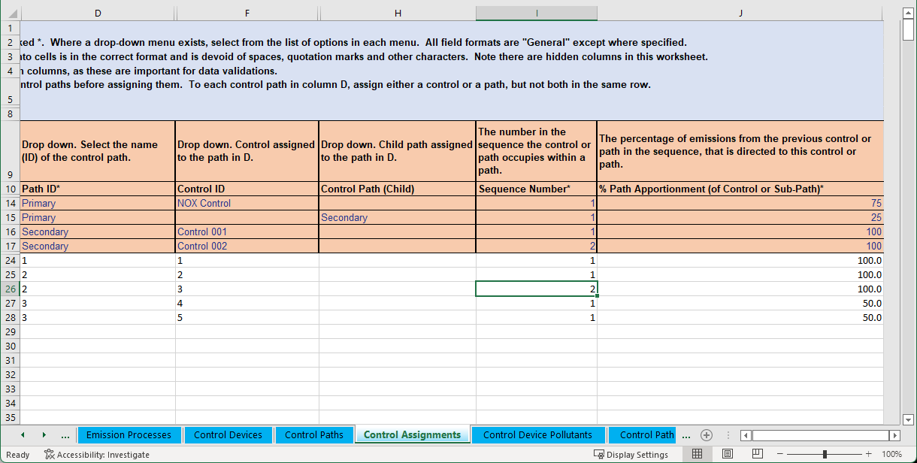
Control Assignments for this Example

Slide 82
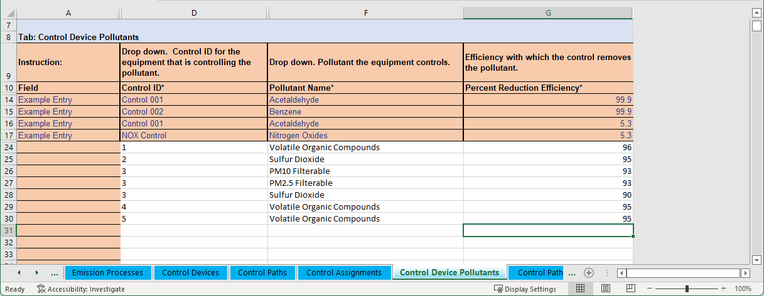
Control Device Pollutants for this Example

Slide 83
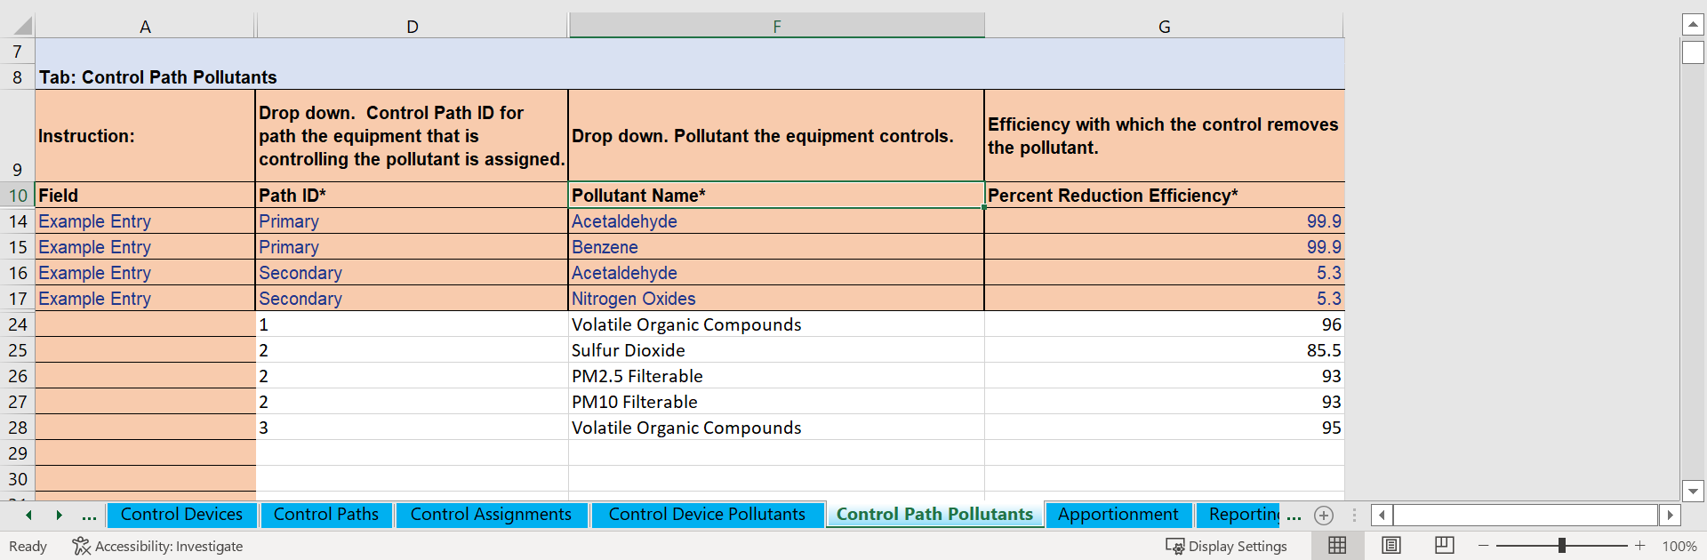
Control Path Pollutants for this Example

Slide 84
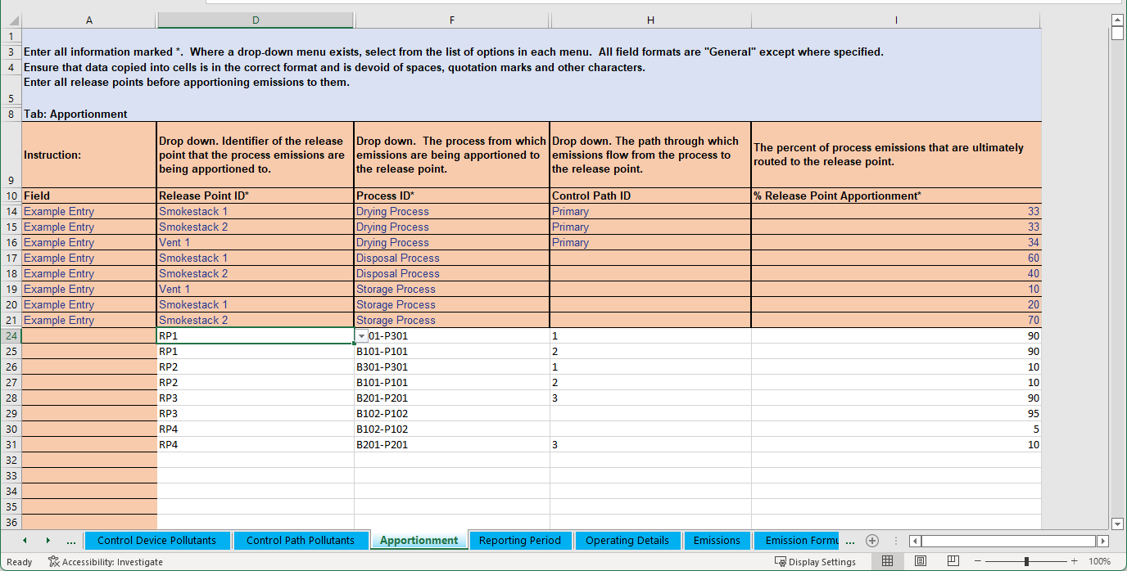
Release Point Apportionment for this Example

Slide 85
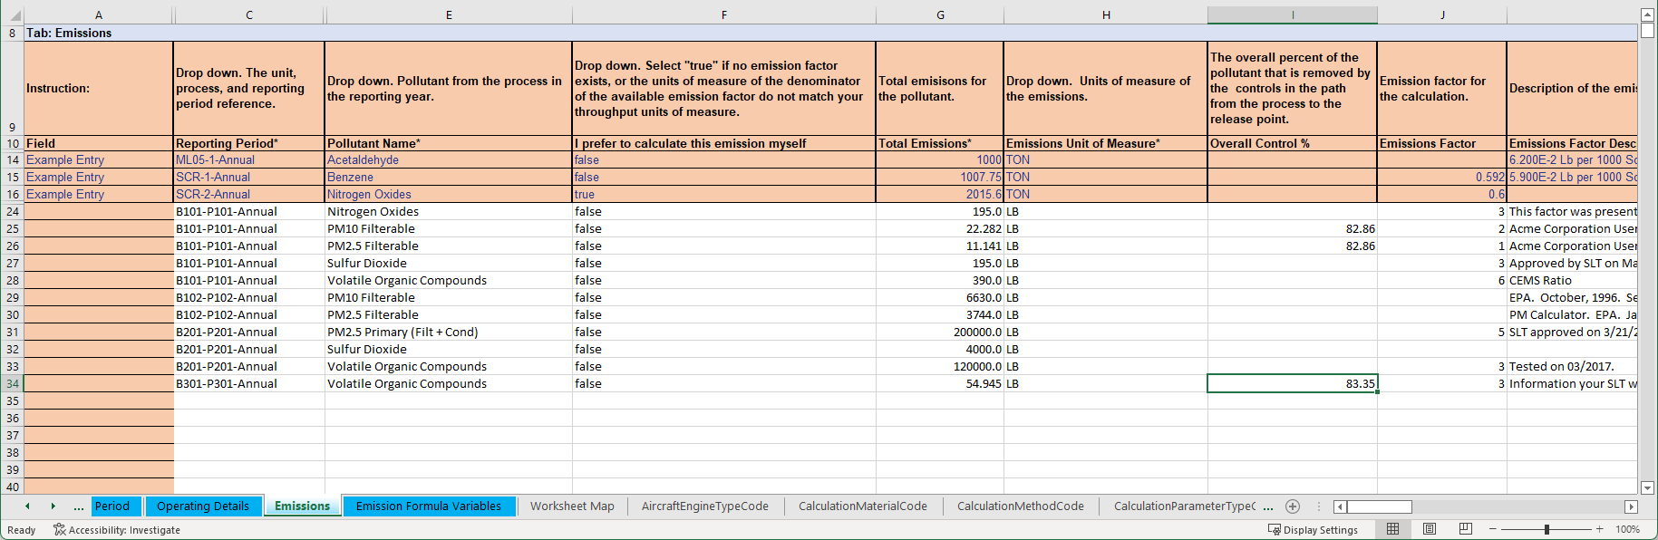
Emissions for this Example

Slide 86
Examples of More Complex Control Device Configurations

Slide 87
In Series
Control 4
Stack 1
Stack 2
Stack 3
Path 2
Path 1
Control 3
Control 2
Control 1
Boiler 1
Boiler 2
Process 1
Process 2
Control devices 1, 2, 3, and 4 are set up in sequence. Boiler and Process 2 send emissions to control 1. Boiler and process 1 send emissions to control 2. Path 1 is the primary path between Boiler and Process 1 to Stack 1. Path 2 is the primary path between boiler and process 2 and stack 1. Path 1 is a “child” path of Path 2. Path 2 is a “primary” path.

Slide 88
Numerical Example of Controls in Series and their Paths
Path 2
Path 1
Control 4
Controls
Control ID | % Effectiveness | Pollutant | % Efficiency | Overall % Reduction
Control 1 | 95% | VOC | 80% | 76%
Control 1 | - | CO | 95% | 90%
Control 2 | 90% | PM10-PRI | 90% | 81%
Control 2 | - | PM-CON | 100% | 90%
Control 3 | 90% | NOX | 90% | 81%
Control 4 | 90% | SO2 | 90% | 81%
Control 3
Paths
In this example we assume 100% of emissions are routed to the release point (% capture = 100%, no fugitives).
Control 2
Path ID | Sequence Number | Assignment (Control or Path) | Apportionment (Control or Path)
Path 1 | 1 | Control 2 | 100%
Path 1 | 2 | Control 3 | 100%
Path 1 | 3 | Control 4 | 100%
Path 2 | 1 | Control 1 | 100%
Path 2 | 2 | Path 1 | 100%
Control 1
Release Points
Unit ID | Process ID | Path ID | Release Point ID | Release Point Apportionment
Boiler 1 | Process 1 | Path 1 | Stack 1 | 100%
Boiler 2 | Process 2 | Path 2 | Stack 1 | 100%
Notes:
The table shows how the different data elements would be entered in CAERS for this example. The numbers are fictious and are for illustration purposes only.

Slide 89
In Parallel
Control 6
Stack 1
Stack 2
Stack 3
Path 3
50%
Path 2
50%
Control 5
Path 1
Control 4
Control 2
60%
Control 3
Boiler 2
40%
Control 1
Process 1
Path 1 is a child path of Path 2. Path 2 is a “primary path” between the process and Stack 3. Path 2 is a child path of Path 3. Path 3 is a “primary path” between the process and Stack 1.
Notes:
50% of total emissions from boiler 2 process 1 go to stack 3, the other 50% go to stack 1.

Slide 90
Numerical Example of Controls in Parallel and Series
Path 3
Control 6
Path 2
Control 5
Controls
Path 1
Control ID | % Effectiveness | Pollutant | % Efficiency | Overall % Reduction
Control 1 | 95% | VOC | 80% | 68%
Control 2 | 90% | PM10-PRI | 90% | 81%
Control 2 | - | PM-CON | 100% | 90%
Control 3 | 90% | CO | 95% | 86%
Control 4 | 95% | NOX | 99% | 75%
Control 5 | 90% | Pb | 95% | 81%
Control 6 | 98% | SO2 | 97% | 95%
Control 4
Control 3
Control 2
Control 1
Notes:
The new path method provides more detailed data. The table shows how the different data elements would be entered in CAERS for this example with a combination of controls in parallel. The numbers are fictious and are for illustration purposes only.

Slide 91
Controls in Parallel and Series Paths and Release Points
Path 3
Control 6
Paths
Path 2
Path ID | Sequence Number | Assignment (Control or Path) | Apportionment (Control or Path)
Path 1 | 1 | Control 2 | 100%
Path 1 | 2 | Control 4 | 100%
Path 2 | 1 | Control 1 | 100%
Path 2 | 2 | Control 3 | 40%
Path 2 | 2 | Path 1 | 60%
Path 2 | 3 | Control 5 | 100%
Path 3 | 1 | Path 2 | 100%
Path 3 | 2 | Control 6 | 100%
Control 5
Path 1
Control 4
Control 3
Control 2
Release Points
Control 1
Unit ID | Process ID | Path ID | Release Point ID | Release Point Apportionment
Boiler 2 | Process 1 | Path 2 | Stack 3 | 47%
Boiler 2 | Process 1 | Path 3 | Stack 1 | 47%
Boiler 2 | Process 1 | Path 2 | Fugitive | 3%
Boiler 2 | Process 1 | Path 3 | Fugitive | 3%

Slide 92
Example with a Back-Up Process
1. The emissions only go to the VCU when the VRU is not working, per permit. The VCU is a backup to the VRU and was only used about 1% of 2019 or about 100 hours.
2. Only one runs at a time, taking 100% of the inlet/emissions.
3. Two different release points. A vent off the VRU, the VCU is a stack/flare.
4. Gasoline vapor is only emissions off the loading rack. So VCU emissions are VOCs. Because we use propane in the VRC it has VOC and NOx/CO.
Tanks
Liquid return
Loading Rack
vapors
VRU (VOC)
Release Point
Bypass N/C
VCU (VOC, NOx, CO)
Release Point
Propane
Notes:
In this example, the VRU is a vapor recovery unit. The VCU is a vapor combustion unit.

Slide 93
VRU and VCU Example Continued
Process 1
VRU
Release point 1
VOCs
Path 1
Process 2
VCU
Release point 2
Propane
VOC, NOX and CO
Path 2
If individual control capture isn’t 100% then rel apportionment should be adjusted to reflect % going to fugitives.
Process 1 (VOC)
Path 1:
VRU sequence 1
Process 2 (VOC, NOX and CO)
Path 2
VCU Sequence 1
Recall VCU is a “backup” for the first process. When the VRU is offline, the VCU is running.

Slide 94
How to Get Help
Regardless of what help you need always send your SLT:
1. Facility name and ID
2. Screenshot(s) of error you are getting
3. BU template (if using) that is giving you errors
4. Diagram -even if by hand and scanned in- of the controls set up you have (especially for complex controls)
Steps:
1. If CAERS issue: Help Desk first (Click Help in UI top right of your screen)
2. If questions about calculations: Your SLT (they will elevate to EPA as needed)

Slide 95
Questions

