Slide 1
Miscellaneous Methods in the ERT
Notes:
Miscellaneous methods in the ERT. I am going to demonstrate the miscellaneous methods summary table that is a new feature of the electronic reporting tool ERT, version seven. This feature will allow all method results to be entered into the ERT.

Slide 2
ERT welcome page
Notes:
When I open the ERT application, I see the welcome page. First I need to select continue to get into the ERT.

Slide 3
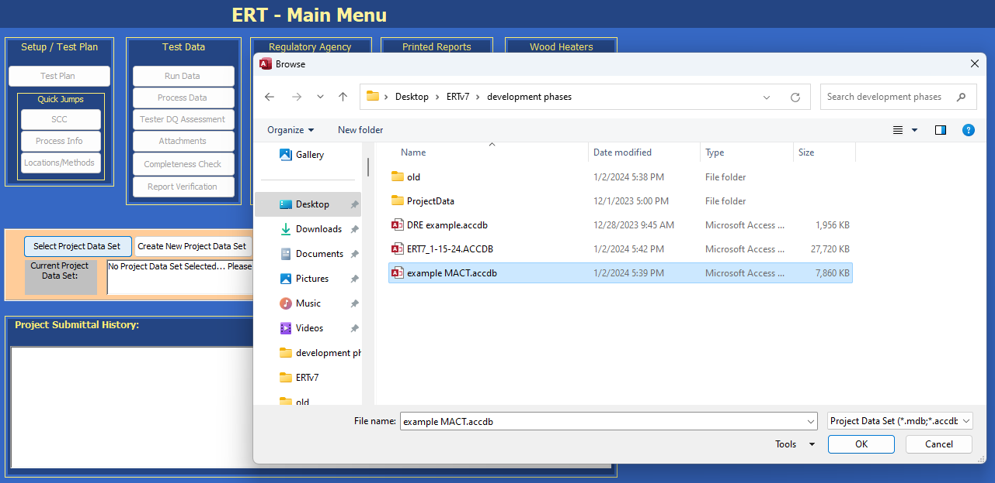
Select a data set
Notes:
Now that I am in Main Menu of the ERT, I need to select the project data set or create a project data set. You can use older data files or you can create a new file. In this instance we will select a project data set. Please remember to store the project data set in the same location which you have your ERT application either on your desktop or computer when working on the file. Issues may occur when working on files if they are stored on servers, Sharepoint or the cloud. As you can see, this file is located on this desktop.

Slide 4
Test Plan Facility/Tester tab
Notes:
As with most ERT files, I'll start with a test plan. Since I am using a file that already has information about the tester and test location with all the example information, I will double check it to make sure that it is correct.

Slide 5
SCC
Notes:
I need to double check the Source Classification Code (SCC) to make sure there was not an update to the SCC. As you can see there is a description in the large yellow box of the process that was tested. If the SCC has been revised, this description will be missing and you will need to Select the SCC from the dropdown list.

Slide 6
Add Method
Notes:
Next I will go to the Location/method tab and I will be adding Method 320 for hydrogen chloride and ammonia. If you notice here in 2A, when I select the location and I select the method, there are a long list of new methods now in the ERT. The Miscellaneous Method summary table will be activated if the method is not an isokinetic method, an instrumental method (3A, 6C, 7E, 10 and 25A) or Method 30B.

Slide 7
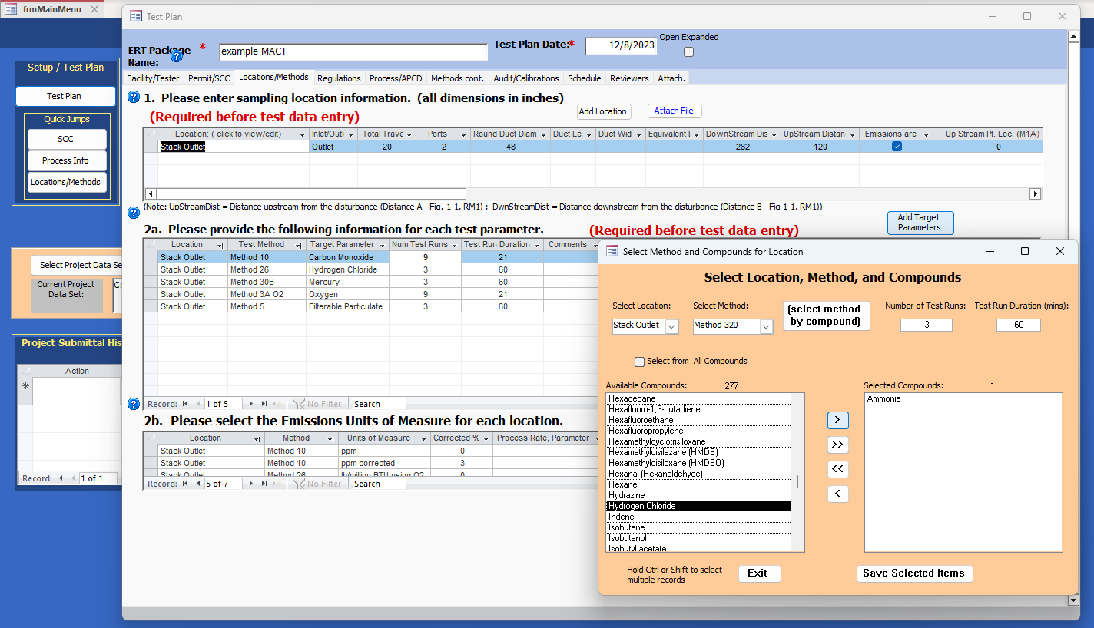
Add Hydrogen chloride
Notes:
I will select Method 320, number of test runs 3, run duration 60 minutes, and have added the ammonia.

Slide 8
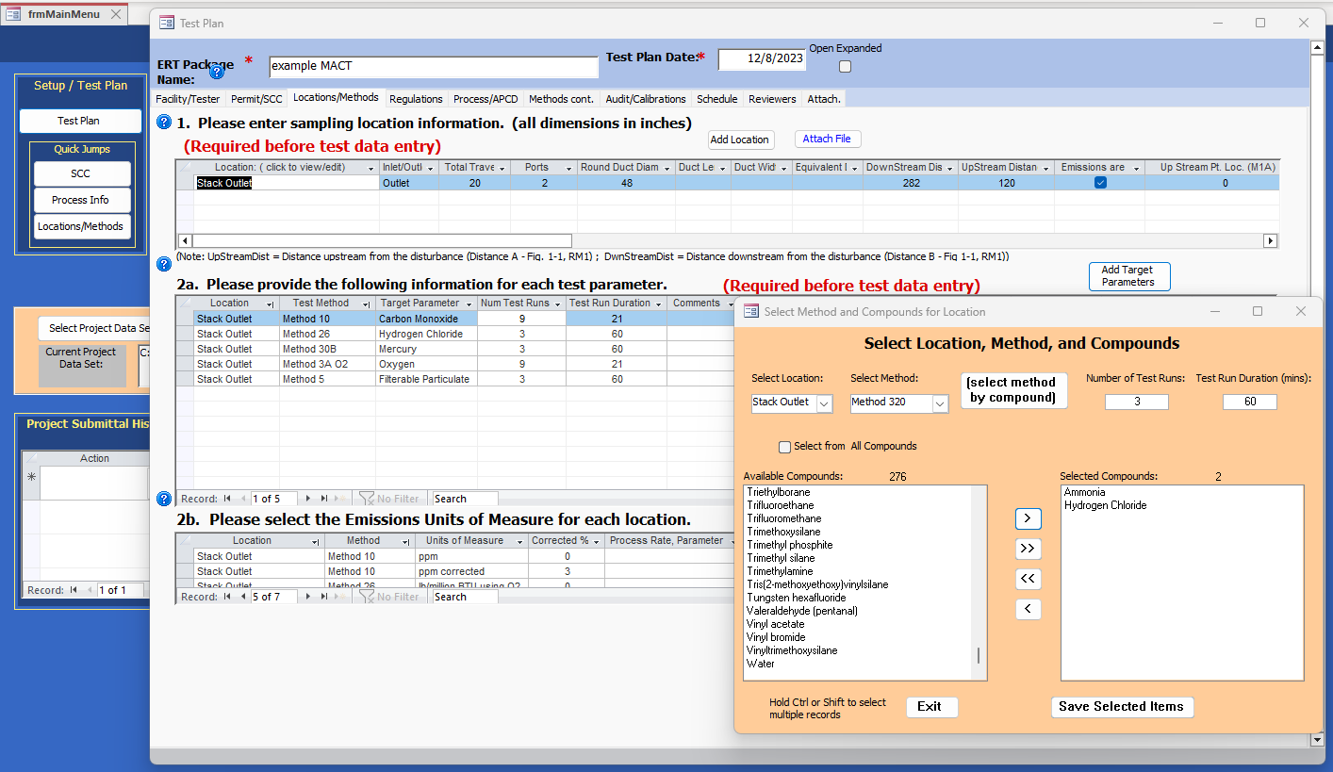
Add ammonia
Notes:
I added the method and compounds exactly same way as adding an isokinetic or instrumental method. Selecting the compound and then moving the available compounds by the single arrow to the selected compound list and Save selected items. And as you can see, now I have hydrogen chloride and ammonia in the list.

Slide 9
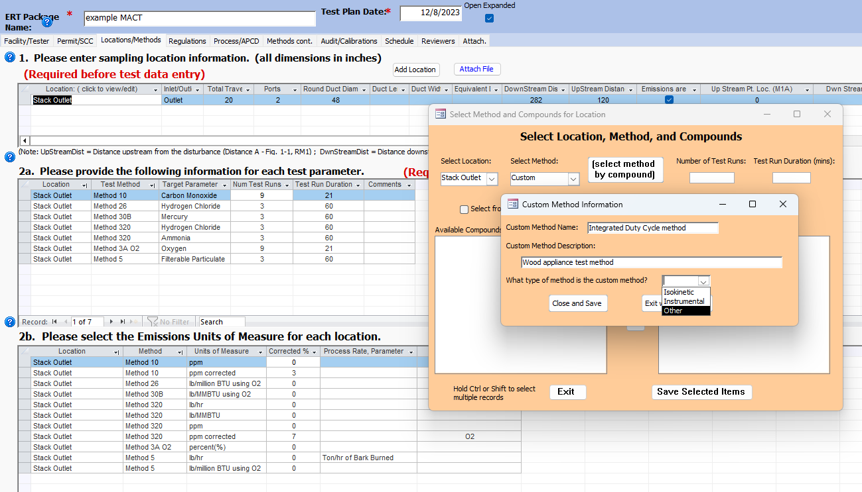
Add miscellaneous method
Notes:
Now, if there happens to be a method that is not in this list that you want to use, all you would have to do is to select custom method. For instance to add Integrated Duty Cycle method, select Custom method. Enter in Custom Method Name: Integrated Duty Cycle method and Custom Method Description: Wood appliance test method. Then we need to answer the question What type of method is the custom method? In the dropdown select Other and select Close and Save.

Slide 10
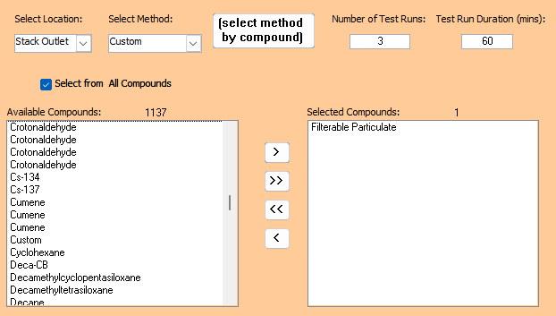
Add compound to miscellaneous method
Notes:
I need to find the compound for the custom method. To do this, check the box Select from All Compounds scroll through the list and select the compound, filterable particulate. The compounds are listed generally in alphabetical order.
Then Select Save Selected Items.

Slide 11
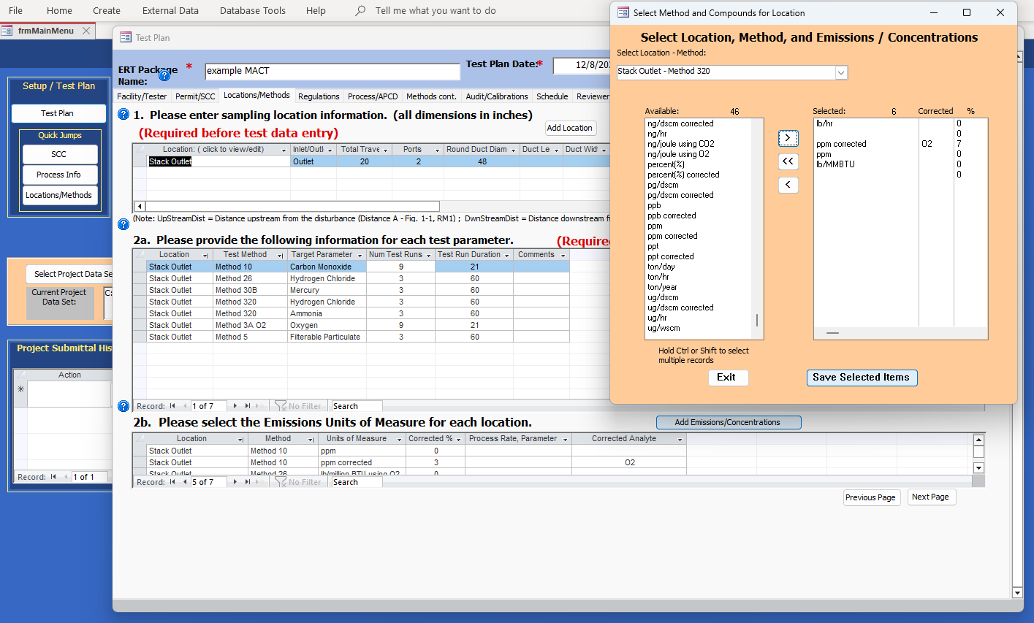
Add Units of measure
Notes:
Once completed 2a., I will move to 2b. Add Emissions/Concentrations. Select Location -Method dropdown of Outlet - Method 320. I will select The appropriate units of measure, lb/hr, ppm, ppm@7%O2 and lb/MMBTU. Be sure to select pounds per MMBTU. You do not, absolutely do not want to select pounds per MMBTU using O2 or CO2 for the miscellaneous methods summary table. There are no calculations done on the summary table except for the process-based emission rate on the emissions tab.

Slide 12
Link Process rate to lb/hr
Notes:
If you have a selection of pounds per hour, and need pound per ton of bark burned, you need to select the Process Rate, Parameter of tons of bark burned per hour. The final unit of measure is pounds per ton of bark burned. For a process-based emission rate, you want to select those process rates with the pounds per hour in 2b. Hours will cancel and then you will have the process-based emission rate. That will be the only calculation that is conducted in the emission tab for the miscellaneous methods table.

Slide 13
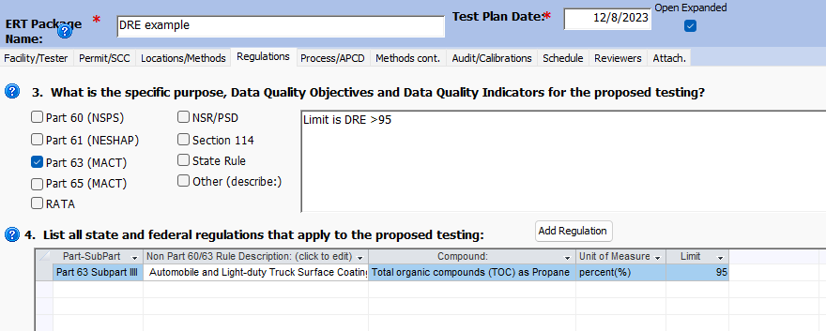
Regulations and limits
Notes:
The last item in the test plan is in the regulations tab to make sure the limits are selected for the compounds. This is a screen shot for the Destruction Recovery Efficiency emission limit. I will go through this example later in the presentation.

Slide 14
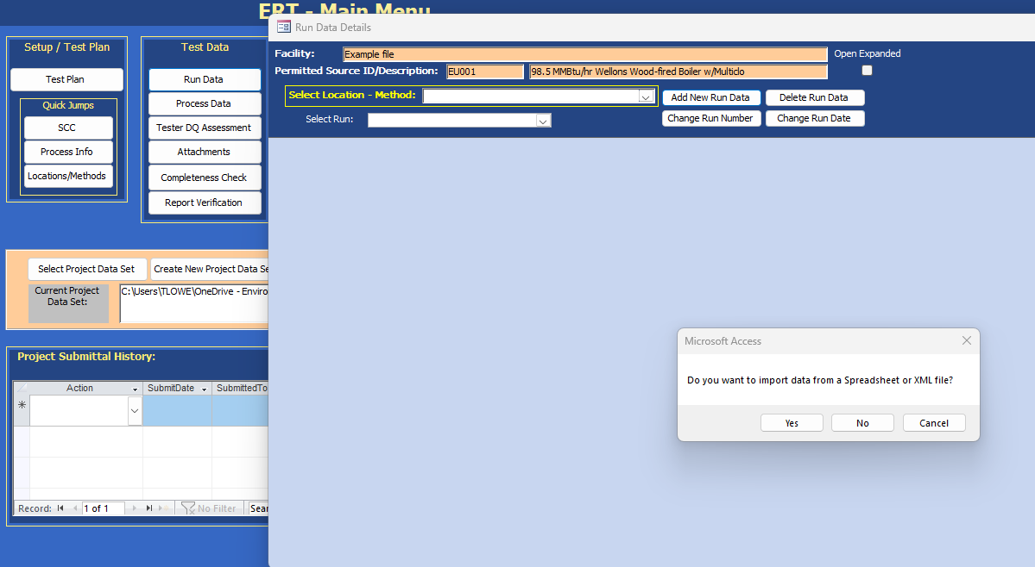
Import data
Notes:
Now I am ready to add the Test Run Data. There are two ways to enter the test run data. As isokinetic and instrumental data, there is an import sheet that can be used to import the data or the data can be entered by hand.

Slide 15
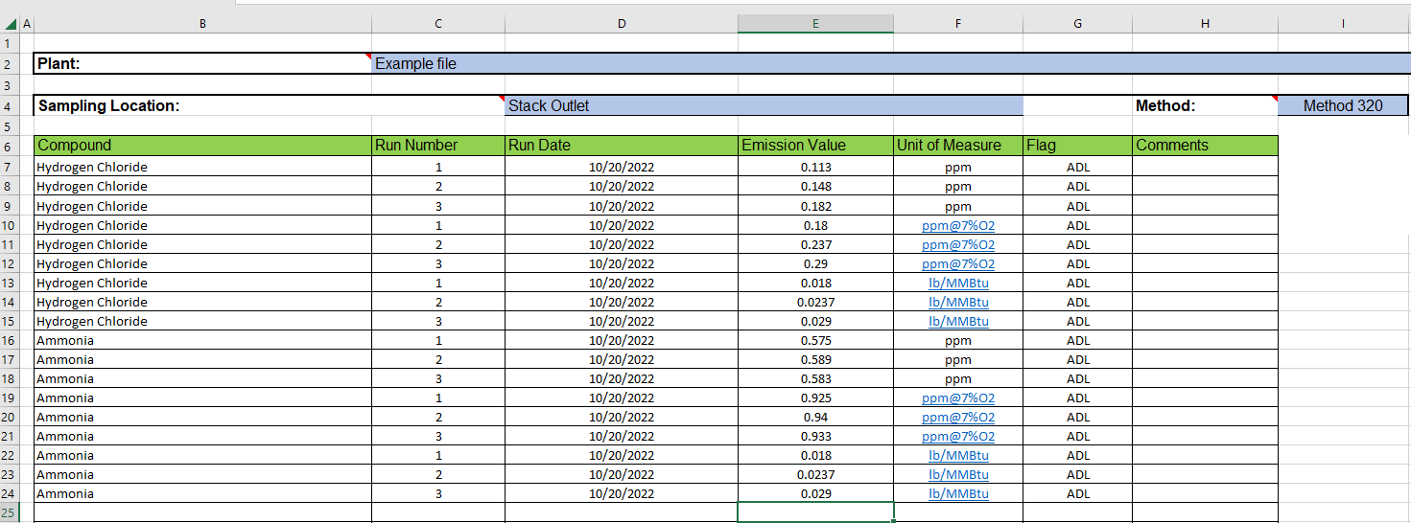
Spreadsheet for miscellaneous methods import data
Notes:
First, I will use the Miscellaneous methods import spreadsheet to enter the data into the ERT.
To complete the spreadsheet, make sure the plant/facility name is the same and the sample location is the same as the ERT sample location. It must be identical. Add the method, compounds, run number date, emission value, unit of measure, flag and comments to the spreadsheet. Make sure the method, compound spelling are identical to 2a of the test plan. Save the spreadsheet and close the spreadsheet.

Slide 16
Import data 2
Notes:
Select Run Data on the main menu then select Add New Run Data. A pop-up will show asking Do you want to import data from a Spreadsheet or XML file? Select yes.

Slide 17
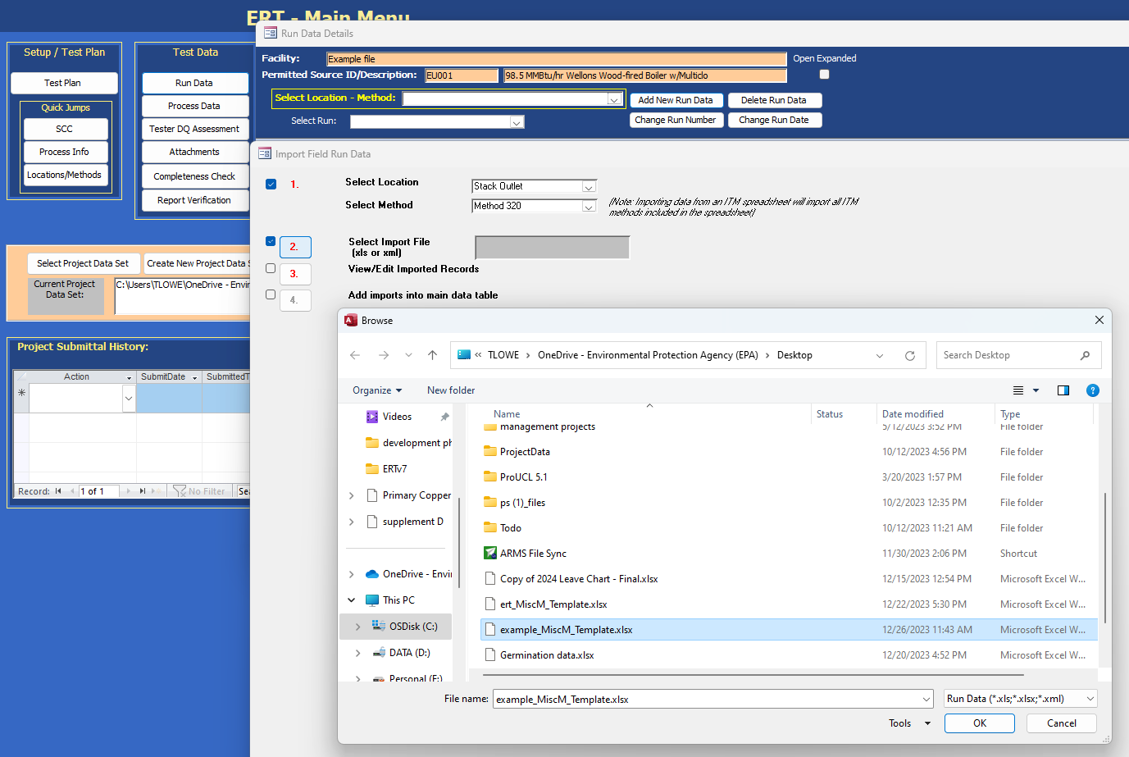
Select spreadsheet file
Notes:
Select Location Stack Outlet, Select Method from drop down list - Method 320. Click 2. Select the Import File and select open. Select the import spreadsheet file from the browse window and select ok.

Slide 18
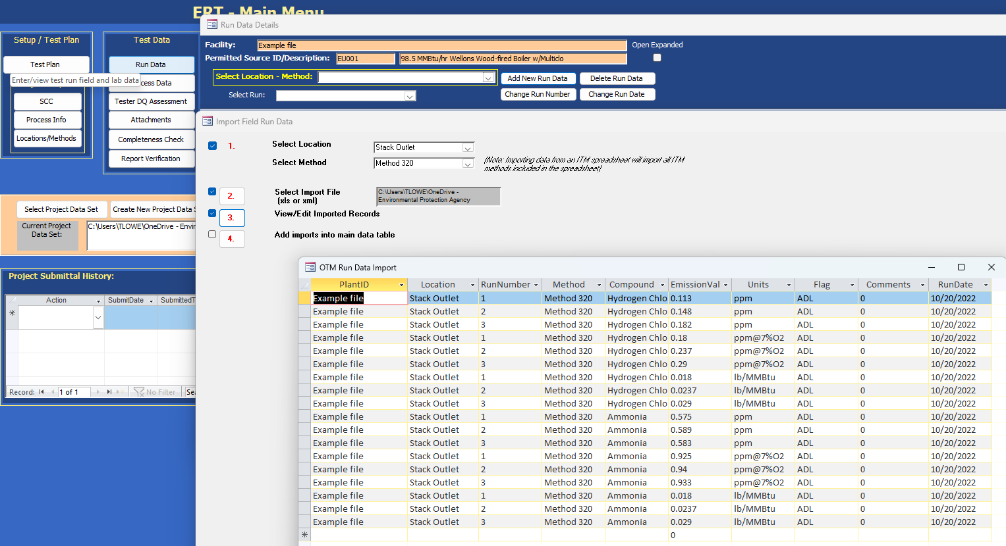
Review imported records
Notes:
In step 3. View the imported data, the data can be reviewed to make sure it is correct.

Slide 19
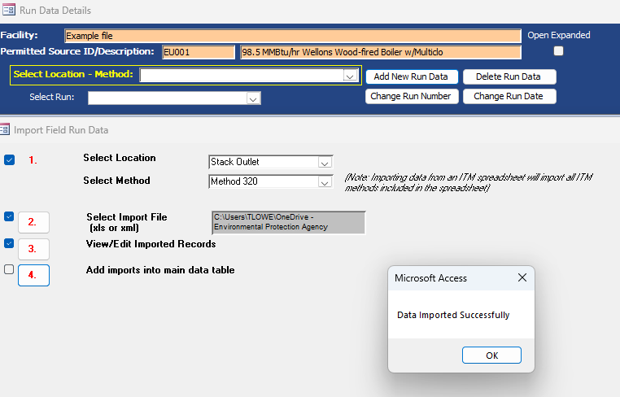
Data import successfully
Notes:
Then select 4 add imports to the main data table. Once import is complete, there will be a pop-up saying the Data imported successfully, select ok .

Slide 20
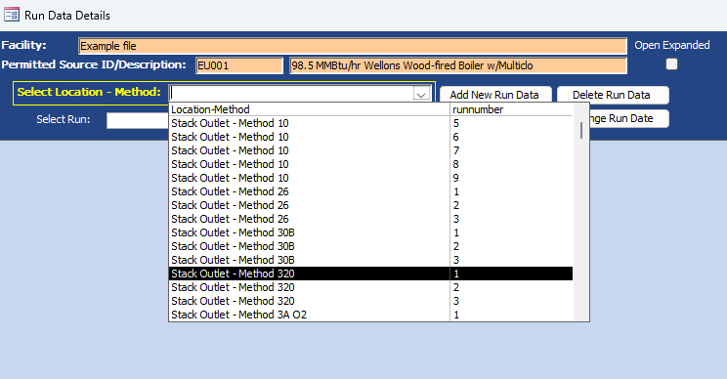
Imported miscellaneous method run 1
Notes:
You can now check the Select Location – Method: for Method 320 Runs 1, 2 and 3.

Slide 21
Import data 3
Notes:
Now I will show you how to add a run without the spreadsheet. Select Run Data in the main menu then select Add New Run Data. A pop-up will show Do you want to import data from a Spreadsheet or XML file? Select no.

Slide 22
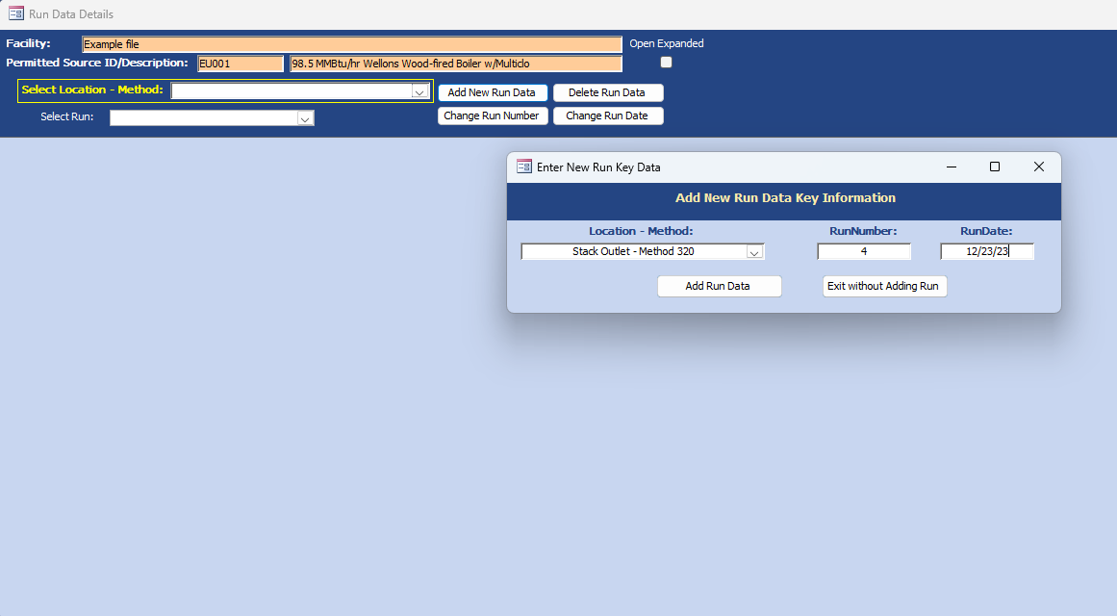
Add Run Data manually
Notes:
I will select Stack Outlet – Method 320 from the dropdown under Location – Method, then I enter run number 4 and the date of 12/23/23.

Slide 23
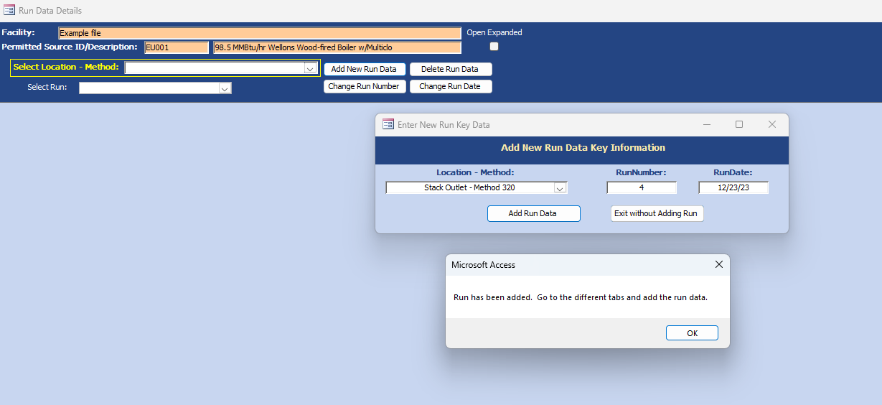
Run has been added
Notes:
There is a message saying Run has been added, I can now go and enter the data. Select ok.

Slide 24
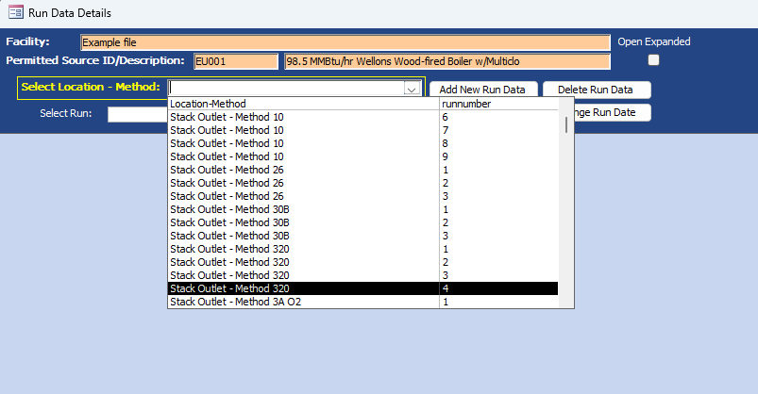
Select the run to add data
Notes:
Go to Select Location – Method and Select stack outlet - Method 320 Run 4.

Slide 25
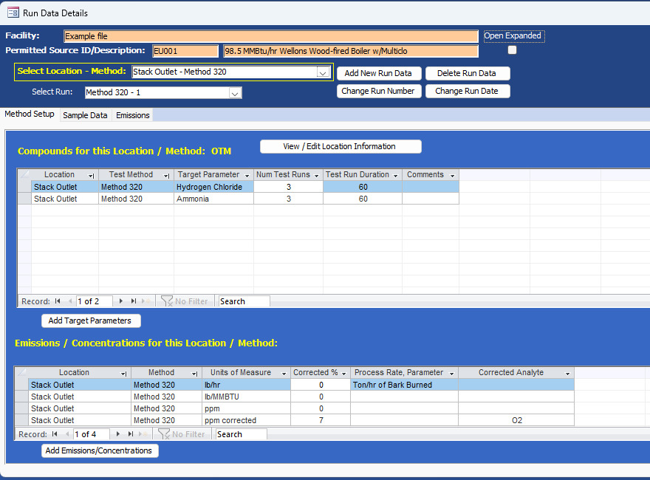
Method Setup tab
Notes:
The tabs Method setup and Emissions are similar to the Isokinetic tab, the instrumental tab, and the 30B tab. You can do the same things in the Method setup tab if you need to edit a location or add target parameters or add an emission concentration that may have been forgotten in the test plan.

Slide 26
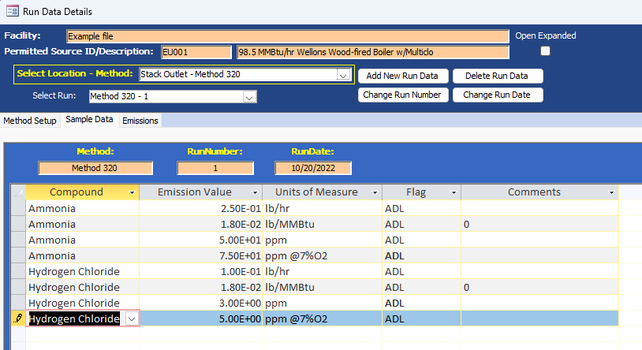
Sample Data tab
Notes:
Go to the sample data tab and as you can see all of the compounds and units of measure that were on the method setup tab are listed here.
This is where you just want to put your total final numbers, final calculated hydrogen chloride and ammonia emission values for ppm, ppm@7%O2, pounds per hour, and pounds per Mm BTU. Just type the emission value with the appropriate unit of measure. You will add your final results. This is just a summary table. It is just final results in the units of measure that you want reported.

Slide 27
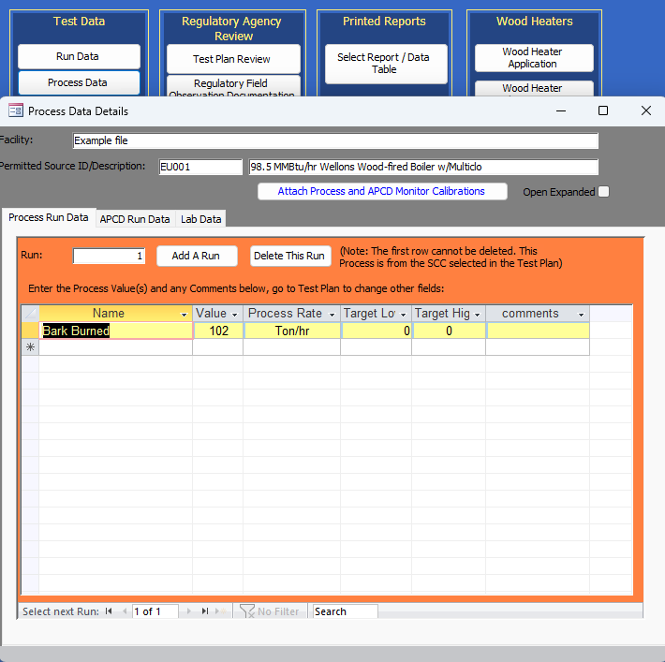
Process Run Data
Notes:
The Process Rate of tons of bark burned per hour is entered under the Process data.

Slide 28
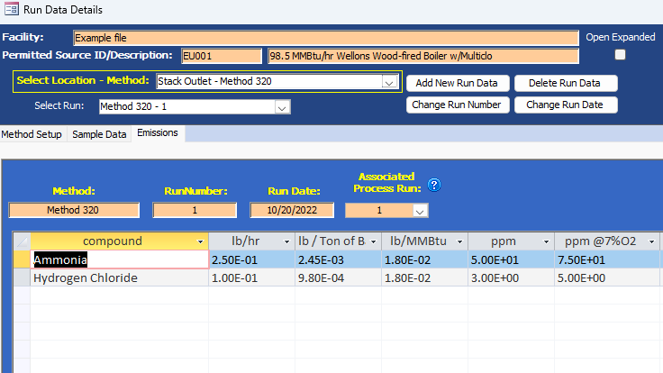
Emissions tab
Notes:
That process rate is used to calculate the pounds per ton of bark burned and that is the associated process Run in the emissions tab. With the miscellaneous method summary table added to the ERT, now all data generated by all methods that were previously not able to be entered into the ERT can be entered. This includes Method 320, 18, 0030, 0031 and so on. It also means that Destruction efficiency, destruction removal efficiency and removal efficiency can be entered into the ERT.

Slide 29
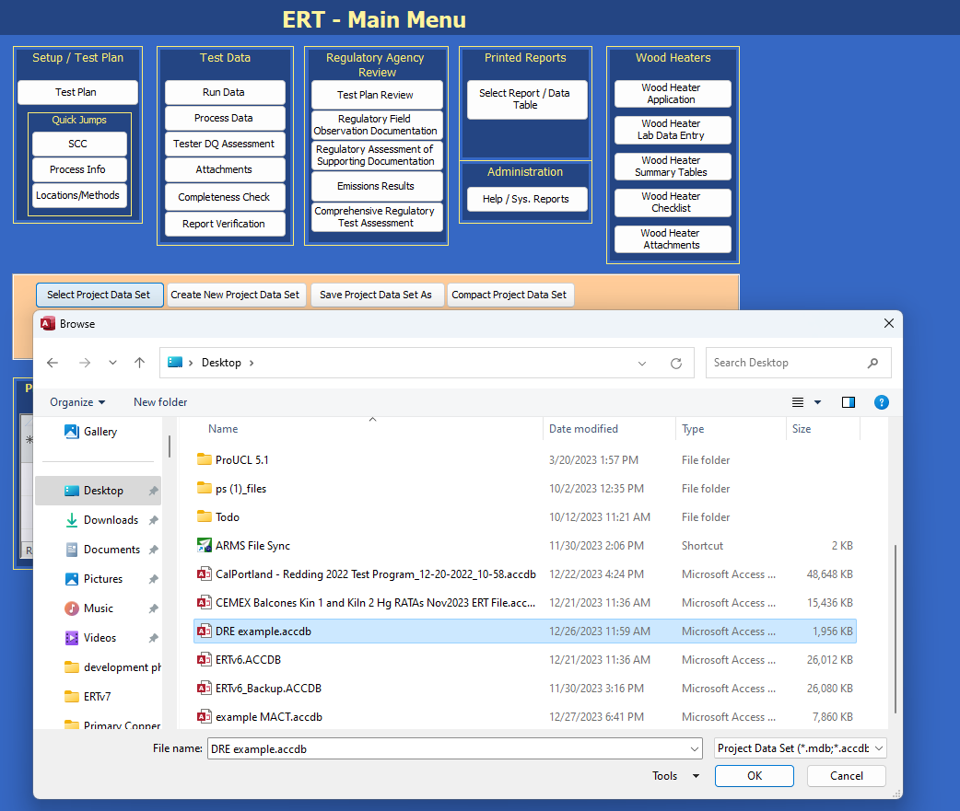
DRE example file
Notes:
I have another data set as an example, and we're going to go to the desktop and select my DRE example file.

Slide 30
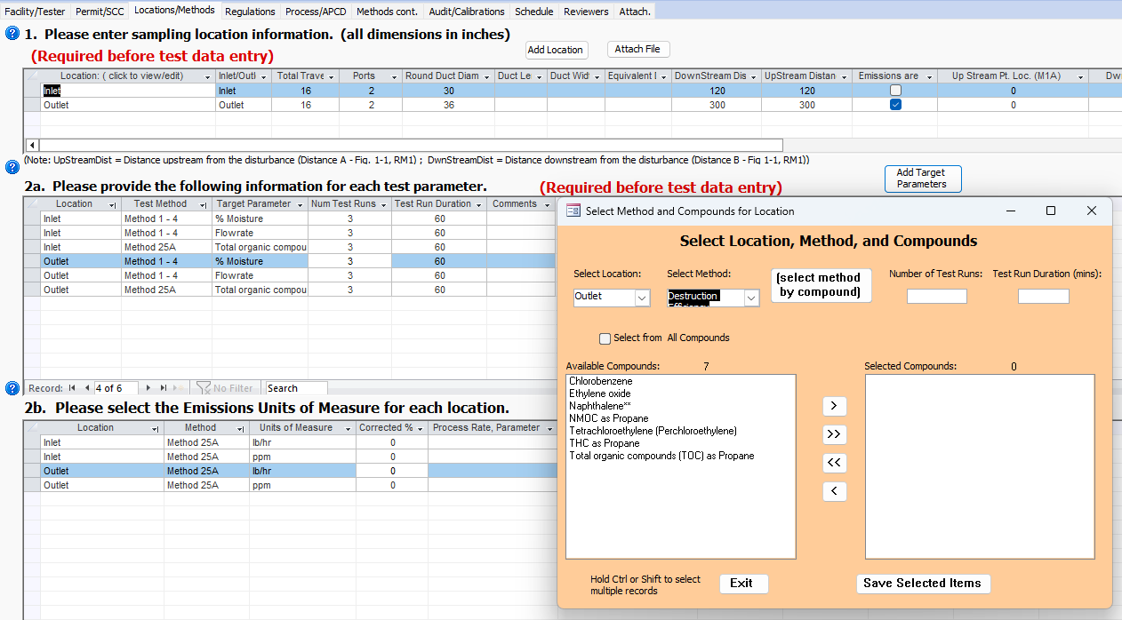
Select compound
Notes:
I created this test plan for the Dre with inlet and outlet Method 25A and Method 1to4 for flow rate and percent moisture data.
When I go into 2a. Methods and Select Add target parameters. I select a location - outlet. For Methods, there is a choice of destruction efficiency, destruction removal efficiency and there's also removal efficiency at the bottom of the list. The method list is alphabetical, I have selected destruction efficiency. A list of available compounds that typically for destruction efficiency are listed.

Slide 31
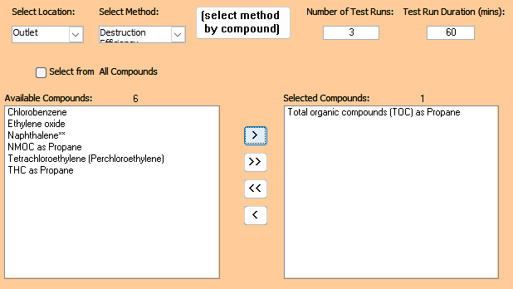
TOC as propane
Notes:
Total organic compounds (TOC) as propane is selected.

Slide 32
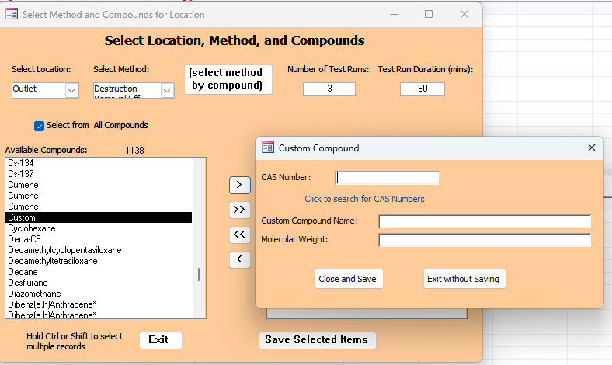
Add custom compound
Notes:
If there is a compound that is missing, you can select the box Select from all compounds and find the compound in the list and add it to the selected compounds. If the compound is not in the list, you can add a custom compound as long as you have the CAS number and the molecular weight by selecting Custom.
In the list of compounds, you will notice it is generally alphabetical and there are a lot of duplicates. Those duplicates are because each one is assigned to a method, and we have multiple methods for a single compound which leads to compound duplications.

Slide 33
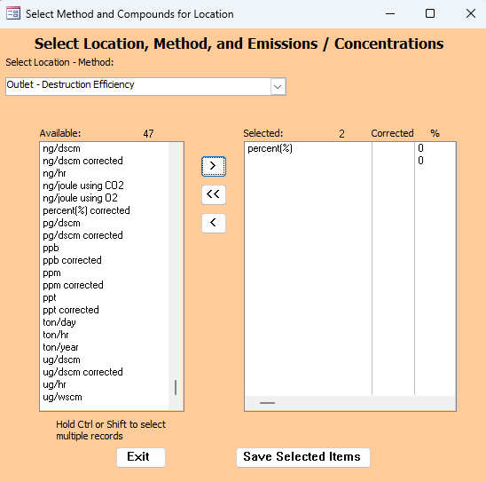
Add unit of measure
Notes:
In 2b I need to add a unit of measure for the outlet - destruction efficiency, I select percent. Select save selected item and then close the test plan. Data cannot be added to Miscellaneous Methods unless a unit of measure is selected in 2b. At least one unit of measure must be added to 2b for the miscellaneous methods.

Slide 34
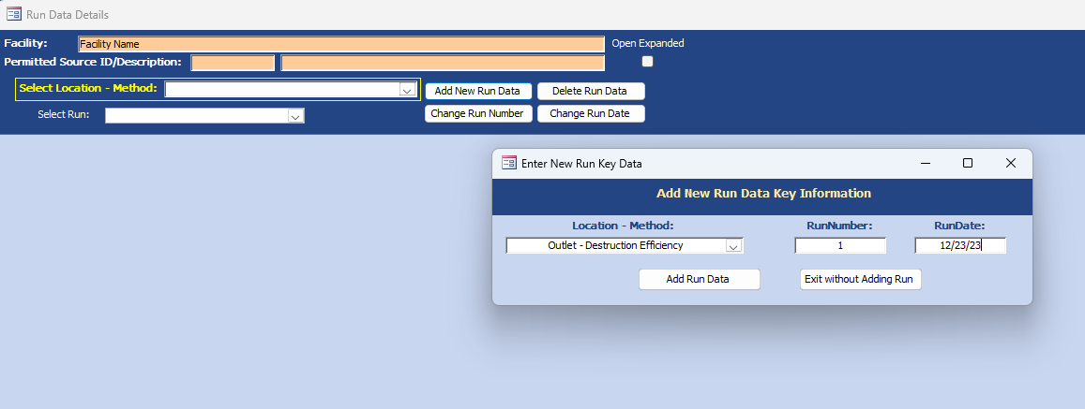
Add DRE run
Notes:
Now I go into the run data on the main menu, I add the run the same way I did before. I will hand enter the data for run 1 for the outlet destruction efficiency.

Slide 35
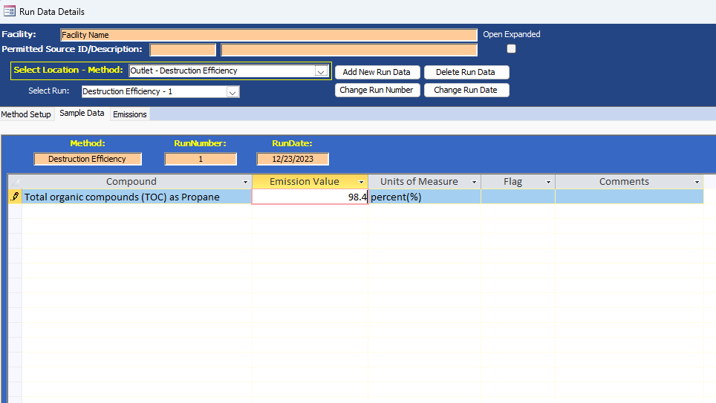
Add emission value
Notes:
Here's the sample data tab for run one destruction efficiency. I entered 98.4 emission value with the percent as the unit of measure.

Slide 36
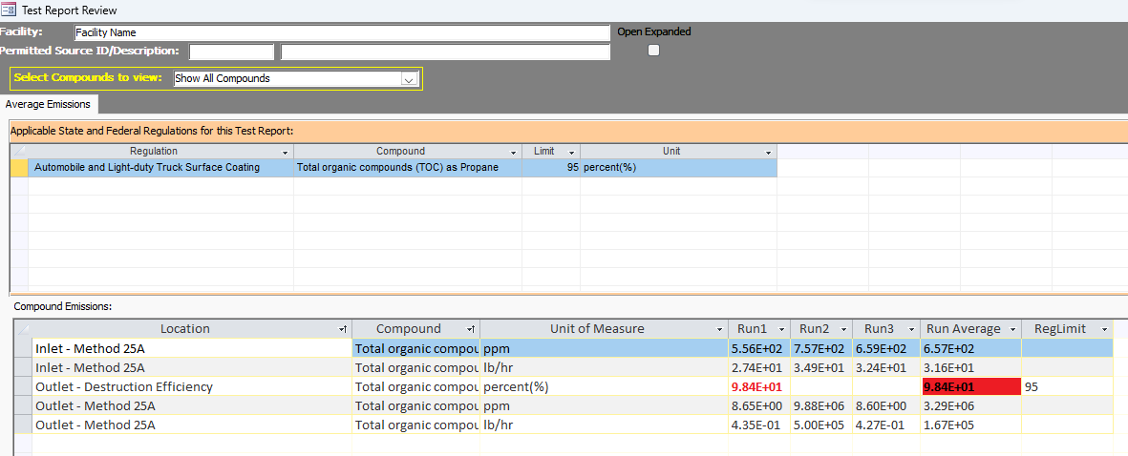
Limit will be over 95%
Notes:
One thing you're going to want to remember under the Regulatory agency review column of the main menu emission results button, for compliance the emission values should be below the limits. However, for destruction efficiency, destruction removal efficiency and removal efficiency, the limit is usually greater than 95%.
The data is 98%, the value will be highlighted red because it is above the limit, which in this case means the destruction efficiency is within compliance.

Slide 37
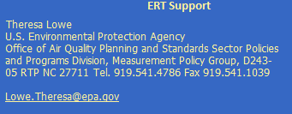
Contact information
Notes:
This has been the demonstration for the miscellaneous method summary table. If you have any questions, please let me know.
My contact information provided.
Thank you.

