Slide 1
Plant Sampling Instructions

Slide 2
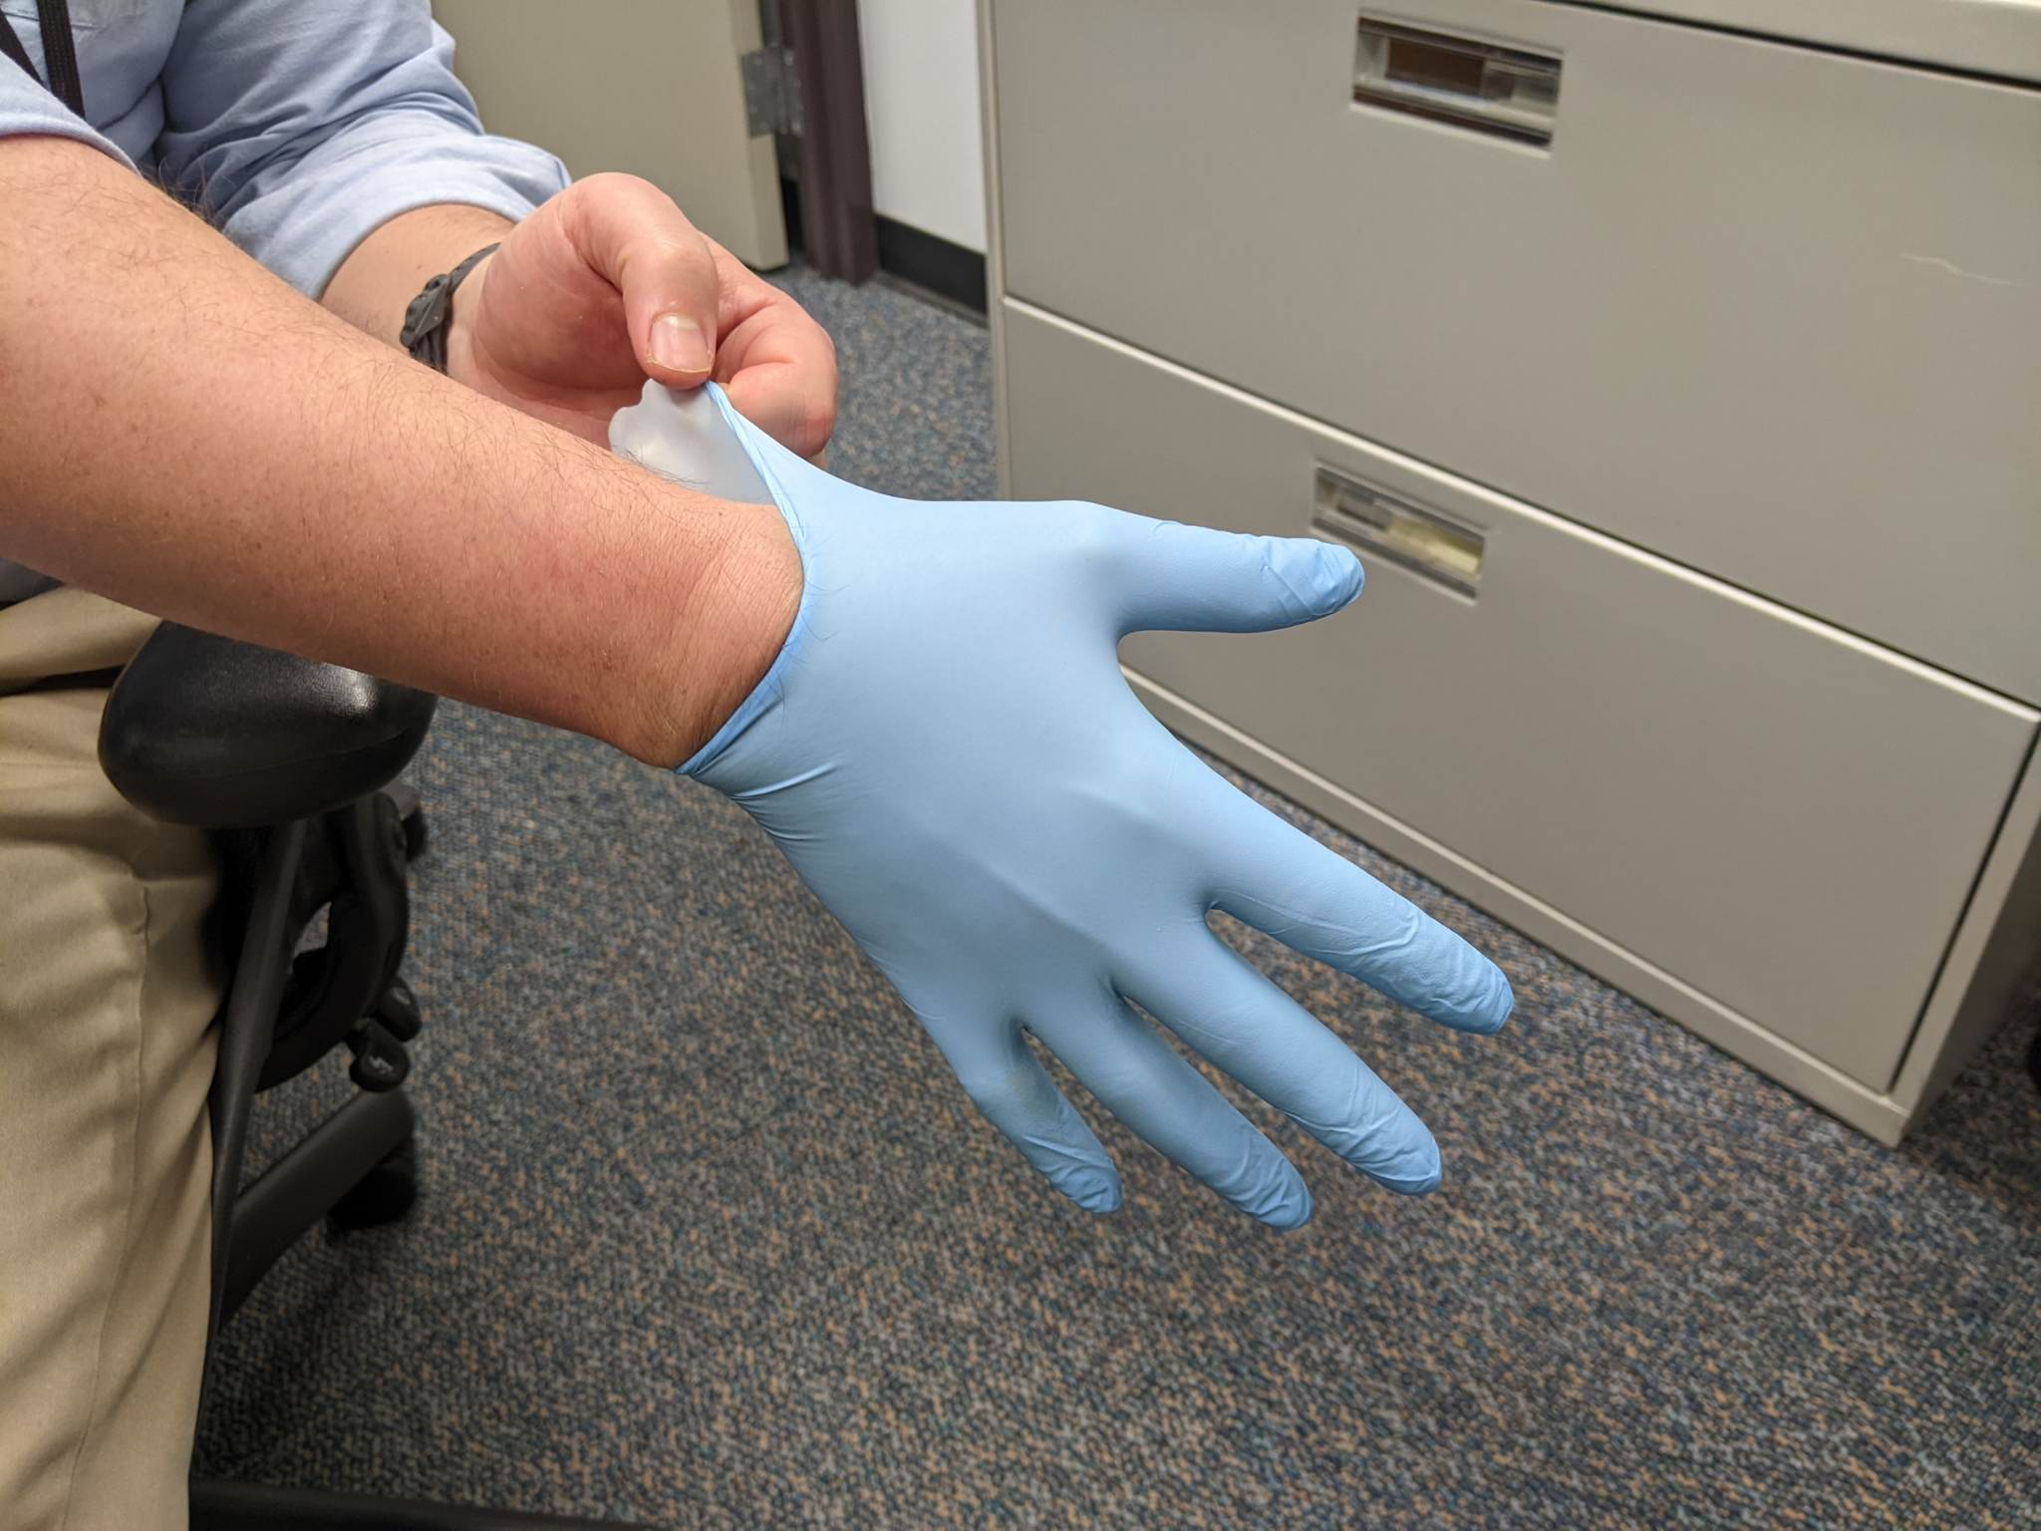
1. Put on a clean pair of nitrile gloves
Change gloves frequently:
after handling contaminated tools,
if gloves get wet,
after touching contaminated surfaces,
before touching clean sampling containers, &
between samples.

Slide 3
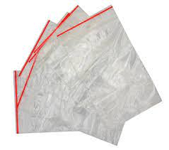
2. Bags and labels
a.) Take out provided plastic Ziploc bag. Keep bag closed to prevent contamination.
b.) Fill out the provided label on each bag with the following information →
ID: ____________________________
Sampler Initials: ___________________
Collection Date:___________________
Collection Time:___________________
Example sample ID:
North Field - Alfalfa 1
Example anonymized ID:
Site Number-Sample Number (1-2 means site 1, sample 2)

Slide 4
3a. Field sampling with tools
When possible, use a 2-person, clean hands/dirty hands sampling method.
1-person (dirty) opens valves (water) or scoops samples (plants, soil)
1-person (clean) only handles sample containers
a) Collect sample using clean tools - Clean tool between each use
b) Place plants in Ziploc bags corresponding to each site
c) Seal bag tightly so that water can not enter the bag during transport
d) Double bag samples (sample label remains on inner bag, protected from water intrusion)

Slide 5
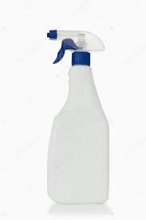
3b. Sampling continued note: video follows showing technique
In between sampling sites, wash the tools with provided soapy water and regular water.
Cleaning instructions:
a.) Shake the soapy water solution (pink tape bottle)
b.) Pour the soapy water into the squirt bottle
c.) Spray the soapy water on the tools
d.) Using the non-soapy water (blue tape bottle), spray the tool down until no bubbles remain
e.) Dry the tools with the provided towels
f.) Repeat sampling/bagging/cleaning for each sample
water
Soapy water

Slide 6
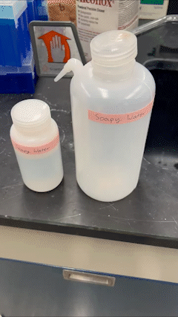
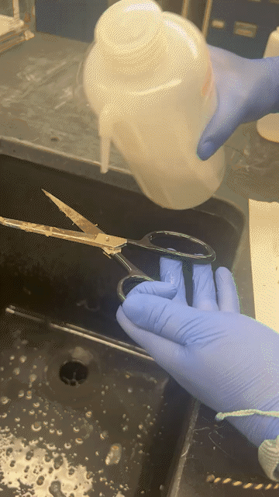
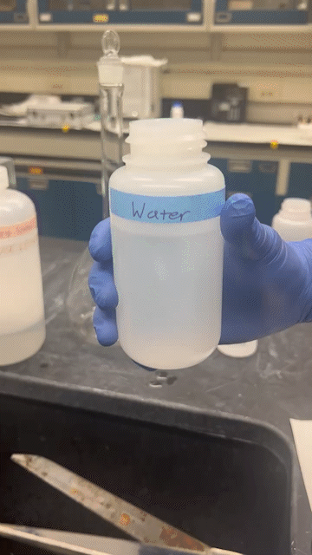
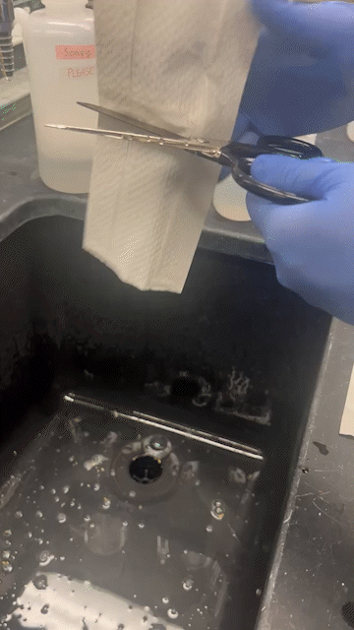
3c. Video Demonstration of Cleaning
Step 1: Shake the soapy water solution (pink tape bottle)
Step 2: Pour the soapy water into the squirt bottle
Step 3. Spray the soapy water on the tools.
Step 4. Pour water on the tools until no soapy bubbles remain.
Step 5. Dry the tools with the provided towels

Slide 7
3d. Sampling continued
There are time when you have the unavoidable situation where samples are pre-mixed.
This is not ideal, but it happens if the materials were pre-mixed for consumer use.
Please sample while each ingredient is separate, before pre-mixing.
But when pre-mixed, use clean tools (e.g., spoon or lab spatula ) to separate the processed/dried sample into the component ingredients.

Slide 8
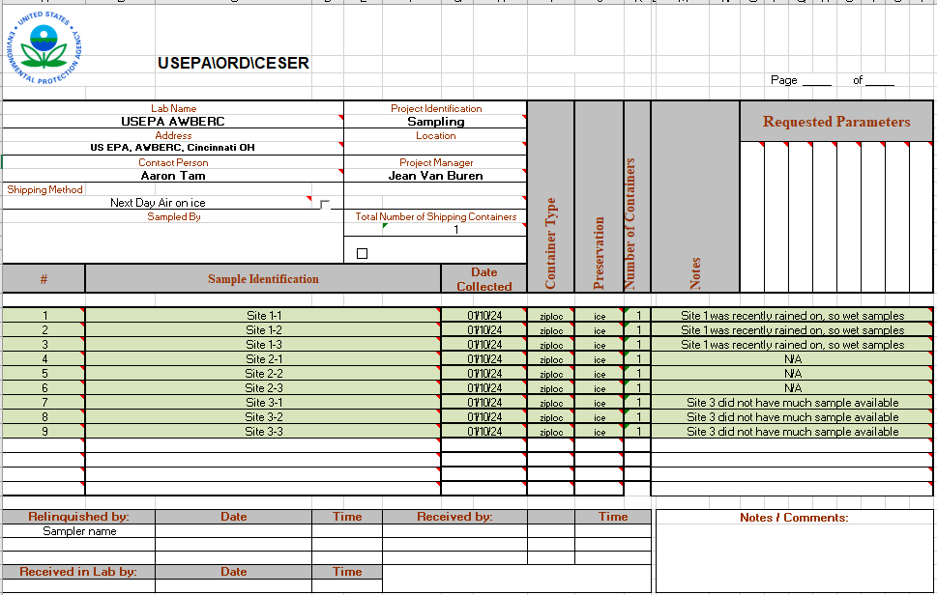
4a. Filling Out Chain of Custody (CoC)
Fill out the information, as shown by the example CoC on the right.
Necessary information
Sample Identification
Site name and sample name
Date collected
Date that the sample was collected
Container Type
What kind of container is the sample in? (Ziploc bag, plastic bottle, etc.)
Notes
Anything information that you believe should be noted
Ex: Rainy day caused wet sample, 2 sites were accidentally bagged together, not much sample present at site, etc.
Relinquished by
Provide the name of who sent the cooler back to the EPA

Slide 9
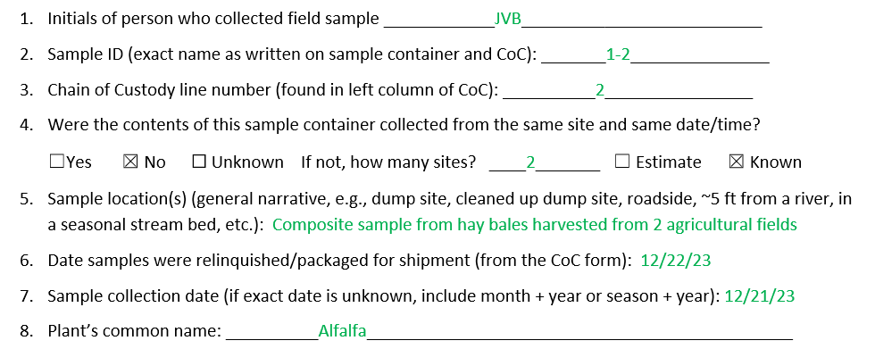
4b. Sample Information Sheet
a.) Fill out the following questionnaire for each site/sample
See example responses ->

Slide 10
5. Shipping on ice: Order of Contents in Return Cooler
First, line the cooler with two trash bags to ensure that there is no leakage
10

Slide 11
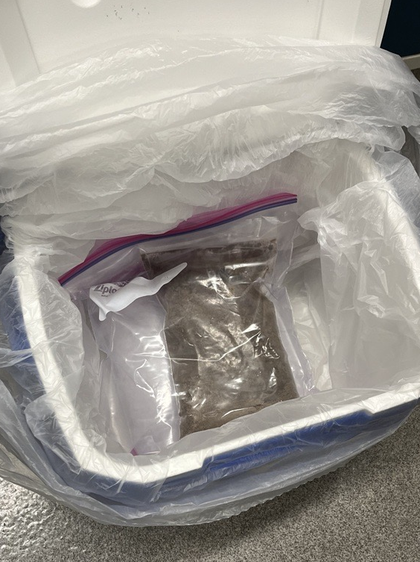
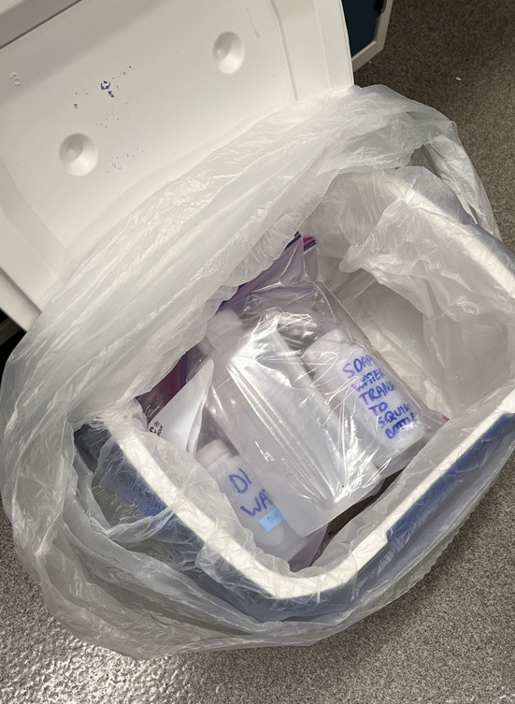
5a. Shipping on ice: Order of Contents in Return Cooler
Place the items into the cooler in the following order to be sent back to the EPA
Sealed Ice Bag 1
*double bag*
2. Sealed Sample Bags
*double bag*
3. Wash bottles and equipment
*double bag if it contains liquid*
4. Sealed Ice Bag 2
*double bag*
5. Packing material, if necessary
!!! NOTE: For all bags, be sure that they are zipped closed all the way! Be sure that no water can leak out of the ice bags/bottles, but if it did, no water can get inside the sample bags or destroy the sample labels.

Slide 12
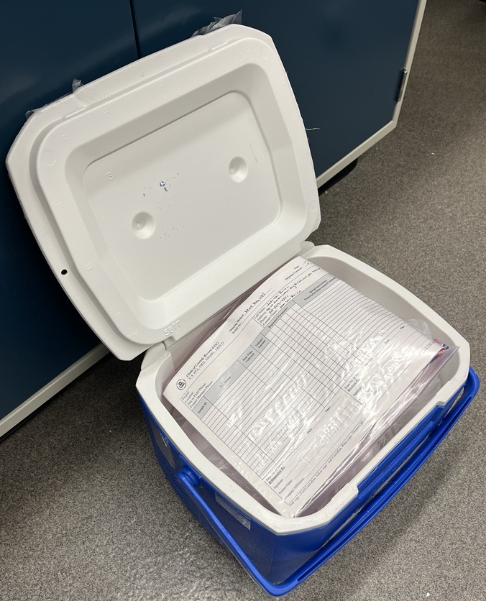
5b. Shipping on ice: Order of Contents in Return Cooler
6. Tie the inner bag
7. Tie the outer bag
8. Sealed bag containing Chain of Custody and Sample Information Sheets
Add more packing material, if necessary

Slide 13
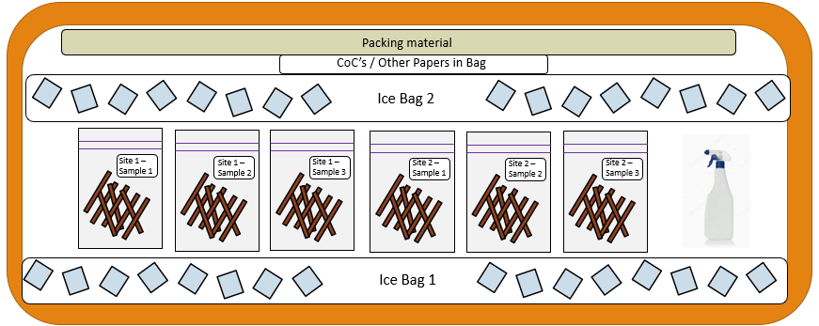
5c. Shipping on ice: Diagram of Cooler
Side view
Top
Bottom

Slide 14
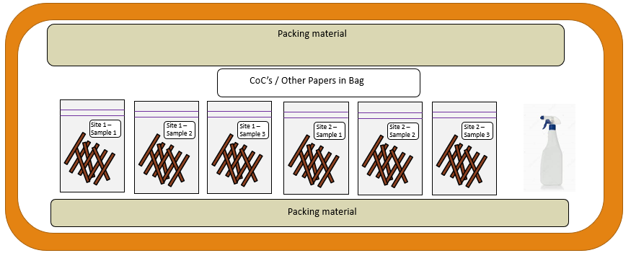
5d. Shipping without ice (dried samples): Diagram of Cooler
Side view
Top
Bottom

Slide 15
5e. Checklist of all items returned
Verify that all contents are in the cooler before sealing it up and sending it out
2X Ice Bag (only for FRESH, not dried, samples)
Bags with samples and filled out labels
Sampling tools and wash bottles
Chain of Custody sealed in Ziploc bag
Sample Information Sheets sealed in Ziploc bag and/or emailed to EPA - VanBuren.Jean@epa.gov and a cc to Rivas.Marcus@epa.gov

Slide 16
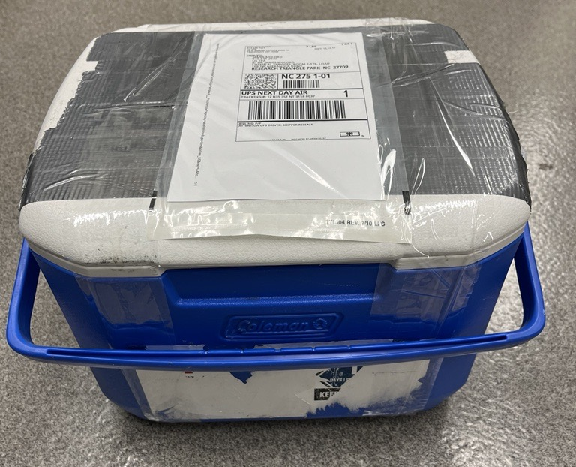
6. Shipment of Cooler
a.) Attach provided UPS return label
b.) Tape the cooler as shown on the right.
Note: The tape should go all the way around the cooler at least twice on both ends
c.) Deliver the cooler to UPS location
Tape

Slide 17
THANK YOU!
Please call or text US EPA’s Marcus Rivas at 816.695.6963 if you have any questions regarding these instructions.

