Slide 1
What is a brownfield?
101.1
Definition
Typical brownfield sites
Common contaminants
1

Slide 2
101.1 What is a brownfield site?
Definition
Typical brownfield sites
Common contaminants
101.2 How are communities affected?
How does a brownfield site affect a community?
How can a brownfield become a community opportunity?
101.3 Reuse process overview
101.4 Who can help your community address brownfield sites?
State and Tribal Response Programs
EPA brownfields technical assistance
EPA Brownfields & Land Revitalization staff
Local experts (licensed site environmental professionals, planners, landscape architects, etc)
Available liability protections
101.5 What resources can help your community address brownfield sites?
Competitive Brownfields Grants
Section 128(a) Grants
Targeted brownfields assessments
Site reuse planning technical assistance
Other federal programs
2
Notes:
TRANSCRIPTION: This training has four parts. In this particular section, so this intro section we're going to talk about what a brownfield is and give you some examples. We also want to talk about who can help your community address Brownfield sites once you find them, what resources are available that can help your community address Brownfield sites? Both free technical assistance as well as grants or contracts or other kinds of Technical Support. And finally, we want to show some of the communities that have already turned brownfield sites into new reuses to inspire you.

Slide 3
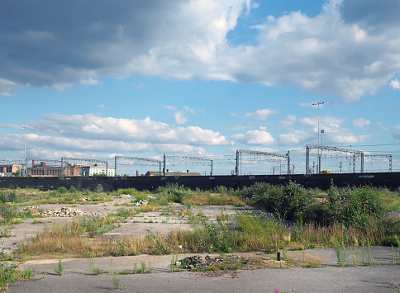
Brownfield Definition
A brownfield site is:
Real property, the expansion, redevelopment, or reuse of which may be complicated by the presence or potential presence of a hazardous substance, pollutant, or contaminant.
Statutory definition found in the Comprehensive Environmental Response, Compensation and Liability Act (CERCLA) §101 (39)
3
Notes:
TRANSCRIPTION:
The brownfield definition on this slide really restates the law, and so the Brownfield site by law is real property. The expansion, redevelopment, or reuse of which may be complicated by the presence or potential presence of a hazardous substance pollutant or contaminant. And those terms are defined in other environmental laws.
This slide highlights the statutory definition of a brownfield.
For example, this may include vacant parcel and occupied and abandoned buildings, and due to the definition this will capture a lot of properties/buildings

Slide 4
Brownfield Definition
In other words, brownfields are:
Properties where the current or future use is affected by real or perceived contamination. Environmental contamination poses a threat to the environment and human health.
Typically, brownfields properties were used for commercial, industrial, or residential activities in the past. Properties may be blighted and vacant, abandoned or occupied.
4
Notes:
TRANSCRIPTION: In other words, brownfields or properties where the current or future use is really affected by the real or perceived environmental contamination. Nobody wants to take that vacant lot or abandoned structure or combination of those because there's a fear that there's environmental contamination. Due to past use past history. Or perhaps even activities that have happened on the site since it was abandoned. The concern really is that there might be some threat to the environment or human head. If. And that that would be an issue that a a future property owner would have to take on board. Typically, brownfield properties were used for commercial, industrial, or residential activities in the past. And it was those past practices that may have resulted in the contamination today. And so they could be blighted, they could be vacant, they could be abandoned, or they could be occupied. And being used in an entirely different way than their original use.

Slide 5
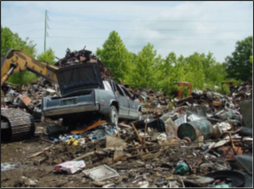
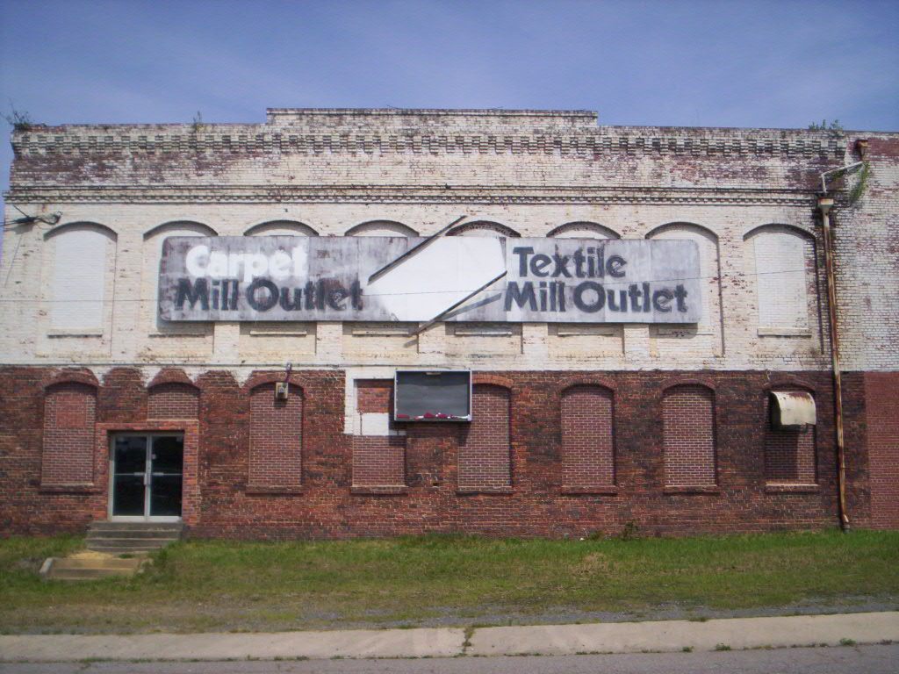
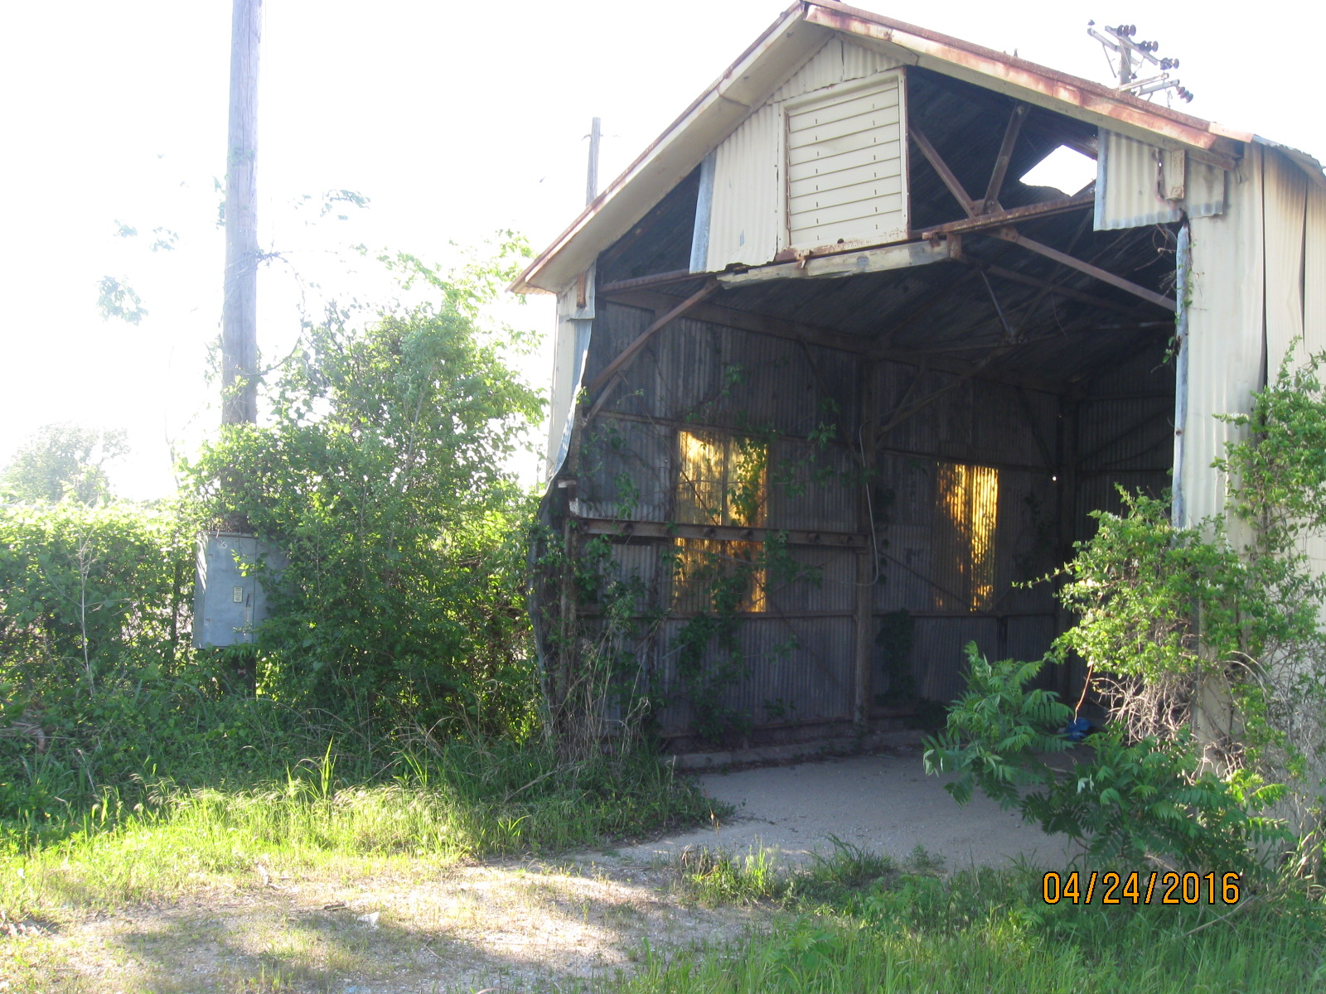
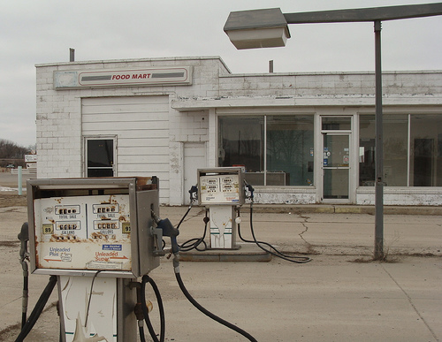
Here are a few examples of brownfield sites
Are these sites contaminated? How do you know?
5
Notes:
TRANSCRIPTION: Here are a few examples of Brownfield sites. And as you can see from these pictures, not all of them look kind of terrifying and scary from an environmental perspective. So I'll just talk about two of those. The one on the top left corner is a former scrap yard. And as you can see, it seems pretty clear there might be both a lot of waste that has to be dealt with, but there might be some other, you know, environmental contaminants there. The one on the bottom right corner is a common example of a brownfield, so that's a closed abandoned gas station. And as you can see, there's still those pumps and there's that area that had the pumps in the canopy, perhaps in the past. And so the question is if there were underground storage tanks at that site, have they been removed and are there any issues that might have occurred been safely addressed or is that something that somebody is going to have to tackle once they purchase that property?

Slide 6
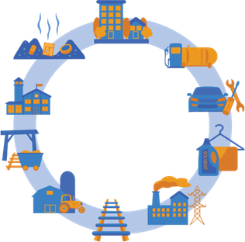
Housing and Residential Areas
Illegal dumping
Gas Station and Fuel Storage
Public and commercial buildings
Typical brownfield sites
Automotive Repair Facilities
Dry Cleaners and Industrial Laundry
Mining Facilities
Agriculture Land and Facilities
Manufacture and Power Generation
Railroad Facilites
6
Notes:
TRANSCRIPTION: This slide really illustrates some past uses of sites that have resulted in brownfields cleanups, housing and residential areas, public and commercial buildings, sometimes because of the materials of construction, sometimes because in their decline they become locations for other activities. Illegal dumping. You wouldn't necessarily have good property records on that, but you might see visible debris on the site, or the neighbors may report some activities. Mining facilities might be because of the materials there as well as any kind of overburden or processing waste, agriculture, land, and facilities might be because of what was stored in any kinds of pesticides or fumigants that were used as well as just the fuels and other machinery operations needed to. Maintain the facilities railroad. Whether it's the railroad, rolling stock repair, or materials that were carried and may have been spilled during transportation, manufacturing, and power generation. Both the materials used to power. Their work, as well as any kind of waste from those processes, dry cleaning and industrial laundries, could be the solvents might be the structures, auto repair facilities, and gas station. It could be the fuels, but also any of kind of repair or waste from those processes and materials used in that activity. So those are just some of the past uses. This is not an exhaustive list, but really just to illustrate the kinds of past uses that might be a brownfield in your community.

Slide 7
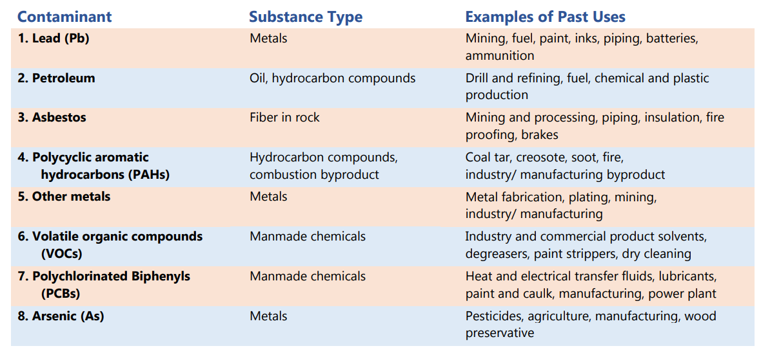
Common contaminants found at brownfields
7
Source: https://www.epa.gov/sites/default/files/2019-10/documents/environmental_contaminants_often_found_at_brownfield_sites.pdf
Notes:
TRANSCRIPTION: On this slide, we list the common contaminants that are found at brownfields and reported to EPA by Brownfield grant recipients. They include lead and metal. Petroleum, an oil or hydrocarbon that includes not only gasoline but also the heating oils, bunker fuels jet fuels that can be found in many different settings. Asbestos and insulator, as well as a fire retardant incorporated industrial, commercial and in residential. Materials and building products. Polycyclic aromatic hydrocarbons, or Papa's. They are the byproducts of incomplete combustion. So think about power plants, areas of. Burning where these might be found, other metals in addition to lead and arsenic that are listed separately. There's a category of other metals that people often report, and those can include cadmium, chromium, mercury, as well as iron and other kinds of metal. Found at brownfields, volatile organic compounds, or VOCs, are those solvents that can vaporize, but they can be found associated with dry cleaning facilities as well as certain kind of manufacturing where the the solvents might have been used to clean metal parts. Or other things before manufacturing or in the manufacturing process. Polychlorinated biphenyls, or PCBs, are often founded in areas of high temperature and their heat-resistant fluids. So PCB Transformers might be a term you're familiar with, and then arsenic, another metal that was used widely in wood preserving. As well as pesticides in other areas.

Slide 8
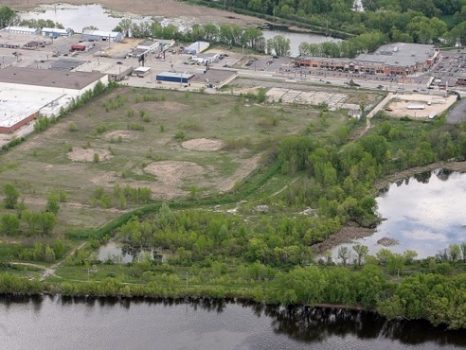
Brownfields result from
Industry, resource extraction, and agriculture
Fuel Terminals​
Tank Farms
Metal Salvage and Recycling
Mines and Mining Operations
Agricultural Land and Facilities​
Industry Spills, Fires and Disaster
Which may leave behind:
Petroleum or fuels
VOCs or solvents
Asbestos or Lead-based paint
PAHs from power generation
Metals from mining extraction
Pesticides and herbicides
Other hazardous substances
8
Notes:
TRANSCRIPTION: Brownfields can result from a range of different past uses, so industry, resource extraction and agriculture might have fuel terminals, tank farms. They might have some kind of metal salvage or recycling, and that might have resulted in some kind of. Hazardous materials distributed in the environment, the mining or mining operations may have distributed mining tailings or overburden from mining extraction areas. Agricultural and land use associated with agriculture might have resulted in pesticide mixing areas, or there might be industry spills, fires or disasters that disseminate materials that were used and controlled, but that natural hazard or fire resulted in their distribution and the environment, and so that could entail. Contamination of petroleum or hydrocarbon fuels, it could be some kind of a solvent that was used in the processing. It could be asbestos or lead-based paint that was used in the structures that have since been destroyed, either due to fire or natural hazards. And of course, any of the waste from power generation might include pH D's or polycyclic aromatic hydrocarbons, as well as metals from mining activities and their use in other materials, or processing pesticides and herbicides or other kinds of hazardous substances.

Slide 9
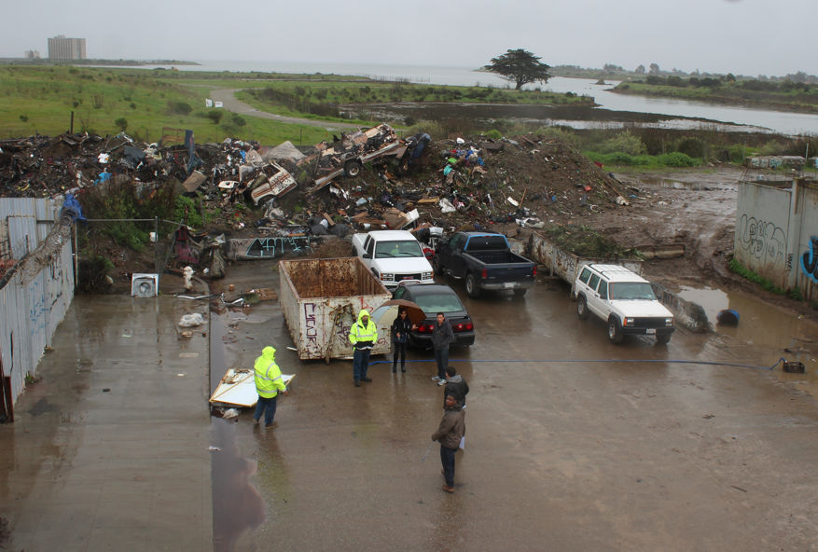
Brownfields result from
Vacancy and abandonment
Former factories
Former Railroad Facilities
Illegal Dumping Sites ​
Drug Labs
Structural Fires
​
Which may leave behind:
Lead-based paint and Asbestos
Petroleum and fuels
PCBs, solvents, other hazardous substances associated with operations
Pesticides and herbicides
​
9
Notes:
TRANSCRIPTION: At many brownfields, it's not clear what the past use was, and the records might be unclear, so it they're vacant, they're abandoned you. There might be some sign there was a former factory or that there was a railroad spur that went through the area. There could have been some illegal dumping, and that wouldn't show up on a record necessarily. In some instances, communities have found drug labs, or they're just some structural hazards or fires that have created a hazardous site. And in those instances, those communities have reported concerns about lead-based paint and asbestos, petroleum or fuels stored above or below ground. PCBS polychlorinated biphenyls, solvents, or other hazardous substances associated with the operations, as well as pesticides or herbicides.

Slide 10
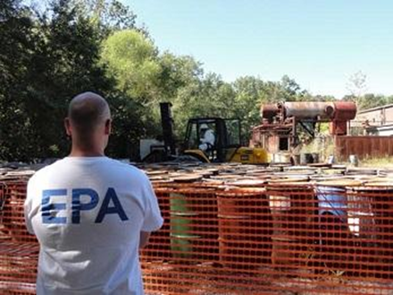
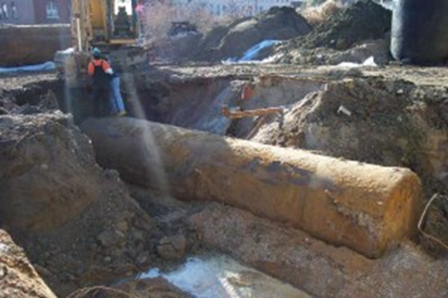
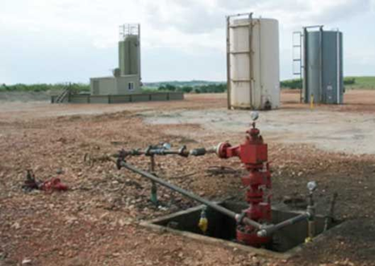
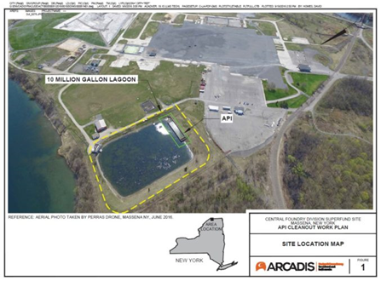
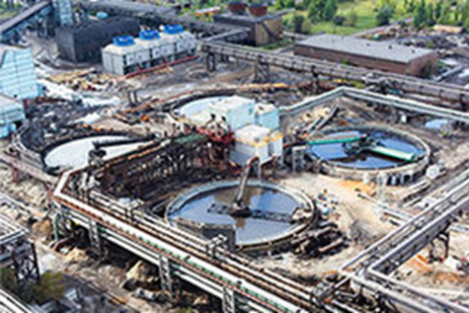
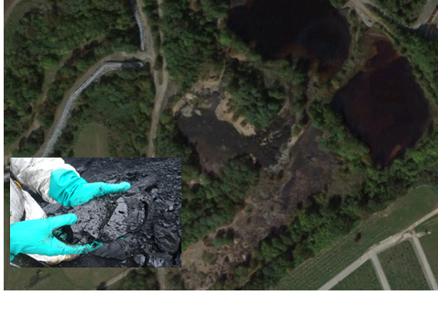
How does pollution get into the ground?
Spills and abandoned drums
Underground storage tanks
Waste injection wells (permitted)
Waste lagoons
Leaking wastewater treatment
Uncontrolled landfills
11
Courtesy of The University of Connecticut Technical Assistance to Brownfields Program
Notes:
TRANSCRIPTION: And this slide just illustrates how certain kinds of past land uses, and in this case on slide 10, public and commercial land use. Might be associated with contamination that's been found and reported to the EPA, such as asbestos petroleum. VOCs or volatile organic compounds. Or solvents, polycyclic aromatic hydrocarbons, or Papa's pesticides lead from lead-based paint or other hazardous substances.

Slide 11
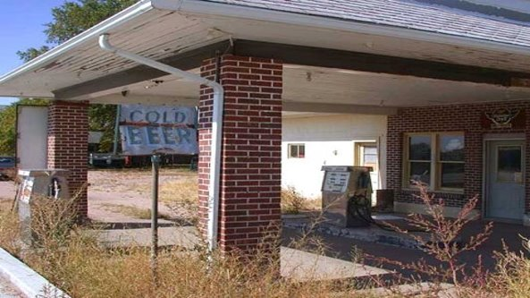
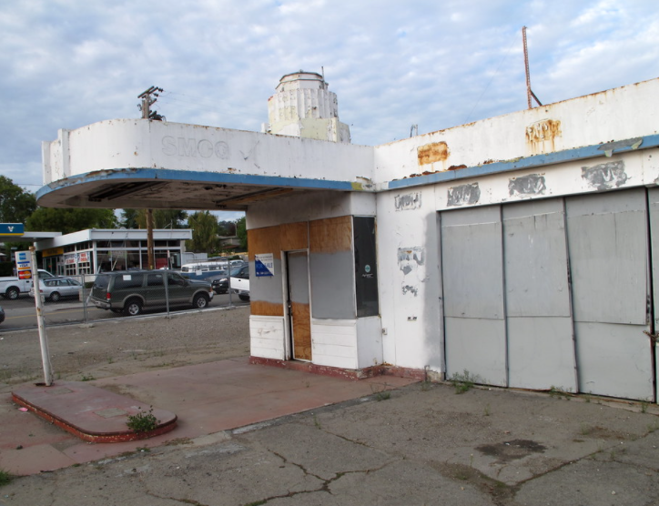
Brownfields result from
Public and Commercial land uses
Gas Stations​
Manufacturing
Schools
Hospitals
Courthouses
Fuel Storage
Auto Repair
Dry Cleaners​ and Industrial Laundry
Salvage Yards​
Which may leave behind:
Asbestos
Petroleum
Volatile organic compounds (VOCs) or solvents
Polycyclic aromatic hydrocarbons (PAHs)
Pesticides
Lead from lead-based paint
Other hazardous substances
​
10
Notes:
TRANSCRIPTION: And this slide just illustrates how certain kinds of past land uses, and in this case on slide 10, public and commercial land use. Might be associated with contamination that's been found and reported to the EPA, such as asbestos petroleum. VOCs or volatile organic compounds. Or solvents, polycyclic aromatic hydrocarbons, or Papa's pesticides lead from lead-based paint or other hazardous substances.

Slide 12
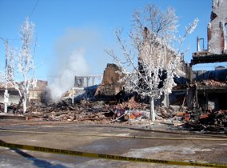
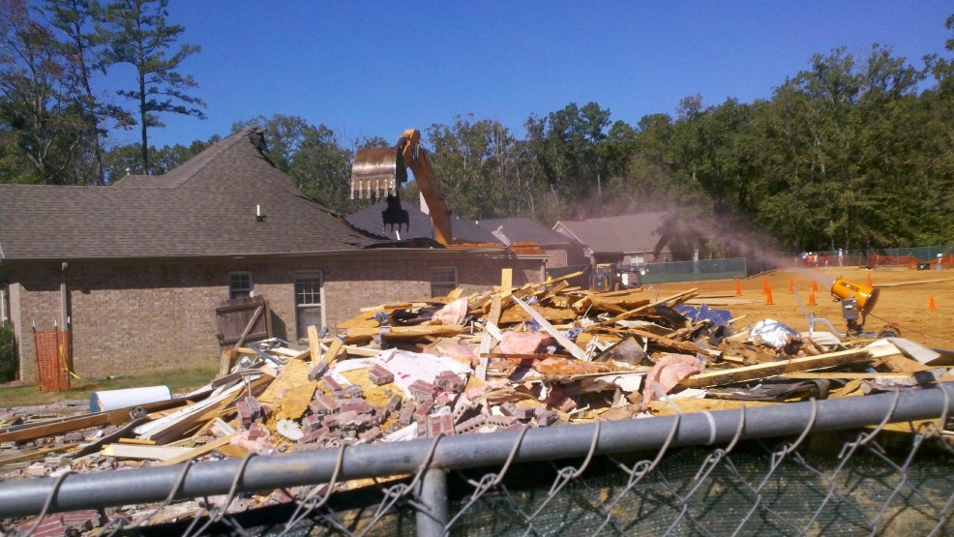
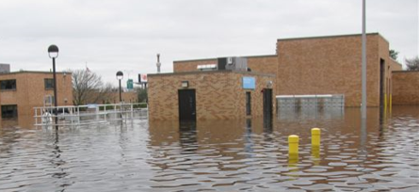
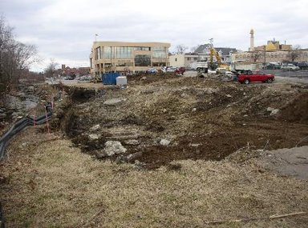
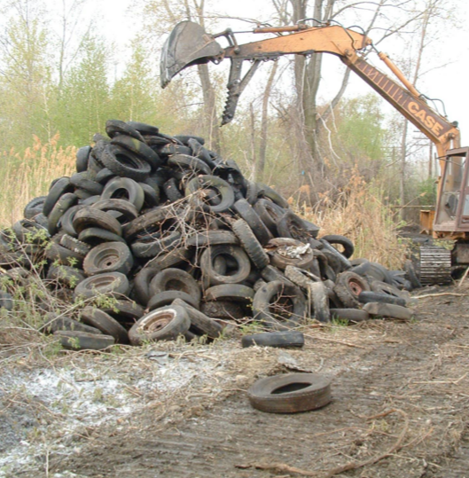
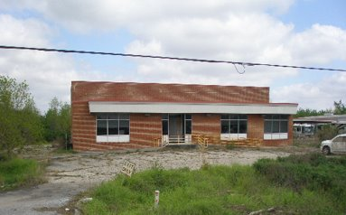
How does pollution get into the ground?
Flooding and extreme weather events
Spills and accidents
Fires and wildfires
Abandoned industry sites
Deteriorating residential and commercial areas
Illegal dumping
12
Courtesy of The University of Connecticut Technical Assistance to Brownfields Program
Notes:
TRANSCRIPTION: Other examples of how pollution gets into the ground include spills or accidents, fires or wildfires, flooding, and extreme weather events. Abandoned industry sites where past operations left some kind of residual contamination, deteriorating residential or commercial areas, as well as industrial and, of course, illegal dumping.

Slide 13
How does pollution get into a building?
*This includes industrial and light industrial buildings.
13
Notes:
How does pollution get into a building? Well, sometimes what was incorporated into a building at that time. Maybe it was 100 years ago. Maybe it was 200 years ago, was not considered hazardous at the time. So, for example, asbestos was really important as an insulator and as a fire retardant. There just wasn't the information available about how dangerous it was as it broke down. Similarly lead paint and as well as you know, heating oils and fuels you we didn't realize at the time the hazards that those substances actually posed to those that were. Occupying buildings as well as those that might be involved in construction or or revitalizing them. Similarly, housing and residential areas might be the material of construction. It might be that other things were used in the materials, for example, again the petroleum, but also in certain areas PCBs or polychlorinated biphenyls, were incorporated into caulk or other building materials. Pesticides might have been applied. Around. The foundation of the building to reduce termites or to keep pests away. And there might be other kinds of contaminants. One example that has been notable more recently is actually abandoned buildings that have been turned into meth labs or drug manufacturers. Sites and so that would be a different kind of a waste that would have to be added. West and of course, we always recognize that there might be a contamination associated with the manufacturing or a power industry, both because of what was used in those industries, but also any of the waste products that came as a result of their manufacturing or operations.

