Slide 1
What does the brownfield reuse process look like?
101.3
Who is involved?
Common brownfield terms
Brownfields Revitalization Process Overview
Site Reuse Planning
Assessment
Cleanup Planning
Remediation
Reuse, Redevelopment and Occupancy
1
Notes:
TRANSCRIPTION: In this section, we want to share what the Brownville reuse process looks like. This includes who's involved, common terms, and providing an overview of the process and steps in that process. These steps include site reuse, planning, assessment and site investigation, clean-up planning, remediation, planning and reuse, development and occupancy.
Notes: In this section we want to share what the brownfield reuse process looks like. This includes who is involved, common terms and providing an overview of the process and steps in that process. These steps include Site Reuse Planning, Assessment and Site investigation, cleanup planning, remediation planning and reuse redevelopment and occupancy.

Slide 2
Getting to revitalization: who is involved?
Local project champion(s)
Community engagement professionals
Policy makers
Environmental professionals
COMMUNITY
Site design professionals
State and tribal leaders
Development community
Community organizations
2
1
Notes:
TRANSCRIPTION: As you begin your brownfield revitalization journey, it will be essential for you to establish a multidisciplinary team as shown in this graphic. And these are all key organizations that might help you start, but you might need to seek other partners based on your project or where you're located or your planned reuse. So think of this as a guidepost. You absolutely will need a local project champion because they will really help garner the support you need locally. Community engagement professionals can also help. You with that as well as environmental professionals who working with your state and tribal program will oversee and help you navigate all the essential requirements for a site assessment or clean up and for planned reuse. Policymakers might help connect you with resources or key things you're going to need to navigate in that process. Site design professionals will help you not only locate what it is you're going to be doing, but also help make it more attractive and also accessible. And of course, community organizations and the developmental community are essential both in helping you identify valued assets in the community, connecting you with resources, but also really garnering. The support you need to move forward with the project and coming up with new ideas and ways that your project can meet Community needs reinforce the value of valued assets and bring new amenities and benefits to the community.
Notes: As you begin your brownfield revitalization journey, it will be essential to establish a multidisciplinary team, as shown in this graphic.
Identifying local project champions and working with policy makers and community engagements experts will help you thoughtfully engage with the community, local residents and youth and help create the reuse vision the community can share and support.
Expertise from environmental, development and community agencies and organization can help your communities navigate the rules, understand any technical and environmental conditions identified at the site and connect you with the needed site cleanup technical support from state or tribal regulatory authorities.
Identifying local project champions and working with policy makers and community engagements experts will help you thoughtfully engage with the community, local residents and youth and help create the reuse vision the community can share and support that will drive your cleanup to ensure safe reuse.
State and Tribal regulatory agency support and 'site signoff' after you complete the required steps based on your planned reuse also will help you secure the financing you need to finalize cleanup and launch further preparation for revitalization and redevelopment.
Like technical oversight, community support can help to secure the needed project support, planning permission, site design and market analysis assistance and funding.
As you work with the community to identify unmet market needs, community engagement may help you identify valued assets and needed amenities to help inform revitalization design with new amenities and benefits.

Slide 3
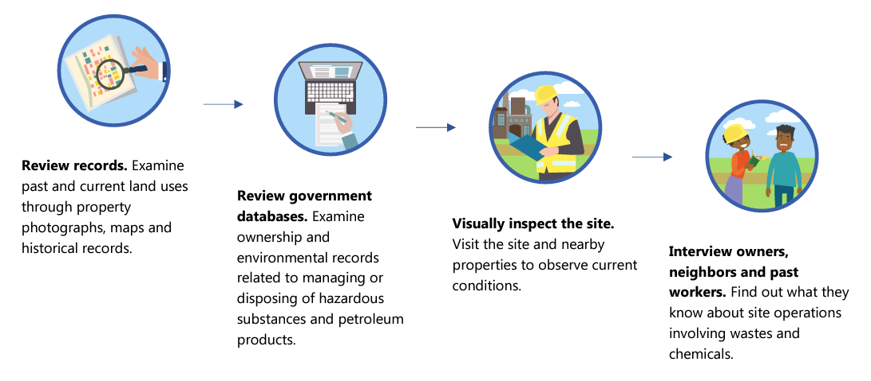
Getting to revitalization: some common brownfields terms
Phase I Environmental Site Assessment (ESA): Potential contamination issues are identified and reported on a site being assessed through a visual inspection, reviewing government records and looking at any other resources available to create a detailed history of the property and its past use.
3
Notes:
TRANSCRIPTION: One key step before purchasing acquiring or accepting property donation of a potential brownfield property is conducting a phase one environmental site assessment, or ESA. This process helps identify potential contamination issues that might need further investigation. The phase one ESA involves looking at individual site and local government records photographs visually inspecting the site and interviewing neighbors past workers or owners to identify the sites past land uses, as well as the history of operations, which may have resulted in or contributed to environmental contamination. This preliminary investigation also helps environmental professionals identify likely contamination or environmental hazards that will require additional investigation. By conducting a phase one environmental site assessment, or ESA, within 180 days before acquiring a property that can also help protect a future owner of the property from environmental liability, should environmental contamination be found on site.
Notes: One key step before purchasing, acquiring or accepting the property donation of a potential brownfield property, is conducting a Phase I environmental site assessment or ESA.
This process helps identify potential contamination issues that may need further investigation.
The Phase I ESA involves looking at individual site and local government records, photographs, visually inspecting the site and interviewing neighbors, past owners or workers to identify site past land uses and the history of operations which may have resulted in or contributed to environmental contamination.
This preliminary investigation, also helps environmental professionals identify likely contamination or environmental hazards that will require additional investigation.
Conducting a Phase I ESA with 180 days before you acquire a property, helps to protect a future owner from environmental liability, if environmental contamination is found on site.

Slide 4
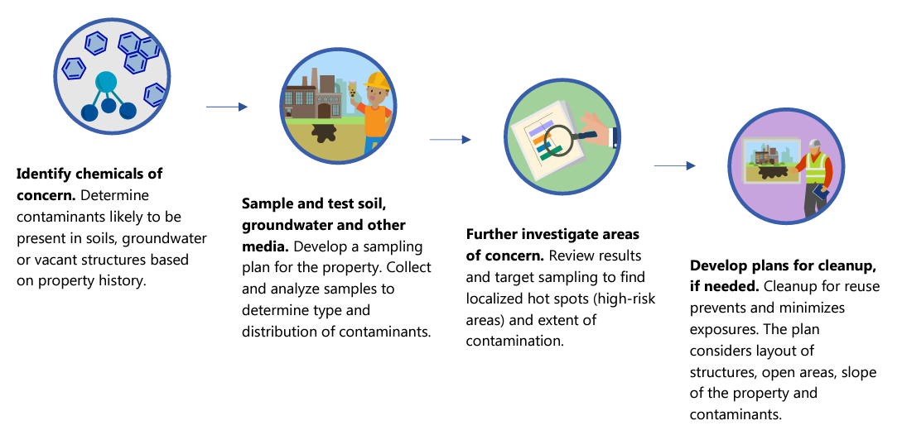
Getting to revitalization: some common brownfields terms
Phase II Environmental Site Assessment (ESA): If a Phase I determines that there could be a contaminant, the next step is to take soil, groundwater, and/or vapor samples, analyze them in the lab, and compare with regulatory screening levels.
4
Notes:
TRANSCRIPTION: The phase two environmental site assessment is the next step in the process to identify contaminants. The levels and extent of contamination at the site, the distribution of those contaminants at the site based on samples taken from the site, surface soils, subsurface soils, groundwater or any building or structures on site. 4 combinations of those. And, the samples after laboratory analysis will be compared to contaminant screening levels for that proposed reuse to understand what hazards exceed regulatory screening levels and to plan further investigation or needed cleanup based on that proposed site reuse. State and tribal environmental authorities will be able to guide environmental professionals and local communities in ensuring sampling and analysis meet their requirements so further investigation and planned cleanup address requirements for safe reuse for resilient revitalization. This step also includes review and screening of the Brownfield site location and potential climate vulnerabilities and anticipated impacts ranging from wildfire, drought, coastal sea level rise in saltwater intrusion, floodplain risks and other climate vulnerabilities that may need to be considered. And incorporate it into the analysis of Brownville cleanup alternatives or ABCA to inform planned cleanup so the site remains safe and cleanups remain protective for future reuse.
Notes: The Phase II ESA is the next step in the process to identify contaminants, the levels and extent of contamination at the site, the distribution of those contaminants at the site based on samples taken from the site surface soils, subsurface soils, groundwater or any building or structures on site.
The samples, after laboratory analysis, will be compared to contaminant screening levels for that proposed reuse, to understand what hazards exceed regulatory screening levels to plan further investigation or needed cleanup based on the proposed site reuse.
State and Tribal environmental authorities will be able to guide environmental professionals and local communities in ensure sampling and analyses meet their requirements so further investigation and planned cleanup address requirements for safe reuse for resilient revitalization.
This step includes review and screening of the brownfield site location and potential climate vulnerabilities and anticipated impacts ranging from wildfire, drought, coastal sea level, flood plain risks and other climate vulnerabilities that may need to be considered and incorporated into the Analysis of Brownfield Cleanup Alternatives or ABCA to inform planned cleanup so the site remains safe and cleanups remain protective for future reuse.

Slide 5
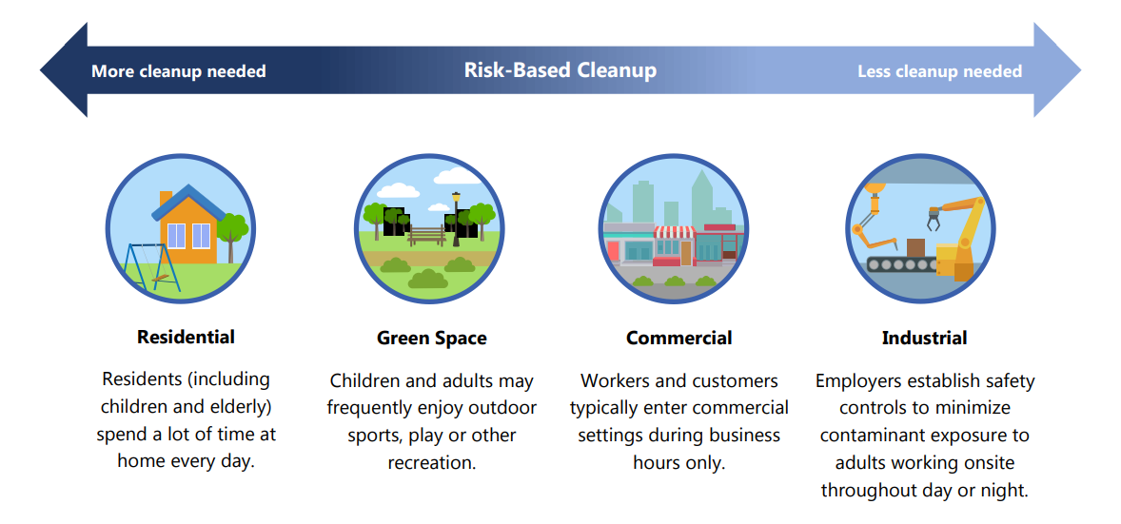
Getting to revitalization: some common brownfields terms
Risk-Based Cleanup: The amount of cleanup required at a brownfield depends on how the site will be reused. A risk-based cleanup will consider sensitivities of the specific populations and their time spent on the property. States and tribes use this approach to determine the required level of cleanup necessary at brownfield properties.
5
Notes:
TRANSCRIPTION: As shown on this slide, when you're thinking about revitalization, there's another common brownfield term you need to be aware of and that's risk-based cleanup. And that term is used to really illustrate the concept that whatever the reuse that you are planning, you need to make sure that your. Assessment and cleanup is planned for that kind of reuse, so if you're planning on putting industry on a site that might require a different level of cleanup and different standard that your state and tribal response program will help you reach. But that would be in contrast to if you were going to reuse the site for residential redevelopment, and that would have the most stringent and strict requirements for cleanup as well as investigation, just to make sure that that reuse is going to be safe and that you've undergone an investigation prior to that clean up planning. That's really in line with that we use.
Notes: Risk-based cleanup is the term used to illustrate the concept shown in this slide which indicates the required level of cleanup depends on the risk posed by the contaminant and the population that may experience that exposure and the length or duration of that exposure based on a planned type of reuse.
For example, the most stringent and protective cleanup is used for residential reuse as people of all ages live there for long periods of their lifetime, some their entire lifetime.
This contrasts with an industrial reuse where it is expected working adults will work during work hours and have reduced exposures to hazards associated with past brownfield uses and will have safety controls to minimize workplace exposures.
That is the extent and level of cleanup varies on the type of contaminant, type of reuse, the types of exposures that may occur based on that type of reuse and the type of user that may encounter that reuse and exposures that need to be prevented.
Risk-based cleanup goes from the most stringent and protective cleanup for residential reuse where families and people of all ages will live their lives. A residential reuse requires steps to remove, treat and reduce contaminants and remove and reduce exposure pathways, so no exposures can occur.
By contrast, other reuses are cleaned to reduce exposure risks for users based on that reuse which may be a greenspace or recreational reuse or commercial uses during working hours or industrial reuse that may result in a building or parking lot placed over areas where contaminants are undergoing treatment or contained with limited chance of exposures.
State and tribal programs are the regulatory authorities that govern and oversee risk-based cleanup levels for safe reuse of brownfields.

Slide 6
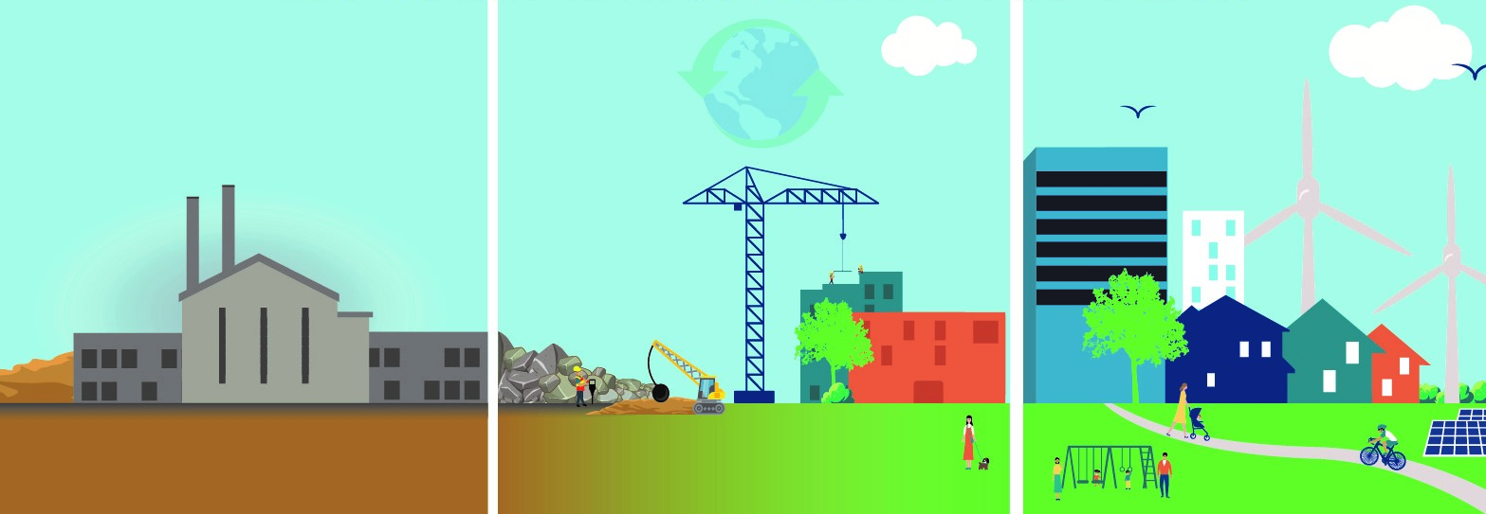
Getting to revitalization: some common brownfields terms
Land Revitalization: The process of ensuring how the site or building can be safely reused based on site conditions and environmental, economic and social conditions affecting the site.
6
Notes:
TRANSCRIPTION: Another important common brownfield term is land revitalization. And that is the process of ensuring how the site or building can be safely reused based on site conditions and environmental, economic and social conditions affecting the site.

Slide 7
Brownfields Revitalization Process
Transforming a brownfield site might go something like this:
CLEANUP PLANNING
REUSE, REDEVELOPMENT AND OCCUPANCY
SITE REUSE PLANNING
ASSESSMENT
REMEDIATION
Community visioning
Market analysis
Conceptual plan
Phase I/II Environmental Assessments
Is the property safe for the envisioned use?
Is cleanup necessary?
Develop a cleanup and management plan (if necessary)
Implement cleanup. This may involve:
Removing contaminants or capping the site
Limiting future activities
Development
Occupancy and reuse
Ongoing monitoring, if necessary
7
Notes:
TRANSCRIPTION: This slide really tries to illustrate the brownfields revitalization process visually, and you know, talk you through the steps of transforming a Brownfield site. The key point is you need to understand early in the process what your site reuse is going to be, and that site reuse planning is a preliminary step that will really help the rest of the steps proceed smoothly. So knowing how your site reuse is going to occur will inform your investigation. A residential reuse might require additional detailed initial analysis as compared to some other kind of site reuse, so having that vision and involving the community and creating that Community vision. Having a market analysis so you understand how that site reuse is going to fit into the area and having a conceptual plan. Which will help you move forward smoothly through the other steps of the revitalization process. That assessment, cleanup planning, revitalization and making sure your Reus redevelopment also involves the occupancy of future tenants or owners of the structure.

Slide 8
Site Reuse Planning
SITE REUSE PLANNING
SITE REUSE PLANNING
Envisioning something new at the brownfield site
Local governments can use Federal and State funding for area-wide planning and market studies.
Community members can shape a new vision for brownfield sites.
Owners and developers identify sites, consider projects and conduct financial feasibility studies.
Elm Avenue Revitalization Workshop
December 2017
8
Notes:
TRANSCRIPTION: Site reuse planning. Envisioning something new at a brownfield site has several key groups that need to be involved and are integral to successful projects. Local governments have some authority oversights, but they can also use federal and state funding to think about that. Brownfield site individually, but also think about the larger context for that site and with area-wide planning or other market studies that might be going on or are planned. Community members might have. Information about the site they might have worked nearby and have additional information that's really valuable to the investigation, as well as the reuse planning, and they can help shape a new vision for a Brownfield site and might be very critical to getting the kind of support that will be needed for. The project to move forward. Owners and developers identify sites they consider projects, and they also conduct financial feasibility studies that might be very important to ensure the resources are needed for the planned project that also meets the Community visions and the local government goals.

Slide 9
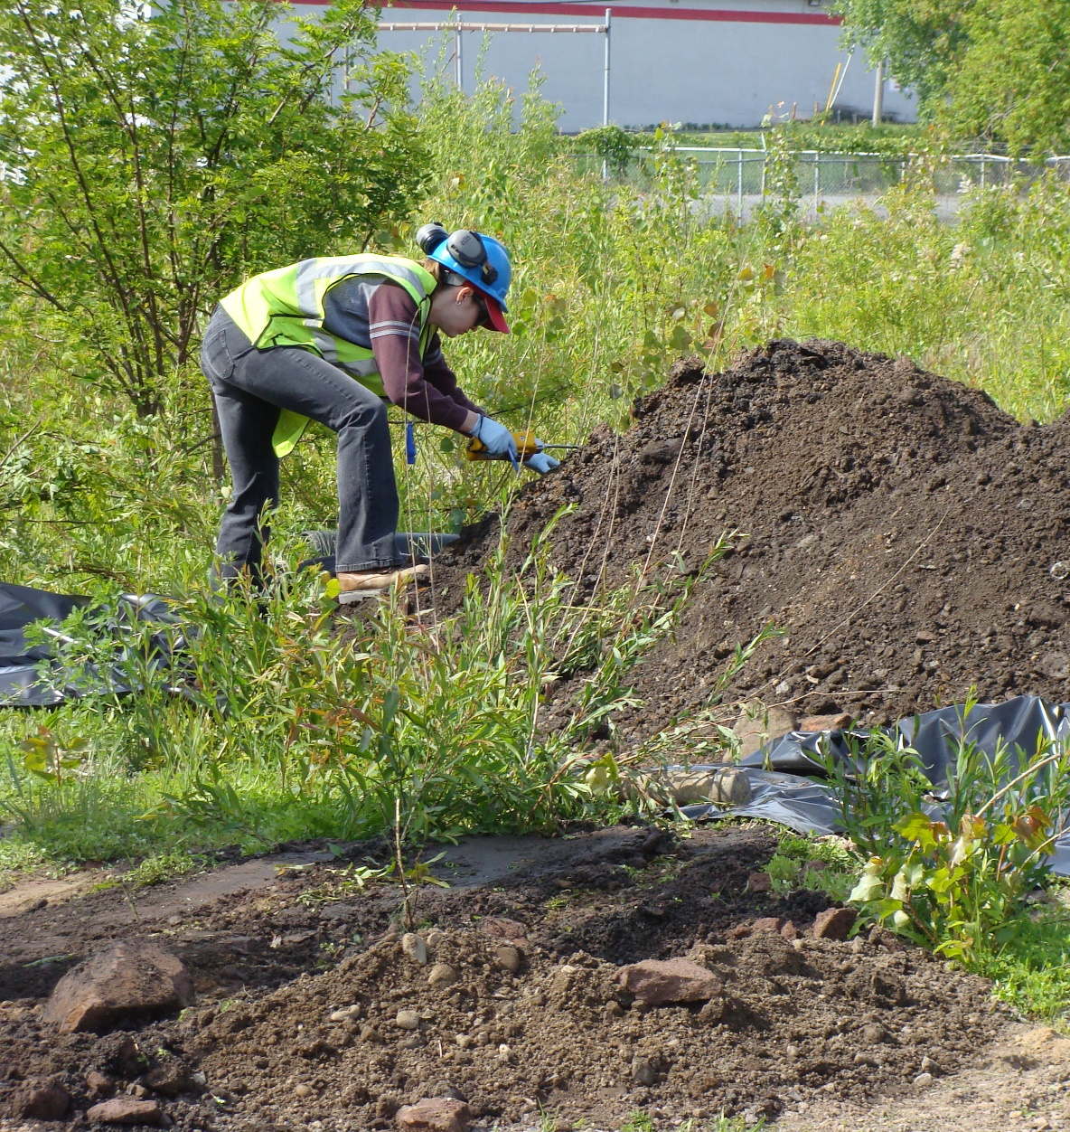
Assessment
ASSESSMENT
Is the site contaminated? How to find out:
Phase I ESA review available information on past land uses and determine whether there are known or potentially significant environmental liabilities.*
Phase II ESA take soil, groundwater, and/or vapor samples, analyze them in the lab, and compare with regulatory screening levels.
If contaminants are confirmed to be present, an environmental professional must evaluate and recommend mitigation measures, which may be subject to review and approval by state or local agencies.
9
*Formally called “Recognized Environmental Conditions”
Notes:
TRANSCRIPTION: The assessment step really answers the question. Is the site contaminated and the way that is done is in environmental professional. Conducts a Phase One environmental site assessment, or ESA, and that involves reviewing all the available information about the property past land uses past operations. And determine whether there are known contaminants or suspected or potentially significant environmental contaminants, and then associated environmental liabilities. That is then used to either inform further investigation or determine there aren't hazards there. The Phase II environmental site assessment means there have been known or suspected contaminants that require further investigation and that involves the environmental professional going to the site. Collecting soil, groundwater, subsurface soil or vapor sand. Poles bringing them to a lab to be analyzed and then comparing any results with the regulatory screening levels to determine whether needed investigation must continue or there is information to plan a required cleanup based on the planned reuse. If contaminants are confirmed to be present and environmental, professional must evaluate and recommend mitigation measures which may be subject to review and approval by state and tribal response programs or local agencies.

Slide 10
Cleanup Planning
CLEANUP PLANNING
CLEANUP PLANNING
The amount of contaminated cleanup needed depends on the site’s future use
INDUSTRIAL
More needed
RISK-BASED CLEANUP
Less needed
Residents spend a lot of time at property
People frequently enjoy outdoor sports, play and recreation
Workers and customers are typically in commercial settings only during the day
Employers establish safe controls to minimize exposure to contaminants
10
Notes:
TRANSCRIPTION: Clean-up planning based on the results of that site investigation and site assessment. Really brings the results of those assessment processes together with what the planned reuse is and when those results of the assessment compared to regulatory screening levels, state and tribal response programs likely informed and advised the Community and the environmental professional. About the needed steps for cleanup, this slide illustrates the point made earlier about risk-based cleanup. And how that planned reuse informs the decisions on the needed cleanup. And so a residential reuse plan based on that Community vision may require more extensive cleanup. And more stringent levels be met prior to any kind of residential redevelopment, and this might be in contrast to an industrial reuse that may not require the same level of cleanup based on the planned industrial use and state and tribal response programs. Will be very. Helpful in making those decisions and in guiding communities and their environmental professional on the needed steps to make those clean-up planning decisions.

Slide 11
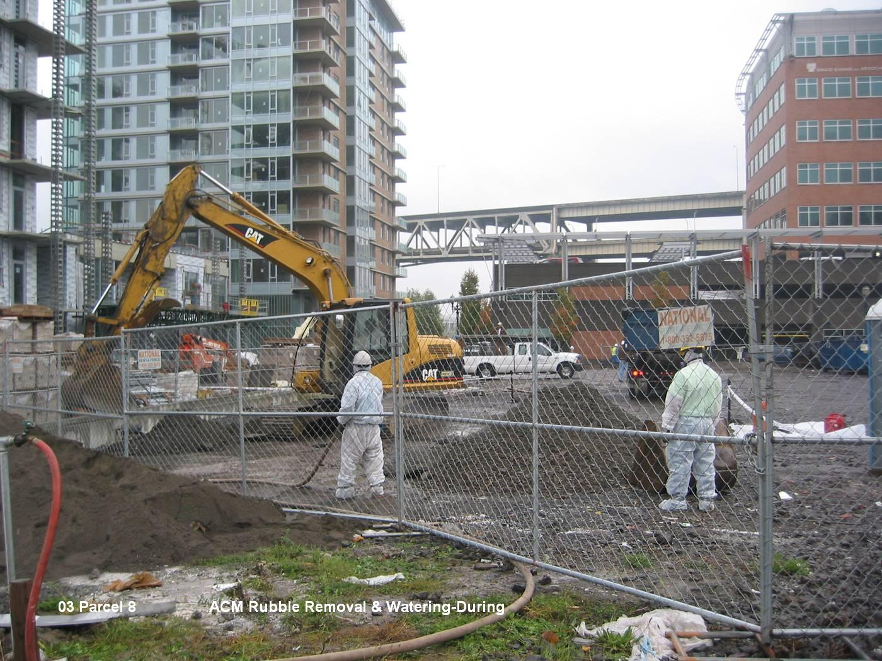
Remediation
REMEDIATION
REMEDIATION
Cleaning up and protecting the site so it can be safely reused
Tailor cleanup to the intended future use of the site. May include:
Soil removal and replacement
Soil treatment to neutralize contaminants
Soil capping that places a barrier between contaminated soils and the ground
Deed restrictions that ensure that future activities and uses are limited to ones that can coexist safely
Periodic inspections to ensure any contamination left in place is no longer a public health threat
11
Notes:
TRANSCRIPTION: Clean up and remediation are really intended to protect the site and protect those who will be living or using the site so it can be safely reused. And so the cleanup can be tailored to the site and the future reuse, as well as the contaminants, and they may include any of the individual or combinations of soil removal and replacement with clean material. And that would include removing the contaminant with the soil. Soil treatment to neutralize, to biodegrade, to immobilize contaminants so they may not move, and can be safely contained on site and soil capping, which provides a clean barrier both a geotextile or soil barrier that can. Be between where the contaminated soil is contained or is ongoing treatment and the ground to prevent any exposures. Deed restrictions will be records that can be put on the property that document what kinds of soil cleanup is required. And what is ongoing and any restrictions on the reuse? And of course, a periodic inspection is essential to ensure that any contamination left in place is no longer a public health threat and any ongoing soil treatment is proceeding as designed.

Slide 12
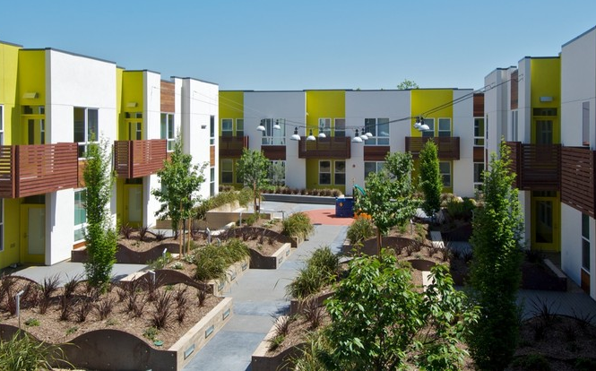
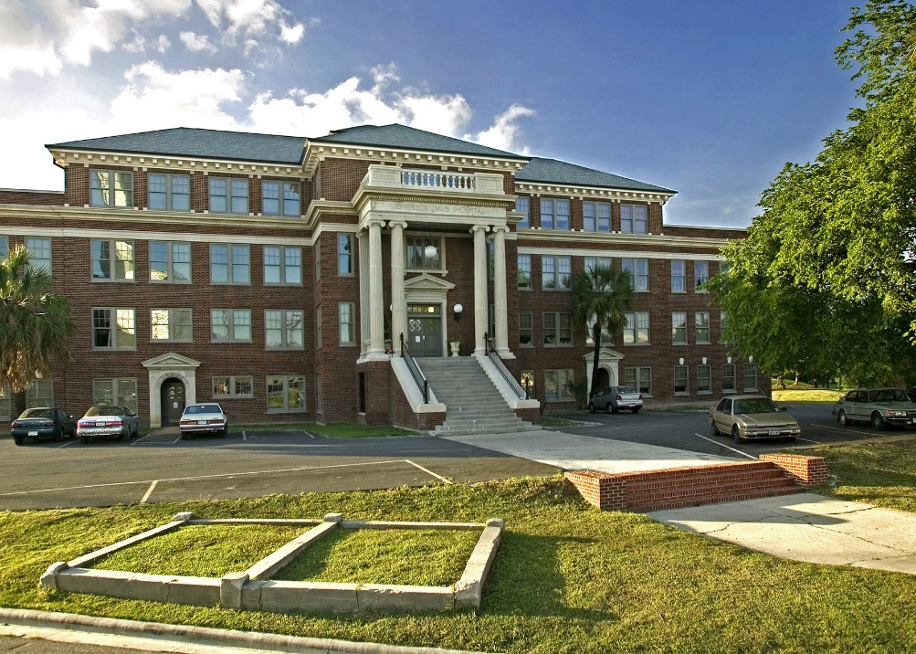
Reuse, Redevelopment and Occupancy
REUSE, REDEVELOPMENT AND OCCUPANCY
A new chapter begins!
Development that has followed this path may:
Remove blight and contamination in the community
Provide benefits like affordable housing or jobs
Keep workers and residents safe during construction and into the future
12
Notes:
TRANSCRIPTION: Once the brownfield remediation is complete, a new chapter can begin for the community and the redevelopment, reuse and occupancy can be part of those things. So in addition to an individual contaminated site being addressed. The brownfield redevelopment process removes blight and of course, the exposure to contamination from the community. It also can bring additional benefits like affordable housing or jobs and new economic development prospects. The community has learned through the process about what a brownfield is and what it takes to turn it into something safer and healthier. And in addition, they have a new understanding that workers and residents are safe because the former contaminated site has been cleaned up and so they're more protected during construction and redevelopment. Often brownfields redevelopment spurs New Hope and also new attention to other sites that can be part of the resilient use the community seeks.

