Slide 1
What financial and other resources are available to help my community address brownfield sites?
101.4
State and Tribal Response programs
EPA Brownfields Technical Assistance (TA)
EPA Brownfields TAB Providers
Available support for Brownfields projects
CERCLA Liability protections
1
Notes:
TRANSCRIPTION: In this section, we're going to talk about what financial resources are available to help your community adjust Brownfield sites. And that includes competitive Brownfield grants, Section 128, a grants targeted brownfields assessment or TBA's site reuse planning, technical assistance and other federal programs.

Slide 2
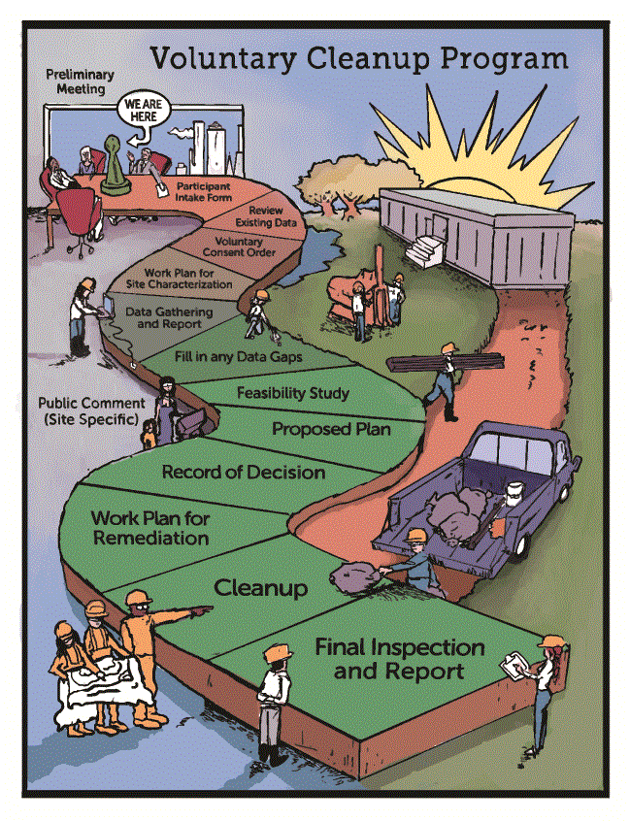
State and Tribal Response Programs
Historically, reuse of contaminated or potentially contaminated properties was hampered by the fear of federal liability under the Superfund law* - which can result in responsibility for very costly damages.
States have developed Voluntary Cleanup Programs (VCPs) and Tribes have developed Tribal Response Programs to help address sites with relatively low environmental risk.
Brownfields sites often are cleaned up under the oversight of state/tribal VCPs, or state/tribal response programs. These programs provide guidance and oversight making sure cleanups are protective of human health and the environment.
Property owners, banks, & developers often seek assurance that a cleanup under these programs will protect them from EPA enforcement.
* ”Superfund” is a nickname for the Comprehensive Environmental Response, Compensation, and Liability Act (CERCLA)
2
Notes:
TRANSCRIPTION: State and tribal response programs are the programs that are governed by section 128A. Historically, reuse of contaminated and potentially contaminated properties was hammered by the fear of federal liability under the Superfund law, or CERCLA, which can result in responsibility for very costly damages because of contamination. States developed voluntary cleanup programs, VCP programs, and tribal response programs to help address sites with relatively low environmental risk. As compared to the CERCLA sites, brownfield sites often are cleaned up under the oversight of state and tribal VCPs, or state and tribal response programs. These programs provide guidance and oversight, making sure cleanups are protective of human health and the environment. Appropriate for that reuse so property owners, banks, and developers often seek assurance that a cleanup under these programs will protect them from EPA enforcement and liability.
Notes: Historically, reuse of contaminated or potentially contaminated properties has been hampered by the fear of federal liability under Superfund law* - which is typically very costly and time consuming
States developed Voluntary Cleanup Programs to help address sites with lower environmental risk.
Brownfields sites often are cleaned up under the oversight of state/tribal “voluntary cleanup programs,” or state/tribal response programs. These programs provide guidance and oversight making sure cleanups are protective of human health and the environment.
Property owners, banks, & developers, however, needed reassurance that a cleanup under these programs would protect them from EPA enforcement.

Slide 3
EPA's Brownfields Technical Assistance (TA)
3

Slide 4
EPA’s Brownfields Technical Assistance (TA)
These resources can help your community, tribe, or organization get started on addressing brownfield sites
Technical Assistance to Brownfields Communities (TAB)
Topic-specific TA
Independent resource
TA providers are EPA grant recipients who were competitively selected
Communities access TA providers directly
Provide information and direct project assistance
4
Notes:
TRANSCRIPTION: EPA also provides free technical assistance to communities, so we call that TA. These resources can help your community, tribe, or organization get started on addressing Brownfield sites, so technical assistance to brownfield communities or tab provide topic-specific technical assistance. So they are an independent resource. The providers are EPA grant recipients and they have been competitively selected from across the country. Communities can access these TA providers directly. Really. And then they can provide you information in response to your needs, and they can also provide any specific direct project assistance to the Community asked for.

Slide 5
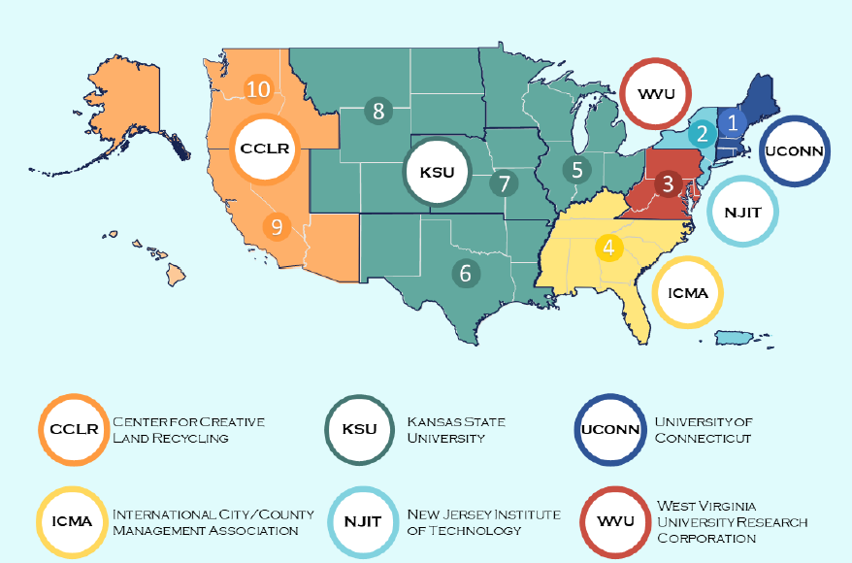
EPA’s Brownfields Technical Assistance
Technical Assistance to Brownfields (TAB) Providers
Using EPA grant funds, TAB providers work regionally to assist communities and other stakeholders on brownfield issues, such as:
preparing grant applications; ​
performing site inventories; ​
reviewing historical information; ​
design of investigation/sampling/field analysis; and​
cleanup and redevelopment planning. ​
5
Current TAB providers available Oct 2021 – Sep 2024
Notes:
TRANSCRIPTION: This slide illustrates how the Brownfield technical assistance. Provided by the technical assistance to Brownsville tab providers is actually geographically located and so there are certain tab providers you will contact based on what region of the country you live in. And this map can be found on the EPA brownfield's web page. So using EPA grant funds, those tab providers work regionally. To assist communities and other stakeholders on Brownfield issues, such as preparing grant applications, performing site inventories or compiling lists of brownfield sites, reviewing that historical information about past land use and operations that might be associated with potentially. Contaminated sites, design of investigation, sampling or field analysis to further investigate sites and of course plan cleanup and redevelopment.

Slide 6
Topic-specific technical assistance
Available to communities nationwide via these EPA grantees:
Technical Assistance to Tribal Nations and Entities
Available: Coming Soon
Equitable Development in Brownfields Planning
Available: 2021- 2024
State Program Implementation
​Available: Aug 2017 – February 2024
Support Nonprofits Seeking to Reuse Brownfields
Available: 2023 – 2028
National Brownfields Training Conference
​Available: 2023 –2030
Land Banking Strategies to Support Brownfields
​Available: 2023-2028
Anti-displacement Research
​Available: 2023-2028
6

Slide 7
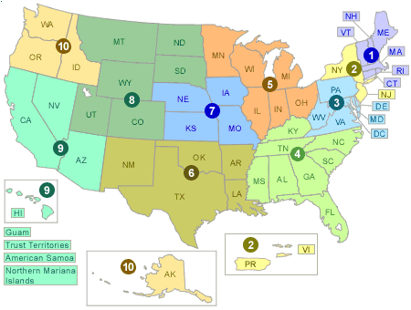
EPA Brownfields Regional Staff
EPA has 10 regional offices, each of which works directly with several states, tribal nations and/or territories.
You may contact an EPA regional representative to learn more about applicable laws, regulations, policies, and technical assistance.
7
Notes:
TRANSCRIPTION: EPA Brownfields and regional staff are also nationwide. EPA has 10 regional offices, each of which works directly with several states, tribal nations and or territories. You may contact an EPA regional representative to learn more about applicable laws, regulations, policies, and technical assistance.

Slide 8
Check for local experts
Ask around! Your community may already have professionals, elected leaders and local government staff who have the expertise and experience to support your plans.
Assess your community capacity, agency experts and access to local leaders with the experience, expertise and other connections
that can help your community be successful.
Plan to ensure all sectors of your community are represented to bring the widest array of
views and experts to complete your community
project.
8
Notes:
TRANSCRIPTION: Working with experts in Community development is another important part of brownfields revitalization, so check for local experts. Ask around your community may already have professionals, elected leaders and local government staff who have the expertise and experience to support your plans. And link your brownfield work with community development. Assess your Community capacity, agency experts and access to local leaders with the experience, expertise and other connections that can help your community be successful. Plan to ensure all sectors of your Community are represented to bring the widest array of views and experts to complete your Community project. The goal is really for you to craft and create the Community vision that works for you and turns that brownfield into a safe reuse.

Slide 9
Range of expertise needed to support safe brownfields reuse
Economic development & housing specialist
Public health professional
Environmental Regulatory Agency
Architect
Licensed site environmental professional
Attorney
Community
engagement specialist
Planner
Engineer
Landscape Architect
Lender
Geologist
Project manager
Environmental technician
Developer
Resilience specialist
9
Notes:
TRANSCRIPTION: What kind of experts do you need for you to be successful with your brownfields projects? Well, the range of expertise you need really depends on the kind of site that you are proposing as well as this type of brownfield reuse that you're thinking about you might need. Architects, planners, community engagement specialists. You will probably need an environmental professional. Your state and tribal response program or, uh, VCP program will be instrumental in helping oversee any kind of activities that you need. Do you have a public health specialist that can serve on your Advisory Board? Do you need some other kinds of technical assistance that are unique to your site? Or unique to the planned reuse. Maybe you're planning to add some solar panels to a building, and so you might need some. Additional technical expertise in modeling or in design, as well as just general engineering, architecture and project management expertise. So think about what you're going to need for your brownfield project, not only in its current state and what's required for site. Investigation and cleanup planning, but also that can support the redevelopment vision that the community is developing.

Slide 10
Liability protections available to site owners and prospective purchasers
State and local governments, nonprofit organizations, and other entities can be found to be liable under CERCLA by virtue of property ownership or their actions with respect to a site.
To encourage acquisition and investment in brownfield reuse, CERCLA provides a defense to liability if certain responsibilities are met.
Conducting All Appropriate Inquiries (AAI) on a property (before taking title) is necessary for obtaining liability protection under CERCLA for prior contamination.
AAI must be conducted before the property is acquired and the owner must comply with all other applicable statutory criteria.
Continuing obligations are applicable after property acquisition.
CERCLA liability protections include:
Innocent landowners defense
Contiguous property owners defense
Bona fide prospective purchasers defense
Government entities that acquire property through an involuntary transfer or acquisition, or through the exercise of eminent domain authority by purchase or condemnation
10
Notes:
TRANSCRIPTION: There are liability protections that are available to site owners and prospective purchasers. State and local governments, nonprofit organizations, and other entities can be found to be liable under CERCLA by virtue of property ownership or their actions with respect to a site. CERCLA liability protections include innocent landowner defense, contiguous property owner defense, bona fide prospective purchaser, defense government entities that acquire property through an involuntary transfer or acquisition or through the exercise of eminent domain authority by purchase or condemnation. So to encourage acquisition and investment in brownfields reuse, CERCLA provides a defense to liability if certain responsibilities are met. Conducting all appropriate inquiry on a property before taking title, whether by purchase or donation, is necessary for obtaining liability protection under CERCLA for prior contamination. AAI must be conducted before the property is acquired and the owner must comply with all other applicable statutory criteria. Continuing obligations are applicable after property acquisition.

