Slide 1
Update on EPA’s Endangered Species and Pesticides Activities
June 6, 2024 Pesticide Program Dialogue Committee Meeting

Slide 2
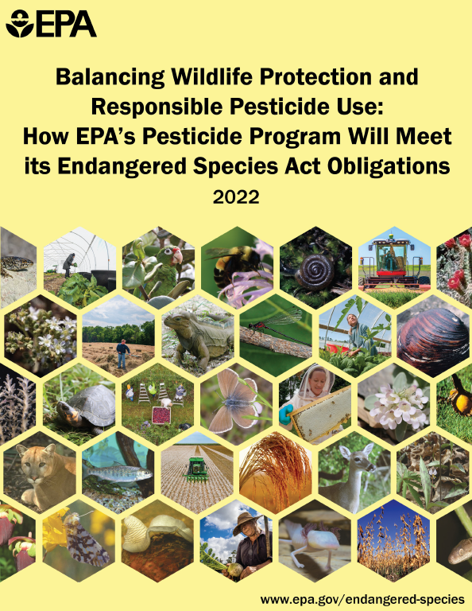
ESA Activities

Slide 3
ESA Strategies General Process
Systematic process that covers most common situations
Additional chemical specific issues are still considered
1. Mitigations needed?
2. Identify Mitigations
Runoff, erosion, and drift mitigations
3. Implementation
Mitigation/spatial extent
Prevent likelihood of “jeopardy” and minimize “take”
Assess impacts to species.
Specific to use and rate
Allows for emerging technologies
Programmatic
Utilize regulatory processes
Describe risks/potential impacts

Slide 4
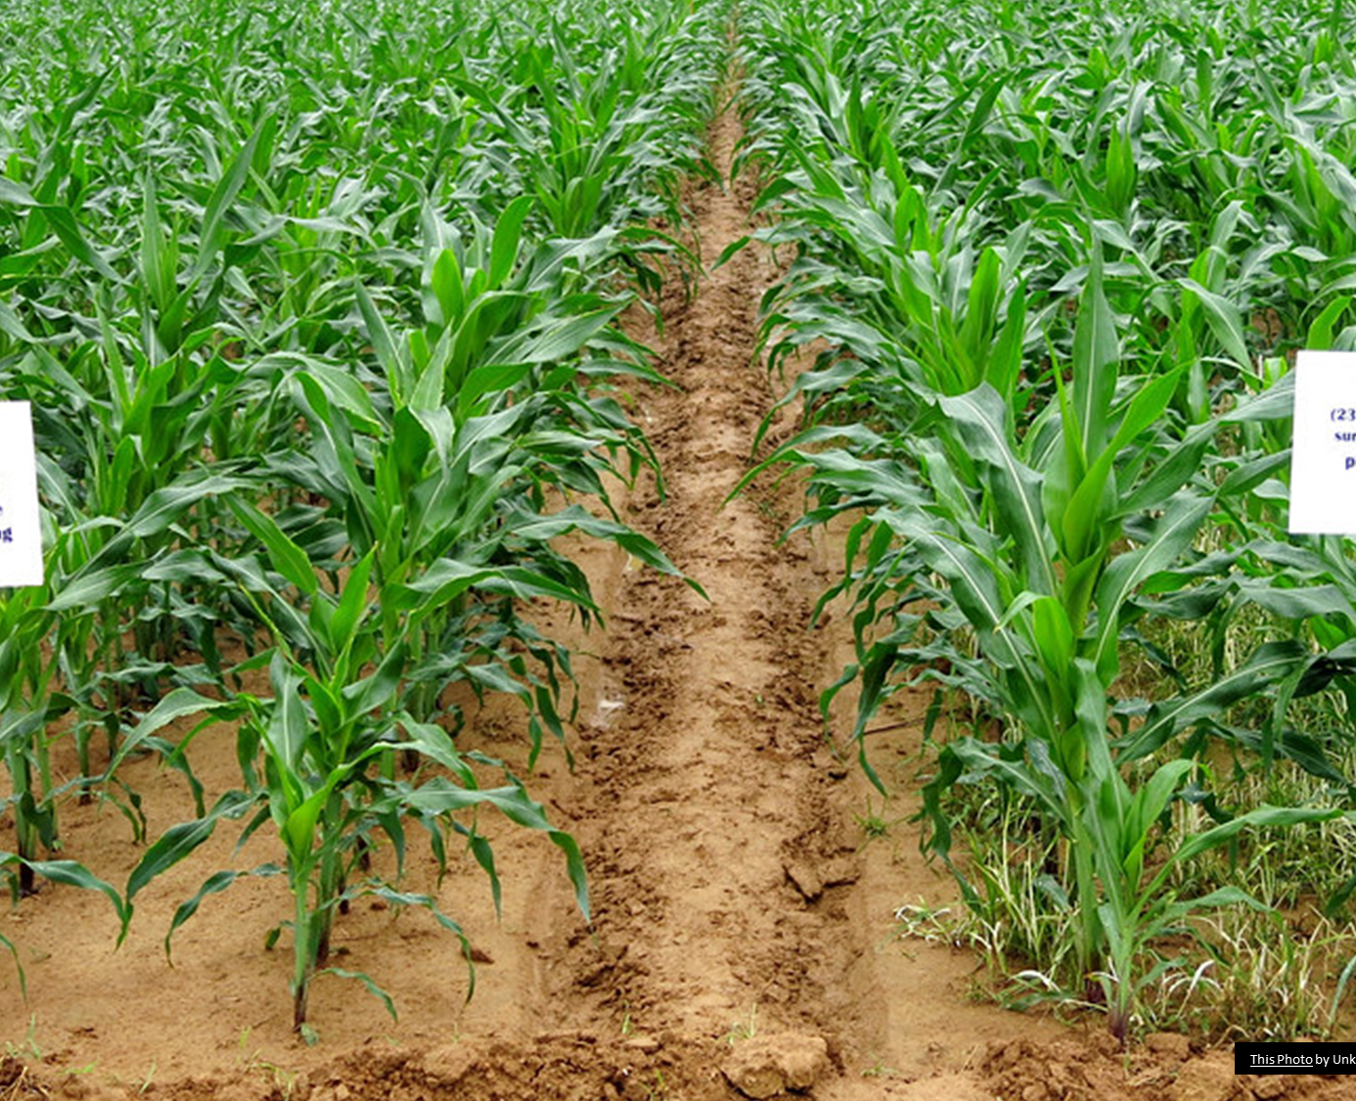
Herbicide Strategy
Public comments and other input under evaluation
Published summary of themes from public comments
Topics included: Number and effectiveness of mitigations, maps (PULAs), clearer communication on point system
https://www.epa.gov/pesticides/epa-publishes-update-herbicide-strategy-progress
Final strategy deadline extended to August 2024

Slide 5
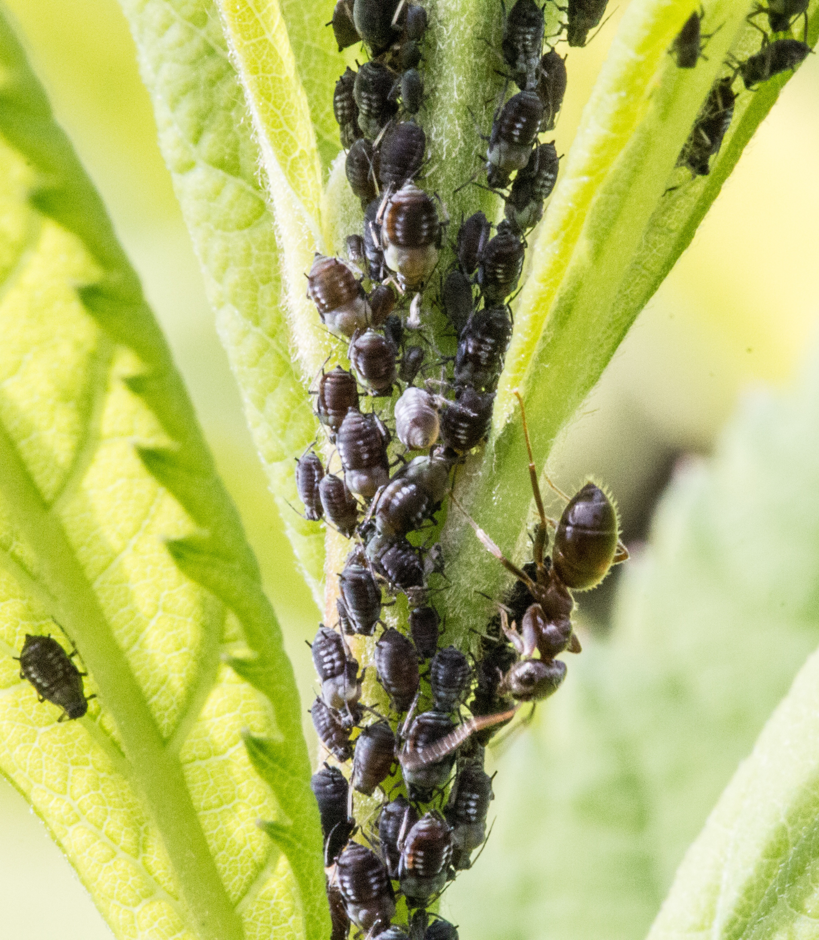
Insecticide Strategy
Similar concept as herbicide strategy
Draft strategy scheduled for July 2024 for public comments
Final scheduled for Spring 2025

Slide 6
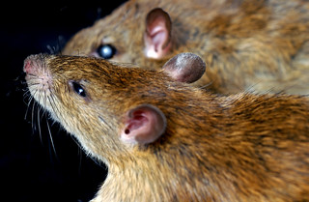
Rodenticide Strategy
Effects determinations, jeopardy predictions, and mitigation strategy for 11 rodenticides
Planned Next Steps: Evaluate public comments; Final BE and strategy schedule for November 2024
Amended PIDs begin to be released for comment in 2025

Slide 7
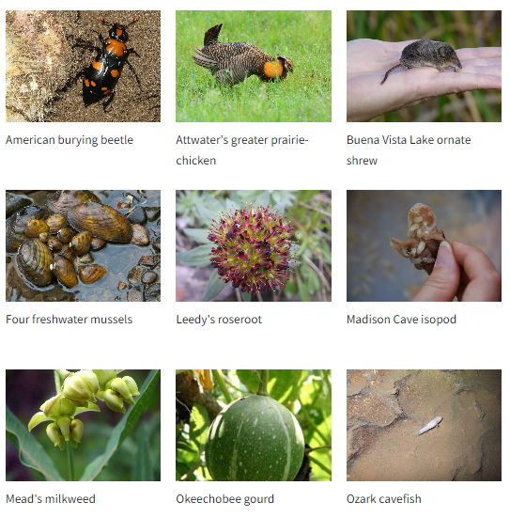
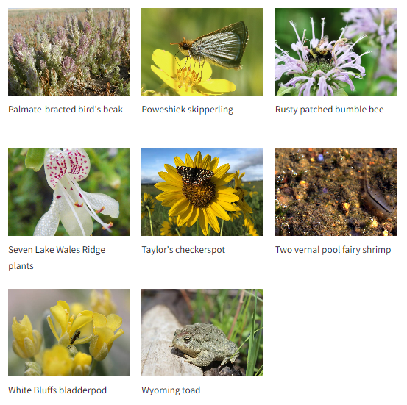
Vulnerable Species Pilot Project

Slide 8
Hawaii Strategy and Workshop
Why consider Hawaii separately?
Held workshop in March 2024
Next steps
Nene, Kathleen Misajon, NPS

Slide 9
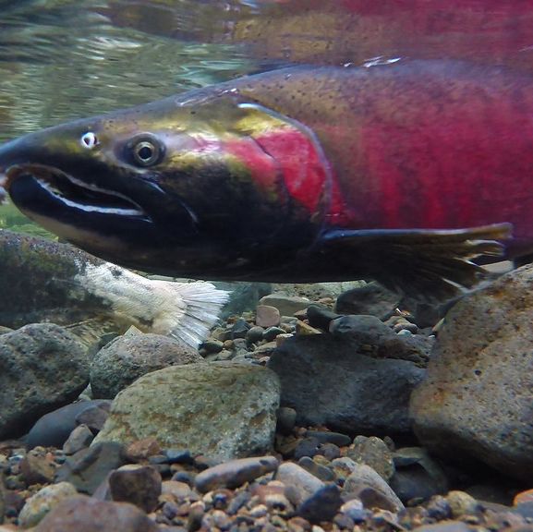
Programmatic Consultations with NMFS
Programmatic develops common approach to assessing and mitigating risks to species
Actions covered by the programmatic consultation can be processed more efficiently.
Starting with new AIs
Under programmatic, EPA will have completed consultation for actions prior to finalizing registration actions
Programmatic BiOp would implement mitigation and conservation measures up-front to insure no jeopardy

Slide 10
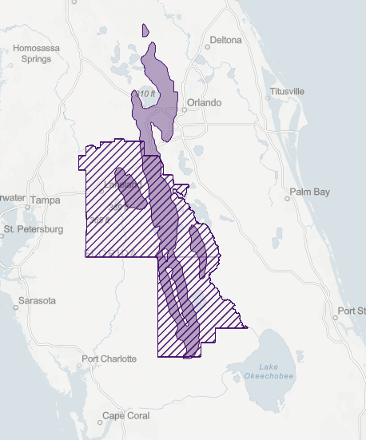
Mapping Refinements
Pesticide use limitation area (PULA)
Species habitat/locations relevant to pesticide labeling and species conservation
Developing and testing draft process for refining PULAs
Goals: Explicit mapping of areas important for species conservation

Slide 11
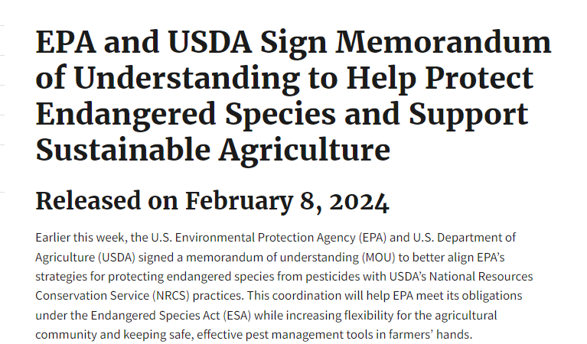
Coordinating with USDA on Mitigation
EPA-USDA mitigation workshop on May 9
EPA mitigation crosswalk for NRCS practices

Slide 12
Online Mitigation Menu
Menu of runoff measures will appear online.
Future pesticide labels will point to website.
June 18th public webinar on draft website.

Slide 13
Offsets
EPA continues exploring how to incorporate offsets
February 13-14 CropLife workshop
Near-term path.
Offsets roadmap for multiple species.
Working groups to focus on key issues (e.g., costs and suitable species)

Slide 14
Upcoming/Recent BEs and BiOPs
Upcoming Biological Evaluations
Acetamiprid and Dinotefuran (Draft 2023 / Final Nov 2024)
Bicyclopyrone and Benzovindiflupy (Draft Sept 2024; Final Sept 2025)
Rodenticide BE (Final; Nov 2024)
Biological Opinions
Final BiOp from FWS on Enlist and Enlist Duo (2023) and Implement ESA bulletins (Jan 2024, complete)
Implement final BiOp from NMFS on diazinon and malathion (Complete)
Final BiOps from NMFS on methomyl and carbaryl (2024, complete)
Draft BiOps from FWS on methomyl and carbaryl (Expected 2024)

Slide 15
Select Ongoing and Upcoming ESA Activities
Late 2023 (completed)
DRAFT rodenticide BE and mitigation strategy
Early 2024
Mid 2024
Final methomyl and carbaryl BiOps
Finalize herbicide strategy and begin to inform registration and registration review decisions
Late 2024/Early2025
Final BEs for acetamiprid and dinotefuran
2025 and beyond
Finalize insecticide strategy and begin to inform registration and registration review decisions
Draft Herbicide strategy and vulnerable species public comments
Hawaii workshop
Updated Enlist mitigation requirements per BiOp
Release DRAFT insecticide strategy for public comment
DRAFT online mitigation menu
DRAFT acetamiprid and dinotefuran BEs
Final Enlist BiOp
Draft BEs on benzovindiflupyr and bicyclopyrone
Mitigation workshop
Implement NMFS BiOp on 2 OP insecticides
Outreach on refining pesticide use limitation areas (PULAs) and begin process of revising PULAs
Determine if vulnerable species pilot should include additional species and provide additional information on the pilot
Draft Hawaii Strategy for public comment
FINAL rodenticide BE and mitigation strategy
Develop fungicide strategy
Continue revising PULAs for ESA mitigations

Slide 16
Thank You!

