Slide 1
Educational Partnerships for Innovation in Communities (EPIC) 社区创新教育伙伴关系
Highlights from The African and SE Asian Experiences 非洲和东南亚经验的亮点
Anthony Socci, Ph.D.
Senior Lead for International Climate Adaptation and Resilience Policy
US Environmental Protection Agency
Office of International & Tribal Affairs
Washington, DC USA
Notes:
MARC

Slide 2
Educational Partnerships for Innovation in communities (EPIC) Capacity Building tool 社区创新教育伙伴关系 (EPIC) 能力建设工具
EPIC is a simple tool/framework for highly effective, action-oriented partnerships that bring the untapped and underutilized intellectual resources of universities to the service of local governments and communities to enhance their capacity to adapt, build resilience, develop more sustainably, and more. EPIC 是一个简单的工具/框架，旨在实现高效、以行动为导向的伙伴关系，将大学未开发和未充分利用的智力资源为地方政府和社区提供服务，以增强其适应能力、增强复原力、更可持续地发展等。
The EPIC model matches existing university courses and administrative structures with local government and community needs without having to redesign courses or alter class schedules. Minimal burden placed on faculty while students acquire experience grappling with real world issues of local concern. EPIC 模型将现有的大学课程和行政结构与当地政府和社区的需求相匹配，而无需重新设计课程或改变课程表。 减轻教师负担，同时让学生获得解决当地关心的现实问题的经验

Slide 3
Educational Partnerships for Innovation in communities (EPIC) Capacity Building tool 社区创新教育伙伴关系 (EPIC) 能力建设工具
EPIC partnerships provide students with experience working on real world issues locally as part of their normal coursework, in a structured and safe setting, while also exposing them to potential career paths. EPIC 合作伙伴关系为学生提供在当地解决现实世界问题的经验，作为他们正常课程的一部分，在结构化和安全的环境中，同时也让他们接触潜在的职业道路
EPIC partnerships tend to build trust and sustained relations over time between local governments and universities. These are not one-off engagements but long-term results-oriented relationships that maintain over time. EPIC 合作伙伴关系往往会随着时间的推移在地方政府和大学之间建立信任和持续的关系。这些不是一次性的合作，而是长期以结果为导向的关系。
EPIC tool is sufficiently flexible to accommodate differences in geographies, politics, economies and cultural norms. EPIC 工具足够灵活，可以适应地理、政治、经济和文化规范的差异。
EPIC partnerships are local in nature but scalable to state, country and international networks. EPIC 合作伙伴关系本质上是本地的，但可以扩展到州、国家和国际网络。

Slide 4

Links to EPIC Model Animation: https://www.youtube.com/watch?v=_OS3ci-NI9w; or https://www.epicn.org/the-epic-model/.

Slide 5
EPIC Matches Community Needs with University Capacity EPIC 将社区需求与大学能力相匹配
Cities 城市:
Limited capacity and skills 有限的能力和技能
Limited resources and access to skills and new knowledge有限的资源以及获得技能和新知识的机会
Tendency to be risk averse 厌恶风险的倾向
Universities 大学:
Abundant skill & know how 丰富的技能和专业知识
Ready access to broad range of skills and new knowledge 随时获取广泛的技能和新知识
Innovative & not risk averse 创新且不规避风险

Slide 6
University Assets in Service to Local Communities 大学资产为当地社区服务
Multidisciplinary expertise 多学科专业知识
Multiple skill sets: design, policy analysis, engineering, law, planning, outreach & communication etc… 多种技能：设计、政策分析、工程、法律、规划、外联和沟通等
Technical skill, familiarity with best practices, knowledge and experience 技术技能、熟悉最佳实践、知识和经验
New ways of thinking and looking at problems 新的思维方式和看待问题的方式
Time, capacity and student energy 时间、能力和学生精力

Slide 7
Benefits to Students 对学生的好处
Gain real world experience as part of their course work 作为课程作业的一部分获得现实世界的经验
Learning enlivened and deepened by grappling with genuine local issues 通过解决真正的当地问题来活跃和深化学习
Chance to work across disciplines 跨学科工作的机会
More energized and more focused 更有活力、更专注
Better understanding of what local government does and how it operates 更好地了解地方政府的职责及其运作方式
Gain greater sense of community and social responsibility as students and involved citizens 作为学生和参与其中的公民，获得更大的社区意识和社会责任感
Opens to view additional unforeseen career opportunities at the local government level 开阔眼界，看到地方政府层面其他不可预见的职业机会
Notes:
Courtney!!!!!

Slide 8
Partial Range of Disciplines & Expertise Involved 涉及部分学科和专业知识
Climate Adaptation/Mitigation/Resilience 气候适应/减缓/恢复能力
Sustainable Development 可持续发展
Affordable housing 可负担住宅
Sustainable transportation 可持续交通
Engaging marginalized communities 参与边缘化社区
Economic development/redevelopment 经济发展/再发展
Brownfield redevelopment 棕地重建
Waste/Litter 废物/垃圾
Green architecture 绿色建筑
Community education 社区教育
Livability 宜居性
Economic development/redevelopment 经济发展/再发展
Brownfield redevelopment 棕地重建
Waste/Litter 废物/垃圾
Green architecture 绿色建筑
Community education 社区教育
Livability 宜居性
Environmental Planning 环境规划
Urban Planning 风险规划
Risk Assessment 风险评估
Ecological Systems 生态系统
And so much more… 其他

Slide 9
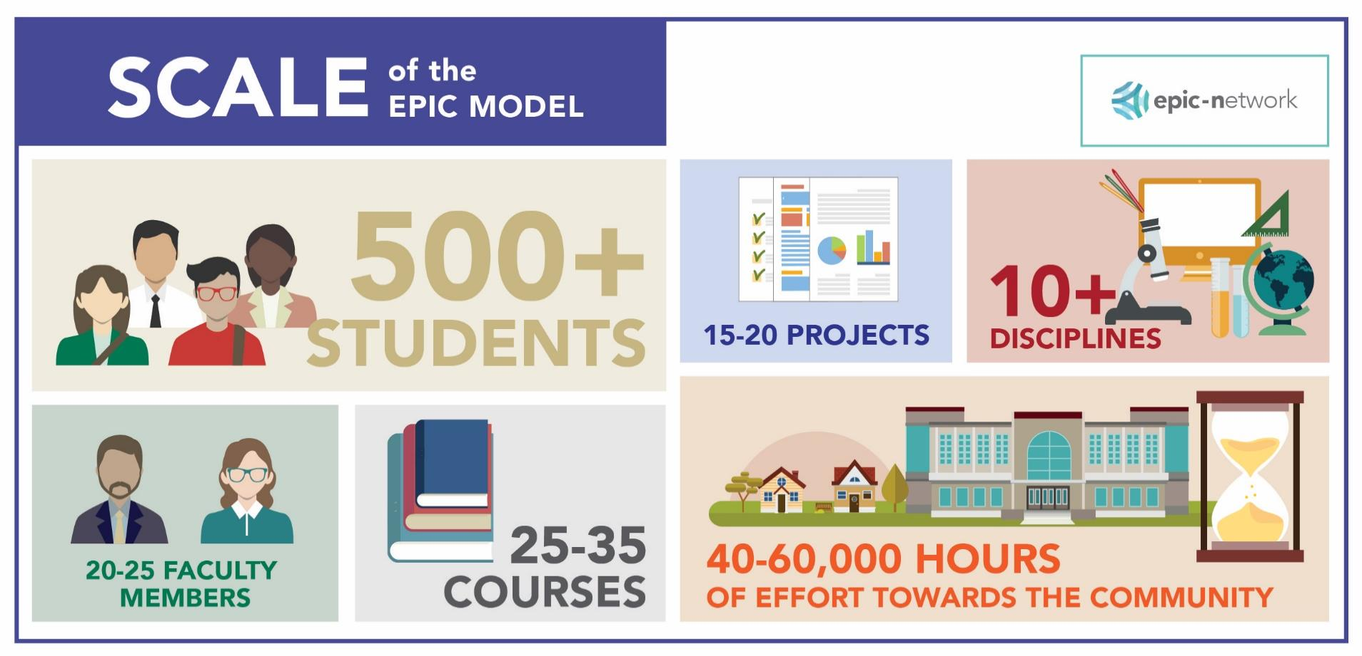

Scale of Typical Engagement During an Academic Year (US Example) 学年期间的典型参与程度 （美国例子）

Slide 10
Sample Range of Community Projects 社区项目示例范围
Climate Adaptation/Mitigation/Resilience 气候适应/减缓/恢复能力
Nature-based Adaptation/Resilience 基于自然的适应/恢复力
Disaster Risk Assessment & Risk Mapping 灾害风险评估和风险绘图
Disaster early warning systems 灾害预警系统
Sustainable Redevelopment Planning 可持续重建规划
Climate Risk Assessment & Planning 气候风险评估与规划
Affordable housing 负担得起的住房
Sustainable transportation 可持续交通
Waste/Litter 废物/垃圾
Green architecture 绿色建筑
Community education 社区教育
Livability 宜居性
Engaging marginalized communities 参与边缘化社区
Economic development/redevelopment 经济发展/再发展
Brownfield redevelopment 棕地重建
And so much more… 其他

Slide 11
Journey of the EPIC Tool from the U.S. to Africa, SE Asia & latin America EPIC 工具从美国到非洲、东南亚和拉丁美洲的应用
The EPIC model originated at the University of Oregon in 2009 and was subsequently adopted by scores of universities and local governments but.. EPIC模型于2009年起源于俄勒冈大学，随后被数十所大学和地方政府采用，但是……..
EPA forges an international partnership (NSF - US National Science Foundation, ICLEI - Local Governments for Sustainability, UN GAN – Global Adaptation Network, ICMA – International City/County Management Association, START - System for Analysis, Research and Training, ICLEI Global – Local Governments for Sustainability and the EPICN - EPIC Network Secretariat) to host a first international training on the EPIC tool in 2017. EPA 建立国际合作伙伴关系（ （NSF - 美国国家科学基金会、ICLEI - 地方政府可持续发展、UN GAN - 全球适应网络、ICMA - 国际城市/县管理协会、START - 分析、研究和培训系统、ICLEI 全球 - 地方政府可持续发展和 EPICN - EPIC 网络秘书处）将于 2017 年举办首次 EPIC 工具国际培训
First regional training on the EPIC model in Cape Town, South Africa in November 2017, for local government and university officials from cities in sub-Saharan Africa. Emergence of EPIC Africa Regional Network, first its kind outside the US. 2017 年 11 月，在南非开普敦为撒哈拉以南非洲城市的地方政府和大学官员举办了首次 EPIC 模式区域培训。EPIC 非洲区域网络的出现，是美国以外的首个此类网络。
February 2020, the leadership of the EPIC Africa regional network host an in-person African-led training on the EPIC model in Durban, South Africa, for other African city and university official thereby expanding the original EPIC Africa network. First instance of Africans training other Africans. 2020 年 2 月，EPIC 非洲区域网络的领导层在南非德班为其他非洲城市和大学官员举办了由非洲主导的关于 EPIC 模式的面对面培训，从而扩大了原有的 EPIC 非洲网络。非洲人培训其他非洲人的第一例。
In May 2021, a training workshop on the EPIC model was hosted remotely for city and university officials from various Asian cities representing an expansion of the EPIC model into the Asia-Pacific region. This workshop also witnessed the advent of the EPIC Asia regional network, the second EPIC network outside the US. 2021 年 5 月，为来自亚洲各个城市的城市和大学官员远程举办了 EPIC 模型培训研讨会，代表着 EPIC 模型扩展到亚太地区。本次研讨会还见证了 EPIC 亚洲区域网络的诞生，这是美国以外的第二个 EPIC 网络。
.
Between June and September 2022, four EPIC training workshops were hosted in Pretoria South Africa, Windhoek Namibia, Gaborone Botswana, and Harare Zimbabwe. 2022 年 6 月至 9 月期间，在南非比勒陀利亚、纳米比亚温得和克、博茨瓦纳哈博罗内和津巴布韦哈拉雷举办了四次 EPIC 培训研讨会。
Two EPIC training workshops were hosted in Latin America in late 2022. As a result of these latter 2 workshops 10 new EPIC projects are now underway in cities in 5 Latin American countries. 2022 年底在拉丁美洲举办了两场 EPIC 培训研讨会。由于后两场研讨会的成果，10 个新的 EPIC 项目目前正在 5 个拉丁美洲国家的城市进行。
Four EPIC training workshops are currently taking place in Monrovia Liberia, Banjul Gambia, Mombasa Kenya and Lusaka Zambia. 目前正在利比里亚蒙罗维亚、冈比亚班珠尔、肯尼亚蒙巴萨和赞比亚卢萨卡举办四期 EPIC 培训研讨会。
To date, the EPIC model has been implemented by more than 70 university-based programs in more than 350 diverse institutions/communities globally, to complete more than 1800 projects mobilizing more than a million hours of expert-supervised student effort. 迄今为止，EPIC 模式已在全球 350 多个不同机构/社区的 70 多个大学项目中实施，完成了 1800 多个项目，动员了超过 100 万小时的专家监督学生的努力。

Slide 12
Highlights of EPIC Tool in African cities EPIC Tool 在非洲城市的亮点
Durban, South Africa – Durban city council worked with the University of KwaZulu-Natal and its students for assistance in developing and implementing a flood management plan and a disaster early warning system for an QRW informal community living along the Palmiet River. Most recently, the Durban area was struck by the worst rains and floods in the history of SA, resulting in nearly 500 deaths and damage to over 19,000 dwellings, largely confined to informal communities. However, because of a community-led disaster early warning system being in place, the QRW community along the Palmiet River saw no deaths. 南非德班 - 德班市议会与夸祖鲁-纳塔尔大学及其学生合作，为帕尔米特河沿岸的 QRW 非正式社区制定和实施洪水管理计划和灾害预警系统提供援助。 最近，德班地区遭遇了南澳历史上最严重的降雨和洪水，造成近 500 人死亡，19,000 多处住宅受损，其中大部分位于非正规社区。 然而，由于社区主导的灾害预警系统已经到位，帕尔米特河沿岸的 QRW 社区没有出现死亡事件。
Nairobi, Kenya – Nairobi city council sought assistance from the University of Nairobi, as well as an NGO, to identify options for redeveloping and making more resilient, sustainable, and user-friendly, its notoriously deteriorated central business district. Following a localized student-led pilot effort aimed at showing the potential value of implementing one of the options presented, the President of Nairobi approved and supported a full-scale effort to implement the work beyond the pilot area. The work of redeveloping the CBD to be more resilient, sustainable and user-friendly, is on-going and has the support of local businesses as well. 肯尼亚内罗毕 - 内罗毕市议会向内罗毕大学以及一家非政府组织寻求帮助，以找到重建其恶化的中央商务区并使其更具弹性、可持续和用户友好的方案。 继旨在展示实施所提出的选项之一的潜在价值的由学生主导的本地试点工作之后，内罗毕总统批准并支持在试点地区之外开展全面工作。 重建中央商务区以使其更具弹性、可持续和用户友好的工作正在进行中，并得到了当地企业的支持。
Lusaka, Zambia – Lusaka mayor and city council signed an MOU with the University of Zambia to provide them with options for identifying flood and other natural hazard risks within one of the city’s largest informal communities, as well as providing options for redevelopment. The university provided the city council with a natural hazard risk map of the area as well as options for redeveloping this informal community. The mayor and city council were so impressed with the work that they extended support to the university for additional EPIC work at the rate of $25K per year for the next 5 years. At the present, the city is beginning to implement some of the ideas presented by the university to reduce the risk of floods in high-risk areas. 赞比亚卢萨卡 - 卢萨卡市长和市议会与赞比亚大学签署了一份谅解备忘录，为他们提供在该市最大的非正式社区之一内识别洪水和其他自然灾害风险的选择方案，并提供重建的选择方案。 该大学向市议会提供了该地区的自然灾害风险图以及重建这个非正式社区的选项。 市长和市议会对这项工作印象深刻，因此他们在未来 5 年内以每年 25,000 美元的价格向大学提供额外的 EPIC 工作支持。 目前，该市正在开始实施大学提出的一些想法，以减少高风险地区的洪水风险。
Mbale City, Uganda - University students worked with Mbale city officials to generate maps and plans , situational analysis reports, prepared for action, policy briefs prepared on selected aspects of urban development, review of 5 –year development plans for LGs, improvement in livelihoods through evening markets as a result erection of street lighting, opening of roads and drainage systems, and construction of water reservoirs and public toilets. 乌干达姆巴莱市 - 大学生与姆巴莱市官员合作，制作地图和计划、情况分析报告、行动准备、城市发展的政策简报、审查地方政府的五年发展计划、通过夜市改善生计，结果提升街道照明、开放道路和排水系统以及建造水库和公共厕所水平。

Slide 13
Durban, South Africa 南非德班
Video of Durban Floods of 2022
https://fb.watch/l88kgNeJ6J/

Slide 14
Lusaka, Zambia
赞比亚卢萨卡

Slide 15
Mbale, Uganda
乌干达姆巴莱

Slide 16
Highlights of EPIC Tool in SE Asian cities EPIC Tool 在亚洲城市的亮点
Long Xuyen City, Vietnam - Because of its location in the Mekong Delta area, Long Xuyen is affected more acutely from flooding. Consequently, the City of Long Xuyen called upon students from An Giang University to provide options for ameliorating frequent flooding in parts of the city. Students mapped drainage systems, urban flooding areas, and frequently inundated areas in the city center and, in addition, proposed city initiatives on sustainable drainage and waterlogging management that would contribute to the city’s master plan for resilience to climate change by 2035. Students also worked with local officials to document the inadequacy of existing drainage systems as well as the lack of complete, new and old drainage systems along many streets and identified possible pathways to a more sustainable, more resilient climate-proof city. 越南龙川市 - 由于位于湄公河三角洲地区，龙川地区受洪水影响更为严重。因此，龙川市呼吁安江大学的学生提供解决方案，以缓解该市部分地区频繁发生的洪水。 学生们绘制了排水系统、城市洪泛区和市中心经常被淹没的地区的地图，此外还提出了可持续排水和内涝管理的城市倡议，这将有助于该市到 2035 年抵御气候变化的总体规划。 学生们还与当地官员合作，记录了现有排水系统的不足以及许多街道上缺乏完整的新旧排水系统的情况，并确定了建设更可持续、更具适应力的气候城市的可能途径。
City of Manado, Indonesia – Despite recurrent flooding events, the city of Manado lacked an operational plan to pre-empt and/or minimize the flooding and its impacts. To address the situation the City of Manado reached out to the Manado Politeknik Negri University and its students to assist the city in devising and implementing a flood early warning system, especially for those areas and communities most impacted by these recurrent floods, as part of an EPIC project. In response, students first mapped known and potential flood risk areas using drones, ground surveillance and data already collected by the city and then assembled and strategically placed and tested a series of sensors at 4 strategic locations to gather continuous information on water conductivity, changes in water volume and changes in rates of water flow, allowing water levels and water speed to be determined at any time at known locations. Students subsequently worked with city officials to develop protocols for decision making regarding who is responsible to make decisions when sensors detect impending flood waters; which agencies should be involved in decision-making; what the critical time is for making decisions to act; how decisions should be verified and by whom; and how decisions should be disseminated. 印度尼西亚万鸦老市 - 尽管洪水事件频发，但万鸦老市缺乏预防和/或尽量减少洪水及其影响的行动计划。 为了解决这一问题，万鸦老市联系了万鸦老理工大学及其学生，协助该市设计和实施洪水预警系统，特别是针对那些受这些反复发生的洪水影响最严重的地区和社区，作为该系统的EPIC项目一部分。 作为回应，学生们首先使用无人机、地面监视和城市已经收集的数据绘制了已知和潜在洪水风险区域的地图， 然后在 4 个战略位置组装、战略性放置和测试一系列传感器，以收集有关水电导率、水量变化和水流速率变化的连续信息，从而可以在已知位置随时确定水位和水流速度。 随后，学生们与城市官员合作制定决策协议，确定当传感器检测到即将发生的洪水时由谁负责做出决策， 哪些机构应参与决策； 做出行动决定的关键时刻是什么？ 决定应如何验证以及由谁验证； 以及如何传播决定。

Slide 17
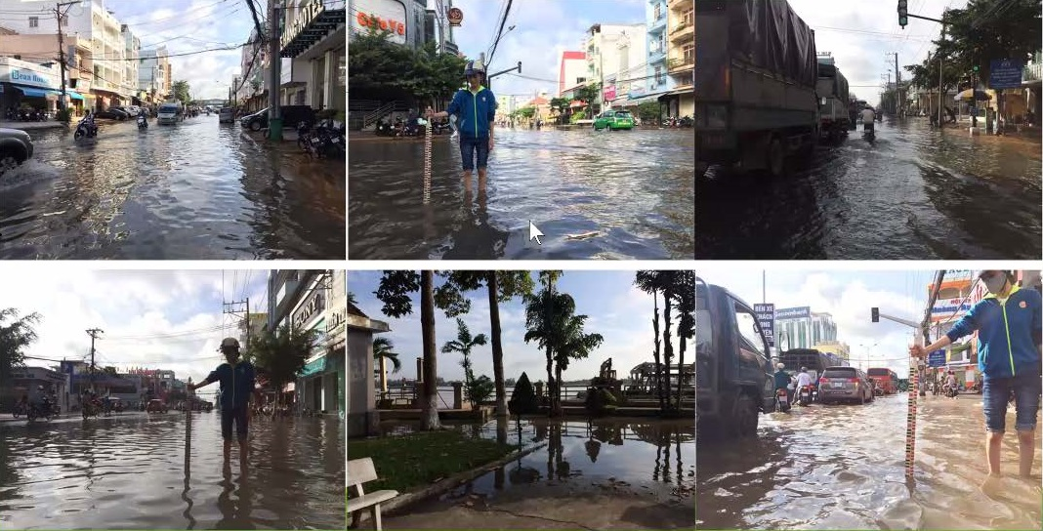
Long Xuyen City, Vietnam
越南龙川市

Slide 18
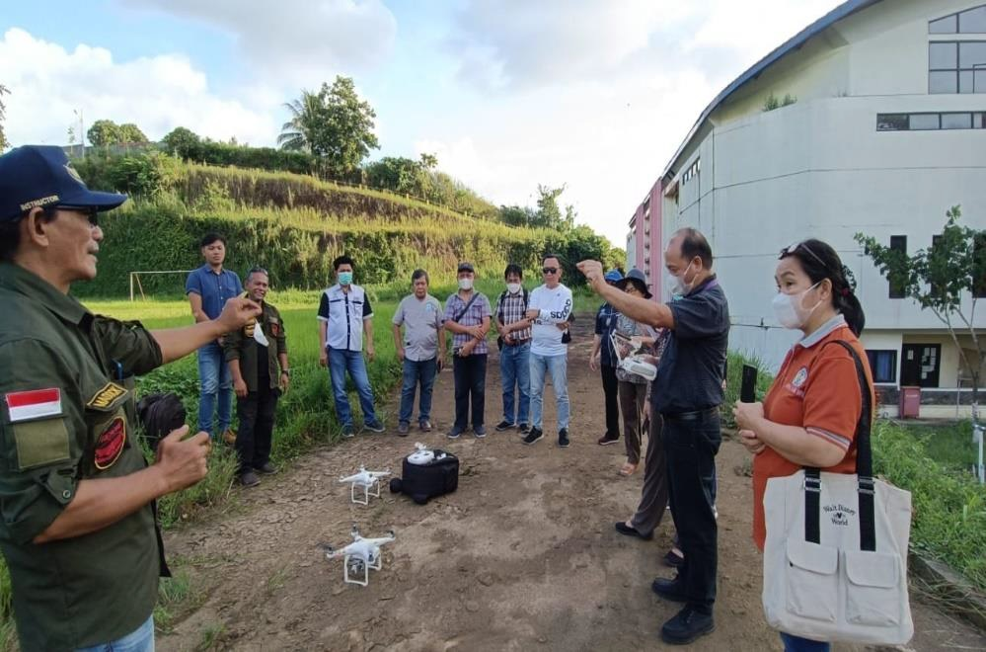
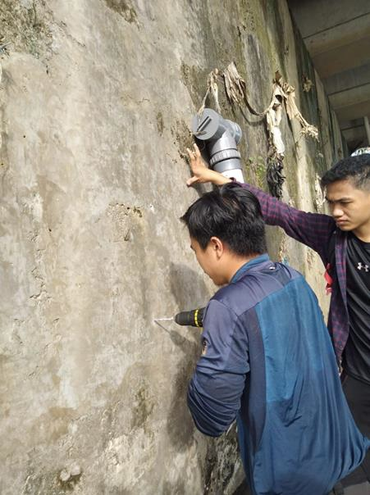
City of Manado, Indonesia
印度尼西亚万鸦老市

Slide 19
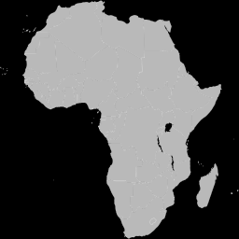
Idealized Fully Scaled Pan-African EPIC Network
of the Future
未来理想化的全规模泛非洲 EPIC 网络
Durban and other metro centers, South Africa
Lusaka, Zambia
Windhoek, Namibia
Gaborone, Botswana
Harare, Zimbabwe,
Maputo, Mozambique
Mombasa and Nairobi, Kenya
Mbale, Uganda
Kinshasa, DRC
Brewerville City and Lake Piso, Liberia
Banjul, Gambia
EPIC North Africa
EPIC West Africa
EPIC East Africa
EPIC Central Africa
EPIC Southern Africa?

Slide 20
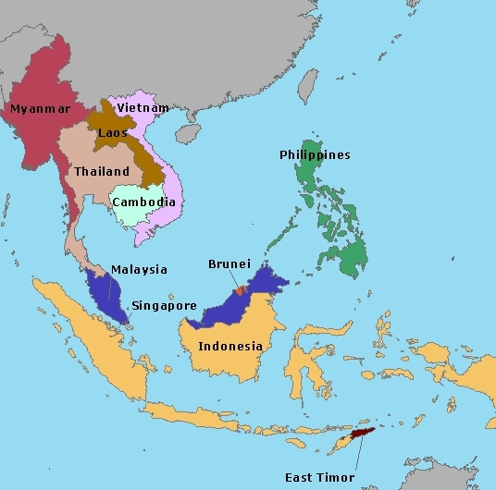
Seberang Perai City, Malaysia
Hat Yai, Thailand
Long Xuyen City, Vietnam
Penang, Malaysia
Chiang Mai, Thailand
Calamba City, Philippines
Alor Gajah, Malaysia
Thaklong Municipality, Thailand
Manado, Indonesia
Iloilo City, Philippines
Bandung, Indonesia
Bangkok, Thailand
VienAn Village, Vietnam
Pathum Thani, Thailand
EPIC Asia Network
亚洲 EPIC 网络

Slide 21
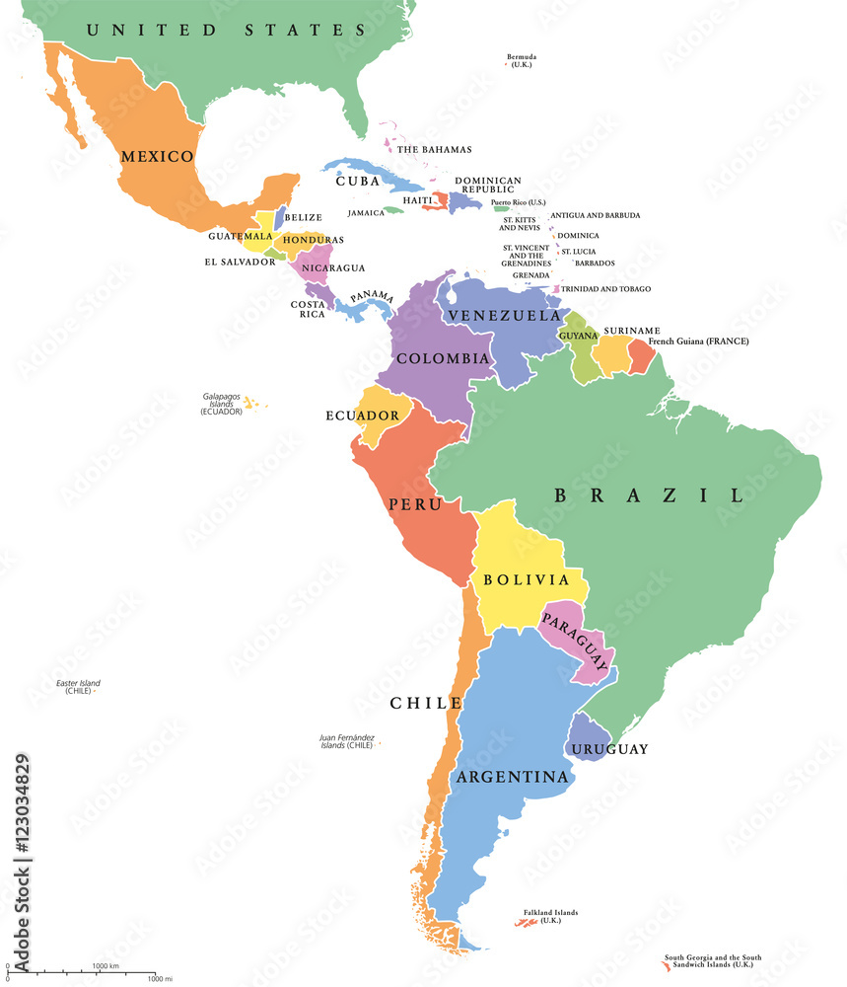
Veracruz, Mexico
Metro Mexico City, Mexico
Guadalajara, Mexico
Colima, Mexico
Lima, Peru
Santa Elena, Ecuador
Nova Xavantina, Brazil
Território do Confisco, Brazil
Curitiba, Brazil
EPIC Latin America
拉丁美洲 EPIC 网络

Slide 22

EPIC Europe
EPIC North America & EPIC-N Global Secretariat
EPIC Asia
EPIC Africa
EPIC Latin America
EPIC AU & NZ
Idealized Fully Built-Out Global EPIC Network of the Future 理想化的完全构建的未来全球 EPIC 网络

Slide 23
“One of higher education’s most successful and comprehensive service-learning programs.” 高等教育最成功、最全面的服务学习项目之一
Scott Carlson, May 24, 2013
“Perhaps the most comprehensive effort by a university to infuse into its curricula sustainability and community outreach.” 也许是一所大学将可持续性和社区外展融入其课程的最全面的努力
Michael Burnham, Greenwire
August 23, 2010
[EPIC] “has been a great partnership and has provided invaluable information for our city – we’ll be able to use it for a long time” EPIC一直是很好的合作伙伴关系，为我们的城市提供了宝贵的信息——我们将能够长期使用它
Randy McClement, Mayor, City of Frederick, MD
‘I feel somewhat guilty in accepting this award as I feel I have become a serial abuser of the EPIC model because I have used it repeatedly over time, having initially been its biggest skeptic.’ 接受这个奖项让我感到有些内疚，因为我觉得自己已经成为 EPIC 模型的连续滥用者，因为我最初是它最大的怀疑者，但随着时间的推移，我反复使用它。
Mike James, Former Asst. City Manager, Lemon Grove, CA – April 2018
Notes:
MOOCs!!
Caught on – simplicity of idea seems to resonate
Existing courses – Scale – Breadth
FUNDERS (interested)
50k -> 1million - PROVOST

Slide 24
Contacts and Selected WEB Links 联系人和网页链接
Worldwide EPIC Network Secretariat, USA
info@epicn.org; See also: www.epicn.org
EPIC Africa Regional Network
Dr. Mzime Murisa, Harare, Zimbabwe, EPIC Africa Network Manager - mmurisa@start.org or mzime@epicn.org
Dr. Sean O’Donaghue, Durban, South Africa, EPIC Africa Network Co-Lead - Sean.ODONOGHUE@durban.gov.za
Dr. Gilbert Siame, Lusaka, Zambia, EPIC Africa Network Co-Lead - siamegilbert@yahoo.co.uk
EPIC Asia Regional Network
Dr. Kay Phanthuwongpakdee, EPIC Asia Regional Manager - kaynp@epicn.org
Additional Contact & Web Link
Dr. Anthony Socci, US EPA Office of International Affairs, International EPIC-N Partner, Washington, DC – socci.anthony@epa.gov; See also: www.epa.gov/international-cooperation/epas-role-international-climate-adaptation-and-resilience

Slide 25

Read about the ARC-X Adaptation Resource Toolkit Below
了解以下 ARC-X 适应资源工具包

Slide 26
EPA’s Climate Change Adaptation Resource Center (ARC-X):
EPA 气候变化适应资源中心
Responding to the Needs of Local Communities in the US
响应美国当地社区的需求
Notes:
26

Slide 27
ARC-X was built from the bottom up, based upon lengthy consultations involving state and local officials expressing what they need to address present and projected climate impacts ARC-X 是自下而上建立的，基于州和地方官员的长期磋商，他们表达了解决当前和预计气候影响的需要
Designed to help local government officials make more informed decisions 旨在帮助地方政府官员做出更明智的决策
ARC is Not Prescriptive ARC 不是规定性的

Slide 28
Goal of ARC-X – Serve as an interactive, web-based platform
to help empower 40,000 communities in the US to anticipate, prepare for, and adapt to the impacts of climate change. ARC-X目标：作为一个基于网络的互动平台，帮助美国 40,000 个社区预测、准备和适应气候变化的影响。
Small and mid-sized communities in particular: 尤其是中小型社区
  Lack technical expertise and experience with adaptation 缺乏技术专长和适应经验
  Lack sufficient resources to devote to adaptation 缺乏足够的资源用于适应
  Are often overwhelmed by huge volume of information about climate adaptation, much of which is irrelevant to their community and setting 经常被大量有关气候适应的信息淹没，其中大部分与他们的社区和环境无关
  Are challenged to integrate available information into a single package that will provide them with a comprehensive roadmap on how to evaluate and prepare for the risks posed by climate change 面临将现有信息整合到一个单一包中的挑战，该包将为他们提供如何评估和应对气候变化带来的风险的全面路线图

Slide 29
ARC-X - Building and Strengthening Adaptive
Capacity of Communities ARC – X 建设和加强社区的适应能力
ARC-X helps communities integrate climate adaptation into the work they do by: ARC-X 帮助社区将气候适应融入到他们所做的工作中,通过以下方式：
  Training: increasing awareness of ways climate change may affect their ability to implement desired programs 培训： 提高人们对气候变化可能影响其实施所需计划的能力的认识
  Tools and Technical Support: providing data, information, tools and technical support 工具和技术支持 - 提供数据、信息、工具和技术支持
  Financial incentives: supporting climate-resilient investments in communities across the country 资金支持 - 支持全国社区的气候适应型投资

Slide 30
What’s in the ARC-X Resource Center?
ARC-X 资源中心有什么？
Once users select the areas of interest to them, they will find information about: 一旦用户选择了他们感兴趣的领域，他们将找到以下信息：
  the risks posed by climate change to the issues they care about; 气候变化给他们关心的问题带来的风险
  adaptation strategies they might consider implementing; 他们可能考虑实施的适应策略
  case studies illustrating how other communities have successfully adapted to those risks; 案例研究说明其他社区如何成功适应这些风险
  tools to replicate the successes of other communities (the relevant tools & technical support!) 复制其他社区成功的工具（相关工具和技术支持！）

Slide 31
On-going Enhancements to the ARC-X System ARC-X 系统的持续改进
Pages on ARC-X that serve as the system’s hub for: ARC-X 上的页面作为系统的中心
  Climate and environmental justice in adaptation 适应中的气候和环境正义
  Climate adaptation in Tribal communities 部落社区的气候适应
  EPA’s Geographic Programs EPA 的地理计划
Provide users with an ability to explore strategies for adapting to particular types of climate risks (e.g., extreme heat; sea level rise). 使用户能够探索适应特定类型气候风险（例如极端高温、海平面上升）的策略。
Highlight adaptation strategies that yield co-benefits 强调产生协同效益的适应策略
Additional case studies 更多的案例
Updated scientific information such as the 5th National Climate Assessment on the impacts of climate and global change in the US 更新科学信息，例如关于美国气候和全球变化影响的第五次国家气候评估
Enhancements based on feedback from ongoing survey of users 基于正在进行的用户调查反馈的增强功能

Slide 32
State-Level Versions of ARC-X ARC-X 的国家级版本
EPA facilitates the development of state-and-city-level versions of ARC-X in collaboration with local universities EPA 与当地大学合作促进州和市级版本 ARC-X 的开发
  Provide code and content of ARC-X free of charge 免费提供ARC-X的代码和内容
  Provide technical support 提供技术支持
Encouraging host universities to: 鼓励大学
  Form partnerships with, and leverage expertise of, other universities in the state 与该州其他大学建立合作伙伴关系并利用其专业知识
  Ensure engagement of historically black colleges and universities and other minority-serving institutions 确保历史悠久的黑人学院和大学以及其他少数族裔服务机构的参与
Examples of custom ARC-X systems under development 正在开发的定制 ARC-X 系统示例
  Indiana (Launched in September 2017) 印第安纳州（2017 年 9 月推出）
  Pennsylvania, North Carolina, Louisiana, New York 宾夕法尼亚州、北卡罗来纳州、路易斯安那州、纽约州
  Sao Paulo, Brazil 巴西圣保罗

Slide 33
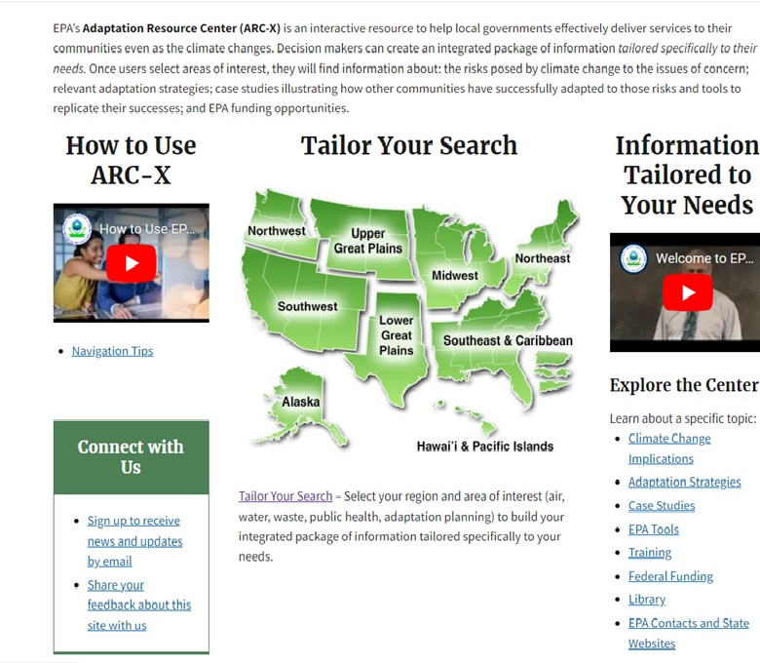
ARC-X Interactive Interface ARC-X交互界面

Slide 34
Contact Information 联系方式
Link to ARC-X Resource Toolkit: ARC-X 资源工具包链接
https://www.epa.gov/arc-x
Joel D. Scheraga, Ph.D.
Senior Advisor for Climate Adaptation
Office of the Administrator / Office of Policy
U.S. Environmental Protection Agency
Email: Scheraga.Joel@epa.gov

