Slide 1
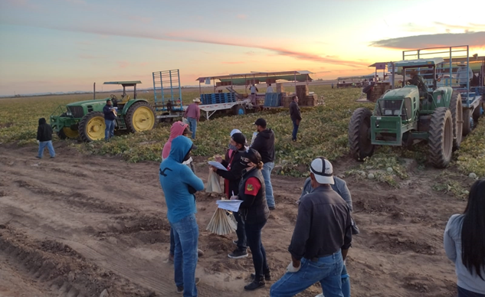
PPDC Farmworker Work Group Update
June 6, 2024
Photo courtesy of Emma Torres, Campesinos Sin Fronteras

Slide 2
Summary of November 2023 PPDC Meeting Discussion
    The formation of a new PPDC Farmworker Work Group was discussed and approved at the November 2023 PPDC meeting.
    Potential charge questions from that discussion included:
      What does EPA know about the lived experiences of diverse farmworkers with regard to their interactions with worker protection standards and the protections in place for them?
      How does EPA incorporate information about the farmworkers experiences throughout the whole process of how we regulate pesticides, ensure implementation of regulations and policies, and then monitor that compliance and ensure that there is good enforcement?
      How do we take into account "in the field" implementation farmworkers and growers are doing when evaluating a pesticide registration?

Slide 3
PPDC Farmworker Work Group Members
Name | Organization
Walter Alarcon | National Institute for Occupational Safety and Health, Centers for Disease Control and Prevention
Alanna Bares | Office of Environmental Health Hazard Assessment, California Environmental Protection Agency
Becca Berkey | Northeastern University
Nathan Donley | Center for Biological Diversity
Alexis Guild | Farmworker Justice
Joseph G. Grzywacz | San Jose State University
Kaitlin Picone, EPA Co-Chair | EPA Office of Pesticide Programs
Michelle Ranville | USDA Office of Pest Management Policy
Alexis Temkin | Environmental Working Group
Emma Torres | Campesinos Sin Fronteras
Mily Treviño-Sauceda, Co-Chair | Alianza Nacional de Campesinas, Inc.
Brian Verhougstraete | Michigan Department of Agriculture and Rural Development

Slide 4
PPDC Farmworker Work Group: Progress to Date
Workgroup coordination began in March 2024
Meetings
  April 10, 2024
  April 30, 2024
  May 7, 2024
  May 15, 2024
  May 21, 2024

Slide 5
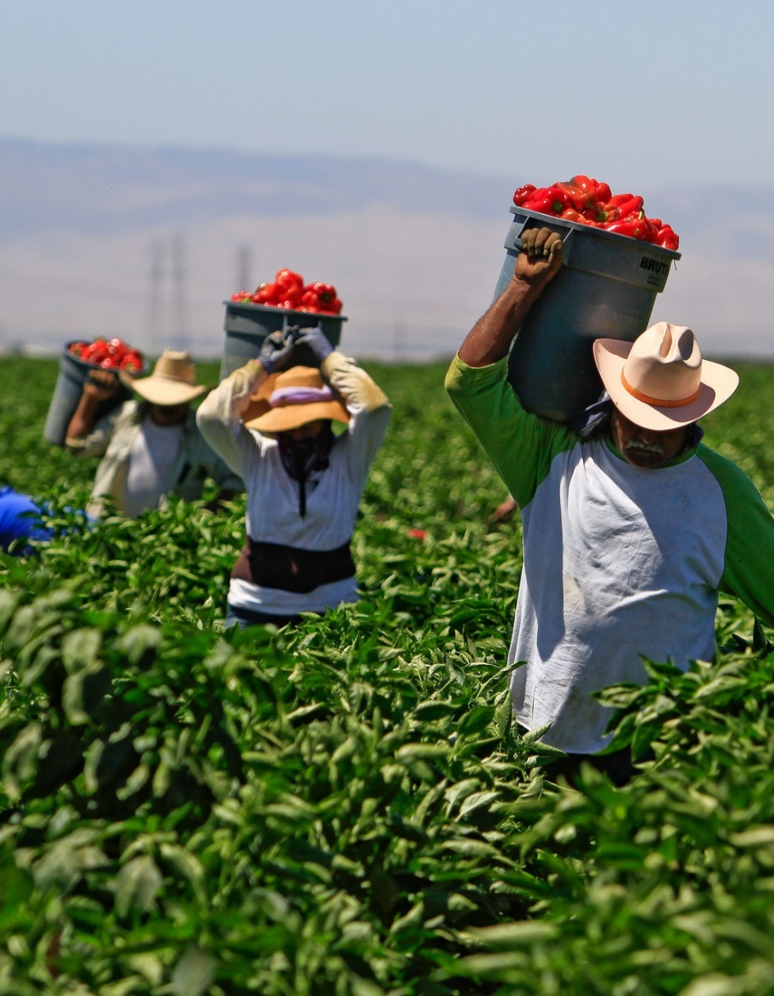
Who are Farmworkers?
Farmworkers are individuals involved in agricultural production including planting, cultivating, harvesting, and processing crops for sale, and caring for animals (Arcury & Quandt, 2009)
  Migrant – individuals whose principal employment is agriculture on a seasonal basis, and who establishes a temporary home.
  Seasonal – individuals who principal employment is agriculture on a seasonal basis, and does not change residence
National Agricultural Workers Survey (NAWS)**:
  Average age of farmworker: 39.4 (as of data collected in 2021-22)
  68.4% of farmworkers foreign born (60.7% of all farmworkers born in Mexico)
  42% of all farmworkers are unauthorized to work in the United States
  Highest estimates are that 85% of agricultural workers in the US are "settled"
2012 Census of Agriculture*:
  2.7 million+ hired farmworkers (on 26.9% of all farms) → 16% migrant/contract laborers
  2 million+ unpaid laborers on U.S. farms (on 42.3% of all farms)
Economic Research Service (ERS) of the USDA, data from the Agricultural Resource Management Survey (ARMS):
  Hired farmworkers work primarily on large farms with sales of over $500,000 per year, comprise 1/3 of the all people working on farms (other 2/3 farm operators and their families)
*Note that the 2017 Census of Ag was released in April 2019, so these numbers may have changed slightly
**Limitations: 1) only crop workers, 2) doesn’t account for H-2A workers, 3) survey conducted on farm:
https://www.doleta.gov/naws/research/docs/NAWS_Research_Report_13.pdf
Photo courtesy of Joe Grzywacz, San Jose State University

Slide 6
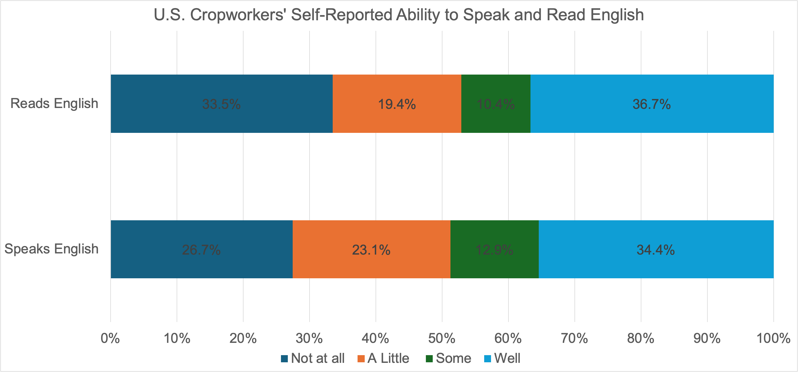
Source: https://www.dol.gov/agencies/eta/national-agricultural-workers-survey/naws-data-table/naws-data-finder-results

Slide 7
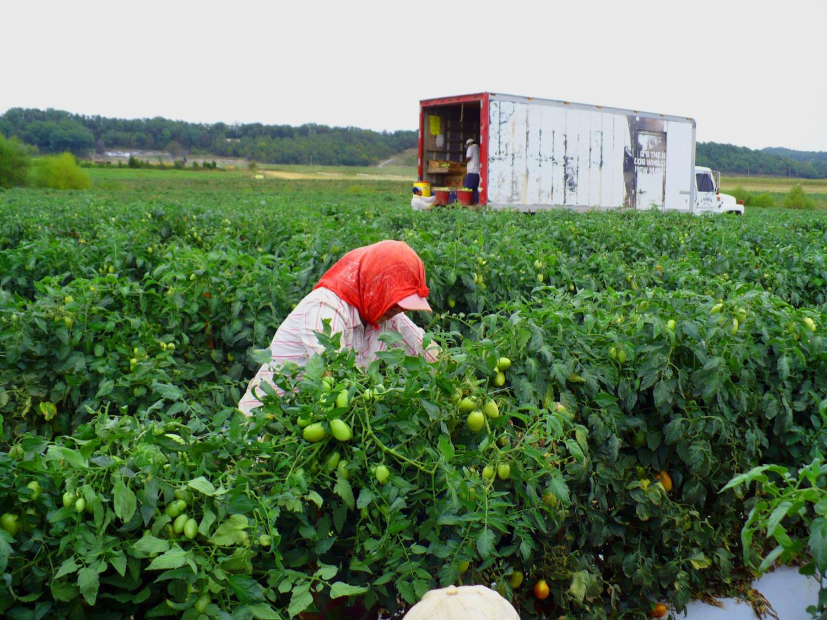
Who are Farmworkers?
2014 Census of Agriculture Organic Production Survey:
  14,048 organic farms and ranches in the United States (less than 1% of the nation’s total farms according to the 2012 Census of Agriculture total of 2,109,303 farms)
  8,439 of these farms (60%) report utilizing hired agricultural labor including contract labor
Economic Research Service (ERS) of the USDA, data from the Agricultural Resource Management Survey (ARMS):
  Hired farmworkers work primarily on large farms with sales of over $500,000 per year, comprise 1/3 of the all people working on farms (other 2/3 farm operators and their families)
Agricultural workers are at increased risk of acute pesticide poisonings in comparison to non-agricultural workers, particularly through drift, early reentry into a treated area, and use in conflict with the label.
  The incidence rate was almost twofold higher in female agricultural workers compared to males (Source: Calvert et al. Acute pesticide poisoning among agricultural workers in the United States, 1998-2005. Am J Ind Med. 2008 Dec;51(12):883-98)
Photo courtesy of Joe Grzywacz, San Jose State University

Slide 8
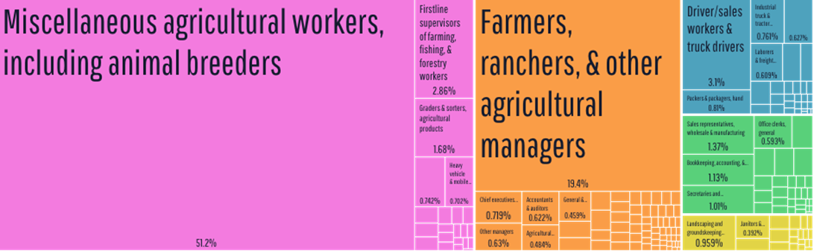
Who are Farmworkers?
Source: https://datausa.io/profile/naics/farming

Slide 9
Draft PPDC Farmworker Work Group Charge Questions
How can EPA better collaborate with farmworker organizations to seek input and relevant data from farmworkers to help ensure the feasibility of risk mitigation strategies for agricultural pesticides? What are the best strategies for documenting and evaluating growth/maturation in that essential collaboration?
How does EPA use information from farmworker organizations about real world scenarios of agricultural pesticide use in shaping policies and strategies to meet its legal mandate?
How is EPA acknowledging and acting upon the recommendations from previous workgroups, such as the previous PPDC Farmworkers & Clinicians Workgroup and the NEJAC Farmworker Workgroup? What improvements could enhance EPA’s responsiveness to these recommendations, including transparency in discussing recommendations that may not be acted upon?

Slide 10
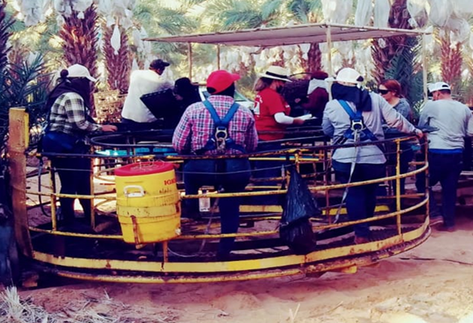
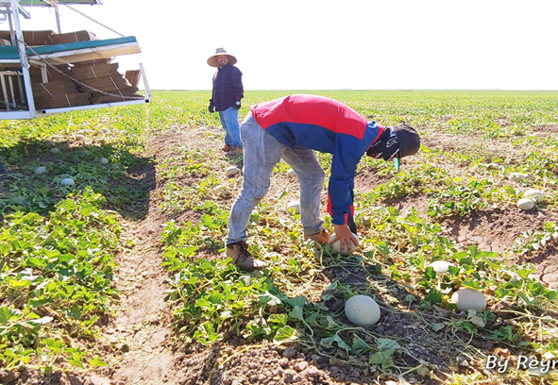
Discussion & Questions
Photos courtesy of: Joe Grzywacz (right) and Emma Torres (top & bottom)

