Slide 1
Draft Risk Evaluation for Asbestos Part 2: Evaluation Including Legacy Uses and Associated Disposals of Asbestos
Public Webinar
May 13, 2024
Office of Pollution Prevention and Toxics
Office of Chemical Safety and Pollution Prevention
U.S. Environmental Protection Agency

Slide 2
Briefing Purpose and Key Findings
Purpose:
Highlight scope and outline of the Draft Asbestos Part 2 Risk Evaluation
Provide overview of risks identified
Key Takeaway: Cancer and Non-Cancer Risks Identified
Occupational exposures to asbestos through construction/demolition
General population exposures near asbestos releasing facilities/activities
Consumer (do-it-yourself) exposures from inhalation of asbestos fibers released during activities modifying asbestos containing materials (ACMs)
Take-home exposures from handling asbestos contaminated clothing worn during occupational activities
Bystanders in take-home and consumer exposure scenarios

Slide 3
Introduction to Asbestos
Generic commercial designation for a group of naturally occurring mineral silicate fibers of the serpentine and amphibole series.
EPA definition (TSCA Title II, 1986) is asbestiform varieties of six fiber types:
  Chrysotile (serpentine)
  Crocidolite (riebeckite)
  Amosite (cummingtonite-grunerite)
  Anthophyllite
  Tremolite
  Actinolite
Primarily used as fire retardant in construction and manufacture of cement pipes, utility vehicles, and brakes
Current regulations and reporting
  Occupational Safety and Health Administration (OSHA)
  EPA Office of Air and Radiation (OAR)
  State and local
  EPA Asbestos Part 1 Final Rule under TSCA

Slide 4
Asbestos History and Timelines
July 2017 Risk Evaluation Rule
November 14, 2019 Safer Chemicals, Healthy Families v. EPA
December 2020 Asbestos Part 1 Risk Evaluation
June 2022 Asbestos Part 2 Scope Released
August 2023 TSCA 8(a) Rule Effective (Data Call In) Asbestos Part 2 White Paper Letter Peer Review
February - May 2024 Data Submission Period
April 2024 Draft Asbestos Part 2 Risk Evaluation Release
December 2024 Court Mandated Asbestos Part 2 Risk Evaluation Final Release
9th Circuit Court required TSCA Asbestos Risk Evaluation to expand scope beyond chrysotile, the only fiber with ongoing use, to consider legacy uses and associated disposals
Chrysotile Asbestos Risk Evaluation (Part 1) continued forward
Asbestos Part 2 Risk Evaluation developed to address:
  Additional fiber types: crocidolite (riebeckite), amosite (cummingtonite-grunerite), anthophyllite, tremolite, actinolite, Libby Amphibole Asbestos, asbestos-containing talc
  Legacy uses: uses without ongoing or prospective manufacturing, processing, or distribution
  Disposals: future disposal of legacy uses and past disposal
  Cancer and non-cancer human health effects
  Take-home exposures from occupational activities and general population exposures from environmental releases
  Dermal and oral exposures

Slide 5
Draft RE Overview
Exposure Assessment
Sections 3.1, 3.3, 4.1, 4.2, and 5.1
Risk Characterization
Section 5.3
Occupational Exposure Scenarios
Occupational Risk Characterization
Inhalation Exposure
Inhalation Risk
Hazard Assessment
Section 5.2
Take-Home Exposure Scenarios
Take-Home Risk Characterization
Inhalation Exposure
Occupational, consumer and general population hazard values for lifetime cancer, IUR and non-cancer chronic, POD
Inhalation Risk
DIY Exposure Scenarios
Inhalation Exposure
DIY Risk Characterization
PChem and Fate
Section 2
General Population Exposure Scenarios
Inhalation Risk
Inhalation Exposure
General Population Risk Characterization
Releases to Ambient Air
Environmental Exposure Scenarios
Inhalation Risk
Release Assessment
Section 3.2
Ecological Exposure Scenarios
Dermal Exposure
Risk Determination
Section 6
Ingestion Exposure

Slide 6
Summary of PChem and Fate
The strong Si-O-Si covalent bonds in the silicate tetrahedra of asbestos fibers result in environmental stability, negligible water solubility, high tensile strength, hardness, and inertness.
Small asbestos fibers (<1 μm) can remain suspended in air and water. Deposition expected to be higher closer to the asbestos source and eventually settle to soils, water bodies, and sediments.
Asbestos fibers in water settle into sediments and biosolids from wastewater treatment processes, so aquatic and terrestrial organisms are not expected to update asbestos fibers from water.
Incineration of asbestos fibers results in morphological changes during recrystallization yielding non-asbestos fibers and negligible releases to air.
Property | Chrysotile | Crocidolite | Amosite | Anthophyllite | Tremolite | Actinolite | Libby Amphibole
Essential Composition | Silica sheet (Si₂O₅), with a layer of brucite (Mg(OH)₂) | Na, Fe silicate with some water | Fe, Mg silicate | Magnesium and iron silicates | Ca, Mg silicate with some water | Ca, Mg, Fe silicate with some water | Winchite (84%), richterite (11%), and tremolite (6%)
Hardness (Mohs) | 2.5–4.0 | 4.0 | 5.5–6.0 | 5.5–6.0 | 5 to 6 | 6.0 | –
Flexibility | High | Fair to Good | Good | Poor: very brittle, non-flexible | Poor: generally brittle | Poor: brittle, non-flexible | –
Tensile Strength (MPa) | 1,100–4,400 | 1400-4600 | 1500-2600 | ≤30 | <500 | ≤7 | –
Decomposition Temperature (°C) | 600–850 | 400–900 | 600–900 | 1,150–1,340 | 950–1,040 | 1,140–1,296 | –
Excerpt from Table 2-1 in Draft RE document

Slide 7
Environmental Risk
EPA did not calculate risk to aquatic organisms due to a lack of useable aquatic environmental exposure data
  Limited aquatic exposure data did not yield numbers outside of Superfund sites; therefore, no representative numbers were available to calculate risk
  Concentrations of concern (COCs) were calculated for:
    Acute COC: Asiatic clams (Corbicula sp.) - 20 fibers/L chrysotile asbestos
    Chronic COC: Asiatic clams (Corbicula sp.) - 10 fibers/L chrysotile asbestos
    Chronic COC: Japanese medaka (Oryzias latipes) – 10,000 fibers/L chrysotile asbestos
EPA did not calculate risk to terrestrial organisms due to a lack of relevant ecological (apical) endpoints such as mortality and reproductive effects
In accordance with the Asbestos Part 1 Risk Evaluation, EPA concludes that there is very limited potential for asbestos exposures to aquatic or sediment-dwelling organisms and risk is not observed from exposure to asbestos fibers

Slide 8
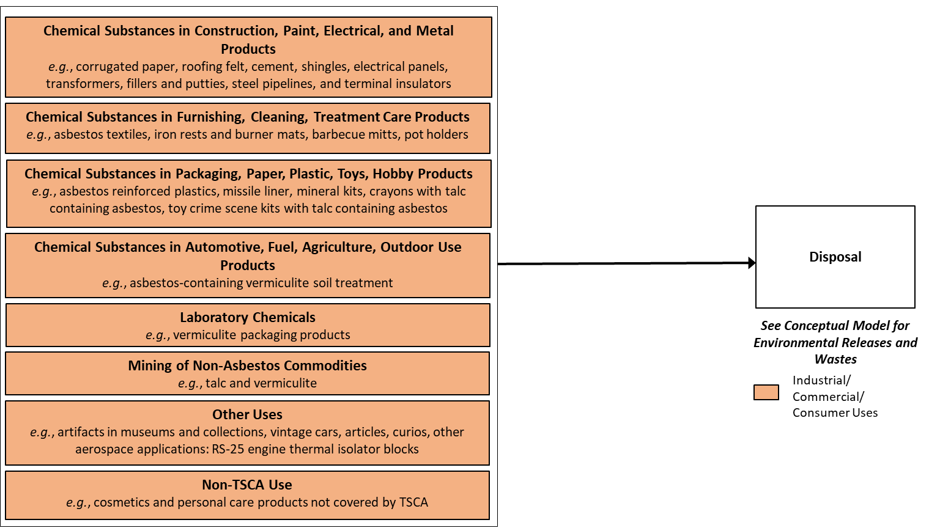
Summary of Asbestos Conditions of Use
Figure 1-2 in Draft RE document

Slide 9
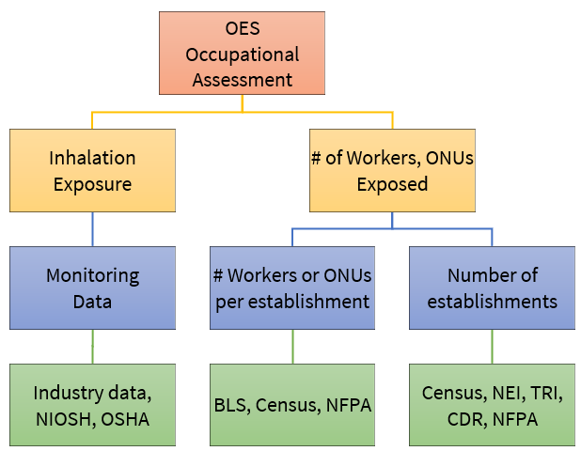
Exposure - Occupational
Inhalation exposure estimates based on monitoring data.
Targeted Populations:
  Male and female workers >16 years of age
  Female workers of reproductive age (16 to <50)
Short-Term workers – 30 min.
8-hr time weighted average workers – 8-hrs TWA
  Higher exposure-potential worker: directly generate friable asbestos through actions such as grinding, sanding, cutting, or abrading.
  Lower exposure-potential worker: may come into direct contact with friable asbestos while performing their required work activities.
  Occupational non-users (ONUs): workers who may be in the vicinity of asbestos but are unlikely to have direct contact with ACM.
Figure 5-1 in Draft RE document

Slide 10
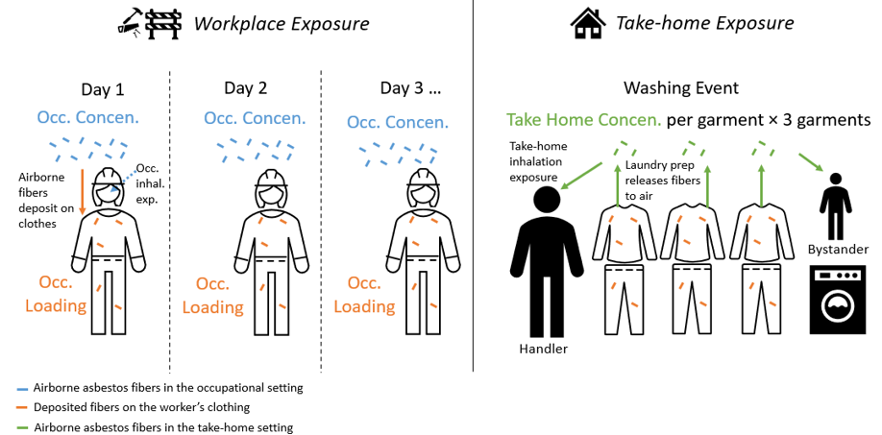
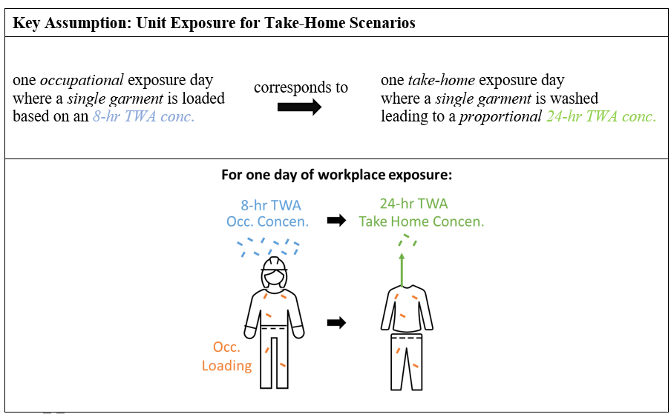
Exposure – Take Home
Figure 3-2 in Draft RE document
Take home exposures
Inhalation only
Asbestos fiber concentrations based on occupational monitoring data
Exposure scenario: fibers loaded onto clothing/garment during some occupational activity subsequently inhaled during garment handling at home
Bystander exposure in the take-home assessment
Person in proximity to the garment handling activity
Multiple age groups considered for bystander
  Children bystanders in main RE
  Adults and lifetime in appendix
Figure 3-3 in Draft RE document

Slide 11
Exposure – Consumer Do-It-Yourself
Inhalation exposure estimates based on monitoring data.
Activity-based scenarios for DIY users.
  ≥ 16 years all genders
  62 year duration
Activity-based scenarios for DIY bystanders.
  All ages, all genders
  78 years duration
EPA built DIY scenarios for repair and removal activities in which asbestos containing materials (ACM) are modified and asbestos fibers are released.
  Repair – Assumed one task per year. The length of time spent on the task varies for low-end, high-end, and central tendency exposure estimates. Exposure Factor Handbook and professional judgement used.
  Removal – EPA reviewed the frequency of replacement for various home materials. Only the first replacement job is likely to involve removing ACM.

Slide 12
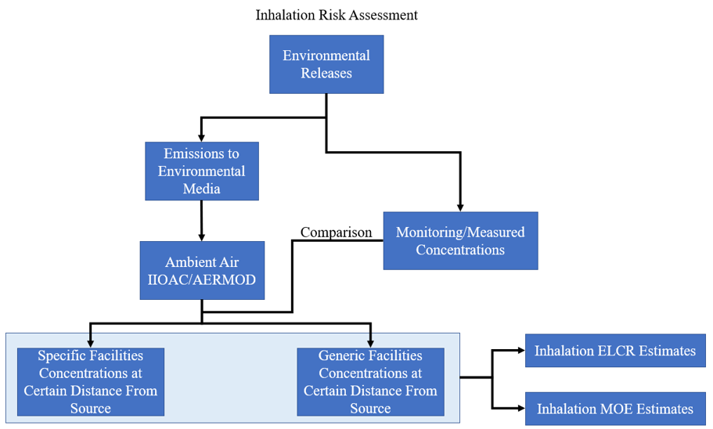
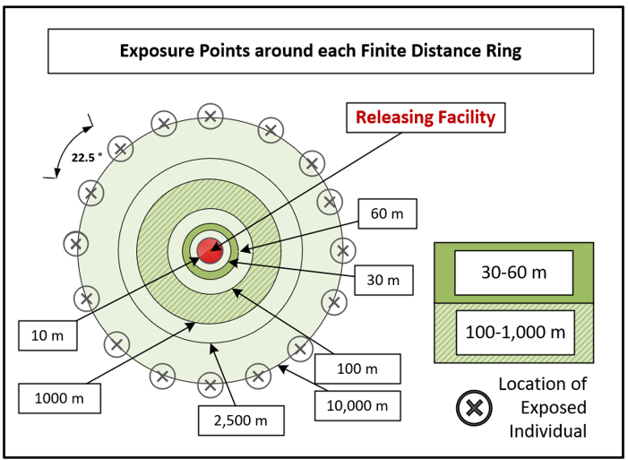
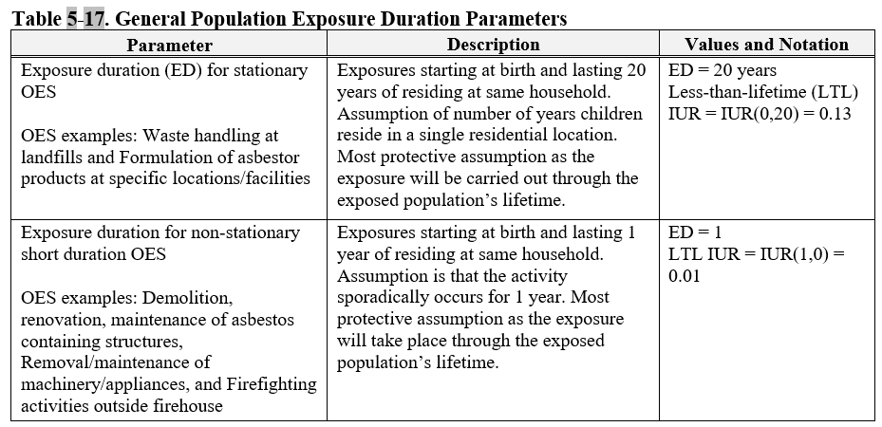
Exposure – General Population
Figure 5-2 in Draft RE document
Asbestos fibers released into the environment from occupational activities and people that reside at certain distances from the release inhale the fibers.
Distances considered in this assessment: 10, 30, 60, 100, 1,000, 2,500, 5,000, and 10,000 m.
Exposures 0-1 and 0-20 years in RE (additional exposure durations in Appendix L).
From monitoring data
Figure 5-3 in Draft RE document

Slide 13
Human Health Hazard
Cancer inhalation unit risk (IUR): 0.2 per fiber/cc
  Based on mesothelioma and lung cancer with quantitative adjustment for laryngeal and ovarian cancers
  Account for the EPA existing IURs
    1988 RE 0.23 per fiber/cc
    2014 IRIS 0.17 per fiber/cc
    2020 RE 0.16 per fiber/cc
  Sensitivity analysis conducted and no change in risk across IURs
Non-cancer point of departure (POD): 0.026 fiber/cc
  Based on localized pleural thickening (LPT)
  Cohort from O.M. Scott plant in Marysville, Ohio
    Most robust and relevant information for dose-response analysis
    Over 50 years of follow-up
  POD selected in 2014 IRIS Libby Asbestos Assessment

Slide 14
Risk characterization
The development of all exposure scenarios for this risk evaluation is based on the understanding that friable asbestos are modified (e.g., removed, sanded, cut, disturbed) to release fibers. ACMs that stay in place without any modification done to it, are not expected to result in releases, and hence no human exposures and risks are expected.
EPA used measured or estimated air concentrations to calculate exposure concentrations required for risk assessment, such as average daily concentration (ADC), margin of exposure (MOE), and excess lifetime cancer risk (ELCR).
Estimated risks for all populations for non-cancer chronic and lifetime cancer.
Population | Benchmark | Value
Occupational | ELCR | 1 x 10⁻⁴
General Population | ELCR | 1 x 10⁻⁴ to 1 x 10⁻⁶
DIYers and Take Home | ELCR | 1 x 10⁻⁶
Occupational and Non-Occupational | MOE | 300

Slide 15
Risk Characterization Approach
Population of Interest | Exposure Scenario | Sources of Uncertainty
Workers and ONUs | Adolescent (≥16 years old) and adult workers exposed to asbestos for the entire 8‐hr workday for up to 250 days per year for 30 and 40 working years (CT and HE respectively) Few OESs where more detailed information about identified job types and categories was available were split between higher and lower exposure-potential workers | Number of workers per COU Which industries and occupations are associated with the uses assessed Split between higher and lower exposure-potential workers Larger data variability for nonusers Representativeness of the data and variability due to work practices
Take Home Garment Handler | Adolescent (≥16 years old) and adults exposed to asbestos during handling of clothing contaminated with asbestos from occupational activities, for 40 working years CT and HE driven by worker exposure concentrations | Concentration data used may include non-asbestos and smaller particle sizes and overestimate risk Variability due to products and asbestos concentrations differences across activities and asbestos containing products

Slide 16
Risk Characterization Approach
Population of Interest | Exposure Scenario | Sources of Uncertainty
DIYers (Consumers) | Adolescent (≥16 years old) and adult DIYers exposed to asbestos fibers during an activity that modifies asbestos containing materials LE, CT and HE driven by monitoring concentration data, frequency and duration of activity | Determination of products and potential to release asbestos fibers Concentration data used may include non-asbestos and smaller particles sizes and overestimate risk
General Population | All genders and age groups indoor environments exposed to asbestos fibers infiltrating from outside from occupational exposure activities and disposal releases LE, CT and HE driven by release concentration data | Meteorological data from specific locations versus generalized approaches Number of emissions per year
Bystanders | Individuals of all ages exposed to asbestos fibers through DIYers and take-home activities

Slide 17
COUs Found to Contribute to Unreasonable Risk (UR)
Industrial/commercial use (5):
Chemical substances in construction, paint, electrical, and metal products
  Construction and building materials covering large surface areas – paper articles; metal articles; stone plaster, cement, glass, and ceramic articles
  Machinery, mechanical appliances, electrical/electronic articles
  Other machinery, mechanical appliances, electronic/electronic articles
Chemical substances in furnishing, cleaning, treatment care products
  Construction and building materials covering large surface areas – fabrics, textiles, and apparel
  Furniture and furnishings – stone, plaster, cement, glass, ceramic articles, metal articles, and rubber articles
Consumer use (3)
Chemical substances in construction, paint, electrical, and metal products
  Construction and building materials covering large surface areas – paper articles; metal articles; stone, plaster, cement, glass, and ceramic articles
  Fillers and putties
Chemical substances in furnishing, cleaning, treatment care products
  Furniture and furnishings – stone, plaster, cement, glass, and ceramic articles; metal articles; or rubber articles
Disposal (1)
Distribution for disposal

Slide 18
Soliciting Comments
EPA seeks feedback on the assessment of risk for asbestos as presented in the Asbestos Part 2 Draft Risk Evaluation and welcomes specific input on each section of the Asbestos Part 2 Draft Risk Evaluation.
  Take-home exposure scenarios.
  Non-cancer endpoints used to characterize risk.
  Single risk determination for asbestos where the Agency intends to determine that asbestos, as a chemical substance, presents an unreasonable risk of injury to health when evaluated under its conditions of use.
EPA is not requesting public comment on the hazard, exposure, or risk characterization sections of part 1, as those sections remain unchanged.
EPA encourages all potentially interested parties to comment on the Asbestos Part 2 Draft Risk Evaluation.
To the extent possible, cite any public data related to or that supports responses.
To the extent possible, describe any supporting data that is not publicly available.
Do not include CBI in comments. See Federal Register Notice for details on CBI submission.
Comments must be submitted by June 17, 2024
Comment Link: https://www.regulations.gov/commenton/EPA-HQ-OPPT-2021-0254-0048

Slide 19
Links and Contacts
Relevant Links:
Federal Register: https://www.federalregister.gov/documents/2024/04/16/2024-08024/asbestos-part-2-supplemental-evaluation-including-legacy-uses-and-associated-disposals-draft-risk
Draft Risk Evaluation for Asbestos Part 2: https://www.regulations.gov/document/EPA-HQ-OPPT-2021-0254-0049
Comments should be submitted to docket: EPA-HQ-OPPT-2021-0254-0048
Risk evaluations for Asbestos under TSCA: https://www.epa.gov/assessing-and-managing-chemicals-under-tsca/risk-evaluation-asbestos-0
General information on TSCA: https://www.epa.gov/assessing-and-managing-chemicals-under-tsca/frank-r-lautenberg-chemical-safety-21st-century-act
Contact for Technical Information:
Peter Gimlin, Existing Chemical Risk Management Division
gimlin.peter@epa.gov

